Slide 1
Land Acknowledgement
We would like to acknowledge with respect the Onondaga Nation, firekeepers of the Haudenosaunee, the indigenous peoples on whose ancestral lands Syracuse University now stands.
Notes:
Anita
Hello, my name’s Anita Kuiken, I am the Falk College of Sport & Human Dynamics librarian and I’ll be kicking things off for us today. First and foremost, I would like to acknowledge with respect the Onondaga Nation, firekeepers of the Haudenosaunee, the indigenous peoples on whose ancestral lands Syracuse University now stands. NEXT SLIDE

Slide 2
Works in Progress Webinar: Lessons Learned from Establishing a Bibliometric and Research Impact Team at Syracuse University
Emily Hart, Science Librarian & Research Impact Lead
Brenna Helmstutler, iSchool Librarian
Anita Kuiken, Librarian for Falk College of Sport & Human Dynamics
Stephanie JH McReynolds, Librarian for Business, Management, and Entrepreneurship
Contact our team at: riteam@syr.edu
Notes:
Anita
Thank you for making time and space to join us today as we contribute to the Works in Progress Webinar Series with Lessons Learned from Establishing a Bibliometric and Research Impact Team at Syracuse University. Thank you to our OCLC hosts, Rebecca, Merrilee, and Mercy. It’s been an absolute pleasure working with you all.
We’re really excited to have the opportunity to share our story, and hopefully have some time to engage in conversations with all of you after the presentation. We think our presentation will be especially relevant to those who are newer to research impact and bibliometrics…...for those interested in forming a research impact team or launching research impact services at their libraries…...and for anyone interested in capitalizing on subject librarian relationships and expertise.
If you have questions during the presentation, please put them in chat and we’ll answer them during the Q&A time at the end. NEXT SLIDE

Slide 3
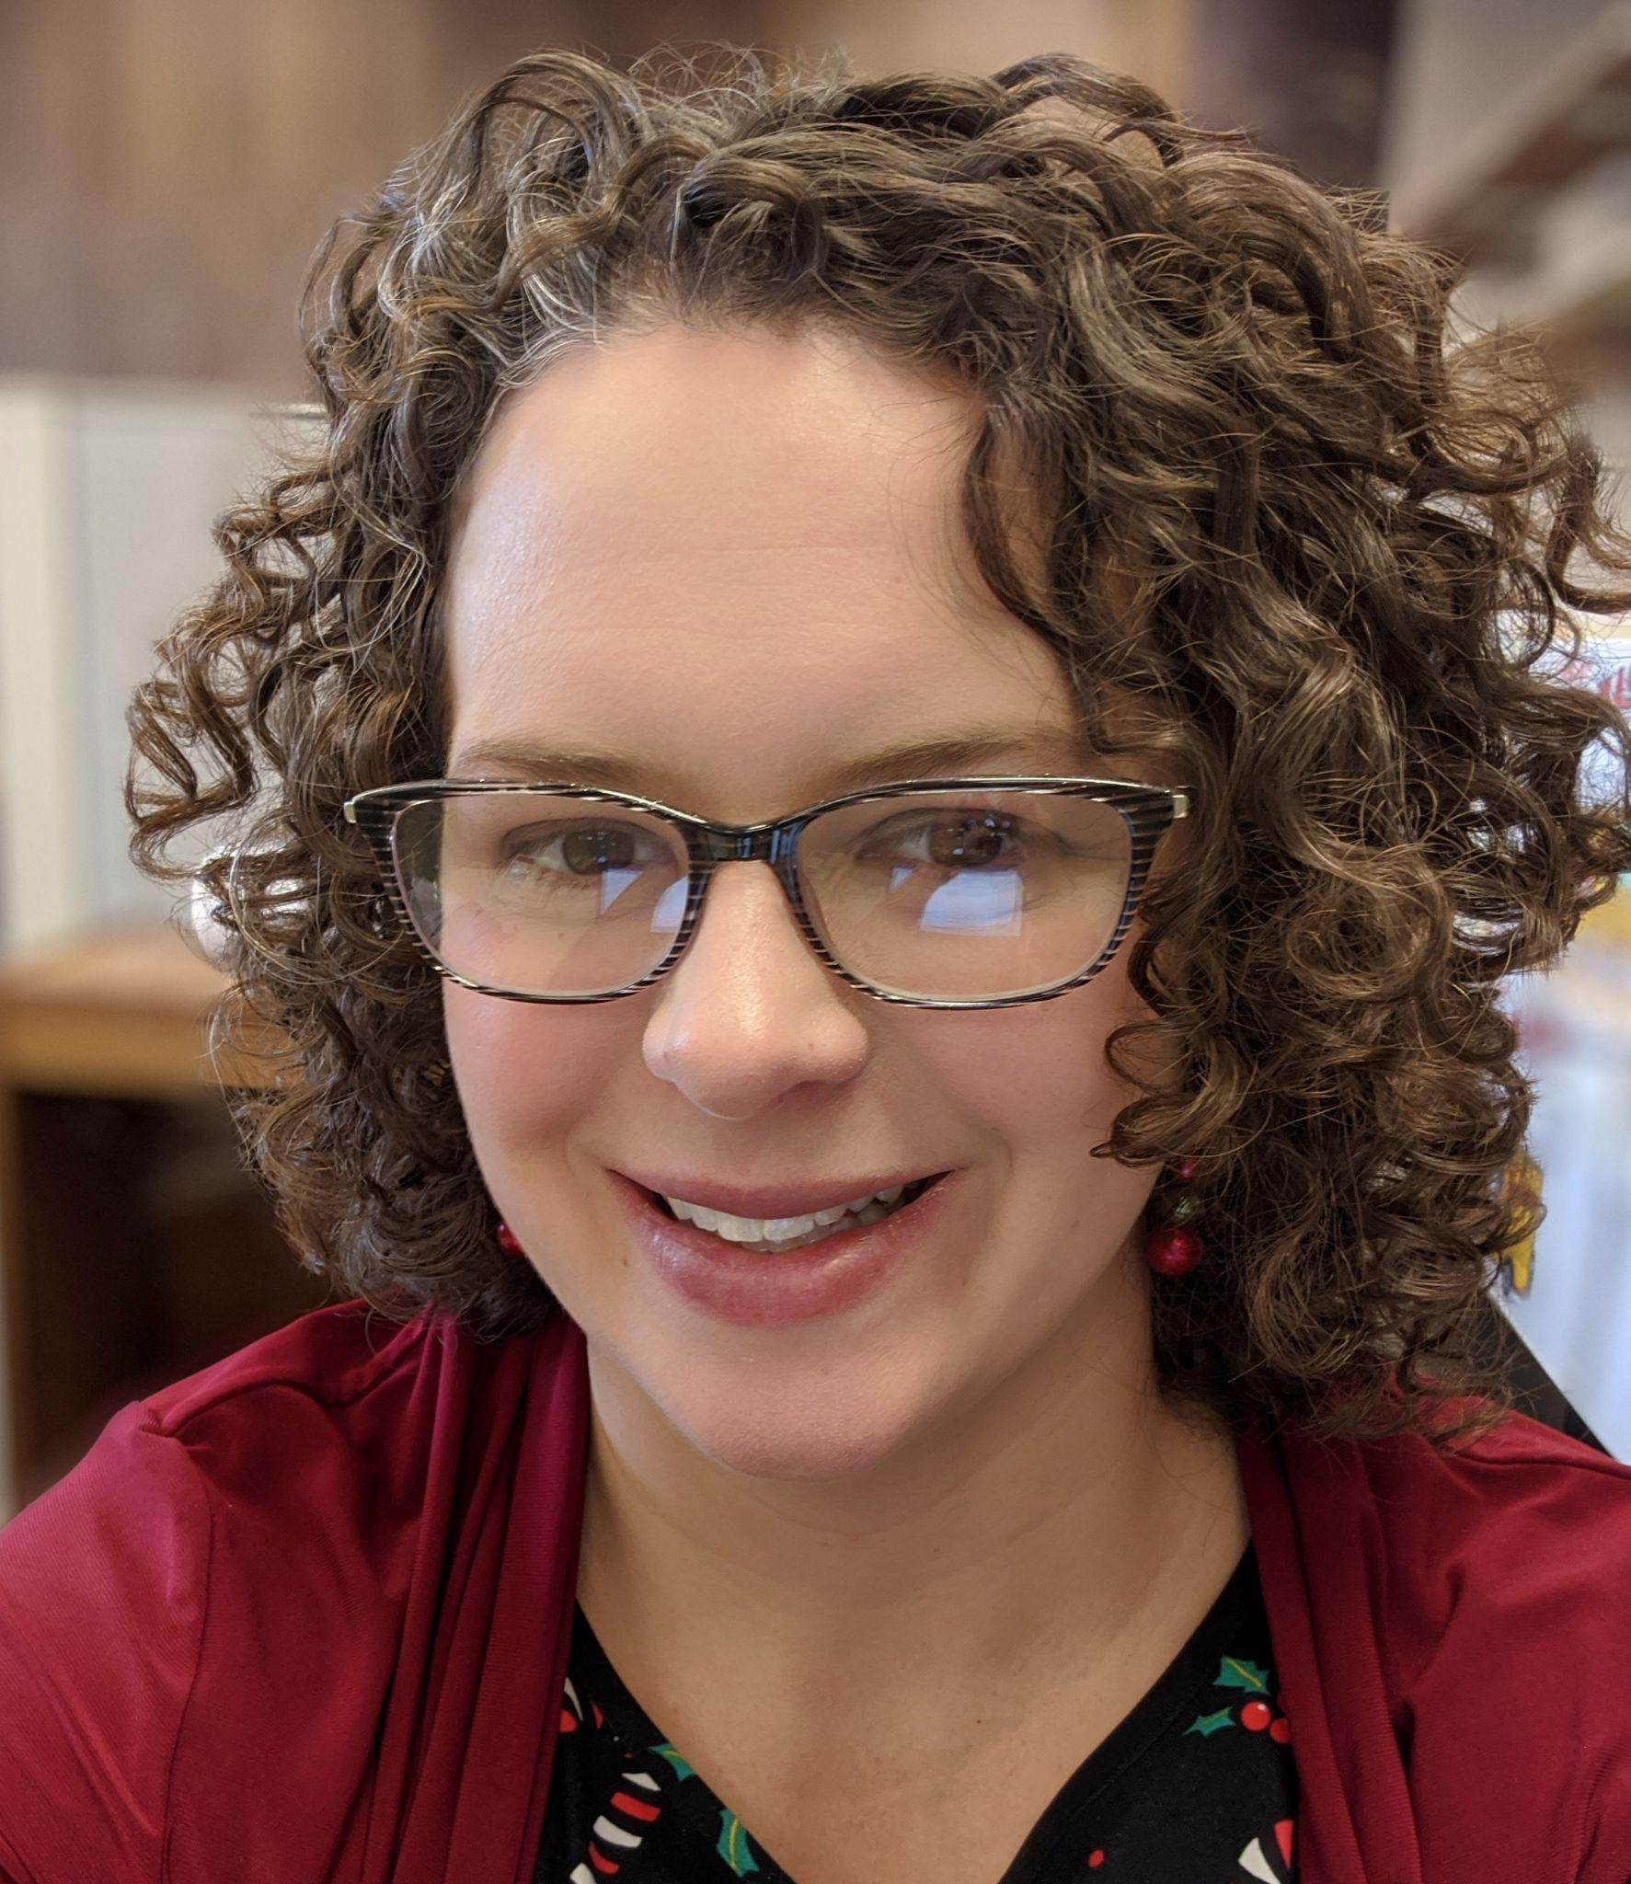
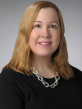
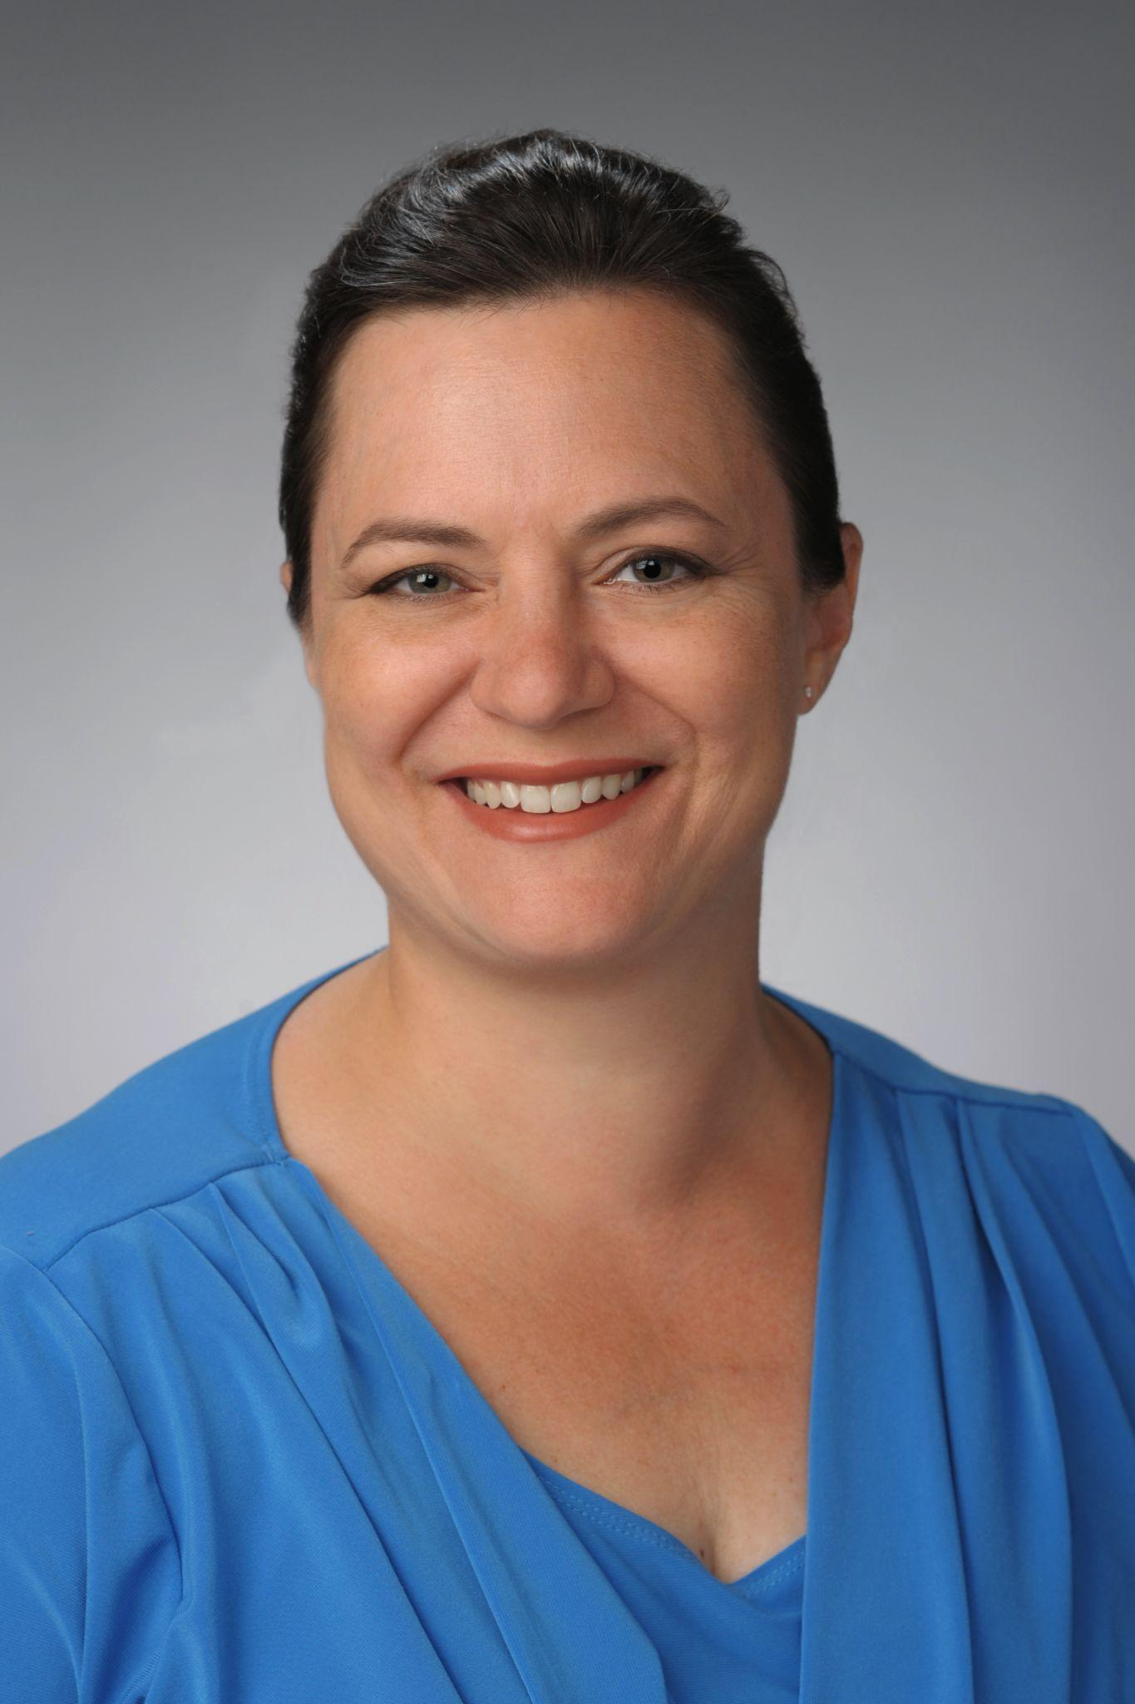
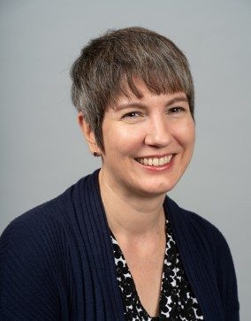
Who We Are
Emily Hart
Science Librarian /Arts & Sciences
Biology, Chemistry, Communication Sciences and Disorders, Forensic Sciences, Mathematics, Neuroscience, Physics and Astronomy, Psychology
Brenna Helmstutler
iSchool Librarian
Data Science & Analytics, Information Management & Technology, Library & Information Studies
Anita Kuiken
Falk College of Sport & Human Dynamics Librarian
Exercise Science, Food Studies, Human Development & Family Science, Marriage & Family Therapy, Nutrition Science & Dietetics, Public Health, Social Work, Sport Management, Aging Studies Institute
Stephanie McReynolds
Business Librarian / Whitman
Business, Management, & Entrepreneurship
Notes:
Today, I am joined by my fabulous Research Impact Teammates: Emily Hart, our Research Impact Team lead and Science Librarian, Brenna Helmstutler, iSchool Librarian, and Stephanie McReynolds, Business, Management, and Entrepreneurship Librarian NEXT SLIDE

Slide 4
Presentation Overview
Libraries & University background
Team development
Working with campus partners
Use Cases by User Type
Individual Researchers
Groups (Departments, Schools/Colleges)
University (Interdisciplinary Institutes and University Offices)
Where we’re headed
Notes:
Anita
Just a quick presentation overview so you know what we’ll be covering. We’re going to start off today with a little background about who we are, how our team developed, who our campus partners are, and then dive into some of our use cases which we’ll share according to user types: Individual researchers, Groups (Departmental, Schools or Colleges), and University which includes work with interdisciplinary Institutes and University Offices. And, as we go we’ll share what’s in store for the future.
OK, let’s get started, take it away, Brenna!

Slide 5
R1 Status: University Response
New & Unique Campus Support Structures
Office/division restructuring
Office of Research: Proposal Support Services – 3 new positions
Associate Deans for Research (ADRs) Leadership Group
Response to SU’s mission of increasing research trajectory
Initiatives to support & promote interdisciplinary research
Intramural grants, new faculty hires, and interdisciplinary research clusters
Notes:
Brenna slides 5-7 3 minutes, 10 seconds
SU was awarded R1 status in 2015. This status informed significant and exciting changes to the overall structure to enhance the research mission of the university, specifically working towards solidifying Syracuse University as a major research university with global impact and scope.
A direct outcome of this added emphasis on research was the establishment and alignment of administrative research positions across campus, which included the creation of Associate Dean for Research positions across the University’s schools and colleges, and the Libraries.
These positions meet as a group regularly with the Vice President for Research to discuss different initiatives that will propel the University towards research excellence.
A few of these initiatives, in addition to the department restructuring within the Office of Research include fundraising and the reappropriation of funds to create internal faculty research grants, the formation of new institutes (such as the BioInspired Institute) to promote cutting edge interdisciplinary research, and the strategic recruitment and hiring of new faculty researchers.

Slide 6
R1 Status: SU Libraries Response
Initial Ad Hoc Services: 2015-2020
Research Information Management (RIM) system, Pure/Experts@Syracuse (Est. 2016)
Collaboration with the Office of Research
Open access initiatives
Institutional repository promotion
Use of research metrics tools to support researchers & campus reporting
Move Towards Holistic Services 2020-
Libraries’ Department of Research & Scholarship Restructuring
Digital & Open Scholarship Team
Research Impact Team
Ad Hoc / Reactionary
Holistic / Evidence Based
Notes:
Brenna
The Libraries have worked hard over the past few years to respond to these campus wide changes. A few of the initiatives taken on by the Libraries include: establishing and maintaining a Research Information Management System or RIM, in collaboration with the Office of Research. This system serves to highlight faculty research activities at the University. we have used Elsevier’s RIM product, Pure, since 2016, and our instance is called Experts@Syracuse. The Libraries also engage with campus researchers about open access and funder mandates and encourage depositing of author post-prints into our institutional repository, SURFACE. We use metrics tools like Experts@Syracuse, Scopus, Web of Science, and Journal Citation Reports to support researchers during the tenure and promotion process and have worked diligently to establish strong relationships with our Office of Research on several fronts.
While the Libraries were making significant progress on these efforts, they were happening ad hoc, and taking up significant time in people’s jobs. Essentially these new thrust areas needed more attention, but lacked coordination and designated people to champion them.
Throughout this process, we’ve been very thankful for the guidance from our Associate Dean for Research Excellence, Scott Warren, and our Head of Collections and Research Services, Annie Rauh, who spearheaded many of these initiatives, and had the vision and drive to push for formalizing efforts around research services, which led to the eventual creation of our team.

Slide 7
Department of Research and Scholarship
Head of Collections and Research Services
Subject Instruction Team Lead
Research Impact Team Lead
Digital and Open Scholarship Team Lead
Collections Team Lead
Liaison Librarians
Liaison Librarians
Open Scholarship and Data Librarians
Collection Development, Government Documents, and Architecture Librarians
Notes:
Brenna:
The Libraries’ Department of Research & Scholarship, which is comprised of liaison and functional librarians, was restructured into teams in 2020. These teams were organized into focus areas that need more attention, and individuals within the department were assigned to the teams based on interests and skill sets.

Slide 8
Research Impact Team
Developing knowledge and services in support of University research at both the individual and institutional levels.
Research systems & tools (Pure, Web of Science)
Research impact & metrics - including disciplinary differences
Research impact related guides/content
ORCID & other researcher profiles
Research activity reporting
Institutional level data cleanup
Funding discovery tools & outreach
Systematic Reviews
Responsible research assessment
Notes:
The Research Impact Team was originally tasked with developing knowledge and services in support of the University research enterprise. Some of the core activities that fall within our purview include:
- Co-management of our RIM system (Experts@Syracuse) with the Office of Research
- Knowing the ins and outs of research systems and reporting tools
- Creating easy to digest content about topics like research metrics and responsible research assessment
- Assisting with the development and maintenance of researcher profiles
- Reporting on University research productivity
- Author affiliation data clean-up in Scopus and Web of Science, which can have a positive influence on University rankings
- We also assist with grant discovery and systematic reviews

Slide 9
SU Libraries Research Impact Team
2020
2021
2022
2023
Team Building
Outreach & Use Cases
Documentation & Tools
Systems & Assessment
inception
shared skills
defining services
mission statement
short & long term planning
content development
marketing & advertising
campus connections
internal & external presentations
discipline specific learning
skill enhancement (data viz, reporting)
tool evaluation
system connectivity
process documentation
BRI community engagement
needs assessment
research study
service assessment
system development
Notes:
Emily
Since the creation of our team in 2020, our focus has shifted from defining services and developing shared baseline knowledge and skillsets, to outreach and marketing, establishing connections with individuals and groups on campus and beyond, and strengthening our knowledge of our systems and bibliometric best practices. As subject librarians, we each came to the team with different connections and disciplinary knowledge, but we have worked hard to develop knowledge of topics like publishing and metrics across subject areas, including the humanities and social sciences. We have also become a knowledge center for understanding how the University’s research systems and resources interact. In the future we plan to continue developing our reporting and visualization skills which is a newer area for us and perform a more in-depth campus needs assessment.

Slide 10
Interfacing with campus partners
Office of Research
Proposal Support Service
Research Development Group
Institutional Research
Liaison librarians
Notes:
Emily
One of the most important aspects of our work has been maintaining strong relationships with campus partners, including the Office of Research, who we co-manage our RIM system with, Proposal Support Services (also in the Office of Research), and Institutional Research. Because of these strong connections, it has helped us learn about different aspects of the research enterprise at SU, and to be involved in conversations we may not otherwise have known about. Two examples of this include our colleagues in Proposal Support Services creating a spot for a member of our team on the Research Development group, which is made up of research development professionals from across the University; and these same colleagues recently helping us advocate for a spot on the faculty activity reporting system implementation team. Other strong partnerships come from our subject liaison colleagues in the Department of Research and Scholarship, who help us connect with researchers and graduate students in different departments, and to communicate with their liaison areas about our services.

Slide 11
SU Systems & Resources
Current Tool Kit
Future
Research Information Management System - Pure (Experts@Syracuse)
Academic Analytics
Web of Science
Scopus
Inspec Analytics
SURFACE (Digital Commons)
ORCID Institutional
Lens.org
Journal Citation Reports
Journalytics
Google Scholar
Others for humanities/social sciences
Visualization tools (learning)
Tableau Desktop
Tableau Prep
Vosviewer
New campus systems
Faculty Success
Cayuse
Resource evaluation (Trials)
Lens.org institutional toolkit
Dimensions
Altmetric Explorer
Notes:
Emily
To respond to the needs of researchers and units on campus, we use a variety of subscription based and freely available tools. Common activities we’re involved in include pulling data to report on the scholarly activities of researchers and groups at the University, identifying potential publication venues, and pulling appropriate metrics to help tell the story of our research impact. We have become experts at knowing which tools index what data, where to find certain metrics, which resources cover certain disciplines, and where the resources overlap.
A few of the tools we have access to are our RIM system Experts@Syracuse, powered by Pure, Academic Analytics, Scopus, Web of Science, ORCID Institutional, and more.

Slide 12
Understanding the Value of Use Cases
Following the lead of research impact experts at the University of Waterloo, we are gathering use cases to demonstrate the value of our services to various potential users (individuals and campus entities).
Recommended resources for developing research impact services, from the University of Waterloo:
Emerging Roles for Libraries in Bibliometric and Research Impact Analysis (webinar)
Library Impact Practice Brief Supporting Bibliometric Data Needs at Academic Institutions
Notes:
Steph: Our team has learned a lot from the experience of research impact experts at the University of Waterloo, such as the importance of documenting processes, including the research impact tools (such as bibliometrics software) used. We encourage anyone who is interested to please learn more about what Waterloo has done. We have included links here to their ARL practice brief and a really informative OCLC webinar.
One main takeaway we would like to share is how valuable gathering use cases can be, not only as part of the documentation process, but as a way to be ready to communicate the value of research impact services to potential users and to university administration.
If you go to the practice brief, you will find two case studies highlighted. These case studies demonstrate the value that the University of Waterloo’s research impact services have brought users. The first case study shows how research impact services allowed for a better understanding of the research production originating from University of Waterloo faculty. The second case study focuses on how an interdisciplinary research center used bibliometric software to gain a better understanding of the research and collaborations taking place in and outside of the center, as well as how the center’s output and citations compared to research centers at peer institutions. NEXT SLIDE, PLEASE

Slide 13
Research Impact Team Use Cases
Individual
Groups
University
Interactions with individual faculty and/or student researchers
Interactions with academic departments & interdisciplinary institutes
Interactions with groups like colleges, the Office of Research, & campus-wide implementation teams
Tenure & promotion reporting (counts & impact story)
Tenure & promotion planning & preparation
Researcher profiles
Identifying interdisciplinary journals
Systematic review & evidence synthesis
Open access inquires
Grant compliance reporting
Group research profiles
Regularized reporting
Equity in reporting (Humanities, Social Sciences)
Disciplinary best practices for research productivity reporting
Funding opportunity resources
Benchmarking (future)
Tracking impact on rankings (future)
Records clean-up (Scopus/Web of Science)
Campus systems interconnectivity
Intramural grant reporting
RFI’s/proposals
RIM System (Pure)
ORCID Institutional
Product/tools evaluation
University research rankings
Responsible research assessment
Notes:
Steph: Here is a very brief overview of our various use cases by user type, starting with the support we have provided to individual researchers, then going to the department and interdisciplinary institute level, and finally to the broader school or college level, as well as University-wide offices, such as the Office of Research, and campus-wide systems implementation teams.
Starting with individual researchers, we have compiled research metrics and data in support of individuals going up for tenure, we have provided guidance on setting up and maintaining researcher profiles, as well as identifying journals for publication. Our team has conducted systematic reviews and has provided guidance on systematic reviews and other forms of evidence synthesis. We have also fielded open access inquiries.
Departments and interdisciplinary institutes have approached us for education on metrics, researcher profiles, and how to use metrics to tell the story of the impact of the research originating from their department or institute. We have had conversations with departments to help them begin to identify best practices (that are disciplinary specific) that they can use to inform how they report on their research outputs. We have also helped departments and institutes identify funding opportunities for their research. In the future, we expect to conduct benchmarking studies with departments and institutes. We also hope to identify and recommend methods for tracking how the research being conducted within the department or institute contributes to real world impact and/or department and University rankings.
At the University level of schools and colleges, as well as University-wide offices, we have worked a great deal with the Office of Research and have conducted clean-up of records in Scopus and Web of Science, have advised on the interconnectivity of systems, such as ORCID, PURE, and Faculty Reporting Systems. We have provided data for grant proposals and Requests for Information (or RFIs). We have provided expert input when evaluating potential new systems (such as a faculty reporting system) and research metrics related databases. We expect to provide more reporting services in the future to inform University research rankings. We also plan to continue to have conversations about, and advocate for, at the University level, practices that support responsible research assessment.
Now Anita and Brenna will offer a closer review of a use case for an individual faculty member. Brenna, please go ahead and tell us about this use case. NEXT SLIDE, PLEASE

Slide 14
Research Impact Team Use Cases
Individual
Groups
University
Interactions with individual faculty and/or student researchers
Interactions with academic departments & interdisciplinary institutes
Interactions with groups like colleges, the Office of Research, & campus-wide implementation teams
Tenure & promotion reporting (counts & impact story)
Tenure & promotion planning & preparation
Researcher profiles
Identifying interdisciplinary journals
Systematic review & evidence synthesis
Open access inquires
Grant compliance reporting
Group research profiles
Regularized reporting
Equity in reporting (Humanities, Social Sciences)
Disciplinary best practices for research productivity reporting
Funding opportunity resources
Benchmarking (future)
Tracking impact on rankings (future)
Records clean-up (Scopus/Web of Science)
Campus systems interconnectivity
Intramural grant reporting
RFI’s/proposals
RIM System (Pure)
ORCID Institutional
Product/tools evaluation
University research rankings
Responsible research assessment
Notes:
Brenna 23 seconds
The reporting phase of tenure & promotion typically involves a short turnaround time for preparation before portfolio submission for both the faculty member and the research impact librarian, as we have discovered. Instead of advance planning with reporting in mind, it is more of a “just in time” approach. Anita and I will share our experiences in working with faculty in this phase who are from our respective liaison areas.

Slide 15
Tenure & Promotion (T & P) Reporting
Use cases from our respective liaison areas:
iSchool faculty
Food studies faculty
Team developing skillset to identify the impact needs and values of other disciplines
Notes:
Brenna/Anita
Brenna 1 minute, 10 seconds
The iSchool is a professional school comprised of Library & Information Studies, Information Management & Technology, and Data Analytics. The Library school was established in 1915, and in 1974 it became the school of info studies. It was the 1st library school to embrace the broader field of information.
The faculty member I worked with had prolific publications, but not in the last few years as their focus was on course development, revision, and instruction. They were especially interested in being able to discuss the international impact of their work. I compiled a comprehensive report of bibliometrics and altmetrics. Using altmetrics were especially valuable to the faculty member in supplementing traditional citations with mentions from syllabi, library holdings, and presentations, all of which showed evidence of significant international impact to curriculum and research in their field. Lessons learned were that each faculty member has a individual impact story that may not include regular or recent publication, so thinking outside of the box, regularly developing a tools knowledge base, and collaborating with colleagues are a must! The team is in the process of identifying additional tools which capture international impact, as we will discuss later.
Anita (2:31)
While Brenna and I pull from our liaison areas, we four on the Research Impact Team, support tenure & promotion portfolios across the University as well as work with our liaison colleagues to support requests they field in their areas. I’m sharing an experience with one of my faculty in Food Studies, a newly developing discipline, that presents unique challenges because the body of literature is newly developing, it’s interdisciplinary, and can be either academic or professional in nature. The program is primarily focused on sustainable food systems, people’s cultural relationship to food, and the human right to food and nutrition. SU was one of the first Universities to dedicate faculty to a Food Studies department, whereas, other institutions developed food studies institutes or centers that pull faculty from across their institution. So there’s more at stake for faculty in this small department than just making promotion or tenure, they’re working hard to develop a body of critical food literature and lay a strong foundation for this new department, so it can stand on its own merit and affect the change they want to see in the world.
Concerns brought to my attention at the time included literature that is often published in niche journals w/ no or small impact factors which, at that time, was the only metric this faculty member was aware of. In addition, they had a newly published book that had not yet garnered any attention. Anxiety was high and this junior faculty member was even more concerned with how their portfolio would be viewed by a college-wide tenure & promotion review committee comprised of faculty from more established disciplines who were also more science-based.
Like Brenna, I compiled a report of bibliometrics and altmetrics, where I could find them, and supplied qualifying remarks for the faculty member to include in their portfolio. The faculty member successfully navigated through to promotion, much to my relief!
I learned a lot from this particular engagement. It was clear that we librarians, well, and by we, I mean me in particular, needed to learn more about supporting value-based metrics in the social sciences, humanities, and in some cases public health in order to help junior faculty develop their portfolios and arm them with language to tell their stories in understandable ways to audiences across disciplines in their own department, college, and at the University level. We also need to be more involved in the long game of planning and preparation in advance for tenure and promotion, as well as, working to educate science-based faculty participating on t & P review committees about what metrics or indicators their social science, humanities, and the arts colleagues value in their disciplines. NEXT SLIDE

Slide 16
Tenure & Promotion - Planning & Preparation
Use cases in the Visual & Performing Arts, Engineering, Earth Science, and Languages, Literatures, and Linguistics departments involved discussion around:
Publishing goals
Knowledge distribution channels
Researcher profiles
Value-based research goals
Notes:
Anita (1:35)
In response to some of the marketing we’ve been doing around our team and services over the past year, we find ourselves newly engaged with individual faculty well in advance of tenure and promotion deadlines. This is where we’d like to be positioned going forward rather than brought in at the last minute at or near an emotionally charged t & p deadline. Through these conversations we’ve identified a gap in faculty research support services, namely help with pre-publishing planning that could intentionally position a publication to attract the kind of attention a researcher hoped for. Individual use cases in the Visual & Performing Arts, Engineering, Earth Science, and Languages, Literatures, and Linguistics departments all involved conversations in one or more of the following:
Discuss publishing goals, identify target audiences and find the right publishing opportunity for manuscripts.
Identify knowledge distribution channels like institutional repositories, pre-print repositories, and other open access venues where faculty could connect with new audiences and promote their work.
Discuss the value of creating and updating researcher profiles like ORCID, Google Scholar, and Pure.
Instigate conversations around value-based research goals and associated indicators.
Discussions around translating research work from one discipline to another in order to reach different audiences.
These same conversations were happening at a couple of group-level entities, as well. NEXT SLIDE

Slide 17
Research Impact Team Use Cases
Individual
Groups
University
Interactions with individual faculty and/or student researchers
Interactions with academic departments & interdisciplinary institutes
Interactions with groups like colleges, the Office of Research, & campus-wide implementation teams
Tenure & promotion reporting (counts & impact story)
Tenure & promotion planning & preparation
Researcher profiles
Identifying interdisciplinary journals
Systematic review & evidence synthesis
Open access inquires
Grant compliance reporting
Group research profiles
Regularized reporting
Equity in reporting (Humanities, Social Sciences)
Disciplinary best practices for research productivity reporting
Funding opportunity resources
Benchmarking (future)
Tracking impact on rankings (future)
Records clean-up (Scopus/Web of Science)
Campus systems interconnectivity
Intramural grant reporting
RFI’s/proposals
RIM System (Pure)
ORCID Institutional
Product/tools evaluation
University research rankings
Responsible research assessment
Notes:
Anita (:30)
Before we developed the Research Impact Team, there was no dedicated group of librarians to support bibliometrics and research impact at a group level at SU. This is something very new for us and have valued and leaned on the expertise and support of our librarian colleagues and information professionals at other institutions -- many of whom are attending today! The next two use cases will highlight some of the work we’ve doing at a group level. NEXT SLIDE

Slide 18
Languages Literatures & Linguistics
Language Matters Workshop Series
Our role
What we’ve learned so far
Reformat workshop content for future Research Impact Team educational programming and marketing campaigns
Notes:
Anita (2:45)
Our engagement with the Languages Literatures and Linguistics department (or LLL) began after the University announced plans to adopt a new faculty activity reporting system and also made a change to the faculty tenure and promotion form, which now requires the addition of research metrics including number of citation counts or reviews, number of peer reviewed publications, and total grants and grant dollars received. Concerned by this requirement, as using “standardized” metrics could unfairly characterize or measure their work, the department pulled together to discuss the reality of their situation and resolved, with support from college level administration, to come up with a more meaningful and equitable solution. We met with the department in Spring 2021 to discuss their concerns and share a few best practices on responsible research methods. LLL had also secured a grant to host a workshop series dedicated to exploring a variety of issues around research design, analysis, and dissemination that they titled “Language Matters.” In fall 2021, they enlisted our help and offered to subsidize work our Graduate Assistant, Snehal Dhumal, will do to reformat content created in this workshop series for our educational programming and marketing campaigns across the University.
For us, this new opportunity is particularly challenging because individual faculty member’s research could be characterized as either social science or humanities and, because of this distinction, a preferred publication format could be a book or article that would be published either domestically or, in a lot of cases, internationally in languages other than English for very small audiences in publication formats that may or may not be indexed by databases.
We are in the midst of this series now. We’ve delivered two sessions – one that gave a general overview of the information and bibliometric landscape and another that dove more deeply into bibliometrics and altmetrics, the tools used, and more frank discussions around value-based research evaluation, and how to capture the social impact of faculty work. Our last sessions will include introductions to developing researcher profiles like ORCID, Google Scholar, and Experts, our instance of Pure, followed by a hands-on workshop and a last session on Open Access. These sessions have been delivered in the spirit of partnership where we’re merging LLL research expertise with our tools and what we know of the information landscape to help them create a meaningful solution.
By the end of the second session, we knew that workshop content had started to sink in as LLL faculty exclaimed (and I paraphrase here): This process is messy! There’s no one solution. And, at this stage, the University will very likely just accept what we (LLL) define for ourselves as the experts in our field.
Our work continues, as our team dives more deeply into the responsible use of metrics. I turn things over to my colleague Stephanie who will share what we’re working with right now. NEXT SLIDE

Slide 19
Responsible Use of Research Metrics
As quantitative measures, research metrics should:
Complement and support (not supplant) qualitative, expert assessment of research
Account for differences in publication and citation practices by discipline
No single metric (such as h-index) should be relied upon as the sole indicator of quality.
Notes:
Steph: So, the responsible use of research metrics (or responsible research assessment) is a key concept that our team is still learning how to implement in our own research metrics practices. We are also learning how to advocate for the responsible use of metrics when speaking to faculty, departments, and other entities, such as the Office of Research. As Anita just mentioned, this concept is especially relevant to the conversations we have been having with the Department of Languages, Literatures and Linguistics (or LLL). NEXT SLIDE, PLEASE

Slide 20
Guidelines for Responsible Use of Research Metrics
DORA (San Francisco Declaration on Research Assessment)
Leiden Manifesto
These statements outlining responsible research assessment guidelines have been signed or publicly endorsed/adopted by many organizations and individuals.
Notes:
Steph: Two well-known statements, DORA and the Leiden Manifesto, offer nuanced and in-depth responsible research assessment guidelines. As our team continues to build our services, and have conversations with various entities, such as LLL, closely examining and considering these guidelines is becoming more and more important. Our goal is to find ways to practically apply these principles to our work. NEXT SLIDE, PLEASE

Slide 21
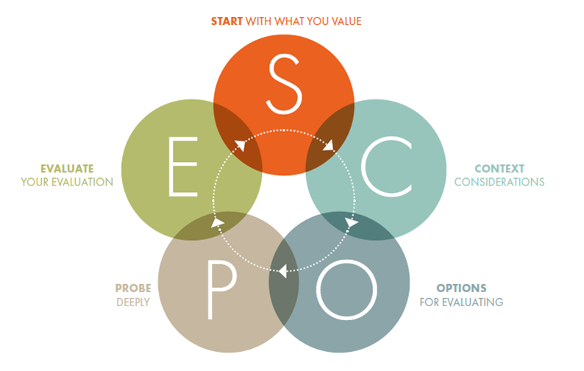
SCOPE Framework for Research Evaluation
INORMS Research Evaluation Group (2021) A one-page overview of the five-stage SCOPE Framework
Notes:
Steph: Fortunately, there are a number of groups that have created resources for practically applying responsible research assessment principles. The INORMS Research Evaluation Group has created a broad framework for responsible research assessment with the acronym of SCOPE. This is relevant to our work with the LLL department, especially the first part of the process, because it recommends Starting with what you value. So, what do you value about the entity you are evaluating. Is it the quality of research produced? Are you basing your evaluation on just the available data sources (so the available metrics) instead of figuring out the steps and tools necessary to actually evaluate what you value, instead of valuing what you can produce with your particular metrics toolkit? Most importantly, when you start your evaluation, you should be co-designing and co-interpreting that evaluation with the entities that you are evaluating. And this is really relevant to our conversations with LLL because we have been asking them to articulate in their research planning what they value and the impact they would like to have. NEXT SLIDE, PLEASE

Slide 22
Social Sciences & Humanities Responsible Research Assessment Frameworks & Resources
ENRESSH Policy Brief
HuMetricsHSS
Federation for the Humanities and Social Sciences
Notes:
Steph: There are also discipline specific frameworks and resources. The following social sciences and humanities focused resources are also relevant to our work with LLL: The European Network for Research Evaluation of the Social Sciences and the Humanities has created a policy brief on research evaluation; HuMetricsHSS takes a values approach to understanding and evaluating research; and The Federation for the Humanities and Social Sciences offers resources on building and sharing research impact.
So, now we are going switch gears a bit and Emily will tell us about another use case.
NEXT SLIDE, PLEASE

Slide 23
Interdisciplinary Institutes
Aging Studies Institute & BioInspired Institute
interdisciplinary research units made up of faculty from multiple departments
Assistance with
research productivity tracking
reporting on research productivity
research visibility at the institute level
OA compliance
Notes:
Emily
A main University focus has been to foster opportunities for interdisciplinary research. To support this goal, our team has focused on doing outreach to some of the most active interdisciplinary research groups on campus, including the Bioinspired and Aging Studies Institutes. These are interdisciplinary research units made up of faculty from different departments. A few of the ways we’ve interacted with these groups at the institute level include:
– Establishing new methods for research productivity tracking
– Developing a variety of research productivity reports
– Assisting with the development of institute level, public research profiles
– And tracking open access compliance for grant reporting purposes

Slide 24
ASI Grant Compliance Use Case
01
Experts@Syracuse researcher profiles
Link research outputs at the individual level to the larger grant through a database relation
Tracking research activities associated with large NIH grant
02
Institute level profile in Experts@Syracuse
Pure API to institute website
Institute Level Public Research Presence
03
Track articles published via multiple sources
Work with grant administrators to establish best practices and train authors to deposit open access versions in PubMed Central or SURFACE
Tracking OA Compliance
04
Institute level dashboard in Experts@Syracuse
Track pubs via database feeds that aren’t indexed in Scopus/Pure
Annual reporting & grant compliance
Reporting
Notes:
Emily
Over the past year we worked closely with the Aging Studies Institute, to help develop solutions for tracking research activities related to their large NIH, institute level grant. Their goals include finding ways to group the activities of SU faculty researchers associated with the grant in one place, such as a dashboard, so that they can have a place to run reports, but also have a public, institute level research presence (which is a desire of the institute, and also a requirement for the grant). Beyond a quick glance dashboard and public research profile, the institute needs the ability to track and report on activities that are specifically related to the grant, such as downstream publications, awards, and subsequent grants. They are also responsible for tracking open access compliance for grant affiliated publications, and have annual reporting commitments to the University. In order to meet these needs, our team has worked to develop an institute level research profile and reporting dashboard in our RIM system, Experts@Syracuse. We have also worked with Pure to learn about ways to link individual publications and outputs to a grant, by creating a “relation” at the publication level…to the institute level grant…in no way is this a perfect solution, because this method is time intensive, but it’s a start, and we’re working within the bounds of the tools that we have access to. Beyond using Experts@Syracuse, which runs on Pure and primarily on Scopus data, we are also working on solutions to monitor additional literature indices, such as Web of Science, the Lens, Google Scholar, etc…as the social sciences and psychology research happening in the Aging Studies Institute is likely not all captured by Pure and Scopus. Ultimately, the solution to the needs of ASI are multifaceted, requiring several tools and steps. Our goal is to come up with a process that will not only help ASI, but that can be replicated by other institutes who are facing similar grant and university reporting requirements.

Slide 25
Research Impact Team Use Cases
Individual
Groups
University
Interactions with individual faculty and/or student researchers
Interactions with academic departments & interdisciplinary institutes
Interactions with groups like colleges, the Office of Research, & campus-wide implementation teams
Tenure & promotion reporting (counts & impact story)
Tenure & promotion planning & preparation
Researcher profiles
Identifying interdisciplinary journals
Systematic review & evidence synthesis
Open access inquires
Grant compliance reporting
Group research profiles
Regularized reporting
Equity in reporting (Humanities, Social Sciences)
Disciplinary best practices for research productivity reporting
Funding opportunity resources
Benchmarking (future)
Tracking impact on rankings (future)
Records clean-up (Scopus/Web of Science)
Campus systems interconnectivity
Intramural grant reporting
RFI’s/proposals
RIM System (Pure)
ORCID Institutional
Product/tools evaluation
University research rankings
Responsible research assessment
Notes:
Emily
The Research Impact Team is not only supporting individuals and groups, but frequently working with units such as the Office of Research, Proposal Support Services, and Institutional Effectiveness, who are responsible for looking at research activities and systems across the University. Frequent interactions at this level include responding to Requests for Information for external grant proposals (in the form of creating reports on university research productivity), cleaning up author affiliation data that can influence university rankings, co-managing the University’s RIM system, and participating in conversations about the interconnectedness of University wide systems for data collection and reporting.

Slide 26
Libraries Advocating for Optimal System Use
To have a fully realized public research presence and robust reporting capabilities…connect the systems!
Faculty Activity Reporting System (Faculty Success)
RIM (Pure)
ORCID Institutional
Tangential systems
Digital Commons (SURFACE)
Web of Science
Scopus
Cayuse (proposal management)
Notes:
Emily
A recent use case highlighting our activities has been the Libraries’ and Research Impact Team’s involvement in the implementation of a new faculty activity reporting system. The University recently selected the system, Faculty Success (formerly called Digital Measures), by Watermark. The Libraries were involved throughout the process, starting with sitting in on conversations and demonstrations from different vendors such as Digital Science and Interfolio during the product selection process, but ultimately the decision on system selection was out of the Libraries’ hands. During the next phase, the Libraries advocated alongside the Office of Research to have representation on the Faculty Success implementation team. I was fortunate to be selected to sit on this committee, representing the Libraires.
Our knowledge of how research systems connect and the way data moves between these systems has been invaluable to this process.
What is the Libraries’ role in conversations at this level?
• Providing expertise around the interconnectedness, purpose, and benefits of systems such as Experts@Syracuse and large literature indices like Scopus & Web of Science
• Answering questions about how our systems could work together and complement each other. Thinking through how to minimize data entry duplication in multiple systems, and using best practices for sharing data between systems.
• On the committee I also played a role in advocating for fairness in data collected about research and scholarly works that would collected for annual reporting and tenure and promotion purposes. This included sharing insights into disciplinary differences for areas such as the humanities and social sciences.
• The Libraries also used their knowledge of consortial agreements and vendor contract review to both procure contracts and assure that data imports and API use were not in violation of our vendor contracts
Most recently, my role has been focused on helping dispel misunderstandings about the purpose of our RIM system, Experts@Syracuse, and the differences between it, and the new faculty activity reporting system. I have also become the champion for emphasizing the great potential of these systems if we invest time and the resources up front to connect them. If the connections between these systems can be developed, which has been done at other Universities, then there is great potential to have a fully realized public University research presence, one that is much more inclusive of faculty research across disciplines including the arts and humanities, and one that would also offer enhanced research reporting capabilities across campus units and the university as a whole.

Slide 27
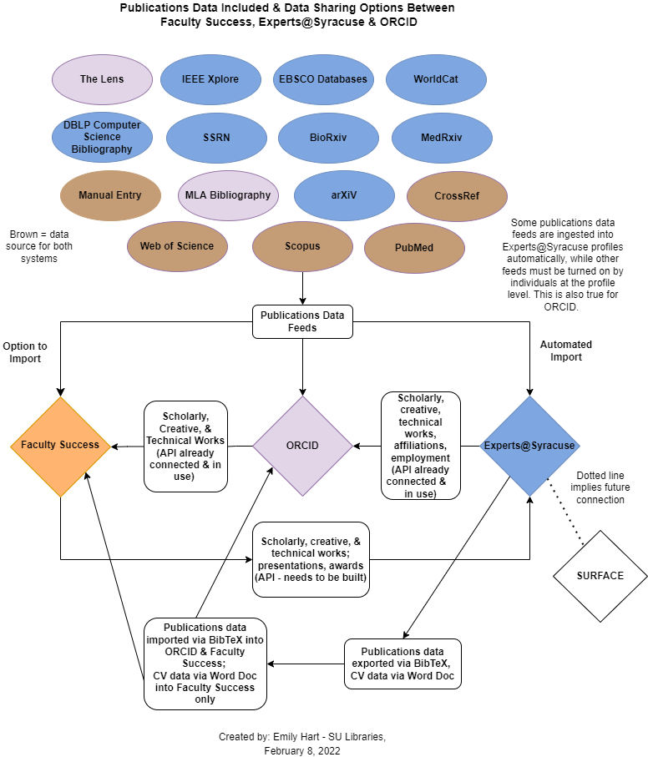
Notes:
Emily

Slide 28
Use Cases Are Informing Future Projects
Database Trials
Research Guide Development
Education and Outreach
Needs Assessment
Notes:
Steph: So, our use cases are informing our future projects and the direction of our team efforts moving forward. Through each experience, we are learning more about the University’s research metrics needs, both on an individual researcher level and at the group level. We are also learning about which types of metrics and reporting we can provide and where there may be gaps in what we can offer, based on the limitations of the tools (or databases) that we have access to. An understanding of user needs is informing a few broad areas of our future planning, which are Research Guide Development, the need for Database Trials, Education and Outreach efforts, and then a little further down the road, what we are learning will inform a more formal Needs Assessment.
NEXT SLIDE, PLEASE

Slide 29
Conversations with Research Impact Community
Thank you to the University of Rochester librarians
THANK YOU for participating in this webinar and for taking the recent research impact OCLC survey.
Join the OCLC Research Support Listserv to learn of upcoming webinars and small group discussions about research impact use cases at your institutions.
Contact Rebecca Bryant at OCLC to offer your perspective on supporting research impact services.
Please reach out if you have follow-up questions or would like to connect with us. Contact us at riteam@syr.edu.
Thank you to OCLC for helping to make these conversations possible!
Notes:
Steph: As we are focusing on Syracuse University research impact needs, we are also connecting with colleagues and having conversations with those in the broader research impact community. We are learning a lot from our colleagues at the University of Rochester, who are also doing this work. In particular, we have had a few really enlightening conversations with their team about the challenges and nuances of serving researchers in the social sciences and humanities.
We would really like to connect with you, as well, and thank you for participating in this webinar and for taking the recent OCLC survey. We have a link here to those survey results, which show there is significant interest in this topic, especially with sharing what you are doing to support research impact at your own institutions.
We would like to encourage you to join the conversation in a number of ways. Subscribe to the OCLC Research Support Listserv to find out about upcoming webinars and discussions, such as a call that will go out this spring and will focus on small group discussions of research impact use cases at your institutions. Contact Rebecca Bryant at OCLC, if you are interested in sharing your experience with supporting research impact services. We have found the experience of preparing for and giving this webinar to be really valuable for our own reflection and conversations as a team. Thank you so much to OCLC for our conversations and for facilitating this webinar!
If there is time for questions and opening up a discussion now, we would like to do that. I know our OCLC colleagues have been monitoring the chat. Are there any questions to begin the conversation?

