Slide 1
OCLC Research Library Partnership • January 25, 2022
Operationalizing the Art Research Collective Collection: “Year One” Progress Report

Slide 2
OpArt project team
Dennis Massie
Chela Scott Weber
Senior Program Officer, Resource Sharing
Senior Program Officer, Archives and Special Collections
Brian Lavoie
Senior Research Scientist

Slide 3
Today’s agenda
Welcome
Beginnings – the spark of an idea; initial plans
Getting real – learning and adjusting as we go
Preliminary analysis – art research collective collection by the numbers
Next steps
Discussion

Slide 4
beginnings

Slide 5
Cleveland Museum of Art
Frick Art Reference Library
Getty Research Institute
Museum of Fine Arts, Houston
University of Nevada, Las Vegas

Slide 9
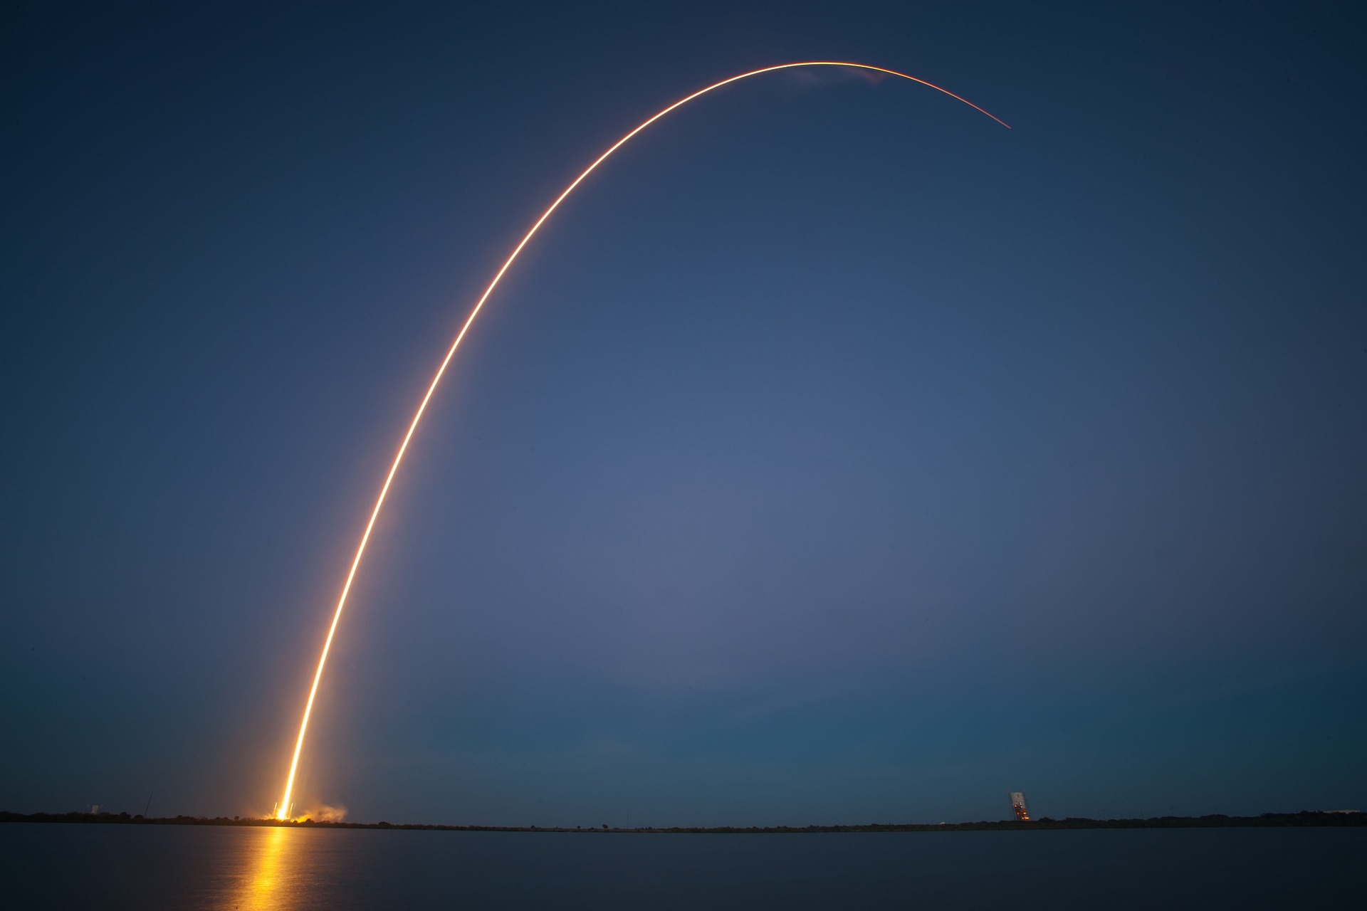
2020: The end of (OpArt’s) beginning
Passed through new internal project proposal review process
Interviewed directors of 12 SHARES art libraries
Formed and convened our advisory board
Received a grant from the Samuel H. Kress Foundation

Slide 10
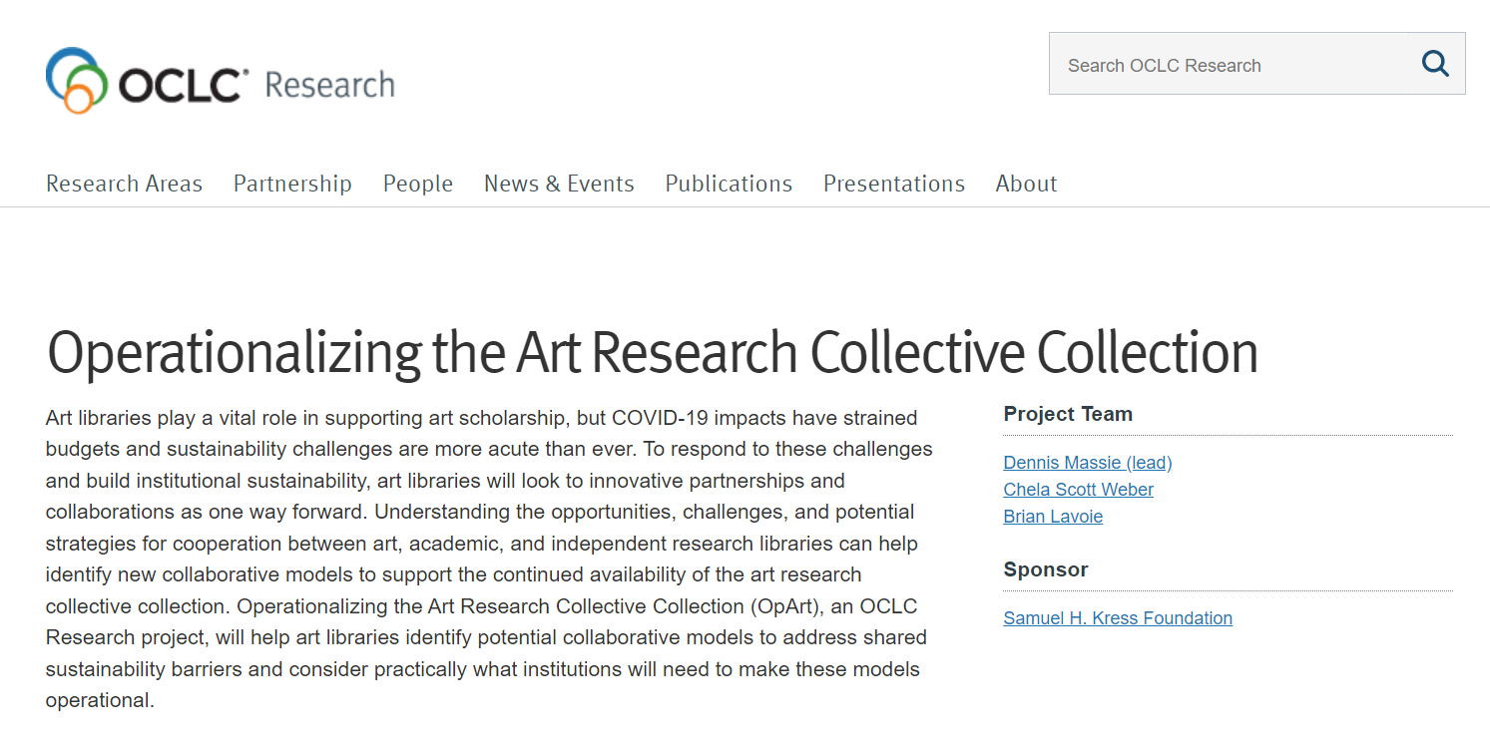
4 phases over 2 years
Analyze art research collective collections
Identify art research collection sharing patterns
Conduct collaborative case studies
Operationalize collaboration
The goal of the OpArt project is to help art libraries identify potential collaborative models to address shared sustainability barriers and consider practically what institutions will need to make these models operational.

Slide 11
Getting real

Slide 12
Advisory Group
Jon Evans, Museum of Fine Arts, Houston
Rebecca Friedman, Marquand Library, Princeton University
Roger Lawson, National Gallery of Art
Autumn Mather, Art Institute of Chicago
Keli Rylance, Saint Louis Art Museum
Lori Salmon, Institute of Fine Arts, New York University
Kathleen Salomon, Getty Research Institute
Tony White, OCAD University

Slide 13
Evolution of the Proxy Collection
1st Try: Proxy
Art Research
Collective Collection
66 institutions
7.2m distinct publications
12.5m total holdings
Revised: Proxy
Art Research
Collective Collection
85 institutions
7.7m distinct publications
14.8m total holdings

Slide 14
Project Phases
data-driven analysis
qualitative analysis
I. Opportunities for cooperation
across art research collections
III. “Deep dive” into case studies
of real-world collaboration
II. Cooperation patterns
in resource sharing
IV. Recommendations on how to make collaboration work

Slide 15
Project Phases
data-driven analysis
qualitative analysis
I. Opportunities for cooperation
across art research collections
III. “Deep dive” into case studies
of real-world collaboration
II. Cooperation patterns
in resource sharing
IV. Recommendations on how to make collaboration work

Slide 16
Project Phases
data-driven analysis
qualitative analysis
I. Opportunities for cooperation
across art research collections
III. “Deep dive” into case studies
of real-world collaboration
II. Cooperation patterns
in resource sharing
IV. Recommendations on how to make collaboration work

Slide 17
Some preliminary analysis

Slide 18
Phase 1: Collective collection analysis
Art Research
Collective Collection
Proxy
Collective Collection
WHAT?
WHO?
WHERE?

Slide 19
Size
Proxy
Art Research
Collective Collection
85 institutions
7.7m distinct publications
14.8m total holdings

Slide 20
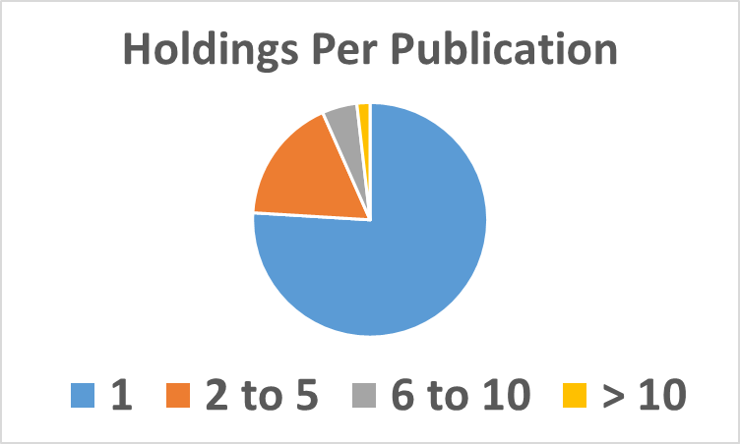
Holdings Overlap
76% held by one group member

Slide 21
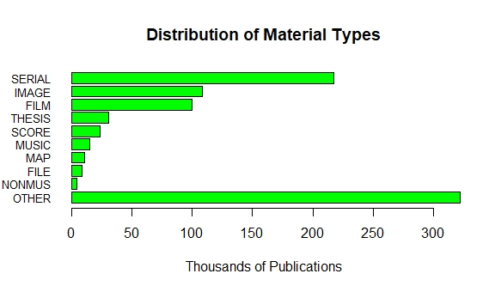
Material Types
6.9 million books

Slide 22
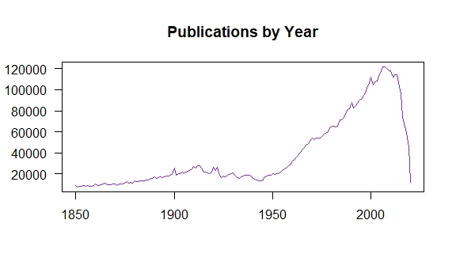
Publication Date Profile

Slide 23
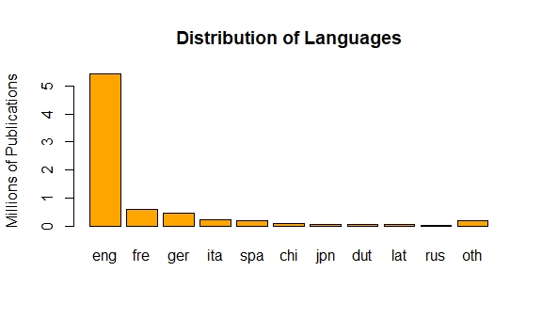
Languages
366 languages

Slide 24
Country of Origin
263 countries & territories

Slide 25
Art Discovery Group Catalogue (ADGC)
ADGC
Collective Collection
71 OCLC symbols
16.2m distinct publications
25.1m total holdings
ADGC
Collective Collection
Without
proxy group
members
57 OCLC symbols
14.5m distinct publications
19.6m total holdings

Slide 26
Overlap
Without proxy group members
Proxy
Art Research
Collective Collection
Proxy
Art Research
Collective Collection
ADGC
Collective Collection
ADGC
Collective Collection
50% of proxy collection
is in ADGC collection
27% of proxy collection
is in ADGC collection

Slide 27
Next steps

Slide 28
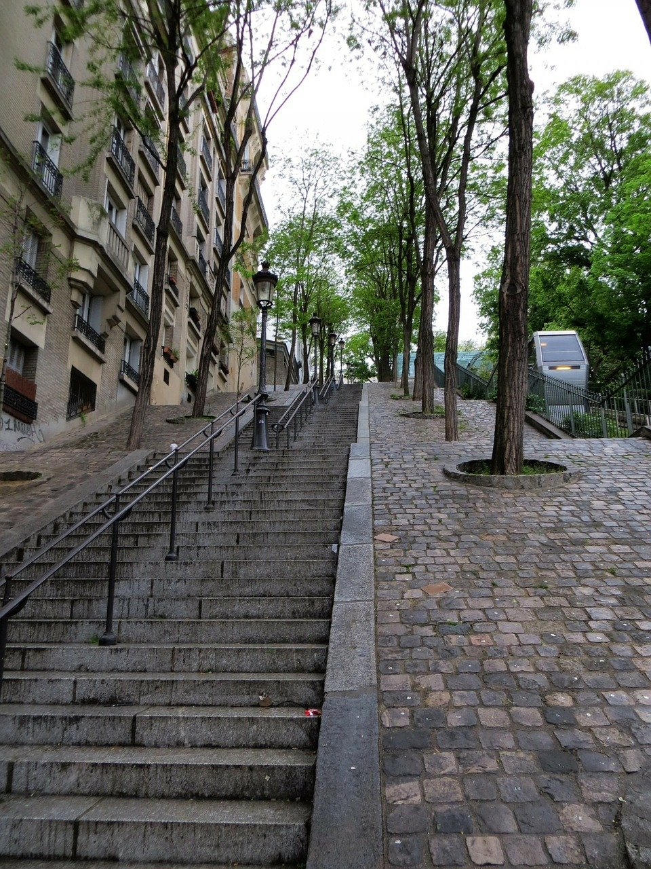
Next steps for OpArt
Subject analysis, etc.
ILL data analysis
Partnership case studies
Synthesize, report out
Identify areas for action and further study

Slide 29
discussion

Slide 30
Thank you!
Dennis, Chela & Brian
massied@oclc.org
weberc@oclc.org
lavoie@oclc.org

