Slide 1
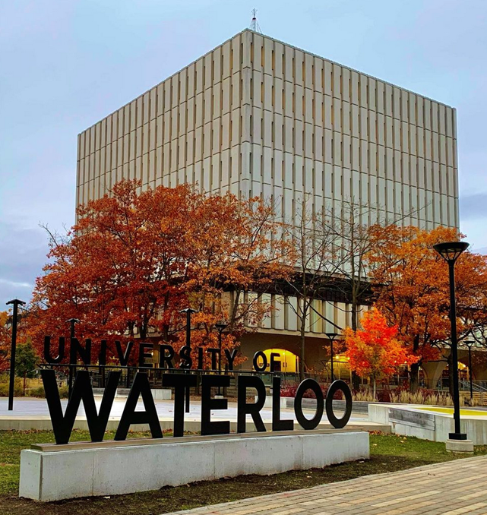
Works in Progress Webinar: Training students on the Critical Evaluation of Information (CEI) at the University of Waterloo
Kate Mercer, MI, PhD
Kari D. Weaver, MLIS, Ed.D

Slide 2
Land Acknowledgement
We acknowledges that much of our work and daily living takes place on the traditional territory of the Neutral, Anishinaabeg and Haudenosaunee peoples. The University of Waterloo’s main campus is situated on the Haldimand Tract, the land promised to the Six Nations that includes six miles on each side of the Grand River.
Reconciliation is a complex process, that includes making mistakes, learning, apologizing, and moving forward. Please consider reading some of the following sources to deepen your knowledge
Indian Givers: How the Indians of the Americas Transformed the World by Jack Weatherford
21 Things You May Not Know About the Indian Act: Helping Canadians Make Reconciliation with Indigenous Peoples a Reality by Bob Joseph
94 Calls to Action
The Xwi7xwa Library is a centre for academic and community Indigenous scholarship

Slide 3
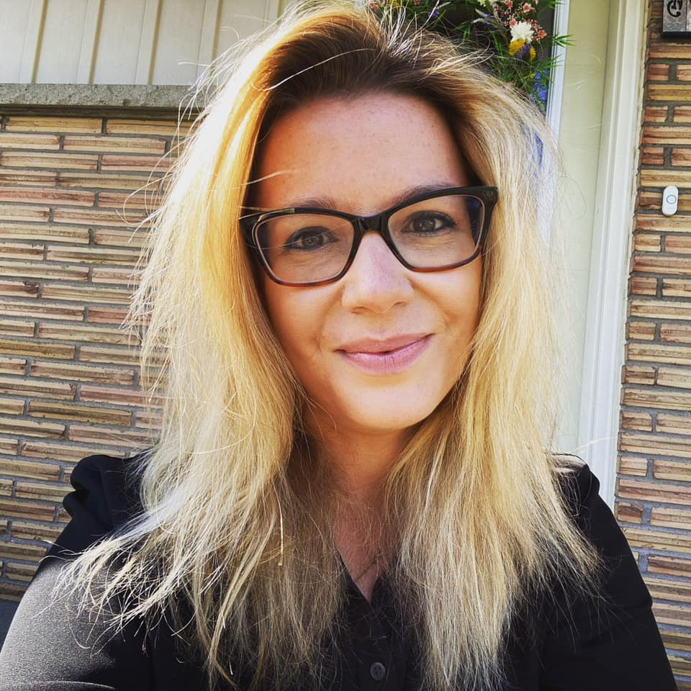
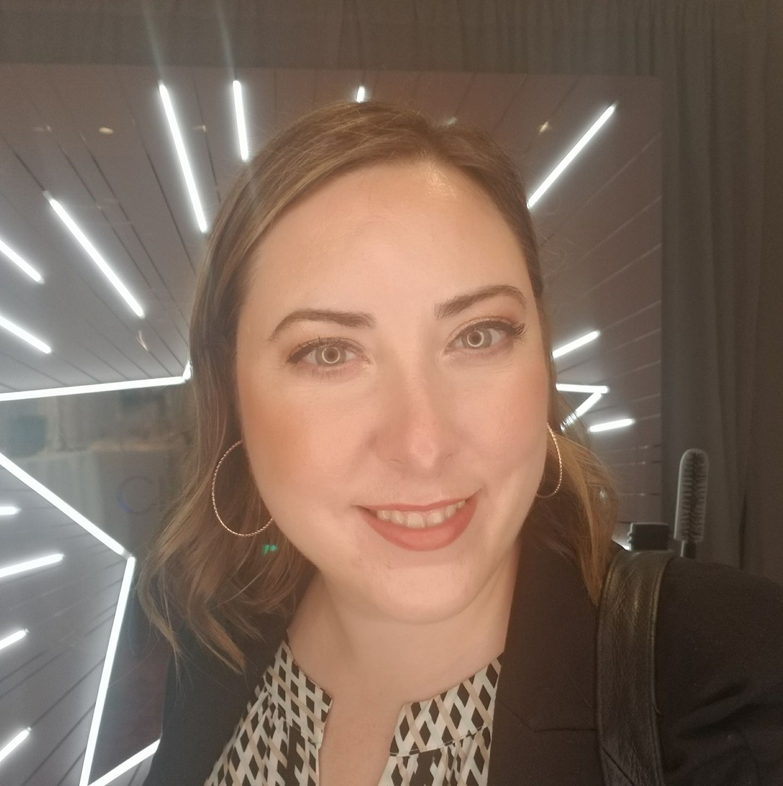
Who are we ?
Kate Mercer, Liaison Librarian for Systems Design Engineering, Biomedical Engineering, University of Waterloo
Kari Weaver, Learning, Teaching, and Instructional Design Librarian, University of Waterloo

Slide 4
What today is about?
In this presentation, we will discuss a new pedagogy and theory called Critical Evaluation of Information (CEI)
This is a type of information literacy training approached through the norms of disciplinary practice, to meet users where they are.
Library instruction has shifted from training undergraduate students on the mechanics of search to discussions on the evaluation of sources and the decision-making processes on what sources to use.
We will also examine disciplinary values and hierarchies, about why some sources like peer-reviewed journal articles are more highly valued than others.

Slide 5
Timeline
Fall 2017 – Began to reframe approach to teaching Library workshop in first year communications classes
Fall 2018 – Refined approach to teaching Library workshop, included more standardized lessons, cohesive approach across the library with a focus on evaluation
Winter 2019 – Worked with health, engineering, and ID librarians to incorporate critical appraisal elements into STEM info literacy
Fall/Winter 2019/2020 – Training and implementation of new process, data collection & gathering with various collaborators
Summer 2020 – Designed and Collaborated on plans to support remote learning
Fall 2020 – Began to gather data around move to online learning

Slide 6
Background on Information Literacy
Info literacy has historically focused on teaching tools (databases, citation managers, books, catalogues)
It has often been rooted in what the library has to offer
The way it’s been taught has been aimed at meeting needs of students in the academic environment
It’s really rooted in the practice of the LIS discipline

Slide 7
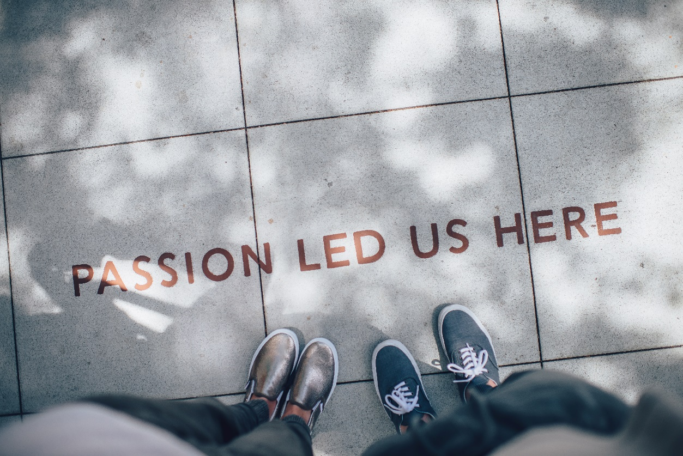
Let's talk discipline – in this context, STEM.
Historically STEM information literacy focused on presenting information that is inherently boundaried, that is to say - textbooks, peer reviewed journal articles, and library purchased monographs
There is a general cultural movement to a new information landscape that presents many types of information as equally valid, and STEM training is cautiously embracing this
STEM information is notoriously discipline specific – for example engineers generally seek information that is not inherently tied to the library, while bench science still tends to be more ‘traditional’ in type

Slide 8
STEM context of Information Seeking
Scientific discovery at its core is the product of STEM inquiry, and is founded in seeking, creating, and disseminating information
To successfully create new information, one must have a basis of skills and knowledge that are built through learning foundational information
STEM students often depend on Google as a first line resource, and the information available through Google can be as valid and good as in traditional academic sources – students just need to be critical of it.
It is not that online STEM information is incorrect, it’s that it’s correct enough but most importantly presented in a user-friendly way.

Slide 9
What is being ‘critical’
The phrase Critical Evaluation of Information has been intentionally chosen to link this idea to critical theory, as well as the ‘critique process.
Critical theory looks at critiquing society and culture to uncover and break down power structures.
Critique, is a discipline-specific process of having a dialogue about the work you present.

Slide 10
Threshold Concepts and the ACRL Framework
The learning is cyclical, not linear.
They are meant to be rooted in a specific discipline.
These are meant to help students connect learning across different aspects of a discipline.
Threshold Concepts are ideas that are concepts but once the understanding is gained, it results in an internal shift that is never lost.

Slide 11
Threshold Concepts and the ACRL Framework
They are incredibly useful to help understand and navigate information
They have been critiqued for not having a clear definition
Some people think it oversimplifies disciplinary knowledge
They also inherently are meant to work in one discipline
This is complicated in an increasingly multidisciplinary world

Slide 12
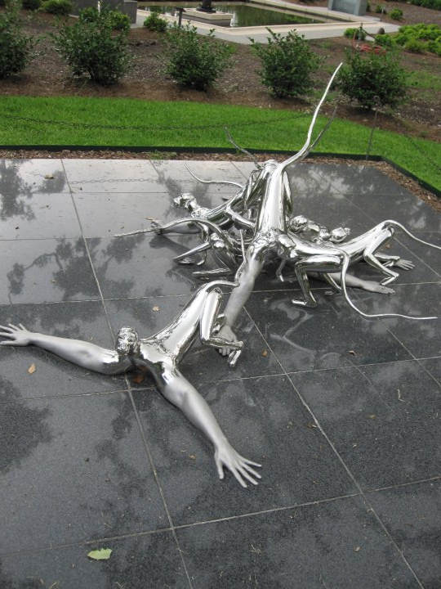
STEM Pedagogies & Information Literacy
Many STEM students are building knowledge with a goal of having at least an option for pursuing a career where their professional information needs have an ethical component.
Librarians and instructors often have to navigate co-ops or work terms where they are getting information from practitioners.
STEM information is largely grounded in the knowledge that you have to understand the structure and process of what you’re learning, and then scale that knowledge up.
Students are notoriously overconfident in their ability to find the right information to be successful

Slide 13
What is our current practice?
Agile
Flexible
STEM-centered
Multidisciplinary
Learner focused
Information as a partner

Slide 14
CEI: Background
Threshold concepts were always supposed to be recursive.
The experience of realizing you are not an expert can be very disquieting for students
As STEM students learn, they realize that knowledge is iterative
So how do we teach them to be critical, when they don’t always know enough or have enough context to be critical?

Slide 15
CEI: STEM context
CEI aligns with STEM specific learning approaches
The scientific method is about applying knowledge and hypothesis testing
The critique, used in many disciplines including engineering, is about having a conversation.
Mercer K, Weaver D, Figueiredo R, Carter C. (2020) Critical Appraisal: The Key to Unlocking Information Literacy in the STEM Disciplines. College & Research Libraries News, 81(3), 145-148. DOI: 10.5860/crln.81.3.145
Borland M, Mercer K. (2020) Introducing Critique to Enhance Traditional Evaluation in Your Large Classroom. Canadian Design Workshop.

Slide 16
CEI: Considering the needs of the learner
STEM learners who are developing their information literate abilities
employ self-reflection around why they are using a piece of information;
examine their own biases of what makes a piece of information ‘good’;
understand that authority is constructed, and building a deep understanding of context is necessary;
seek out diverse perspectives during information seeking, and assess each perspective both within their academic context as well as equally in the context the knowledge was created in;
identify expert perspectives to help critique information;
explore a process of critiquing information in a way that justified why a piece of information is necessary, and what it contributes to why they need it;
understand discipline-specific, professional obligation grounded ethical requirements of information;

Slide 17
CEI: The process
CEI proposes a four-step process where students’ information seeking, evaluation, and use aligns with established STEM pedagogies, such as critique and the scientific method, to discuss and contextualize the source. This approach connects identifying and clarifying context, understanding a chosen source, the application of an evaluative framework (e.g. RADAR, CRAAP, anything) students own lived experiences as applied to a specific problem or question.
Step 1: Define context
Step 2: Find a source
Step 3: Use any Evaluative Framework
Step 4: Critique / Applying Scientific Method
Mercer K, Weaver K. (2022). Critical Evaluation of Information as a new threshold concept for navigating STEM information. Science & Technology Libraries. DOI: 10.1080/0194262X.2022.2032909

Slide 18
CEI: In practice
Generally done in a 1 hr workshop, with 15-110 students
Students have a brief background lecture, then are brought into discussion with the instructor around information.
The goal of the lecture/discussion is to include them in it – ask where they find information. Tell them it’s ok to say Google. Talk about Reddit, social media, every type of source as equal.
After initial discussion, talk to them about being critical, and bias.
Give them a problem (you are a student at work, asked to…)
Ask them to read an article
Give them a worksheet with your chosen evaluative framework, and ask them to go through it with their neighbour – tell them it’s ok to talk
Discuss.

Slide 19
CEI: In practice – work integrated learning
When students go on work terms (co-ops, placements, summer jobs) they generally don’t have access to library resources, so they need strategies that can be applied in non-academic contexts
For example: Engineering firms, pharma companies, government jobs, start-ups, industry
We intentionally connect information to decision making.
“What information do you need to know to make the best decision for your job”
“You may have access to some academic sources, but how do you flesh out that knowledge?”
“How do you find good foundational knowledge?
Information isn’t just what you look up on Google – it’s emails, youtube videos, talks with co-workers, networks, Netflix shows, social media. All of these can be really valuable sources, but you have to be critical of them in a different way than you do of academic sources.

Slide 20
CEI: In practice – Move to online
It works, albeit not as in depth, if you use a module-based approach
Students provided very positive feedback about the modules we created (which surprised us!)
Instructors also were very excited to include them
You do have to streamline content quite significantly
Our bias, is we like in person better – having a conversation is hard.
Yes, you can have discussion boards, but students have an easier time opening up with conversations that are in person

Slide 21
CEI & Assessment
We have begun to assess this in several classes. Students completed a pre-research worksheet where they were asked to describe where they found their information, what sources were consulted, and how they determined its credibility.
Lamont G, Ohaegbu C, Mutch S, Butt H, Mercer K, Weaver K. (2021). A comparison of in-person and asynchronous information-seeking behavior instruction among first-year engineering students. Paper presented at 2021 ASEE Virtual Annual Conference Content Access, Virtual Conference. https://peer.asee.org/37118

Slide 22
CEI Tips
Giving boundaries helps
Don’t try and search the whole internet
Acknowledge it’s ok to not know everything
Be Creative
Meet students where they are
Speak the same disciplinary specific language
Create a culture of being wrong, and learning more
Use tools they use in other contexts.
Make it fun
Always have a conversation

Slide 23
CEI Next Steps
Test more
Complete a more in-depth source analysis
Build out the pedagogy itself
More deeply examine faculty perspectives

Slide 24
Final thoughts
Uptake is very strong – we generally have 80-95% of faculty members continue to participate
The principles of this hold true across any discipline
This is largely a language issue.
Relationship building is huge with faculty instructors. This emerged from relationships, and trust that we could deliver something other than “search the catalogue, teach citations”
Misinformation is dominating the landscape, and it is so important we teach tools around critiquing all information.

Slide 25
Questions?
Weaver, K. D., Mercer, K., & Lamont, G. (2022). The RADAR framework for evaluating sources of information. In S. Rowland & L. Kuchel (Eds.) Teaching Science Students to Communicate: A Practical Guide. Springer Nature.
Mercer, K., Weaver, K. D., & Lamont, G. (2022). Critical information evaluation in the Sciences. In S. Rowland & L. Kuchel (Eds.) Teaching Science Students to Communicate: A Practical Guide. Springer Nature.
Mercer K, Weaver K. (2022). Critical Evaluation of Information as a new threshold concept for navigating STEM information. Science & Technology Libraries. DOI: 10.1080/0194262X.2022.2032909
Lamont G, Ohaegbu C, Mutch S, Butt H, Mercer K, Weaver K. (2021). A comparison of in-person and asynchronous information-seeking behavior instruction among first-year engineering students. Paper presented at 2021 ASEE Virtual Annual Conference Content Access, Virtual Conference. https://peer.asee.org/37118
Mercer K, Weaver K, Lamont G, Moffatt C. (2021). First year communications classes: Applications of critical evaluation in a problem-based learning framework. 2021: Proceedings of the Canadian Engineering Education Association (CEEA-ACEG) Conference June 20 - 23 PEI. DOI: 10.24908/pceea.vi0.14881
Lamont G, Mercer K. et.al. (2020) Information-seeking behavior among first-year engineering students and the impacts of pedagogical intervention. Proceedings of the American Society of Engineering Education (ASEE) Annual Conference June 22-26 Online [Paper, Presentation] https://peer.asee.org/34827
Mercer K, Weaver D, Figueiredo R, Carter C. (2020) Critical Appraisal: The Key to Unlocking Information Literacy in the STEM Disciplines. College & Research Libraries News, 81(3), 145-148. DOI: 10.5860/crln.81.3.145
Kate Mercer
kmercer@uwaterloo.ca
Kari Weaver
kdweaver@uwaterloo.ca

