Slide 1
This project was made possible in part by the Institute of Museum and Library Services, through grant LG-246349-OLS-20. The IMLS is the primary source of federal support for the nation’s libraries and museums.
https://confluence.ucop.edu/display/NAFAN
Notes:
Today I’ll be sharing some ongoing work with you on the “Building a National Archival Finding Aid Network” project, also known by its acronym “NAFAN”.

Slide 2
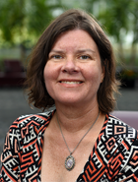
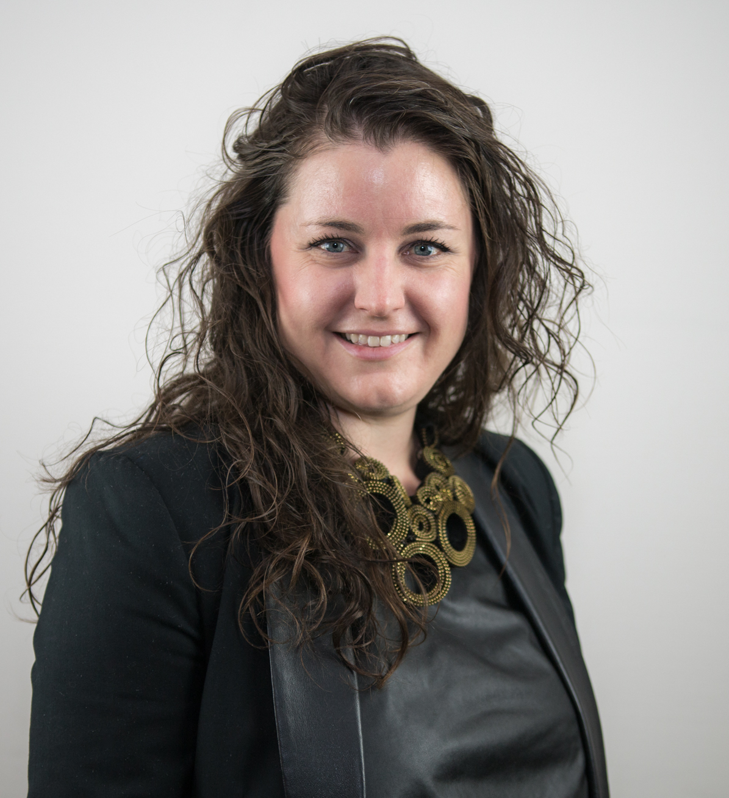
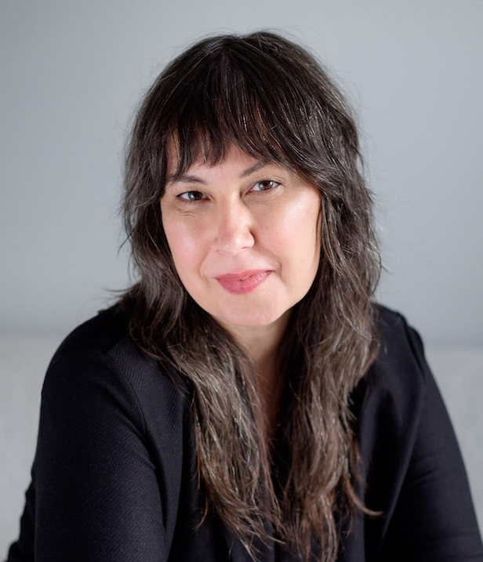
Creating, Maintaining, and Sharing Archival Descriptions: The Experiences and Values of US Archivists
Why Are Users Searching Archives Online? Results of a User Survey from 12 State and Regional Archival Finding Aid Aggregators (NAFAN)
The Broadest Possible Range of Users: Learning About Users of Archival Aggregations
​
Merrilee Proffitt (she/her/hers) ​
Senior Manager OCLC Research
@merrileeiam / proffitm@oclc.org
Lesley A. Langa, Ph.D. (she/her/hers) ​
Associate Research Scientist
@lesleylanga / langal@oclc.org
Chela Scott Weber (she/her/hers)
​Senior Program Officer OCLC Research
@partly_cloudy / weberc@oclc.org

Slide 3
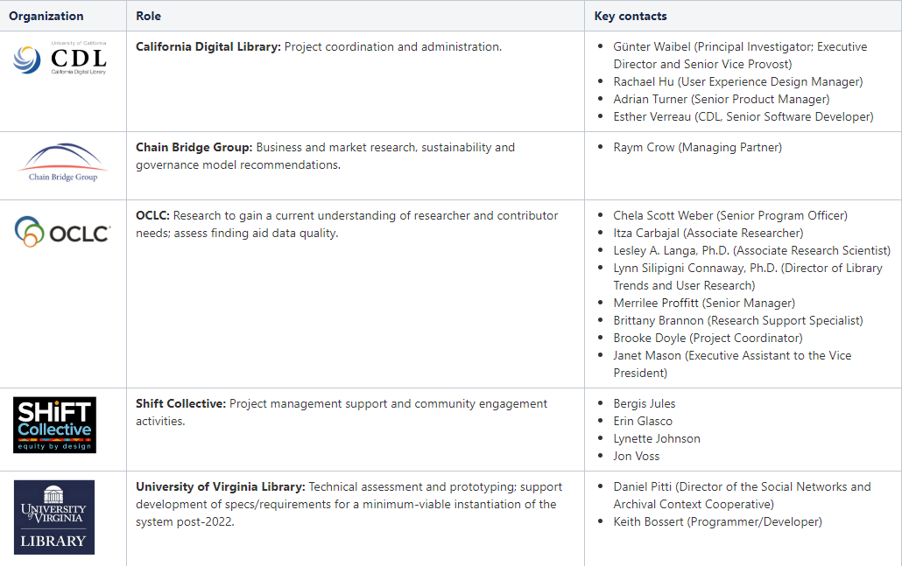
Project Team
Notes:
CDL has assembled a broad team to coordinate and lead the different activity streams:
CDL: leading the project, coordination and admin
Chain Bridge Group: sustainability and governance models
OCLC: end user and contributor research
Shift Collective: project management and community support
UVA: technical assessment and prototyping

Slide 4
Research Advisory Group
Bill Stingone, New York Public Library
Derek Mosley, Auburn Avenue Research Library on African American Culture and History, Atlanta-Fulton Public Library
Hillel Arnold, Rockefeller Archives Center
Holly Mengel, University of Pennsylvania, Kislak Center (PACSCL)
Lydia Tang, Lyrasis
Molly Bruce Patterson, Rhode Island College (RIAMCO)
Rachel Walton, Rollins College
Ricky Punzalan, University of Michigan, School of Information

Slide 5
Research Data Analysis
Focus Group Interviews with Archivists
10 Interviews / 52 Archivists total
Multiple archive types, positions ranging from entry level to leadership
Analysis focused on:
Enabling and constraining factors related to creating archival description
Enabling and constraining factors related to participating in aggregation
Perceived value of aggregation
Cultural Heritage Institutions
Notes:
Also learning a lot about broader environment of systems archivist are using including ILSs, needs around data migration and manipulation

Slide 6
Research Data Analysis
Two major sources of user data:
Pop-Up survey
Hosted on 12 Regional Aggregator sites
3300 complete, usable responses
Gathered demographic and research needs info
Semi-structured individual interviews
25 interviews, 45-60 min
5 user types: Academic, Advanced Academic, Professional, Personal Interest, Genealogist
Analysis focused on:
Describing and classifying users, based on needs, motivators, behaviors
Benefits and challenges of using aggregators
Researchers
Notes:
Also learning a lot about the larger research environment in which they are operating/discovering aggregators, expectations set by allied products like Ancestry.com, what their ideal archives search tool would look like, needs and desires around discovery of digital assets

Slide 7
Creating, Maintaining, and Sharing Archival Descriptions: The Experiences and Values of US Archivists
Notes:
Merrilee

Slide 8
Focus Group Interview Summary
10 focus groups
52 participants total
24 participating in aggregation
28 not participating in aggregation
Representing 27 states and District of Columbia
Divided into five group types
Leadership / Administrative
Public Services & Tech Services, small institution
Public Services & Tech Services, large institution
Technical Services & Systems Responsibilities
Very Small Institution / Lone Arrangers
Notes:
Merrilee

Slide 9
Participants by Archive Type
Academic archive | 22
Museum library / archive | 11
Government archive | 6
Public library archive | 4
Community archive | 4
Historical society archive | 3
Independent research library | 2
International organization | 1
Performing arts archive | 1
Regional archive | 1
Total | 52
Carnegie Classifications Breakdown
2 worked at archives in Baccalaureate Colleges (1 Arts & Sciences Focus, 1 Diverse Fields) ​
5 worked in Master’s Colleges & Universities (2 M1, 3 M2)​
15 worked in Doctoral Universities (10 R1, 4 R2, 1 D/PU) ​
Notes:
Lynn
Museum library and archive type with 11 participants included those from large and small art, history, and other types of museums.
R1: Doctoral Universities – Very high research activity
R2: Doctoral Universities – High research activity
D/PU: Doctoral/Professional Universities
M1: Master's Colleges & Universities – Larger programs
M2: Master's Colleges & Universities – Medium programs

Slide 10
Participants by US Region
11 total
8 total
13 total
2
11
9
3
5
2
2
14
4
20 total
Notes:
Merrilee
US Census Regions and Divisions map from https://www.eia.gov/consumption/commercial/maps.php#census
https://hangingtogether.org/nafan-focus-groups-aligning-participant-selection-with-project-values/

Slide 11
Aggregation Contributor Research Questions
What are the enabling and constraining factors that influence whether organizations describe the archival collections in their care?
What are the enabling or constraining factors that influence whether organizations contribute to an aggregation of archival description?
What value does participation in an archival aggregation service bring to organizations?
Notes:
Merrilee

Slide 12
Final Protocol
Please tell us about your role in working with archival collections at your institution.
Please tell us briefly about how archival description gets produced and published in your institution.
This question focuses on producing and publishing archival description where you work. What are the things that make producing and publishing archival description in your home institution easy or difficult? What are the things that support this work and make it easier, either that you have now or would like to have?
Notes:
Merrilee

Slide 13
Final Protocol (continued)
Think about your current process / the hypothetical scenario where your home institution would contribute to an archival aggregation platform. What about the process is/would be easy? What about the process is/would be difficult?
What makes/would make participation in a finding aid aggregation valuable for your institution? What makes/would make your participation in a finding aid aggregation valuable for your researchers? Do you think there are other things an aggregator could offer that would be valuable to your institution or researchers?
If you had a magic wand and could create your ideal national-scale finding aid aggregation system, how would it work and what would it do?
Notes:
Merrilee

Slide 14
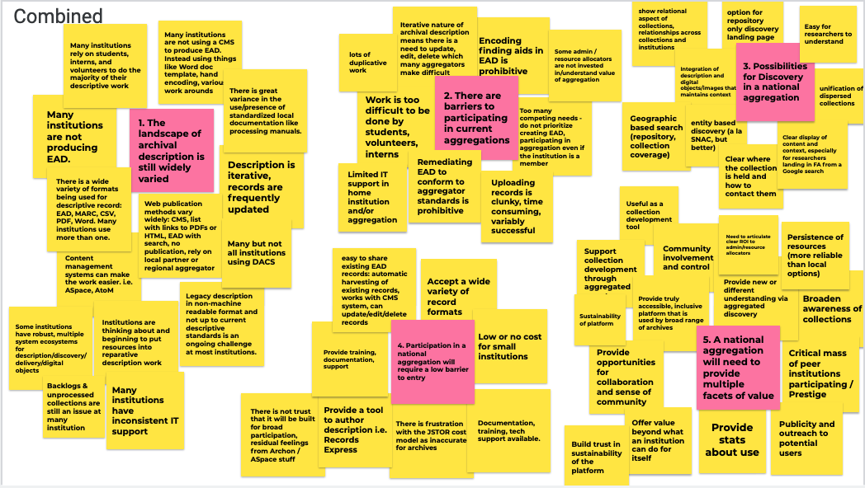
Theme Analysis
Notes:
Once we had the interviews completed, which was in June 2021, team members read through the transcripts and individually identified themse that we thought were present across the interviews. This is a screenshot from the first team meeting where we met to discuss and aggregate observations about themes.

Slide 15
Four Themes
Things that constrain creating archival description
Things that enable creating archival description
Incentives to participate in aggregation (current or perceived)
Disincentives to participating in aggregation (current or perceived)
Notes:
Although this was a useful approach, we ultimately arrived at four high level themes which better align with the research questions.
Theme 1: Circumstances, resources, or realities that prevent the archivist or institution from creating archival description. Use these codes only for the creation of archival description, not to capture what is said about sharing or contributing description to an aggregator/aggregation.
Theme 2: Circumstances, resources, or realities that facilitate the archivist or institution in creating archival description. Use these codes only for the creation of archival description, not to capture what is said about sharing or contributing description to an aggregator/aggregation.
Theme 3: Things people like or value in a current or imagined aggregation or that would help convince them to contribute to the aggregation.
Theme 4: Things people dislike or are frustrated by in a current or imagined aggregation or that would prevent them from contributing to the aggregation.

Slide 16
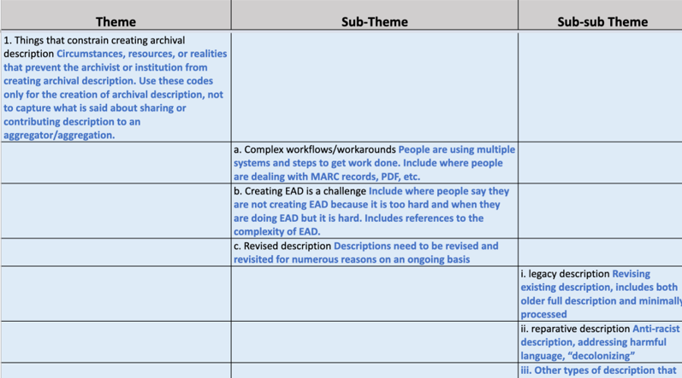
Codebook
Notes:
And then we developed a codebook which had subthemes and sometimes sub-subthemes nested under the four themes. For the focus group coding we used excel. After test coding a few interviews with a larger group of readers, Lesely and I coded the all the interviews, meeting to discuss agreement or disagreement on codes.

Slide 17
Constraints
Complex workflows / workarounds (n=29)
Dealing with legacy description (n=19)
Lack of control over IT / software (n=16)
Enablers
Collection Management Systems (n=21)
Worksheets / templates (n=14)
Documentation / manuals (n=8)
n=number of focus group interview participants
Notes:
Here is a view of the themes that came up most frequently by the number of speakers than mentioned it.

Slide 18
Constraints
Enablers
“...our library IT is baffled by our needs.”
-Special Collections Archivist, Academic archive, West
“ArchivesSpace makes it easy for us...It's been a sea change for us in terms of time savings."
-Supervisory Archivist, Academic archive, West

Slide 19
Incentives to participate
Increased visibility / awareness of collections (n=25)
Uncovering connections between collections (n=22)
Ease of contributing records in an automated way (n=21)
Disincentives to participate
Data requirements (n=19)
Difficult to edit / update records (n=14)
Difficult to submit records (n=8)
n=number of focus group interview participants

Slide 20
Incentives
Disincentives
“...we're so small and such a niche [topical archive] that we're not a destination necessarily for a lot of people.”
-Archivist, Independent research library, West
"We can't delete things. It is a process for us to delete, we have to put in a request and make sure that it gets taken down...We're doing an anti-racist descriptive practices deep-dive into all of our finding aids, we're having to do this whole process of uploading and editing over and over again."
-Special Collections archivist, Academic archive, West

Slide 21
Description constrainers
Complex workflows / workarounds (n=29)
Dealing with legacy description (n=19)
Lack of control over IT / software (n=16)
Description enablers
Collection Management Systems (n=21)
Worksheets / templates (n=14)
Documentation / manuals (n=8)
n=number of focus group interview participants ​
Notes:
Merrilee

Slide 22
Why Are Users Searching Archives Online? Results of a User Survey from 12 State and Regional Archival Finding Aid Aggregators (NAFAN)
Notes:
Lesley
Hi my name is Lesley Langa and I work in OCLC Research on the Library Trends & User Research team. I’ll be focusing on a different part of the research we’ve undertaken to delve into the users of archival aggregators.

Slide 23
Who are the current users of finding aid aggregations? Do they align with the persona types and needs identified in recent archival persona work?
What are the benefits and challenges users face when searching for descriptions of archival materials within finding aid aggregations?
Researchers: Research Questions
Notes:
Lesley
Based on prior literature we know very little about archival aggregator users. There are personas that exist for prior projects on users of archival discovery systems, and the Online Archive of California performed an evaluation some time ago, and so we went into this project wanting to get a much fuller picture.
Personas from Stanford, Rockefeller, Orbis Cascade Alliance
Stanford University Libraries, Georgia Tech, and University of Michigan. (2017). ArcLight Personas. Stanford Digital Repository. Available at: https://purl.stanford.edu/hk349dn1751

Slide 24
Data that describe need
Demographics: where are researchers located? How old are they? What is their profession?
Purpose for researching: Why are they using the aggregation site?
Behaviors: How frequently do they visit the site? Do they use other sites for their search? If yes, which ones?
Notes:
Lesley
Here you can see what we’re looking to know. This will help us to know what kinds of information drew them to an aggregation site, what their next steps may be, and the functionality that they desire in the new NAFAN platform.

Slide 25
Purpose
Capture data on users of online aggregators
Identify potential interviewees for qualitative data collection
Design
Hosted by 12 aggregators
Convenience sample
Opt-in
Opened March 18 - Closed on May 31
~3,300 responses
Survey
Methods
Notes:
Lesley
The purpose of the survey was to capture data on users of aggregators. Previous studies of this nature generally looked at individual archives themselves, rather than across aggregators, and were generally smaller N than we wanted for this project. We designed and launched a pop-up survey for users that we placed on the websites of each extant archival aggregator. The survey was designed to do two things, first provide descriptive statistics of users, and second to identify potential interviewees.
The survey was hosted by 12 aggregators. It opened on March 18, 2021, and closed on May 31. The sample was a convenience sample, with users opting in, rather than a randomized sample. Future research could use a random sample, but given the lack of large N studies on this, we felt that a convenience sample was a good starting point. We ended up with over 3,000 responses, which as a higher number than we were even expecting.

Slide 26
Demographics
How the user found the aggregator
Purpose for research
Type of material wanted for research
Preference for digital vs. physical materials
Impact of COVID on research
Survey
Questions
Notes:
Lesley
In the survey, we asked questions about demographics such as profession, age and gender. We asked how they found the aggregator. We asked what the purpose of their research was, the type of material they wanted, whether they wanted it physically or digitally, and whether COVID has impacted their archival use.

Slide 27
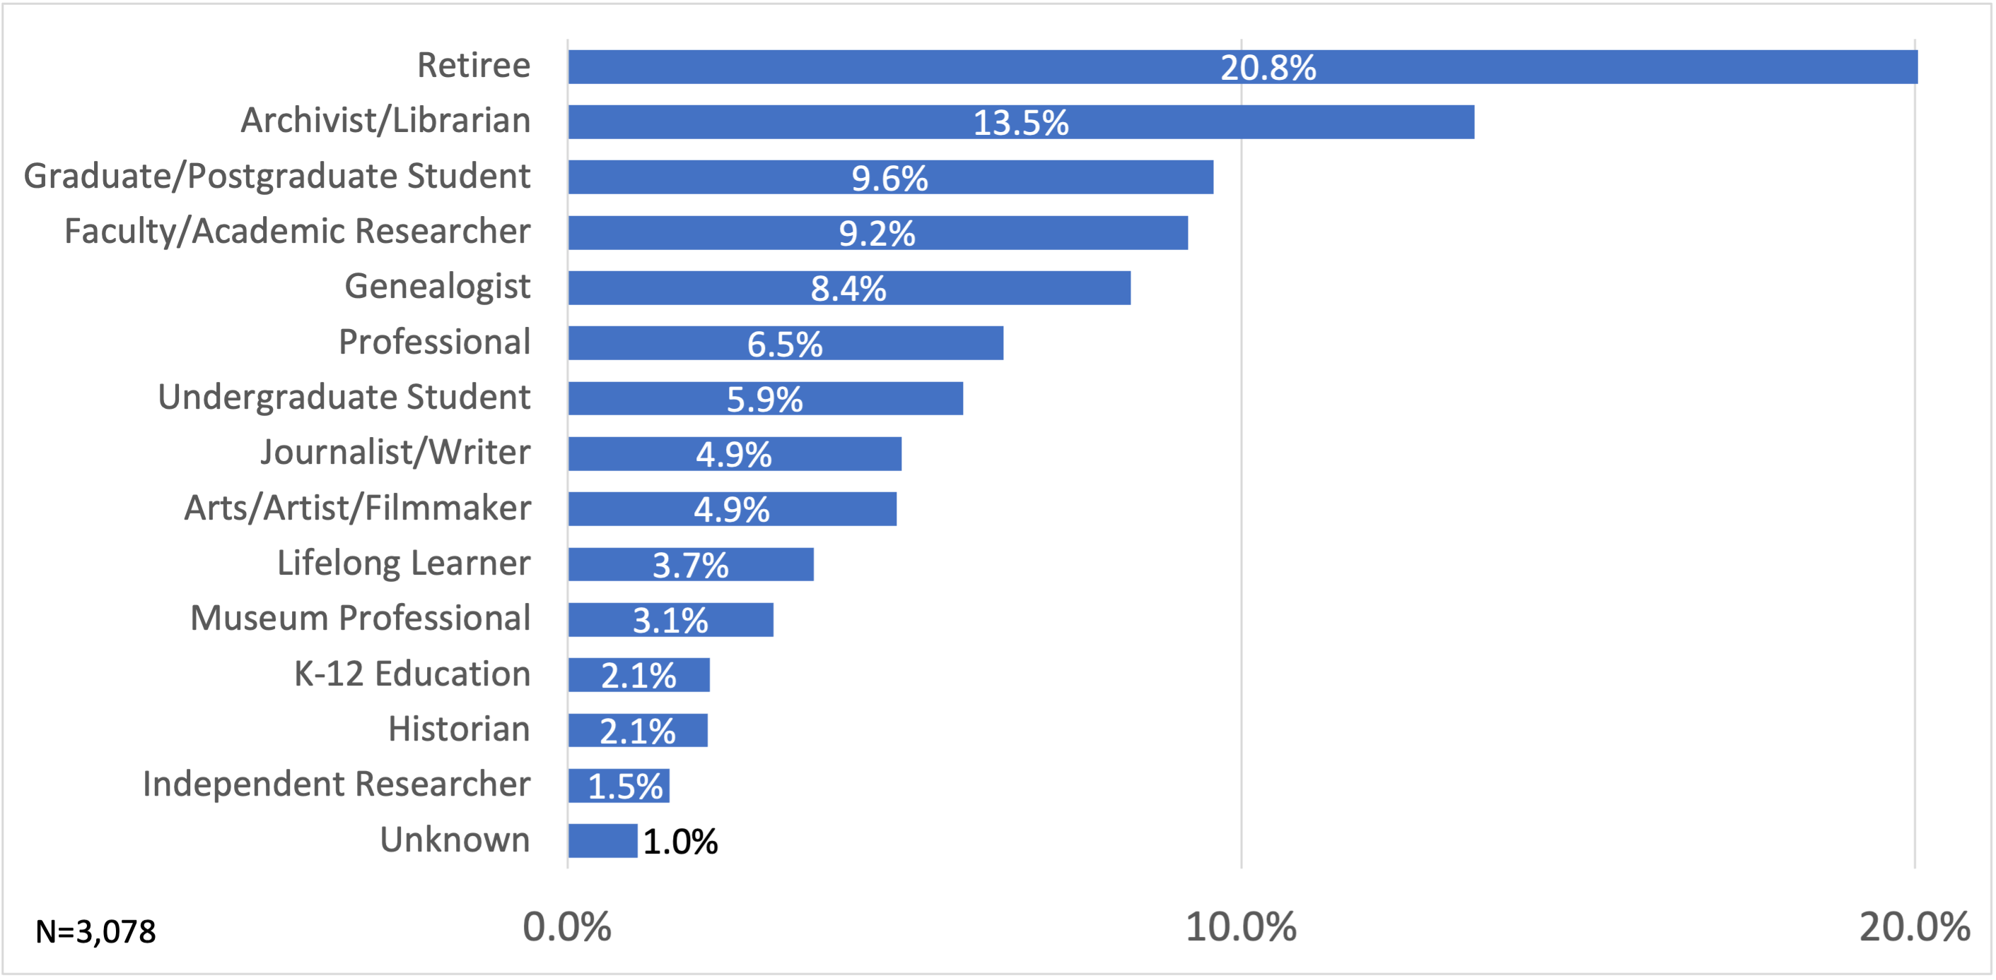
Pop-up Users, by profession
Notes:
Lesley
Across our users, we had a high percentage of respondents that self-identified as retired. In the bar chart on this slide for professions of users ranked by percentage, they appear at the top of our distribution at 20.8%. The next highest ranked profession is archivists and librarians at 13.5% followed by graduate students and post graduate students and faculty or academic researchers that are roughly the same at 9.6% and 9.2%, respectively. Genealogists are ranked fifth at 8.4%.
The remaining 10 professions are 6.5% or less of our respondents. The range of professions include journalist, historian, independent researcher, museum professional, artist, tradespeople, lawyers, lifelong learner and K-12 educators and parents.

Slide 28
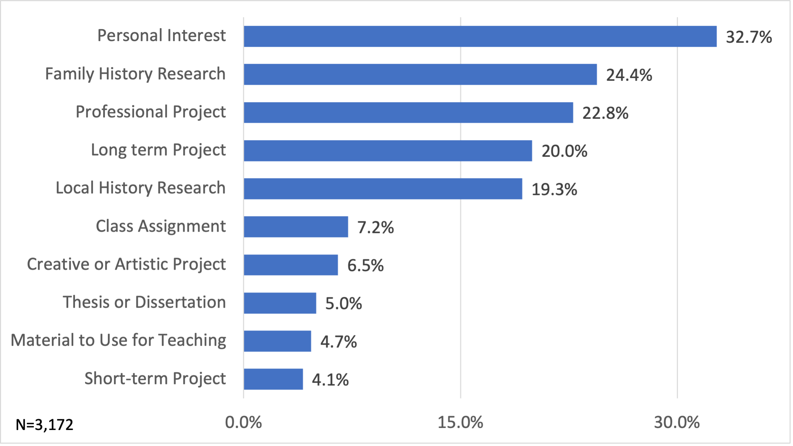
Pop-up Users, by project purpose
*Percentages do not sum to 100%
Notes:
Lesley
We asked participants about their research habits and why they came to the aggregation website. Respondents could select all of the response option, which is why the chart does not sum to 100%.
You can see in the bar chart on this slide that 32.7% of respondents indicated that their project purpose was a personal interest. The next four project purpose categories are strong reasons why respondents came to search at the aggregation websites. Family history research projects make up 24.4% of the reason respondents are searching aggregation websites. Projects that respondents are doing as a part of their professional responsibilities makeup 22.8%. Long term projects that can take months or years to complete make up 20% and 19.3 % of respondents are conducting local history research.

Slide 29
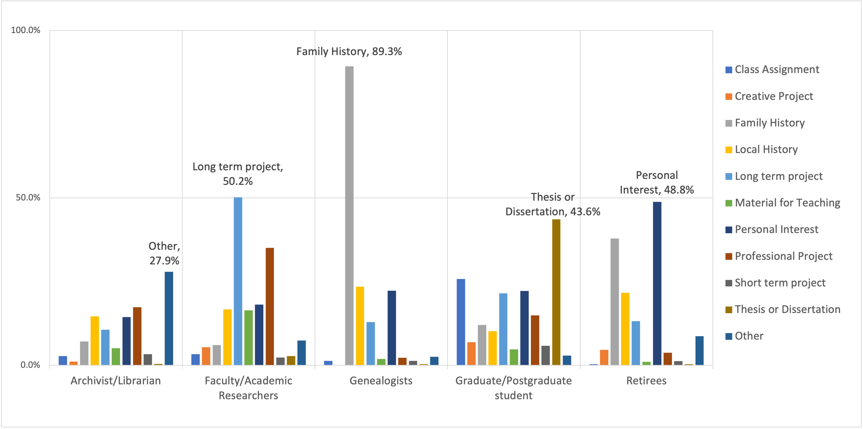
Top 5 professions by project purpose
*Percentages do not sum to 100%
Notes:
Lesley
We asked participants about their research habits and why they came to the aggregation website. Respondents could select all of the response option, which is why the chart does not sum to 100%.
You can see in the bar chart on this slide that 32.7% of respondents indicated that their project purpose was a personal interest. The next four project purpose categories are strong reasons why respondents came to search at the aggregation websites. Family history research projects make up 24.4% of the reason respondents are searching aggregation websites. Projects that respondents are doing as a part of their professional responsibilities makeup 22.8%. Long term projects that can take months or years to complete make up 20% and 19.3 % of respondents are conducting local history research.

Slide 30
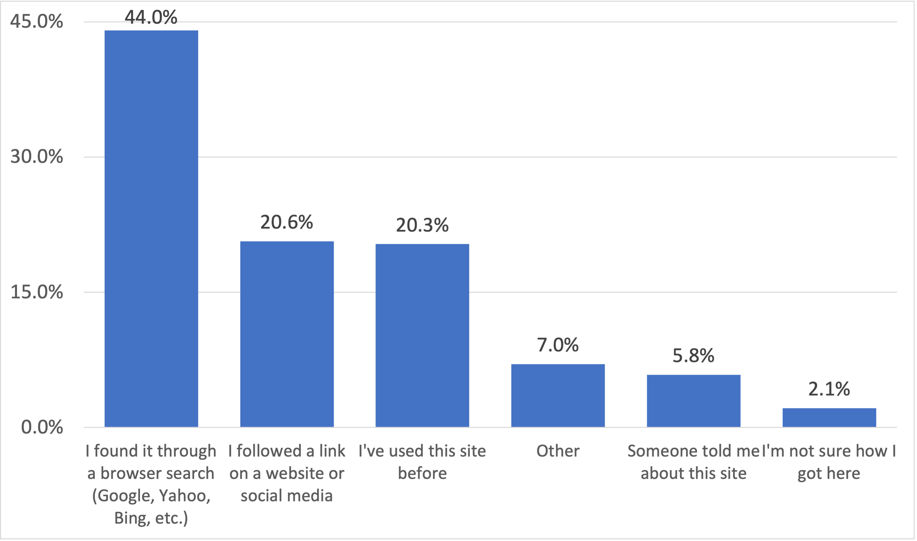
How Pop-up Users found aggregator websites
Notes:
Lesley
Nearly half of the NAFAN pop-up survey respondents indicated that they found the archival aggregation site where they are conducting research through a browser search. Roughly 20% of respondents indicated that they found the aggregation site through a link from another website or social media and/or know the aggregation website and have used the site before.

Slide 31
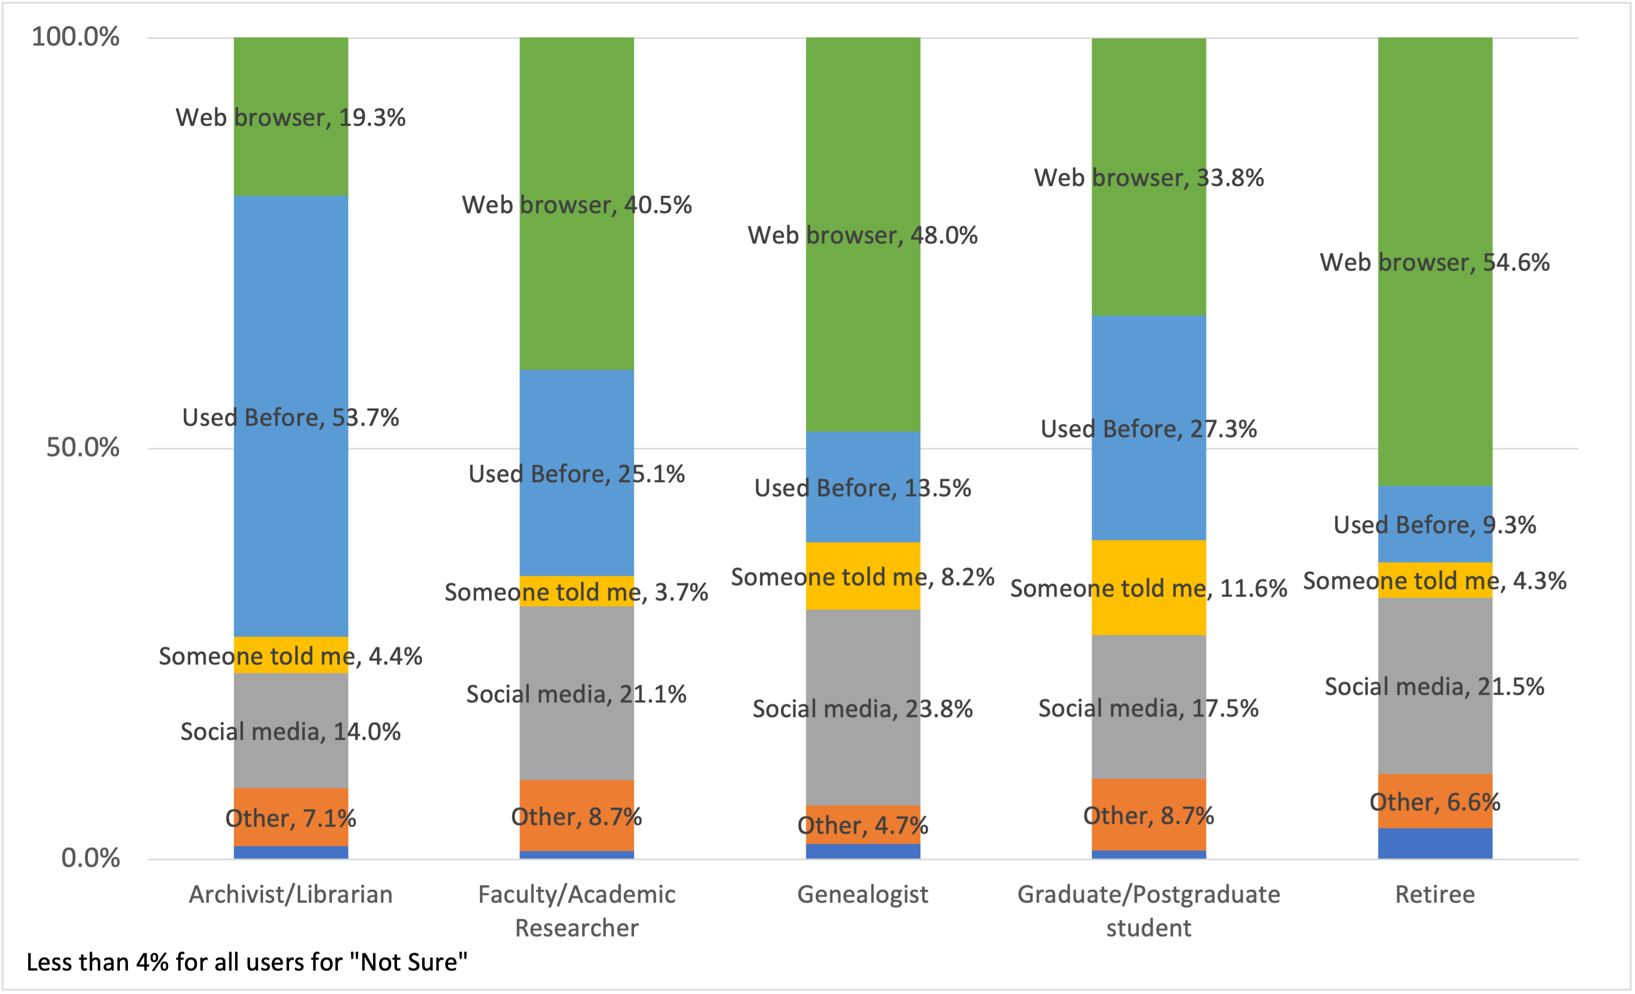
How the top 5 professions found aggregator websites
Notes:
Lesley
Nearly half of the NAFAN pop-up survey respondents indicated that they found the archival aggregation site where they are conducting research through a browser search. Roughly 20% of respondents indicated that they found the aggregation site through a link from another website or social media and/or know the aggregation website and have used the site before.

Slide 32
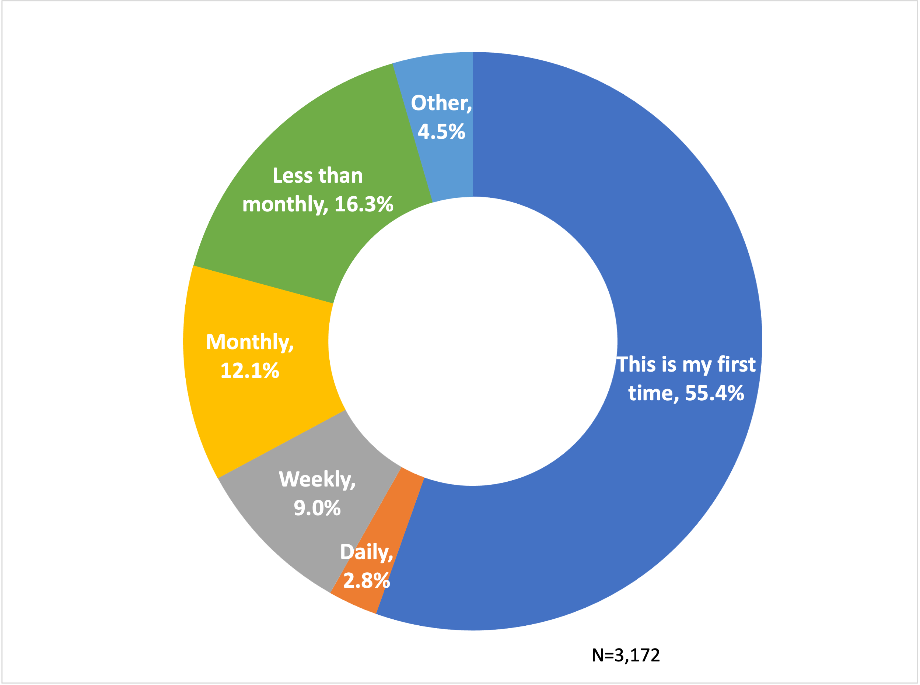
How frequently pop-up users visit aggregator websites

Slide 33
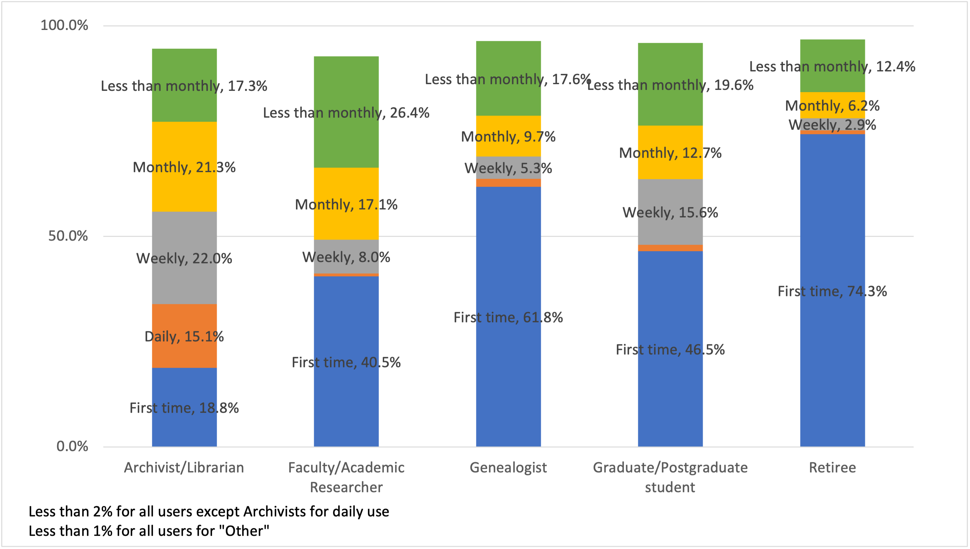
Top 5 professions visit frequency to aggregator websites

Slide 34
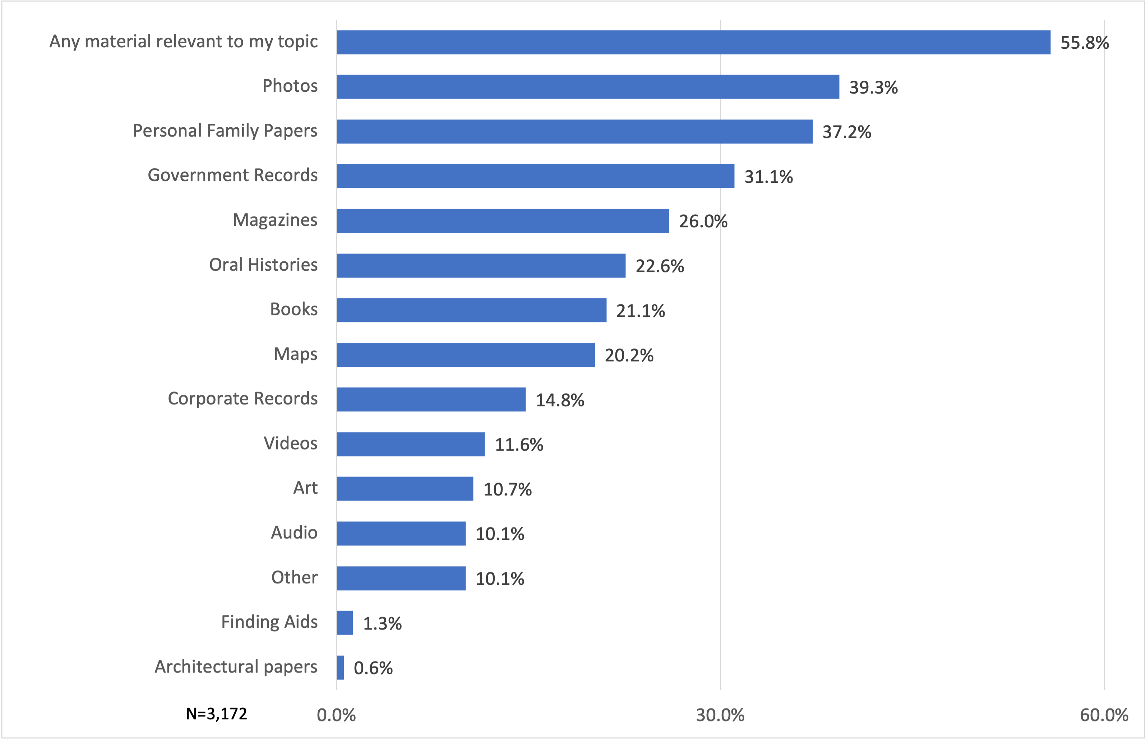
Pop-up Users, by material preference
*Percentages do not sum to 100%
Notes:
Lesley
Nearly half of the NAFAN pop-up survey respondents indicated that they found the archival aggregation site where they are conducting research through a browser search. Roughly 20% of respondents indicated that they found the aggregation site through a link from another website or social media and/or know the aggregation website and have used the site before.

Slide 35
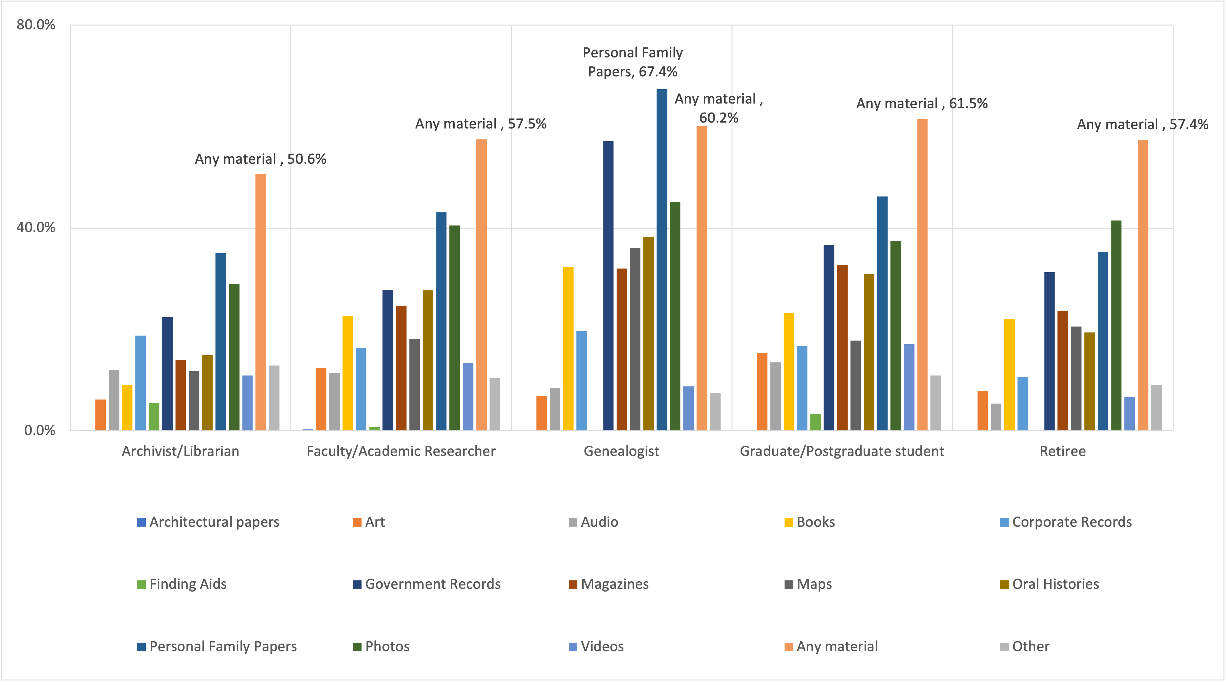
Top 5 professions by material preference
*Percentages do not sum to 100%
Notes:
Lesley
Nearly half of the NAFAN pop-up survey respondents indicated that they found the archival aggregation site where they are conducting research through a browser search. Roughly 20% of respondents indicated that they found the aggregation site through a link from another website or social media and/or know the aggregation website and have used the site before.

Slide 36
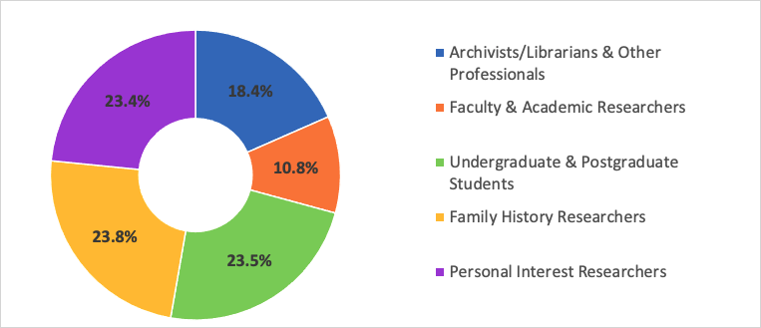
TwoStep Cluster Method
Notes:
Lesley
To identify the individuals we wanted to invite for interviews, we performed further analysis on the survey data. Specifically, we wanted to categorize users into buckets that takes into account how similar they are to one another by characteristics like their project purpose and their profession.
The TwoStep Cluster Analysis procedure is an exploratory tool designed to reveal natural groupings (or clusters) within a data set that would otherwise not be apparent. The algorithm employed by this procedure has several desirable features that differentiate it from traditional clustering techniques:
The ability to create clusters based on both categorical and continuous variables.
Automatic selection of the number of clusters.
The ability to analyze large data files efficiently.
With over 3,000 users in the survey, the cluster analysis was a suitable method. You can see in the top chart on the left that the silhouette measure was “fair” making this analysis a good fit for our data. While moving into “good” is desirable, it’s hard to do with real world data from a convenience sample, like our survey. We feel satisfied with this approach and you can see that it provided useful cluster categories in the donut chart in the middle of the slide.

Slide 37
NAFAN User Clusters
Archivist/Librarian & Other Professionals (N=559) – public and technical service archivists/librarians, journalists, writers, tradespeople
Faculty and Other Doctoral Degrees (N=328) – faculty, post-doc, independent researcher, museum professionals
Family History Researchers (N=722)– local history, professional genealogist, hobby genealogist
Personal Interest Researchers (N=711) – general search with a range of profession and education
Undergraduate and Postgraduate Students (N=712) – Indicate their profession is undergraduate/postgraduate student
Notes:
Lesley
Here’s a more detailed look at the clusters to show you the types of users that are grouped into each. From prior persona studies, we knew that archivists, faculty, and students were common users. What we found in this survey data is a high presence of personal interest and family history interest groupings in our user population.

Slide 38
The Broadest Possible Range of Users: Learning About Users of Archival Aggregations
Notes:
Lesley
Hi my name is Lesley Langa and I work in OCLC Research on the Library Trends & User Research team. I’ll be focusing on a different part of the research we’ve undertaken to delve into the users of archival aggregators.

Slide 39
Extant studies focus on the needs of academics, especially historians and other humanists (Rhee, 2015)
Literature investigating broader cross-section of archival users indicates that different researcher types have significantly different needs. (Duff, 2005)
Archival software projects have developed personas reflecting a more diverse spectrum of researchers (ArcLight, 2017; Project Electron, 2019; ArchivesSpace, 2016)

Slide 40
Sampled from pop-survey participants
25 interviews, 5 per persona type
Archivist/Librarian,
Faculty and Doctoral Degrees,
Family History Researcher,
Personal Interest Researcher,
Undergraduates/Postgraduates
Interview Research Participant Selection
Notes:
Building off analysis on user cluster types, individuals were invited to share their individual experiences.

Slide 41
Semi-Structured, Virtual, 1-1 interviews, 45-60 minutes
1 interviewer, 1 notetaker from research team
Interviews collected July - August 2021
Codebook developed through inductive/deductive approach March - June 2022
Using QDA NVivo with a 3-coder team with coding running June - July 2022
Interview Research Methods

Slide 42
Who are the current users of aggregated archival description?
Do current user types align with the persona types and needs identified in recent archival persona work (i.e., what characteristics are present vs not)?
Why are the current users trying to discover and access archival collections via aggregation of archival description?
How are current users discovering and accessing aggregations of archival description?
What are the benefits and challenges users face when searching archival description in aggregation?
Interview
Research Questions
Notes:
Practices are changing in the evolving digital research environment, which can be attributed to changing contexts, situations, and environments.
(Connaway, White, Lanclos, and Le Cornu 2013; Connaway, Lanclos, White, Le Cornu, and Hood 2012)
Motivation: determine the information-seeking behaviors and research practices of scholars using primary sources beyond the traditional academic researcher from field like the humanities (Rhee 2015) Recent work on archival user personas at multiple institutions indicate that users of archives are not academic scholars but also genealogists, local historians, hobbists, creatives from fields such as journalism, film, writers; as well as public services librarians and archivists. This data and findings aim to identify the different contexts, situations, and behaviors of end-users both in regards to aggregators as well as other archival information seeking systems.

Slide 43
What future directions would users want archival aggregators to take?
What other tools are users using to discover or access archival materials and
description?
Interview
Supplemental Research Questions
Notes:
Motivation: There is a significant gap in the literature in understanding researcher needs related to aggregations of archival description

Slide 44
Codebook Themes
Discovery - Refers to the ways users search for and identify archival resources (primary child codes: Challenges, Enablers, Benefits)
Access - Refers to the ways users locate, retrieve, and use archival resources (primary child codes: Challenges, Enablers, Benefits, Types of Access)
Aggregators – Comments specific to archival aggregator use and knowledge

Slide 45
Codebook Themes
Needs – references to what may satisfy a user's information need
Motivators – references to what motivates users to seek archival resources
Decision Making – user describes direct aspects impacting the process of making choices regarding archival research
Research Duration – timeframe of the user’s research that guides or influences a user’s pursuit of archival resources

Slide 46
Codebook Themes
Sources – mentions of specific information sources used in their research
Pandemic – instances and ways in which the pandemic impacted archival research
Magic Wand – any suggested changes, new additions, or ideal scenarios by users regarding archival aggregation systems

Slide 47
1. Please describe a typical research project and the research process you go through over the course of the project.
Needs – references to what may satisfy a user's information need
Motivators – references to what motivates users to seek archival resources
Research Duration – timeframe of the user’s research that guides or influences a user’s pursuit of archival resources

Slide 48
2. We identified you via a survey you took at [Aggregator in Month]. What were you looking for? Are there specific reasons or situations for which you use [Aggregator]?
Aggregators – Comments specific to archival aggregator use and knowledge

Slide 49
3. Please describe the ways you look for archival materials. What other resources and/or tools do you use to find archival materials?
Discovery – Refers to the ways users search for and identify archival resources (primary child codes: Challenges, Enablers, Benefits)
Sources – mentions of specific information sources used in their research
Needs – references to what may satisfy a user's information need
Motivators – references to what motivates users to seek archival resources

Slide 50
4. Once you locate the description of archival material that interests you, what do you typically do next?
Access - Refers to the ways users locate, retrieve, and use archival resources (primary child codes: Challenges, Enablers, Benefits, Types of Access)
Decision Making – user describes direct aspects impacting the process of making choices regarding archival research
Pandemic – instances and ways in which the pandemic impacted archival research

Slide 51
5. Think about a recent attempt to search for archival material for your research. What did you find particularly delightful about the experience? What did you find particularly frustrating?
Pandemic – instances and ways in which the pandemic impacted archival research
Discovery - Refers to the ways users search for and identify archival resources (primary child codes: Challenges, Enablers, Benefits)
Access - Refers to the ways users locate, retrieve, and use archival resources (primary child codes: Challenges, Enablers, Benefits, Types of Access)

Slide 52
6. If you had a magic wand, what would be your ideal way of finding archival material for your research?
Magic Wand – any suggested changes, new additions, or ideal scenarios by users regarding archival aggregation systems

Slide 53
Persona types heavy overlap or lack of clarity in distinctions between previously identified roles
Users struggle to recognize or remember specific archival aggregator sites.
COVID-19 pandemic restrictions introduce extraordinary circumstance behaviors and responses (from both user & institution)
Users don't cleanly delineate between archival and non-archival research or formats
Interview Research Challenges
Notes:
Itza

Slide 54
Users utilize a variety of non-aggregator sources to locate archival materials.
Decision making factors play a key role in how and if users pursue archival resources (in person or online)
Inequitable access to collections stems from structural and professional issues
Many users are aware of resource challenges and limitations of archival institutions
Interview
Insights
Notes:
Itza
Motivation: There is a significant gap in the literature in understanding researcher needs related to aggregations of archival description

Slide 55
Works Cited
ArchivesSpace (2016), "ArchivesSpace User Personas," https://archivesspace.atlassian.net/wiki/spaces/ADC/pages/66355248/User+Personas
Duff, Wendy M. (2005), “Working as Independently as Possible: Historians and Genealogists Meet the Archival Finding Aid,” The Power and the Passion of Archives: A Festschrift in Honour of Kent Haworth, edited by Reuben Ware, Marion Beyea, and Cheryl Avery (Ottawa: Association of Canadian Archivists).
Rhee, H. L. (2015). "Reflections on Archival User Studies," Reference & User Services Quarterly, 54(4), 29–42, https://doi.org/10.5860/rusq.54n4.29.
Rockefeller Archives Center (2019), “Project Electron Personas,” https://github.com/RockefellerArchiveCenter/personas.
Stanford University Libraries, Georgia Tech, and University of Michigan (2017), “ArcLight Personas.” Stanford Digital Repository, https://purl.stanford.edu/hk349dn1751.

Slide 56
Thank you! Any Questions ?
Notes:
Hanging Together blog posts on NAFAN https://hangingtogether.org/tag/nafan/
Paste NAFAN wiki into chat, encourage people to sign up for the email updates, Slack if they are interested https://confluence.ucop.edu/display/NAFAN
Plug confernece session at SAA, upcoming info session webinars,

