Slide 1
The International ILL Toolkit: a crowd-sourced tool for global resource sharing
OCLC Research Library Partnership Works in Progress Webinar • February 17, 2022
Brian Miller
Lapis Cohen
Dennis Massie
The Ohio State
University Libraries
University of
Pennsylvania
OCLC Research Library
Partnership
Notes:
Greetings. Welcome, everyone. I’m delighted that you could join us today for this Webinar about the international ILL Toolkit.
The Toolkit’s emergence is an exciting development that fills a longstanding need for information about interlibrary loan suppliers willing to share internationally. And its origin story is a perfect example of how the world’s collection sharing practitioners regularly band together, with skill and creativity, to overcome the many logistical barriers standing between researchers and the materials they need.

Slide 2
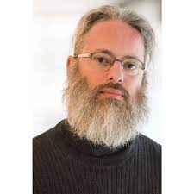
Introductions
Brian Miller
Head, Interlibrary Services
The Ohio State University Libraries
Lapis Cohen
Library Specialist
University of Pennsylvania
Dennis Massie
Senior Program Officer, OCLC
Research Library Partnership
Notes:
Three of us will be speaking about the Toolkit over the course of the next hour.
Brian Miller, Head of Interlibrary Services at the Ohio State University.
Lapis Cohen, Library Specialist at the University of Pennsylvania.
And me. I’m a Senior Program Officer with OCLC Research and the longtime coordinator of the SHARES resource sharing consortium.
Brian and Lapis are the real stars of the show and deserve the lion’s share of the credit for the existence of the toolkit and what it has become and indeed is still becoming.

Slide 3
Agenda
Agenda
I. Past (pre-history, origins of the Toolkit, process of building)
Brian
II. Present (contents of the Toolkit in its current form)
Lapis
III. Future (where we go from here, under whose auspices, sustainability, how to make it even better and shared more widely)
Dennis
IV. Questions, discussion
Notes:
This is how our time together will unfold.
Brian will get us started by recounting how and why the Toolkit came to be and describing some of the issues and decision points we encountered while building it.
Lapis will walk us through the Toolkit as it exists today.
And I’ll wrap up the presentation portion of the program with a brief look ahead at what the future may hold for this ever-growing crowd-sourced tool.
After that we should have plenty of time for questions and discussion. We’ll be asking you to drop your comments and questions into Chat.
With that, I will turn things over to our first speaker, Brian.

Slide 4
Past
PAST
Notes:
Hi. I’m Brian Miller from The Ohio State University, and I’m going to talk about the past, or what has led us to this point.

Slide 5
Familiar scenarios
Familiar scenarios
Student needs a Spanish language article in journal from Argentina.
Faculty member asks for a book published in Japan.
Researcher wants proceedings paper from small conference in Poland.
Notes:
So it’s probably a familiar scenario where your users have asked for relatively rare things, published outside your country, and many times in a foreign language. And we often don’t know where our users are getting the citations, but the scenarios listed here are not all that unusual. And you can swap in different countries or material formats for those on screen, but the problem is still the same: where am I going to get this?
And your first thought is usually like mine:
Please . . . . . let a domestic library own this! Or I want to get this through my network, whether that’s OCLC, RAPID, DOCLINE, or another . . . . and please let it be from a lender that’s free to me . . . . or if there is a charge, please let me pay through IFM!
But we all know it doesn’t always turn out that way. It’s not going to be that easy.

Slide 6
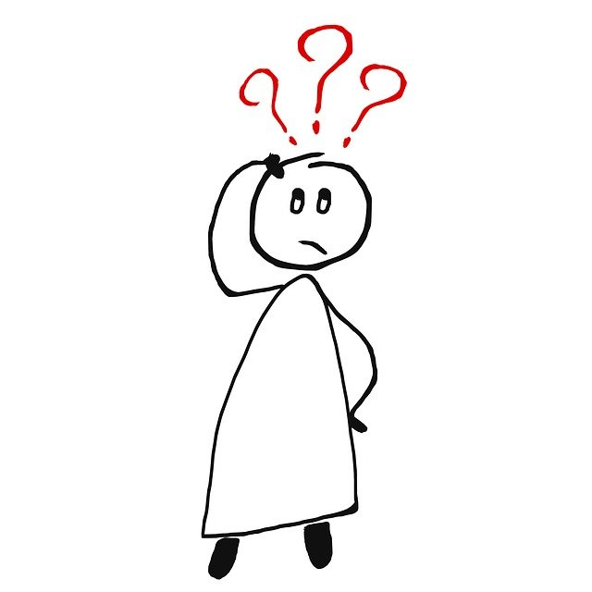
Problem: how to find internationsl lenders
Problem: how to find international lenders?
We often exhaust all libraries through our usual ILL request networks.
OCLC has a global network, but . . .
Not all overseas libraries with holdings on WorldCat participate in OCLC resource sharing
Not all overseas libraries have holdings on WorldCat
Notes:
So when we get those requests, we often exhaust all libraries first through our usual ILL request networks. But if unfilled, one of two things might happen.
First, if you’re lucky, you might find overseas libraries with holdings on WorldCat. But many of them are always lowercase in the Policies Directory because they don’t participate in OCLC resource sharing. So you can’t send an OCLC request, and now you’re going to have to find contact info for that foreign library.
Or second, the worst case scenario is: there are no holdings on WorldCat at all for the foreign publication, so now where are you gonna look?

Slide 7
Traditional solutions
Knowledge resides in a local expert ILL practitioner
You might maintain your own international cheat sheet/list
Conference presentation handouts
Invest significant time searching foreign library web sites
Pose questions to email listservs
Give up and cancel user’s request
But not very efficient or effective!
Notes:
So I’ve done each these things before and maybe you have, too:
Perhaps you’ve got a local expert, the wise owl, who might know where to try, and so you ask them. But what if that person is out, or they just retired, and now you have to be the expert?
Maybe you have a local cheat sheet or sticky notes on your desk of out-of-country places you’ve used before?
Maybe you have a tip sheet handout from a conference presentation you attended several years back. And now you have to remember where you put it?
Or maybe you’ll have to invest some time, that you don’t have, googling foreign library web sites, perhaps without English language pages, and you have to remember that foreign language you took back in high school.
Or exasperated, you might turn to one of the national email listservs for help and hope that someone replies.
Or maybe you just give up and cancel the user’s request.
I think we’ve all been there, and these are each incredibly imperfect solutions. They’re not always the most efficient use of your time, and they don’t always effectively get the user what they need.
So surely, there’s got to be a better way! And that’s what we’re working toward with the International ILL Toolkit.

Slide 8
Finding a better way!
March 2021 OCLC SHARES town hall conversation:
Let’s combine our expertise into
one crowd-sourced master list
for everyone to use!
Ohio State and Penn agreed to seed the document.
OSU: We’ll start with our locally curated cheat sheet of known overseas lenders.
Penn: Plus, let’s mine our ILLiad data for int’l requests we filled (System ID = OTH).
Notes:
So the SHARES consortium folks have virtual town hall meetings once a week to discuss common problems and share information, and I brought up the dilemma of finding international lenders to them back in a March 2021 discussion. And I suggested: why don’t we create a crowd-sourced, master list of known overseas lenders as well as their ILL contact and catalog info for everyone to use rather than our own separate cheat sheets. And this idea was well received.
So here at Ohio State I decided that I’d help seed the list with the local cheat sheet we’d been using. And my new friend Lapis at Univ of Pennsylvania said ‘That’s great, but why don’t we also mine our ILLiad databases for int’l requests we’ve filled, where the SystemID field = Other. And that was just brilliant! So we combined our resources based on our knowledge, experience, and data and came up with about 200 known overseas lenders to start with.

Slide 9
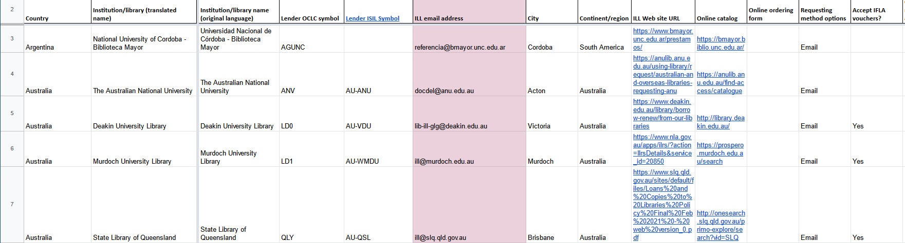
Creating the list (https://bit.ly/3DvOJiK)
Populated a Google spreadsheet for ease of access and managing view/edit rights
Determining information fields that would be useful and easy to maintain
Determining order of fields, formatting, language for library names, and country name
Deduping OSU and Penn entries
Data clean-up and inserting links
Notes:
So as we began pulling this info together and working with Dennis, our SHARES Coordinator and town hall moderator:
We had to decide where to put this master list. And we settled on a Google spreadsheet that would be easily accessible and where we could manage the view/edit rights. And the URL is right there in the upper right of this slide if you want to take a look at it. And along with the spreadsheet, Dennis got to work creating submission forms linked from the spreadsheet so that folks could suggest new entries at any time.
We also had to determine what fields would be useful and easy to maintain. And that weren’t likely to change or go out-of-date.
And then we made decisions on the order of the fields, the formatting for the cells, the language to use for library names. We even had political considerations for how to list a country’s name, like the terms “United Kingdom” versus “England” OR if Hong Kong and Taiwan should be under China or separate entries. And so we often defaulted to the terms used by the International Federation of Library Associations, or IFLA.
Of course, Lapis and I also had to dedupe our OSU and Univ of Penn entries.
And we did a lot of data cleanup for harmonization as well as lots of looking up and inserting links for libraries’ ILL office web pages and online catalogs.

Slide 10
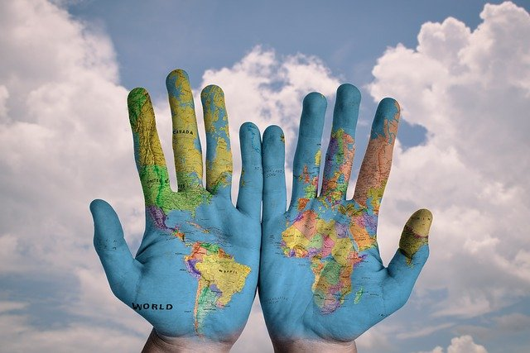
Conferring with experts to lend a hand
Consulted:
ALA RUSA STARS International ILL Committee
IFLA Document Delivery and Resource Sharing Section Standing Committee
Questions posed to them:
Do you see value in this tool?
Are there similar endeavors underway?
What advice do you have to make our tool better?
Can you help publicize and promote?
Notes:
And then before we rolled this out to others, we also wanted to consult some international ILL experts about our Toolkit idea and get their feedback.
So we talked to the ALA RUSA STARS International ILL Committee and the IFLA Document Delivery and Resource Sharing Section Standing Committee.
And we asked them:
If they saw value in such a tool? And they said: Yes, definitely.
And if there were any similar efforts underway? There were not.
What advice to make better? Since ILL is all about sharing, they recommended adding a section about U.S. libraries willing to lend overseas. Because after all, it’s often said that to be a good borrower you have to be a good lender. And also, add a column to the spreadsheet for ISIL codes. We’re very familiar with OCLC symbols here in the U.S., but other parts of the world use ISIL – or the International Standard Identifier for Libraries and Related Organizations. So we put that in, too.
And then lastly, we also asked if these groups could help publicize and promote the tool when we were ready. And part of that is why the RUSA STARS International ILL Cmte has helped us to put on this webinar today.
So that’s a little history of how this free International ILL Toolkit came to be. And my friend Lapis is now going to provide you with a little walkthrough of the elements in the Toolkit as it exists today.
And if you have dual monitors, or multiple windows open on your desktop, feel free to have the live Toolkit up and open in a browser. The URL for it is in the Chat. And please feel free to bookmark it so you can use the site later. (International ILL Toolkit: https://bit.ly/3DvOJiK )
Take it away, Lapis . . . .

Slide 11
PRESENT
Notes:
Thank you, Brian. To quote the much-missed Australian band, the Go-Betweens, “and the clock turns, and it’s now.” So, let’s take a look at the current state of the International ILL Toolkit.

Slide 12
Four Factor Index
Current Tools in the Toolkit!
Notes:
There are currently four tools in the toolkit: first, a listing of lenders outside the United States of America; second, a listing of libraries in the United States, who have indicated they are able to supply globally; third, a set of tips and tricks delineated by country or region; and, finally, a set of interlibrary loan request templates translated, line by line, in a dozen different languages.
Just a quick side note, there will be times in the upcoming slides when I’ll be doing my best to pronounce names, or other words, in languages other than English. Apologies in advance for any mispronunciations, no disrespect is intended.

Slide 13
Front Page News
Notes:
Here, once again, is a quick snapshot of the front page, the first sheet, of the toolkit: the listing of libraries outside of the United States. As of the time of writing up these notes (February 10, 2022), there were 217 libraries listed, from 44 different countries!
There are over 20 information filled columns on this page of the toolkit, so we couldn’t quite fit in a complete view with a panoramic picture, however – don’t worry, we will be hitting all the highlights over the next few slides!

Slide 14
Order of the Day
First two columns are static, (easy library identification while scrolling)
Ordered alphabetically by Country (in English)
Sub-ordered alphabetically by Institution/Library name within each country (in English)
Institution/Library name in original language
City and Continent/Region columns too!
Notes:
Lenders outside of the United States are ordered firstly by the English language name of that country (as you see here, beginning with Argentina, then Australia – and further down Austria, Belgium and so on). Then, within each country, the listing is by the English language version of the institution or library name – thus within Australia: Deakin University Library before Murdoch University Library, before the State Library of Queensland. The decision to use English in this prominent role, on an international toolkit, was based on the broad use of English as a common second or third language in many areas of the world (and, to be quite honest, on the language qualifications, such as they are, of Brian, Dennis and myself).
Those first two columns (country and institution name) are static, they don’t move as you scroll rightwards, in order to make it easier to always see which entry you are looking at as you consult the information for that specific library across all the other columns.
The toolkit also includes the original language institution name, as another point of verification for libraries – hence, Universidad Nacional de Cordoba – Biblioteca Mayor (for National University of Cordoba, in Argentina). In some cases, such as for libraries in Georgia, Japan and South Korea, the names will be listed in their original, non-roman alphabets.
Finally, there are columns listing both the city where a library is located, and also the region (Asia, Europe, Middle East, North America, South America), in case you want to narrow your search to within a specific geographic area.
It is worth noting that the toolkit is a spreadsheet, and you can always download the current version to your local computer. On that locally saved version, you can feel free to make any adjustments that are helpful to you: filtering by region, or re-ordering by the original language name of the institutions, highlighting certain entries, or even adding “local notes”. Whatever makes your workflow easier!

Slide 15
Symbol Hunting
Includes both OCLC and International Standard Identifier for Libraries and Related Organizations (ISIL) symbols for ease of exact identification
Notes:
The toolkit includes two different symbol identifiers for libraries. The first is the OCLC Lender Symbol, which can be useful in cases where a library has uploaded their holdings to OCLC Worldcat (which may be how you know that they own particular title), but they are not active suppliers in OCLC, so you can’t request from them via Worldshare or any of the other platforms that can request via OCLC, such as ILLiad. The toolkit provides alternate means of requesting from such libraries.
The second Lender symbol listed, the International Standard Identifier for Libraries and Related Organizations, or ISIL, provides unique identification for libraries around the world. Our inclusion of the ISIL symbols was the happy result of a meeting in March 2021, with the IFLA Document Delivery and Resource Sharing Section committee to discuss the toolkit, then still in a formative state. Dr. Silvana Mangiaracina, of the Italian National Research Council, Research Area of Bologna, suggested that the ISIL symbols would be more familiar, and more useful, to many library staff members outside of the United States, and provide authoritative, unique identifiers worldwide.
Indeed, one of the great joys of this project has been the support and active collaboration with library colleagues from around the world, and this is merely the first example we will touch on today.

Slide 16
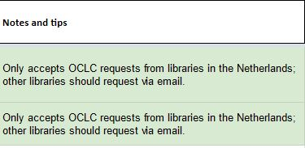
Highlights (highlighted)
Email address column highlighted (in Magenta)
Library specific “Notes and Tips”
Keep track of all the latest additions!
Notes:
We wanted to make sure that email addresses, which are most often the primary point of contact between requesting and supplying libraries, would always be immediately visible when you scroll across the toolkit – so that column is highlighted in magenta.
Another highlight of the toolkit is the “Notes and Tips” column, which has useful information, specific to that entry. For example, the University of Amsterdam, as well as the University of Utrecht (both in the Netherlands), will accept OCLC requests from libraries within that country – libraries outside of the Netherlands can still request from either institution, albeit via email.
We wanted to highlight the Notes & Tips column today for two reasons, firstly, we believe it can be quite helpful to have entry-specific information that might otherwise be quite hard to discover. However, to be quite honest, it is only sparsely populated at the current time. We want to reiterate that the toolkit is still a work in progress, and would like to call on folks to please feel free to submit additional information, and thus improve the toolkit for everyone (and perhaps not the last time you will hear that invitation today either)!
Finally, the rows of all recently added, or updated, entries are highlighted in green, so that you can readily see when additional suppliers, or new information in an existing entry, has been added to the toolkit. This can also be helpful if you download the toolkit as a spreadsheet on your local computer and want to quickly check to see if you have the most recent version. The last column at the far right of the sheet will always include the date when any entry has been added, or updated.

Slide 17
Online (Clickable!) Links
Online library catalog
Interlibrary Loan webpage (additional policy/contact information)
Online ordering forms (where available)
Notes:
Sometimes, when you’re navigating a library website in a language that is not your own, it can be hard to locate certain important pages quickly. The toolkit includes active, clickable links for online library catalogs, to verify if a library owns the needed title (as well as checking whether something generally circulates, and providing the call number or shelf mark, which can be a helpful reference to include when placing a request).
There is a column containing the link to a library’s interlibrary loan webpage, where additional specifics regarding ILL policies, addresses and contact information can often be found. Finally, there is a link to the online ordering form, if such a form is an active means of requesting from that particular library.

Slide 18
Requesting, Payment, and Delivery
Or, how do I request it? How do I pay for it? How will I receive it?
Notes:
Requesting, payment and delivery -- or, how do I request it? How do I pay for it? How will I receive it?
Requesting: what options are available? Should I request via email or using an online web request form?
Payment: does the supplying library accept IFLA vouchers, and do they accept any other means of payment, such as credit card, or wire transfer? International postal reply coupons no longer seem to be quite as in vogue as was once the case, while bitcoin has not (yet!) become an accepted means to pay for loans or copies.
Finally, is the library able to supply copies, or loans or both? And, if they can supply, how should I expect delivery – via emailed scans or snail-mailed photocopies? For loans – will they arrive by expedited courier or by postal service?
It is well worth emphasizing that empty boxes do not necessarily mean “NO” for that particular entry – it just means that information was not available at the time the entry was created or updated. Perhaps whoever created that entry had only ever requested copies from a particular library, and so had no information, one way or the other, as to whether that library is able to supply loans.

Slide 19
Adding to the Toolkit
Online submission forms for each section of the Toolkit (links are highlighted at the top of each sheet)
Notes:
In that vein, we encourage folks to actively collaborate -- there are links to a Google submission form in the grey box at the top of the Toolkit sheets. We welcome all new entries, as do librarians around the world who are currently using the toolkit!
[Google submission form for Libraries outside the United States: https://forms.gle/tL28A99b2fyNW6aS9 ]
Comments about entries, or requests for edits, updates or removals can always be sent via email to Dennis, whose email address is also in the grey box at the top of the Toolkit sheets, as well on the submission form itself.

Slide 20
Submission Forms
Not all fields are required, enter as much information as you have available
Notes:
The submission forms parallel the columns in the toolkit. Fill in as much information as you have for an entry, even if you don’t know the answer to every question on the form. Only a handful of fields are required, and someone else may be able to add additional “pieces of the puzzle” for that entry later. For example, if you don’t know a library’s ISIL symbol – don’t worry, we will look that up and include it in the entry.
We would also very much like to take moment to thank all of the library folks from around the world who have already made submissions and suggestions. Special tip of the hat to the very recently retired Richard Foster, who had been the Manager of Interlibrary, Document & Research Services at the New York Public Library, for his many helpful submissions and suggestions, as well as thoughtful conversations regarding how to improve the toolkit.

Slide 21
United States of America Lenders
Content and highlighting mirrors entries for Lenders Outside the U.S.
Initial version of the Toolkit was non-United States libraries only
In conversation with librarians around the world, the usefulness of a more global perspective became readily apparent
Currently 36 U.S. Libraries (always looking for more!)
Notes:
The second tool in the kit, the second sheet, contains a listing of libraries in the United States who have indicated that they are able to supply copies, or loans, or both services, to libraries around the world. This is the International ILL Toolkit, and “international” certainly does not simply mean “any place outside the United States”!
The columns of information for U.S. libraries fully parallel that of the non-U.S. Libraries (except there is no separate country listing!). You will still see the institution or library name, OCLC and ISIL symbols, email address, online catalog links, interlibrary loan policy webpages, online request form links, payment and delivery policies, and any notes or tips (such as contacting a library to set up an account, before placing any requests). All newly created or updated entries are likewise highlighted in green.
This page is another great example of the conversations which have helped to improve the toolkit, and a wonderful reminder of the importance of a truly global perspective as we work to make it better and more useful, no matter where you are, as you request or supply. The first public version of the toolkit only included non-U.S. lenders, however, librarians from around the world accentuated how valuable a listing of U.S. libraries who could supply material globally would be, and so we sent out the call via listservs and forums, to U.S. libraries, asking them to “opt-in” (as we had no good central source of information to readily identify which U.S. libraries regularly supply internationally). So far, 36 libraries have answered the call (and if you are at a U.S. library that would like to be added to the list, please feel quite free to send us your information through the online submission form. We thank you, and librarians and patrons around the world thank you.
[Google Submission form for U.S. Libraries: https://forms.gle/Jmoug8ivF5BNUP1j8 ]

Slide 22
Tips and Tricks (are Treats)
Notes:
The next tool we’ll examine today is an ever-growing list of tips and tricks. The tips are ordered by country and region, with general tips at the top of the page.
Such tips and tricks were also part and parcel of those long ago “cheat sheets” that both Brian and I had compiled at our respective institutions, perhaps you have your own lists. These are useful resources that we had uncovered, gathered, stumbled across, or were just plain outright gifted. As an example: we at Penn have been consulting the extraordinarily valuable Karlsruhe Virtual Catalog for many years, utilizing its ability to search dozens of catalogs, including national and union catalogs across Europe and adjoining (and some not so adjoining) areas simultaneously – as well as being able to navigate to those catalogs with a single click in order to search them directly. There are also links to search online and open access resources, such as the Directories for Open Access Journals and Open Access Books, and HathiTrust, amongst others.
However, I only learned about it from one of our very own patrons (back in the days when patrons would still come into ILL offices to chat), the redoubtable Professor Georg Knauer, who was Emeritus Professor of Classical Studies at the University of Pennsylvania until his death in 2018 (may his memory be for a blessing), who asked if we were familiar with the Karlsruhe Catalog, which he found helpful for his own research. After a quick look, and seeing how useful a resource it could be for us, it was quickly added to our local cheat sheet. Barring that query from Professor Knauer, we might have had to wait years to stumble across that particular tool.
And one more closely related thank you, to Silvia Cho, Interlibrary Loan Supervisor at The Graduate Center, City University of New York (CUNY), who quite recently noted that although there are many valuable resources linked out from within the Karlsruhe catalog, it would be even more helpful (and involve fewer layers of clicking) to add new, more country specific entries on the Tips page, with direct links to such useful sites as SUDOC (in France) or Dialnet (in Spain), amongst others.
[Google Submission form for Tips: https://forms.gle/9qXJgfR9xQc7LNCY7 ]

Slide 23
More Tips, More Treats
Catalogs!
Extended Services!
Dissertations!
Notes:
How can this listing of tips help you? Here are just a few, select examples:
Looking to delve more deeply into national or union catalogs and databases specific to a certain country or region? Here are links to resources for Australia (with TROVE), the Czech Republic, Denmark, Israel (with Rambi), Japan (with CiNii), Poland (with NUKAT), the United Kingdom (with JISC), and as previously noted countries in and around Europe, via the Karlsruhe Virtual Catalog.
There are also links to some freely available, generous extended services. Stumped with a patron request for an East Asian title? The toolkit has a pointer to the University of Pittsburgh’s valuable East Asian Gateway service. Reached a dead end searching for a Russian or other Slavic language title? The Slavic Reference Service, based at the University of Illinois, will be happy to help.
Is your patron searching for a dissertation completed at the University of Bath, or another university in the United Kingdom? The EThOS database is rich resource, with many dissertations already freely available digitally for researchers to consult.
One of our hopes for this particular tool, is that it can become a durable repository for a multitude of international ILL tips, tricks and resources in one place – smoothing the way for discovery by librarians around the world, rather than having to individually rediscover them across many different websites, listservs or via word of mouth -- only for them to potentially be lost to institutional memory if that staff member retires or moves to a new position.

Slide 24
Request Templates
English
Arabic/العربية
Chinese (Traditional)/中文
Dutch/Nederlands
French/Français
German/Deutsche
Hebrew/עִברִית
Italian/Italiano
Japanese/日本語
Korean/한국어
Russian/русский
Spanish/Español
Notes:
The final tool we’ll discuss today are the ILL Request Templates, which are line by line translations of customizable interlibrary loan request forms, for either copies or loans. On this slide you see the base English request template and the version in Arabic, to the right.
This tool is another example of those happy conversations and collaborations that have marked the iterative evolution of this project. In a 2021 meeting that Brian and I attended with the RUSA STARS International ILL Committee, Jenny Vitti, the ILL Borrowing Coordinator at Emory University, mentioned that she had done some work on translated ILL request forms, beyond simply plugging them into Google Translate, and would we like to see them? We could do no better, and no worse, than to quote James Joyce at that point, “yes, yes, yes!”
Jenny’s idea, that better translations could be achieved if done in consultation with folks who were not only native speakers of the languages in question, but who were also familiar with library terms, certainly resonated with Brian, Dennis and myself. Our belief is that chances of success for requests are heightened by having more nuanced translations, with library specific words in the templates, along with the display of respect inherent in meeting potential supplying libraries partway -- by showing that we have made some effort to communicate with them in their native language, rather than simply sending a request in our own mother tongue.
After examining the templates provided by Jenny, we discussed the finer points of what the exact text and formatting should be for the base request template in English, nailing down the specific language and citation field order, that would most clearly and completely let potential supplying libraries know precisely what was being requested.
Once that was finalized, we then consulted with additional language experts at our respective institutions, to arrive at our current quorum of request templates in Arabic, traditional Chinese, Dutch, French, German, Hebrew, Italian, Japanese, Korean, Russian and Spanish. We have also received additional comments and suggestions, which have further improved the templates. In that vein, a merci bien to Luc Bissonnette, Coordonnateur de projets, responsable du système Colombo, for helping us improve and fine tune the French template.
The template includes an introductory section, identifying the requesting institution, and establishing the maximum cost the borrower is willing to pay for the needed loan or copy, and also asks for swift notification if the holding library is not able to supply (so that requests do not remain in limbo indefinitely).
There are then individual lines for specific bibliographic citation information, divided between copy and loan requests, including spaces for: local transaction number, Book or Journal Title, Author, volume and issue, article/chapter title, publication date, page range, ISBN/ISSN, OCLC Worldcat number, Call Number/Shelfmark and a last line for any additional information deemed necessary.

Slide 25
Templates too
Line by line translation
Can copy and then edit for local use
Can have separate Loan and Copy request templates
Created in collaboration with language experts, familiar with library terminology
Always looking to add new languages!
Notes:
The line-by-line translation makes it easy to keep track of the meaning of each term, on each line – especially if you don’t happen to know eleven other languages!
The templates can be copied and saved locally, as Word documents, or in Excel, or in email – to be further edited and customized for local use, such as creating separate Loan and Copy request forms or by incorporating them as email templates in ILLiad, using merge fields to automatically paste in the citation information.
Finally, we are always looking to add new language templates, so if you are, or you know a language expert at your institution for an as yet unrepresented language, please do feel free to get in touch.
Tempus fugit, and the present is continuously slipping from view, and so with that I now turn things over to amicus meus, we say in Latin, Dennis, for a few glimpses at some of the many possible futures for the Toolkit…

Slide 26
FUTURE
Notes:
Thank you, Lapis. You know I do love it when you speak Latin to me.
So, now let’s briefly explore what the future might hold for the International ILL Toolkit. Brian, Lapis and I definitely have some hopes and aspirations for this work-in-progress we’ve set in motion.

Slide 27
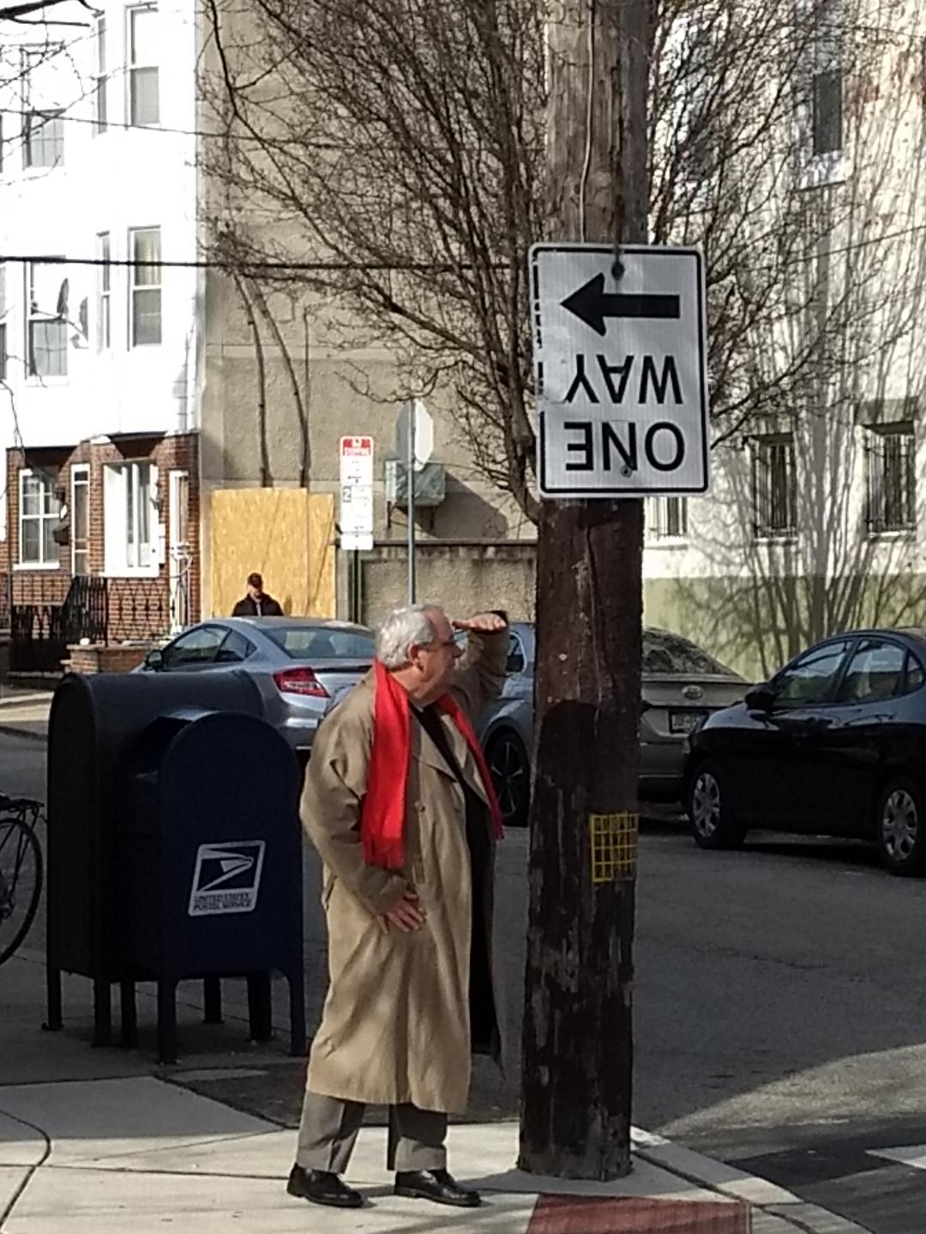
Looking ahead
More is definitely more!
Lenders
Tips
Languages
Features
Users
Conversation
Notes:
Some of our hopes and aspirations are easy to guess. Most all of them would benefit from your help and involvement.
Obviously, we’d like to keep adding lenders willing to share internationally, tips and tricks by country and region, and requesting templates in more languages. Maybe you or someone you work with has language expertise in Turkish or Hindustani or Farsi and can help us develop a new requesting template. Or perhaps you have ideas about how we can make the toolkit more user friendly for non-English speakers.
Or maybe there’s a feature we haven’t thought of that you’d like to suggest or help build. While we were preparing for this Webinar, Brian hit upon the idea that some ILL practitioners may not have ever shared internationally and might find a “things to consider when getting started” checklist useful. So that’s one idea of a new feature that might be added to the toolkit. What are your ideas? What would you find useful? Perhaps you’ve developed an international sharing resource of some kind that might fit into the toolkit. Naturally, we’d like to see more users. Help us get the word out. Share the toolkit with your friends.
And we’d love to see the toolkit be a catalyst for conversations among resource sharing folks. That’s already happened to same extent, as Lapis and Brian have described – conversations with committees such as the RUSA STARS international ILL committee, the co-sponsors of today’s Webinar, and conversations with individuals who have shared questions, ideas and suggestions, such as Richard Foster of New York Public Library and Silvia Cho of the Graduate Center CUNY. Brian, Lapis and I have done some brainstorming about ways to encourage more conversation around the toolkit. One idea is to convene some informal virtual town halls where interested folks can come together and compare notes and share what they know about international sharing. What are your ideas for sparking conversations across borders about international ILL?

Slide 28
Accessibility
Notes:
There are some important aspects of the Toolkit that we didn’t think much about in the rush to build and refine it, but that we now realize warrant some serious and sustained attention. Top of mind in that category is accessibility.

Slide 29
Accessibility support in Google Sheets
Notes:
Brian, Lapis and I are by no means experts when it comes to making a spreadsheet like the International ILL Toolkit more user friendly for folks with a visual impairment.
The Toolkit is a Google Sheet, and if you click on Tools within a Google Sheet…

Slide 30
Accessibility support in Google Sheets
Notes:
…one of the choices on the list of Tools is accessibility.

Slide 31
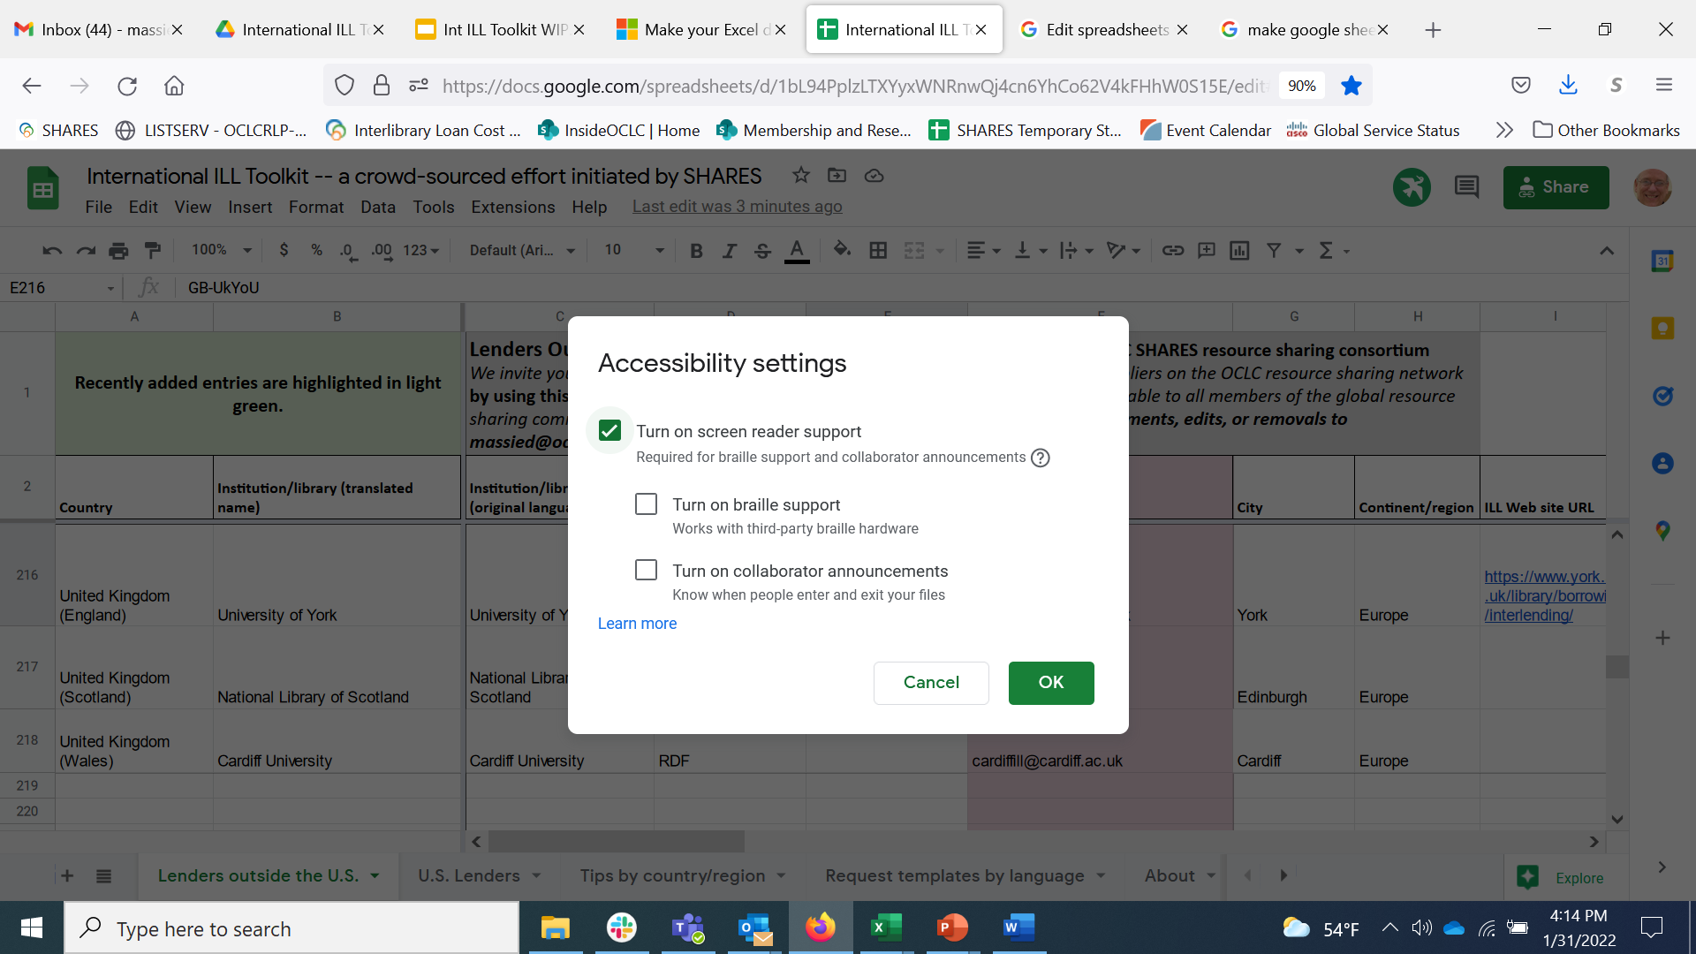
Accessibility support in Google Sheets 2
Notes:
You can turn on screen reader support, and turn on Braille support…

Slide 32
Accessibility support in Google Sheets 3
Notes:
…which adds a range of tools that help a person with a visual impairment navigate and use the Google Sheet.

Slide 33
Accessibility support in Google Sheets 4
Notes:
So the accessibility support in Google Sheets doesn’t help Brian, Lapis and me make the design of the spreadsheet itself more accessible but does help a user utilize tools that will help them navigate and make sense of the information in the spreadsheet.

Slide 34
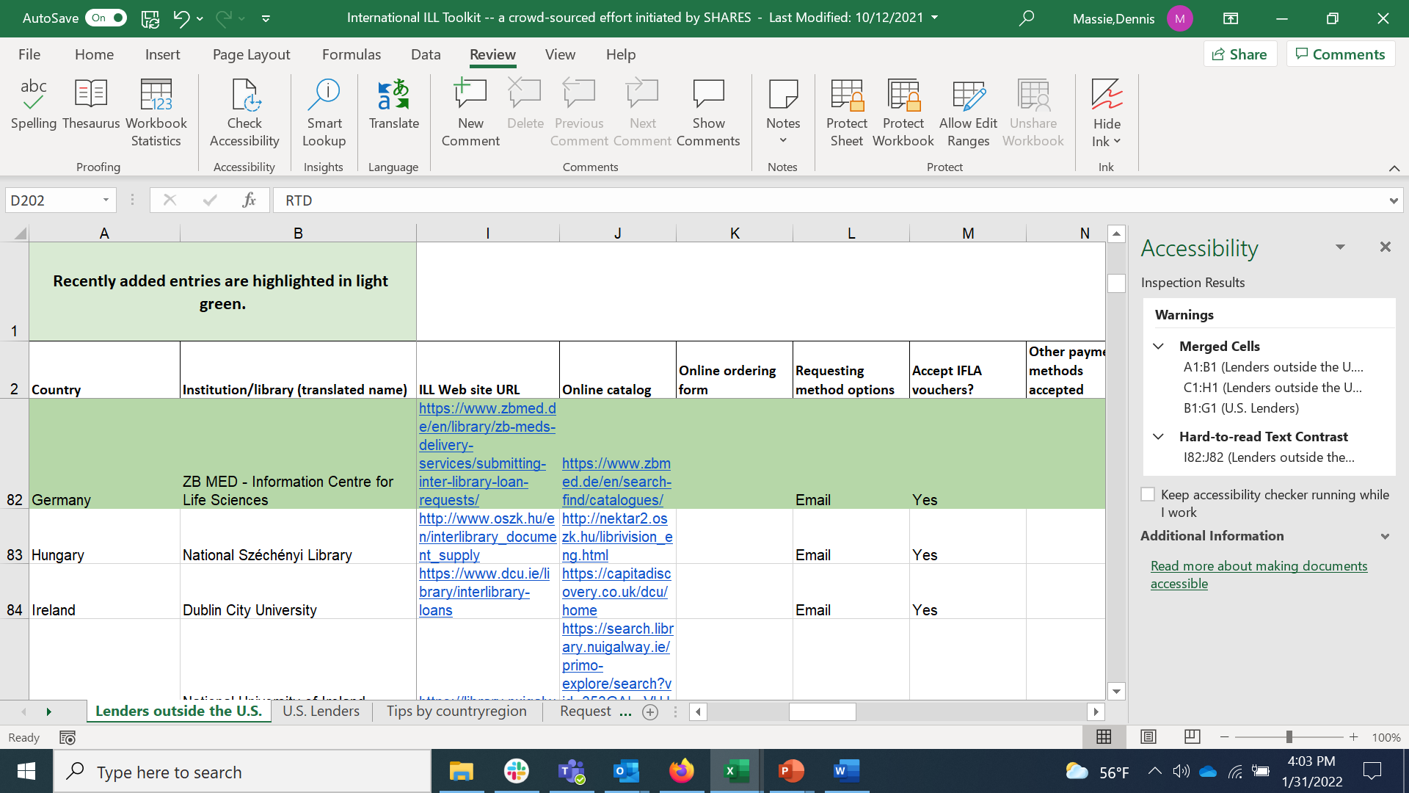
Accessibility check in MS Excel
Notes:
Meanwhile, Microsoft Office applications like PowerPoint and Excel have an Accessibility Check Feature.

Slide 35
Accessibility check in MS Excel 2
Notes:
So I downloaded the Toolkit from Google Sheets as an Excel spreadsheet and ran the Accessibility check.

Slide 36
Accessibility check in MS Excel 3
Notes:
And Excel came up with a couple of suggestions that would make the Toolkit more user friendly for someone with a visual impairment.

Slide 37
Accessibility check in MS Excel 4
Notes:
I did not know this previously. Someone using a screen reader and working their way through a spreadsheet is going to run into difficultly if the spreadsheet has merged cells.

Slide 38
Accessibility check in MS Excel 5
Notes:
And the International ILL Toolkit has 3 instances of merged cells. So that will require a bit of thinking on our part to get this corrected.

Slide 39
Accessibility check in MS Excel 6
Notes:
The second accessibility tip offered on the Toolkit by Excel is that blue text in a green cell can present readability issues as there isn’t enough contrast.

Slide 40
Accessibility check in MS Excel 7
Notes:
Lapis already has a fix planned for this one. We’ll highlights just columns A and B for new entries, since those are static, and folks will see the green for those entries, no matter how far right they scroll., and perhaps just the A column cell for the US lenders & Tips sheets. So, again, it seems like any conversation we have about the Toolkit results in some tangible improvement.
But I do suspect that this may be just scratching the surface when it comes to making the International ILL Toolkit more usable to folks with a visual impairment.
Brian, Lapis and I will approach addressing this potential shortcoming the same way we’ve approached every aspect of building and refining the toolkit – turn to experts in the community. Many libraries have an accessibility librarian on staff. And there are many resources available that contain excellent guidance.
Perhaps you have some advice for us on how to make the International ILL Toolkit more accessible. If so, please let me know.

Slide 41
Sustainability
The toolkit lives on a Google Drive associated with a personal Gmail account.
Where should it live?
Under whose auspices?
Notes:
Another significant issue for the future is the sustainability of the Toolkit. We got this project started in a big hurry, needed to be nimble, and used the collaborative tools at hand. Which has been fine so far and could be fine for the foreseeable future.
But we’ve been talking about possibly making the Toolkit available in a more durable format than Google Sheets. And, longer term, Brian, Lapis and I will want to establish a succession plan so that the Toolkit can continue to provide value to the global resource sharing community far into the future, without it being dependent upon the three of us for its care and feeding. We have a few ideas in mind and would also love to hear your suggestions. Maybe you hold the key to helping us find the Toolkit a forever home.

Slide 42
Let’s have more conversation
The toolkit is an opportunity for resource sharing practitioners from across the globe to come together for an extended virtual conversation.
Notes:
I’d like to return to the idea of the toolkit possibly providing an opening for having more conversations about international resource sharing.
I mentioned earlier that we’ve talked about scheduling some informal town halls around use of the Toolkit. It also might make sense to link up with other efforts that focus on the international sharing of library materials, such as those sponsored by the IFLA Document Delivery and Resource Sharing Section Standing Committee.
Brian, Lapis and I will be meeting again in March with the members of the RUSA STARS International ILL Committee, the co-sponsor of today’s Webinar, to talk about some next steps we can take with the Toolkit, particularly the idea of using it to being more ILL folks who share internationally into regular contact with each other. (Actually, full disclosure, Lapis is actually a member of that committee now, joining last July for a 2-year term.)
We’re almost to the discussion portion of the program today, so I very much hope we’re all about to have such a conversation about international sharing here among us, in real time.
Brian, Lapis and I would love to hear your ideas about other ways that the toolkit might be useful for providing a reason to get together with other resource sharing practitioners across the globe to talk shop.

Slide 43
International ILL Toolkit https://bit.ly/3DvOJiK
Join the fun!
Share information about international Suppliers
List your own institution as a Lender
Submit tips for specific countries
Contribute a new request template in a different language
Tell your friends
Notes:
My last slide is a call to action. Get involved! Join the fun! Add to the content and the value of the Toolkit. Use the Toolkit. Help us spread the word. This thing is a work in progress and very much a living document. Together we can all make it much better and more useful.
Again, Brian and Lapis deserve the lion’s share of the credit for the creation of the International ILL Toolkit. Many in OCLC SHARES and across the global resource sharing community have also had a hand in its development. It’s a great example of a community banding together to make the world a better place.
Thanks for listening. We look forward to hearing your questions, comments and ideas. Now I’ll turn things back over to Mercy.

Slide 44
DISCUSSION

Slide 45
Thank you!
Brian Miller
Lapis Cohen
Dennis Massie
The slides and a recording of this presentation will be shared widely.

