Slide 1
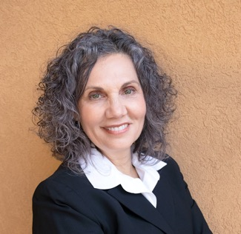



10 February 2021
Public Libraries Respond to the Opioid Crisis with Their Community
Lynn Silipigni Connaway, Ph.D.
Director of Library Trends and User Research
connawal@oclc.org
@LynnConnaway

Slide 2

    More than 128 people die in the U.S. everyday from an opioid overdose.¹
Photo by nosheep is licensed under Pixabay
Notes:
I’m going to start with a staggering statistic. In 2018, more than 128 people died everyday from an opioid-related overdose in the United States.
That’s almost 47,000 people a year. Overall, drug overdoses killed more than 76,000 Americans in 2018.
In comparison, in 2014, this number was 28,647 (https://www.cdc.gov/mmwr/volumes/65/wr/mm655051e1.htm)
1 https://www.cdc.gov/drugoverdose/data/statedeaths.html

Slide 3

Implications of COVID-19
In a June 2020 survey, 13% of respondents reported started or increased substance use.
Most states experienced increases in rate of overdose deaths during first quarter of 2020 compared with t same period in 2019
  7 states (plus the District of Columbia) experiencing increases ranging from 25% to 50% from March 2019 - March 2020
https://www.cdc.gov/mmwr/volumes/69/wr/mm6932a1.htm?s_cid=mm6932a1_w
https://jamanetwork.com/channels/health-forum/fullarticle/2772241
Photo by Tumisu is licensed under Pixabay
Notes:
In the past year with the challenges introduced with the COVID-19 pandemic – things are much worse.
The Centers for Disease Control reported that in a June survey panel, 13% of respondents reported started or increased substance abuse to cope with stress or emotions related to COVID-19. And it seems reasonable that as the effects of the pandemic continue, that this number will continue to increase.
Several states also reported dramatic increases through March 2020.
https://www.cdc.gov/mmwr/volumes/69/wr/mm6932a1.htm?s_cid=mm6932a1_w

Slide 4
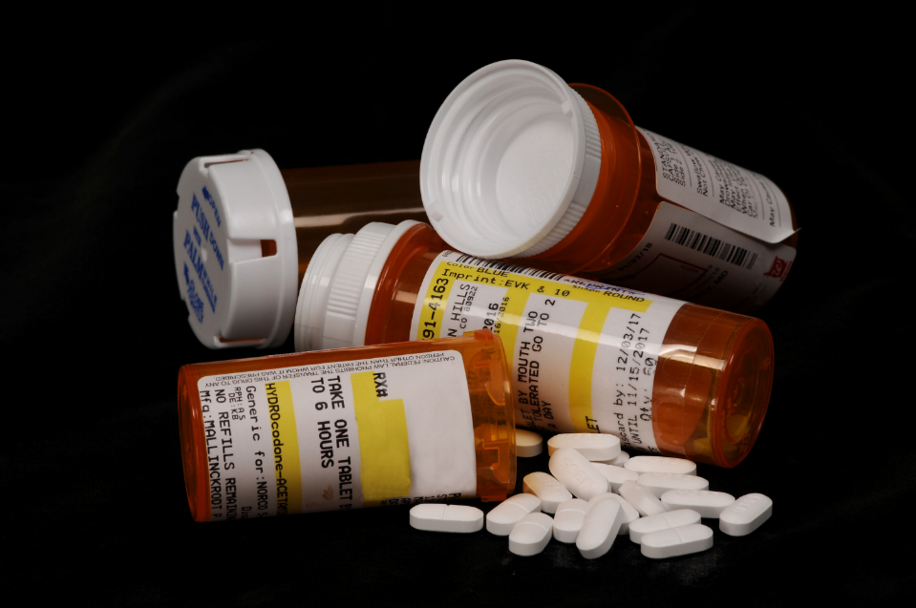
Misuse of prescription opioids costs $78.5 billion a year
Opioids by K-State Research and Extension is licensed under CC BY2.0
“Opioids” by K-State Research and Extension is licensed under CC By 2.0
Notes:
More than 20 percent of patients who have been prescribed opioids misuse them, and the Centers for Disease Control and Prevention has estimated that misuse of prescription opioids costs $78.5 billion a year. (1) This is the cost for treatment for those experiencing addiction, emergency services for people who overdose, and policing efforts.
This is a massive problem in the United States and it is impacting people deeply. It is very difficult at this point to not know someone who has been affected by this crisis – people have lost their children, their parents, their friends – or they know someone who has. It is simply devastating.
Reference
(1) Florence, Curtis S et al. “The Economic Burden of Prescription Opioid Overdose, Abuse, and Dependence in the United States, 2013.” Medical care vol. 54,10 (2016): 901-6. doi:10.1097/MLR.0000000000000625
https://www.ncbi.nlm.nih.gov/pmc/articles/PMC5975355/

Slide 5

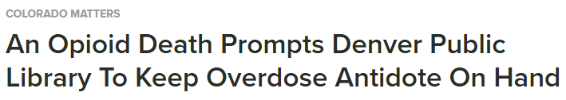




Notes:
So you may be asking, “what does this have to do with libraries?”
These are just a few headlines from news media in the United States about the impact that this crisis is having on U.S. public libraries. Over the past few years, stories like these have been common, as communities face the realities of opioid addiction and overdose – and libraries certainly have not been spared.
Headlines like these, as well as ongoing concerns and questions raised by library staff in all the places that they meet, such as at conferences and in meetings as well as in the online space through listservs and emails, prompted us to look at how we could capture and share how libraries are responding to the opioid epidemic with their communities.

Slide 6
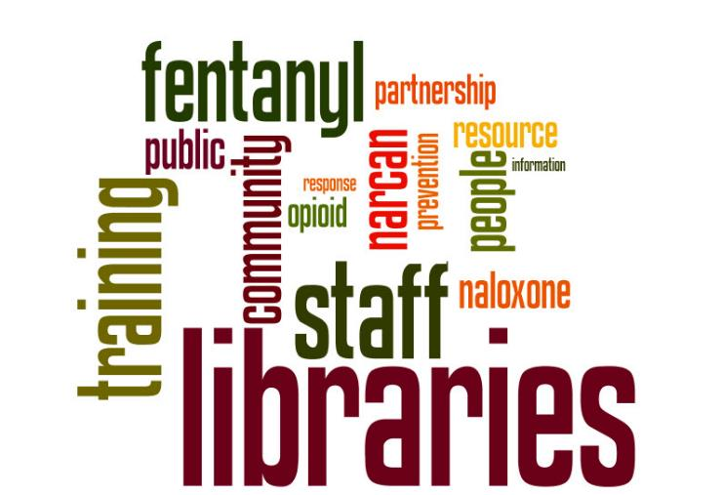
Notes:
These concerns really sparked the origin of this project.
What we heard from library staff prompted OCLC and PLA to partner on offering a free, online townhall in September 2017. This was open to everyone, and it was an opportunity to hear about how this crisis was impacting libraries. We invited speakers ranging from library staff who were creating responses to community partners who had suggestions and ideas for approaches to share their ideas in this webinar. These words on the screen were some of the most common that surfaced in the chat between participants. You’ll note the focus on things like training, staff, and community. As well as things like fentanyl which is often combined with opioids and can be deadly, as well as naloxone and it’s namebrand, “Narcan.”
From this webinar, OCLC and PLA decided that we needed to and wanted to do more to address these concerns in the community, so we partnered together on project called “Libraries Respond to the Opioid Crisis with their Communities”

Slide 7

Project partners
OCLC
  Global library cooperative providing technology services, research, and learning programs
Public Library Association
  Largest association dedicated to the needs of public library professionals in the U.S. and Canada
Notes:
The Public Library Association (PLA) is the largest association dedicated to supporting the unique and evolving needs of public library professionals. In collaboration with its parent organization, the American Library Association, PLA strives to help its members shape the essential institution of public libraries by serving as an indispensable ally for public library leaders.
OCLC is a nonprofit global library cooperative providing shared technology services, original research and community programs so that libraries can better fuel learning, research and innovation.
Together, we have the capacity, reach, and networks to research, synthesize, and disseminate project learnings to strengthen libraries and their role in the community.

Slide 8

Project funder
The Institute of Museum and Library Services is the primary source of federal support for U.S. libraries and museums. IMLS funds projects that advance the role of libraries as community anchors, and demonstrate collaborative approaches, have the potential for national impact, and focus on timely issues.
Project number LG-00-18-0298-18
Notes:
I’d like to acknowledge and provide my appreciation for the funding provided to support this project from the Institute of Museum and Library Services.

Slide 9


Association for Library and Information Science Education (ALISE), award-winning research
In 2020, the project team and research was recognized as the recipient of the Connie Van Fleet Award for Research Excellence in Public Library Services to Adults.
This Photo is licensed under
CC BY-NC

Slide 10
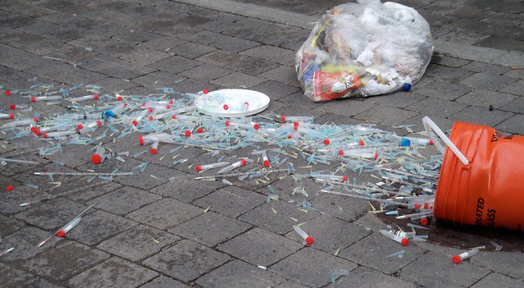
“Obviously, our biggest challenge is that people
keep dying and we can’t work fast enough.”
- Community Partner Director
Syringes by Sam Nabi is licensed under CC BY 2.0
Notes:
Let’s start to explore what we learned while conducted the research for this project.
At the core of this problem are people in our communities who are dying from opioid overdoses. And that concern is something that we have heard as we embarked on the journey for this project. And there also is the impact that this has on the family and friends – the people who love this person who has an addiction or who has died from their addiction or an overdose.
This is a community-wide problem and it requires community-wide responses.

Slide 11
Project goals
Identify and share knowledge and resources that will help public libraries and community partners develop effective strategies to address substance misuse
Notes:
This project had three overarching goals.
The first was to help public library directors and staff to make informed decisions about strategies, policies, and activities. Taking what we learn from the experiences of others and then promoting their lessons learned to strengthen the efforts of others.
As a profession, librarians are extremely generous when it comes to sharing their ideas and resources, and we aim to capitalize on that to help others more quickly develop their own responses. It is something that comes up very often, “how do we avoid reinventing the wheel.”

Slide 12
Project goals
Raise awareness among other sectors that libraries, in their role as community anchors, make powerful partners
Notes:
One of the requirements of this research is that the libraries that we are profiling are all involved in supporting their community with the help of local partners. They are seeking out the strengths of other organizations in the community and working together on solutions and opportunities. What we heard is that the idea of partnering with libraries to meet community needs isn’t always at the top of the minds of these partners, and we want to work to change that. We want to encourage the inclusion of libraries as key partners, resulting in stronger coalitions and networks. We want libraries to have a seat at the table in addressing these issues that have deep impact on the community, such as the opioid epidemic.

Slide 13
Project goals
Shift traditional systems of practice that result in siloed efforts and limited impact
Notes:
There always will be another issue on the horizon, something else that we need to be engaged in and responding to. And we will go further if we do this together. Working with partners isn’t a new concept – it’s well accepted as a valuable approach when you can find the right partner. Partnerships always may not be possible, perhaps because of time, or subject matter, or even location. But, when it works successfully, it means that we can equip libraries—and their partners—to deal not just with current needs, but with future challenges, as well.
The development of relationships and infrastructure that can support changes and needs is something that can live well beyond a single project or activity. How do we invest in infrastructure that can benefit us in the years to come?

Slide 14
Project activities
Case study research in eight libraries (Sept 2018 – August 2019)
Cross-sector discussions (August – October 2019)
Call-to-action white paper (Sept 2019 – March 2020)
Dissemination to the field (Sep 2018 – ongoing)
Notes:
The project officially ended in December 2020, and I’ll walk through the key activities that were undertaken. The one thing that will continue though is our dissemination of the project findings. With the effects of the COVID-19 pandemic many libraries are closed to public activities, most libraries aren’t able to offer the types of programming or services that you’ll see highlighted in this presentation. However, we are committed to continuing to advocate for these findings and encourage library staff to evaluate how they may be able to get involved in related activities.

Slide 15
Case studies
Produce eight case studies that explore a diverse set of communities in which the library is an active partner in response to the opioid epidemic.
Notes:
I’ll focus the majority of the conversation today about this deliverable for the project, which was the case study research that profiles how libraries are responding to the opioid crisis with community partners.

Slide 16
Criteria considered for site selection
Diversity of community size, region, geographic distribution, and demographics
Diversity of service population size
Health data: uninsured rate, opioid prescribing rate,
drug overdose death and mortality rate
Must have worked with community partners on programs/services related to the opioid crisis
Represent a range of community interventions
Notes:
There were a range of factors going in to selecting libraries to participate. At the time, there were many libraries across the country that were doing some form of opioid-related programming, but we were looking for diversity in both the types of programming and the communities that they serve. These are some of the key data points we considered.
The biggest challenge was finding libraries serving smaller communities which also could meet the other criteria, such as working with a partner. The case studies include libraries that serve a community a bit larger than 16,000 to more than 800,000. They represent a range of different resources, different staff and different communities.

Slide 17
Case study sites
Everett, WA
Salt Lake, UT
New Orleans, LA
Peoria, IL
Kalamazoo, MI
Blount County, TN
Twinsburg, OH
Barrington, RI

Slide 18
Methodology
Case studies using qualitative interviews with up to 9 individuals at each location
  Library Director/Deputy Director
  Library Administrator/Manager
  Library Frontline Staff
  Community Partner Director
  Community Partner Frontline Staff
  Community Member (up to three per location)
Interviews were transcribed and coded into NVIVO for analysis

Slide 19
Interview questions
What makes the library a strong partner in an effort like this?
How did your library decide to offer this program/service?
Community Partner
Library Staff
What has been your overall experience interacting with the library for these programs and services?
Why do you think it's important for the library to be involved in this work?
Library Board
Community Member
Notes:
I wanted to share a few examples of the kinds of questions that we asked during the interviews. There were four different groups of interviewees: library staff, library board members, staff at the community partner organizations and community members/patrons. With most interviews, we had no more than 14 main questions, plus some prompts to dig in a little deeper if there was an opportunity. Most of the interviews with library and community partner staff lasted around 45 minutes. Interviews with community members were closer to 15 minutes.
Here are examples of the questions that we asked.

Slide 20
Types of programs and services
Naloxone training, staff and patrons
Community reads and author talks
Changes to physical layouts in bathrooms
Peer navigators
Deterra disposal bags
Recovery Court
Awareness and information campaigns
Mental health and substance abuse related health programming
Notes:
Through our research, a range of programming and services were surfaced. What is key about this to the project and to the library field is that this is a range of activities and options that libraries can choose to implement. There is no one-size or prescription for how to handle this. Each library has a different community and different needs, so what fits one, will not necessarily work in others.
What we did find though, is that this range includes activities and programming that can fit all kinds of communities and budgets. For example, hosting a community reads event where everyone reads the same book and then the library hosts a discussion is something that many libraries can do, and it doesn’t require a major investment, and it is well-aligned with other programming that the library already offers. This aspect of flexibility and adaption is something that we see as being essential to encouraging libraries to adopt these programming opportunities. We have to be willing to let people determine what is best for them locally and supporting that as much as we can.
These responses range from ones that are high-touch, involving trained staff and detailed partnership – such as the peer navigator programs, which connect people with lived experience, people who have dealt with their own addictions or overdoses to lower-touch examples such as providing medication disposal bags to patrons which can be used to safely dispose of unused or unwanted prescription medications so that they can’t be abused.

Slide 21
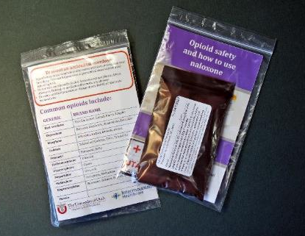
Libraries’ role in their community’s opioid crisis
Connect people to information and resources
  Book discussions, awareness campaigns, health programming
Equip people with knowledge and skills
  Recovery Court
Respond to community needs
  Peer navigator support, Deterra bags, naloxone access
Photo: courtesy Peoria Public Library
Notes:
This organizes the information about the types of programs and services in a different way. Unsurprisingly, programs and activities work best for both library staff and the community, when they’re a natural extension of what libraries do well in their communities. Many of the interviewees for the project felt that their response was aligned with the information needs of their communities.

Slide 22
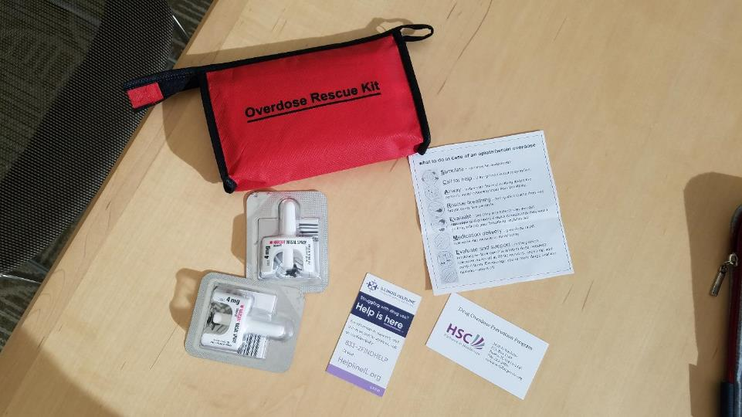
Peoria Public Library
Overdose Rescue Kit
Includes Narcan, instructions for use and information for more help.
Photo courtesy: Peoria Public Library
Notes:
The next few slides represent examples of the types of programming and services that we found in the libraries that were the case study sites.
This is an Overdose Rescue kit – courtesy Peoria Public Library. It contains several doses of Narcan, which is the opioid overdose reversal drug, naloxone, which can be administered to someone to revive them from an overdose. It also includes instructions for using the Narcan, and what to do to get more help.

Slide 23
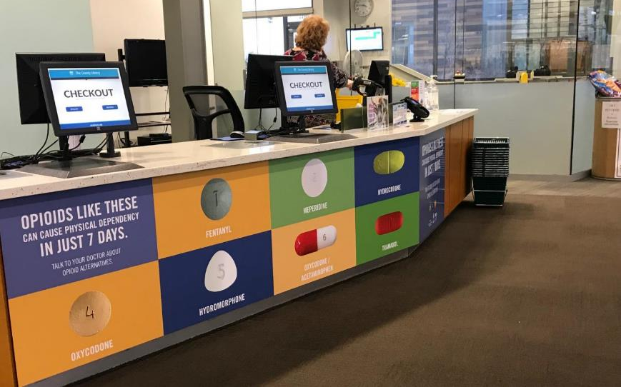
Salt Lake County Library System
Use Only As Directed, public awareness campaign.
“Opioids like these can cause physical dependency in just 7 days.”
Photo courtesy: Salt County Library System
Notes:
This is a large display at the checkout desk of the public library in Salt Lake County, Utah. This is an example of how to encourage the community to both recognize what an opioid can look like as well as to increase awareness about the potential hazards.
This display cannot be missed if you are in the library, and it sparks conversation with patrons, as well as within families. Staff noted that children have asked about the “candy” in the pictures. Which is a good reminder to parents that children often don’t realize a pill is a potentially dangerous medication.

Slide 24

Salt Lake County Library System
Use Only As Directed, public awareness campaign.
7,000 opioid prescriptions are written everyday in Utah
Photo courtesy: Salt Lake County Library System
Notes:
This is another example of the public awareness campaign at the Salt Lake Library System. Hanging from the ceiling when you enter the library are 7,000 paper pill bottles, the kind that you would get a prescription in from the pharmacy. This represents the 7,000 prescriptions for opioids that are written everyday in the state of Utah. Every day.
In 2017, there were 650 drug overdose deaths in Utah. (1)
This display and the one on the previous slide were funded entirely by the library’s partners at the health department. The library didn’t need to pay for anything, but they did provide the space to make the display possible. And everyday, hundreds of people walk through the doors of the library and can see these displays and have an opportunity to learn about how the opioid epidemic is affecting their community and maybe learn how to protect themselves and the people they love.
https://www.cdc.gov/nchs/pressroom/states/utah/utah.htm

Slide 25
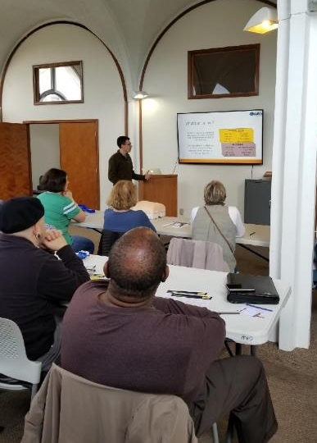
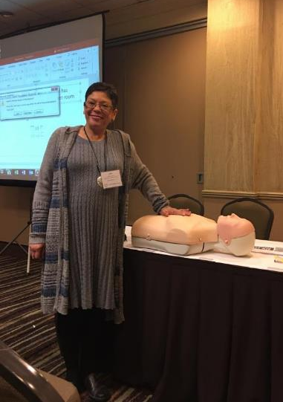
New Orleans Public Library, “Bystander Training”
Provides first aid training, including an opportunity to practice administering naloxone.
Photos courtesy: New Orleans Public Library
Notes:
The New Orleans Public Library rolled out training on how to use the opioid overdose antidote, naloxone, into a training that they offer in partnership with the local health department. The program is called “Bystander Training” and it also includes how to perform CPR, and how to stop bleeding after trauma. This approach of including the naloxone training with other common health concerns helps to reduce the stigma of a drug overdose and gives people the opportunity to understand more about how addictions to opioids form and why it is impacting so many people.
The health department provides all the trainers of these events, and both organizations help to promote the training. The library is scheduling these events in different locations around their system to help reach more community members.

Slide 26
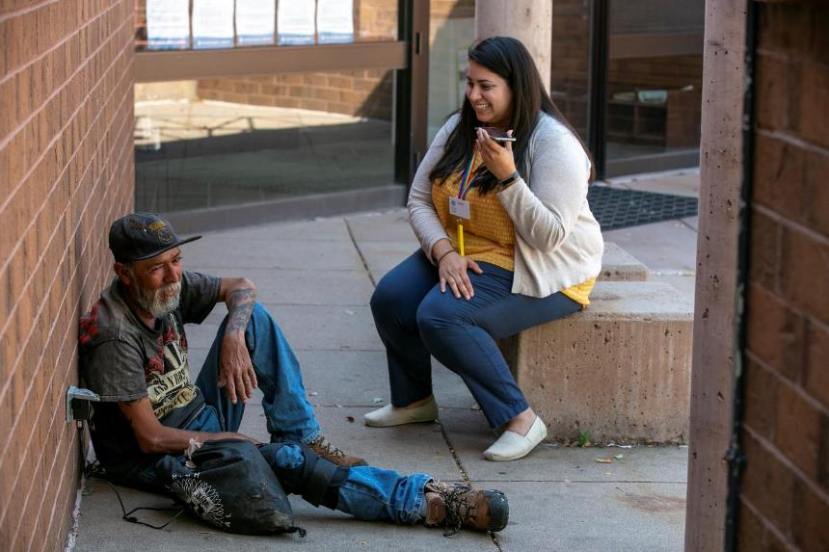
Denver Public Library, Community Resource Program
Provides access to peer navigators to help community members by providing support and connecting them to public services.
Photo courtesy: Giles Classen
Notes:
One of the most impactful programs that we learned about is the Denver Public Library’s Community Resource Program. This originally was designed to help with patrons who were experiencing homelessness, and as the opioid epidemic became more prevalent, the library also began to work with patrons on opioid-related issues.
A power aspect of the Denver program is that it includes the use of peer navigators. These peer navigators are staff members who have what is called “lived experience.” They formerly may have experienced homelessness, or addiction themselves, and now they have an opportunity to work helping others. They are able to use their experiences to connect to people and provide access to services that the library and their partners offer.
These peer navigators go out and meet people and introduce themselves and look for opportunities to provide some support. Some days this could mean giving them access to a phone to make a call, or it may be connecting them to a local shelter or housing assistance. And sometimes, they literally just are someone with compassion and patience with whom to talk.

Slide 27
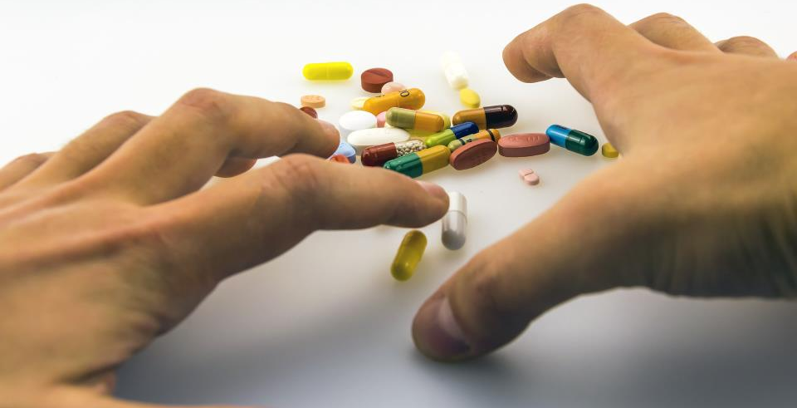
“I feel that there's been a lot of progress. And for a guy like me, who has been to prison, who's suffered, struggled with using for a long time, I'm hanging out with librarians, the police. I'm still alive. I still know people that use, and I don't use, but I'm still talking to those people…But now, there are people that have historically not liked people like me, treating me like a human, and giving me the opportunity to be a human, instead of just a junkie. And that is absolutely phenomenal.”
- Community member using the library services
Image by Emilian Danaila from Pixabay
Notes:
I mentioned that part of the interview protocol focuses on community members who used the services provided by the library and their partners. We recruited community members from each location and interviewed up to three of them about their experiences.
I wanted to share a few of these because they can be quite impactful and give you a sense of how important this work can be. This quote is from a community member who was sees the opportunity to hang out with librarians and be treated like a human as phenomenal.

Slide 28
Types of partners
Health Departments
the most common partnership, and is also well-aligned with the needs of the crisis
Recovery Court
focused on improving the lives of individuals who were in prison on drug offenses
Non-profit organizations
Recovery Institute, places peer navigators in the community
Utah Naloxone, gets overdose antidote, naloxone, in the community
Notes:
Libraries working with health departments came up in several of the case studies that we conducted. It’s a natural fit because of the type of activities and concerns that surface with addiction and overdose. These are government-funded organizations that often have responsibility for public health concerns, which would include the opioid epidemic.
Another example we found was a library partnering with Recovery Court – this type of court is focused on addressing individuals who have been in prison for drug offenses. Through this partnership the library provides life skills training to participants in Recovery Court. This life skills training includes things like managing finances, finding a job, and cooking healthy meals. The library designed the curriculum for these classes and offers all of the training. It was well-aligned with the training that the library already provided in the community and it is a highly-valued partnership.
Other examples of partnerships include those with non-profit organizations that are working in this area. One example includes an organization in Utah that provides the opioid overdose antidote naloxone for free for the library to distribute to the public. Another organization helps to place peer navigators in the community, to help people access local services more readily.

Slide 29
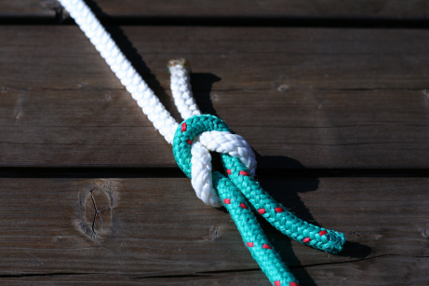
“We're so grateful to libraries for their willingness to do this because it is sensitive messaging. We understand that…culturally it has got a lot of stigma associated with it and a lot of misinformation and that can be delicate thing. But their willingness to address that, and to become ambassadors, and to help eliminate some of that misinformation is a huge benefit to the community as a whole.”
- Community Partner
Image by Chris Wolf / Pixabay

Slide 30
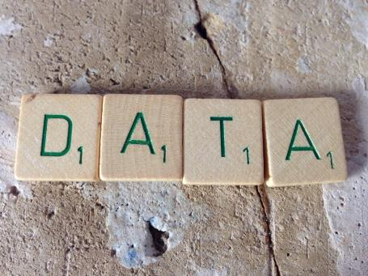
Research findings
Ease of the partnership activities.
There were few challenges and the
organizations reported that they
had well-aligned missions, and
motivated staff.
Lack of awareness about libraries
as partners until the opportunity
surfaced.
Patron privacy is a challenge with
evaluation, particularly on a
sensitive subject.
Research Data Management by janneke staaks is licensed under CC BY 2.0
Notes:
A few trends surfaced as we looked at the data. The first is that the partnerships between the libraries and the organizations to develop and offer the programming were perceived positively. The interviewees reported very few issues and had a mutual appreciation for each other.
The second issue is that the partner organizations often note that they didn’t think about the library as a partner before the opportunity to work together in the opioid response emerged. There were some existing relationships, but they weren’t very detailed, and the opioid response brought a new focus to the value of working together.
And finally, when we talked to the library staff and their partners about how they know that these efforts are successful…what the impact is, they can’t provide much information, other than statistics on usage.

Slide 31
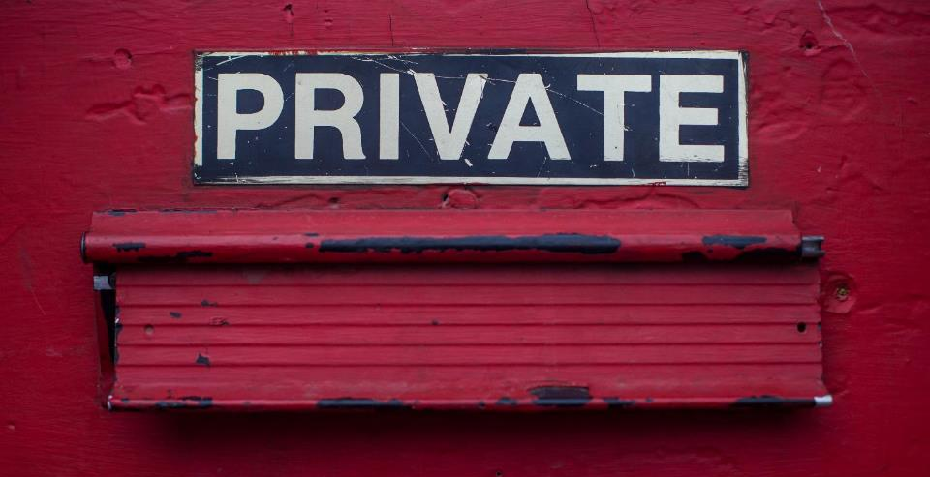
“Opiate addicts or people addicted to opiates are less likely to talk about that than people who have other addictions to other substances.”
– Community Partner Director
“There's other people that are very, very guarded. So just ask something like, ‘What's your name?’ And they see me write that down, I could lose trust right there.”
– Community Partner, Frontline Staff
Image by Dayne Topkin / Unsplash
Notes:
These are a few quotes from interviewees about evaluating these services. They shared that seeking help for an issue related to opioid misuse can be a highly sensitive request. And again, the stigma attached to drug use is real, and there can be perceived consequences from individuals who are seeking information – whether it’s an individual who needs help, or someone who is seeking support for a friend or family member. This concern absolutely plays out in how libraries are collecting information about patrons using services connected to the opioid crisis.
Interviewees indicated that confidentiality is critical to being able to provide services, which has made capturing any information about the long-term impact of their efforts very difficult. Instead, we found that more libraries focus on the number of people served and capture anecdotal information from staff as it becomes available.

Slide 32
The power of partnership
Amplify impact of collective efforts
Leveraging a partner’s resources/assets to strengthen the program/initiative—or even make it possible
Work in an area or topic where libraries might be unfamiliar/uncomfortable
Develop relationships that can be activated for future issues/projects
Notes:
Looking more at the partnerships, some of the advantages, that likely won’t come as a surprise, are outlined here. These are exactly the kinds of things that surface when organizations collaborate successfully, and it certainly is what we are seeing in this project as well.
One of the key parts of this work is that we would like people to see that these relationships won’t only serve the needs of the opioid crisis, but rather, realationships that have lasting impact as trust develops between organizations who can rely on each other as the needs in the community change.

Slide 33
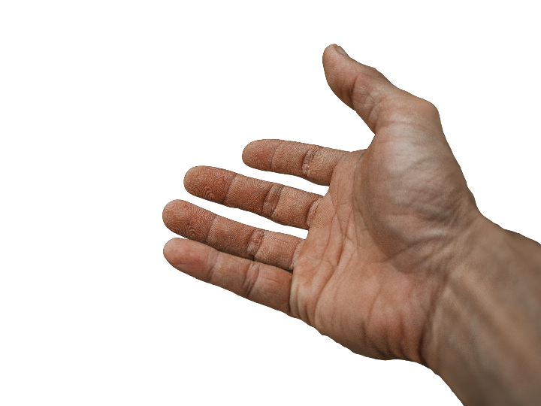
“It benefits me because I feel more prepared to help someone. I think anytime you feel more prepared and trained, you're much more likely to help someone.”
- Community Member who received naloxone
from the library
Image by truthseeker08 from Pixabay
Notes:
This quote came from a community member who received training on how to administer naloxone, which can reverse an opioid overdose. This perceived sense of being better prepared to help someone is huge. Knowing that naloxone is available and how to use it can lead to helping someone survive an overdose.

Slide 34

“I'm a pastor in a neighborhood where there are lots of drugs, and some of my congregation have family members who are abusing drugs. Two years ago, we actually had someone die outside of our gates from an overdose. We want to be able to assist our family members, but also our communities, and help the persons who are addicted to substance, particularly opioids.”
– Community member who participated in response training
Photo by Nina Strehl on Unsplash
Notes:
This community member also spoke to the importance of being trained and aware of ways that you can help people who are addicted. He has felt this need directly when someone died outside of his church two years ago. By participating in the training provided by the library and their partner, he was able to get more information to support his community and possibly prevent another tragedy.

Slide 35

“It's refreshing, and to admit, I'm comfortable with talking with people like [the peer navigators] instead of talking with people that have not been in this situation that I've been in. They have a tendency to talk down to me or they really don't understand the road that we've been on and the road that we're on now.”
- Community member who has engaged with peer navigators
Photo by Joshua Ness on Unsplash
Notes:
And finally, this was shared with someone who has been speaking with a peer navigator who works out of the library. The interviewee shared that the access to a peer navigator makes a difference in his willingness to share his story and ask someone for help. He valued the fact that the peer navigator has had experiences similar to his own and that made him more relatable to the patron.
In the past, he felt that people without that shared, lived experience would talk down to him and really couldn’t understand where he was coming from and the road that he had traveled. But a peer navigator is someone who has been there and that makes a difference to him.

Slide 36
Virtual discussions
Through virtual discussion, gather additional insights and resources from government agencies, public health and human services organizations, philanthropic and community organizations, and library leaders.
Notes:
Once we completed the case study research and wrote them up for publication – we moved to the next phase of the project, which was engaging other organizations and getting their feedback about our project and the opportunity for moving ahead together.
Because partnerships are such an important part of this work, we sought input and guidance from organizations outside the library field. We also wanted them to hear about what is happening in libraries around the opioid crisis and look for opportunities for how we can all work together in addressing the crisis. In fall 2019, we invited a cross-sector of organizations to participate in an online meeting where we asked the attendees to share their thoughts about the case studies, and to share resources from their organizations that they think will benefit libraries and the public.
We were able to take their suggestions, resources and ideas and include them with our findings into the project’s Call to Action.

Slide 37
CALL TO ACTION

Slide 38
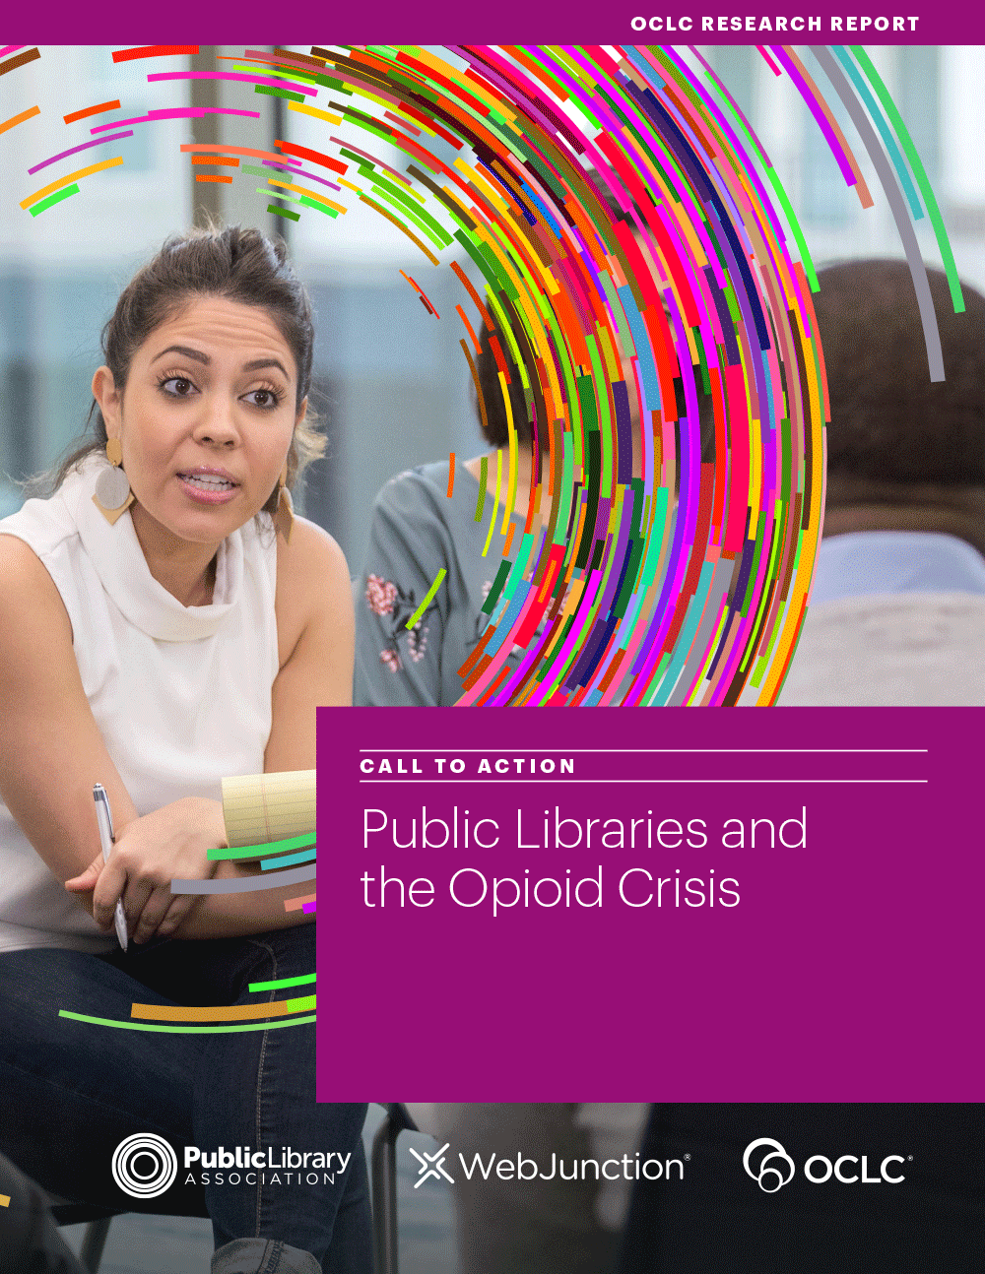
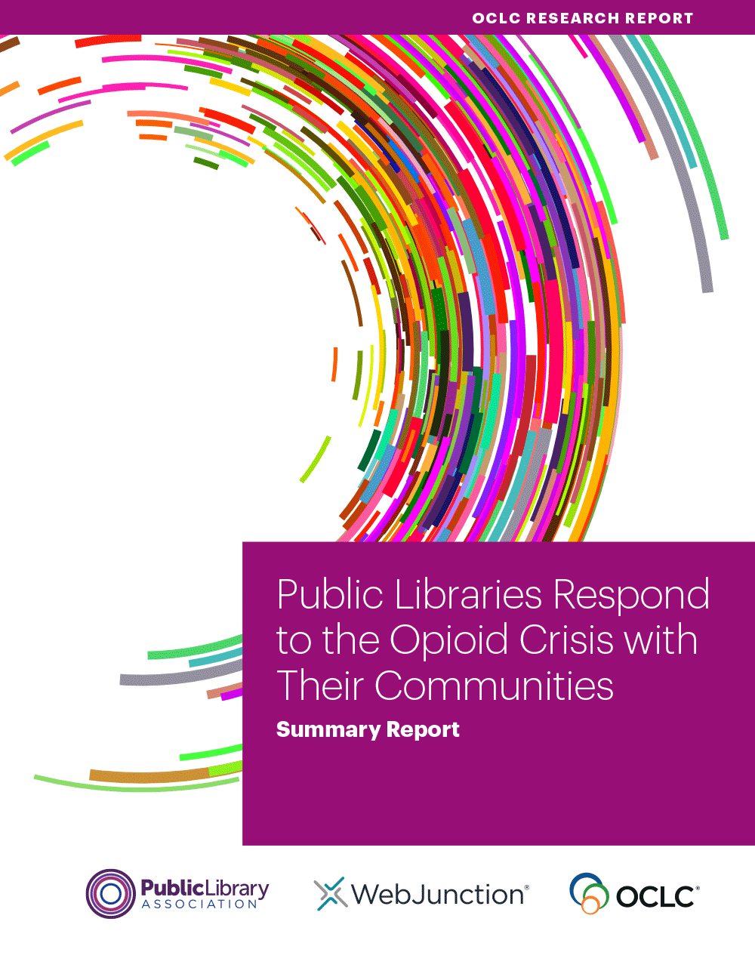
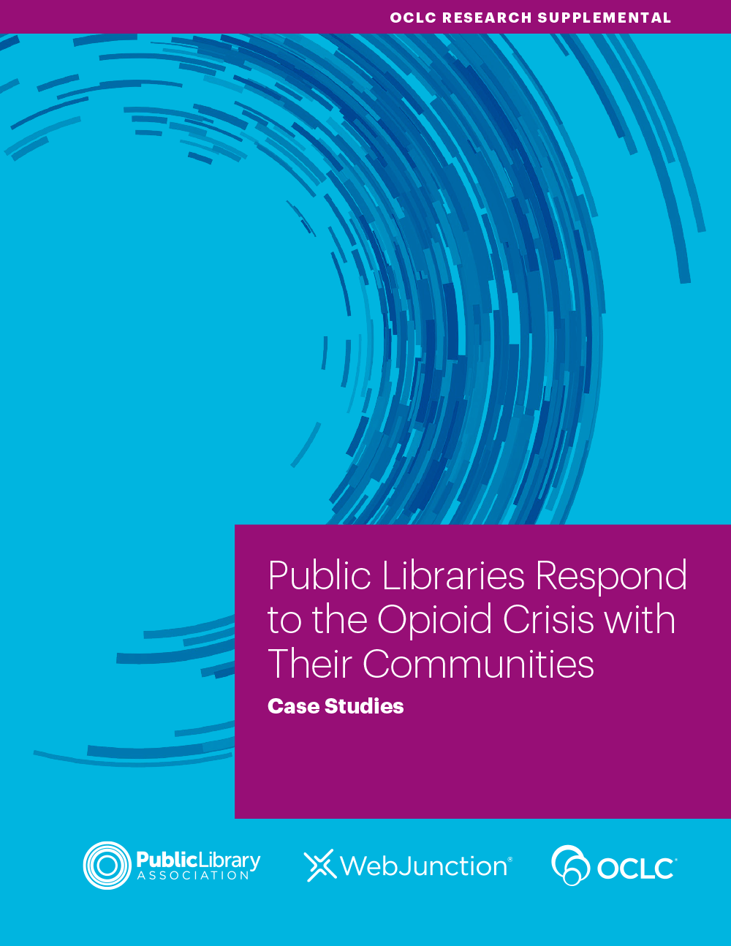
oc.lc/libraries-opioid-crisis
Notes:
The call-to-action report is the culmination of this grant-funded project, and it highlights ways for libraries to engage with the topic as gleaned from our case study research and discussions with public health and human service organizations, nonprofits, library support organizations, and government agencies.
This is a freely available report, which you can access along with the case studies and the summary report on the research. You can access the call-to-action report and the companion reports on our website. Just follow the friendly URL here, and we’ll also add the link to the chat.

Slide 39
Call to Action Steps
Explore your community data
Consider community assets and connect with partners
Increase awareness and knowledge of the issue among staff and the community
Offer community engagement and programming options
Focus on library staff care
Notes:
This is the call to action of the research findings and outlines steps that library staff can take to not only support the community through this crisis, but also to help staff and other stakeholders learn the facts about the crisis and to identify a role for the library to play in addressing this important health care issue.
We hope that what you have heard today will inspire you to take a look at the report and seek ways for your library to respond. And remember the power of partnerships in this response. You can find subject matter experts, resources and sometimes even funding to provide additional resources and support to your community.

Slide 40
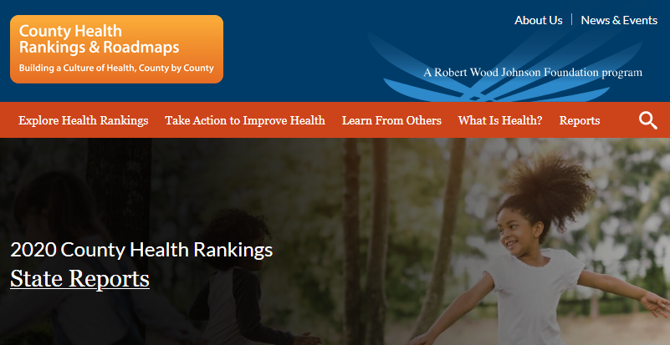

Call to Action: Explore data
Explore your community data
https://www.countyhealthrankings.org/
Notes:
The first step is to review community data to help you identify not just the impact of the opioid crisis, but other health-related community concerns. One of the resources that we recommend for this step is the County Health Rankings from the Robert Wood Johnson Foundation.
https://www.countyhealthrankings.org/

Slide 41
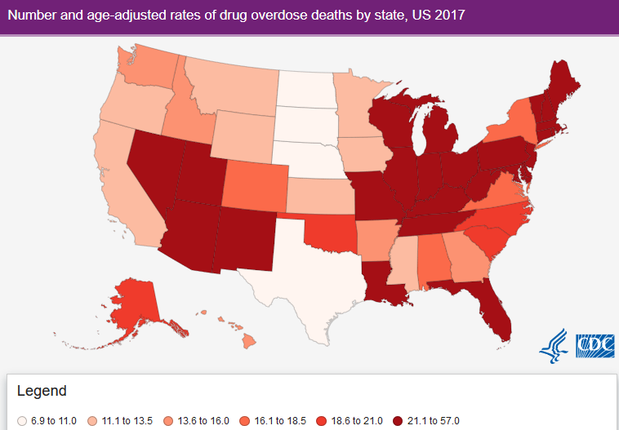
Call to Action: Explore data
Explore your community data
Connect with local and/or state health departments
Review online sources
for data
  County Health
  Rankings
  Drug Overdose
  Death Rate Maps
Notes:
We also used data from County Health Rankings to inform the research of the project, because we really wanted to include communities that were having different experiences with the opioid epidemic.
And as we walk through these examples, you’ll see that these suggestions really do resonate across public health concerns in your community – you can use this approach to address more than just the opioid crisis.

Slide 42

Call to Action: Consider assets
Consider community assets and connect with partners
Explore local organizations and coalitions
  Community-Led Libraries Toolkit
Listen to the needs of potential partners and seek opportunities for alignment
Seek a seat at the table
Notes:
The second step is to consider your local assets.
A great example of this can be found in the case study from the Kalamazoo Public Library. Kevin King, a member of the library leadership team, actively sought out ways to not only find out how the library could help, but also information to help inform decisions at the library.
Community-Led Libraries toolkit: https://www.vpl.ca/sites/vpl/public/Community-Led-Libraries-Toolkit.pdf

Slide 43
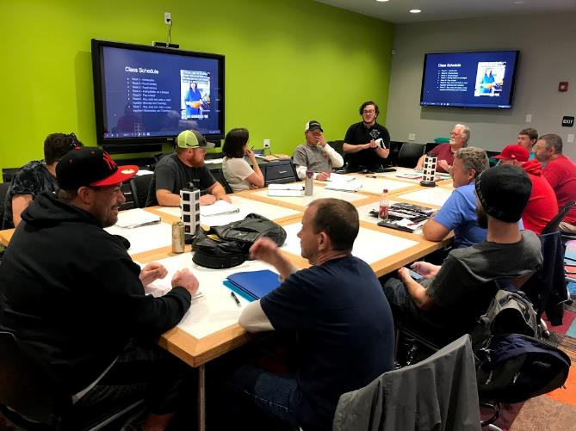
Strengths of libraries
A trusted organization
Physical space for meetings
A safe, nonstigmatized space
Marketing reach for programs
Vetted topical resources
Knowledgeable staff
Notes:
A key part of connecting with partners is being able to tell the library story. And this isn’t always a place where we excel. Be bold, be clear and be proud of what libraries can do. In the cross-sector discussions, one of the things that we heard over and over was “I hadn’t thought about libraries as partners, but it makes perfect sense, and I get it.”
Some of the things we encourage people to emphasize are:
* Libraries are trusted organizations that can reach diverse community members. Helping partners to get to people they may not be reaching.
* Libraries also have vetted topical resources, including books, journals and databases – think of the number of items already in your collection that can help reinforce the mission of local partners.
* Libraries have staff knowledgeable in curating and connecting people with community resources

Slide 44
Library partnerships
Local health departments were the most common partner
Non-profit organizations focused on prevention, treatment, or recovery support
At least half were involved in a community coalition to address substance misuse and the opioid crisis

Slide 45

Call to Action: Increase awareness
Increase awareness and knowledge of the issue among staff and the community
Seek to increase understanding and addressing the crisis
Stigma prevents people from acknowledging issues and needs
Libraries connect people to range of information on health-related topics, including substance use disorder
Notes:
The next step is to increase awareness and knowledge of the issue among staff and the community. One of the biggest challenges with this topic is the stigma associated with opioid misuse. And that stigma can impact our biases not just in the community, but with staff, as well. Providing statistics and information about addiction and substance use disorder can help.

Slide 46
Call to Action: Increase awareness
Increase awareness and knowledge of the issue among staff and the community
Resources
  Trauma-informed care
  Mental Health First Aid
Understanding the facts
  Of 12- to 17-year-olds who misused prescription opioids, 57% got them from a friend or relative¹
  The genes that people are born with account for about half of a person’s risk for addiction²
1. Centers for Behavioral Health Statistics and Quality;
2. National Institute on Drug Abuse
Notes:
1. Centers for Disease Control and Prevention. 2020. “America’s Drug Overdose Epidemic: Data to Action.”
https://www.cdc.gov/injury/features/prescription-drug-overdose/index.html.
2. Center for Behavioral Health Statistics and Quality. 2017. Results from the 2016 National Survey on Drug
Use and Health: Detailed Tables. Rockville, MD: SAMHSA. https://www.samhsa.gov/data/sites/default/files
/NSDUH-DetTabs-2016/NSDUH-DetTabs-2016.pdf.
3. National Institute on Drug Abuse. 2018. “Understanding Drug Use and Addiction.”
https://www.drugabuse.gov/publications/drugfacts/understanding-drug-use-addiction.

Slide 47

Call to Action: Focus on staff care
Focus on library staff care
Acknowledging compassion fatigue.
Create a post-crisis plan, how will the library deal with traumatic events?
  Check on Employee Assistance Programs
Notes:
The American Institute of Stress emphasizes “the emotional residue or strain of exposure to working with those suffering from the consequences of traumatic events. It differs from burn-out, but can co-exist.” Compassion fatigue is an issue for library staff and surfaces with other topics, as well. For example, during the Great Recession library staff experienced compassion fatigue from helping people locate information related to filing for unemployment, assistance programs, housing options, and job seeking.
And this feels very real to many of us as we are in the midst of the coronavirus epidemic. I think there is stress in wanting to help people in your libraries while adhering to closure orders for the good of the community. It’s knowing that the resources and programming your library provides can be a lifeline to individuals who need social connection either in person, or through your public access computers. We can see how closely this all is connected when it comes to public health concerns.

Slide 48

Call to Action: Engagement and programming
Offer community engagement and programming options
Informational displays with books
Update the library’s website with resources
Distribute free pamphlets on substance use disorder
Host a community forum or conversation
Promote drug take-back events
Distribute naloxone
Notes:
And our last step in the Call to Action is the type of programming, resources and services the library might be able to offer in connection with opioid misuse.

Slide 49

“So I hope … that this study is just another piece of proof that this is something that we need to do.”
- Community Partner, Frontline Staff
Photo by PublicDomain Pictures on Pixabay
Notes:
One of the frontline staff of a community partner who was interviewed shared this with the research staff. And it really speaks to the importance of both the research and what is happening. Through the call-to-action white paper, and in presentations like these, we want to help more libraries and more organizations find the opportunity to work together and help to address this crisis.

Slide 50
Questions and Discussion
oc.lc/opioid-response
Lynn Silipigni Connaway, Ph.D.
Director of Library Trends and User Research
connawal@oclc.org
@LynnConnaway
Notes:
You can learn more about this project at the URL oc.lc/opioid-response

Slide 51
Notes:
Questions?

