Slide 1

Metadata
directions
Lorcan Dempsey
OCLC
@LorcanD
Eurasian Academic Libraries Conference
June 29-30, 2021

Slide 2
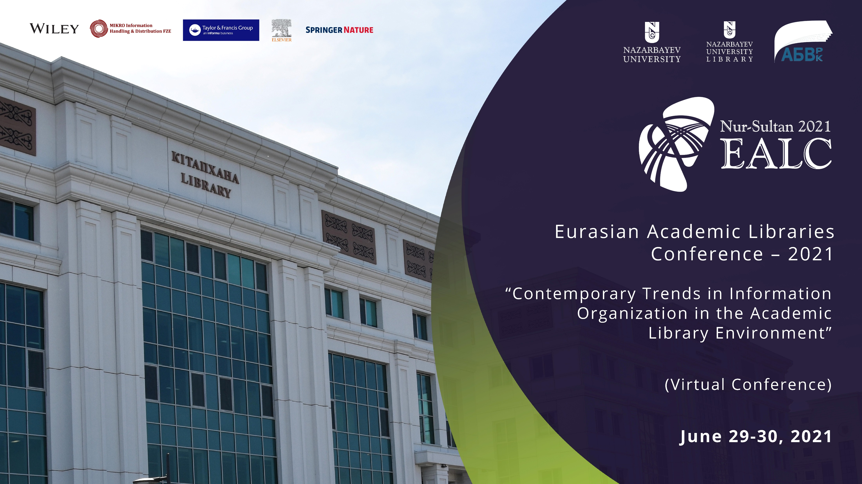

Slide 3

Divided into three parts
1
Metadata
2
Two directions
3
OCLC

Slide 4
Metadata …
A user may be
a person or a program.
Data that relieves a potential user of having to have full advance knowledge of the existence or characteristics of a resource.
… Schematized assertions about a resource.

Slide 5
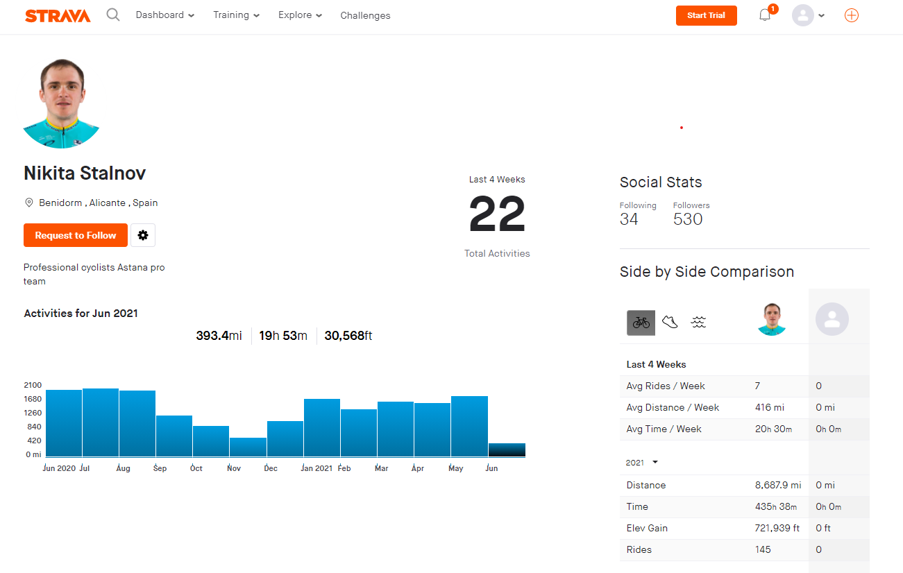
The intelligence in the
digital environment
Resources
Discover, compare, reuse, buy, …
Workflow
Tie resources and people together
to get jobs done.
Environment

Slide 6
Divided into three parts
1
Metadata
2
Two directions
3
OCLC

Slide 7
2 directions
Entification
A singular identity for all resources of interest (entities).
Associated with metadata.
Graph.
Pluralization
Better represent identity, memory and experiences of communities
Repair harm.
‘Just description’

Slide 8
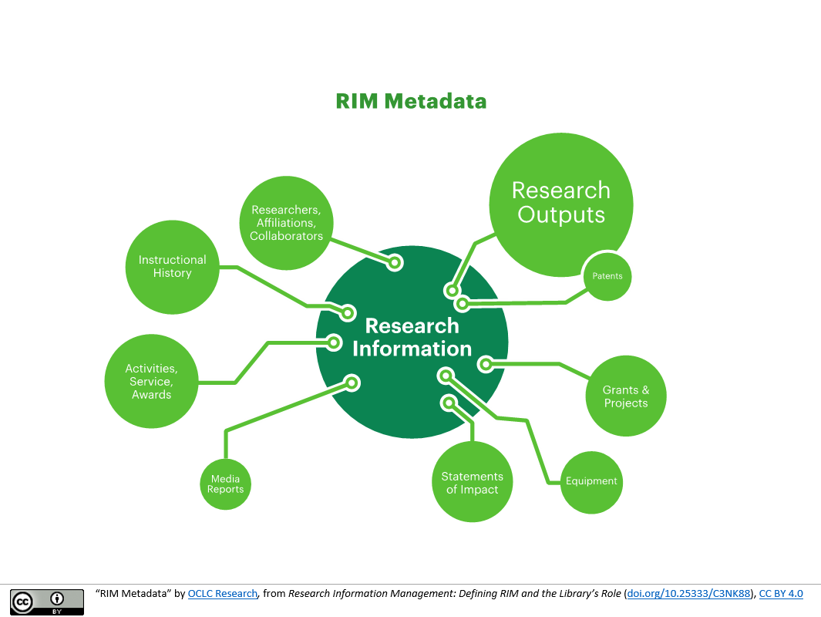
Entification
Example .. Research information management
Create singular identity (‘entification’)
Gather information about entities (e.g. cards)
Create relationships between entities – graph
(navigation – citation, co-creation, derivative, affiliation, recommendations, …)
Digital
Workflow

Slide 9
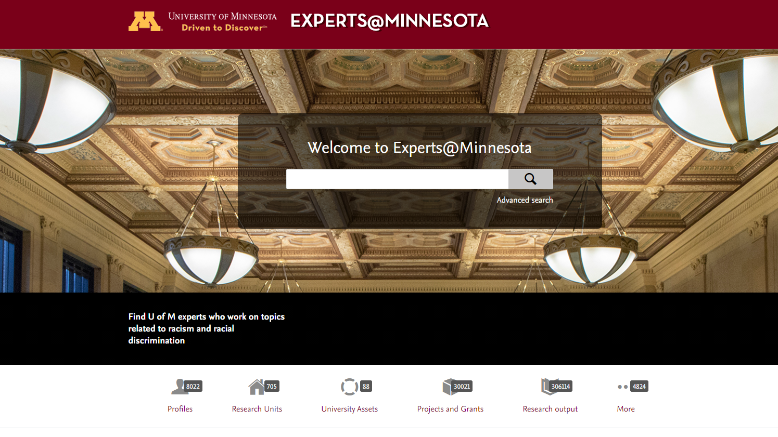

Slide 10
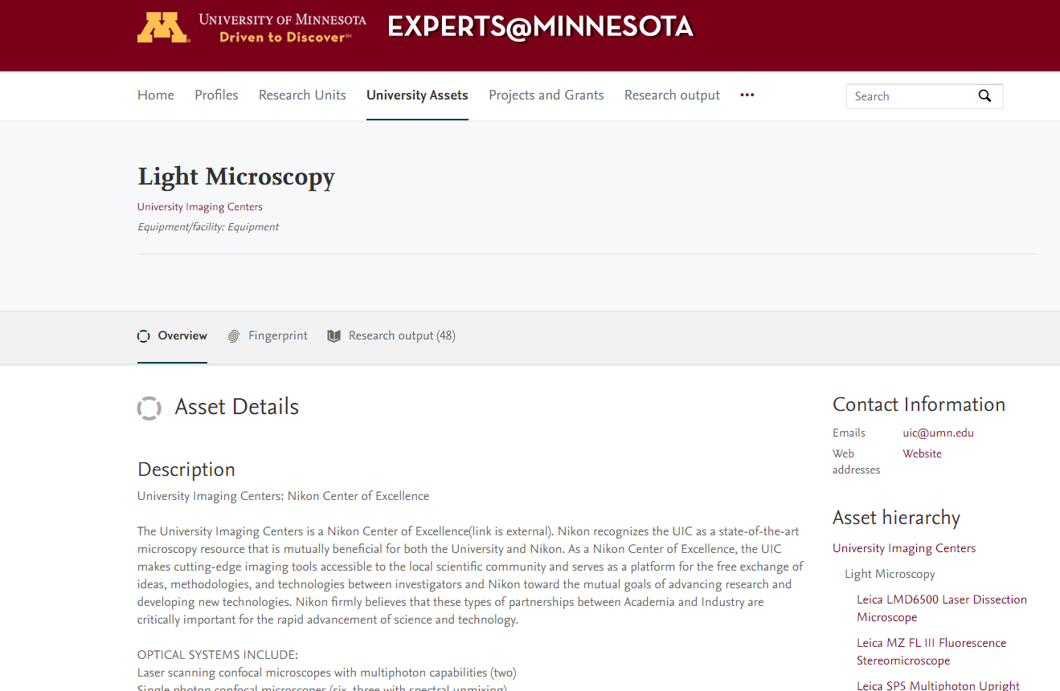

Slide 11
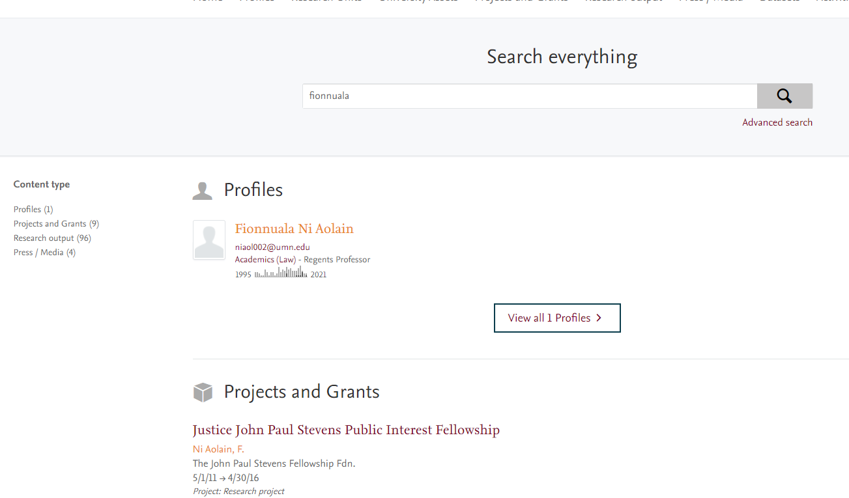

Slide 12
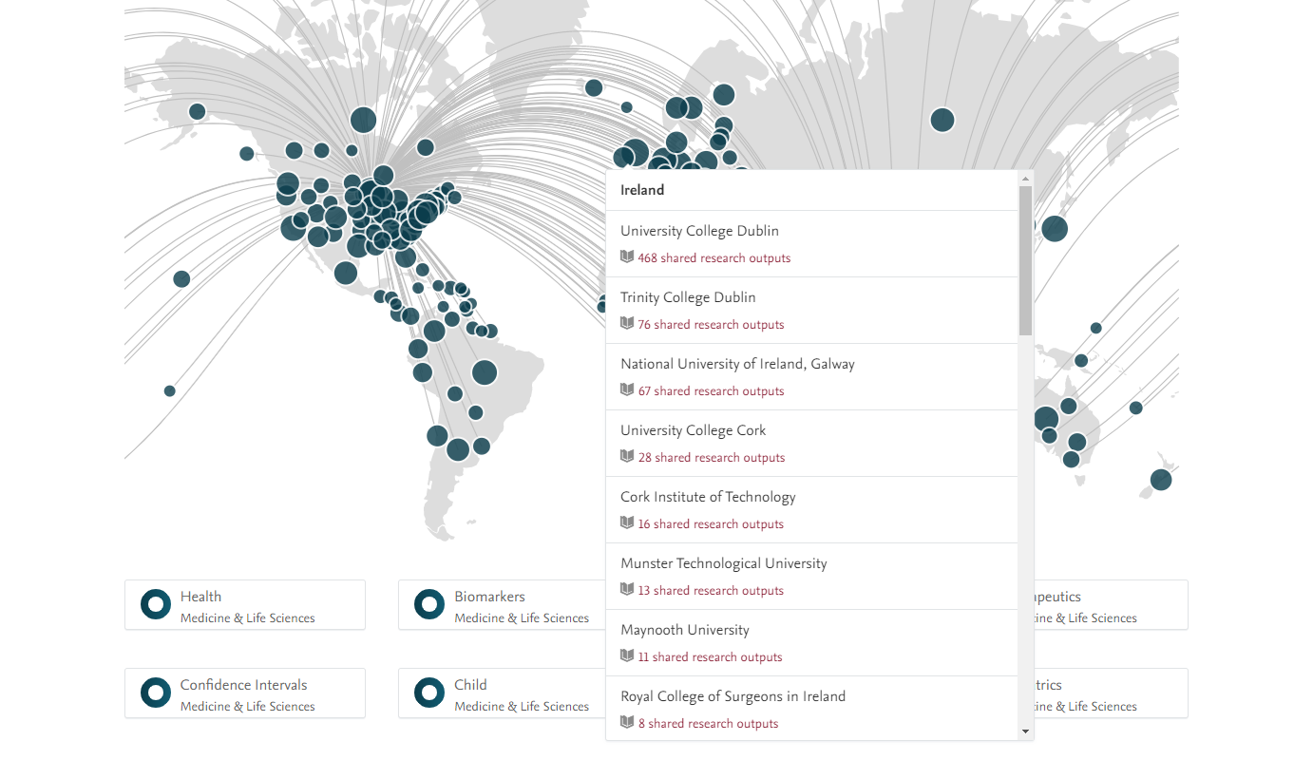

Slide 13
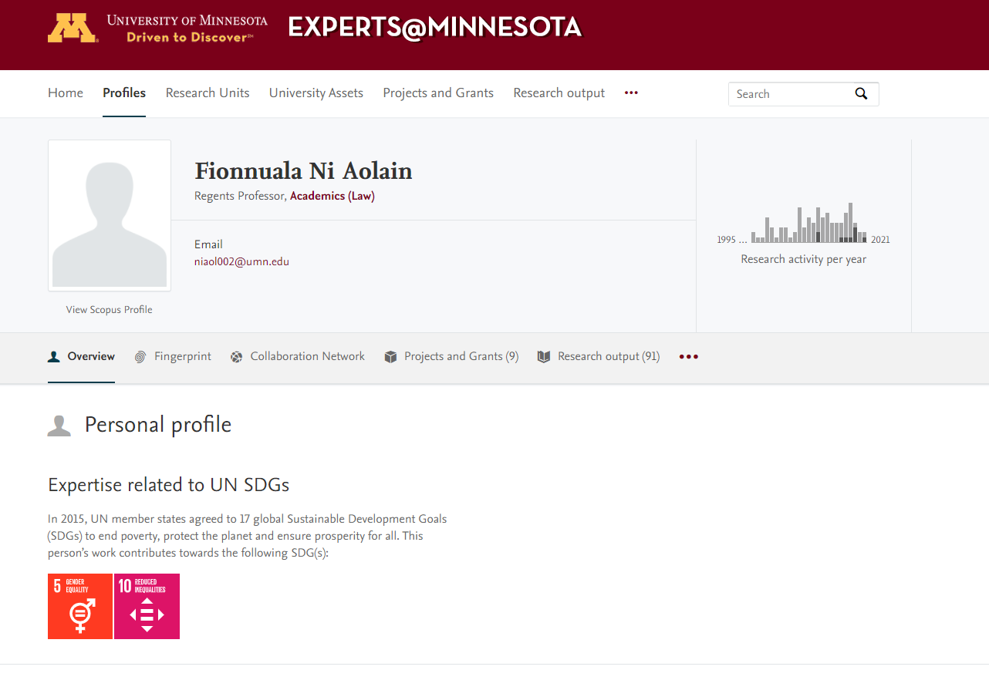

Slide 14
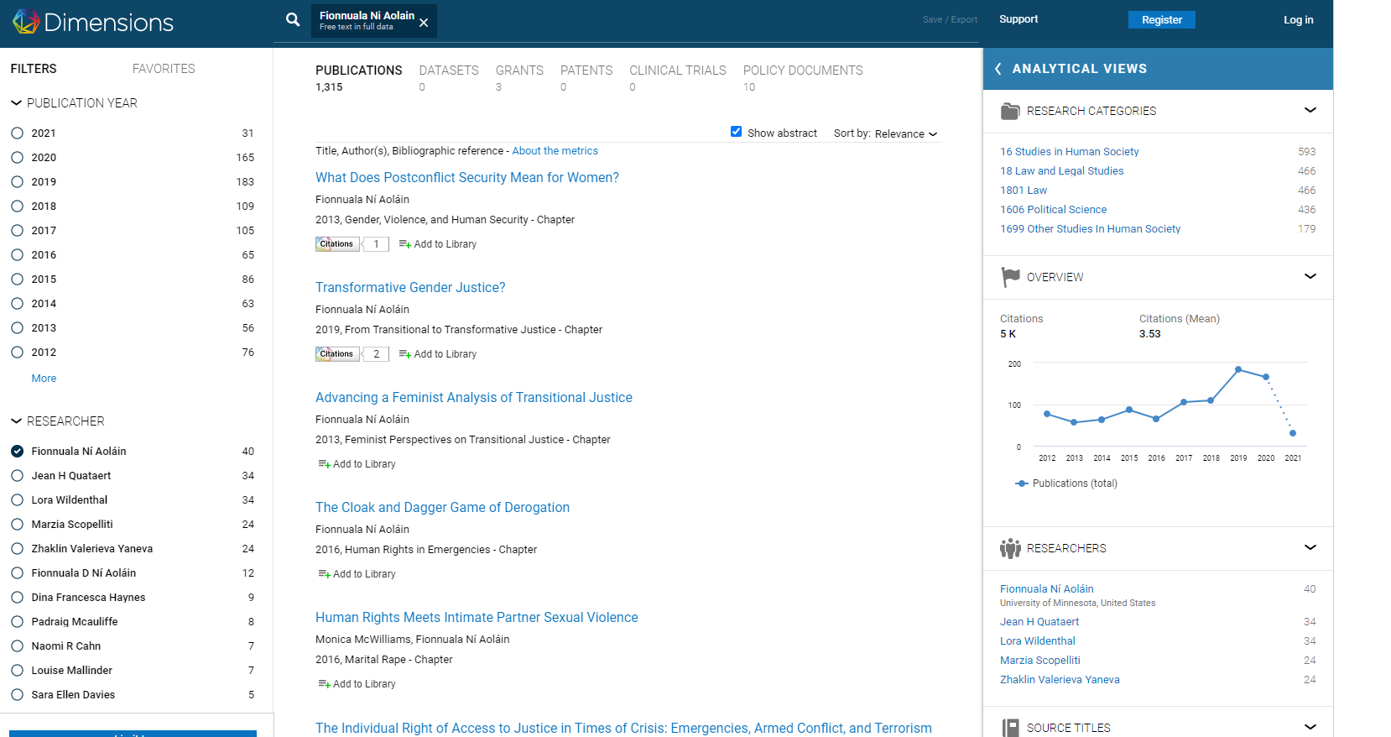

Slide 15
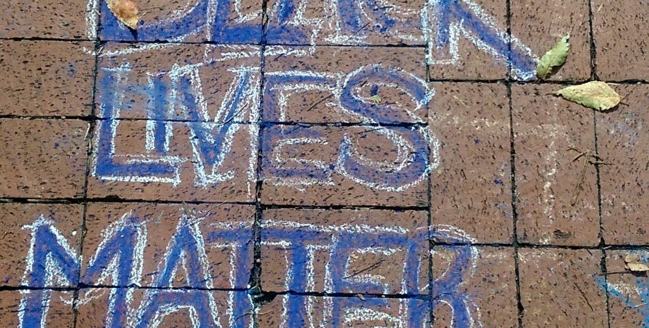
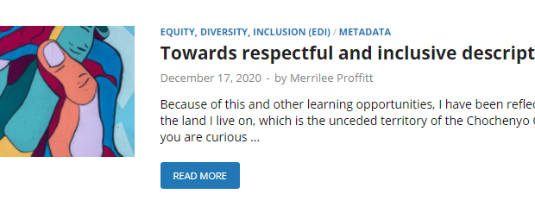
Pluralization
Harmful description
Dated description
Don’t respect cultural protocols or norms
Represent colonial or occupier perspective
Don’t include important experiences or perspectives
Embody partial cultural assumptions
http://documentingferguson.wustl.edu/omeka/archive/files/330421c03f623cf82bd562f4367c8d72.jpg

Slide 16
Equity, Diversity, and Inclusion in the OCLC Research Library Partnership (2017)
Survey
Most changed (ranked)
Activities & events
Recruitment & retention
Outreach to marginalized communities
Collection building
Selection of materials for digitization
Institutional website
Metadata descriptions for archival materials
Most planned (ranked)
Search and discovery interfaces
Metadata descriptions in library catalogs
Metadata descriptions in digital/digitized collections
Terminologies and/or vocabularies
Notes:
We also saw this reflected in a survey we did in 2017 across members of the OCLC RLP on Equity, Diversity, and Inclusion efforts. Although institutions had active efforts in many different EDI efforts, they struggled to find traction in that very same area, describing collections in a respectful and inclusive way. This explains why the webinars have done on these topics have been so popular, and why so many people view the recordings and slides of these sessions. People are hungry for tools and models to advance their own work.

Slide 17
4 sources of metadata about resources
Professional
Community
Program
-matically
promoted
Intentional
Enriching the
graph
Knowledge work
Adding to the graph
Knowledge
contribution
Choices, clicks >
analytics
Responsible description underlines library values and expertise.

Slide 18
Divided into three parts
1
Metadata
2
Some trends
3
OCLC

Slide 19

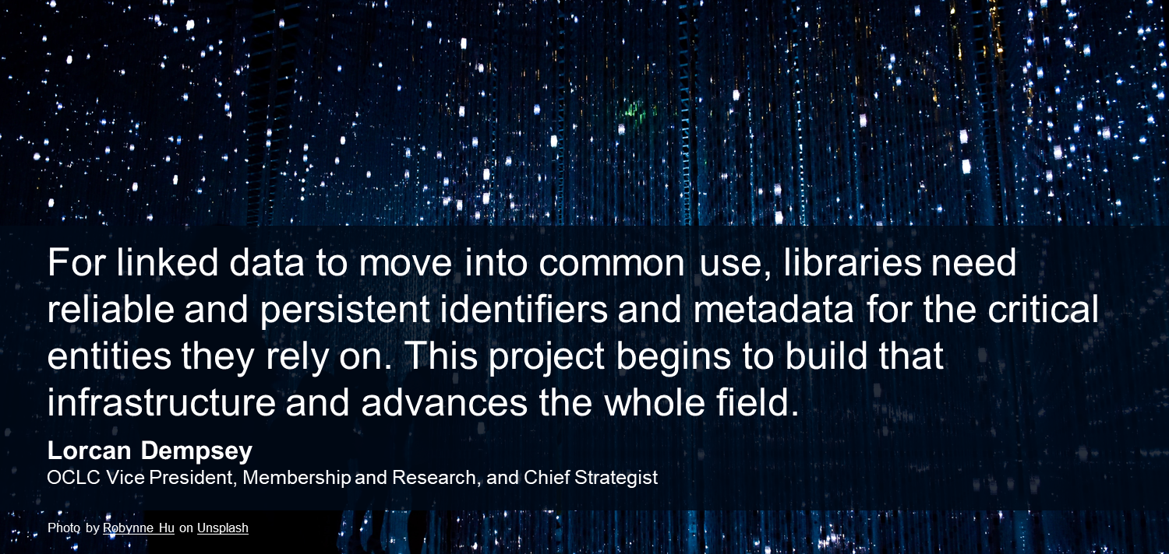
Entification:
Shared entity management infrastructure
Notes:
This is the Shared entity management infrastructure project.
In the words our boss, Lorcan Dempsey
For linked data to move into common use, libraries need reliable and persistent identifiers and metadata for the critical entities they rely on. This project begins to build that infrastructure and advances the whole field.

Slide 20
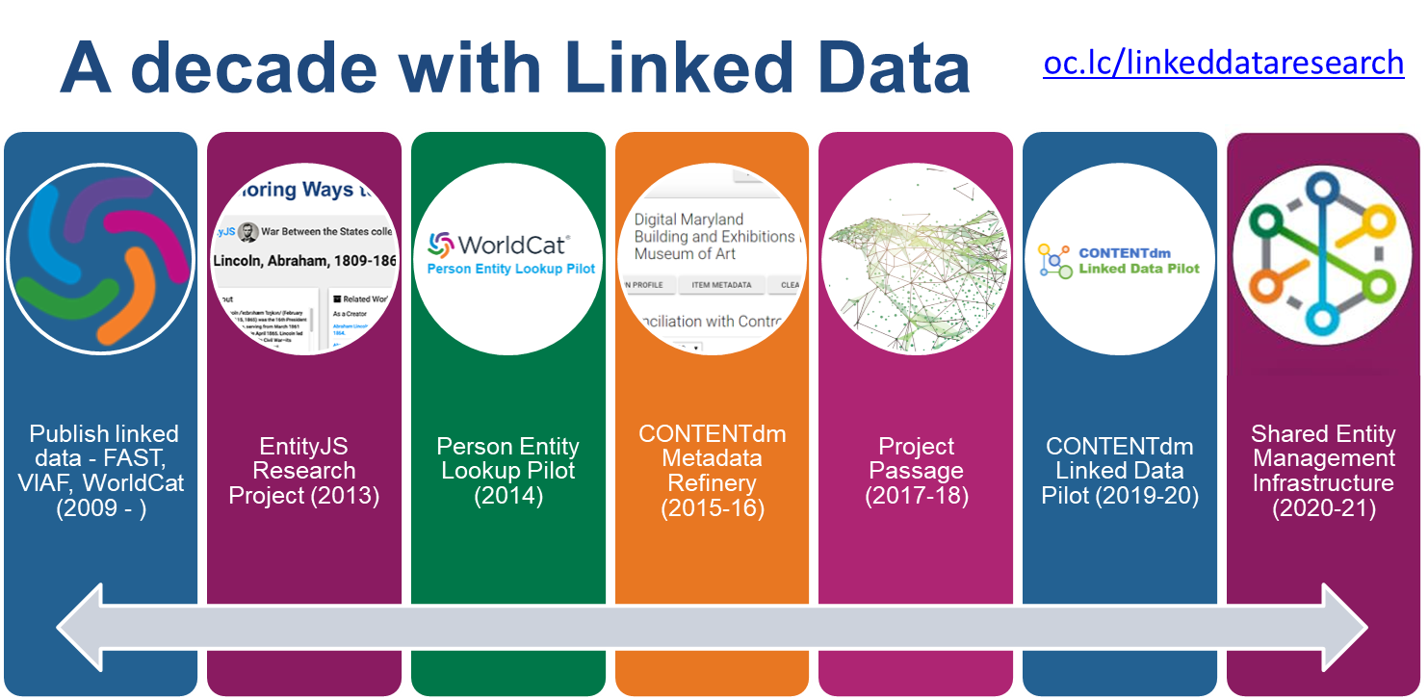
Notes:
OCLC has been in this game for a long time, over a decade. And over that time, we have learned a great deal about what is needed to “do linked data at scale.”
I’m going to review this history briefly here but focus primarily on the last 2 years leading to the culminating effort to put all of the research, experimentation, and prototyping to use in an effort that extends throughout calendar year 2021.
If you want more details on the decade’s worth of projects, or even if you want some “getting started” primers on linked data, you can use the link that appears at the top of this slide.

Slide 21

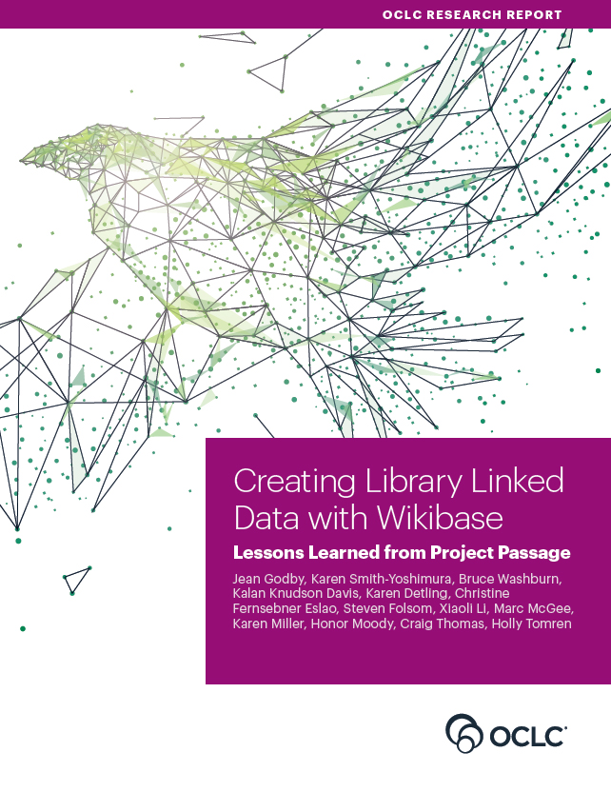
Project Passage Conclusions
Selected Conclusions
A Linked Data infrastructure can create data that exceeds current library standards.
Ontologies are vitally important.
User interface enhancements to the infrastructure can improve library workflow.
A knowledge graph requires tools to import external datasets.
Interoperability between datasets is crucial for import and export.
Linked data work diminishes the distinction between bibliographic and authority data.
oc.lc/passagereport
Notes:
It would take many slides to do this project justice, so instead, I would urge you to take a close look at the accompanying report written by both OCLC staff and several of the library participants and published by OCLC Research in 2018.
But here’s a quick summary of our findings:
We learned that the Wikibase linked data infrastructure can be used to create structured data with a precision that exceeds current library standards
The platform enables user-driven ontology design but raises concerns about how to manage and maintain ontologies
Supplemented with OCLC’s enhancements and stand-alone utilities, the platform enables librarians to see the results of their effort in a discovery interface without leaving the metadata-creation workflow; more robust tools are required for local data management
To populate knowledge graphs with library metadata, tools that facilitate the import and enhancement of data created elsewhere are recommended.
The pilot also underscored the need for interoperability between data sources, both for ingest and export.
And finally, Traditional distinction between authority and bibliographic data can disappear in a linked data description.

Slide 22
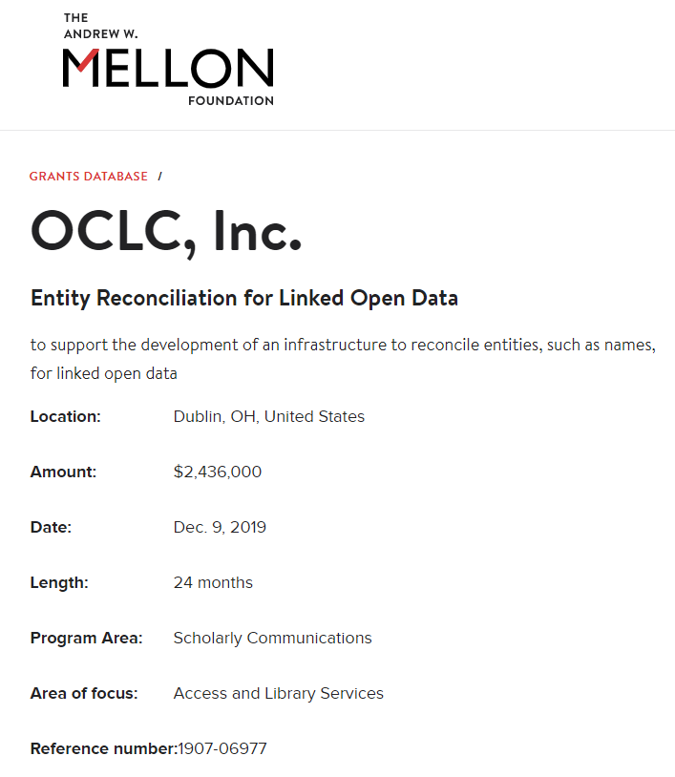
Shared entity management infrastructure
Production infrastructure for Work and Person entities
Support for multiple descriptive and encoding standards
Use of persistent identifiers
Most importantly: a collaboration with the library community
Notes:
To give you a quick overview:
This $2.436 million grant will support linked data management initiatives underway in the library and scholarly communications community.
OCLC will match this grant funding with additional investments to publish authoritative and easily accessible entity descriptions for works and persons as part of a persistent, centralized infrastructure that will be jointly curated by the community and OCLC when completed in December 2021.
This infrastructure will aggregate links to other representations of works and persons in external vocabularies and authority files that will provide a solid foundation for libraries, cultural heritage organizations and scholarly communications communities to ultimately make their materials more connected and discoverable on the web.
Additionally, we anticipate that libraries will use this infrastructure to:
increase connections (context) between their materials and other relevant collections
improve the consistency and efficiency of metadata workflows across collections and material types
improve MARC record quality and accuracy
…which will result in new, more efficient, metadata workflows!
In 2020, we are ramping up very quickly as we focus on data that OCLC already has, including authority data, bibliographic data, and other vocabularies that we maintain. …and in 2021, we will look to add more data sources and refine them to bring this to an even larger scale.
The features and functionality that we create will be primarily API-based, but we will also be providing a basic UI (user interface) and…along the way (in 6-month increments) we will be testing with library partners and collaborating with the library community to make sure this infrastructure meets their expectations.
[Current as of 2/15/21]

Slide 23


























Advisory group members
Notes:
As you can see here, 26 different institutions, including public, academic, research and national libraries are now part of our advisory group and we will continue to stay in close communication with additional linked data organizations, including LD4P, PCC, ALCTS Directors of Technical Services at Large Research Institutions and more to ensure that this infrastructure will meet their needs.
As of August 31, 2020, Project Entity Management advisory group members include:
ABES (Agence bibliograhique de l’enseignement superieur) – Benjamin Bober
Biblioteca Nazionale Central di Roma (BNCR)– Giuliano Genetasio, Andrea De Pasquale
Bibliotheque nationale de France (BnF) - Anila Angjeli
Brigham Young University Library - Greg Reeve
British Library - Andrew MacEwan
Central Michigan University Libraries - Melissa James
Cleveland Public Library - Chatham Ewing
Cornell University Library – Jason Kovari, Simeon Warner, Steven Folsom, Huda J. Khan, Lynette Rayle, and John Skiles Skinner
DnB (Deutsche National Bibliothek) - Reinhold Heuvelmann
Harvard Library - Marc McGee and Christine Fernsebner Eslao
National Library of Medicine - Barbara Bushman
National Library Board, Singapore - Haliza Jailani
National Library of New Zealand – Nicola Frean and Jason Murphy
New York University Libraries - Nancy Lin
Oxford University – Andrew Dunning, Alexander Hitchman
Princeton University Library - Sarah Hamerman
Smithsonian Libraries - Jackie Shieh
Temple University Libraries - Holly Tomren
U.S. Army Engineer Research and Development Center – Molly McManus
Universita di Bologna –Alessandra Citti, Raffaella Gaddoni, Chiara Semenzato
University of California, Davis Library - Xiaoli Li
University of Minnesota Libraries - Stephen Hearn, kalan Knudson Davis
University of Pennsylvania Libraries - Jim Hahn
University of Tennessee University Libraries - Anchalee (Joy) Panigabutra-Roberts
University of Victoria Libraries – Dean Seeman
Yale University Library - Daniel Lovins and Youn Noh
[Current as of 2/15/21]

Slide 24
Timeline of activities
2020
2021
January - June
July - December
January - June
July - December
Wikibase: Millions of entities
Simple search & read
Ramp up: 10s of millions of entities
Creation and editing tools
Add more data sources
Advanced querying, new UI tools
Scale and refine
Prepare for release
Production
release
Notes:
Along the way we’re doing six-month checkpoints.
Currently we’re leveraging Wikibase as a primary technical component….and we’ll be doing so at least through the second checkpoint.
At that point, we’re making an architectural decision on whether to proceed primarily based on Wikibase, move to a hybrid approach, or to move to a different technology in order to scale much larger.
Along the way, we’ve got multiple communication channels for input and iteration of our work. So, in addition to the testing that I mentioned earlier, we’re having a number of different conversations with other partners as well.
[Current as of 2/15/21]

Slide 25

OCLC awarded
Mellon Foundation grant
Reimagine Descriptive Workflows
Convening in 2021 – first step in a global conversation
Diverse group of experts, practitioners, and community members
Examine and learn from localized efforts
Improve practices, tools, infrastructure and workflows at scale and at a community level
Develop a community agenda, which identifies the issue and maps a path forward
Visit oc.lc/reimagine-workflows to learn more
Notes:
OCLC has a special privilege in stewarding WorldCat, which gives us a compelling interest in understanding how better to advance this important repair work, and some standing which makes us a natural convener….So I’m pleased to share that OCLC has been awarded a grant from the Mellon Foundation to convene a diverse group of experts, practitioners, and community members in order to examine and learn from their localized efforts… and determine ways to improve practices, tools, infrastructure and workflows at scale, and at a community level.
In this project, OCLC will:
convene a conversation on how the community can address the systemic issues of bias and racial equity within our current collection description infrastructure.
share with our member libraries the desire to build more inclusive and equitable library collections… and provide description approaches which promote effective representation and discovery of previously neglected or mis-characterized people, events and experiences.
…and finally, develop a community agenda which will be of great value in clarifying issues for those who do knowledge work in libraries, archives and museums. This agenda will help prioritize areas for attention, and provide valuable guidance for those national agencies and suppliers who serve these communities.
We believe that this will be a significant landmark in repairing the bibliographic infrastructure that we all rely on.

Slide 26
Survey If you had a magic wand…
Change in mindset: it’s okay to slow down, take care with the problem.
Bring library leaders them into the process.
More Indigenous librarians, more Indigenous library school students (especially in metadata work).
Linked data (mapping inappropriate terms to more appropriate ones)
Potential for FAST (Faceted Application of Subject Terminology)
Notes:
We not only asked about problems but also tapped into collective wisdom about potential solutions. These included a change in mindset, hiring more Indigenous librarians particularly into cataloging and metadata positions.
We were happy to hear from very many of our interviewees that they think that linked data is an important part of the solution. This is exciting since OCLC has been investing in linked data for over a decade and this ties to some of pathbreaking work that Mary will touch on next. So over to you Mary!
<Transition to Mary Sauer-Games to finish the presentation>

Slide 27
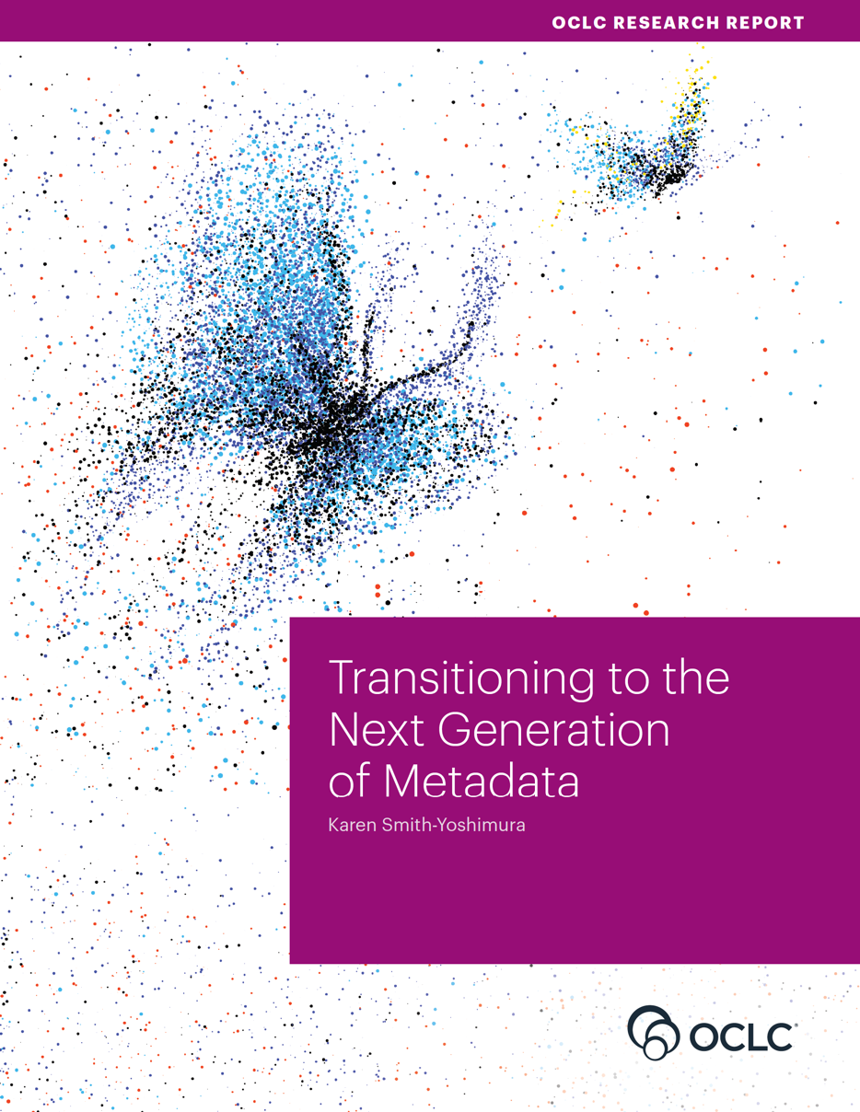
Lorcan Dempsey
OCLC
@LorcanD
Thank
you
DempseyL@OCLC.org

