Slide 1
Finnish University Libraries’ Network | 18 March 2021
Where are we Going and What do we do Next?
Demonstrating Value and Impact of Academic Libraries in Uncertain Times
Lynn Silipigni Connaway, PhD
Director of Library Trends and User Research, OCLC Research

Slide 2
2021 Higher Ed Trends
Mental Health Awareness
Artificial Intelligence for Learning
Online Learning is More Prevalent
Virtual Reality for Education
The Rise of Massive Open Online Course (MOOCS)
Notes:
Bouchrika, Imed. 11 Top Trends in Higher Education: 2020/2021 Data, Insights & Predictions. Guide2Research. August 24, 2020. https://www.guide2research.com/research/trends-in-higher-education

Slide 3
The Value of Academic Libraries
Goal: Academic libraries demonstrate alignment with and impact on institutional outcomes
  Promote impact & value of libraries to higher education community
Notes:
Association of College and Research Libraries. (2010). Value of Academic Libraries: A Comprehensive Research Review and Report, researched by Megan Oakleaf. Chicago, IL: Association of College and Research Libraries. Retrieved from: http://www.ala.org/acrl/sites/ala.org.acrl/files/content/issues/value/val_report.pdf

Slide 4


Polling Question
Has your library aligned its strategic plan and goals with those of your institution?
  Yes
  No
Polling

Slide 5

Free pdf online
acrl.org/value
– or –
Purchase print from ALA Store
www.alastore.ala.org

Slide 6
How far have we come and
what do we do next?
An agenda for action-based research on student learning and success

Slide 7
Data Collection
Individual Interviews with Provosts
Selected Literature
Focus Group Interviews & Feedback from Advisory Group
Three data sources
Iterative process
  Advisory group
  Literature review
  Provost interviews
Notes:
This slide depicts three data sources:
Selected literature on student learning and success identified in the RFP and documents found in LIS and higher education databases
Focus group with Advisory Group Members
Consist of library administrators from a variety of community colleges, 4-year colleges and universities around the country
Members provide us feedback throughout the process and put us in touch with provosts or similarly high-level academic administrators in their institutions
Individual, semi-structured interviews with provosts from each Advisory Group member’s institution
Process of data collection is iterative, with findings from each source informing the other
E.g., focus group and provost interview protocol was based on the themes that we identified in the initial database searches

Slide 8


Literature Selection:
Indexed by LIS &/or higher ed databases
2010-2016
Themes in 2010 VAL Report
Published in US
Value
of Academic Libraries
Notes:
Image: http://bit.ly/2m8AV9n (https://www.flickr.com/photos/leyeti/5220948222/) by Anthony Jauneaud / CC BY-NC 2.0
Selection criteria are: 1) indexed by LIS and/or higher education databases or identified by the project team or ACRL (e.g., ACRL Assessment in Action (AiA) studies, Ithaka S+R surveys, see Relevant ACRL Documents section), 2) published between 2010-2016, 3) contained themes identified in the 2010 VAL Report, and 4) published in the US, except for studies outside the US deemed relevant by the project team
Association of College and Research Libraries. (2010). Value of Academic Libraries: A Comprehensive Research Review and Report, researched by Megan Oakleaf. Chicago, IL: Association of College and Research Libraries. Retrieved from: http://www.ala.org/acrl/sites/ala.org.acrl/files/content/issues/value/val_report.pdf

Slide 9

Notes:
Here’s a word cloud of the themes by frequency of documents they were present in. The larger the word, the more documents that included the theme.
To reiterate:
The selection criteria for LIS and higher education documents reviewed are: 1) indexed by LIS and/or higher education databases or identified by the project team or ACRL (e.g., ACRL Assessment in Action (AiA) studies, Ithaka S+R surveys, see Relevant ACRL Documents section), 2) published between 2010-2016, 3) contained themes identified in the 2010 VAL Report, and 4) published in the US, except for studies outside the US deemed relevant by the project team
Selected higher education databases were:
Academic Search Premier
Education Resources Information Center (ERIC)
ProQuest Education Journals, and Teacher Reference Center
Selected LIS databases were:
Library and Information Science Abstracts (LISA)
Library Literature & Information Science Full Text (H.W. Wilson)
Library, Information Science & Technology Abstracts (LISTA)

Slide 10
Notes:
The team compared the differences in proportion of themes discussed in documents from the higher education literature versus the LIS literature.
Search terms used for the database searches included the word “Library” and its derivatives.
For this reason, this comparison is only able to inform of differences in the proportion of themes between what is being said about student learning outcomes as related to libraries within the higher education literature versus the LIS literature, not student learning outcomes in general.
We are going to conduct a search more broadly to identify trends in higher education related to outcomes that advance the mission and goals of the university, including student outcomes
Results of this literature review will be contained in the final version of the report
Documents labeled as higher education literature were those retrieved from higher education databases that were not indexed by LIS databases and reports from Ithaka S+R. Therefore, a total of 354 documents of the total 535 documents (66%) were reviewed when making this comparison given that the team retrieved documents for review that were not indexed by databases (e.g., AiA studies). There were:
n=18 documents designated as higher education literature (about 5% of the total documents)
n=52 documents (15%) designated as both higher education and LIS literature since they were indexed by both databases
n=284 documents (80%) were from LIS literature.
This figure illustrates the percent difference between thematic code by whether a document is from the higher education literature, LIS literature, or higher education and LIS literature.
Which themes vary most by the proportion of documents to which they are applied?
LIS literature and higher ed. and LIS literature combined discuss service more than higher education literature
LIS literature discusses service and success in college more than in higher education and LIS literature

Slide 11
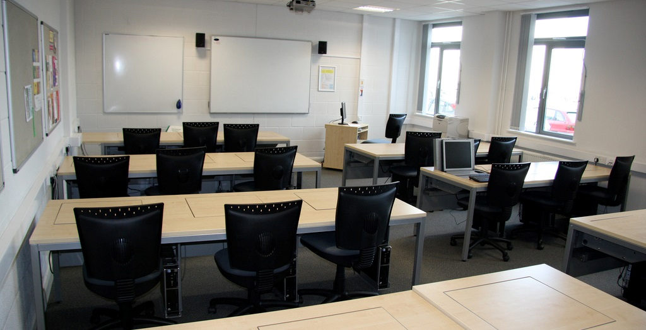
Focus group interviews
N =14 (of 14)
90 minutes
Transcribed
NVivo for analysis
Thematic coding scheme
  One team member coded, another checked
Value
of Academic Libraries
Notes:
Image: http://bit.ly/2lSj7wz (https://www.flickr.com/photos/jamesclay/3509153661/) by James F Clay / CC BY-NC 2.0
Next, we will examine which findings from the content analysis resonate with practicing librarians in higher education
Based on focus group interviews with 11 advisory group members; the other three were unable to meet and were sent focus group questions that they completed. The responses to these questions were included in analysis
Coded transcripts in Nvivo using thematic coding scheme, allowing for inductive categories to be pulled from the data
Another team member checked the codes

Slide 12
Notes:
Focus group interview participants most often discussed:
Communication (20%, n=54)
Collaboration (17%, n=46)
Service (16%, n=44)
They less frequently mentioned the themes of:
Accreditation (n=0, 0%)

Slide 13
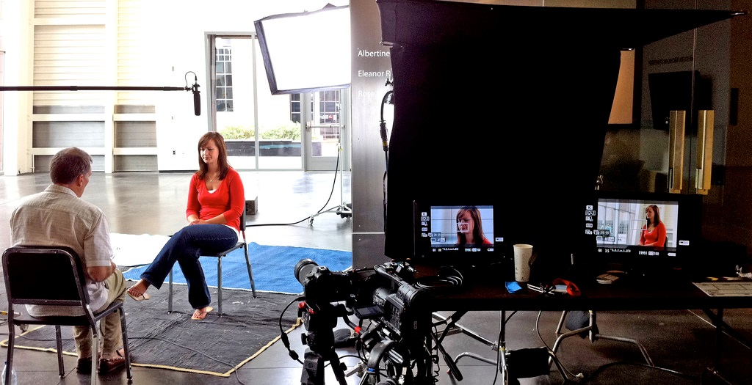
Provost individual interviews
N = 14 provosts (of 14)
45 minute average
Transcribed (9 of 14)
Detailed interview notes
(5 of 14)
NVivo for analysis
Thematic coding scheme
  One team member coded, another checked
Value
of Academic Libraries
Notes:
Image: http://bit.ly/2l80QhO (https://www.flickr.com/photos/richevenhouse/4880193319/) by Fellowship of the Rich / CC BY-NC-ND 2.0
Three team members interviewed the provosts on the phone and recorded the interviews. Nine of the fourteen interviews were transcribed. The other five were deemed to have low sound quality, so team members took in-depth notes and recorded juicy quotes.

Slide 14
Notes:
Themes discussed most by provosts were:
Communication (17%, n=199)
Institutional planning (14%, n=159)
Themes not discussed frequently by provosts were:
Accreditation (2%, n=18)
Top themes for focus group interview with librarians were communication, collaboration, and institutional planning
The theme among the librarians was accreditation, and this was the least mentioned theme among the provosts

Slide 15
Notes:
This slide depicts key differences in themes discussed by advisory focus group members versus provosts
Not a surprise that accreditation is not discussed by either. As an Advisory Group Member( LM07, Research University, Secular, Public) says “accreditation is just a task to be done.”
Key differences are:
Provosts discussed learning in college more than advisory group members
Provosts discussed space more than advisory group members
Advisory group members focused more on service than provosts
Advisory group members focused more on collaboration than provosts

Slide 17

“….it needs to be sort of multi-level communication from the provost to those relationships you have with other units like the centers for teaching and learning to the academic units to the individual relationships that, that librarians and staff have with faculty and students.”
(Advisory Group Member LM03, Research University, Secular, Public)
Value
of Academic Libraries
Notes:
Image: http://bit.ly/2mpfvoQ (https://www.flickr.com/photos/30003006@N00/2439637326/) by urbanfeel / CC BY-ND 2.0
“There's one other thing I was uh, when I was sitting here thinking about every, a lot of what's come out is that we're not islands, not that we ever were, but I think part of our success in reaching to students and faculty is the way we collaborate with others….one thing I will say is I think it needs to be sort of multi-level communication from the provost to those relationships you have with other units like the centers for teaching and learning to the academic units to the individual relationships that, that librarians and staff have with faculty and students. You know, all of those levels reinforce each other, and any alone doesn't quite work as well.” (Advisory Group Member LM03, Research University, Secular, Public)
Making connections is not as simple as having a conversation with one specific group or implementing the same strategies to make connections across various ones.
Outreach beyond the library necessary for its success relates to recognizing and adapting to the unique “eco-system” of relationships within the specific institution (Advisory Group Member LM14, Research University, Secular, Public).
Establishing multi-level communication requires collaboration. Librarians must have the ability to recognize how the multiple stakeholders within their specific university ecosystem interrelate and leverage their relationships to attain “shared goals,” rather than just library-oriented ones (Advisory Group Member LM07, Research University, Secular, Public).

Slide 18
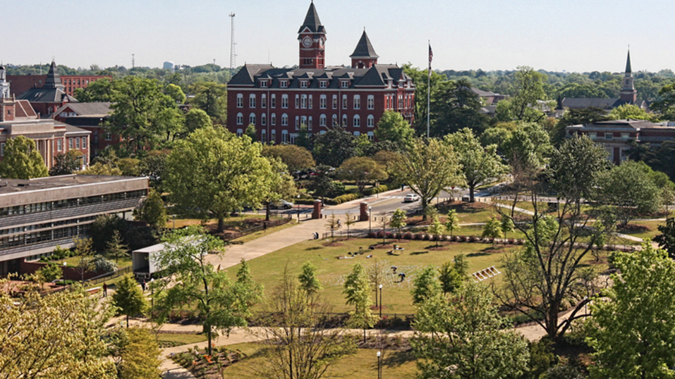
Language
Differences
Librarians use “service”
Provosts use more specific terms
  Teaching & learning
  Customer service
  Space
Value
of Academic Libraries
Notes:
Image: https://www.flickr.com/photos/australianshepherds/4515927995/

Slide 19

“[Librarians] have to be able to sell to the deans that this is something valuable that the deans want to be a part of, and the deans are going to be impacted by their faculty feeling like that this is a worthy thing because if we use money for one thing, we can’t use if for something else. I think customer service…becomes really important in this kind of environment.
(Provost Interviewee PP07, Research University, Secular, Public)
Value
of Academic Libraries
Notes:
Image: https://www.flickr.com/photos/28500561@N03/5507077908/

Slide 20
Academic LibrarY
Value and Impact

Slide 21

“…the whole kind of conversation around fake news is this really important example of how important it is in our daily life and civic health in order to bring critical skills to bear on understanding information and being able to critically evaluate the source of that.”
(Advisory Member LM03, Research University, Secular, Private)
Value
of Academic Libraries
Notes:
Image: https://www.flickr.com/photos/mxmstryo/3507201141/ by mxmstryo / CC BY 2.0
“If I’m understanding you correctly, the whole kind of conversation around fake news is this really important example of how important it is in our daily life and civic health in order to bring critical skills to bear on understanding information and being able to critically evaluate the source of that.” (Advisory Member LM03, Research University, Secular, Private)

Slide 22

“The drive to knowing more about what students get from a college education is not going to go away. We are going to have to continually look at, quality.…This drive towards knowing what students get from their college education, is going to continue to be important. I can't imagine that part of it would go away with the Trump Administration.”
(Provost Interviewee PP06, Research University, Secular, Public)
Value
of Academic Libraries
Notes:
Image: http://bit.ly/2lPIVLg (https://www.flickr.com/photos/dej611/9983732323/) by Dej611 / CC BY-NC 2.0
“The drive to knowing more about what students get from a college education is not going to go away. We are going to have to continually look at, quality. We need to pay a lot of attention to access and affordability. Accreditation will continue to be analyzed and scrutinized in Washington. This drive towards knowing what students get from their college education, is going to continue to be important. I can't imagine that part of it would go away with the Trump Administration.” (Provost Interviewee PP06, Research University, Secular, Public)

Slide 23
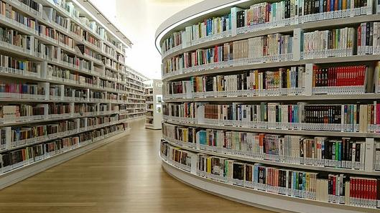
“I think each of us would have some example of our shared strategic initiatives around enhancing students' success. And promoting innovation and teaching and learning. What's underlying all of this is that all of us see our work as directly tied to the mission of the university.…Academic libraries are those directly connected to the mission of their unique institution.”
(Advisory Group Member LM13, Research University, Non-Secular, Private)
Value
of Academic Libraries
Notes:
Image source: https://www.flickr.com/photos/benhosg/32627578042

Slide 24

“Thinking of how these new learning environments work, and how the library would enhance students' and faculty's ability to access and process knowledge, data information, in those particular kinds of environments. That's what libraries need to do to be successful.”
(Provost Interviewee PP02, Research University, Non-Secular, Private)
Value
of Academic Libraries
Notes:
Image: http://bit.ly/2l8fAwO (https://www.flickr.com/photos/napafloma-pictures/16081970310/) by Patrick BAUDUIN / CC BY-NC-ND 2.0
“There's not one specific thing a library can do, because the environments are so different. Thinking of how these new learning environments work, and how the library would enhance students' and faculty's ability to access and process knowledge, data information, in those particular kinds of environments. That's what libraries need to do to be successful.” (Provost Interviewee PP02, Research University, Non-Secular, Private)
The way that libraries can impact learning is contextually-bound because of their dependency on the mission and goals unique to their institution. The importance of context in shaping how librarians communicate value is exemplified by the following provost account.

Slide 25
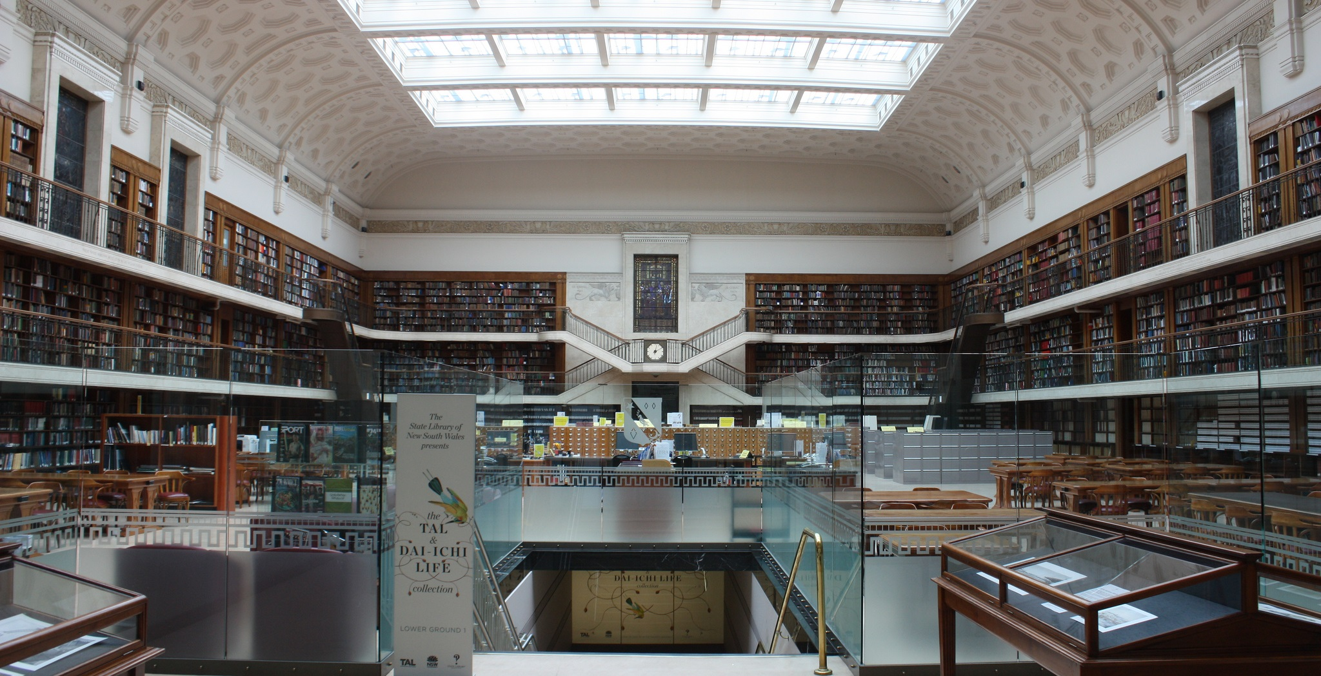
“My biggest concern is that the students aren't coming together…there's a hunger within our undergraduate student population to actually socialize.
The library has always been that crossroads for campuses. It could serve in this capacity, pulling students together.”
(Provost Interviewee PP04, Research University, Secular, Public)
Value
of Academic Libraries
Notes:
Image: http://bit.ly/2lQ0XwV (https://www.flickr.com/photos/dlebech/6803716862/) by David Lebech / CC BY-NC 2.0
“My biggest concern is that the students aren't coming together. The library can be that place, that nexus where students can come to study together. Yes, everything's posted online and they know they can do this alone, but there's a hunger within our undergraduate student population to actually socialize. The library has always been that crossroads for campuses. It could serve in this capacity, pulling students together.” (Provost Interviewee PP04, Research University, Secular, Public)

Slide 26
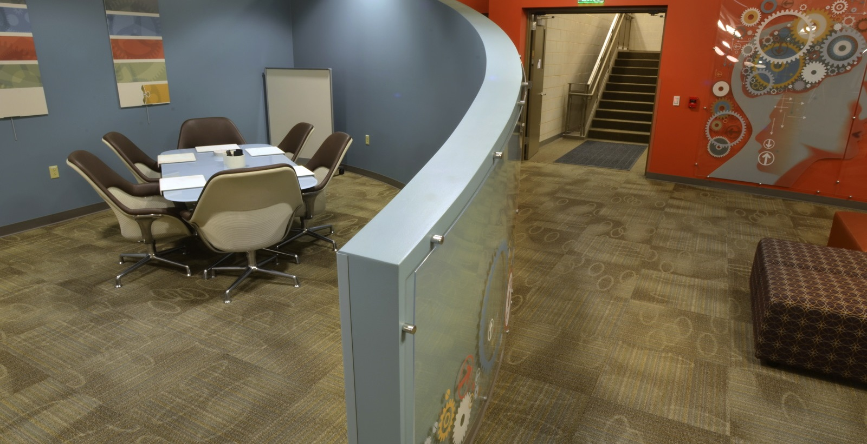
“Only sharing space, such as with a writing or computer lab is low level. There needs to be cooperative programming and interaction.”
(Advisory Group Member LM06, Research University, Secular, Public)
Value
of Academic Libraries
Notes:
Image: http://bit.ly/2m9i39Y (https://www.flickr.com/photos/stnorbertcollege/11839410166/) by stnorbert / CC BY-NC-ND 2.0
“Only sharing space, such as with a writing or computer lab is low level. There needs to be cooperative programming and interaction.” (Advisory Group Member LM06, Research University, Secular, Public)

Slide 27

“The way many of our faculty and students research now, it’s less about going to a physical space but accessing information in their offices.…I think that that is one of the challenges of changing the paradigm.”
(Provost Interviewee PP13, Research University, Non-Secular, Private)
Value
of Academic Libraries
Notes:
Image: http://bit.ly/2m3H2uS (https://www.flickr.com/photos/rolexpv/9752688231/) by Raul Pacheco-Vega / CC BY-NC-ND 2.0
“For so long [librarians] have had a role of support rather than integration into work. Much more of a partnership rather than support is needed, so it’s proactive in its orientation rather than reactive. The way many of our faculty and students research now, it’s less about going to a physical space but accessing information in their offices. Trying to imagine a new way where it’s not just a service model, but it’s actually an integration and partnership model, I think that that is one of the challenges of changing the paradigm.” (Provost Interviewee PP13, Research University, Non-Secular, Private)
Provosts suggest the importance of collaborating with faculty and students, such as introducing a liaison program. As conveyed by one provost, it is very important for libraries to “establish themselves as a critical link or a critical piece” early on by having “intentional interventions” (e.g., in orientations, by going to classes or convincing instructors to bring classes to the libraries, online or on campus) (Provost Interviewee PP05). The goal of the library should be to go beyond its role as “a service body” and instead be integrated into the lives of its potential users (Provost Interviewee PP13).

Slide 28

“…we have to be willing to do types of data collection that libraries have shied away from in the past.…I think that we have to be able to be willing to have conversations on campus about tracking user behavior in ways that libraries just haven't done.”
(Advisory Group Member LM14, Research University, Secular, Public)
Value
of Academic Libraries
Notes:
Image: http://bit.ly/2mHdL6q (https://www.flickr.com/photos/pong/2404940312/) by Rob Pongsajapan / CC BY 2.0
“To truly be able to look at, and be able to tell those stories, and to come up with those snippets of information that will resonate with other leaders, we have to be willing to do types of data collection that libraries have shied away from in the past. That involves tracking user behavior in a way that we've seen in a couple of the different studies that have looked at retention. There are ways of extrapolating and growing that out a little bit more so that we are dealing with large datasets, and we could...We could still keep it anonymous when we look at it in aggregate, right? I think that we have to be able to be willing to have conversations on campus about tracking user behavior in ways that libraries just haven't done.” (Advisory Group Member LM14, Research University, Secular, Public)
Privacy only was mentioned once, but is an important area of exploration. This topic is particularly fraught in the areas of assessment and academic libraries since there is a lack of established best practices and standards addressing the methods and contexts that may threaten the privacy of students. For this reason, privacy, when broadly defined, can be viewed by librarians in some instances as less of an ethics issue and more of an impediment, as articulated by the following participant [read quote].

Slide 29

“We should be helping people learn how to think, learn how to be skeptical, learn how to use critical thinking skills, learn how to be self-reflective. I think because those things are so much harder to assess and to demonstrate we have not done as good a job telling that story.”
(Provost Interviewee PP10, College, Non-secular, Private)
Value
of Academic Libraries
Notes:
Image: https://www.flickr.com/photos/deia/6461457

Slide 30
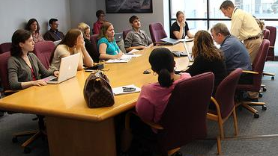
Priority Areas
Communicate the library’s contributions
Match library assessment to the institution’s mission
Include library data in institutional data collection
Quantify the library’s impact on student success
Enhance teaching and learning
Collaborate with educational stakeholders
Value
of Academic Libraries
Notes:
Image link: http://bit.ly/2lSj7wz

Slide 31
Polling Question
Do you have a 2-minute impromptu speech ready to tell the story of how the library contributes to the institutional mission and goals?
  Yes
  No
Polling

Slide 32

Recommendation
Identify & articulate both learning & success outcomes
Engage students in redesigning library space to demonstrate library’s impact for learning outcome
Library resource or service usage & its relationship to student retention exemplifies the effect of library’s service, collection, &/or space for success outcome
Value
of Academic Libraries
Notes:
Image: https://www.flickr.com/photos/kimmanleyort/2130314519/ by Kim Manley Ort / CC BY-NC-ND 2.0
Based on these initial findings, we’ve come up with the following recommendations.

Slide 33
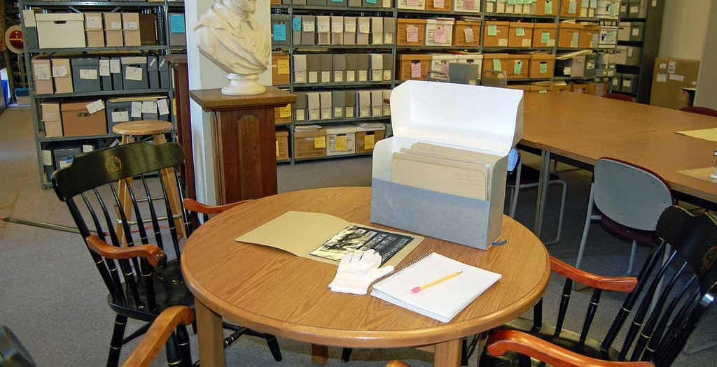
Recommendation
Focus less on service & more on sharing space & collaborative programming with groups both on & off campus
Value
of Academic Libraries
Notes:
Image: https://www.flickr.com/photos/ubarchives/4663516752/ by ubarchives / CC BY-NC-ND 2.0

Slide 34
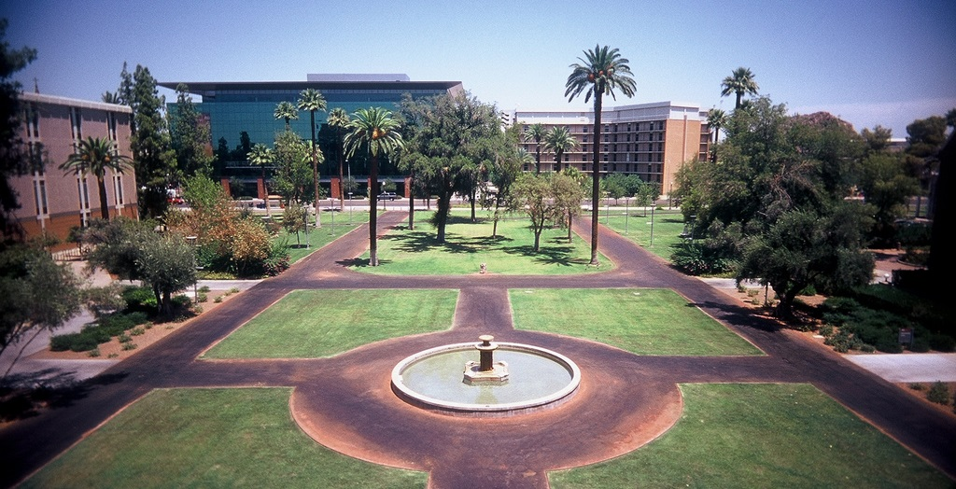
Recommendation
Bolster collaboration with other campus units or external partners, including consortia, on assessment-based efforts
Value
of Academic Libraries
Notes:
Slide 31: Image: https://www.flickr.com/photos/pagedooley/3887095398/ by Kevin Dooley / CC BY 2.0

Slide 35
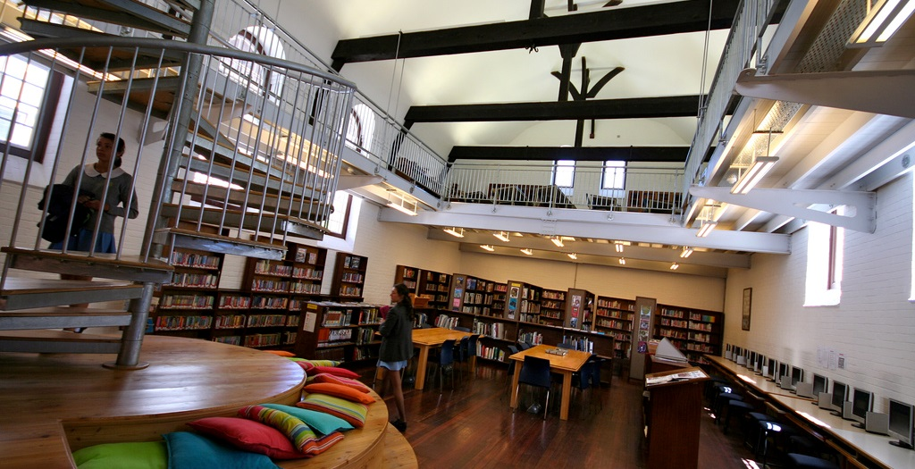
Recommendation
Communicate how library services, collections, and spaces address the larger mission of the institution by becoming better at marketing & customer service
Value
of Academic Libraries
Notes:
Image: https://www.flickr.com/photos/edublogger/5119742141/ by Ewan McIntosh / CC BY-NC 2.0
Strategically align the student success goals and metrics with the Chancellors’/Presidents’ institutional priorities on student success.

Slide 36
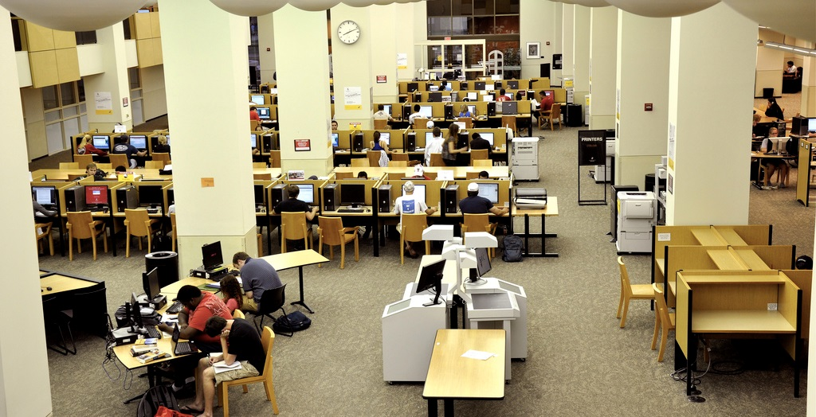
Recommendation
Study the assessment & student-centered outcomes of diverse populations across various institutions using multiple methods
Value
of Academic Libraries
Notes:
Image: https://www.flickr.com/photos/kimberlykv/4495272217/ by Kimberly Vardeman / CC BY 2.0

Slide 37
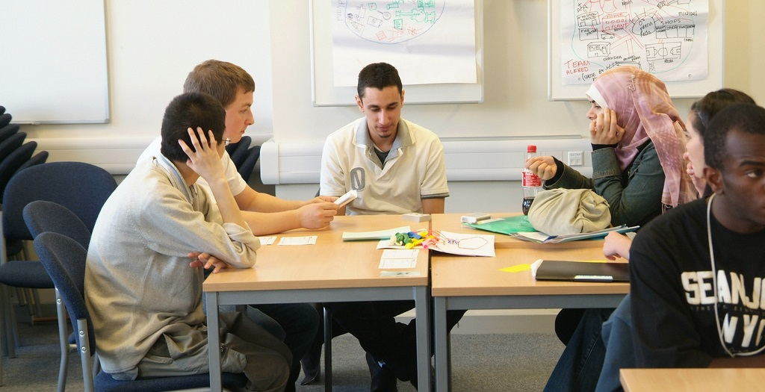
Recommendation
Continue to develop & foster relationships and engagement with academic administrators & other academic services, such as student services, offices of sponsored programs, teaching & learning, etc.
Value
of Academic Libraries
Notes:
Image: https://www.flickr.com/photos/goodimages/1448139556/ by Gianni / CC BY-NC-ND 2.0

Slide 38

Recommendation
Represent data in different contexts & visualizations
to make case with
diverse groups of
academic administrators
Value
of Academic Libraries
Notes:
Image: https://www.flickr.com/photos/skinnylawyer/6337956175/ by InSapphoWeTrust / CC BY-SA 2.0

Slide 39
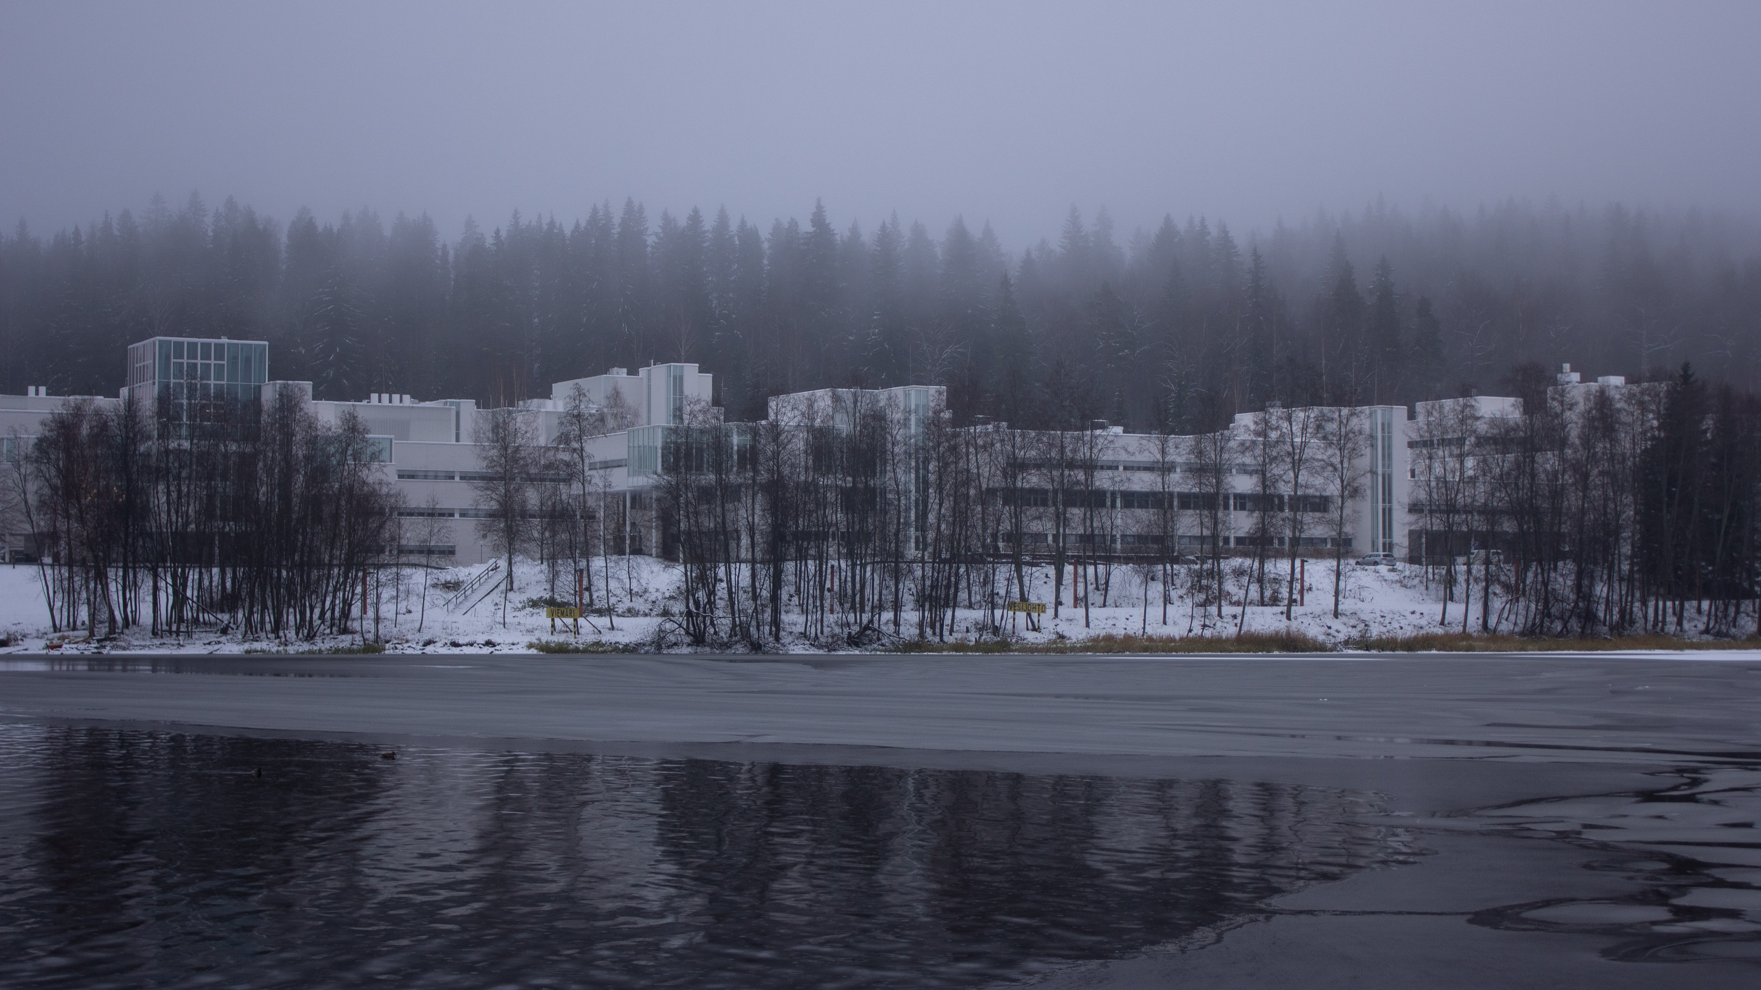
“I see that [libraries] play a role as a partner, facilitating both learning and doing in new and different ways, both helping all of us to embrace information in critical and yet meaningful ways.”
(Provost Interviewee PP03, Research University, Secular, Private)
Value
of Academic Libraries
Notes:
Photo by K8 on Unsplash
https://unsplash.com/photos/KcwT1AxrzbQ

Slide 40

“By focusing on relationship building instead of service excellence, organizations can uncover new needs and be in position to make a stronger impact.”
(Mathews, 2012)
Value
of Academic Libraries
Notes:
Image: https://www.flickr.com/photos/marcomagrini/698692268/
Mathews, Brian. 2012. Think Like a Startup: A White Paper to Inspire Library Entrepreneurialism. http://chronicle.com/blognetwork/theubiquitouslibrarian/2012/04/04/think-like-a-startup-a-white-paper/.

Slide 41

Discussion & Questions
Value
of Academic Libraries
Notes:
Image: https://www.flickr.com/photos/noarau/5540659743/ by Thomas Rusling / CC BY-NC-ND 2.0

