Slide 1
25 June 2021 * VIVO 2021 conference
Case Studies of US Research Information Management
Rebecca Bryant, PhD
Senior Program Officer,
OCLC Research Library Partnership
bryantr@oclc.org @RebeccaBryant18
https://orcid.org/0000-0002-2753-3881

Slide 2
We acknowledge and celebrate the Indigenous people on whose traditional land and airways we meet, and pay our respect to the elders past and present
If you are unsure whose land you are currently residing upon, we encourage you to visit native-land.ca
Notes:
We (speakers and attendees) are all in different places, and the technology we use similarly flows over and across a multitude of landscapes. We all express gratitude towards those who were here before us and seek to learn more in paying respects to and honoring these people and we invite you to join with us in reflection, knowledge seeking, and appreciation.

Slide 3
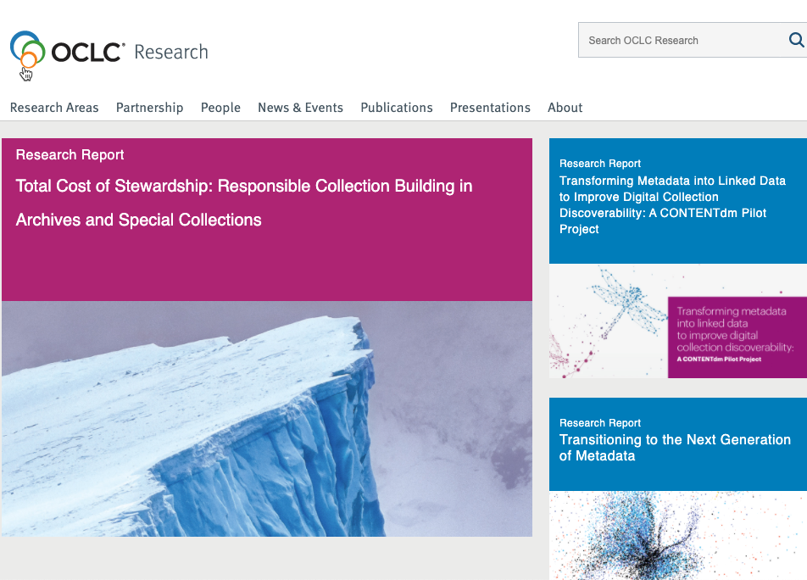
Devoted to challenges facing libraries and archives since 1978
Aims to scale and accelerate library learning, innovation, and collaboration
oc.lc/research
The OCLC Research Library Partnership supports collaboration and learning among a transnational group of research libraries
oc.lc/joinRLP
Notes:
OCLC Research concentrates its efforts on research devoted exclusively to the challenges that libraries, archives and museums face.
The OCLC Research Library Partnership includes some 130 research library partners who collaborate with other libraries and each other on research and related issues through working groups.

Slide 4
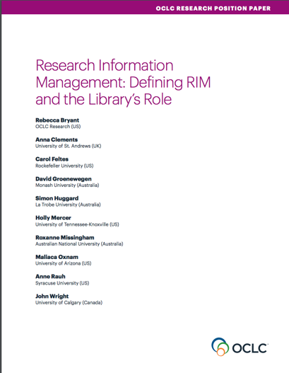
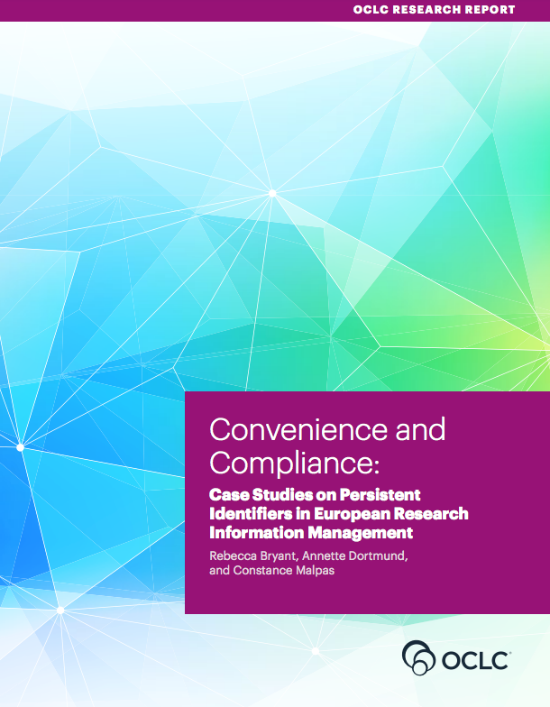
OCLC Research publications on Research Information Management
oc.lc/rim
Notes:
OCLC Research recognizes that libraries are playing a larger role in Research Information Management, and we want to better understand these trends so we can share information with the library community to inform decision making.

Slide 5
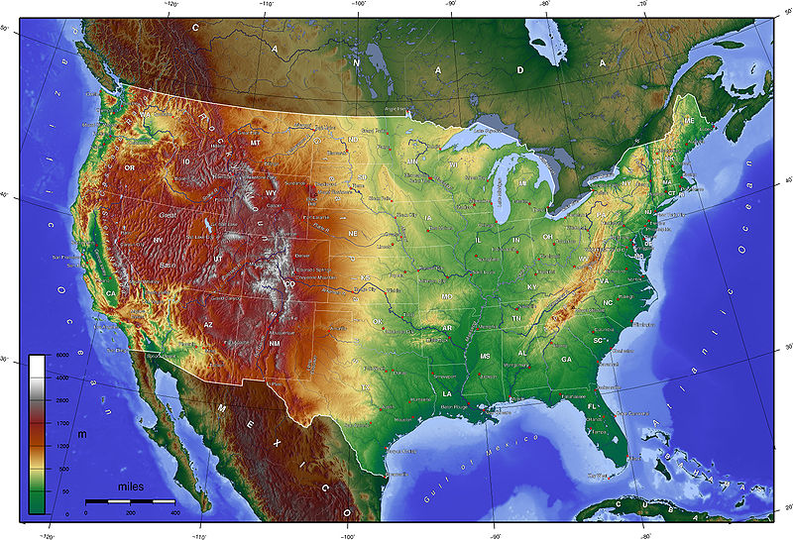
Research Information Management in the United States
Project Team
Pablo de Castro, euroCRIS & Strathclyde University
Jan Fransen, University of Minnesota
co-PI
Rebecca Bryant, PhD, OCLC Research
co-PI
Brenna Helmstutler, Syracuse University
David Scherer, Carnegie Mellon University
oc.lc/us-rim-project

Slide 6
Project goals
Examine & document the the breadth and depth of RIM practices at case study institutions in the United States
Synthesize practices, documenting
Use cases
A RIM system framework
Pain points
Offer recommendations to institutions
oc.lc/us-rim-project

Slide 7
Project overview
Scope
Methodology
Outputs
5 US research universities with a diversity of:
RIM use cases
Products
Scale & scope
Stakeholders
Case study approach
Semi-structured interviews with 39 individuals at 7 institutions
Forthcoming OCLC Research report (expected September 2021)
Webinars, blogs, & conference presentations

Slide 8
RIM Systems support. . .
These might be called:
Researcher Profile System
Expert Finder System
Research Information System (RIS)
Research Networking System (RNS)
Faculty Activity Reporting (FAR) system
Faculty Information System (FIS)
Current Research Information System (CRIS) (if used, not used in the same way as in Europe)
The transparent aggregation, curation, and utilization of quality metadata about institutional research activities
oc.lc/rim
Notes:
Transparency is important, as stated in the Leiden Manifesto on research metrics. https://www.nature.com/news/bibliometrics-the-leiden-manifesto-for-research-metrics-1.17351 , which states:
4) Keep data collection and analytical processes open, transparent and simple. The construction of the databases required for evaluation should follow clearly stated rules, set before the research has been completed. This was common practice among the academic and commercial groups that built bibliometric evaluation methodology over several decades. Those groups referenced protocols published in the peer-reviewed literature. This transparency enabled scrutiny. For example, in 2010, public debate on the technical properties of an important indicator used by one of our groups (the Centre for Science and Technology Studies at Leiden University in the Netherlands) led to a revision in the calculation of this indicator⁶. Recent commercial entrants should be held to the same standards; no one should accept a black-box evaluation machine.

Slide 9
RIM
Faculty Activity Reporting
HR/Academic Affairs sectors to support workflows
Home grown
CRIS systems
Publishing sector
New entrant, with institutional repository at the core
Library sector
Open source, seeded by NIH to catalyze team science
Public portals
Notes:
Home by Lagot Design from the Noun Project

Slide 10
Use CASES

Slide 11
Six Primary US RIM Use Cases
 | Texas A&M | Penn State | Virginia Tech | UCLA | Miami
Faculty Activity Reporting (FAR) | decentralized | ✔ | ✔ | ✔ | decentralized
Public Portal | ✔ | ✔ | in progress | ✔ | ✔
Open Access Workflow |  | ✔ | ✔ | ✔
Strategic Reporting & Decision Support | ✔ | ✔ | ✔ | ✔
Metadata Reuse |  | ✔ | ✔ | ✔
Compliance Monitoring |  |  |  | ✔

Slide 12
RIM Use Cases at Case Study Institutions
 | Texas A&M | Penn State | Virginia Tech | UCLA | Miami
Faculty Activity Reporting (FAR) | decentralized | ✔ | ✔ | ✔ | decentralized
Public Portal | ✔ | ✔ | Launching soon | ✔ | ✔
Open Access Workflow |  | ✔ | planned | ✔
Strategic Reporting & Decision Support | ✔ | ✔ | ✔ | ✔ | ✔
Metadata Reuse |  | ✔ | ✔ | ✔ | planned
Compliance Monitoring |  |  |  | ✔

Slide 13
Products in use
 | Texas A&M | Penn State | Virginia Tech | UCLA | Miami
Faculty Activity Reporting (FAR) | Moving to institutional implementation of Interfolio | Digital Measures | Elements | Home grown / Interfolio | Multiple products across colleges
Public Portal | VIVO | Pure | Elements Discovery module | Profiles RNS | Pure, transitioning to Esploro
Open Access Workflow |  | Home grown | Elements | Elements
Strategic Reporting & Decision Support | MySQL (with Elements as metadata harvester) | SciVal, Home grown | Elements & home grown Data Commons | Home grown | Pure, SciVal
Metadata Reuse |  | ✔ | ✔ | ✔
Compliance Monitoring |  |  |  | Elements

Slide 14
CASE STUDIES

Slide 15
Virginia Tech

Slide 16
About Virginia Tech
Public research university
Enrollment:
~30,000 undergraduates
>7,000 graduate & professional students

Slide 17
Virginia Tech—key facts
Relies primarily on Elements
Metadata harvester
Data store
FAR workflow
Public portal (Discovery module), in development
Administrative responsibility is shared
Office for Faculty Affairs (Provost’s office)
Libraries
Office of Analytics & Institutional Effectiveness
University DataCommons
Ingests Elements data/combines with other institutional data
Supports Incentive-Based Budget planning/tracking
Data governance leadership for campus
Home grown

Slide 18
Virginia Tech Use Cases
Faculty Activity Reporting | ✔
Public Portal: Expertise Discovery & Research Showcase | Launching soon
Open Access Workflow | Planned
Strategic Reporting & Decision Support | ✔
Metadata Reuse | ✔
Compliance Monitoring
Notes:
Faculty Activity Reporting: Provide a database of information that could be used to complete faculty annual reports and generate related documents, including promotion and tenure dossier materials and college or program-level accreditation reports.
Metadata reuse: Maintain a comprehensive database of Virginia Tech faculty scholarship, accounting for different disciplines and types of scholarly products. The University DataCommons provides that database, with control over how and what information is entered as well as how the data are collected, used, and (if necessary) migrated to a future system.
Strategic reporting and decision support: Specifically, support the PIBB budget model. The RIM system populated by Elements and embodied by the UDC assists colleges in goal setting.
Public portal - research showcase: The new Elements Discovery portal, branded Virginia Tech Experts, will provide a public website.
Open access workflow: While Virginia Tech had not approved a campus-wide open access policy as of this writing, faculty members can now deposit open access versions of their publications in VTechWorks directly from Elements. If Virginia Tech later chooses to implement a communication/workflow to encourage OA deposits, it can do so through Elements.

Slide 19
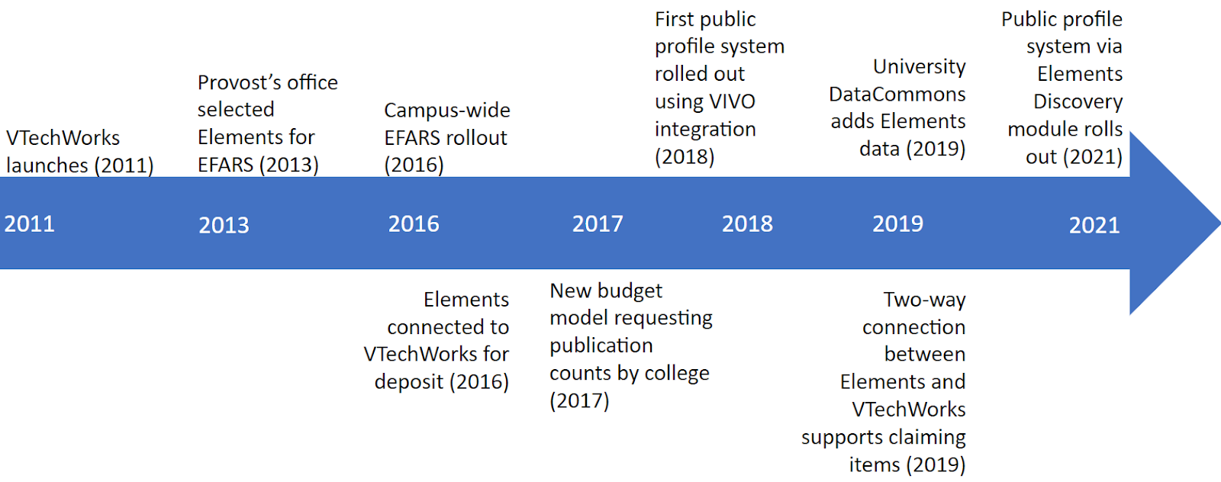

Slide 20
UCLA

Slide 21
About UCLA
University of California, Los Angeles (UCLA)
Public research institution
Enrollment: 31,000 undergraduate students & 13,000 postgraduate students in >300 degree programs
One of 10 campuses of the University of California System
University of California (system)
Largest higher education system in the US
Comprised by 10 research universities, including UCLA
In total, >250,000 students, 22,000 faculty members, 150,000 staff
The California Digital Library (CDL) serves as a central library hub to support UC-wide efforts

Slide 22
UCLA—3 distinct systems
Opus & Interfolio:
Home grown system aggregating faculty information, coupled with
UC Publication Management System (UCPMS)
Supports institutional OA policy for 22,000 faculty and thousands of other researchers
Elements for metadata harvesting
UCLA Profiles
Profiles RNS
1,000+ public profiles of biomedical researchers
Interfolio systems for tenure/promotion & annual reviews
Managed by California Digital Library
Managed by UCLA personnel office
Managed by Clinical & Translational Science Institutes at UCLA and UCSF
Home grown

Slide 23
RIM Use Cases at UCLA
 | UCLA
Faculty Activity Reporting (FAR) | ✔ | Opus & Interfolio systems on UCLA campus
Public Portal | ✔ | UCLA Profiles includes only biomedical researchers. Supported by UCSF
Open Access Workflow | ✔ | UC Publication Management System notifies researchers of publications eligible for OA deposit
Strategic Reporting & Decision Support | ✔ | Opus & UCPMS
Metadata Reuse | ✔ | Opus data is reused in many systems, including UCLA Profiles
Compliance Monitoring | ✔ | Discrete uses to manage compliance with federal grant requirements, thru UCPMS.

Slide 24
Simplified timeline for UCLA
UC launches OA policy for faculty (2013)
OA policy expanded to include all UC researchers (2015)
CDL begins licensing Symplectic Elements (Dec 2013)
UC PMS roll out begins across all UC campuses, including UCLA and still ongoing today (2021)
2010
2011
2012
2013
2014
2015
2016
2017
2018
2019
2020
2021
Opus development begins (2013)
Opus database developed (2016)
Interfolio roll out, also expanding to include annual reviews
UCLA licenses Interfolio RPT (2016)
Entire campus now using Interfolio RPT (2020)
UCSF Profiles launched (2010)
Expansion of biomedical profiles to other UC campuses (2017-)
UCLA Profiles launched (2020)

Slide 25
Conclusions

Slide 26
Recommendation for US RIM Community
Move beyond the use case
Recognize RIM Systems as a single, umbrella product category

Slide 27
Recommendations for Institutional Leaders
Metadata quality matters
Work across campus
Institutional investment is crucial
Don’t scrimp on dedicated staff
Persistent Identifiers (PIDs) are essential
DOIs, ORCIDs, RORs, RAIDs, etc.
Support a future of "enter once, reuse often"
ETL processes are hard everywhere
Array of skills needed
Technical
Metadata
Project management
Communications
If you are planning for only 1 use case, you are thinking too small
Research information is an institutional asset
Publications metadata is a university asset
It should be included in campus wide data governance efforts
Must be complete, transparent if used for reporting
Libraries have an important role

Slide 28
References
Bryant, Rebecca, Annette Dortmund, and Brian Lavoie. 2020. Social Interoperability in Research Support: Cross-Campus Partnerships and the University Research Enterprise. Dublin, OH: OCLC Research. https://doi.org/10.25333/wyrd-n586
Bryant, Rebecca, Anna Clements, Pablo de Castro, Joanne Cantrell, Annette Dortmund, Jan Fransen, Peggy Gallagher, and Michele Mennielli. 2018. Practices and Patterns in Research Information Management: Findings from a Global Survey. Dublin, OH: OCLC Research. https://doi.org/10.25333/BGFG-D241
Bryant, Rebecca, Annette Dortmund, and Constance Malpas. 2017. Convenience and Compliance: Case Studies on Persistent Identifiers in European Research Information. Dublin, Ohio: OCLC Research. doi:10.25333/C32K7M
Bryant, Rebecca, Anna Clements, Carol Feltes, David Groenewegen, Simon Huggard, Holly Mercer, Roxanne Missingham, Maliaca Oxnam, Anne Rauh and John Wright. 2017. Research Information Management: Defining RIM and the Library’s Role. Dublin, OH: OCLC Research. doi:10.25333/C3NK88
de Castro, Pablo. 2014. 7 things you should know about Institutional Repositories, CRIS Systems, and their Interoperability. COAR blog, 6 October 2014. https://www.coar-repositories.org/news-updates/7-things-you-should-know-aboutirs/

