Slide 1
Digital Pedagogy Certificate Program
Brandeis University

Slide 2
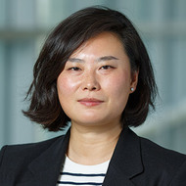
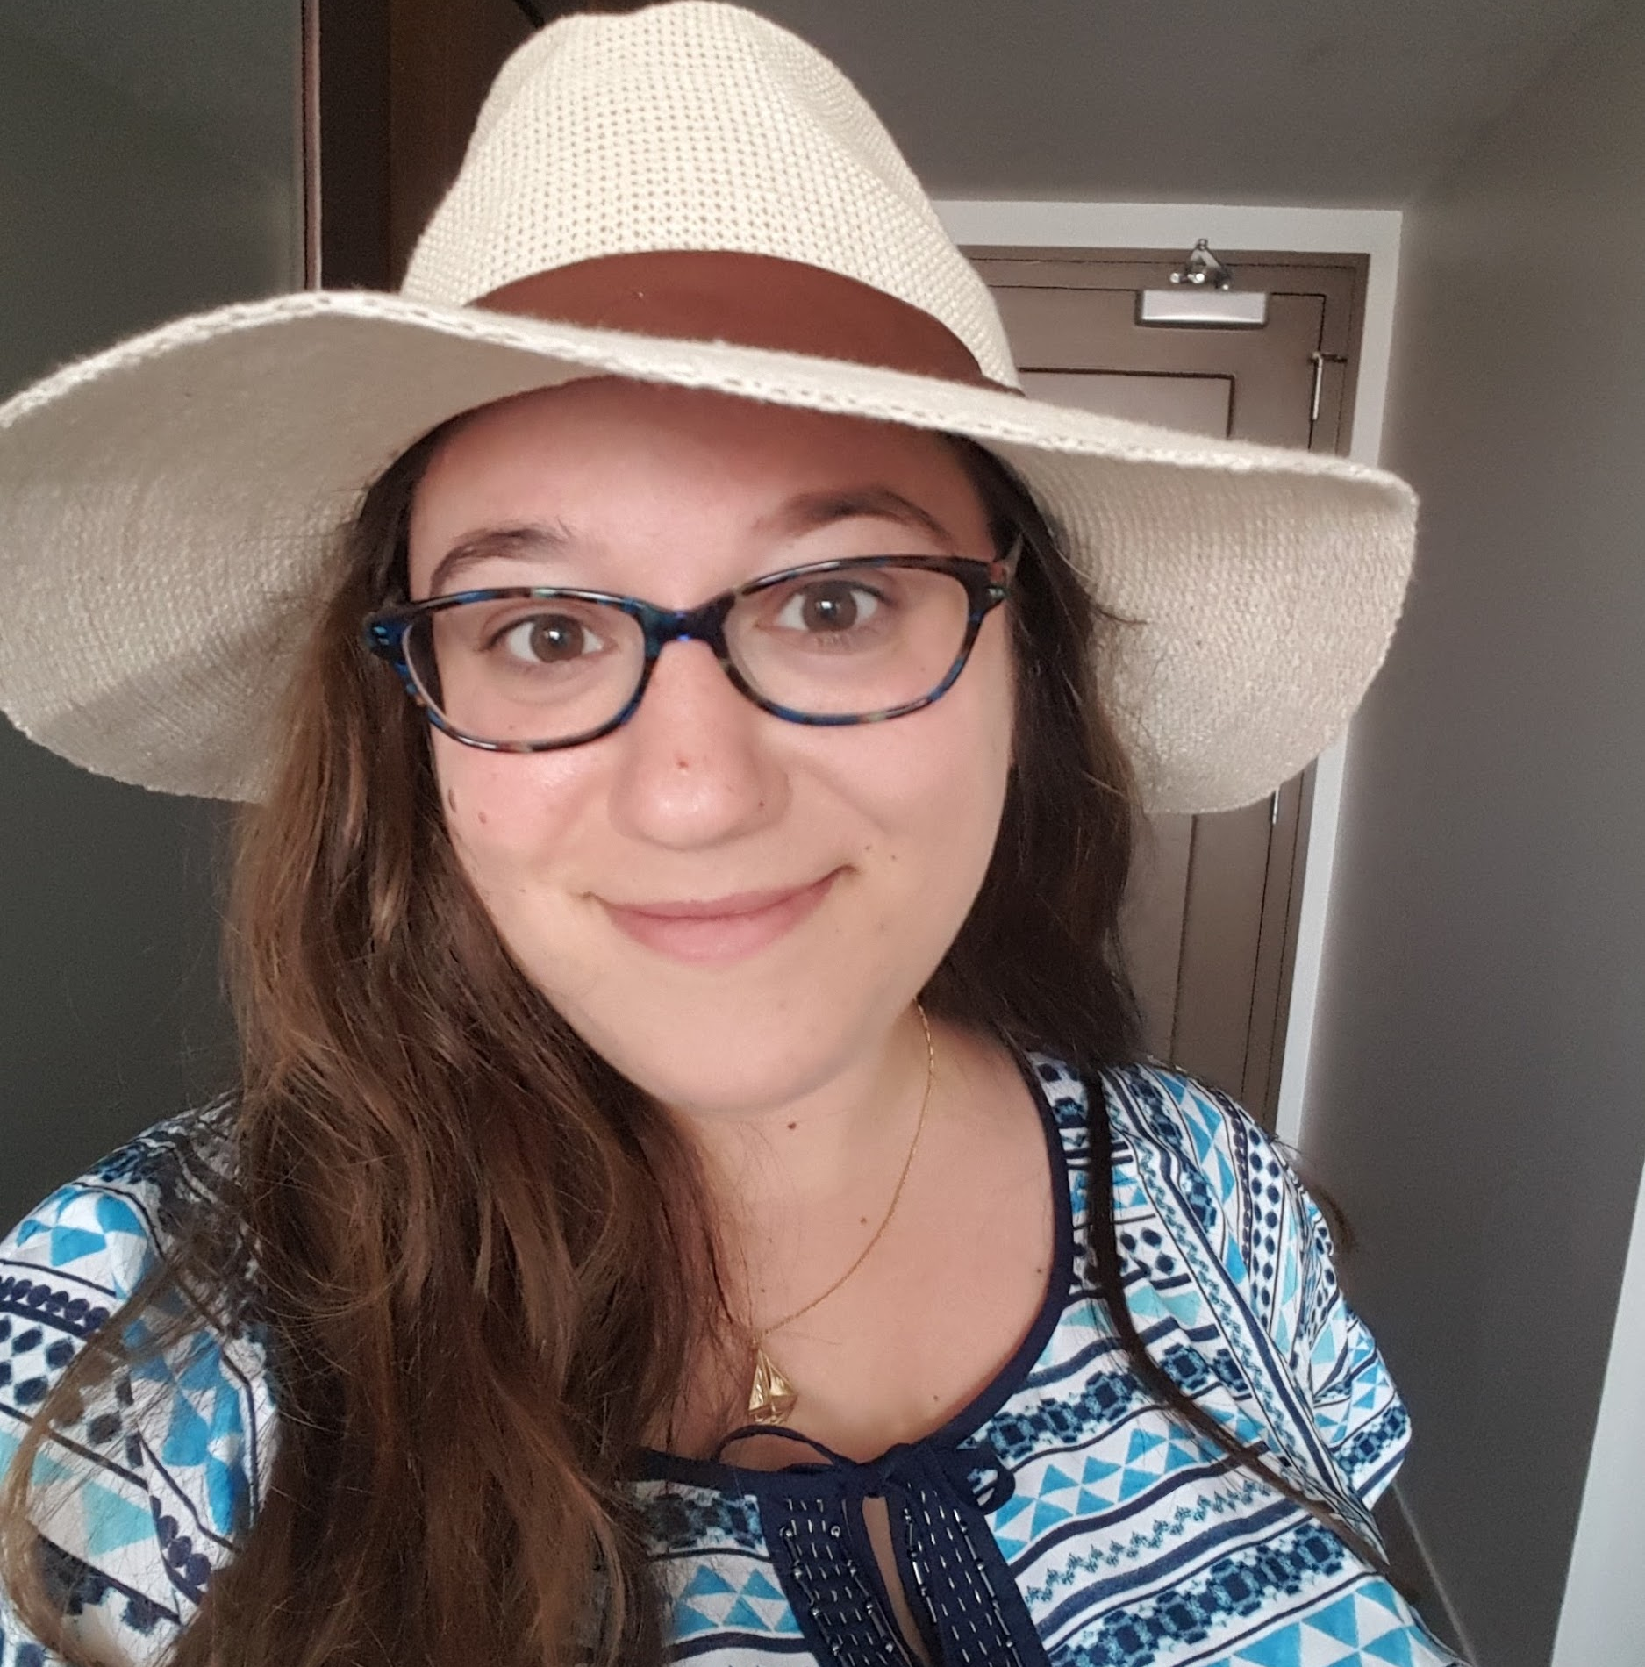
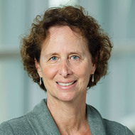
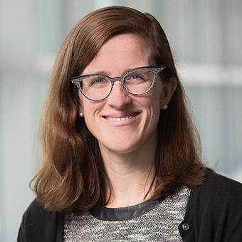
Welcome!
Bofang Li, Faculty Adviser, University Writing Center and Senior Lecturer
Esther Brandon, Digital Literacy Specialist
Lisa Rourke, Director, First-Year Writing
Laura Hibbler, Associate University Librarian for Research and Instruction

Slide 3
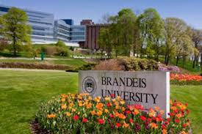
About Brandeis and the Teaching Innovation Grant
Brandeis University:
R1 located in Waltham, MA
17 doctoral programs; more than 50 master’s and non-degree programs
Student population:
5800 total (3600 undergraduates; 2200 graduates)
42% of graduate students are from an international background
Provost’s Teaching Innovation Grant
Annual grants to promote excellence and innovation in teaching
The grant allowed us the opportunity to work across disciplines and departments
We applied!

Slide 4
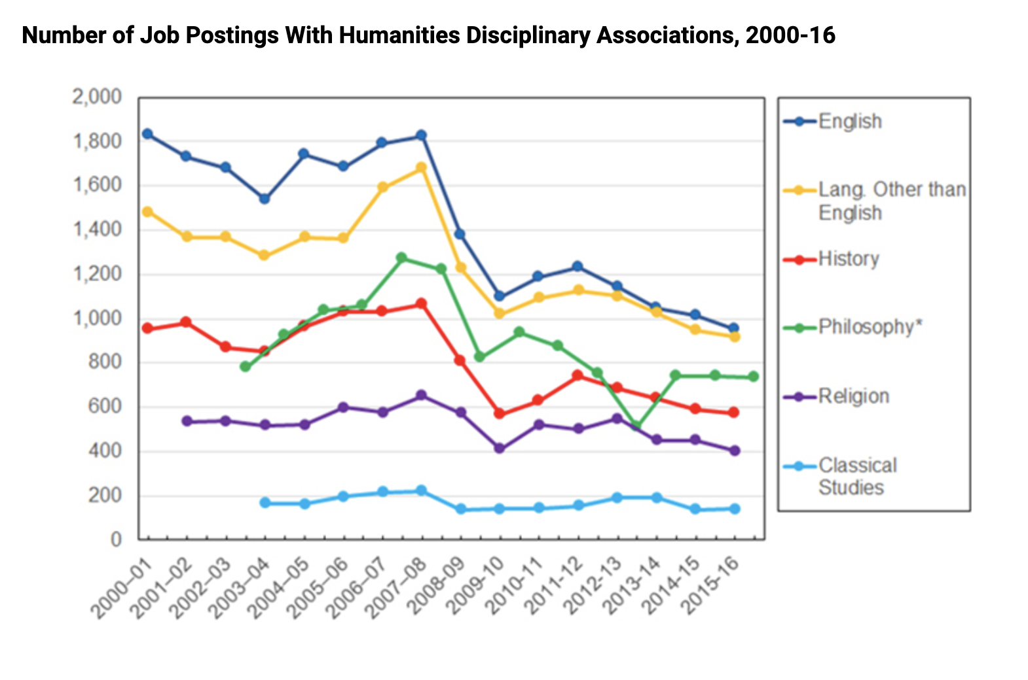
Impetus for the Digital Pedagogy Certificate Program
State of the academic job market for humanities
In 2015-16, 1000 History PhDs awarded
Under 600 tenure-track jobs
Digital Humanities one of the few growing fields; call for digital skills more and more common in job ads
Benefits of inter and cross disciplinary research and teaching
Need for professionalization beyond the academy
Existence of the “digital skills gap” in the workforce in general
Inside Higher Ed

Slide 5
Building a Team for Success
The following partners at Brandeis collaborated on this project:
Brandeis University Writing Program
Graduate School of Arts & Sciences
Library colleagues, including our Data Analysis Specialist
Instructional Designers
Campus partners are an essential part of success of a program like this. They play key roles in:
Workshop promotion
Share information about the workshop series
Identify potential attendees who have expressed interest in expanding their teaching skills
Development of workshop content
Identified topics that are of most interest to our students

Slide 6
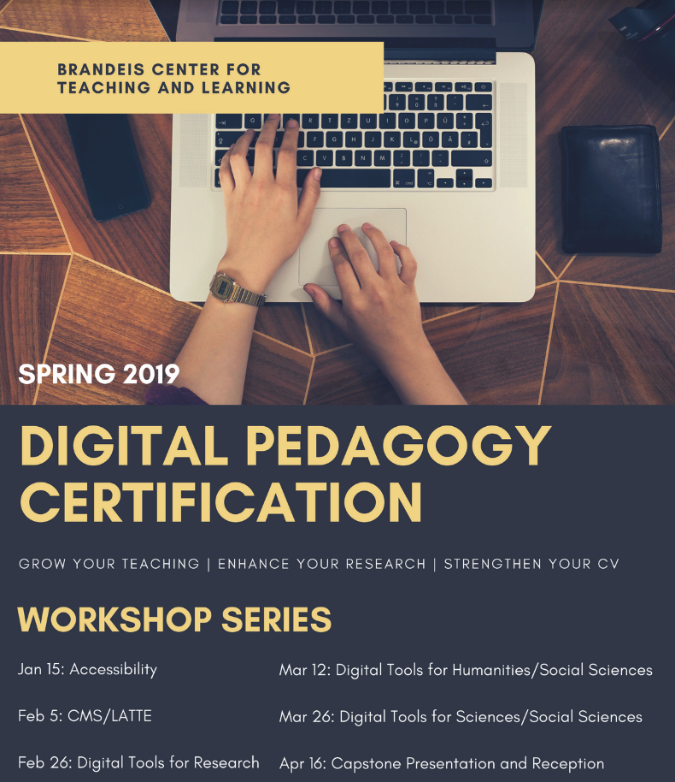
Recruitment and Selecting a Cohort
We received 27 applications each year.
Our participants included students from the following departments:
Ancient Greek and Roman Studies
Anthropology
Biology
English
History
Math
Near Eastern and Judaic Studies
Psychology
Politics
Russian
Sociology

Slide 7
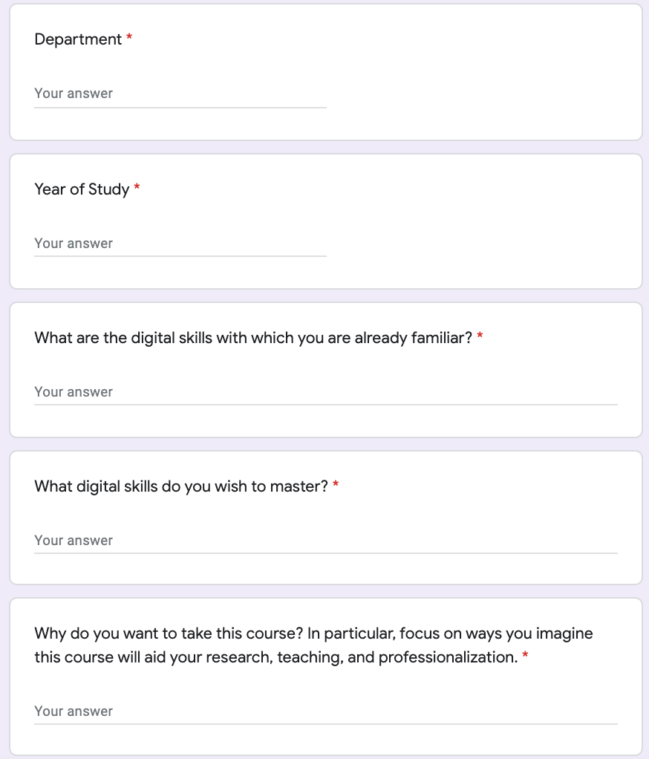
Application Process
Tool
Google Form
Application questions
Range of departments
Year of study
Familiarity with digital tools
Synergy with skills desired
Impact of the program on the student’s work

Slide 8
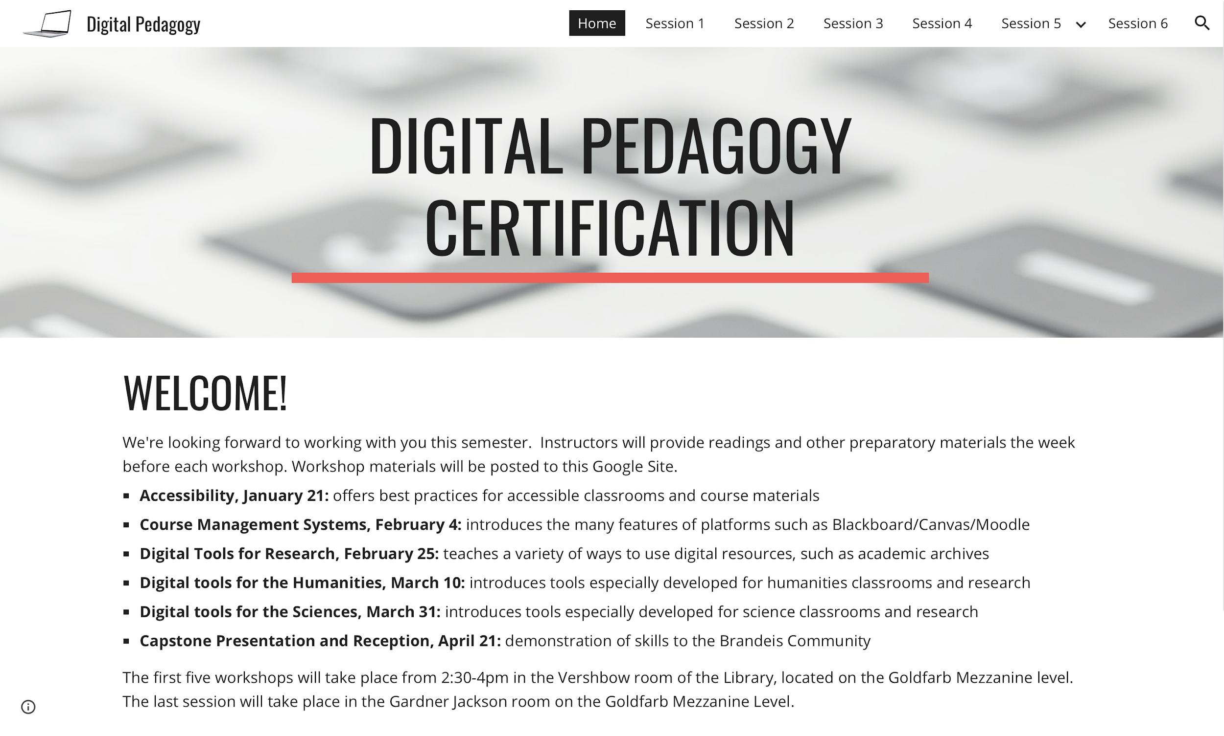
Logistics
Program
Six 90 minute workshops
instruction + group work
Choose 5/6 workshops
Curriculum
Experts from around campus
LMS Course
Space
In person: Classroom with collaborative stations and monitors
Remote: Zoom with breakout rooms
Communication
Google Group
Google Site as LMS

Slide 9
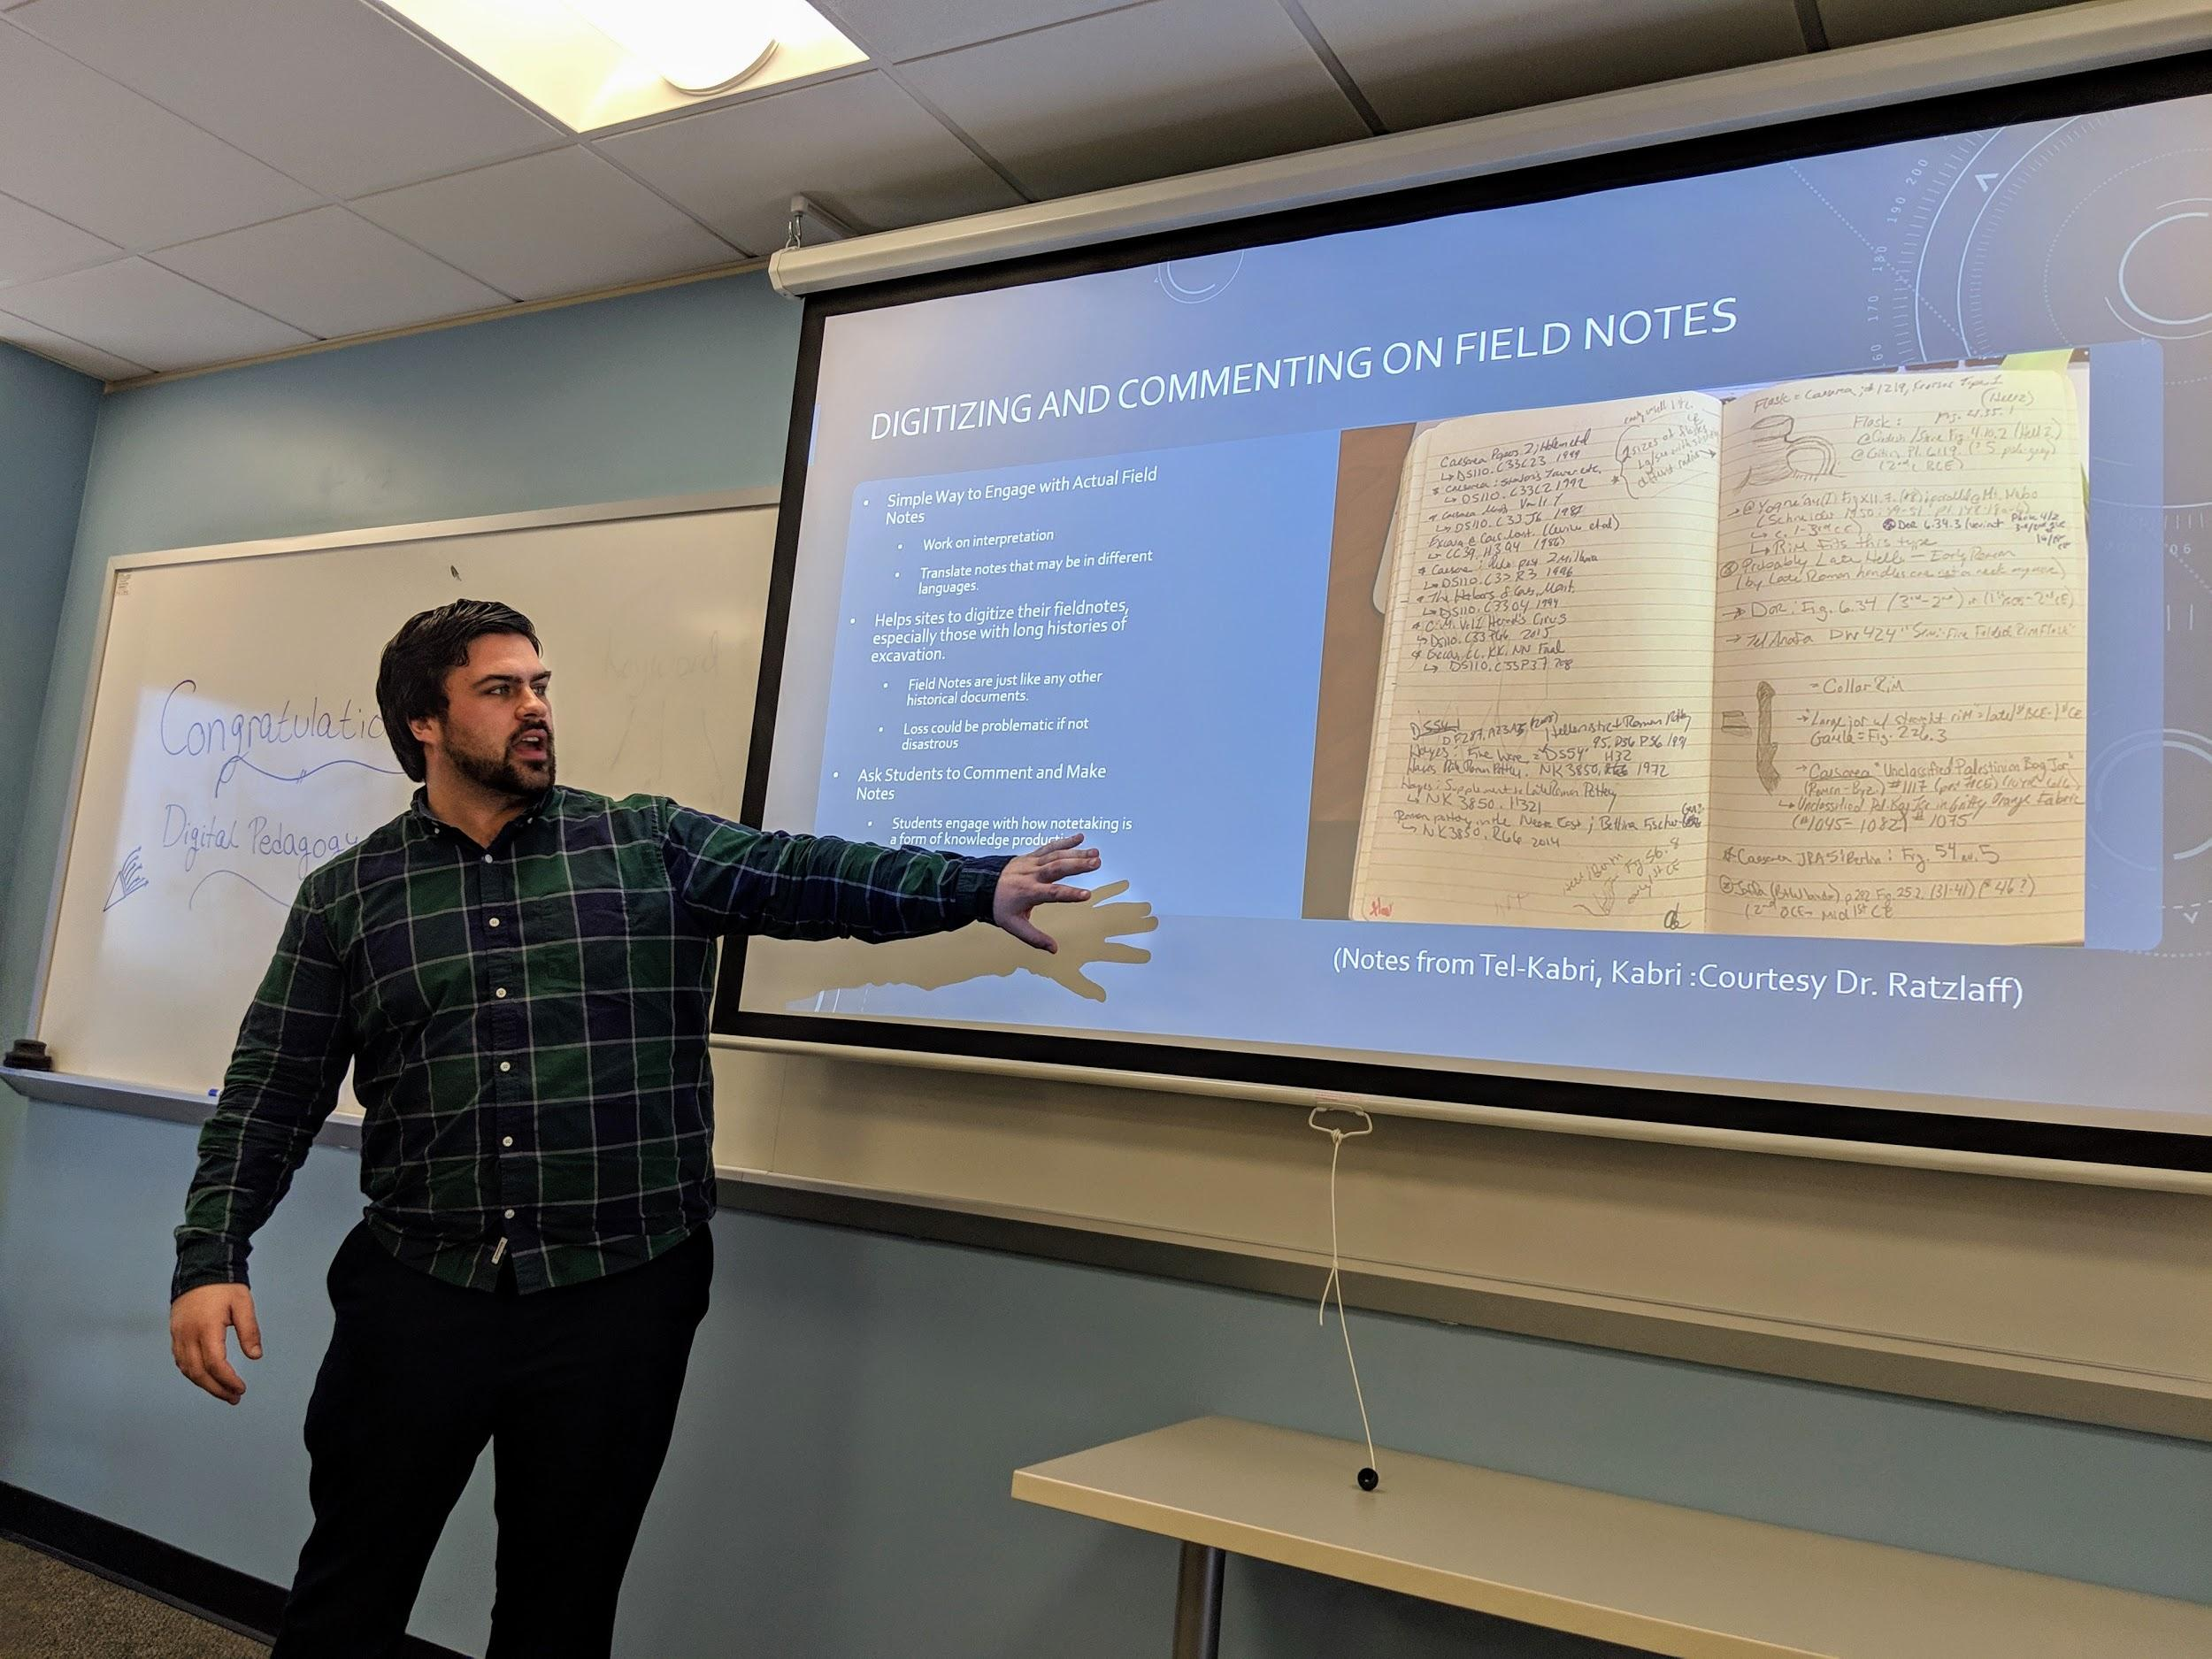
Designing the Program
Workshop Series Topics
Accessibility
Course Management Systems
Digital Tools for Research
Digital Tools for the Humanities
Digital Tools for the Sciences
Capstone Presentations

Slide 10
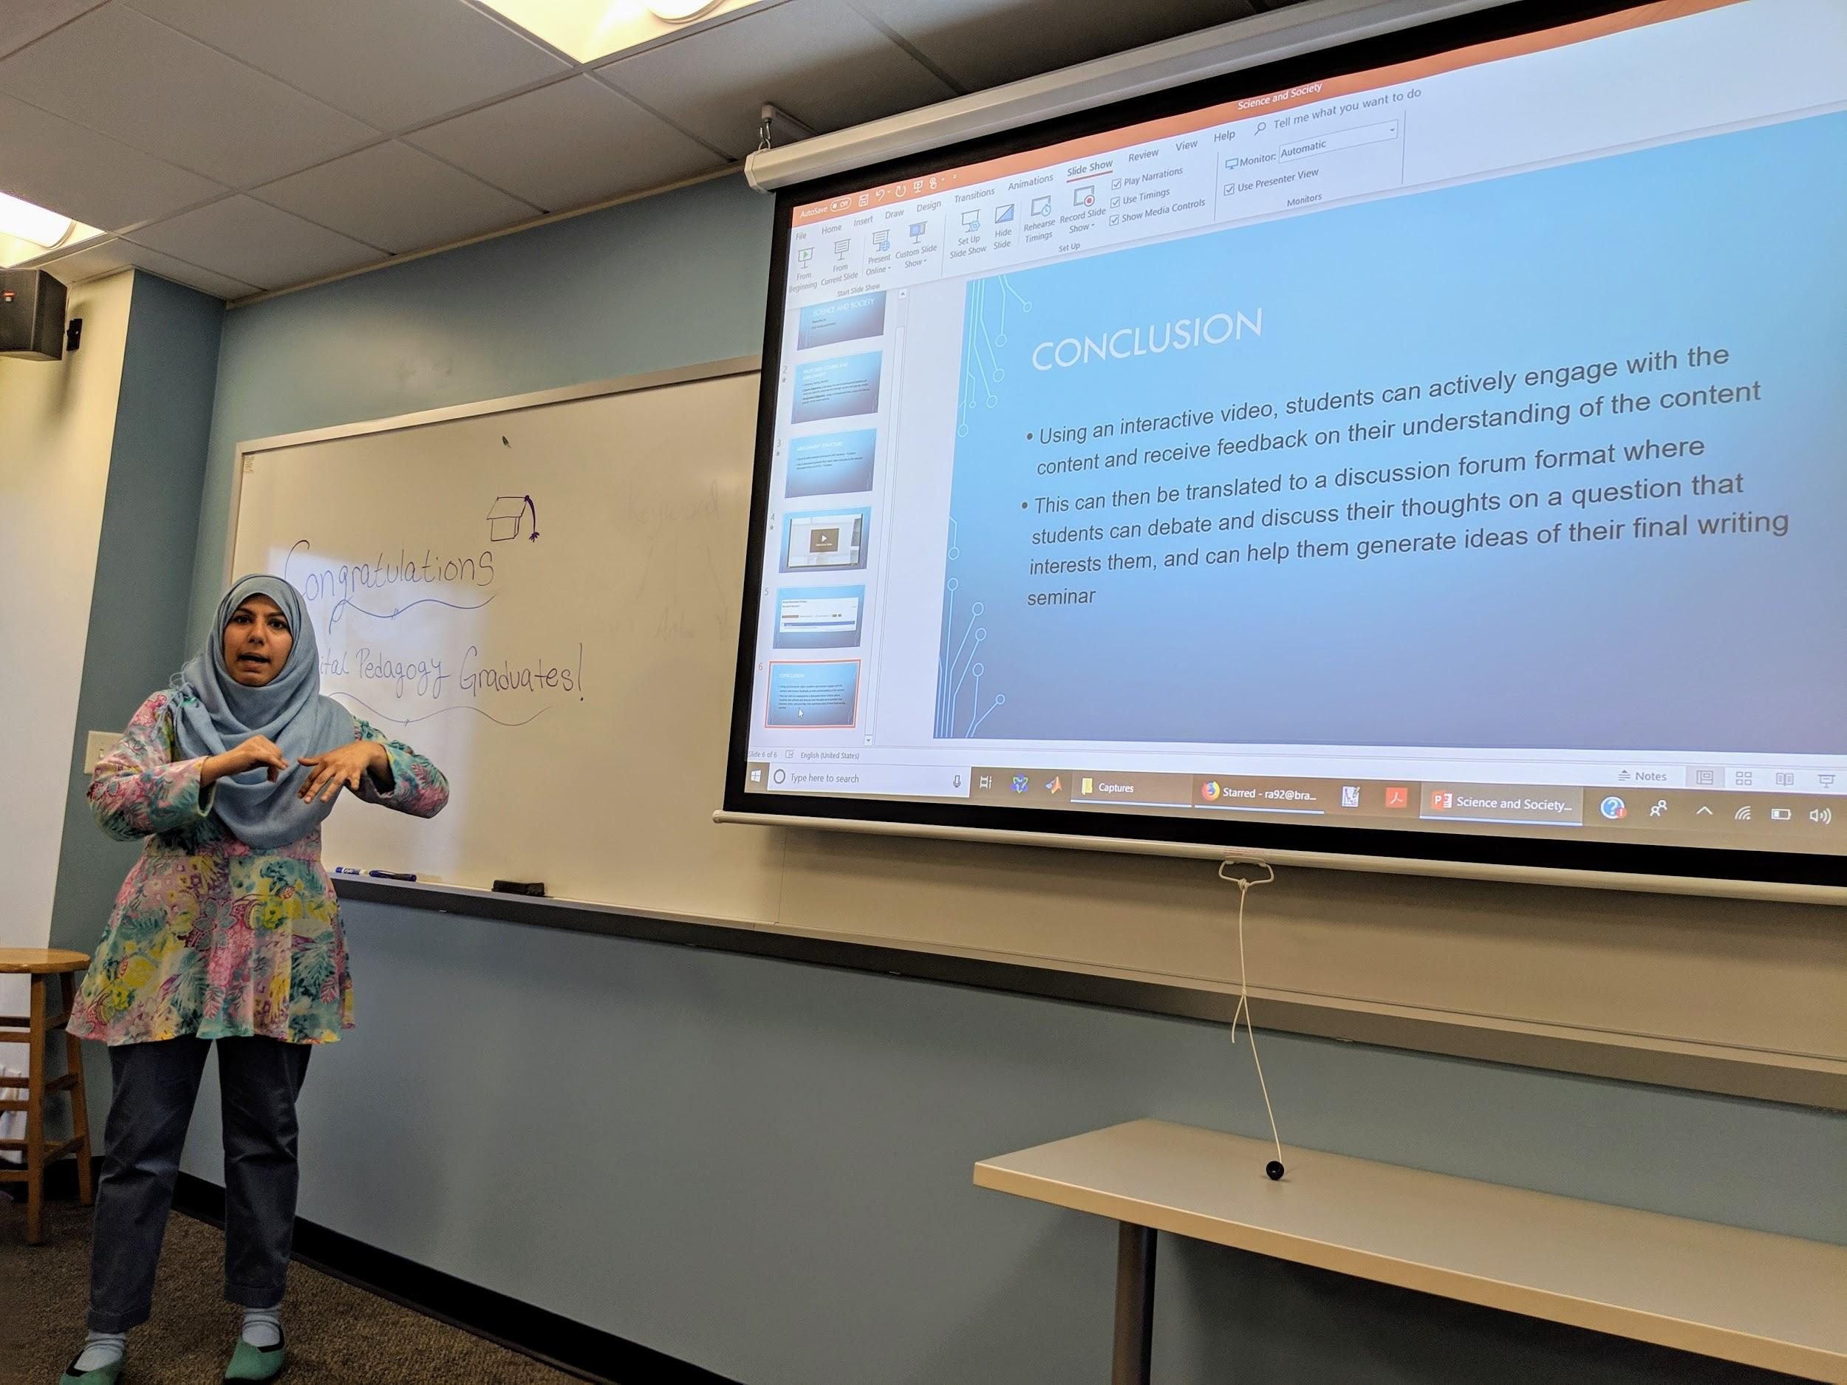
Capstone Presentations: Celebrate Success!
“The interactive nature of the sessions were great!”
“I liked sharing class ideas and practical uses.”
“Thank you so much for allowing me to be a part of this wonderful opportunity.”

Slide 11
Impact on Academic Community
Reached departments across campus--eleven different departments have had graduate students participate.
By expanding the pedagogical skills of graduate students, the program has had a positive impact on the experiences over 300 undergraduates who were in classes taught or TA-ed by these graduate students.
Impact during the abrupt shift to online learning during Spring 2020
The program has been so successful that it’s now permanently funded by the Graduate School of Arts and Sciences

Slide 12
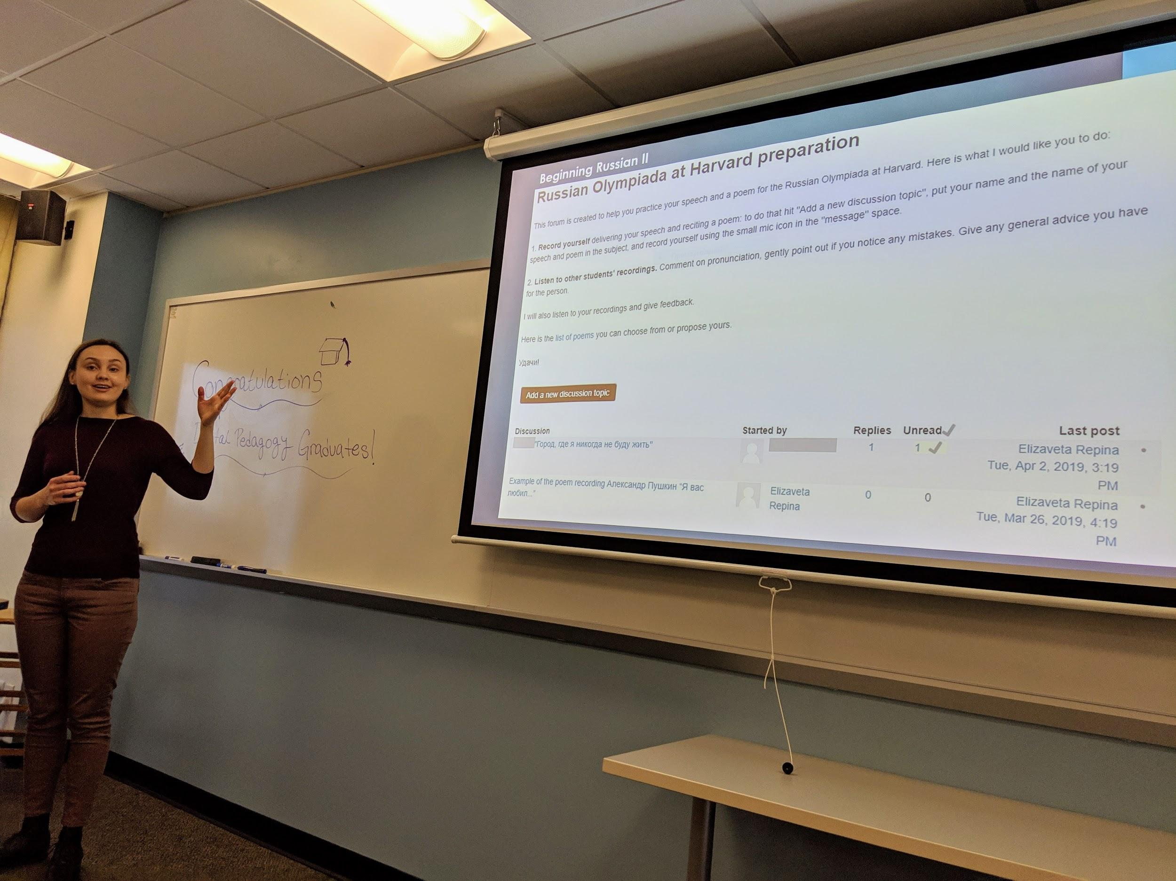
Feedback from Participants
“I have found useful tools and new ways of looking at teaching.”
“...ways in which the tools and tools like them can be used; thinking about methodology and finding tools to suit your needs rather than vice versa.”
"Thanks to my experiences in the Digital Pedagogy workshop, I'm serving on an {name of online teaching committee at the college where he’s now teaching}. It's been an interesting experience so far!"

Slide 13
Tips for Starting a Similar Program at Your Own School
Collaborate with campus partners.
Involve a diversity of scholarship and departments.
Think through logistics.
Focus on learning goals, not the technology.
Create engaging workshop sessions.
Relate workshops to the methods of teaching graduate students are already doing.
Build in room for experimentation.
Maintain flexibility.
Celebrate accomplishments.

Slide 14
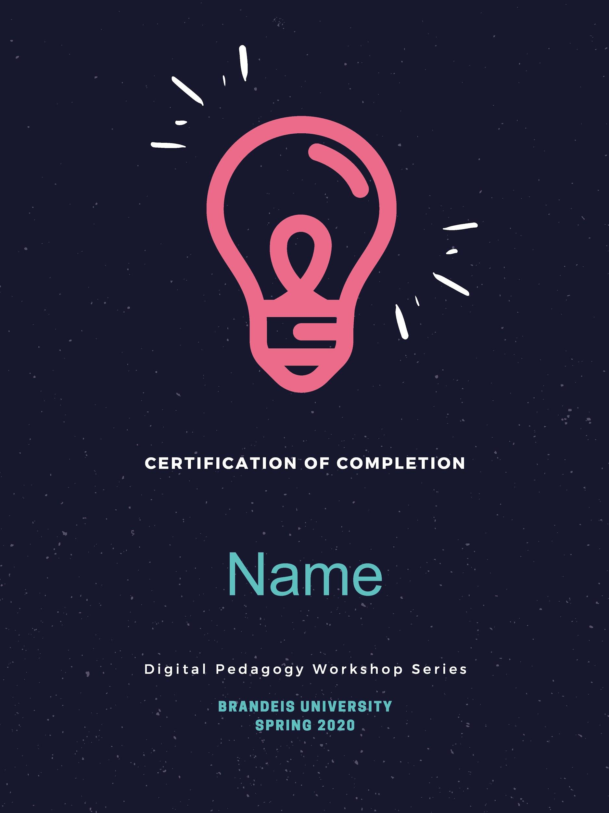
Questions?

