Slide 1
Works in Progress Webinar | 20 April 2021
Total Cost of Stewardship:
Responsible Collection Building in Archives & Special Collections
Chela Scott Weber and Carrie Hintz
RLP Collection Building and Operational Impacts Working Group

Slide 2
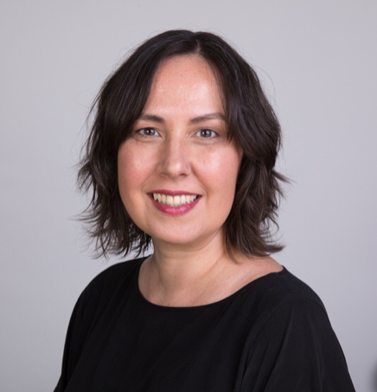
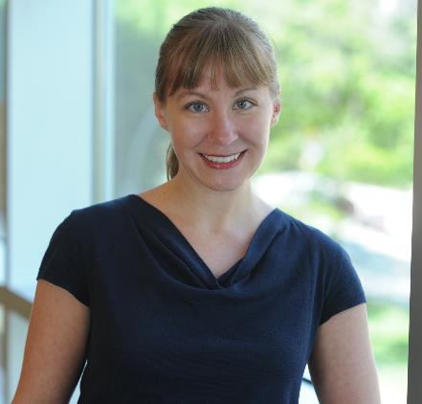
Chela Scott Weber
Sr. Program Officer, OCLC Research Library Partnership
Carrie Hintz
Associate Director, Rose Library, Emory University

Slide 3
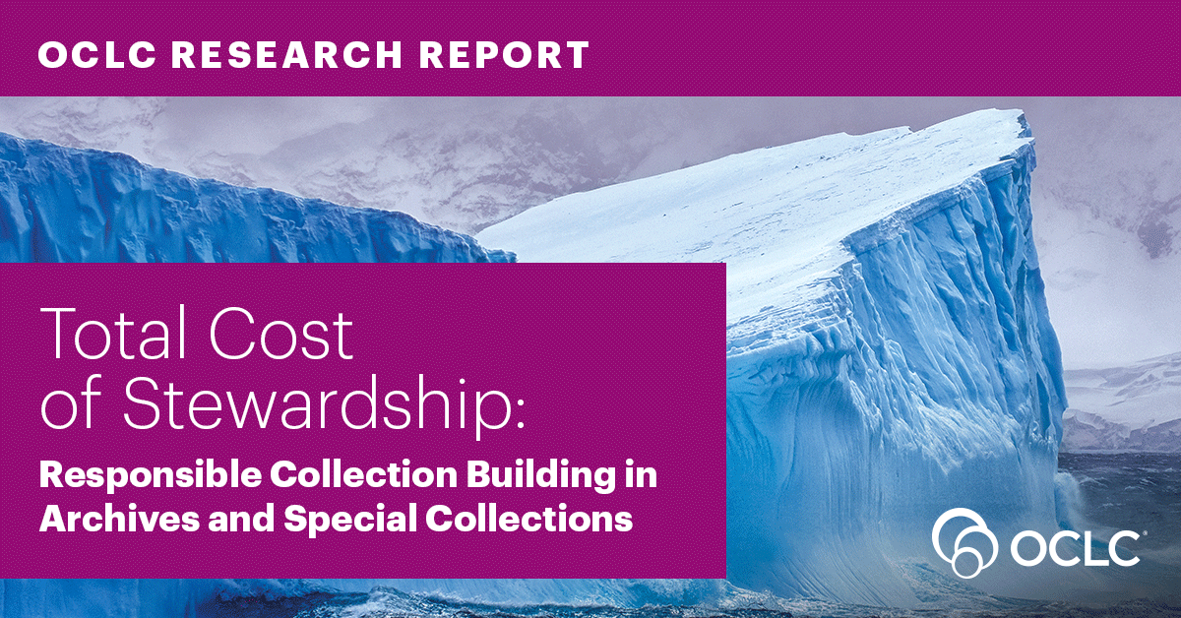

Slide 4
Total Cost of Stewardship
Developed by the OCLC RLP Collection Building and Operational Impacts Working Group
Body of materials include:
  OCLC Research report: Total Cost of Stewardship: Responsible Collection Building in Archives and Special Collections
  Annotated bibliography of related resources
  Total Cost of Stewardship Tool Suite: a set of Communication Tools, Cost Estimation Tools, and a Manual to guide end users in implementing the Tool Suite.
Notes:
Developed by the OCLC Research Library Partnership’s (RLP) Collection Building and Operational Impacts Working Group, Total Cost of Stewardship is a framework that proposes a holistic approach to understanding the resources needed to responsibly acquire and steward archives and special collections. The Total Cost of Stewardship Framework responds to the ongoing challenge of descriptive backlogs in archives and special collections by connecting collection development decisions with stewardship responsibilities.
This OCLC Research report is a collection of resources designed to support archives and special collections in making informed, shared collection building decisions; bring together collection management and collection development considerations; and support communication between colleagues in curatorial, administrative, and technical services roles.
The collection of materials published includes:
An OCLC Research report: Total Cost of Stewardship: Responsible Collection Building in Archives and Special Collections
An annotated bibliography of related resources
The Total Cost of Stewardship Tool Suite, comprising of a set of Communication Tools, Cost Estimation Tools, and a Manual to guide end users in implementing the Tool Suite.

Slide 5
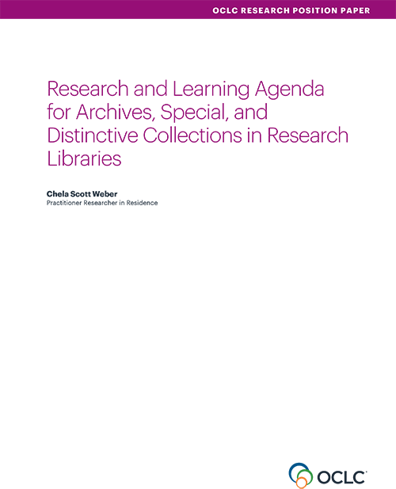
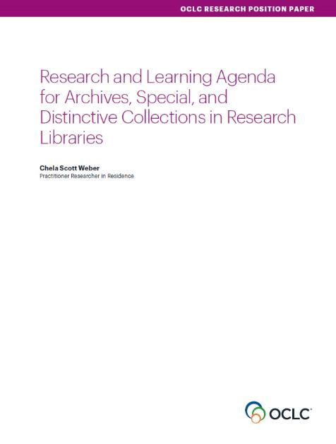
Our Work in Archives, Special, and
Distinctive Collections:
oc.lc/rlp-agenda

Slide 6
Collection Building & Operational Impact
Working Group Members
Matthew Beacom
Yale University
Heather Briston
UCLA
Martha Conway
University of Michigan
Gordon Daines
Brigham Young University
Andra Darlington
Getty Research Institute
Audra Eagle Yun
University of California Irvine
Ed Galloway
University of Pittsburgh
Carrie Hintz
Emory University
Jasmine Jones
UCLA
Brigette Kamsler
George Washington University
Mary Kidd
New York Public Library
Sue Luftschein
University of Southern California
Nicholas Martin
New York University
Erik Moore
University of Minnesota
Susan Pyzynski
Harvard University
Andrea Riley
NARA
Gioia Stevens
New York University
Chela Scott Weber
OCLC

Slide 7



Slide 8
Working Group Goals
explore the intersections between current collecting and collection management practices
seek ways to better integrate collection management considerations into the collection development process
bring together colleagues across these important, interdependent functions
Notes:
Working Group Goals
explore the intersections between current collecting and collection management practices
seek ways to better integrate collection management considerations into the collection development process
bring together colleagues across these important, interdependent functions

Slide 9
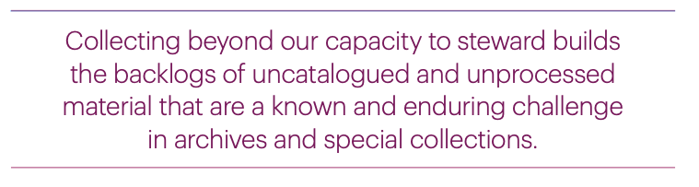

Slide 10
Total Cost of Stewardship:
All of the costs associated with building, managing, and caring for collections so that they can be used by and useful to the public.

Slide 11
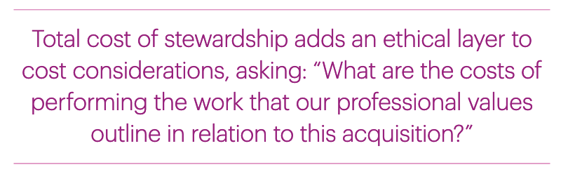

Slide 14
Total Cost of Stewardship Tool Suite
Communication Tools
Cost & Capacity Estimation Tools

Slide 17
Collection Development Policy
Collecting mandate or mission of institution
Background or history of the collection
User communities the repository serves
Scope of collection - strengths, areas of focus, current priorities, gaps, limitations
Statement of what you don’t collect
Methods of acquisition (gift, purchase, transfer, etc.)
Who is authorized to make collecting decisions

Slide 19
Quick Cost Estimator
Estimates time for archives and special collections processing and cataloging
Built using widely accepted models for time estimation in archives and special collections
Can be used flexibly and iteratively
Supports decision making and communication related to collection acquisitions

Slide 20
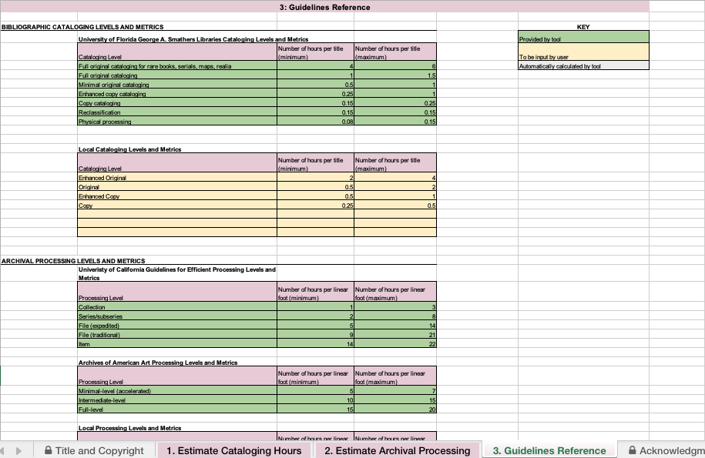
Quick Cost Estimator:
Time
Estimation
Models

Slide 21
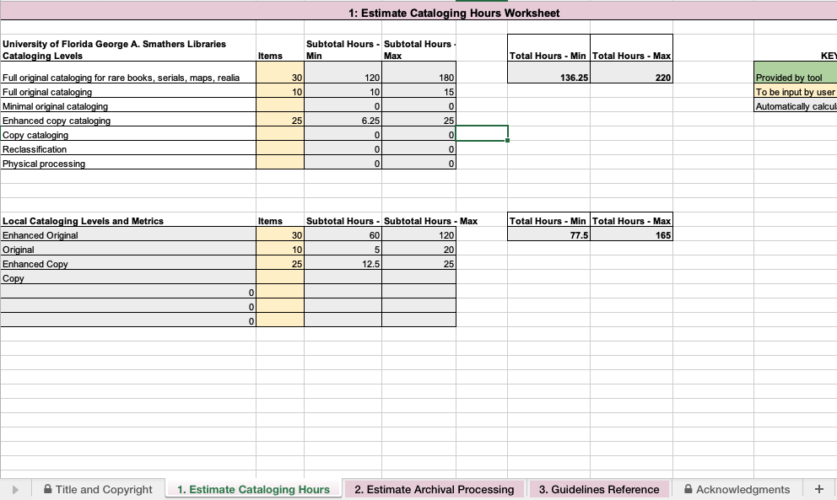
Quick Cost Estimator:
Cataloging
Estimates

Slide 22
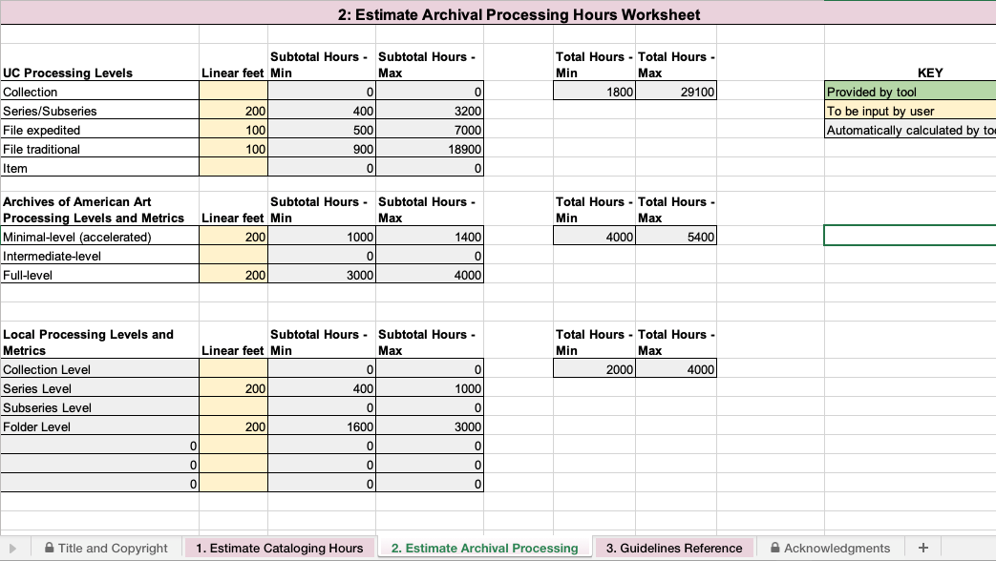
Quick Cost Estimator:
Processing
Estimates

Slide 23
Operational Impact Estimator
Lays out institutional staffing and budgetary capacity for collection stewardship activities
Estimates the work required to steward a specific collection
Compares collection needs and institutional capacity
Supports decision making and communication related to collection acquisitions

Slide 24
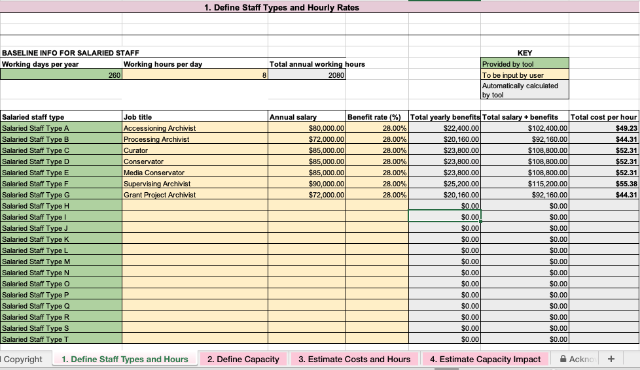
Operational Impact Estimator:
Define
Staffing
Notes:
Allows you to lay out the staff roles and associated salaries for everyone who works on collection management activities

Slide 25
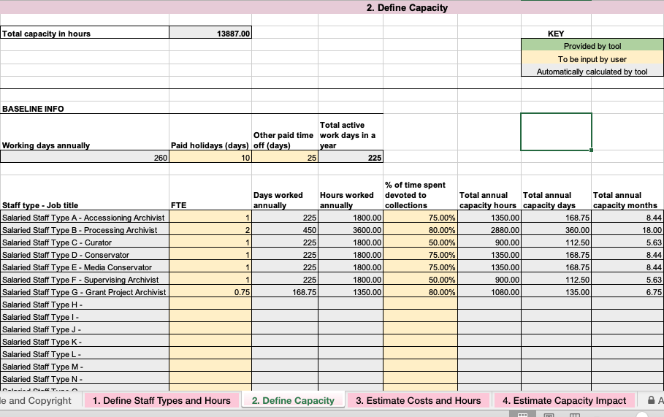
Operational Impact Estimator:
Define
Staff Capacity
Notes:
And then define the percentage of time those positions allocate to collection management activities

Slide 26
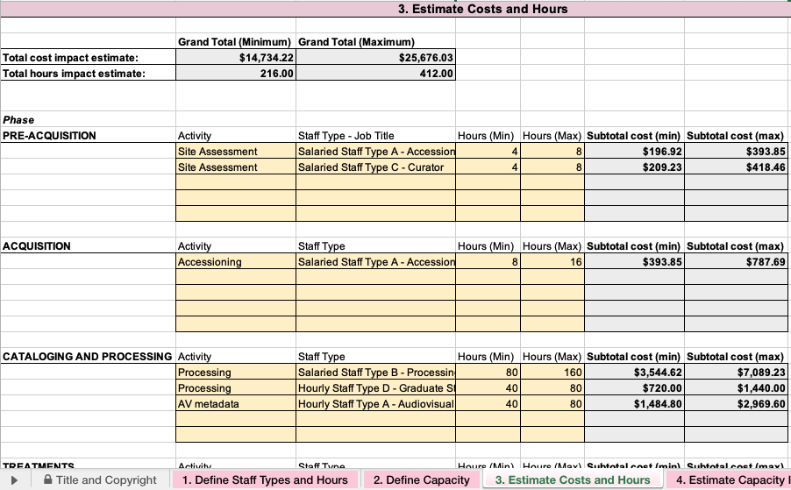
Operational Impact Estimator:
Estimate
Costs
Notes:
Then walk through the collection lifecycle from pre-acquisition through to ongoing stewardship, to estimate likely necessary activities and the time they will take

Slide 27
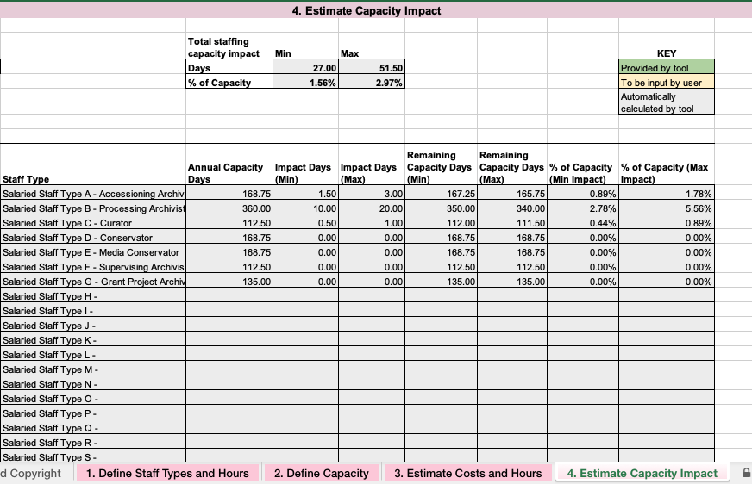
Operational Impact Estimator:
Estimate
Capacity
Impact
Notes:
And the tool then takes all of that data and shows you how that potential acquisition would impact your annual capacity to do this kind of work

Slide 29
Operational Impact Report
Collection overview – scope, size, formats, current condition
Collection assessment and needs – anticipated conservation, cataloging, or processing needs
Assessment of institutional capacity
Costs of acquisition and stewardship
Potential risks
Overall impact assessment

Slide 31
Acquisition Proposal
Alignment with collecting priorities
Assessment of value
Collection History
Overview of collection content and condition
Rights and restriction information
Operational Impact Report or other outline of costs
Assessment and Recommendations

Slide 32
Processing Plan
Administrative information
Collection overview and analysis
Processing evaluation – format, condition, restriction, and appraisal needs
Processing work plan – arrangement and description, who will do what, supplies
Work summary – appraisal decisions, changes from the plan, stakeholder comments

Slide 33
Digitization Project Assessment
Project overview – material, scope, audience, sponsor
Research and value analysis – alignment with priorities, research value, rights and restrictions on access
Project needs & work analysis – technical, physical, and descriptive needs, institutional capacity, timeline and cost
Assessment and recommendations

Slide 34
Putting the Tool Suite to Work for You
Designed to enact framework and compliment each other
Broadly applicable and flexible
Accompanying usage guides and examples
Customizable
Use to create new or review existing documents
Can be used iteratively

Slide 35

What’s Next
Tutorial Videos
Office Hours May 6, 11, 12
Twitter Chat May 20th #oclc_tcos
RBMS Conference June 2021
DCDC Conference July 2021
SAA Conference July 2021

Slide 36
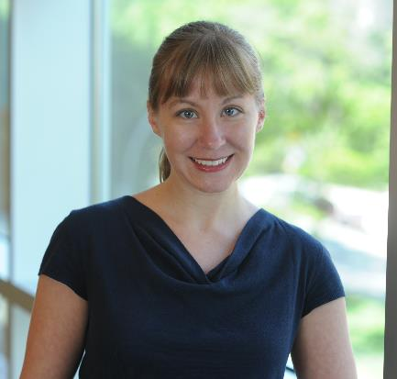
Communication Tools in Action: Case Study from the Rose Library, Emory University
Carrie Hintz
Associate Director
Rose Library

Slide 37



About me
Curator
Head of Collection
Services
Administrator

Slide 38









About the Rose
25 Staff Members
5 Major Collecting Areas
Occupy space on 6 different floors of the main library building
Preservation and Digitization are separate units that serve 12 campus libraries

Slide 39
Total cost of stewardship infographic
“Total cost of stewardship framework” by OCLC Research, from Total Cost of Stewardship: Responsible Collection Building in Archives and Special Collections
(https://doi.org/10.25333/zbh0-a044), CC BY 4.0

Slide 40


Total cost of stewardship infographic
Total cost of stewardship framework” by OCLC Research, from Total Cost of Stewardship: Responsible Collection Building in Archives and Special Collections
(https://doi.org/10.25333/zbh0-a044), CC BY 4.0

Slide 41


Building Blocks in Place
“One Pager”
CURATOR’S
GROUP

Slide 42




New Workflow
Information
Gathering
Conversation
Operational
Impact Statement
Potential
Acquisition
Report
Collection
Strategies
Group

Slide 43
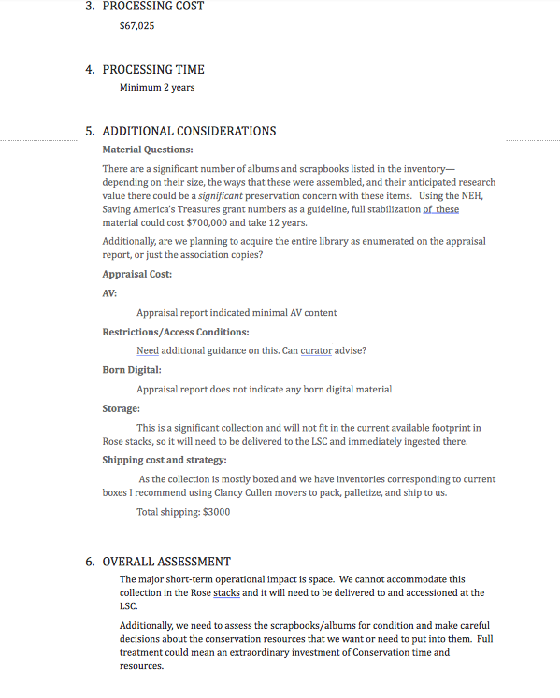
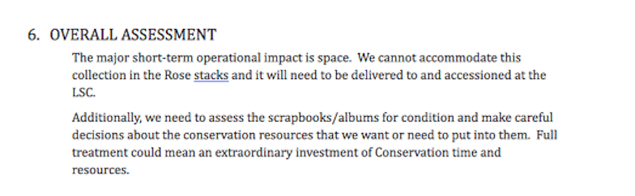
Operational Impact Report

Slide 44
More Conversations!

Slide 45
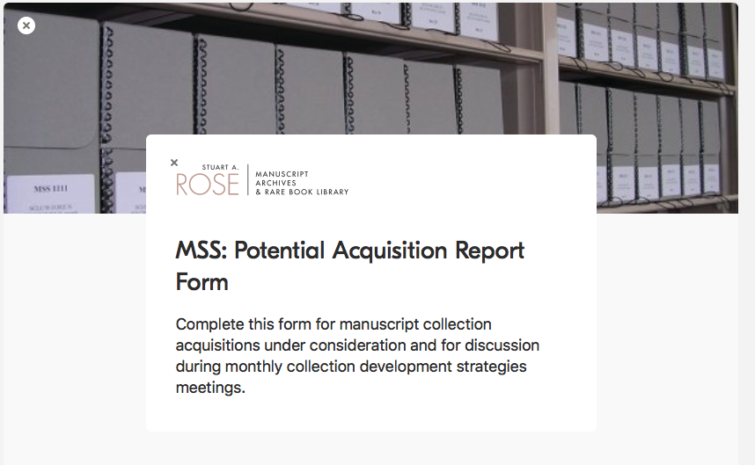
Potential acquisition report webform

Slide 46
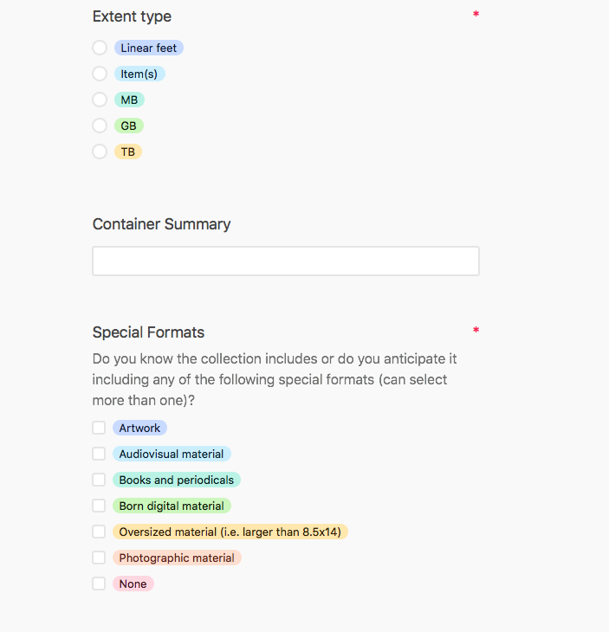
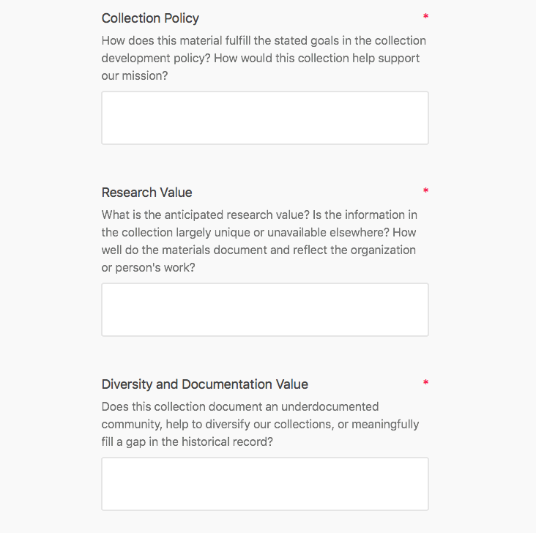
Screenshot of potential acquisition form webform

Slide 47
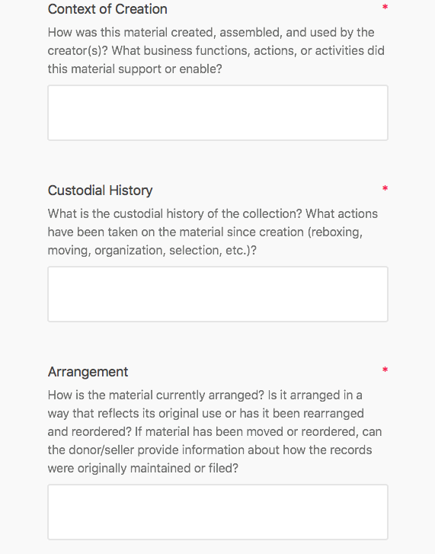
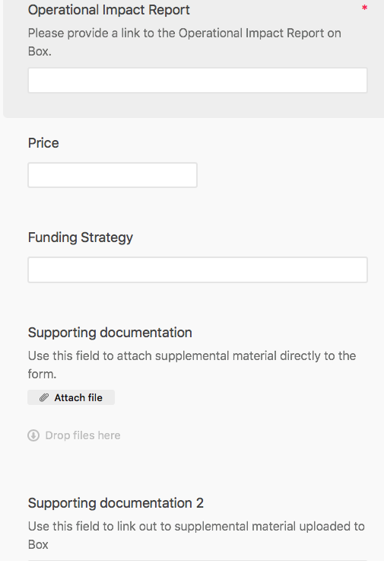

Screenshot of potential acquisition form webform

Slide 48
Initial Takeaways
Communication
And Advocacy
Decision
Making
Trust
Workflow management

Slide 49




Communication, Advocacy, and Information Needs
Research
Value
Cost to Process
Or Promote
Context of
Creation and Use
Payment Terms
Size

Slide 50
Initial Takeaways
Communication
And advocacy
Decision
Making
Trust
Workflow management

Slide 51
Decision Making
Prioritize
Plan
Collaborate

Slide 52
Initial Takeaways
Communication
And advocacy
Decision
Making
Trust
Workflow management

Slide 53
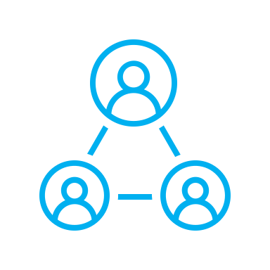
Trust and Transparency

Slide 54
Initial Takeaways
Communication and advocacy
Decision making
Trust
Workflow management

Slide 55
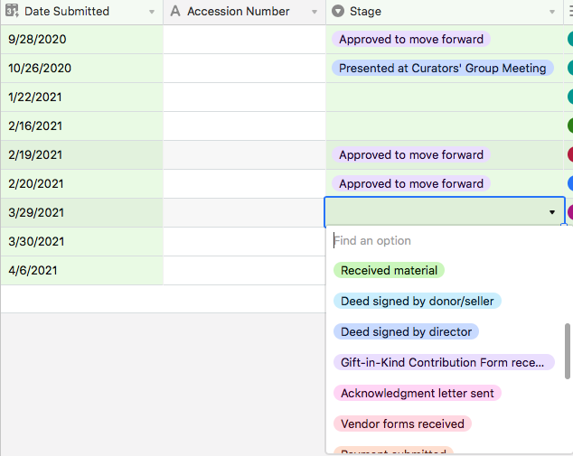
Workflow Transparency

Slide 56
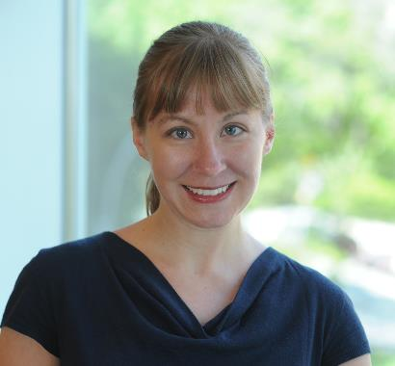
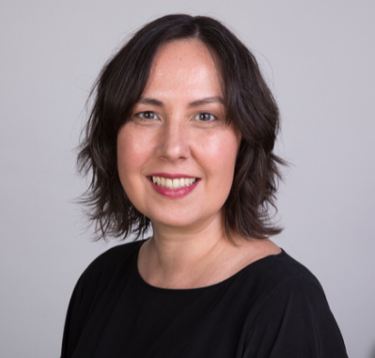
Thank you.
Questions?
Carrie Hintz
Chela Weber

Slide 57
What’s Next
Tutorial Videos
Office Hours May 6, 11, 12
Twitter Chat May 20th #oclc_tcos
RBMS Conference June 2021
DCDC Conference July 2021
SAA Conference July 2021

