Slide 1
Creating, Curating, and Using
Cultural Heritage Metadata and Resources
in a Linked Data Environment
Jeff Mixter, OCLC
Greta Bahnemann, Minnesota Digital Library
Notes:
Greta
Good morning! Welcome to: “Creating, Curating, and Using Cultural heritage Metadata and Resources in a linked Data Environment”
Greta Bahnemann – Metadata Librarian MDL
Jeff Mixter - Lead Software Engineer at OCLC Research

Slide 2
Today’s Agenda
Pilot Project Introduction & Background Information
Technical Background
Project Overview
Technical Framework
Pilot Tools Prototyped by OCLC
Participant Feedback and Outcomes
Questions
Notes:
Greta
We are here to discuss a recent project spearheaded by OCLC Research on Linked Data and CONTENTdm images and their metadata
Today’s Agenda:
Pilot Project Introduction & Background Information
Technical Background
Project Overview
Technical Framework
Pilot Tools Prototyped by OCLC
Participant Feedback and Outcomes
Questions

Slide 3
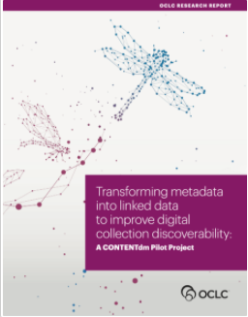
Pilot Project Overview
OCLC partnered with 5 institutions that manage their digital collections with OCLC’s CONTENTdm service to investigate methods for - and the feasibility of - transforming metadata into linked data to improve the discoverability and management of digitized cultural materials and their descriptions.
Notes:
greta
Following is an overview of the pilot
which started in the Fall 2019 - and ended in the Fall 2020
OCLC partnered with 5 institutions that manage their digital collections with OCLC’s CONTENTdm to investigate methods for - and the feasibility of - transforming metadata into linked data to improve the discoverability and management of digitized cultural materials and their descriptions.

Slide 4
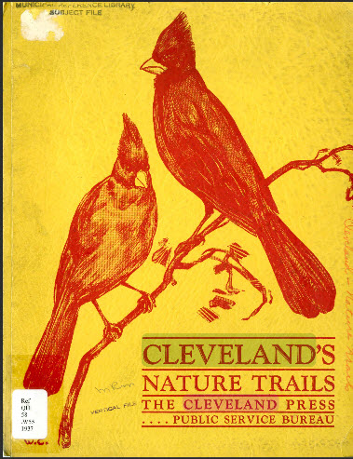
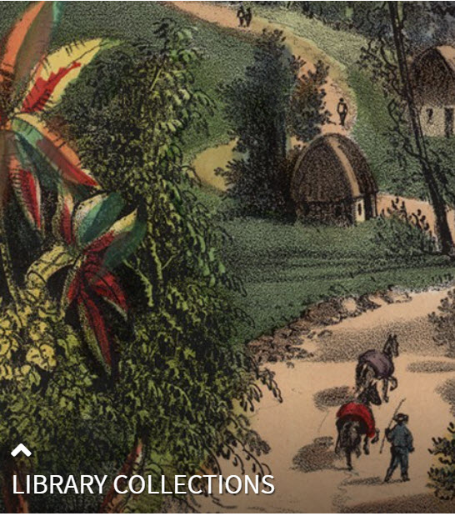
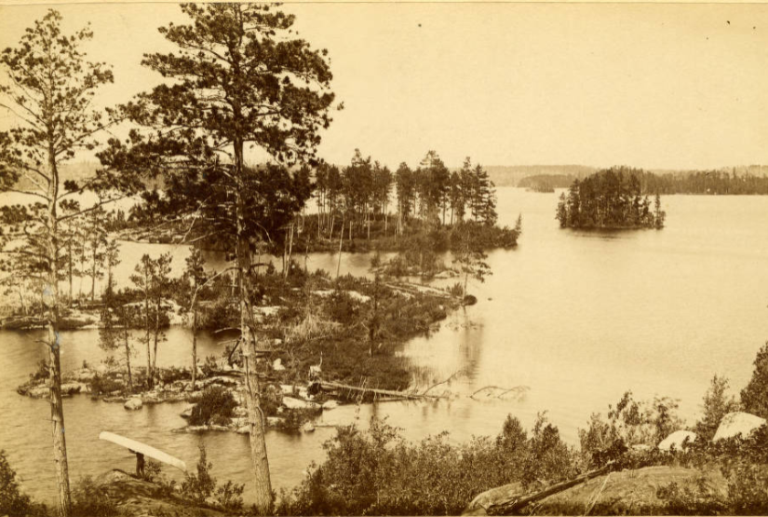
Pilot Participants
Cleveland Public Library
Huntington Library, Art Museum, and Botanical Gardens
Minnesota Digital Library
Notes:
greta
The first phase of the Pilot began in the fall of 2019 with three library partners:
Cleveland Public Library
Huntington Library, Art Museum, and Botanical Gardens
Minnesota Digital Library

Slide 5
Pilot Participants
Temple University Libraries
University of Miami Libraries
Notes:
greta
In Phase 2 two more libraries joined - Temple University Libraries and University of Miami Libraries.

Slide 6
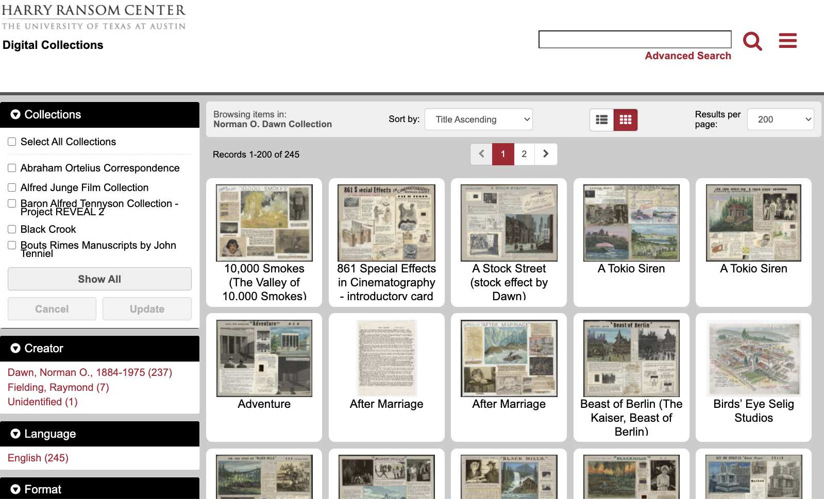
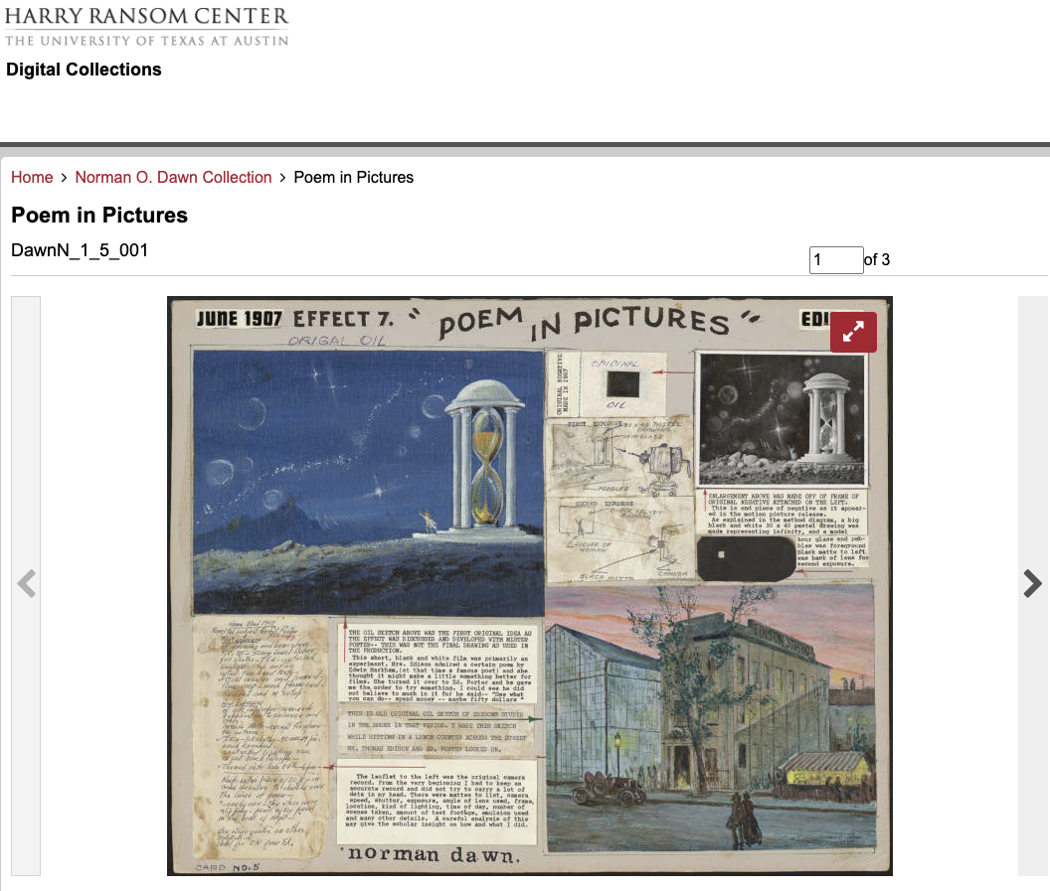
What is CONTENTdm?
CONTENTdm is OCLC’s digital content management service
Libraries, archives, and museums use CONTENTdm to build and showcase their digital collections
They also use CONTENTdm to securely manage their digital materials in a cloud based system
https://hrc.contentdm.oclc.org/digital/collection/p15878coll15
Notes:
Greta
But before we go too much further - I want to be sure you are all familiar with CONTENTdm. CONTENTdm is OCLC’s premiere digital content management system
Used to build digital collections - and has the robust ability to showcase digital content with complex metadata…
Turn things over to Jeff and he is going to speak more about the technical side of the pilot.

Slide 7
What is Wikibase?
Wikibase is the technical platform that supports WikiData: a multilingual graph of structured data that provides accurate and consistent data across Wikipedia articles
The platform supports:
creating and editing structured data
searching for entities
exploring entity data
Notes:
Jeff

Slide 8
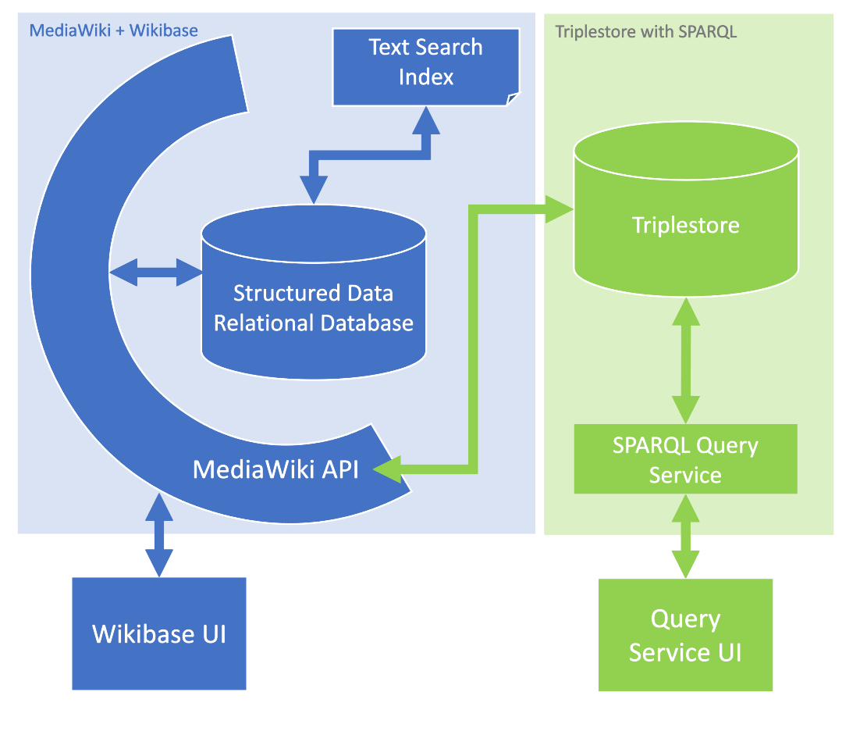
What is Wikibase?
Notes:
Jeff

Slide 9
Project Goals
Evaluate the diversity of CONTENTdm descriptive data practices
Develop a shared and extensible data model
Test the balance between human attention and automation to reconcile metadata headings to linked data entities
Prototype ways to help subject matter experts contribute to descriptions
Experiment with discovery tools to make hidden connections visible
Learn about the institutional and individual interests in the paradigm shift of moving to linked data
Notes:
Jeff
The CONTENTdm Linked Data Pilot ran over the past year from September 2019 to August 2020. We are now summarizing our conclusions and producing a report of those findings for release in early 2021.
Several OCLC staff were actively involved with the Pilot as well as five library partners who currently use CONTENTdm, OCLC’s digital asset management system.
Building on lessons from past linked data research at OCLC, the purpose of this Pilot was to model a linked data environment from the creation of item descriptions, managing those descriptions, and assessing the impact of linked data entities on end user discovery of those materials.

Slide 10
Project Question areas
Divergent practice and collection assessment
Shared data models for diverse collections and institutions
Machine learning and human intervention
Tools for subject matter experts
Discovery tools
The paradigm shift
Notes:
Jeff
The CONTENTdm Linked Data Pilot ran over the past year from September 2019 to August 2020. We are now summarizing our conclusions and producing a report of those findings for release in early 2021.
Several OCLC staff were actively involved with the Pilot as well as five library partners who currently use CONTENTdm, OCLC’s digital asset management system.
Building on lessons from past linked data research at OCLC, the purpose of this Pilot was to model a linked data environment from the creation of item descriptions, managing those descriptions, and assessing the impact of linked data entities on end user discovery of those materials.

Slide 11
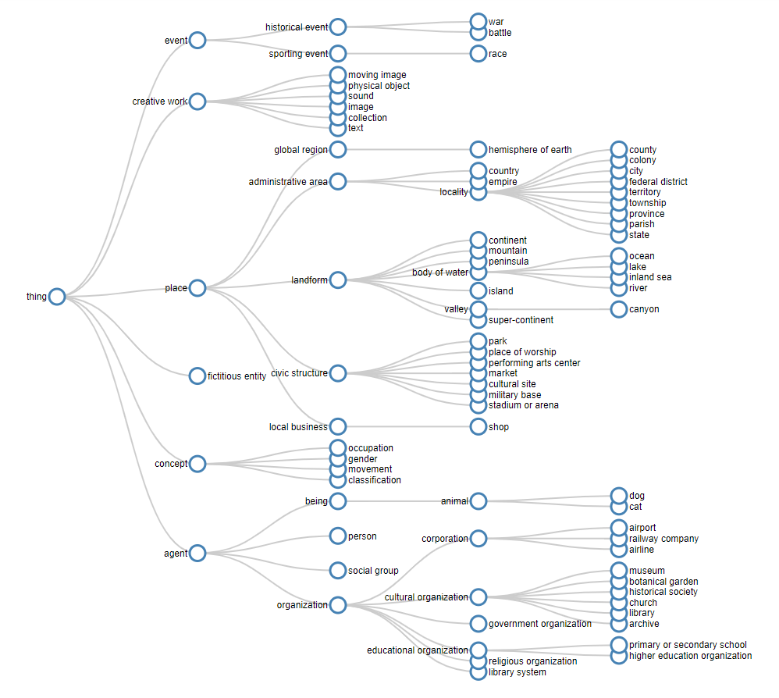
Pilot Goals: Phase 1
Phase 1: Map existing CONTENTdm metadata into a common linked data data model
Notes:
Jeff
I want to say a little more about the overall mechanics of the project. We were intentionally starting from scratch. In the first phase, we needed to build a system to manage item descriptions as linked data entities and needed to populate that system with real data. Jeff is going to speak next about many of those details. Note that for all five of the partners, only a subset of their current CONTENTdm collections were used so that none of us were overwhelmed with millions of items.
In the second phase, we now had some data to work with and could focus on how library staff could manage and improve those descriptions. OCLC research staff prototyped some tools to evaluate new methods for describing cultural heritage materials. Greta is going to talk about some of those tools a bit later.
And in the third phase, we had real data that had gone through some revision and improvement so we could look at how entity data enhances the discovery experience for end users. Elliot is going to say more about that after Greta.

Slide 12
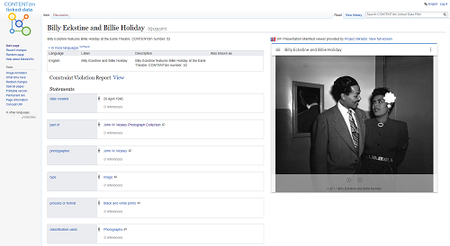
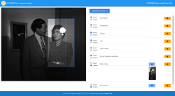
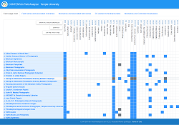
Pilot Goals: Phase 2
Phase 2: Develop and use tools to manage linked data descriptions
Notes:
Jeff

Slide 13
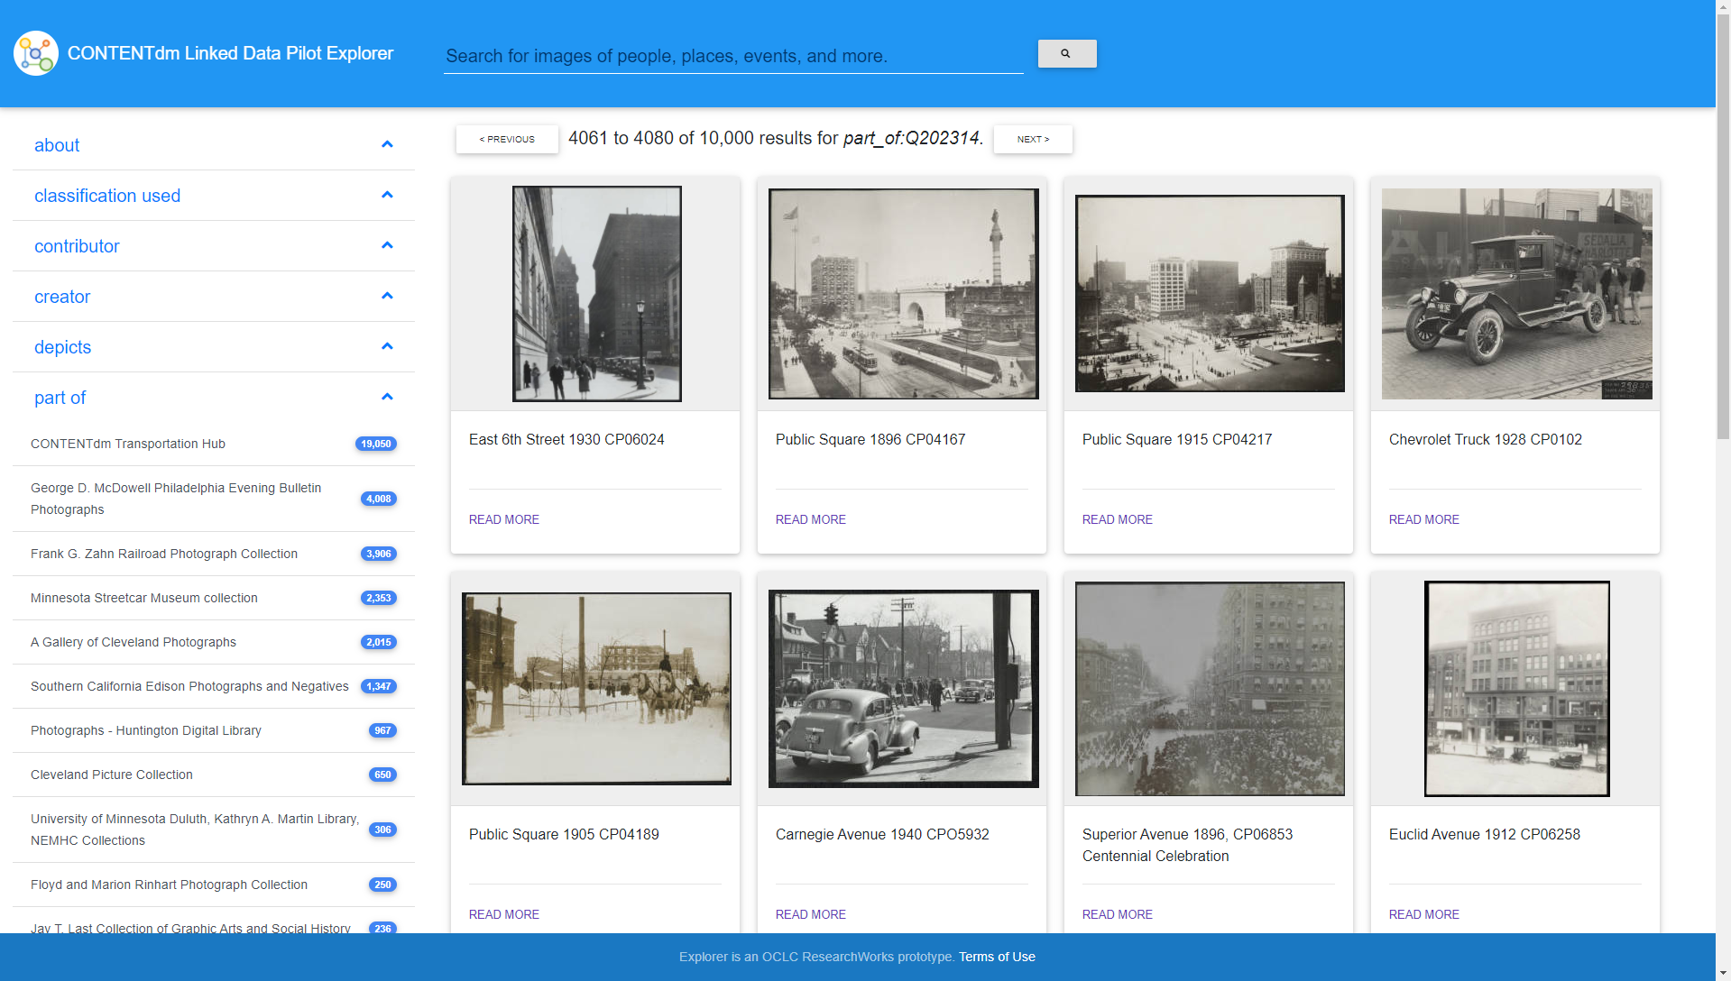
Pilot Goals: Phase 3
Phase 3: Use Wikibase linked data to improve end-user search and discovery
Notes:
Jeff

Slide 14
Some conclusions
Metadata quality is vital to successfully transforming text descriptions to entities
Libraries will need new tools to do this efficiently
Reconciling text to entities at scale will require dedicated infrastructure
Using linked data entities helps improve and maintain the quality of item descriptions
Notes:
Jeff
The formal work phases of the Pilot have wrapped up and we do have some initial conclusions. This will surprise no one listening to me right now, but metadata quality is important. Since we were working mostly with pre-existing text-based data in CONTENTdm, the more consistent those metadata descriptions were, the easier it was to map those descriptions to known entities. As we contemplate migrating text descriptions to linked data entities in the future, we know that automated entity reconciliation is going to be absolutely critical.
That said, some of this work is still going to be manual. Libraries will absolutely need new tools to make this process achievable and efficient. Working with metadata descriptions in bulk will be an important part of those tools.
I mentioned the automated reconciliation process. Another thing that was clear is that processing that much diverse descriptive data and matching to a diverse set of authorities and other vocabularies is computationally intensive. A robust infrastructure will be needed to handle those processes at scale.
And lastly, it is also clear that managing descriptions as entities improves metadata consistency and, coupled with new staff tools, makes it easier to maintain metadata consistency over the long term.
And now I will turn it over to Jeff to dive a little more deeply into the infrastructure that we built over the course of the Pilot.

Slide 15
Technical Framework
Notes:
Jeff
going to give you more detail about the linked data framework that we used during the course of the pilot.

Slide 16
Project Workflow
Initial data model
Participants select collections
Metadata extracted and reviewed
Data model review
Data model revised
Wikibase ‘seeded’ with entities
Partner data review
Data ingested into Wikibase
Metadata mapped to new model
Notes:
Jeff

Slide 17
Pilot Tools Prototyped by OCLC
Notes:
Transition to Greta

Slide 18
Prototype Tools Developed by OCLC
Retriever - helps pilot partners search for and create entity descriptions
Linked Data Pilot Explorer - searching and browsing interface for materials in the pilot wikibase
Field Analyzer - looks at how CONTENTdm fields are defined/populated across different collections
Image Annotator - subject analysis tool - ability to add “of-ness” and “about-ness” to images in CONTENTdm
Notes:
Greta
4 tools developed throughout the course of the pilot project and i’m going to give you an overview of each of the tools and their capabilities
1. Retriever
2. Linked Data Pilot Explorer
3. Field Analyzer
4. Image Annotator

Slide 19
Retriever Tool
Based on prior work from OCLC’s Project Passage (previous Linked Data research work)
Helper tool with a simple keyword search interface to look for matching entities in VIAF, Wikidata, and FAST
Notes:
Based on prior work with OCLC’s Project Passage
Based on prior work with OCLC’s Project Passage
Essentially a helper tool - utilizes a simple keyword search interface
Allows users to look up matching/existing entities in the Virtual International Authority File, Wikidata, and the Faceted Application of Subject Terminology (FAST)

Slide 20
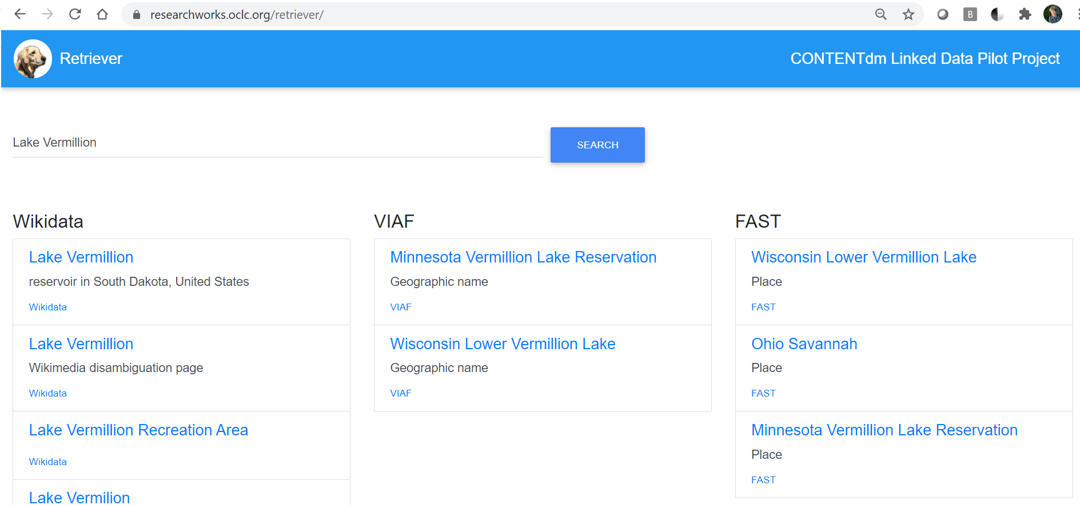
Retriever Tool
Notes:
This slide shows the search results in the Retriever Tool for the term “Lake Vermillion” - a lake in northern Minnesota
3 columns show what the results are for that search in: Wikidata, VIAF and FAST
You can see in the results that some of the terms returned are better matches than others
1. Wikidata says Lake Vermillion is a reservoir in South Dakota
2. FAST indicates it is a lake in Wisconsin
3. but VIAF points us to a more accurate result: “Minnesota’s Vermillion Lake Reservation” – which is the lake we are looking
using this tool helps prevent the creation of duplicate entities – and helps disambiguate

Slide 21
2. Linked Data Pilot Explorer
Search and browse interface for materials in the pilot wikibase
Users can browse by: item type, creator, subject (about or depicts)
See a "More Like This" option when viewing an item
Interface looks familiar, but uses IIIF to pull in images and entity-driven metadata for better connections between items
Uses entity-based description to improve navigation between related items
Notes:
Greta
Users can browse by types, creators, subjects
Features a "More Like This" option – so you can dive into similar content
Displays things in a familiar-looking interface, but uses IIIF to pull in images and entity-driven metadata for better connections between items
AND uses entity-based description to improve navigation between related items

Slide 22
Notes:
OCLC established a new virtual collection entity in the Wikibase for a “CONTENTdm Transportation Hub” that included all of the items that had been found by our cross-collection search of “transportation”
these results were reconciled, transformed, and included in the Wikibase. We selected Transportation - simply because all of the pilot participants had some form of transportation-related items in their collection.
In the Explorer tool, the Transportation Hub collection can be selected as the starting point for browsing and making selections, with facets helping to narrow the scope to different topics, things depicted, source collections, sub-topics, and more.

Slide 23
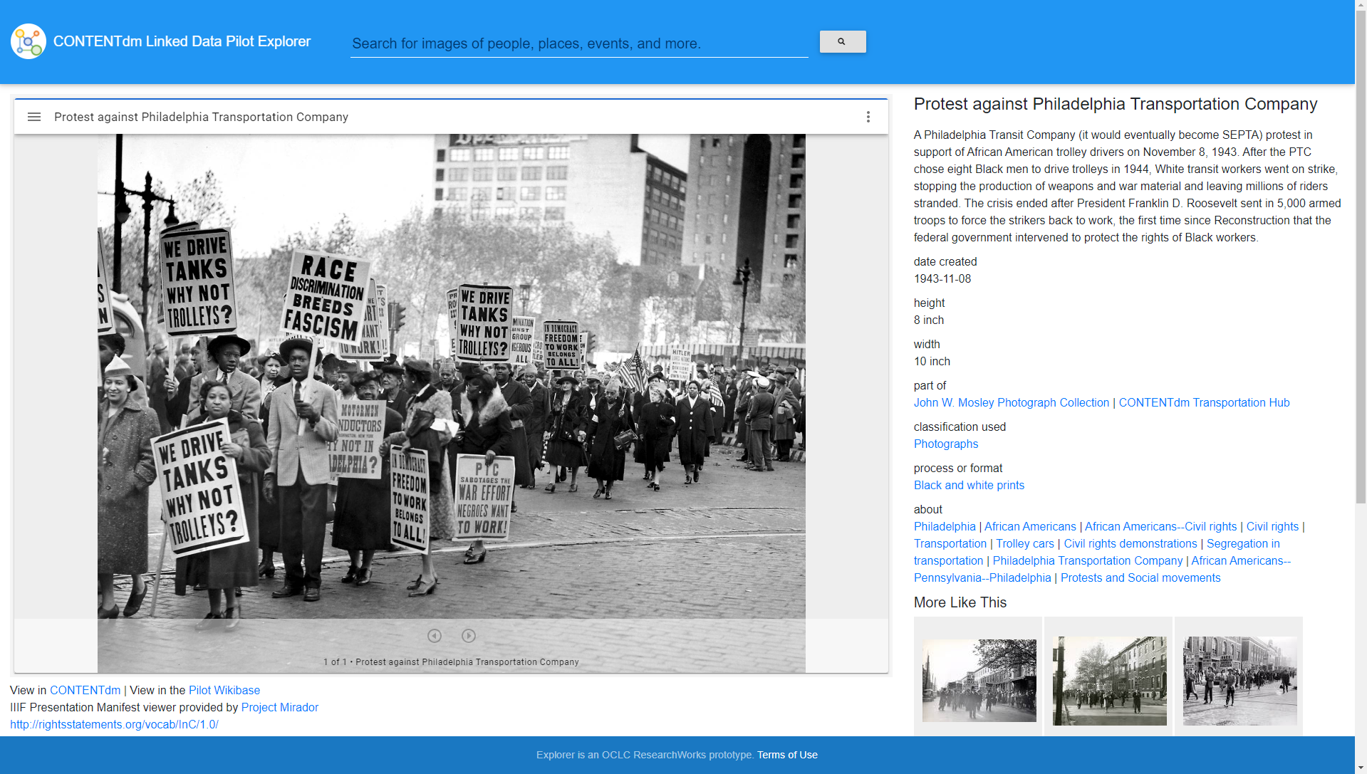
Notes:
Closer view of a record in the Linked data Pilot Explorer tool
Here is an image from the Hub - “Protest against Philadelphia Transportation Company”1942 image in support of hiring African American trolley drivers by the Philadelphia Transit Company.
The advantage of building a hub like this - users can view photographs that are in different collections from the same institution, in this case Temple University
So yes, users could have also been discovered using their CONTENTdm site by searching across all of their collections.

Slide 24
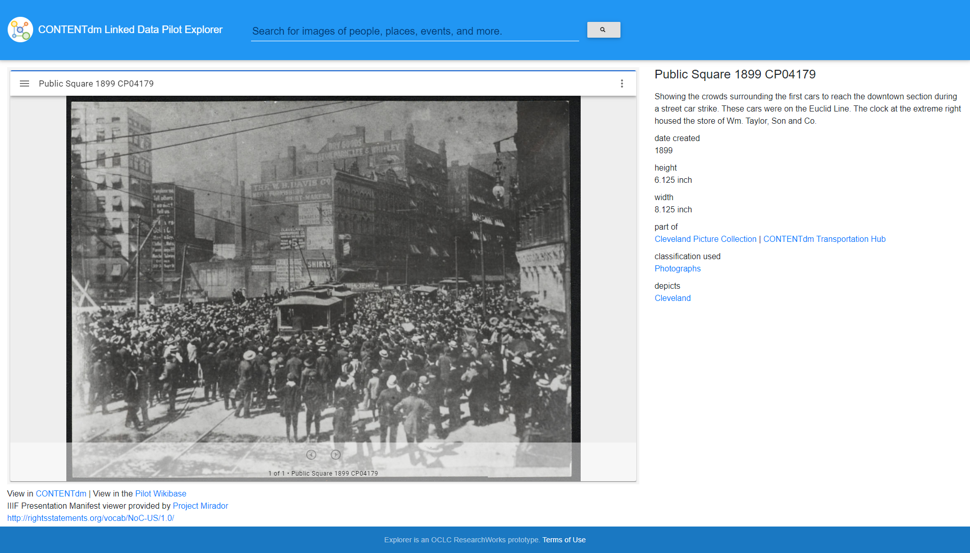
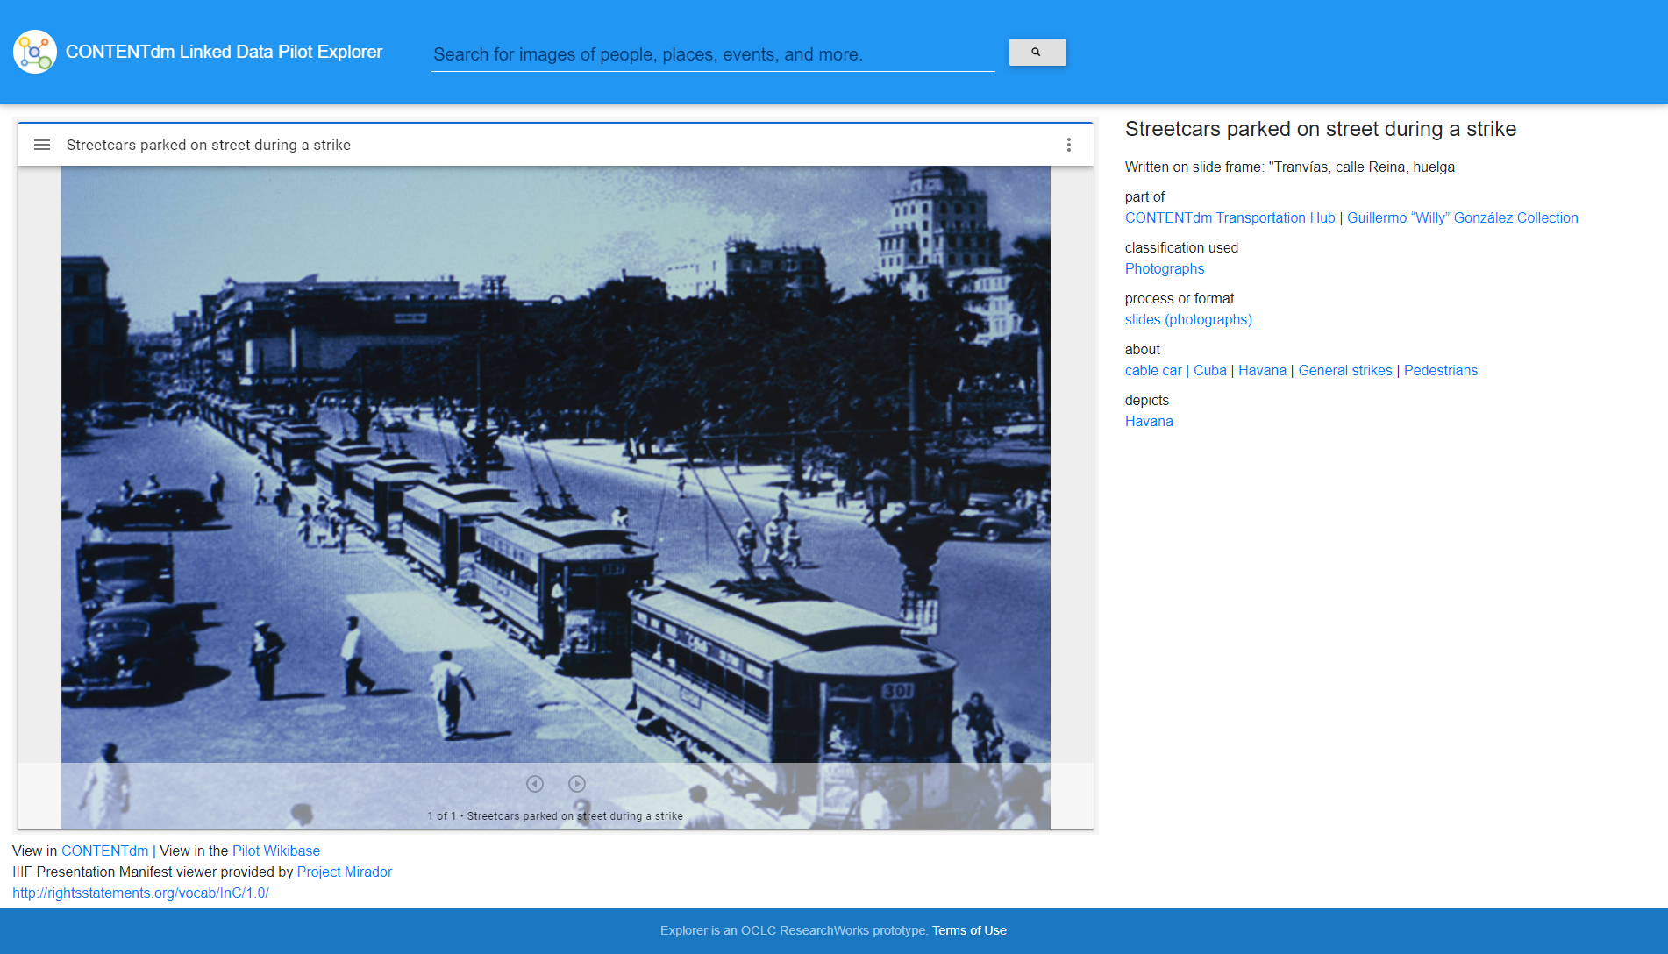
Notes:
Building the Transportation Hub allowed us to find images related to transportation - across different institutions
So here we see images of transit strikes in collections from 2 different pilot institutions:
1. Cleveland Public Library photograph of a trolley car during a transit strike
2. University of Miami photograph of parked trolley cars during a strike in Havana

Slide 25
3. Field Analyzer
Enables CONTENTdm administrators to look at how CONTENTdm fields are defined and populated across different collections
CDM administrators can look at:
Field usage across multiple collections
Field nicknames in CONTENTdm
DC Elements
Allows CDM administrators to ascertain if fields are not mapped or named correctly
Notes:
allows CONTENTdm administrators look at how fields - are defined and populated across the different collections within their CONTENTdm instance
Administrators can look at things like:
1. Field usage across different collections
2. Use of consistent Field nicknames in CONTENTdm
3. Mapping to DC Elements
Essentially gives administrators a bird’s eye view of their collection

Slide 26
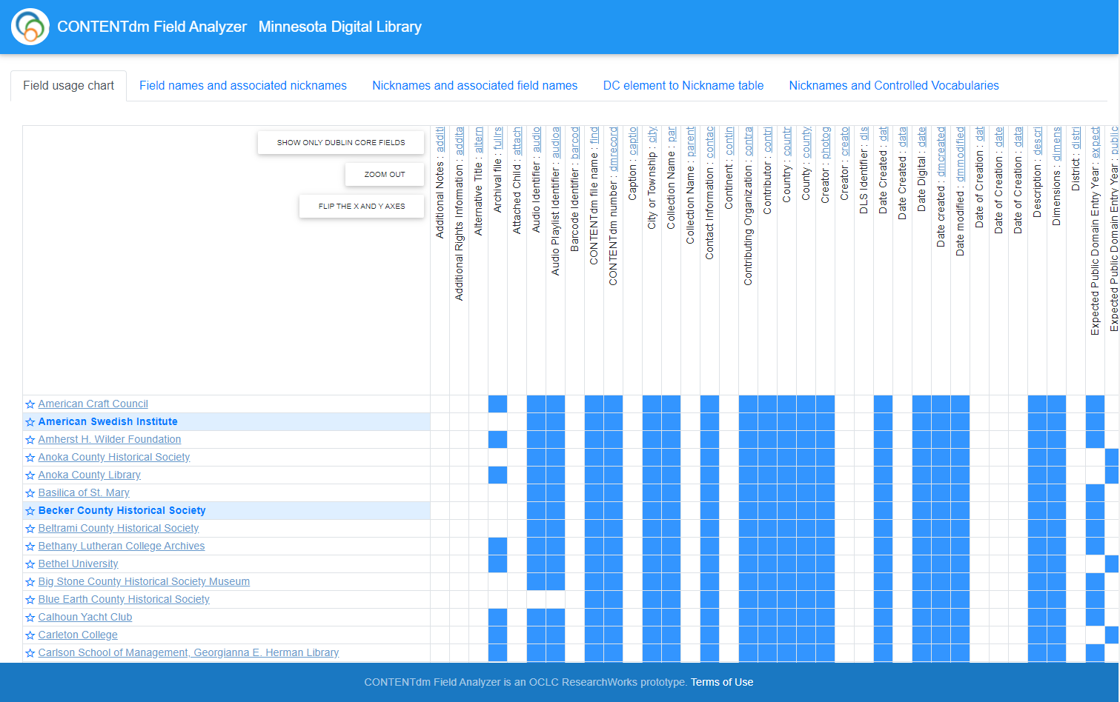
Notes:
Minnesota Digital Library – you can see where I have variances in field usage - across the 197 different collections in MDL
If you look closely on the far right - you can see I have 2 inconsistent names for the field “Expected Public Domain Entry Year” – I took a screenshot before I fixed this

Slide 27
4. Image Annotator
Subject analysis tool - allows CDM users to create 2 levels of description:
“about” - concepts or ideas
“depicts” - identify and “point to” things in the image
Notes:
Greta
Subject analysis tool – and in my mind is the tool with the greatest potential to change how we think about and catalog cultural heritage materials in digital collections
Allows CDM administrators to create 2 levels of description:
1. “about” - concepts or ideas
2. “depicts” – which gives us the power to identify and “point our digital finger” to things found in the image

Slide 28
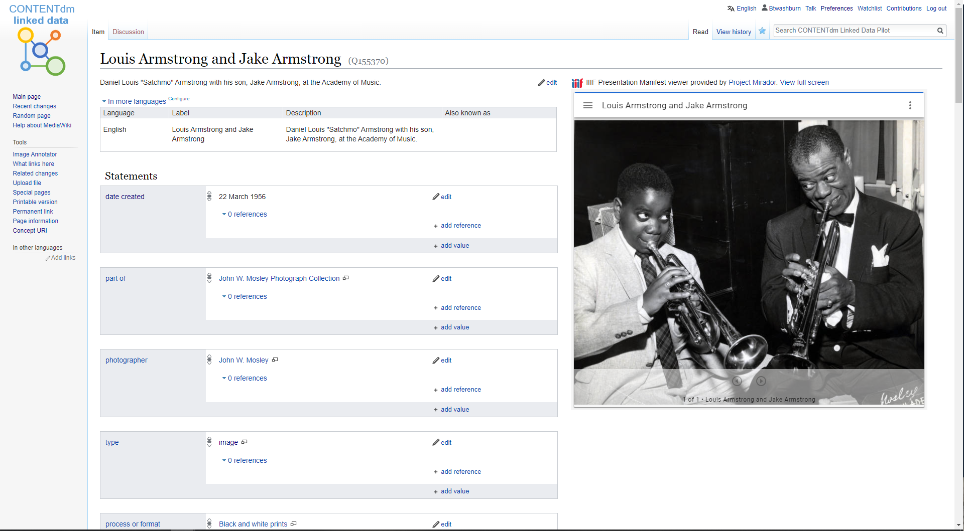
Notes:
Use this portrait of Louis Armstrong with his son Jake to show how we can use the Image Annotator to enhance image description.

Slide 29
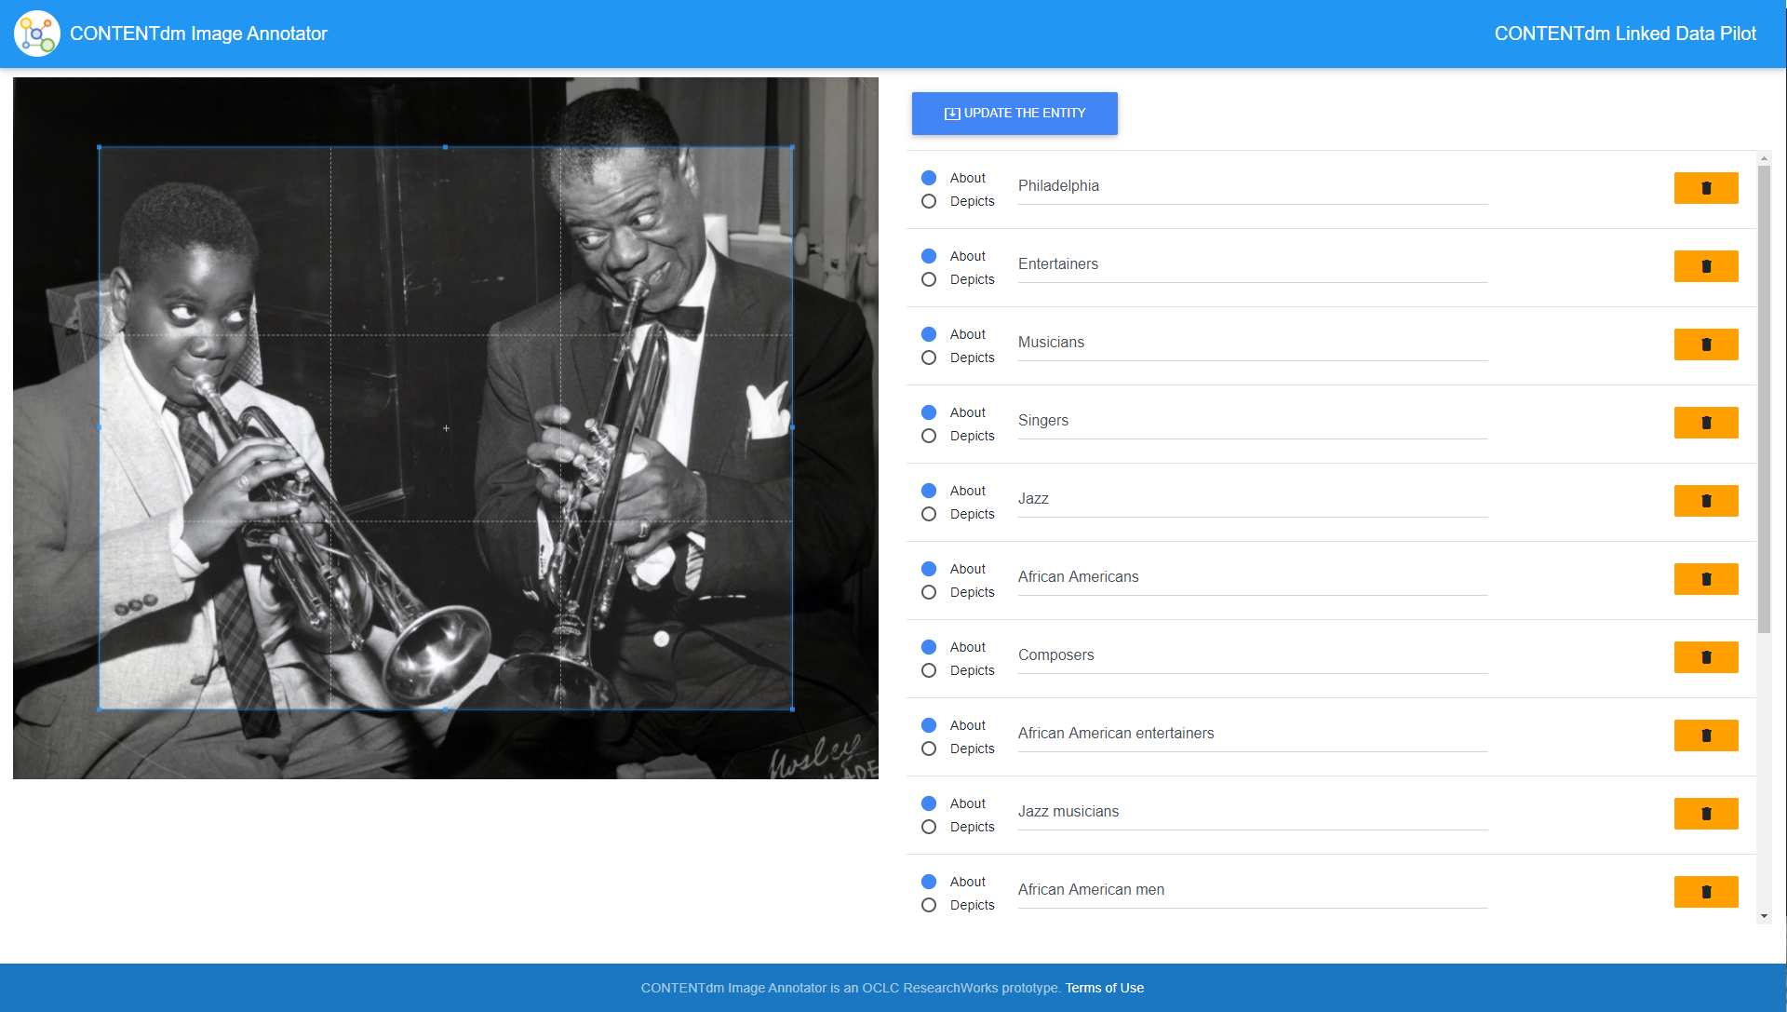
Notes:
The Image Annotator presents the work’s image - along with a list of the “about” or “depicts” statements that are part of the entity description.
This presentation of some of the elements associated with the entity description was designed to help us focus on the questions we all ask about images:
• What is the image about?
• What does it depict or show?
• And can portions of the image be used to depict or show us other things?
You’ll notice that initially the subject headings show just “about” relationship with the work- but we can edit that and make some new determinations

Slide 30
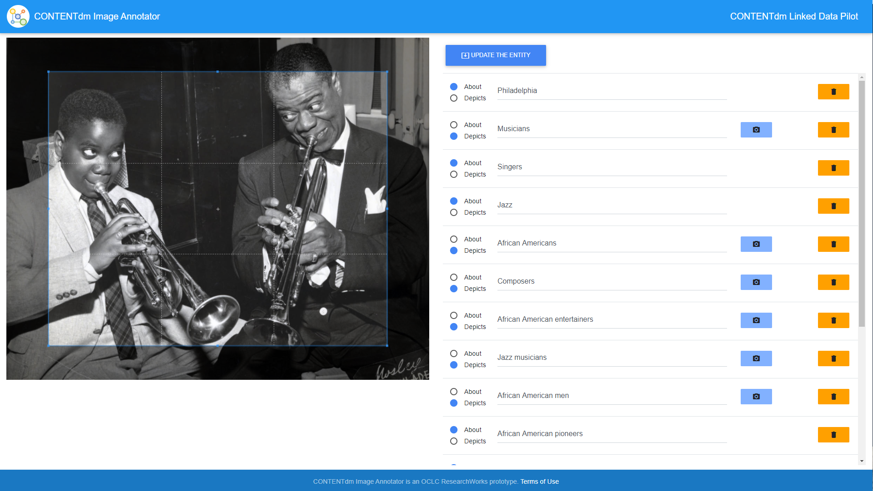
Notes:
In the Image Annotator, the properties have been edited to show both ABOUT and DEPICTS relationships
You can see that the image is
ABOUT: Philadelphia, singers, and jazz
DEPICTS: musicians, African Americans, composers, African American entertainers, jazz musicians, African American men, and more

Slide 31
Notes:
When the radio button for “depicts” is selected, the blue “camera icon” appears - so that a cropped portion of the image can be “photographed” or captured and then associated with a subject heading
In this instance, the LC heading for Louis Armstrong can be associated with a cropped portion of the image that depicts just Louis.
And of course, I do the same with his son Jake.

Slide 32
Notes:
The Image Annotator also provides a way for additional headings for things that the image is about, or that it depicts, to be included.
Here, a cropped portion of the image depicts “trumpet” can be associated with the CONTENTdm pilot Wikibase’s conceptual entity description of a “trumpet”

Slide 33
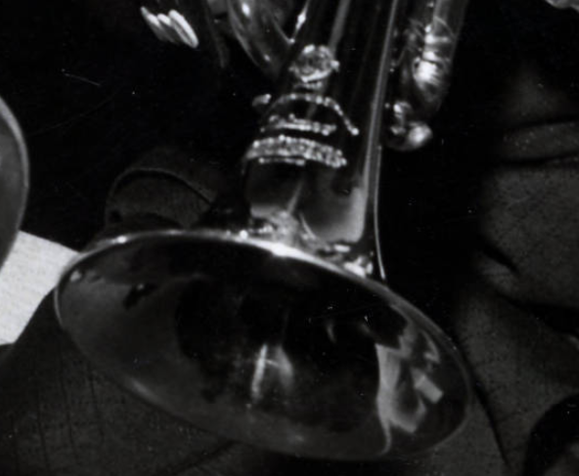
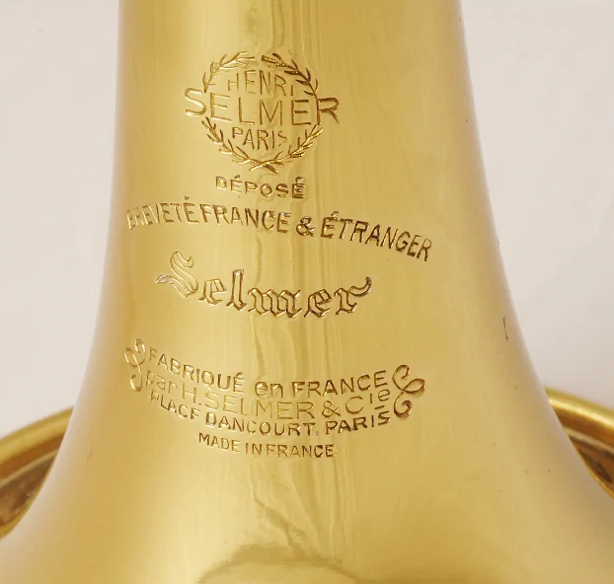
Notes:
But after taking a closer look at the trumpet, a subject expert might see the inscription near the trumpet bell – for the Henri Selmer Company in Paris
According to the Selmer Company archive, Louis Armstrong was “one of the best ambassadors of the SELMER trumpet”
Armstrong is known to have played their “K-Modified B flat major trumpet” which was manufactured in 1954
And this does appears to be the trumpet he is playing in this 1956 photograph.

Slide 34
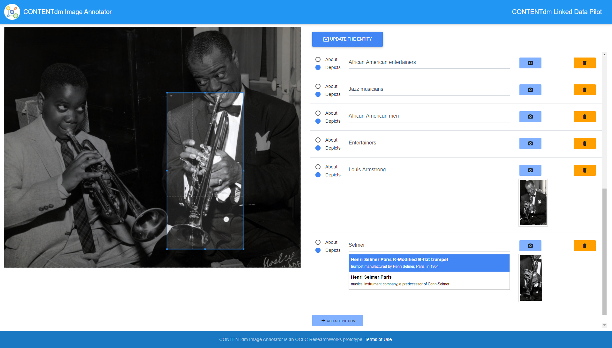
Notes:
An entity description of that Selmer trumpet exists in the CONTENTdm Wikibase,
so this image crop can be associated with an entity describing that trumpet model – taking the entity description beyond just text and including an image
These cropped parts of images depict actual entities – and have the power to enhance our understanding of the image while allowing domain experts to add NEW KNOWLEDGE

Slide 35
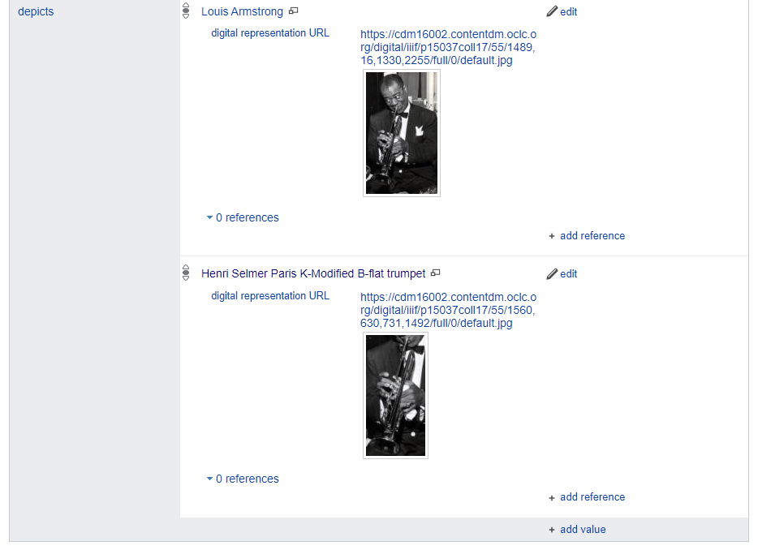
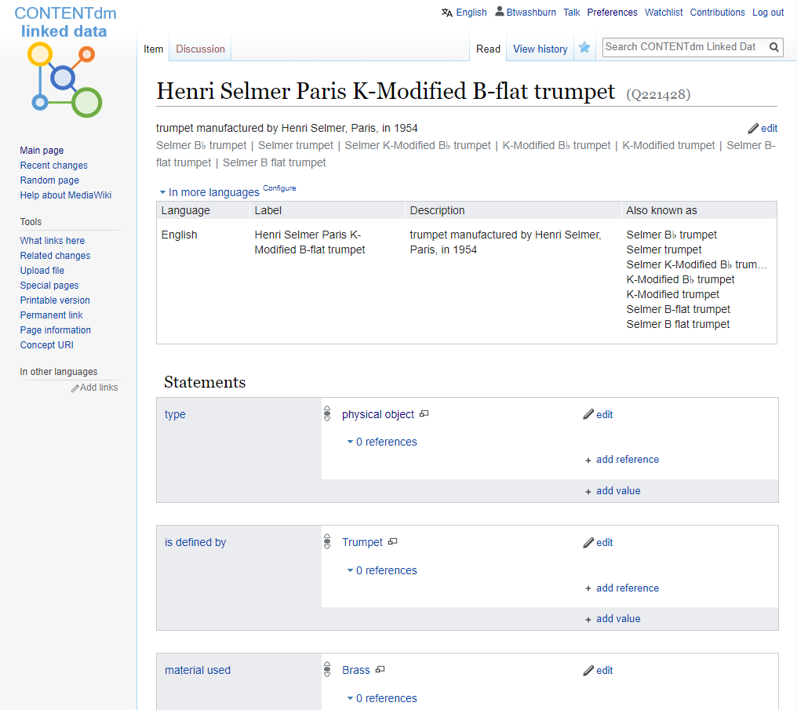
Notes:
Greta
Once the Image Annotator edits have been completed, the user clicks the Update button, and the modifications are made by an associated script to the original Wikibase entity.
This view of the portion of the reset Depicts statements include the links to the cropped images, using the IIIF Image API standard.
So this slide shows the connection between the identification process in the Image Annotator and the sussing out of the Wikibase entity - Something we have never seen in CONTENTdm before
so that concludes the overview of the tools - and I want to mention as a participant, I found this to be one of the most interesting parts of this pilot. opportunity to see ways CONTENTdm could grow in the future

Slide 36
Participant Outcomes and the Future
Notes:
Greta
Finally a little bit about Participant outcomes

Slide 37
What we learned as partners
Importance of consistent metadata practices
Challenges of using large-scale vocabularies to describe highly local materials
Wikibase as an example of what creating linked data descriptions could look like
Value of learning alongside colleagues from other institutions and OCLC
Notes:
Greta
Tremendous opportunity to learn about Wikibase. As partners we learned the:
1. reinforced the mportance of consistent metadata practices
2. the ongoing Challenges of using large-scale vocabularies to describe highly local materials
3. learned more about Wikibase - as an example of what creating linked data descriptions could look like
4. Finally – the tremendous Value of learning alongside colleagues from other institutions and staff at OCLC research
turn it over to Jeff

Slide 38
Future of CONTENTdm
More tools for administering CONTENTdm collections
Radically new ways of describing cultural heritage materials
Image Annotator
Describing entities, not just records
Increased emphasis on inter-institutional sharing and collaboration
A system that fosters interaction, exploration, and creative reuse
Notes:
Jeff
mention PRoject Client update working group

Slide 39
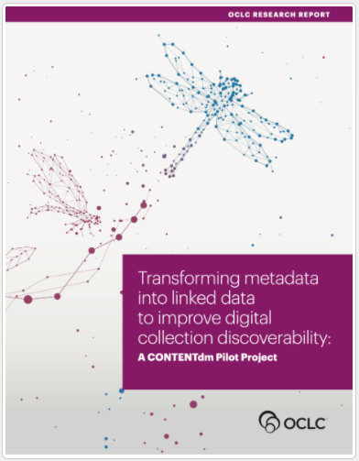
The Final Report
https://oc.lc/transform-linked-data
Transforming Metadata into Linked Data to Improve Digital Collection Discoverability
Shares the findings from the Linked Data Pilot Project
OCLC partnered with five institutions that manage their digital collections with OCLC’s CONTENTdm
Investigate methods for—and the feasibility of—transforming metadata into linked data
Goal: improve the discoverability and management of digitized cultural materials and their descriptions.
Notes:
Jeff

Slide 40
Questions?
Thank You!
Jeff Mixter - mixterj@oclc.org
Greta Bahnemann - bahne002@umn.edu
Notes:
Ask for questions

