Slide 1
5 October 2021 | Works in Progress Webinar
NAFAN Research Overview

Slide 2
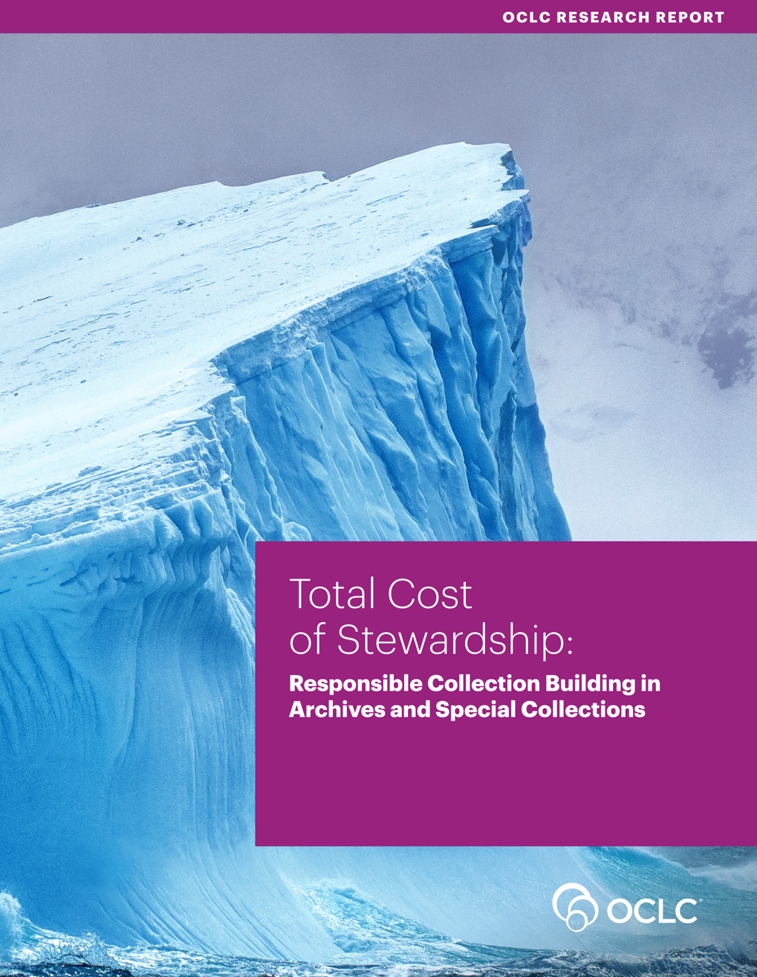
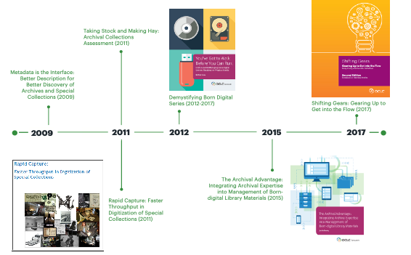
Our Work in Archives, Special, and
Distinctive Collections:
https://oc.lc/stewardship-report
Notes:
OCLC Research has a long history of work in the area of archives, special, and distinctive collections in research libraries. We work in special collections because they are an important sight of knowledge creation, made possible by library’s commitment to the stewardship of their distinctive collections. The unique nature of material in special collections can make scaling a challenge, and we work to identify areas of common need and patterns of innovation to help libraries scale learning and expertise with these collections.

Slide 3
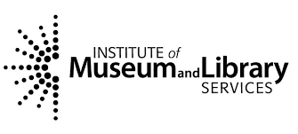
This project was made possible in part by the Institute of Museum and Library Services, through grant LG-246349-OLS-20. The IMLS is the primary source of federal support for the nation’s libraries and museums.
https://confluence.ucop.edu/display/NAFAN
Notes:
Today we’ll be sharing one of our current projects benefitting archives and special collections - our ongoing work on the “Building a National Archival Finding Aid Network” project, also known by its acronym “NAFAN”.

Slide 4
Presentation Overview
NAFAN Project Overview
Research Design
Archival Aggregation Users
Finding Aid Data Research Questions and Methods
5. Questions

Slide 5
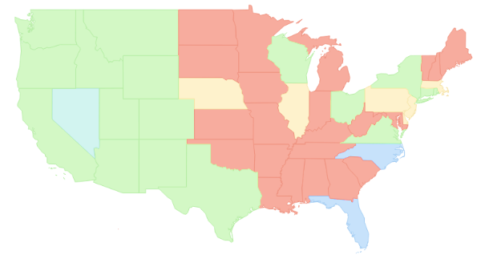
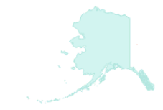
Building a National Archival Finding Aid Network (NAFAN)
▇ = Statewide/regional coverage
▇ = Partial coverage
▇ = Defunct aggregation
▇ = No coverage
*not to scale
Notes:
So what is NAFAN?
Project led by the California Digital Library and
supported by IMLS through their National Leadership in Libraries grants, This is a 2-year project, running from September 2020 through August 2022
For a bit of background:
There are 15 extant archival aggregators in the US, which share very similar characteristics: within a given state or region, they are ingesting and providing persistent hosting of finding aids. In many cases, they are the primary, finding aid interface for their contributors
There are 3 meta-aggregators, which we define as programs that harvest and index finding aid data from aggregators and individual institutions. They are the History of Medicine Finding Aid Consortium, and the Social Networks and Archival Context program -- or "SNAC", and of course our own ArchiveGrid, which in many ways is the current de facto national aggregation of archival description.
There is not comprehensive coverage for discovery of archival collections nationally

Slide 6
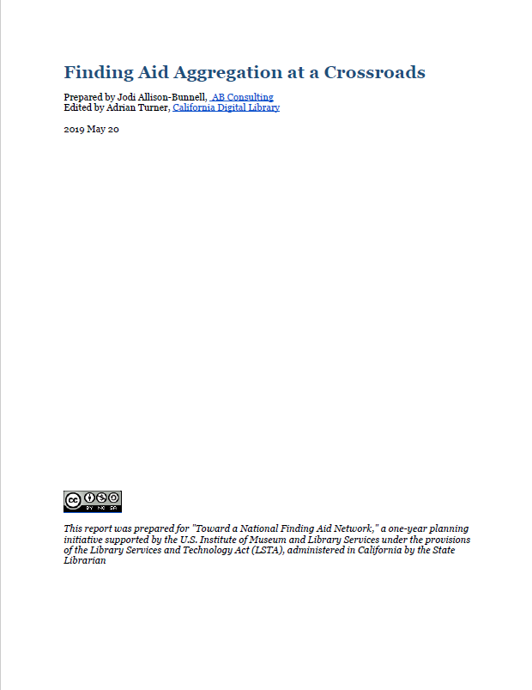
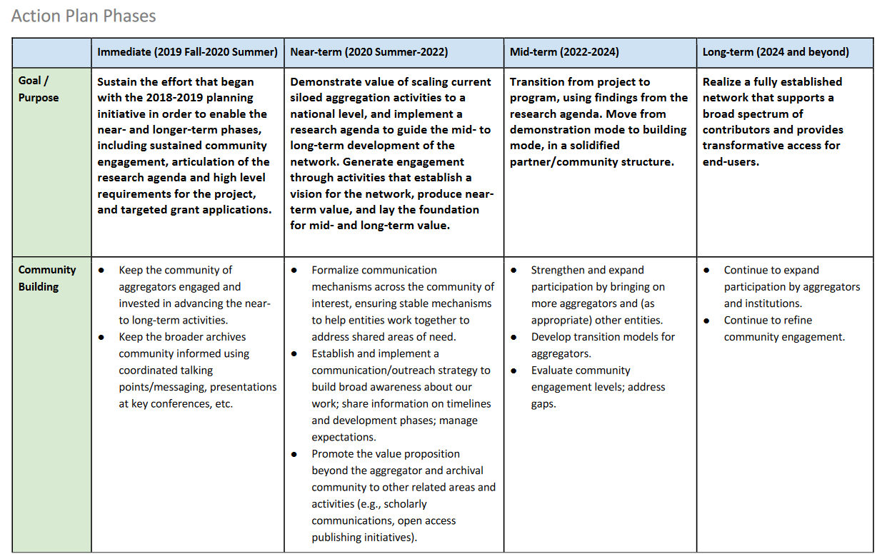
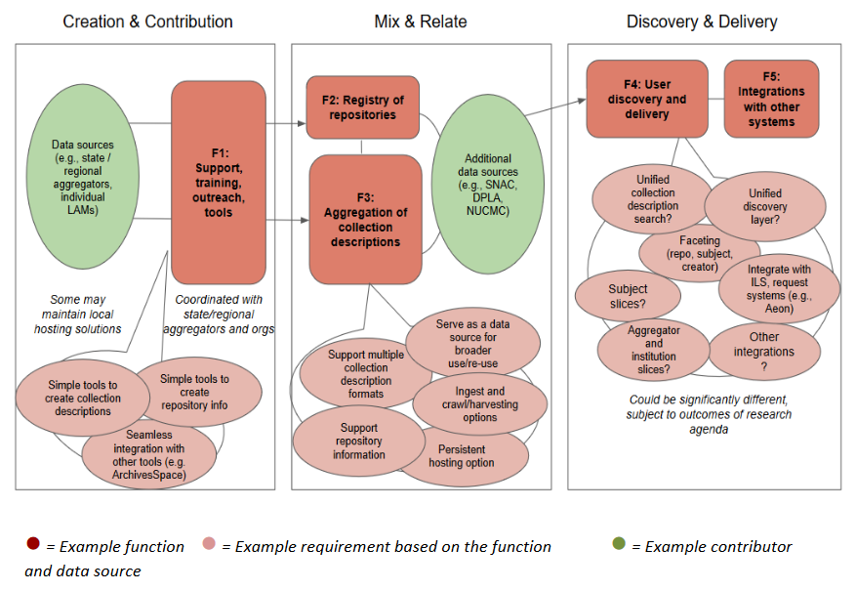
Background: Report and Action Plan (2018-19)
Supported by the Institute of Museum and Library Services under the provisions of the Library Services and Technology Act (LSTA), administered in California by the State Librarian
https://confluence.ucop.edu/display/NAFAN/Project+Reports+and+Resources
Notes:
The CDL maintains the Online Archive of California -- or OAC -- which brings together finding aids across that state.
They have been reevaluating the scope and sustainability of the OAC, and believed it was a timely opportunity to convene a broader conversation with other aggregators to explore a more shared infrastructure and service model.
In late 2018, the California Digital Library received 1 year of LSTA funding from the California State Library to initially explore -- with other regional and statewide finding aid aggregators -- the idea of a national finding aid network
Findings from that grant indicated that this is an idea worth pursuing, which lead to the current phase of work.

Slide 7
NAFAN
“A national finding aid network that is community-driven, -sustained, and -governed.”
▇ = Statewide/regional coverage
▇ = Partial coverage
▇ = Defunct aggregation
▇ = No coverage
*not to scale
Notes:
So one of the major pieces of the vision of this project is to create a truly national aggregation service bringing together collections from a wide variety of archives across the country – in museums, academic libraries, public libraries, historical societies, community archives.
This is a 2-year R&D phase,
It builds directly on the prior work of the 2018 planning phase
Over the next two years, we want to explore and create the blueprint for implementing a national finding aid network that is community-driven, -sustained, and -governed

Slide 8
Activity Streams
Research
Technical assessment and prototyping
Community engagement
Sustainability and governance planning
Notes:
For this 2-year R&D project, we have 4 activity streams -- work will be happening in parallel across these areas:
Research:
Technical assessment and prototyping:
Community engagement:
Sustainability and governance:

Slide 9
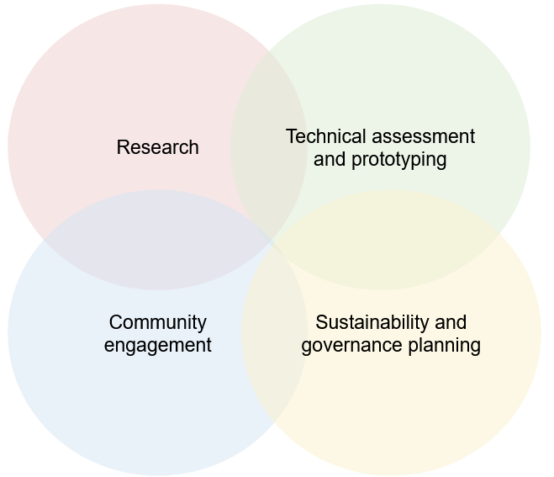
OCLC’s Primary Role: Research
Notes:
OCLC staff will be contributing to other activity streams, but our primary role is to take the lead on conducting research.
Initiate research to gain a current understanding of the needs of both researchers and cultural heritage institutions in regard to finding aid aggregation. Evaluate the quality of existing finding aid data at scale in order to scope the network's initial functionality to the specific existing characteristics of the data, and lay the groundwork for iterative data remediation and expanded network features in subsequent phases.

Slide 10
OCLC Research NAFAN Team
Brittany Brannon
Lynn Silipigni Connaway
Brooke Doyle
Lesley A. Langa
Janet Mason
Merrilee Proffitt
Bruce Washburn
Chela Scott Weber
Associate Research Scientist (TBD)
Notes:
We are presenting to you today, but we are representing the work of this full team of OCLC colleagues listed here. And it really is a very fun and collaborative team effort, with each person bringing unique expertise to the project. So with that, I'll turn it over to Lynn, to talk about our big picture approach to this research, and some background on our goals and methodologies.

Slide 11
Research Design

Slide 12
Research Goal Summary
Qualitative: Identify needs of both researchers and cultural heritage institutions regarding finding aid aggregation.
Quantitative: Evaluate an aggregation of finding aids in order to:
scope the network’s initial functionality to the existing finding aid data
lay the groundwork for data remediation and expanded network features in later phases of development.
Notes:
Qualitative research to understand of the needs of researchers and cultural heritage institutions related to archival aggregations
Quantitative research to evaluate the quality of existing finding aid data at scale

Slide 13
Research Background
2018-2019 Grant Report and Action Plan
Outlined multiple potential avenues for exploration
Required narrowing, prioritizing, turning into research questions
Literature Review
Limited research on non-academic users
No research on aggregation
Persona Research Review
Strong work on archival personas in service of software projects
Commonalities across the personas

Slide 14
Research Data Sources
Researchers
Cultural Heritage Institutions
Aggregated Finding Aid Data
Notes:
Based on the literature and persona work, we determined three main avenues of explorations or sources of data we wanted to examine: End users, cultural heritage institutions and the professionals who work there, and the extant finding aid data available to us through current aggregations.
We’ll walk you through each of these, the research questions they address, and how we will be collecting and analyzing the data.

Slide 15
Research Design
Front-end
Back-end
Pop-up researcher survey
Cultural Heritage Institutions Focus Group Interviews
Individual researcher interviews
Finding Aid Data Analysis

Slide 16
Cultural Heritage Institutions:
Research Questions
What are the enabling and constraining factors that influence whether and how institutions describe the archival collections in their care?
What are the enabling or constraining factors that influence whether institutions contribute to an aggregation?
What value does participation in an aggregation service bring to institutions?

Slide 17
Focus Group Interviews
10 groups, 5-6 participants each
Recruiting via email lists and Twitter
274 respondents to our participant screening survey
Organizing groups based on institution size, job responsibility, years experience, participation in aggregation
Interviews transcribed; theme analysis conducted
Conducted virtually in June 2021
Cultural Heritage Institutions:
Data Collection
Notes:
In June we completed focus group interviews with archivists across a wide variety of types and sizes of archives, both that do and do not participate in aggregation. The interviews were recorded and transcribed for coding and analysis.

Slide 18
Research Advisory Group
Bill Stingone, New York Public Library
Derek Mosley, Auburn Avenue Research Library on African American Culture and History, Atlanta-Fulton Public Library
Hillel Arnold, Rockefeller Archives Center
Holly Mengel, University of Pennsylvania, Kislak Center (PACSCL)
Lydia Tang, Lyrasis
Molly Bruce Patterson, Rhode Island College (RIAMCO)
Rachel Walton, Rollins College
Ricky Punzalan, University of Michigan, School of Information

Slide 19
Archival Aggregation Users

Slide 20
Who are the current users of finding aid aggregations? Do they align with the persona types and needs identified in recent archival persona work?
What are the benefits and challenges users face when searching for descriptions of archival materials within finding aid aggregations?
Researchers: Research Questions

Slide 21
Pop-Up Survey
Hosted by 12 aggregators
Gathered demographic data about researchers, and their information needs
Using to identify candidates for semi-structured interviews
Analyzed using descriptive statistics
Collected March to May 2021
4354 total, 3300 complete responses
Semi-Structured Interviews
Virtual, 1-1, 45-60 minutes
25 interviews, 5 per persona type
Begin conducting interviews October 2021
Interviews transcribed, coded, analyzed
Researchers: Research Methods
Notes:
We conducted a pop-up survey data from March-May, hosted by 12 aggregators.
We had a total of 4354 responses that yielded 3300 complete, usable responses. This was much more than we expected and we are quite pleased with the response.
We have begun data analysis and it is ongoing.
We also will be conducting approximately 25 individual semi-structured interviews with end users, identified through the pop-up survey to represent the 5 identified persona types.
Interviews will be digitally recorded and transcribed for coding and analysis. We will use NVivo to code responses to the open-ended questions using a codebook we will develop from the emerging themes of the interviews.

Slide 22
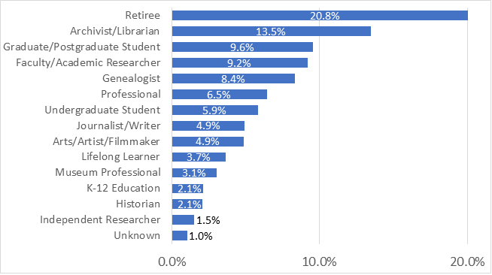
Pop-up Users, by profession
Notes:
We looked across all of these persona projects and identified commonalities, and put together these composite user types against which to compare our data. We are now working on cluster analysis of the Pop-Up survey results to see if they align with these persona types, to help us guide selection of users for our 1:1 semi-structured interviews

Slide 23
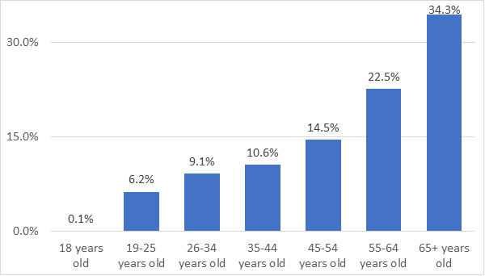
Pop-up Users, by age
Notes:
We looked across all of these persona projects and identified commonalities, and put together these composite user types against which to compare our data. We are now working on cluster analysis of the Pop-Up survey results to see if they align with these persona types, to help us guide selection of users for our 1:1 semi-structured interviews

Slide 24
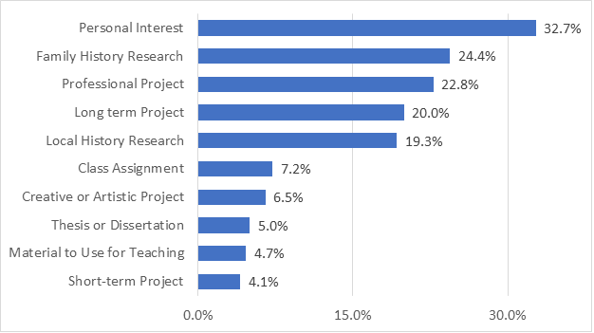
Pop-up Users, by project purpose
Notes:
We looked across all of these persona projects and identified commonalities, and put together these composite user types against which to compare our data. We are now working on cluster analysis of the Pop-Up survey results to see if they align with these persona types, to help us guide selection of users for our 1:1 semi-structured interviews

Slide 25
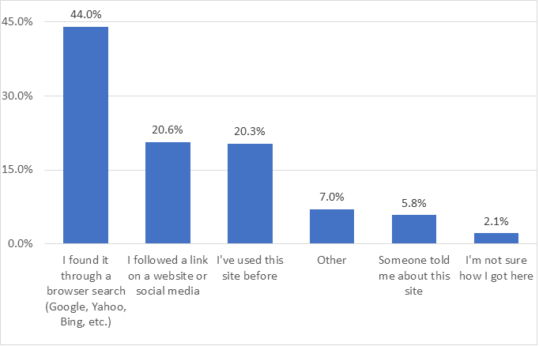
How Pop-up Users Found the Archival Aggregator Website
Notes:
We looked across all of these persona projects and identified commonalities, and put together these composite user types against which to compare our data. We are now working on cluster analysis of the Pop-Up survey results to see if they align with these persona types, to help us guide selection of users for our 1:1 semi-structured interviews

Slide 26
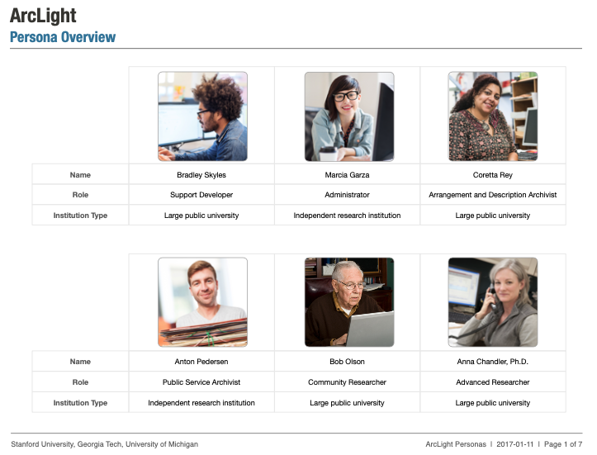
Notes:
As I mentioned previously, there are a number of good projects out there that had created archival user personas in service of archival discovery software projects. This is one example from the ArcLight project led by Stanford, as well as for the Rockefeller Archives Center’s Project Electron, and the ArchivesSpace public user interface development.
Stanford University Libraries, Georgia Tech, and University of Michigan. (2017). ArcLight Personas. Stanford Digital Repository. Available at: https://purl.stanford.edu/hk349dn1751

Slide 27
Previous Personas
Strong work on archival personas in service of software projects (Rockefeller Archives, ArcLight, Orbis Cascade)
Commonalities across the personas for persons that visit or work in archives
Pop-Up Survey
3300 complete responses allows a quantitative approach to grouping users (Two-step cluster analysis)
Semi-Structured Interviews
Invited interviewees are identified by their persona cluster
25 interviews, 5 per each persona type
Researchers: Personas
Notes:
We conducted a pop-up survey data from March-May, hosted by 12 aggregators.
We had a total of 4354 responses that yielded 3300 complete, usable responses. This was much more than we expected and we are quite pleased the response.
We have begun data analysis and it is ongoing.
We will also be conducting individual semi-structured interviews with end users, identified through the pop-up. Interviews will be digitally recorded and transcribed for coding and analysis. We will use NVivo to code responses to the open-ended questions using a codebook we will develop from emerging themes.

Slide 28
Archival User Types
Academic – K-12, undergrad
Advanced Academic – Faculty, graduate student, post-doc
Enthusiast – local history, genealogy, personal interest
Professional – author, documentarian, journalist, lawyer
Archivist – public service, technical services, curatorial
Notes:
We looked across all of these persona projects and identified commonalities, and put together these composite user types against which to compare our data. We are now working on cluster analysis of the Pop-Up survey results to see if they align with these persona types, to help us guide selection of users for our 1:1 semi-structured interviews

Slide 29
NAFAN User Types
Archivist/Librarian & Other Professionals – public and technical service archivists/librarians, journalists, writers, tradespeople
Faculty and Other Doctorates – faculty, post-doc, independent researcher, museum professionals
Family History Researchers– local history, professional genealogist, hobbyist genealogist
Personal Interest Researchers – general search with a range of profession and education
Undergraduates and Postgraduates – Indicate their profession is undergraduate/postgraduate student
Notes:
We looked across all of these persona projects and identified commonalities, and put together these composite user types against which to compare our data. We are now working on cluster analysis of the Pop-Up survey results to see if they align with these persona types, to help us guide selection of users for our 1:1 semi-structured interviews

Slide 30
Finding Aid Data Research questions and Methods
Notes:
Next, we’ll take a look at quantitative data analysis work that is focused on finding aid data.

Slide 31
What is the structure and extent of consistency across finding aid data in
current aggregations?
Can that data support the needs to be identified in the user research phase of the study? If so, how? If not, what are the gaps?
Finding Aid Data:
Research Questions
Notes:
OCLC Research is carrying out quantitative data analysis with a representative sample of finding aids from the NAFAN project participants.
We’re investigating the structure, content, and consistency of finding aid data, as we prepare to be ready to evaluate questions and needs that are identified in the user research phase of the study.

Slide 32
Phase 1: Dimensions for analysis
Search: all discovery systems have a keyword search function; many also include the ability to search by a particular field or element.
Browse: many discovery systems include the ability to browse finding aids by title, subject, dates, or other facets.
Results display: once a user has done a search, the results display will return portions of the finding aid to help with further evaluation.
Sort: once a user has done a search, they may have the option to reorder the results.
Facet: once a user has done a search, they may have the option to narrow the results to only include results that fall within certain facets.
Notes:
An EAD Tag Analysis study that OCLC carried out in 2013 worked with a different aggregation of EAD documents, based on about 120,000 finding aids drawn from OCLC’s ArchiveGrid discovery system.
That analysis looked at EAD tag and attribute usage from a discovery perspective, identifying these five high-level features that were often present in discovery systems.
Searching, by keywords or by specific fields, is a common discovery feature, as is the ability to browse across documents by facets of various kinds.
The content of search result displays are in the critical path of discovery … the display elements help researchers disambiguate and select relevant resources.
And some data elements may be used to sort or narrow a search result.

Slide 33
EAD elements that impact discovery
Dates
unitdate
Extent data
extent
Collection title sources
unittitle, titleproper/@type=filing
Content tags in dsc
corpname, famname, function, genreform, geogname, name, occupation, persname, subject
Content tags in origination
corpname, famname, name, persname
Content tags in controlaccess
corpname, famname, function, geogname, name, occupation, persname, subject
Material type
controlaccess/genreform
Repository information
repository
Notes
abstract, bioghist, scopecontent
Derived from "Thresholds for Discovery: EAD Tag Analysis in ArchiveGrid, and Implications for Discovery Systems" published in code4lib Journal issue 22.
Notes:
The EAD tag analysis used that framework of high-level discovery features to select EAD elements and attributes that, if present, could be accessed, indexed, and displayed.
This is the categorization of EAD elements and attributes that the study found to be relevant for supporting discovery system features.
For example, dates could potentially be search terms, the basis for browsing or sorting, and important for disambiguating similarly named collections in displays.
Or material types, represented by form and genre terms, could be important for narrowing a large result using a facet.
The question then was, how often are they used?

Slide 34
Defining Thresholds for Discovery
Notes:
OCLC’s 2013 study developed these usage thresholds after evaluating the EAD aggregation, and we re-used them for the NAFAN data analysis.

Slide 35
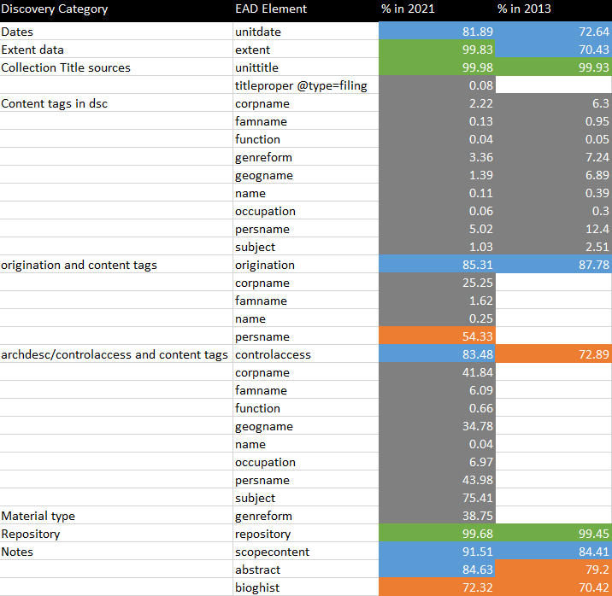
Defining Thresholds for Discovery
Notes:
This color-coded table compares the usage thresholds from the 2013 study (on the right) with the same tag analysis applied to the NAFAN corpus in 2021 (on the left).​
You may notice that there are some elements that we have added for analysis in the 2021 study, and therefore lack an entry in the 2013 column.
This is thanks to input from the NAFAN project team and the advisory board on additional EAD elements of interest. That input has helped to breathe new life into old research.​
​The findings of the earlier study in 2013 were decidedly mixed.
Some important elements were at the high or complete thresholds.
But many elements that are necessary for discovery interfaces were at medium or low use.
Though the NAFAN EAD aggregation is a different corpus of data provided by different contributing institutions at a different time, the EAD tag analysis for it hasn’t changed dramatically. ​
Some elements have moved from the high threshold to complete, and some from medium to high.
We found that use of content tags in the EAD origination and archdesc controlaccess elements, which had not been evaluated in the 2013 study, mostly were getting closer to medium or high level usage.
Apart from that, the 2013 study’s appraisal of how well EAD supports the typical features of discovery systems could be considered mostly unchanged.​
This may be due in part to the static nature of some finding aids. Once written and published, some EAD documents may not receive further updates and improvements.
In an evaluation of finding aid processing dates from one of the NAFAN partners, we noted that 2/3’s had not been updated in the last 5 years, and 1/3 had not been updated since the time of our 2013 study.
So, it is not too surprising that the analysis results for a similar set of data would not show dramatic shifts.

Slide 36
Phase 2: More research opportunities
Finding aid links to digital content
Specifying physical characteristics and genre
Content element value connections to controlled vocabularies
Consistency of institutional contact information
Informing researchers about access to, use of, and reuse of materials
Notes:
Though replicating the 2013 EAD Tag Analysis was an important step to confirm what we previously understood about the content and character of EAD finding aids, it only scratched the surface of what’s left to learn.
While OCLC’s qualitative research is still being carried out, we can pursue other quantitative research now to learn more about the NAFAN finding aid aggregation.
Here are some of the areas that we’re investigating:
What is the linking potential of the NAFAN EAD finding aids?
What is the completeness and consistency of the description of collections' physical characteristics and genre?
Are content element values associated with controlled vocabularies, or can they be?
Is institutional contact information in EAD finding aids consistent and reliable?
How do EAD finding aids inform researchers about access to, use of, and reuse of materials in the described collections?
We have preliminary results for two of these studies that I can share now.

Slide 37
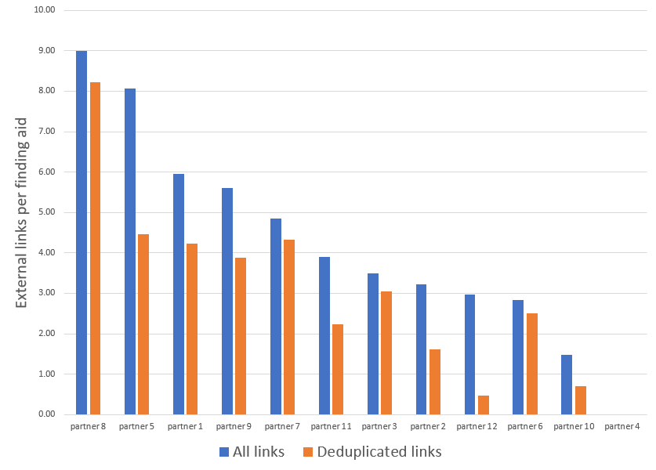
Finding aid links to digital content
EAD elements
a
archref
bibref
dao
daoloc
extptr
extref
extrefloc
ptr
ref
title
Notes:
A first step in analyzing links was to extract the link URLs from the EAD elements and attributes that are designed for connecting to external resources.
Those EAD elements are shown here.
We focused on “external” links, that is, URLs that led to a digital resource somewhere on the web rather than links within the same EAD document.
Those external resources could belong to the same institution that created the finding aid.
This graph shows the average number of external links per finding aid for each NAFAN partner, ranging from a high of 9 links per finding aid to a partner that did not make use of external links.
Those counts are represented by the blue bar in the chart, while the orange bar represents the average # of links per finding aid after de-duplicating the links.
For some institutions, even after de-duplicating their links the average # per finding aid doesn’t drop very much, but for other institutions it drops quite a bit, suggesting that (in the latter case), the same external resources are linked to from many or most of their finding aids, while in the former case the range of linked resources is more varied, if not richer.

Slide 38
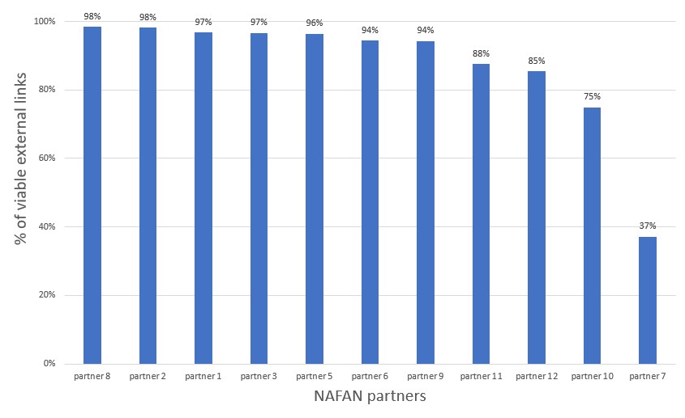
Finding aid links to digital content
Notes:
We also tested the viability of external links.
The decay of link quality is a common and pervasive issue on the web, and the issue tends to correlate with the amount of time that has passed since the document was last updated.
For example, a recent study of external links in New York Times articles from between 1996 and 2019 found that 25% of links were inaccessible.
Since a fair amount of the NAFAN EAD document corpus may not have been updated in several years, we wondered whether we would find a similar reduction in their link accessibility occurring over time.
We found over 600,000 unique external links in the NAFAN data.
And we have tested a 25% sample of those links.
Overall, link quality is much better than what might have been expected given what has been reported in other studies for web link quality in general, and for most NAFAN partners the link quality is excellent.
Though we do not have conclusive evidence yet to support this correlation being a cause, it may be that the use of persistent identifiers and URLs is a more consistently followed practice in library and archives data, and therefore has avoided some of the decay in quality that we see elsewhere on the web.
For example, one NAFAN contributor used persistent URLs, from at least 5 different URL providers, for around half of their external links.

Slide 39
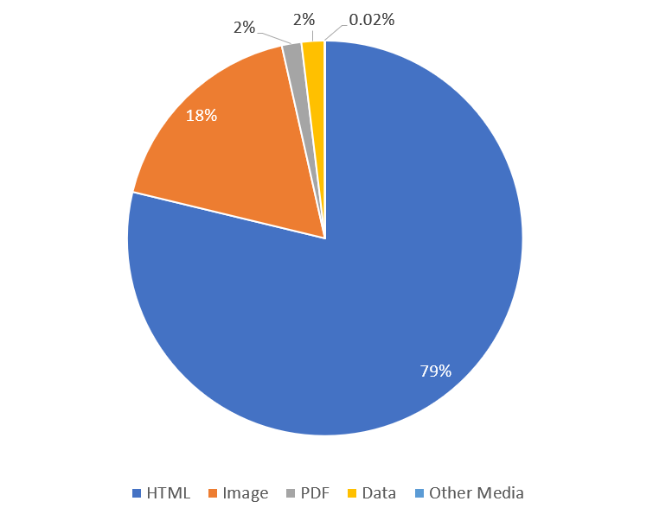
Finding aid links to digital content
Notes:
We also examined the responses for the external links that we successfully tested.
The resulting percentages of Media Types is misleading, but we can’t tell yet by how much.
There likely are many links to HTML resources, but the 79% percentage is too high, if we consider the user experience of some of those resources.
For many of the HTML resources, the web page is used to provide a framework for presenting the core content which may be an image, streaming media, or an embedded PDF document.
A more in-depth review of the HTML resources would be needed to derive a more accurate assessment.

Slide 40
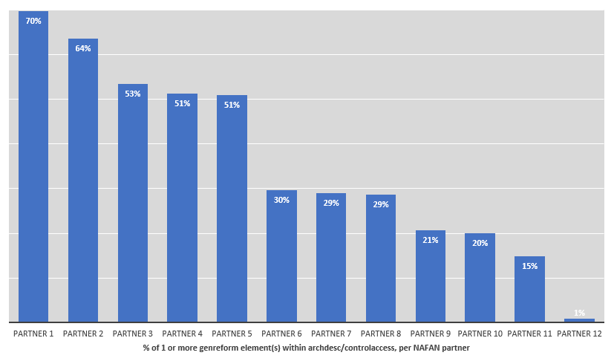
Physical characteristics and genre
Notes:
The OCLC Research pop-up survey revealed an interest in a broad range of materials, including some materials that may not be expected to be commonly included in the types of archival collections described by finding aids: periodicals, newspapers, and other published content.
What can EAD documents tell us about the form and genre of the materials in their associated collections?
The NAFAN Data Dashboard shows how widely the "genreform" element for Genre or Physical Characteristics is used within archdesc/controlaccess (where controlled access terms are expected to be representative of all or most of the collection).
The analysis indicates that at least one genreform term is present in this upper level of controlaccess for about 38% of the NAFAN finding aids.
The presence of a genreform term varies considerably across the range of NAFAN participant aggregations, with some making little use of this element directly in archdesc/controlaccess while several participants include it in 50% or more of their finding aids.

Slide 41
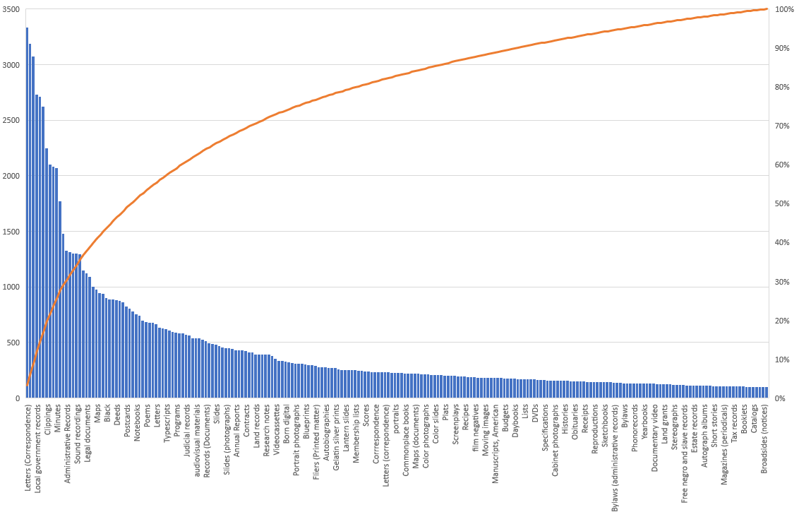
Physical characteristics and genre
Notes:
After normalizing and clustering the genreform element values there were over 5,300 distinct terms, which seems high for an element that might be expected to draw from a more limited range of values.
A wide range of controlled vocabularies, including local ones, were used as sources which would expand the set of distinct terms.
While the number of distinct values is high, their occurrence counts reflects a very long tail, with 84% of the distinct terms used in fewer than 10 different EAD documents.
This chart represents the other end of that scale, including the 228 genreform terms that were found in 100 or more different EAD documents.

Slide 42
Phase 2: More research opportunities
Finding aid links to digital content
Specifying physical characteristics and genre
Content element value connections to controlled vocabularies
Consistency of institutional contact information
Informing researchers about access to, use of, and reuse of materials
Notes:
These results, as noted before, are preliminary. As this data analysis work is completed, we’ll be summarizing the results for others to read and review.

Slide 43
Thank you! Any Questions ?

