Slide 1
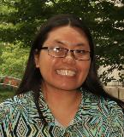
Developing a Boot Camp Program for Graduate Student Success at Rutgers University-Newark
Presented by:
Bonnie L. Fong
Physical Sciences Librarian/Graduate Student Services
Rutgers University-Newark
bonnie.fong@rutgers.edu
OCLC Works in Progress Webinar • December 9, 2021

Slide 2
Some Background Info.
Performed assessment of graduate students needs:
Created “Graduate Student Support” group:
Apply for a 2-year Chancellor’s Seed Grant: 2017-2018
Grant skills | Career-related skills
Research skills (e.g., info. literacy) | Data & digital humanities skills
Theses writing (& publishing) | Scholarly communication
Teaching-related skills | Technology-related skills
Library | Computer Services
Graduate School-Newark | Research Office
Writing Center | Career Development Center
Learning Center | P3 Collaboratory

Slide 3
Overview of Boot Camps
“Boot Camps for Graduate Student Success” funded!
$25,000
6 boot camp themes:
1/more sessions of each theme were taught & recorded
Registration per boot camp was limited to 20 or 30 students
Full day or 2-day boot camps were scheduled for before/after Fall/Spring semesters
Project site: https://libguides.rutgers.edu/bootcamps
Data Skills (2x) | Presentation Skills (1x)
Grant Skills (3x) | Research Impact & Promotion (1x)
Literature Research Skills (3x) | Writing & Publishing Skills (5x)
Notes:
Project site: https://libguides.rutgers.edu/bootcamps
Article about this initiative:
Bonnie L. Fong, “Boot Camps for Graduate Student Success: A Collaborative Initiative,” Journal of Library Administration, 59, 4 (2019): 373–94 https://doi.org/10.1080/01930826.2019.1593710

Slide 4
The Budget
Budget allocation of $25,000 grant:

Slide 5
Data Skills (2-day)
Goal:
provide students with the introductory computational skills needed for data management and analysis in all domains of research, covering the full lifecycle of data-driven research; students learn how to do analyses and how to manage the process to make it as automated and reproducible as possible
Agenda:
Instructors:
volunteer instructors via Data Carpentry
($2,500 workshop coordination fee + travel expenses for instructors)
3-4 helpers – librarians and/or graduate students
$-savings tip: consider teaching the freely available CC-BY Data Carpentry lessons yourself
data organization with Excel & OpenRefine | data analysis
Python [Jan. 2018] or R [May 2018] | SQL
Notes:
Data Carpentry website: https://datacarpentry.org/

Slide 6
Grant Skills (1-day)
Goal:
increase student confidence in applying for grants
Agenda:
Instructors:
senior staff member in the Research Office
science faculty with outstanding records for winning grants
library faculty with experience writing & searching for grants
Student interest tip:
hands-on experience writing at least part of a grant
how to handle the budget portion
hands-on experience searching for grants
the Research Office’s role
writing effective grant applications (NEH, NIH, NSF);
grants searching (Foundation Directory Online; funding agency site)

Slide 7
Literature Research Skills (2-day)
Goal:
prepare students in doing literature research at the graduate school level; teach skills such as using the library catalog, databases, and Internet search strategies, how to conduct literature reviews, current awareness tips, citation management tools, and how to cite sources (to avoid plagiarism)
Agenda:
Instructors:
library faculty
research question formulation | dissertations
overview of finding information | internet searching
books & media | evaluating sources
indexes & databases | plagiarism
citation management tools | literature review

Slide 8
Presentation Skills (1-day)
Goal:
increase student confidence in giving oral presentations and presenting posters; learn how to give effective presentations, from design to speaking skills
Agenda:
Instructors:
part-time lecturer on campus ($)
professional speaker ($)
$-savings tip:
consider faculty, staff, or students – these could be free or low-cost
poster presentations (including PhotoShop)
oral presentations: “Presenting Dense Information in Public Forum”

Slide 9
Research Impact & Promotion (1-day)
Goal:
help students identify strategies for increasing the visibility and impact of their research
Agenda:
Instructor:
librarian
Hands-on tip:
ask students to bring their CV so they can populate the different sites/platforms they’re introduced to (e.g., ORCID, Academia.edu, ResearchGate)
how to measure research impact
strategies for increasing research impact
strategies for promoting research to increase visibility

Slide 10
Writing & Publishing Skills (2-day)
Goal:
prepare students on writing their dissertations and provide them with tips on how to successfully publish while in graduate school or shortly thereafter
Agenda:
Instructors:
Writing Program instructors on-campus ($)
Student interest tip:
separate into two 1-day boot camps: Critical Reading & Writing Skills and Dissertation Completion & Publishing
critical reading strategies | the dissertation process
the research notebook & research process | writing a proposal
critical writing & evaluating sources | getting your work published
attribution & citation
editing & revision

Slide 11
A Few Numbers
Total # of boot camp sessions offered: 17
646
registered for the boot camps
407
invited to join the boot camps (some were capped at 20, others at 30)
177
attended the boot camps (so 43.5% of those invited/accepted)

Slide 12
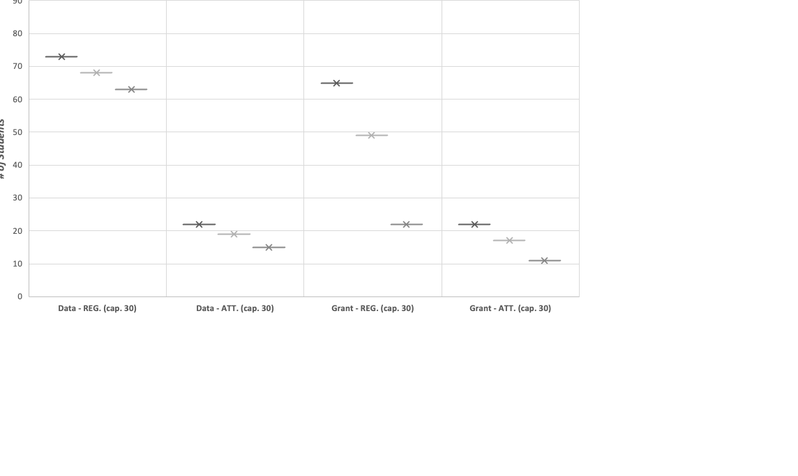
Registration vs. Attendance ⁽¹⁾

Slide 13
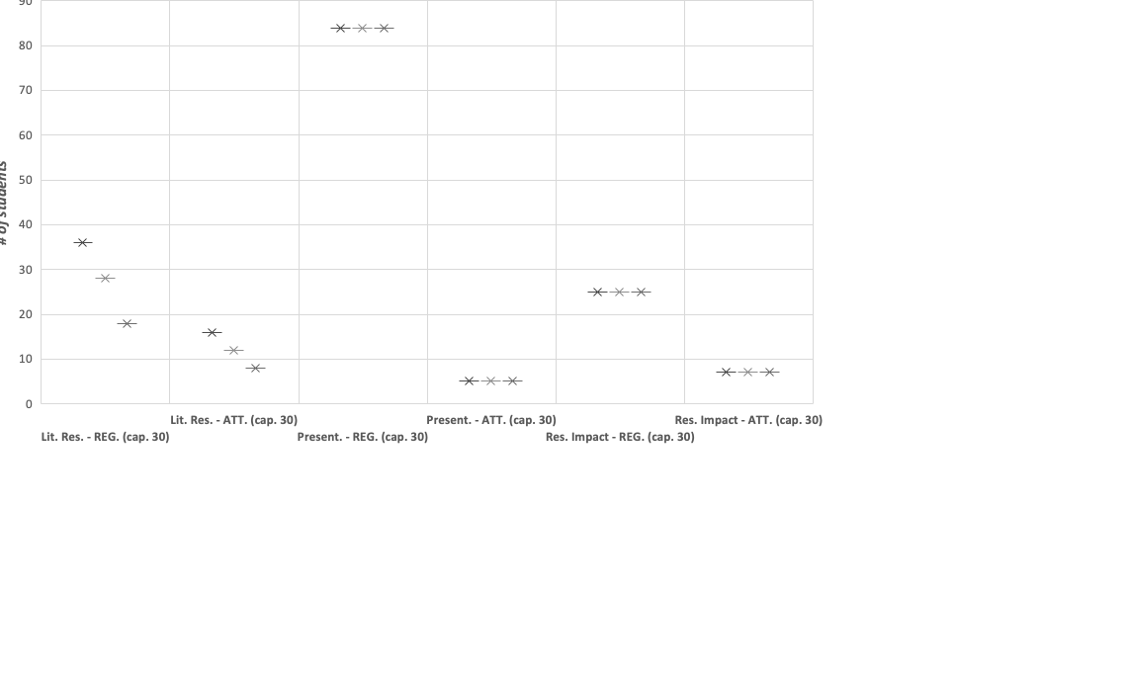
Registration vs. Attendance ⁽²⁾

Slide 14
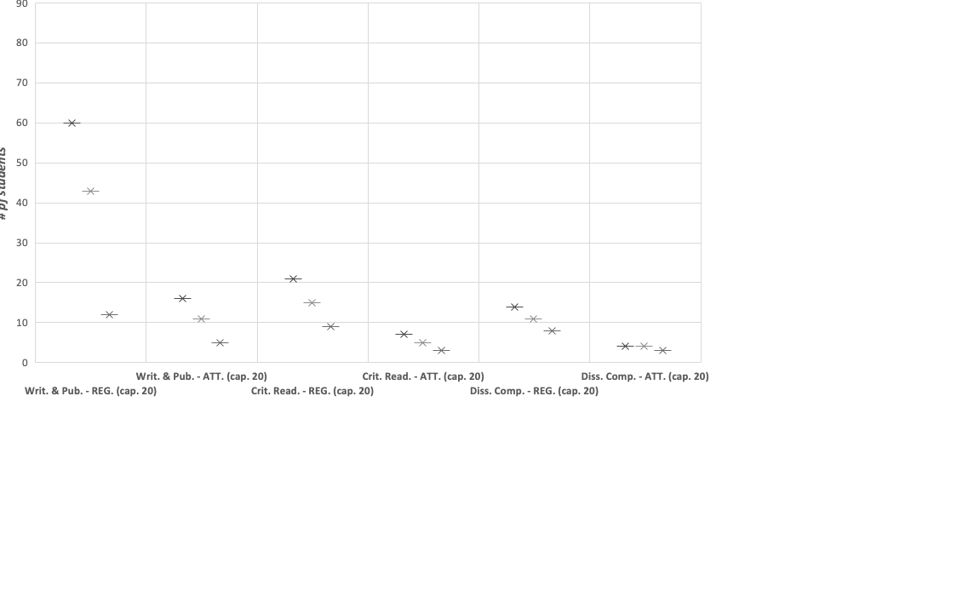
Registration vs. Attendance ⁽³⁾

Slide 15
Student Assessment
Students completed pre- and post-boot camp assessment forms
their confidence levels for theme-related skills were higher post-boot camp
they found the boot camps helpful & valuable
99% would recommend the boot camps to other graduate students in their department
Students learning about the boot camps after they finished expressed interest in seeing them offered again

Slide 16
Co-PI & PI Reflections
Thrilled about the success of the boot camps
lots of student interest
greater percentage of students attending (compared with workshops)
positive student feedback on assessment forms & verbally during or at end of sessions
positive feedback & encouragement from faculty & administrators hearing about how the boot camps went
Some concerns about attendance figures
Interest in continuing, but have not done so (yet?) due to varying reasons

Slide 17
Now & In The Future
Now:
Co-sponsoring workshops/webinars with Graduate School
Registration & attendance has been decent
Attempting a “Literature Research Skills” webinar series
In the future:
Free January boot camps?
Tailoring boot camps for specific departments/schools?

Slide 18
Summary of Takeaways
1st assess student needs & preferences for programming
Find out what the students are interested in learning
Find out when they prefer to attend workshops/boot camps
January seemed to be best for Rutgers-Newark students
Collaborate with others
Helps with promotion & expanding the type of content offered
Can lower costs (possibly to $0) by leveraging others’ expertise
Stay in touch & consider how you can help each other
Apply or ask for funding
Apply for official grants or ask for support from units with funding

Slide 19
Resources
Bonnie L. Fong, Minglu Wang, Krista White, and Roberta Tipton, “Assessing and Serving the Workshop Needs of Graduate Students,” Journal of Academic Librarianship, 42, 5 (September 2016): 569–80 https://doi.org/10.1016/j.acalib.2016.06.003
Bonnie L. Fong, “Boot Camps for Graduate Student Success: A Collaborative Initiative,” Journal of Library Administration, 59, 4 (2019): 373–94 https://doi.org/10.1080/01930826.2019.1593710
Project site: https://libguides.rutgers.edu/bootcamps
Data Carpentry website: https://datacarpentry.org

Slide 20
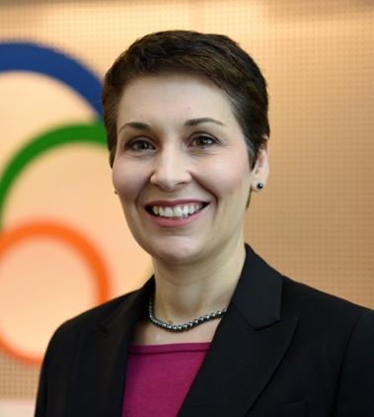
Questions?
bonnie.fong@rutgers.edu
Bonnie Fong
Rebecca Bryant
ACKNOWLEDGEMENTS
I would like to thank Rutgers University-Newark’s Chancellor Nancy Cantor for sponsoring this Chancellor’s Seed Grant project; my co-PIs, Marne Benson, Al Brown, Kinna Perry, Minglu Wang, and Ann Watkins, for their efforts in making this a successful initiative; and all instructors, helpers, students, and support staff for the various ways in which they contributed to this success.
Notes:
My email address: bonnie.fong@rutgers.edu

