Slide 1
What Comes Next?
Grappling with Data, Reconsidering Workflows, and Expanding Collaboration Following a Large-Scale Collection Survey
Weatherly Stephan, Shannon O’Neill, and Kimberly Tarr
2021 January 12

Slide 2

Chela Scott Weber
Sr. Program Officer, OCLC Research Library Partnership

Slide 3
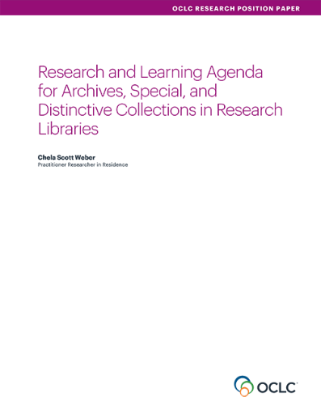
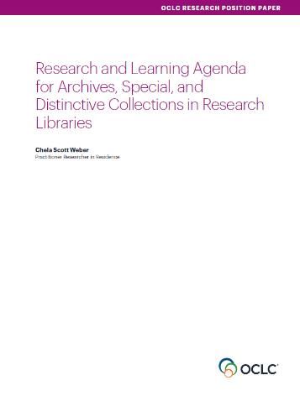
Our Work in Archives, Special, and
Distinctive Collections:
oc.lc/rlp-agenda
Notes:
As many of you who regularly attend our webinars will have heard me say before - OCLC Research has a long history of work in the area of archives, special, and distinctive collections in research libraries. We work in special collections because they are an important site of knowledge creation, made possible by library’s commitment to the stewardship of their distinctive collections. The unique nature of material in special collections can make scaling a challenge, and we work to identify areas of common need and patterns of innovation to help libraries scale learning and expertise with these collections.
Part of that history of work is our Research & Learning Agenda for Archives, Special, and Distinctive Collections.
articulates the shared challenges and opportunities research libraries are are facing in this sphere, and suggests approaches for working on them together.
Is guiding our work in this area now and into the future
One of the major issues surfaced in the agenda is the continuing challenge to responsibly steward the collections that we hold in trust, with descriptive, preservation, and reformatting backlogs continuing to plague us.
This challenge has been a topic of conversation for as least as long as I’ve been an archivist, and in the last decade or so collection surveys have been an important tool in assessing and addressing our backlogs.

Slide 4
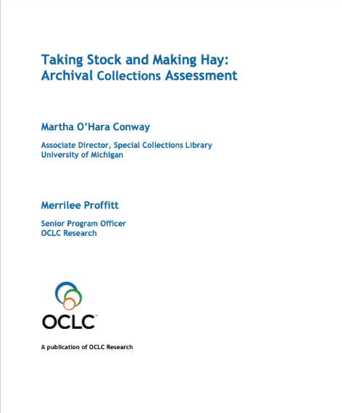
Our Work in Archives, Special, and
Distinctive Collections:
Notes:
Conway, Martha O'Hara, and Merrilee Proffitt. 2011. Taking Stock and Making Hay: Archival Collections Assessment. Dublin, OH: OCLC Research. https://doi.org/10.25333/C33S6M.

Slide 5
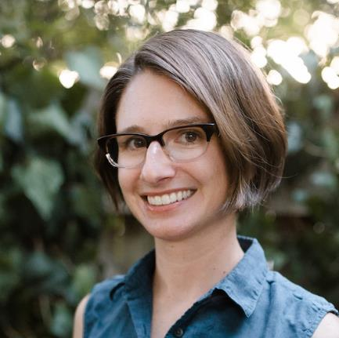
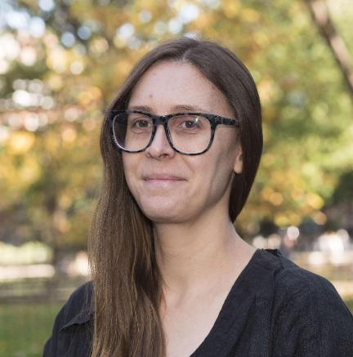

Hello!
Weatherly Stephan
she/her
Shannon O’Neill
she/her
Kimberly Tarr
she/her

Slide 6
Outline of Today’s Talk
Overview of project at NYU
Perspectives on the project, its deliverables, and outcomes
What next steps we’re looking to with the data we collected

Slide 7
Collections Control Project
Overview

Slide 8
Thank you, project staff!
Student Assistants:
Abbie Auster
Michael German
Marissa Grossman
Ahmed Hafezi
Sandra Lolic
Kristen Joy Owens
Archivists:
Shirin Khaki
Jasmine Larkin
Jennifer Neal
Jackie Rider
Craig Savino
Makoroba Sow

Slide 9
Project Origins
Advocacy
Funding
Reorganization

Slide 10
Project Phases
Administrative Data Survey
Shelf Read
Collection Assessment
Offsite Processing

Slide 11
Assessment Impact on Collections Management

Slide 12
Quantifying What We Have
2,947 collections
44,450 linear feet
160+ Terabytes of born-digital records
78,000+ media items
…but what is the backlog?

Slide 13
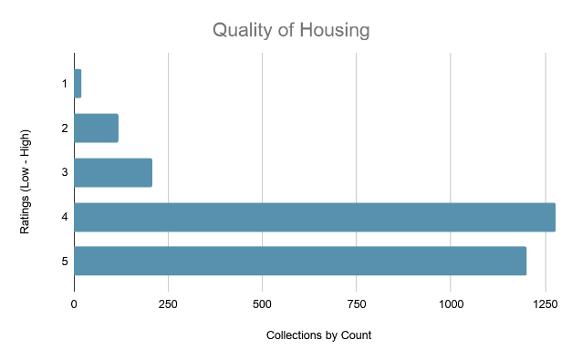
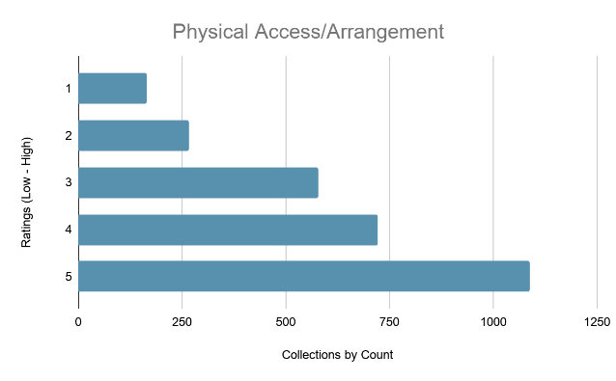
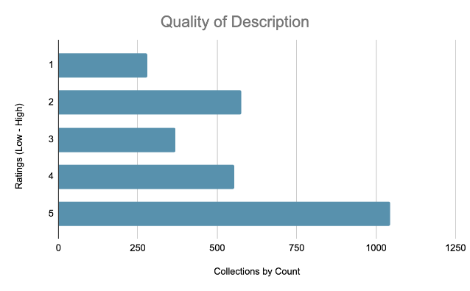
Digging into Data

Slide 14
What’s in a Backlog?
Holdings
2,947 collections
44,450 linear feet
160+ Terabytes
78,000+ media items
Backlog
1,133 collections: 38%
13,663 linear feet: 30%
156 Terabytes: 97.5%
60,000 media items: 77%

Slide 15
What’s in a Backlog?
From 13,663 l.f (35 FTE years):
9 collections measuring 175-400 l.f. make up 17% (2,380.84 l.f. total)
4850.64 l.f. (35%) from accretions or processed portions of collections
15% of backlog collections measure <10 l.f.

Slide 16
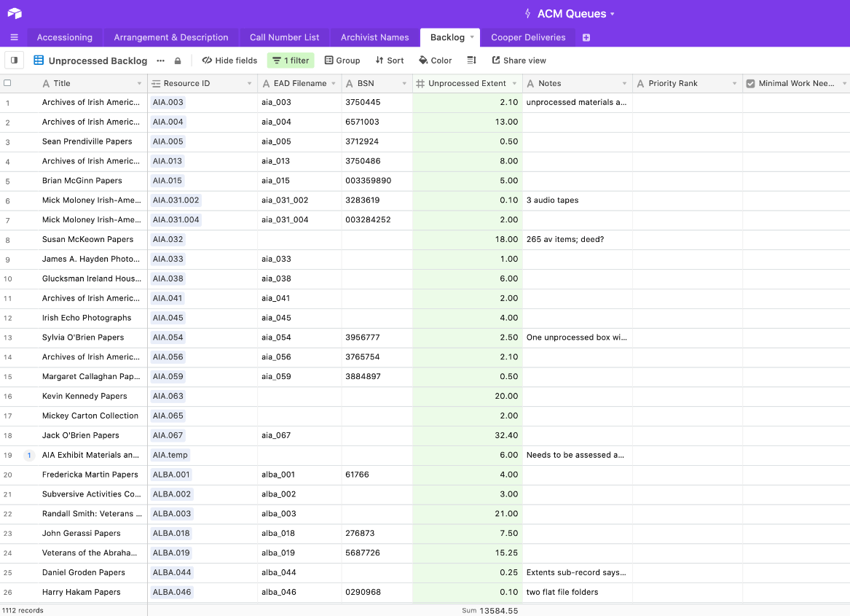
Prioritizing

Slide 17
What will our future assessment tool look like?

Slide 18
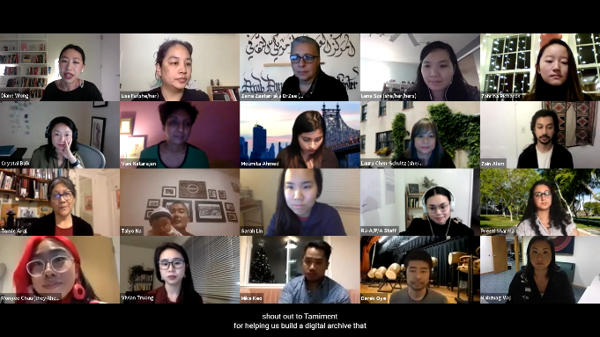
Assessment Impact on Curatorial Work
Still from Zoom recording of “On Community Care: Documenting A/P/A Voices during COVID-19” 12/3/2020

Slide 19

Image of the NYU Special Collections Department’s newly renovated exhibition and reception spaces on the 2nd Floor of Bobst Library, NYU Libraries.

Slide 20
“What you pay attention to grows.” -- adrienne maree brown in Emergent Strategy: Shaping Change, Changing Worlds

Slide 21
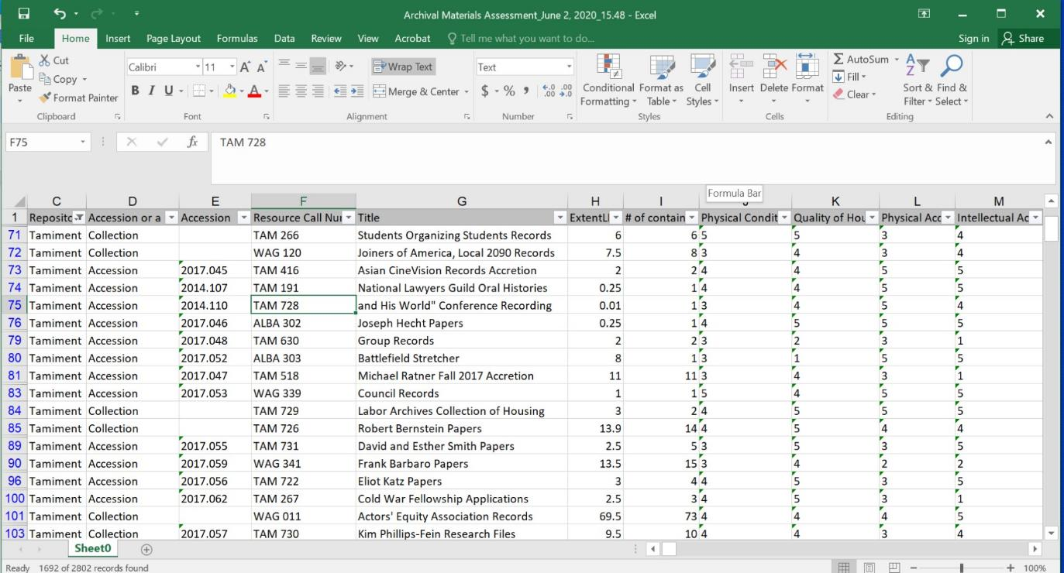
Image of an Excel spreadsheet snapshot, demonstrating the Tamiment assessment data and backlog

Slide 22
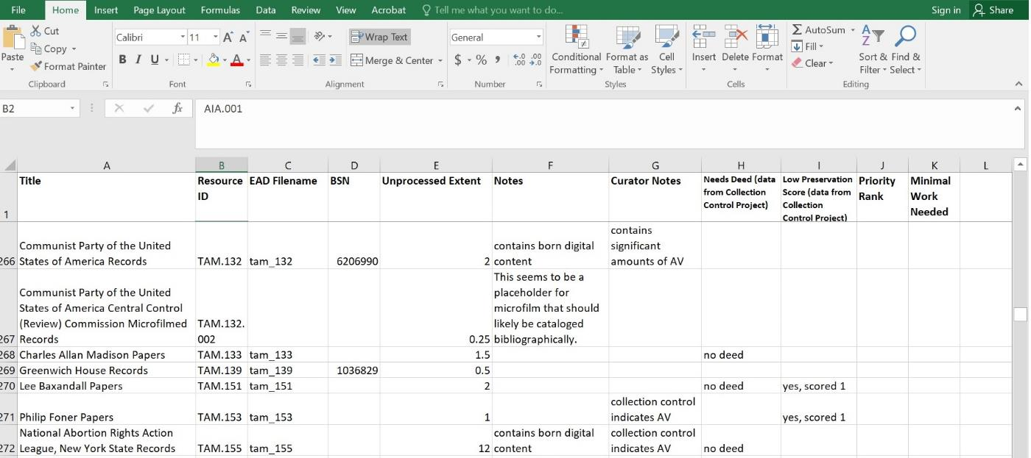
Looking to the Past...
Image of an Excel spreadsheet snapshot, demonstrating curatorial application of assessment data.

Slide 23
… to Inform the Future:
Appraisal and Retrospective Appraisal
Collection Development
Setting Processing and Preservation Priorities
Collections Advocacy

Slide 24
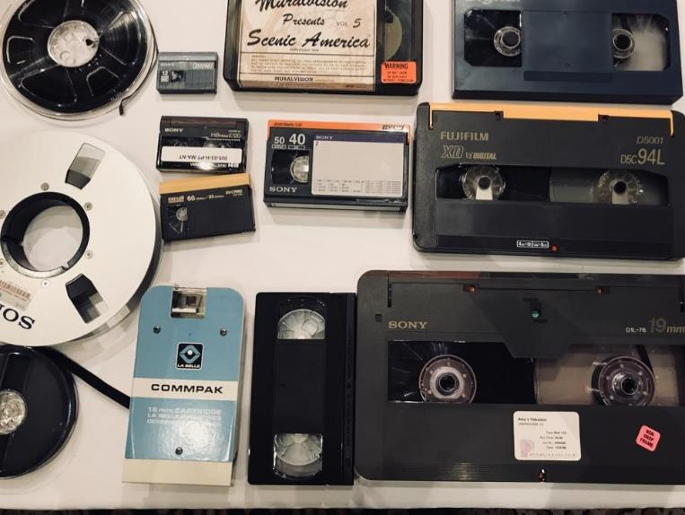
Assessment Impact on Preservation Priorities

Slide 25
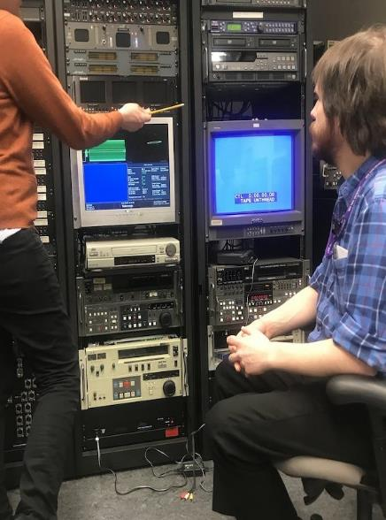
NYU Libraries
Media Preservation Unit
Film Inspection, Conservation, and Scanning
Video Inspection, Conservation, and Preservation Reformatting
Audio Inspection, Conservation, and Preservation Reformatting

Slide 26
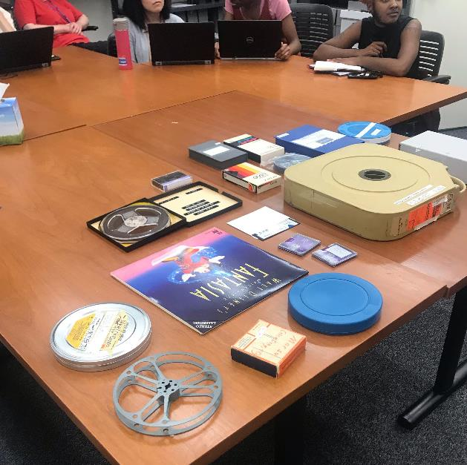
Format Identification Support
In person training
Resources:
  Preservation Self-Assessment Program, University of Illinois
  Videotape Identification and Assessment Guide, Texas Commission of the Arts (2004)
“Identification, Care, and Handling of Special Collections AV Materials” training held at NYU Libraries
Notes:
Resources
Identifying and Dating Archival Audiovisual Formats
The following resources are helpful for identifying analog audiovisual formats:
All formats
The University of Illinois Preservation Self-Assessment Program (PSAP) Collection ID Guide is the most comprehensive illustrated guide: https://psap.library.illinois.edu/collection-id-guide/#audiovisual
The Museum of Obsolete Media is a good place to find information about rare formats: http://www.obsoletemedia.org/
Video
Texas Commission on the Arts Video Identification and Assessment Guide includes videotape formats introduced between 1956 and 1999: http://www.arts.texas.gov/wp-content/uploads/2012/04/video.pdf
Video Preservation Website, Video Format Identification Guide to videotape formats introduced between 1956 and 1995, so is slightly less complete but is in a more handy, web-based document: http://videopreservation.conservation-us.org/vid_id/index.html
The National Archives’ online Archival Formats manual has a page on identifying video: http://www.archives.gov/preservation/formats/video-identify-formats.html
Audio
The Indiana University “Format Characteristics” manual for audio recordings is a lengthy but comprehensive document on archival sound recordings with more details than the PSAP guide. Use the table of contents to find dates for each of the general formats: http://www.dlib.indiana.edu/projects/sounddirections/facet/facet_formats.pdf
The National Archives’ online Archival Formats manual has a page on identifying audio: http://www.archives.gov/preservation/formats/audio-identify-formats.html
Motion picture film
The National Archives’ Archival Formats manual has a page on identifying motion picture film: http://www.archives.gov/preservation/formats/motion-picture-film-identify-formats.html
Little Film.org has visual aids and dates for small-gauge film (8-16mm): http://www.littlefilm.org
Film can be dated by looking for edge code (usually plus signs, circles, squares, and triangles at the edge of the film) that correspond to the date of manufacture. If you find an edge code on a reel of film, you can look the dates up on the edge code chart and know a proximate date of the film’s content: http://www.filmforever.org/Edgecodes.pdf

Slide 27
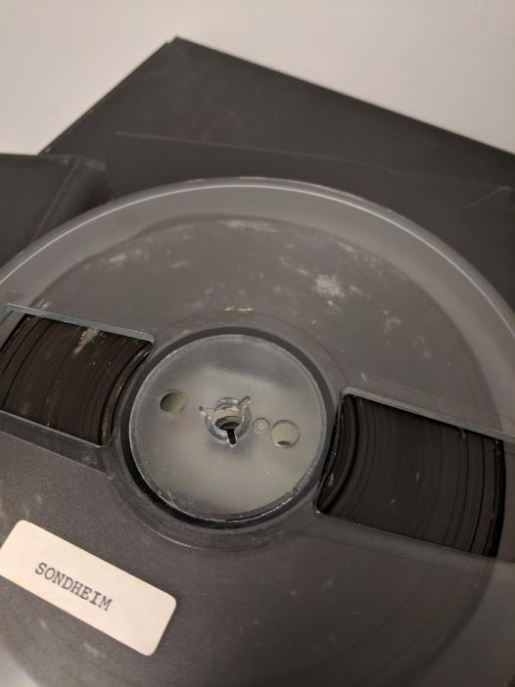
Support During CCP
“What is this?” -- Formats that flummoxed staff or required preservation support for inspection
Appropriate housing
Condition Issues:
  Potential mold
  Acetate deterioration (“vinegar syndrome”)

Slide 28




Collections Control Survey:
What the Data Revealed
Confirmation of assumptions
New discoveries

Slide 29
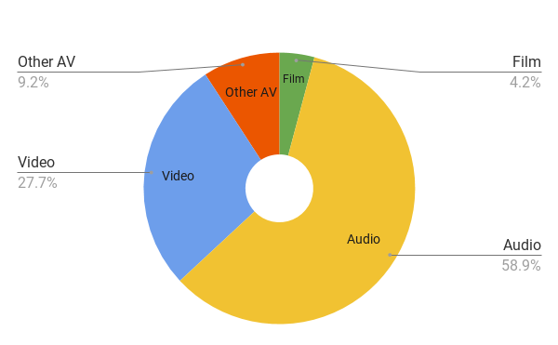
Audiovisual Formats
By Media Type

Slide 30
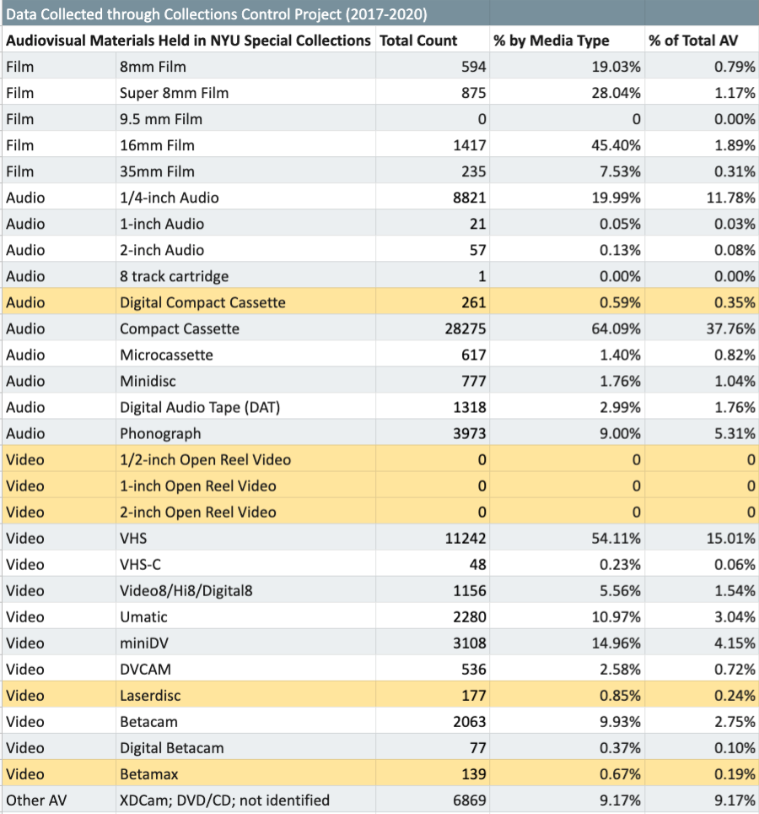
Data Review

Slide 31
What’s Next for Us?

Slide 32
Our Near Future
Stronger collaboration
Advocacy with meaningful data
Communicating our work
Partnering with Development
Understanding the cost of stewardship/value of appraisal

Slide 33
THANK YOU ALL!
Email us at:
Weatherly Stephan was227@nyu.edu
Shannon O’Neill smo224@nyu.edu
Kimberly Tarr kst237@nyu.edu

Slide 34



We’d love to answer your questions!
Weatherly Stephan
she/her
Shannon O’Neill
she/her
Kimberly Tarr
she/her
Chela Weber
she/her

