Slide 1
Linked Data Research
Notes:
This short powerpoint will take a look back at the last decade of activities around linked data research at OCLC.
It accepts the premise that the library community is in the midst of a transformative change in the culture of knowledge work and metadata architecture.
It’s not intended to be a linked data primer or define the concepts that make up that effort.
It is a review of a decade’s worth of applied research that has led to the current effort to build a sustained and scalable production service in support of a shared entity management infrastructure.

Slide 2
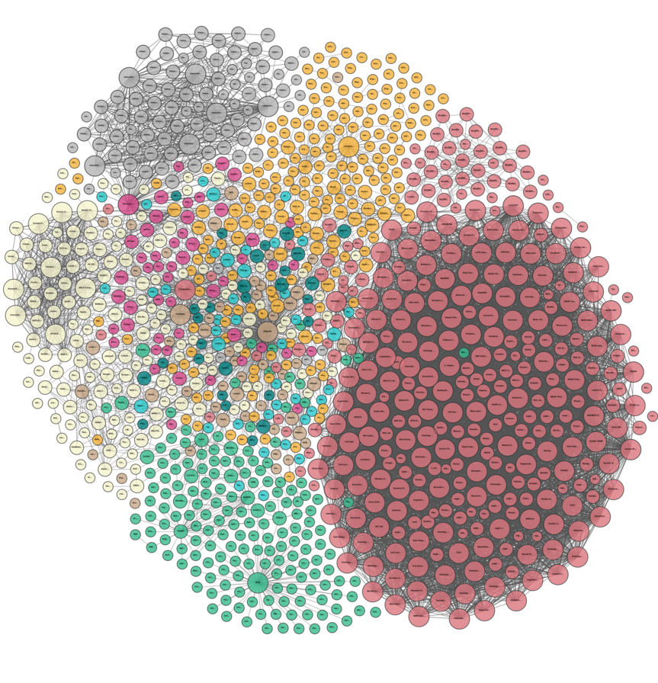
After a decade, it’s okay to keep asking, “Why linked data?”
Notes:
One way to look at linked data is through its technical definition: “A set of best practices for publishing data on the web that is interlinked with other data on the web to allow for more useful semantic queries.”
But for many that may be either incomprehensible in one extreme or superficial in another.
So, another way to look at it is through the question “why linked data?” The answer to that question is because it helps connect data, and through this process you can connect isolated systems and services which allows them to better connect people to libraries and libraries to each other.

Slide 3
Notes:
OCLC has been in this game for a long time, over a decade. And over that time, we have learned a great deal about what is needed to “do linked data at scale.”
I’m going to review this history briefly here but focus primarily on the last 2 years leading to the culminating effort to put all of the research, experimentation, and prototyping to use in an effort that extends throughout calendar year 2021.
If you want more details on the decade’s worth of projects, or even if you want some “getting started” primers on linked data, you can use the link that appears at the top of this slide.

Slide 4
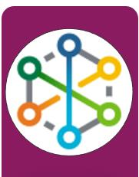
Publish linked data - FAST, VIAF, WorldCat (2009 - )
EntityJS Research Project (2013)
Person Entity Lookup Pilot (2014)
CONTENTdm Metadata Refinery (2015-16)
Project Passage (2017-18)
CONTENTdm Linked Data Pilot (2019-20)
Shared Entity Management Infrastructure (2020-21)
VIAF, FAST, and WorldCat: Publish Linked Data on the web with a UI, API, and downloadable datasets
Notes:
Our effort started over 10 years ago by making the datasets for Virtual International Authority File—VIAF—and the Faceted Application of Subject Terminology—FAST—available as linked data. This effort was extended by expressing WorldCat records themselves as linked data and exposing those entified descriptions through worldcat.org.
These efforts taught us what it meant to publish linked data on the web. Twelve years later, it’s difficult to find a library linked data effort that does not somehow include VIAF or FAST linked data.

Slide 5
Publish linked data - FAST, VIAF, WorldCat (2009 - )
EntityJS Research Project (2013)
Person Entity Lookup Pilot (2014)
CONTENTdm Metadata Refinery (2015-16)
Project Passage (2017-18)
CONTENTdm Linked Data Pilot (2019-20)
Shared Entity Management Infrastructure (2020-21)
EntityJS: Explore how Linked Data maximizes the discovery potential for sets of related entities (related by an event, a literature domain, etc.)
Notes:
After that series of initial work, we started to investigate the use cases for linked data.
The EntityJS project was a prototype to test WorldCat Linked data for exploratory searching
We took WorldCat Linked Data for creative works associated with a topic and built new indexes for entities, including people, organizations, places, events, topics, and works) that were represented in that data,
We examined those entity relationships and built a UI to search the indexes

Slide 6
Publish linked data - FAST, VIAF, WorldCat (2009 - )
EntityJS Research Project (2013)
Person Entity Lookup Pilot (2014)
CONTENTdm Metadata Refinery (2015-16)
Project Passage (2017-18)
CONTENTdm Linked Data Pilot (2019-20)
Shared Entity Management Infrastructure (2020-21)
Person Entity Lookup Pilot: Test use cases and client interoperability for Linked Data as a web service
Notes:
Going beyond end-user use cases, the Person Lookup Pilot investigated how to make linked data accessible from other library systems.
Our findings would prove important for later work.
First, no single source is good at everything and quality varies by element type
Second, aggregating a lot of data creates context at scale; context is key for disambiguating names;
We also learned that language support is important but labor-intensive and inexact.

Slide 7
Publish linked data - FAST, VIAF, WorldCat (2009 - )
EntityJS Research Project (2013)
Person Entity Lookup Pilot (2014)
CONTENTdm Metadata Refinery (2015-16)
Project Passage (2017-18)
CONTENTdm Linked Data Pilot (2019-20)
Shared Entity Management Infrastructure (2020-21)
Metadata Refinery: Evaluate shared tools that help institutions take control of the Linked Data creation workflow
Notes:
In 2015 we experimented with workflows and processes to create linked data from scratch. We focused on how to balance the web-scale networking and computing power of OCLC with the absolutely necessarily human interaction of data domain experts, a necessity that was shown by working with special collections.
The EnittyJS showed the lossy transition in normalizing data to Dublin Core and MARC
We also discovered that mapping to a common schema required a lot of local domain knowledge of the collections and associated metadata
Again, we found that aggregation adds tremendous value. We also learned that while it’s possible to centralize the web applications for linked data work, these new models must support decentralized expertise in cleanup, mapping and connecting linked data entities, especially for special collections materials.

Slide 8
Publish linked data - FAST, VIAF, WorldCat (2009 - )
EntityJS Research Project (2013)
Person Entity Lookup Pilot (2014)
CONTENTdm Metadata Refinery (2015-16)
Project Passage (2017-18)
CONTENTdm Linked Data Pilot (2019-20)
Shared Entity Management Infrastructure (2020-21)
Project Passage: Think big... Build a complete system based on Linked Data, and see how workflows change
CONTENTdm Linked Data Pilot: Think "long tail". Attend to the issues around the rare, local, and unique.
Entity Management: The Future is Now. Given a decade’s experience, build a full entity management infrastructure t a global scale.
Notes:
[PASSAGE]
Knowing what we've learned about discovery of related entities, reconciling strings to things, and linked data creation workflows, Project Passage involved building a complete system based on Linked Data and using it to work out how bibliographic and authority data creation and use will change and support that paradigm shift.
[CDM]
Immediately following Passage, and based on the feedback from the 16 libraries who experimented with the prototype, we applied what we’d learned to descriptions of cultural heritage materials, in an effort to figure out workflows and scalability in identifying people, organizations, places, and works that aren't widely shared or known.
[SEMI]
And ultimately—the goal of any R&D investment—an opportunity to see those efforts pay off with a scaled, sustainable, production service.
I will go into a little bit more detail on these last 3 projects

Slide 9
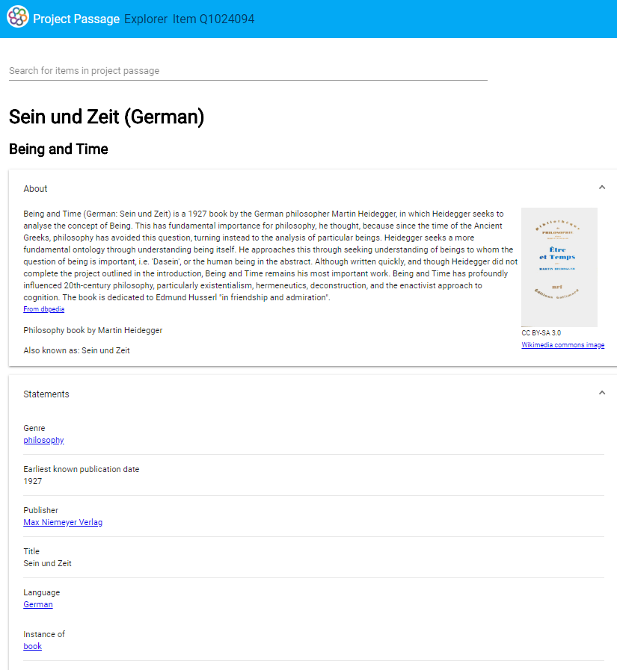
Project Passage Goals & Method
Goals
Create a framework for reconciling, creating, and managing bibliographic and authority data as LD entities and relationships
Build a community of users who could create and curate data in the ecosystem and imagine or propose future workflows
Not originally planned: evaluate Wikibase and Wikidata as technical platform
Method
A Wikibase/Wikidata sandbox in which librarians from 16 US institutions could experiment with creating linked data to describe resources—without requiring knowledge of the technical machinery of linked data.
Use cases where pilot participants created metadata for resources in various formats and languages using the Wikibase editing interface
oc.lc/linkeddatawikibase
Notes:
By 2017 we were in a position where we had studied the various components of ‘doing linked data at scale’; creation, publication, and use but we had not yet looked at the problem holistically to determine how all of these components could be combined to allow for linked data curation.
Project Passage used the Wikibase platform to evaluate how users could effectively create, edit, publish and use linked data for authority metadata all within a single unified system

Slide 10
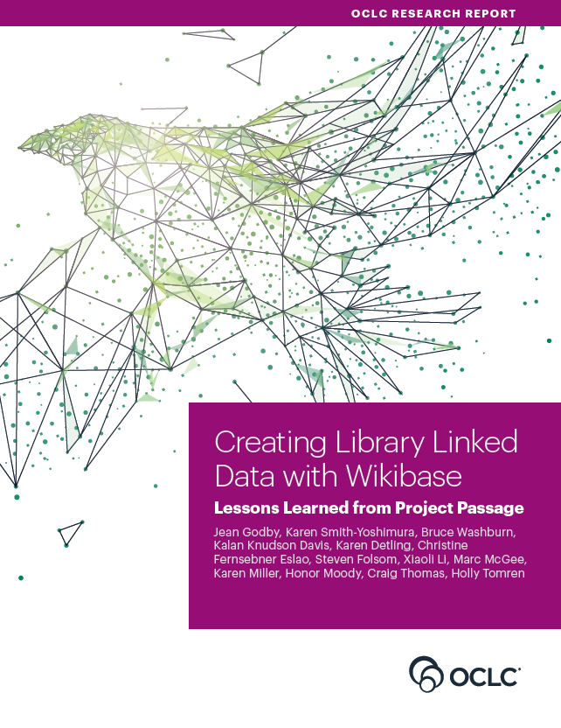
Project Passage Conclusions
Selected Conclusions
A Linked Data infrastructure can create data that exceeds current library standards.
Ontologies are vitally important.
User interface enhancements to the infrastructure can improve library workflow.
A knowledge graph requires tools to import external datasets.
Interoperability between datasets is crucial for import and export.
Linked data work diminishes the distinction between bibliographic and authority data.
oc.lc/passagereport
Notes:
It would take many slides to do this project justice, so instead, I would urge you to take a close look at the accompanying report written by both OCLC staff and several of the library participants and published by OCLC Research in 2018.
But here’s a quick summary of our findings:
We learned that the Wikibase linked data infrastructure can be used to create structured data with a precision that exceeds current library standards
The platform enables user-driven ontology design but raises concerns about how to manage and maintain ontologies
Supplemented with OCLC’s enhancements and stand-alone utilities, the platform enables librarians to see the results of their effort in a discovery interface without leaving the metadata-creation workflow; more robust tools are required for local data management
To populate knowledge graphs with library metadata, tools that facilitate the import and enhancement of data created elsewhere are recommended.
The pilot also underscored the need for interoperability between data sources, both for ingest and export.
And finally, Traditional distinction between authority and bibliographic data can disappear in a linked data description.

Slide 11
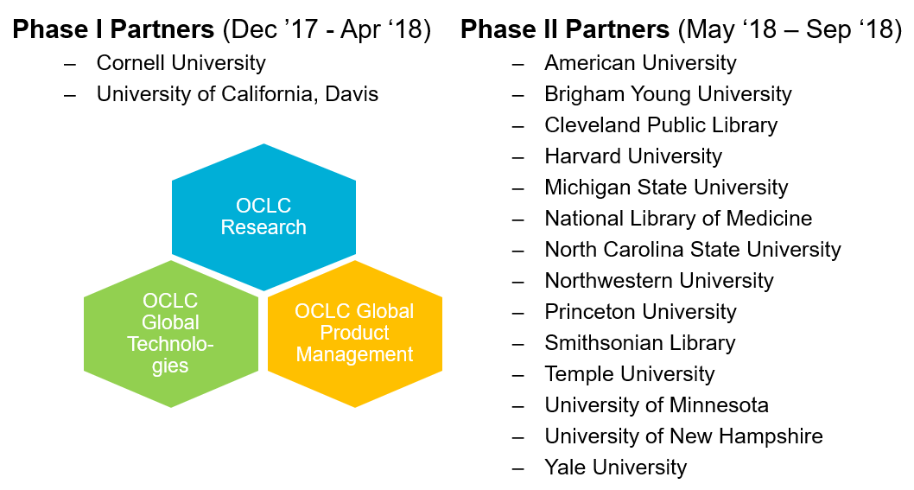
Convene, Understand, Share
Notes:
I need to point out that the strength of Project Passage came from our partners. Not only did they have lots of homework, put in lots of effort, and run several of our regularly scheduled office hours during the project, several of them also contributed their expertise as co-authors of the final report.

Slide 12
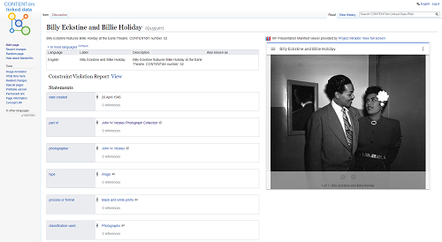
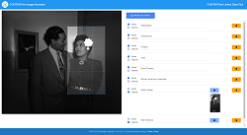
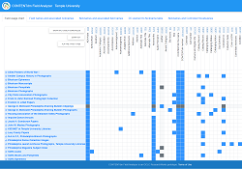
CONTENTdm linked data pilot goals
oc.lc/cdmld
Envision systems and workflows to produce linked data for descriptions of cultural materials and their relationships to people, groups, places, concepts, and events.
Evaluate the diversity of CONTENTdm descriptive data practices
Develop a shared and extensible data model
Test the balance of human attention and automation to reconcile metadata headings to linked data entities
Prototype ways to help subject matter experts contribute to descriptions
Experiment with discovery tools to make hidden connections visible
Learn about the institutional and individual interests in the paradigm shift of moving to linked data
Notes:
As the newest effort undertaken, I’d like to spend a little more time talking about this linked data pilot.
Before the Passage report was even published, the feedback from libraries using that prototype led us to immediately sharpen some of our focus on certain types of collections.
We started by looking back at the refinery project and applying lessons learned from Project Passage is evaluating how these principles apply to cultural materials.
This project envisioned and evaluated scalable and affordable systems and workflows that will be needed to produce rich and usable linked data for descriptions of cultural materials and their relationships to people, groups, places, concepts, and events.
The Linked Data project’s focus on sustainability and scalability raised these 6 questions to investigate, among others:
CLICK

Slide 13
CONTENTdm linked data pilot question areas
oc.lc/cdmld
Divergent practice and collection assessment
Shared data models for diverse collections and institutions
Machine learning and human intervention
Tools for subject matter experts
Discovery tools
The paradigm shift
Notes:
How divergent is descriptive practice across institutions and what tools are needed to make that assessment.
Can a shared and extensible data model be developed to support the differing needs and demands for a range of material types and institution types?
What is the right mix of human attention and automation to effectively reconcile metadata headings to linked data entities?
What types of tools can help extend the description of cultural materials to subject matter experts?
After transformation, are there new discovery tools that can help researchers find new, or previously hidden, connections through a centralized discovery system?
And finally, what are the institutional and individual interests in the paradigm shift of moving to linked data?

Slide 14
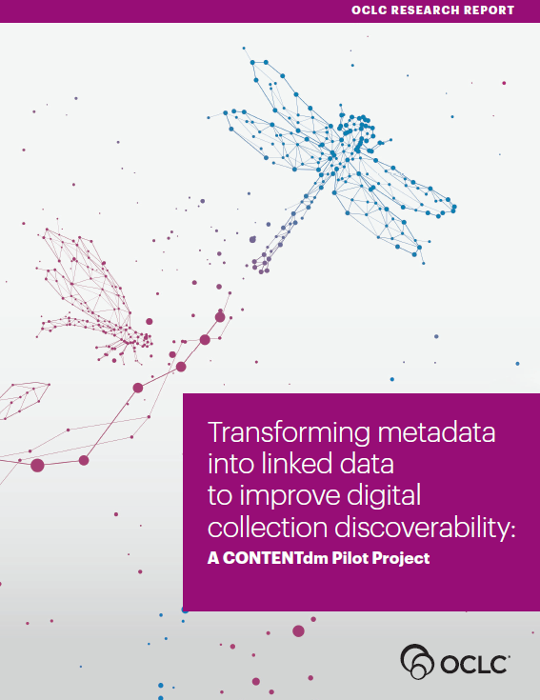
CONTENTdm linked data pilot conclusions
Testing the Linked Data value proposition
Succeeds when descriptions use a shared data model, headings are replaced with identifiers for entities, and entities and their relationships are present in a single discovery system
Evaluating a shared data model
A solid set of initial classes and properties can be generated from existing standards, and then responsively extended as emerging data needs arise
Selecting and transforming metadata
Tools should be shared, and workflows decentralized
Domain expertise needed for accurate transformations
Continuing the journey to Linked Data
Substantial resource commitments required
Benefits accrue long before the journey is completed
It's a paradigm shift; takes time and long-term strategies
Working partnerships represent strength in numbers
Partners shared their ideas and expertise
Gave shape and priority to the work of the pilot
oc.lc/transform-linked-data
Notes:
Please keep an eye out for OCLC Research’s forthcoming report on this latest linked data experiment,
In the meantime, let me review some of that report’s main conclusions.
CLICK
First…testing the value proposition:
Cultural material discovery and data management can be significantly improved:
When the materials are described using a shared and extensible data model,
when metadata string-based headings are transformed to linked data entities and relationships,
and when those entities and relationships are brought together into a single discovery system.
Searches that use a persistent identifier rather than a string heading provides integrated authority control for the entities and greatly improves the precision and recall performance metrics for discovery.
As digital collection string headings are reconciled and converted to entities, additional information from external data sources can automatically and efficiently enrich the entity description.
This supports new discovery and data visualization capacities that would be expensive or impossible to achieve in current digital collection systems.
Turning to the shared data model:
CLICK
Starting with existing Dublin Core and Schema.org models provided a solid set of initial classes and properties.
and
The model could be effectively and responsively expanded based on new entities and relationships represented in the source metadata.
When Selecting and transforming metadata…
These tools should be shared and the workflows decentralized in order to make the conversion scalable.
Domain expertise is needed to determine how locally defined fields are used at the institution level and sometimes at the collection level.
And as we all continue this linked data journey…
Substantial resource commitments will be required to carry out these data transformations across all CONTENTdm institutions and collections, but the community does not need to wait for the transformation to linked data to be fully completed before they can see benefits.
A paradigm shift of this scale will necessarily take time to carry out and calls for long-term strategies and planning.
And since it’s our theme today
The value of library participants as partners in this project cannot be overstated.
As colleagues and thought partners in the work, participants connected with project staff in regularly scheduled office hours throughout the project.
Project participants shared their thoughts on topics ranging from philosophical approaches and concepts to technical details and provided ongoing feedback that steered the project work toward tools and applications of greatest practical value for library staff and researchers.
Recognizing the critical insights contributed by the project partners confirms the importance of involving library staff in this manner for similar technical research projects.

Slide 15
Convene, Understand, Share
Notes:
So one more thank you to the Huntington, Cleveland Public Library, The University of Miami Libraries, Temple University Libraries, and the Minnesota Digital Library for helping OCLC and helping all libraries advance the state of the art.
-----
The final project I will talk about today is actually not a Research project, though several research engineers, data scientists and domain experts are heavily involved. It’s a culminating effort to see a decade’s worth of Research & Development lead to a robust, scalable, and sustainable production service.
CLICK

Slide 16
Shared entity management infrastructure
Notes:
This is the Shared entity management infrastructure project.
In the words our boss, Lorcan Dempsey
For linked data to move into common use, libraries need reliable and persistent identifiers and metadata for the critical entities they rely on. This project begins to build that infrastructure and advances the whole field.

Slide 17
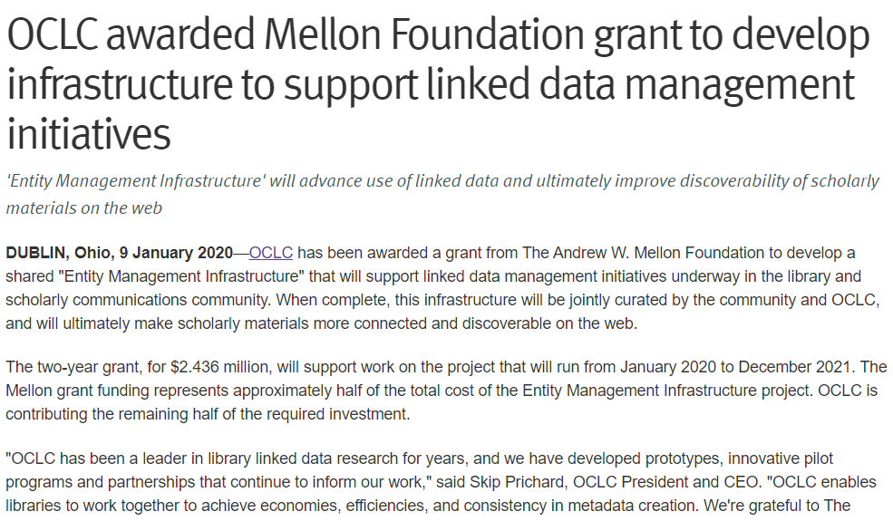
Shared entity management infrastructure
Address infrastructure needs identified by libraries
Start with Persons and Works…
Expand on “native” metadata management
Link library data to non-library data… and shared data to local data
Provide ID creation services to help “at the point of need”
Persistent and maintained entity URIs
Operate at a large scale – and be sustainable
Complement other efforts—LD4, PCC, DCMI, etc.
oc.lc/sharedentitymgmt
Notes:
Half of the funding for this 2-year project project comes from the generosity of the Andrew W. Mellon foundation to support OCLC’s efforts to build a linked data entity infrastructure that will support the field. A rising tide floats many boats.
The goals were largely furnished by the library community and built upon what we learned as part of the Research which I’ve already described at length.
We want to meet libraries’ needs, operate at scale and build a sustainable service, and also complement the myriad of efforts happening in libraries and in knowledge work more generally

Slide 18
Convene, Understand, Share
Notes:
And as you can see here, 26 different institutions, including public, academic, research and national libraries are now part of our advisory group and we will continue to stay in close communication with additional linked data organizations, including LD4P, PCC, ALCTS Directors of Technical Services at Large Research Institutions and more to ensure that this infrastructure will meet their needs.
-----------------------------
As of August 31, 2020, Project Entity Management advisory group members include:
ABES (Agence bibliograhique de l’enseignement superieur) – Benjamin Bober
Biblioteca Nazionale Central di Roma (BNCR)– Giuliano Genetasio, Andrea De Pasquale
Bibliotheque nationale de France (BnF) - Anila Angjeli
Brigham Young University Library - Greg Reeve
British Library - Andrew MacEwan
Central Michigan University Libraries - Melissa James
Cleveland Public Library - Chatham Ewing
Cornell University Library – Jason Kovari, Simeon Warner, Steven Folsom, Huda J. Khan, Lynette Rayle, and John Skiles Skinner
DnB (Deutsche National Bibliothek) - Reinhold Heuvelmann
Harvard Library - Marc McGee and Christine Fernsebner Eslao
National Library of Medicine - Barbara Bushman
National Library Board, Singapore - Haliza Jailani
National Library of New Zealand – Nicola Frean and Jason Murphy
New York University Libraries - Nancy Lin
Oxford University – Andrew Dunning, Alexander Hitchman
Princeton University Library - Sarah Hamerman
Smithsonian Libraries - Jackie Shieh
Temple University Libraries - Holly Tomren
U.S. Army Engineer Research and Development Center – Molly McManus
Universita di Bologna –Alessandra Citti, Raffaella Gaddoni, Chiara Semenzato
University of California, Davis Library - Xiaoli Li
University of Minnesota Libraries - Stephen Hearn, kalan Knudson Davis
University of Pennsylvania Libraries - Jim Hahn
University of Tennessee University Libraries - Anchalee (Joy) Panigabutra-Roberts
University of Victoria Libraries – Dean Seeman
Yale University Library - Daniel Lovins and Youn Noh

Slide 19
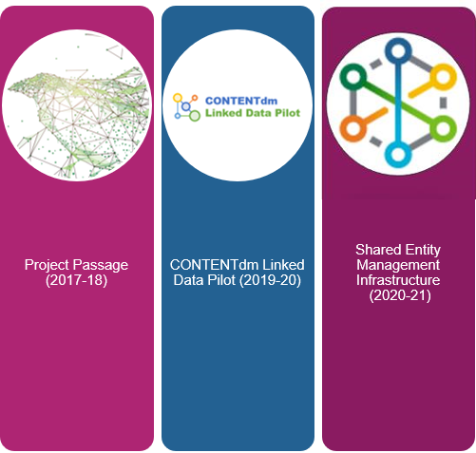
A semantic continuum
Shared, homogeneous, and centralized entities…
Machine-matching, highly automated reconciliation…
Well-accepted context: Persons & Works
Blurs the line between bibliographic & authority work
…accounting for the reality of localized, heterogeneous, de-centralized collections
…with tools for hand-matching, semi-automated reconciliation
Granular context: About, Depicts, Annotations, Notes
Blurs the line between object description & context description
A large centralized infrastructure is needed.
Custom applications and interfaces are needed.
This will facilitate new Knowledge Work in libraries.
Notes:
As a researcher, I can’t help but take one more step back to look at these last three major projects, not in juxtaposition, but as a linked continuum of effort. A lot of metadata description hinges on linking the short tail and the long tail together in order to improve the whole.
So in this new linked data environment…..
CLICK
We balance large, shared, homogenous collections and data…while accounting for a myriad of de-centralized and heterogenous collections.
CLICK
We improve machine-learning and scaled reconciliation with the necessary tools for the dedicated knowledge work that happens in libraries.
CLICK
We can start in the big spaces involving person names and bibliographic works…while acknowledging and preparing for the more difficult work ahead like concepts and aboutness.
CLICK
And we can prepare for the pending paradigm shift that comes with blending bibliographic and authority work together and the challenges of balancing object description with an increase in contextual description.
And across this continuum, we know that a large centralized infrastructure is needed and that custom applications will enhance the effort.
All of this will facilitate a new kind of knowledge work in metadata management, discovery, and access in libraries.

Slide 20
Next Steps
Shared entity management infrastructure
Nearly 100M Linked data entities loaded…and millions more coming
Hands on advisory group feedback starts this month
Complete the project! — December 2021
More Research
Evaluate better balance algorithmic record conversion with domain knowledge expertise
Determine how to pull apart contextual metadata and descriptive metadata
Explore how to leverage the new contextual metadata in end-user applications
Linked data for Concepts and Subjects
Entity Alignment: knowledge graph integration from multiple sources
More convening, more understanding, more sharing
Notes:
Wise developers will tell you that “software is never done”
Well, thankfully, the same is true of Research….
The entity project is well underway with one year left in the project and we’re about to enter an exciting phase of getting intense user feedback.
When it comes to research, we have more and better algorithms to explore, more end-user (both cataloger and library user) feedback to gather and analyze,
And very soon, the web of linked data in libraries will be much, much larger than it was when we started.
And of course, all these efforts will rely on even more convening of experts, more understanding of their challenges and priorities, and more sharing of our combined research efforts.
And with that, I’d like to pass things on to one of our chief conveners, my colleague, Sharon Streams.

Slide 21
OCLC Research
https://www.oclc.org/research
oclcresearch@oclc.org

