Slide 1
OCLC Research Library Partnership • Works-in-Progress Webinar • February 25, 2021
It’s here! The OCLC Interlibrary Loan
Cost Calculator
Dennis Massie, OCLC Research Library Partnership
Brian Miller, The Ohio State University Libraries
Megan Gaffney, University of Delaware
Notes:
Thanks, Mercy. And hello everyone. Thanks for being here today. Brian, Megan and I have been looking forward to doing this presentation for a long time – nearly a year – as we were originally scheduled to talk about the ILL Cost Calculator at the OCLC Resource Sharing Conference in San Antonio last year. And now the moment is finally here.

Slide 2
Dennis Massie
Senior Program Officer, OCLC Research Library Partnership
Brian Miller
Head, Interlibrary Services
The Ohio State University Libraries
Megan Gaffney
Head, Collections Sharing and Delivery
University of Delaware Library
Notes:
As we get started, I’d like to have each of our presenters say hello.

Slide 3
What we’ll talk about today
Dennis: why we built the ILL cost calculator, 3 ways to use it, getting started, privacy and anonymity
Brian: case study: OSU’s experience with the calculator
Megan: reporting functions, aspirations, challenges
All: questions and discussion
Notes:
So here’s the path we’ll be taking today.
I’ll start out and fill you in about why we undertook this project, describe 3 ways to use the calculator to better understand the costs of sharing collections, and lay out a few things to consider as you get started.
Brian will share details of what it was like to gather his data and have it uploaded into the calculator, including how much time he spent on each segment of the process.
Megan will give us a quick tour of the calculator’s reporting functions and talk a little about dream versus reality when it came to building the tool, as well as some of the challenges we faced in trying to create something where the outputs would be actionable, not just interesting.
And we’ll save some time at the end for questions and discussion.

Slide 4
Overview
Dennis Massie
Notes:
So, on with the overview.

Slide 5
Where is the fresh ILL cost data?
Notes:
It took us a few years to put this tool together, but the need that set us on this path still persists. The more recent study shown here, led by Lars Leon of the University of Kansas, was presented by Lars at the 2011 IFLA ILL and Document Supply Conference. The older study was the last in a series conducted by Mary Jackson of the Association of Research Libraries. These studies are nearly 10 and 20 years old now. And these are the last really detailed investigations of ILL costs that I’m aware of.
They’re both excellent pieces of work. But how we share resources has changed a great deal since 2011. The accelerating pace of change in the resource sharing environment was already evident in 2015, when we were first getting deep into the design details of the ILL cost calculator. There was already a yearning, even then, for fresh ILL cost data.

Slide 6
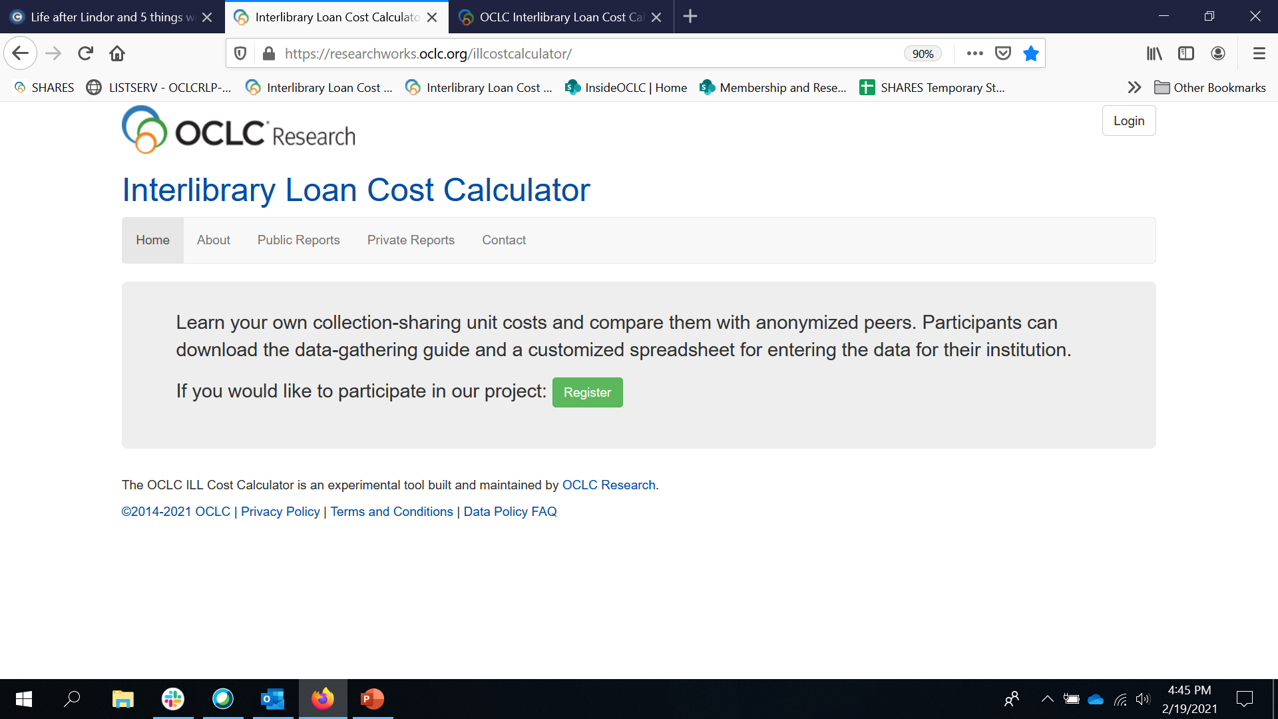
A virtual real-time ILL cost study
Available to early adopters since October 2019
Now open to all libraries
Free experimental tool
Three ways to use it
Public reports
Learn your own unit costs
Query anonymized aggregated ILL data and compare your costs with those of other libraries
Notes:
OCLC Research staff worked with members of the resource sharing community – I’ll show you a list of project participants in a second -- with the idea of creating a tool that will function as a virtual real-time ILL cost study. Not everything we wanted made it into the version that exists today – in the end we just had to do our best and get the tool out into the world and not wait until it could be perfect.
All the pieces of the calculator have been in the hands of beta testers and early adopters for nearly a year and a half. It has 10 sets of real data loaded into the database, and after today anyone who wants to use it can do so for free.
There are three ways to use the OCLC ILL Cost Calculator: Access a public report. Learn your own unit costs by gathering your data and filling out forms in an Excel workbook. Or go all in and upload your numbers into the calculator, unlocking a suite of reports that lets you query the aggregated data.

Slide 7
Designed by people you know
Available to early adopters since October 2019
Now open to all libraries
Free experimental tool
Three ways to use it
Public reports
Learn your own unit costs
Query anonymized aggregated ILL data and compare your costs with those of other libraries
Notes:
Here are some of the folks who toiled long and hard to move the ILL cost calculator from concept to an actual thing you can use. I’m grateful and indebted to each person listed here. And especially grateful to Megan, Brian and Lars. We had one non-US perspective in the planning. Heavy on academic institutions, but we also had some conversations with folks at public libraries and special libraries along the way.

Slide 8
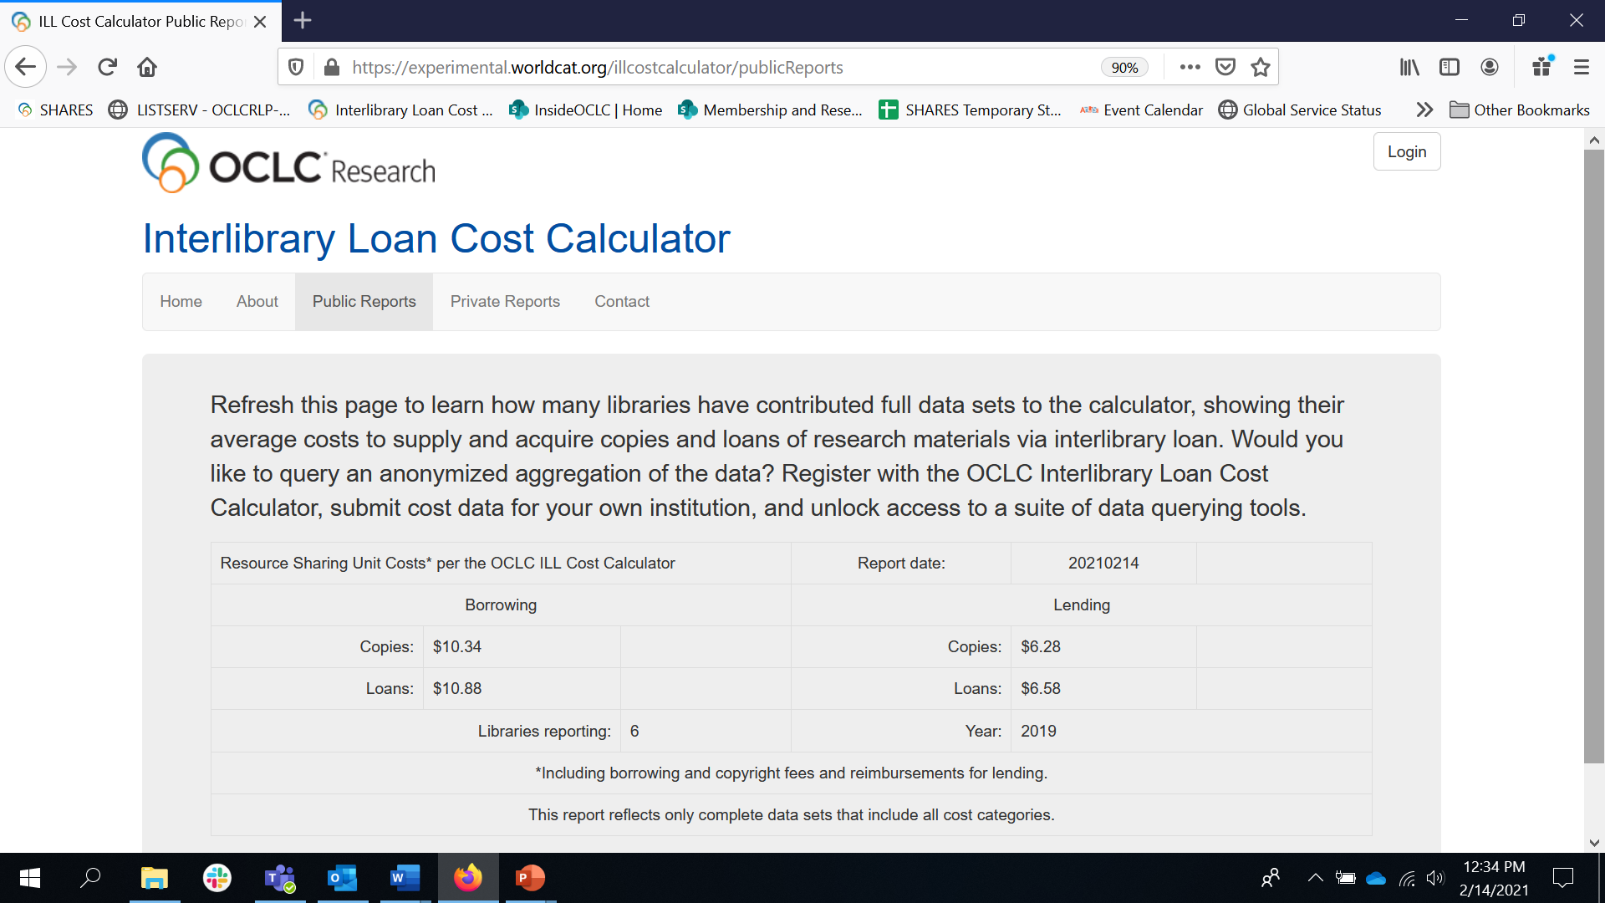
1. Public reports
Anyone with an Internet connection will be able to access this basic report
These are the data points most often quoted from the 2002 and 2011 studies
This data is totally real
See for yourself!
https://researchworks.oclc.org/illcostcalculator/publicReports
Notes:
Now more about those three ways that anybody with an internet connection can use the calculator.
First there is a public report freely available via the app’s Web interface with the click of a button. Don’t strain your eyes – I’ll show you a bigger version in a second. And the URL will be dropped into chat.
Basically, this reports tells you what the average ILL unit costs are for borrowing a loan and a copy and for supplying a loan and a copy – the data points most often quoted in the 2002 and 2011 studies I mentioned previously.

Slide 9
https://researchworks.oclc.org/illcostcalculator/publicReports
Notes:
Here’s a closer view. You can see that these average costs are based on data supplied by 6 institutions. There are 10 data sets uploaded into the calculator, but this public report draws only upon complete data sets where every cost category was reported. Because the sample is so small, one library can really skew the numbers. So the more data we get in there the better. You may have noticed that the 2011 study drew 23 responses and the 2002 study 72.
So if we can get a even hundred data sets uploaded, the calculator’s averages will be even more comprehensive than the comprehensive report we’ve all be quoting for the past 20 years.

Slide 10
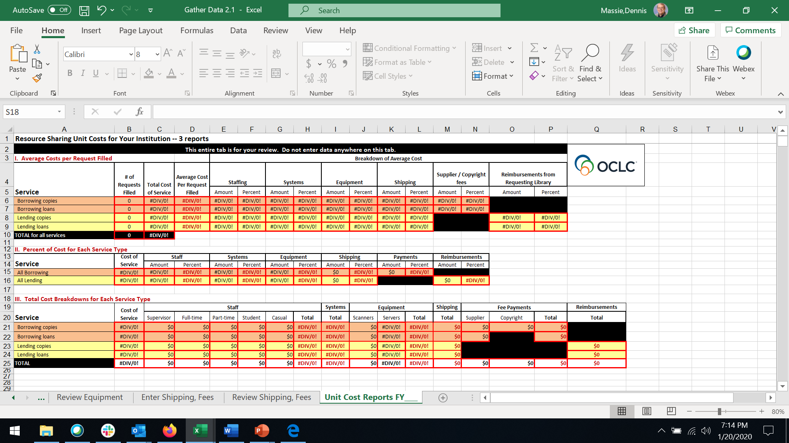
2. Learn your own unit costs
Register
Download the “Gather Data” Excel workbook
Enter your data
Three reports in the workbook reveal your unit costs
Your data never leaves your possession
Notes:
OK, let’s say you’ve looked at the public report, and you want more. You want to know your own unit costs. That’s when you establish a profile within the ILL cost calculator, and download the data gathering worksheet and user’s manual.
Again, don’t strain your eyes looking at this; I’ll give you a closer look in a second.
The main takeaway here is that once you enter your cost numbers into this Excel workbook, there are three reports on the last tab of the workbook that break down your own ILL unit costs.
And if that’s all you wanted to know, congratulations, because you’re done. Mission accomplished!

Slide 11
Notes:
Here’s a closer look at the report. This is of course what it looks like before you plug your data into the various tabs of the worksheet.
The report is based on a design by our next presenter, Brian Miller. We’ve even kept Brian’s color scheme.
You’ll see this report again later with some numbers in it.

Slide 12
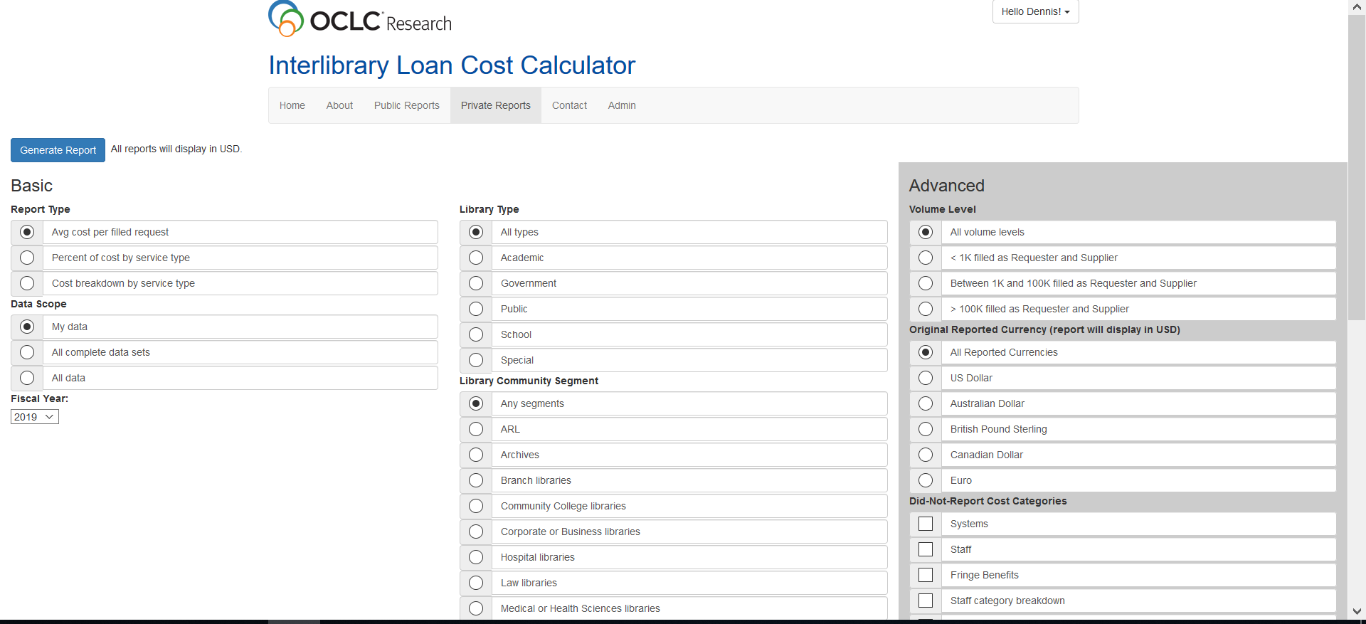
3. Upload your data, unlock the magic
Notes:
The third way to use the ILL Cost Calculator is to send a category level reporting of your costs to OCLC Research for uploading into the calculator’s database.
This unlocks a suite of private reports that allows you to query the aggregated data from anonymized peers who have also chosen to have their data included in the calculator.
The basic reports are the same ones you saw on the last tab of the Gather Data Worksheet. But within the calculator you can choose to run reports for all data contributed by everyone. There are so many filters you can apply that I’m only able to show half of them on this slide. We believe that the ability to query the anonymized aggregated cost data will prove to be the real source of value of the OCLC ILL Cost Calculator
More about those filters in a minute.

Slide 13
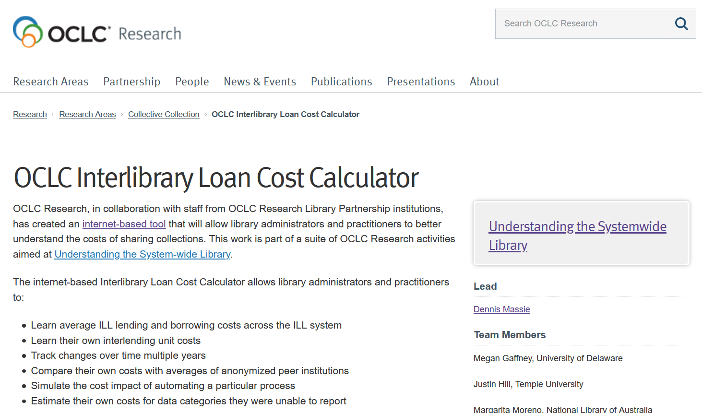
How to get started
Visit the project Website
Notes:
Getting started is easy. Visit the project Web page on the OCLC Research site. The URL is there on the slide, and it will be dropped into chat and shared widely after today’s session -- on the ILL-L list, via the OCLC Community Center, and when we share the slide deck and the recording.
You can also Google it – OCLC, ILL, and calculator should do the trick.

Slide 14
How to get started
Visit the project Website
Download a Quick Start Guide
Notes:
From the project Website you can download this handy Quick Start Guide, which gives you a quick overview of what you’ll need to know, in light blue, and to do, in green, to get rolling with the calculator.

Slide 15
How to get started
Visit the project Website
Download a Quick Start Guide
Go to the Web interface
Notes:
The Quick Start Guide includes a link to the app’s Web interface.
What you really want to do next is read the terms and conditions documents.

Slide 16
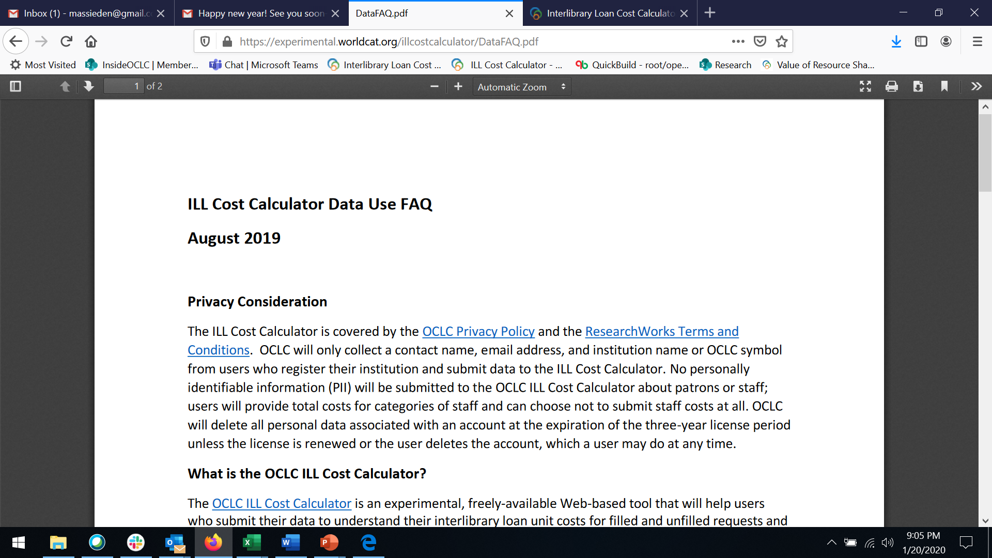
How to get started
Visit the project Website
Download a Quick Start Guide
Go to the Web interface
Read the FAQ
Notes:
One of those documents is the data use FAQ, which lays out particulars on privacy, data use, and the license you’re granting to OCLC by uploading your data.

Slide 17
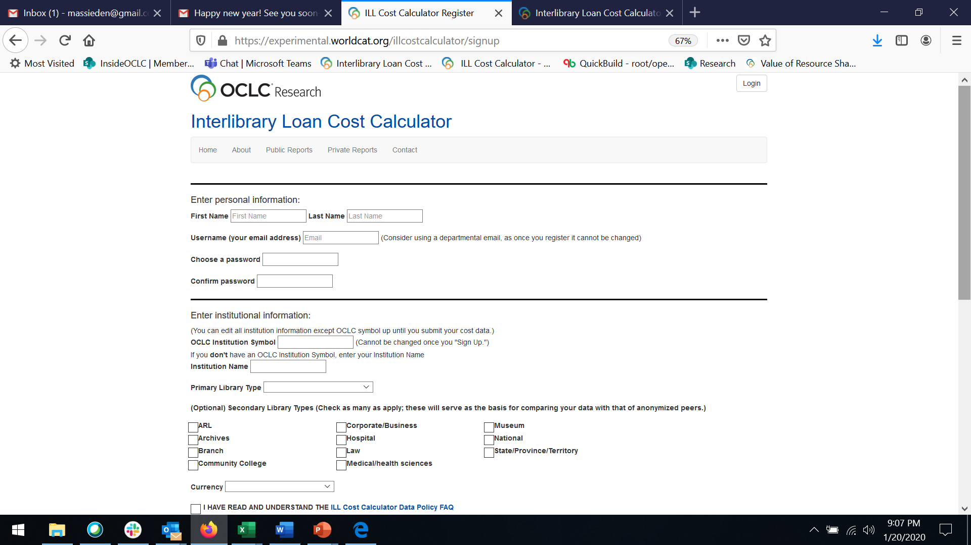
How to get started
Visit the project Website
Download a Quick Start Guide
Go to the Web interface
Read the FAQ
Register
Notes:
Next establish a profile or account. Give a contact person. We recommend using a departmental email address as you can’t change the email associated with the account once you hit submit. Choose a password that will be used only for the calculator; you can always change it or have us reset it for you later.
You can register using your OCLC symbol or, if you don’t have a symbol, the name of your institution. You must choose a primary library type; choosing secondary library types is optional. Let us know your national currency and check the box that you’ve read the terms of use documents. And, voila, you’re in.

Slide 18
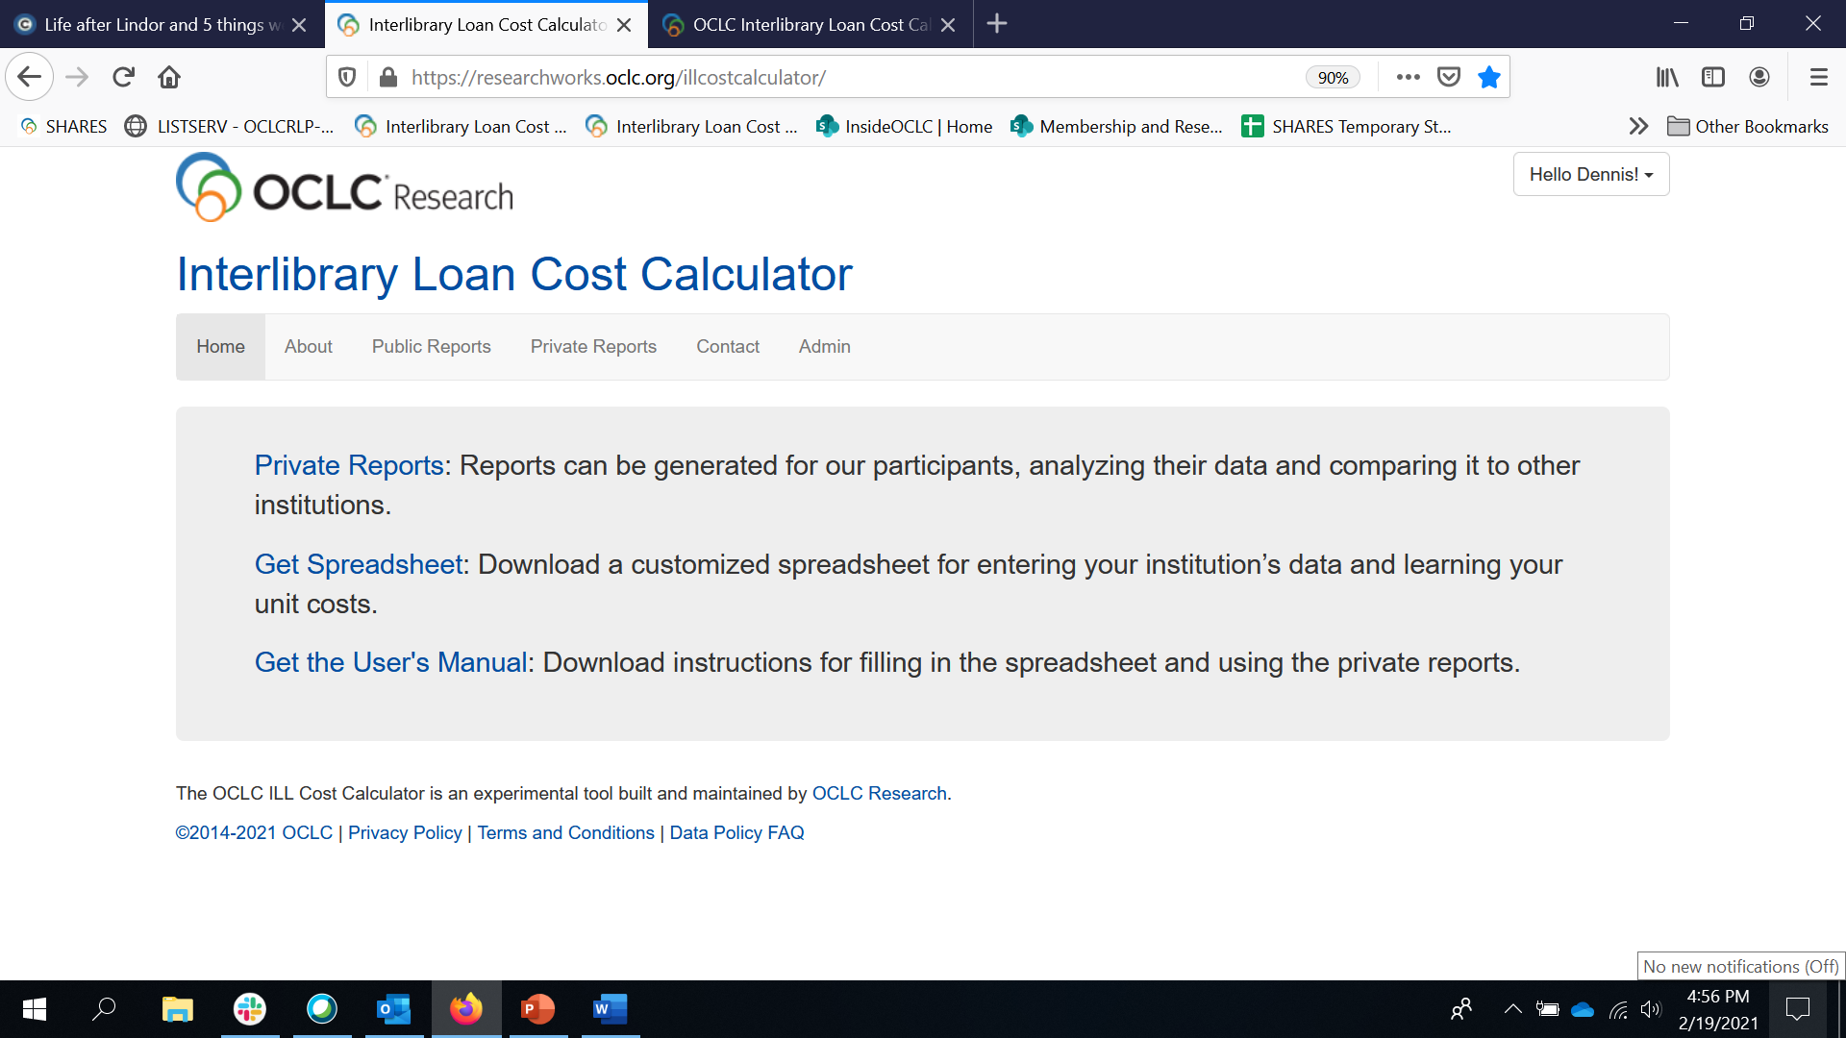
How to get started
Visit the project Website
Download a Quick Start Guide
Go to the Web interface
Read the FAQ
Register
Download the Gather Data workbook and User’s Manual
Notes:
You’ll be asked to log back in and then you can download the user’s manual and the Gather Data Excel workbook. You won’t be able to run any private reports until you’ve uploaded data into the calculator.
But with the manual and the spreadsheet in hand, the fun can really begin.

Slide 19
How to get started
Visit the project Website
Download a Quick Start Guide
Go to the Web interface
Read the FAQ
Register
Download the Gather Data workbook and User’s Manual
Join the new OCLC-ILL-C-CALC-USER-L listserv – instructions in speaker notes!
Notes:
By the way, there is a brand new listserv for users and prospective users of the OCLC ILL Cost Calculator.
Here are instructions for how to subscribe:
Send a message to LISTSERV@oclclists.org
Leave the subject line blank.
In the body of the message write: subscribe oclc-ill-c-calc-user-l
Add your name after that on the same line, or add anonymous if you prefer.

Slide 20
Gathering & submitting (or not) your data
System costs
Transaction totals by category
Staff costs by category
High-end equipment costs
Shipping costs
Fees
Reimbursements
Note: for systems and staff, only category totals are reported to OCLC
Notes:
You’ll be gathering the same data whether you want to learn your own unit costs only, or if you plan to upload your data into the calculator.
Guidance about what types of systems we’re talking about is on the spreadsheet itself and of course in the manual.
Staffing costs can be the trickiest to come up with at some institutions, especially for those folks outside the ILL unit who are part of the lifecycle of an interlibrary loan request. We only want you to provide equipment costs for pieces that cost more than $2K. And of course shipping costs, borrowing fees, and reimbursements need to be gathered and reported.
Then for all cost categories except systems, we’ll ask you to estimate the percentage of cost that should be applied to each of the four transaction categories – Copies Requested, Loans Requested, Copies Supplied, and Loans Supplied. And we’re only looking at filled requests.

Slide 21
Extras, if you upload your data
Categories not reported
Notes:
There are some extra tasks to do if you plan to upload your data into the calculator. We wanted even those who cannot report every cost category to be able to use the calculator. So there is a place where you can note which cost categories you will not be including in your data.
These categories of non-reported data are report filters that can be used in two ways:
One, to compare your costs apples to apples with anonymized peers who also didn’t report those same categories, and two, to look at what your peers reported for the categories that you could not report and infer from that information what your costs for those categories might have been.

Slide 22
Extras, if you upload your data
Categories not reported
Degree of automation
Notes:
Also, because we ended up having to settle for putting all the resource sharing systems into one cost category – we wanted to include a way to see how automating different borrowing and lending processes impacts ILL unit costs. So you estimate how often you automate these processes on the Automation tab, and then you can apply and un-apply the percentages for each task to report queries and see what happens to the aggregated numbers.

Slide 23
The user’s manual is epic (mostly pics)
Notes:
I’ve mentioned the user’s manual a few times – this is a 35-page magnum opus that is probably going to be a work in progress throughout the life of this project.
As you get your hands on it and start using it and have ideas for ways to make it clearer and more useful, please let me know.
There are lots of details and lots of pictures. A clear and concise manual can make the challenging process of gathering and reporting your ILL data so much easier.

Slide 24
Private reports
No one will know that you have data in the ILL Cost Calculator database unless you tell them.
Report queries return results only if there are three or more matches.
You can delete your profile at any time, which breaks the link between your institution’s identity and your data in the database.
Notes:
There are a number of decisions we made when building the calculator that will keep anyone from connecting your data with your institutional identity.
We won’t publicize which institutions have uploaded data into the calculator.
When you’re running reports, any query that returns fewer than three matches will return a prompt to broaden your search. So no one will be able to run a really specific search and try to guess if they’re looking at your institution’s data.
Finally, you’re free to delete your account at any time. Your data remains in the aggregated pool, because without the aggregated data the tool loses its value. But the data is retained as a generic instance of a library of your primary library type, with all other identifying information permanently deleted.
OK, that’s it for me.
Now I’m going to turn things over to Brian Miller of the Ohio State University.

Slide 25
Case Study: Gathering data at ohio state university libraries
Brian Miller
Notes:
So I’m going to review: a) how I gathered and calculated costs at OSU using this tool, and b) where I got the information from and maybe some pitfalls to avoid.
But I’m not going to share today what our actual OSU costs are because I want your attention focused on the tool itself and how to use it and not focused on Ohio State’s actual numbers and expenses which would only distract.
So know that the numbers are completely made up, but how and where I gathered the info is real. Also, these numbers are for CY2019 as I gathered the info in Feb of 2020.
Also, I should point out that Dennis has a very detailed User Manual about how to fill in this tool, so today I’m just giving you a peek of what it looks like and some things to consider. And Dennis’ highly detailed instructions in the User Manual will give you many more specifics.

Slide 26
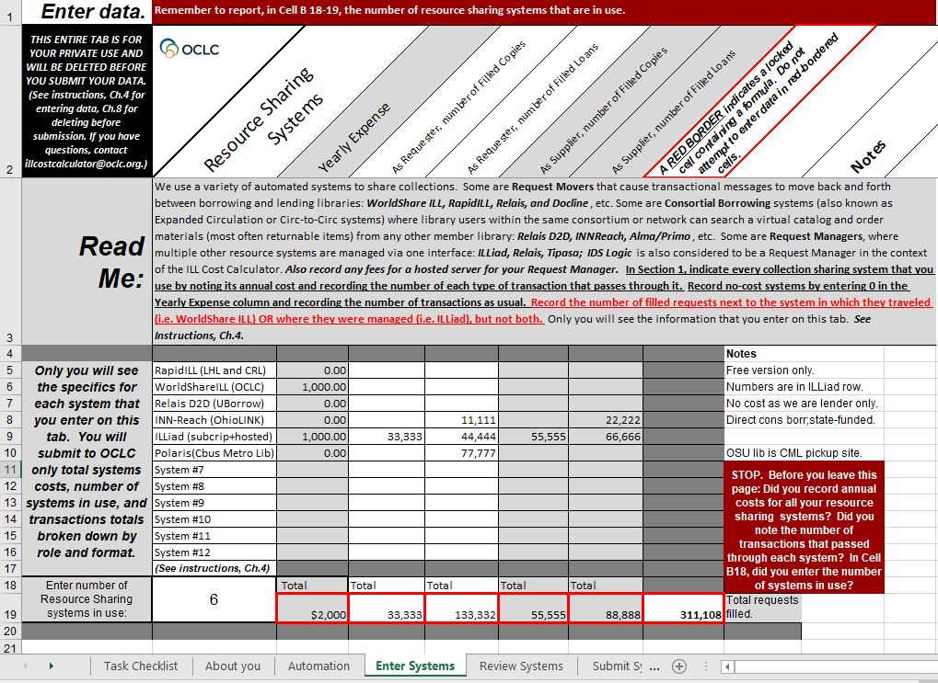
Systems Costs
1. Identify your systems
2. Discover:
which are no cost to your library; and
who has system invoices to obtain $$ amounts
3. Gather filled
transaction numbers
Do not double count same transaction on multiple rows!
Exclude Document Delivery numbers (i.e. filling from your own print or electronic collections for your own users)
This detail info is not shared with OCLC.
NOTE: Numbers on this slide are for illustration only and are not OSU’s actual expenses or request numbers.
Notes:
So the first info you need to gather are your System Costs. Think about:
What resource sharing systems do you use? We have 6 at Ohio State that you can see on lines 5 through 10.
Which ones are free to your institution? 4 of the six which I have denoted with a $0 yearly expense. {Explain}
Which ones does your library pay for and who has those invoices so you can get the cost? 2 of the six we pay for: WorldShareILL (OCLC resource sharing subscription); ILLiad. Invoices from our Acquisitions office.
Gather transaction numbers
Filled requests - Doesn’t really matter if you choose FY or CY just as long as you are reporting what year the data is for. And try to be consistent across all costs. So if you’re gathering transactions from January to December, also get your shipping costs on a later tab for those specific 12 months too.
Note there are columns for borrowing copies, borrowing loans, lending copies, and lending loans. Also note that the spreadsheet excludes document delivery.
Also make sure you do not double count: WorldShareILL and ILLiad example
If squeamish about sharing system costs with OCLC, especially non-OCLC system costs, that’s okay because only you will see this tab of the spreadsheet.

Slide 27
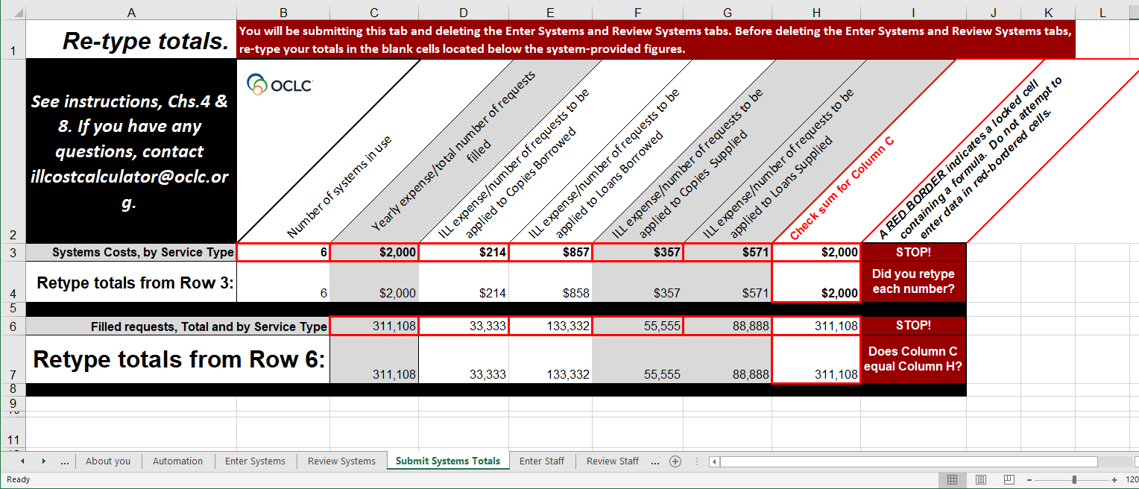
Only this summarized data would be shared with OCLC if you want to contribute to anonymized community aggregate and compare
your costs to others.
Notes:
The dollar amounts and the request numbers that you entered are auto-aggregated to a different tab, and you’ll be deleting that first tab and only sending along this one if you choose to contribute to the calculator’s anonymized aggregation so you can compare with an average for the ILL community. Note how system names and prices are not line-itemed or detailed here.

Slide 28
Staff Costs:
1. Identify:
Who handles transactions
Salaries or hourly wages
2. Calculate:
Fringe benefit amounts
% of time per activity
Don’t include time on DocDel
NOTE: Numbers on this slide are for illustration only and are not OSU’s actual salary or fringe benefit amounts.
Notes:
Staff Costs is where I spent the most time because there are so many people who touch requests across my library system. And that’s what you have to determine first: who handles transactions? For us at OSU, it’s:
The ILL office
Circulation dept which handles all of our INN-Reach OhioLINK consortium loan requests
We also have 8 dept libraries handling loans and scanning for us
Business office does our invoicing and payments for non-IFM requests
Mailroom which does all our packaging and shipping and unpacking too
OSU salaries are all available online from a university HR web site. As a public institution, our salary info is open to all under public records laws, so I could look that up for everyone here. And my business office told me that fringe benefits across the university were calculated in 2019 as 32.3% of one’s salary. So that’s how the info in column D, Fringe benefits, was determined. What took the most time for me was explaining the project to all the people who have a hand in resource sharing here, asking how much of their time was spent on resource sharing in general, and then talking through with them how much time they spent doing each of the resource sharing service types.
So for example, look at row 19 on this spreadsheet. This is my ILL copies specialist. She spends 75% of her time working on copies requests and that’s denoted in the 1st gray column. I am not counting 25% of her time spent on document delivery filling copies from our own print collections for our own users, so that’s why it’s only 75%. And of that 75%, you can see that .56 or 56% of her time was on borrowing copies and .44 or 44% was on lending copies which is based on her estimation of how much time she spent on each based on request volume.
When dealing with staff costs, you’ll probably have to do calculations from Salaries and others from hourly wages. So for salaries, it’ll likely be a percentage of the total salary spent on each service. And for hourly wages, you’ll need to do some calculations on wages paid and average number of hours spent doing certain activities.Again, remember: Do not include time spent on Document Delivery. So factor that out.Also, some people or some locations may be a bit squeamish about sharing staff salary info, but this tab too will be auto-deleted before sending on to OCLC for the community calculator. I didn’t even put names; I just used generic titles. Nevertheless, you don’t submit this tab; instead, OCLC is going to get this from you:

Slide 29
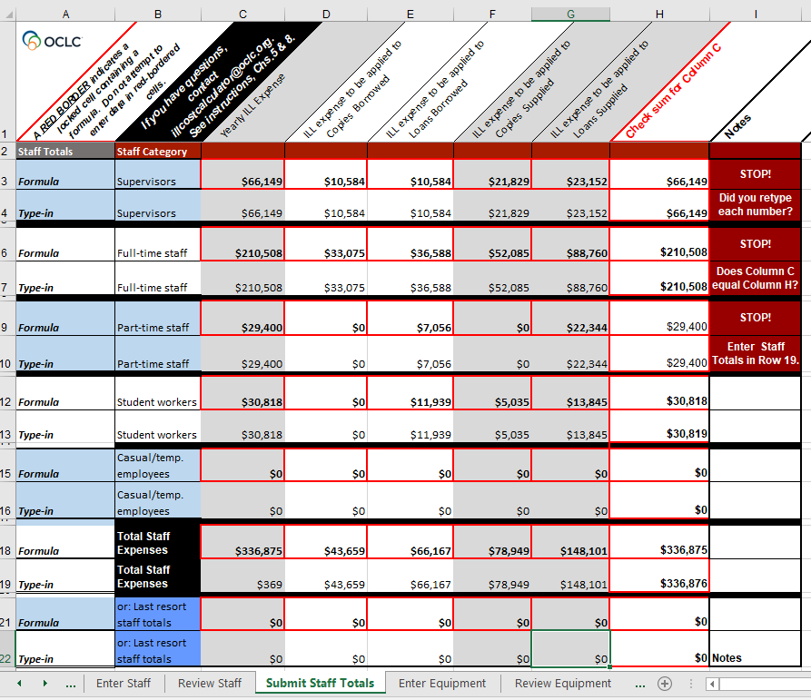
Again:
Only this summarized data would be shared with OCLC if you chose to do so.
Notes:
Amounts are summarized into Supervisors, full-time staff, part-time staff, student workers, and temp employees, but no names are included.

Slide 30
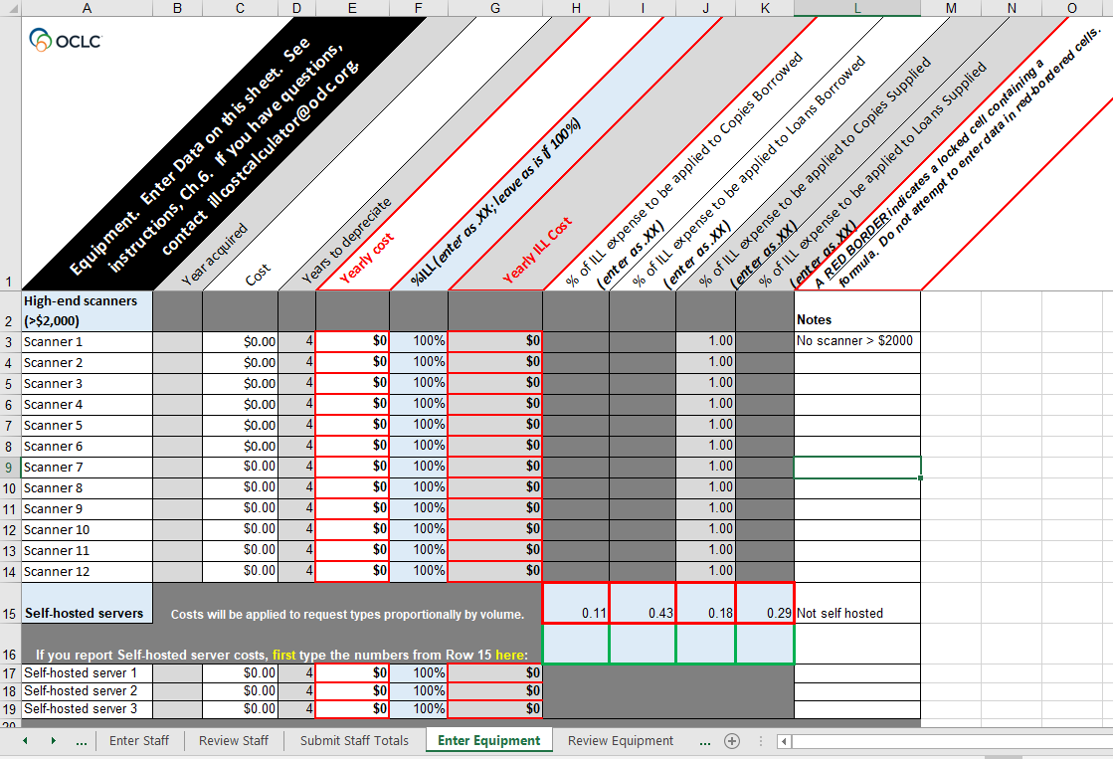
Equipment Costs
1. Identify any high-price
scanners
Set years to depreciate
Set % of time used for ILL
2. Identify self-hosted server
cost if applicable
Notes:
The next cost point is equipment. And here we’re looking for any expensive scanners, or your server cost if you are self-hosted. By expensive scanners, we mean if the purchase price was more than $2000. And you would set a depreciation rate (the default is 4 years) and what percentage of the scanner’s use is for ILL activity.
At OSU our scanners are all older than 4 years and did not cost more than $2000. And we’re not self-hosted for ILLiad so I had no expenses to list here.

Slide 31
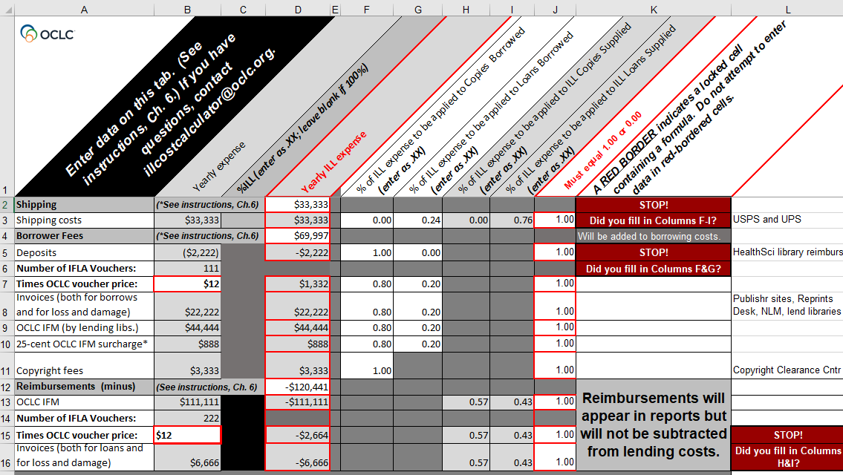
Shipping Costs, Borrower Fees, & Reimbursements
1. Identify:
Shipping costs to supply and return items
Borrower fees (IFM, Invoices, copyright fees, IFLA vouchers)
Reimbursements (IFM, invoices, IFLA vouchers)
2. Calculate:
% per activity
NOTE: Numbers on this slide are for illustration only and are not OSU’s actual costs, fees, or reimbursements.
Notes:
The last cost input tab has to do with shipping, borrower fees, and reimbursements.
The shipping cost line is for your UPS/Fedex/USPS fees or another commercial courier if you pay one. And you roughly calculate the percentages for borrowing loans versus lending loans based on your volume numbers. So on line 3, you can see we do approximately 3x as much lending as borrowing. And this is for USPS + UPS combined as those are the only shippers we use.
The Borrowing fees section, starting on line 4, is everything paid out from IFM to IFLA vouchers to invoices. IFM is easily obtainable from the OCLC Usage Statistics, and ILL invoices at my institution are charged to a certain fund account. So my business office was able to pull that fund info for me for the year.
The reimbursements section, starting on line 12, also covers IFM, IFLA vouchers, and invoices, but it’s what you took in. And those numbers are pulled using fund codes at my institution similar to how the borrowing fees are. And all need to be calculated or estimated across loan or copy activity based on request volume.

Slide 32
Sample Unit Cost Report
NOTE: Numbers on this slide are for illustration only and are not OSU’s actual costs or request numbers.
Notes:
And when you’re done, the spreadsheet auto-calculates and displays your library’s cost breakdown. And reminder: these are not OSU’s real numbers; this is just made up for illustration purposes.
But you’ll be able to see:
Total amount spent across all resource sharing services at your institution (line 10)
Average cost per request filled (column D, rows 6 through 9)
Breakdown by cost category, such as staffing, systems, equipment, etc
Your borrowing versus lending costs (rows 15 vs 16)
And the dollar amount breakdown for each cost category in the given year. (Third, or bottommost chart)
And that’s all fascinating to look at in my opinion! So how long did it take me to gather all those costs?

Slide 33
Time spent gathering and calculating data for Cost Calculator
by OSU’s Head of ILL
Time
Registering and downloading Calculator materials 15 min
Entering Degree of Automation 15 min
Systems Costs 45 min
Staff Costs 6½ hrs
Equipment Costs 0
Shipping costs, borrowing fees, & reimbursements 2¼ hrs
TOTAL: 10 hrs
(spread over 8 days)
NOTE: Time estimates on this slide are real! ☺
Notes:
It was about 10 hours of my time spread over 8 days. With the largest chunk being the staff cost section and talking to all those different units to explain the project and have them estimate how many hours per week they did conducting various resource sharing activities. And the numbers on this slide are real; these are not made-up! So hopefully all this info on the tool and my OSU experience proves useful!

Slide 34
Reports, aspirations, challenges
megan gaffney

Slide 35
The public report is very useful
https://researchworks.oclc.org/illcostcalculator/publicReports
Notes:
We want this tool to be helpful for the entire library community, and we know that some libraries may want basic figures quickly without having to enter their own data.
Anyone can visit the Cost Calculator’s webpage to see a few high-level data points. You won’t need to register, create an account, or submit any information to view the public report. You’ll be able to view the average unit cost for a borrowing copy and loan, and a lending copy and loan, for all of the libraries that have submitted complete data sets to the calculator.
You’ll see how many libraries are included in that overall calculation as well as the year of their data sets.
These overall figures will be useful for getting a really broad picture of resource sharing costs, though you won’t be able to see, for example, what types of libraries are represented in that calculation.

Slide 36
…but we all love more information
Notes:
Creating an account and submitting your own data enables access to the private reports.
This screenshot shows the same query - average cost per filled request - that we saw on the public report, but with a substantial breakdown of the data points that went into the overall calculations.
The private reports allow you to apply filters, like primary and secondary library type, or the contributing libraries’ degree of automation in their resource sharing operation. Those searches can help you to compare your costs with your peers.
The reports are always anonymous, and to really guarantee anonymity, if fewer than three libraries meet the criteria that you’ve selected, your query will not display results.

Slide 37
Our use cases
Users want to know:
Resource sharing unit costs
How their costs compare with peers
The financial impact of automating some processes
What high-performing/low unit-cost libraries are doing
Notes:
From the beginning, our group wanted to build a tool that would provide useful, actionable data. We did not want to create a calculator that would provide a single dollar amount to satisfy curiosity. Our goal was to provide the community with information that could be used to make informed decisions.
Finding out your overall unit cost and how you compare with peers may be critically important as we navigate the COVID-19 crisis. We already have seen significant impacts on library budgets and knowing how much resource sharing costs will be a key factor in making decisions about cancelling subscriptions, prioritizing collections funds, and considering whether to join new collaborative or consortial agreements.
We also hope to help practitioners make decisions about automation and efficiency, which could be more important than ever if staff are working limited time in a physical building or if there are reductions in the staff hours that can be dedicated to resource sharing activities.
Providing ways to query data in various ways will help you understand where peers’ costs may be lower, and those filters and detailed reports can assist you with revisiting some of your own internal procedures.

Slide 38
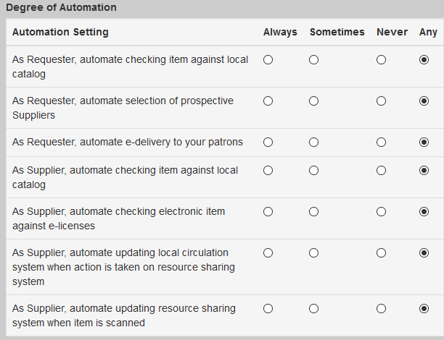
All your questions, answered!
Your report can specify:
Library Type
Community Segment (such as ARL, law library)
Volume Level
Degree of Automation
Year
And more!
Notes:
Here’s an example of those criteria that you can use to run detailed reports.
You can make sure you are comparing apples to apples and looking at your own unit cost in comparison to institutions that are similar to yours both in their library type and their resource sharing volume.
You can also use the calculator to analyze your own unit costs over time, provided you enter data year after year. That historical data will be critically important for contextualizing years that were a total anomaly. We all know that our 2020 data look nothing like the years before it and are unlikely to look like the years that follow, so calculating your unit costs annually will ensure that you have a complete picture of your operation and how it changes over time.
It may be challenging or impossible for you to gather and enter pre-2020 data into the calculator at this point, but if you’re able, that opportunity is available when you create an account.

Slide 39
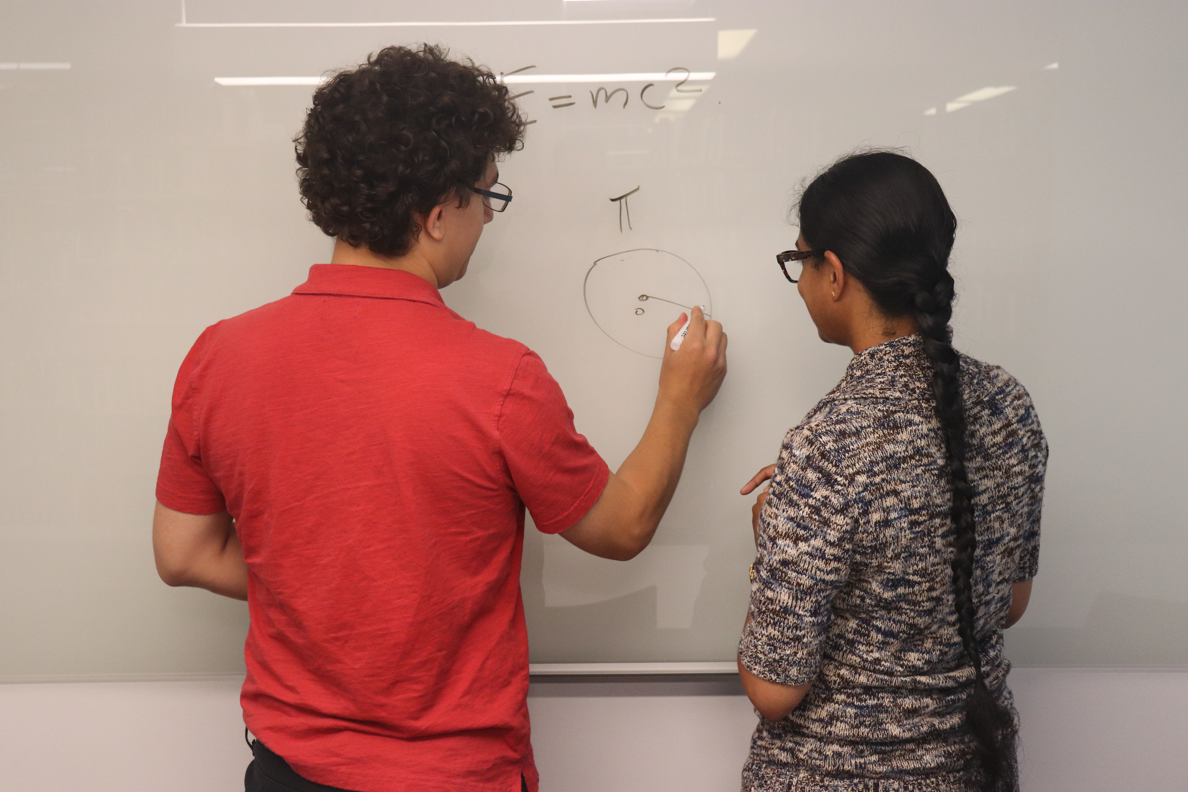
It’s not all about cost
What is my colleague doing more efficiently than I am?
Would new equipment reduce staff time spent on scanning?
How can I automate?
And much more
Image credit: http://staffweb.lib.udel.edu/ImageGallery/document/583Image
Notes:
We really want to emphasize that we’ve built the calculator to reveal more than just numbers. It’s an important tool for refining your operation and incorporating best practices.
Once you have a sense of both your own unit cost and the figures you learn from running detailed reports, you can start making connections. For example, you may learn that a certain library type seems to spend less money on shipping and start investigating whether there are more cost-effective options for your library too.
These questions can help start discussion on a broader level, within consortia and among practitioners, to dive into the ways that resource sharing operations are using automation tools and adopting more efficient workflows.
You may find that your peers’ equipment costs seem very different from your own, and you can begin a conversation to try to learn more about what’s being used in other libraries in your state or consortium.
In this sense, we hope that the calculator is not a final stop for you once you learn your unit cost, but instead a starting point for learning even more about your own operations and those of your peers.

Slide 40
Some of our challenges
Keeping up with changes
Equipment and supplies
Staffing
Many people touch ILL work
Student wages are challenging
Supervisor involvement in daily activity
Unfilled requests in borrowing
Document Delivery costs
Notes:
We’ve talked about the good reasons to participate in our project, but we’ll remind you that it is an experimental tool, and as you know, some experiments do not go as planned.
Building a real-time cost study is enormously challenging when our area of the field is constantly changing. Our group would find that once we figured out how to incorporate one data point into our calculations, another new technology option or question about how to count staff would emerge.
We would discuss at length whether to and how to count certain equipment and supplies, only to find that lower-cost items had no significant impact on overall calculations of unit cost.
We faced real challenges with how to count staff. There are really complicated questions about who should be included, since so many areas of the library touch resource sharing work. We learned that student wages may have different impacts on library expenditures based on the type of financial aid being offered. We struggled with whether to count whether a supervisor was a librarian, and whether it mattered that someone was a supervisor rather than a full-time employee for understanding their impact on day-to-day costs.
We had hoped to answer even more questions with this calculator but found that they were too complex to make it into this iteration of the tool. There was widespread support from the community for our goal to count unfilled requests, particularly since those can be a significant portion of staff time. We also initially hoped to count local document delivery requests, since many libraries include all or some of that function in their resource sharing activities. Ultimately, we found that tracking and counting those requests as part of the calculator was not possible, but we’re hopeful that those elements can be revisited if the tool is updated in the future.
For now, we hope that you’ll use the calculator and upload your data – again, not just to see your own costs, but also to contribute and compare to community averages. We hope the calculator will help your start conversations about best practices, and to make positive changes in your resource sharing operations, based on what you learn.

Slide 41
Questions and discussion

Slide 42
Dennis Massie
Senior Program Officer, OCLC Research Library Partnership
Brian Miller
Head, Interlibrary Services
The Ohio State University Libraries
Megan Gaffney
Head, Collections Sharing and Delivery
University of Delaware Library

Slide 43
Thank you!
Brian Miller
Megan Gaffney
Dennis Massie
The slides and a recording of this presentation will be shared widely.

