Slide 1
October 18, 2021
Envisioning a New Model Library
Ixchel M. Faniel, Ph.D.
Senior Research Scientist
OCLC Research

Slide 2
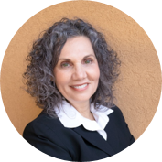
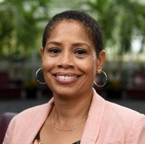
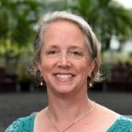
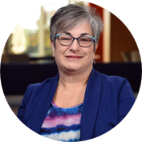
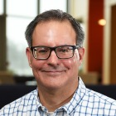
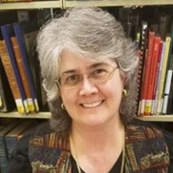
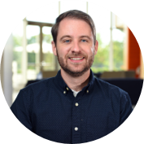


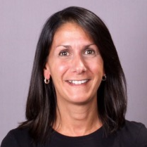
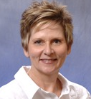
Project Team

Slide 3


How will the pandemic change
the library model?
?
+
=

Slide 4
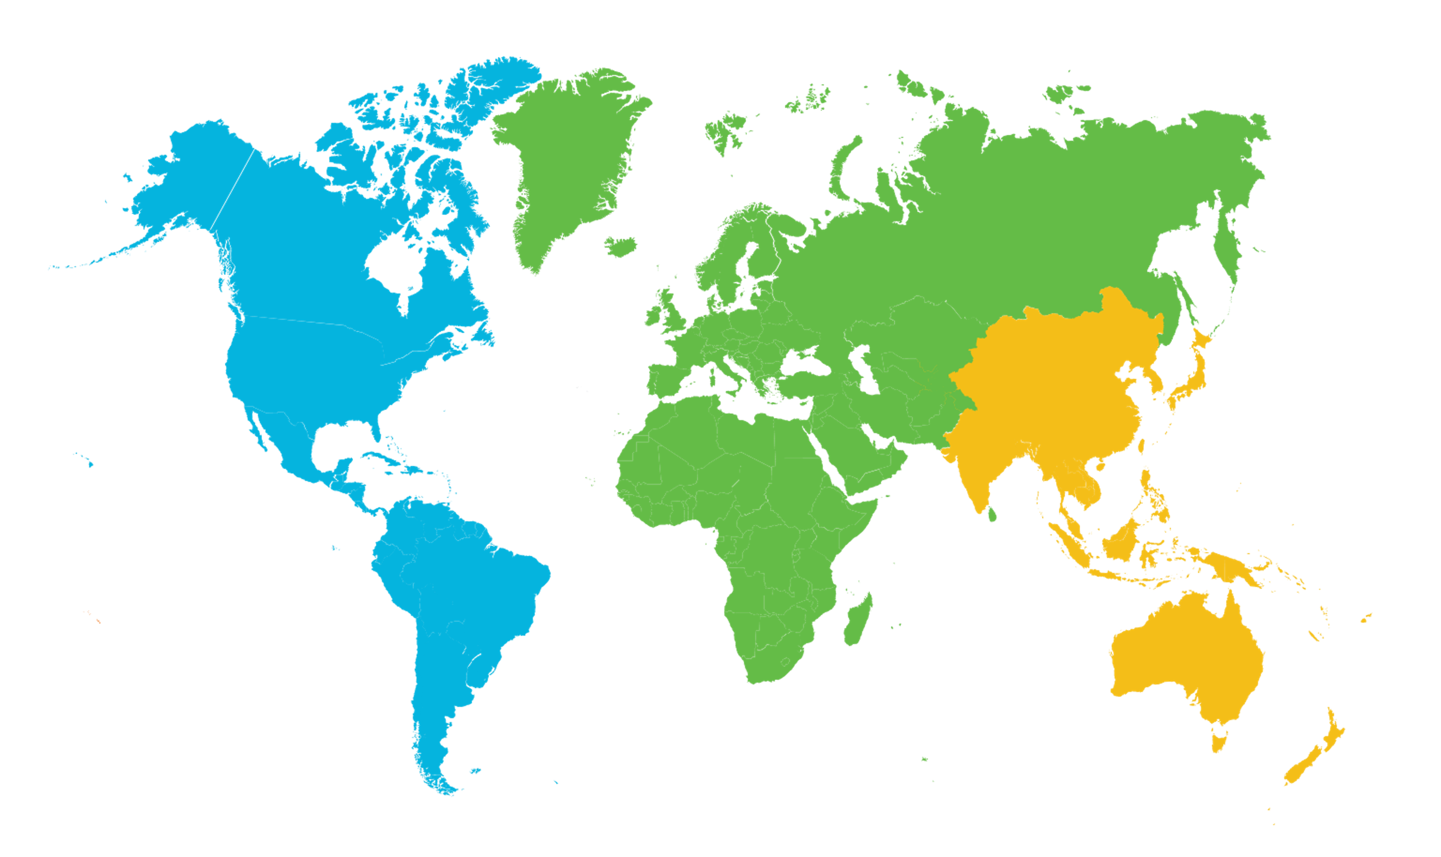
29 library leaders
Americas
Europe & Middle East
Asia Pacific
17 interviewees in 2 countries
9 interviewees in
6 countries
3 interviewees in 3 countries
United States | 12
Canada | 5
Netherlands | 3
United Kingdom | 2
Greece | 1
Italy | 1
Spain | 1
United Arab Emirates | 1
Japan | 1
Australia | 1
Hong Kong | 1
As of 30 June 2020

Slide 5
Leaders by Library Type (n=29)

Slide 6



Library experiences
Work experiences
Collections experiences
Engagement experiences

Slide 7
Poll Question
Which of the three experiences will undergo the most change as you move toward your New Model Library?
Work experiences
Collections experiences
Engagement experiences

Slide 8




Areas of impact
Agility
Virtualization
Collaboration
Space

Slide 9

Work experiences
Embrace flexible work
Foster well-being in the work environment
Train for the future
Challenge traditional divisions of labor

Slide 10

“I think it's proved a lesson to a lot of colleagues that they can do their [jobs] perhaps even more effectively by being more flexible in the way that they're working. At a practical level, that will be an interesting one…we'll start to see a lot more staff requesting flexible working, and how will we deal with that? Because we have a typically formalized structure where that happens.”
Research university, United Kingdom

Slide 11

“Change is hard for a lot of people…we will feel unsafe, scared, and nervous for years…we had [fires and smoke, hailstorms, and rain and water damage in three libraries, followed by the pandemic]. So you have to understand that at a certain point,…we will have to go and have a break. So you need to have a process that recognizes that…we're really needing to recoup in a different way to build that internal resilience.”
Research university, Australia

Slide 12
“We have a curriculum for our librarians…and continuing education for longer-term librarians…to keep our staff trained and upskilled because we are operating in a massively changing environment.”
Urban public, Canada

Slide 13
“Three of my four library technicians began to train…to help them with their workload, but also to expand variance in skill sets…we're all under one umbrella. And to be able to help across the board ensures my library staff remain relevant.”
Four-year college, Canada

Slide 14
Collection experiences
Acquire digital and open content strategically
Create new connections to physical collections
Prioritize resources that close the digital divide

Slide 15

“I think that is the critical part—things have to be seamlessly available to them. If any of the courses require resources, they need to be accessible through the LMS [library management system]. They can't be directed to physical resources they can't get access to or be blocked by [a situation where] there's only one user license.”
Four-year university, Canada

Slide 16

“Hybrid is firmly embedded, works and delivers…in all different spaces from accessing special collections through to…general [collections]. So I think that would be the…significant shift. And I think that’s the… trajectory we’re currently on. And in five, 10 years’ time, hopefully we will have managed to find solutions to deliver on that particular element.”
Research university, United Kingdom

Slide 17
“We need to have information access. We need to have free access to information. That's the rule of the library traditionally…Because of the digital divide. I want to address this issue with the library…This is my mission for coming five years, and also this is the biggest challenge…Especially after this pandemic.”
Research university, Hong Kong

Slide 18

Engagement experiences
Partner for a purpose
Be strategic about going virtual
Invite engagement in physical spaces

Slide 19
“…working with Student Success, and because we were starting to be involved with the academic instructional technology pieces, we got to become part of the major advocacy that had to happen with faculty suddenly going remote…The library has all of these resources, make them available, a good chunk of them online, and you are wanting to talk about educating our community, let's partner on this.”
Four-year college, United States

Slide 20
“But in five years I think we will be delivering digitally much more, not just the content, but the services. I think we will grow virtual reality, augmented reality…I'd love to see some of that start to happen so that my librarian could be anywhere…And libraries using more recordings, more of that asynchronous so that we can reach a wider audience or more of our audience, especially in small places like mine. I have one librarian. She can't teach every class that comes past.”
Four-year university, Canada

Slide 21
“I think students will continue to want a physical presence on campus for learning and studying…if anything, we’re going to build a new library. The physical presence is not shifting away. And I think this pandemic clearly demonstrates that yes have online services, yes provide them, but we also want this. We also want the physical.”
Two-year college, United States

Slide 22
Poll Question
Which of these will be most important for your library in the near future?
Partnering for a purpose
Being strategic about going virtual
Inviting engagement in physical spaces

Slide 23

Setting the foundation
for ongoing conversations
Notes:
Photo by Javier Allegue Barros on Unsplash

Slide 24

oc.lc/new-model-library
What’s next?
What’s next?
OCLC published findings
Discussion groups
Webinars
Virtual focus group interviews
oc.lc/new-model-library
Notes:
Photo by Drew Beamer on Unsplash

Slide 25
Thank you
Ixchel M. Faniel, Ph.D.
Senior Research Scientist
fanieli@oclc.org, @imfaniel

