Slide 1
The Research Library Partnership is a program of the Research Division of OCLC
It provides a unique transnational collaborative network of peers to address common issues
And the opportunity to engage directly with OCLC Research

Slide 2
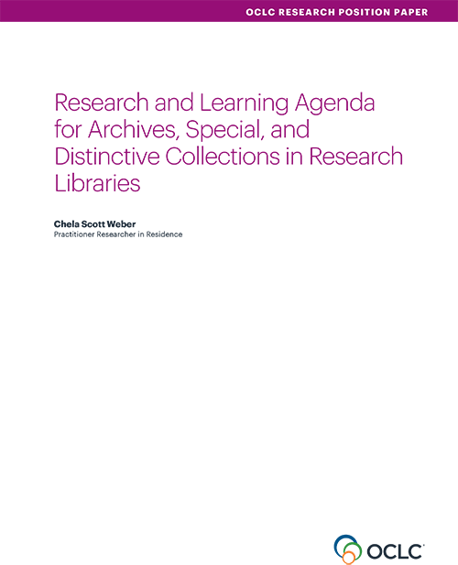
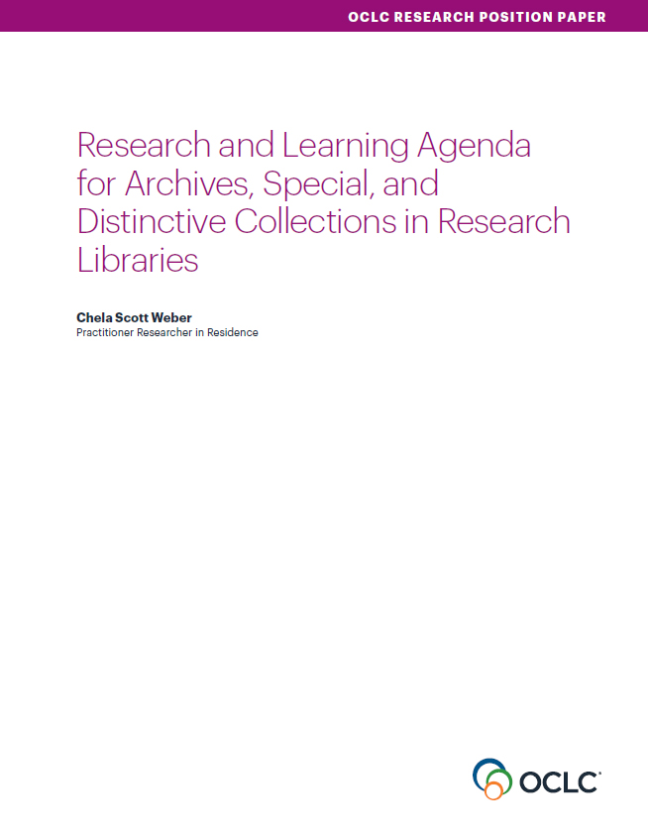
Our Work in Archives, Special, and
Distinctive Collections:
oc.lc/rlp-agenda
Notes:
OCLC Research has a long history of work in the area of archives, special, and distinctive collections in research libraries. We work in special collections because they are an important sight of knowledge creation, made possible by library’s commitment to the stewardship of their distinctive collections. The unique nature of material in special collections can make scaling a challenge, and we work to identify areas of common need and patterns of innovation to help libraries scale learning and expertise with these collections.

Slide 3
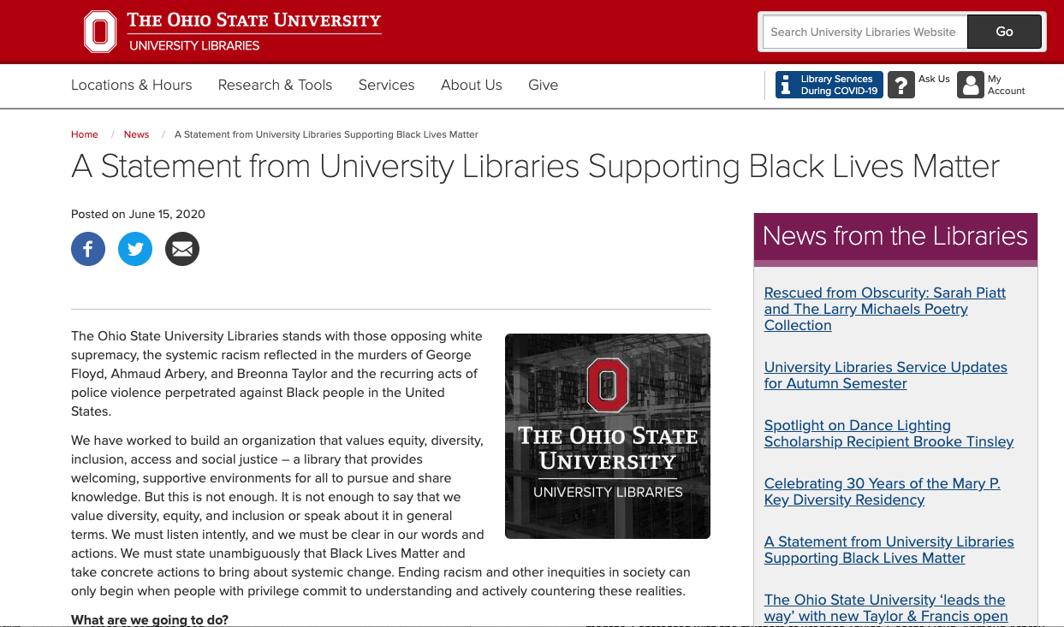
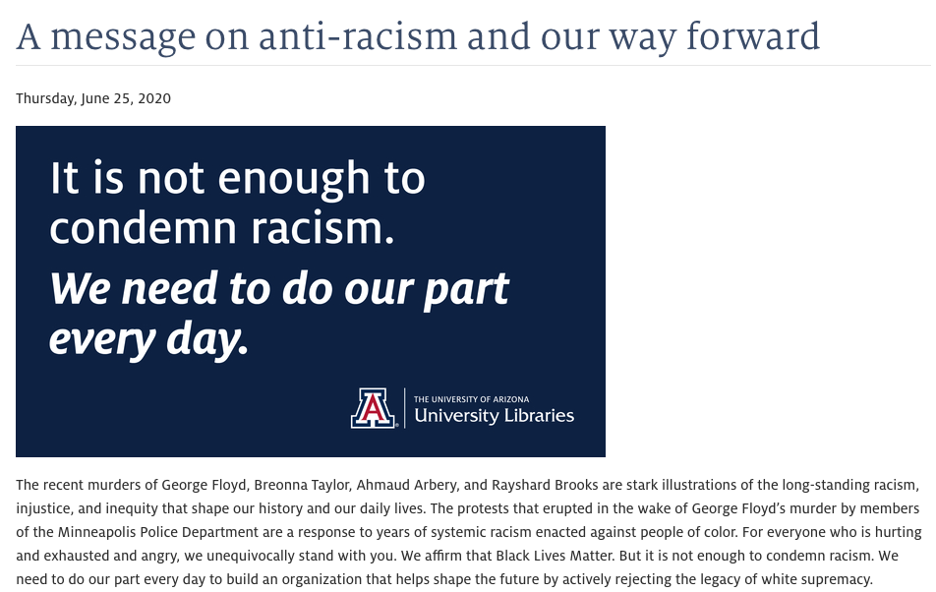
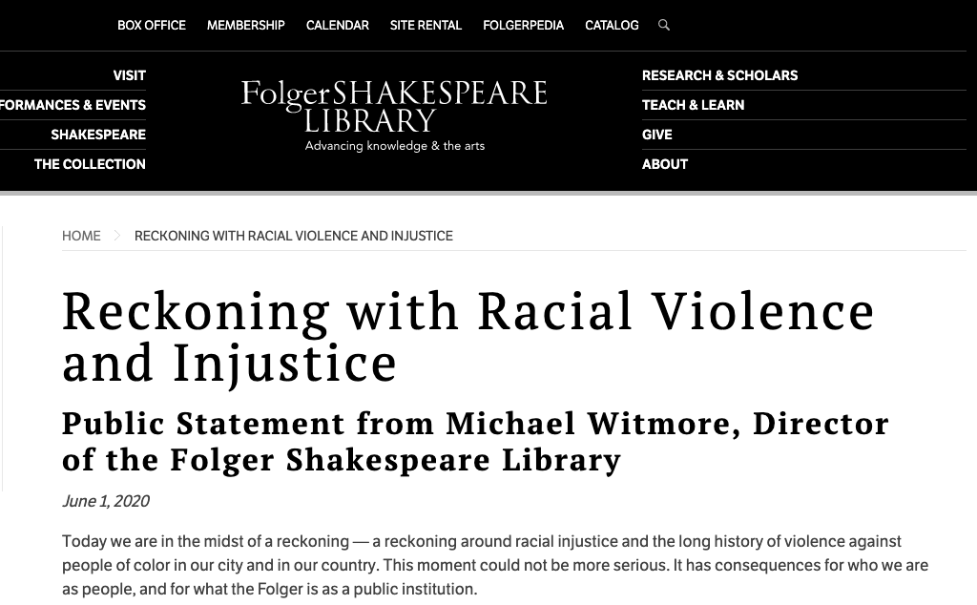

Slide 4
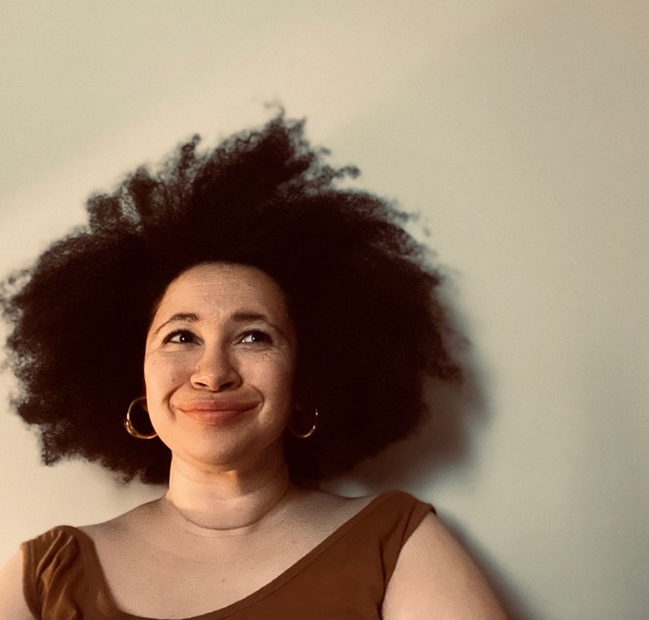
Dorothy Berry
Digital Collections Program Manager,
Houghton Library, Harvard University

Slide 5
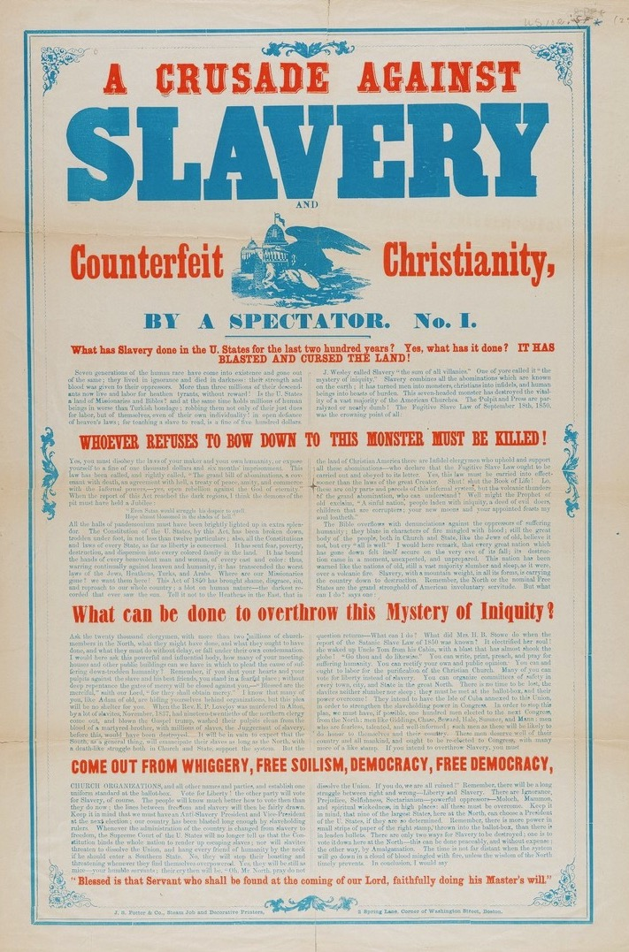
OCLC - WORKS IN PROGRESS
Slavery, Abolition, Emancipation, and Freedom
Primary Sources from Houghton Library
Notes:
Thank you so much for joining me today, I’m excited to share a true work in progress, the Slavery, Abolition, Emancipation, and Freedom: Primary Sources from Houghton Library project.

Slide 6
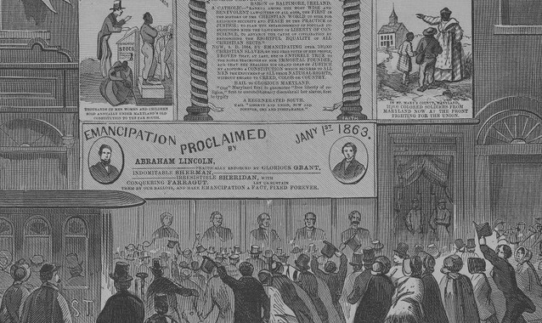
WHAT WE'LL DISCUSS
Project Background
Planning and Adapting
Outcomes and Deliverables
Developing Opportunity
Lessons Learned
Acknowledgements and Questions
TODAY'S TOPICS
Notes:
The structure for today’s talk might feel a little roundabout, but hopefully follows our own local process which was as much at the whims of the unpredictability of the last years as anything else in our work and personal lives.
I’m going to start with some background on the project, including contextualizing this work within larger digital collections goals at Houghton Library. I’ll then get into the planning process and some of the on-the-fly changes that had to be made, along with the desired outcomes, deliverables, and unexpected developments. I will end with a summary of the lessons learned thus far, and acknowledgements for the many friends and colleagues who contributed to the progress thus far.

Slide 7
DIGITAL COLLECTIONS AT HOUGHTON
Haphazard History
Collection development driven by curator endowments and over the counter patron requests
New Selection Process
Central funding, microgrant model open to all staffers
Less than Optimal Movement
Still primarily focused on traditional digitization areas
Project Background
Notes:
I was brought on three years ago as Houghton’s inaugural Digital Collections Program Manager, with the goal of developing a transparent and programmatic model for curating our digital collections. While we had historically had a fairly healthy digitization schedule, we weren’t working programatically enough to built collections. Piecemeal digitization of single pages, partial collections. There was also a goal of developing more equitable digital projects- both in terms of content representation and in terms of proposal submissions- without central funding, digital collection had been largely shaped by curatorial endowments, which were largely focused on promoting the Western canon.
A new digital project submission process was developed, in a sort internal micro-grant model, with an open submission form and a rotating review panel of stakeholders from Houghton Library, as well as Harvard Library’s large university-serving Imaging Services department. While this process was successful in opening up proposals beyond our curatorial division, it didn’t meet our goals of diversifying the materials we digitize. I began creating a list of undigitized African American history materials in our collection in planning for a proposal of my own, when the pandemic shut down our workflows and changed the conversation completely.

Slide 8
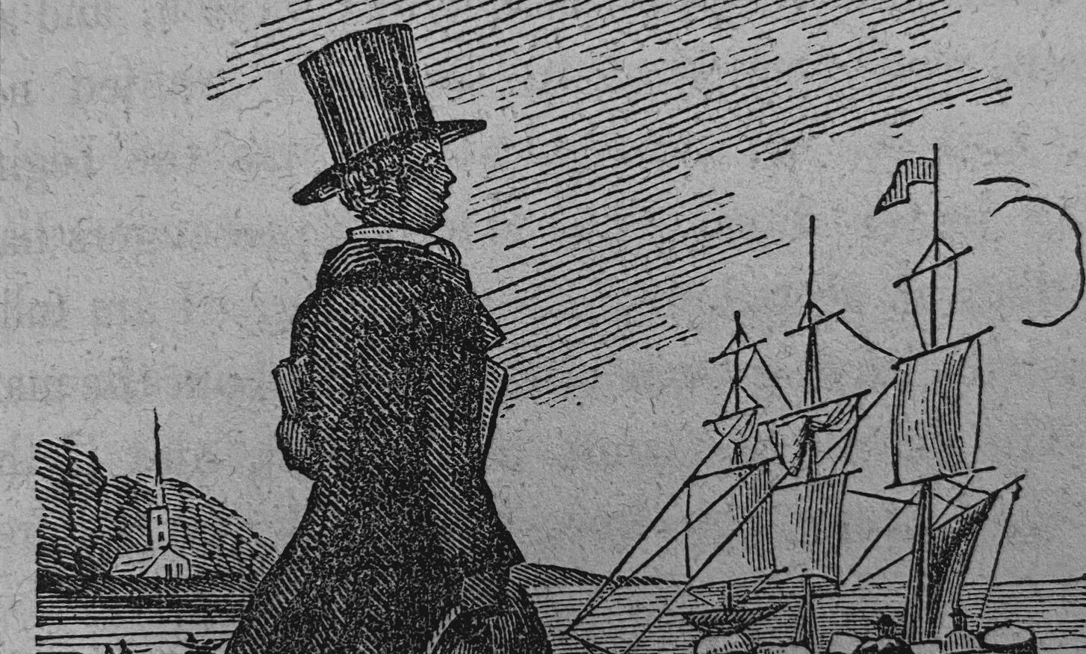
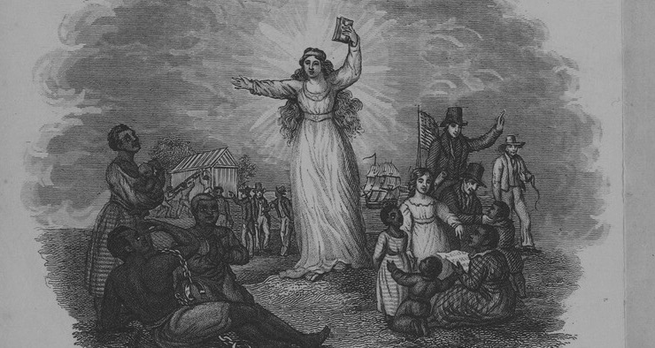
PROPOSAL
Pause all ongoing digitization projects to focus all resources (intellectual, time, financial) on increasing access to African American history materials.
RESPONSE
Expand the initiative to include more staff members and increase future access points
Notes:
In the summer of 2020, with almost all staff working remotely, I began to receive requests from across the library for digital images of African American people/history/books as universities responded to nationwide conversations on race. Due to the aforementioned spotty history, I had very little to offer these colleagues, and decided we needed a major move to address this for the future, while acknowledging the past practices that got us to that point. I wrote up a one page proposal for Houghton’s Senior Management Team asking that we pause all of our ongoing digital projects for the FY21 fiscal year and dedicate our digital collection resources entirely to digitizing materials relating to African American history and culture. That list I’d been building, which had about 500+ items listed at the time, came in handy. The full pause was both symbolic and practical, representing both a responsibility for work we had historically ignored as a library and recognizing the practical limits of taking on a large scale project in a pandemic without bringing on any new staff.
The Senior Management Team responded positively, but requested the project be expanded to include a cross departmental team and an educational component. Though this required developing new project features beyond simple digital access, it was welcomed as both a way to expand our remote project management experience (like many libraries, we had no remote processes before the pandemic), and to increase the number of staff with knowledge and understanding of our Black history holdings.

Slide 9
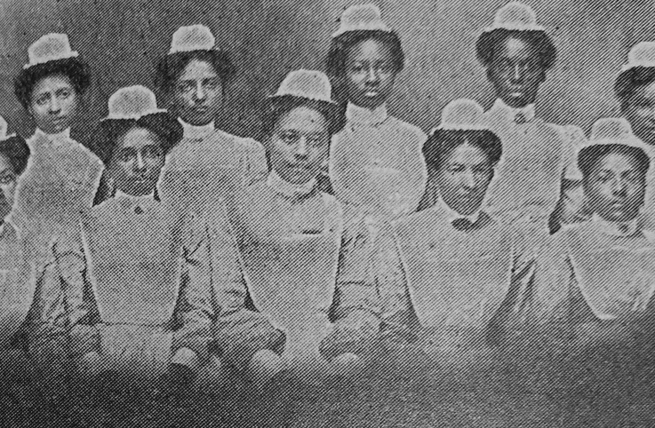
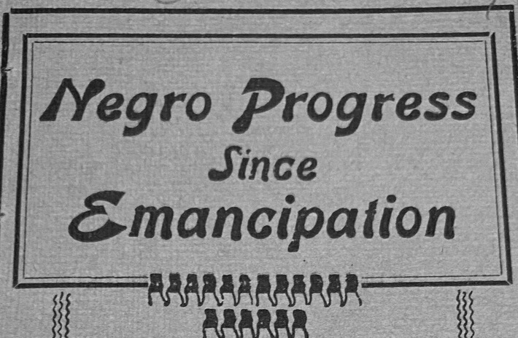
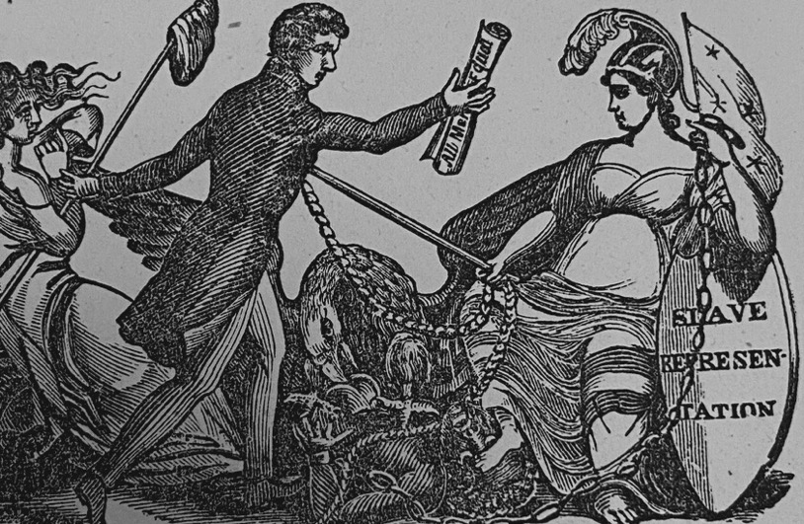
Initial Project Plan
Education
Digitization
Data Access
Develop staff understanding of Black history in our collections and of Black Digital Humanities as a field
Digitize around 800 items across collections from the 18th through early 20th century
Make items accessible with a series in our catalog and via digital collections page
Project Background
Notes:
At this point we were at early July 2020. Staff had not yet begun to return to work from Houghton, but colleagues in Imaging Services were back in action preparing e-reserves for newly remote classes. The SAEF project’s initial development was coeval with the development of a scan-on-demand workflow for patrons needing access to reference scans- which meant I, along with three other colleagues, would be returning to on-site work at the end of the month. My project team members- our assistant curator for modern books and manuscripts, our digital archivist, and a reference librarian, would all remain remote for the next year. Working within these parameters, the initial project plan was fairly simple- developing an easy-lift education program for the team remotely, work with Imaging Services to deliver and digitize materials I pulled on-site, and create new access points for the digitized materials through our catalog, finding aids, and a dataset that would be downloadable via a digital collections page using Harvard’s Spotlight instance, CURIOSity.

Slide 10
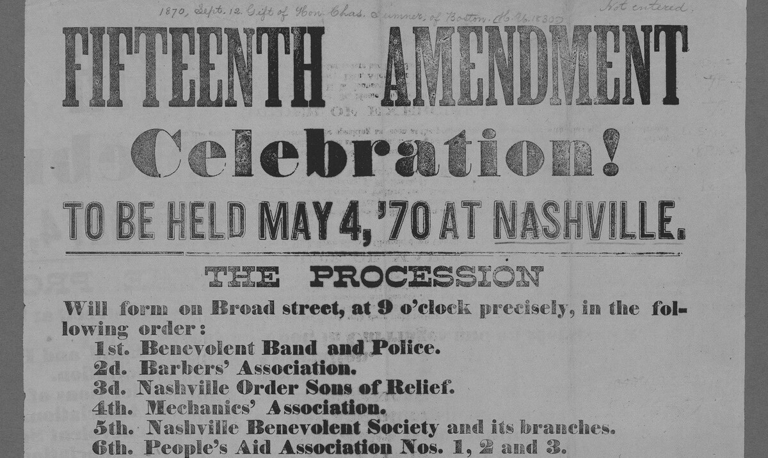
LESSON LEARNED
PLAN FOR OPPORTUNITY TO REALLOCATE BOLDLY
Project Background
Notes:
The first lesson learned from this project, at the very beginning, was the value of planning for unexpected opportunities to make bold proposals. I knew we needed to highlight our African American history holdings, and so had ideas and inventory in mind long before circumstances aligned in a manner that made this project possible. Keeping track of ideas, possibilities, dream-projects, allowed me to jump on the chance to make, what I hope is, a lasting contribution.

Slide 11
PROJECT DEVELOPMENT ON THE FLY
Cross-Departmental Team
Colleagues with professional and/or personal afinitity to the work
Shared Spaces for Remote Work
Hyper-organized Google shared drive and active communication on Teams
Transparency and Flexibility
Adjusting quickly when things aren't working smoothly and when colleagues need a break
Planning and Adapting
Notes:
While I had a project idea fomenting for quite some time, seizing opportunity meant more detailed project development would happen on the fly. By inviting colleagues with professional affinity for the materials and/or DEI work, I knew I had a group that would put in as much effort and energy as they could. Before our first official meeting I set up a Google drive for the project and created detailed documentation including possible tasks for self-directed work, a full list of identified material, a time-tracking sheet, project description, educational readings, and meeting notes. I also set up a Teams channel for project members and encouraged them to be conversational and not afraid to ask questions. While we had Teams and Slack available before the remote turn, we were not, as a library, particularly active users, especially as it came to project management. Creating all of this background documentation was time consuming, but working with a spirit of flexibility meant being willing to throw-out what initially seemed like good ideas. A couple months in, I realized that people were struggling to use the time-tracking sheet and reflected on why it existed in the first place. In our next team meeting, we discussed the issue and pivoted away from tracking time and towards just adding a message to the chat to update team members, “I’m working in this tab in the spreadsheet, I’ve got about 20 rows to go.”

Slide 12
PLANNING CONFLICTS
Team Access vs.
Public Access
Initial Inventory vs. Shelved Reality
Fixed Timeline vs. Shifting Schedule
Balancing the desires of colleagues across the libraries to see what we're working on with the need for team members to be comfortable working messily
Balancing the labor of pulling lists of items from the catalog backend and the labor of cataloging unlisted items sitting on the shelves
Balancing a widely announced one year timeline and dependency on other departments with conflicting responsibilities
Planning and Adapting
Notes:
On the fly planning meant, for me, finding balance with a lot of conflicting motives and realities. One of the first was finding balance between trying to run the remote project, with a small team as requested by Senior Management, and the desire of colleagues across the library to feel like they had enough access to our information and work. I wanted to be protective of the team, who were asked to take on new work in a traumatic period, but also did not want to make this seem like a separate “special project.” Our compromise was to keep all the aforementioned working documents private, but create a public sheet that listed all the initial items and included a tab for colleagues to suggest items we hadn’t seen. The second, and most unexpected, conflict was between what we had pulled from the catalog and what I found on the shelves when I was finally able to return to the office in late July. Call numbers with a single item in our catalog were revealed to be pamphlets with 5-25 uncataloged items bound-with. This required another on-the-fly development- fitting in well to demand for remote cataloging projects, I would come on site for a time-limited shift and take hundreds of photos- cover, title page, back of title page, last page- of pamphlets, upload them to a shared folder, add a transcribed title to a listening, and pass them on to a cataloger colleague. Our system is set up so that we cannot digitize without a catalog record, and even with the records there were questions of condition, possible disbinding, and conservation. That second conflict is an element that became a major feature in the biggest planning problem of the whole project- the library had publicly agreed to let me focus departmental resources for a full fiscal year, but that year was like none other of our professional lives. Schedules where limited for safety reasons, faculty requests for newly remote classes took priority meaning there were many months of the year where no work could be done on the project by colleagues at Imaging Services, and of course, we were all dealing with various personal and familial difficulties.

Slide 13
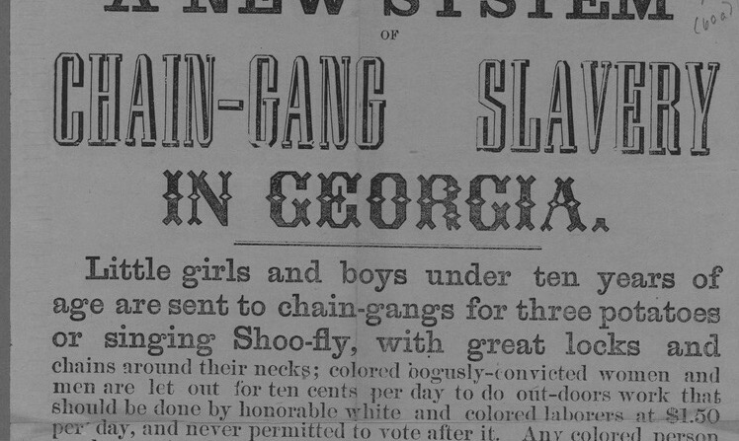
LESSON LEARNED
MAKE FLEXIBILITY YOUR STRENGTH, DETACH FROM EXPECTATIONS
Planning and Adapting
Notes:
These unexpected (and some expected, to be fair) challenges taught the second major lesson of this project- make flexibility your strength, and emotional detach from your own expectations. It is difficult, when you’ve made a bold move, to not put a lot of weight on its success, but owning your flexibility with transparency is a success of its own.

Slide 14
PROMISES WE CAN KEEP
1000+ Newly Digitized Items
Entire archival collections, hundreds of bound pamphlets, books, manuscripts, and broadsides
200+ Newly Cataloged Items
Previously uncatalogued pamphlets made accessible
Archival Description Updated Across Collections
Language edited for accuracy and bias
Outcomes and Deliverables
Notes:
In spite of various hurdles, after a year of identifying, cataloging, digitizing, and logging materials, we are weeks out from launching our digital collections site. In the meantime we’ve already accomplished digitization of over 1000 items including entire archival collections around the domestic slave trade and the Freedmen’s Bureau. We’ve cataloged over 200 previously undiscoverable publications and manuscripts, and we’ve made a great deal of progress in updating archival description for both accuracy and biased language.

Slide 15
Catalog Links
Links at collection level and for single items
Finding Aid Links
New Access Points
Links at item level and across collections
CURIOSity Site
Digital collection site with all materials gathered together, accompanied by project information
Data Set
Tool for navigating the wealth of material by date, location, author, theme, genre, and more
Outcomes and Deliverables
Notes:
The primary goal of this project has been to increase access and discoverability, and so we have been working on ways to put the material in front of researchers who may be approaching from various different angles. Every digital object is linked to either a catalog record or a finding aid (depending on context), is available through Harvard’s digital library, and will soon be available on our CURIOSity site. The early mentioned data set will also be available via the site. We’ve also been trying to make our workflows and processes as accessible as the content itself, and have been posting things publicly to the Houghton Technical Services wiki.

Slide 16
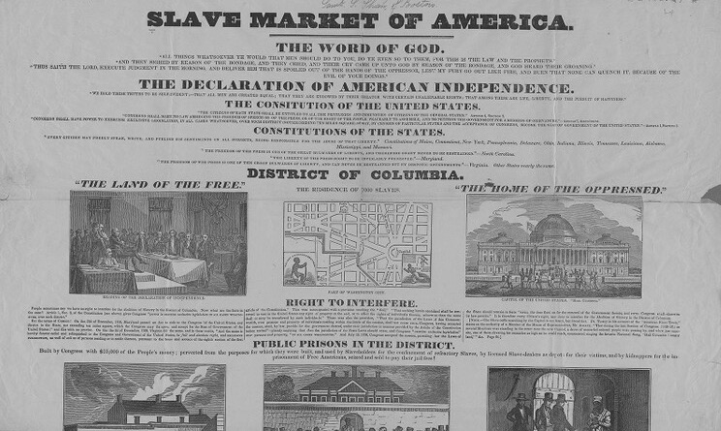
LESSON LEARNED
DON’T BE ASHAMED OF PROMISING EXACTLY WHAT YOU CAN DELIVER
Outcomes and Deliverables
Notes:
The lesson learned here was Don’t Be Ashamed of Promising Exactly What You Can Deliver. Throughout the project people have shared ideas for expansion, new directions, cross library collaborations- many of which were really thoughtful and fantastic. Realizing that we had a limited timeline and that a lot of the labor was falling on my position individually, I realized our most successful option would be to promise exactly what we can deliver- no custom designed site, no enhanced fancy features, but hundredfold increases in access to Black history at Houghton.

Slide 17
SEIZING EXPANSION
Internal Grant Competition
Funding to "Advance Open Knowledge" with a focus on underrepresented materials
What Can Others Do Better?
Bringing in more experts with lived experience and scholarly backgrounds
How Can We Support New [To Us] Research
Enhancing access to data through workflows that can live beyond SAEF
Developing Opportunities
Notes:
Now, throw everything I just said out the window! Kidding, of course, but there actually was an option for project expansion that we did take advantage of- primarily because this option came with the necessary funding and time-release possibilities. In the late Fall of 2020 Harvard Libraries announced an open competition for internal grants aimed at “advancing open knowledge” and improving access and representation of marginalized people. At this point I went back to some of those thoughtful ideas that had been parking-lotted and focused on two big discovery and access themes- what can others do better than we can, and how can we support advanced research on this digital corpus.

Slide 18
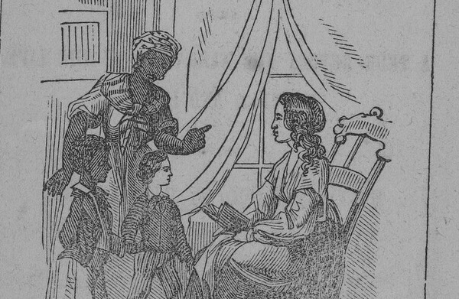
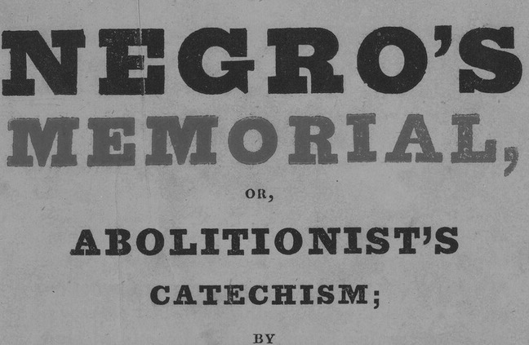
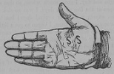
STUDENT HISTORIANS
INTERPRETATIVE TEXT
Student Authors
Different Voices
New Perspectives
Ranging from rising seniors to post-docs
Letting go of narrative control and neutrality
Allowing researchers to speak for themselves
Notes:
One of the first things we recognized others could do better, was creating interpretative text for the digital collections page. I had, on my long list of tasks, writing up an introduction to the collection and some sorts of loose historical contextualizations, but I have neither the time nor background to do anything much more than that. We seized this as an opportunity to provide a platform for emerging scholars, and to invite Harvard students into Houghton as collaborators. We hired five different students to write essays on five themes: Black Voices, Abolitionists, Early Republic, Antebellum, and Reconstruction. We met with the students virtually and provided them with a basic writing guide around tone and content, but generally advised them to not worry about being comprehensive, and to focus on the aspects of their area that were most appealing to them. The only hard requirements we gave them were to use digitized primary sources from the project in their text, and to provide 5 recommended further readings and 5 related digital objects at the end of their essays. The work these scholars submitted is wonderful in its diversity of voice, and thematic pulls in areas none of our staff could have accomplished, like a focus on the visual arts of abolition, or on Black and Indigenous relationships in the Early Republic.

Slide 19
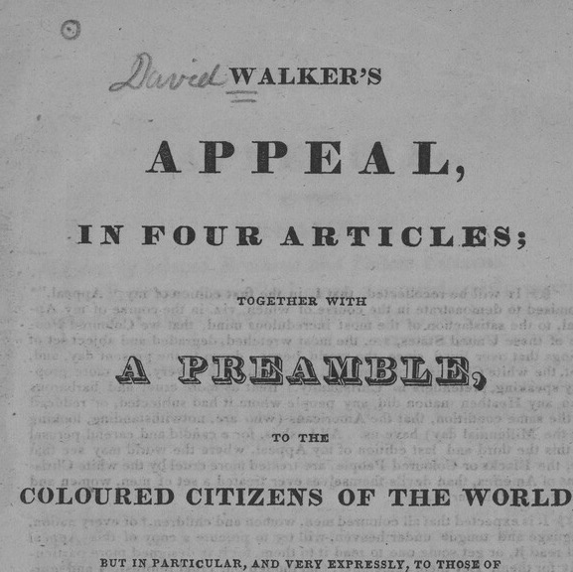
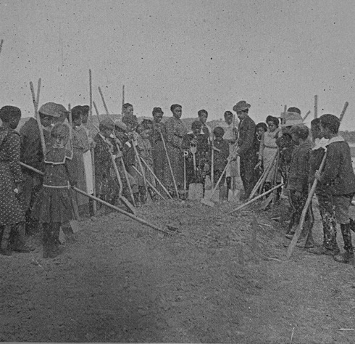
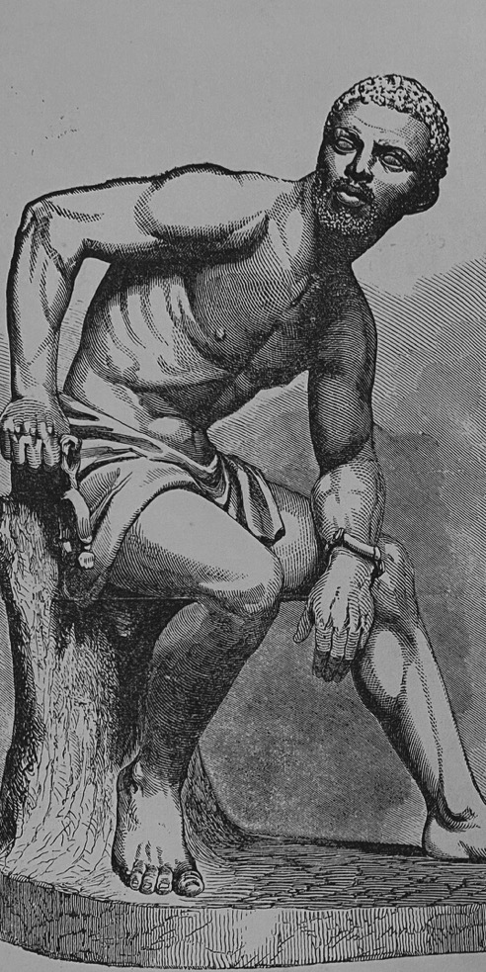
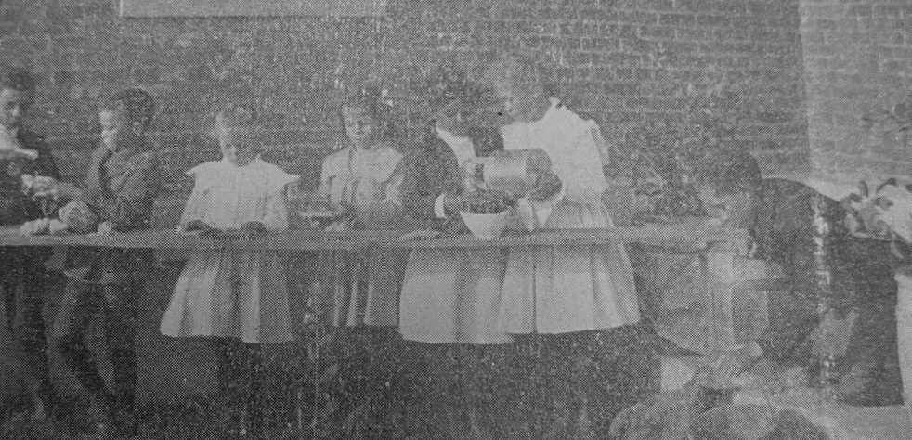
RESEARCH TOOLS FOR BEGINNERS
Digital access can mean a widened user-base, but without tools and assistance that can be more of an ideal than a promise
Developing Opportunities
Notes:
Another key “what can others do better” opportunity came about because of the combination of local Houghton preliminary discussion of wanting to provide services for middle and high school students, and a local Boston colleague inviting me to a panel on the Boston Public School’s Black Studies curriculum, on which she had been an educational consultant. Knowing her background in special collections, I discussed the project with her and was able to use grant funding to support the development of a middle grade educational unit, focusing on restorative justice and personal relation the complex histories in these digital objects. My colleague provided foundational research around the demographics for Cambridge and Boston area students, and worked with us to identify appropriate primary sources to fit her lessons, which will be available on the digital collections site. This felt incredibly important to us not only as a tool to increase Houghton’s reach, but in acknowledgment of the increasing need for remote learning guides.

Slide 20
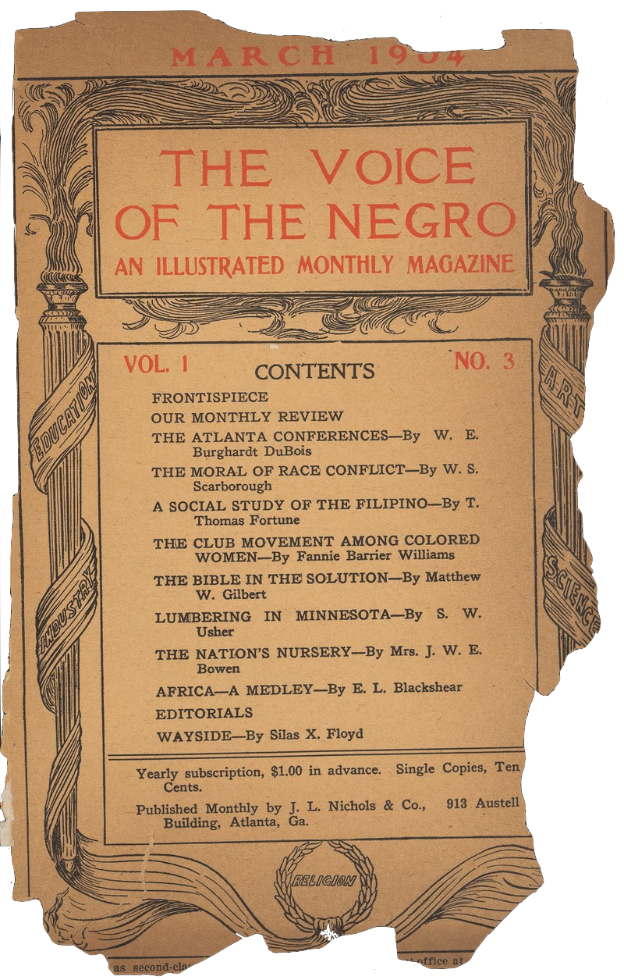
ADVANCED RESEARCH
NEW TOOLS FOR SCHOLARS AND STAFF
New Internal Workflows
From Houghton to Imaging Services to Research Management: full digital object packages for users
Enhanced Collections' Data Access
Flat data sheet becomes object level tags and un-OCRable handwritten materials is test run
Notes:
Perhaps the biggest benefit of the grant funding was the chance to work with colleagues in Research Data Management and Digital Scholarship to use this collection in service of developing new workflows to make future digital collections much more accessible to users. I’m highly simplifying both of the following initiatives both in deference to time and to my own lack of expertise- first we developed a workflow to get digital object packages into medium term storage and then into Dataverse, a repository for research data. With our current system, it is not possible for patrons (or staff, really) to pull large amounts of data from our digital repository, but we knew from the outset that that access could open the door to really unique computational research. My colleague in Digital Scholarship also piloted some machine learning based OCR workflows to get at least partial transcripts for the many handwritten materials in the collection. This enhanced access not only opens up the collection to fresh research, but is providing use cases for products that would benefit projects across Harvard Libraries.

Slide 21
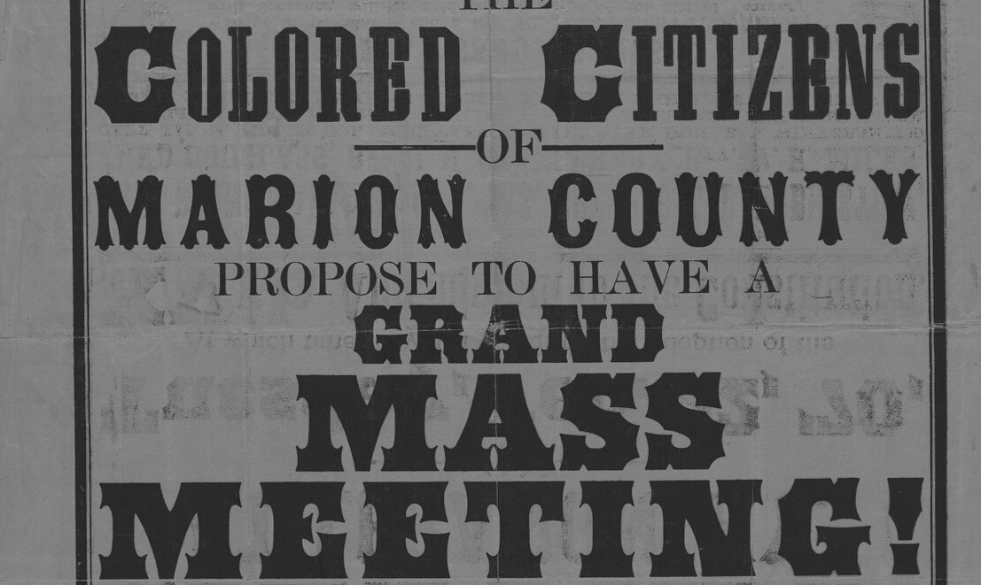
LESSON LEARNED
KEEP A WISH LIST IN YOUR BACK POCKET
Developing Opportunities
Notes:
Lesson Learned - Keep A Wish List in Your Back Pocket. This lesson, for me, is closely paired with promising what you can deliver. I spent much of this project focusing on not asking for more resources, to prove we can still do great things with reallocation and not new allocations, and telling people “That sounds like a great project- maybe for someone else though!” By keeping track of those possibilities, and not just single-mindedly pushing ahead, we were able to do much more than we initially set out to.

Slide 22

TAKE OPPORTUNITY TO REALLOCATE BOLDLY
Be willing to make dramatic pivots with the support of planning and preparation
MAKE FLEXIBILITY YOUR STRENGTH
Be willing to let go of ideas at the speed of disfunction and move to something new
DON’T BE ASHAMED OF PROMISING EXACTLY WHAT YOU CAN DELIVER
Lessons Learned
Be willing to deny requests that sound great but are out of reach
KEEP A WISH LIST IN YOUR BACK POCKET
Keep track of things that are out of reach so you can be ready when opportunity comes
Notes:
Thank you so much for attending today, and listening to what I hope was a useful overview of this work in progress. I know that each of our institutions has different priorities and resources available, and hope that at least some portions of our project resonate. There are probably other lessons to take away from this project, and undoubtedly other lessons I will realize when it is completed, but my four take aways for now are "Take Opportunity to Reallocate Boldly:" Be willing to make dramatic pivots with the support of planning and preparation, "Make Flexibility Your Strength:" Be willing to let go of ideas at the speed of disfunction and move to something new, "Don’t Be Ashamed of Promising Exactly What You Can Deliver:" Be willing to deny requests that sound great but are out of reach, and "Keep A Wish List in Your Back Pocket:" Keep track of things that are out of reach so you can be ready when opportunity comes.

Slide 23
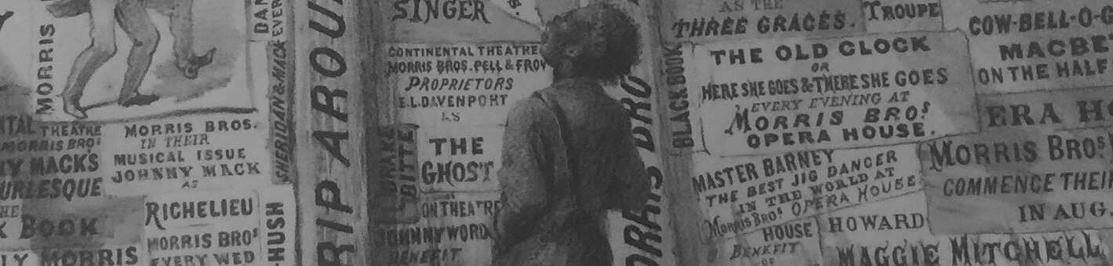
ACKNOWLEDGEMENTS
Houghton Team
Harvard Libraries
Grant Participants
Colleagues
Christine Jacobson, Micah Hoggart,
Monique Lassere,
Meg McNiff,
Vernica Downey,
Susan Pyzynski
Maggie Hale,
Matt Cook,
Ceilyn Boyd,
Bill Comstock,
Sonia Barbosa,
Joe Cavallo
Mekha Aponte,
Lauren Anderson,
Kabl Wilkerson,
Jonathan Karp,
Denson Staples,
Donald Brown
Tamar Evangelestia-Dougherty
Mark Matienzo
Athena Jackson
P. Gabrielle Forman
Jim Casey
Derrick Spires

Slide 24
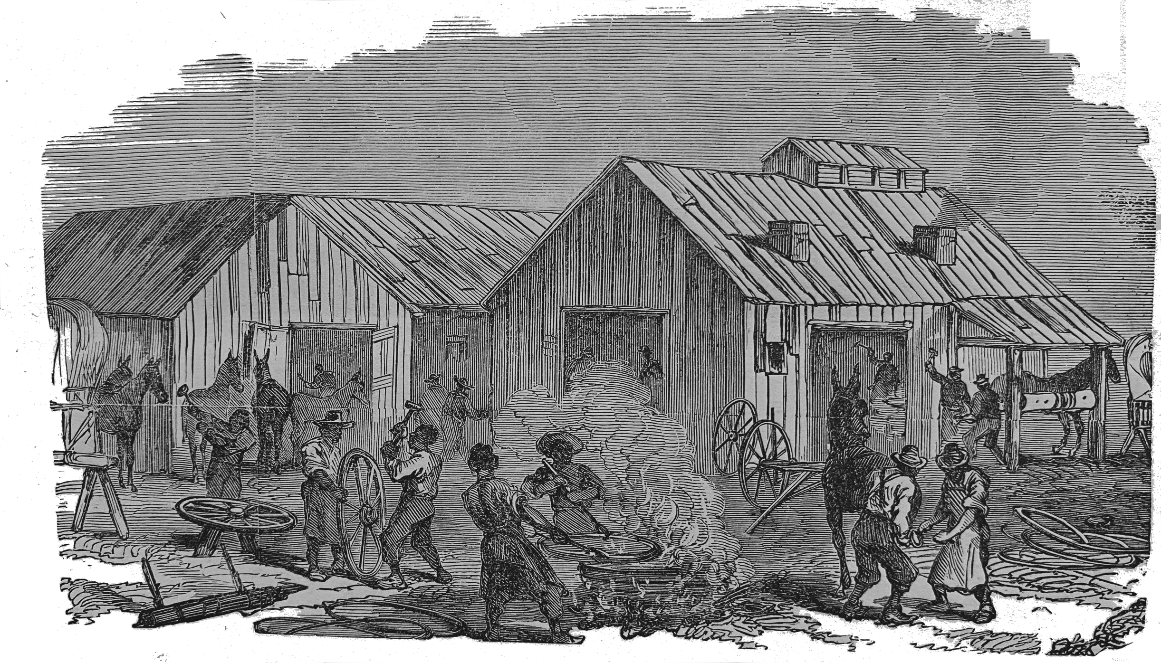
@dorothyjberry
dorothy_berry@harvard.edu
dorothyjudithberry@gmail.com
QUESTIONS AND COMMENTS

