Slide 1
23 September 2021 * OCLC Research Library Partnership
Research Information Management in the United States
Highlights from a new OCLC Research report
Rebecca Bryant, PhD
Jan Fransen
Senior Program Officer,
OCLC Research Library Partnership
bryantr@oclc.org @RebeccaBryant18
https://orcid.org/0000-0002-2753-3881
Service Lead for Research Information Management Systems, University of Minnesota
fransen@umn.edu @umjanlib https://orcid.org/0000-0002-0302-2761

Slide 2
Rebecca Bryant
Senior Program Officer,
OCLC Research Library Partnership
Jan Fransen
Service Lead for Research Information Management Systems, University of Minnesota

Slide 3
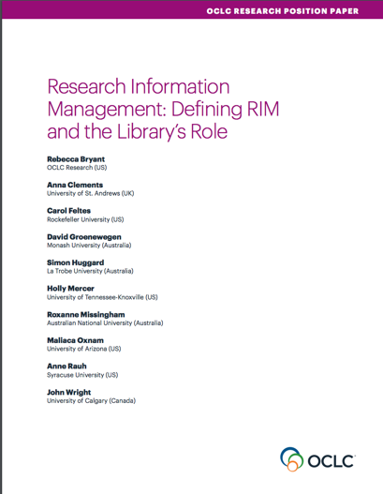
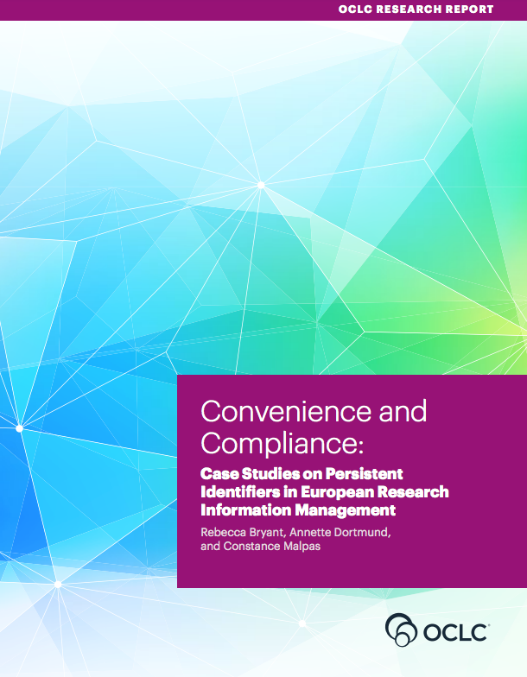
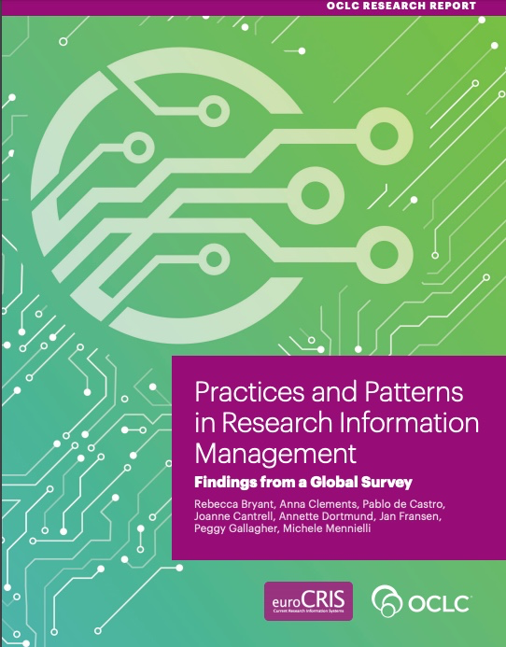
OCLC Research publications on Research Information Management
oc.lc/rim

Slide 4
Research Information Management in the United States
Methodology
Case study institutions
Case study approach
5 US research universities with a diversity of:
Uses
Products
Scale
Stakeholders
Semi-structured interviews with 39 individuals at 8 institutions
Penn State
Texas A&M
Virginia Tech
UCLA
oc.lc/us-rim-project
University of Miami

Slide 5
Research Information Management in the United States
Project Team
Outputs & amplification
Rebecca Bryant, PhD, OCLC Research
co-PI
Report publication
5-part Hanging Together blog series
Jan Fransen, University of Minnesota
co-PI
Pablo de Castro, euroCRIS & Strathclyde University
RLP webinars, discussions, & social media
Presentations at Educause, user group meetings, CNI. . .
Brenna Helmstutler, Syracuse University
David Scherer, Carnegie Mellon University

Slide 6
Goals
Differentiate US RIM practices from those in Europe+
Identify US uses and unite
Offer recommendations to institutional leaders
Demonstrate the central role of the library
Accelerate collaboration & innovation by encouraging vendor-agnostic community of practice

Slide 7
USE CASES

Slide 8
What happens when you have multiple drivers, use cases, & stakeholders?
. . . And in a highly autonomous & decentralized ecosystem

Slide 9
“We have six or seven research profiling systems [on our campus]. That is duplication of service, for sure.”
Photo by Waldemar Brandt on Unsplash

Slide 10
Most institutions have multiple RIM systems,
supporting multiple uses
Penn State
Texas A&M
Virginia Tech
UCLA
University of Miami
Research portal (Pure)
Scholars@TAMU (Elements/VIVO)
eFARS (Elements)
UCLA Profiles (Profiles RNS)
Research Profiles (Pure)
Activity Insight (Digital Measures)
Opus (homegrown/Interfolio)
Florida ExpertNet (homegrown)
Researcher Metadata Database (homegrown)
UC Publication Management System (Elements)
Scholarship@Miami (Esploro)

Slide 11
Most institutions have multiple RIM systems,
supporting multiple uses
Penn State
Texas A&M
Virginia Tech
UCLA
University of Miami
Research portal (Pure)
Scholars@TAMU (Elements/VIVO)
eFARS (Elements)
UCLA Profiles (Profiles RNS)
Research Profiles (Pure)
Activity Insight (Digital Measures)
Opus (homegrown/Interfolio)
Florida ExpertNet (homegrown)
Researcher Metadata Database (homegrown)
UC Publication Management System (Elements)
Scholarship@Miami (Esploro)

Slide 12
Most institutions have multiple RIM systems,
supporting multiple uses
Penn State
Texas A&M
Virginia Tech
UCLA
University of Miami
Research portal (Pure)
Scholars@TAMU (Elements/VIVO)
eFARS (Elements)
UCLA Profiles (Profiles RNS)
Research Profiles (Pure)
Activity Insight (Digital Measures)
Opus (homegrown/Interfolio)
Florida ExpertNet (homegrown)
Researcher Metadata Database (homegrown)
UC Publication Management System (Elements)
Scholarship@Miami (Esploro)

Slide 13
Most institutions have multiple RIM systems,
supporting multiple uses
Penn State
Texas A&M
Virginia Tech
UCLA
University of Miami
Research portal (Pure)
Scholars@TAMU (Elements/VIVO)
eFARS (Elements)
UCLA Profiles (Profiles RNS)
Research Profiles (Pure)
Activity Insight (Digital Measures)
Opus (homegrown/Interfolio)
Florida ExpertNet (homegrown)
Researcher Metadata Database (homegrown)
UC Publication Management System (Elements)
Scholarship@Miami (Esploro)

Slide 14
RIM use cases
Faculty activity reporting (FAR)
Public portal
Metadata reuse
Strategic reporting & decision support
Open access workflow
Compliance monitoring
Notes:
FAR (3): VT, UCLA, PSU
Public Portal: (5)
OA Workflow (2): UCLA, PSU

Slide 15
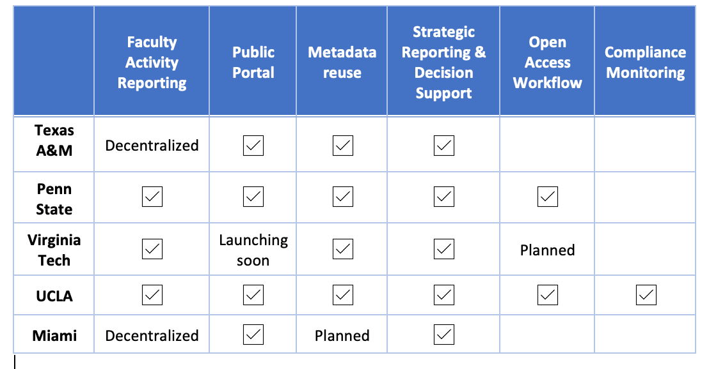

Slide 16
Compliance monitoring in RIM systems: not a US thing?
Think again.
Why so different here?
No external research assessment exercise in the US
But. . . Open Science mandates are requiring more monitoring
RIM systems were designed to do this! Share this with others at your institutions!
Upcoming blog post at hangingtogether.org

Slide 17
UNITE DIVERSE PRACTICES
Notes:
As we were writing up the case studies, we found that we needed a common language to describe the components of each system. It’s one thing to say that a system licenses Elements or Pure or uses VIVO; but that’s only part of what they do to keep their RIM system running.

Slide 18
Research Information Management (RIM) systems support the transparent aggregation, curation, and utilization of data about institutional research activities.
This includes:
Research Networking System (RNS)
Researcher Profile System (RPS)
Expert Finder System (EFS)
Faculty Activity Reporting (FAR) system
Current Research Information System (CRIS)
Notes:
Transparency is important, as stated in the Leiden Manifesto on research metrics. https://www.nature.com/news/bibliometrics-the-leiden-manifesto-for-research-metrics-1.17351 , which states:
4) Keep data collection and analytical processes open, transparent and simple. The construction of the databases required for evaluation should follow clearly stated rules, set before the research has been completed. This was common practice among the academic and commercial groups that built bibliometric evaluation methodology over several decades. Those groups referenced protocols published in the peer-reviewed literature. This transparency enabled scrutiny. For example, in 2010, public debate on the technical properties of an important indicator used by one of our groups (the Centre for Science and Technology Studies at Leiden University in the Netherlands) led to a revision in the calculation of this indicator⁶. Recent commercial entrants should be held to the same standards; no one should accept a black-box evaluation machine.

Slide 19
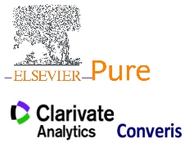
RIM
Faculty Activity Reporting
HR/Academic Affairs sectors
Home grown
CRIS systems
Publishing sector
New entrant, with institutional repository at the core
Library sector
Open source, seeded by NIH
Public portals
Notes:
Home by Lagot Design from the Noun Project

Slide 20
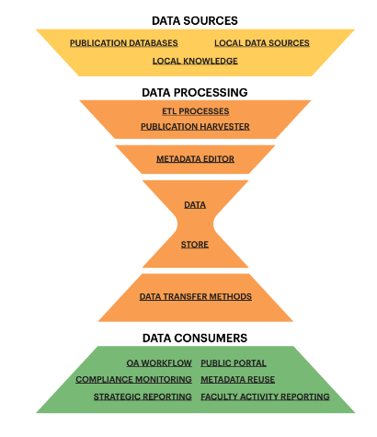
RIM SYSTEM FRAMEWORK
Notes:
As we were writing up the case studies, we found that we needed a common language to describe the components of each system. It’s one thing to say that a system licenses Elements or Pure or uses VIVO; but that’s only part of what they do to keep their RIM system running.

Slide 21
Notes:
So we came up with this framework. It starts at the top with the data sources, and flows through a data store to the consumers of the data that fulfill the use cases. Not every case study has or needs each component, and as we applied the framework we described what the system actually uses, not what the products they license offer.

Slide 22
Notes:
Let’s start at the top. We describe three kinds of data sources. We consider research outputs to be at the core of RIM systems. The bulk of those research outputs are publications, and the RIM system uses metadata in databases and indexes that are either freely available or licensed by the institution.
The other major source of data is local: Most systems use the institution’s HR system to identify the employees that will be included, their affiliations, and other information about them kept at the institutional level. Awarded grant data and courses taught also typically come from existing internal data sources.
And then there’s local knowledge. Unfortunately, not all the data one might want in a RIM system is readily available in another local system. We’re thinking here about information individuals might enter for themselves, like research statements, as well as information about centers and institutes and who is affiliated with them. More than one of the institutions we studied had no documented organizational hierarchy that could be pulled directly from a local data source: The RIM system became the first complete documentation of those relationships.

Slide 23
Notes:
Next we’ll move down to the data processing layer. Once the sources are identified, they need to be transformed into a single database that can be used to meet the use cases.

Slide 24
Notes:
Getting the publications into a single database is often the biggest lift: There’s no one database that has all publications for all researchers at an institution, and persistent identifiers aren’t used as consistently as we might like yet. Also, the publication databases themselves are subject to changing web services and structures.
So most RIM systems rely on a publication harvester that pulls candidate publications from one or more databases based on what is known about each author. We identified four publication harvesters in the case studies: Symplectic Elements, Elsevier Pure, Ex Libris Esploro, and the Profiles RNS Author Disambiguation Engine.
Although preferred publication databases vary by discipline, they don’t vary by institution. The same can’t be said about HR systems, grant tracking systems, and course systems. Even institutions using the same software will implement it differently. That’s where ETL processes come in. ETL stands for Extract, Transform, Load, and it’s where a lot of an institution’s developers spend a lot of their time. You might also have heard them called “crosswalks.”
While some institutions rely on data analysts who occasionally extract data from the local sources and run the queries and other processes necessary to get the data into a form the RIM system can consume, automating these processes ensures that the RIM system’s data is current and accurately reflects the institution’s records. In other words, if you’re planning a RIM system, we suggest you plan for analyst and developer time to fit the internal metadata to purpose.

Slide 25
Notes:
No matter how much you automate, there will always be a need for a metadata editor. This is where you review everything that came in from the data sources through the processes above, and also where you enter local or even individual-level information that isn’t stored anywhere else.

Slide 26
Notes:
And now we get to the data store. The data store might be part of a licensed product, or a custom database developed, hosted, and maintained by the institution.

Slide 27
Notes:
The data transfer methods are the various methods used to extract data from the data store. In most cases, the system had a web service, as well as tools for exporting or reporting. Some also have ways of querying the data store directly using SQL.

Slide 28
Notes:
The items in this bottom layer refer back to the RIM Use Cases. As we review some of the case studies, you’ll see versions of this framework for each system we covered. If a use case is met by the system, it will be listed on this layer.

Slide 29
CASE STUDIES
Notes:
I’m going to cover three of our five case studies here.

Slide 31
About Penn State University
The Pennsylvania State University (“Penn State”) is a state-related research-intensive university
Enrollment:
~75,000 undergraduates
> 15,000 graduate and professional students
24 campuses
Notes:
We’ll start with Penn State. Penn State is a very large institution with 24 campuses across Pennsylvania and a total enrollment of around 90,000

Slide 32
3 RIM systems
Research Portal
Activity Insight
Researcher Metadata Database (RMD)
Public portal with profiles for about 5,500 researchers
Managed by research office & medical college
Supports Faculty activity reporting (FAR) for >7,000 faculty on 24 campuses
Managed by library
Library supports data entry
Supports institutional OA workflow
Aggregates metadata from Pure & Activity Insight
Supports strategic reporting & metadata reuse
Managed by library
Home grown
Notes:
We explored three different systems that meet different use cases:
Elsevier Pure is managed by the research office and the medical college, including its library
Activity Insight is managed by the library
And the Researcher Metadata Database, managed by the library, incorporates data from both.

Slide 33
RIM Use Cases Penn State
 | Penn State
Faculty Activity Reporting (FAR) | ✔ | Library manages Activity Insight FAR system for 24 campuses
Public Portal: Expertise Discovery &/or Research Showcase | ✔ | Elsevier Pure portal includes 5,500 faculty profiles for all campuses and colleges Managed jointly by Office of Research and College of Medicine
Open Access Workflow | ✔ | Home grown Research Metadata Database (RMD) supports institutional OA policy
Strategic Reporting & Decision Support | ✔ | Research Metadata Database (RMD) supports reporting
Metadata Reuse | ✔ | Research Metadata Database (RMD) supports data sharing
Compliance Monitoring
Notes:
All together, the three systems are used to meet almost all the RIM use cases we identified.

Slide 34
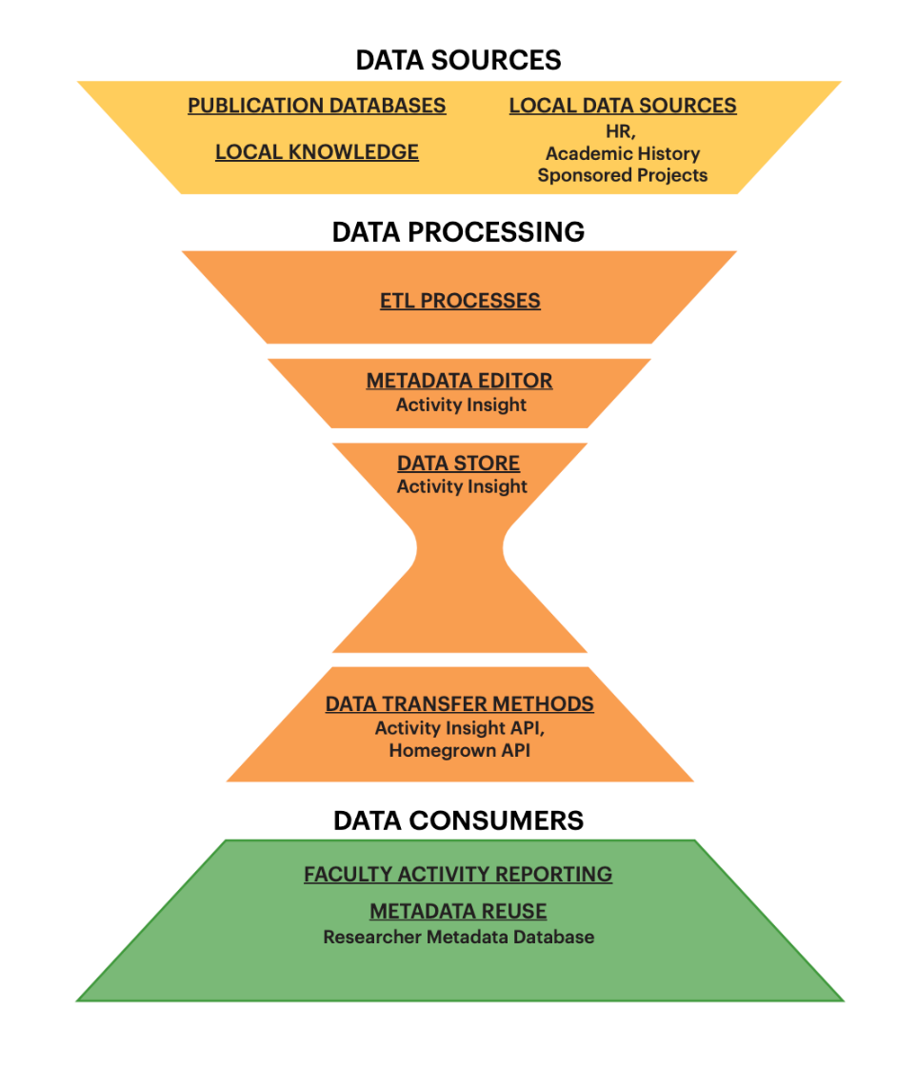
Penn State Activity Insight System
Notes:
Here’s the RIM Framework for Activity Insight, Note that there is no publication harvester: Individuals and their delegates enter their own information, including importing publications from various databases. A team of Libraries staff members also support faculty members, both answering questions and entering data from their CVs.

Slide 35
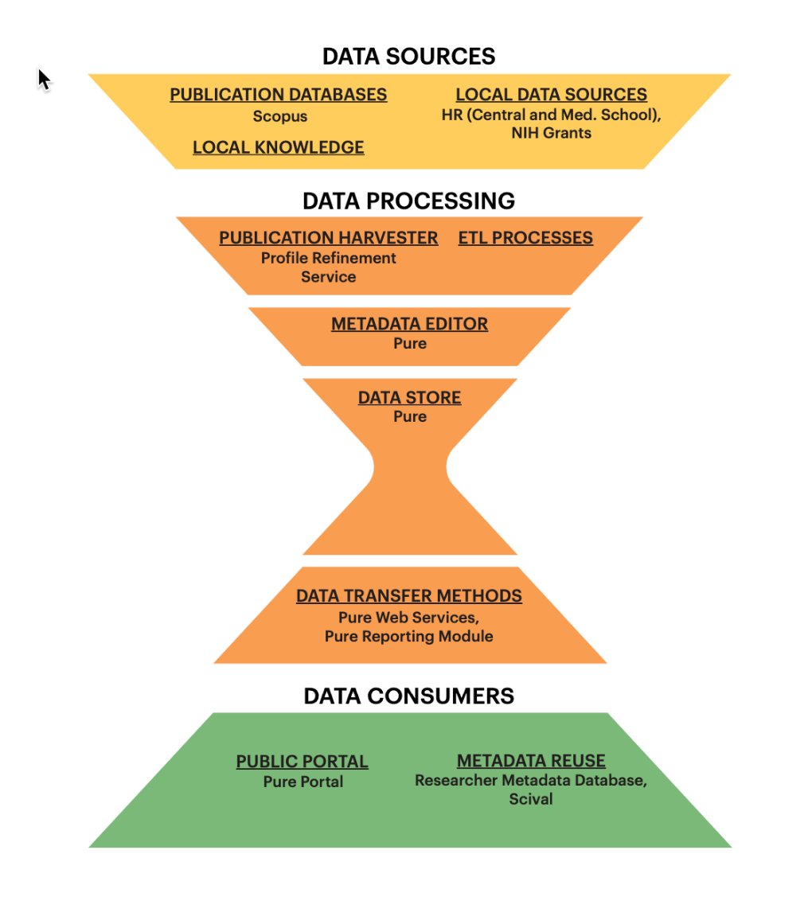
Penn State Research Portal
Notes:
The Framework for Penn State’s Pure system is mostly filled by Pure. The automatic Scopus feed comes through the Profile Refinement Service, a curation service from Elsevier. People can also import from other publication databases. Down at the bottom of the framework, the Portal is a Pure component also.

Slide 36
Researcher Metadata Database
Activity Insight
Pure
Notes:
The two systems together feed into the Researcher Metadata Database, which is a very recent addition.

Slide 38
About Virginia Tech
Public research university
Enrollment:
~30,000 undergraduates
>7,000 graduate & professional students
Notes:
Virginia Tech is public research-intensive institution with about 37,000 students.

Slide 39
Virginia Tech—key facts
Relies primarily on Elements
Administrative responsibility is shared
Office of Faculty Affairs (Provost)
Libraries
Office of Analytics & Institutional Effectiveness
Publication metadata is seen as an institutional asset
University Data Commons
Ingests Elements data/combines with other institutional data
Supports incentive-based budget planning/tracking
Data governance for campus
Home grown
Notes:
Virginia Tech relies primarily on a single licensed product for their RIM system: Elements.
In an excellent example of both technical and social interoperability, the administrative responsibility for that system is shared among three entities. One thing we particularly noted: The publication metadata is seen as an institutional asset. Among other things, this means that the publication metadata is stored in a University Data Commons where it’s governed centrally, like other types of institutional data, and available for budgeting and other institutional analysis purposes.

Slide 40
Virginia Tech Use Cases
Faculty Activity Reporting | ✔ | Provides a database of information that supports faculty annual reports and generates P&T materials. Supports program-level accreditation reports.
Public Portal: Expertise Discovery & Research Showcase | Launching soon | Using the Elements Discovery module
Open Access Workflow | Planned | Faculty members can now deposit open access versions of their publications in institutional repository directly from Elements. Campus OA policy recently approved; Library is working to support compliance.
Strategic Reporting & Decision Support | ✔ | Specifically, supports the PIBB budget model. Conducted through the University DataCommons Assists colleges in goal setting.
Metadata Reuse | ✔ | Maintains a comprehensive database of Virginia Tech faculty scholarship, accounting for different disciplines and types of scholarly products. The University DataCommons provides that database, with control over how and what information is entered as well as how the data are collected and used.
Compliance Monitoring
Notes:
Although it’s made up of multiple pieces, they are connected under one umbrella to meet most of the use cases we identified.
The public portal is scheduled to roll out this fall. Faculty members can deposit open access versions of their publications to the institutional repository from Elements, and a robust open access workflow is under consideration.

Slide 41
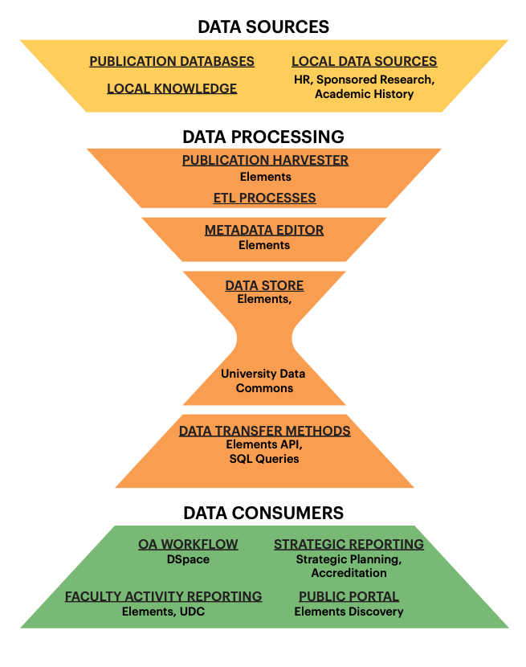
Elements at Virginia Tech
Notes:
The RIM Framework for Elements at Virginia Tech shows the Elements product as the publication harvester, metadata editor, and a data transfer method. Elements acts as a data store, but the data in Elements is also fed to the University Data Commons, which then acts as the data source for strategic planning.

Slide 42
Notes:
Our UCLA case study explores another large institution.

Slide 43
About UCLA
University of California, Los Angeles (UCLA)
Public research institution
Enrollment: 31,000 undergraduate students & 13,000 postgraduate students in > 300 degree programs
One of 10 campuses of the University of California System
University of California (system)
Largest higher education system in the US
Comprised by 10 research universities, including UCLA
In total, >250,000 students, 22,000 faculty members, 150,000 staff
The California Digital Library (CDL) serves as a central library hub to support UC-wide efforts
Notes:
In addition to UCLA itself, the case study addresses the University of California system, particularly with regard to the UC system’s Open Access policy. California Digital Library, or CDL, is the central library hub for all of UC.

Slide 44
UCLA—3 distinct systems
Opus:
UC Publication Management System (UCPMS)
UCLA Profiles
Home grown system aggregating faculty information, coupled with
Interfolio systems for tenure/promotion & annual reviews
Managed by UCLA personnel office
Supports institutional OA policy for 22,000 faculty and thousands of other researchers
Elements for metadata harvesting
Managed by California Digital Library
Profiles RNS
1,000+ public profiles of biomedical researchers
Managed by Clinical & Translational Science Institutes at UCLA and UCSF
Home grown
Notes:
Again, there are three different systems to talk about. Opus is UCLA-only and is used for faculty activity reporting. Initially it was a completely home grown solution, but now UCLA is licensing Interfolio’s FAR product as well. The UC Publication Management System is managed for the whole system by CDL. It uses Symplectic Elements for publication harvesting. Neither of those systems includes a public portal. UCLA Profiles actually started at another system campus, UC San Francisco but it’s now used throughout the system. At this point it’s only for biomedical researchers.

Slide 45
RIM Use Cases at UCLA
 | UCLA
Faculty Activity Reporting (FAR) | ✔ | Opus & Interfolio systems on UCLA campus
Public Portal: Expertise Discovery &/or Research Showcase | ✔ | UCLA Profiles includes only biomedical researchers. Supported by the UCSF campus
Open Access Workflow | ✔ | UC Publication Management System notifies researchers of publications eligible for OA deposit
Strategic Reporting & Decision Support | ✔
Metadata Reuse | ✔
Compliance Monitoring | ✔ | Discrete uses to manage compliance with federal grant requirements, thru UC PMS.
Notes:
Between the three systems, all of the RIM Use Cases we’ve discussed are covered. In fact UCLA is the only case where we noted use for compliance with federal grant requirements, and it’s only used for a couple of very large grants. We think that this use case is going to become more relevant in the US in the future.

Slide 46
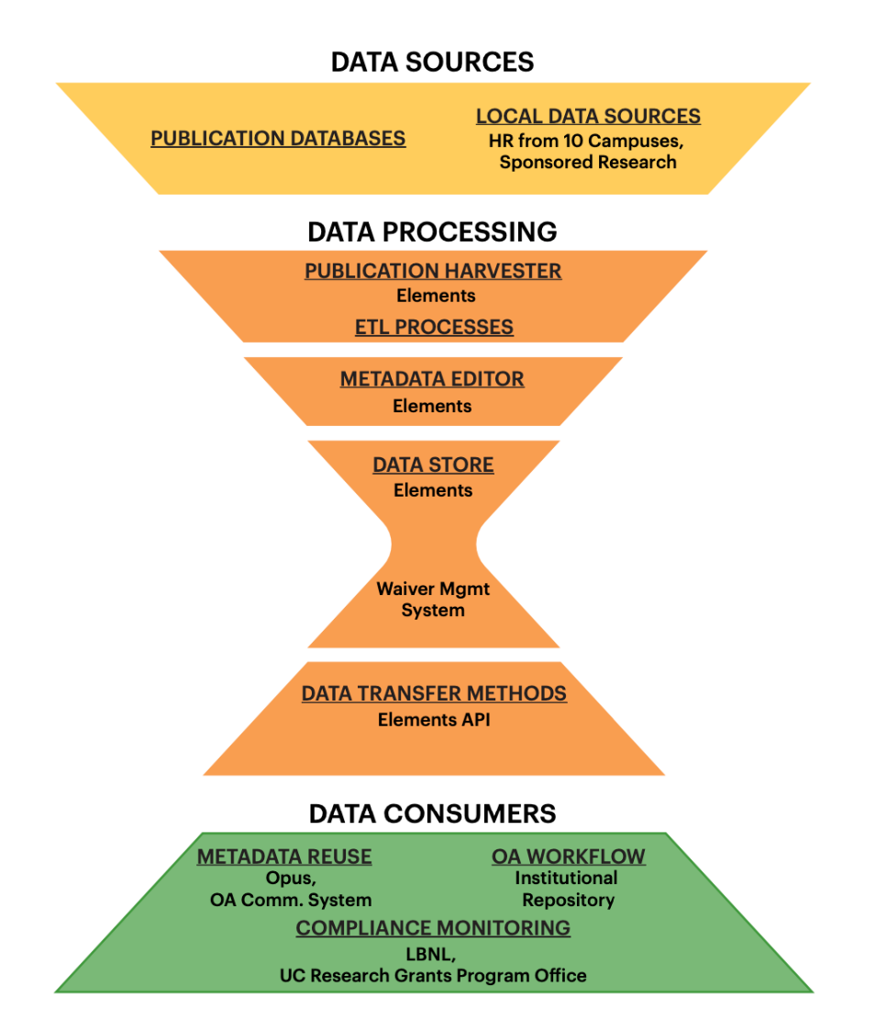
UC
Publication Management System

Slide 47
RECOMMENDATIONS FOR INSTITUTIONAL LEADERS
Notes:
As we were writing up the case studies, we found that we needed a common language to describe the components of each system. It’s one thing to say that a system licenses Elements or Pure or uses VIVO; but that’s only part of what they do to keep their RIM system running.

Slide 48
Libraries are essential partners in research information management (RIM)
Invest in institutional data curation
Support adoption of persistent identifiers (PIDs)
Don’t expect a turn-key system
Support cross-functional teams
Invest in dedicated personnel
Include research information in enterprise data governance efforts

Slide 49
References
Bryant, Rebecca, Annette Dortmund, and Brian Lavoie. 2020. Social Interoperability in Research Support: Cross-Campus Partnerships and the University Research Enterprise. Dublin, OH: OCLC Research. https://doi.org/10.25333/wyrd-n586
Bryant, Rebecca, Anna Clements, Pablo de Castro, Joanne Cantrell, Annette Dortmund, Jan Fransen, Peggy Gallagher, and Michele Mennielli. 2018. Practices and Patterns in Research Information Management: Findings from a Global Survey. Dublin, OH: OCLC Research. https://doi.org/10.25333/BGFG-D241
Bryant, Rebecca, Annette Dortmund, and Constance Malpas. 2017. Convenience and Compliance: Case Studies on Persistent Identifiers in European Research Information. Dublin, Ohio: OCLC Research. doi:10.25333/C32K7M
Bryant, Rebecca, Anna Clements, Carol Feltes, David Groenewegen, Simon Huggard, Holly Mercer, Roxanne Missingham, Maliaca Oxnam, Anne Rauh and John Wright. 2017. Research Information Management: Defining RIM and the Library’s Role. Dublin, OH: OCLC Research. doi:10.25333/C3NK88
de Castro, Pablo. 2014. 7 things you should know about Institutional Repositories, CRIS Systems, and their Interoperability. COAR blog, 6 October 2014. https://www.coar-repositories.org/news-updates/7-things-you-should-know-aboutirs/

