Slide 1
Partnerships, pedagogy, and primary sources
Strategies for working with faculty to engage students with primary sources
Notes:
Chloe

Slide 2
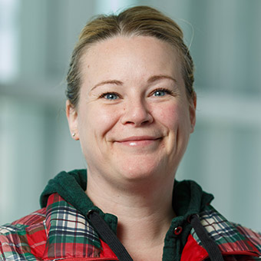
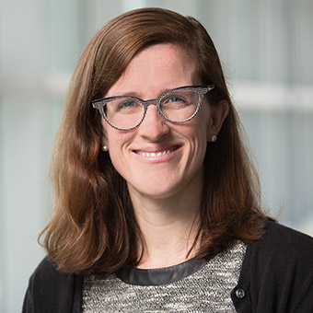
Welcome!
Chloe Gerson, Reference and Instruction Archivist, Robert D. Farber University Archives & Special Collections
Laura Hibbler, Associate University Librarian for Research and Instruction
Notes:
Chloe and Laura

Slide 3
Primary Sources
+
Teaching
Notes:
Chloe

Slide 4
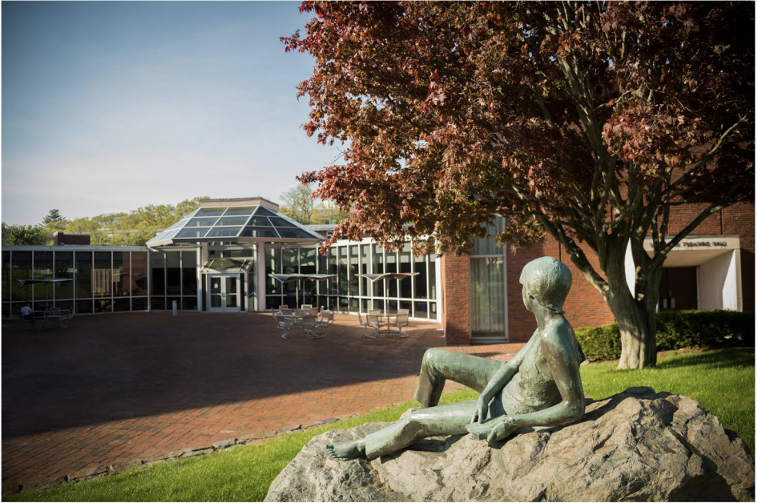
Brandeis University
Located in Waltham, MA (9 miles west of Boston)
Member of the Association of American Universities
Private R1 university
3,688 undergraduates (as of Fall 2019)
43 undergraduate majors and 47 minors
Notes:
Chloe

Slide 5
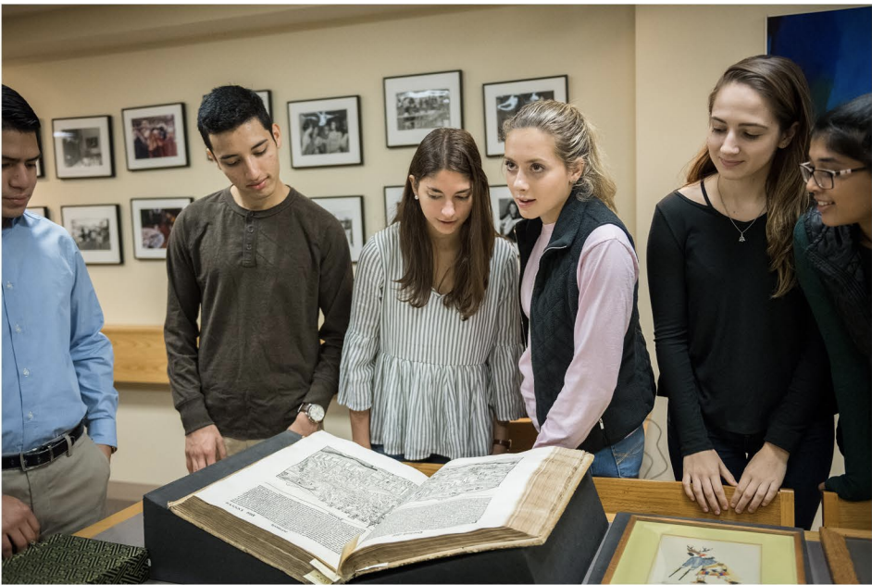
Brandeis Library and Archives
Most subject librarians and archivists have teaching responsibilities included in their job descriptions
Monthly Teaching Discussion (all librarians, archivists, and media specialists are invited to attend the open discussion)
Archives collection strengths:
University History
Judaica
Jewish Feminism
Shakespeare
19th and 20th century literature
History of Science
Notes:
Chloe

Slide 6
Ithaka S + R Study
The goal of the study was “focused on identifying how to effectively support instructors and their students find, access, and use primary sources in classroom environments”
26 schools from around the US and the UK, and ProQuest (study sponsor)
All teams had to complete the IRB process at their respective schools
Ithaka Teaching with Primary Sources Report
Notes:
Chloe

Slide 7
Departments of Brandeis Faculty Participants
15 Faculty were interviewed during the Fall 2019 semester from the following departments and programs:
African and African American Studies
American Studies
English
History
Legal Studies
Near Eastern and Judaic Studies
Sociology
Notes:
Chloe

Slide 8
Themes from Brandeis Findings
How faculty learned to teach undergraduates with primary sources
Faculty approaches to defining primary sources for their students
Representation of marginalized voices within readily available primary sources
Notes:
Laura

Slide 9
Learning to Teach with Primary Sources
“Making mistakes”
“Trial and error”
“Trial by fire”
Notes:
Laura

Slide 10
Approaches to Defining Primary Sources
“I assume that they know...I hope they learn that in high school”
“I’ve come to understand that students sometimes don’t know what I mean when I say a primary source or a secondary source”
Notes:
Laura

Slide 11
Representation of marginalized voices
“Nollywood doesn't have any archive, so I hope it comes up or I hope somebody takes it on to create - because some of the films that came out in the '90s, yes, some you can find on YouTube, but it's - it's been nice to just - and it's really random, too...So sometimes it's just like a film that was very accessible two years ago, five years ago, and now I can't locate it anywhere..”

Slide 12
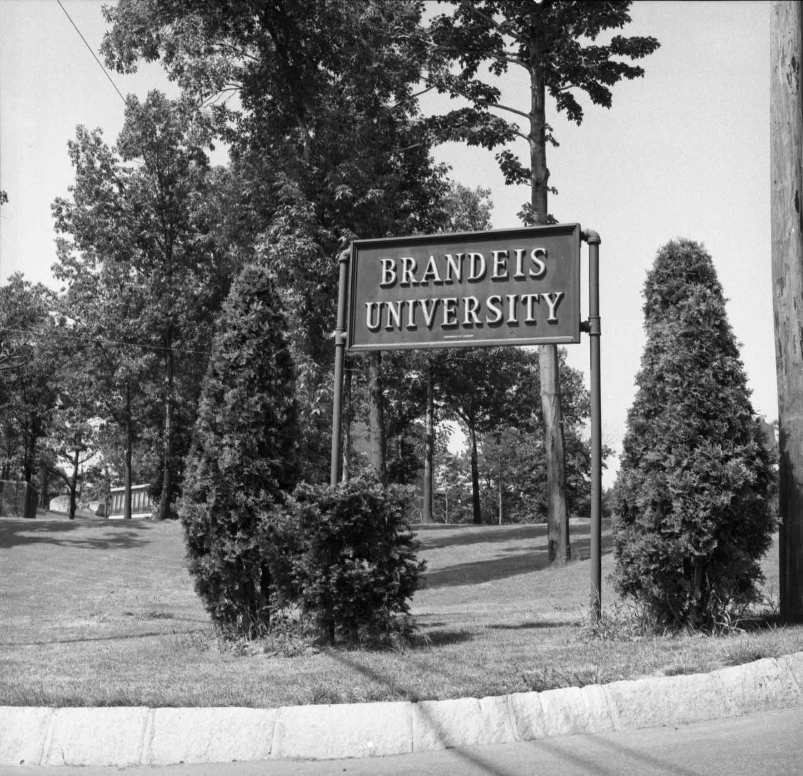
Opportunities for collaboration and engagement during the Covid-19 pandemic
Archives workshops
Brandeis History (students, alumni, parents, incoming students, staff)
In-depth Archival Research
Teaching in the archives (faculty workshop)
Connect with both new faculty and faculty who previously held classes in the library to explore ways to engage students online
Notes:
Chloe

Slide 13
Examples of Class Activities

Slide 14
Create your own finding aid class session example
Sandals
Travel photographs
Cook book
Ceramic pot
Fountain pen
Bike
Yoga mat
Book -Scarf
Chocolate
My pair of glasses
My journal
Brandeis ID card?
My headphones?
My favourite sweater
My mug from home
One of my favourite books
My camera
My laptop?
My ‘blue folder’
“Personal effects of intellectuals”
Scope & contents note (like an abstract of what’s in this)
This collection contains a variety of objects collected from the lodgings of students/scholars at universities in the early 21st century.
Wearables: sandals, scarf, glasses, headphones, sweaters,
Hobbies: travel photographs, ceramic pot, yoga mat, journal
Tools: cook book, fountain pen, laptop, bike, mug, camera
Professional materials: book, brandeis ID, blue folder
Personal items: chocolate, favourite book
Notes:
Chloe

Slide 15
Interrogating Sources class session example
Notes:
Chloe

Slide 16
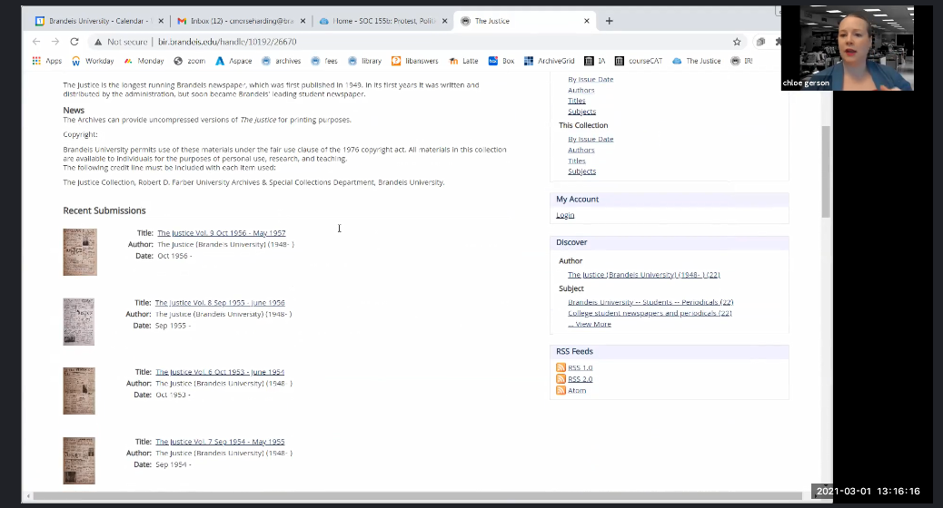
Asynchronous research video collaboration example
Notes:
Chloe

Slide 17
Recreate the experience of developing research questions in the archives
The Question Formulation Technique (QFT), a process for facilitating question development:
1. A Question Focus (QFocus)
2. Rules for Producing Questions
3. Producing Questions
4. Categorizing Questions
5. Prioritizing Questions
6. Next Steps
7. Reflection
www.rightquestion.org
Notes:
Laura

Slide 18
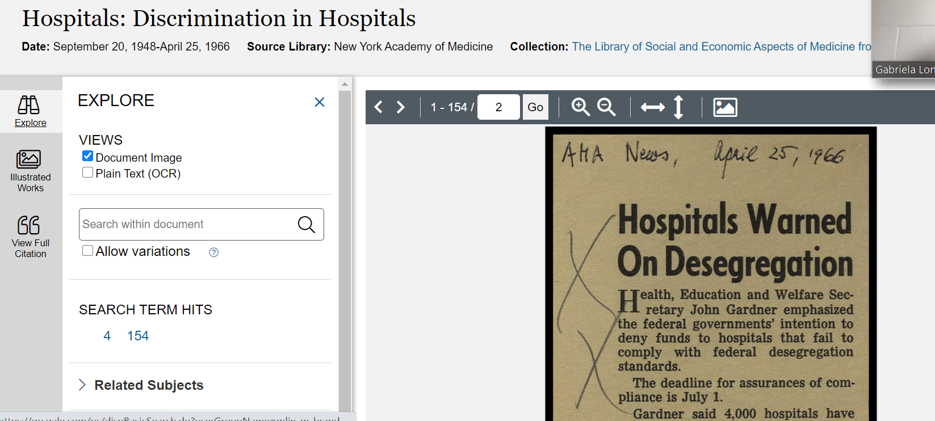
Breakout Room 4
Sample Activity for Critical Engagement with Digitized Primary Sources
Search tip for the class: Why might your classmates want to explore this database? What are some potential limitations of this database?
Your Group’s Database: Public Health Archives: Public Health in Modern America, 1890-1970
Include a screenshot of a primary source from this collection/database:
How might this primary source complement Dr. John Coleman’s oral history?

Slide 19
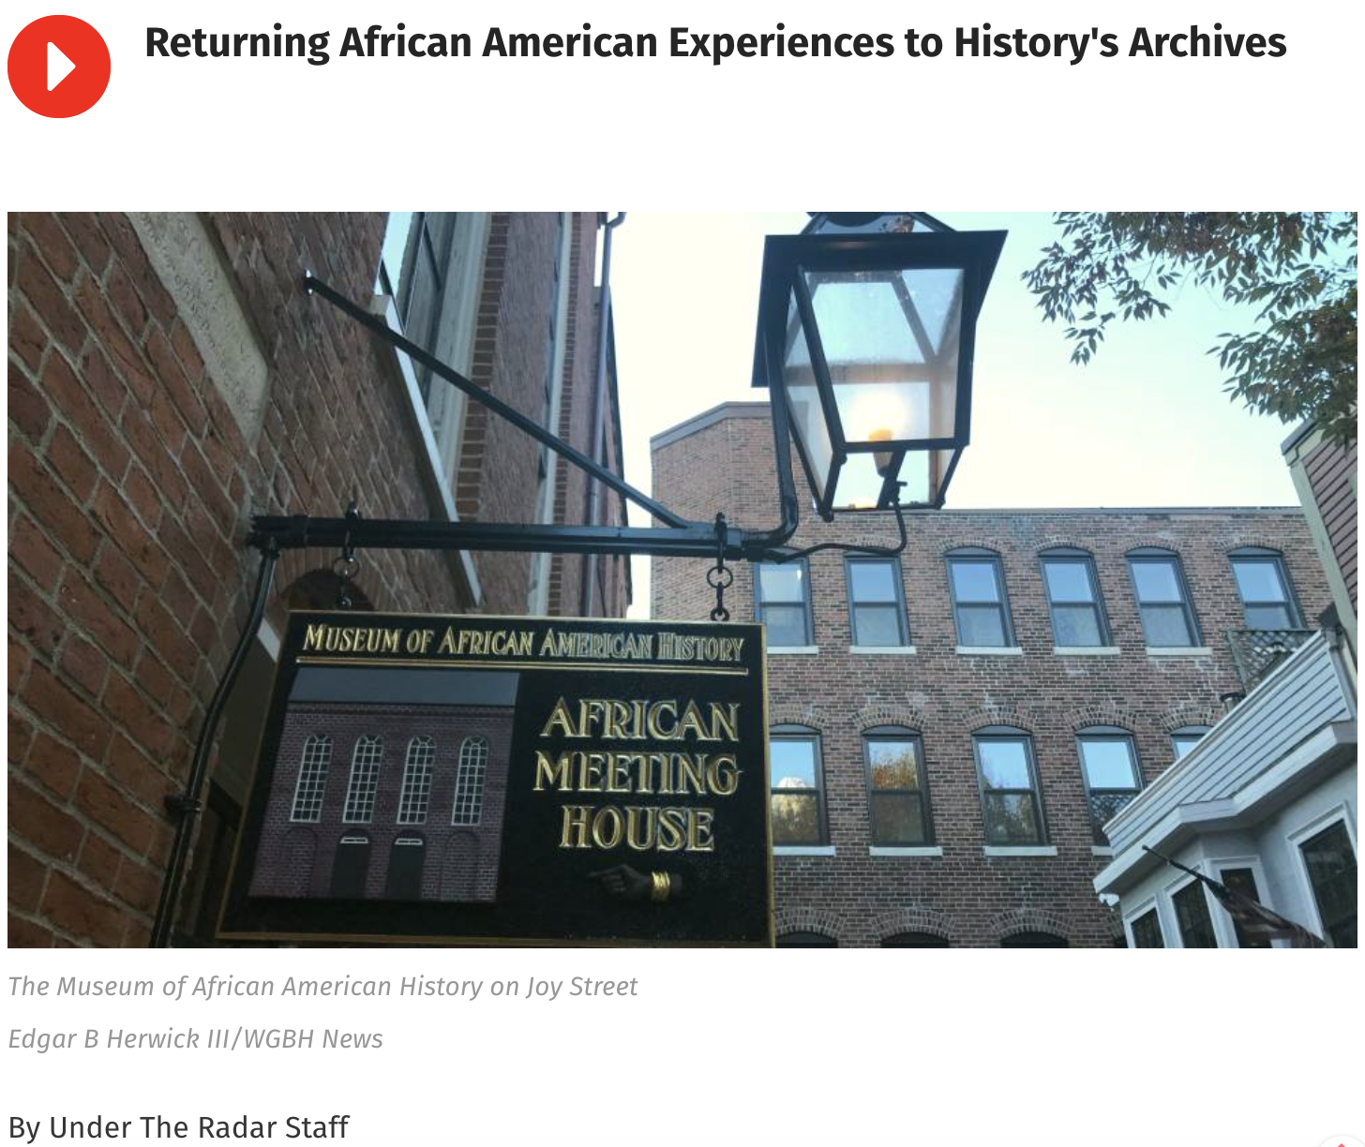
Engaging students in critical discussions about representation in primary sources
Under the Radar. (2019). Returning African American Experiences to History’s Archives. GBH. Retrieved from wgbh.org/news/news/2019/01/18/returning-african-american-experiences-to-historys-archives

Slide 20
Future and post-pandemic Plans
As we think ahead to a return to more in-person teaching, how can we make the most of our expanded digital pedagogy skills AND engage faculty with the in-person experiential aspect of a bringing a class to the Archives?
First Year Experience : Writing Seminar visits to the Archives
Communities of Practice for Faculty
Teaching with Primary Sources certificate program for graduate students

Slide 21
Citations
Please check out The Right Question Institute for additional information and materials:
Right Question Institute. (n.d.) Teach Students to Ask Their Own Questions. Retrieved from rightquestion.org/education
Rothstein, D., & Santana, L. (2011). Make Just One Change: Teach Students to Ask Their Own Questions. Cambridge, Mass: Harvard Education Press.

Slide 22
Questions?

