Slide 1
OCLC Research Library Partnership • November 18, 2020
OCLC RLP Roundtable: Art and Architecture Group

Slide 2
OCLC RLP Art and Architecture Group Roundtable
HOUSEKEEPING ITEMS
Mute yourself when you are not talking
We are recording the session for note-taking purposes but will not share it; any shared written summaries will be attribution-free
Having trouble with your audio? Pick up up your telephone:
1-877-668-4490 toll-free (US/Canada)
08-002061177 toll-free (UK)
1-800-708203 toll-free (Australia)
Other numbers? bit.ly/RLPglobal
Access code: 719 190 792
Participate
Please introduce yourself via chat
Say your name when speaking
Share about your local conditions, actions and plans.

Slide 3
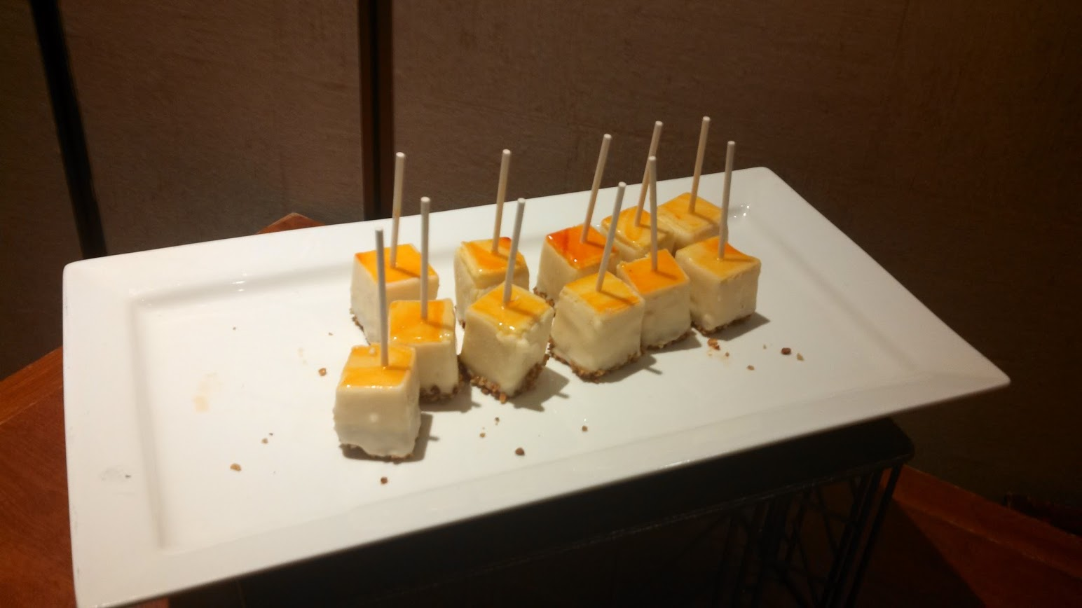
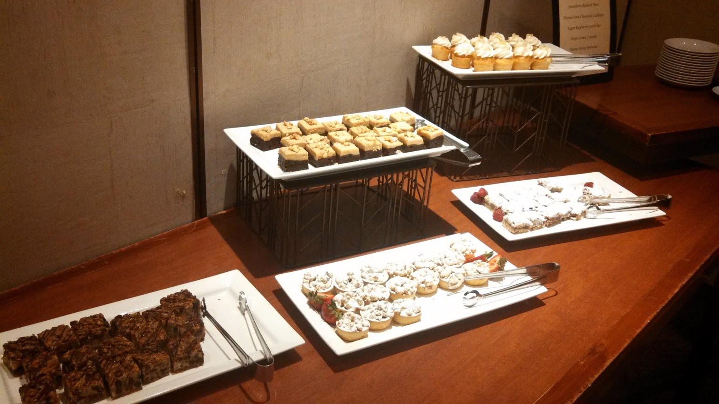
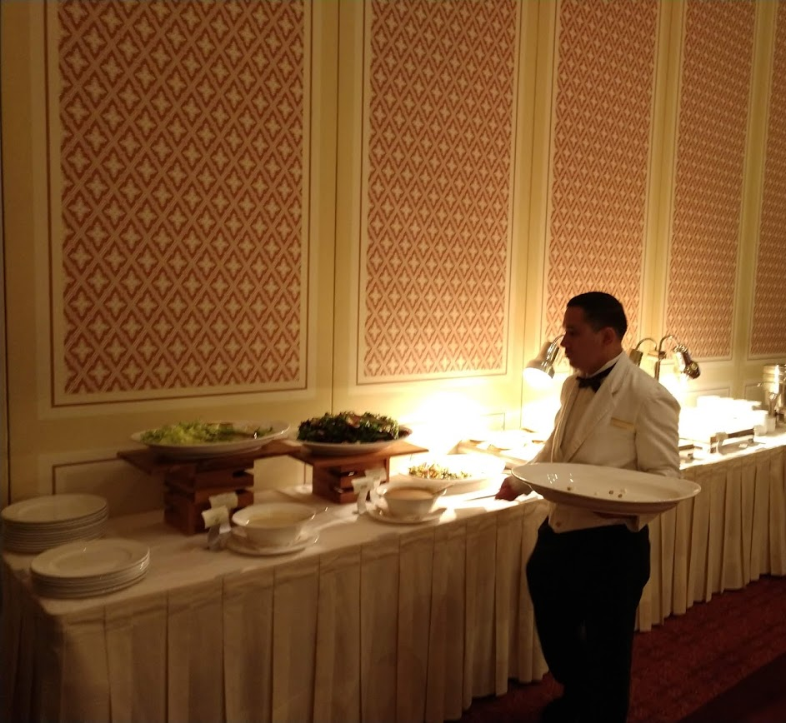
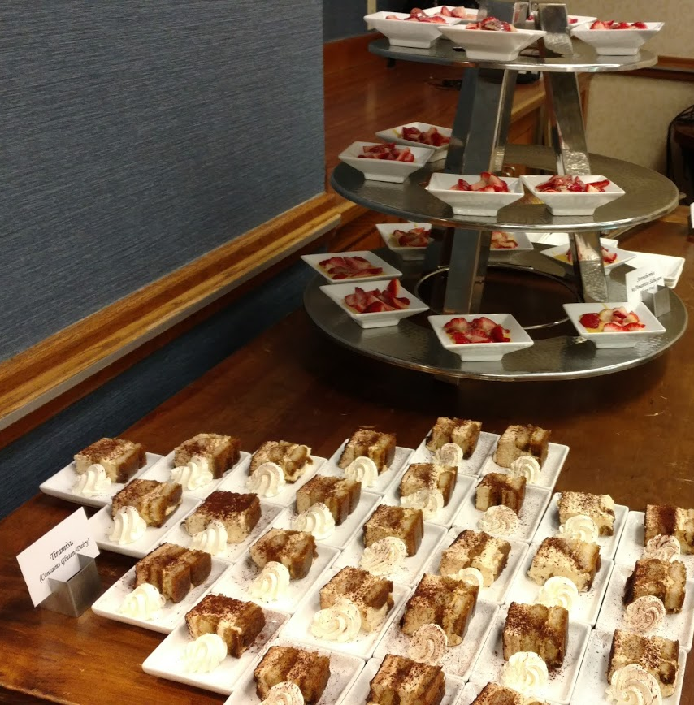

Slide 4
Choose a snack!
Go to: PollEv.com/oclcr001

Slide 5
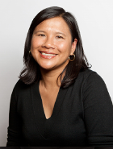
OCLC Research Library Partnership
Team Members
Dennis Massie
Merrilee Proffitt
Resource Sharing
Senior Manager
Chela Scott Weber
Mercy Procaccini
Learning Communities; REALM Project
Archives and Special Collections

Slide 6
Today’s proposed agenda
Welcome
Updates:​
Art Discovery Group Catalog
Kathleen Salomon, Aimee Lind, Getty Research Institute ​
New draft protocols for sharing special collections
SHARES Sharing Special Collections Working Group​
Round robin roundup – special 2020 question set
Report on a forthcoming OCLC Research project focused on art and museum libraries, the art research collective collection, and the characteristics of successful library partnerships

Slide 7
Today’s proposed agenda
Welcome
Updates:​
Art Discovery Group Catalog
Kathleen Salomon, Aimee Lind, Getty Research Institute ​
New draft protocols for sharing special collections
SHARES Sharing Special Collections Working Group​
Round robin roundup – special 2020 question set
Report on a forthcoming OCLC Research project focused on art and museum libraries, the art research collective collection, and the characteristics of successful library partnerships

Slide 8
Today’s proposed agenda
Welcome
Updates:​
Art Discovery Group Catalog
Kathleen Salomon, Aimee Lind, Getty Research Institute ​
New draft protocols for sharing special collections
SHARES Sharing Special Collections Working Group​
Round robin roundup – special 2020 question set
Report on a forthcoming OCLC Research project focused on art and museum libraries, the art research collective collection, and the characteristics of successful library partnerships

Slide 9
Sharing protocols for special collections
Out for review to SEG, SHARES BP
Drafted by a SHARES Sharing Special Collections Working Group
Ohio State, Frick, GWU Law, UNLV, RLP Team
3 workflows
Digitize portions, digitize whole works, lend physical items
Input from special collections staff
SSC WG working in parallel with RBMS Task Force charged with revising the ACRL guidelines on sharing special collections
SHARES protocols will be released for broader review in early 2021

Slide 10
Today’s proposed agenda
Welcome
Updates:​
Art Discovery Group Catalog
Kathleen Salomon, Aimee Lind, Getty Research Institute ​
New draft protocols for sharing special collections
SHARES Sharing Special Collections Working Group​
Round robin roundup – special 2020 question set
Report on a forthcoming OCLC Research project focused on art and museum libraries, the art research collective collection, and the characteristics of successful library partnerships

Slide 11
Round Robin questions – 2020 edition
Diversity, equity and inclusion; anti-racism initiatives
Collaboration/partnerships
Balancing daily tasks and future planning, amidst disruption
What you’ve stopped doing
Digitization efforts
Supporting independent researchers
Distinctive library programming

Slide 12
Time for a poll
Choose your top three topics
Go to: PollEv.com/oclcr001

Slide 13
Diversity, equity & inclusion: How is your library supporting anti-racist work in your staffing or staff development, collections, services and policies?

Slide 14
Diversity, equity & inclusion: How is your library supporting anti-racist work in your staffing or staff development, collections, services and policies?
Task forces and committees
Strategic plans, goals and policy statements
Diversity recruitment
Education and training
Collection development – policy and acquisitions
Descriptive practice

Slide 15
Diversity, equity & inclusion: How is your library supporting anti-racist work in your staffing or staff development, collections, services and policies?
Task forces and committees
Strategic plans, goals and policy statements
Diversity recruitment
Education and training
Collection development – policy and acquisitions
Descriptive practice
“…formed a library-wide committee and a number of task forces to address specific departments and issues…”
“…A consulting firm has been hired for the Getty as a whole. …The Getty Research Institute Task Force includes library staff...”
“…we have/are supporting diversity, equity & inclusion through UNLV University Libraries Inclusion and Equity Committee (IEC)…”

Slide 16
Diversity, equity & inclusion: How is your library supporting anti-racist work in your staffing or staff development, collections, services and policies?
Task forces and committees
Strategic plans, goals and policy statements
Diversity recruitment
Education and training
Collection development – policy and acquisitions
Descriptive practice
“…The UNLV University Libraries has established a new strategic plan which includes diversity efforts in all themes/goals of the plan…”
“…The Library is working on a policy statement to publish publicly on our website…”

Slide 17
Diversity, equity & inclusion: How is your library supporting anti-racist work in your staffing or staff development, collections, services and policies?
Task forces and committees
Strategic plans, goals and policy statements
Diversity recruitment
Education and training
Collection development – policy and acquisitions
Descriptive practice
“…The IEC has developed the Diversity Recruitment Project https://digitalscholarship.unlv.edu/lib_iec_reports/ in efforts to increase representation/retention of historically underrepresented groups…”
“…Library staff are included in a newly-formed DEAI Task Force, and specifically in a working group dedicated to diversifying our staff and leadership…”

Slide 18
Diversity, equity & inclusion: How is your library supporting anti-racist work in your staffing or staff development, collections, services and policies?
Task forces and committees
Strategic plans, goals and policy statements
Diversity recruitment
Education and training
Collection development – policy and acquisitions
Descriptive practice
“…At the faculty/staff level, The UNLV University Libraries includes goals for diversity, equity & inclusion education…”
“…Staff are taking Unconscious Bias and Anti-Racism training, led by the consulting firm. Staff also had the opportunity to take part in ‘listening sessions’ facilitated by the consulting firm…”

Slide 19
Diversity, equity & inclusion: How is your library supporting anti-racist work in your staffing or staff development, collections, services and policies?
Task forces and committees
Strategic plans, goals and policy statements
Diversity recruitment
Education and training
Collection development – policy and acquisitions
Descriptive practice
“…At Marquand we are updating and adding addendums to our Collection Development Policy to ensure that we do not miss important publications (contemporary and rare) from people of color and underrepresented groups…
“…We are also working specifically with a few rare book dealers to fill in gaps for some areas in the twentieth century...”

Slide 20
Diversity, equity & inclusion: How is your library supporting anti-racist work in your staffing or staff development, collections, services and policies?
Task forces and committees
Strategic plans, goals and policy statements
Diversity recruitment
Education and training
Collection development – policy and acquisitions
Descriptive practice
“…started several Anti-Racism working groups to address metadata in finding aids and subject headings…”
“…gathering resources related to anti-racist cataloging practices and are identifying cataloging projects where these practices could be implemented…”
“…Catalogers are involved and making subject heading and classification changes on a case-by-case, as well as wholesale basis…”

Slide 21
Diversity, equity & inclusion: How is your library supporting anti-racist work in your staffing or staff development, collections, services and policies?
Five Getty-wide goals have been identified:
Develop Getty’s workforce so that it reflects the diversity of Southern California and the nation
Confront and eliminate racism and discrimination in the workplace
Improve communication within the Getty community to help contribute to a culture of trust
Enhance diversity of collections, interpretations, exhibitions, digital content, and public programs
Deepen engagement between all areas of Getty and BIPOC and other diverse communities locally and nationally

Slide 22
Diversity, equity & inclusion: How is your library supporting anti-racist work in your staffing or staff development, collections, services and policies?
Task forces and committees
Strategic plans, goals and policy statements
Diversity recruitment
Education and training
Collection development – policy and acquisitions
Descriptive practice
Share what’s happening at your institution

Slide 23
Collaboration: What types of new partnerships have deve- loped during the pandemic? How have existing partnerships helped you address challenges brought on by the pandemic?

Slide 24
Collaboration: What types of new partnerships have deve- loped during the pandemic? How have existing partnerships helped you address challenges brought on by the pandemic?
Existing partnerships, relationships and professional associations “like ARLIS” have “proved their worth”
New resource sharing initiatives
Internal collaborations
Attending conferences and events virtually that you’ve never been able to attend in person
Partnering to offer internships

Slide 25
Collaboration: What types of new partnerships have deve- loped during the pandemic? How have existing partnerships helped you address challenges brought on by the pandemic?
Existing partnerships, relationships and professional associations “like ARLIS” have “proved their worth”
New resource sharing initiatives
Internal collaborations
Attending conferences and events virtually that you’ve never been able to attend in person
Partnering to offer internships
“…There has been a lot of communication with peers about both reference and process issues…
“…A lot of local, regional, national webinars to check-in, compare notes, and offer advice about working in the pandemic….
“…Just hearing others going through similar issues has been comforting…”
“…IRLA colleagues regularly share information that informs our work…”

Slide 26
Collaboration: What types of new partnerships have deve- loped during the pandemic? How have existing partnerships helped you address challenges brought on by the pandemic?
Existing partnerships, relationships and professional associations “like ARLIS” have “proved their worth”
New resource sharing initiatives
Internal collaborations
Attending conferences and events virtually that you’ve never been able to attend in person
Partnering to offer internships
“…ILL participated in a free RapidILL trial offered in response to the pandemic…”
“…ILL staff volunteered for the IFLA Document Delivery and Resource Sharing (DDRS) Standing Committee’s Resource Sharing in the Times of COVID-19 Initiative…”
“…SHARES Town Halls have been a valuable source of community and information…”

Slide 27
Collaboration: What types of new partnerships have deve- loped during the pandemic? How have existing partnerships helped you address challenges brought on by the pandemic?
Existing partnerships, relationships and professional associations “like ARLIS” have “proved their worth”
New resource sharing initiatives
Internal collaborations
Attending conferences and events virtually that you’ve never been able to attend in person
Partnering to offer internships
“…Catalog maintenance, image remediation projects, and IIIF manifest indexing...Interdepartmental crowd-sharing of transcription projects…”
“…Curatorial collaboration for digital programming relating special collections material with current exhibitions…”
“…UNLV University Libraries have created a Librarian Role in Canvas in efforts to increase visibility virtually with faculty and students within courses…”

Slide 28
Collaboration: What types of new partnerships have deve- loped during the pandemic? How have existing partnerships helped you address challenges brought on by the pandemic?
Existing partnerships, relationships and professional associations “like ARLIS” have “proved their worth”
New resource sharing initiatives
Internal collaborations
Attending conferences and events virtually that you’ve never been able to attend in person
Partnering to offer internships
“…Staff have been able to attend conferences virtually that they wouldn’t normally attend, bringing greater understanding of systems, acquisitions, specific subject areas, pedagogy, etc...”

Slide 29
Collaboration: What types of new partnerships have deve- loped during the pandemic? How have existing partnerships helped you address challenges brought on by the pandemic?
Existing partnerships, relationships and professional associations “like ARLIS” have “proved their worth”
New resource sharing initiatives
Internal collaborations
Attending conferences and events virtually that you’ve never been able to attend in person
Partnering to offer internships
“…Supporting internships through ARIAH (Association of Research Institutes in Art History) and others through privately funded programs to support undergraduates from regional colleges, as well as some institutional funding…”

Slide 30
Collaboration: What types of new partnerships have deve- loped during the pandemic? How have existing partnerships helped you address challenges brought on by the pandemic?
“…Partnerships within the library have been fruitful. Many hands make light work of catalog maintenance, image remediation projects, and IIIF manifest indexing, so those who may never have reason to do that kind of work have been very busy from home assisting these kinds of projects…”
-National Gallery of Art

Slide 31
Collaboration: What types of new partnerships have deve- loped during the pandemic? How have existing partnerships helped you address challenges brought on by the pandemic?
Existing partnerships, relationships and professional associations “like ARLIS” have “proved their worth”
New resource sharing initiatives
Internal collaborations
Attending conferences and events virtually that you’ve never been able to attend in person
Partnering to offer internships
Share what’s happening at your institution

Slide 32
Managing whiplash: How are you and your colleagues managing to balance daily tasks with future-oriented long-term planning in our vastly altered current landscape?

Slide 33
Managing whiplash: How are you and your colleagues managing to balance daily tasks with future-oriented long-term planning in our vastly altered current landscape?
Take one project at a time and don’t over-commit
Reach out to colleagues to keep in touch
Have a growth mindset in order to roll with the changing landscape

Slide 34
Managing whiplash: How are you and your colleagues managing to balance daily tasks with future-oriented long-term planning in our vastly altered current landscape?
Take one project at a time and don’t over-commit
Reach out to colleagues to keep in touch
Have a growth mindset in order to roll with the changing landscape
“The word whiplash is an accurate way to describe the situation!”
“It is overwhelmingly frantic.”
“We’re keeping a wish list for brighter days!”

Slide 35
Managing whiplash: How are you and your colleagues managing to balance daily tasks with future-oriented long-term planning in our vastly altered current landscape?
“…Marquand is also prepping for a move to swing space for 4 years starting in the spring... so those projects are way behind due to the quarantine and prioritized very high. We have been managing with re-deployed staff and colleagues willing to help…”
“…The Getty has been cognizant of the increased challenges of maintaining work/life balance and has made many adaptations and concessions for those who are caring for family members in addition to working full-time…”
“…The Clark is currently in the reaccreditation process with the AAM, as well as strategic planning with our board. It is overwhelmingly frantic…”

Slide 36
Managing whiplash: How are you and your colleagues managing to balance daily tasks with future-oriented long-term planning in our vastly altered current landscape?
“…We have been open 3 days/week by appointment, which has made all of our work relating to onsite patrons manageable. Having two days when the library is closed to guests allows us to do everything else, from scanning to attending meetings and re-shelving…
“…Very little time is left to plan for the long-term, but somehow the constraints that we're facing this year have really allowed us to fine-tune our services and eliminate work that no longer serves anyone, overhaul the types of library use and work statistics we keep, and to more clearly imagine what we want our library services to look like in the future. We're keeping a wish list for brighter days!”
-Winterthur Library

Slide 37
Managing whiplash: How are you and your colleagues managing to balance daily tasks with future-oriented long-term planning in our vastly altered current landscape?
“…This time has done both - made it hard to think past today as well as provided time to ponder and develop long-term projects. Our time working on-site, for many of us one or two days per week, is very valuable and packed with the immediate work of unpacking boxes of books, scanning ILL requests, pulling circulation requests, and cataloging as much as possible...
“…But we've outlined some good ideas for new collection development areas, adoption of the Gallery's enterprise digital asset management system and how that will change our workflows, experimenting with LOD in our bibliographic records and participating in the PCC Wikidata Pilot Project…” -National Gallery of Art

Slide 38
Managing whiplash: How are you and your colleagues managing to balance daily tasks with future-oriented long-term planning in our vastly altered current landscape?
“The word whiplash is an accurate way to describe the situation!”
“It is overwhelmingly frantic.”
“We’re keeping a wish list for brighter days!”
Share what’s happening at your institution

Slide 39
What are you no longer doing: As staffing and onsite presence have been minimized, what services have been abandoned, why, and how was this received?

Slide 40
What are you no longer doing: As staffing and onsite presence have been minimized, what services have been abandoned, why, and how was this received?
Services
Constituents
Processes
Events
Access to physical space
Reactions?

Slide 41
What are you no longer doing: As staffing and onsite presence have been minimized, what services have been abandoned, why, and how was this received?
Services
Constituents
Processes
Events
Access to physical space
Reactions?
“…Campus Covid-19 safety protocols do not allow self-scanning, printing, and other self-service for the few by appointment patrons that we welcome…”
“…No ILL borrowing of physical materials…”
“…We are no longer servicing special collections in two separate reading rooms …because we do not have adequate staffing to cover. We are now servicing all collections in our main reading room….”
“…No physical reserves. No recalls…”

Slide 42
What are you no longer doing: As staffing and onsite presence have been minimized, what services have been abandoned, why, and how was this received?
Services
Constituents
Processes
Events
Access to physical space
Reactions?
“…We are still not able to really help patrons outside of the Princeton community, which was something that we proudly offer…”
“…We are being very selective with gift offers. It seems that lots of people cleaned house during lockdown and want to turn over their books to libraries…”
“…Many area researchers--especially graduate students and faculty-- have indicated that they rely heavily on our Library for their research and teaching and are anxious for it to reopen…”

Slide 43
What are you no longer doing: As staffing and onsite presence have been minimized, what services have been abandoned, why, and how was this received?
Services
Constituents
Processes
Events
Access to physical space
Reactions?
“…We are no longer:
“Doing original cataloging for books or manuscripts due to the loss of the two catalogers we had on staff.
“Creating new digital collections, due to the loss of the librarian who managed our internal digitization projects
“Purchasing any new collection items outside of a few current publications needed for our graduate programs….”
“…Temporarily cancelled print newspaper subscriptions…”

Slide 44
What are you no longer doing: As staffing and onsite presence have been minimized, what services have been abandoned, why, and how was this received?
Services
Constituents
Processes
Events
Access to physical space
Reactions?
“…Several exhibitions have been postponed and/or canceled along with local conferences and events. Not all have gone virtual, but a few have…”
“…For the UNLV University Libraries, the biggest change was reducing hours and eliminating any physical events…”

Slide 45
What are you no longer doing: As staffing and onsite presence have been minimized, what services have been abandoned, why, and how was this received?
Services
Constituents
Processes
Events
Access to physical space
Reactions?
“…Our stacks are closed to staff and fellows, which is different, so we are having to pull all books for requests...”
“…We went from an open-stacks, browsable environment open to the public and with no circulation, to a closed-stacks environment closed to the public and with circulation to the home offices of our graduate students, fellows and staff…”

Slide 46
What are you no longer doing: As staffing and onsite presence have been minimized, what services have been abandoned, why, and how was this received?
Services
Constituents
Processes
Events
Access to physical space
Reactions?
“…No big complaints…”
“…Faculty and patrons have been grateful for any access to materials…”
“…While we have received many physical material requests, most have been understanding of our inability to provide them right now…”

Slide 47
What are you no longer doing: As staffing and onsite presence have been minimized, what services have been abandoned, why, and how was this received?
“…I can't think of any services we've abandoned, rather we've re-imagined them. Our reference services now include virtual training sessions. Our one-on-one orientations for new staff and fellows also still take place, but online. Our stacks are closed to staff and fellows, which is different, so we are having to pull all books for requests…” (National Gallery of Art)
“…While we have curbside services for staff and residential scholars in the Los Angeles area, we have adapted our ILL services for remote scholars to include eBook and physical book/home delivery services...) (Getty Research Institute)
“…The Libraries have mostly converted (if possible) services to a virtual environment. Services like course reserves have been expanded to digital when available and any physical material is quarantined for 7 days now…” (UNLV)

Slide 48
What are you no longer doing: As staffing and onsite presence have been minimized, what services have been abandoned, why, and how was this received?
Services
Constituents
Processes
Events
Access to physical space
Reactions?
Share what’s happening at your institution

Slide 49
Digitization efforts: Have digitization efforts expanded during the pandemic? What is being digitized? Are delivery or discovery mechanisms changing? How are priorities being set, and who is setting them?

Slide 50
Digitization efforts: Have digitization efforts expanded during the pandemic? What is being digitized? Are delivery or discovery mechanisms changing? How are priorities being set, and who is setting them?
Efforts expanding?
What is being digitized
Delivery/discovery
Priorities
Staff

Slide 51
Digitization efforts: Have digitization efforts expanded during the pandemic? What is being digitized? Are delivery or discovery mechanisms changing? How are priorities being set, and who is setting them?
Efforts expanding?
What is being digitized
Delivery/discovery
Priorities
Staff
“…We are doing boatloads of scanning for virtual fellows and other remote users…”
“…Since most staff members are working from home exclusively, very little digitization is taking place with the exception of a few Getty Research Institute specific publications and grant-funded projects with imminent deadlines…”
“…Digitization efforts have not expanded...”

Slide 52
Digitization efforts: Have digitization efforts expanded during the pandemic? What is being digitized? Are delivery or discovery mechanisms changing? How are priorities being set, and who is setting them?
“…The majority of digitization that's taking place right how is for ILL/resource sharing…”
“…Some production digitization is taking place in our image collections…”
“…We now have an internal CDL: Controlled digital lending program that is accessed through our online catalogue--mostly for reserves...”
Efforts expanding?
What is being digitized
Delivery/discovery
Priorities
Staff

Slide 53
Digitization efforts: Have digitization efforts expanded during the pandemic? What is being digitized? Are delivery or discovery mechanisms changing? How are priorities being set, and who is setting them?
“…What has expanded is linking catalog records to digitized materials made available by other institutions…”
“…We use ContentDM, and were able to continue adding to the digital collections from home throughout the lockdown period, uploading materials that had been scanned before the closure…”
“…We're just scanning as PDFs but simultaneously in the format that is appropriate for eventual inclusion in our ContentDM collection…”
Efforts expanding?
What is being digitized
Delivery/discovery
Priorities
Staff

Slide 54
Digitization efforts: Have digitization efforts expanded during the pandemic? What is being digitized? Are delivery or discovery mechanisms changing? How are priorities being set, and who is setting them?
Efforts expanding?
What is being digitized
Delivery/discovery
Priorities
Staff
“…We are putting reserves and course material first, followed by research needs, and then creating lists/queues of anticipated needs and high request items…”
“…At this point, I guess you could say that our digitization priorities are being determined by patron demand…”

Slide 55
Digitization efforts: Have digitization efforts expanded during the pandemic? What is being digitized? Are delivery or discovery mechanisms changing? How are priorities being set, and who is setting them?
Efforts expanding?
What is being digitized
Delivery/discovery
Priorities
Staff
“…Scaling up in terms of staff has been the most challenging. Anyone who can scan has done their part…”
“…Considering adopting a ‘digitization on demand’ system similar to what the Archives of American Art does. Due to our current staff shortages, we have not implemented that just yet…”

Slide 56
Digitization efforts: Have digitization efforts expanded during the pandemic? What is being digitized? Are delivery or discovery mechanisms changing? How are priorities being set, and who is setting them?
“…One project related to digitization that we're working on from home is providing indexing for our digitized rare books so chapter stops can be located as well as other notable features like plates or maps. This is a beautifully enhanced feature of our IIIF Universal Viewer and a great thing to accomplish now…”
-National Gallery of Art

Slide 57
Digitization efforts: Have digitization efforts expanded during the pandemic? What is being digitized? Are delivery or discovery mechanisms changing? How are priorities being set, and who is setting them?
Efforts expanding?
What is being digitized
Delivery/discovery
Priorities
Staff
Share what’s happening at your institution

Slide 58
Independent researchers: What is your institution doing to serve unaffiliated users? Are you able to provide access to e-resources and other materials?

Slide 59
Independent researchers: What is your institution doing to serve unaffiliated users? Are you able to provide access to e-resources and other materials?
Physical access
Remote access
Services
Informal art librarian network

Slide 60
Independent researchers: What is your institution doing to serve unaffiliated users? Are you able to provide access to e-resources and other materials?
Physical access
Remote access
Services
Informal art librarian network
“…Unaffiliated local independent researchers can book a seat and access both our physical resources as well as e-resources…”
“…As a public institution, UNLV University Libraries has made access to the libraries by appointment only…”
“…Winterthur has been open to all by appointment since August, and I am making sure that unaffiliated users are aware that they are welcome to make appointments…”

Slide 61
Independent researchers: What is your institution doing to serve unaffiliated users? Are you able to provide access to e-resources and other materials?
Physical access
Remote access
Services
Informal art librarian network
“…Our Rights Librarian has been researching rights to see what we can make available without restrictions…
“…We have been working on an EZ Proxy solution to allow access to eResources for our most active Readers…
“…Reference staff created a LibGuide pointing users to free resources…”

Slide 62
Independent researchers: What is your institution doing to serve unaffiliated users? Are you able to provide access to e-resources and other materials?
Physical access
Remote access
Services
Informal art librarian network
“…We don't have a way for unaffiliated users to access e-resources remotely…If they're not able or willing to come in, we'll search and/or scan for them…”
“…We are maintaining a queue of requests for scans of materials from Special Collections and General Collections to be handled when we can return on-site…”
“…We continue to fulfill Reproductions and Permissions requests for existing digital files…”

Slide 63
Independent researchers: What is your institution doing to serve unaffiliated users? Are you able to provide access to e-resources and other materials?
Physical access
Remote access
Services
Informal art librarian network
“…as I said at the beginning, our network is large and art librarians help each other out when possible…”

Slide 64
Independent researchers: What is your institution doing to serve unaffiliated users? Are you able to provide access to e-resources and other materials?
“…I am making sure that unaffiliated users are aware that they are welcome to make appointments…
“…To this end, I took control of the library's Google business page (formerly overshadowed by Winterthur Museum & Garden info) so that the library's hours and visit protocol could be posted and updated regularly…
“…Now people who search ‘libraries near me’ or just ‘Winterthur Library’ will see that result right away, and will know that our onsite services are available...”

Slide 65
Independent researchers: What is your institution doing to serve unaffiliated users? Are you able to provide access to e-resources and other materials?
Physical access
Remote access
Services
Informal art librarian network
Share what’s happening at your institution

Slide 66
Distinctive library programming: What programming are you offering and how are you making it complementary to or distinctive from your parent organization’s other offerings?

Slide 67
Distinctive library programming: What programming are you offering and how are you making it complementary to or distinctive from your parent organization’s other offerings?
Remote orientations, tours, bibliographic instruction, liaising and reference
Featuring the library collections
Contributing to parent institution’s programming

Slide 68
Distinctive library programming: What programming are you offering and how are you making it complementary to or distinctive from your parent organization’s other offerings?
Remote orientations, tours, bibliographic instruction, liaising and reference
Featuring the library collections
Contributing to parent institution’s programming
“…adapted our in-person library orientations tours and library catalog training session into a virtual hybrid orientation/ training…”
“…offering more remote bibliographic instruction courses…”
“…one-on-one meetings with Reference Librarians via phone or Zoom…”

Slide 69
Distinctive library programming: What programming are you offering and how are you making it complementary to or distinctive from your parent organization’s other offerings?
Remote orientations, tours, bibliographic instruction, liaising and reference
Featuring the library collections
Contributing to parent institution’s programming
“…livestreaming from the rare book room, where we'll have a big selection of materials set up to show off…”
“…created power points and videos featuring library collections as an alternative to teaching live…”

Slide 70
Distinctive library programming: What programming are you offering and how are you making it complementary to or distinctive from your parent organization’s other offerings?
Remote orientations, tours, bibliographic instruction, liaising and reference
Featuring the library collections
Contributing to parent institution’s programming
“…showing off library selections relating to Winterthur's book club and ever-popular Crafternoon series…”
“…participated in a few virtual Princeton University Art Museum events that have featured contemporary artists and the new building design…”

Slide 71
Distinctive library programming: What programming are you offering and how are you making it complementary to or distinctive from your parent organization’s other offerings?
“…We've done a good bit of teaching in the form of livestreaming from the rare book room, where we'll have a big selection of materials set up to show off. We found that using two devices (both connected to Zoom) has allowed one device to be used for closeup views that catch lots of good material details, while the other has a broader view of the teaching space…”
--Winterthur Library

Slide 72
Distinctive library programming: What programming are you offering and how are you making it complementary to or distinctive from your parent organization’s other offerings?
Remote orientations, tours, bibliographic instruction, liaising and reference
Featuring the library collections
Contributing to parent institution’s programming
Share what’s happening at your institution

Slide 73
Next steps for round robin responses

Slide 74
Today’s proposed agenda
Welcome
Updates:​
Art Discovery Group Catalog
Kathleen Salomon, Aimee Lind, Getty Research Institute ​
New draft protocols for sharing special collections
SHARES Sharing Special Collections Working Group​
Round robin roundup – special 2020 question set
Report on a forthcoming OCLC Research project focused on art and museum libraries, the art research collective collection, and the characteristics of successful library partnerships

Slide 75
Art Research Collective Collection project
Grew out of RLP discussion at ARLIS in 2019
CMA, Frick, Getty, MFA Houston, UNLV
3 components
Understand the nature of the art and museum library collective collection
Analyze how the collections have been shared via ILL
Develop case studies of successful partnerships involving art/architecture/museum libraries
We’ll be calling for advice and participation in early 2021

Slide 76
One last Round Robin question
Is there anything else you'd like to share with the rest of the RLP Art and Architecture Group?
“…The Dean of the UNLV University Libraries just noted that she is receiving continuous comments of how our efforts to provide excellent service and access during a constant changing environment is great appreciated and beloved by all…”

Slide 77
Thank you!
Dennis, Chela, Merrilee & Mercy
OCLC RLP Program Officers
massied@oclc.org
weberc@oclc.org
proffitm@oclc.org
procaccm@oclc.org

