Slide 1
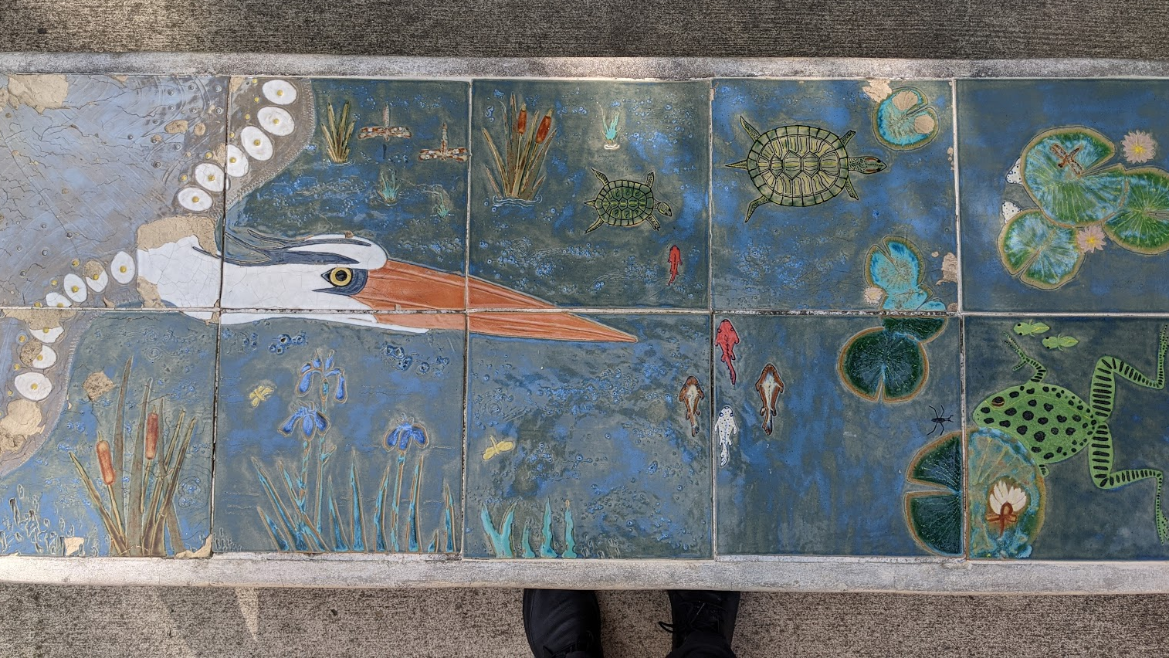
College, consortium, collaboration, collective collection
Boston Library Consortium Board meeting, 4 December 2020
Lorcan Dempsey & Constance Malpas, OCLC
Notes:
Picture: photo taken by Lorcan Dempsey:
“We live here”
Christina Grote.
Tiled surface of concrete bench, Creekside Part Gahanna
Gahanna Parks and Recreation Foundation

Slide 2
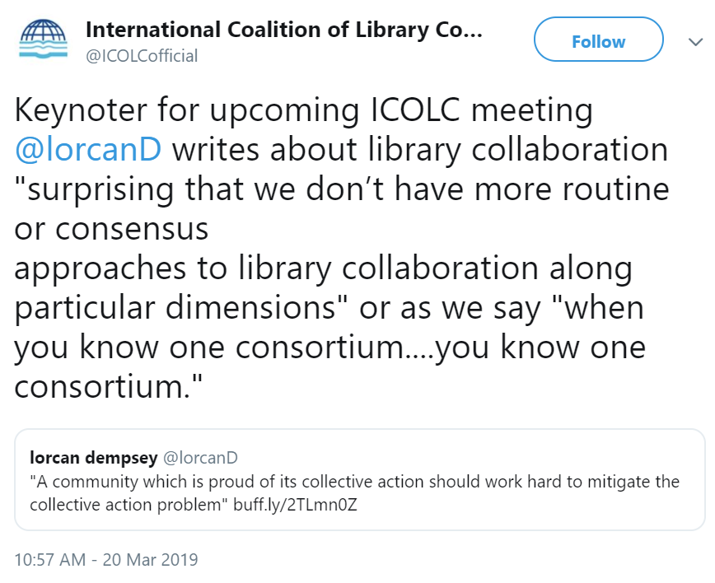


Slide 3
College
College
Consortium
Collaboration
Collective collection

Slide 4




Doctoral research and scholarship
Research
Career-directed
Liberal education
Specialized baccalaureate and professional master’s
Interdisciplinary baccalaureate education

Slide 5
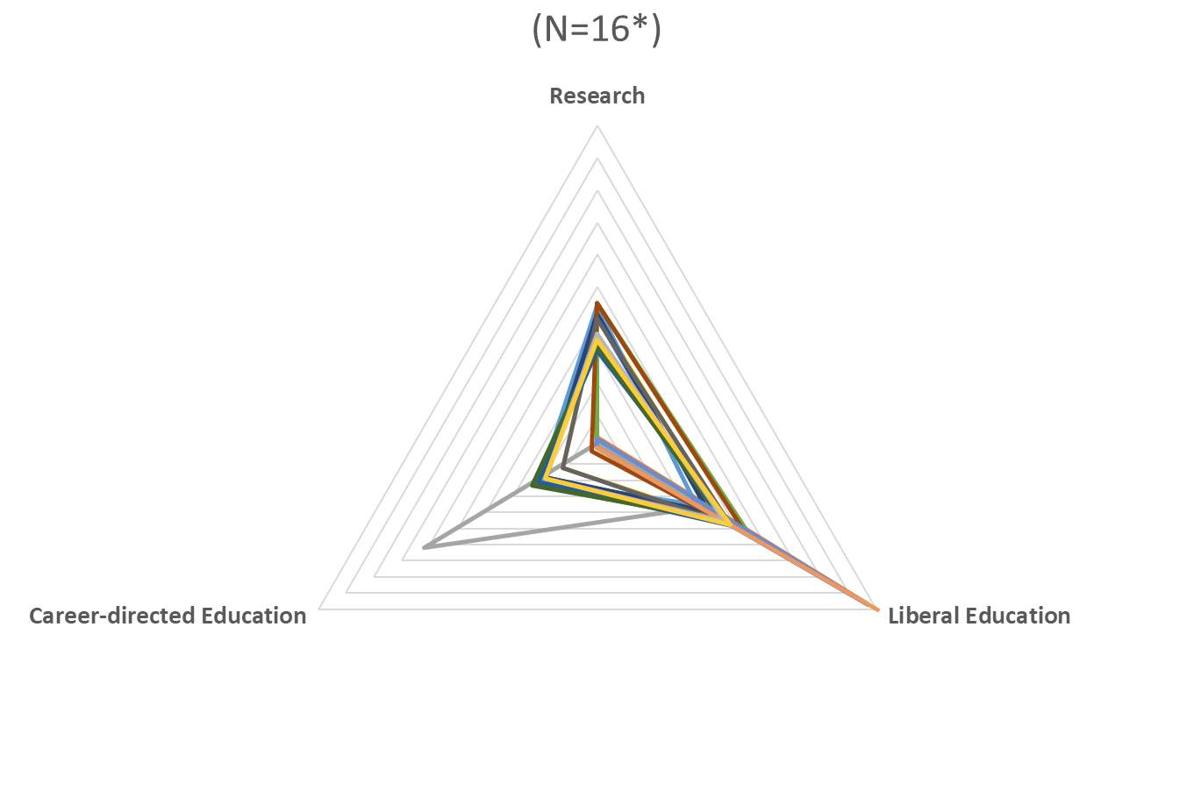
BLC Institution Directions
Tufts University R: .45, LE: .53, C: .02
Brandeis University R: .45, LE: .55, C: .00
oc.lc/libfutures
Bentley University R: .01, LE: .37, C: .62
Williams College R: .00, LE: 1.00, C: 0.00
*excludes institutions for which IPEDS data is not available (MBL WHOI and Massachusetts State Library) and a
specialized university (UMass Medical) excluded from scope of University Futures, Library Futures project

Slide 6


Shared emphasis: interdisciplinary undergraduate education

Slide 7
Collaboration opportunities?
Library support for High Impact Practices
Scaling library learning: instructional design
Course reading lists, LMS integrations
Coordinated acquisitions
…

Slide 8
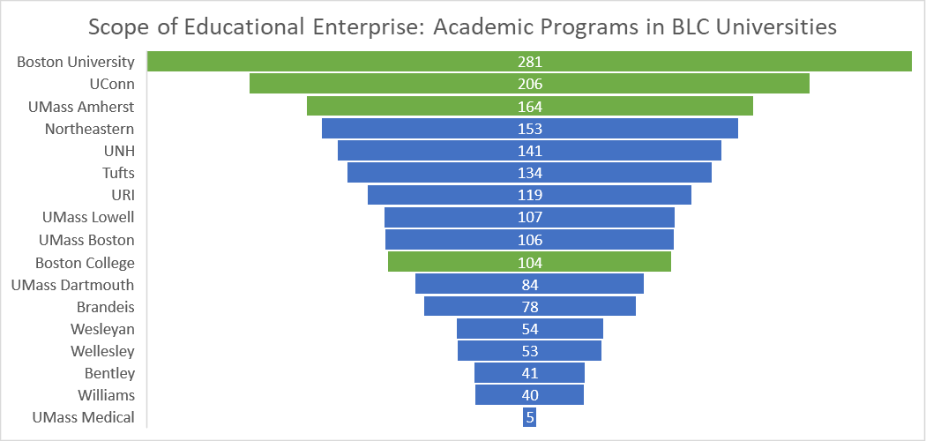
Institutions
ARL member
N=615 discrete programs/majors
Source: IPEDS Completions data

Slide 9
Programs and Majors in BLC Institutions
40% of academic programs in BLC are offered by a single university
Prospective collection coordination?
Grow distinctive collections
Rationalize purchasing for core curriculum
Maximize total scope
Source: IPEDS Completions data
Notes:
More than 600 discrete programs/majors in the group.

Slide 10
College
College
Consortium
Collaboration
Collective collection

Slide 11











Consortial activity is about ‘right
scaling’
But the network has changed our
notions of scale
(Right)
Scaling
Shared print
Research data

Slide 12




Why consort?: rightscaling
Scaling capacity
Scaling learning
Scaling innovation
Scaling influence

Slide 13

Scaling learning
Scaling innovation
Scaling capacity
Scaling influence

Slide 14
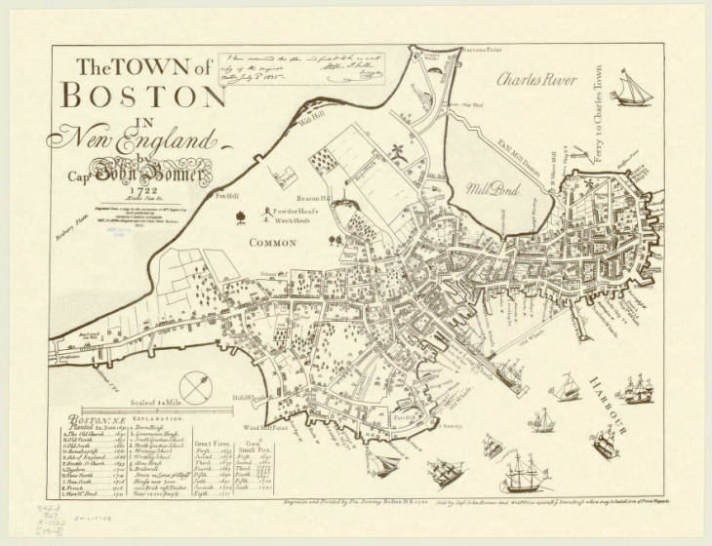
In rapidly changing environments, it’s important to realize that tacit knowledge trumps explicit knowledge. …
Tacit knowledge becomes accessible through shared practice.
… By working together, we also develop deeper, trust-based relationships that create a safer environment for us to explore new insights with others in our group that we have a hard time expressing to ourselves.
John Hagel
Soft power of consortia?
Notes:
Original CollectionAmerican Geographical Society Library – Maps
Original Item ID842-d .B67 A-1722 (19--?]
RepositoryAmerican Geographical Society Library, University of Wisconsin-Milwaukee Libraries
Digital PublisherUniversity of Wisconsin-Milwaukee Libraries
Rightshttps://uwm.edu/libraries/digital-collections/copyright-digcoll/
Digital IDam015108
Digital Formatimage/tif; Image/jp2
Digital CollectionAmerican Geographical Society Library Digital Map Collection

Slide 15
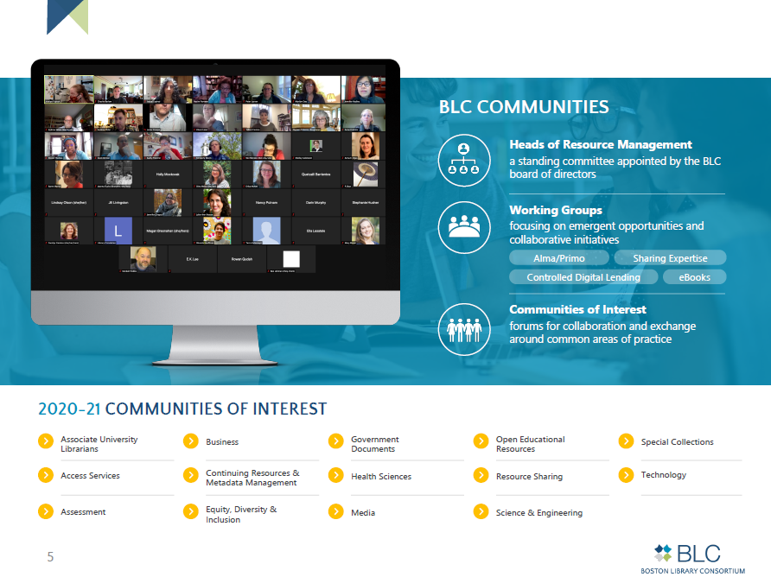
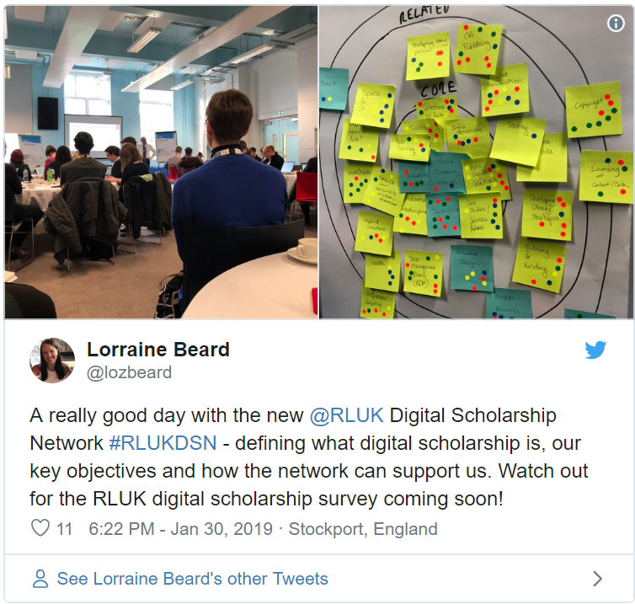

Slide 16

Learning & innovation:
Soft power of existing networks
… networking
… discuss direction
… 'pool uncertainty’
… shared practices
… communities of practice
… peer learning
… try once, deploy many times
… spread risk
Scaling innovation
Scaling learning

Slide 17
Scaling capacity
Scaling learning
Scaling innovation
Scaling influence

Slide 18
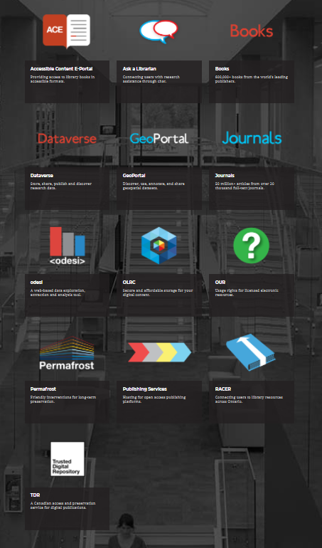

Scholars Portal is a service of the
Ontario Council of University Libraries. Founded in 2002, Scholars Portal provides a shared technology infrastructure and shared collections for all 21 university libraries in the province.
Through the Scholars Portal online services, Ontario’s university students, faculty and researchers have access to an extensive collection of e-journals, e-books, social science and geospatial data. Scholars Portal also supports the online interlibrary loan platform for Ontario’s universities, a virtual chat reference service, and other tools designed to aid and enhance academic research in Ontario.

Slide 19




Slide 20
?
Negotiation and licensing
Negotiation and licensing
Negotiation and licensing
Shared D2D
Shared D2D
Shared D2D
Shared ILS
Shared ILS
Shared Print
Collections
Shared Print
Collections (EAST)
Shared digital infrastructure
Shared digital infrastructure
Shared Research
Data Management

Slide 21


Scaling capacity
Scaling learning
Scaling innovation
Scaling influence

Slide 22
Scaling capacity
Scaling learning
Scaling innovation
Scaling influence

Slide 23
College
Consortium
College
Collaboration
Collective collection

Slide 24
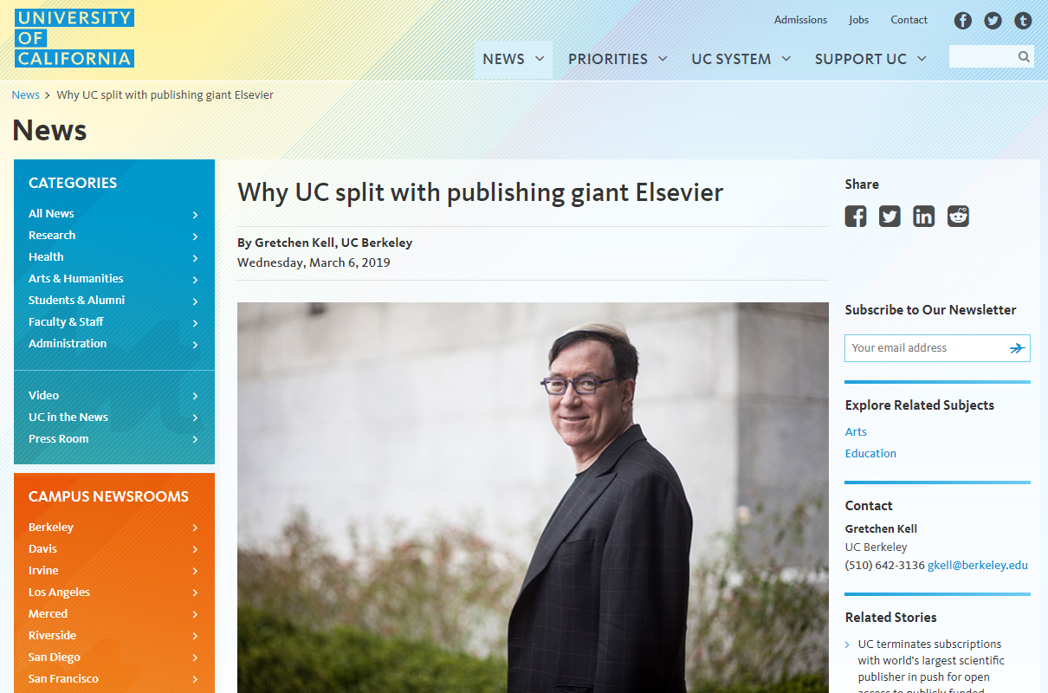
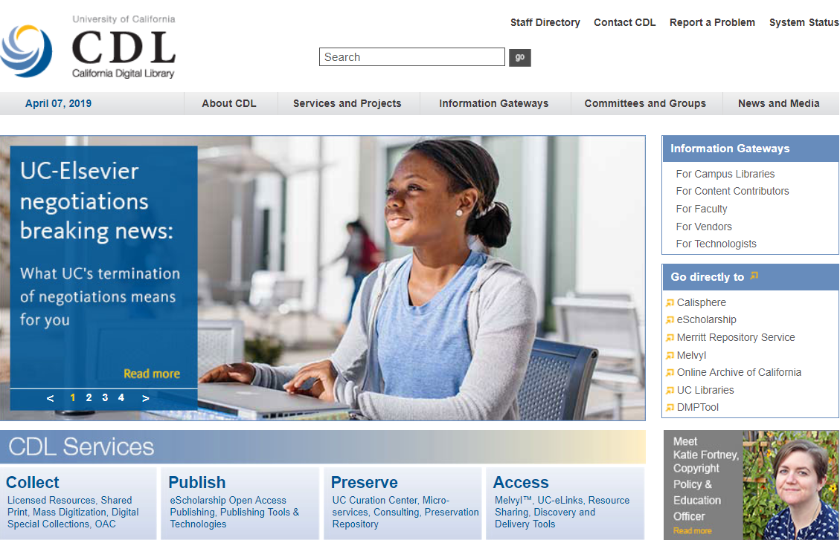
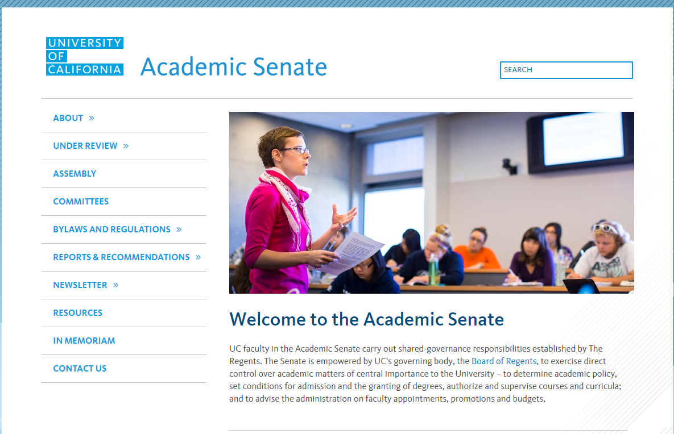
Levels of organizational alignment
UC: Shared capacity and organizational alignment.
OhioLINK: State system.
BTAA: Rolls up to provost level.
BLC: A gathering of independent organizations.

Slide 25

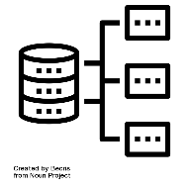


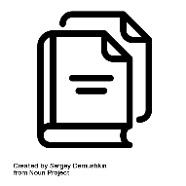
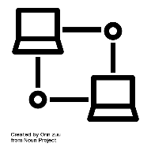

15 libraries
6 library management systems
26 resource sharing networks
6 discovery interfaces
7 shared print programs
5+ resource sharing platforms

Slide 26
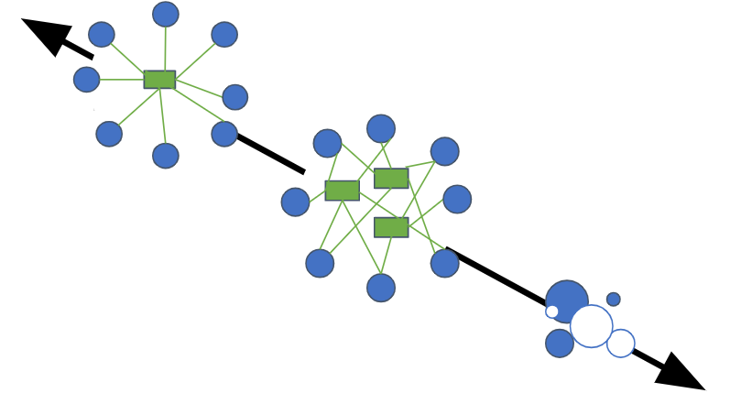
Consolidation
Level of coordination:
tradeoff
between
autonomy
and
consolidation
Cooperation
(autonomy)

Slide 27
Shared expertise
Prospective collection
development
Staff exchanges
Shared IR
Shared print
Autonomously developed colls
Group system
Shared budget/negotiation
Interop
Level of coordination:
tradeoff
between
autonomy
and
consolidation
Local system

Slide 28
Consolidation
Integrated user experience
Ease of management
Reduced coordination costs
Consortial agency
Local optimization
Close to the user
Control of costs
Pragmatic
Institutional agency
Cooperation
(autonomy)
Level of coordination:
tradeoff
between
autonomy
and
consolidation

Slide 29
Collective action problem
Continuous socialization
Interoperability is a vote for status quo
Consortium at right scale?
Libraries have multiple consortial homes

Slide 30

Collective action issue
Consolidation
Trade-offs:
Systemwide vs local optimization?
Efficiency vs control?
Integration vs interoperability?
Cooperation
(autonomy)

Slide 31
Survey 3: Collective action
Where would greater consolidation at the consortial level provide benefits? (choose as many as you wish)
  Sharing expertise
  Shared print initiatives, including shared off-site storage
  Shared Institutional Repository / Research Data Management
  Controlled digital lending / E-collection resource sharing
  Coordinated digitization
  Coordinated acquisitions

Slide 32
College
Consortium
Collaboration
College
Collective collection

Slide 33
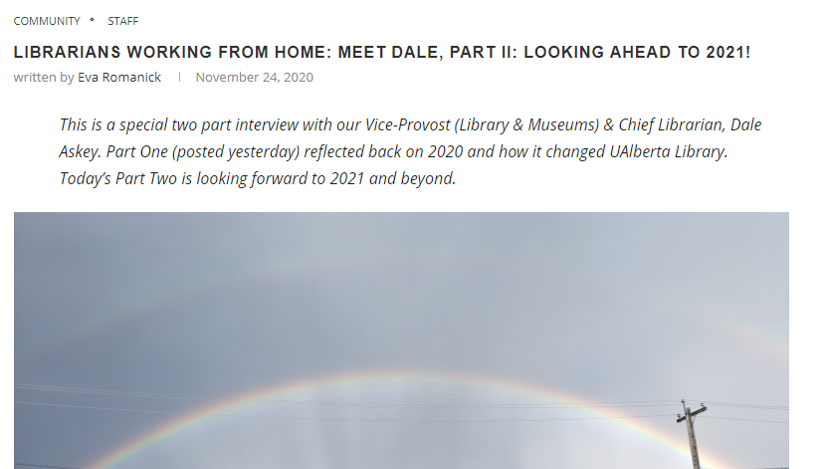
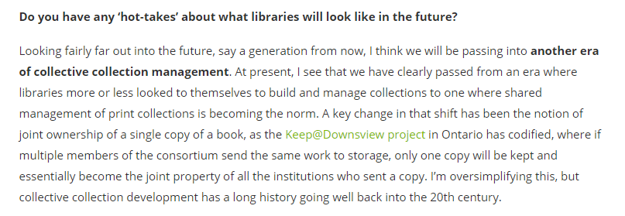

Slide 34
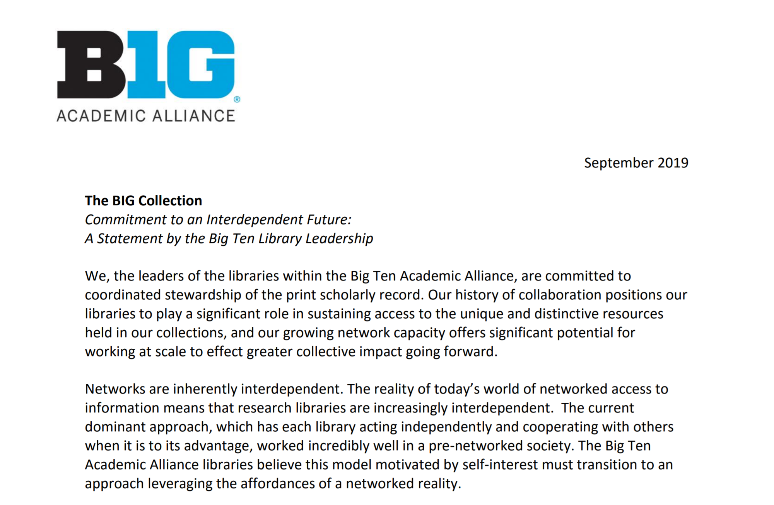
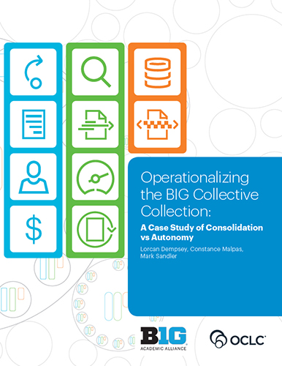

Slide 35
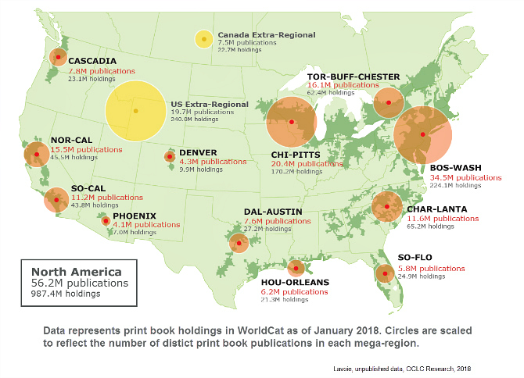
To extend the reach of materials available to users, especially as any individual library is collecting a progressively smaller part of relevant resources,
to make their management more efficient (by sharing costs and responsibilities),
to coordinate collections above the individual library level, allowing individual libraries to specialize and contribute within a defined network of responsibilities
and to collaboratively steward the scholarly and cultural record.
Motivations

Slide 36

“The traditional model of building large stand-alone collections is inefficient and ineffective” D. Way
Prospective
coordination
Retrospective
coordination
Optimize local, autonomously developed collections.
Believed to be unsustainable but not changing.
Optimize distributed collection at the consortium level.
Believed to be desirable but not happening.
Resource sharing: benefiting from the aggregate.
Shared print: rebalancing collections across libraries and hubs.
Digitization: release the content of books, broaden access, preserve.
Shared collecting responsibilities. Central purchasing/selection.
Libraries focus on distinctive.
Shared description and transaction data for decision support.
Collections/Acquisitions/Resource sharing integration.

Slide 37









Efficient
Network
Fulfillment
Systemwide
Awareness
Collective
Collections
Explicit
Commitments
Optimally
Distributed
Collections

Slide 38
Conscious coordination
Collective Collections
Systemwide
Awareness
Efficient
Network
Fulfillment
3
2
Aggregated data: holdings, usage, policies
Decision support tools, management dashboard
Unified discovery of consortium holdings
Harmonized policy frameworks
Horizontal integration of fulfillment networks
Optimally
Distributed
Collections
Explicit
Commitments
3
Agreed strategy and commitments
Policy and funding support
Agreed consortial agency
Shared print stewardship, shared collections storage
Prospective collections coordination: acquisitions
Coordinated digitization
1

Slide 39
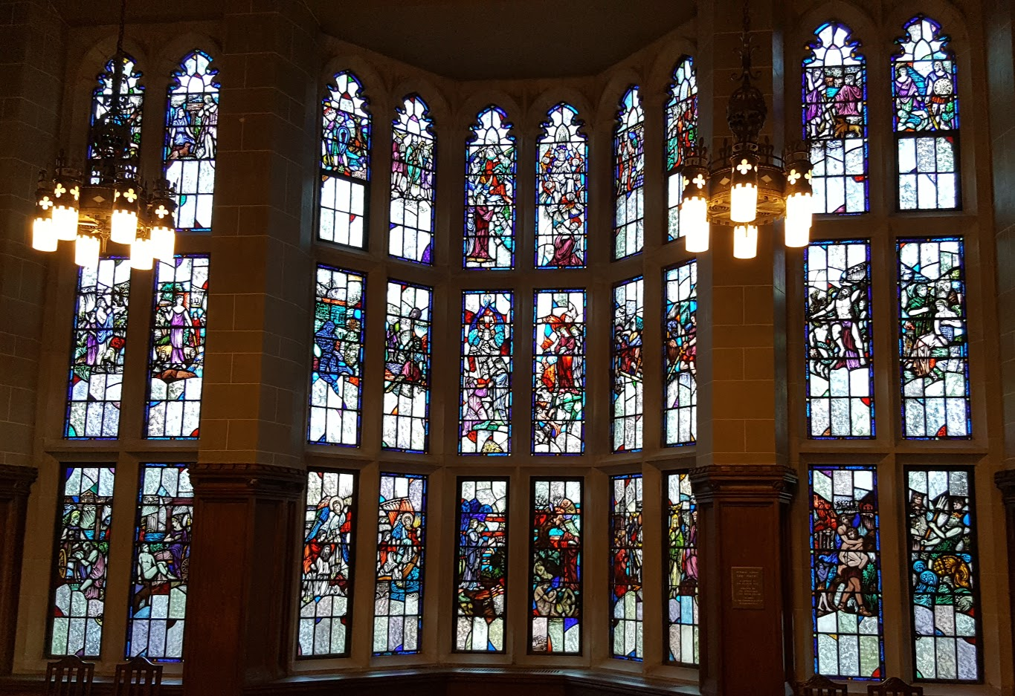
Library strategy
Collaboration is a set of strategic and tactical choices, which is very influenced by people and politics.
Collaboration is as much about strategic choices as are internal library operations and should be approached with the same discipline.
The impulse to local control may be a barrier to longer term collective progress.
Thank you …
@LorcanD
@ConstanceM

