Slide 1
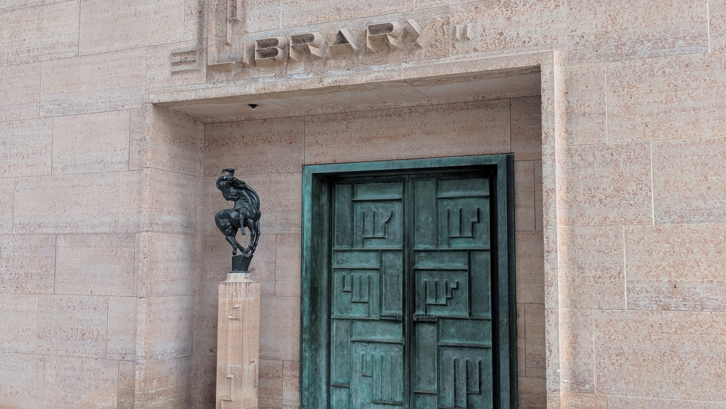
Lorcan Dempsey, OCLC
@LorcanD
Symposium on the Future of Libraries
ALA Midwinter, Philadelphia, 25 Jan 2020
Big shifts: Libraries, networks, collections

Slide 2
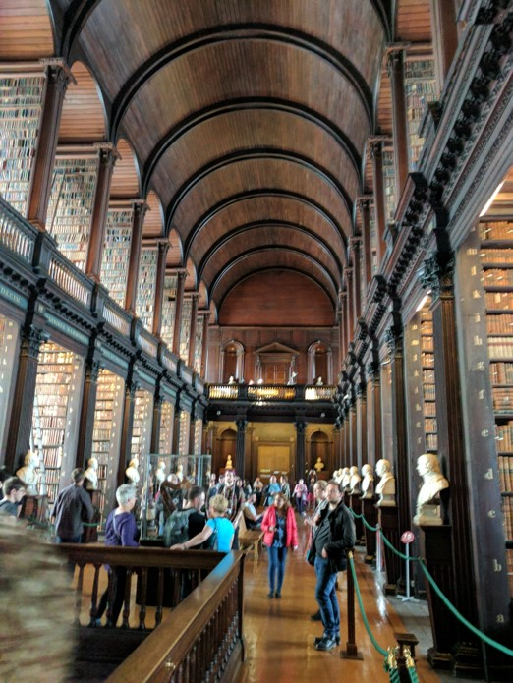
Some context

Slide 3

Libraries are not ends
in themselves
Big Shift from collection-centric model of excellence to engagement-oriented model supporting distinctive needs of parent community: teaching, learning, research workflows
Library excellence should be determined in the context of strategic fit to university interests.
A massively diversified higher education system in the US

Slide 4
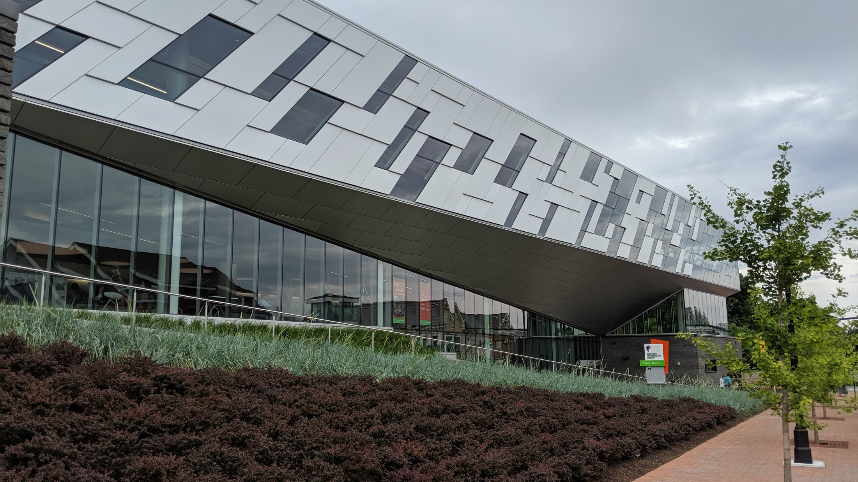
20 years ago I was
in the libraries business.
Today I am in the
Columbus business.
Pat Losinski, CEO
Columbus Metro. Library
Notes:
Personal communication from Pat Losinski

Slide 5
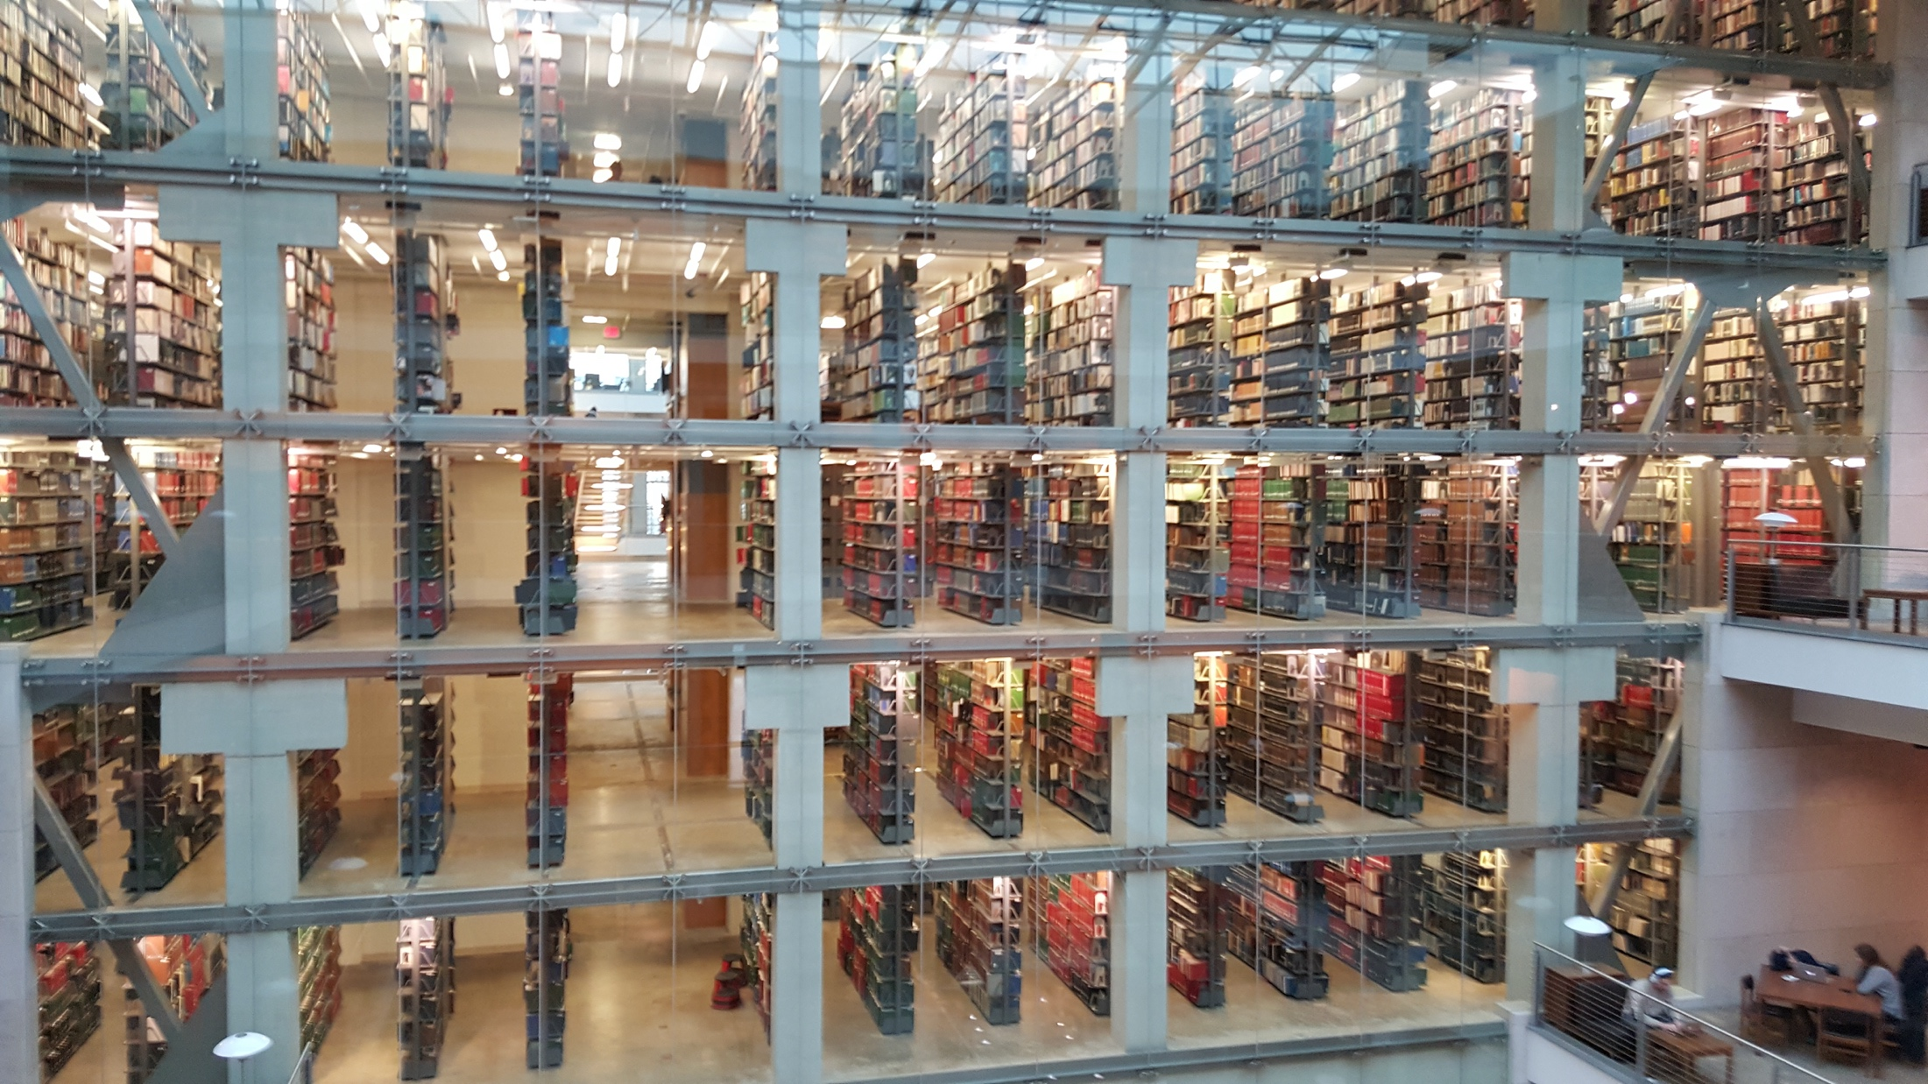
… to be vital to the academic enterprise, the Libraries must position itself as an active, engaged participant in solving university-level problems (Looking outside ourselves); …
Damon Jaggars, The Ohio State University
Notes:
Pic from http://www.yourlightingbrand.com/portfolio-posts/ohio-state-library/
Damon Jaggers blog entry - https://library.osu.edu/blogs/osulstaff/2016/02/29/from-the-director-february-29-2016-drinking-from-the-fire-hose

Slide 6



Higher education: three poles
Research
Distinctive focus on doctoral research and scholarship
Career
Liberal Education
Distinctive focus on preparation for professions.
Distinctive focus on interdisciplinary baccalaureate education.
OCLC Research and Ithaka S+R collaboration with support from Andrew W. Mellon Foundation

Slide 7
Library services framework
Systematize library planning and assessment
Academic success
Off-campus
Information access
Unique collections
Support scholarship
Transform publishing
Showcase expertise
Different libraries will have service portfolios shaped to meet the needs of their home institution.

Slide 8
Higher education: three poles
Research
Think about . . .
Research data management
Digital scholarship
Text and data analysis services
Research impact librarian
Research data librarian
Office of sponsored research
VP for Research
Library services
Library staffing
Library stakeholders
Career
Liberal Education
E-portfolios
Training and internship resources
First Year Experience Librarian
Guided pathways support
Career Services
VP Enrollment
Instructional design services
Open Educational Resources
Fablab
Student Success Librarian
Teaching/Learning Librarian
Dean of Undergrad Education
Department chairs

Slide 9
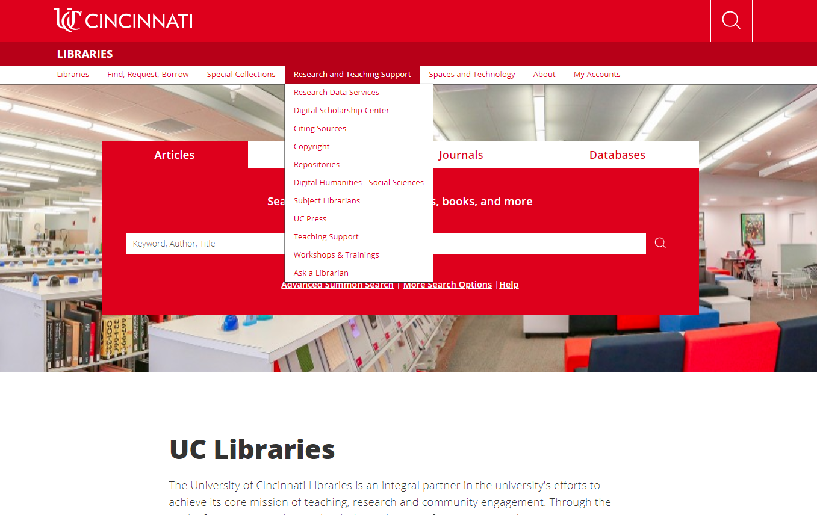

Slide 10
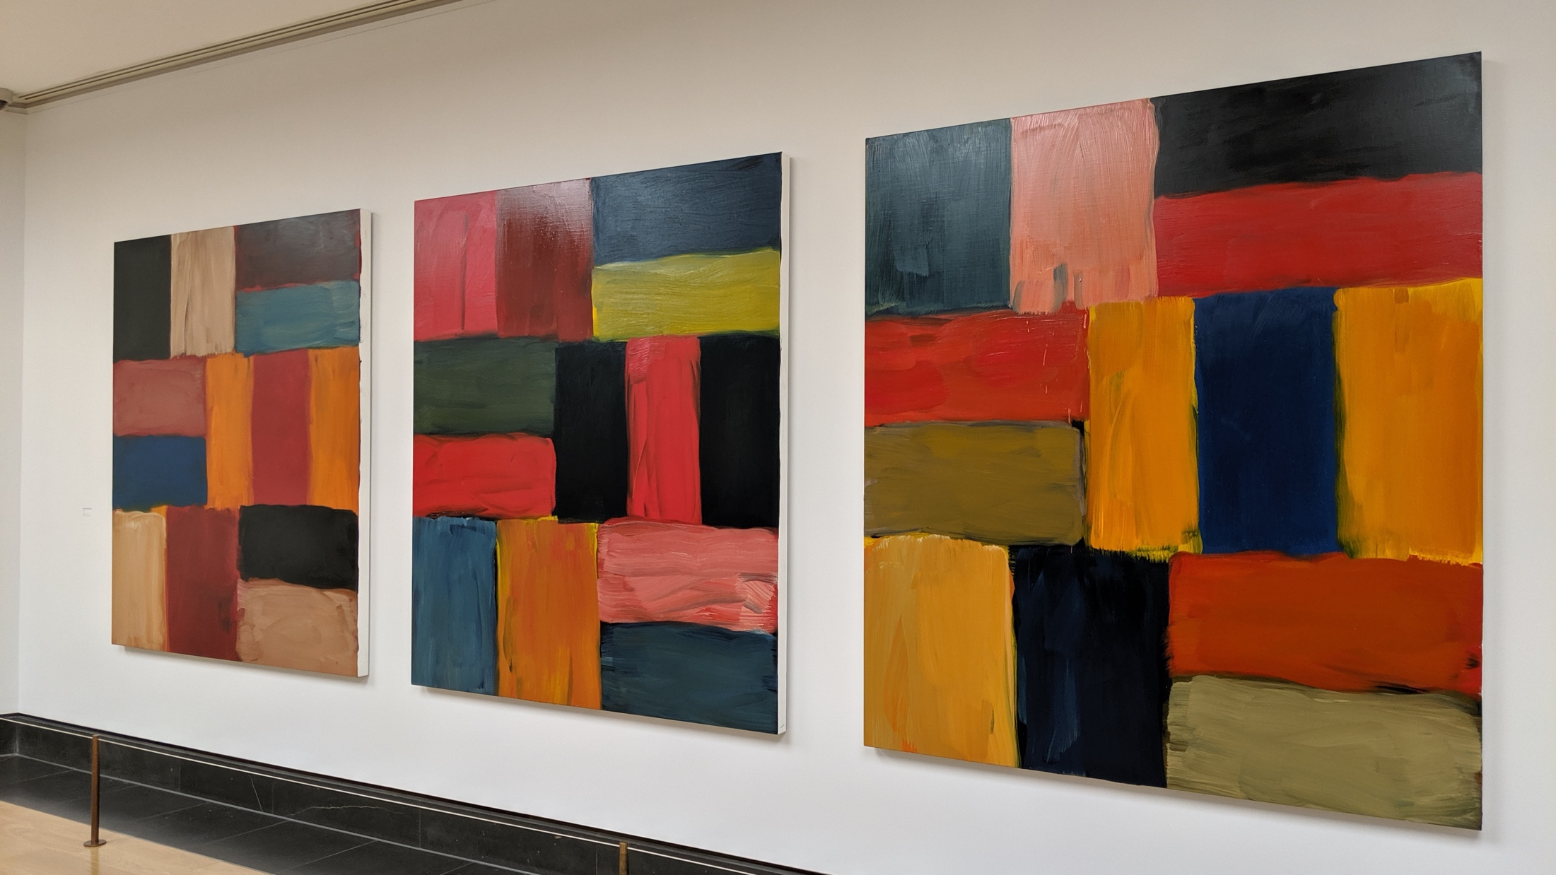
collections
redux

Slide 11
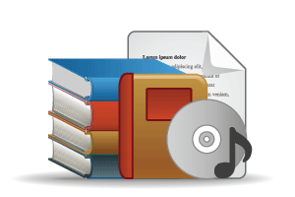

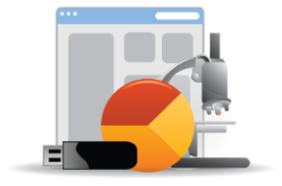
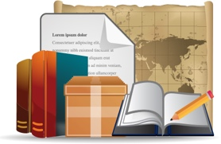
Open Web Resources
‘Published’ materials
Commodity:
In many collections
Licensed
Purchased
Low Stewardship
High Stewardship
Unique/rare: in few collections
Research & Learning Materials
Special Collections
Local Digitization
“OCLC Collections Grid” by OCLC Research, CC BY 4.0

Slide 12
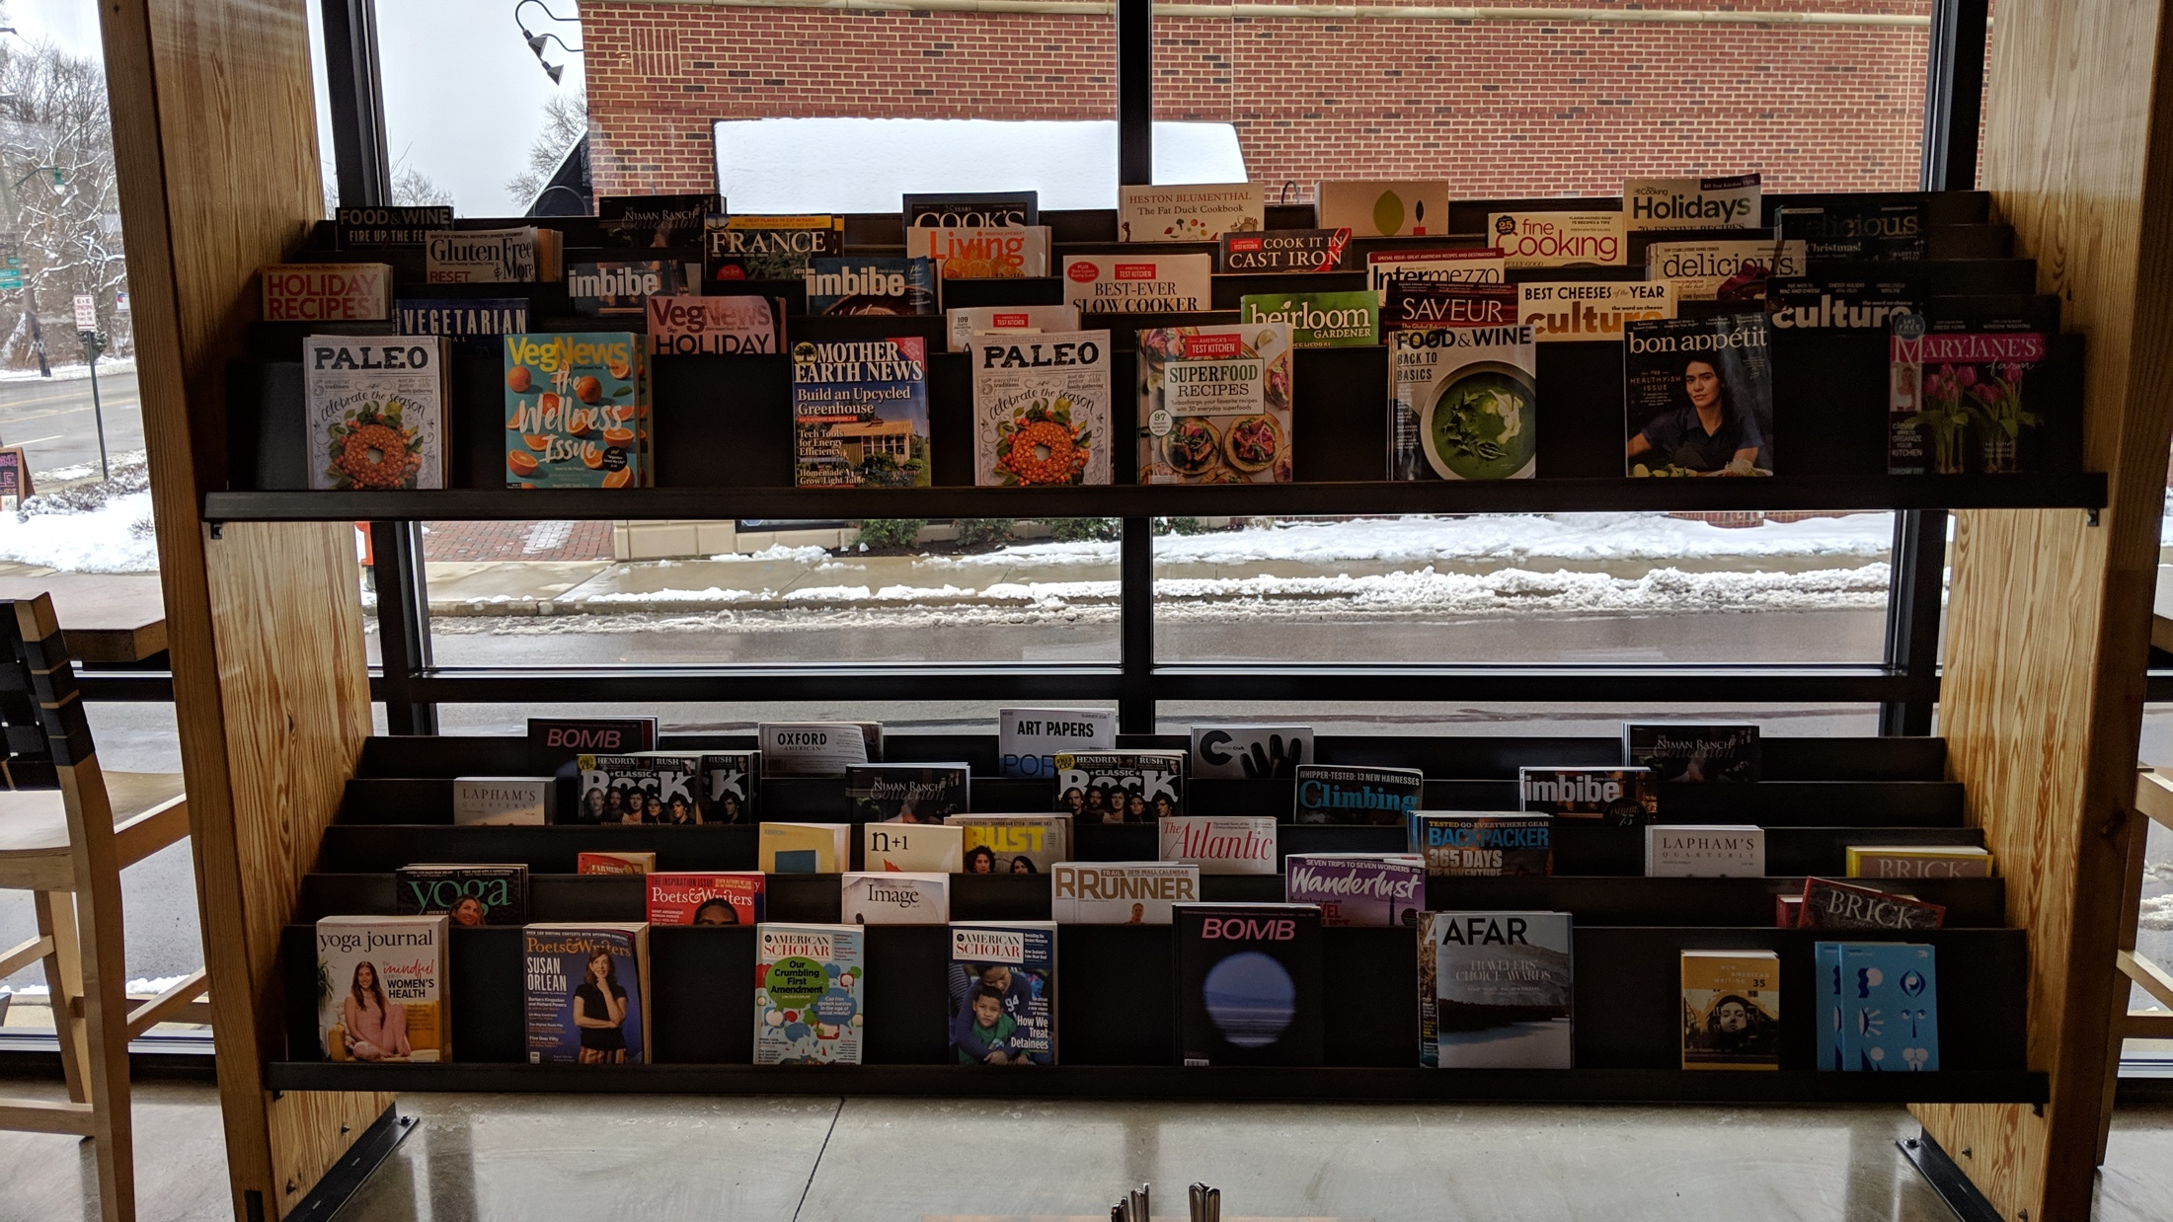




Licensed
Large part of scholarly record will be openly available.
Shift to pay to publish models emerging but uneven mix between pay to read and pay to publish.
Government, funder and institutional mandates spreading.
Current licensing models and big deal under pressure.
Consortial role being examined.
Mix of licensing, spot acquisitions, resource sharing, …
Uneven move to open. No single trajectory.
New publishing and ‘reading’ models.
Publishers developing new business and service models.
Reading at scale – text is aggregated and mined for insight (collections as data)
Research outputs are diversifying.
Researchers interested in disclosing and discovering research data, methods, software, …
Identity, workflow and content are blurring.
Workflow is the new content.
Research outputs generated throughout research life cycle.
Research in digital environment supported by new tools and services.

Slide 13
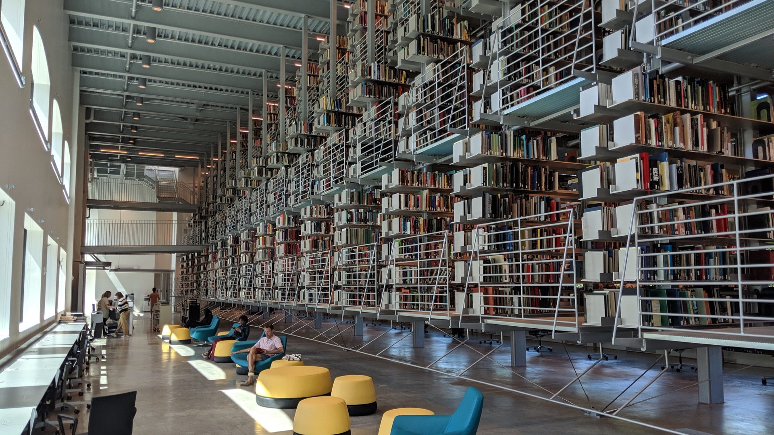
Purchased
Shift of library budgets from purchased to licensed
Print monograph budgets squeezed as a higher proportion of collection budgets go on licensed materials.
Print management commands a disproportionately large amount of staff time.
Just in case model outmoded but not superseded.
The historic method of autonomous local collection building is increasingly inefficient and mismatched with requirements.
Still the dominant model.
Rise of the collective collection
More purposeful
sharing to
  extend reach,
  manage more effectively,
  release space,
  optimize across libraries,
  steward the scholarly record.
A natural corollary is increased local specialization – responding to local emphases in research or learning.
Digital, data driven, demand
Shift to (shared) purchase of ebooks.
Demand driven approaches.
Data driven (across resource sharing, discovery, acquisitions, collections).

Slide 14
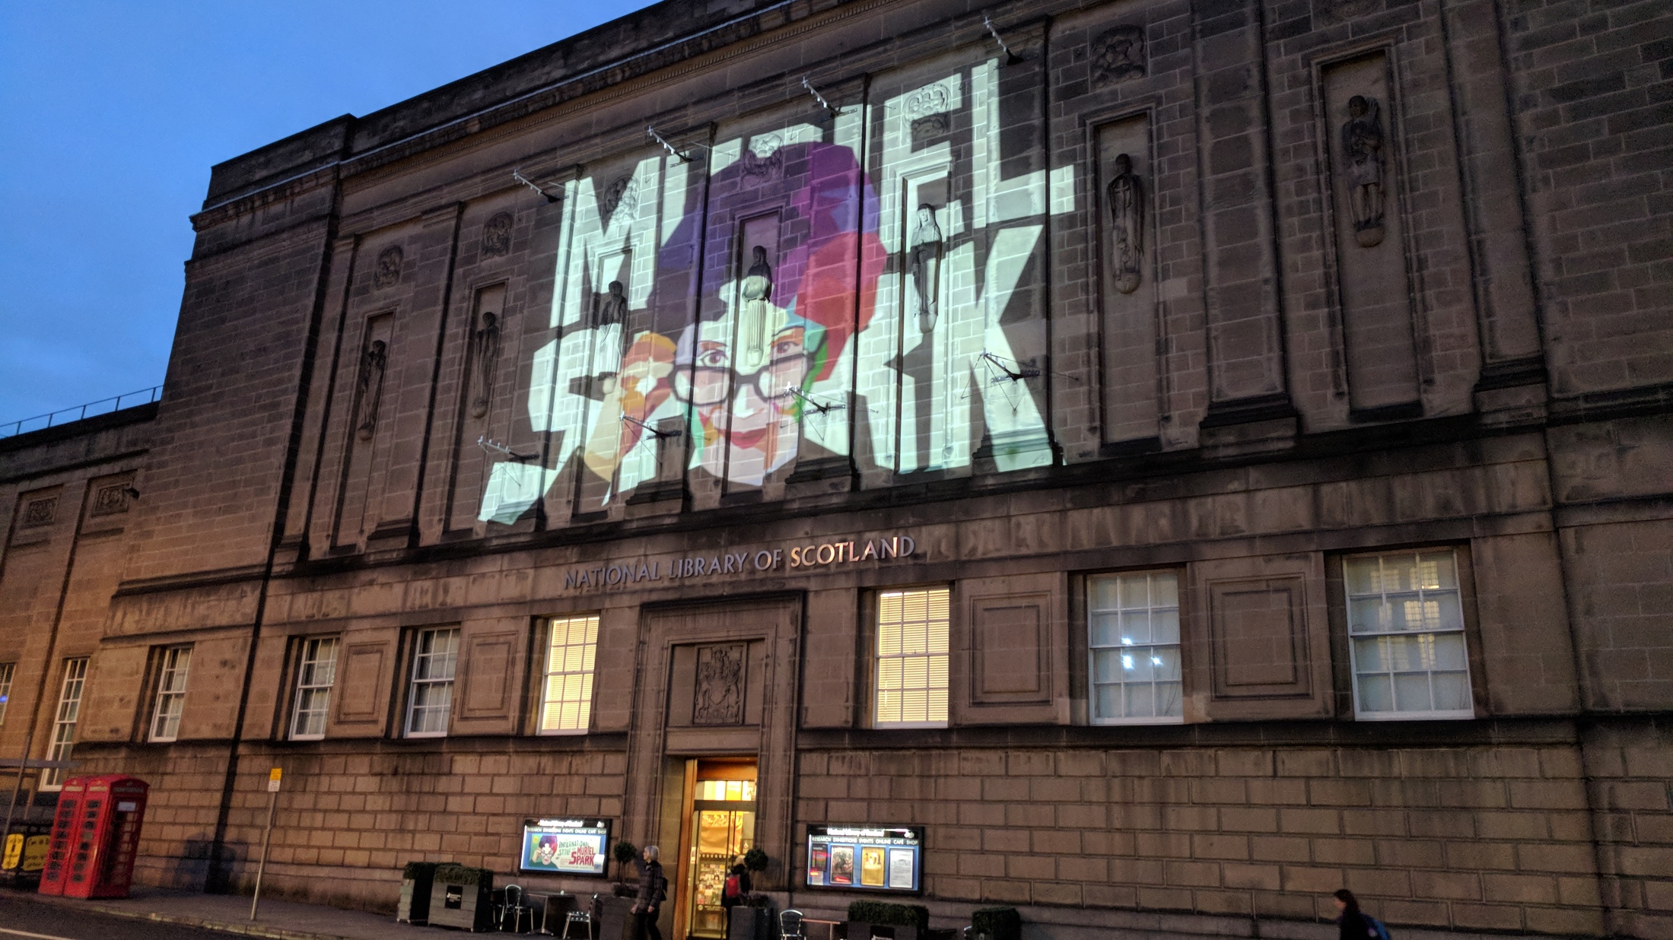
Special
Libraries are stepping up to a role helping create, manage, and disclose research and learning materials across campus.
Research is collaborative, facilitated by automated workflows and generates a variety of potentially sharable research.
Open educational resources are also a focus of increased attention.
The distinctive has come more into focus.
Supporting local research
Sharing with external community.
Emerging interest in coordinated development of distinctive collections to avoid unnecessary duplication or competition.
Institutional: research and learning materials

Slide 15













The rich universe of the web
arXiv, SSRN, RePEc, PubMed Central (disciplinary repositories that have become important discovery hubs);
Google Scholar, Google Books, Amazon (ubiquitous discovery and fulfillment hubs);
Mendeley, ResearchGate (services for social discovery and scholarly reputation management);
Goodreads, LibraryThing (social description/reading sites);
Wikipedia, Yahoo Answers, Khan Academy (hubs for open research, reference, and teaching materials).
FigShare, OpenRefine (data storage and manipulation tools)
Github (software management)

Slide 16



Then and now:
three flips in a network environment
Abundance
Then: Attention abundant, resources scarce
Now: Resources abundant, attention scarce
Convenience
Then: Users built workflow around library
Now: The library has to build services around the users’ workflow
Creation
Then: Library supported consumption
Now: Library supports creation, curation, disclosure.

Slide 17
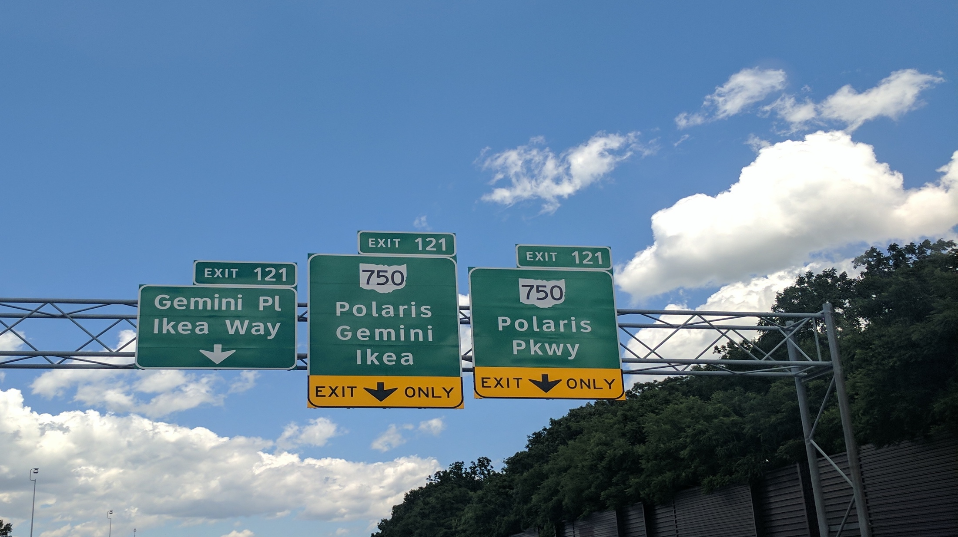
Three Emerging collection emphases

Slide 18
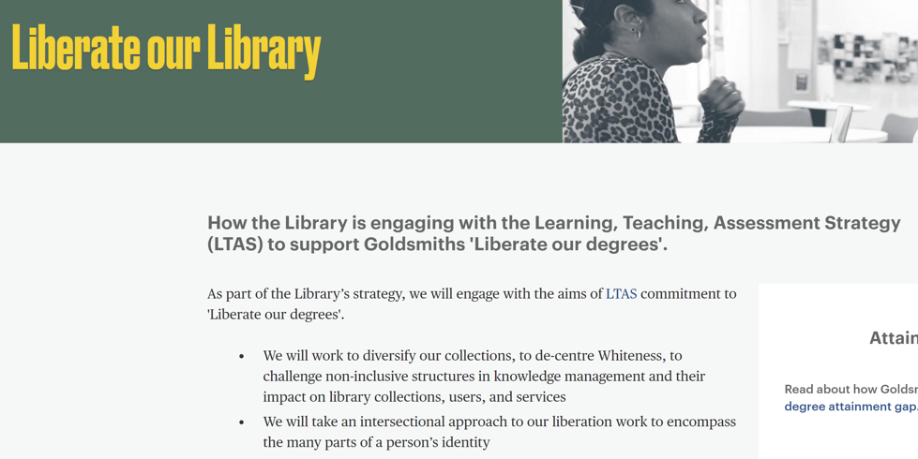

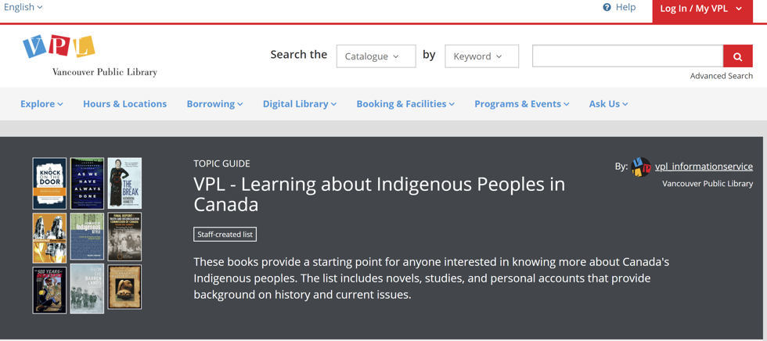
Pluralizing collections

Slide 19
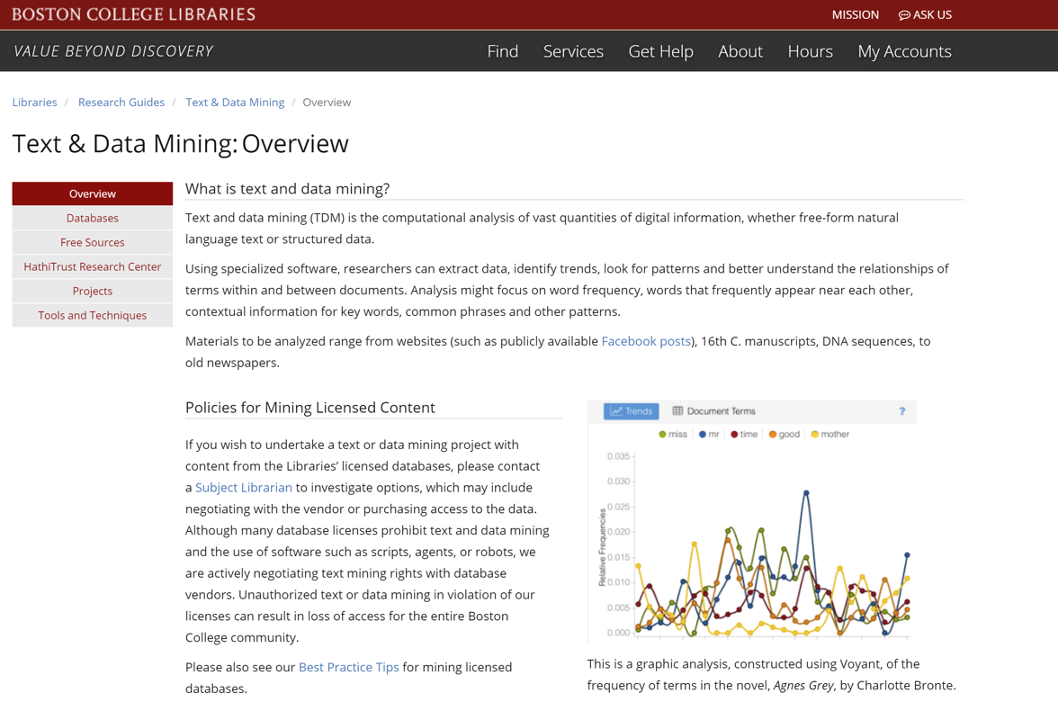
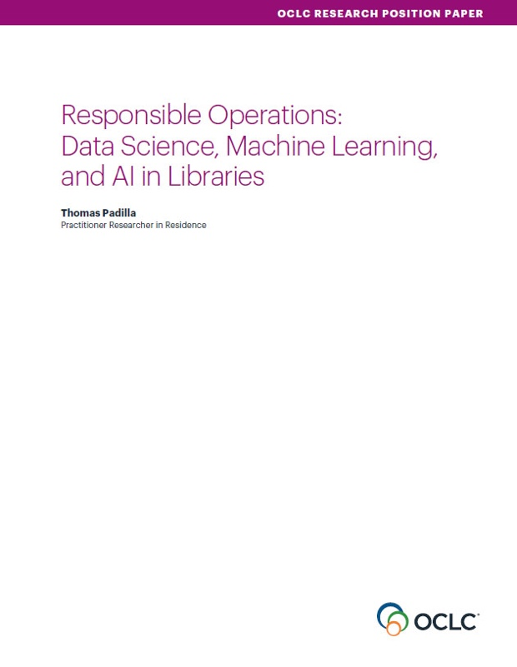
Analyzing collections at scale

Slide 20
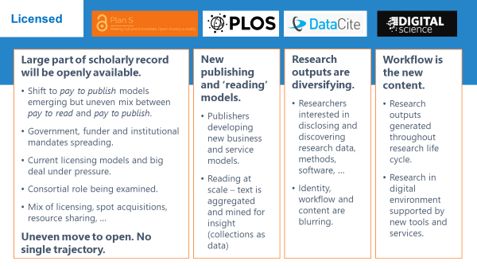
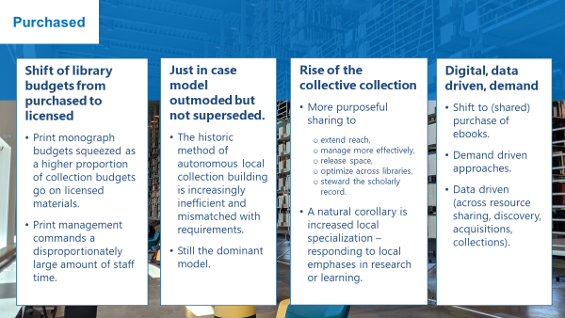
Optimizing collections
Buy/license what you need; use what you buy/license.
Specialize.

Slide 21
Three systemic collection directions

Slide 22
Reconfiguration
of library collaboration by network/digital environment.
Reconfiguration
of the information space by network/digital environment.
Reconfiguration
of research work by network/digital
environment.
The collective collection
The facilitated collection
The inside out collection

Slide 23
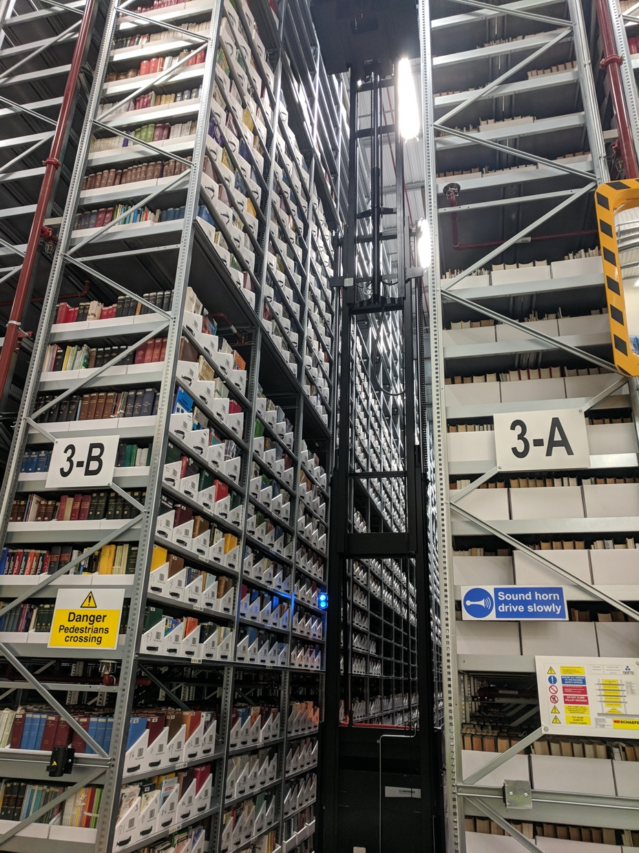
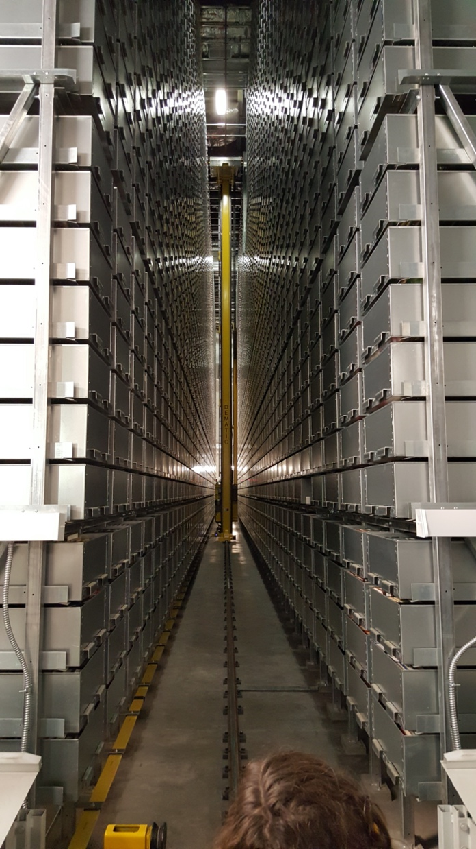
The rise of the collective collection
Reconfiguration
of library collaboration by network/digital environment.

Slide 24
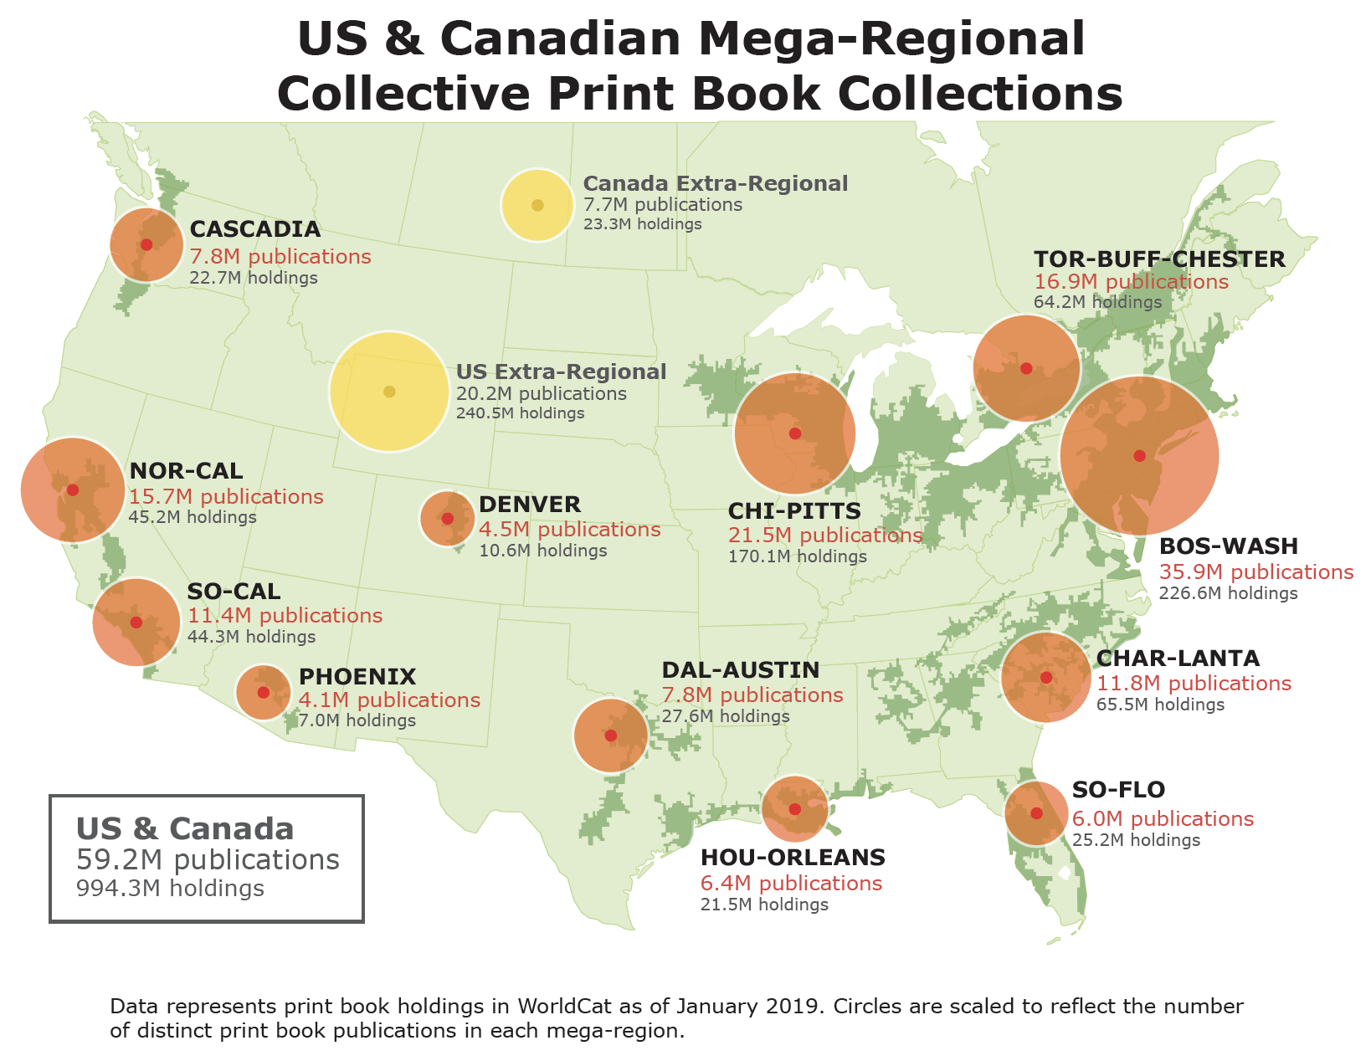
More purposeful coordination
to extend the reach of materials available to users beyond those available at one library
to make their management more efficient (by sharing costs and responsibilities)
to coordinate collections above the individual library level, allowing individual libraries to specialize and contribute more extensively within a defined network of responsibilities
to collaboratively steward the scholarly and cultural record.
“US & Canada Mega-Regional Collective Print Book Collections” by OCLC Research, from The US and Canadian Collective Print Book Collection: A 2019 Snapshot (doi:10.25333/7zjv-jv94), CC BY 4.0

Slide 25

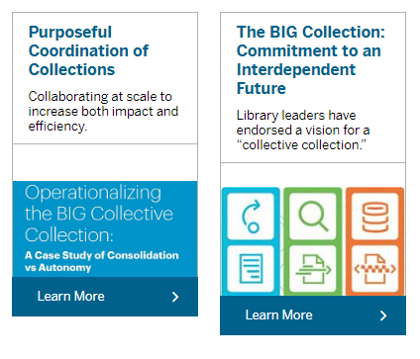
“
… the library leaders of the Big Ten Academic Alliance have endorsed a vision for a “collective collection.” … We will individually and collectively invest in strategies that transition our focus from building local collections to creating a shared, fully networked collection that supports our local students and scholars. With ever increasing rigor, we will manage the separate collections of the Big Ten as if they were a single shared collection, maximizing access to and ensuring the preservation of the scholarly record in support of our common mission.
Through collective action, we will create the BIG Collection of the Big Ten Academic Alliance to support the premier institutions we serve.

Slide 26
The specialized collection
A large part of existing print collections will move into shared stewardship in next few years?
Agreements emerging around retention and sharing.
Digitised corpus.
Collective action:
a tradeoff between consolidation and autonomy
Reconfiguration of library collaboration by network/digital environment.
The collective collection

Slide 27
Reconfiguration of the information space by network/digital environment.
Facilitated
Collection

Slide 28
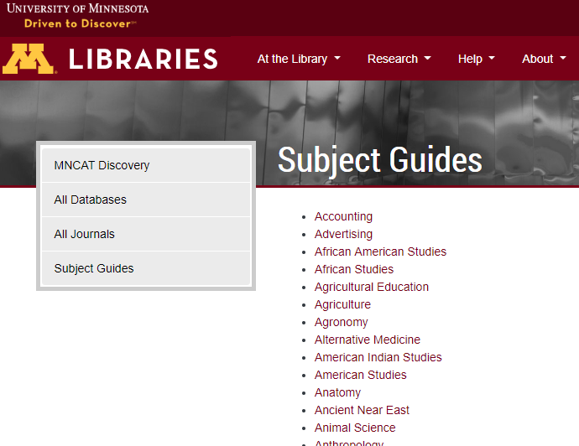
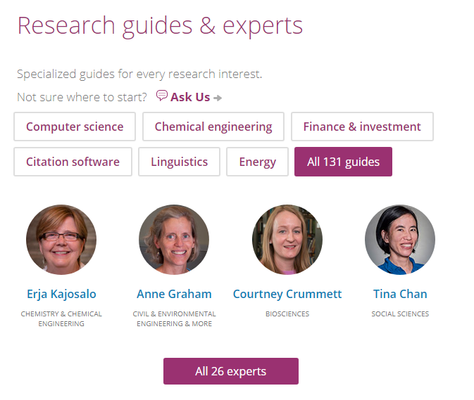
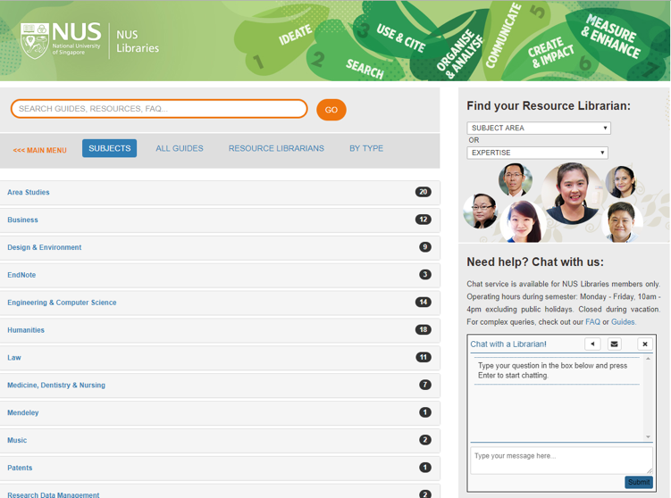

If the library is to be seen as expert
then its expertise must be seen.

Slide 29
The ‘external’ collection:
Pointing researchers at Google Scholar;
Including freely available ebooks in the catalog;
Providing access to Open Access and Open Educational resources
Creating resource guides for web resources.
The ‘borrowed’ collection
The shared print collection
The shared digital collection
The shared scholarly record
Collective
collections
A collections spectrum
The ‘owned’ collection
The ‘licensed’ collection
The ‘demand/data-driven’ collection
The ‘facilitated’ collection
Note: Libraries have variable
Investments across the entire
spectrum
Print logic: Purchased and
physically stored
Network logic: Meet research and
learning needs in best way

Slide 30
The specialized collection
Specialization of locally acquired/held collections?
Engagement
Understand and respond to needs of faculty and students.
A diffuse responsibility for stewardship of the scholarly record
Reconfiguration of the information space by network/digital environment.
The facilitated collection

Slide 31
Reconfiguration
of research work by network/digital
environment.
The inside out collection

Slide 32
Research outputs
R-
infra-structure
Expertise
Special collections

Slide 33
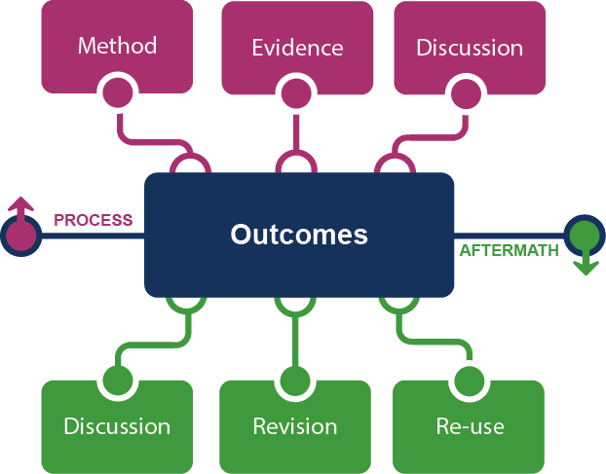
Supporting the creative process: the emerging scholarly record
Research outputs
Notes:
This is how we framed out the scholarly record in terms of nature and scope of what it might contain.
Start with published outcomes: the reporting of results, conclusions, ideas and so forth from a particular scholarly inquiry.
These outcomes are still the coin of the realm for scholarly activities, so they are privileged here at the center of the picture;
A lot of these outcomes take the form of text-based materials like books and journal articles, but often supplemented by additional materials such as video, graphics, and interactive programs.
Rest of scholarly record divided into two broad areas: process and aftermath
Process: process of scholarly inquiry; process by which outcomes are produced. Identified three categories of materials generated in this phase in which there is interest in including them as part of the scholarly record:
Method materials related to the methodology of scholarly inquiry (e.g., software, computer models, digital lab notebooks, sampling frames, experimental protocols, instrument calibrations)
Evidence raw materials/inputs to scholarly work (e.g., data sets, survey results, new or enhanced primary source documents, links to findings from other scholarly works);
Discussion refining and improving ideas, methods, conclusions (e.g., pre-prints, listserv/blog discussions, conference presentations, annotated commentary, grant proposals).
Anchoring outcomes directly to the methods employed, evidence used, and formative discussions conducted during the process of scholarly inquiry helps contextualize and deepen our understanding of these outcomes, facilitate replicability, and leverage results into new research.
Once the outcomes from a research project have been formally published or otherwise made available, scholarly activities surrounding that piece of work may still continue in the “aftermath” phase.
Activities in the aftermath phase may include Discussion (through similar channels as those in the process phase, but also post-publication formal reviews and commentary);
Revision published work can be revised in various ways (the work may be enhanced with additional findings; errors may be corrected or clarifications made, etc.)
Re-use (the work may be edited or re-packaged into new forms, such as conference presentations, summaries, blog posts, versions for the “popular media”, etc.).
Not saying that everything discussed here will end up in the scholarly record. But picture represents the maximal scope and depth of materials regarding which there is increasing interest in systematic collection and curation.
Note that some of the materials in the outlying components are becoming or might become outcomes in their own right. Data sets are a good example: in some disciplines the publication of an important data set is now considered a first-class scientific outcome.
More on the evolving scholarly record:
Lavoie, Brian, Eric Childress, Ricky Erway, Ixchel Faniel, Constance Malpas, Jennifer Schaffner, and Titia van der Werf. 2014. The Evolving Scholarly Record. Dublin, Ohio: OCLC Research.
http://www.oclc.org/content/dam/research/publications/library/2014/oclcresearch-evolving-scholarly-record-2014.pdf.

Slide 34











Notes:
http://global.oup.com/uk/orc/busecon/economics/carlin/

Slide 35
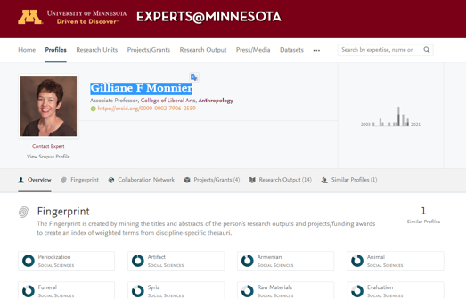
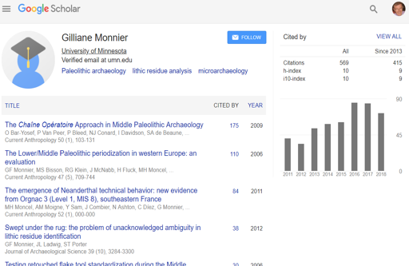
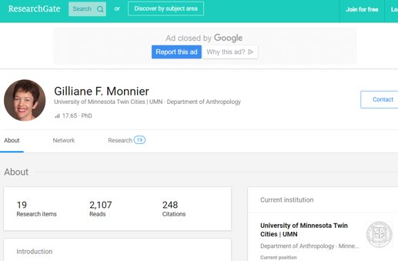
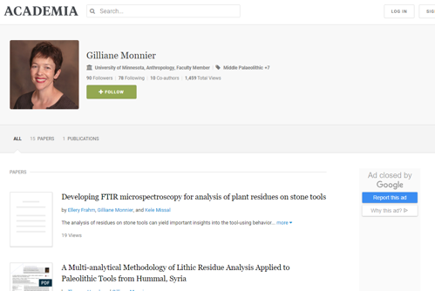
Blurring of workflow,
Research outputs and identity
Expertise

Slide 36
Creation, management and disclosure
Vice president for research
Medical center
R-
infra-structure
Tech Transfer Office
CIO
News Bureau
Institutional Reporting
Research Data Management
Advancement & corporate relations
Provost
Data Warehouse
RIM/Profiling system
Digital scholarship
LIBRARY
Colleges & depts
Institutional Repository
User education & training
Disciplines & departments
Graduate school
Office of undergraduate research
Researcher
Research manager
Library
Campus center for teaching & learning

Slide 37












Researcher
Librarian
Research
manager

Slide 38
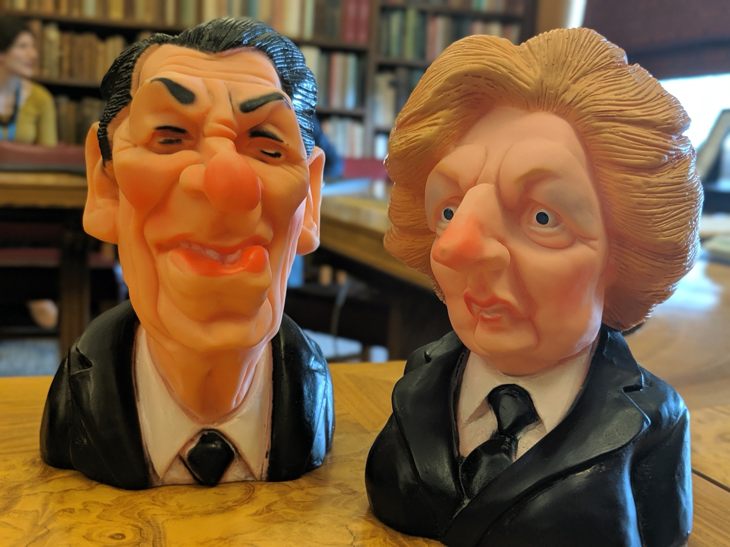
Special
collections
Research
Reputation
Relevance

Slide 39
Support for creation, management and disclosure of evidence, memory, community
Reconfiguration of research work by network/digital
environment.
Workflow is the new content
Reputation and access
manage and disclose the intellectual outputs and expertise of the institution.
From discovery to discoverability
The inside out collection

Slide 40
Three systemic trends
Increasingly organize collections at the network or systemwide level.
Assemble a coordinated mix of local, external and collaborative services around user needs.
Create, manage and make discoverable
evidence, community, memory..
The collective collection
The facilitated collection
The inside out collection

Slide 41
Three emphases
Represent identities, experiences memories of all community
Aligned closely with institutional needs
Collections as programmatically prospected data
Pluralize
Optimize
Analyze at scale

Slide 42
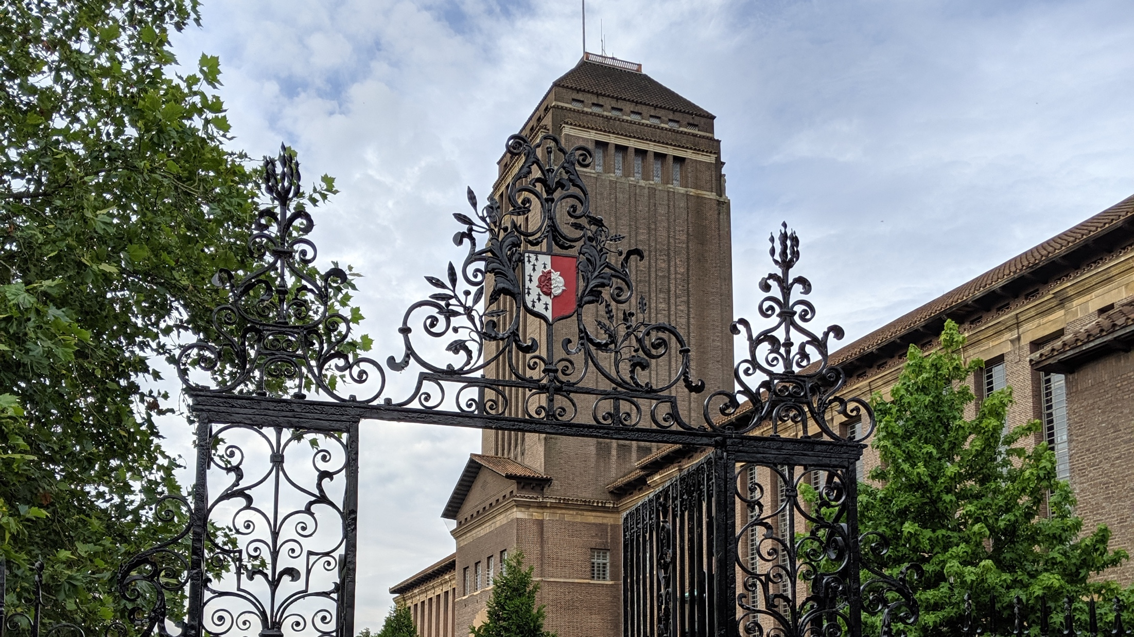
In conclusion: the big shift, value and values

Slide 43
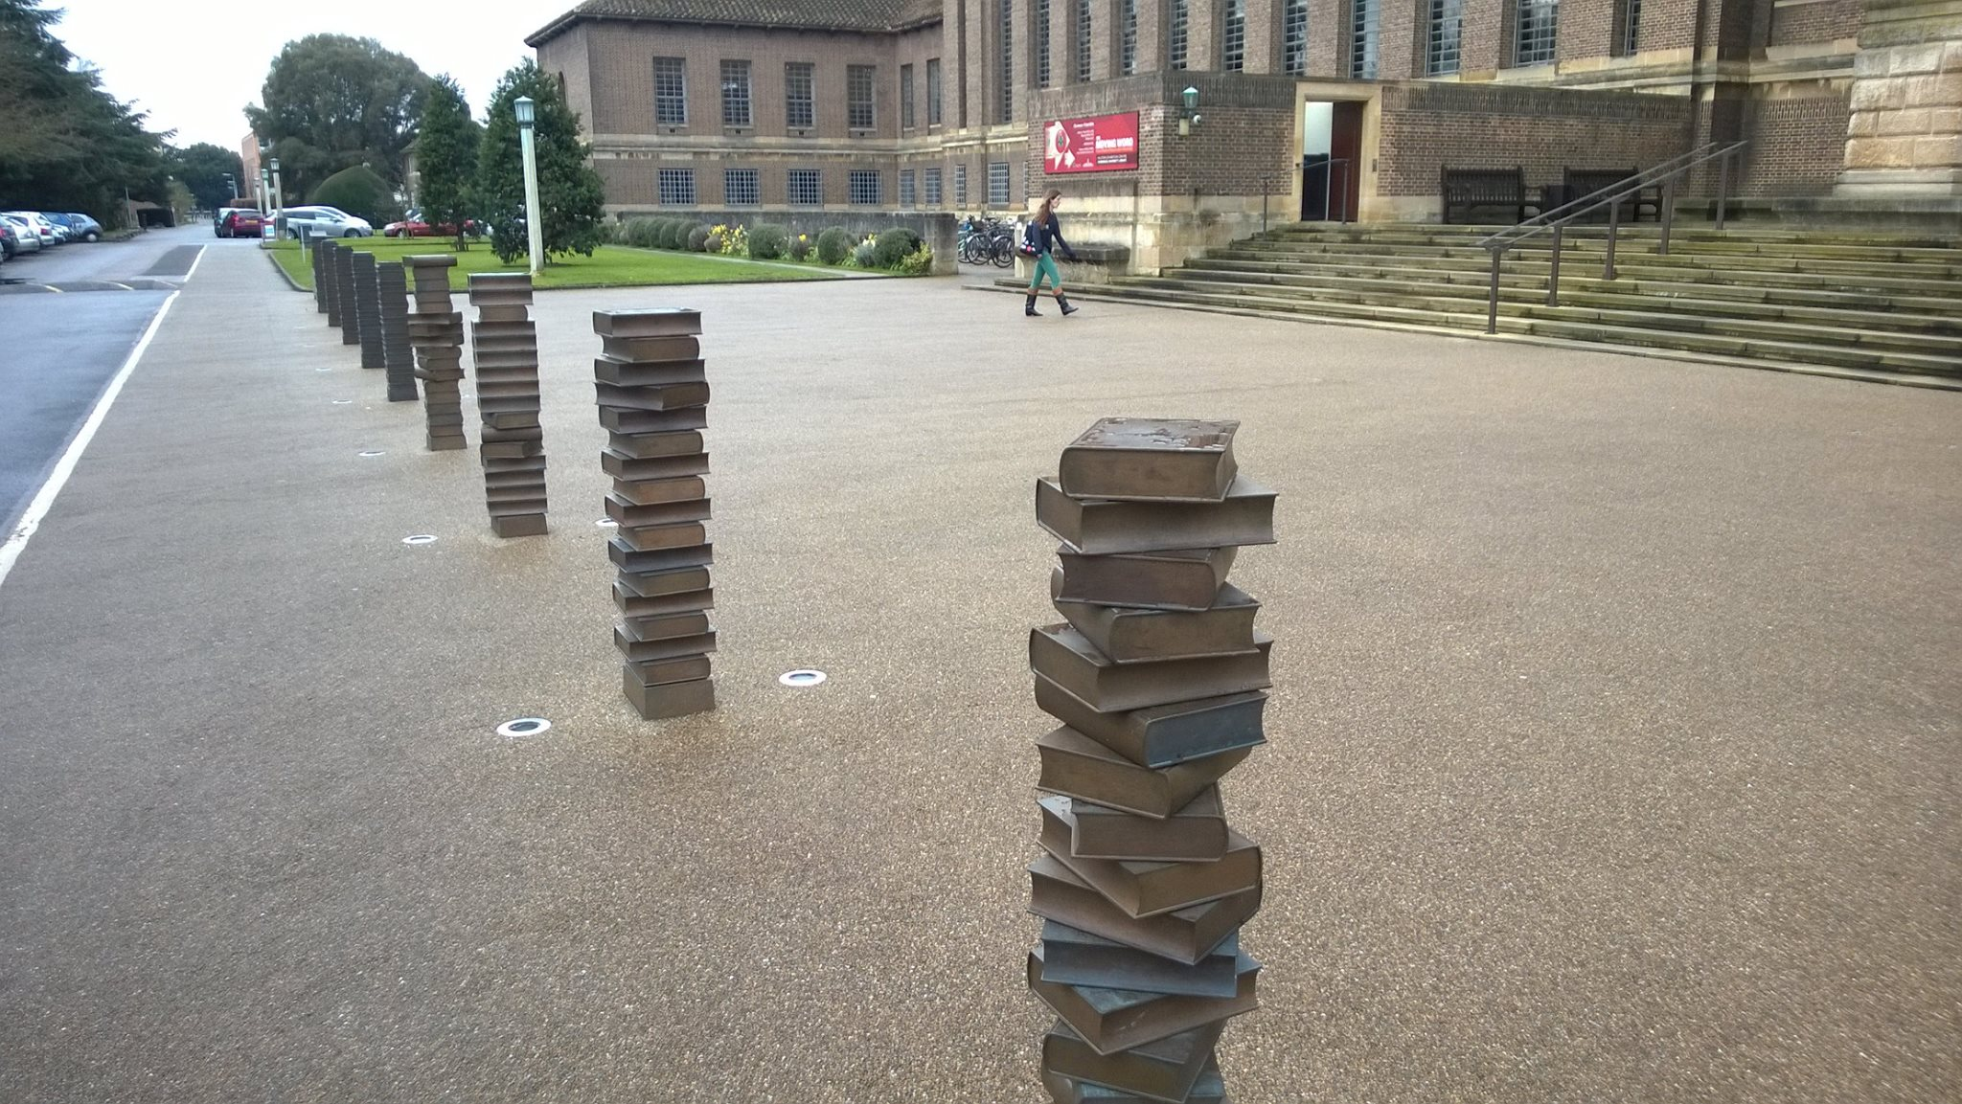
Critical advocate and consultant in complex information environment
The library story
  Identity
  Value
  Workflow
The current library story
  Identity
  Value
  Workflow
The new library story?
  Identity
  Value
  Workflow
Support users as creators
COLLECTIONS
SERVICES
COMMUNITY
Make community successful
Notes:
The library identity, value and workflow were very bound up with collections. When associated with services those things become more diffuse and the library story more complicated. The challenge is to recreate the library story as identity, value and workflow are increasingly bound up with expertise, community, …..

Slide 44
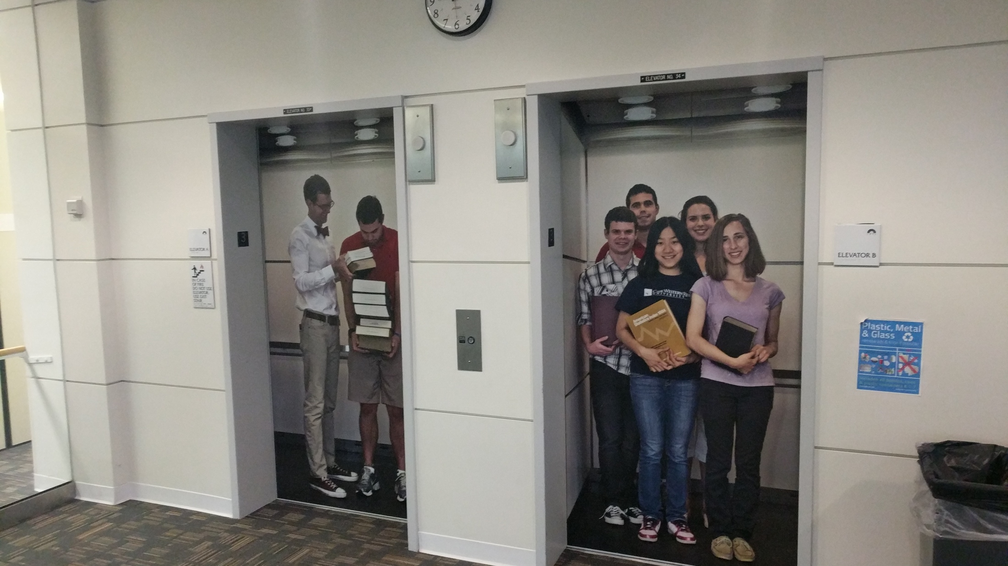
Notes:
These are pictures of faculty/students on the elevator doors at the library in Case Western Reserve University. Lovely initiative. I used it as the background to a remark about the library story … we are in a transitional moment when it takes a tall building to communicate the library elevator pitch.

Slide 45
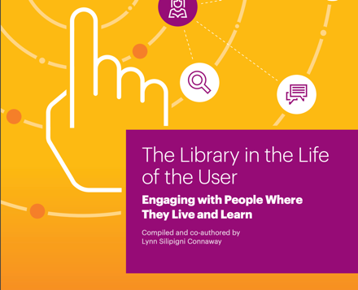
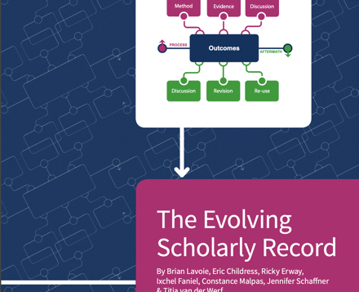
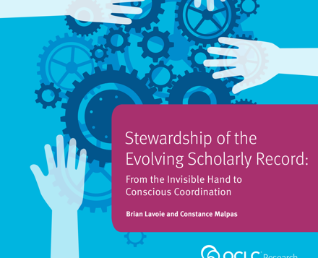

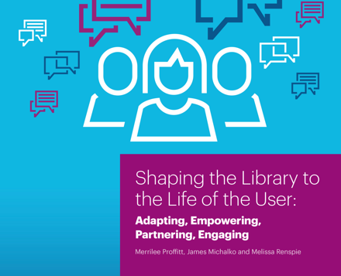
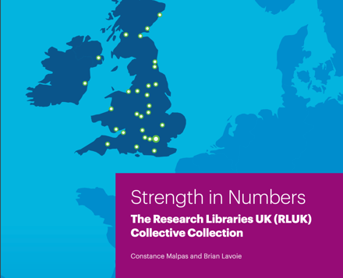
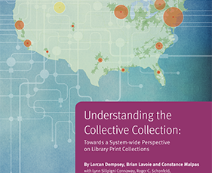
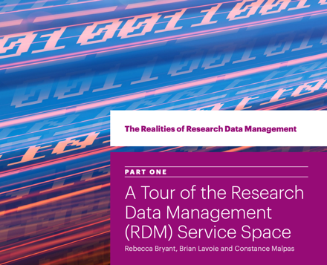

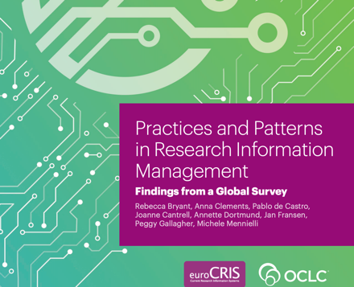
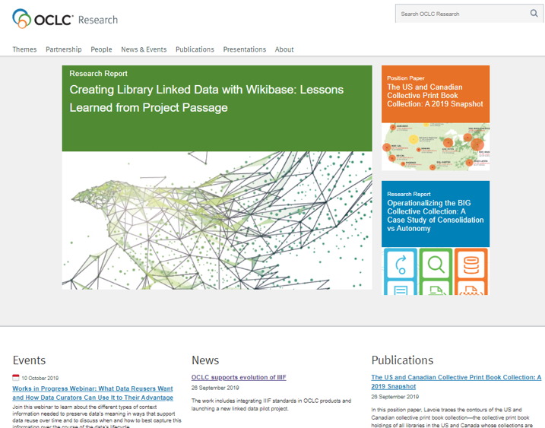
Thank you
Lorcan Dempsey
@LorcanD
https://www.oclc.org/research
All photographs by
Lorcan Dempsey
(Thanks to Keith Webster for some slides)

