Slide 1

Sonia Yaco
Associate Director, Head of Special Collections and University Archives, Rutgers University
Utilizing ontologies to describe artists’ books and other amorphous genres
Notes:
Introduction
Artists’ books, ranging from wordless book-like objects to hand-made codices, stand at the crossroads of sculpture and the book form. Distinct from books about art, the genre is notoriously difficult to define.
The curse of artists’ books is once you learn what they are, you will spend your life explaining it to others. This is true whether you are describing a collection to a class, doing appraisal work, or writing a collection development policy. Today I’m going to suggest an ontology as a visual tool that can be used to explain the genre, to map general collecting practices, and to document specific institution’s practices. Some variants for this ontology will be shown. I’ll then demonstrate how the same technique can be applied to other amorphous collecting areas in your library.

Slide 2
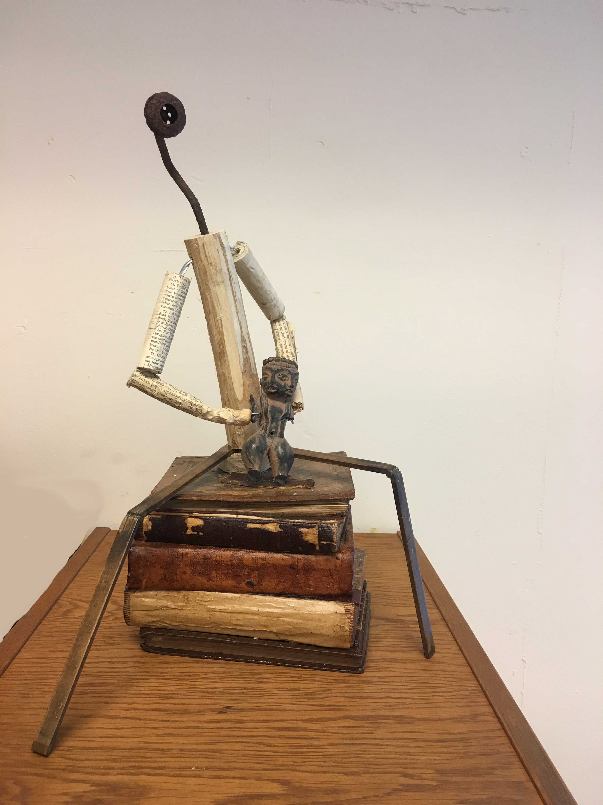
What does, “We collect artists’ books” mean?
Notes:
What’s an artist’s book? It’s above all a conversation about the concept of a book: the interaction of its physical nature and intellectual content.
Artists books and artists book collections use a cacophony of names, definitions, characteristics and hierarchies for the genre. A review of collections in the UK in 1993 lists 25 distinct definitions for artists’ books. Definitions for the genre range from simple agency-based to complicated faceted subsets and often contradict each other. Bookworks or Book arts for instance may be seen as a subset of or distinct from artists’ books. Clive Phillpott sees “a distinction between ‘artist’s books,’ meaning books and booklets authored by artists, and ‘bookworks,’ meaning artworks in book form.” He describes some artists’ books as having “low cover prices and large editions.” The Modern Art Museum inverts the definition. ”Bookworks is a current term that refers to mass-produced, inexpensive books, conceived and designed entirely by artists, and printed in a range of media (e.g. offset lithography, photocopy, mimeograph).” Art and Architecture Thesaurus Online, defines bookworks as a sub-genre of artists’ books “that emphasize the physical book as a work of art rather than the content.’” Even the punctuation and plurality of the genre is in question; artist singular, plural, possessive or not. Rutgers historically have used the plural possessive “artists’ books”.
What an institution collects may or may not fit their genre definition. Definitions of the genre and selection criteria may overlap or conflict. For Sonja Graimprey cost is one way to distinguishes between inexpensive “artists books”, made by one author, and more costly “livres d ’artistes”, made with exquisite materials, but selected often within price constraints. Many libraries will include secondary sources in their artists book collections. Others include altered books, popup books, and illustrated books, as part of artists book collections, but although distinct from artists books themselves.
How can we explain better the genre?
With no agreement on name, definition, characteristics, or selection criteria, a narrative description of the universe of artists books is unlikely to add clarity.

Slide 3
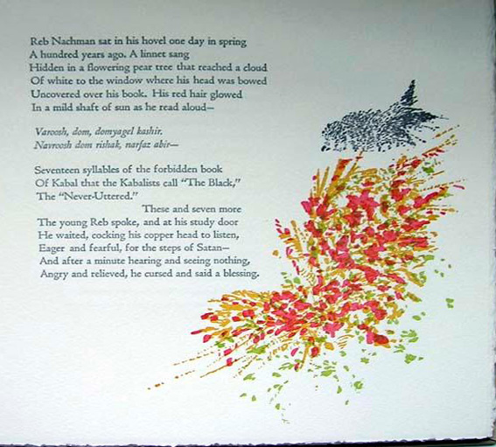
Creating a clearer picture
Notes:
Another technique to describe these collections may hold more promise. Ontologies are a visual chart of problem domains or research areas. A method developed by Arkalgud Ramaprasad and Thant Syn uses meta-analysis and synthesis to create ontologies. These ontologies have been used in multiple fields including cultural heritage. Using constructs from decision science and information science, problem domains are broken into key functions, agents, outcomes, and characteristics. For example, Ramaprasad and co-authors present a systematic, exhaustive analysis of India’s antiquities laws with an ontology. Ramaprasad and I propose an ontology to visualize the semantics of cultural heritage artifacts. With Saleha Rizvi we deconstruct the intersection of cultural heritage and curriculum. We use a related ontology to discuss the informatics of cultural heritage instruction and to map current literature in the same domain. Using cluster analysis we identify dominant, non-dominant, and neglected research areas in integrating primary source collections and instruction.

Slide 4
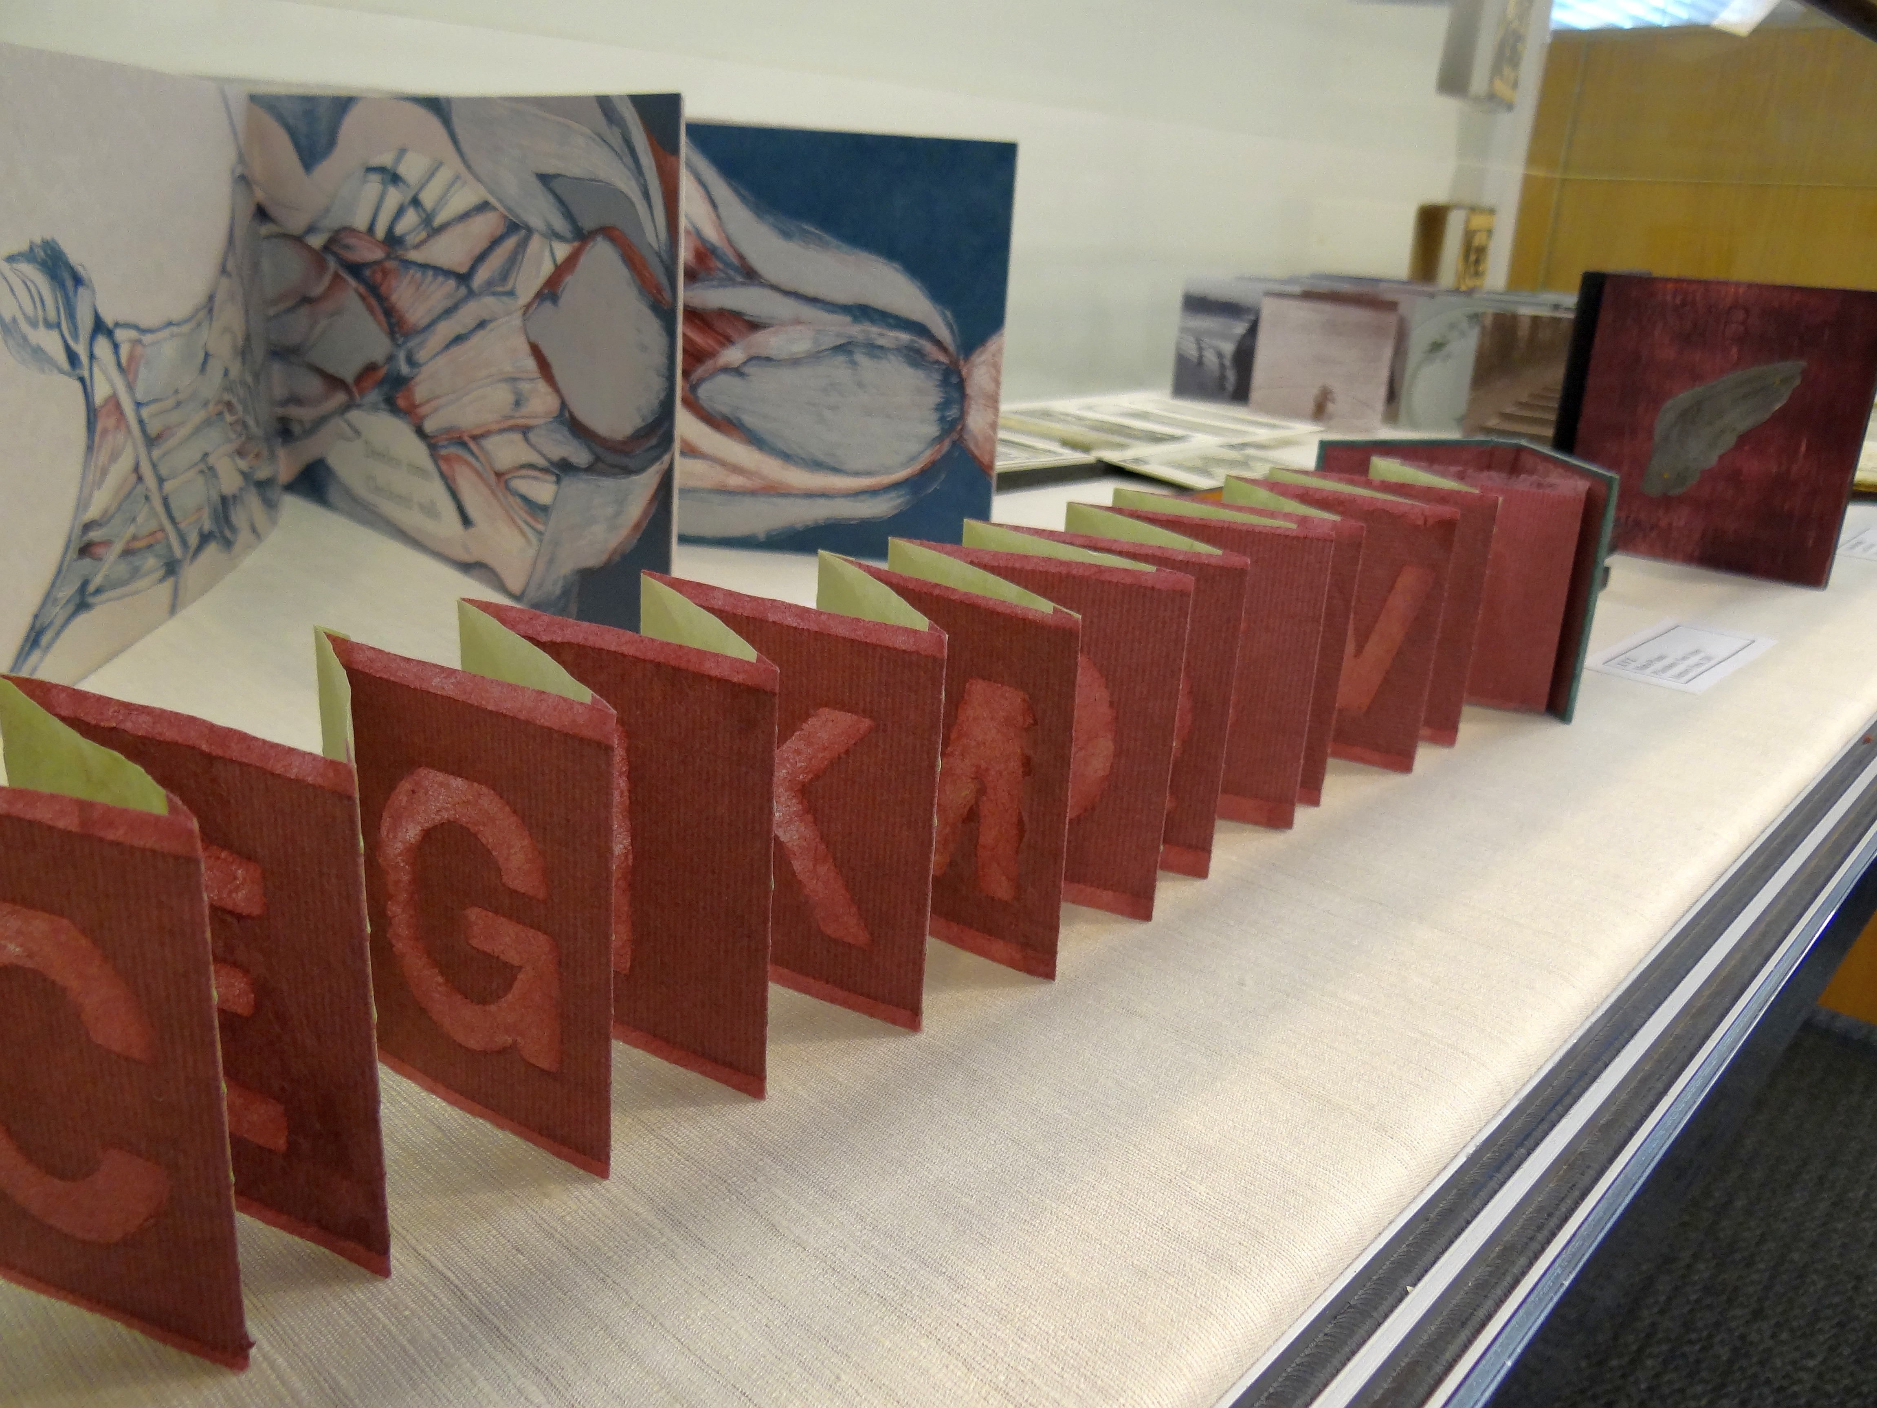
Gathering the data
Notes:
To begin the analysis, I needed a corpus of collection descriptions. I gathered policies, descriptions, or definitions of artists’ book collections from a variety of sources. I consulted the websites of Big Ten Academic Alliance libraries, lists of libraries collecting in this genre, and institutional membership list of College Book Art Association. To find more collections I interviewed book artists, art and rare book librarians, and rare book catalogers, reviewed secondary sources on artists books and artist book collections, and searched Google and Google scholar.
The primary criteria for inclusion in the dataset was formal acquisition policies or narrative describing the genre and/or their collection. Excluded were rare book or general library policies that simply stated that artists’ books are collected, without providing any additional information. Also excluded were descriptions of exhibits hosted at a library about collections not held by that library such as traveling exhibits or exhibits of private collections.
The result was 109 collection descriptions, with only a dozen were formal collection development policies. The break down was
92 US and 17 UK. Most repositories were connected to university or college.

Slide 5
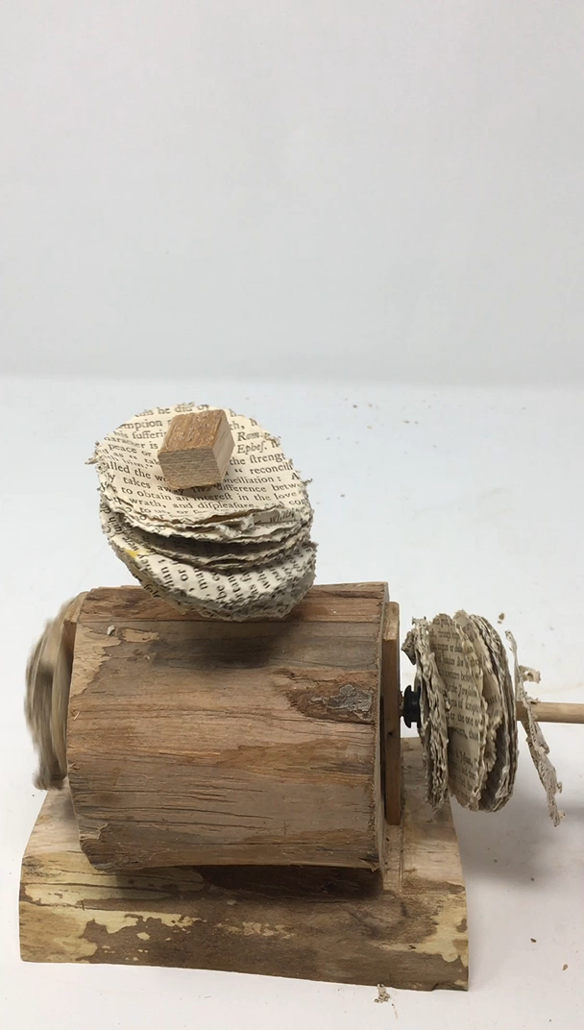
Constructing the ontology
Notes:
I deconstructed the narratives into artists’ book characteristics, library functions, nomenclature, and collecting criteria to create an ontology. The terms are intended to be accessible and understandable to a range of audiences from cultural heritage professionals to students.
It’s important to note that this is one of several possible ontologies to describe collecting for this genre.

Slide 6
Artists’ book collections ontology
What do you collect? Why?
Notes:
The ontology answers the question: What do you collect and why. It provides a structured natural-English framework composed of columns or dimensions. Concatenating an element, or word from each dimension with the connecting words makes a natural-English sentence. Each sentence describes a potential pathway of the artists books ontology.
Structure, which I’ll go through in detail is :
[Libraries] Function [+] Edition [+] Nomenclature [created as a/an] Artifact [artifact created by the] Creator [based on the] Criteria [for] Outcome
Example:
[Libraries] Purchase [+] Unique [+] Bookworks [created as a/an] Physical [artifact created by the] Artist [based on the] Library holdings [for] Teaching

Slide 7
Ontology dimension: Function
Libraries…
Notes:
To break t down, the ontology begins with Functions, Libraries Purchase and Receive artists books. Some also Create them as student projects or as individual librarians.

Slide 8
Ontology dimension: Edition
Notes:
The spectrum of Editions that are collected ranges from Unique to Mass produced Multiples
and includes Hand-made Limited edition Fine edition/press

Slide 9
Ontology dimension: Nomenclature
Notes:
I’ve listed the Nomenclature alphabetically, with no inference of hierarchy or definition. Whether Artists books are part of or include book arts, is immaterial for this dimension. My initial list was longer including for instance movable or wordless book. If I found no incidence of the term in the survey data, I moved it to the glossary. Movable books for instance are included with popups.
Altered books Artists books Book arts Book objects Book sculptures Bookworks

Slide 10
Ontology dimension: Creator
Created by:
Notes:
Maker
Artist, other (Publisher, illustrator, writer)

Slide 11
Ontology dimension: Artifact
As a/an ____ artifact:
Notes:
Created as a Physical Artistic Political/philosophical Container Content- focused Conceptual Artifact

Slide 12
Ontology dimension: Selection criteria
Based on:
Notes:
Selection criteria – based on characteristics of Artist or Press
Or
Content Physical form Enduring value Cost Creation date Library holdings Preservability

Slide 13
Ontology dimension: Outcome
For:
Notes:
Outcome
Teaching Research Programming Exhibits

Slide 14
Artists' book collections: an ontology
Notes:
Here’s the full ontology, which describes all the possible elements in the genre, without specifying a relationship, hierarchy, or prescription.

Slide 15
What do you collect? Why?
[Libraries] Purchase [+] Unique [+] Bookworks [created as a/an] Physical [artifact created by the] Artist [based on the] Library holdings [for] Teaching
Notes:
Putting it all together –
For example, one aspect of a repository’s collecting policy of buying unique “bookworks” that are made by an artist, created as a physical artifact, selected based on the library holdings to be used for teaching, could be represented with the pathway:
Libraries purchase unique bookworks created as a physical artifact by the artist based on library holdings for teaching

Slide 16
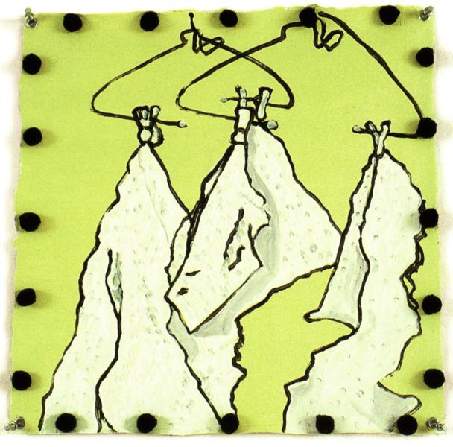
The artist book ontology as framework
Notes:
Where does that get us?

Slide 17
Rutgers SC/UA artists' book collection acquisition policy
Notes:
The ontology can be used to describe an institution’s current policy, or their practice at a particular moment in time, or to compare different institutions policies.
This can be used as a stand alone visual summary or as part of a collection development policy,

Slide 18
Artists' book collections: mapping the universe
Notes:
The ontology can be used to map the universe as described in literature. This shows the results of the 109 repositories I surveyed.

Slide 19
Artists' book collections: Functions and Edition
Notes:
Ranked in order of frequency, keeping in mind more than one element is possible in each dimension, and that only elements that were discussed were listed.

Slide 20
Artists' book collections: Nomenclature
Notes:
These frequencies correspond to the occurrence of terms or their synonyms in the descriptions, without regard to how the terms are defined or the hierarchy assigned to them.

Slide 21
Artists' book collections: Artifacts
Notes:
While most of the dimensions were tabulated by me and cross-checked with using searching synonyms with a SQL query, this one was too subjective for that to be practical. Most collections emphasized the book as an artistic or conceptual artifact.

Slide 22
Artists' book collections: Creator
Notes:
Most highlighted the role of artists in creating artists books, fewer mentioned publishers, illustrators, or writers as creators. Often the role of publisher, illustrator, and writer is unmentioned in collection narratives.

Slide 23
Artists' book collections: Criteria
Notes:
Characteristics of the artist, whether geographic, institutional affiliation, gender, was most frequently mentioned. Era of creation, and similar characteristics of the press, featured high, as did the content. The existing strengths or gaps in a collection were considered as were competing organizations holdings.

Slide 24
Artists' book collections: Outcomes
Notes:
Not surprisingly the mostly university- related libraries in the survey, primarily collect to facilitate teaching and research

Slide 25
Modifying the ontology
Notes:
The flexibility of the ontology allows adjusting dimensions to better describe a collecting policy. In this case the artifact dimension has been removed and a sub-dimension, Characteristics, has been added. This library wanted to clarify what about how artists and presses were selected – by locale, gender, race, and/or affiliation. Libraries may collect works by Kentucky women and women-owned presses; Latinx artists, or artists affiliated with the Book Arts Workshop.

Slide 26
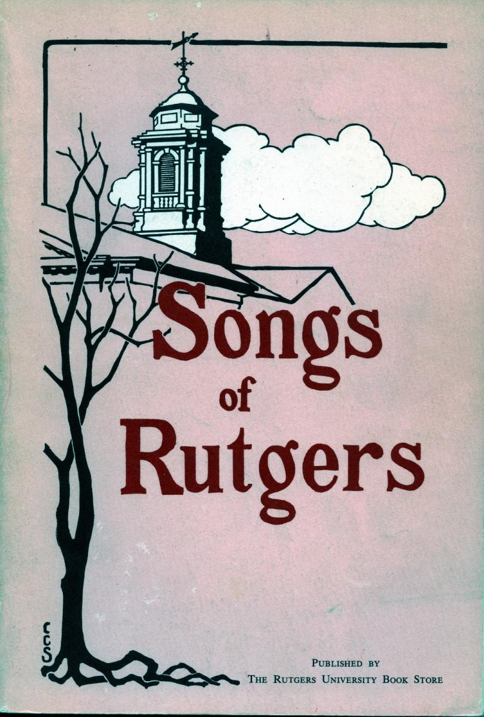
Adapting for other genres
Notes:
Artists’ books are not the only unstructured or broadly defined genres that libraries collect. History of medicine, Eastern European studies, protest literature or University Archives all could adapt the ontology to help communicate their collecting policies.

Slide 27
University Archives …
Notes:
As an example, lets look at University Archives. The Dimensions, columns, are similar to the artists book ontology but slightly modified, the elements within differ significantly. Yet the ontology retains the ability to visually, succinctly describe collecting practices in University Archives. This illustrates Rutgers practices, but it could be expanded to describe the universe of University Archives practices.

Slide 28
University Archives ontology: Function, Format, and Creator
Notes:
At Rutgers, University Archives receives and assembles, but never purchases, a variety of formats created by a specific set of creators. As with the artists book ontology, this structure can be used to compare and contrast practices with other repositories. Salisbury University Archives may purchase ephemera. Yale may collect from alumni, but not student organizations.

Slide 29
University Archives ontology: Criteria and Outcome
Notes:
University Archives selects material with criteria differing from many collections – the importance of the faculty member and legal requirements to keep the president’s papers, for instance. The outcome includes enhancing alumni relations and documenting the history of the university.

Slide 30
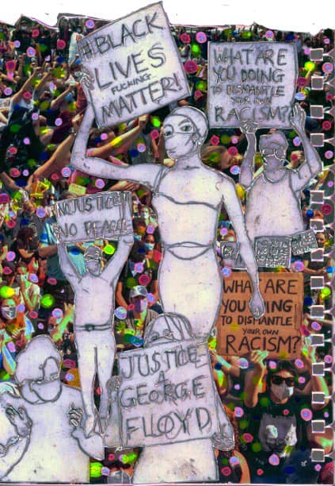
Conclusion
Notes:
These ontologies are flexible tool that can succinctly paint a picture of collections. Like artists books, that can be a way to begin a conversation about collecting policies. They can be used to augment or guide narrative collection descriptions.

Slide 31
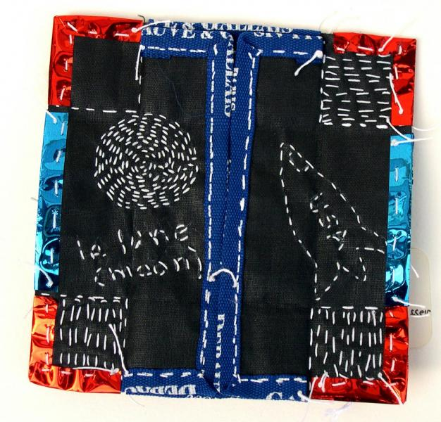
Questions?
Notes:
Questions?

