Slide 1
Webinar • March 31, 2020
Prioritizing People: Accessibility and Digital Libraries
Nathan Tallman, Hanning Chen, and Valerie Yazza

Slide 2
Nathan Tallman
Digital Preservation Librarian, Penn State University
Hanning Chen
Product Analyst, OCLC

Slide 3
Valerie Yazza
Senior User Experience Designer, OCLC

Slide 4
About Us
Product Owner, Product Analyst, and Senior User Experience Designer
You may or may not be familiar with these roles or have them in your organization. But you have users. You probably want users to use your collections; but your users may have impairments.
Thinking about your collections through the lens of these roles may help you make your collections more accessible to impaired users.

Slide 5
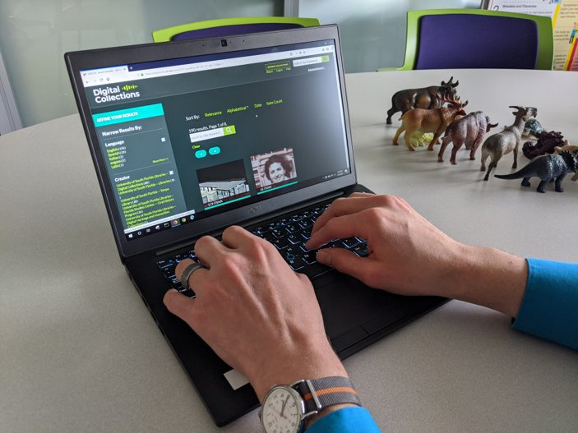
Screen Reader Demonstration

Slide 7
Product Ownership
Comes from the Scrum/Agile framework.
PO is the chief stakeholder, defines the vision, prioritizes work, and liaises with other stakeholders.
Interfaces with the development team/vendor and other stakeholders/rest of the organization.
PO is accountable for delivering maximum value.
If accessibility is important to your organization and users, it’s the product owner’s job to deliver an accessible application.

Slide 8
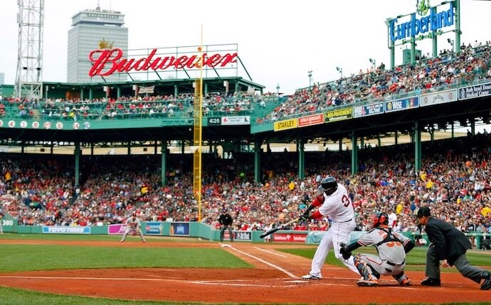
Everyone Benefits
Closed captions on video content
Accessibility: Allow people who might be deaf or hard of hearing to have access to the videos.
User Experience: Allow your audience the ability to enjoy your content, regardless of the environment they are in.
Headings clarify the structure of a page
Creating a logical and coherent website in general.
Alt text on image and UI elements
Better understand the contents and functions of a website.
For example:
Bad Alt Text alt="Baseball player hitting a ball at a baseball field"
Good Alt Text alt="David Ortiz of the Boston Red Sox batting from home plate at Fenway Park"

Slide 9
Web Accessibility
Our physical spaces are accessible, our digital spaces need to be as well.
Guidelines
W3C Web Accessibility Initiative
Web accessibility means that websites, tools, and technologies are designed and developed so that people with disabilities can use them. More specifically, people can:
perceive, understand, navigate, and interact with the Web
contribute to the Web
Universal Design

Slide 10
Hosted/SaaS Software

Slide 11
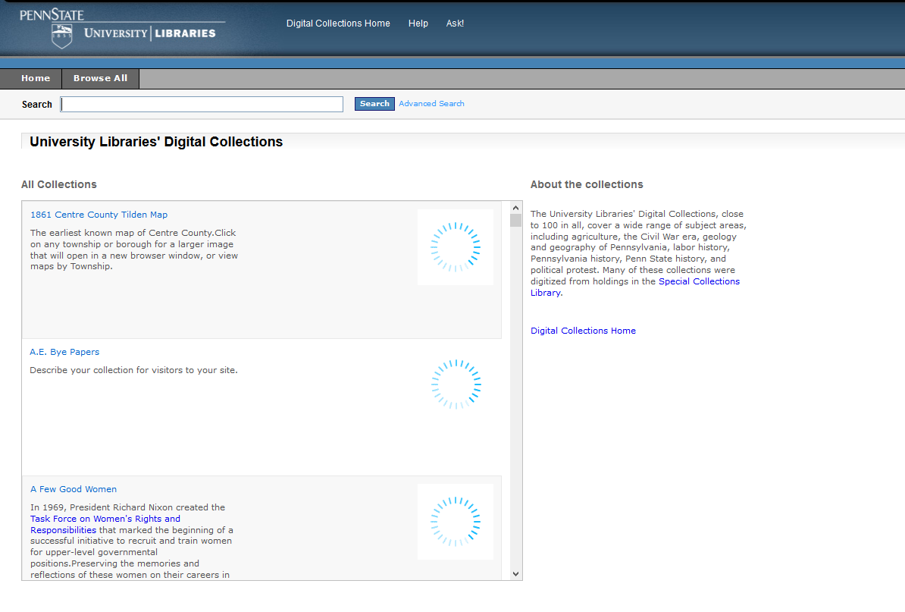
CONTENTdm 6.x
PSU had stability and maintenance issues with our self-hosted instance.
Known issues with accessibility and mobile devices.
OCLC’s new hosted version of CONTENTdm advertised accessibility improvements, so we asked for a trial.

Slide 12
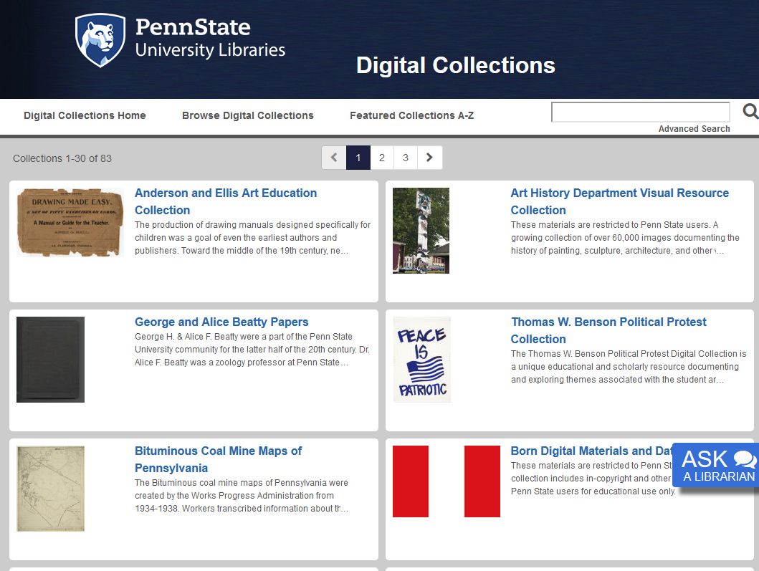
CONTENTdm Responsive
Worked with Penn State IT Accessibility Group to test new CONTENTdm with some of our collection.
Results were disappointing based on OCLC messaging and strongly worded emails sent.
OCLC listened and their response showed they cared. Successive improvements were made, with additional rounds of testing and report sharing.

Slide 13
Accessibility is Maturing
Accessibility is evolving.
We are fortunate to work with partners on accessibility issues.
Education of everyone on the production chain is ongoing.
Standards are being established and revised.
We are learning more about accessibility as the entire society learns more.
CONTENTdm team at OCLC is taking the issue seriously and is continuously making accessibility improvements to our product.

Slide 14
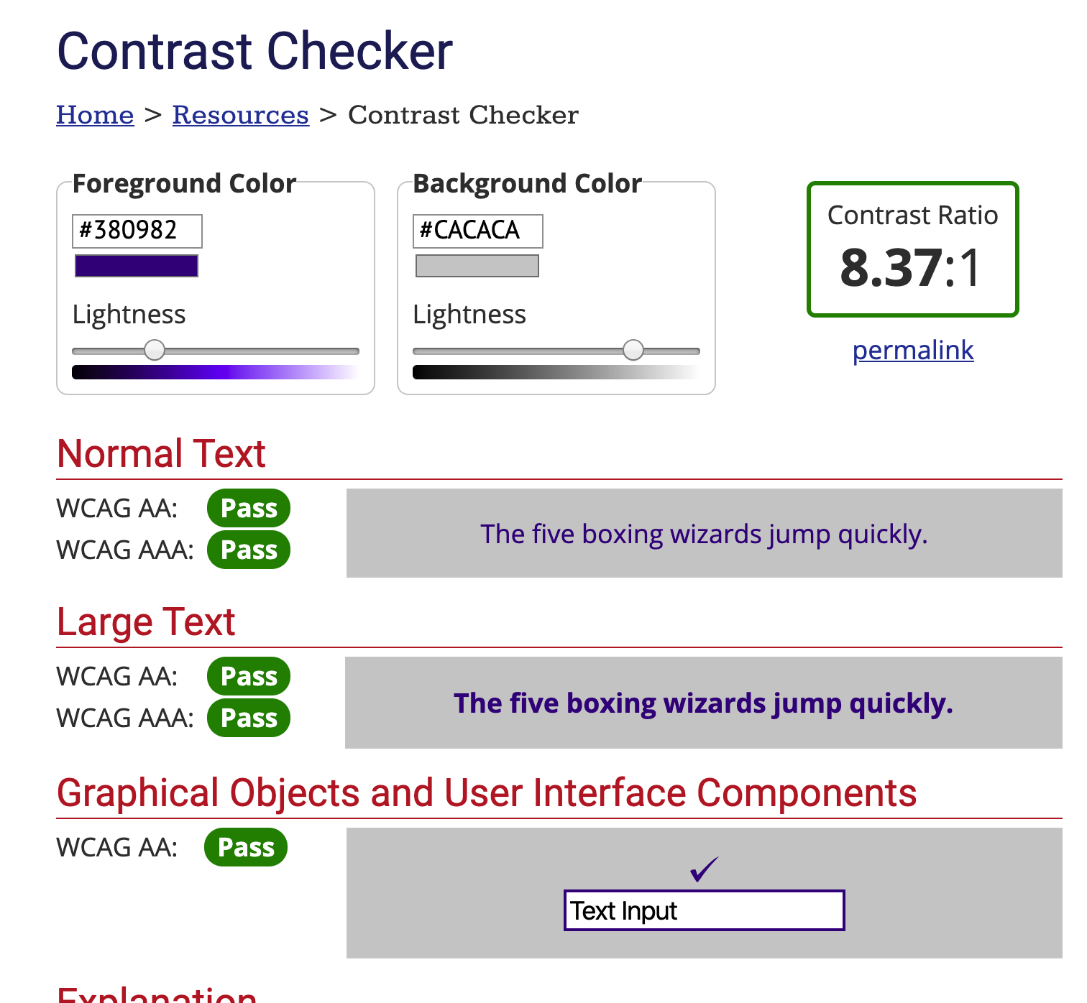
Keeping Your Website Accessible
When uploading content
Use descriptive yet simple language for your content
Give relevant names to your titles, subjects, and descriptions
When using a Website Configuration Tool
Test intended colors with WebAIM Contrast Checker
webaim.org/resources/contrastchecker/
Text size 'Medium' is the intended sizing for the text

Slide 15
Developing Software

Slide 16
Cultural Heritage Objects Repository
Samvera-based digital repository with Blacklight as the only starting UI.
Accessibility a priority, required feature from day one. Every incremental release undergoes some form of accessibility testing.
Full testing with EIT Accessibility Group as needed and planned for major releases.
MVP includes minimal/no JavaScript or other fancy UI features to maintain focus on core accessibility for graceful fallback.
Staff need an accessible interface too.

Slide 17
Best Practices

Slide 18
Best Practices for Adapting Software
Working with Vendors
Test all claims
Don’t be reluctant to ask or give feedback to the development team
When customizing, be careful not to reverse accessibility
Test customizations with SiteImprove – it can be downloaded as a Chrome extension
Accessibility is always evolving; we are constantly working to make improvements to our products

Slide 19
Best Practices for Creating Software
Universal design
Progressive enhancement
Routine testing, both automated & manual (WCAG) and human using adaptive tech
Valid, semantic HTML encoding
Unicode! (Accessibility for all languages!)
Know how to use ALT and ARIA attributes
Test content without CSS and JS enabled
Remember screen readers when adding hidden content and for skipping non-primary content

Slide 20
Resources
W3C Web Accessibility Initiative
Resources to help with accessibility evaluation are described in Evaluating Web Accessibility Overview.
Web Accessibility Evaluation Tools List https://www.w3.org/WAI/ER/tools/
Web Accessibility Perspectives Video (YouTube)
Universal Design
WebAIM Contrast Checker: webaim.org/resources/contrastchecker/

Slide 21
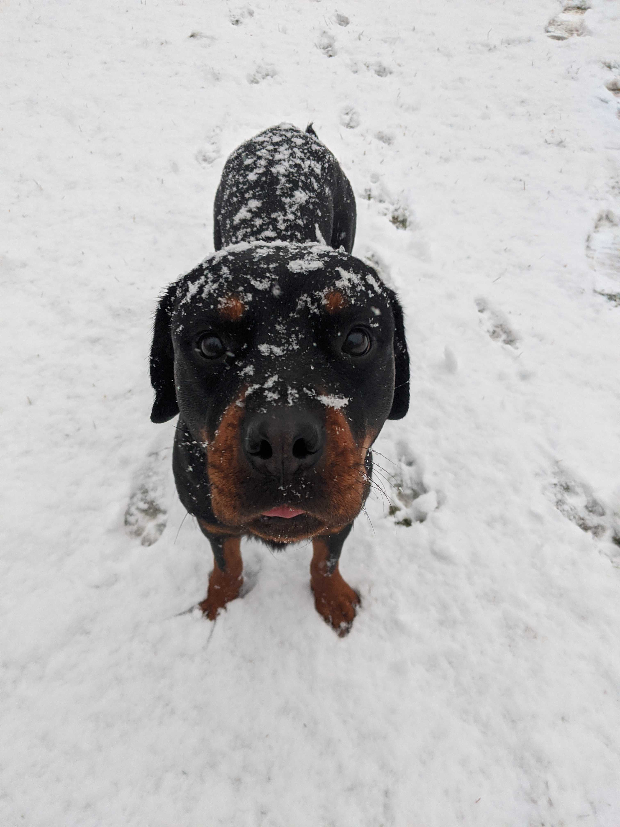
Questions?
Nathan Tallman
Digital Preservation Librarian, Penn State University
ntt7@psu.edu
Hanning Chen
Product Analyst, OCLC
chenha@oclc.org
Valerie Yazza
Senior User Experience Designer, OCLC
yazzav@oclc.org

