Slide 1
David W. Lewis, Mike Roy and Katherine Skinner
OCLC Webinar
May 28, 2020

Slide 2
David W. Lewis
Mike Roy
Katherine Skinner

Slide 3
Agenda
Introduction — David
Literature Review — David
Census of Infrastructure Providers — Katherine
Providers Case Studies — Katherine
Library Survey — Mike
Library Focus Groups — David
Questions

Slide 4
Introduction

Slide 5
Mapping Digital Scholarly Communication Infrastructure
Grew out of “2.5% Commitment” Proposal
Funded by Andrew W. Mellon Foundation
Principal investigators Mike Roy and David W. Lewis
Consultants:
Educopia Institute — Katherine Skinner
TrueBearing Consulting

Slide 6
Mapping Digital Scholarly Communication Infrastructure
Looked at Infrastructure only, not content
Looked at both open and proprietary, nonprofit and for profit

Slide 7
Mapping Digital Scholarly Communication Infrastructure
Project Goals:
Map the range of infrastructure that supports digital scholarly communications
Survey college and university libraries to understand their current investments in this infrastructure and their motivations for doing so

Slide 8
Mapping Digital Scholarly Communication Infrastructure
Project Activities:
Literature Review — Bibliographic Scan
Census of Infrastructure Providers
Case Studies of Infrastructure Providers
Survey of Academic Libraries
Focus Groups of Academic Library Leaders

Slide 9
Bibliographic Scan

Slide 10
Bibliographic Scan
https://educopia.org/mapping-the-scholarly-communication-landscape-bibliographic-scan/

Slide 11
Bibliographic Scan
206 projects
139 were nonprofit, 67 commercial
There are 17 organizations that support multiple projects
6 Commercial — Artefactual Systems, Atypon/Wiley, Clarivate Analytics, Digital Science, Elsevier, and MDPI
11 Nonprofit — Center for Open Science, Collaborative Knowledge Foundation (Coko), LYRASIS/DuraSpace, Educopia Institute, Internet Archive, JISC, OCLC, OpenAIRE, Open Access Button, Our Research (formerly Impactstory), and the Public Knowledge Project

Slide 12
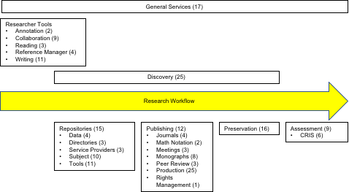

Slide 13
General Services
Creative Commons, Crossref, IIIF, Orcid, etc.
Most nonprofit and community managed

Slide 14
Researcher Tools
Important collaboration, reading, and reference manager tools are commercial. For example ResearchGate, Academia.edu, Mendeley, and Endnote
Writing tools are a mix. Data2paper, Jupyter Notebook and Fidus Writer are non-profit. Authorea and Overleaf are commercial

Slide 15
Discovery
The big powerful tools are commercial, for example Google Scholar, Microsoft Academic, or Scopus.
There are some significant nonprofit projects, for example Unpaywall and DOAJ. Interesting tools like the Open Access Button and Open Access Helper.
AI tools like Meta and IRIS.AI

Slide 16
Repositories
Mostly nonprofit. Redundancy in basic products
Some specialized products, for example Avalon, Omeka, Mukurtu, or OSF Preprints
Most of the tools are nonprofit
Big repository collection are a mix with Figshare, Slideshare, SSRN and Vimeo being commercial and Zendo, arXiv, bioRxiv, medRxiv being non-profit. Sci-Hub??

Slide 17
Publishing
Big category. Wide range of tools. Some robust general purpose tools and some small niche tools.
Mix of commercial and nonprofit. Important nonprofit tools like OJS and tools from Coko.
Some redundancy in nonprofit tools, especially for monographs

Slide 18
Preservation
Most tools nonprofit
Most noted failure with Digital Preservation Network

Slide 19
Assessment
Most of the tools that matter are commercial, for example Altmetric, PlumAnalytics, Dimensions, Pure, and Symplectic Elements
Nonprofit tools DSpaceCRIS and VIVO

Slide 20
Census of Infrastructure Providers

Slide 21
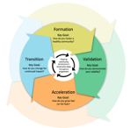
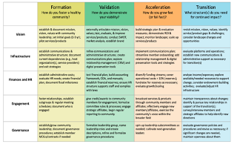

Slide 22
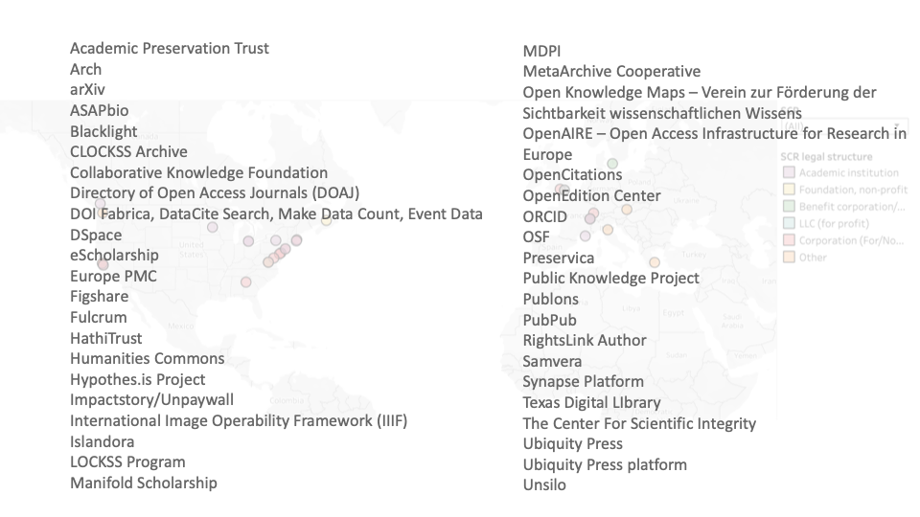

Slide 24
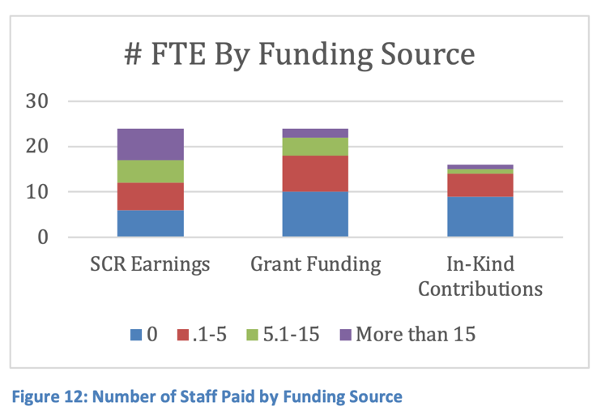

Slide 26
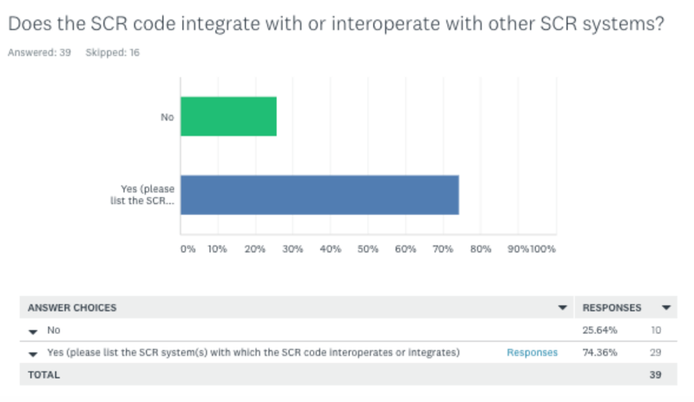

Slide 28
Providers Case Studies

Slide 29
Library Survey

Slide 30
Question:
How much do libraries spend on the infrastructure that supports publication, access, and preservation of scholarship and data?
Notes:
Thanks to Nathan Brown and Brianna Morrow from True Bearing for major help with survey design and implementation, and to Kathleen Shearer from COAR and to CARL for sharing the work that they did in creating a similar survey for Canada.

Slide 31
What counts as an investment?
hosted data platforms
hosted publishing
hosted repository
local data platforms
local publishing
local repository
preservation
consulting services
scholarly communication tools
staffing
other
Notes:
Add lists of tools

Slide 32
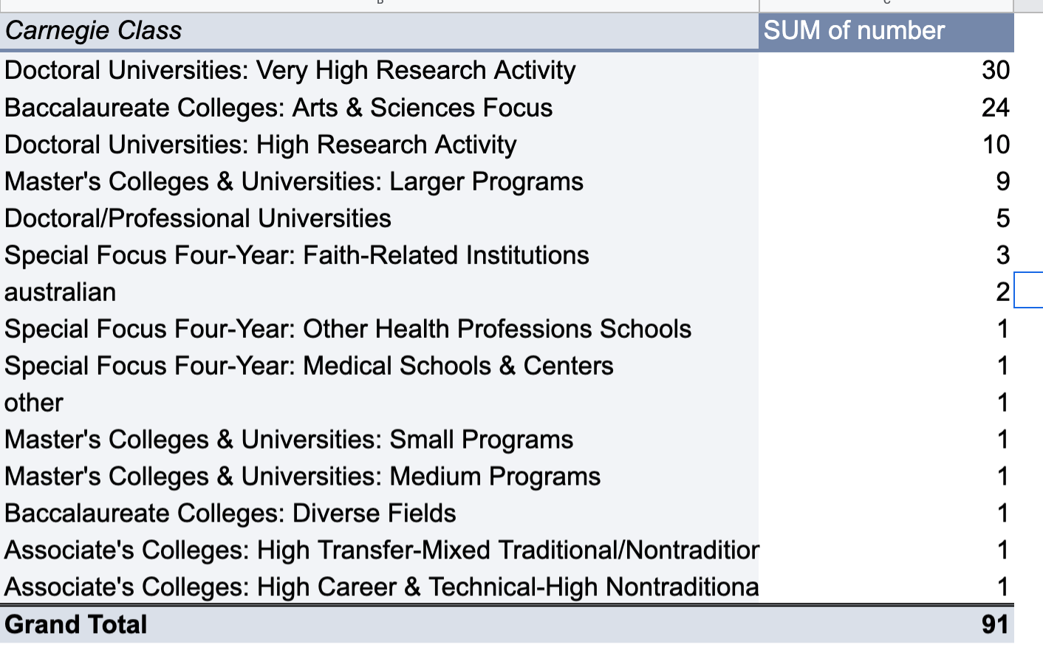
Who answered our survey?
Notes:
Chart of enrollments, Carnegie Class, location, library budgets (w/ and w/o staffing)

Slide 33
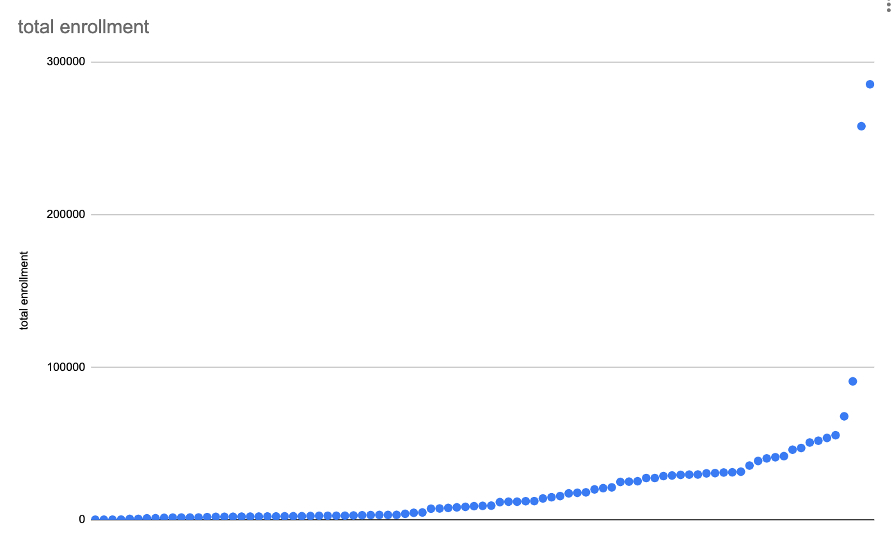
Who answered our survey? Enrollment (avg=22,000)
Notes:
Chart of enrollments, Carnegie Class, location, library budgets (w/ and w/o staffing)

Slide 34
Caveats
Low response rate
Bias towards “fans” of open
Some of the data is incomplete
Contribution from one major unit may skew the results
Reports from respondents were that this data was not easily gathered
Constraining the investor to the library only may skew the result as many schools fund this via multiple areas of the institution (e.g. IT, Provost)

Slide 35
Findings
Total money invested: $14.1 million
Average per library: $150,000
% of library budget (w/ salary): 1.5%
% of library budget (w/o salary): 2.8%
$ per student enrolled: $8
Note: Please do not quote quite yet; these data are still being validated !
Notes:
How staff costs are distributed across various responsibilities
How investment varied by Carnegie class
How investment varied by size of institution

Slide 36
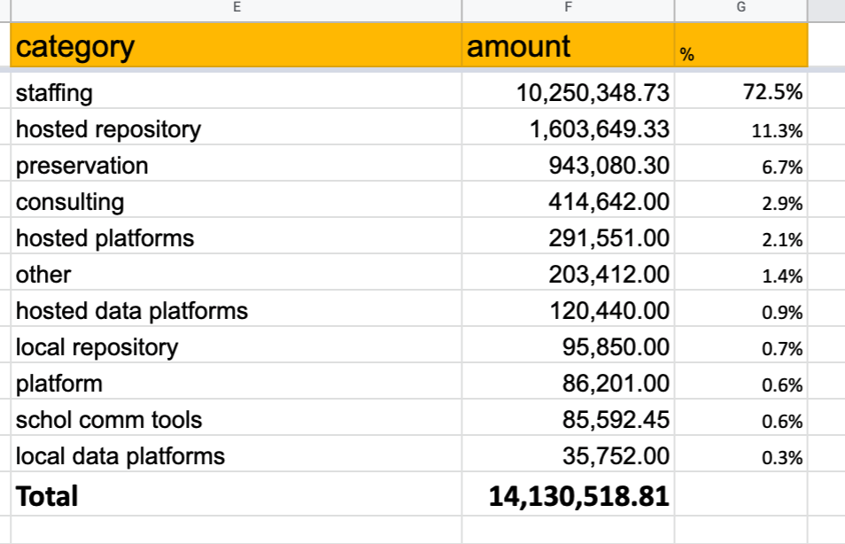
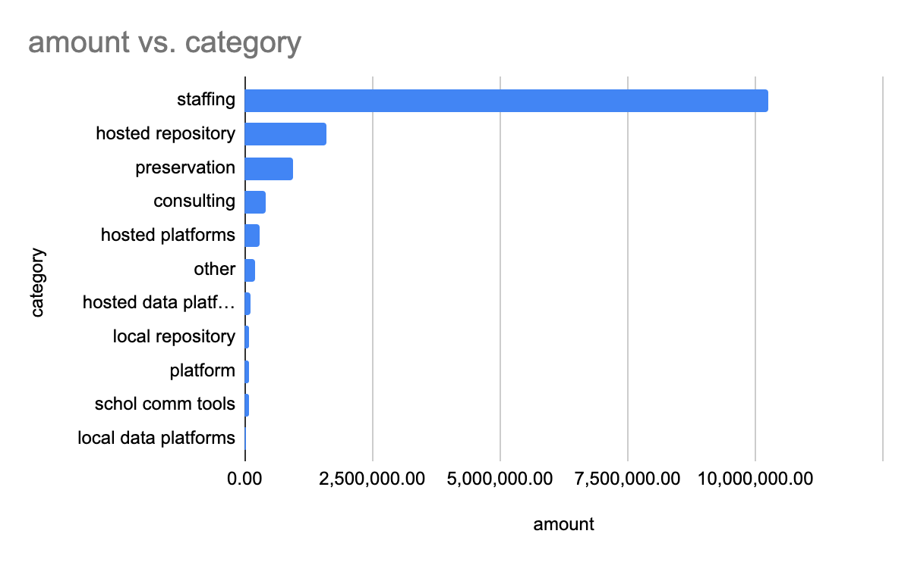
Investment by Category

Slide 37
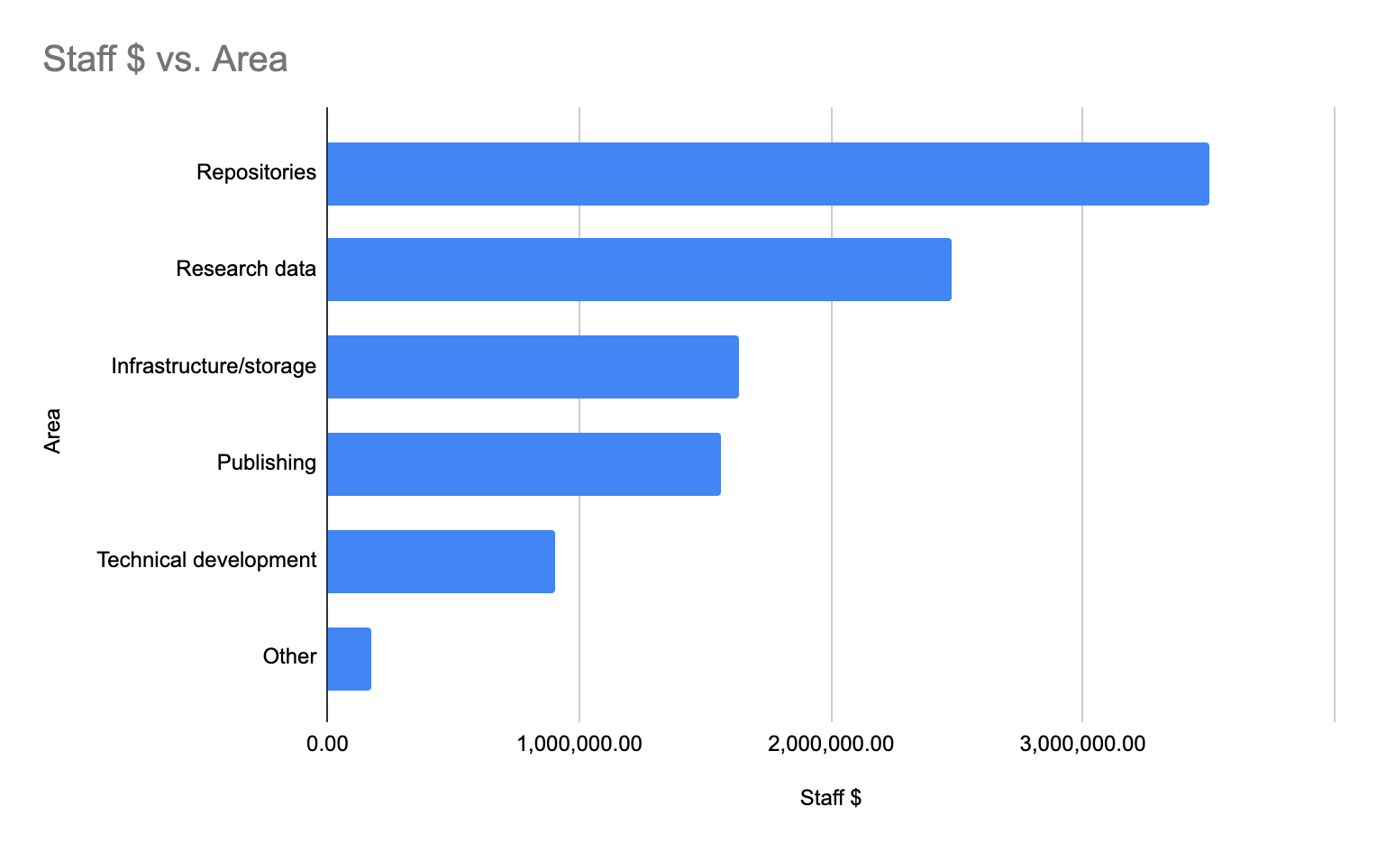

Slide 38
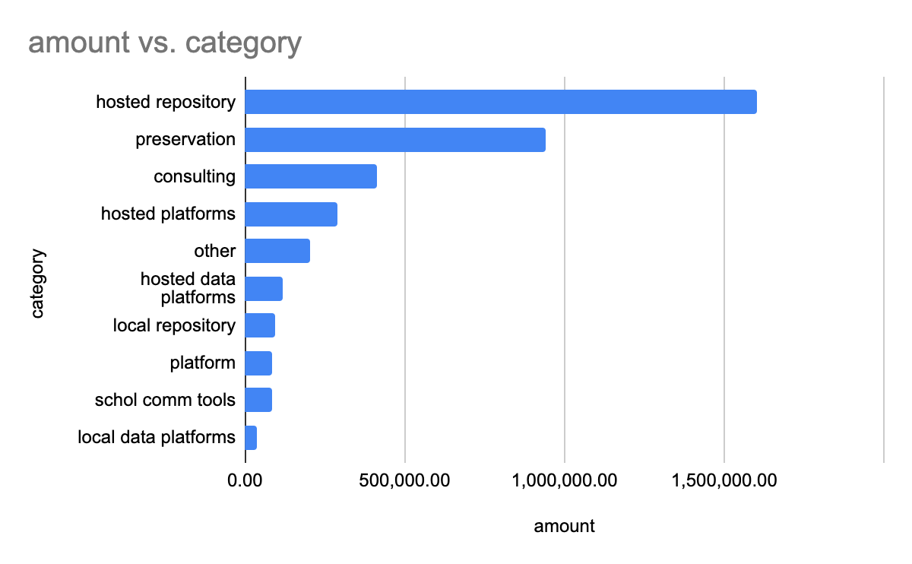

Slide 39
Next Steps
Share results with survey respondents
Write up results to share with broader community
Decide whether or not to run survey again and if so, how frequently under the auspices of what organization
Connect this with the other inputs of our broader project (census, focus groups, case studies, lit review) to draw broader conclusions about the current state of affairs in this area

Slide 40
Library Focus Groups

Slide 41
Focus Groups
The focus groups were held at:
ALA Annual meeting on June 24, 2019 — 2 sessions 7 participants
ARL meeting in Washington, D.C. on September 25, 2020 — 2 sessions 12 participants
CNI meeting in Washington, D.C on December 9, 2019 2 sessions 12 participants
Virtual sessions on February 19, 21 and 28, 2020 — 10 participants
Participants — Total 41 — 10 from liberal arts colleges, 7 from mid-sized universities, 23 from research universities, and one from an organization serving academic libraries

Slide 42
Amount of investment:
Wide range of investment in infrastructure
Many participants had difficulty providing a number
Need for a standard methodology
How to account for staff was often difficult
Several had worked to complete the earlier “2.5%” survey and had found it time consuming
Several participants said that 2.5% was insufficient and a larger portion of the library budget needed to be allocated to open initiatives

Slide 43
What Drives the Investment Decision?
Want to be part of the community
Open and Non-Profit preferred. Open exchange (in and out easily based on standards) more important than on whether or not the platform is for-profit. There were however many concerns about open and non-profit projects
Keep up with the Jones What peers are doing often drives decisions by directors
Or Not… Needed more than simply “virtue signaling”
Value of groups. Consortiums are important, especially for smaller institutions. The group provides cushion
Seat of the pants

Slide 44
What Matters When Choosing Tools
Functions matter more than tools
Ownership of content
Privacy
Balancing staffing and out of pocket cost
In-house expertise versus vulnerability with commercial products
Exit strategy

Slide 45
Community’s Ability to Create and Maintain Projects
The library community does not have the capacity to develop and maintain effective solutions
Decision making processes are time consuming
The overhead of library collaborations, especially the engagement of library leadership is difficult to maintain
Too much emphasis on consensus and being too inclusive
Library community often creates multiple solutions to a problem. This spreads limited resources thin
There is often not sufficient transparency for projects, especially on non-technical aspects such as governance and finances

Slide 46
Frustration with How Open Projects are Funded
Current membership models are frustrating — membership fatigue
Projects start off as an ad hoc, grants or coalitions of the willing, but then inevitably revert to a membership model and pleas to join
It was noted that many projects are being carried by a single institution. This means that the project is dependent on the support of one institution or a single individual. This is a dangerous vulnerability
The inability to plan on a broad system-wide basis has meant that it is difficult to judge the importance of different investments that would lift the field as a whole

Slide 47
Questions and Comments
Project website: https://educopia.org/mapping-scholarly-communications-infrastructure/

