Slide 1
IDCC 2020 • Dublin, Ireland • February 17-20, 2020
Identifying Opportunities for Collective Curation During Archaeological Excavations
Ixchel M. Faniel, PhD
Senior Research Scientist
fanieli@oclc.org
@imfaniel

Slide 2
https://alexandriaarchive.org/secret-life-of-data/
Acknowledgements
Study
Part of the NEH-funded Secret Life of Data (SLO-data) project (grant #PR-234235-16)
Co-authors
Anne Austin, Sarah Whitcher Kansa, Eric Kansa, Jennifer Jacobs, Phoebe France
Additional SLO-data Personnel
Partner: Ran Boytner, Institute for Field Research
Consultant: Elizabeth Yakel, University of Michigan

Slide 3
Archaeological Excavations: Key personnel
Manage and document excavation areas as material culture unearthed
Specialists
Analyze and document aspects of material culture
Conservators
Trench Supervisors
Data Managers
Students and Community Members
Project Director
Stabilize and preserve materials
Catalogue finds
Manage incoming data
Excavate and assist

Slide 4
Archaeological Data
Excavation Data
Trench supervisors conduct field excavation
Document excavation procedures and relationships among the materials being excavated
Specialist Data
Specialists analyze the materials
Create data and draw conclusions integral to interpretation of the archaeological site
Notes:
Image: Public domain (no attribution) via https://pixabay.com/vectors/computer-data-database-diagram-1294359/

Slide 5
Research Motivation
Researchers face challenges moving from idiosyncratic to collective data practices (Edwards et al., 2011; Akmon et al., 2011;
Darch et al., 2015, Mayernik 2015)
Researchers not satisfied with their data curation activities
(Johnston et al., 2018)
Archaeology community wants training in open, FAIR data
(Geser 2019)

Slide 6
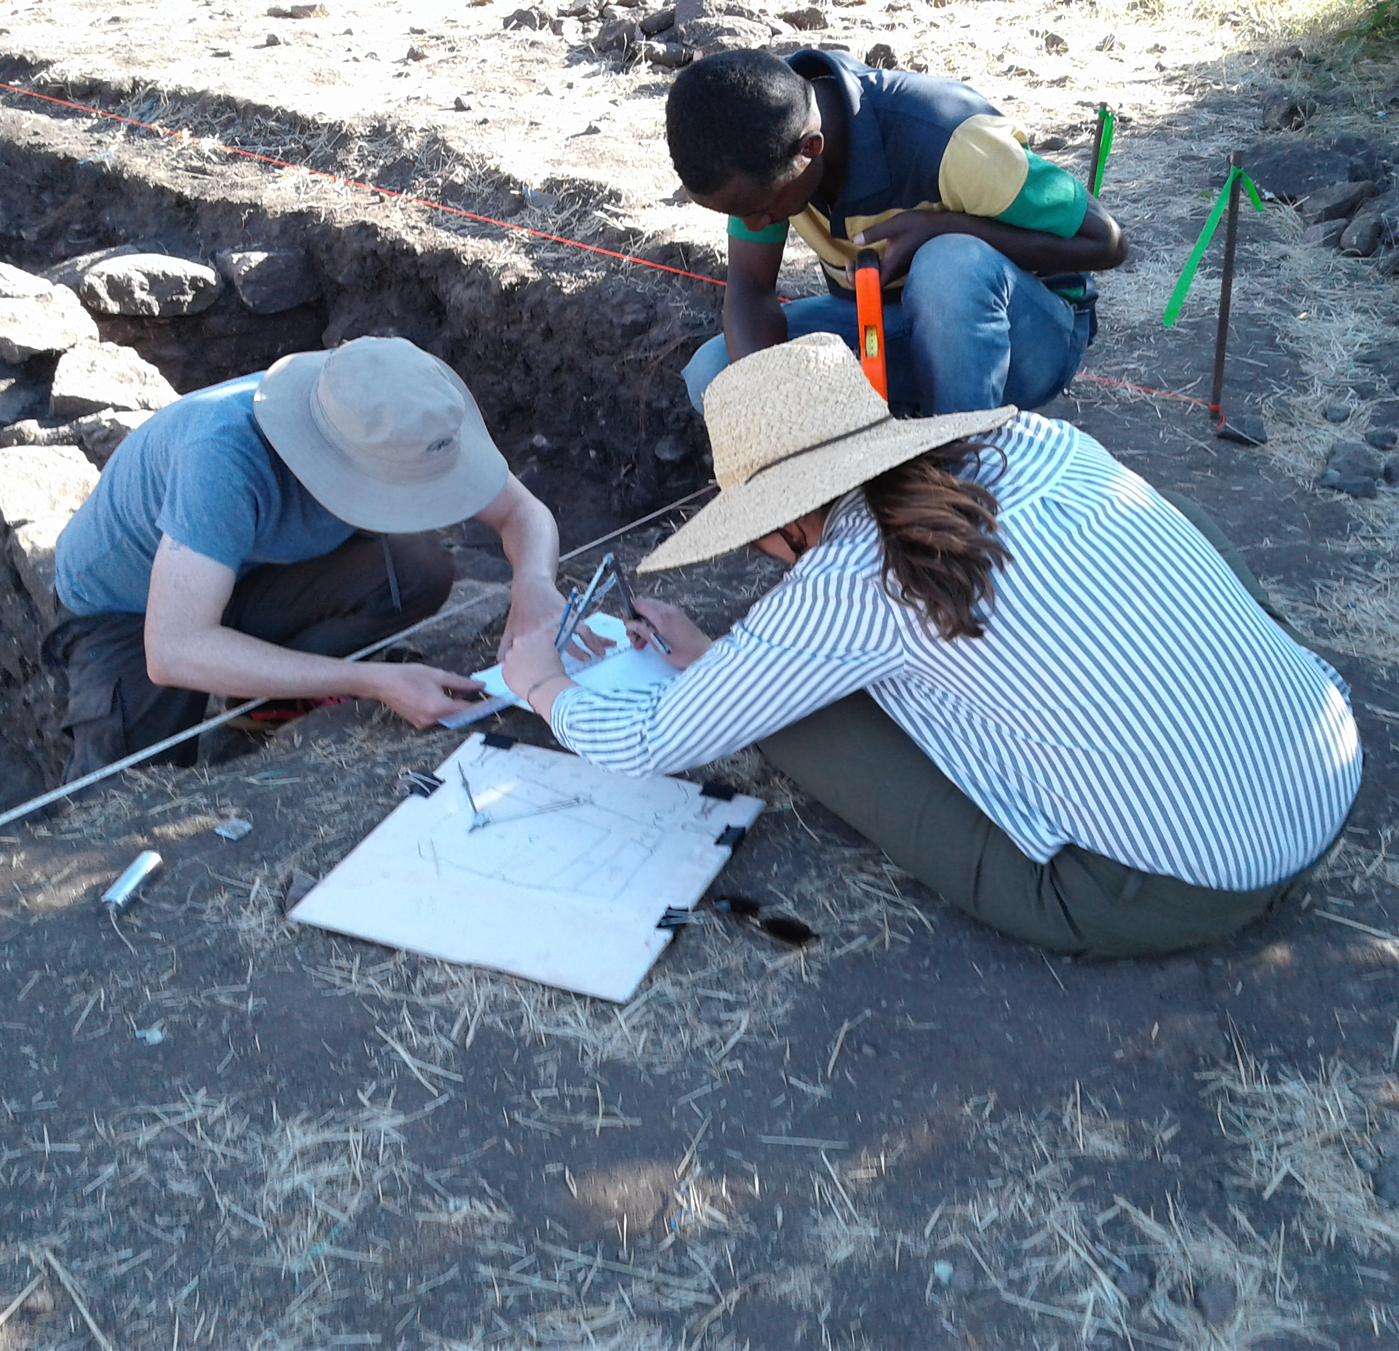
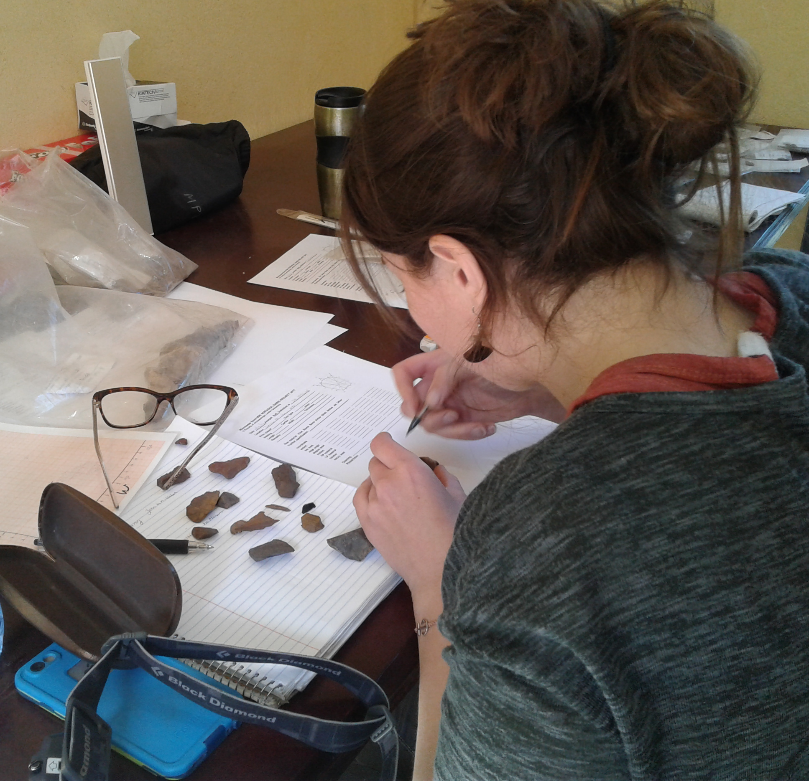
Research Questions
How are specialist data being integrated with excavation data during archaeological excavation projects?
What opportunities for collective curation might improve the integration of specialist data with excavation data?
Notes:
Images taken by project staff

Slide 7
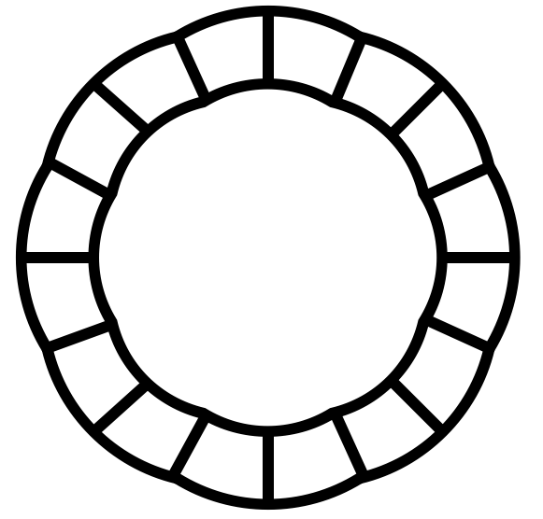
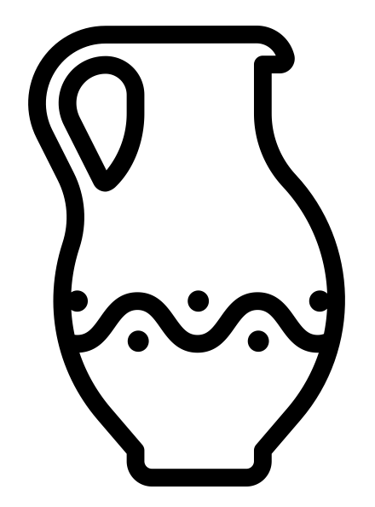
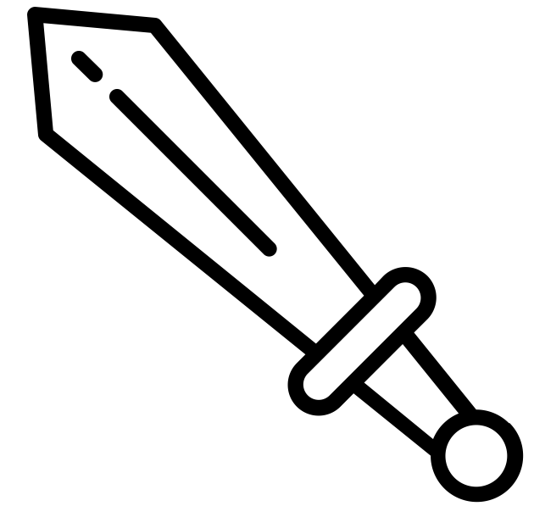
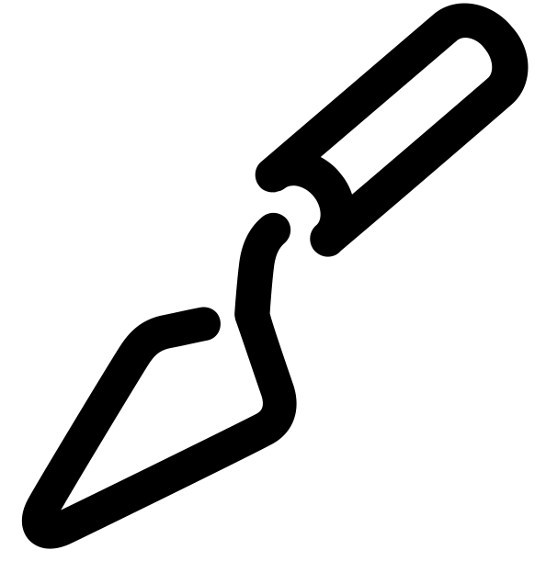
Research Sites
Four archaeological excavation sites
Span three continents
Use digital and paper recording
Represent more than 10 specialist areas
Represent new and long-standing excavations
Image attribution: Dead Fish by iconsmind.com from the Noun Project; Trowel by stefano corradetti from the Noun Project; jug by Laymik from the Noun Project; Swords by Zee Lbs from the Noun Project; Badge by Montu Yadav from the Noun Project
Notes:
Continents image: Public domain (no attribution required) via https://pixabay.com/illustrations/social-media-icon-continents-globe-2210580/
Computer image: Public domain (no attribution required) via https://pixabay.com/vectors/computer-data-database-diagram-1294359/
Paper image: Public domain (no attribution required) via https://pixabay.com/vectors/computer-data-database-diagram-1294359/
Dead Fish by iconsmind.com from the Noun Project
Trowel by stefano corradetti from the Noun Project
jug by Laymik from the Noun Project
Swords by Zee Lbs from the Noun Project
Badge by Montu Yadav from the Noun Project

Slide 8
Research Methodology
Year 1 Data Collection
Year 1 Data Analysis
Year 1 Findings and Recommendations
Year 2 Data Collection
Year 2 Data Analysis
Year 2 Findings and Recommendations

Slide 9
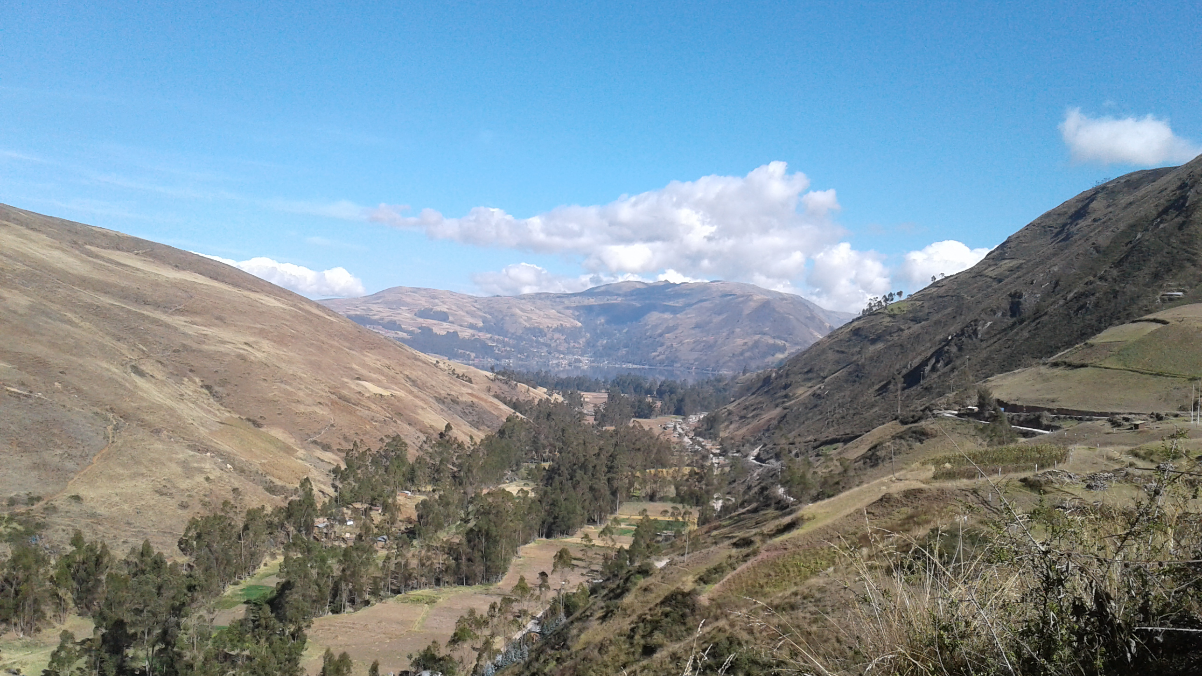
The Americas Project
Notes:
Image taken by project staff

Slide 10
Having specialist trench supervisors did not ease data integration.
“So whatever, you know, special data [one trench supervisor] may have people collecting for what she's sampling out or what [another trench supervisor] may be taking...I still have kind of the way we’ve been doing it so that the information that we're taking now can be comparable with at least other chunk of material that's been collected over the last 10 years.”
- Project director, Americas project
Collective curation must start at the point of data creation.

Slide 11
Recommendations
Develop clearly written documentation guidelines for trench teams
Appoint bilingual supervisor to evaluate and supervise field work
Develop a written specialist agreement
ACCEPTED
AND
IMPLEMENTED

Slide 12
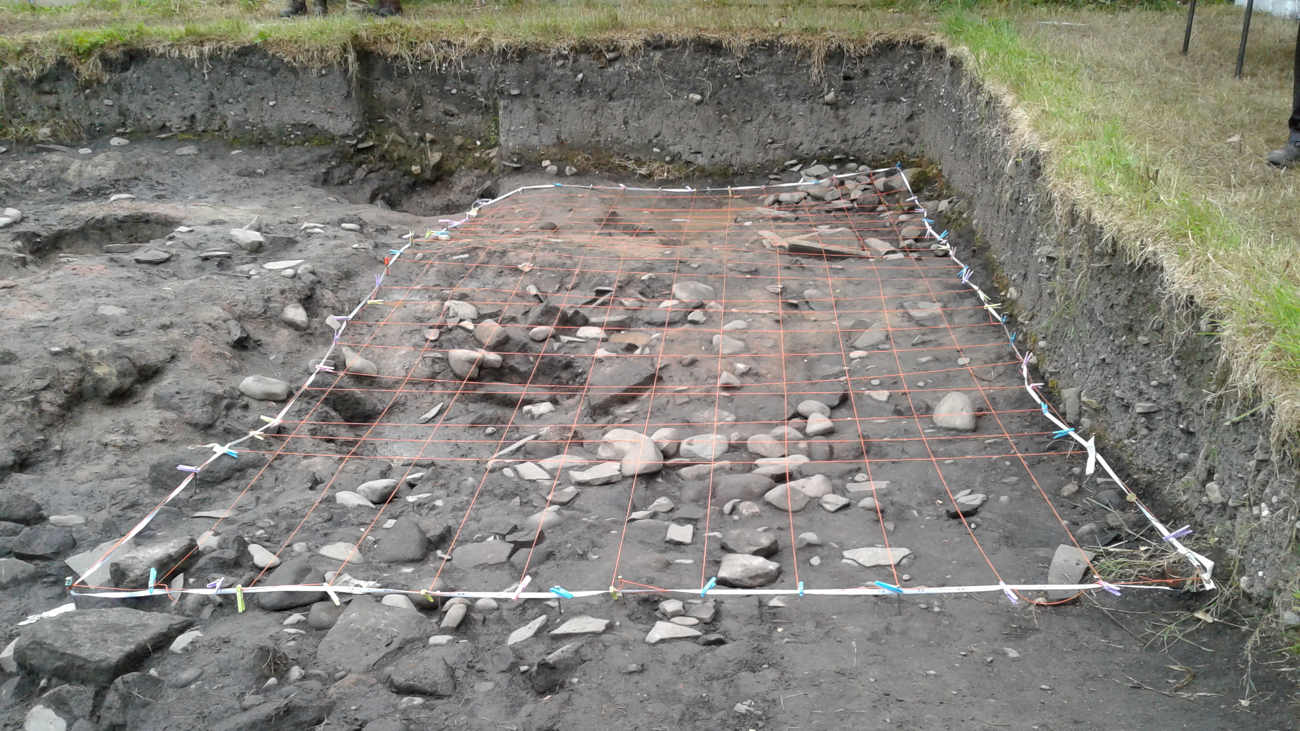
Europe Project 1
Notes:
Image taken by project staff

Slide 13
Limited project director-specialist communication about data exchange.
“But as far as I know, there is no convention set for…how reports are produced and what format they're produced in…Different specialists use so many different things.”
“So, it might just be that some of the specialist information doesn't get into the database, it just remains as a report that's there as part of the project [paper] archive.”
- Archaeobotanist,
Europe project 1
- Co-director,
Europe project 1
Collective curation requires negotiation of needs and expectations.

Slide 14
Recommendations
Track progress of specialist analysis and incorporate into annual reporting
Develop a specialist agreement
Train specialists in database structure and determine how to best integrate their data
Train project director and data manager in options to integrate different data formats
ACCEPTED
BUT
POSTPONED
REJECTED

Slide 15
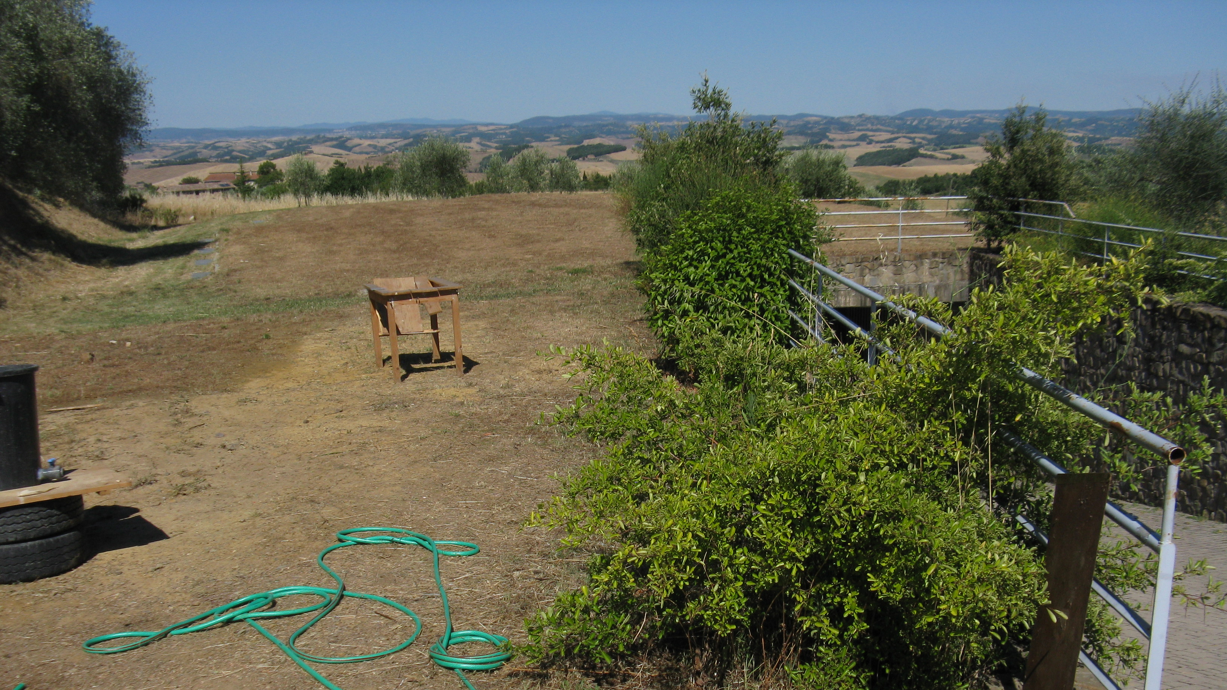
Europe Project 2
Notes:
Image taken by project staff

Slide 16
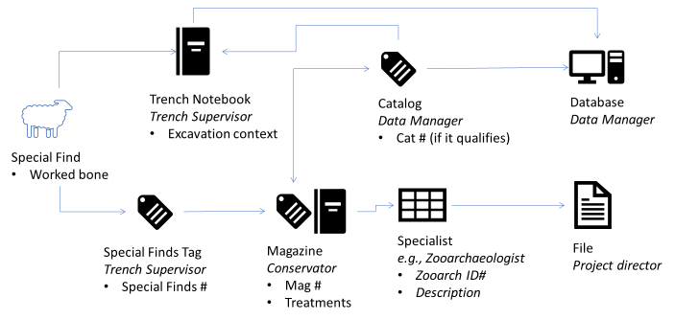
Specialists were not part of the project’s data workflow.
Specialist data siloed
Collective curation requires redesigned workflows that eliminate silos.

Slide 17
Recommendations
Develop a written specialist agreement
Train project director and data manager in options for integrating different data formats
ACCEPTED
AND
IMPLEMENTED

Slide 18
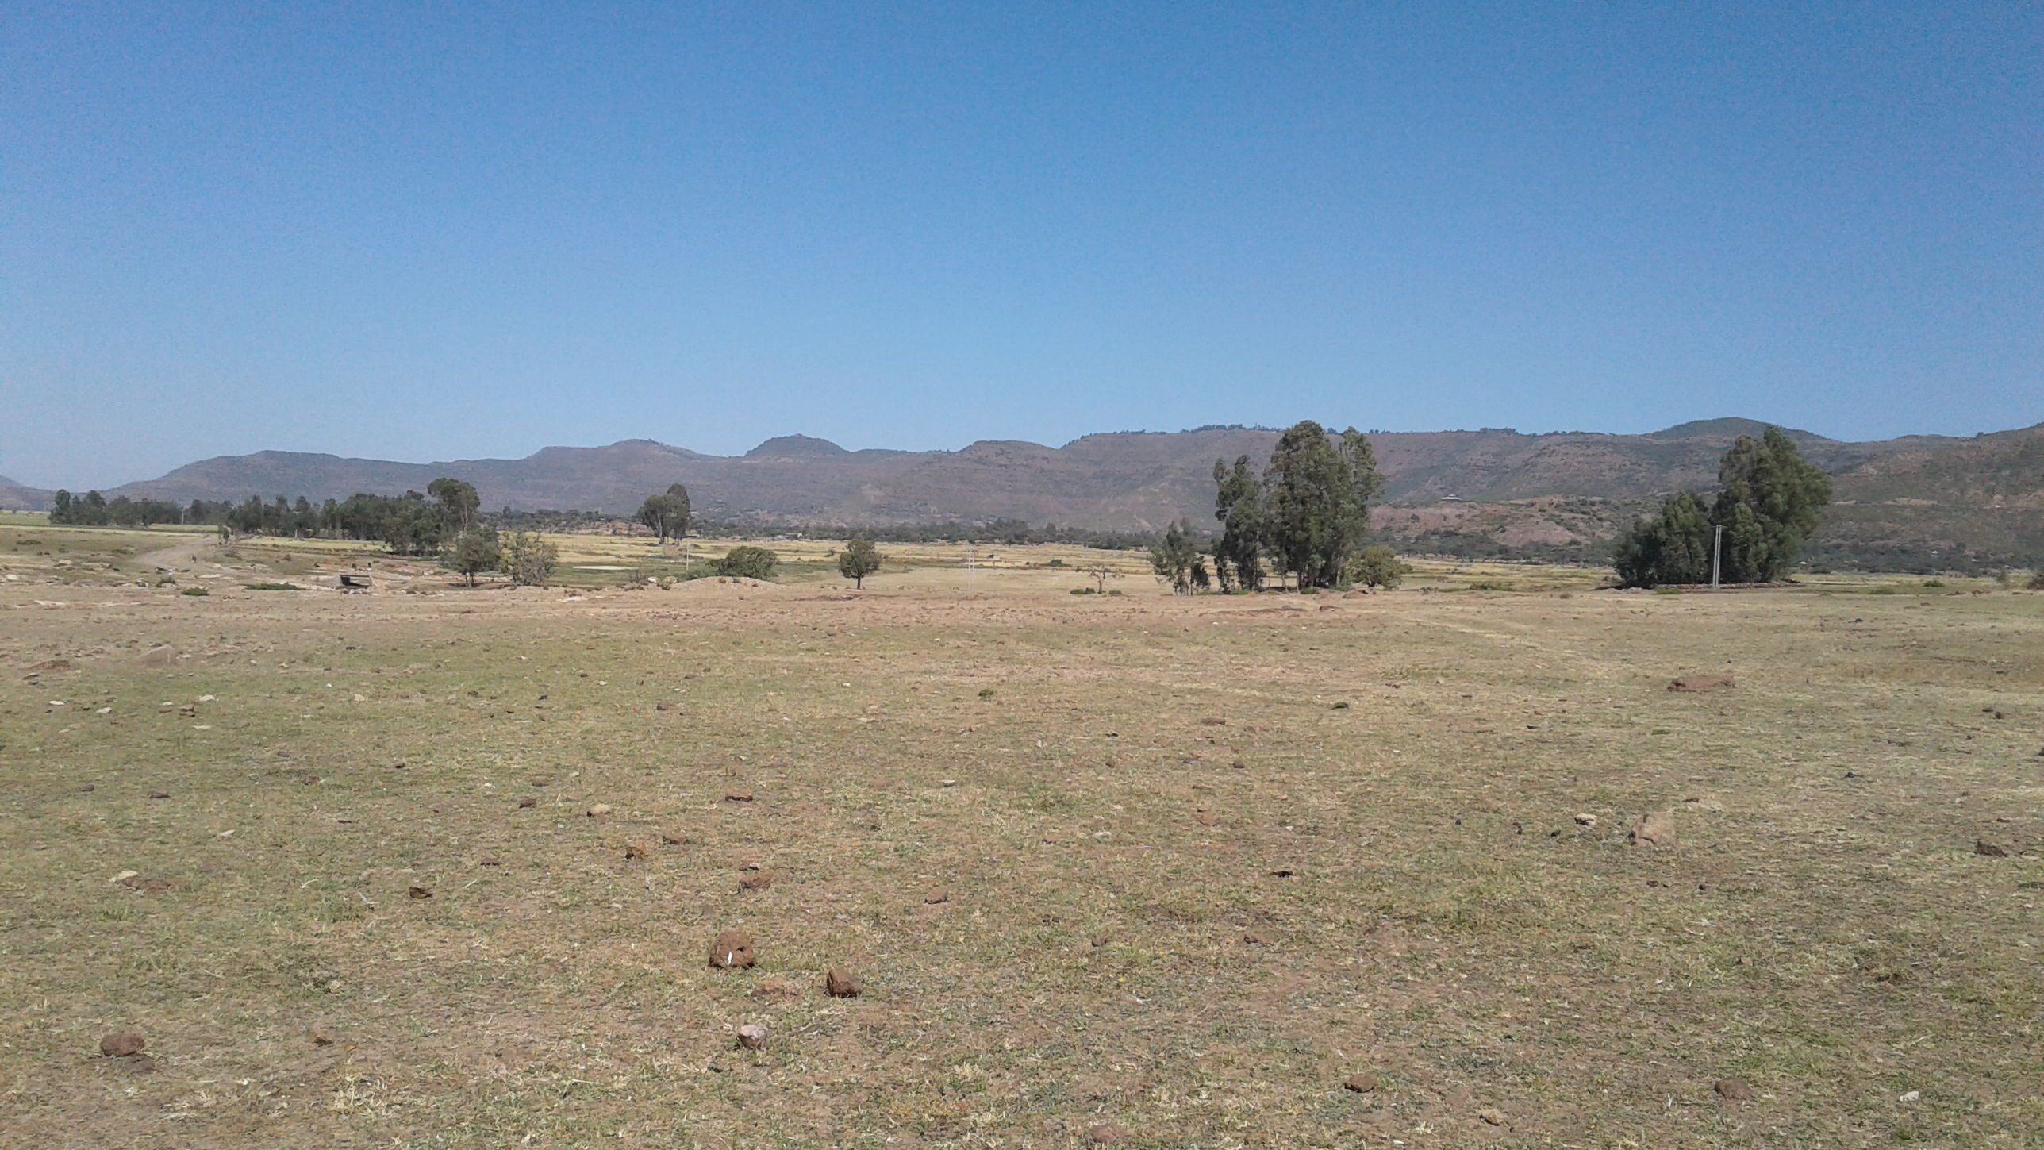
The Africa Project
Notes:
Image taken by project staff

Slide 19
Specialist-trench supervisor discussions fuel intellectual data integration.
“So there are a lot of these amorphous highs across the site...If one of the excavators was able to say, ‘Absolutely. I see that this amorphous whatever in my trench actually corresponds to this thermal feature or a concentration of metal,’…we could take that signature and look in areas that haven't been… excavated…So I had hoped for that, but it hasn't happened.”
- Geophysicist, Africa project
Collective curation needs intellectual as well as digital data integration.

Slide 20
Recommendations
ACCEPTED
AND
IMPLEMENTED
Develop written specialist agreement
Restructure daily meetings to accommodate discussions about current field season’s excavations among trench supervisors and specialists
ACCEPTED
BUT
POSTPONED

Slide 21
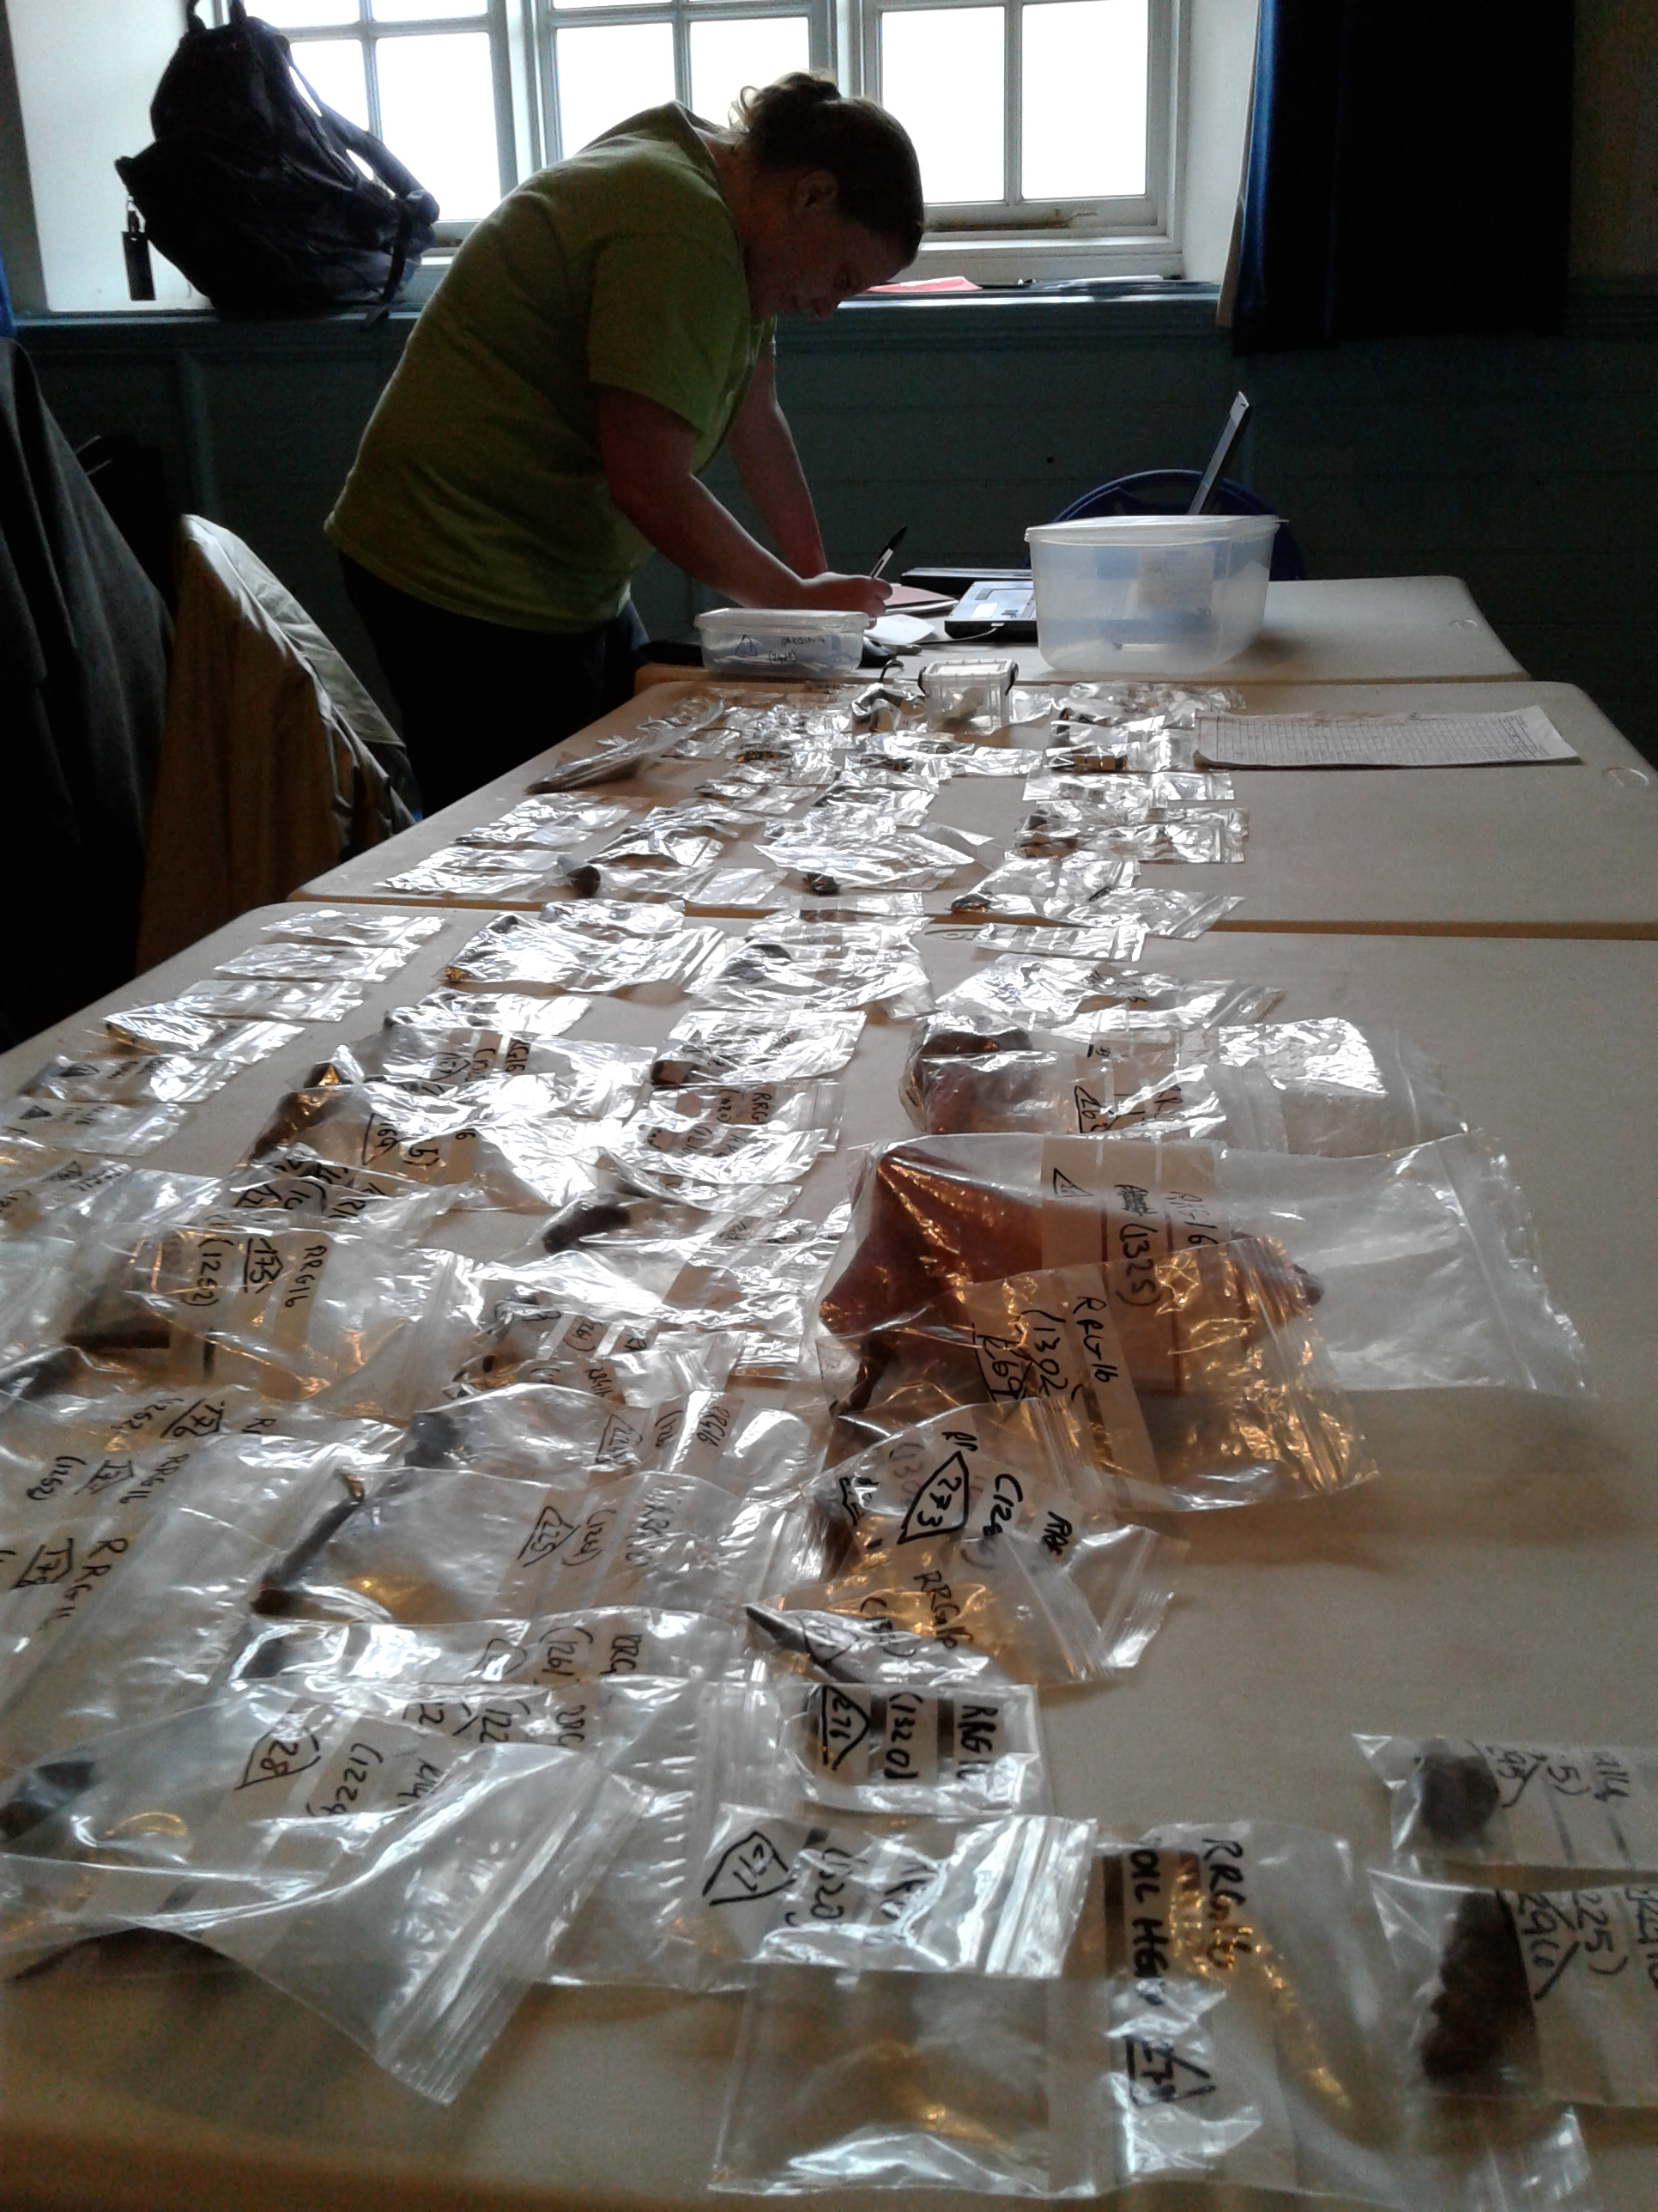
Implications for collective curation
Encourage collective development of documentation guidelines
Require DMPs to explicitly address integration of the different data created within a team
Use data agreements to open conversations about integrating data in team-based settings
Support intellectual as well as digital data integration
Notes:
Image taken by project staff

Slide 22
References
Akmon, D., Zimmerman, A., Daniels, M., & Hedstrom, M. (2011). The application of archival concepts to a data-intensive environment: Working with scientists to understand data management and preservation needs. Archival Science, 11(3-4), 329-348. Retrieved from https://doi.org/10.1007/s10502-011-9151-4
Darch, P. T., Borgman, C. L., Traweek, S., Cummings, R. L., Wallis, J. C., & Sands, A. E. (2015). What lies beneath?: Knowledge infrastructures in the subseafloor biosphere and beyond. International Journal on Digital Libraries, 16(1), 61-77. Retrieved from https://doi.org/10.1007/s00799-015-0137-3
Edwards, P. N., Mayernik, M. S., Batcheller, A. L., Bowker, G. C., & Borgman, C. L. (2011). Science friction: Data, metadata, and collaboration. Social Studies of Science, 41(5), 667–690. https://doi.org/10.1177/0306312711413314
Geser, G. (2019). Key results of the ARIADNEplus 2019 community needs survey. ARIADNEplus. Available online: https://ariadne-infrastructure.eu/wp-content/uploads/2019/11/ARIADNEplus-Survey-2019-Summary.pdf

Slide 23
References
Johnston, L., Carlson, J., Hudson-Vitale, C., Imker, H., Kozlowski, W., Olendorf, R., & Stewart, C. (2018). How important are data curation activities to researchers? Gaps and opportunities for academic libraries. Journal of Librarianship and Scholarly Communication, 6(1), eP2198. https://doi.org/10.7710/2162-3309.2198
Mayernik, M. S. (2015). Research data and metadata curation as institutional issues. Journal of the Association for Information Science and Technology, 67(4), 973-993. Retrieved from https://doi.org/10.1002/asi.23425
All photographs taken by project team members

Slide 24
Thank you
Ixchel M. Faniel, PhD
Senior Research Scientist
fanieli@oclc.org
@imfaniel

