Slide 1
The OCLC Research Library Partnership provides a unique transnational
collaborative network of peers to address common issues as well
as the opportunity to engage directly with OCLC Research
Thank you for underwriting and participating in our programs
oc.lc/rlp
Find recordings of our webinars and future offerings at oc.lc/wipwebinars
Sign up for news via OCLC RLP Announce at
oc.lc/rlp-announce
Notes:
Hello and welcome. I’m Merrilee Proffitt, Senior Manager for the OCLC Research Library Partnership, OCLC Research. Thank you for joining us today’s webinar Re-envisioning the Fabric of the Bibliographic Universe
This is a special Works in Progress Webinar that we are recording in May 2020 to support subsequent discussions. We are doing this in support of the OCLC Research Library Partnership, a transnational network of research libraries. We offer extensive professional development opportunities, most offered virtually, enabling active, international participation, without travel.
I want to acknowledge the OCLC RLP which both underwrites and inspires our work. Thank you for your continued support and input into our work – these are crucial to our success.

Slide 2
May 2020
Re-envisioning the Fabric of the Bibliographic Universe*
Notes:
Title: credit to Kalen Knudson Davis (University of Minnesota) – used in her blog post!
Making knowledge more connected and discoverable online has been the expectation driving linked data efforts for several years. We are finally seeing practical applications surfacing from which libraries can now benefit. Moving from a traditional records-based approach to resource description to representation of a dreamed-for knowledge graph, what have been the challenges encountered so far?
In this session, we will explore the experiences of national and research libraries in linked data exploration, looking at milestones over time. We’ll look at the journey that OCLC and others have been on, transitioning from entity-based description research, to prototyping and now to actual practices, covering work that has been undertaken with library partners right up to the present day. With the generous support of The Andrew W. Mellon Foundation, OCLC recently announced the development of a shared “Entity Management Infrastructure.” OCLC is inviting libraries who are interested in participating in this effort to join us. The promise of an ecosystem is poised to become reality in 24 months when, the infrastructure will become available—jointly curated by the community and OCLC—making scholarly materials easier to find and use.

Slide 3
18,000
member libraries worldwide who elect
48
delegates to Global Council, who elect
6
members of the 15-member
OCLC Board of Trustees
Notes:
The founders of OCLC created the concept of a Global Council and made it part of the governance structure to ensure that they heard directly from the members and to have a way of considering new ideas, initiatives, and participation.
So, the OCLC cooperative is member-governed. Its 18,000 member libraries worldwide elect 48 member representatives – delegates – to OCLC's Global Council, who in turn elect six members of the 15-member OCLC Board of Trustees.
[Notes current as of 3/26/20]

Slide 4
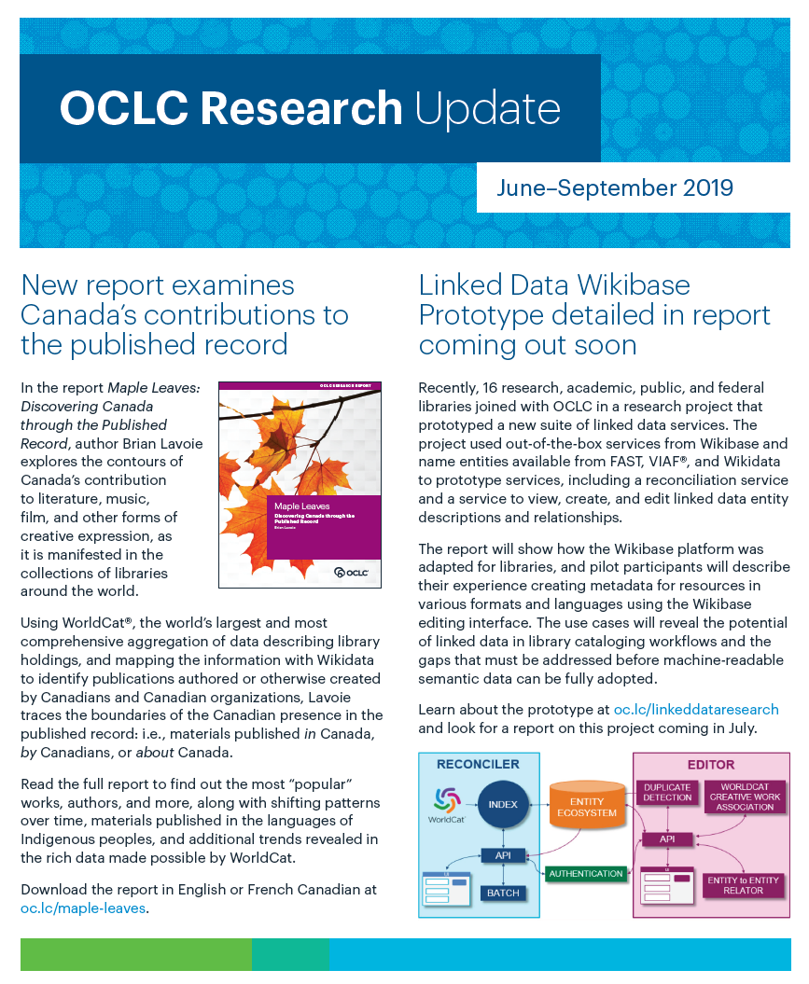
OCLC Research
Scale and accelerate library learning, innovation, and collaboration.
Notes:
Current version of flyer: https://www.oclc.org/content/dam/research/publications/2019/research-update-june-sept-19.pdf

Slide 5
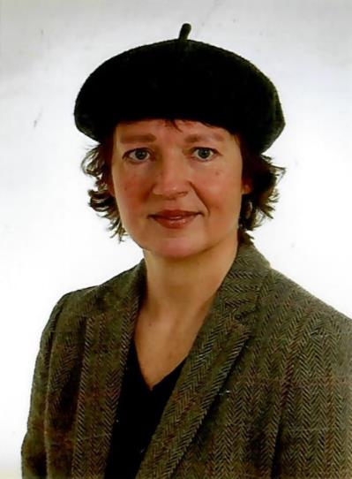
OCLC Research presenters
Annette Dortmund
Karen Smith-Yoshimura
Notes:
I am thrilled to welcome our presenters Annette Dortmund and Karen Smith Yoshimura we will explore the experiences of national and research libraries in linked data exploration, looking at milestones over time. We’ll look at the journey that OCLC and others have been on, transitioning from entity-based description research to prototyping and now to actual practices
And now I will turn things over to Annette who will kick things off for us!

Slide 6
Metadata landscape and library experiences
Notes:
Thank you, Merrilee. I am going to talk about the experiences libraries are making when trying to work with new platforms, such as Wikidata.
So first, let us look a little bit at the background for these developments, the current metadata landscape.

Slide 7
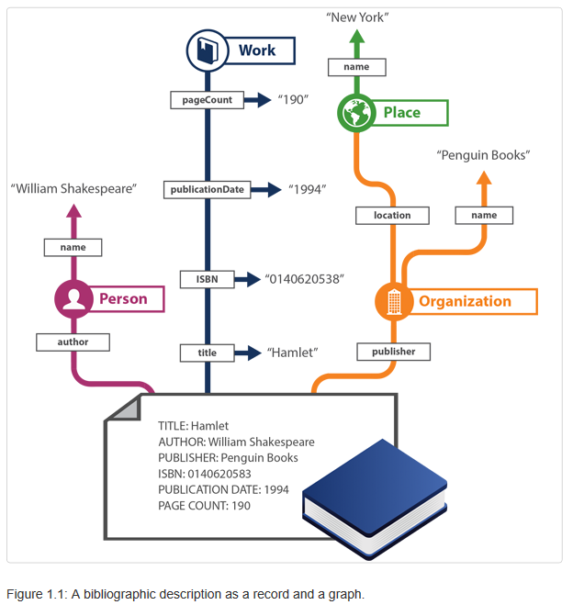
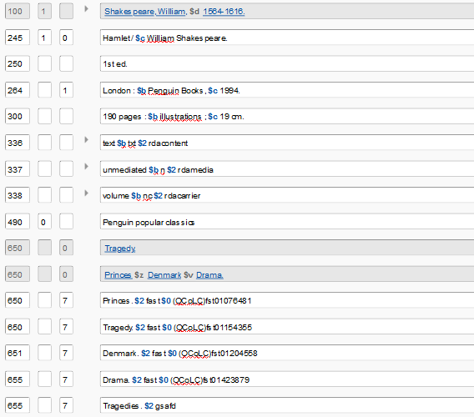
Library Linked Data
MARC screenshot above extracted from OCLC WorldCat.
Figure on the right from: Carol Jean Godby, Shenghui Wang, and Jeffrey K Mixter, Library Linked Data in the Cloud: OCLC’s Experiments with New Models of Resource Description (San Rafael: Morgan & Claypool, 2015), https://www.oclc.org/research/publications/books/library-linked-data-in-the-cloud/contents.html.
Notes:
For decades, libraries have created and shared bibliographic descriptions using the Machine-Readable Cataloging (MARC) format. Hundreds of millions of MARC records are now available in online catalogs that show what libraries hold and make accessible to their patrons. MARC records – and records in other, similar library-community standards - also power key library activities such as resource sharing and collection development. But, because these standards were developed about 50 years ago, MARC records can be understood only by library systems and are generally incomprehensible to data consumers elsewhere.
Since about 2008, standards experts in the library community have looked to linked data as potentially transformative for the bibliographic universe.
In a linked data world, descriptions will make use of information in so-called knowledge graphs, featuring descriptions of the persons, places, or things of interest—commonly known as “entities”—that are connected to other entities via machine-understandable relationships – and persistent identifiers.
This transition from human-readable records to knowledge graphs really represents a paradigm shift.
Knowledge graphs have the potential to replace or at least connect the many data silos that libraries use, and to make library data comprehensible to data consumers outside the library world.

Slide 8
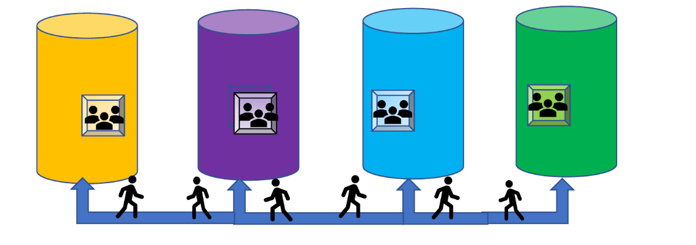
Moving between the Silos
Research
Information
Library Catalog
Archives
Digital Collections
Notes:
Research libraries, for example, create and maintain metadata for research datasets, digital collections, and archives in different systems, with a wide variety of standards and terminologies, resulting in “silos of data” each with its own content descriptions and practices and managed by different staff on various systems that do not share data, and do not easily interoperate with each other. In the example on the slide, only the library catalog will likely use a MARC format, or an international equivalent.
Libraries engaged in special and digital collections management need more flexible approaches to what used to be authority management, to better serve the rare and unique collections in their care and the researchers interested in them. Linked data offers the possibility to better model and reveal relationships and networks of collaboration and influence represented within and across these collections.
Bibliographic information for research assessment purposes is often collected in systems specifically designed for Research Information Management, in dedicated RIM systems, also called CRISs in Europe, or in repositories. Libraries are often heavily involved in this activity, but the systems in use are rarely interoperable with traditional library systems, workflows, or standards. To populate them, sources such as Scopus, Web of Science, Google Scholar, and Crossref are harvested at scale. Identifiers play a crucial role in this; the ORCID iD in particular is becoming a de facto standard researcher identifier in the scholarly communications ecosystem. Linked data offers the possibility to make use of these identifiers for the creation of a knowledge graph describing relationships within the scholarly communications landscape and beyond.
Entity management in a linked data environment could help bridge all these silos.
As a participans in a recent OCLC Linked Data prototype phrased it: “We need a shared community practice that isn’t as restrictive [as MARC] and gives us more flexibility in what we can say about the entities and resources we’re interested in.” (https://www.oclc.org/en/member-stories/ld-prototype.html)

Slide 9
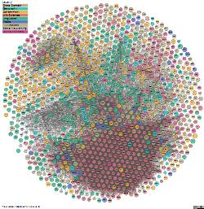
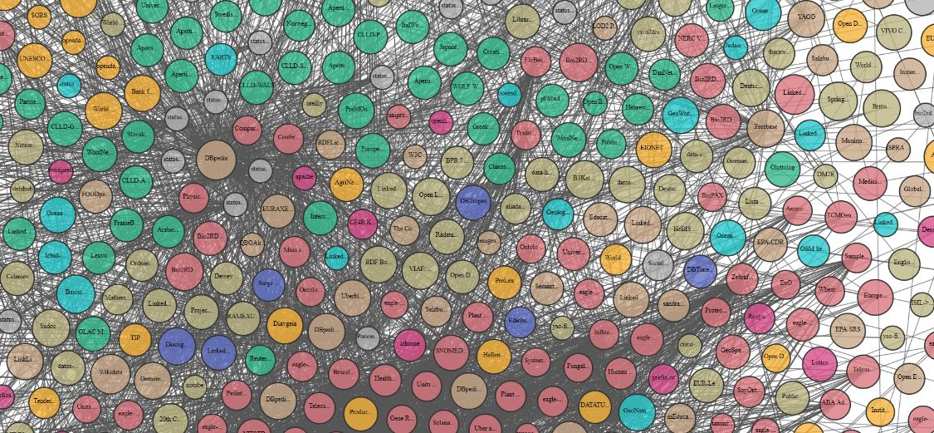
Bridging the Domains
From lod-cloud.net
Notes:
What you see here is the center of the LOD cloud diagram, hosted on the site mentioned above. The image in the upper right hand corner shows the full cloud, the larger image its central part. The LOD cloud shows datasets that have been published in the Linked Data format. The most recent version contains 1,239 datasets with 16,147 links (as of March 2019 – still the latest version in April 2020).
The lines connecting the circles are the links between the identifiers in the different datasets. These links build bridges across those datasets, and bridges across different domains. Identifiers have also been called the “glue” in this context [for the Semantic Web].
The number of linked data sources published by the library community with the express purpose to become part of this cloud has increased over the years—national libraries released their catalogues as LD, and identifier hubs such as the Library of Congress’ id.loc.gov and OCLC’s Virtual International Authority File (VIAF) were made available as LD. Two datasets that we’ve pointed out here on the slidesby the yellow arrows are the Virtual International Authority File (VIAF) on the right, and Wikidata on the left, both pretty close to the center of the cloud. By contributing to or re-using identifiers from one or both of those “identity hubs”, library data can become a part of these bridges across different domains.
In this context, libraries have begun to engage actively on Wikidata, a trend that could be strongly observed from at least 2018 onwards, be it at EuropeanaTech in Rotterdam in the spring of 2018 or at the Semantic Web in Libraries (SWIB) conference in November 2018.
https://pro.europeana.eu/event/europeanatech-conference-2018
http://swib.org/swib18/

Slide 10
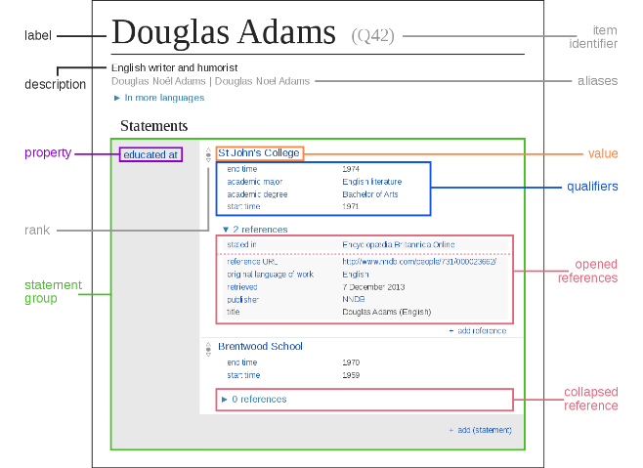
Disambiguating Wiki*
Wikipedia -- a multilingual web-based free-content encyclopedia
Wikidata.org -- a collaboratively edited knowledge base of structured data used by Wikimedia sister projects and others
Data model in Wikidata by Charlie Kritschmar (WMDE) - Own work, CC0, https://commons.wikimedia.org/w/index.php?curid=49616867
Notes:
Before moving on …
Let us first clarify some terminology we are using in this presentation.
First, when talking about the Wiki-universe, we need to distinguish
Wikipedia, a multilingual web-based free-content encyclopedia, that you are probably all familiar with from Wikidata,
launched in 2012, a collaboratively edited knowledge base of structured data used by Wikimedia sister projects and others.
It can also be used any other interested party, human or otherwise.
AND, importantly, Wikidata generates identifiers for every entity described. The identifier for the person Douglas Adams would be (very fittingly) the Q42 in the screenshot above.

Slide 11
Disambiguating Wiki*
Wikipedia -- a multilingual web-based free-content encyclopedia
MediaWiki -- free and open-source wiki software
Wikidata.org -- a collaboratively edited knowledge base of structured data used by Wikimedia sister projects and others
Wikibase -- a MediaWiki extension to store and manage structured data
Notes:
We also need to distinguish these two applications, Wikipedia and Wikidata, from the underlying software. For this presentation, it is important to note that Wikibase is the software that powers Wikidata, but can also be used to setup independent instances of structured data, independent of Wikidata.

Slide 12
Libraries and Wikidata / Wikibase
Notes:
As I said earlier, libraries have begun to engage actively on Wikidata, and have also begun to experiment with independent Wikibase instances.
So let us look at this in some more detail next.

Slide 13
Why Wikidata?
structured, open data with identifiers
native support for multilinguality (interface and item labels)
field-level history of changes
simple, straightforward user interface, hiding complexity
library community Wiki* resources
large Wikibase developer community
shared values
Notes:
Why would libraries use Wikidata?
Wikidata offers important functionality out of the box that libraries have long been missing in their traditional systems. Native support for multilingual interfaces and labels, for example. A field-level history of changes that allow for a high level of quality control and reduces concerns about working in a shared environment.
Wikidata has a comparatively simple, straightforward user interface, that hides a lot of complexity from first sight and just recommends itself to crowd-sourcing or community engagement projects.
And so forth. I could go on for much longer.
Wikidata and Wikibase are also safe options for libraries because of the strong community support they receive.
Library specific training resources and documentation is available, Wikidata is in an early phase of becoming part of the Library Carpentry Curriculum.
The large Wikibase developer community provides a growing set of tools and programs to help query, edit, or visualize the data or enhance the user interface.
Last, but not least, many libraries feel they share values with the Wiki’ community and the Wikimedia foundation – a focus on open knowledge, on operating as a non-profit, and on community governance.

Slide 14
Forms of engagement
Libraries engage by
consuming Wikidata as a linked data source
contributing to Wikidata
working with a separate Wikibase instance implemented locally
combined approaches depending on the data and use cases in question
Notes:
Libraries getting engaged with Wikidata can do so in a number of ways
Libraries may consume Wikidata as a linked data source, or choose to contribute to Wikidata.
Or they may wish to work with a separate Wikibase instance they implement locally.
It all depends on the circumstances, and not least the purpose of their engagement.

Slide 15
Purpose of engagement
enhancements of existing data in library catalogues
richer descriptions of archival or special collections
enhanced visibility of library resources
community engagement, crowd-sourcing
digital humanities projects, …
→ to capture structured data, publish it as linked data, and to connect it to the wider knowledge graph
Notes:
Working with Wikidata can have all kinds of purposes.
Enhancing existing data or descriptions in library catalogues, e.g. with identifiers,
creating richer descriptions of archival or special collections,
enhancing the visibility of library resources,
enabling the community to contribute knowledge and expertise, and so forth.
Ultimately, Wikidata or Wikibase are used to capture structured data in ways and formats not possible within traditional bibliographic or authority workflow,
to create or publish linked data, and – most importantly – to connect library data with a wider knowledge graph via identifiers.

Slide 16
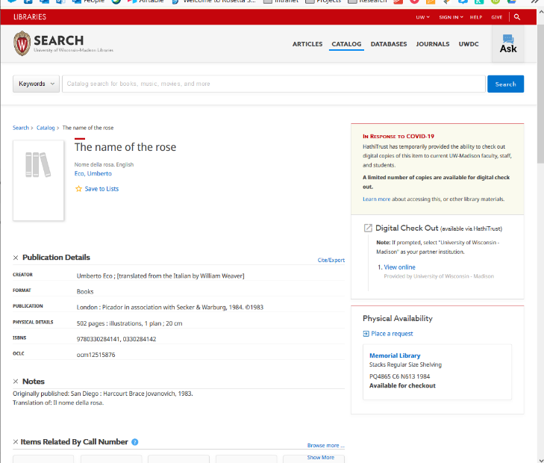
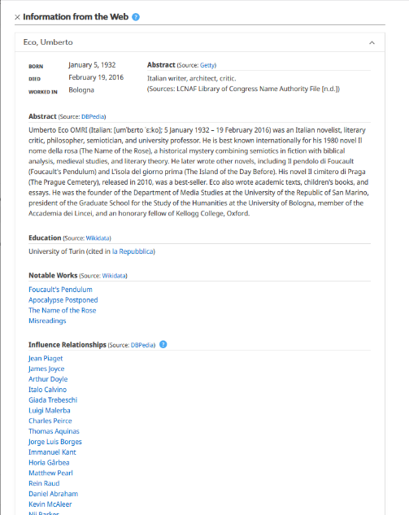
Examples
University of Wisconsin–Madison Libraries
Notes:
So, for example...
The University of Wisconsin–Madison Libraries enrich their catalogue with author identifiers from a number of sources including Wikidata – here a screenshot from Umberto Eco's "name of the rose" on the left, and the section "Information from the Web" from that full record on the right. And you may be able to see that information about Education and Notable Works was pulled in from Wikidata.
As part of this project, the library also registers faculty members in Wikidata, illustrating Wikidata’s role as part of the Research Information Management persistent identifier graph.

Slide 17
Examples
National Library of Sweden
upload parts of their National Bibliography to Wikidata
mostly works used as references on Wikipedia in Swedish, and their authors
https://se.wikimedia.org/wiki/Projekt:Strategisk_inkludering_av_biblioteksdata_p%C3%A5_Wikidata_2018/Strategic_Inclusion_of_Library_Data_in_Wikidata
Notes:
The National Library of Sweden is engaged in a project with Wikidata to upload parts of their National Bibliography to Wikidata,mostly works that are used as references on Wikipedia in Swedish, and their authors.
https://se.wikimedia.org/wiki/Projekt:Strategisk_inkludering_av_biblioteksdata_p%C3%A5_Wikidata_2018/Strategic_Inclusion_of_Library_Data_in_Wikidata

Slide 18
Examples
National Library of Wales
sharing images with Wikimedia Commons, using Wikidata to enrich and enhance the metadata for those images
sum of Welsh literature on Wikidata – the Welsh bibliography
improving access to data, enriching user experience, connecting our data with the wider semantic Web
Notes:
The National Library of Wales even engaged a National Wikimedian (Jason Evans).
They used Wikidata to enrich and enhance the metadata for images they shared with the Wikimedia Commons.
By uploading metadata to Wikidata (and pulling it back after a while) over time the library benefitted from significant enrichments of their data.
Getting geocodes for place names from Wikidata, e.g., meant they could now present content on maps.
Getting multilingual labels back from Wikidata meant they can suddenly offer their English only metadata in Welsh, too, and in many other languages.

Slide 19
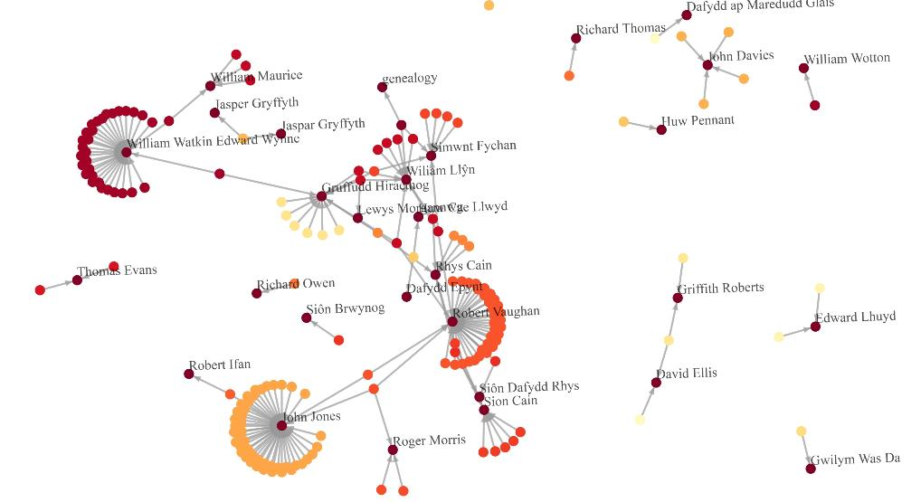
Examples
National Library of Wales
https://twitter.com/WIKI_NLW/status/1198899394738868224/photo/1 (Jason Evans, @WIKI_NLW)
Notes:
Visualisations of the content are made at lot easier, with tools readily available from the Wiki ecosystem. For example, in a recent project with their manuscript collection, for which they have all their data in Wikidata, they were able to visualize the network of scribes and what manuscripts they contributed to, how they worked together, in which groups, etc.
(https://twitter.com/WIKI_NLW/status/1198899394738868224/photo/1)

Slide 20
Examples
National Library of Wales
sharing images with Wikimedia Commons, using Wikidata to enrich and enhance the metadata for those images
sum of Welsh literature on Wikidata – the Welsh bibliography
improving access to data, enriching user experience, connecting our data with the wider semantic Web
Notes:
Their current project is the “sum of Welsh literature on Wikidata” – the Welsh bibliography.
Again, pulling enriched data back from Wikidata means that they can apply much more complex filters and answer more complex research questions:
Which one of our authors also has a portrait in the National Gallery?
Which one of them had a nobel prize nomination, or ever gave a speech in Parliament?

Slide 21
Examples
Europeana
encourages contributing institutions to register identifiers and vocabularies in Wikidata
values crosslinks between equivalent elements in vocabularies, including authoritative datasets (VIAF)
https://pro.europeana.eu/page/get-your-vocabularies-in-wikidata
Notes:
Europeana encourages its contributing institutions to register identifiers and vocabularies in Wikidata so Europeana can reuse them.
Europeana favour Wikidata in this context because – as they state on their website – they prefer to use “large, rather generic and multilingual data sources”, especially those “where equivalent elements in other vocabularies are indicated”, and also because Wikidata can “bring together crowdsourced resources and authoritative datasets (such as VIAF) and so guarantees a good balance between the authority and the quality we are looking for.”
https://pro.europeana.eu/page/get-your-vocabularies-in-wikidata

Slide 22
Why separate Wikibase instances?
exploration and experiment
data ingest and reconciliation
specialized use cases with highly specialized, original, or sensitive / confidential information
extending entity management beyond the library domain (e.g. GLAM)
→ ecosystem of separate Wikibase instances emerging
(https://wikibase-registry.wmflabs.org/wiki/Main_Page)
Notes:
So far for using Wikidata. But why would libraries decide to use separate Wikibase instances instead, or in addition?
These separate Wikibase instances are mostly used for
- exploration and experiment, such as in the OCLC Passage pilot my colleague Karen is going to talk about in a minute.
- data ingest and reconciliation before merging the resulting data set with Wikidata
- or very specialized use cases. Many domain specific projects prefer to use a separate Wikibase instance, to store highly specialized information, in non-standard ways, perhaps even partially sensitive or even confidential, in ways not supported by the central Wikidata instance.
Last but not least Wikibase is also used to extend the scope of linked data work beyond just the library domain, in particular to include other cultural heritage institutions, such as archives and museums. (GLAM – galleries (art museum, art gallery), libraries, archives, museums)
With all these initiatives, an ecosystem of separate Wikibase instances is emerging and a Wikibase registry has been set up to start tracking those.
Discussions are also underway concerning the relationship of these separate instances with Wikidata – think of potential future Wikibase federation.
https://wikibase-registry.wmflabs.org/wiki/Main_Page

Slide 23
Examples
German National Library
Investigating the use of Wikibase as infrastructure for their authority file, to support use by the wider GLAM community
Conference together with GND partners and Wikimedia Germany in 2018 (https://wiki.dnb.de/display/GNDCON2018/GNDCon+2018)
Notes:
Let us look at some examples.
German National Library (DNB)
is currently investigating the use of Wikibase as a potential replacement for (or complement to) their current infrastructure for their authority file GND.
This in in context of their initiative to open up their library authority file for use in the broader cultural heritage community.
In November 2018, DNB hosted a first “GNDCon”, a conference or “fan convention” around the GND authority file, jointly organized by the National Library, the GND-cooperative and Wikimedia Deutschland (!), featuring Wikidata as an important part of the ecosystem.

Slide 24
Examples
ABES and French National Library
French National Entities File (FNE) project (https://www.transition-bibliographique.fr/fne/french-national-entities-file/)
open data platform for controlled vocabularies, authorities and entities
proof of concept implementation based on Wikibase
Notes:
ABES (Bibliographic Agency for Higher Education in France) and BnF (the French National Library) launched the French National Entities File (FNE) project in 2017 to develop an open data platform on which to manage controlled vocabularies, authorities and entities.
The intent is to make collections discoverable and accessible and to enable the professional community to jointly create and maintain entities related to their resources,
while facilitating the use of these entities in local production environments.
In 2019, the project includes a proof of concept implementation using Wikibase to support the FNE project.
Ultimately, the goal is to effect a bibliographic transition of catalogues to the web of data – as illustrated in the project logo here.
https://www.transition-bibliographique.fr/fne/french-national-entities-file/

Slide 25
Examples
Dutch Royal Library
Enriching the historical newspapers collection with linked named entities, i.e. names of persons, locations and organisations mentioned in the newspaper articles
linked to corresponding resource descriptions in intl. knowledge bases such as DBpedia, Wikidata and VIAF
Corrections by users encouraged!
xPortal demo (3:20' ff.)
Notes:
The Dutch National Library is currently focusing on enriching their historical newspapers collection with linked named entities, I
.e. names of persons, locations and organisations mentioned in the newspaper articles
that are linked to corresponding resource descriptions in international knowledge bases such as DBpedia, Wikidata and VIAF.
They set up an enrichment infrastructure, with a enrichment database that is able to store any type of enrichment for any object from the library collections,
without modifying the original data. Generally speaking, the enrichment database contains links between identifiers of objects from the library collections and related identifiers.
Linking named entities in newspaper articles to resource descriptions in Wikidata offers new search functionality.
Users are even encouraged to correct or remove links when they see wrong ones, or add links!
Let us see how this works in detail. The following is a portion of their demo of the functionality. Enjoy!

Slide 26
OCLC Experiences with Linked Data & WikiBase

Slide 27
OCLC & Linked Data
Publish linked data - FAST, VIAF, WorldCat (2009 - )
EntityJS Research Project (2013)
Person Entity Lookup Pilot (2014)
CONTENTdm Metadata Refinery (2015-16)
Project Passage (2017-18)
CONTENTdm Linked Data Pilot (2019-20)
Entity Management Infrastructure (2020-21)
From research to production
Notes:
OCLC has a long history of working with linked data…stretching back well over a decade.
Back in 2009 OCLC began work to understand what it meant to publish linked data. This started with publishing FAST and VIAF data as linked data and, ultimately in 2012, we published all of WorldCat.org as linked data.
Our next set of work explored use cases for linked data The Entity JS Research Project investigated end user discovery applications across descriptions of different entities (people, organizations, places, events, concepts, works) …and our Person Entity Lookup Pilot explored the features and user requirements of a shared reconciliation service for personal names. .
In 2015, we began testing what processes and pipelines were needed to create original linked data…specifically focusing on the balance between compute power (that OCLC can bring to the table) and with the absolutely necessary decentralized domain expertise that our library partners bring to the table.
In 2017, we had learned a great deal about all of the components that are needed to do linked data at scale. Whether it be to create, publish or use…but we had not taken a step back to take a look at it holistically…to determine how all of these components could fit together inside a single infrastructure to allow us to actually curate linked data over time.
So, Project Passage, using the Wikibase infrastructure, tested how a user could create, edit, publish and use linked data…all in a single system working specifically with authority metadata. ….and the ongoing CONTENTdm linked data pilot is testing those principles with cultural heritage metadata.
So... All of this work and expertise culminated earlier this year when OCLC was awarded a Mellon Foundation grant to design, build and publish an Entity Management Infrastructure to help support linked data work by libraries around the world.
This represents a transition from research to production, taking advantage of all OCLC’s linked data research, prototyping, and lessons learned to build a production-ready infrastructure.
First, I’ll talk a bit more about our experiences with using Wikibase: Project Passage and the CONTENTdm Linked Data pilot.

Slide 28
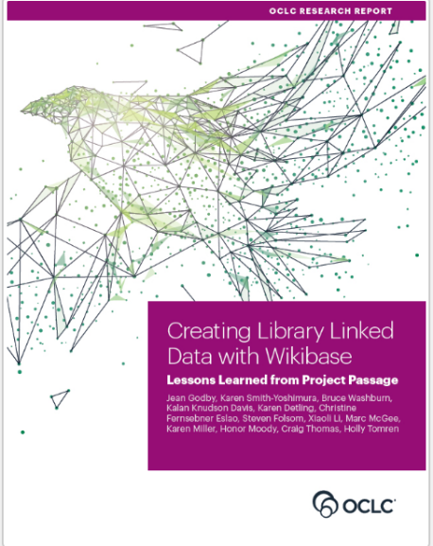
About Project Passage
Ran from December 2017 through September 2018
16 OCLC Member libraries participated
Objective: Evaluate a framework for reconciling, creating, and managing bibliographic and authority data as linked data entities and relationships
Pilot Wikibase instance included 1.2M entities from matches among Wikidata, VIAF, and WorldCat
Godby, Jean, Karen Smith-Yoshimura, Bruce Washburn, Kalan Davis, Karen Detling, Christine Fernsebner Eslao, Steven Folsom, Xiaoli Li, Marc McGee, Karen Miller, Honor Moody, Holly Tomren, and Craig Thomas. 2019. Creating Library Linked Data with Wikibase: Lessons Learned from Project Passage. Dublin, OH: OCLC Research. https://doi.org/10.25333/faq3-ax08.
Notes:
Our report on what we learned from this experience was published last August.

Slide 29
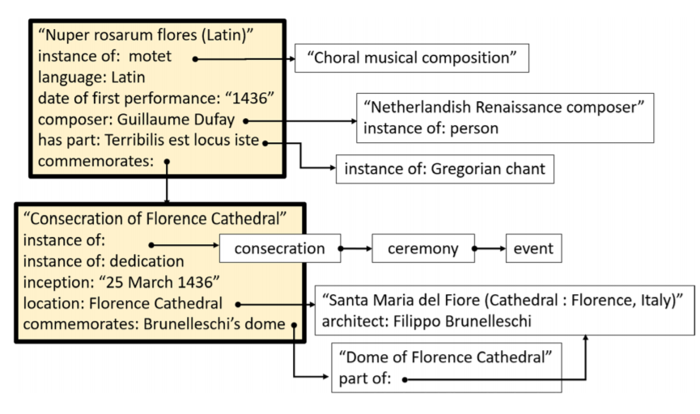
Example of “Entification”
From: Godby, Jean, Karen Smith-Yoshimura, Bruce Washburn, Kalan Knudson Davis, Karen Detling, Christine Fernsebner Eslao,
Steven Folsom, Xiaoli Li, Marc McGee, Karen Miller, Honor Moody, Craig Thomas, and Holly Tomren. 2019. Creating Library
Linked Data with Wikibase: Lessons Learned from Project Passage. Dublin, OH: OCLC Research. https://doi.org/10.25333/faq3-ax08.
Notes:
This example from Project Passage shows the entities represented in a sacred musical composition commissioned for and performed at the consecration of Florence Cathedral in 1436. The items and properties describing the musical score, the consecration event, and the interconnections between the two were all added to the brief entity for the musical work that was imported into Passage from Wikidata - producing a network of relationships that exceeds the detail currently represented in corresponding MARC-based library authority files.
This figure shows that the Nuper rosarum flores commemorates the consecration of the Florence Cathedral, but the inverse is also true: the consecration was commemorated by the motet. This inverse relationship could be automatically generated and revealed in the Project Passage discovery layer.

Slide 30
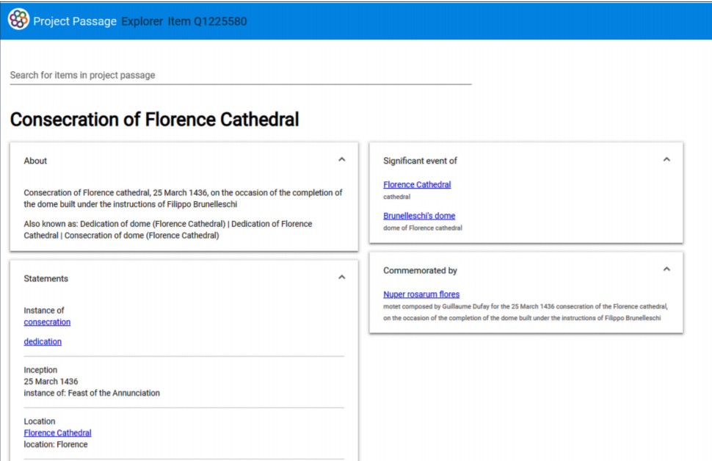
Notes:
This shows the Project Passage’s discovery layer display of the entities shown in the previous slide. It generated the inverse relationship, the “Commemorated by” relationship to the “Nupra rosarum flores” . Although “discovery layers” are usually considered as a public-facing interface, the Project Passage experience demonstrated that is *also* important for the metadata creators – to see the impact of the entities and relationships they are entering, immediately, as part of the workflow. In this case, just having the relationship that the music commemorates the consecration of the cathedral suffices to also effect the display of the entity for the Consecration of Florence Cathedral event.

Slide 31
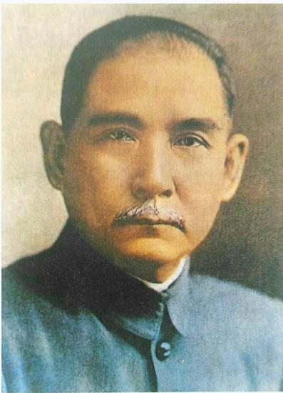
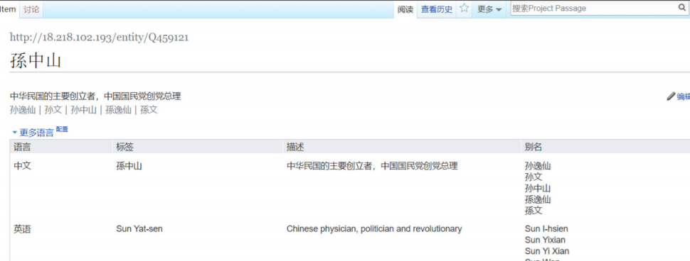
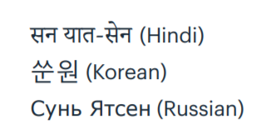
Multilingualism
Other labels in Wikidata
Notes:
Another highlight from our Project Passage experiences was the imbedded multilingualism. This shows the Wikibase editor display with the language set to Chinese. There’s no need to transliterate the name when entering Chinese – that can be handled by others using a different language editor. Indeed, there are a variety of writing systems in represented in the labels in Wikidata, including Hindi, Korean, and Russian, shown here. The multiscript support replaces “language of cataloging” and obviates the need for transliterations when we re-envision the fabric of the bibliographic universe.

Slide 32
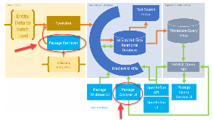
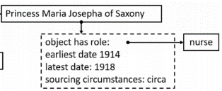
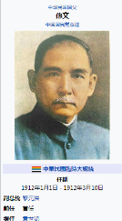
Some lessons
Need for tools to ingest data from other sources and provide a discovery layer
Structured data created with more
precision than current library standards
Multiscript support replaces “language of cataloging” and obviates the need for transliterations
Notes:
To populate knowledge graphs with library metadata we need tools to facilitate the import of data created elsewhere and a discovery layer to allow metadata specialists to see the results of their effort without leaving the metadata-creation workflow. This was especially important to quench the temptation to include inverse relationships which could be shown through a discovery application instead of the data itself.
Most use cases demonstrated that we could enrich the descriptions in structured data with a precision that exceeded current library practices.
With the embedded multiscript support, people could add structured data in their own writing systems and thus the minimizes the need to also include transliterations as in current library practices. The ability to change one’s language interface replaces the “language of cataloging” we use now.

Slide 33
CONTENTdm linked data pilot
Three Phases:
Map record-oriented metadata to entities
Develop staff tools to manage metadata in Wikibase
Use entities to drive end-user discovery
Notes:
CONTENTdm is OCLC’s digital collection management service; Used by 2500+ libraries worldwide; 75+ million digital records managed today; Record-based data model; Textual descriptions
The one-year project will investigate how linked data can:
Increase end-users’ ability to discover, evaluate, and use unique digital content.
Improve library staff efficiency with an easier way to manage descriptive environment
We are working with five library partners.

Slide 34
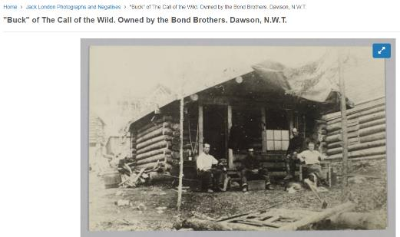
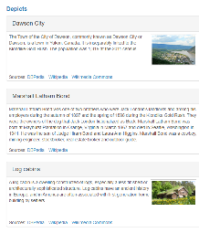
Mapping metadata to entities
CONTENTdm
Transformation & Mapping
Wikibase
CONTENTdm
Javascript Plug-in
Notes:
We made a lot of progress during phase 1 of the project.
As you’ll see here:
1. Created capabilities to import, clean and reconcile existing CONTENTdm collections to authorities in VIAF and FAST.
2. Implemented a prototype on Wikibase.
3. Created a plug-in for CONTENTdm to give existing collections added context using linked data and developed export paths for sharing data with external partners.

Slide 35
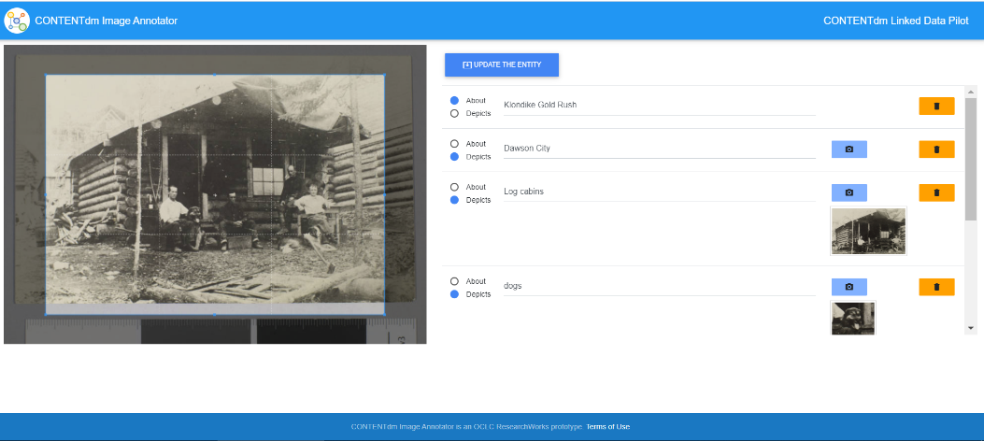
Staff tools
CONTENTdm
Transformation & Mapping
Wikibase
CONTENTdm
Javascript Plug-in
Notes:
Additionally, we have been building staff tools for use and review by the pilot partners and new tools for enhancing end-user discovery
like this image annotator to support new ways to describe and interact with Digital Metadata

Slide 36
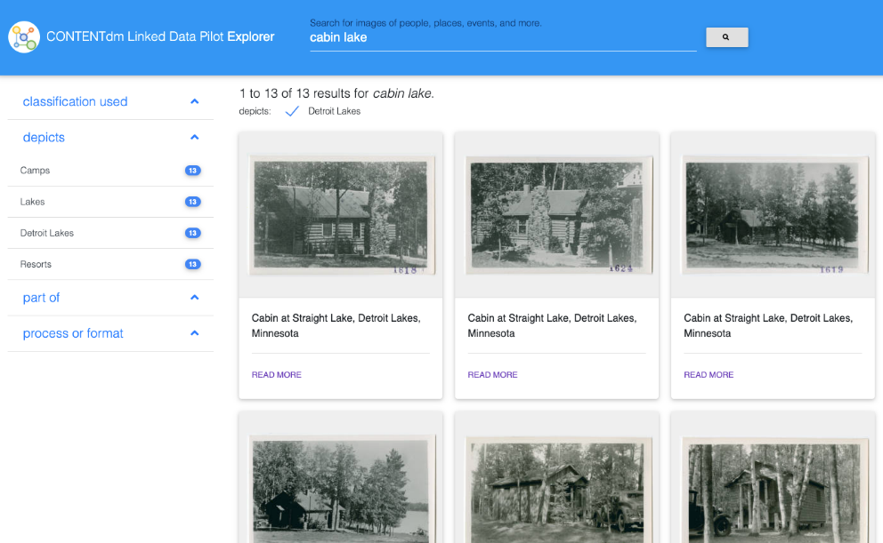
End-user discovery
Notes:
This Explorer application connects digital content based on entity relationships in the underlying descriptions

Slide 37
Applying what we’ve learned
Experience with how to build performant entity management systems
New approaches to large-scale metadata enrichment
Metadata cleanup and reconciliation requires new tooling and distributed effort to be scalable
Visit oc.lc/cdm-linked-data-pilot to learn more
Notes:
As we continue to work through the final phase of the pilot, we are drawing from what we learned to inform our linked data initiatives.
We have a much better understanding of how to build entity management infrastructure and library staff needs for successful metadata enrichment.

Slide 38
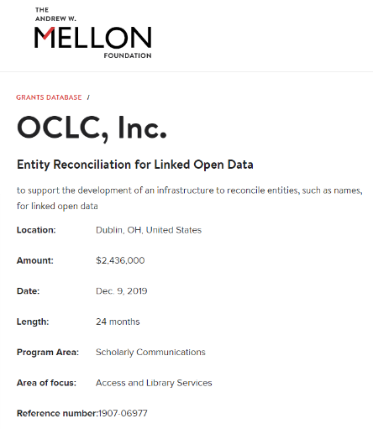
Shared Entity Management Infrastructure overview
Two-year, $2.436M grant, matched by OCLC
Production infrastructure for Work and Person entities
Support for multiple descriptive and encoding standards
Use of persistent identifiers
Most importantly: a collaboration with the library community
Notes:
To give you a quick overview:
This $2.436 million grant will support linked data management initiatives underway in the library and scholarly communications community.
OCLC will match this grant funding with additional investments to publish authoritative and easily accessible entity descriptions for works and persons as part of a persistent, centralized infrastructure that will be jointly curated by the community and OCLC when completed in December 2021.
This infrastructure will aggregate links to other representations of works and persons in external vocabularies and authority files that will provide a solid foundation for libraries, cultural heritage organizations and scholarly communications communities to ultimately make their materials more connected and discoverable on the web.
Additionally, we anticipate that libraries will use this infrastructure to:
increase connections (context) between their materials and other relevant collections
improve the consistency and efficiency of metadata workflows across collections and material types
improve MARC record quality and accuracy
…which will result in new, more efficient, metadata workflows!
In 2020, we are ramping up very quickly as we focus on data that OCLC already has, including authority data, bibliographic data, and other vocabularies that we maintain. …and in 2021, we will look to add more data sources and refine them to bring this to an even larger scale.
The features and functionality that we create will be primarily API-based, but we will also be providing a basic UI (user interface) and…along the way (in 6-month increments) we will be testing with library partners and collaborating with the library community to make sure this infrastructure meets their expectations.

Slide 39
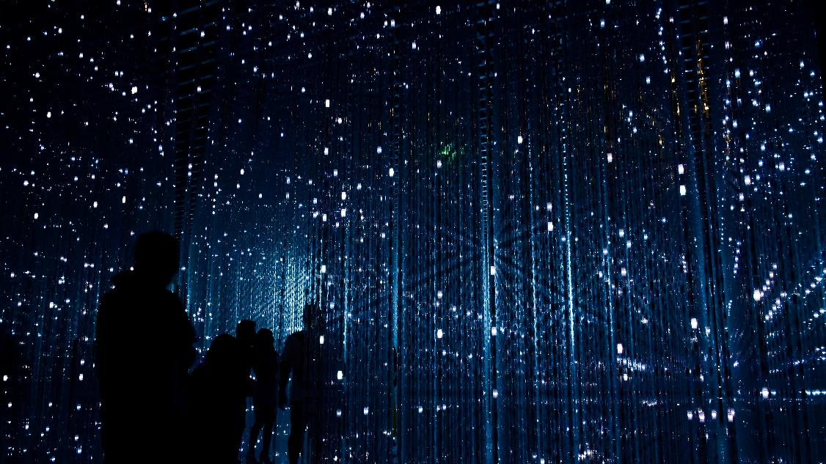
For linked data to move into common use, libraries need reliable and persistent identifiers and metadata for the critical entities they rely on. This project begins to build that infrastructure and advances the whole field.
Lorcan Dempsey
OCLC Vice President, Membership and Research, and Chief Strategist
Photo by Robynne Hu on Unsplash
Notes:
No matter how far along a library is with using new data models (including BIBFRAME) or if they wish to continue to work in MARC, they will see improved quality and efficiency from this project.
Just as we have provided infrastructure for OCLC numbers and authority records to help improve discovery experiences and connect systems, OCLC will create a new library infrastructure for persistent identifiers and connections to authoritative resources that will place library collections in a broader context.

Slide 40
Advisory group members
Notes:
As you can see here, 22 different institutions, including public, academic, research and national libraries are now part of our advisory group and we will continue to stay in close communication with additional linked data organizations, including LD4P, PCC, ALCTS Directors of Technical Services at Large Research Institutions, the OCLC Research Library Partnership and more to ensure that this infrastructure will meet their needs.
As of 21 May 2020, our advisory group members include:
ABES (Agence bibliograhique de l’enseignement superieur) – Benjamin Bober
BnF (Bibliotheque nationale de France) - Anila Angjeli
Brigham Young University Library - Greg Reeve
British Library - Andrew MacEwan
Central Michigan University Libraries - Melissa James
Cleveland Public Library - Chatham Ewing
Cornell University Library – Jason Kovari, Simeon Warner, Steven Folsom, Huda J. Khan, Lynette Rayle, and John Skiles Skinner
DnB (Deutsche National Bibliothek) - Reinhold Heuvelmann
Harvard Library - Marc McGee and Christine Fernsebner Eslao
National Library of Medicine - Barbara Bushman
National Library Board, Singapore - Haliza Jailani
New York University Libraries - Nancy Lin
Princeton University Library - Sarah Hamerman
Smithsonian Libraries - Jackie Shieh
Temple University Libraries - Holly Tomren
Università di Bologna - Alessandra Citti, Raffaella Gaddoni, Chiara Semenzato
University of California, Davis Library - Xiaoli Li
University of Minnesota Libraries - Stephen Hearn, kalan Knudson Davis
University of Oxford
University of Pennsylvania Libraries - Jim Hahn
University of Tennessee University Libraries - Anchalee (Joy) Panigabutra-Roberts
University of Victoria Libraries – Dean Seeman
Yale University Library - Daniel Lovins and Youn Noh

Slide 41
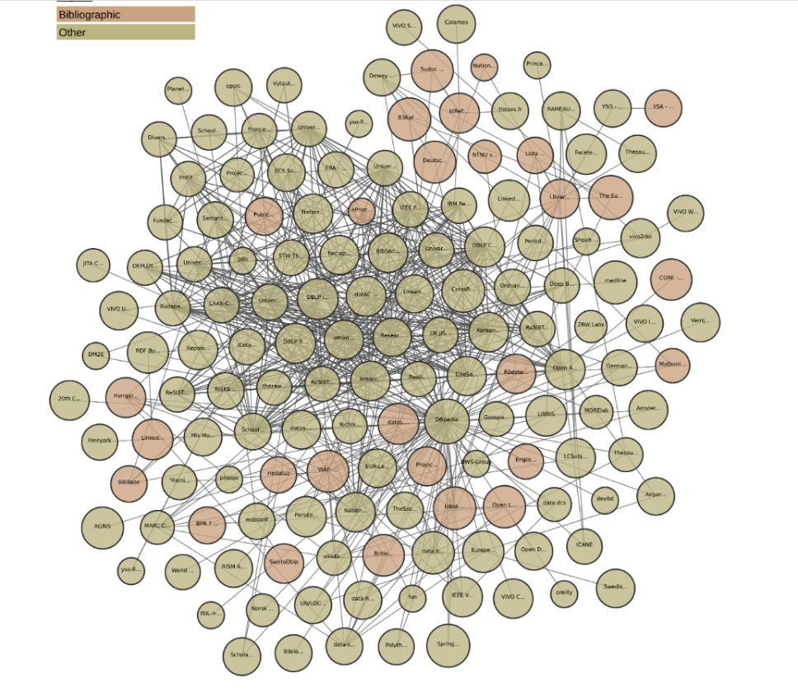
Let’s add to the
fabric of the
bibliographic universe!
From lod-cloud.net
Notes:
This is the portion of the Linked Data cloud you saw earlier, filtered for just the bibliographic domain.

Slide 42
Sources / Further Reading
“ARL White Paper on Wikidata: Opportunities and Recommendations,” April 18, 2019, https://www.arl.org/publications-resources/4751-arl-white-paper-on-wikidata-opportunities-and-recommendations#.XLik9ehKhPa.
Jean Godby et al., Creating Library Linked Data with Wikibase: Lessons Learned from Project Passage (Dublin, OH: OCLC Research, 2019), https://doi.org/10.25333/faq3-ax08.
Karen Smith-Yoshimura, “Analysis of 2018 International Linked Data Survey for Implementers,” The Code4Lib Journal, no. 42 (November 2018), https://journal.code4lib.org/articles/13867.
Karen Smith-Yoshimura, “The Rise of Wikidata as a Linked Data Source – Hanging Together,” Hanging Together (blog), August 6, 2018, http://hangingtogether.org/?p=6775.

Slide 43
Sources / Further Reading (cont.)
OCLC and linked data (available at oc.lc/linkeddata)
Shared entity management infrastructure (available at oc.lc/sharedentitymgmt)

Slide 44
RLP Works in Progress
Thank you!
oc.lc/linkeddata
Contact: Annette Dortmund
Contact: Karen Smith-Yoshimura
dortmuna@oclc.org
smithyok@oclc.org
@libsun
@KarenS_Y
Notes:
You can find more deteails about OCLC‘s linked data work at the URL given here. We‘ve also gathered some other sources for further reading in the following slides.
Merrilee Thank you all for joining us today! We look forward to discussions. This concludes today’s webinar.

