Slide 1
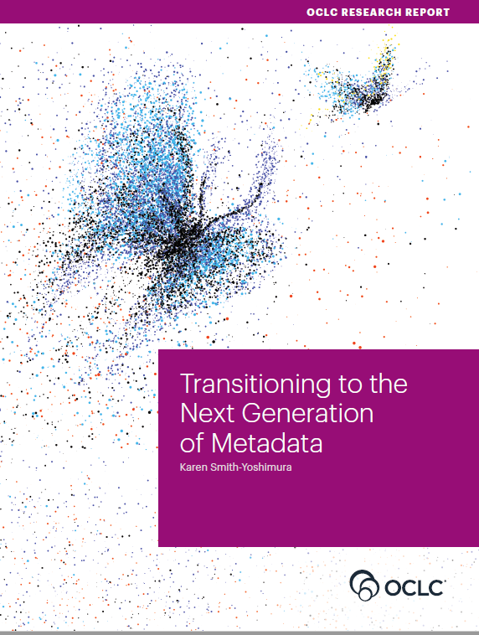
RLP Works in Progress Webinar • 12 November 2020​
Transitioning to the Next Generation of Metadata

Slide 2
Karen Smith-Yoshimura
OCLC Research Senior Program Officer
Introduction and overview

Slide 3
OCLC RLP Metadata Managers Focus Group – Report fodder
62
Partners in 11 countries
777
Pages of response compilations
93
Hours of discussion
Notes:
First, some background on the OCLC Research Library Partners Metadata Managers Focus Group. The discussions and responses to question sets over the last six years (2015 -2020) provided the fodder for the Transitioning to the Next Generation of Metadata report.

Slide 4
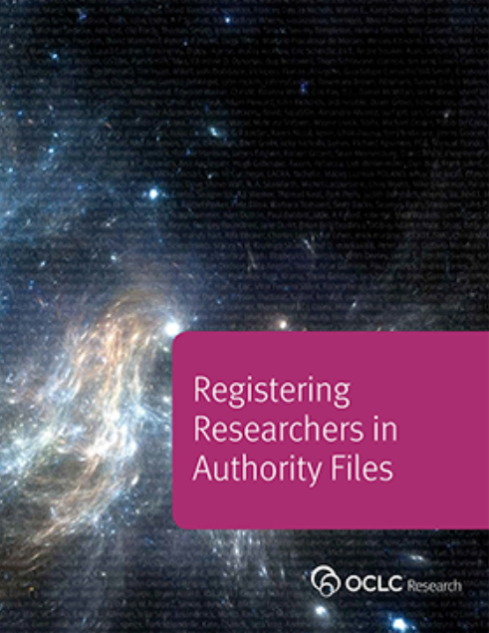
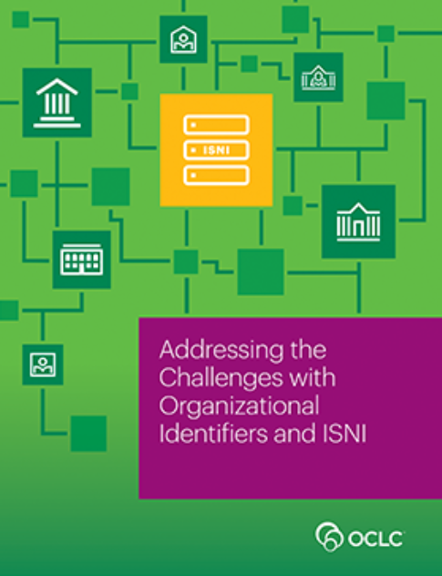
Spin-off working groups
(2014)
(2016 )
Notes:
These discussions also led to working groups who published the results of their investigations. These are two examples.

Slide 5
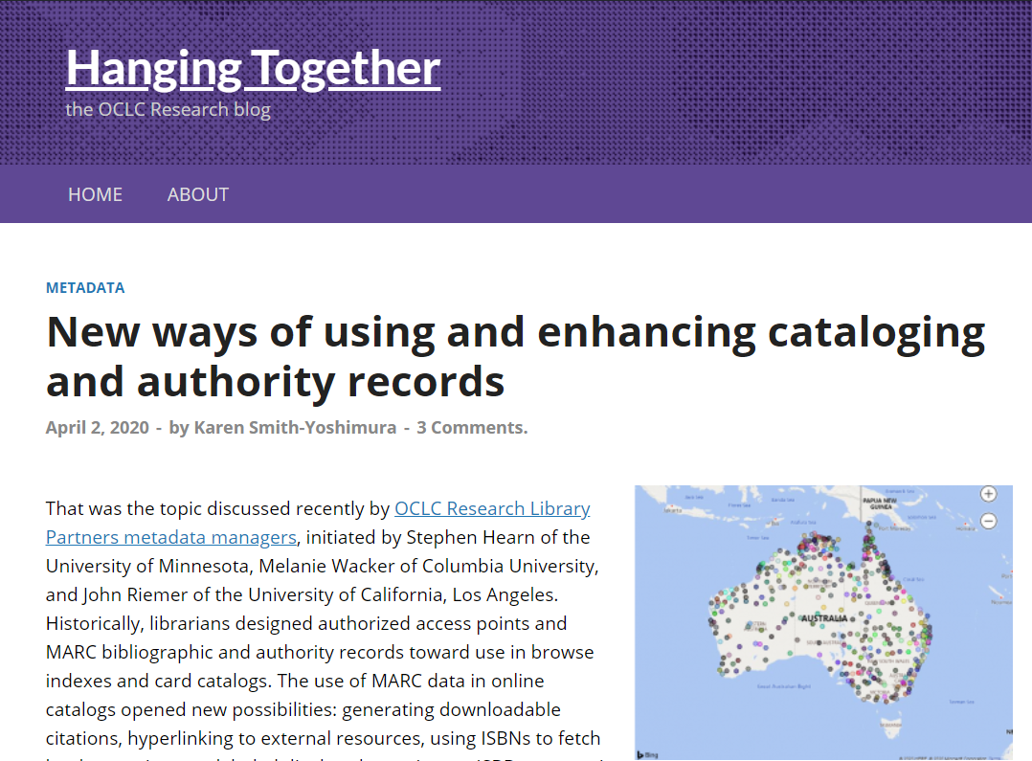
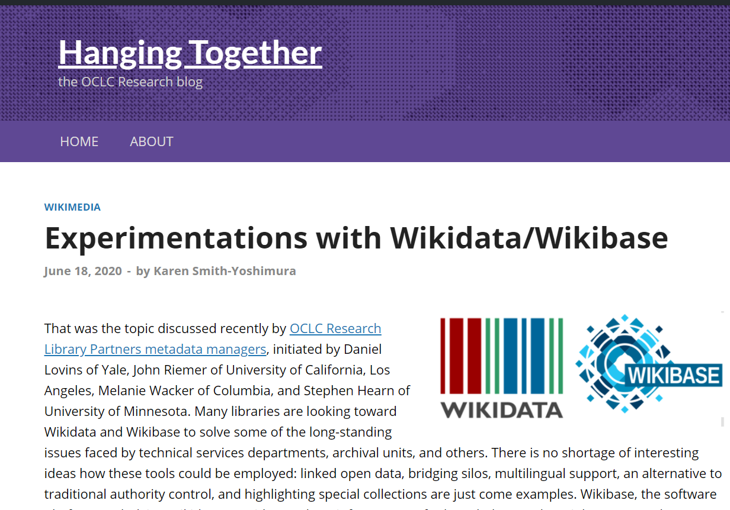
36 HangingTogether Blog Posts summarizing discussions
Notes:
All the discussions and Focus Group responses were summarized on our HangingTogether blog, 36 of them in this six-year period.

Slide 6
The Transition to Linked Data and Identifiers
Describing “Inside-Out” and “Facilitated” Collections
Evolution of “Metadata as a Service”
Preparing for Future Staffing Requirements
Impact
(48 pp, 148 citations)
Notes:
And I did a “meta-synthesis” of all of them and categorized them into these five sections in the report. The report includes 148 citations, not just to the HangingTogether blog posts, but to other OCLC Research reports and references the Focus Group members included in their responses to question sets. Our discussant panel today features three of the Focus Group members who served on the Planning Group and initiated some of the topics covered by the report.

Slide 7
Discussant panel
Melanie Wacker
Metadata Coordinator, Columbia University
Current PCC Chair
Jennifer Baxmeyer
Assistant University Librarian for Metadata Services
Princeton University
Previous PCC Chair
John Riemer
Head, Resource Acquisitions and Metadata Services, UCLA
Past PCC Chair

Slide 8
Transition to Linked Data & Identifiers
“Persistent identifiers were viewed as crucial to transitioning from current metadata to future applications.”
Notes:
[Melanie] Many Focus Group discussions focused on the changes taking place in the transition to linked data and identifiers. Looking back and when reading through the entire report, one quickly realizes that linked data and stable identifiers factor prominently into most other topics that the Group has been discussing -- may that be staffing requirements or research data.

Slide 9
“Identity management poses a change in focus…to describing entities …and the relationships among them.”
Notes:
One of the shifts underway is from authority control to identity management, and the value of “identifier hubs” such as Wikidata to aggregate identifiers pointing to the same entity and also offering labels in different languages and writing systems. The discussion at the Metadata Managers Focus Group brought to light a surprising number of projects and much experimentation, some at individual institutions and some on the network level.

Slide 10
PCC Strategic Plan, January 2018-December 2021
SD4: Accelerate the movement toward ubiquitous identifier creation and identity management at the network level. We aspire to attain an environment where identity management work activity is characterized by much greater proportions and numbers of entities receiving identifiers; many non-NACO institutions participating; and strategic partnerships and collaboration existing among cultural heritage organizations, rights management agencies, Wikidata, and others. We expect to find ways in a linked data environment where collaboration on identity management can interoperate across multiple data sources. Attainment of this vision will increase both human and machine usage of this data and its overall value.
Notes:
With my PCC head on, I would like to point out that in the current PCC Strategic Directions, this is the focus of SD4: “Accelerate the movement toward ubiquitous identifier creation and identity management at the network level”.

Slide 11
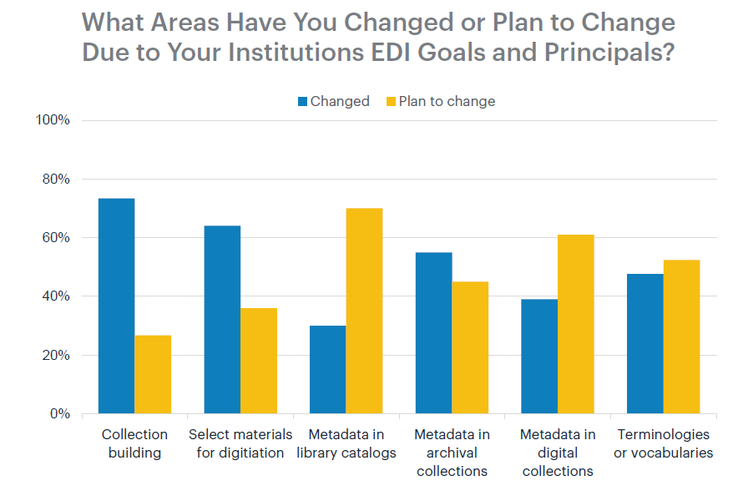
“Addressing language issues is important as libraries seek to develop relationships and build trust with marginalized communities.”
Notes:
When OCLC Research did a 2017 survey of the Research Library Partnership on Equity, Diversity, and Inclusion, metadata in library catalogs (third from left) lagged behind changes institutions had already changed in their workflows to comply with their EDI goals and principles. Ability to link to multiple vocabularies with different labels is a promising approach to address language issues.

Slide 12
The transition entails…
Expanding the use of persistent identifiers
Moving from “authority control” to “identity management”
Addressing the need for multiple vocabularies and equity, diversity, and inclusion
Addressing linked data challenges
Notes:
While persistent identifiers are the backbone of linked data and identifier hubs accommodating different multiple labels, scripts and languages offer promise to solve some very important issues -- there is of course more to it. Other issues that need to be addressed include tools, systems that are able to consume linked data, discovery interfaces able to take advantage of the underlying data, ontologies, training, best practices, and new workflows -- it really touches on everything that we do.

Slide 13
Describing “Inside-Out” and “Facilitated” Collections
Archival collections
Archived websites
Audio and video collections
Image collections
Research data
https://researchworks.oclc.org/iiif-explorer/
“Metadata underlies all discovery regardless of format, now and in the future…”
Notes:
The next section focused on specific challenges in describing the materials created and curated by institutions (Lorcan Dempsey’s “Inside-Out” collections), reflecting the firm belief that metadata underlies all discovery regardless of format, now and in the future. These are the five formats covered. Image collections provided an opportunity to highlight the ResearchWorks IIIF Explorer to showcase the wonderful opportunity to retrieve images across different institutions and collections.

Slide 15
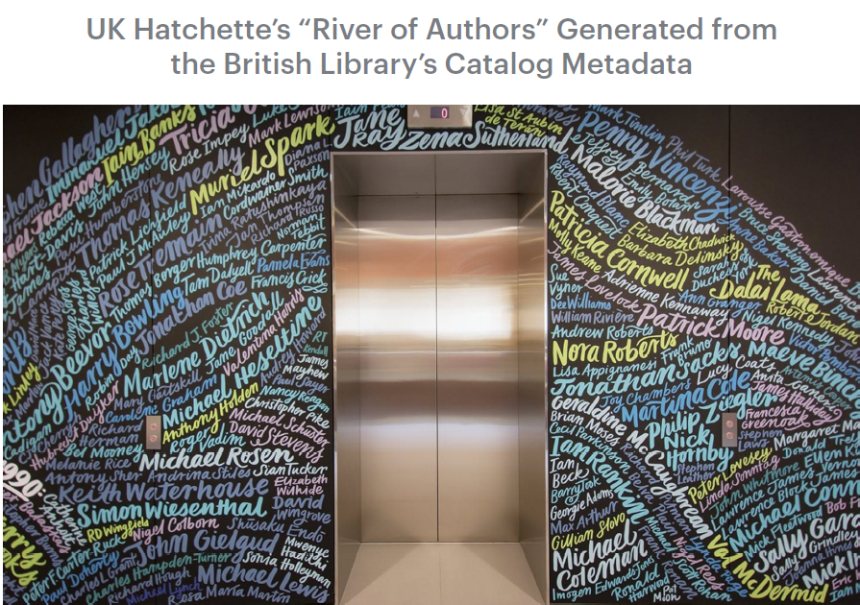
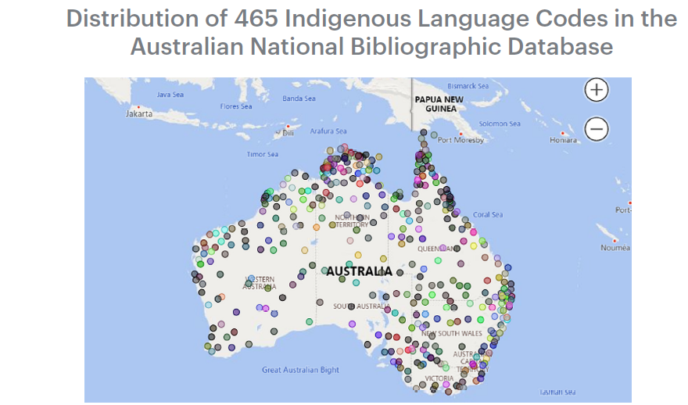
Evolution of “Metadata as a Service”
New applications
Bibliometrics
Plus:
Metrics
Consultancy
Semantic indexing
Notes:
[Jennifer] We also covered uses of metadata beyond describing materials, “Metadata as a Service”. This included new applications, such as visualizing the distribution for different Australian aboriginal languages represented in the Australian National Bibliographic Database drawn from the language codes assigned (on the left) and bibliometrics supplied by the British Library to the UK Hatchette’s publisher group on their top authors represented in the BL’s catalog used to decorate their headquarters (on the right).

Slide 16
Preparing for Future Staffing Requirements
Notes:
[John] The implications of the transition on staffing generated lots of discussion on the culture shift necessary, plus learning opportunities, the new tools and skills needed, self-education, and addressing staff turnover.
It probably has always been a quintessential role for professionals to take on new types of work and activities, to establish best practices, and once adequately trailblazed to delegate the activities to others and integrate them into the system. This might have seemed to be an occasional activity focus, when a new set of cataloging rules comes along or a new type of material needing to be described.
What is different now is that this role of trailblazing, figuring out new strategies and techniques, retooling and reconfiguring and problem-solving, is turning into a full-time obligation.
Why so? The metadata world is a multi-polar one. There are different partners with similar goals to collaborate with in achieving library aims, and so there are different schemas, identity registries, and standards in play. There is a premium on identifying batch actions that can be taken on metadata in lieu of individual record remediation.
The amount of material a library wishes to describe for discovery is ever increasing at a time when it is hard to sustain past staffing levels, and the approach of managing the workload in an manner exclusively within the library domain just is not scalable.
The new skills demanded for success by today’s metadata professionals will include a focus on overall principles, the ability learn new tools and techniques quickly, being conversant with information professionals in other settings and cultures, an ability to identify common interests, and a willingness to collaborate when opportunities arise.
The time to modernize the professional positions in a metadata unit is not just when the position becomes vacant and one fervently hopes for administrative approval for reposting. On an incremental annual basis, professional positions should be examined for growth toward these new needs.

Slide 17
Impact
Notes:
The report concludes with the work underway at OCLC on the Shared Entity Management Infrastructure and the Focus Group’s expectation that it will address many of the challenges documented in the report around persistent identifiers, especially providing language-neutral links to trustworthy sources. A key take-away: Good linked data require good metadata!

Slide 18
Transitioning to the Next Generation of Metadata, RLP Works in Progress webinar * 12 November 2020​
Thank you!
Contacts: Karen Smith-Yoshimura
smithyok@oclc.org (until 30 November 2020)
Melanie Wacker: mw2064@columbia.edu
Jennifer Baxmeyer: bax@Princeton.EDU
John Riemer: jriemer@library.ucla.edu

