Slide 1
OCLC RLP Webinar Series:
Social Interoperability in Research Support
FALL 2020
September 10
Case study: Librarians on interdisciplinary research teams at the University of Miami
September 23
Case study: Implementing a shared GIS position at Rutgers University through cross-campus collaboration
Stakeholder spotlight: Research development and synergies with the library
November 17
August 26
October 14
Case study: Providing robust research support services at Syracuse University through cross-campus partnerships
Cross-campus partnerships, the library, and the university research enterprise
October 27
Stakeholder spotlight: Campus communications and synergies with the library
. . . And more to be announced soon. All available at oc.lc/wipwebinars

Slide 2
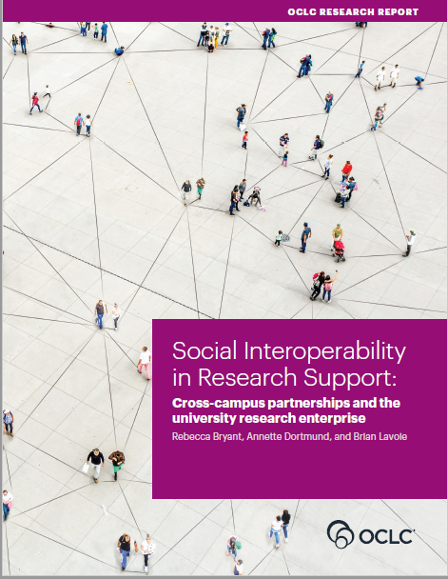
Explores the social and structural norms that shape cross-campus collaboration
Offers a conceptual model of key university stakeholders in research support
Provides recommendations for successful cross-campus relationship building
Download the report at:
oc.lc/social-interoperability
Brian Lavoie, PhD
Annette Dortmund, PhD
Rebecca Bryant, PhD

Slide 3
Today’s speakers
Kineret Ben-Knaan, Research & Assessment Librarian
Angela Clark-Hughes, Director, Rosenstiel School of Marine & Atmospheric Science Library
Kelly Miller, Associate Dean, Learning & Research Services
James Sobczak, STEM Librarian

Slide 4

Librarians on interdisciplinary research teams: A case study from the University of Miami
Kineret Ben-Knaan, Research and Assessment Librarian
Angela Clark-Hughes, Director, Rosenstiel School of Marine and Atmospheric Science Library
Kelly Miller, Ph.D., Associate Dean for Learning and Research Services
James Sobczak, STEM Librarian
September 10, 2020

Slide 5
Changing Roles of Librarians in the 21st Century
In the digital age, librarianship has been adapting to meet the changing needs of the 21st-century research enterprise by building expertise in:
  scholarly communication
  data management, and
  digital scholarship
Emerging area: What is the role of the librarian on interdisciplinary research teams?

Slide 6
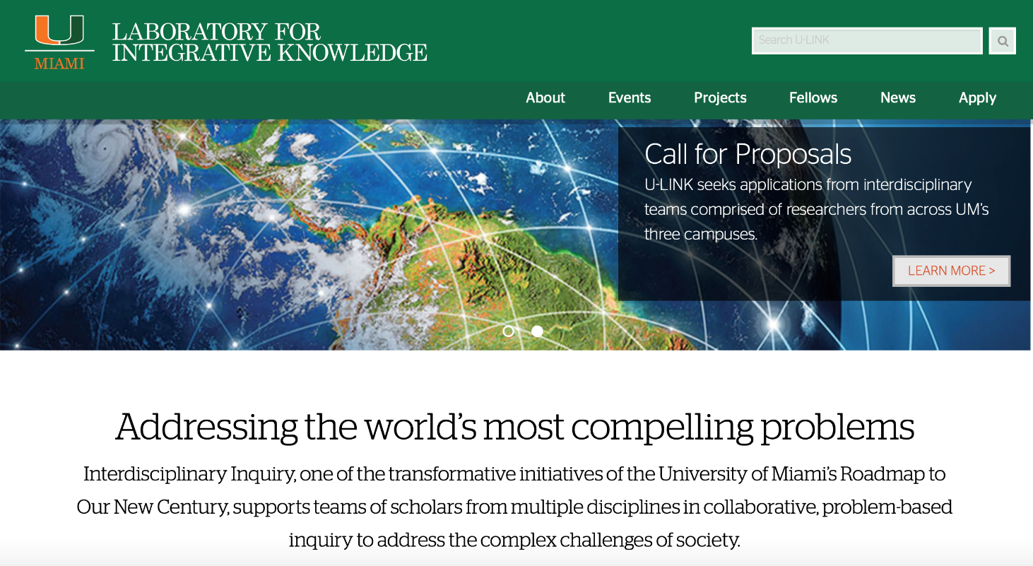
Notes:
At the University of Miami, we’ve had an extraordinary opportunity to explore this emerging area of librarianship thanks to the University’s Laboratory for Integrative Knowledge initiative also known as U-LINK.
The goal of the strategic program is to address the world’s most compelling problems through interdisciplinary inquiry. Teams of scholars from multiple disciplines receive funding to pursue solutions to complex problems facing the world.
In the first three years of U-LINK’s existence, from January 2018 through this summer 2020, librarians have been embedded on each of the award-winning teams. This opportunity has provided librarians with direct knowledge of the needs and demands of interdisciplinary teams. The experience has allowed them to deepen their relationships with research faculty members and experiment with new ways to share their expertise and skills.

Slide 7
University of Miami Laboratory for Integrative Knowledge (U-LINK)
Key Elements include:
Program to support problem-based interdisciplinary research
Phased funding opportunities for research teams
Science of Team Science (SciTS) training for research teams
Interdisciplinary opportunities for UM students
Team-building through informal and formal dinners, symposia, and seminars
Creation of gathering spaces in UM Libraries on three campuses
Acknowledge importance of collaborative research in hiring, promotion, tenure
  For more information, see: https://ulink.miami.edu/about/index.html
Notes:
The program is focused on grand challenges or wicked problems that require multiple disciplines to interact with one another in the creation of solutions.
Funding for research teams is provided in several phases. The first phase offers funding for teams to develop their concept while team-building, and the second phase provides funds for the team to begin implementation of the proposed experiment or project – creating prototypes, collecting preliminary data, etc. leading to external grant proposals.

Slide 8
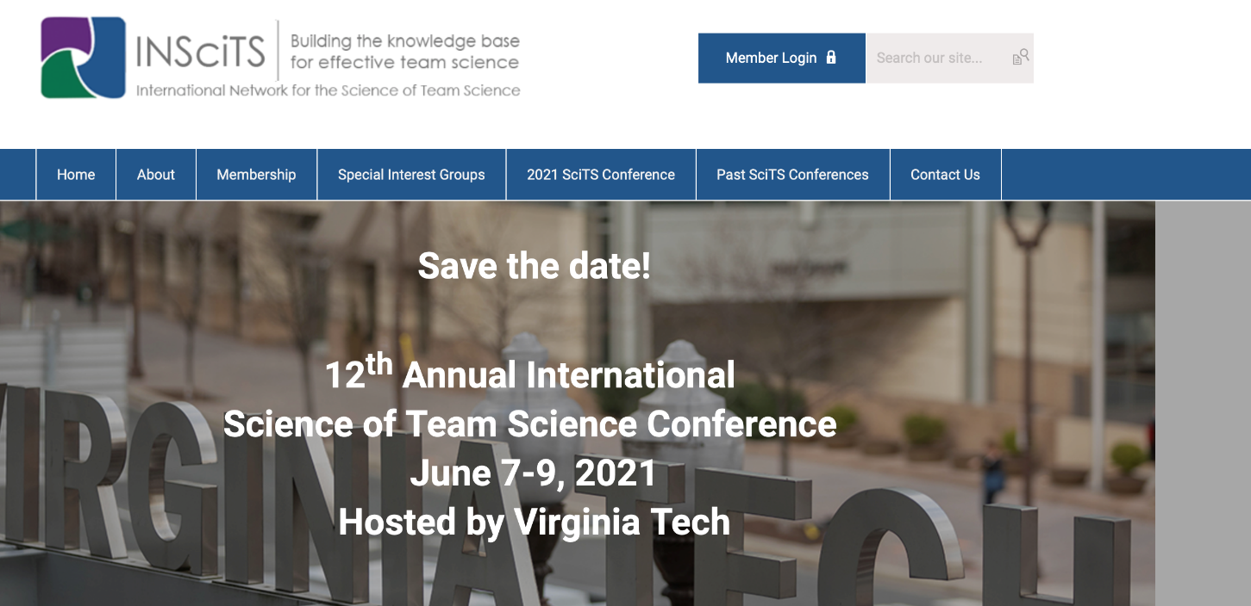
Science of Team Science Training
Notes:
Training in the science of team science is based in emerging scholarship in the ”Science of Team Science,” research on how scientists, social scientists, humanists, and others work together across disciplines to solve complex problems. An annual Science of Team Science conference is now taking place. We presented at the most recent conference in May.

Slide 9
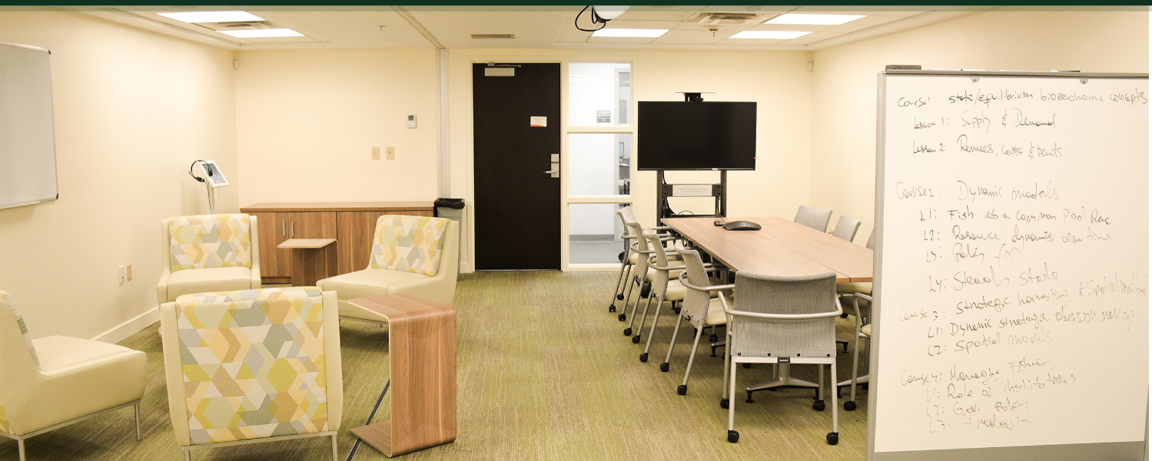
U-LINK Library Spaces for Interdisciplinary Research
Faculty Exploratory at the University of Miami Libraries’ Richter Library
Notes:
The ULINK Vision also includes the creation of social opportunities to help the teams bond and curated spaces in the UM Libraries for teams to gather. This aspect of the program connects with our UM Libraries’ long-term vision and planning for a future renovation of the third floor of Richter Library, our largest library, to create a “Faculty Research Commons.”

Slide 10
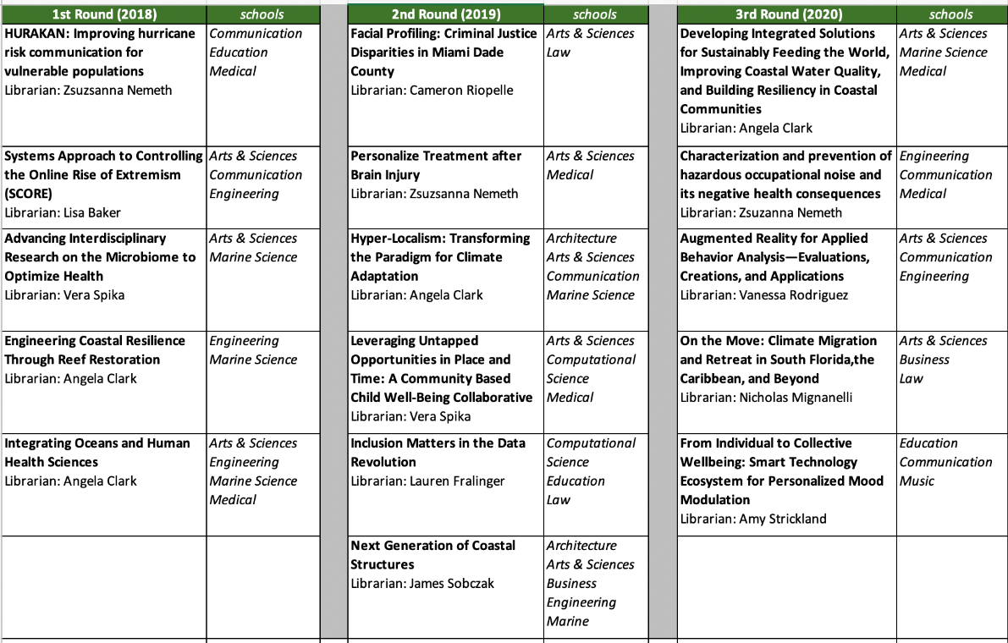
U-LINK Teams: 2018 - 2020
Notes:
The program has funded more than a dozen interdisciplinary research teams. As a senior administrator, I served on the U-LINK Action Team, a committee that was facilitated by the VP for Research. We reviewed each application to the program and advised on the program’s development.
This is a chart showing each of the three rounds of Phase 1 Funding between 2018 and 2020. Topics have included the ailing health of the oceans, facial profiling, hazardous noise, and other societal problems. Faculty participants have been drawn from across the University’s eleven disciplinary schools, and nearly a dozen librarians have been involved as team members.

Slide 11
U-LINK Librarian
Angela Clark-Hughes, Director, Rosenstiel School Library
  BS in Community Psychology from Georgia State University (1995)
  MLIS from Simmons (2000)
  Joined the University of Miami in 2004
  President Elect (2021-2022) - International Association of Aquatic and Marine Science Libraries and Information Centers (IAMSLIC)

Slide 12
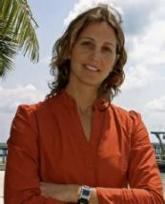
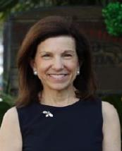
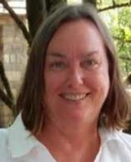
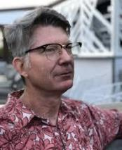
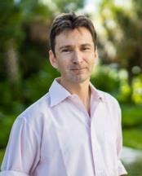
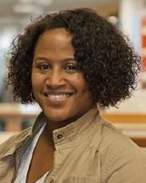

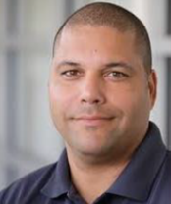
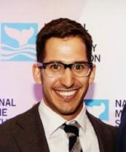
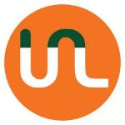
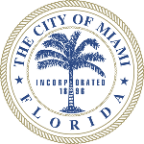

Hyper-Localism: Transforming the Paradigm for Climate Adaptation
Atmospheric Sciences
Architecture
English
Communication Studies
Marine Geosciences
Information Sciences
GIS / Mapping
Communications, PhD Student

Slide 13
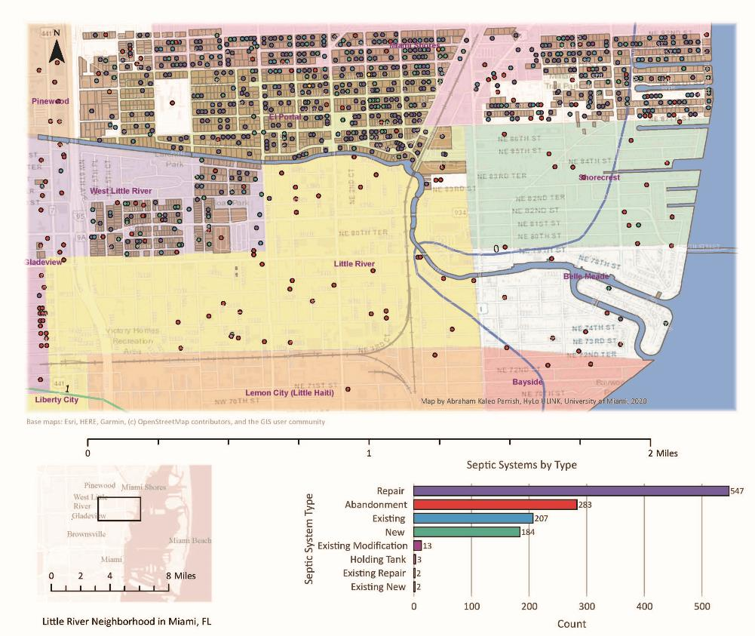
Integrated Climate Risk Assessment (ICRA)
      Elevation
Greenness
Wealth Distribution
Housing
Heat
Hydrology
Septic

Slide 14
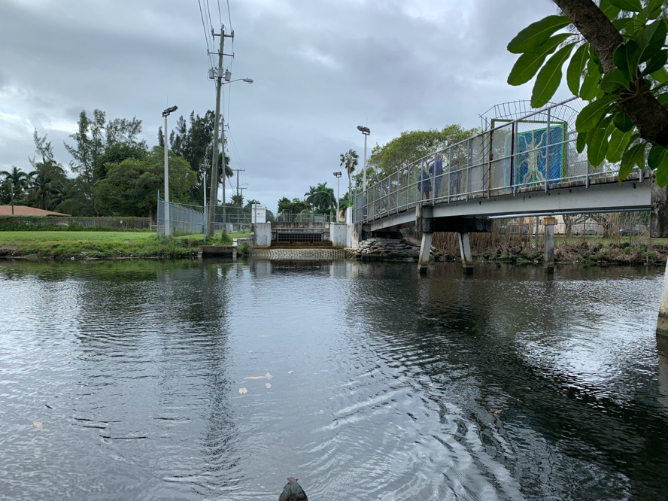
Evaluating storm drain pumping stations after a heavy rain event.
Photos: Tyler Harrison

Slide 15
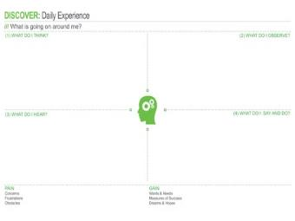
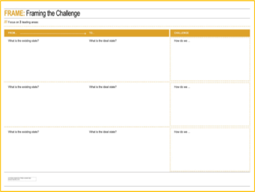
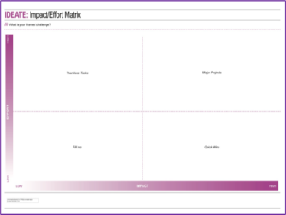
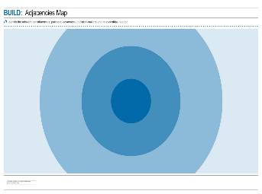
Photovoice
Frequent flooding – too deep to drive through
A broken bench in the sun at a bus stop
A tree provides some shade at a bus stop
Design Thinking

Slide 16
I've contributed as a team member by:
Helping develop, test and create the Integrated Climate Risk Assessment (ICRA) protocol.
Facilitating Photovoice and Design Thinking Workshops with two Miami communities.
Collaborating on two articles on our protocol and study results.
Co-writing a successful grant proposal for external funding (received 2020).

Slide 17
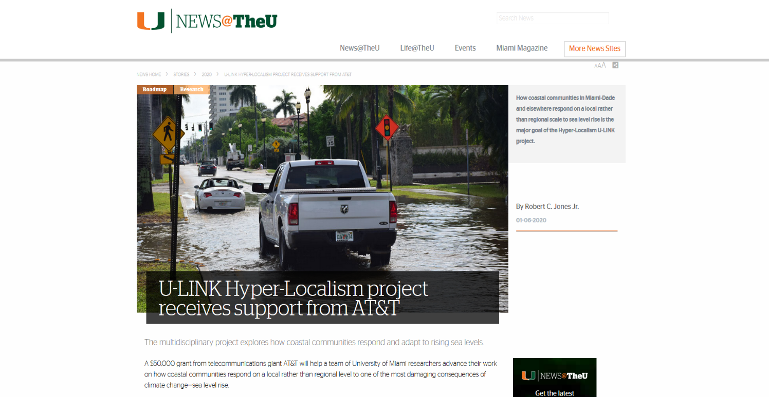

Slide 18
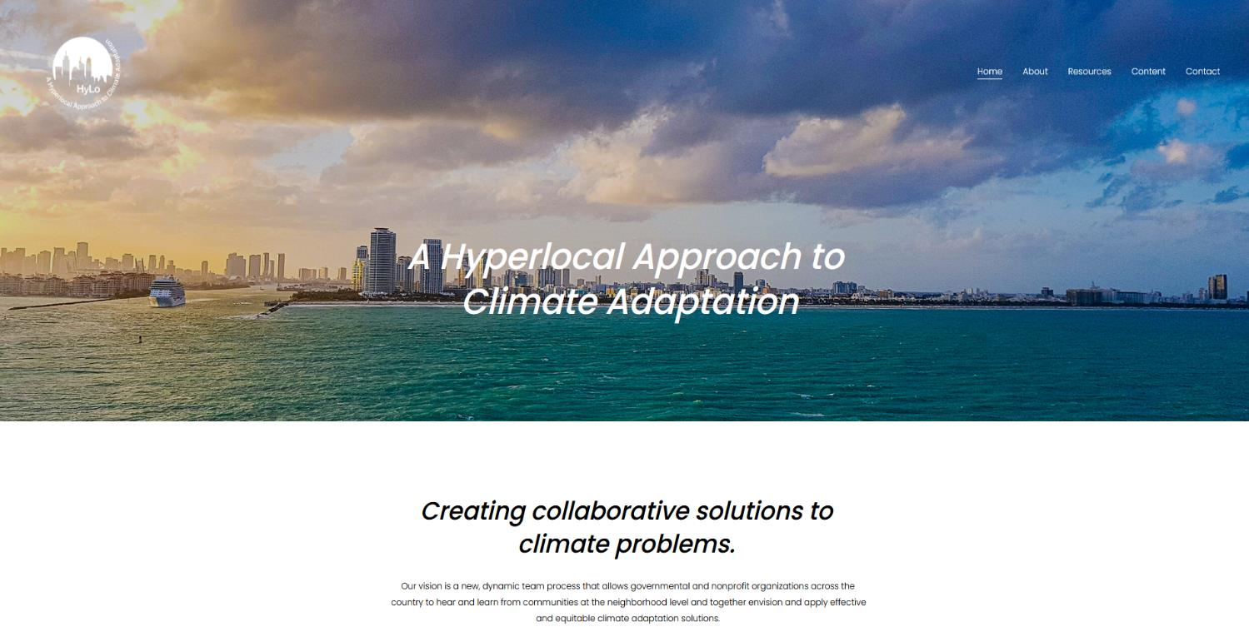

Slide 19
U-LINK Librarian
James Sobczak, STEM Librarian
  MLIS from the University of Washington (2018)
  MArch from Yale University (2012); BS in Architecture (2007)
  Joined the University of Miami in October of 2018

Slide 20

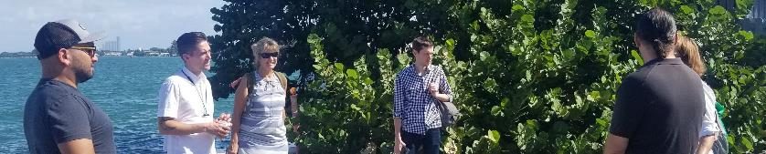
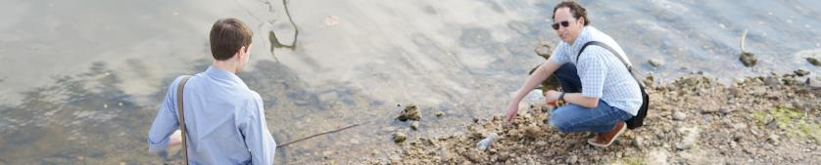
My U-LINK Teams
Next Generation Coastal Structures
PHASE
2
Plastics as Material Cultures

Slide 21
I've contributed as a team member by:
Conducting preliminary literature searches
Coordinating access to library meeting spaces
Collaborating on the scholarly output of my U-LINK teams
  Helped author (or contribute to) articles, presentations, op-eds
Engaging and promoting emerging technologies
  Examples: 360 Video, Microsoft Teams

Slide 22
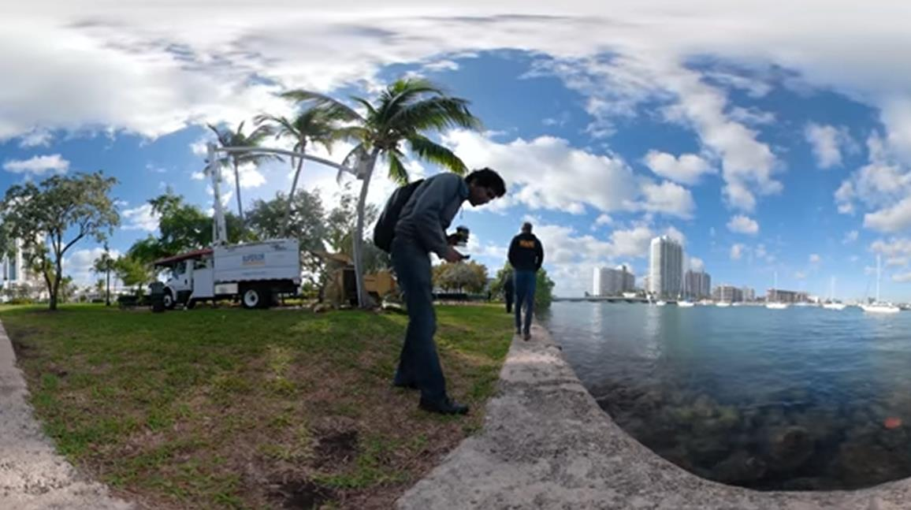

Notes:
Because my Next Generation Coastal Structures Team needed to document the complex and dynamic environments of the coastal sites we visited on our field trips, I had the idea of leveraging the University of Miami’s Creative Studio A/V equipment loan program to introduce the team to a GoPro's 360-degree waterproof camera, which could allow teams to virtually revisit sites and capture information not readily available in still imagery. Not only could they use this tool for this specific research project, they now know that this equipment is available to them and their students outside of U-LINK as well. So here we have a kind of synergy between two separate library programs, U-LINK and Creative Studio, each supporting the efforts of the other.

Slide 23
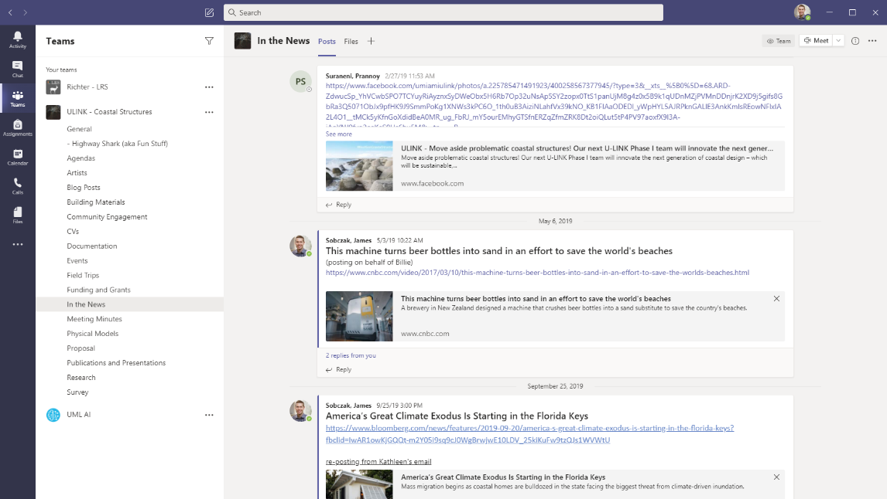
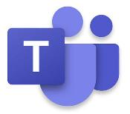

Slide 24
U-LINK has given me opportunities to:
Directly engage with faculty and researchers in my subject areas
Become a more informed subject librarian
Train in the “Science of Team Science”
Advocate for librarians as collaborative partners

Slide 25
Lessons Learned
There is not “one best way” to be a U-LINK librarian
Put yourself out there and try things
Realize that interdisciplinary science is difficult
  Each team dynamic is different, and each team has different needs
  Faculty might not know what you can contribute, so show them
  Do not take slow progress or failure as a personal insult to your ability

Slide 26
Assessment
Using annual surveys and focus groups with U-LINK librarians, we have sought to answer these key questions:
What roles do librarians play on the teams?
How do the teams benefit from the involvement of librarians?
What are the challenges or barriers to librarian involvement on the teams?
How can the library better support librarians in these emerging roles?
Notes:
This extraordinary opportunity has opened new avenues for our librarians to collaborate with researchers and become their partners.
It has also opened the door for UM libraries to gain insight into Interdisciplinary research and its challenges. This, inside knowledge has informed our library renovation planning, it may guide our professional development investment, and help the libraries better respond to Interdisciplinary research needs in the future.
From the beginning, we recognize the importance of assessing our participation on ULINK. Not only to ensure the success of our librarians in this initiative but also to identify challenges in research projects where librarians and libraries can step-in and help overcome in the future (meaning seeding the way for future opportunities).
So, In 2018 and 2019, we conducted surveys and a focus group to learn about librarians’ experiences on the teams. We wanted to know about librarian roles, benefits to the team, challenges, and how the library can better support the librarians in these emerging roles.

Slide 27
Survey Questions
In what ways have you interacted with your U-LINK Team?
What is the most meaningful interaction you've had with your U-LINK Team, and why?
Is there anything that your team has asked you to do that you think is "out of scope" for your role?
What strategies for engaging with your team have you found useful?
What advice would you give to future librarians participating in U-LINK teams?
Is there anything else that you would like to share about your experience working with U-LINK teams?
Notes:
To examine these questions, we developed an open-ended survey instrument that was distributed annually to librarians who participated on U-LINK research teams.
The results of the survey accumulated from two consecutive annual activities.
6 [out of 7] librarians participated on the 2018 survey, and 5 [out of 8] participated on the 2019 survey.
Results were analyzed and clustered around overlapping themes.

Slide 28
Findings: Key Roles and Contributions
Librarians contribute to interdisciplinary research teams primarily by:
finding and accessing information resources across disciplines,
connecting teams to experts and resources, and
improving collaboration and communication strategies.
Notes:
This first area is not surprising, but the second two are particularly interesting and promising. Librarians are serving as connectors and also serving to help the teams cohere and engage more meaningfully.

Slide 29
Findings: Challenges to Librarian Involvement
Level of inclusion and involvement
Clear expectations
Rewards and compensation
[Initial] lack of confidence
Leadership changes in higher administration
Notes:
During the focus group, challenges, and barriers to a successful partnership between librarians and research teams have surfaced.
Several librarians expressed frustration about the level of inclusion on their teams, some mentioned the need to determine clearer expectations - what is exactly the role of the librarian in interdisciplinary research teams? this question does not have a general answer of course- as each librarian comes with different expertise and skillsets.
With regard to the level of inclusion, it is important to note that: librarians who took part in more than one research team indicated that the librarian’s integration also relies heavily on whether the research agenda was established. In addition, other team dynamics may influence the level of inclusion of any team member not only the librarians.
Librarians also discussed the differences between them and other team members regarding rewards, shared authorship, and grants. Should rewards be different? In most cases they were different.
Lack of confidence in their own abilities and skills to participate as a research team member, was another issue we discussed. However, we noticed that concerns related to self-confidence faded once librarians gained more experience (after our first year of our participation).
Lastly, we learned that leadership changes in higher administration may also influence the librarians' participation on this or other similar projects in the future. Regardless of our contributions, inclusion and value. .

Slide 30
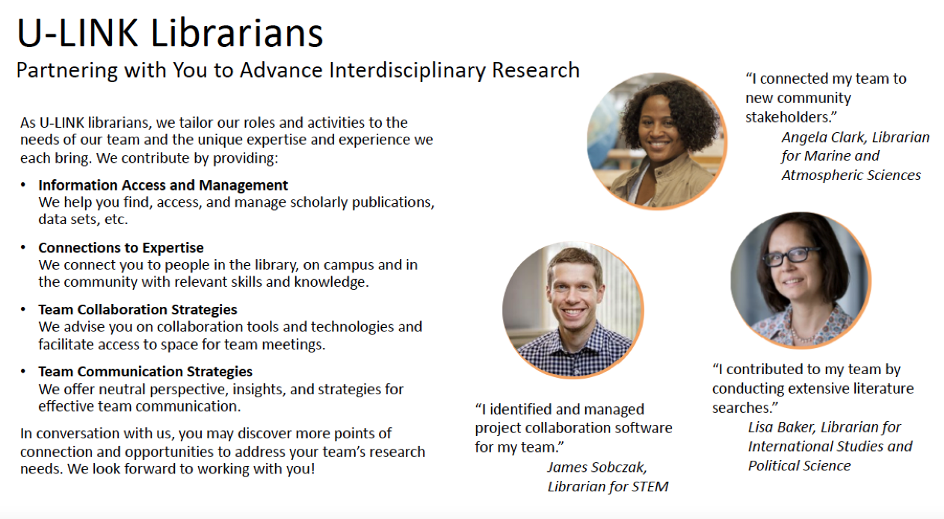
Notes:
With these findings, we were able to refine our description of the U-LINK librarian program to educate faculty members applying for U-LINK grants about the beneficial roles that librarians can play on the teams.
On this informational sheet distributed to applicants, librarians are quoted about how they contributed to their teams: by connecting their team to community stakeholders, conducting extensive literature searches, and identifying and managing project collaboration software for the team.

Slide 31
Emerging Roles: Librarians as Integration Specialists or Cultural Translators
Librarians may be evolving into “integration specialists,” helping teams address their most challenging problems:
  managing large teams,
  navigating communication with other team members, and
  finding a common language.
Another term that may be applicable is “cultural translator.”
Notes:
In the context of Science of Team Science (SciTS), prior research studies have examined the value of adding knowledge-bridging collaborators, such as librarians, to scientific teams. One study indicated that participation of a bridge builder or knowledge broker, such as a librarian, contributed to the integration of successful teams. Librarians can serve as “integration specialists.”
With their unique skill sets and neutral vantage points, librarians can help teams address some of the most common challenges they face, including how to
Manage large teams
Navigate difficulty communicating with team members, and
Find a common language with which to address the proposed problem.
Another way to describe the role of librarians might be as “cultural translators,” who are necessary for breaking down silos of all sorts – in this case, between disciplines, and for the benefit of society.

Slide 32
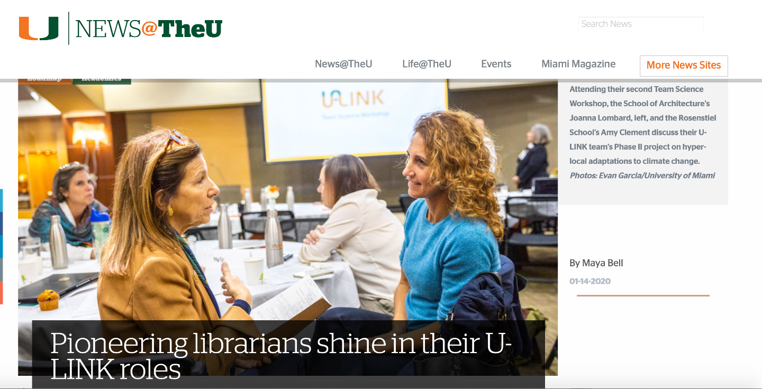
Notes:
The librarians have been called “pioneers” by University administrators who designed the U-LINK program. Dr. John Bixby, our former Vice Provost for Research, confessed in this local news story that he didn’t expect the librarians to become such important U-LINK partners. But, he said, “each of them has added content expertise to the team in which he or she is embedded and, pretty much without exception, our teams have reported that the librarians have become a critical aspect of their team.”

Slide 33
Next Steps
Collecting data on faculty perspectives in a survey of 2020 teams
Connecting with new Vice Provost for Research to develop next iteration of U-LINK program following the retirement of the outgoing VP for Research and his team
Supporting a U-LINK experiment to fund “Social Equity” grants in response to call for racial justice; librarians are serving as application reviewers
Developing our plans for a Faculty Research Commons

Slide 34
Connect with Us
Key Sources
Questions? Ideas? Please reach out to us:
Kelly Miller
kelly.miller@miami.edu
Angela Clark-Hughes
aclark@rsmas.miami.edu
Kineret Ben-Knaan
kbenknaan@miami.edu
James Sobczak
jsobczak@miami.edu
Crowston, K., Specht, A., Hoover, C., Chudoba, K., & Watson-Manheim, M. (2015). Perceived discontinuities and continuities in transdisciplinary scientific working groups. The Science of the Total Environment, 534, 159-172. http://dx.doi.org/10.1016/j.scitotenv.2015 .04.121
Hall, K., Vogel, A., Huang, G., Serrano, K., Rice, E., Tsakraklides, S., & Fiore, S. (2018). The Science of Team Science: A Review of the Empirical Evidence and Research Gaps on Collaboration in Science. American Psychologist, 73(4), 532-548. http://dx.doi.org/10.1037/amp0000319
Tett, G. (2015). The silo effect : The peril of expertise and the promise of breaking down barriers (First Simon & Schuster hardcover ed.). New York: Simon & Schuster.

