Slide 1

The search for a more efficient av survey
Ben Harry
Curator of Audiovisual Materials and Media Arts History
BYU – L. Tom Perry Special Collections
Notes:
Thank you, I would like to thank Chela, Merillee and Mercy for allowing me to present, and helping me to get this presentation ship shape and Bristol fashion. I sincerely hope that this will be useful to those participating today or viewing this webinar later. I have created this presentation for the manuscript archivist or librarian who may have to deal with audiovisual materials found in their collections. I found a great deal of information and support for dealing with audiovisual materials available, but much was directed towards an audiovisual archivist, who might be working in an archival environment that specializes in these collections or works primarily with these types of materials. as I continue with these projects, I realize that I also certainly could be more well-read, I regularly find more and more resources from which to draw, and many of these would have helped with this process. But I would present our experience here, and My goal for this presentation is to be a bridge between the very specialized world of AV archiving and those with a traditional archives background, and see if we can’t demystify some of this for archives and archivists working in broader manuscript contexts.
My presentation style is not to have the exact same content in my slides as I read in my presentation. I hope you don’t find this style maddening, but I simply cannot abide reading a powerpoint, so I apologize if this is difficult to digest. At least it will be available later, where you can pause the recording when the visual is not matching what I am presenting.

Slide 2
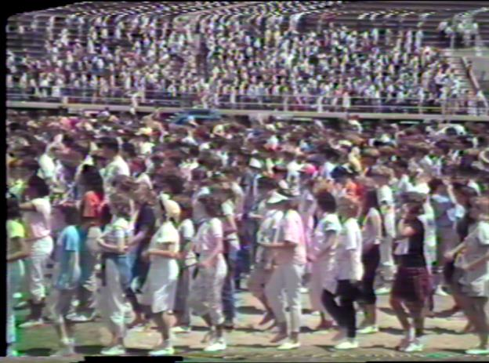
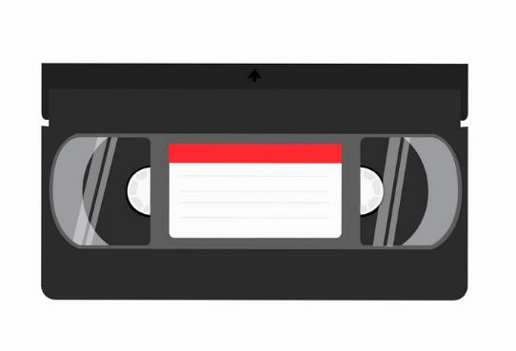
Ben’s Vernacular
Content
Carrier
Notes:
I would also like to quickly establish how I will refer to audiovisual recordings. I us the term “content” for the audiovisual intellectual content fixed in video or audio signals, and the term “carrier” to describe the physical audiovisual item that has a specific format. A carrier’s format and its content are somewhat inseparable because the format has such a great impact on the content, but since these carriers are at risk of physical deterioration and format obsolescence, we will talk about each one separately and refer to the process of maintaining one without the other. I am also sure that I will annoyingly refer to Av and audiovisual interchangeably.

Slide 3
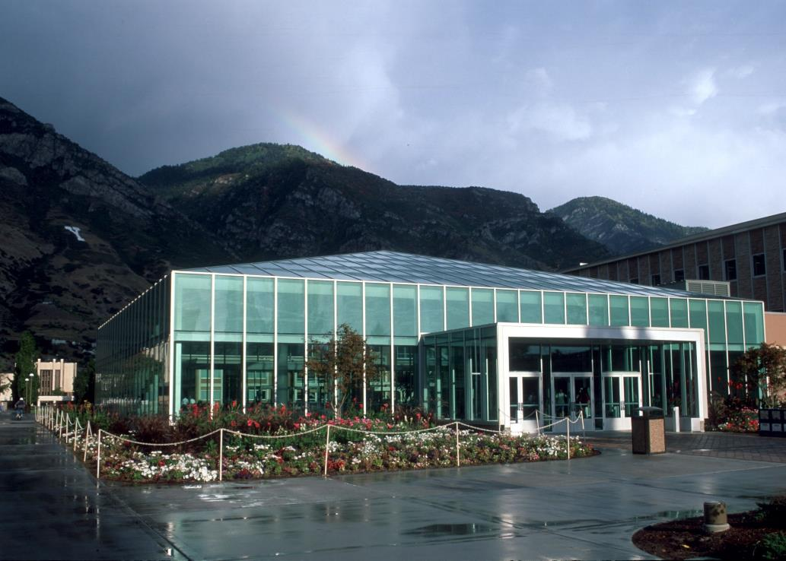

- BYU Library -
L. Tom perry special collections
Notes:
To provide you with some background to the situation we are facing, I will tell you a little bit about the L. Tom Perry special collections nested within the library, located at Brigham Young University, in provo Utah. At last count, the special collections has approximately 12,000 manuscript collections and over 86,000 individual containers in those manuscript holdings.
As many of these manuscript collections are from the 20th century, some type of audiovisual carriers are included within a majority of the collections. --

Slide 4
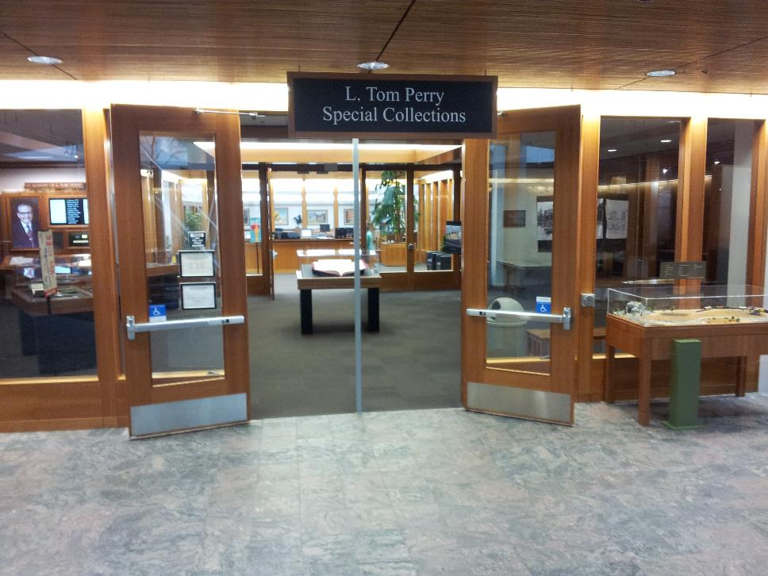
Where We Begin
BYU L. Tom Perry Special Collections (rare books and manuscripts)
Curators are assigned stewardship duties over collecting areas
  Typically by century
  University Archives
In 2018 I was hired into a newly-created position of Curator of Audiovisual Materials and Media Arts History
Notes:
How we specifically divide the duties in our special collections is by assigning curators stewardship duties over specific collecting areas: which are typically defined by time period: nineteenth-, twentieth-,
and twenty-first-century. The curators certainly work with donors to acquire collections, but their duties also include the shepherding of the materials, once acquired, through the subsequent processing and preservation stages, and then the promotion of those collections.
Due to our significant collections which document cinema, radio, journalism and television, I curate a unique subject-based manuscript collecting area designated as Media arts history. I then have a second responsibility as the curator of audiovisual materials. This newly-created position was designed to facilitate the sustainable preservation and access to the information contained on all audiovisual carriers found in special collections and
support the various manuscript curators in prioritizing preservation decisions in their collection stewardships. –

Slide 5
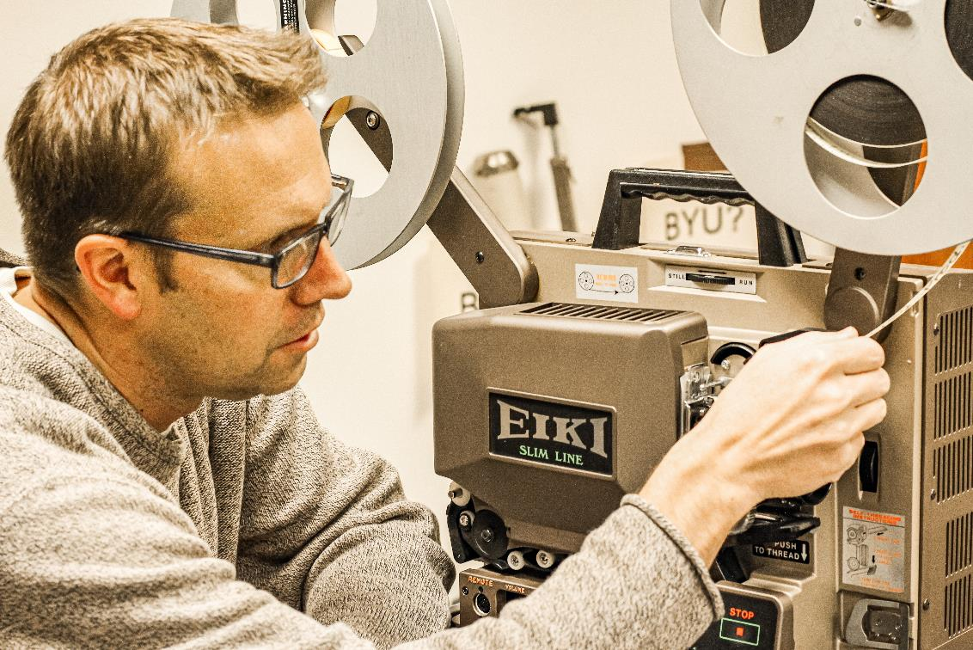
Where We Begin
In 2018 I was hired into a newly-created position of Curator of Audiovisual Materials and Media Arts History
What holdings do we have that are audiovisual in nature?
My Audiovisual Specialization
Notes:
When I was hired in 2018 to this position, it was apparent that to effectively engage with the collections, I would require a sufficient level of detail regarding the types and amounts of audiovisual materials found in the stacks, of which there was no current specific record.
My professional background is in audiovisual archiving. A graduate of the emeritus moving image archive studies program at UCLA, I began with motion picture film archiving and then branched out to include video and audio formats through my work as the media archivist at the national baseball hall of fame, and working in the national audiovisual conservation center of the library of congress in Culpeper virginia. With this background, and in my new duties as a manuscript archivist, I recognized that there is AV present in just about every manuscript collection, but that there is not always a great deal of crosstalk between paper-based archival discussion and the audiovisual archiving community which typically engages with others within this specialization, or focuses on media-only collections.

Slide 6
Hopeful to be Helpful
Archivists WITHOUT a background in Audiovisual technology
Happy to help
  Wrote an article
How did we find out what we have?
Why did we make those choices?
Limited resources due to diversified duties
Notes:
This situation leaves a great deal of AV material under the purview of archivists who might not be terribly comfortable or experienced in working with audiovisual materials. This situation has the potential to intimidate and result in hesitation when engaging with these materials, and I was hoping that I could provide a place to start with this presentation and my recently published article on this effort. I think that between the two, my article and this presentation, a person could gain some insight into what we did at BYU, why we did it, and hope this might dispel some of the uncertainty and trepidation that can arise when finding pockets of AV in manuscript collections.
As it is with my position, as I am sure many of you do the same, I wear multiple hats, and my time and resources were very limited, having only a few hours a week to dedicate to the locating, describing, and assessing of all AV found in the collections. , So, the pressing questions I had were “where is the AV hiding in this sea of hollinger boxes, and how am I going to find and identify it in a reasonable manner?”

Slide 7
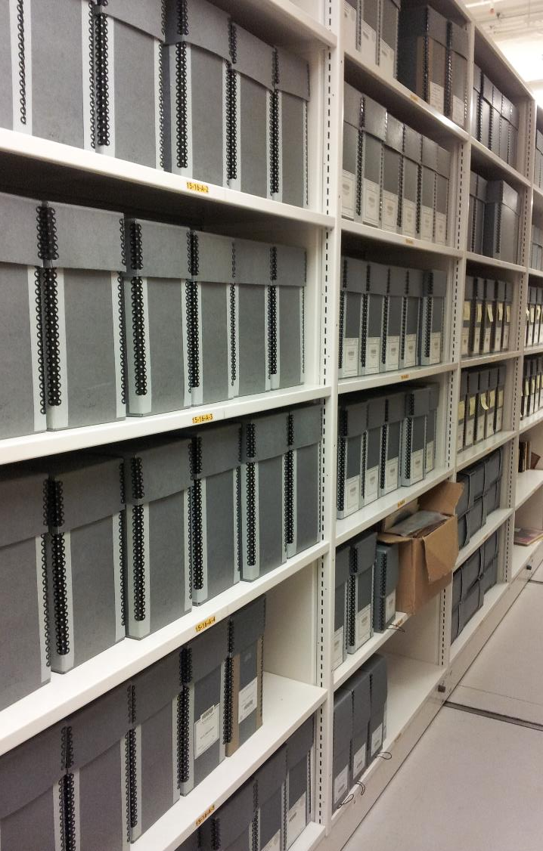
Physical Arrangement
Mostly kept in original order and organization, sometimes there was an AV box created at the tail end, but never consistent.
Notes:
Our manuscript collections are primarily arranged in original order, seeking to preserve some relational insight regarding how these disparate elements could have been contextually connected by their creator. They live on compact shelving that covers about a football field of space underground in the library.

Slide 8
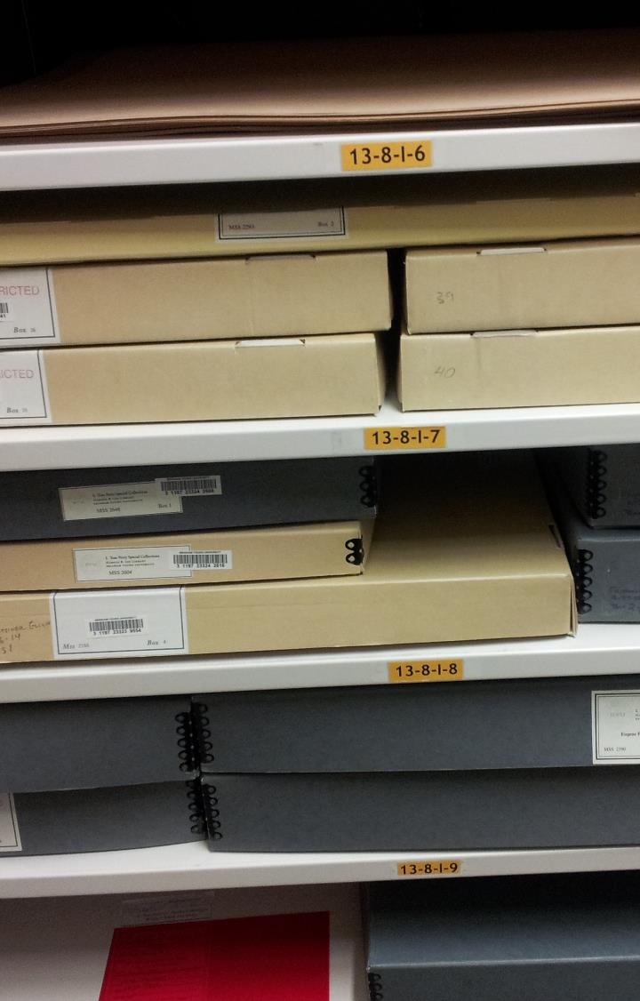
Physical Arrangement
Mostly kept in original order and organization, sometimes there was an AV box created at the tail end, but never consistent.
Notes:
As I walked up and down these aisles, I found some obvious Av materials, but it was mostly archival boxes and cartons. I knew that AV lurked in here, and I needed to search it out.

Slide 9
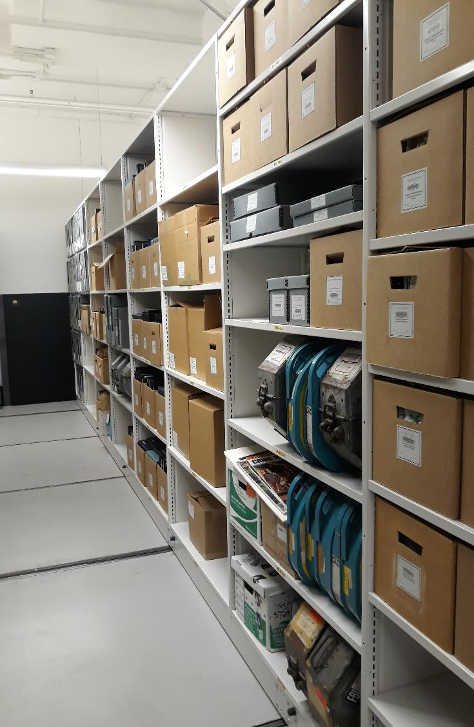
Physical Arrangement
Mostly kept in original order and organization, sometimes there was an AV box created at the tail end, but never consistent.
Notes:
I knew many containers would have paper only, and I also knew that many containers exclusively housed AV only,

Slide 10
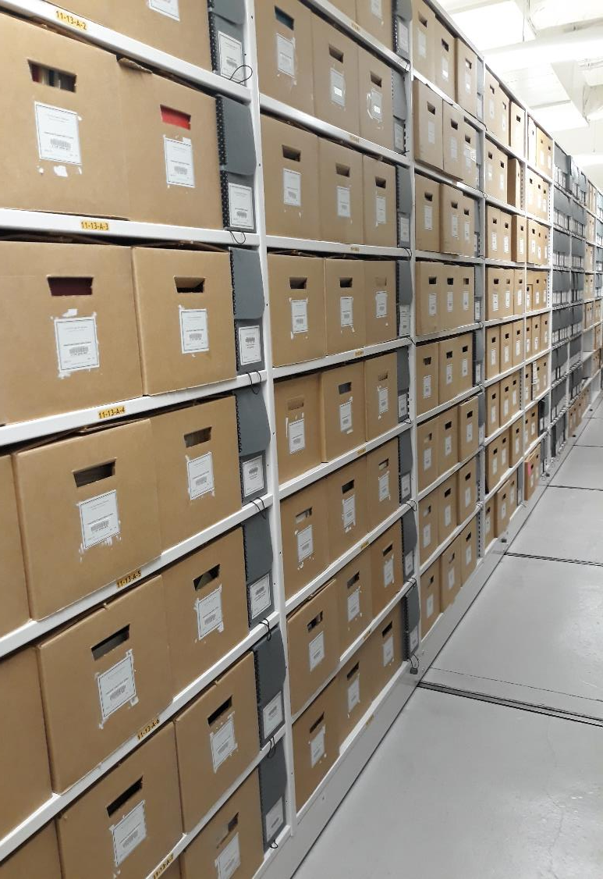
Physical Arrangement
Mostly kept in original order and organization, sometimes there was an AV box created at the tail end, but never consistent.
Notes:
and then there were some where it was mixed in together.

Slide 11

Notes:
I could start to see the road before me stretching out, and I imagined the task of pulling all 86 thousand containers in front of me. I needed to find a way to avoid opening every single container myself and documenting what I found . . . and my first thought was to turn to the records, finding aids, and databases to lead me to the hidden AV.

Slide 12
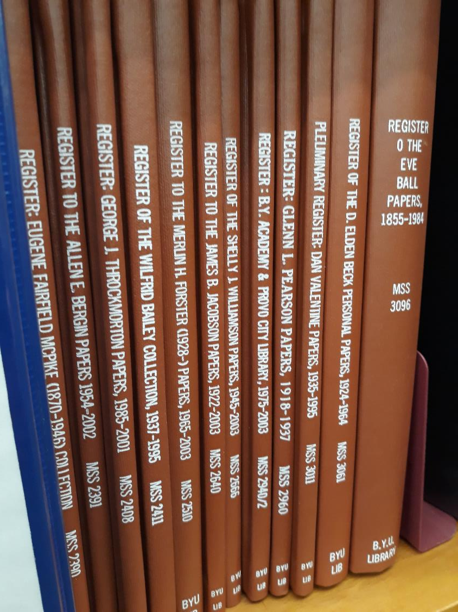
Printed and bound registers
Notes:
Some of our finding aids are only available in holdover physically-printed and bound finding aids,

Slide 13
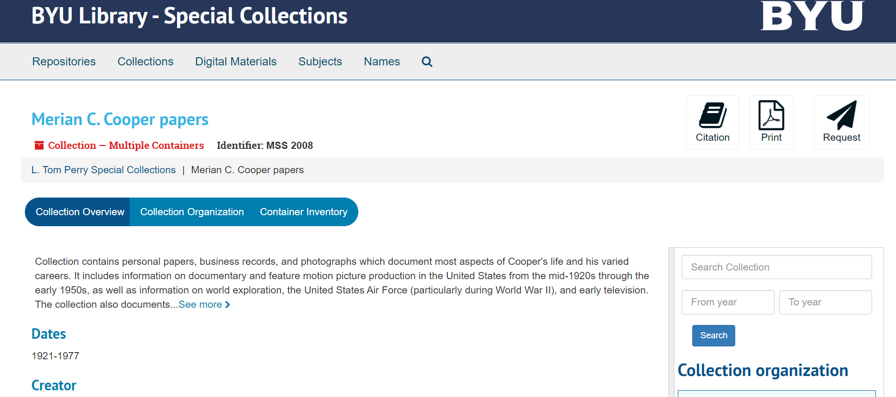
Notes:
some are online in our new ArchiveSpace application,

Slide 14
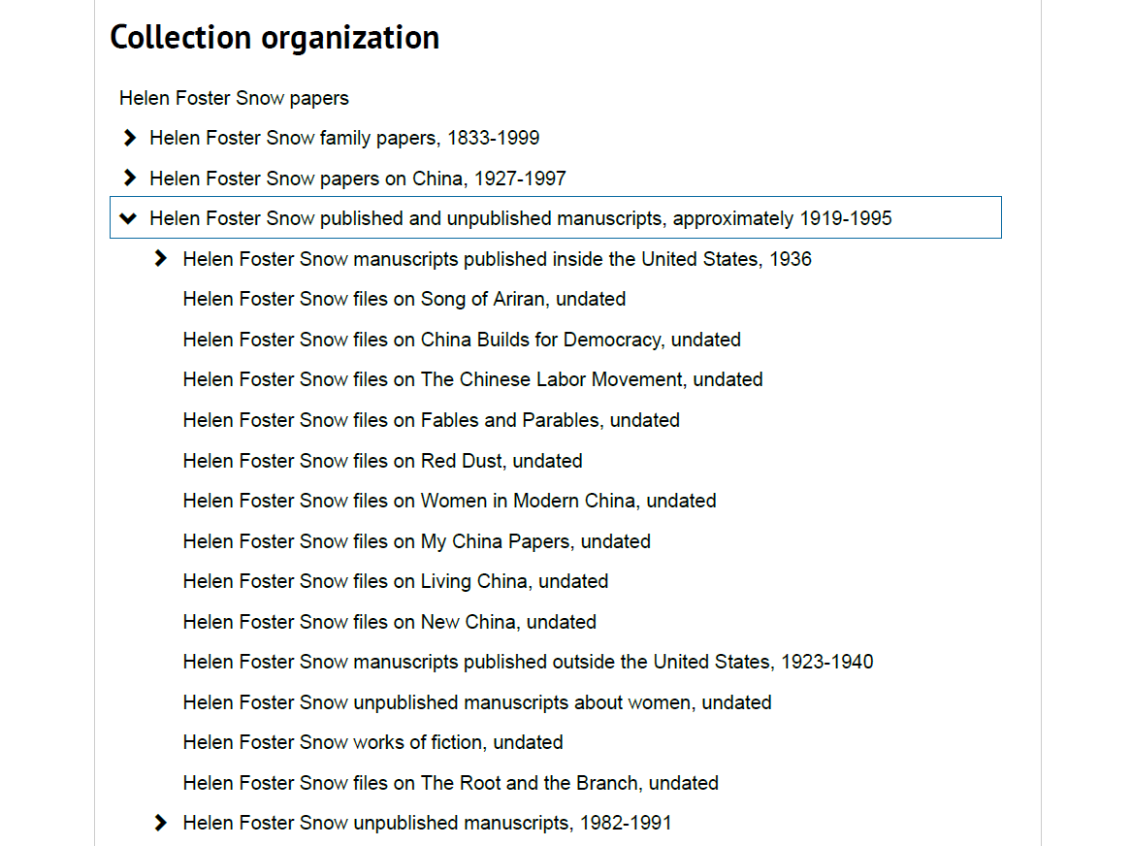
Notes:
and some are in the various formulations we have progressed through in the last 20 years

Slide 15
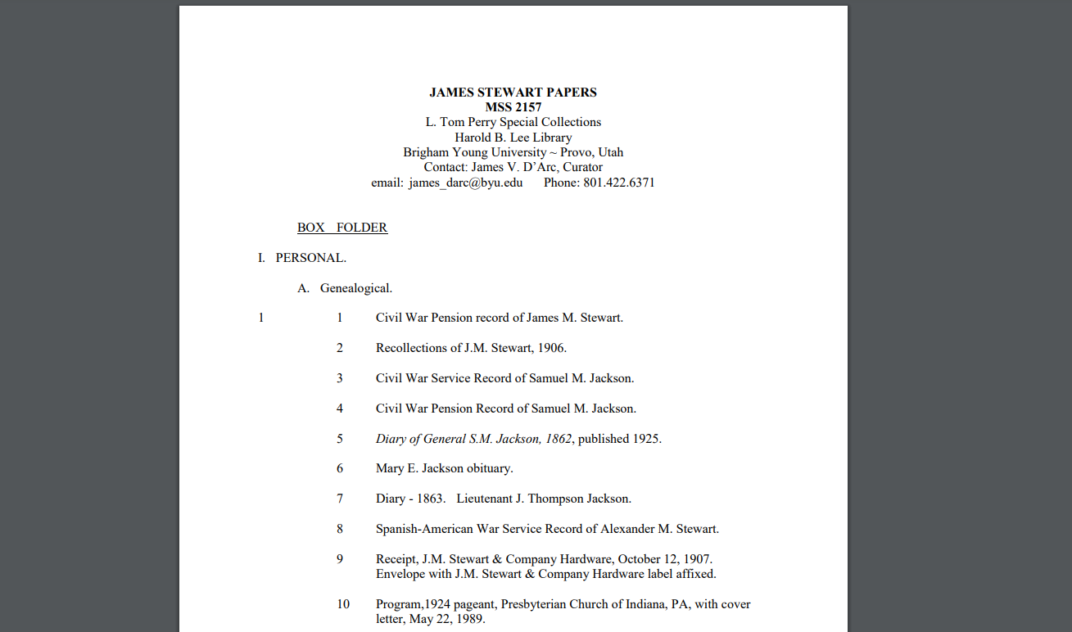
PDF, XML, etc.
Notes:
(like some xml documents, word perfect files, and things).

Slide 16
Records in the finding Aid
Finding Aid is NOT up to date. We had a few examples where an inventory was made, but often just had “Tape A” as an identifier. Often it was “AV materials” and some sometimes “6 audiocassetes, 8 vhs tapes”
Notes:
Some collections have good descriptions. But many are not up to date, many just have a container near the end described as “av materials” , these often have some formats and counts, but these are hit and miss and often inaccurate. We also have some descriptions that hint at the presence of AV materials, such as “oral history” but it wasn’t clear whether this was a typed transcript, an analog recording, or just what exactly. At times, AV items were described as ‘Tapes” and this was just lacking the specificity I was looking for.

Slide 17
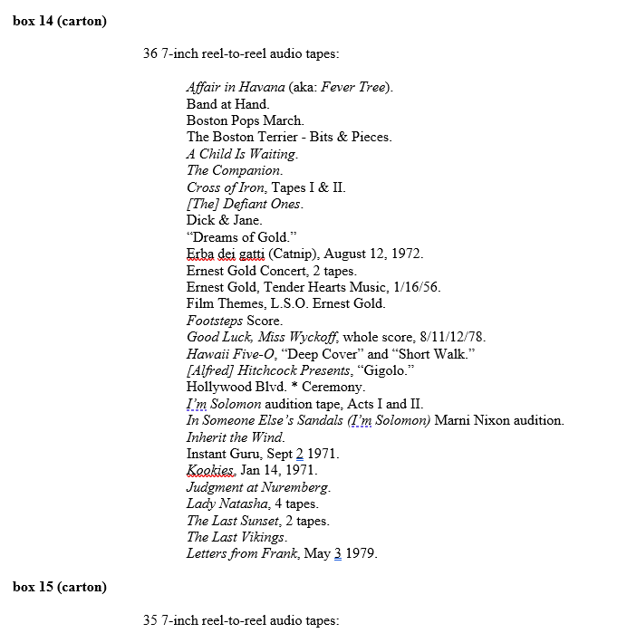
Notes:
Finally, even the best case scenario was a detailed listing of the contents of a container, yet the title of the items were simply what was written on them: such as “tape 6” or Erba dei gatti were. Which wouldn’t be of much help to a researcher. It is simply the nature of Av materials that to discover and describe them, they need a machine for playback. There is no scanning with the eye that we can do with paper docs, looking at just the top of the pages, or flipping through a folder to verify that these are all meetings minutes in chronological order, or even looking at folder tabs in a container to get a feel for what type of documents are kept therein. So it is understandable that these would be simply described by what is written on the physical carrier. Which was absolutely at the mercy of the creator of the records or manuscripts

Slide 18
Records in the finding Aid
Finding Aid is NOT up to date. We had a few examples where an inventory was made, but often just had “Tape A” as an identifier. Often it was “AV materials” and some sometimes “6 audiocassettes, 8 vhs tapes”
  Databases are only as valuable as the information that is entered.
  We inherit a legacy of works in progress.
  Backlog is an inherent issue with limited resources.
Notes:
As we know, Databases are only as valuable as the information that is entered. We are inheriting a legacy where not everything is entered into computer databases, and really it has only been the last 25 years that we have been doing this. I have been here over 2 years and haven’t made much headway on our backlog, so I am the last person who can cast stones. And this is a common situation that many of us find ourselves in.

Slide 19
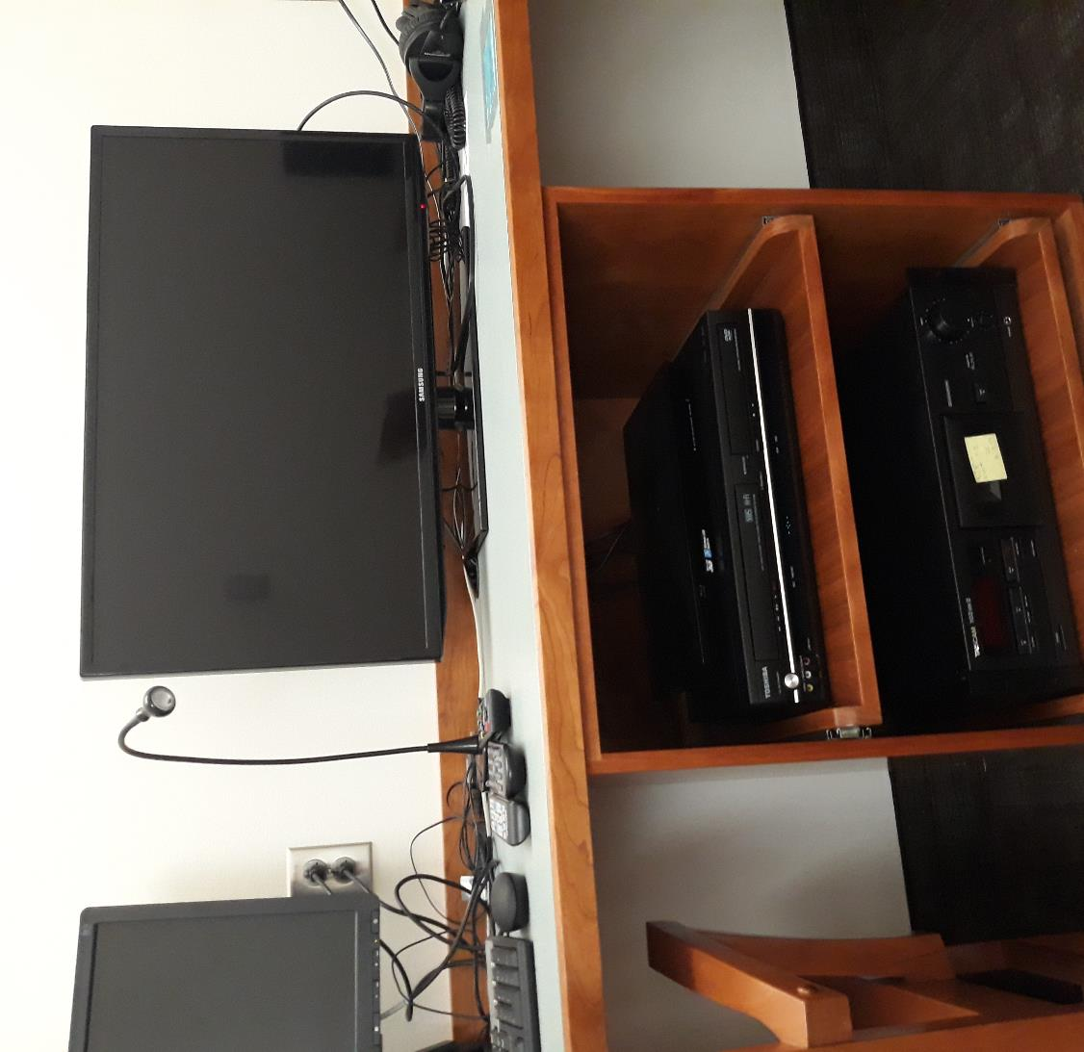
Our Situation
Ability to share AV with patrons
Reading Room playback
Digitization to DVDs
Notes:
The means we had for access to these audiovisual items was through some legacy playback equipment in the reading room. Here, a patron could play back vhs, audiocassette, and dvd or bluray discs. This isn’t ideal because the playback of analog recordings inherently wears out the material, and it also presents the possibility of catastrophic damage and loss if the tape gets destroyed or the disc gets scratched. irRegular maintenance on the equipment and untrained operation by a patron, staff, or faculty could result in the partial or complete loss of the original material.

Slide 20
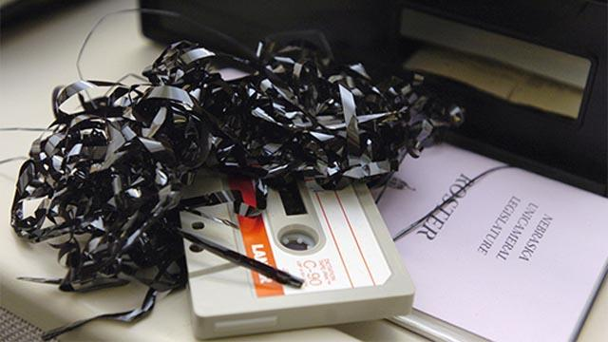
Disaster waiting to happen
Notes:
In this there is a justified reason to hesitate when accessing av materials. Machines can be quite destructive even when a person does have a good deal of experience. I had a belt in a machine break just a few months ago, and it resulted in some crinkling of the tape as I had to manually extract the media carrier from the machine before I could repair it. So once again, I am not pointing fingers of blame or shame on those who have hesitated when dealing with these. But the truth is also, that technology has developed far enough that we now have sufficiently robust digital technology and established guidelines for standards that aid us in the preservation and access of these materials, and these materials do have expiration dates.

Slide 21
Problem: AV Fragility
Playback equipment is disappearing
Knowledgeable experts are disappearing
Materials breaking down
Untrained handling destroys materials
Notes:
There is ample motivation to get these materials safely digitized for access and preservation purposes sooner than later.

Slide 22
“There is now consensus among audiovisual archives internationally that we will not be able to support large-scale digitisation of magnetic media in the very near future. Tape that is not digitised by 2025 will in most cases be lost.”
-NFSA.gov.au, Oct. 2018
Notes:
These recordings are at risk. Although this opinion is a little too soon, in my estimation. The National film and sound archive of Australia predicts that content stored on magnetic media only has until the middle of the decade to be widely recoverable . Now, I don’t believe it will be absolutely unrecoverable, but it is no stretch of the imagination to foresee these materials becoming more expensive to transfer through boutique audiovisual transfer facilities. Presently, There is still a good amount of this analog equipment out there, and quite a few vendors offer services of transfer, but these will diminish over time. so now is the time to deal with these materials while the market supports keeping costs lower, and before things become too fragile or cost prohibitive to transfer.

Slide 23
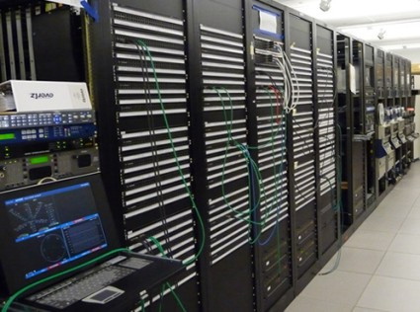
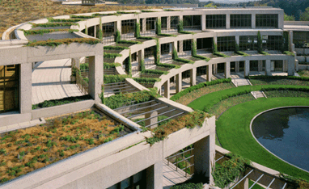
2019 Culpeper, Virginia
Notes:
When I started at the Library of congress in 2009. We were digitizing in a production environment that preserved audio and video at an amazing scale. Here we were ten years later in 2018, and at BYU we hadn’t really engaged in such a systematic program, so I felt it was time to get us up to speed.
With a sense of urgency, and with so many decisions dependent upon the knowledge of what we actually had it was a high priority to capture this information. – here I am thinking of grant seeking, personnel hiring, building out our own AV transfer capabilities, and so forth. So many of these essential decisions hinged on getting some good data about what exactly we have in our collections.

Slide 24
Where We Begin
(Review)
Urgency with addressing AV
86,000+ containers
Limited resources due to diversified duties
Just had to get started!
  Where?
  Who?
  When?
Notes:
So, in review, I wanted to start our assessment last week, yesterday, or a month ago, I had 86 thousand containers to go through, and I had roughly one or two hours a week to dedicate to it. Sound familiar? Probably so.
In fact, I was so eager that I jumped right into the process and in hindsight might have even forced the issue a bit hastily, but I thought if I could get immediate feedback, I could adjust as we went along. But I just, had to get started. I love gathering information and coming up with well-thought-out principles which drive practices, but I really wanted to avoid having things stall this assessment. I felt I could trust my experience and instincts, if I made sure to watch things closely, check back and thoughtfully review the feedback I would receive.

Slide 25
AV Assessment: Initial Trial
Needed a sample to see what we were finding
  Format
  Feedback
Piggy back onto annual shelf read
Compact shelving, one bay, directions to students
Notes:
Contacting our physical stacks manager, I found that he employed six students that help him manage the physical stacks. He had a regular process in place where those students would visit each box in the entire manuscript area and verify what it is on each shelf location, as well as peek inside containers to identify potential conservation issues. We call it an ‘annual shelf read’ but the time frame isn’t quite always so exact, it is like painting the golden gate bridge, just when you finish, it is time to start again. When I began talking with him, he had just recently re-started this effort only a week or so before, which lead to my hurried attempt to piggy back onto this procedure and adjust on the fly. So the students were starting in bay 11 of the manuscript stacks that week. That very Thursday, I quickly took over the following weekly training meeting to present to the students examples of audiovisual carriers and the project as a whole.

Slide 26
Notes:
I sold them on the value of content on AV carriers, I taught them to appreciate the last century of machine readable formats, and I presented them with a visual guide of most common formats to aid in the identification of AV formats they would encounter.

Slide 27
AV Assessment: Initial Trial
Data Decisions
  Data set we wanted.
  Data set we needed.
  What was MOST essential or TRULY essential?
What can you actually tell from a physical carrier?
Grouping materials of large numbers
Notes:
The project design had to answer some essential questions. Due to my experience in audiovisual archives, I knew that there was only so much information a person can glean from a physical inspection.
I had participated in AV assessments in the past. There are some tools available that can really help a person wrap their minds around the considerations one needs to have in mind when inspecting and assessing media. I had attempted these types of actions before and tried to capture as much data as possible.

Slide 28
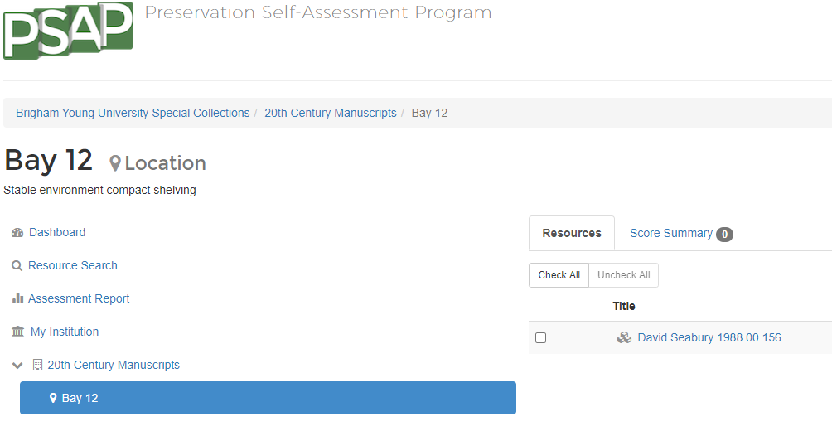
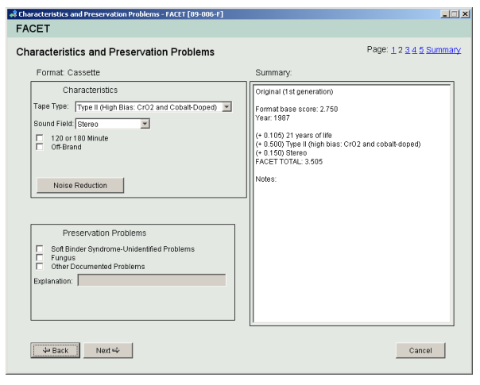
Media Assessment Tools
Notes:
Here are some examples of really nice systems that allow one to describe the conditions of an individual AV carrier in significant detail.
In my previous experience I had found that after I had spent many of my own and or other’s hours filling these fields out, that by and large I ignored them when we actually reached the point of digitization. Although it might be listed on the carrier how long the recorded content was thought to have been, anecdotally I would report that almost half the time it was incorrect. So the granular data from these assessments was more of a suggestion than reliable data. Also, I wasn’t exactly looking for granular at this time, I was looking for more numerical scale data across the entire repository. And these tools didn’t offer the shortcuts I knew I needed to take.
It can be very time consuming, using a tool such as FACET to describe a box of cassettes. Sometimes you have a box of 96 cassettes. AV assessment tools usually, want a description of each item so that it can compile that data and it could tell you how many items you had suffering from mold, or how many items you had of one recording configuration. all great data that can yield powerful reports, but in this situation it just made more sense to use math and determine that a container had 96 audiocassettes in it, and we could move on. If we count rows of 4 by 12, stacked up two high, that was 96 audiocassettes. What if they are stacked a little funny underneath and there is actually only 90?, or even 100? To me These were acceptable discrepancies. Rather than take the time to count them all out, since we are talking about containers in the thousands and AV items in the 100 thousands, I was focused on rounded, large numbers for decision-making, so even if I came out with a total number for a format type that is 100 items off for some of these most common formats, I was going to be okay.
As far as conservation issues go, it is common to find these issues at the container level. If one single cassette in a given box has mold issues, then usually the whole box did.
So I felt comfortable recording these at the container rather than the item level.

Slide 29
AV Assessment: Initial Trial
Data Required
What format(s) in each container.
Numerical count of each format.
Is that it?!
Notes:
As I reviewed my own past experiences and the new project before me, and knowing that these student workers probably had little contact with specific av materials, I cut the data fields to be gathered to such a small unit that it surprised me. What I needed was a count of each format in each physical container. That was it. What is the format in the container, and how many are there. That was enough for me to make analyses that could inform in-house digitizing initiatives, personnel requests, and would facilitate the solicitation of grant funds for preservation.

Slide 30
Applying MPLP Principles
Expend the greatest effort on the most deserving or needful materials
Establish an acceptable minimum level of work and set that as the benchmark
Get the most information available in a usable form in the briefest time possible
Embrace flexibility
Notes:
In my mind I thought of the MPLP approach and how it had the potential to liberate from lengthy processing to prioritizing making materials available to patrons more quickly by letting go the desired level of granularity that so many of us crave to give our collections.
Addressing point number 1: Due to physical format, an urgency is inherent with these materials, I would count these materials as being needful and deserving.
Addressing point number two, yes, what is the minimum essential that balances getting the necessary data required. I really needed to apply a razor to this question of what I needed and what I felt comfortable extrapolating from the gathered information.
Number three: okay, that was my goal from the beginning. The key terms are most, usable, and briefest.
And to point 4: well, this also inspired me to just jump right in, and adjust as we go along rather than spend too much time deliberating about possible scenarios, and get some real ones to adapt to.
Okay, so MPLP was all about NOT doing things at the file level
And indeed I recognize that each AV item needs to be handled individually when digitizing and describing, as in all reality AV items most commonly require item-level description which would seem to go against the application of MPLP practices as we usually apply them. but I was looking for the macro view of what I had in the special collections as a whole. AV already gives us headaches at times when thinking in traditional organization levels. as An audiovisual carrier can be understood as its own intellectual content container as a myriad of recordings can be stored on one single carrier. So I truly tried to apply the spirit of the principles rather than the letter. and holding fast to these principles did provide useful clarity in approaching some of the more difficult discussions.
The desired result would allow me to not only compile a report on the numbers and data that would drive decisions, but I could present a curator with a list of AV item counts and formats found in a specific collection, broken down by container level. This would be a great step to enabling us to collaboratively address our audiovisual holdings.
So I gave the students a few weeks to work through bay 11, and this is what I got back

Slide 31
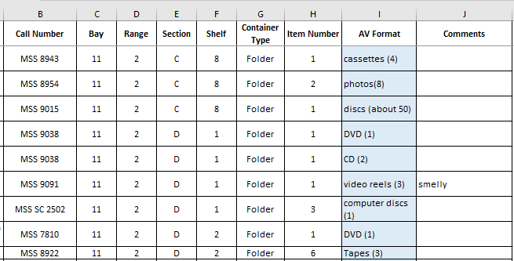
Notes:
<Wait four seconds>Hmmm. Yes, I was getting a collection call number identification, a physical container, and a location. But, oh boy, did I need to provide some better training. What qualifies as media? How would I characterize a floppy disk? It requires a machine to get at its information, but is it media? Is it Audiovisual? I needed to define for myself and the workers more specifically what we were looking for, and how to identify it in the report.

Slide 32
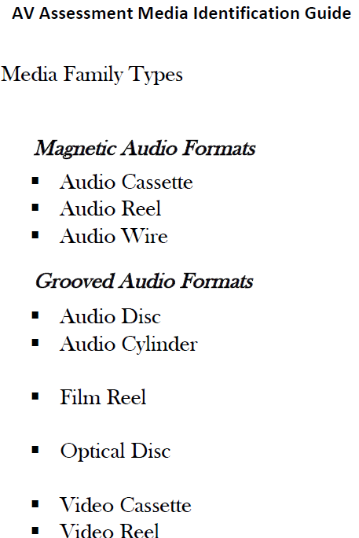
AV Assessment: Re-Tooling
Training
  AV Identification Guide
  Enthusiasm level
  Breakout groups
Notes:
One of the first things I realized is that I needed to improve the way I teach the identification of AV materials. Particularly in light of the fact that my audience had no experience with these. This lead me to conceptually change how I trained the identification of these carriers. I reordered the AV guide, creating a taxonomic approach, and pointing out that we needed to be much more specific in our descriptions for the data to be useful.
I broke them down into groups of grooved media, magnetic media, optical media, and transparent film. Then I demonstrated how specific identification within these genus could be performed.
While I was doing this training, I saw some studentses eyes glaze over and I knew I had lost them. On the other hand, I had one student who sat forward on the edge of her seat, and she started asking questions and independently inspecting the examples I had brought. It was at that point that the light in my head turned on. I was asking a lot of some of these students who had no interest in retro AV formats to try and learn and remember all of these variant formats.
I also had calculated that if our initial findings held up to extrapolation, that up to 75 or even 80% of our AV holdings were in just 5 of our most common formats. These weref VHS, standard audiocassettes, optical discs, gramophones discs, and quarter-inch open reel audio.
If I could get the majority of the students to correctly identify just those 5 types, and to know enough to recognize AV items that were not one of these five, then they could move through the process quite quickly, and identify much of what they came across.
You see, If the audit became too daunting, they would likely get discouraged, maybe avoiding the AV step all together, or even prohibitively slowing down the shelf read so the collection’s manager wants to remove this aspect.
I had to face it that as much as I love audiovisual technology, This was a topic they may have NO natural interest in. All of us, when we are engaged in something we find fascinating, will increase our efficiency and energy, and on the flip side we can get discouraged, confused, and bored with things we don’t really care about. These students weren’t archival studies students, they were marketing, business, engineering, dramatic arts, or students of music. This was an on-campus job that they would have for a few years until they could find something more related to their studies and careers of choice.
So in the middle of this training meeting I already began to adapt the process in my mind. After the meeting I spoke with the collections manager to make sure it was okay for me to approach this particularly interested student. Which it was, and we came up with this new approach: Five of the students would complete the shelf-read as normal, but adding an audiovisual identification column. They would identify the five most-common formats specifically, and provide a numerical count per format per container. If they could identify items as AV, but they weren’t one of these base 5, they could just record that there was AV (and then a count).
This interested student would not perform the shelf read as the others would, but would take those hours earmarked for the shelf-read each week, and dedicate them to going through containers already identified as containing AV. She would verify formats and counts, and using the AV guide be able to specifically identify more obscure formats.
I would only need to audit a few containers a week that she had already checked to make sure she was identifying things correctly. And If anything was particularly questionable to her, she just flagged it in yellow for me to inspect myself. My one hour a week that I could dedicate to this project, would now be much more efficient and meaningful!

Slide 33
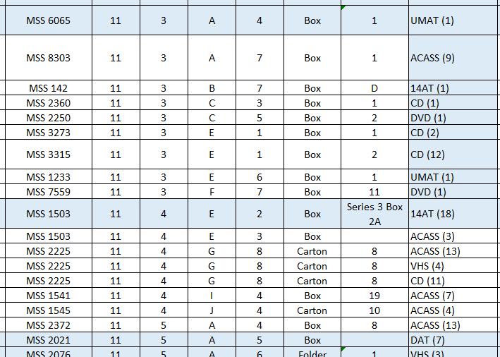
Results: Specific Data
Notes:
The final result, was that from November of 2018 to March of 2020, under a year and a half, we had a first-pass of all 86,000 containers.
Now we had collection identification, container location, and a line item for each format type.
I have outlined here how one physical container, carton 8 of MSS 2225, had 13 cassettes, 4 vhs, and 11 optical discs contained therein. This illustrates how we handle multiple format types within a single physical container.
<Count four>

Slide 34
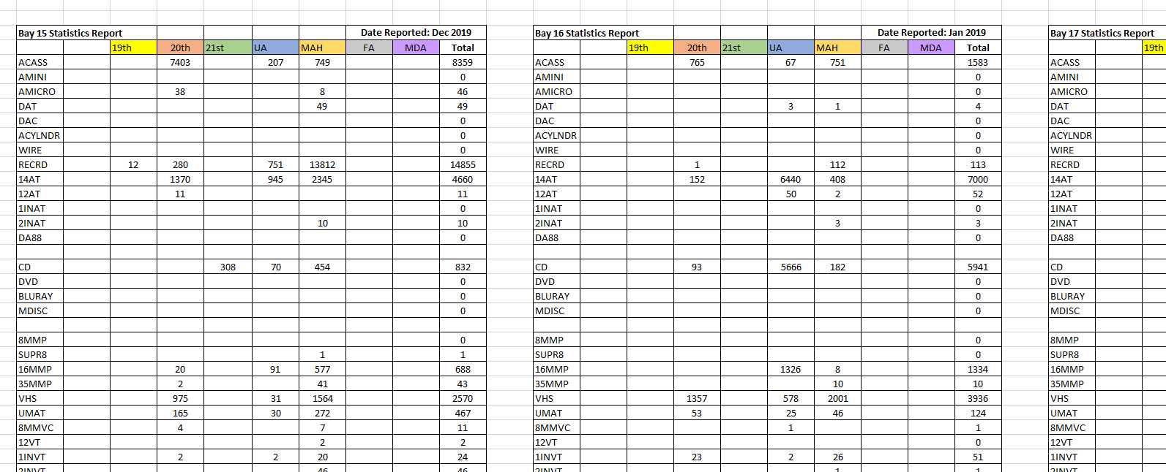
Results: Format- and Curator-specific Data
Notes:
We were able to compile the data across entire bays, breaking down data by format type and by collecting area.
<Count four>

Slide 35
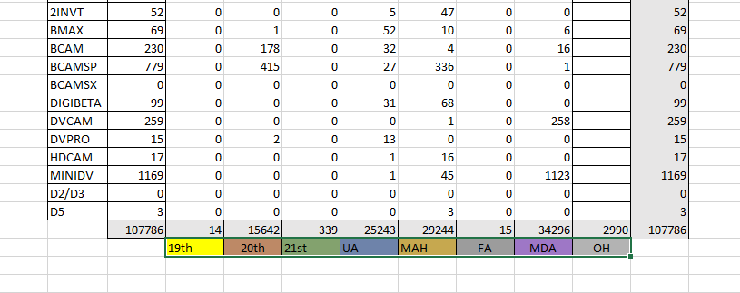
Results: Format- and Curator-specific Data
Notes:
We could also easily compile that data from all bays and across all collecting areas to have our composite data for the Special Collections.
<Count four>
It took the five only about until July 2019, which is eight months, to perform their initial audit, and then the AV specialist, left employment here, and when I found another who finished the work, we finished up our first AV audit in December of 2019. So, it took just over a year. But I am sure we could have even done it in less time without the turnover of the AV specialist.
From these findings I was able to compile and synthesize the data write up a report on the state of AV in the special collections.

Slide 36
Proposals to Library Administration
Dedication support for digital storage
  410 TB digital storage over lifespan of project (about 15TB per year)
Dedication support for in-house and boutique outsourcing for AV preservation
  Purchase of a motion picture film scanner
  Additional AV Preservation lab supervisor position
  Annual budget line item for
    AV Lab equipment (both purchase and repair)
    Boutique outsourcing
Notes:
Based upon those numbers, I was able to propose some recommendations to library administration.
And these are the main recommendations I included in the report.
I asked for a commitment to the digital storage of the content in digital form. To help the administration understand the scale that such an undertaking would result in, both an estimated total as well as an estimated yearly requirement.
I also was able to use data to back up the request for an in-house preservation effort. I received quotes for the transfer of our major holdings from outside vendors, and could compare those costs to my estimations of in-house digitization. Not only would it be a huge savings, but it would involve students in the transfer of these materials, providing them with employment and experiential learning opportunities.

Slide 37
What Are the Next Steps?
Preservation Prioritization
Generating a Workflow
Prioritization
Notes:
The av assessment documentation has taken on a life of its own In helping us take further steps in these processes. The initial question we had after generating a list of what exists, was to ask what items to digitize first? If we were indeed facing these timelines of inability to preserve the content on these carriers, then some content might be relegated to NOT being preserved. How do I make selections of what to prioritize? How could I make this assessment work with the minimum amount of re-invention for the next step?

Slide 38
What Are the Next Steps?
Preservation Prioritization
Format
Create a risk scale. This is hard because some formats are already cost-prohibitive
Notes:
So, During the time that the assessment was in process, I was reviewing reports and documentation to come up with a risk rating system for each format type. Some of this rating is guesswork, because the newest formats haven’t been around long enough to broadly fail yet, there isn’t a great amount of data on some of these. Also each collection seems to present its own unique challenges, and had its own unique storage history. There are a lot of different opinions out there, and on different days I myself had different feelings about these formats and their prospects for longevity. Added to that is the fact that some of these formats were likely already cost-prohibitive, unless we could identify and champion content that was of the highest priority. But at the risk of feeling like I was reading tea leaves that kept moving about in my cup, I came up with a rubric to assign a value to each format considering it’s fragility as well as its risk of obsolescence.
Now, I just mentioned that some of these formats are very expensive to transfer. Such as 2-inch video quad machines. But, atleast now that we KNOW where they are located, and curators and subject specialists can look at these specifically and determine if the content is worth putting together a proposal for. There are going to be tough decisions to make, but now we can move forward from a place of information.

Slide 39
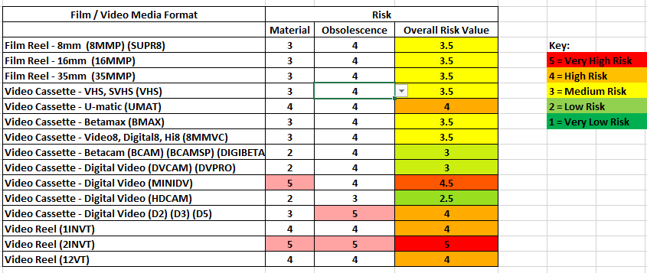
Format Risk Evaluation
Notes:
Some of these values are subjective for our institution, so please, you are welcome to look over ours as a reference, but also understand that we have a dry climate here, that our storage situation is robust and mold is thankfully NOT something we have to battle with as many others do, and I took into account these types of considerations when compiling these.
<beat> Also these are subject to change. If I find greater difficulty in transferring one of these formats than anticipated, I will move it up on the scale. These are initial rankings and subject to further experience. Also, each collection has its own history, and these are gross generalizations for each format type.

Slide 40
What Are the Next Steps?
Preservation Prioritization
Content
Need the curators to engage
Notes:
The second side of the prioritization coin was that of content. I didn’t want to spend all our time preserving materials solely based upon their format. I needed to mine the specialized knowledge of the curators and subject specialists in identifying collections that were in most need of preservation or were most commonly utilized by patrons.
I knew the curators were busy, so I just asked them to rank the collection as a whole, not requiring them to inspect the collection’s holdings individually. Certainly some collections warrant such a close review, but I curators often know their collections so well, it simply takes a moment for them to consider how to evaluate content at the collection level.
To offer my support in this process, I made a suggestion rubric to facilitate the curator coming up with an evaluative rank for each collection’s content.

Slide 41
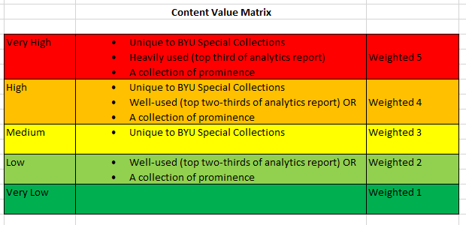
Notes:
So here is the list of my suggestions.
The single most-influential question I felt was whether the material was unique. If the curator believes us to have the only surviving recording, then it needs to be a 3 or above. And no matter how well used it was, it would only garner 2 if they believed it could be found elsewhere. Specific requests by curators and patrons drive much of our preservation efforts, but this value was an effective tool to drive the systematic digitization when requests are slow.

Slide 42

Funding requests
This allowed a detailed report to administration about what we had and what we were facing.
It facilitated comparing outsourcing cost to in-house cost.
This will also be helpful with grants, mainly with prioritization and carrier counts.
Notes:
As I mentioned earlier, completing this assessment has allowed us to make decisions based upon data, and has provided direction in our actions.
<beat>

Slide 43
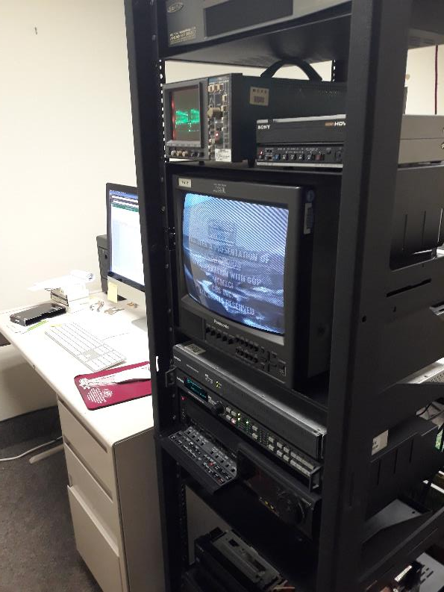
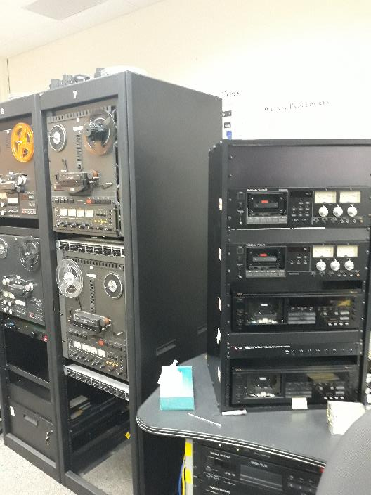
In house digitization
Notes:
During the time of this assessment process I also began the oversight of a media digitization lab here in the library. We had inherited a good amount of audio equipment for such transfers, and we had some funding for student labor, so we put together some suites where this preservation could take place immediately. even while this assessment was still in process, we began the prioritized digitization of our holdings. As soon as the first Bay’s report was complete and I had my risk and content matrices in place, we were able to prioritize the preservation of these materials for at least one specific bay. This began in April of 2019, just a few months into this project.
During this time we were able to purchase some needed equipment and begin the build out of the video preservation suites, and base decisions upon the data we had gathered. We could really hit the ground running: as soon as we had our equipment tested and ready, we could begin working with prioritized projects to work out the kinks of the workflow.

Slide 44
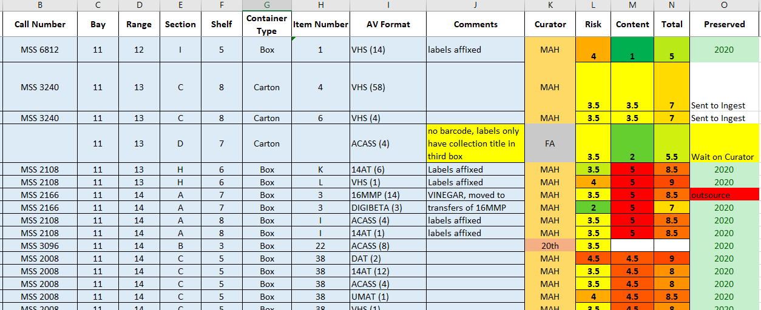
AV Assessment Expands and Evolves
Notes:
And indeed, the assessment documents have become our entire preservation workflow roadmap. Our preservation is driven by patron research requests, curator requests, and then the values we have established in these columns.
On the assessment sheet is now where we keep track of preservation completion. Project size is typically performed by container for a manageable project to engage with, in the lab. When a transfer technician completes a project and needs a new one, if there isn’t a pending request in the queue, they simply have directions to look at the assessment and choose one that has an 8 or above total rating on the preservation prioritization scale. When all those are exhausted, we will look to all the 7.5’s and so forth. It has allowed us to create a workflow that ideally can manage itself as much as possible.

Slide 45
Work in Progress
Metadata
Integrating Metadata
Current project to figure out workflow to update cataloging records and finding aids
New or Old
Balancing new acquisitions and legacy collections
Notes:
As this webinar series implies, this entire venture is a work in progress. We are still ironing out how we best update our metadata. In the actual transfer of the content we are finding that a significant amount have incorrect identification, labeling, dates, and so forth. The post-digitization process and the expectations of who will update this metadata and how to discern which is authoritative are something we are still working out. But this process has given us actual problems to work through and address. with a critical mass of actual files and situations to address, we hope to develop robust procedures.
Furthermore, To facilitate the initial processing of collections, and not have things simply described as “Tape 6” in metadata, we are trying to integrate AV digitization into the processing of new collections as they are acquired. Of course, We have a century of backlog as well, so we are trying to balance these workflows and project streams. Often times new acquisitions might be even more fragile because their storage situation hasn’t been as kind as ours to our legacy holdings.

Slide 46
Limitations and Shortcomings
Data required and procedures shifted during first survey period
Invariably materials were missed in first survey
Developing method to update most efficiently
Shelf-read and AV assessment progress in their own directions. Stakeholders’ needs require monitoring.
Notes:
By beginning the work and adjusting mid-process, we left some inconsistencies in our initial survey, and we need to circle back through this assessment to get things consistent. Certainly we have also found that materials were missed in the initial survey. Every few weeks we find some AV materials that were not on the assessment,
My goal is for this process to be iterative and even become a fixed component of the annual shelf-read. We have developed a method of verification and discovery of missed materials and are just now putting it into practice.
thankfully the assessment can be ever updated. It is a living document rather than a static report, and requires no software development to enact changes. I am consistently tweaking and updating the assessment myself as we discern new needs we wish it to address.
There is work and refinement yet to be done.

Slide 47
Limitations and Shortcomings
Risk Value for grooved gramophone discs does not have sufficient granularity.
  Consolidation of all types affects material rating as well as obsolescence rating
  (Transcriptions would be 4.5, LPs would be 2.5)
Some things just take time
Notes:
My rubric for risk assessment has shortcomings.
One glaring example is that the identification of the subsets of grooved gramophone discs has proven too difficult for student identification. The fragility of these various types ranges significantly, but for expediency I have assigned one risk value for all variants of these, including LPs, which are really quite materially stable, and are not near obsolescence due to a revival in their popularity. Recordable discs, called transcriptions, acetates, lacquers, and so forth are much more fragile than pressed LPs or course-groove discs. Also, older discs from eras when the technology wasn’t as standardized require specialized players that have speed variation and swappable stylus sizes.
So, I have notions to try and introduce more variation, but I am still working through how to do this most efficiently. Whether this is something I want to add to the AV specialist’s plate, or if it is a task I will reserve for myself. Maybe one year that is all I have the AV specialist do, is become adept at disc identification and then cleanup the survey of our disc holdings.
Curators are busy, and it will require time to have each collection evaluated for content. My vision is that as we continue to witness the positive results of our digitization and the demonstrated value of the digitized files, everyone will become more invested. In the meantime, we can feel assured that what we ARE working on is valuable and prioritized, even if we don’t have all things assessed yet.

Slide 48
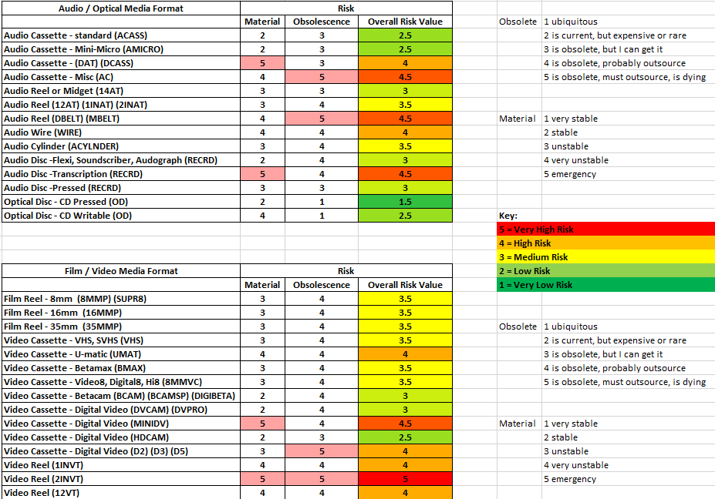
Notes:
So once more just a quick run through of the Risk Value matrices

Slide 49
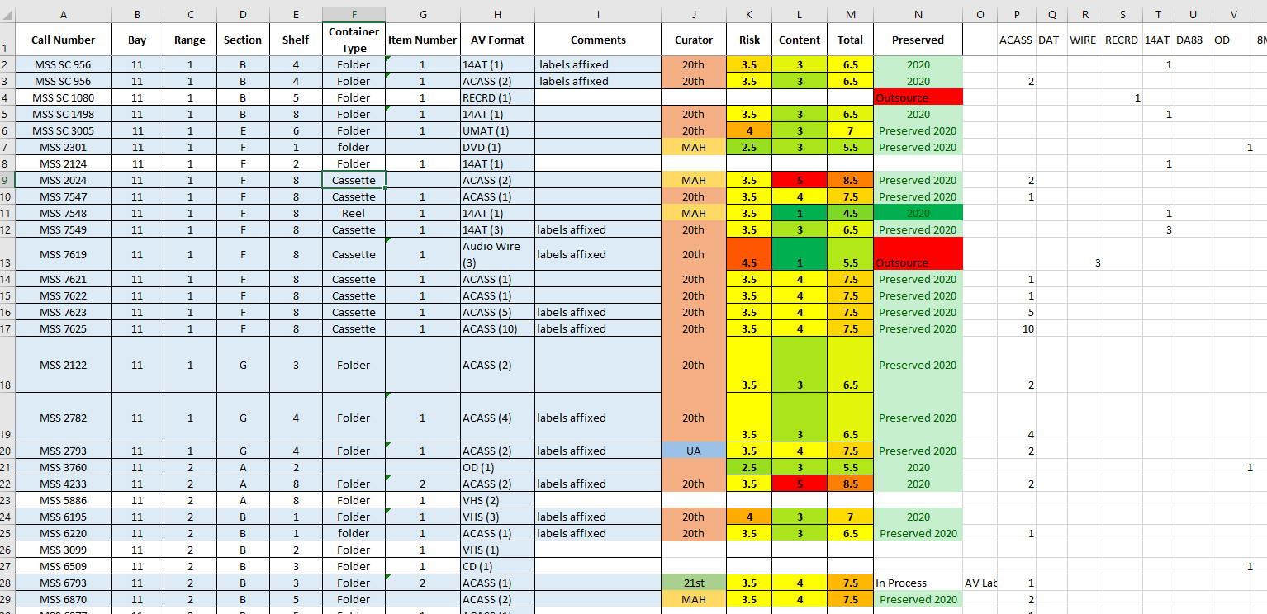
Notes:
And once more just a quick run through of the assessment worksheet

Slide 50
Thank You
Benjamin Harry
Curator of Audiovisual Materials and Media Arts History
Brigham Young University
ben_harry@byu.edu
Article:
“Finding AV Needles in Manuscript Haystacks: Conducting an Audiovisual Assessment/Audit in Manuscript Archives”
Journal of Western Archives: Volume 11, Issue 1, Article 5 (2020)
Notes:
I hope this report of what we have done is helpful. Please also see my article for a slightly different approach on this exact project. I didn’t want to just read my article, and so I have used this webinar to present on this topic in a bit of a different way. I want to thank OCLC again for this opportunity to present out work and hope it may be of help to others.

