Slide 1
Works In Progress Webinar – February 27, 2020
Cues and Clues: How Students Identify Online Resources in the Face of Container Collapse
Tara Cataldo and Chris Cyr

Slide 2
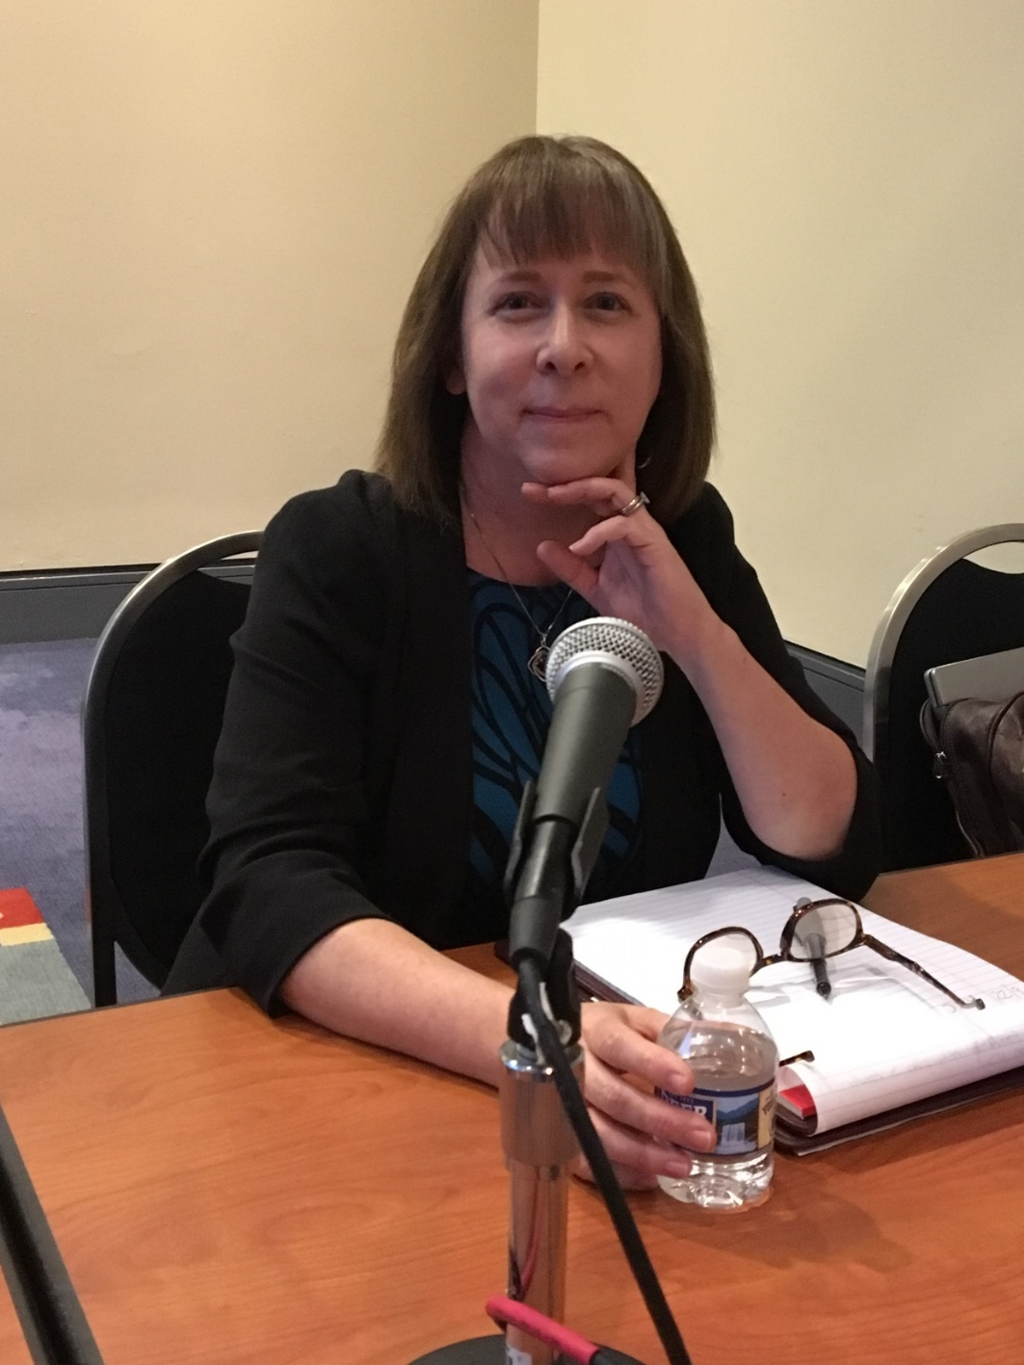
Tara Cataldo, MLS
Science Collections Coordinator
University of Florida

Slide 3
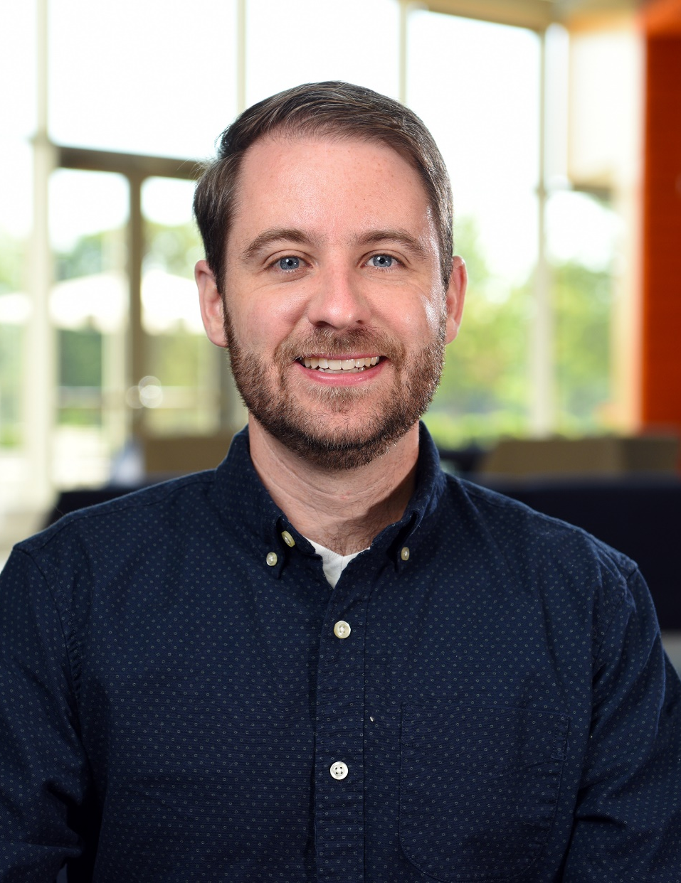
Chris Cyr, Ph.D.
Associate Research Scientist
OCLC Research

Slide 4
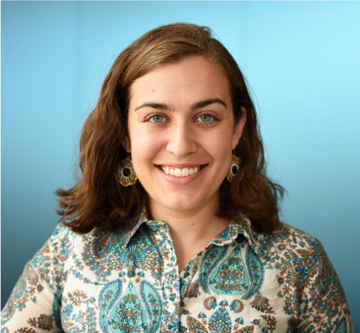
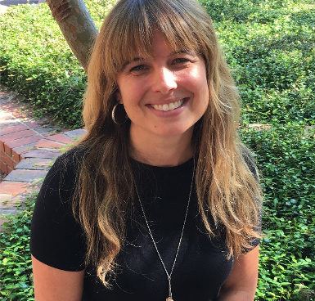
Brittany Brannon
Research Support Specialist
OCLC Research
Amy Buhler
Engineering Librarian
University of Florida

Slide 5





Slide 6
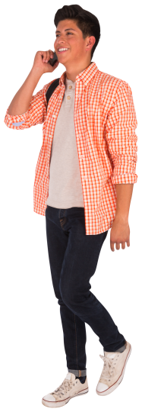
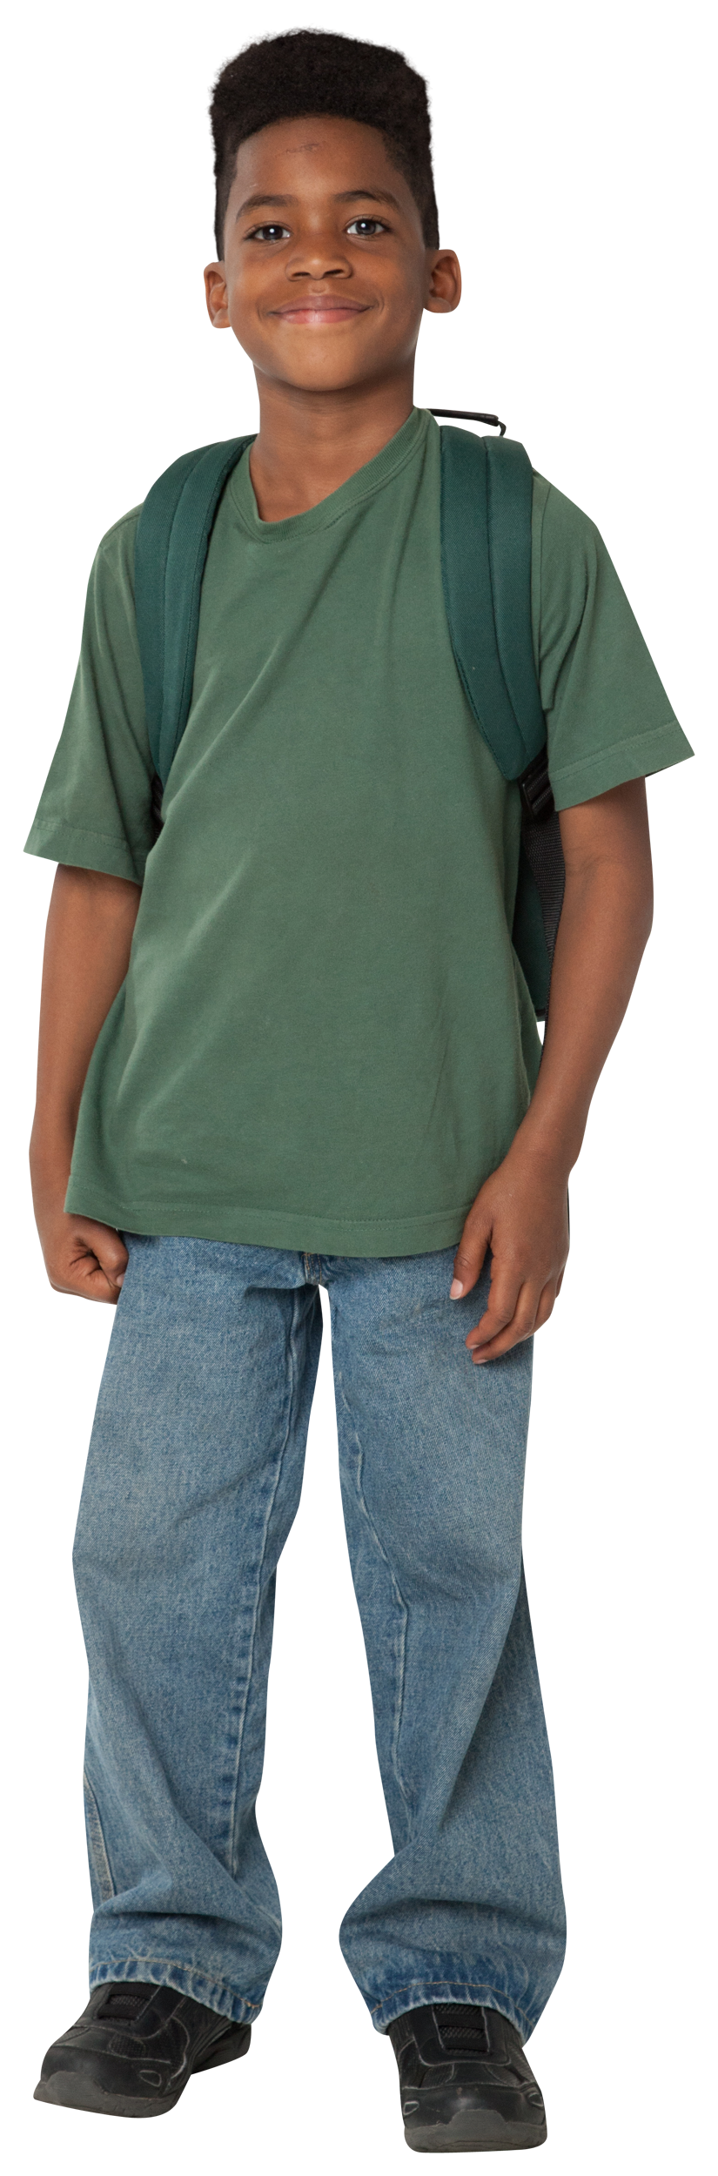
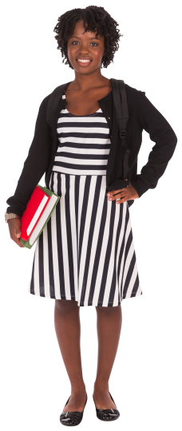
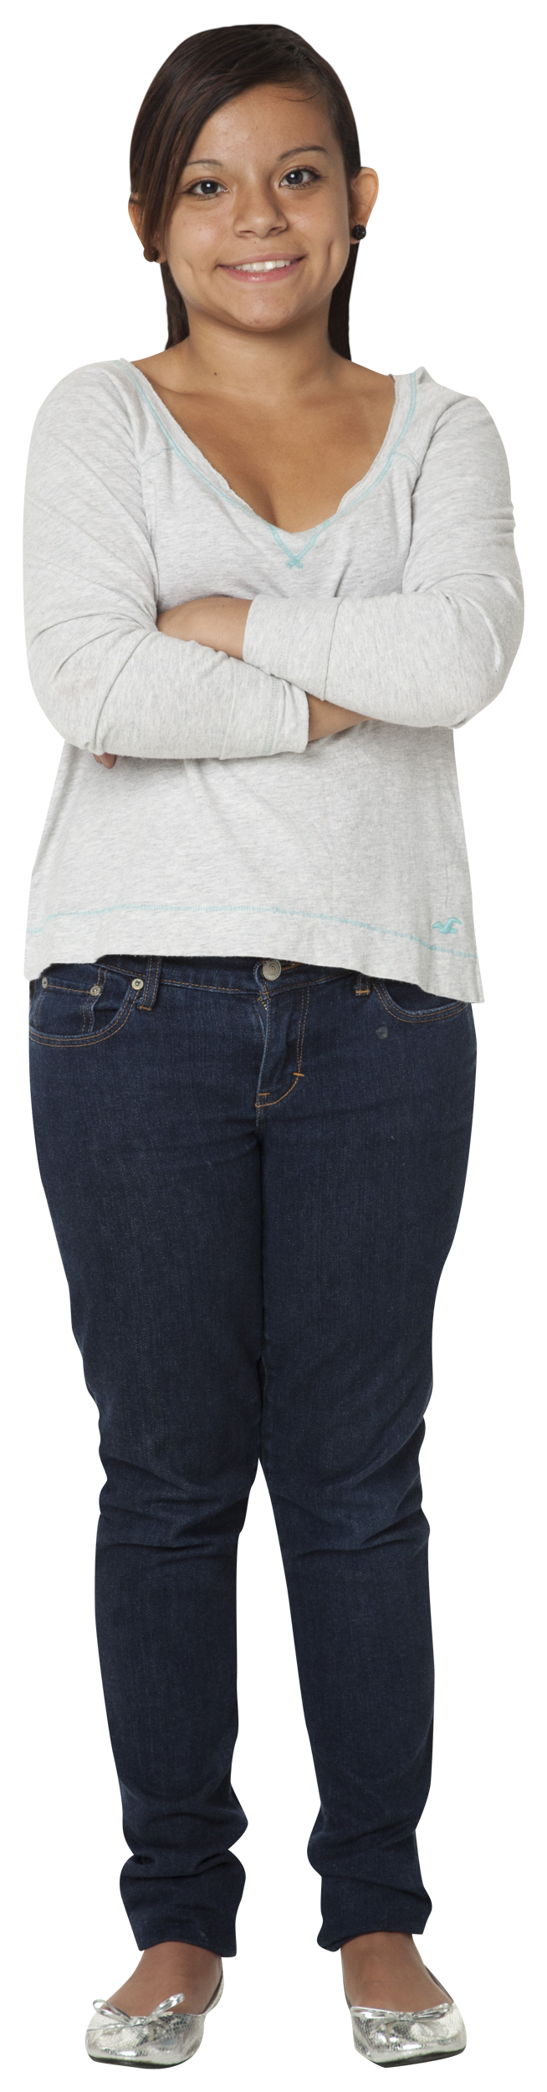
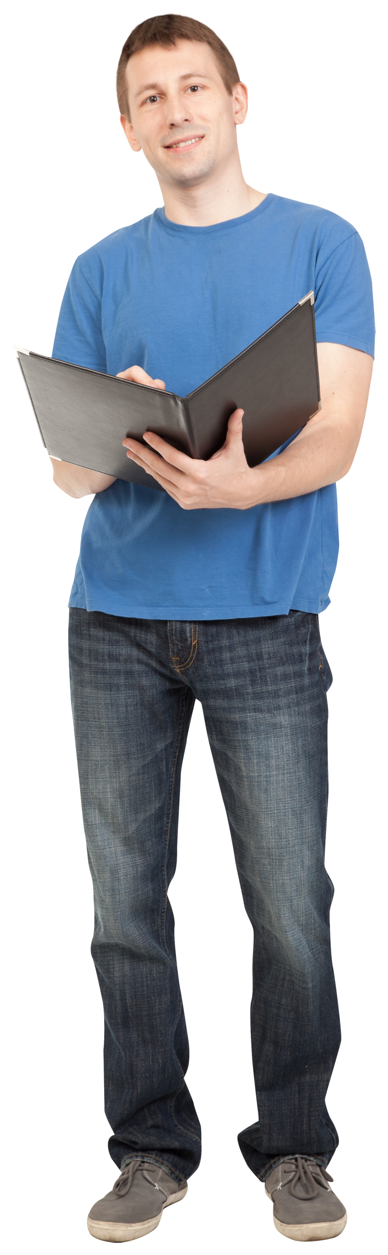
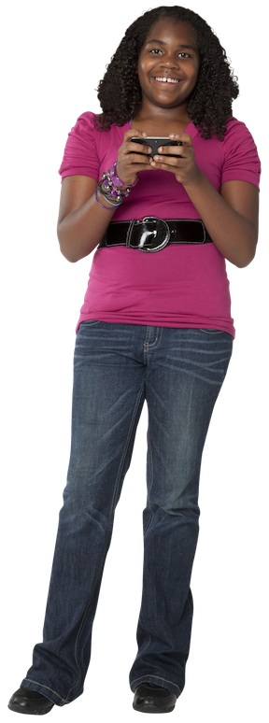
Our Cohorts
30 Community College
Students
30 Undergraduate Students
30 Graduate Students
29 Grades 4-5
30 Grades 6-8
26 Grades 9-12

Slide 7
What is container collapse?

Slide 8
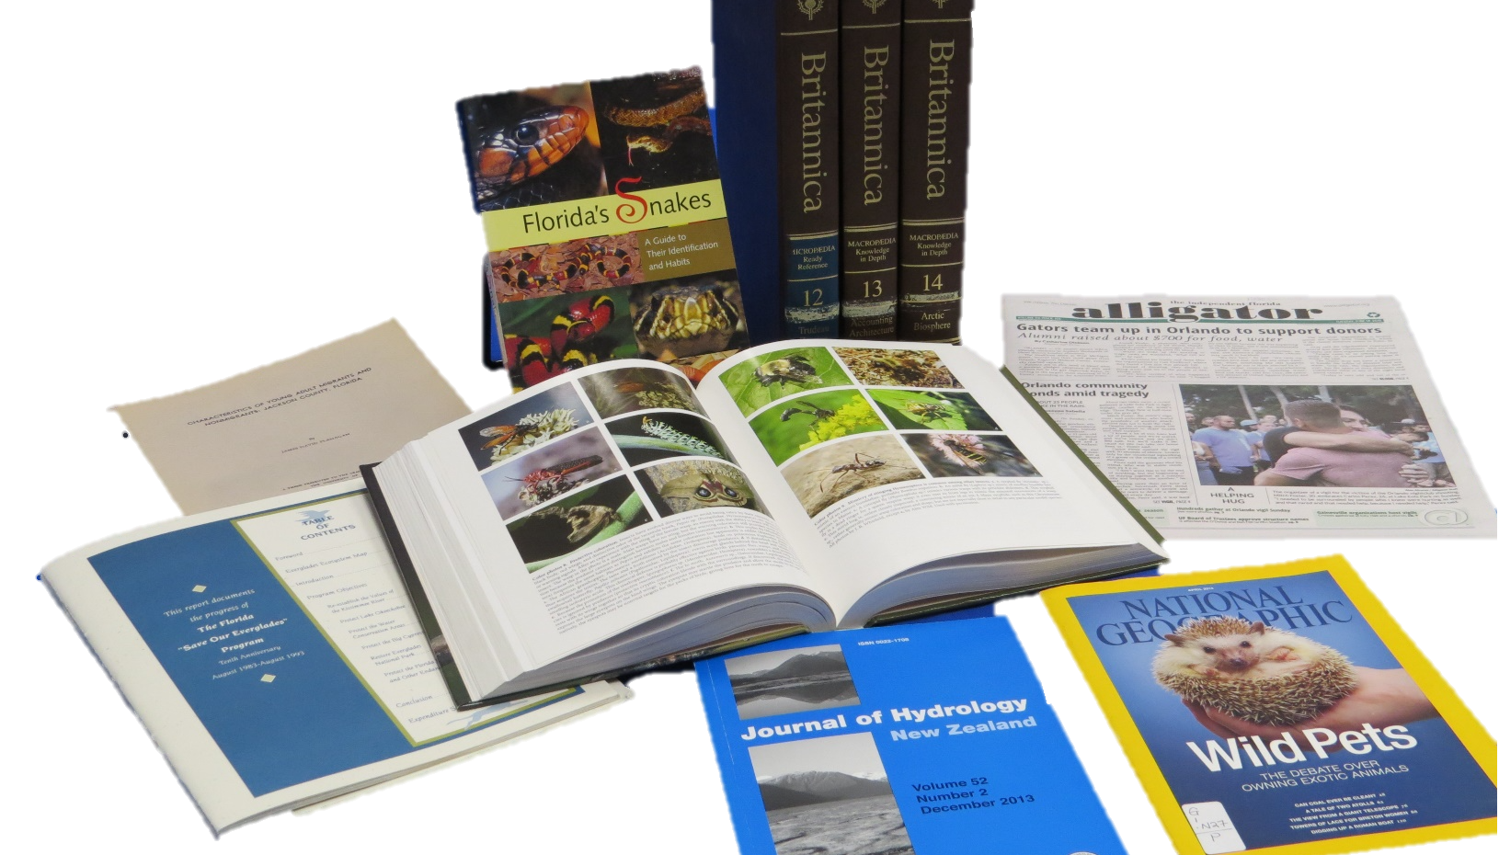
Notes:
Image created by RSIC

Slide 9
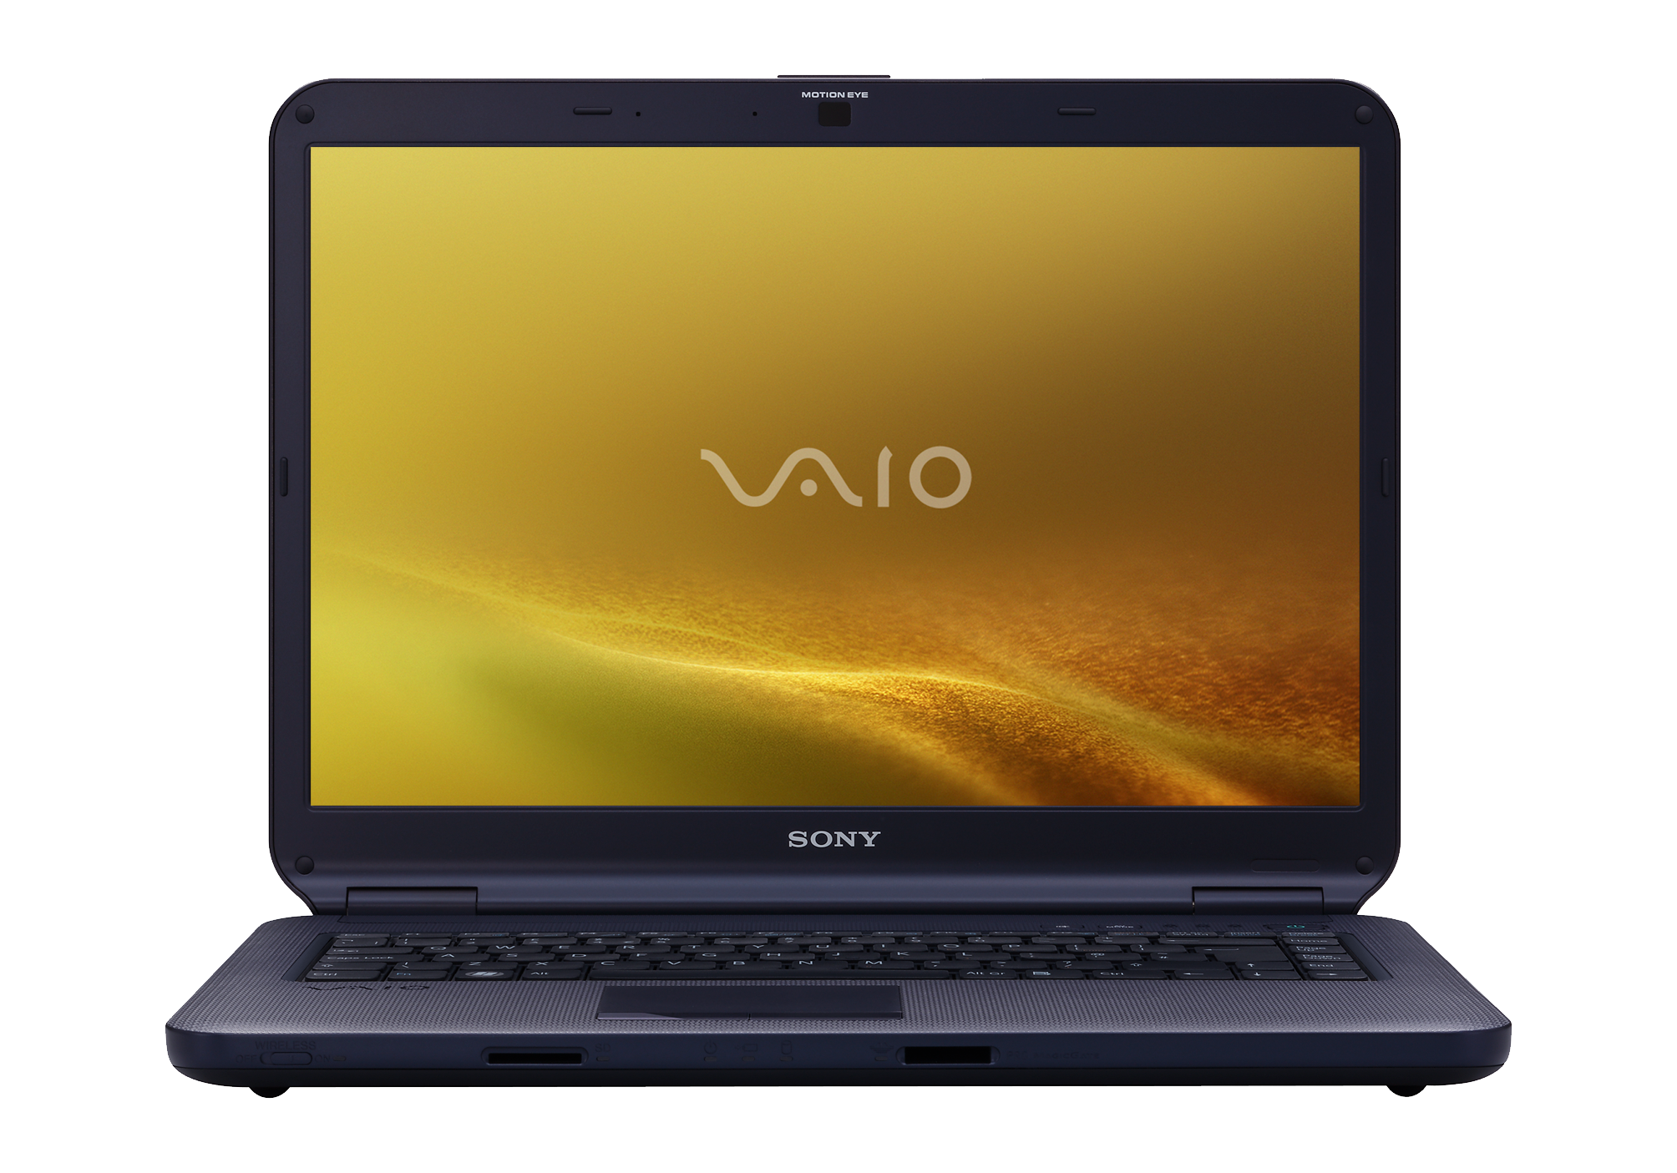
http://pngimg.com/download/5926
Notes:
http://pngimg.com/download/5926

Slide 10
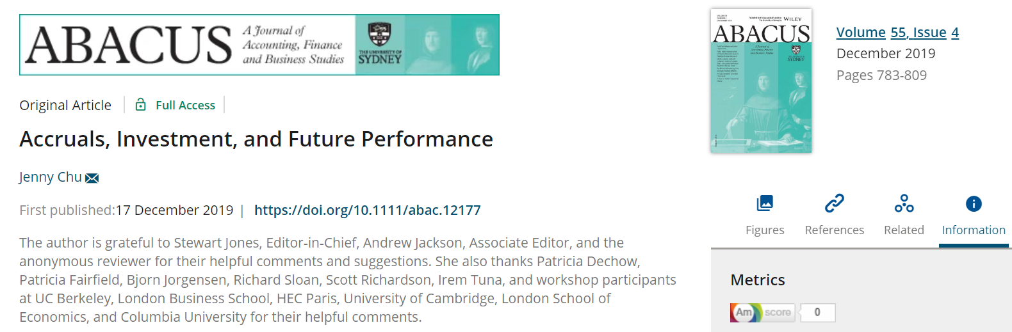
https://onlinelibrary.wiley.com/doi/full/10.1111/abac.12177
Notes:
https://onlinelibrary.wiley.com/doi/full/10.1111/abac.12177

Slide 11
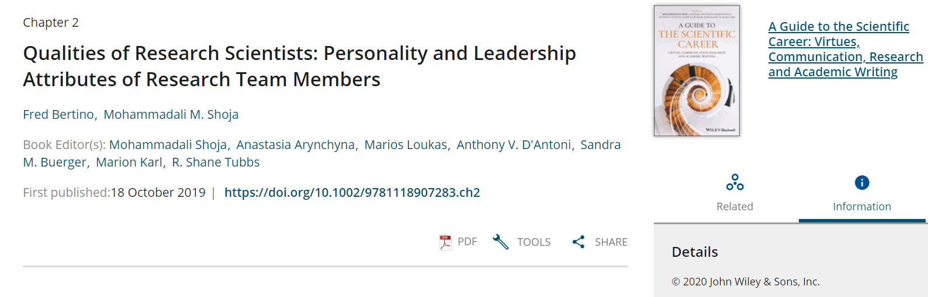
https://onlinelibrary.wiley.com/doi/10.1002/9781118907283.ch2
Notes:
https://onlinelibrary.wiley.com/doi/10.1002/9781118907283.ch2

Slide 12
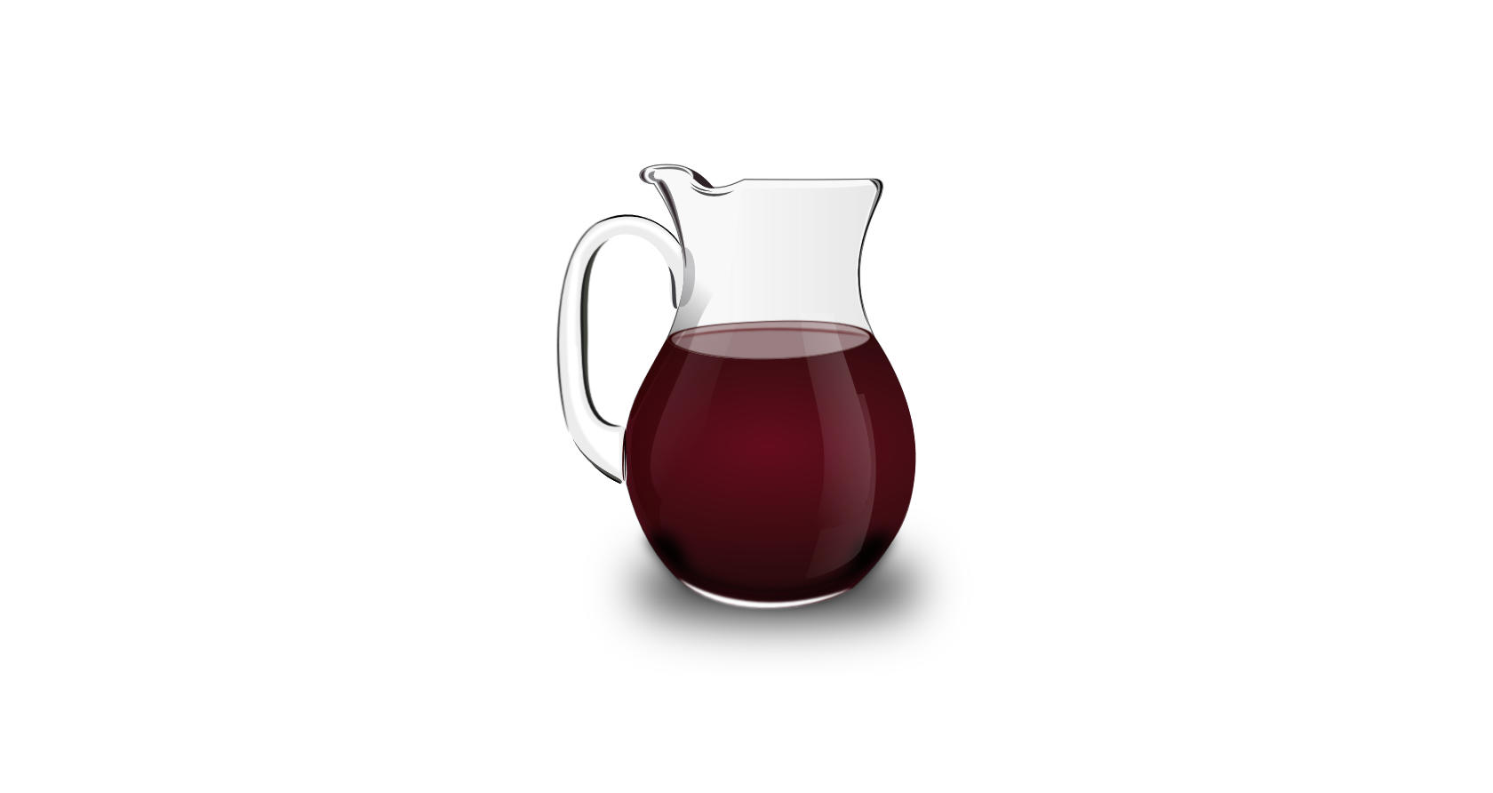
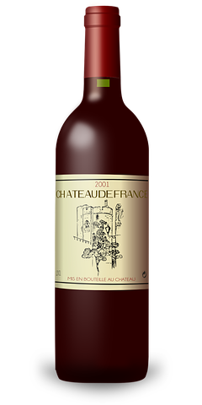
Container Collapse
Physical format
  Context and cues for container
Digital format
  “Decanted” from original container
https://publicdomainvectors.org/
Notes:
Decanter: https://publicdomainvectors.org/en/free-clipart/Red-wine-pitcher/75845.html
Wine bottle: https://publicdomainvectors.org/en/free-clipart/Bordeaux-red-wine-bottle-vector-drawing/11526.html

Slide 13
Do Students Care?
“Google Generation are format agnostic and have little interest in the containers (reports, book chapters, encyclopedia entries)”
  Williams, P., & Rowlands, I. (2007)

Slide 14
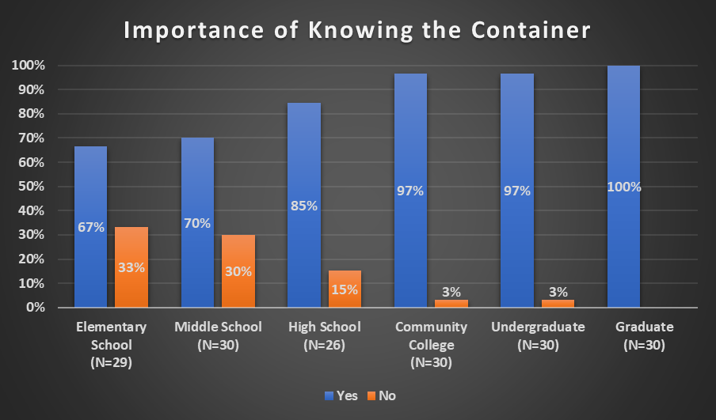

Slide 15
Do you think it is important…? Yes.
“Yes. That'll help you decide how credible it is.”
  Undergraduate student
“...for the sake of citing, you have to know what you're citing from”
  Undergraduate student
“I feel like you have to know the perspective it was being written from…”
  High school student

Slide 16
Do you think it is important…? No
“I mean, as long as it's good useful information, why not use it?”
  Middle school student
“I don't really care what it's coming from. I just care if it's good or not.”
  Elementary school student

Slide 17
Methods

Slide 18

Researching Students’ Information Choices (RSIC): Determining Identity and Judging Credibility in Digital Spaces
4 Years
12 Researchers
8 Advisory panel members
175 students
4 Google Simulations

Slide 19

Point of Selection Behavior
Citability
Credibility
Helpfulness
Container

Slide 20
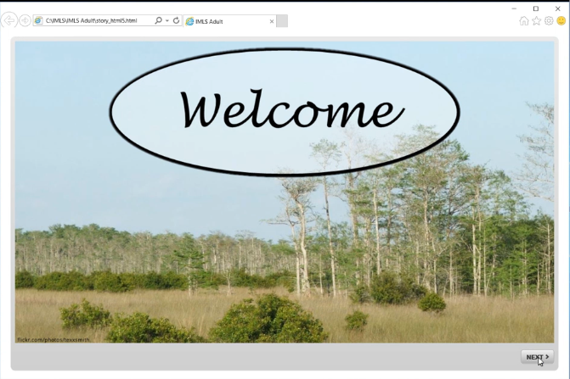
https://ufdc.ufl.edu/IR00010595/00001

Slide 21
Containers
Book
Blog
Conference proceeding
Journal
Preprint
News
Magazine
Website

Slide 22
Mixed Methods
Simulations
  Articulate’s Storyline data
Think-aloud protocol
  NVivo coding
Survey and Interviews

Slide 23
How well can students identify containers?

Slide 24
Percent of Containers Correctly Identified
N=175

Slide 25
Why did some students identify more containers correctly than others?
Statistical predictors
  Demographics, cues mentioned, and simulation behaviors
Find variables that have the biggest impact
  Both positive and negative

Slide 26
Variables of Interest
Demographics | Cues | Behaviors
Cohort | Genre | Total simulation duration
Confidence searching for information online | Source | Number of different container labels applied during container task
Parent or guardian with bachelor’s degree | Aboutness | Number of resources clicked on during container task
 | Visual appearance
 | URL
 | Google result snippet

Slide 27
Multivariate Regression
Impact of variable on percent of containers correct
  Significant or insignificant
  Positive→ Increases percent
  Negative→ Decreases percent
Controlled comparisons
  Independent
  Other variables held constant
  Sensitivity to controls
Four different models
  Demographics, cues, behaviors, all variables

Slide 28
Why Controlled Comparisons?
Example of cohort
  Higher cohorts generally identify more containers correctly
  Risk of spurious correlation
  Account for cohort
N=175

Slide 29
Demographics

Slide 30
Demographic Statistics
Cohorts size ranged from 26 to 30
67% had parent or guardian with Bachelor’s Degree
N=175

Slide 31
Impact of Demographic Variables
Variable | Demographics Model | Full Model (All Variables)
Cohort | + | +
Confidence searching | + | +
Parent with degree | + | +

Slide 32
Impact of Confidence on Container Identification
N=175

Slide 33
Logan and Danielle
Two undergraduate students
Both have confidence level of 4
Logan is a first generation college student, Danielle is not
Danielle expected to correctly identify 6% more containers
55%
61%

Slide 34
Cues

Slide 35
Number of Participants Who Mentioned Cue
N=175

Slide 36
Impact of Cues
Variable | Cues Model | Full Model (All Variables)
Genre | + | +
Source |  | +
Aboutness | - | -
Visual appearance
URL
Google result snippet | -

Slide 37
How Cues Impact Correct Container Identification
Help
  Genre (16% increase in cues model, 6% in full model)
  Source (5% increase in full model)
No significant impact
  Visual appearance
  URL
Hurt
  Aboutness (5% decrease in cues model and full model)
  Google snippet (13% decrease in cues model)

Slide 38
Behaviors

Slide 39
Different Container Types Used
N=175

Slide 40
Source Clicks During Container Task
N=175

Slide 41
Impact of Behavior Variables
Variable | Behavior Model | Full Model (All Variables)
Total simulation duration | - | -
# of container labels | +
Resources clicked | + | +

Slide 42
Brennan and Mia
Meet Brennan and Mia
Brennan clicked on every resource, Mia clicked on none
Brennan is predicted to correctly identify 19% more resources
69%
50%

Slide 43
Discussion

Slide 44
Deep Engagement
Deep and thoughtful engagement with the resource
  Click on/explore resource
  Heuristics do not help
    URL, visual appearance, Google snippet
Focus on cues that indicate container types
  Genre and source

Slide 45
Personal Background
Life experience matters
  Cohort remains important
  Parent with college degree helps
  Confidence helps

Slide 46
Information Literacy
Extra support for first generation college students
More information literacy in K-12
Steer students away from some heuristics
  Towards cues that encourage deeper engagement.

Slide 47
Information literacy examples
Citation management software
  Mixed success identifying container
Hands on activities

Slide 48
“What is this? I think it looks like a journal, right? Oh, it's super long though. So maybe it is a book. There are multiple chapters. Yeah. Okay, book. This is hard. I don't know [laughter].”
- undergraduate student

Slide 49
Questions & Discussion
Chris Cyr cyrc@oclc.org
Tara Cataldo ttobin@ufl.edu
Brittany Brannon brannonb@oclc.org
Amy Buhler abuhler@ufl.edu
http://guides.uflib.ufl.edu/RSIC @RSICstudy
#containercollapse

Slide 50

Ixchel Faniel,
Senior Research Scientist
Lynn Silipigni Connaway,
Director of Library Trends and User Research
Amy Buhler,
Engineering Librarian
Chris Cyr,
Associate Research Scientist
Tara Cataldo,
Life Sciences Librarian
Randy Graff,
Director of Educational Technologies
Erin Hood,
Research Support Specialist
Brittany Brannon,
Research Support Specialist
John Donaldson,
Programmer
Summer Howland,
Instructional Designer
Rachael Elrod, Education Librarian
Samuel Putnam, Engineering Librarian
Shakiyl Kirlew,
Research Assistant
Christine Towler,
Research Assistant
Joyce Valenza,
Teaching Professor
Robin Fowler,
Program Assistant
Kailey Langer,
Research Assistant

Slide 51
Acknowledgements
We would like to thank the entire RSIC team for their guidance in this project
This project was made possible in part by the Institute of Museum and Library Services grant number LG-81-15-0155

Slide 52
References
Bertino, F., & Shoja, M. (2019). Qualities of research scientists: personality leadership attributes of research team members. A guide to the scientific career: virtues, communication, research, and academic writing. Wiley.
Chu, J. (2019). Accruals, investment, and future performance. Abacus: a journal of accounting, finance, and business studies. 55(4), 783-809.
Williams, P., & Rowlands, I. (2007). Information behaviour of the researcher of the future: The literature on young people and their information behaviour. British Library/JISC.

