Slide 1
Case study: Supporting bibliometric and research impact analysis at the University of Waterloo
Presentation for OCLC Research Library Partnership
December 3, 2020
Laura Bredahl, Alison Hitchens
University of Waterloo Library
Notes:
Welcome everyone! We’re really happy to talk with you today

Slide 2
Land acknowledgment
We acknowledge that all University of Waterloo Library locations are located on the traditional territory of the Neutral, Anishnaabeg and Haudenosaunee people. The University of Waterloo is situated on the Haldimand Tract, the land promised to the Six Nations, that includes ten kilometers on each side of the Grand River which flows through Waterloo Region.
We also acknowledge the Land Back Camp in Waterloo Park, adjacent to the University of Waterloo.
Notes:
Before we get started we want to recognize that both Laura and I are speaking to you from the traditional territory of the Neutral, Anishnaabeg and Haudenosaunee people. The University of Waterloo is situated on the Haldimand Tract, the land promised to the Six Nations 236 years ago, that includes ten kilometers on each side of the Grand River which flows through Waterloo Region.
It is important to note that currently there is an occupation of Waterloo Park, adjacent to the university of Waterloo, as local Indigenous people try to dialogue with our local government. We’ve included a link to the Land Back Camp if you would like to read more about it.

Slide 3
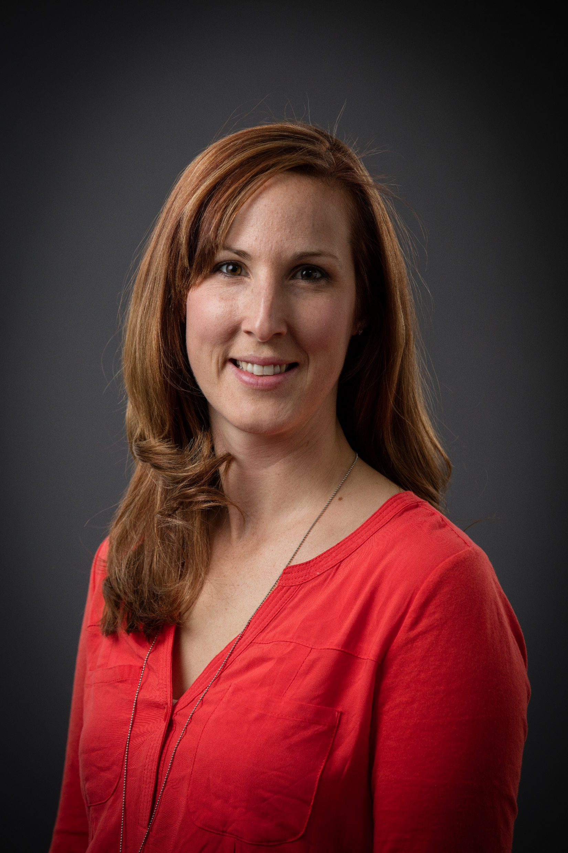
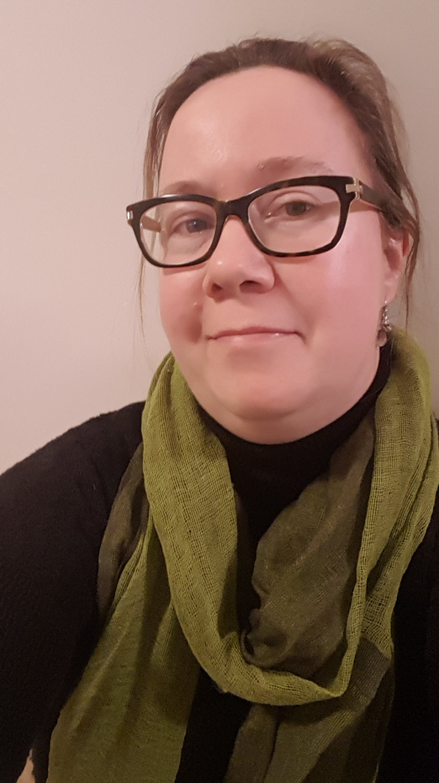
Presenters
Laura Bredahl, Bibliometrics and Research Impact Librarian
Alison Hitchens, Associate University Librarian, Collections, Technology and Scholarly Communication
Notes:
Since this is an audio only session, here’s who you are listening too! I’m Alison and I’ll start the presentation to give background on bibliometrics at Waterloo and the impact on the library. My picture is on the bottom right. Then Laura will take over to talk about the evolution of bibliometric services on campus and highlight some local use cases. We’re planning on leaving 10-15 minutes for questions at the end.

Slide 4
ARL Practice Briefs
This presentation relates to work done for the Association of Research Libraries (ARL) Research Library Impact Pilots program
Research topic: “(How) does the library help to increase research productivity and impact?”
Practice brief written by Shannon Gordon (former Bibliometrics and Research Impact Librarian at Waterloo) and Alison Hitchens
Notes:
The genesis of this presentation is from a draft I sent to Rebecca for comment back in the summer. The ARL has a program looking at various research topics including “how does the library help to increase research productivity and impact.” They solicited both research projects and practice brief proposals. We will send Rebecca the link to the practice brief once published but it essentially sets out the bibliometrics program at Waterloo, what we’ve learned and what may be needed to set up a similar program elsewhere.

Slide 5
Poll: Describe your familiarity with bibliometrics
I eat citation data for breakfast
I’m aware of the H-Index
I’ve helped a researcher understand their impact
I know we subscribe to some bibliometric tools
I know the word but I don’t really know what it means
Notes:
Before we get too far in, let’s do a quick poll on your familiarity with bibliometrics. Pick the answer that best reflects you.

Slide 6
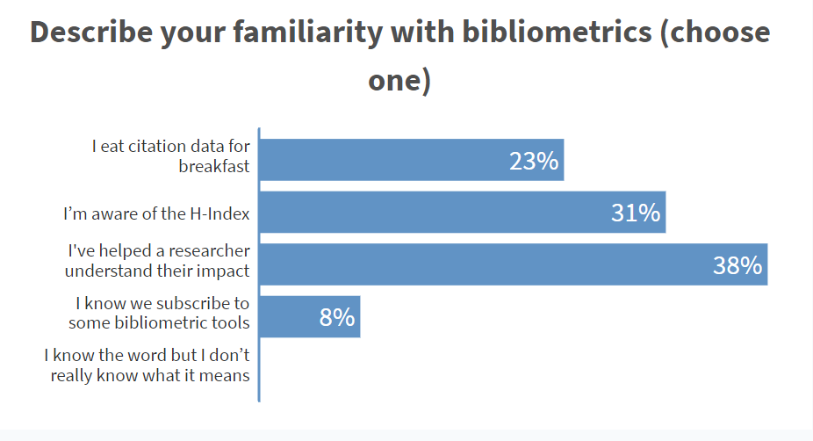

Slide 7
What are bibliometrics?
A method for counting and analysing academic publications, citations, and authorship to measure research outputs.
“Bibliometrics serve as one tool, among many, used by universities, funders, ranking organizations, and others to measure research outputs.”¹​
1. University of Waterloo Working Group on Bibliometrics, Lauren Byl, Jana Carson, Annamaria Feltracco, Susie Gooch, Shannon Gordon, Tim Kenyon, Bruce Muirhead, Daniela Seskar-Hencic, Kathy MacDonald, M. Tamer Özsu, Peter Stirling (2016). White Paper: Measuring Research Outputs Through Bibliometrics. UWSpace. http://hdl.handle.net/10012/10323
Notes:
Bibliometrics are a method for counting and analysing publications, citations, and authorship to measure research outputs. Common outputs include journal articles and conference proceedings. They are used to help answer questions such as what are our areas of research strength? How are we doing compared to a similar research institute? How many people are citing my article? And where are some potential research collaborations? They are just one tool in measuring research output and impact. Some other common metrics are research funding awards, publication acceptance rates, and number of highly qualified personnel, e.g. number of Canada Research Chairs.

Slide 8
Getting started with bibliometrics and research impact at the institutional level
Calculate your academic footprint
Use of bibliometrics by government, funders, ranking groups
Strategic plan theme: Transformational Research
Published “Whitepaper: Measuring Research Output Through Bibliometrics”
Provost established Working Group on Bibliometrics
Hired Bibliometrics and Research Impact Librarian
<2011
2011
2012
2012
2015
2016
Notes:
The library has been supporting individual researchers to explore the impact of their publications for a number of years. Our optometry librarian developed a workshop and guide called Calculate your academic footprint which outlines a process for creating a master publication and citation list, for keeping citation counts current, and how to calculate a more robust and accurate h-index.
In 2012, the university realized that we need to have an understanding at an institutional level because important stakeholders including funders, ranking organizations and various accountability organizations are increasingly using bibliometrics as one way to understand research impact.
For example, in Ontario, the Ministry of Training, Colleges and Universities developed Strategic Mandate Agreements with Ontario universities outlining key areas of differentiation. Institutions need to provide metrics on how they are meeting goals in their key areas. The province identified number of publications, number of citations and citation impact as measures to understand research impact of institutions across Ontario in their areas.
The federal government has also used bibliometric and research impact data to determine funding opportunities in areas of priority to the government, for example in 2007 the Mobilizing Science and Technology to Canada’s Advantage Plan.
Decisions on funding for programs like the Canada Excellence Research Chairs are highly dependent on institutions showing research excellence and impact in those areas.
This makes it essential that institutions understand these measures and how they may be assessed by external stakeholders.
The university strategic plan also identified a transformational research theme which needed ways to measure progress.
We formed the Working Group on Bibliometrics, including the Library, Office of Research, Institutional Analysis and Planning and representatives from all faculties. The advisory board is made up of the Director of IAP, the university Librarian and the VP, University Research. The purpose of the WG is to assist the university in understanding how bibliometrics are used and provide resources to support researchers and administrators to use them more effectively. Support of internal and strategic decision making. I’ll talk about the next two items in more detail after the next poll.

Slide 9
Poll: bibliometrics at your institution
My institution:
has a position devoted to bibliometrics and research impact
has librarians who regularly help researchers with bibliometrics
chiefly supports bibliometrics in a unit other than the library
doesn’t do much with bibliometrics; or requests are ad hoc
Notes:
Here’s our next quick poll! What is going on at your institution?

Slide 10
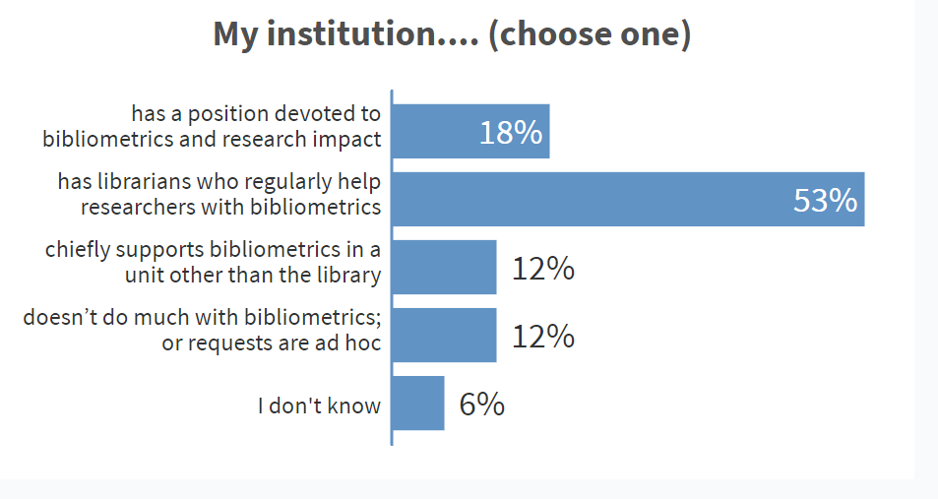

Slide 11
New specialization: Bibliometrics and Research Impact Librarian
Key partnerships
Institutional Analysis and Planning
Office of Research
Liaison Librarians
Key roles
Campus strategic advice
Data analysis & replication
Education
Vendor relationships
Notes:
One outcome of the campus partnership on bibliometrics and in support of the transformational research theme of the campus strategic plan was the recognition of the need for a campus expert. This led to a new specialization in the library and I’ve included a link to the job description if you are interested in more details. The way that Waterloo approached the Bibliometrics and Research Impact librarian is unique. Rather than being envisioned as support for individual faculty members, although she does provide some of that support in collaboration with our liaison librarians, this librarian very much works at the institutional level with key partners at IAP and OR.
The BRIL is expected to be the campus expert on bibliometrics and associated tools. She handles requests for bibliometric data analysis and replication of rankings methodologies. She is also expected to supply individual and group instruction around bibliometrics, altmetrics and the use of bibliometric tools.
We have also provided opportunity for MLIS interns to learn about bibliometrics. 30% of the work on our information services and resources MLIS intern is in support of bibliometric work.

Slide 12
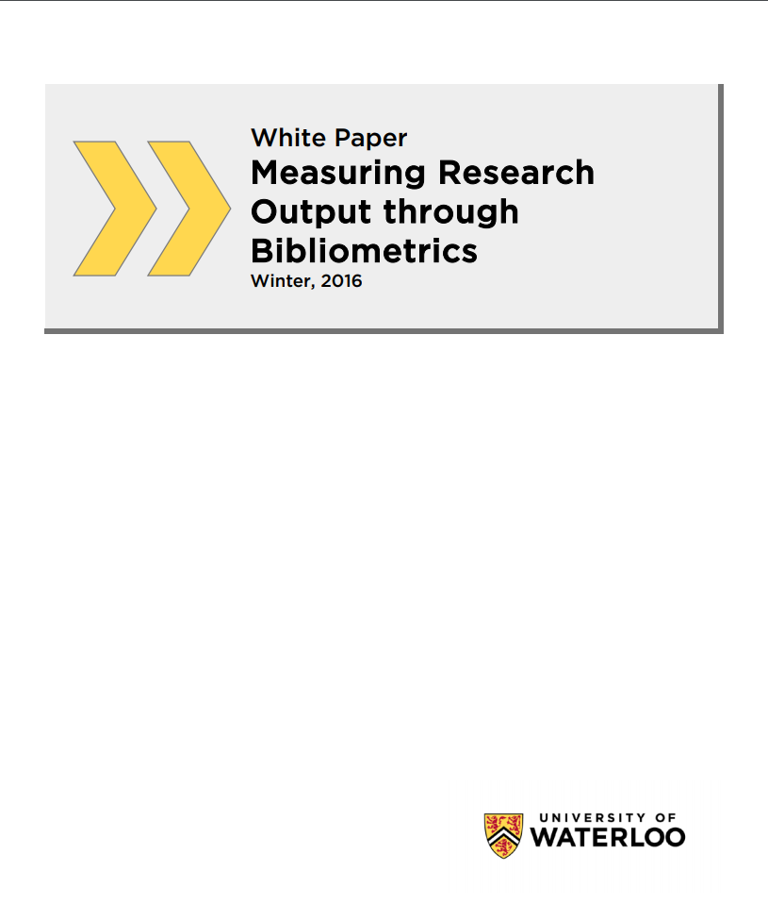
White paper and consultation
Key messages
Work from a basket of measures
Involve those being measured
Appropriate use & limitations
Understand disciplinary cultures
Do not compare across disciplines
DOI: 10.13140/RG.2.1.3302.5680
Notes:
An important component to institutional readiness for a robust bibliometrics service was a university wide consultation process and development of a whitepaper on bibliometrics. The link to the whitepaper is on the resources slide.
A three-stage consultations process followed to consult with and gain input from a wide variety of stakeholder groups. The consultation included the bibliometrics advisory group and working group, Dean’s Council, ADRs, FAUW, UG Student Relations, Grad Student Relations, Library staff, IAP and the campus at large. Finally, the white paper went to Senate Grad and Research Council and the Senate. The white paper is available in our institutional repository and there is a separate guide to the content available from the library.
The white paper is grounded in an extensive literature search and contains detailed information on bibliometrics sources, methodology and assessment.
Some of the key messages include:
The need to work from a basket of measures to gain a fuller picture of research impact
Involving those being measured in the process
When to use bibliometrics and when not to and the limitations to keep in mind when interpreting the data
The reminder that you cannot and should not compare across disciplines
The consultation was deliberate in its planning and phasing – chances to offer input, build up awareness and education – no surprises when published, avoid alarm

Slide 13
Why the library?
Deep knowledge of bibliographic data and tools
Expertise across various points of the research lifecycle and scholarly communication
Awareness of disciplinary limitations
Long history of liaising with both academic support units and faculties
Viewed as “neutral” from standpoint of library not having high stake in the impact data
Notes:
One of the questions ARL wanted us to think about in our practice brief was “why the library?” The library has….
Although bibliometrics is very much a partnership, I think these factors explain why it is the library that has the focused position on bibliometrics.

Slide 14
Impact on the library
Partnership building
Raises profile on campus
Engagement and opportunities
Reconnect with bibliometrics for collections analysis
Notes:
In preparing for this presentation, Rebecca asked us to think about what the impact is on the library by involving ourselves in institutional level bibliometrics. As someone who suddenly became an acting AUL in 2016 and picked up this bibliometrics portfolio, it was clear to me that being connected to an known by high level administration in Office of Research really had an impact on building partnerships in other areas such as research data management. It was a lot easier to send an e-mail or pick up the phone and call an AVP Research because they knew me through the working group on bibliometrics.
It also led to engagement and opportunities in other work. For example, I was asked to sit on the Office of Research Systems Advisory Group and the library was involved in the introduction of Pure to campus. I think our close relationship with IAP is one factor that led to strong involvement of the library in the latest round of campus strategic planning. When IAP set up 7 working groups to develop issue papers in support of the strategic plan, our UL was able to advocate for a librarian on each group.
This type of engagement, in addition to the work Laura does, raises the profile of the library on campus.
Finally, although libraries have been using bibliometrics for collections analysis for many years we haven't done this systematically at Waterloo. Now that I have both collections and bibliometrics in my portfolio, I am starting to reconnect with this and think about how it can aid our collections decision making.

Slide 15
Evolution of Bibliometrics at UWaterloo
Working Group on Bibliometrics:
White Paper
Research Metrics Framework –
Supporting 2013-2018 institutional strategic plan research themes
Strategic Plan 2020-2025 Research Areas of Excellence
Bibliometric Assessment Tools Report
Strategic Plan 2020-2025 Research Areas of Excellence – Indicators
<2016
2015-2017
2019
2019
2020-2021
Notes:
Laura
Thank you Alison.
I will be talking in a bit more detail about the evolution of our bibliometrics and research impact services at Waterloo as well as some specific use cases that will give you some practical insight into the types of projects that we have worked on here.
This diagram gives us a high look at some of the projects coming out of the Working Group on Bibliometrics that Alison mentioned previously as one of the outcome of the transformational research theme from our previous strategic plan:
The foundational work provided by the White Paper in 2016 was followed by the development of the Research Metrics Framework over the years 2015-2017. This framework aimed to provide detailed bibliometrics indicators attached to each of the major research themes from the previous strategic plan. These themes were strongly tied to the establishment and renewal of several of our research institutes.
In 2019 the Bibliometric Assessment Tools Report was created. This report provided an extremely detailed review of our existing bibliometrics assessment tools, our known use cases and an overview of other prominent bibliometrics tools. One of the primary recommendations that came out of this report was that we should continue to subscribe to both InCites and SciVal if the funding was available. This recommendation was endorsed by our Advisory Board so we have now renewed both tools for a 3-year term. We see there being new developments made in other tools, such as dimensions, however at this time we have chosen to renew our existing tools as they are useful to our current needs and we will continue to monitor development within other tools.
The working group on bibliometrics is also supporting the current Strategic Plan that has identified new Research Areas of Excellence. Work is currently being done to help define these research areas and develop appropriate research excellence indicators. These don’t only include bibliometrics but will be integrated into report in collaboration with our Institutional Analysis and Planning unit and Office of Research.
I also wanted to mention a couple possible new projects:
- Were working with various campus stakeholder in work related to Equity Diversity and Inclusion indicators at the institutional level. This is a very timely project but as I am discovering is something that already has a robust body of research to work from.
- There is also interest as the institutional level to integrate bibliometrics more broadly into work related to research computing data and the development of an annual or regular reporting structure. This project is very new and there are still many details that have to be work out and then piloted.

Slide 16
Evolution of Bibliometrics at UWaterloo
Community of Practice (est. 2020)
Informal
Open to anyone at UWaterloo
Training and sharing knowledge
Presentation/discussion format
Currently 35+ members, 13-16 ppl per meeting so far
Notes:
Laura
CoP:
Informal
Open to anyone at UWaterloo
Training and sharing knowledge
Presentation/discussion format
Currently 35+ members, 13-16 ppl per meeting so far
Members identified learning from other (and their mistakes) was key
Wanted a balance of training and discussion
Specific topics and training needs discussed each meeting
Presentations on:
Disciplinary metrics using SciVal
Recent articles on Bibliometrics
Methodologies generating metrics
History of bibliometrics at UW
Pure

Slide 17
Evolution of Bibliometrics at UWaterloo
Expansion of bibliometrics skills across campus
Waterloo Institute of Nanotechnology
Water Institute
Interdisciplinary Centre on Climate Change
Faculty of Mathematics
Faculty of Engineering
Faculty of Science
Centres & Institutes
Faculties
Stakeholders
WGB
Office of Research
Institutional Analysis & Planning
Notes:
Laura
The expansion of bibliometrics across campus is enabled by a growing base of experts that have the knowledge, skill and time to devote to doing bibliometric work. Often there is not a unique position made for this work but there is room created in the person’s job duties to focus more on this area.
Position titles include:
Research Analysis and Proposal Development Officer
Director of Planning
Communications and Research Coordinator
Assistant Director, Research Programs

Slide 18
Use Cases
Notes:
Laura
talk about some specific use cases as it’s very common for this type of work to use “use cases” to illustrate the complexity of the work.

Slide 19
Use Case: Validation of University Rankings
What is Validation of University Rankings?
University Rankings: ARWU/Macleans/QS/THE
Match ranking methodology as closely as possible.
Purpose:
Understanding and verify data from rankings
Monitoring performance
Determine how well research aligns with ranking areas
Provide explanations for rankings at a local level
Notes:
Laura
The first use case I will talk about is the work done around validation of university rankings.
What I mean by validation is taking the methodologies of the various ranking bodies, such as CWTS Leiden, Shanghai’s ARWU, MacLeans, which is a Canadian magazine that provides annual rankings, QS and the Times Higher Education,….we take these methodologies and try to match them as closely as possible in order to
- Understanding and verify data from rankings
- As well as monitor our performance, as a university
- To determine how well our research aligns with the ranking areas used
- And to provide local level analysis and explanations for our specific rankings
We find that this work involves in-depth knowledge of:
the ranking organization’s methodology, such as their inclusion and exclusion criteria, for example, what document types they include, year ranges etc.
also knowledge of their definitions of the bibliometric indicators they use, such as citations, scholarly output, how they calculate faculty counts, etc.
we also need to understand the underlying data sources they use such as Scopus, Web of Science, Dimensions, etc.,
And lastly is it also essential to understand the bibliometric assessment tools such as SciVal or InCites that the various ranking body’s may be using.

Slide 20
Use Case: Validation of University Rankings
How do we compare to comparator institution’s rankings (U15 in Canada)
How does our subject area focus influence the rankings?
Do we have unique publication practices? (doc type etc.?)
Are we publishing in the ranked journals?
Is our data getting captured?
Notes:
Laura
These validation exercises also help us to dig deeper into questions like:
How do we compare to our comparator institution’s rankings, as a Canadian institution we are interested in comparing ourselves to the group of top ranking universities who are part of a group called the U15.
- We are also interested in looking at how our subject area focus might influence the rankings?
If our unique publication practices might gain us some insight around our rankings. For example, the chart on this slide is illustrating that Uwaterloo researchers publish heavily in conference proceedings. Therefore, we might be interested in looking further into the coverage of proceedings in the database the rankings are using.
We can also look further into whether our data is being captured accurately. For example, could using author disambiguation systems such as ORCID help to better capture our researchers works within the various databases.

Slide 21
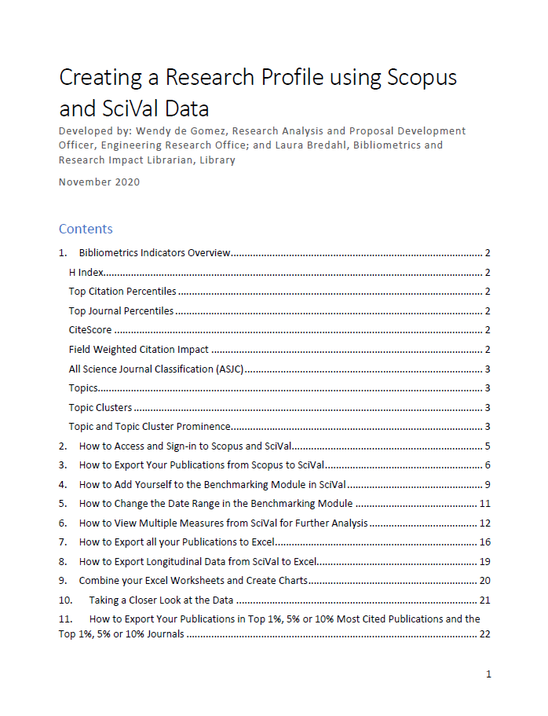
Use Case: Faculty of Engineering
Faculty of Engineering:
Collaborate closely with their Research Analyst
Provide support in developing and presenting training
Consult on use of metrics and training materials
Presentations at the Faculty level, Engineering Chairs
Presentations at the Department level, Faculty members and Chairs
Individual and group training, Faculty Members
Notes:
Laura
The next use case I would like to share with you highlight the type of support my role provides in growing the bibliometrics expertise within our faculties across the institution in order to build a network of expertise. Faculties such as the Faculty of Science, Faculty of Mathematics, and the Faculty of Engineering have various depths of expertise within their units and this is continually growing as they make the case for have more resources put behind this work.
These positions support a range of activities, including:
Researcher level support and training
Faculty level analysis and reporting
Dashboard creation
Strategic decision making
For this use case I will talk about the work I have been doing in collaboration with the Research Analyst from the Faculty of Engineering.
I have provided support in the development and presentation of overviews of bibliometrics and tailored training for member of the faculty.
I also consult on use of metrics and various types of training materials
My work with the research analyst has been exceptionally rewarding as I have a colleague with a high level of skill who is basically my counterpart within a specific unit so we have learned a lot from each other.
We have done
Presentations at the Faculty level, at the Engineering Chairs Council meeting in order to introduce bibliometrics at the adminstative level within the faculty and to get by-in from the Chairs
This enable us to develop presentations at the Department level, for Faculty members and the Chairs, and tailor the overviews to their departmental data.
We are now in the process of developing and delivering individual and group training, to Faculty Members who are interested in their own data for annual reviews and promotion and tenure packages.

Slide 22
A Basket of Measures and the Limitations of Bibliometrics
Only part of the picture
Metrics should be complemented with other relevant and appropriate metrics and information.
High-level metrics (such as subject area aggregations) can often be frustrating to researchers with niche or under-represented research areas.
Dataset Limitations
Bibliometrics data are dependant on the indexed journals in any given bibliometric tool. It is therefore important to acknowledge the data source in reporting. No data source or combination of data sources will have 100% recall. Manual supplementation of data can be time consuming and can introduce error.
Discipline discrepancies
Not all disciplines are well represented in bibliometric analysis tools because of differences in how research outputs are captured in the predominant bibliometric tools. Many non-STEM fields are not captured well and will have to rely on alternative metrics.
Notes:
Laura
When we start talking with departments and faculty we always begin with some basic principles in the responsible use of metrics.
Basket of measures
Dataset Limitations
Discipline discrepancies.
Training:
As mentioned before faculty are interested in learning to use these systems for their individual use, primarily for tenure and promotion:
Therefore we try to emphasize:
The use of ORCID as an interoperable name disambiguation
Encourage the responsible use of metrics
Encourage not using over simplified metrics (ie. H-index)

Slide 23
Category-Normalized Citation Impact, by institution
Reduce impact of institution size
Expected performance
Notes:
This is an example of one (of many) slides that we have prepared for a department.
We try to present an overview of their statistics so they are hearing about these data in a meaningful concrete manner.
For example: we talk about the Category-Normalized Citation Impact that helps to normal data by size, discipline and year.
In this chart for example, we would talk about how the the total publication count is only part of the story. If we want to talk about impact in comparison to other institutions, it might be best to look at the CNCI metric.

Slide 24
Use Case: Strategic Planning
Purpose
Identify metrics for areas of research excellence across the university
Monitor over term of the strategic plan
Methodology
Development of robust search strings for research areas
Import publication lists by affiliation from Scopus into SciVal
Benchmarking and trend analysis reporting
Cross-reference publications with Master List of UW Authors to gather total author counts per research area.
Notes:
Laura
The last use case I’m going to talk about is an ongoing project we are working on that is looking at the areas of research excellence identified in the current strategic plan. At this time the intention is to develop a sound methodology for capturing these research areas and identify appropriate bibliometrics indicators that can be used throughout the plan.
For the methodology we are developing robust search strings for each of the research areas. We chose this method as it captures the research area regardless of the researcher or unit it is taking place in. We want to capture the institution broadly not necessarily individual research groups.
We perform the search within Scopus with affiliation search applied, then we import these publication sets into SciVal so we can do benchmarking and trend analysis.
Outside of the SciVal system we also cross-referenced each publication with a Master List of UW Authors, pulled from Scopus, to gather the total UW author counts per research area. I was very excited when I discovered that you can pull the entire list of UW affiliated authors, with their Scopus IDs, from Scopus. For UW this is a list of over 18000 authors.

Slide 25
Use Case: Strategic Planning
Search String Example:
(TITLE-ABS-KEY((climate OR climates) W/4 (change OR adaptation* OR "adaptive management" OR effect* OR action OR capitalism OR equity OR feedback OR finance OR justice OR impact* OR investment* OR mitigation OR risk* OR prediction* OR signals OR signal OR "tipping point" OR urban OR regional OR model* OR varia* OR warming OR policy OR governance OR capitalism OR "climate forcing" OR "radiative forcing" OR investment OR "climate service" OR global OR awareness OR bioeconomy OR carbon OR "decision making" OR "environmental education" OR "sustainable development education" OR "energy conservation" OR emission* OR extreme* OR "food chain*" OR framework OR hazard* OR island OR "land use" OR megacit* OR consumption OR production OR anthropocene OR atmosphere* OR "clean development" OR……
Notes:
Laura
This is an example of one of the searches. As you can see it is a pretty standard advanced search using Boolean logic. We are attempting to be as comprehensive as possible as we are aware that one of the weaknesses of doing analysis based on search strings is that it can introduce institutional bias. The flip side of this is that they are extremely flexible. We felt the flexibility outweighed our concern with introducing bias. Additionally, the bias may be irrelevant in this analysis as we are looking specifically at a narrow range of topics that we expect Waterloo to lead in. The current questions are more around establishing a baseline, and identifying the indicators that we are interested in looking at.

Slide 26
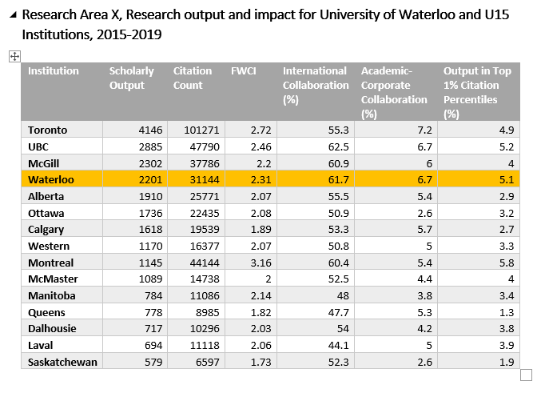
Use Case: Strategic Planning
Notes:
Laura
This is an example of an table that we have developed for these reports.
Just this week I was reviewing this with some colleague within our Office of Research and they suggested sorting based on the FWCI as sorting by scholarly output allow the size of the institution to influence the order of the list. A normalized value such as the FWCI reduces the influence of the size of the institution on the data.

Slide 27
What we don’t do
Individual level consultations – some exceptions
General instruction programs
this may change over-time. Ex. Development of asynchronous tutorials
Notes:
Laura
That is all I have for use cases. I just wanted to take a moment to mention the types of work that we don’t do.
We currently don’t focus on provided support, through my position, for individual level consultation. Although there are exceptions, we feel we have to think strategically about this level of service. And have therefore chosen to expand our bibliometric services through expanding expertise across campus. This is a slow process but create a robust service this is more scalable.
We also don’t current do any general instruction programs. So, we don’t spend a lot of time creating resources for, what I like to call, serendipitous instruction. We focus more in tailored instruction through our collaborations with other bibliometrics experts across campus. I will train the train so to speak.
However, as we identify and develop materials that may be more broadly of interest, we may begin to post materials and resources online.

Slide 28
Resources
The White Paper, "Measuring Research Output Through Bibliometrics", provides a high-level review of bibliometrics, and provides recommended practices for working with bibliometric data. DOI: 10.13140/RG.2.1.3302.5680
Bibliometrics and Research Impact Librarian, Job Description https://hr.uwaterloo.ca/.jd/00006514.pdf
BRI Guides from Uwaterloo - https://subjectguides.uwaterloo.ca/prf.php?account_id=12924
The Bibliomagician Blog - https://thebibliomagician.wordpress.com/
Discussion List: Lis-Bibliometrics https://www.jiscmail.ac.uk/cgi-bin/webadmin?A0=LIS-BIBLIOMETRICS
Notes:
Laura

Slide 29
Poll: What is the focus of your bibliometrics program?
Help individual researchers
Help research groups, centres and institutes
Help research and campus administration

Slide 30
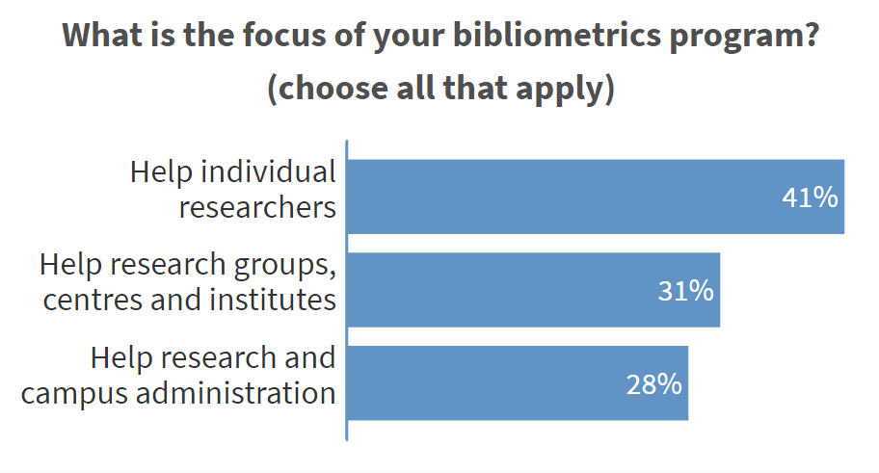

Slide 31
Thank you
Questions?
Notes:
Laura
And
Alison

