Slide 1
THURSDAY 24 SEPTEMBER 2020
Kick-off: OCLC-LIBER Open Science Discussion Series
MODERATORS:
ASTRID VERHEUSEN, EXECUTIVE DIRECTOR, LIBER
TITIA VAN DER WERF, SENIOR PROGRAM OFFICER AT OCLC RESEARCH
WEBEX HOST:
RENEE VAN DEN BOSCH
REPORTER:
REBECCA BRYANT
Notes:
Welcome to the Kick-off session of the OCLC-LIBER Open Science Discussion Series. It’s good to see all of you here.
My name is Astrid Verheusen, I am the Executive Director of LIBER, and together with Titia van der Werf, program officer at OCLC Research, I will be moderating the opening session today.

Slide 2
Housekeeping Rules
Please keep your microphone muted during the webinar.
If you have any questions please make sure to deposit them in the chatbox look for the “Everyone” option. All questions will be addressed during the Q&A at the end of the webinar.
If you experience any technical difficulties please contact the WebEx host via the chatbox, look for the “Host” option in the chat
Today’s webinar will be recorded. The recording will be published on the event webpage.
Notes:
Let’s start with some housekeeping rules to make this webinar run smoothly. Please keep your microphones muted during the webinar. We will have a Q&A at the end of the presentations so if you have any questions for our speakers please make sure to deposit them in the chat box. Please use the option to send to Everyone. If you have technical problems while joining please make sure to contact: Renée van den Bosch in the chat, look for the “Host” option in the chat. Today’s webinar will be recorded and we will make the recording available after the end of the webinar.

Slide 3
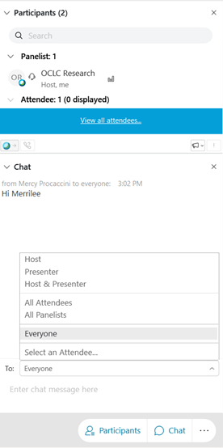
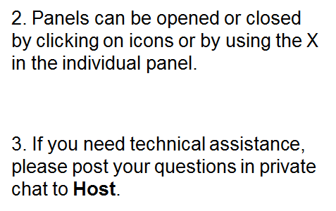
Panel Orientation

Slide 4
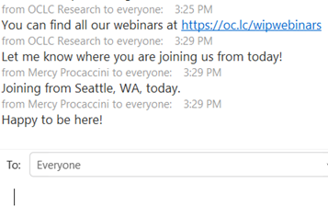
Chat panel

Slide 5
Recorded Webinar
We are recording this webinar so you’ll have the opportunity to watch it again or share it with your colleagues.
The slides and webinar recording will be posted on our website and we’ll send you a note when they are available.
Thank you for joining us!

Slide 6
Notes:
Today’s kick off, which has the form of a webinar, is meant as an introduction to the main topics of Open Sciences. After this kick off there will be a serie of discussion meetings each addressing one of the topics of Open Science to stimulate the discussion about these. This initiative is the result of a collaboration between LIBER and the OCLC Research Library Partnership.
LIBER is the European Association of Research Libraries, consisting of 450 national, university, and other research libraries, and LIBER has worked for nearly 50 years as a coalition to meet the mission of enabling world-class research.
The OCLC Research Library Partnership is a transnational network of more than 130 research libraries, offering professional development opportunities for library staff, and connects libraries to the influence of OCLC Research
LIBER and OCLC have agreed to initiate community engagement across each other’s networks on issues that could benefit from more research.
Originally we planned to have a face-to-face workshop in Vienna in March this year. This was cancelled but we took the opportunity to take the workshop online and intensify the discussions.

Slide 7
The OCLC- LIBER Open Science Discussion Series
Introduction webinar
LIBER Open Science Roadmap
Perspectives from OCLC on Open Scholarship
Discussion series
Explore the key areas of Open Science
Each key area has its own session, facilitated by subject matter experts and interactive audience participation
A maximum of 15 people per discussion
Round-up Session: 5 November
Notes:
Today we are together for 60 minutes.
We introduce the main topics of Open Science using LIBER’s Open Science Roadmap that was published in 2018. Although time has gone by and the world is different now than it was 2 years ago, the topics on Open Science have remained the same.
We also introduce the OCLC perspective on supporting open scholarship and reliable access to the content that libraries are producing, curating, and preserving.
After today we will have a series of small group discussions on research libraries and open science. So we will have separate sessions on Scholarly Publishing, FAIR data, OS skills etc.
We are aiming for very interactive discussions and that’s why we have decided to have a limited number of registrations. So there will be a maximum of 15 people per session. Each session will be facilitated by subject matter experts.
Mind you, the meetings are already fully booked but we can still invite you to the round up session which will take place on Thursday November 5. This Round-up session will have the form of a webinar again that summarizes discussions and outputs from the previous discussion sessions.

Slide 8
Objectives and desired outcomes
Offer the audience a forum for discussion and for exploring their role in the Open Science ecosystem
Offer a platform to stimulate the exchange of ideas, both in Europe and worldwide
Identify key research questions that LIBER in cooperation with OCLC can address to advance the role of research libraries in an emerging open science landscape
Notes:
We want to engage OCLC Research Libraries Partnership and LIBER membership in co-creating the infrastructure for Open Science.
By doing so, we hope to:
● Give library leaders a forum for discussion and explore their role in the open science ecosystem.
● Offer a platform to stimulate the exchange of ideas, both in Europe and worldwide, as we aim for an audience both in Europe and in the US
● Identify three key research questions that LIBER in cooperation with OCLC can address to advance the role of research libraries in an emerging open science landscape.
The issues should be relevant to both communities and in areas where cross-pollination can foster alignment of longer-term views and approaches.
We are convening discussions to create a bold vision of the “ideal future state” in the open science ecosystem, the role of the library, and also the role of the community. A summary of all discussions will be shared after the round-up session in several ways and via several platform, like the LIBER and OCLC websites and newsletters.

Slide 9
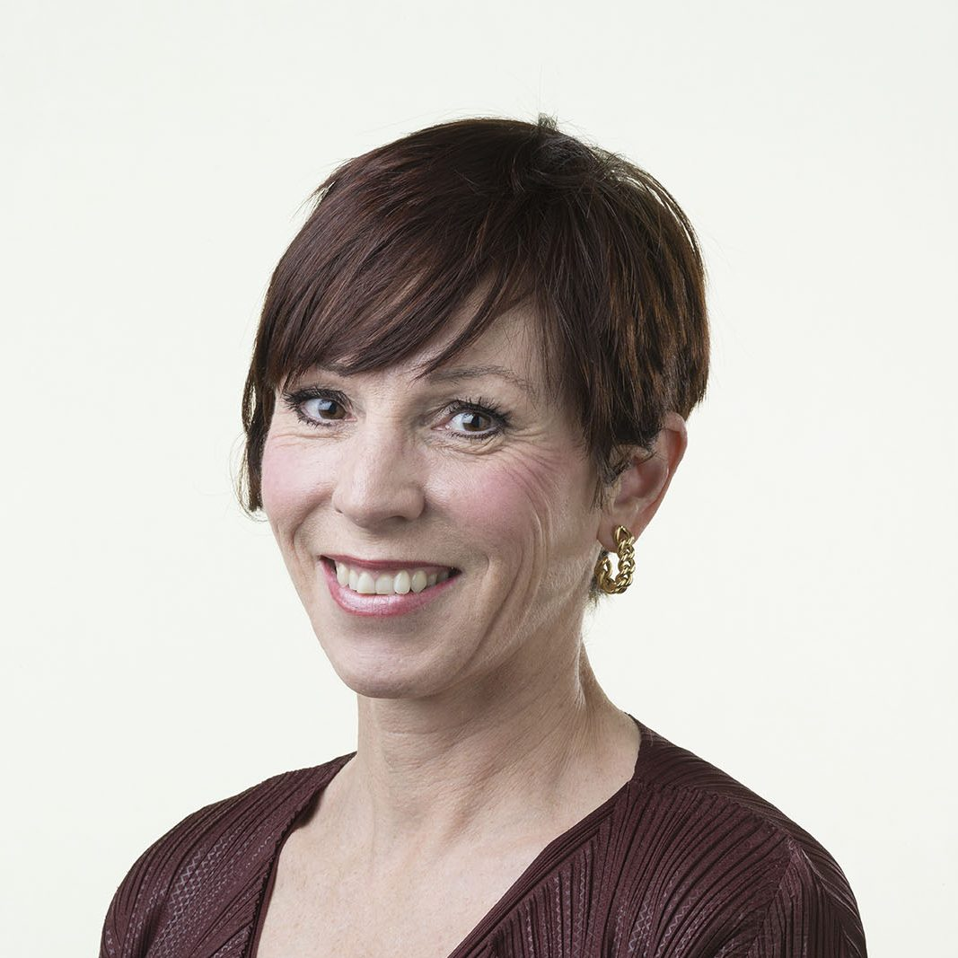
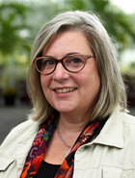
Speakers
Jeannette Frey, LIBER President, Director of Bibliothèque Cantonale et Universitaire (BCU) Lausanne & President LIBER
Rachel Frick, Executive Director, Research Library Partnership, OCLC
Notes:
Joining us today are Jeannette Frey, Director of Bibliothèque Cantonale et Universitaire in Lausanne and president of LIBER, and Rachel Frick, Executive Director of the Research Library Partnership to introduce the LIBER Open Science Roadmap and elaborate on how OCLC is supporting open scholarship Without further delay, I would like to introduce our first speaker for today, Ms Jeannette Frey, will be introducing the main topics of Open Science taking the LIBER Open Science Roadmap as a starting point..

Slide 10
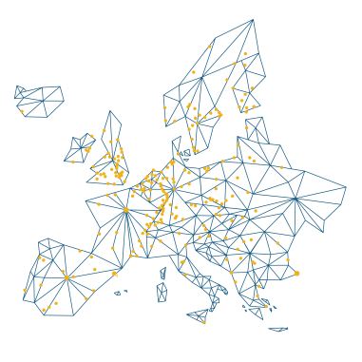
LIBER Open Science Roadmap
Jeannette Frey, LIBER President Thursday 24th September 2020

Slide 11
450 libraries
ONE mission
DEVOTED TO
OPEN SCIENCE
Policies, tools and infrastructures - reshaping research processes and mindsets in favour of Open.
WORLD-CLASS RESEARCH
Knowledge and training so that libraries can support outstanding research and — by extension — the growth and sharing of knowledge.
Notes:
Thanks to Astrid for her introduction
To beginn, for those who do not already know LIBER, a few words about what LIBER is.
LIBER is the Ligue des Bibliothèques Européennes de Recherche,
Founded in 1971, and based in The Hague, it is Europe’s largest network of research libraries
with about 450 members
We aim to support research libraries in their development
Our aim is to enable world class research,
by supporting research libraries
in their aim to provide world class services

Slide 12
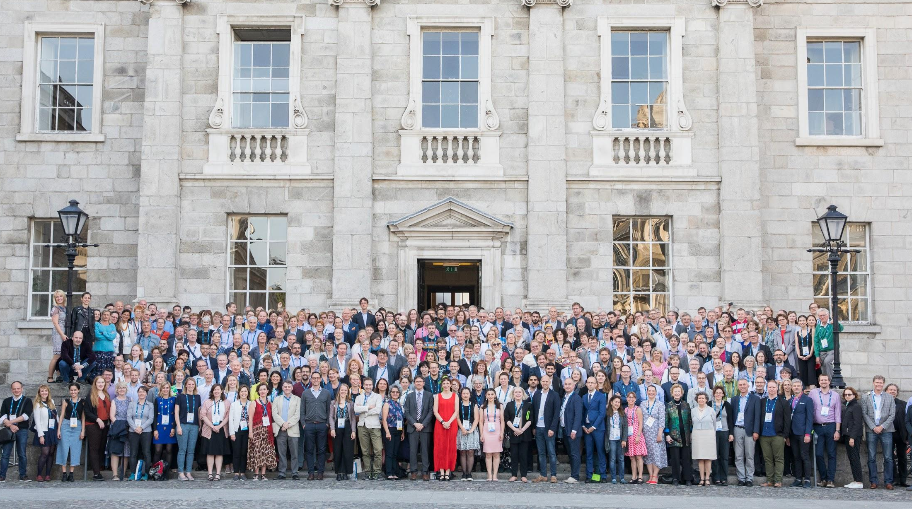
A network in 40 countries
Notes:
- LIBER members are university and research libraries, national, and special libraries from 40 countries

Slide 13
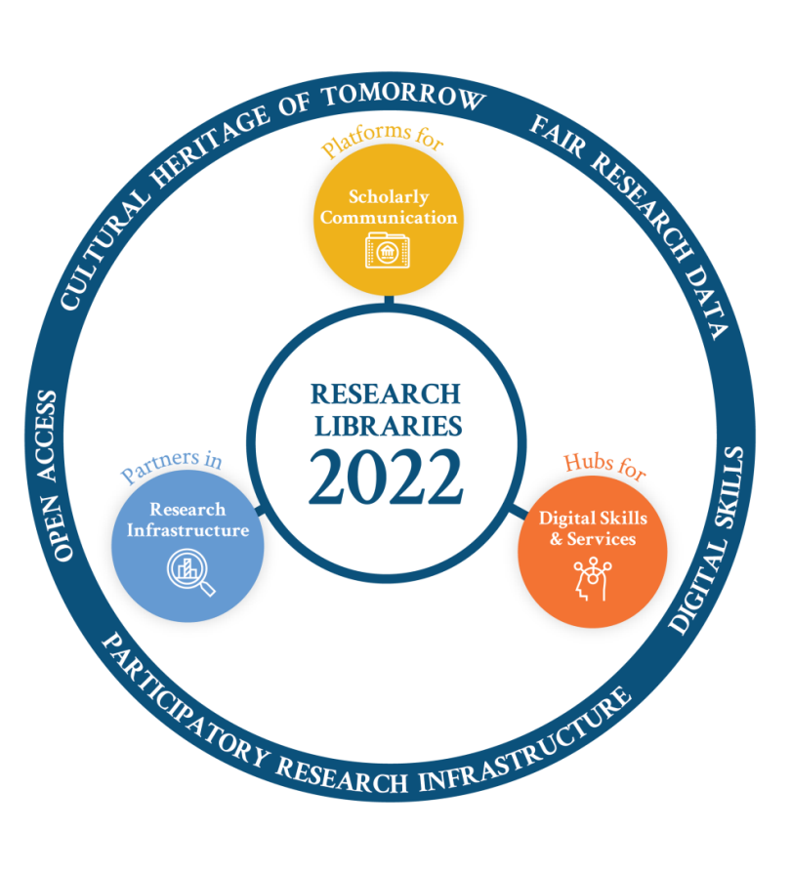
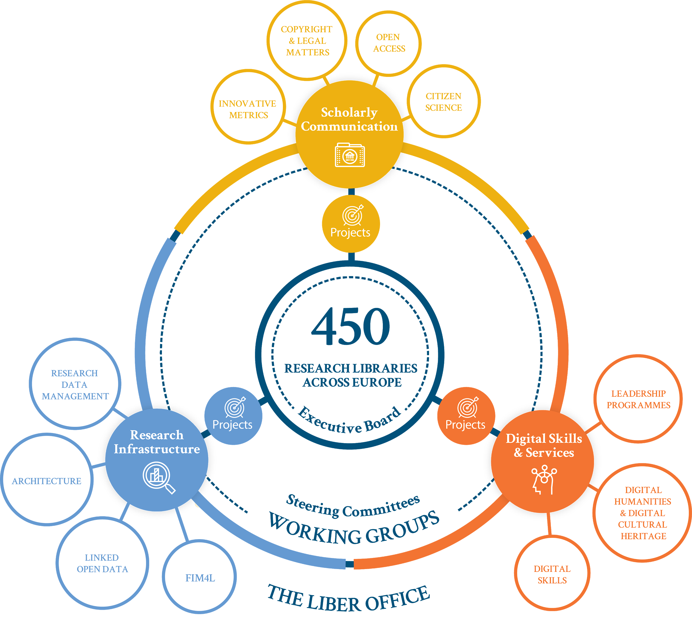
Strategy
Implementation
Notes:
A few words about the current LIBER strategy 2018-2022. Our vision is that in 2022:
Open Access is the main form of publishing.
Research Data is Findable, Accessible, Interoperable and Reusable (FAIR)
Digital Skills underpin a more open, transparent research life cycle.
Research Infrastructure is participatory, tailored and scaled to the needs of diverse disciplines.
Cultural Heritage of tomorrow is built on today’s digital information
Working towards this through our WGs and projects, led by the Executive Board and supported by the Office.

Slide 14
“
A revolution is required: one which opens up research processes and changes mindsets in favour of a world where policies, tools and infrastructures universally support the growth and sharing of knowledge.
Notes:
LIBER's strategy cannot be achieved by LIBER alone, it requires a revolution!
One which opens up research processes and changes mindsets in favoir of a world where policies, tools and infrastructures universally support the growth and sharing of knowledge.

Slide 15
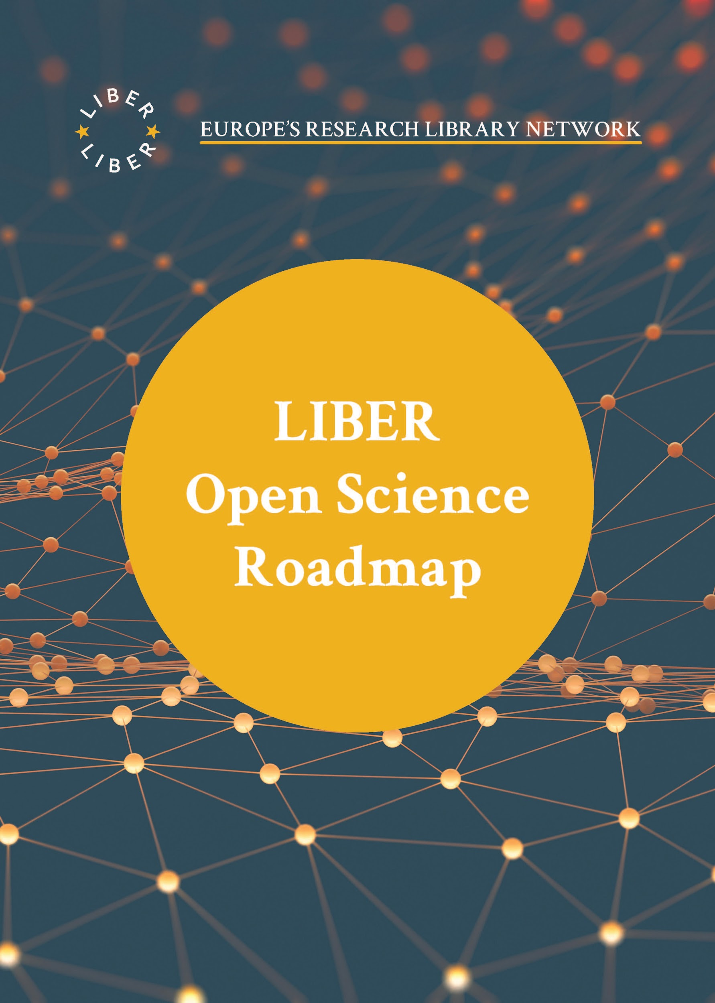
Open Science Roadmap
Translates Open Science Policy Platform (OSPP) advice for libraries.
⇢ https://zenodo.org/record/1303002
Focus Areas
Scholarly Publishing
FAIR Data
Research Infrastructures & the EOSC
Metrics & Rewards
Open Science Skills
Research Integrity
Citizen Science
Notes:
- As Open Science is so central to our present strategy, and to help this Open Science revolution, we've written a roadmap, where you will find a description of the context, the challenges and the practical recommendation on 7 focus areas reflecting the priorities the Open Science Policy Platform (OSPP) highlighted in its advice to the European Commission.
- There focus areas are:
Scholarly Publishing
FAIR Data
Research Infrastructures & the EOSC
Metrics & Rewards
Open Science Skills
Research Integrity
Citizen Science

Slide 16
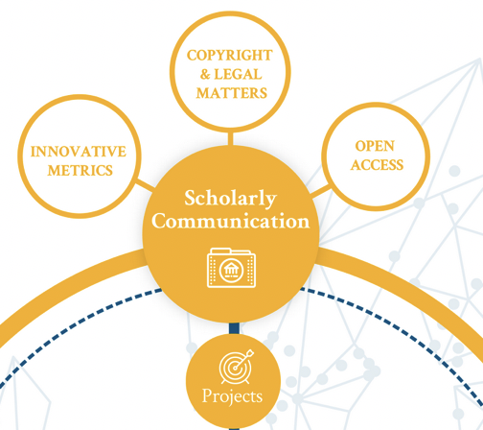
Scholarly Publishing
Ensure an Open Science policy is in place at your institution
Champion Open Science: be a publisher!
Apply 5 principles for Open Access negotiations
Be a facilitator of knowledge creation, examine new models for journal delivery such as mega journals
Notes:
Indeed, libraries are well placed to make the Open Science revolution happen!
Let’s beginning with Scholarly Publishing, a topic that is also one of the strategic direction of LIBER
As we, research libraries, are active since centuries in this field, we do have skill to enter new innovative approaches.
First, you may ensure that an Open Science policy is in place at your institution.
Then, you may champion Open Science by embracing a new role as a publisher of information
IF you are not the publisher and you are negotiating with commercial publishers, apply the 5 principles for Open Access negotiation which you will find on the LIBER Webpage.
You may also be a facilitator of knowledge creation by examining new models for journal delivery such as mega journals, like the Wellcome Open Research platform

Slide 17
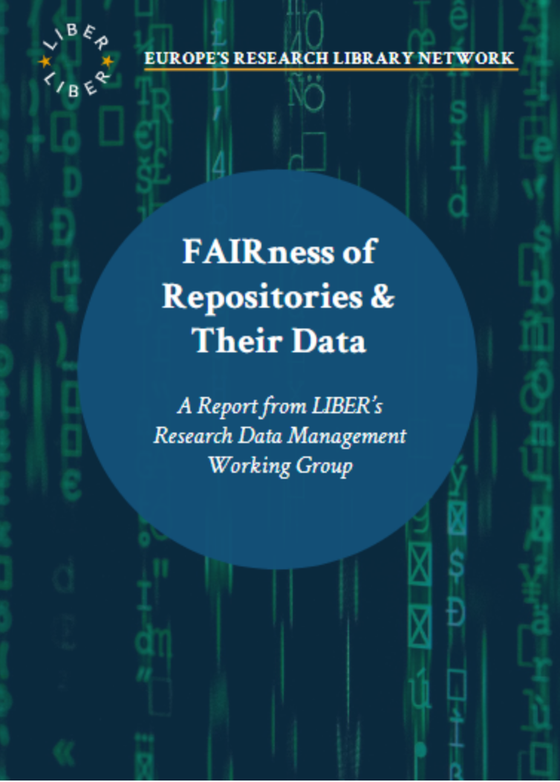
FAIR Data
Invest in staff with good data skills
Promote FAIR principles to your organization
Make Data Management Plans mandatory in your institution
Provide certified repositories and tools for researchers to support FAIR data management
Automate as much as possible metadata production
Advocate for copyright legislation which support FAIR
Share FAIR best practices and case studies
Notes:
Second focus area is FAIR data. Metadata production is one of our core competencies,
So making research data findable, Accessible, Interoperable and Reusable is a field were we can can play an important supporting role.
The European Commission is also strongly committed to FAIR data as an essential element of Open Science.
What can we do? We may invest in staff with good data skills, of course, but also invest in training our own staff so to be able to promote FAIR principles to researchers, students and technical staff.
We should also work with universities, research infrastructures and funders to make FAIR-compliant outputs mandatory, for example by making Data Management Plans mandatory in our own institution.
These Data Management Plans should be machine readable.
Many research libraries participated in the creation of repositories, now we should make sure to provide certified repositories and tools for researchers to support FAIR data management.
As this is additional work on new kind of metadata, we should automate as much as possible metadata production and data management during the entire data lifre-cycle.
Still, we are at risk of not being able to share data due to national legislation, so we should advocate for copyright legislation which supports FAIR data and text and data mining.
This is a complex process, and sharing of best practices and case studies is also very welcome.

Slide 18
Research Infrastructure & EOSC
Link your institutional strategies and policies to the EOSC
Be a member of EOSC
Promote EOSC to students, researchers and other staff members as a source and a place to publish research outputs
Advocate for your institution to embed infrastructure training into the curricula of students and doctoral students
Contribute to the development of EOSC
Notes:
To implement Open Science, we need new research infrastructure.
European Open Science Cloud is an initiative of the European Commission to build the infrastructure required to support Open Science.
LIBER is currently present on the Executive Board of EOSC as an observer.
July 29, the EOSC Association was established as a private law body with public service mission under Belgian law. It will gather EOSC stakeholders such as research funders, policymakers, research performing organzsations and operators of research infrastructure in order to contribute to EOSC developments.
Currently, intensive work is taking place to finalize and publish the core documents of EOSC, like the Strategic Research and Innovation Agenda (SRIA), the landscape report.
A first call for members is currently taking place.
What can research libraries provide in this area?
We can link our institutional strategies and policies to the EOSC – and also be a member of EOSC, why not?
We also have to promote EOSC to students, researchers and other staff member, both as a source of information and a place to publish research outputs.
We may also advocate for our institutions to embed infrastructure training into the curricula of students and doctoral students.
And of course, contribute to the current and future development of EOSC by giving feedback during consultations on the core documents, and sharing best practices.

Slide 19
Metrics and Rewards
Embrace San Francisco Declaration on Research Assessment (DORA) and the Leiden Manifesto
Collaborate in development of next-generation metrics focusing on evidence-based quantitative and qualitative indicators
With funders and HR, develop new methods of assessing and rewarding researchers in their careers (OS-CAM)
Retain high standards when reporting metrics for individual researchers
Notes:
We have to change the traditional methods of assessing the outputs of scientific research if Open Science is to thrive, so not ot measure merits of research and not influence of the journals
Libraries should of course help by participating in the development and implementation of open scholarly metrics.
We can for example:
Embrace San Francisco Declaration on Research Assessment (DORA) and the Leiden Manifesto
Collaborate in development of next-generation metrics focusing on evidence-based quantitative and qualitative indicators
With funders and HR, develop new methods of assessing and rewarding researchers in their careers, by using Open Science Career Assessment Matrix
Retain high standards when reporting metrics for individual researchers
But we may also take care to retain high standards, ethically and technically, when reporting metrics for individual researchers

Slide 20
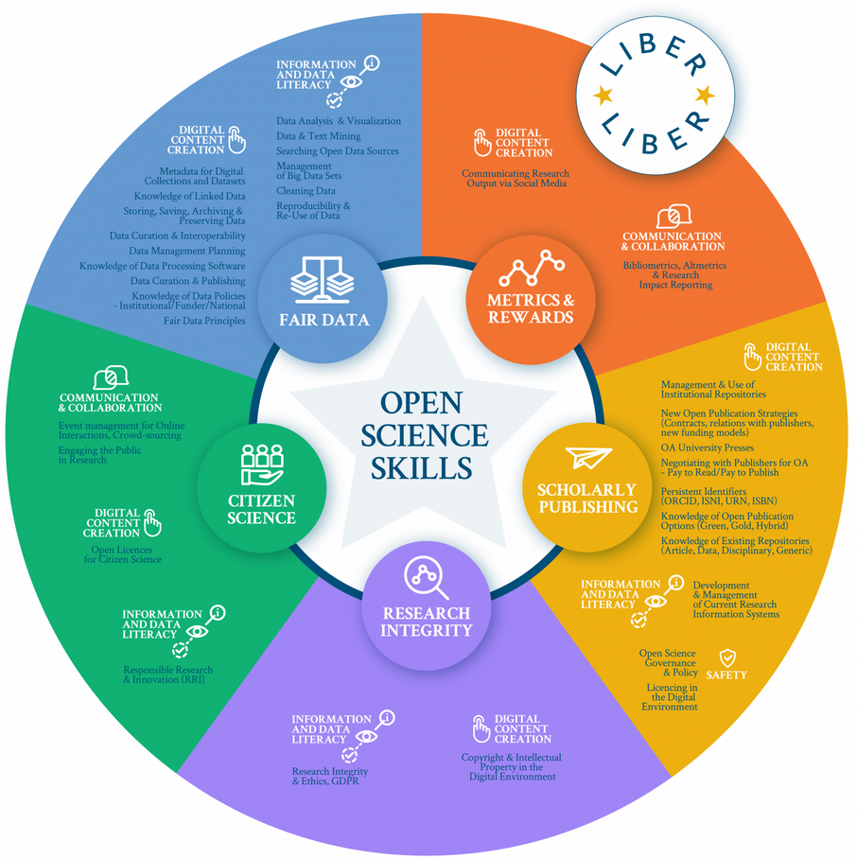
Open Science Skills
With other partners, provide a multidisciplinary one-stop-shop for researchers to support OS workflow
Incorporate OS skills in academic training for students
Provide innovative digital training materials and courses to support skills development
Build expertise in metadata, persistent identifiers, ontologies to be able to support OS infrastructure
Notes:
For Open Science to become the de-facto mode of conducting research and scholarship in Europe, researchers need disciplinary specific skills and broad cross-disciplinary capabilities.
Research libraries should play a key role in training students and researchers.
To implement this in your library, you can for example, with other partners, provide a multidisciplinary one-stop-shop for researchers to support OS workflow
Incorporate OS skills in academic training for students
Provide innovative digital training materials and courses to support skills development, something lots of us progressed quickly during covid-19 crisis!
Librarians are already experts in metadata, so we may build expertise and developpe further our expertise in fields like persistent identifiers, ontologies to be able to support optimal OS infrastructure

Slide 21
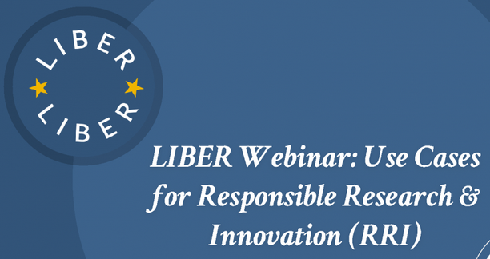
Research Integrity
Participate in establishing Codes of Conduct for Research Integrity integrating openness, transparency and accountability
Train researchers about legal and ethical aspects of scholarly communication, copyright, data management and OS
Provide services to counter malpractice
Notes:
Lots of information are circulating every day, and unfortunately, there are also lots of false information circulation. Continued public trust in science is fundamental to secure support to publicly funded research, but also for democracy.
Libraries have a key role to play in supporting research integrity by
Participate in establishing Codes of Conduct for Research Integrity integrating openness, transparency and accountability
Train researchers about legal and ethical aspects of scholarly communication, copyright, data management and OS
Provide services to counter malpractice as plagiarism and fraud.

Slide 22
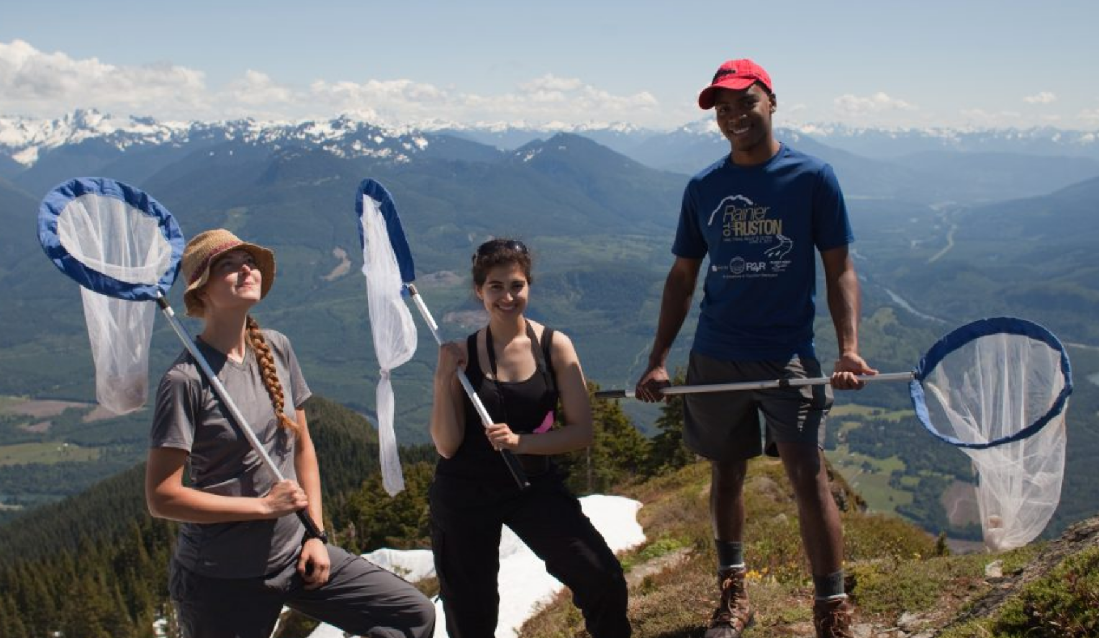
Citizen Science
Promote the library as an active partner in Citizen Science
Promote good conduct in Citizen Science through the library’s services
Develop a set of guidelines (methodologies and policies) for Citizen Science
Develop skills to be a strong and active partner in Citizen Science (science communication, information technologies, project management)
Notes:
Last but not least, Citizen Science is very important in establishing links between science and society.
It is therefore necessary that research libraries assist and lead Citizen Science projects.
To do this, we can:
Promote the library as an active partner in Citizen Science
Promote good conduct in Citizen Science through the library’s services
Develop a set of guidelines (methodologies and policies) for Citizen Science
Develop skills to be a strong and active partner in Citizen Science (science communication, information technologies, project management)

Slide 23
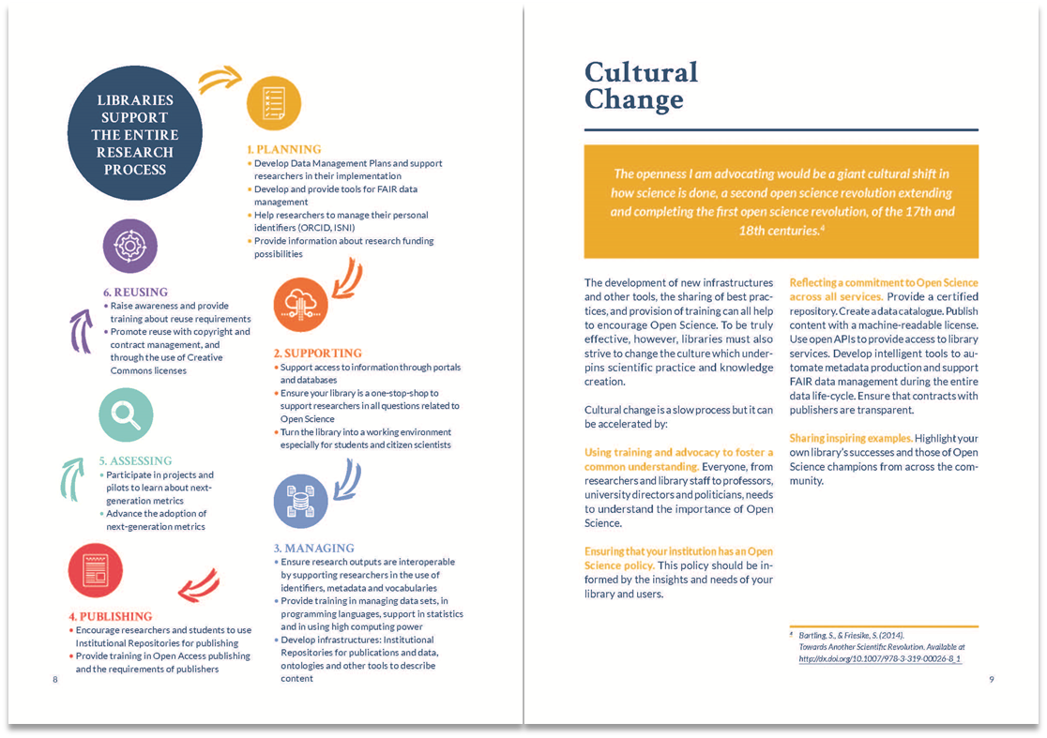
Libraries can raise awareness, provide training, open research collections to innovative research methods and develop supportive policies and infrastructures.
Notes:
So you see that Libraries have many roles to play.
These are some of the roles LIBER sees for libraries, and today we want to hear from you: what is your vision of the future role of libraries?
Which challenges can we solve?
That is what we want to go into with you with these workshops.

Slide 24
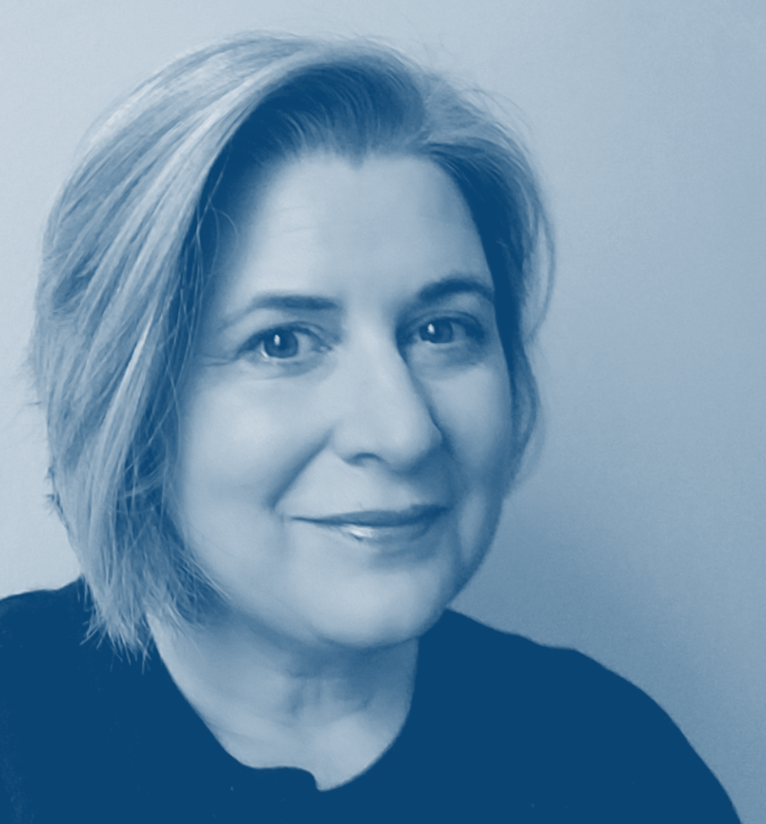
SEPTEMBER 24, 2020
OCLC and Open
Rachel L. Frick
Executive Director, OCLC Research Library Partnership

Slide 25
“A revolution is required, one which opens up research processes and changes mindsets in favour of a world where policies, tools and infrastructures universally support the growth and sharing of knowledge.”
https://libereurope.eu/blog/2018/07/03/liber-launches-open-science-roadmap/
Notes:
Where in the landscape, the larger environment, does an organization like OCLC need to focus to respond to the innovations in scholarly communication, changes in user services and expectations, and the basic research infrastructure, like metadata provisioning and persistent id’s?

Slide 26
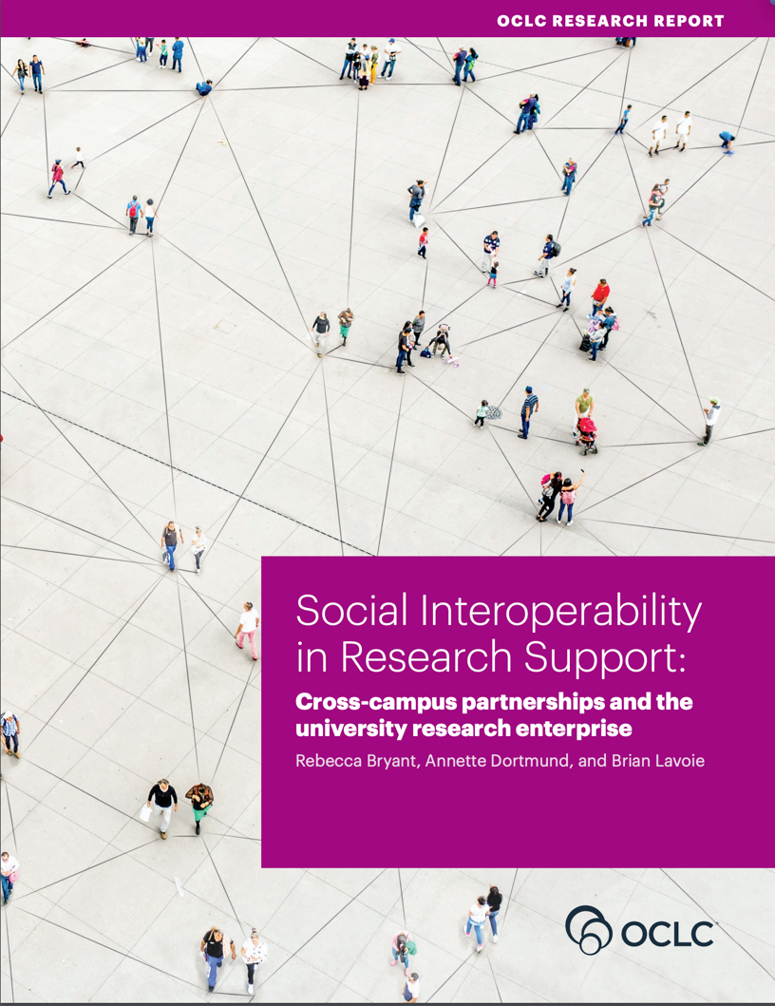
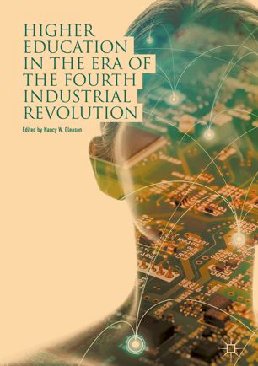
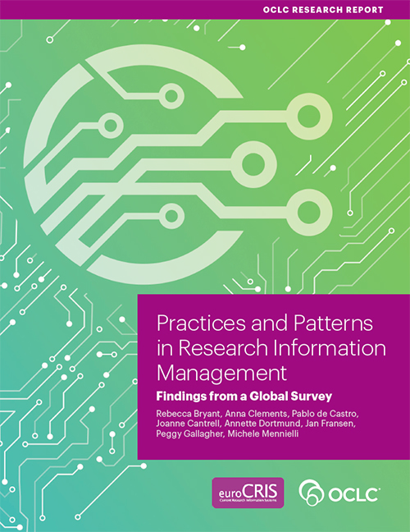
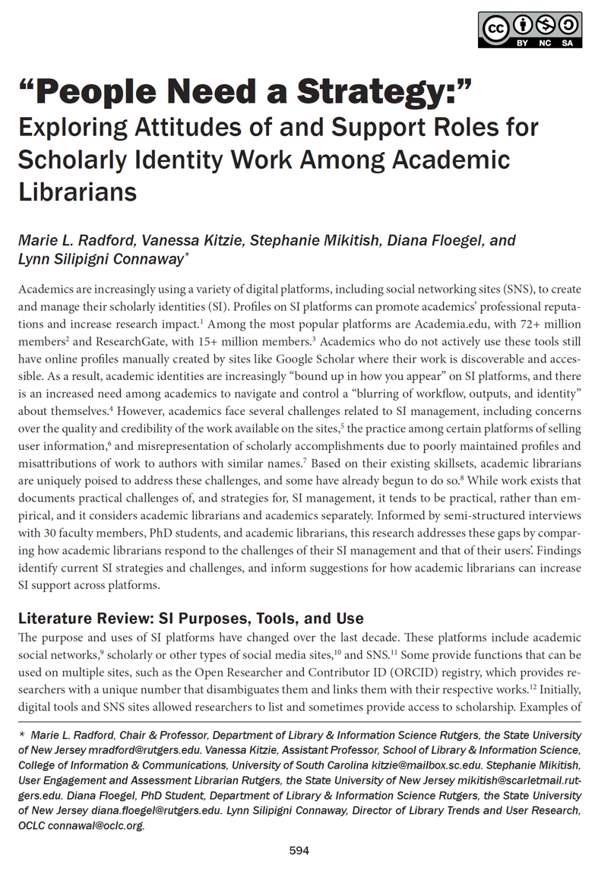
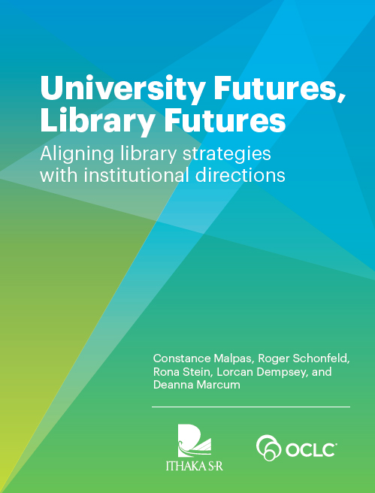
OCLC Research & Global Council

Slide 27
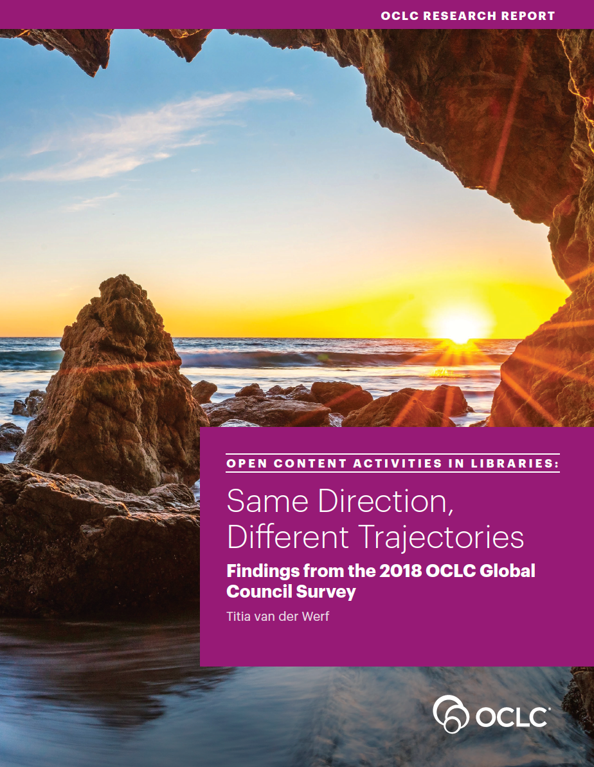
“What is the status of OA and
open content in libraries across the world?”
Survey gathering data about libraries’ open content efforts, investments, and opinions
Report synthesizing the survey findings
Growth areas:
RDM/FAIR data
interacting with ‘collections as data’ with AI-driven tools
Conclusion: high-involvement and same direction, also many country-specific differences
Notes:
The 2018-2019 Open Content Survey was initiated by the OCLC Global Council. It expressed interest in investigating libraries’ efforts and ambitions to support access to open content, asking, “What is the status of open access and open content in libraries across the globe?”.
A survey was developed to gather initial information on libraries’ open content efforts, investments, and opinions across the GC-network and beyond.
This Report synthesizes the survey findings: 97% of respondents are highly involved in open content activities, and the overwhelming majority are
stepping up their activities and planning new ones. The figures suggest a future increase in involvement of 10-18% across all open content activities. Future growth areas are:
RDM/FAIR data and
interactions with collections as data (digitized open collections) with the help of AI/machine learning techniques.
The main, high-level conclusion is that libraries are following the same direction even if there are many interesting differences/priorities by country.

Slide 28
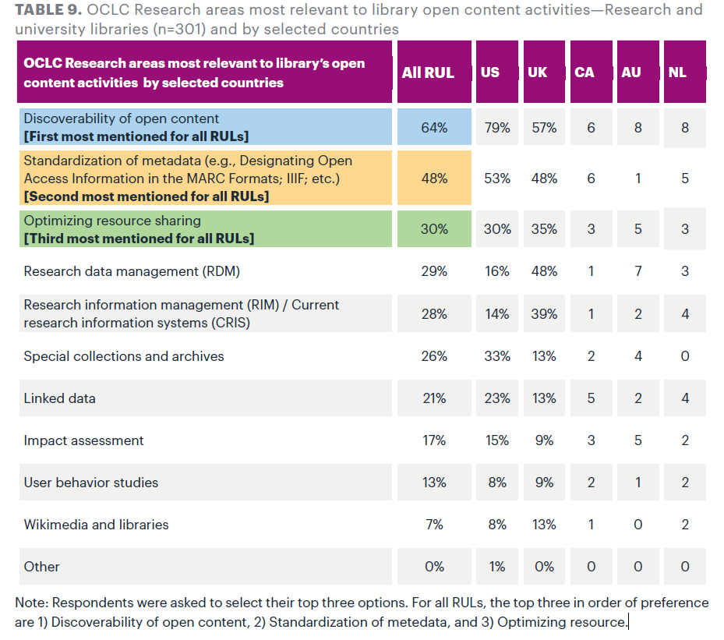
OCLC Research areas most relevant to libraries’ open content activities
“OCLC Research areas most relevant to library open content activities—Research and university libraries (n=301) and by selected countries” by OCLC Research, from Open Content Activities in Libraries: Same Direction, Different Trajectories—Findings from the 2018 OCLC Global Council Survey (https://doi.org/10.25333/vgmw-ba86), CC BY 4.0
Notes:
The 2018-2019 Open Content Survey was initiated by the OCLC Global Council. It expressed interest in investigating libraries’ efforts and ambitions to support access to open content, asking, “What is the status of open access and open content in libraries across the globe?”.
A survey was developed to gather initial information on libraries’ open content efforts, investments, and opinions across the GC-network and beyond.
This Report synthesizes the survey findings: 97% of respondents are highly involved in open content activities, and the overwhelming majority are
stepping up their activities and planning new ones. The figures suggest a future increase in involvement of 10-18% across all open content activities. Future growth areas are:
RDM/FAIR data and
interactions with collections as data (digitized open collections) with the help of AI/machine learning techniques.
The main, high-level conclusion is that libraries are following the same direction even if there are many interesting differences/priorities by country.

Slide 29
Access
Content
Data
Education
Scholarship
Science
Notes:
There are several areas in the “Open“ movement:
Access
Content
Data
Education
Scholarship
Science
In order to be successful, OCLC needs to pick the strategic areas.
The industry-wide shift to Open is a trend of much broader scope than the move towards Open Access (OA). Whereas OA is exclusively concerned with making current research publications freely available, it is part of a larger trend of making public sector and scholarly information more easily and freely available and re-usable in a digital environment. As such, the shift to Open aims to unlock massive amounts of data, information and knowledge—contained in publications, information systems, databases, collections, etc.—by increasing their digital availability and removing access restrictions. In doing so, it is bound to impact libraries who have a role in managing and providing access to this content.

Slide 30
Defining Open Content
Digital​
Accessible immediately and online​ (no technical barrier)
Freely available (no authorization or cost barrier)
Fully reusable in a digital environment​ (rights defined)

Slide 32
Traditional Content Providers at OCLC
Notes:
OCLC partners with publishers, aggregators for many years, OCLC is increasingly receiving OA content from these content providers. Today, we work with close to 350 partners, of which almost 100 provide fully or hybrid OA materials, which is peer reviewed.
Some examples – Oxford and Cambridge UP, Sage, Brill, Wiley, Springer, Elsevier and Taylor & Francis

Slide 33
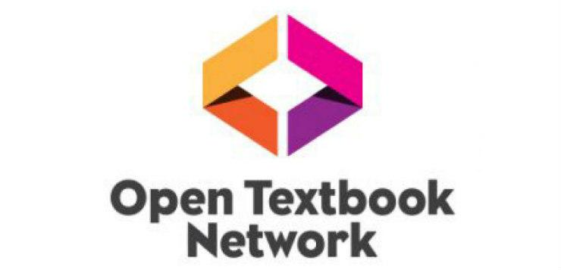
Open Content Providers at OCLC
Notes:
In addition to the classic providers, OCLC was already collecting several thousand Institutional Repositories and other library materials through the Digital Collection Gateway.
However, in recent years, special OA directories have emerged which make millions of open content items available.
OCLC’s Business development group proactively seeks out partnerships with providers of high quality, freely available content from OA aggregators, digital libraries and publishers.
Here are examples of some of our 66 open content partners
Learning and exploring open content and what different providers can give you is a bit like learning a new language. It can seem overwhelming at first but then you start to sense the patterns, then remember some names and before you know it you can make small talk.
Open Content ingested through controlled/licensed sources
Gold Journals
Open Education Resources (OER)
Hybrid content published through traditional publishers
Open Content ingested through open sources
E.g. through OCLC - Digital Collection Gateway
Archives / Special Collections
Institutional and disciplinary repositories

Slide 36
Advocacy & Engagement
Notes:
COAR, SPARC, IIIF, ORCid, and DataCite
National and regional bibliographic infrastructure development
Partner with thought leaders
Bibliographic infrastructure development
Support MARC21 Open standards

Slide 37
Areas of Continued Exploration
Linked data prototyping and open data
OER and open textbooks
Institutional publishing of open content
Curation & preservation of open content

Slide 39
Q & A
Notes:
Invite people to deposit their questions in the chat or raise their hand and unmute.

Slide 40
Thank you for joining!
Notes:
Closing remarks

