Slide 1
Dynamics of Change: Continuing the Conversation on Library Naming, Finding and Relationship Building with Indigenous Peoples
Presentation by Desmond Wong, May Chan, Jamie Lee Morin and Oy Lein Jace Harrison
Presented at the OCLC Works in Progress Webinar June 22, 2020

Slide 2
POSITIONALITY
WHO WE ARE

Slide 3
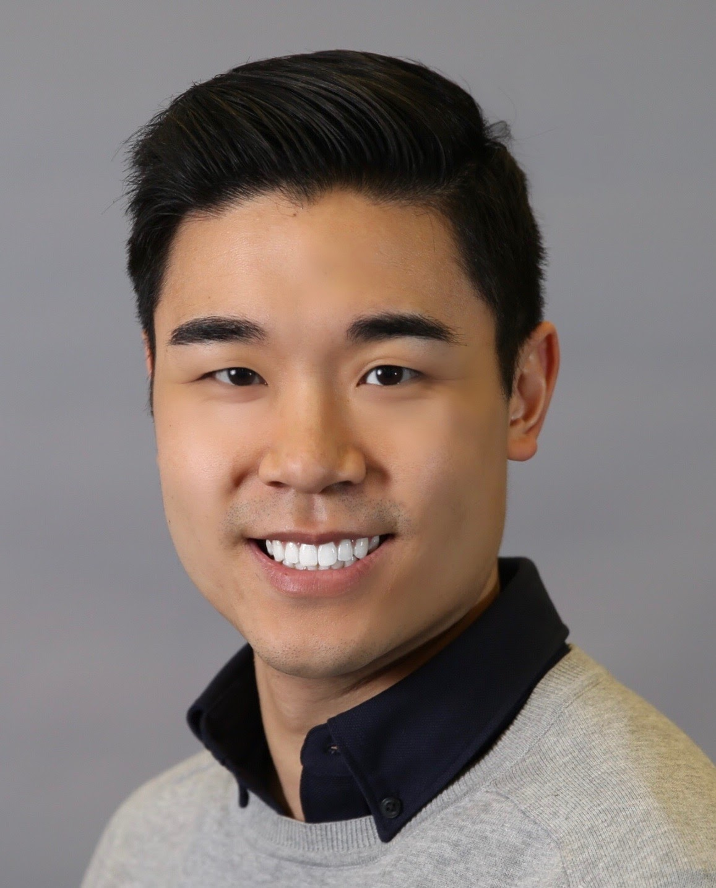
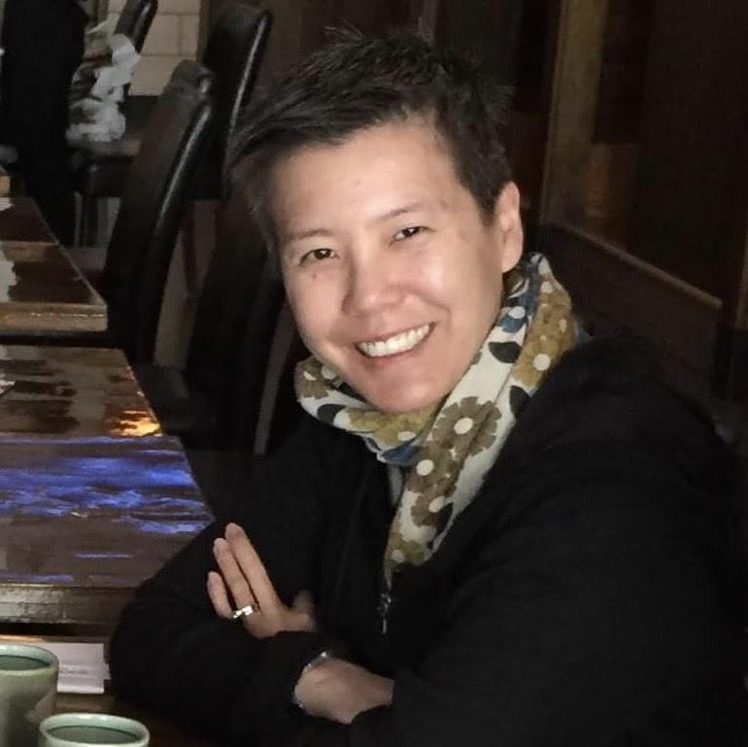
Who We Are
DESMOND WONG
OUTREACH LIBRARIAN
UNIVERSITY OF TORONTO LIBRARIES
MAY CHAN
HEAD, METADATA SERVICES
UNIVERSITY OF TORONTO LIBRARIES
Notes:
Desmond’s positionality statement: Hello Everyone. My name is Desmond Wong and I am the Outreach Librarian at the University of Toronto Libraries. My main responsibility is to work with Indigenous students, faculty and staff to build relationships and trust and to ensure that the Library is living up to its obligations as a settler institution on Indigenous Lands. I am a settler, and a second generation Chinese diasporic person, with ancestral and familial roots through Hong Kong and China. I live and work in Mississauga of the Credit River, Haudensaunee and Anishinaabe Territory in what is now Toronto and I am very happy to be with you all today. May’s positionality statement: I’m May Chan. I am the Head of Metadata Services at the University of Toronto Libraries. My department provides resource description for the libraries in the Central system, and varying levels of support for non-Central libraries. I am a 2nd generation Chinese-Canadian settler. My parents grew up in colonial Hong Kong and eventually immigrated to Canada. Only very recently, through working with Desmond, did I see immigration as a colonial process displacing Indigenous peoples. I continue to grapple with the tension between being complicit in the systemic oppression of Indigenous peoples and being active in supporting reconciliation.

Slide 4
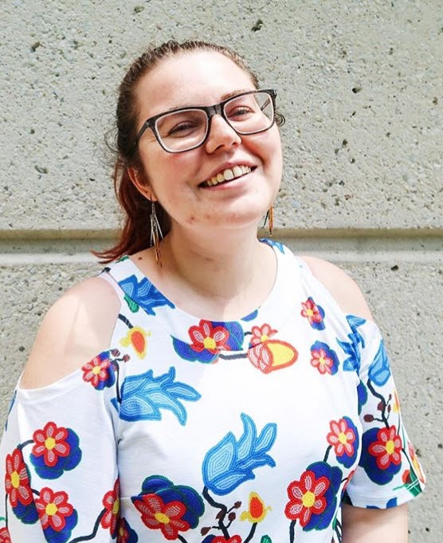
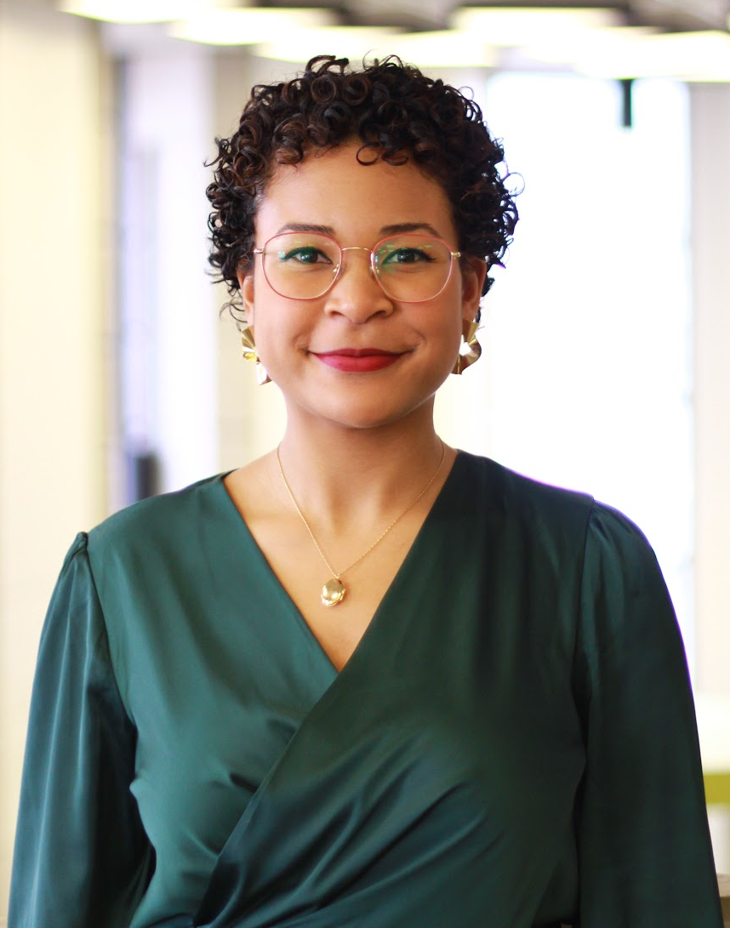
Who We Are
OY LEIN “JACE” HARRISON
LIBRARY GRADUATE INTERN
UNIVERSITY OF TORONTO LIBRARIES
JAMIE LEE MORIN
LIBRARY GRADUATE INTERN
UNIVERSITY OF TORONTO LIBRARIES
Notes:
Jace’s positionality statement: My name is Oy Lein “Jace” Harrison. I am one of the Library Graduate Interns who worked on these projects --my major project was conducting an environmental scan of library responses to the TRC Calls to Action.
Oy Lein is my Chinese name and Jace is the African name that represents by Jamaican heritage. I am learning about what it means to reconcile with the Indigenous community as both a Black and Coloured cisgendered woman. I want to thank the Indigenous community members who have and continue to be patient with me as I learn. My pronouns are she/her.
Jamie’s positionality statement: My name is Jamie Lee Morin. I’m one of the Library Graduate Interns at UTL. My responsibility in this position was developing an Indigenous Cultural Competencies Toolkit for UTL. I’m an urban-raised Metis woman navigating my privilege of being a white-passing, cisgendered Indigenous woman and in growing up in a big city like Toronto. My pronouns are she/her.

Slide 5
Agenda
Overview of Major Issues + Context
Environmental Scan
Toolkit
Generative Engagement
Conclusion
Notes:
DESMOND
May and I will provide a quick overview of a major issues and some context that inspired two research projects, that is, to conduct an environmental scan and develop a cultural competency toolkit.
Jace will then present on some high level findings from the environment scan she conducted.
Following Jace, Jamie will highlight core content of the toolkit she developed.
Just before we conclude, May will speak briefly on the generative impact of these projects, and our approach to engaging staff and the external community for UTL to be held accountable.
Land Acknowledgement: Before we get into the presentation, we would like to begin by acknowledging the lands on which we work --the traditional territory of the Seneca, Huron-Wendat and, most recently, the Mississaugas of the Credit First Nation. We recognize that Tkaranto (what settlers refer to as Toronto) is bound by the Dish with one spoon treaty --an agreement between the Mississaugas, Haudenosaunee, and Anishinaabe, that recognizes we all eat from one dish, sharing one spoon. We try and instill the values of shared responsibility in our positions here at UTL.

Slide 6
OVERVIEW OF MAJOR ISSUES AND CONTEXT
Desmond Wong & May Chan

Slide 7
OVERVIEW OF MAJOR ISSUES
Vocabulary and description: use of racist and socially biased language
Imposing a Western knowledge structure: ghettoization of Indigenous materials under the history section.
Notes:
Desmond
Overview of issues in Library of Congress (LC) Subject Headings, LC Classification, and Dewey
Indigenous metadata and resource description has taken and continues to take a paternalistic and heteropatriarchal approach to its wording. The words used currently in library metadata reflect a deeply colonial worldview that places Indigenous in an incorrect assumptive position of hierarchy and dominion of nation states. For example, the broadest Library of Congress Subject Heading currently states Indians of North America, using both the pejorative and inaccurate term “Indians” to describe Indigenous Peoples and placing them within a worldview and context of a European name for the Lands which they steward. These terms do not accurately reflect the complexity of the relationships between these Nations, nor their multivariate and complex relationships to Land.
However, this metadata issue is not one that can be solved by approaching metadata structures alone. Because Indigenous epistemologies differ so greatly from that of colonial thought, it requires a holistic revision of library structures and services. To that end, we will be sharing work that has been done at the University of Toronto, but also our colleagues at other institutions. On the face of it, there may not be much of an obvious connection between our various initiatives. However, we hope to reinforce the fact that traditional silo-ing of library workflows do not work to serve our Indigenous users, nor can this work be solved with library problem solving solutions. We call for a consultative and relationship building approach for accountability and relationality of this work. This cannot happen without appropriate knowledge and capacity building in all aspects of library work. To quote Audre Lorde “For the master's tools will never dismantle the master's house. They may allow us temporarily to beat him at his own game, but they will never enable us to bring about genuine change”. The work we wish to do is liberatory, towards collective freedoms in tandem with a deep and embodied understanding of how settler colonialism affects and is indeed the foundation of our work and to push towards an emancipated futurity.
I will now pass the time on to May, who will explain more of the University of Toronto Libraries context.
Point A: Vocab and Description
The most well known example of this is “Indians of North America,”
A project carried out by the Manitoba Archival Information Network (MAIN) identified 1094 problematic LCSH
These were terms that were found in their catalogue and Peoples living in the Manitoba area, so there are definitely more.
Point B:Western Knowledge Structure
Indians of North America or class E75-E99 is a sub-heading of the History section. All Indigenous materials regardless of when they were published, or, the subject that they describe, are catalogued in this section
Dewey?

Slide 8
CONTEXT: THE LIBRARY ECOSYSTEM
The University of Toronto is a tri-campus system with seven colleges
93,081 students (Fall 2019)
4,648 faculty, 7405 staff, 158 Librarians (Fall 2018)
700+ undergraduates programs and 300+ graduate programs (Fall 2019)
42 libraries
18 are part of the Central Library system
14 central services
20+ tri-campus library committees
Cataloguing and Authorities User Group (CAUG)
Notes:
MAY
Not long after i started at the University of Toronto Libraries in 2018, Desmond raised the issues he just outlined to me in a real way: through numerous user complaints about 1) the use of Library of Congress subject heading “Indians of North America” and 2) non-granular approach to applying subject analysis and classification to works about Indigenous peoples.
I brought forth these issues to my department, but realized that, although we are the largest cataloguing department in the UTL system, we would not be able to make changes with consulting other cataloguers from other libraries.
Before going further, I’d like to take the opportunity to describe the environment we work in. The University is a tri-campus system with seven colleges. Student, faculty, staff, and librarians combined is over a 100K people. The library system consists of over 40 libraries, 18 of which belong to the central library system. There are 14 central services, one of which is my department. There are numerous cataloguers throughout the system.
Given the complex nature of the library ecosystem, we collaborate formally through tri-campus committees. There are over 20 of these, one of which is the Cataloguing and Authorities User Group (CAUG).
I brought forth the issues raised by Desmond to CAUG in the fall of 2018. At the time, there were mixed responses in terms of taking action.
However, one outcome was the expressed interest in learning about what other Canadian libraries were doing were with regards to subject headings.
Desmond and I decided that we needed to meet staff where they were at. We took this expressed interest literally and identified two projects, that is, conducting an environmental scan and developing a toolkit, to increase awareness of the issues.
We want to emphasize that work is very much a work-in-progress. Because it is localized to our workplace, we are not presenting solutions to offer you. Because systemic change is messy, challenging and slow. we do not want our presentation to be received as a narrative of linear progress. We do hope that some aspects of our work will resonate with you, that it might lead to connections external to our workplace for mutual and critical learning.
I will pass the time over to Jace to share the findings from the scan.

Slide 9
ENVIRONMENTAL SCAN
Oy Lein “Jace” Harrison

Slide 10
ENVIRONMENTAL SCAN
Research Question: How are Canadian academic libraries responding to the TRC Calls to Action in the area of Metadata?
Semi-structured interviews
48 librarians and archivists representing 38 institutions.
Notes:
JACE
As was said, I was charged with conducting a national environmental scan of Indigenous metadata initiatives
And the central research question I tried to answer was: How are Canadian academic libraries responding to the TRC Calls to Action in the area of Metadata?
As the scan progressed I ventured outside of academic libraries and began to interview associations, public and school libraries, and some archives. Since so many people are forming partnerships and collaborations, this made sense. I also ventured outside of metadata. It was more common to find an individual or handful of librarians working on these projects and they are a volunteer from whichever department they are situated
At the projects end I had conducted semi-structured interviews with over 48 librarians and archivists representing 38 institutions across Canada

Slide 11
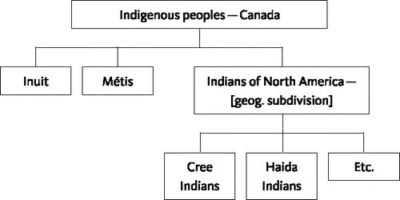
A COLONIAL WORLDVIEW
Canadian Government
Indigenous Nations
Bone, C., & Lougheed, B. (2017). Library of Congress Subject Headings Related to Indigenous Peoples: Changing LCSH for Use in a Canadian Archival Context. Cataloging and Classification Quarterly, 83-95.
Notes:
JACE
The issues that we are addressing in our catalogue are reflective of the larger systemic oppression of Indigenous folks. Marisa Elena Duarte and “Understanding how colonialism works can help those in the field of knowledge organization appreciate the power dynamics embedded in the marginalization of Native American and Indigenous Peoples materials [...]”
The images on the slide were taken from the Manitoba Archival Information Network Project (MAIN), and in the team’s corresponding article they discuss how Library of Congress reflects the same Western
The library is a reflection of the world through the colonizer’s eyes. And the tools that the state uses to continually oppress Indigenous Peoples is reflected in the catalogue.
Learning about colonial oppression outside of a library context is vital to understanding how we as professionals and individuals continue to perpetuate this oppression. We also need to understand how responses to this oppression --UNDRIP, TRC-- can be reflected in a library context

Slide 12
BARRIERS
Funding & time
Skilled Labour
Technical Challenges
Value of Records
Consortia
Colloquial Language
Labour & resource Intensive
Sharing Records
Holistic Change
Social Change
Integrated library system
University and College curricula
Political influence
Cultural competency
Colonial culture
Notes:
JACE
Librarians have obviously been encountering several barriers when attempting to change or improve metadata on Indigenous materials, some of the major ones being:
Sharing records across institutions
How can we ensure that we are using the same terminology to describe Indigenous materials? Who is using their resources to determine this terminology through consultation with the community?
Labour and Resource Intensive: Many libraries do not have the funding, time and personnel needed to carry out this work. Especially smaller libraries
Most LSPs do not allow a mass change for subject headings or authority records.
Also, a lot of these items just need to be recatalogued --they were catalogued incorrectly to begin with. Librarians are asking: how do we negotiate our attention between new materials moving into the collection and recataloging old materials?
E.g. One librarian moves a batch outside the catalogue and then recatalogues it back in once a month
Cultural Competency: Them or their peers not having the required knowledge of Indigenous worldviews and ontologies to make the appropriate changes
For example, one public librarian, who is working in the Dewey Decimal classification system, is struggling with how to categorize Indigenous stories which for the most part can be found under the mythology and folklore section. Indigenous stories don’t necessarily fall under the categories of myth folklore or even religion. How do we determine what is a creation story, what is religion, and what is legend?
Holistic Change: And the need for holistic change from other departments --change cannot happen in isolation. The library is a fully integrated system and we need communication across departments in order to maintain consistency. Collections needs to work on expanding our selection of Indigenous materials. Folks on the front end need to know how to locate Indigenous materials that might be hidden under inappropriate terminology

Slide 13
RESPONSE
Classification
Cataloguing
Culture
Notes:
JACE
The following are some of the major strategies that librarians are using to combat these barriers.
It is important to acknowledge that every institution is very much on their own journey of reconciliation because every institution has a unique relationship with their Indigenous patrons and community.

Slide 14
CLASSIFICATION ADDRESSING AN IMPOSED WESTERN KNOWLEDGE STRUCTURE
Sovereignty reflected on the bookshelf
Cataloguing Indigenous materials with the correct subject headings
Easily identifiable on shelves
E.g. Spine labels, stickers
Creating an “Indigenous Collection”
Supporting Community collections/bringing them into the library catalogue
Maintaining LOC or Dewey classification schemas
Notes:
JACE

Slide 15
CATALOGING ADDRESSING THE USE OF RACIST AND SOCIALLY BIASED LANGUAGE
Language
Changing or adding broad terms
E.g. Indians of North America → Indigenous Peoples >North America
Creating local subject headings based on alternative vocabulary lists
E.g. UBCIC, MAIN, Xwi7xwa
Enhancing existing records
Linked Data
Wikidata
Notes:
JACE
Changing or adding broad terms. E.g. Indigenous Peoples --North America: Most institutions have replaced Indians of North America with Indigenous Peoples --North America (Indigenous Peoples >South America). Some folks are using First Nations, Aboriginal etc. They are also looking at other broad subject headings like Off-reservation boarding school → Residential school, Eskimo → Inuit.
These are easier to change in the catalogue because they are indisputable/easy to consult on.
But, for this example specifically (point at slide) we must keep in mind that Indian, Indigenous, Aboriginal, and even First Nations are umbrella terms used to describe a very diverse group of Peoples. They are also still colonial terms.
Even when we get more regionally specific with “Indigenous Peoples> North America” North America includes thousands of nations within both Canada and the US. This same problem occurs regionally
Creating Local Subject Headings: As a temporary fix, most librarians are creating local subject headings based using the vocabulary lists developed in “decolonial” description projects
RECATALOGING
Enhancing records:
Adding subject headings
Adding into the notes field

Slide 16
CATALOGING ADDRESSING THE USE OF RACIST AND SOCIALLY BIASED LANGUAGE
Relationships
Developing relationships with publishers, vendors, and LSP providers
Becoming consortia members, NACO/SACO members
Waiting for changes to be made at Library and Archives Canada (LAC) and Library of Congress (LOC)
Notes:
JACE
Developing relationships with publishers and vendors: Institutions are attempting to outsource as much of the labour as possible by developing relationships with publishers and vendors so that changes can be made from the source. Librarians are also collaborating with public libraries, school libraries and archives in the area to share and distribute labour
Addressing the labour barrier:
Applying for a NACO funnel membership so that they can contribute new name and subject authorities through PCC. And, a lot of libraries are doing this with the idea of dispersing labour. If more libraries are contributing NACO and SACO members than each region can add the proper terminology for Indigenous Nations in their region. For UNBC, they are too small for a SACO membership, so they are going to focus on NACO instead and rely on larger libraries to contribute to SACO
Critiques:
Even if we were adding subject and name authorities through NACO/SACO that would involve hundreds of subject headings, which is why we should be pushing for changes to LCSH. But we should be mindful that both take a very long time.
Building Connections with other libraries in the area so they can collaborate on consultation, making a list, or other initiatives that UNBC might not have had the capacity to do on its own in the past
Waiting for changes to be made at a higher level: Lastly, to be quite frank, a lot of libraries are waiting for changes to made at a higher level through the Library of Congress (LOC) and Library and Archives Canada (LAC). And, until that happens librarians are doing PATCHWORK. Librarians realize that this is a structural problem. Indigenous communities and cultures will change, and we will have to keep on consulting and making these changes ourselves until there is systemic change across Canada.
Librarians are split on whether we should be making changes or not. Some argue “Hey, I don’t want to do all of this work just for LAC to turn around, change everything, and then I have to do it all over again.” Other librarians recognize that (1) LAC is working with little resources and is just as understaffed as the rest of us. (2) Library of Congress might take longer to (3) this is a political issue. If you choose to be inactive that is a political choice

Slide 17
FRAMING THE ISSUES
“A queer approach to language resists the idea that naming is ever outside of power or resistance. In both cases, the project of a critical library classification becomes less about correction and more about locating the ruptures in the structure, developing what Olson has called ‘techniques for making the limits of our existing information systems permeable’ (p.101). A corrective approach attempts to ‘smooth out the ruptures in the catalog to lay bare its contingencies, rendering the constructed quality of library classification and cataloguing less visible to the user, and therefore, more difficult to apprehend and understand’ (105).”
Drabinski, E. (2013). Queering the Catalog: Queer Theory and the Politics of Correction. The Library Quarterly: Information,
Community, Policy, 83(2), 94-111.
Notes:
JACE
Recognize that these are systemic challenges
A national living thesauri
Multiple synonymous terms
Emily Drabinski suggests that patchwork is not necessarily a bad thing, but rather it is a tool that points out the ruptures in a structure. And it makes the coloniality of the system much more visible
Makes visible that our Western classification and knowledge systems were not created with Indigenous knowledge systems in mind.
We would need complete systemic change to happen at LAC and LOC, but it is also important that this continues to happen at a grassroots level first.
Now I’m going to pass it over to Jamie

Slide 18
TOOLKIT
JAMIE LEE MORIN
Notes:
JAMIE

Slide 19
DEVELOPING THE TOOLKIT
Began researching for development in 2018
Drafting in 2019
Expected draft completion in June 2020
Notes:
JAMIE
As mentioned earlier, my main project during my time with the TALint program has been the development of a toolkit geared towards non-Indigenous librarians.
The goal of this toolkit is to assist with the development of workplace cultural competency, especially when it comes to working with (and for) Indigenous patrons and materials at UTL.
The researching component of developing the toolkit began in 2018. What this looked like was examining materials, such as books, presentations, other toolkits from different fields to see how the development of Indigenous cultural competency was approached.
We anticipate a good copy of the toolkit draft to be completed this month, with an eventual internal release. In additional recognition of how times can change, the toolkit was developed with the anticipation that it would grow overtime, or perhaps be potentially adapted for other institutions someday.

Slide 20
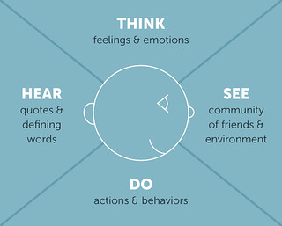
SAMPLE EMPATHY MAP
Empathy mapping and personas are an aspect of User Experience Design.
Persona: the person in the middle.
Empathy Map: what the persona may be thinking, seeing, hearing, and doing in specific situations.
Image credit: Sarah Best on Flickr, of Joy Burke’s Empathy Map (2012) https://www.flickr.com/photos/sarahbest/7657046528
Notes:
JAMIE
Part of the design decision for developing my approach to the toolkit is a couple aspects of User Experience Design, which would be developing a persona (the person in the middle) and an empathy map (which is what they are experiencing in specific situations).
With this in mind, I also took into consideration, between conversations with librarians and exploring the landscape of librarianship-at-large, at determining average starting points for learning more about Indigenous issues and gaining comfort in advocating for Indigenous communities and experiences. I considered three major perspectives for non-Indigenous librarians: (1) not knowing much or anything about Indigenou issues, experiences, and histories; (2) some knowledge with a desire to improve; and (3) has considerable knowledge and would either like a refresher, or have a resource to point to for those who may not be as far along in their Indigenous cultural competencies journey.
With these personas made, I developed three empathy maps (one for each journey), and used these perspectives to develop and adjust sections of the toolkit, right down to the use of language. The wording used in the toolkit is deliberate, as it is designed to be accessible, and to reflect in the multitude of ways we all access knowledge and learn.

Slide 21
ENHANCING CULTURAL COMPETENCY
Current toolkit format
Land Acknowledgement
Information Authority
101 (Terminology and Assumptions)
Taking Responsibility (on Active Allyship)
Conversations with Colleagues
Resources and Bibliography
Notes:
JAMIE
While the toolkit is still in development, we’re anticipating that it will be a ten page pdf document. It will touch on the following areas:
Land acknowledgement
Information Authority
101 (Terminology and Assumptions)
Taking Responsibility (on Active Allyship)
Conversations with Colleagues
Resources and Bibliography for Cultural Competency
In this presentation, I will highlight specific sections

Slide 22
LAND ACKNOWLEDGMENT
The Land Acknowledgement is a formal statement recognizing the unique and enduring relationship that exists between Indigenous peoples and their traditional territories.”
Notes:
JAMIE
You may remember at the beginning of our presentation, we gave a land acknowledgement.
According to indigenous.utoronto.ca, “The Land Acknowledgement is a formal statement recognizing the unique and enduring relationship that exists between Indigenous peoples and their traditional territories.”
The land acknowledgement is also recognizing the land in which we live and work on. Even though most of our ancestors may not have been part of the early settlers who ended up staying on these lands, we are all invited into the spirit of the treaty.
Land acknowledgement source: https://indigenous.utoronto.ca/about/land-acknowledgement/

Slide 23
INFORMATION AUTHORITY
Our knowledge is not usually gained firsthand, but is mediated through secondary sources.
Who decides which materials about Indigenous peoples and topics are represented in a library collection?
Notes:
JAMIE
Information authority is the idea of what we think or believe is often not determined first hand, but told to us by a secondary source (Wilson 1983).
With this in mind, as information professionals, we act as knowledge mediators and have the ability to shift perceptions on a variety of topics.
With this in mind, this is where moves such as what MAIN have done are important, as it can help ensure that better sources are connected to researchers.

Slide 24
EXAMPLE: ASSESSING AN ITEM
Who created this item and for what reason?
Notes:
Jamie
Things to consider:
Was the person who created this item Indigenous? If so, what nation? Who claims them? If they aren’t Indigenous, was the item created in consultation with Indigenous peoples, or created about them with no consultation? Does the item help or harm the community?

Slide 25
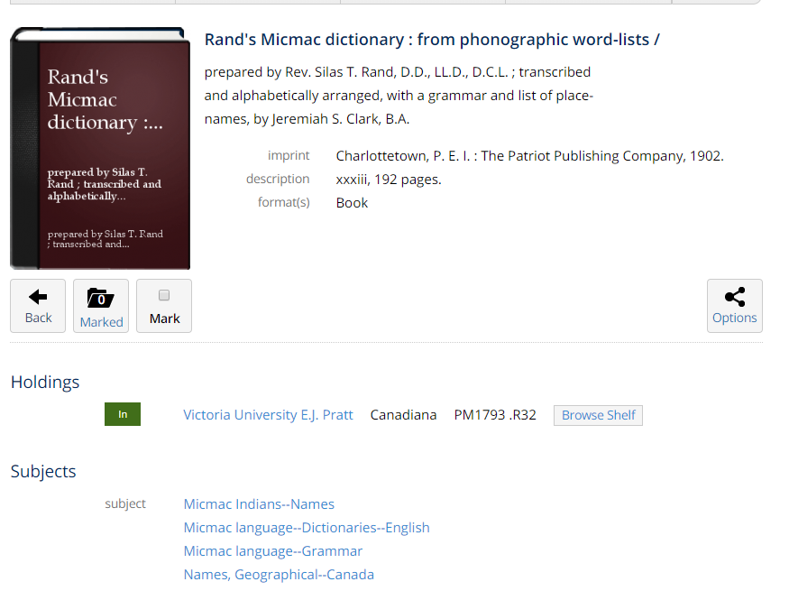
EXAMPLE: ASSESSING AN ITEM
This item is housed in the Victoria University E. J. Pratt Library. It is a Mi’kmaq to English dictionary created by Reverend Silas T. Rand.
Notes:
JAMIE
A quick example that I have pulled up for this presentation is this item, the Micmac Dictionary: From Phonographic Word-Lists. This particular copy was imprinted in 1902 and is an example of a tool used to undermine Indigenous languages, cultures, and worldviews at the time of its creation. By having access to Indigenous languages, there was the ability to translate Bibles into Indigenous languages, and to share stories that were perhaps not meant to be shared beyond the Maritimes.
However, this book can now have a new function - as a tool for language revitalization.
There is a dictionary also held in our collection, in Fisher Library, that is a complete Anishinaabemowin Bible. During the International Year of Indigenous Languages (2019), this book (among others) were brought up for an event involving several Indigenous community members from on and off-campus, many of them language teachers. The item was perused and copies were made for language teachers and learners by the library. The language dialect in this book is among the closest to what our ancestors spoke.
Image source: http://go.utlib.ca/cat/4420852

Slide 26
TERMINOLOGY
This section aims to demonstrate shifts in language not only within the workplace, but even beyond.
Notes:
JAMIE

Slide 27
EXAMPLE: INAPPROPRIATE TERMINOLOGY
“Let’s have a pow wow about this.”
“They’ve gone off the reservation.”
Notes:
JAMIE
For example, I have heard these two phrases in various workplaces. They are both not appropriate to say.

Slide 28
EXAMPLE: INAPPROPRIATE TERMINOLOGY
“Let’s meet about this.”
“They’re acting on their own.”
Notes:
JAMIE
Instead of saying “Let’s have a pow wow about this,” say “Let’s meet about this.” That’s all it is - a meeting - not a very spiritually and culturally significant event that can last upwards of three days.
Instead of saying “They’ve gone off the reservation,” just say that they’re acting on their own. Going off the reservation calls back to times before 1951, when First Nations folk who lived on reserves would have to seek permission from an Indian Agent to leave the reservation. As many of these requests were denied, First Nations folks would sneak off the reservation to do what they needed to do, such as hunt. If they were caught, the minimum penalty was three months in jail, and the maximum was almost immediate death.

Slide 29
TAKING RESPONSIBILITY
This area will discuss starting points for the development and sustenance of meaningful relationships between non-Indigenous librarians and respective Indigenous communities (on campus and beyond).
Notes:
JAMIE
This section will discuss ways to begin developing and sustaining meaningful relationships between non-Indigenous librarians and respective Indigenous communities. Every relationship will look, begin, and be maintained differently, so the approach for this area is quite generalist.

Slide 30
CONVERSATIONS WITH COLLEAGUES
This section is currently under development in the toolkit, but will discuss ways to begin having conversations with colleagues and supervisors about Indigenous issues.
Some preliminary plans for 2020-2021:
Presenting to a wider range of colleagues
Building a community of practice
Learning through a book club
Notes:
JAMIE

Slide 31
GENERATIVE ENGAGEMENT
May Chan & Desmond Wong
Notes:
MAY
Need to engage beyond just the cataloguers
Need holistic, systemic change

Slide 32
PLANTING
Internal Engagement
Cataloguing and Authorities User Group (October 2018, December 2018, March 2019, April 2020)
2020-2021 Work Plan
Senior Staff (June 2019)
University of Toronto Archivists Group
Senior Staff (February 2020)
Community of Practice
Book Club Pilot (March-April 2020)
Notes:
MAY
CAUG x 4
Senior Staff 1
UTAG
Senior Staff 2]
Community of Practice
DESMOND
Book Club
Digital Community of Practice
In order to increase opportunities for interaction and cultural competency, we worked together to create opportunities to learn together. This was spurred by an expressed need by library staff for a safe space to dialogue and encouraged by Indigenous community members.
We read Chelsea Vowel’s Indigenous Writes: A Guide to First Nations, Métis and Inuit issues as a primer for our discussions. The idea of a digital discussion space and book club was brought forward by May and received great support from library administration and attendees. We discussed a variety of difficult topics, including treaties, identities, terminologies and nationhoods amongst others. Participants were encouraged to bring supplemental materials to share with the group and we structured the learning space to be an open and respectful place facilitated by colleagues.
We don’t want to give off the impression that after this one book club, we are suddenly culturally competent. This book club is only one part of a series of initiatives past, present and future that aim to increase Knowledge of obligations, traditional stories, ways of being and worldviews. As a next step, we will be working towards a permanent community of practice amongst staff to continue learning and checking in with Indigenous community members in an iterative manner.

Slide 33
NURTURING
External Engagement
Indigenous community
University community
Symposia
Making Meaning (February 2018, Edmonton, AB)
In Our Own Words (June 2018, Toronto, ON)
Sorting Libraries Out (March 2019, Vancouver, BC)
Local meetups
Big Heads meetings
OCLC focus groups
CFLA-FCAB
Indigenous Matters Committee
Cataloguing Ethics Steering Committee
Notes:
MAY
The research that Jace and Jamie had done gave us the opportunity to engage with staff internally.
However, it is also important to stay connected with the larger environment that we are part of. It is a way for us to stay accountable.
Here are some of the external communities and networks that our team are part of as part of our work.

Slide 34
CONCLUSION & QUESTIONS

Slide 35
THANK YOU
If you have any further questions please email us at:
Desmond Wong: de.wong@utoronto.ca
May Chan: ms.chan@utoronto.ca
Oy Lein Jace Harrison: jace.harrison@mail.utoronto.ca
Jamie Lee Morin: jamielee.morin@mail.utoronto.ca

