Slide 1
Providing Robust Research Support Services at Syracuse University Through Cross-campus Partnerships
Notes:
Christina INTRODUCE TEAM!!!!
So that we have a better idea of who’s in the audience today, please share in the chat where you’re from, and your job title. (Christina will ask at the beginning of her section – someone else type in chat)

Slide 2
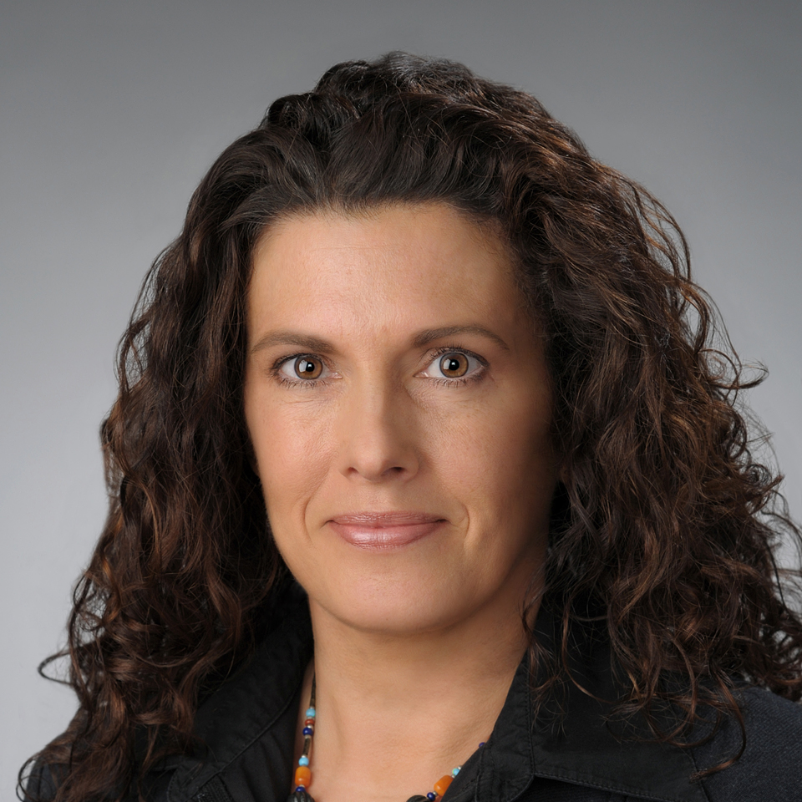
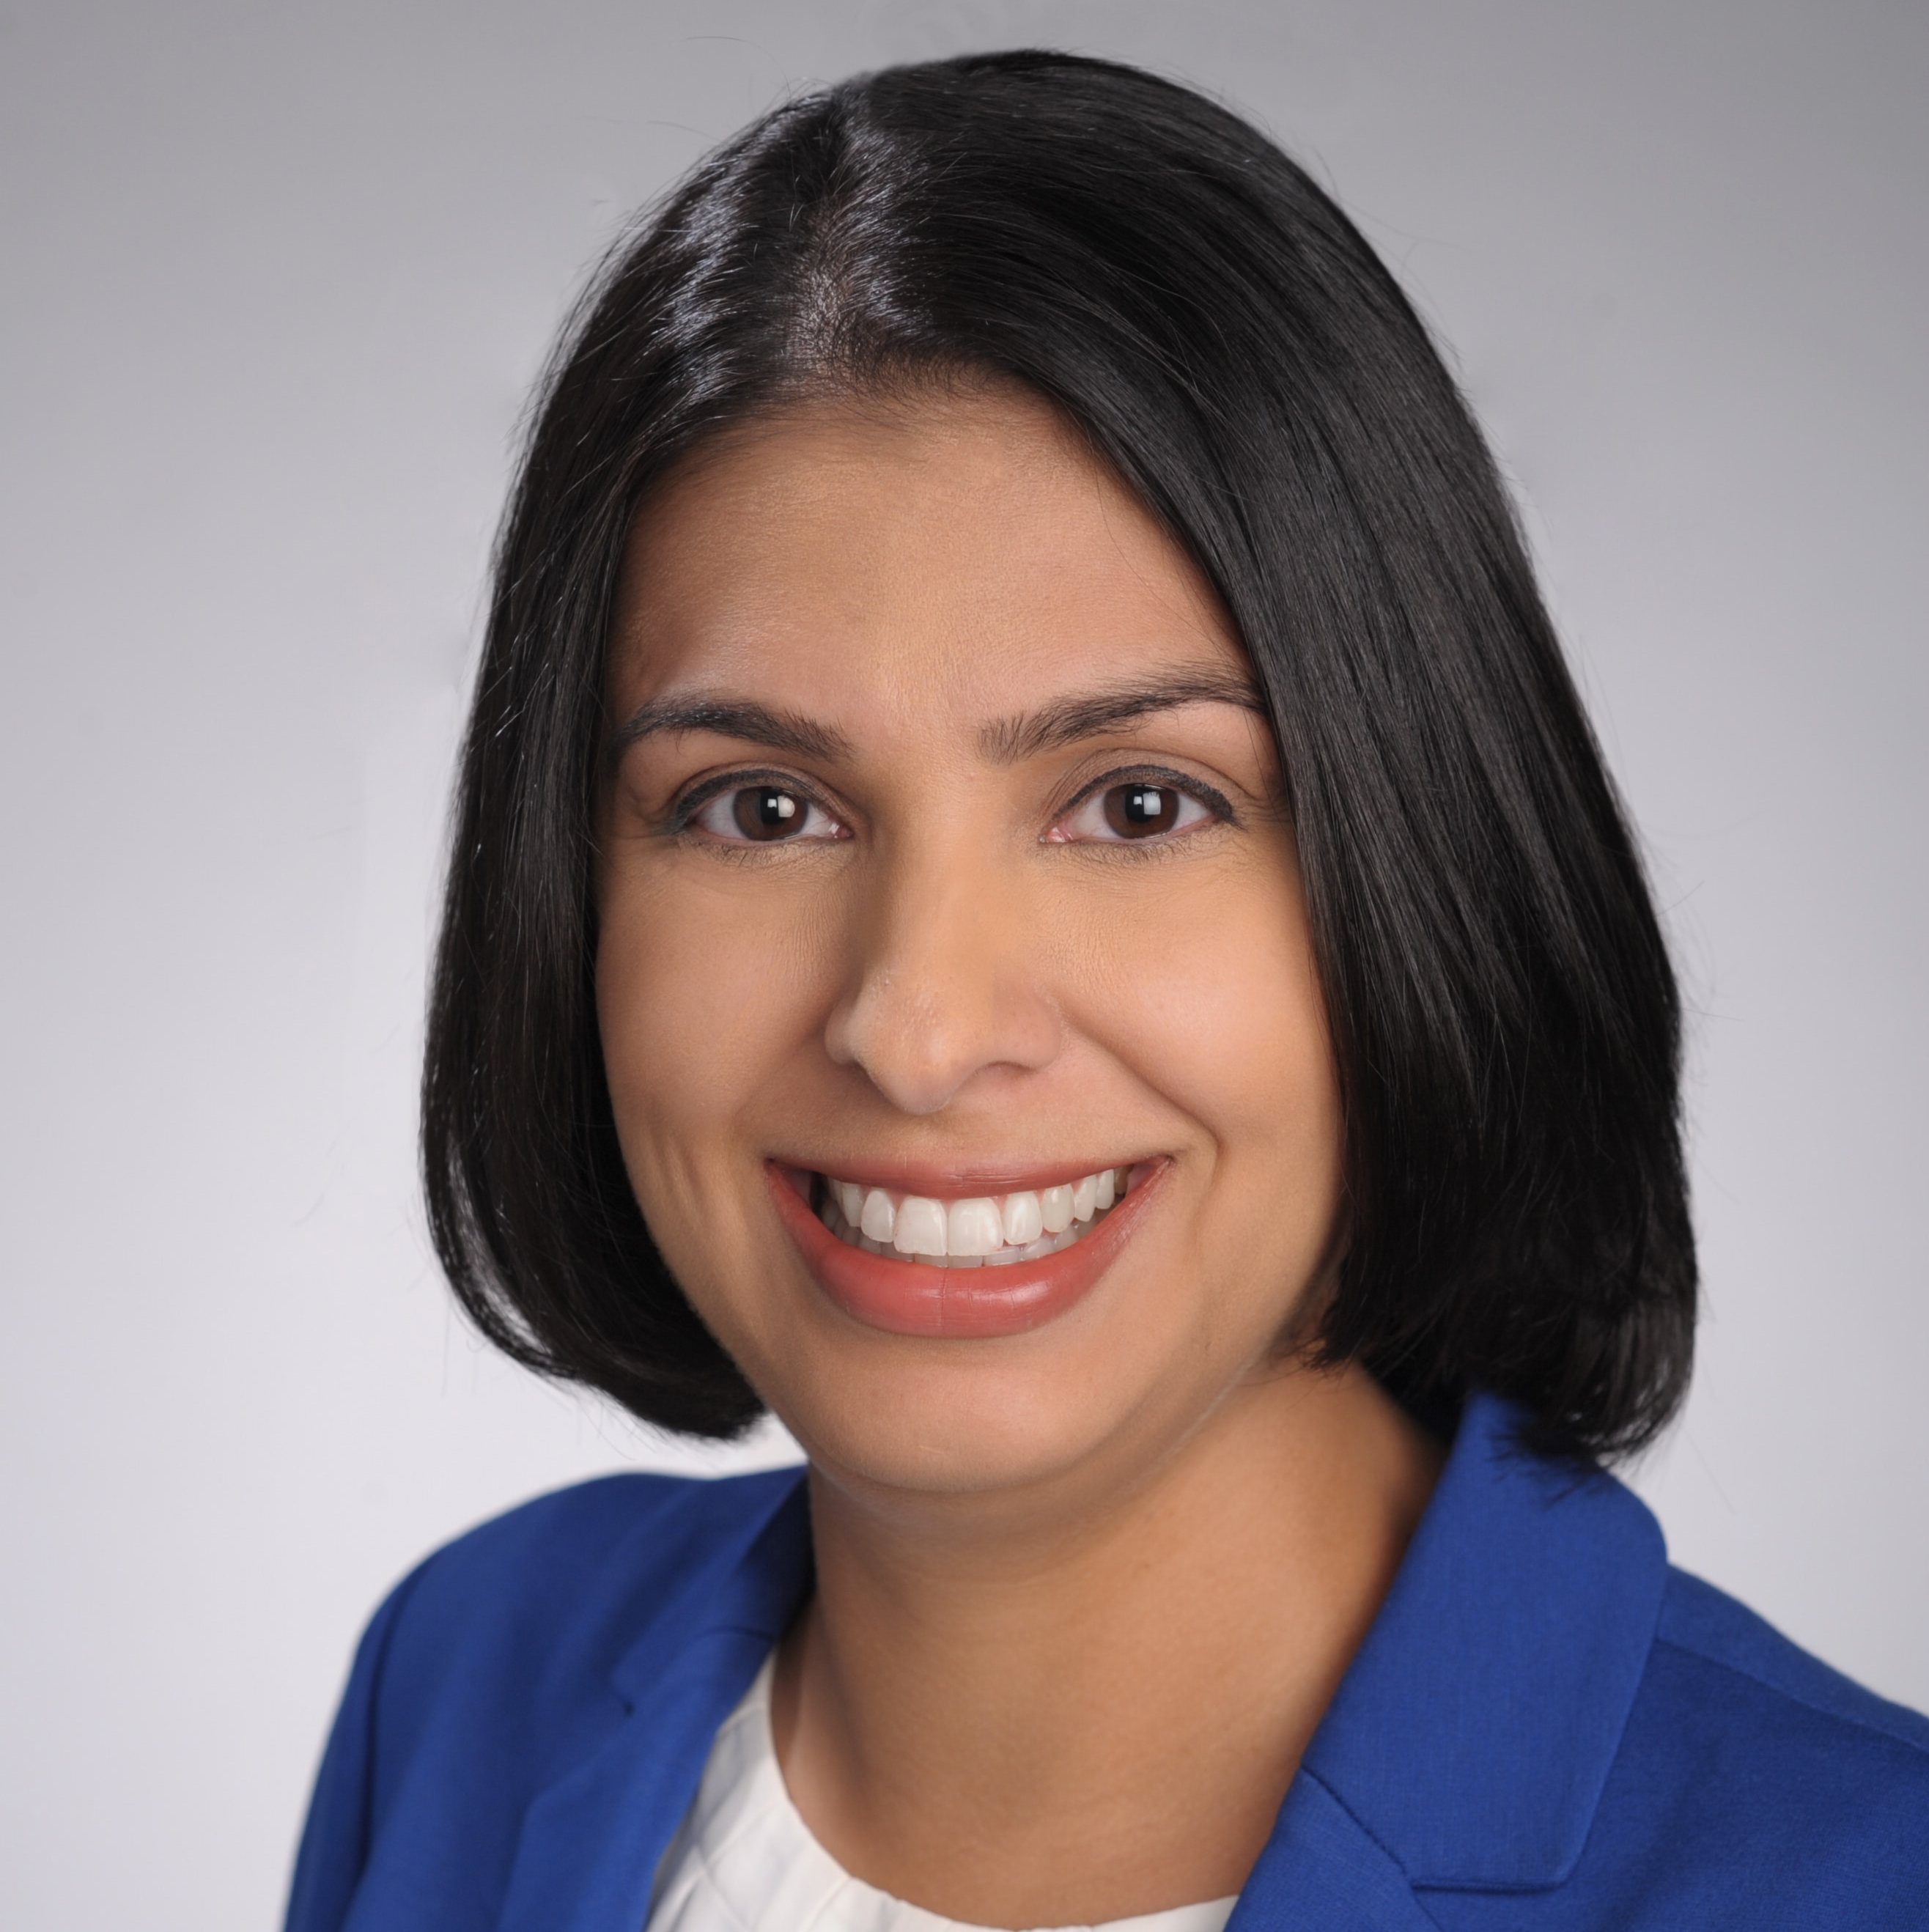
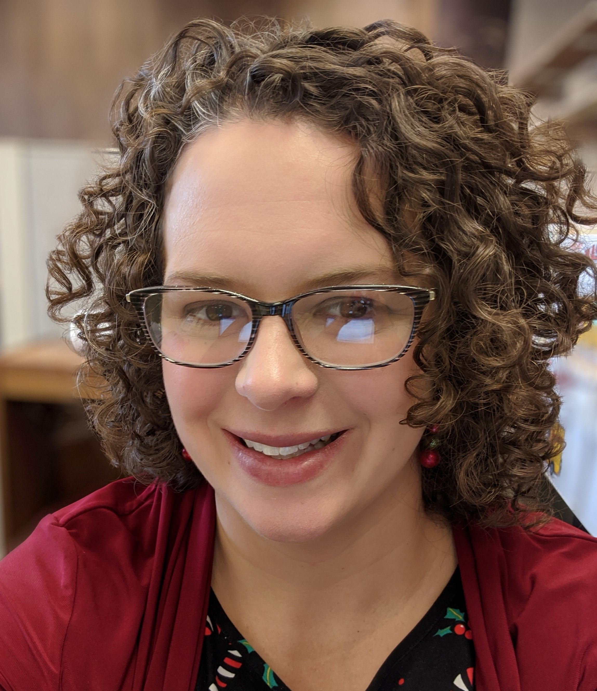
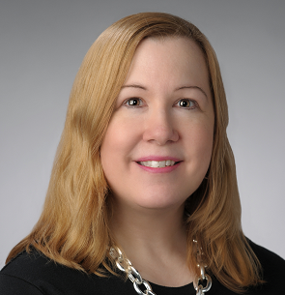
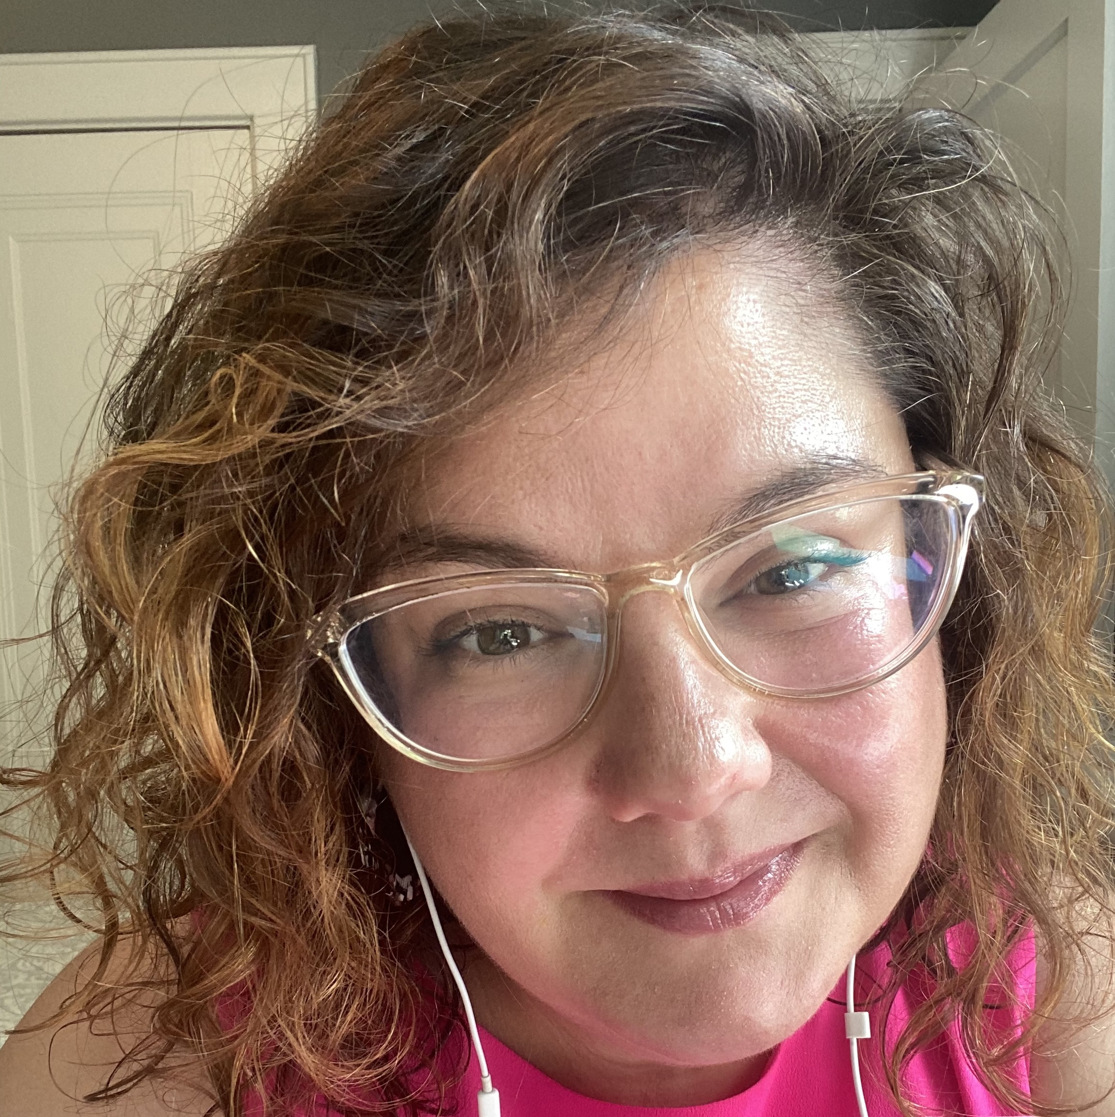
Presenters
Christina Leigh Docteur
Office of Research
Chetna Chianese
Office of Research
Emily Hart
Libraries
Brenna Helmstutler Libraries
Anne Rauh
Libraries

Slide 3
Agenda
Your profiles
Please share you name & institution in chat!
Our unit profiles
Collaboration activities
Research reputation
Learning, training, and networking
Administration
Future efforts
Conclusion
Questions
Notes:
Christina

Slide 4
Setting the Stage
Notes:
Christina
- Ask audience to

Slide 5
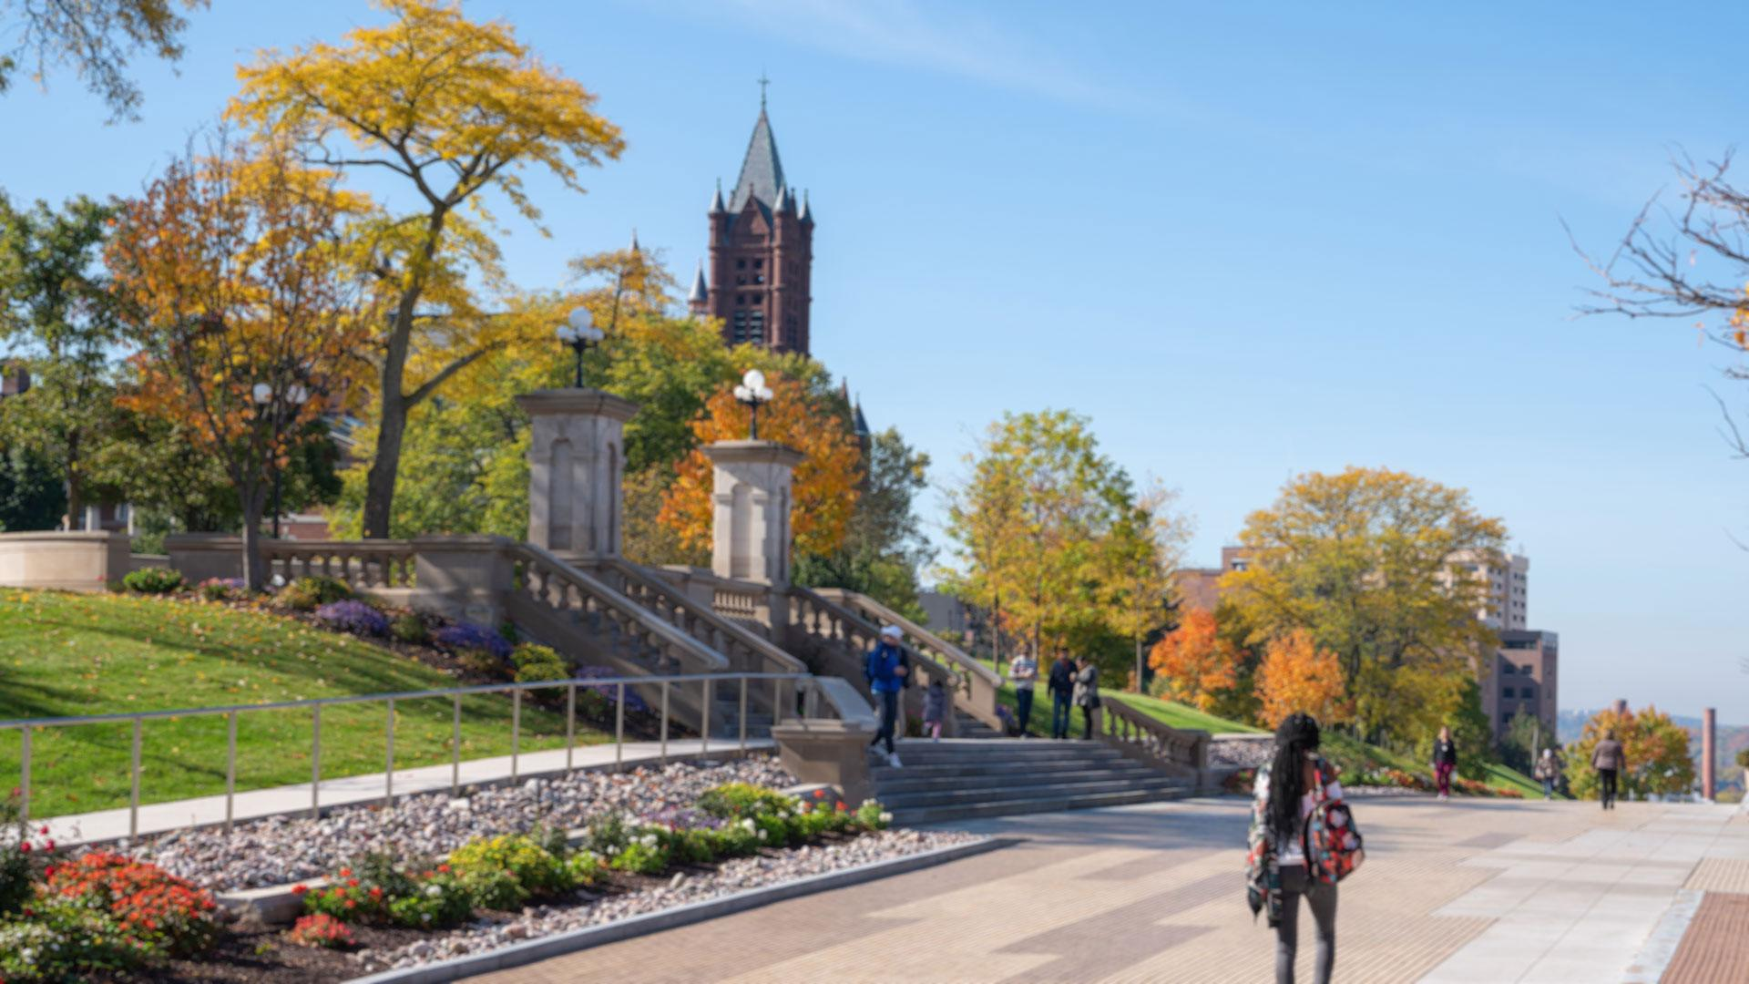
Syracuse University
Private research university
R1 (Research Intensive) Carnegie Classification of Institutions of Higher Ed (up from R2 in 2015)
15,000 undergraduates
5,000 graduate students
Notes:
Christina

Slide 6
Restructuring to Focus on Research
New & Unique Campus Support Structures
Office/division restructuring
Office of Research: Proposal Support Services – 3 new positions
Libraries: Dept of Research & Scholarship (DRS) – focus teams including Digital & Open Scholarship and Research Impact
Associate Deans for Research (ADRs) Leadership Group
Response to SU’s mission of increasing research trajectory
Initiatives to support & promote interdisciplinary research
Intramural grants, new faculty hires, and interdisciplinary research clusters
Notes:
ADR Leadership GROUP - REVITALIZATION AND ACTIONING - as a platform for facilitating research support. Topics brought for discussion
Office new; all new roles in last two years; university took on concrete mission of increasing research trajectory; 5 of us in roles dedicated to this mission and then roll out
Strategic library reorganization to better support these initiatives
DRS-Research Impact Team
Emily’s Script
The exciting structural changes mentioned by Annie and Christina, came in response to a shift in University priorities. This shift included placing added emphasis on the research mission of the university; Specifically working towards solidifying Syracuse University as a major research university with global impact and scope.
A direct outcome of this added emphasis on research, was the establishment and alignment of administrative research positions across campus, which included the creation of Associate Dean’s for Research positions across the University’s schools and colleges, and the Libraries.
These positions meet as a group regularly with the Vice President for Research to discuss different initiatives that will propel the University towards research excellence.
A few of these initiatives, in addition to the department restructuring within the Office of Research and the Libraries, include fundraising and the reappropriation of funds to create internal faculty research grants, the formation of new institutes (such as the BioInspired Institute), to promote cutting edge interdisciplinary research, and the strategic recruitment and hiring of new faculty researchers.

Slide 7
Office of Research
5 administrative units and main office
Led by Interim VPR since January 2020
~40 total staff
2 interdisciplinary centers also included but operate independently
Notes:
Christina

Slide 8
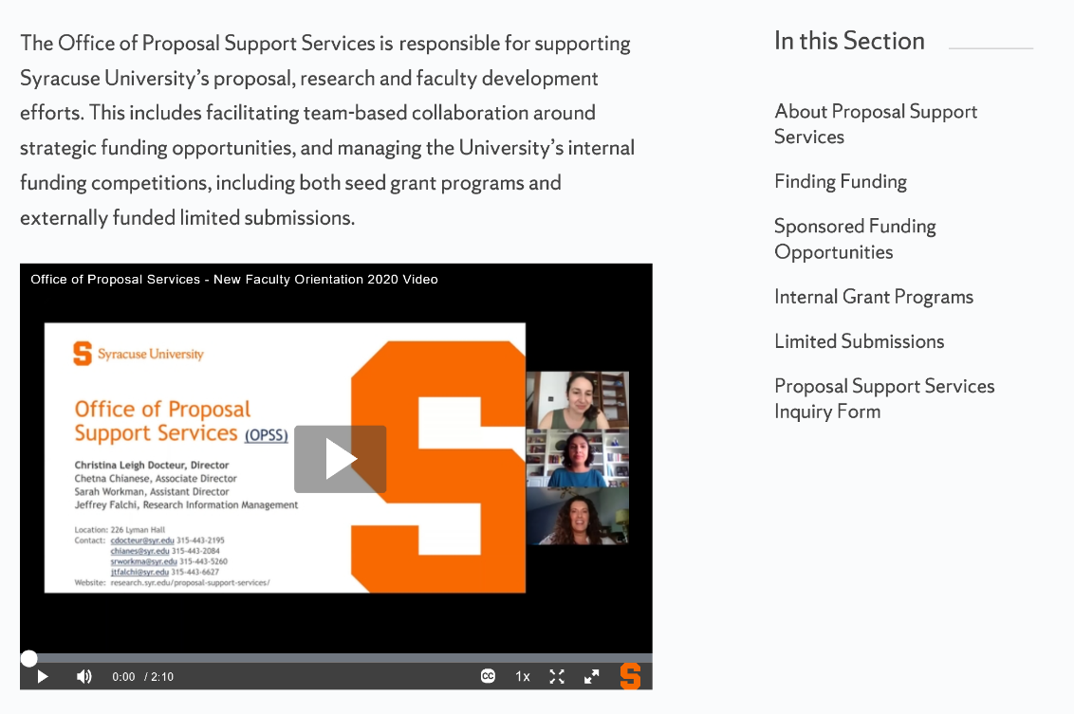
Proposal Support Services
New research development arm of Office of Research
Manage intramural grants, limited submission, & many award nominations
Funding opportunity circulation
Grant development for large or multidisciplinary projects
Hub of “SU RD Team” working with staff in schools, colleges & other units (like library!)
Notes:
Christina

Slide 9
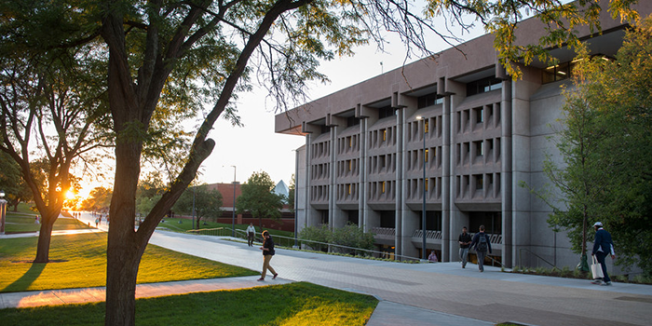
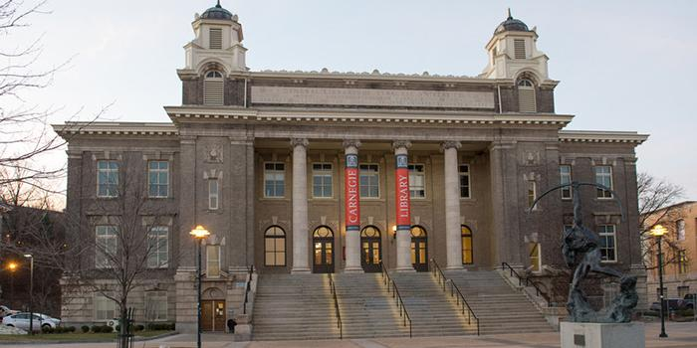
Syracuse University Libraries
4.8 million items
1.2 million visits annually
205 total staff FTE
53 librarians
161 student employees
Organized like academic college
Dean reports to provost
Associated deans focused on research & academics
Includes Syracuse University Press
Notes:
Annie

Slide 10
Department of Research and Scholarship
Head of Collections and Research Services
Subject Instruction Team Lead
Research Impact Team Lead
Digital and Open Scholarship Team Lead
Collections Team Lead
Liaison Librarians
Liaison Librarians
Data and Open Scholarship Librarians
Collection Development, Government Documents, Subject Branch Librarians
Notes:
***In the chat, can you share if your library been re-orged recently or is planning to re-organize with an eye toward University research?

Slide 11
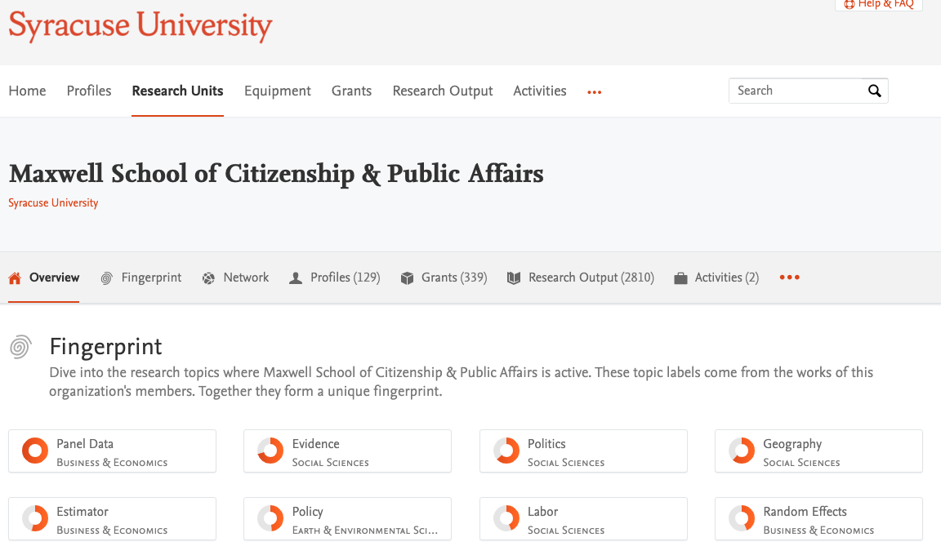
What Prompted Collaboration?
Notes:
Annie
Christina and Annie began collaborating when she worked for the Maxwell School on a project we will talk about in more depth later, Experts@Syracuse.

Slide 12
Research Impact Team
Team focuses on supporting the University Research Enterprise at both institutional and individual level.
RIM System
Research Metrics
Responsible Metrics
Research Reputation
ORCID
Funding Discovery
Systematic Reviews
Notes:
Emily

Slide 13
Identifying & Filling in the Gaps
From independent reactionary services to…
Exploring where we overlap
Shared planning & collaboration
Greater reach
Notes:
Emily
But what was missing? Why were we coming together? What were the holes?
Outlining the common areas where researchers need support.
Declining research reputation (Activity set 1)
Bigger picture of Syracuse experience [serendipitous combination of experience & need],
Emily - Connecting researchers to funding opportunities
Proposal development
Support for research activities
Promoting & disseminating research works
Enhancing the research reputation of the university

Slide 14
Collaboration Activities: Research Reputation
Notes:
Emily transition to Brenna

Slide 15
Cross-Campus Partners & Shared Learning
Bryant, Rebecca, Annette Dortmund, and Brian Lavoie. 2020. Social Interoperability in Research Support: Cross-Campus Partnerships and the University Research Enterprise. Dublin, OH: OCLC Research. https://doi.org/10.25333/wyrd-n586
Notes:
Brenna
OCLC recently produced a report “Social Interoperability in Research Support: Cross-Campus Partnerships and the University Research Enterprise”
We have been embracing this Collaborative work through our activities
Research support developed & provided by multiple campus stakeholders
Shared learning between units facilitated by meetings & workshops
Active development of jointly hosted events for librarians, staff, and faculty

Slide 16
Experts@Syracuse (Pure)
Jointly Managed
Experts includes: faculty profiles, reporting module, & funding sources
Subject librarians have profiles
Graduate student support
Notes:
Brenna
Features: also identifying experts at SU and forming collaborative research networks
Experts is a jointly managed system
Subject librarians have profiles to showcase own productivity and have first hand knowledge of Experts for school/college/department queries
I have a Research Reputation Graduate Student Employee
o Projects-Humanities pilot (Writing Studies, Rhetoric, and Composition program-built out profiles, data analysis-involved in meetings with us (OoR & Libs, RD for Humanities), various requests for profile buildouts
o RIT support as we have developed team description and functions, strategic planning
o Documents-process document for those building profiles for departments, resource spreadsheets
o Experts@Syracuse Profile Management LibGuide: instructions, FAQs, automatic vs manual population of content

Slide 17
Research Reputation
Scopus & Web of Science Affiliation
Research Metrics Challenge
Notes:
Brenna
Scopus/Web of Science project: Adapted from initiative at Case Western and Univ. of Rochester
Scopus 2019 (250 added), 2020 (4 added)
Web of Science 2020
Impacts collaborative efforts in university rankings and enhancing visibility and accuracy in proper affiliation with SU
Research Metrics Challenge (2019)
Adapted to SU from Brown and other universities; Stacy Konkiel’s 30 day impact challenge: the ultimate guide to raising the profile of your research)
Working group (volunteers of subject librarians) planning (research guide, weekly email challenges) and pilot implementation including launch sessions for two groups within our pilot: subject librarians/faculty
Weekly challenges include: researcher profile, SURFACE/OA, altmetrics
Challenge objectives for faculty
Discover new metric tools to use in order to demonstrate scholarly impact
Identify metrics that apply based on discipline and rank in career
Develop an online presence to amplify research visibility and prowess
Recognize SU subject librarians as partners in synthesizing scholarly impact
● Impacts on Office of Research activities-research reputation management
○ Grants: workshops, proposal development
○ Experts@Syracuse: researcher profile creation, reporting
○ ADRs/Research Admins meetings

Slide 18
Collaboration Activities: Learning, Training, and Networking
Notes:
Chetna

Slide 19
Tools for Learning
Research Guides – ORCID, DMPTool, Scopus, Mendeley, InCites
Funding Discovery
Pivot
Foundation Directory Online
Notes:
Chetna
Research Guides - Some of the tools are very heavily used by Research Development like DMPTool and ORCID (esp with SciENcv)
Pivot – maintained by Office of Research, but training guides produced by PSS and Libraries
Foundation Directory Online – subscribed by Library, but trainings supported by both

Slide 20
Training Activities & Workshops
Joint hosting of trainings for the tools for learning
Ex. Funding Discovery Tools for Librarians
Utilizing Experts@Syracuse
Women in Science & Engineering (WISE) Graduate Student Sessions
Research impact
Funding opportunities
Notes:
Chetna
Funding Discovery Tools for Librarians – PSS training for libraries on SU grant submissions & funding searches
WISE:
2 sessions:
Introduction to Funding Opportunity Resources
Introduction to Application Materials

Slide 21
Networking
Pure User Group - PSS & Library reps attended conference
Faculty FUNding
Faculty award winners share experience, tools discussed for funding discovery and research reputation.
Plan to reframe content in virtual format
Notes:
Chetna
“Utilizing Experts@Syracuse”: training research admins & RD professionals to help populate and utilize the data
Pure User Group
PSS & Library reps attended conference to learn & discuss tool
Allowed for power brainstorming between us off campus!
Faculty FUNding
planned but canceled
reframe content by creating videos with faculty award winners sharing grant and/or research consultation experience with Office of Research, Librarians
virtual workshop

Slide 22
Collaboration Activities: Administration
Notes:
Transition to Christina

Slide 23
Productivity Enhancements
Co-teaching = broader reach, deeper content, co-learning
Increased registration for sessions
Multiple voices & techniques for trainees, and sharing of language/ process between trainers (i.e. “bibliometrics” and “PIVOT-framing”)
We’re our own best customers
Funding Discovery Tools for Librarians
Build Your Experts Profile
Increasing staff capacity by leveraging combined talent
Librarians serve as intramural grant & limited submission reviewers
RD leaders sit on library hiring committees & advise P&T cases
Notes:
Christina
We’re our own best customers, though institution is the winner
Funding Discovery Tools for Librarians – Office of Research trains librarians to apply for grants (institutional process), and techniques to support funding searches
Build your Experts Profile Lab – Library leadership teaches librarians to build out expert profile & invites RD leadership to participate

Slide 24
Shared Costs Savings
Shared costs = more resources
More resources for research initiatives & staff development
PURE “Experts” $$ split; jointly sponsoring sessions for 2x coverage at ½ cost; hosting more on-campus visitors
United front with vendors
Or … less resource cutting due to COVID-based strain
Notes:
Christina
“united front to our vendors [to avoid price gouging and/or selling to multiple units”

Slide 25
Leveraging Platforms, Data & Knowledge
Institutional repository
Data management and grant compliance
Open access journal support
Notes:
Annie
Through continued collaboration, we have seen how there are time when have the same end goal but different paths to get there. We have also found instances where we have a different motivations for completing something, but that those motivations take us down the same path.
These additional examples are places we have found other overlap through our platforms, data, and knowledge.
Increased institutional data repository awareness & usage (SURFACE)
Greater grant compliance, With open access (data management plans) and SciENV
Enhanced proposal development support
Ex. Humanities RD & Philosophy librarian team

Slide 26
Selected Future Collaborations
Reactionary to evidence-based planning
Needs assessment
ORCID institutional subscription
Understanding university rankings
Shared promotion of resources and services
New faculty/staff joint training opportunities
Notes:
Emily
Question - To expand on what we’ve shared, we’re interested in hearing about your successful or planned collaborative projects. Please share your examples in the chat. (Emily will ask this question at the end of future collaborations slide – someone else will type in chat)
Moving from reactionary to evidence-based planning
Needs assessment of school/college research leadership
Faculty focus groups – use of metrics, research dissemination habits, research support needs
ORCID institutional subscription
Institutional Research collaboration to better understand university rankings related to research
Collaborative development of marketing materials on topics
Funding discovery tools AND Funding opportunities
Support services for researchers at different stages of research lifecycle
Continued shared promotion of resources and services
Development of new faculty/staff joint training opportunities

Slide 27
Conclusion

Slide 28
Interoperability Challenges
Language
Research Administration versus Research Development
Proposal Development
Working together
Google Drive versus Microsoft OneDrive
Scheduling via Outlook
Notes:
Annie
Tie into report

Slide 29
Takeaways from the Joint Efforts
Enhanced Syracuse University visibility (and reputation!)
Understanding evolution of research emphasis
Strong line of communication and shared goals between units
Overall, positive outcomes for faculty, staff, students
Connecting pieces of the research lifecycle
Notes:
Brenna and Chetna
While the Research Impact group focuses on impact and dissemination, and the Proposal Support focuses on funding & competitiveness through applications, all of it is reputation enhancing:
Enhanced SU institutional visibility (through enhancement of multiple research platforms),
Cumulative benefits: campus research development group
Recognizing added benefits, such as understanding changes in research emphasis areas with new VPR during transition.
Strong line of communication and shared goals between units, resulting in better and consistent cross marketing of services
Ex. starting places for faculty on the Libraries’ website (faculty researcher
Overall, positive outcomes for faculty and students (as indicated by pre and post surveys), ---------------------------------------------------------------
Measurable activity:
- Experts meetings/workshops: number of attendees
Funding graduate student workshop: assessment
Post-doc workshop
Informal connections across campus
Anecdotal stories
InCites workshops-number of attendees
DRS FY 20 goals connected to Office of Research

Slide 30
Questions?
Christina Leigh Docteur, Office of Research, cdocteur@syr.edu
Chetna Chianese, Office of Research, cchianes@syr.edu
Emily Hart, Syracuse University Libraries, ekhart@syr.edu
Brenna Helmstutler, Syracuse University Libraries, bhelmstu@syr.edu
Anne Rauh, Syracuse University Libraries, aerauh@syr.edu
Notes:
Christina

