Slide 1
November 30, 2020
Adding Cyrillic Script to WorldCat
Jenny Toves, OCLC
Cynthia Whitacre, OCLC
Notes:
Cynthia: Thank you for inviting us to speak today. Millions of bibliographic records in OCLC’s WorldCat database were created before it was possible to add non-Latin scripts, or they were created in local library systems that don’t have that capability. Thus, these collections remain hidden to researchers searching in those scripts. We plan to talk about a project to add Cyrillic to WorldCat to help uncover those collections.

Slide 2
Jenny Toves
Software Architect Manager,
OCLC
Cynthia Whitacre
Senior Metadata Operations Manager, OCLC
Notes:
Cynthia: I’m Cynthia Whitacre, and I’d like to introduce my colleague Jenny Toves. We included our photos, so you can remember us in the future if you look back at these slides.

Slide 3
THE idea
Notes:
Cynthia: With OCLC’s implementation of Unicode in late 2016, it became possible add any number of scripts to WorldCat records. Concern about the lack of script in many older records in OCLC and its effect on the access to these materials has led to the discussion, especially among catalog librarians who work directly with non-Latin languages, on the possibility of some kind of automated, mass-transliteration that could be applied to certain languages.

Slide 4
New Directions in Non-Latin Script Access
ALCTS CaMMS Committee on Cataloging: Asian & African Materials June 23, 2018 presentations
Barry - The Past, Present, and Future of Original Script
Riley - Extending Access - Supporting Improved Discovery
Smith-Yoshimura - Non-Latin Script Access - Past, Now, Future
Notes:
Cynthia:
At ALA Annual 2018 in New Orleans, ALCTS held a program "New Directions in Non-Latin Script Access", and the idea of doing this type of automated enhancement, especially for Russian, was given new impetus. John Riemer from UCLA and I talked about the possibility. I encouraged UCLA to investigate, this being something libraries could potentially do to enhance WorldCat. UCLA took that and formed a project team, consisting of catalogers of non-Roman titles and an IT expert.
Simultaneously, Karen Smith-Yoshimura of OCLC who had spoken at this ALA meeting was pursuing this idea with her OCLC Research colleagues including Jenny Toves.

Slide 5
The Project
Adding Cyrillic script to WorldCat records is possible by automation
One-to-one correspondence between Latin script alphabet and Cyrillic script alphabet
Automated addition is possible for many languages that use Cyrillic script
Russian selected first
English language of cataloging only
Notes:
Cynthia:
UCLA chose Russian as a starting point since it was a language with a (mostly) one-to-one relationship between transliteration and Cyrillic characters, as well as language that a number of UCLA’s original catalogers were familiar with.
Russian is the 9th most common language among the resources described in WorldCat. If Russian worked well, there was the desire to move on to other languages following the initial project. Note that only English language of cataloging records (those marked eng in 040 $b) were included, since we could be reasonably sure that the same Romanization rules were followed for the transliterated Russian fields.

Slide 6
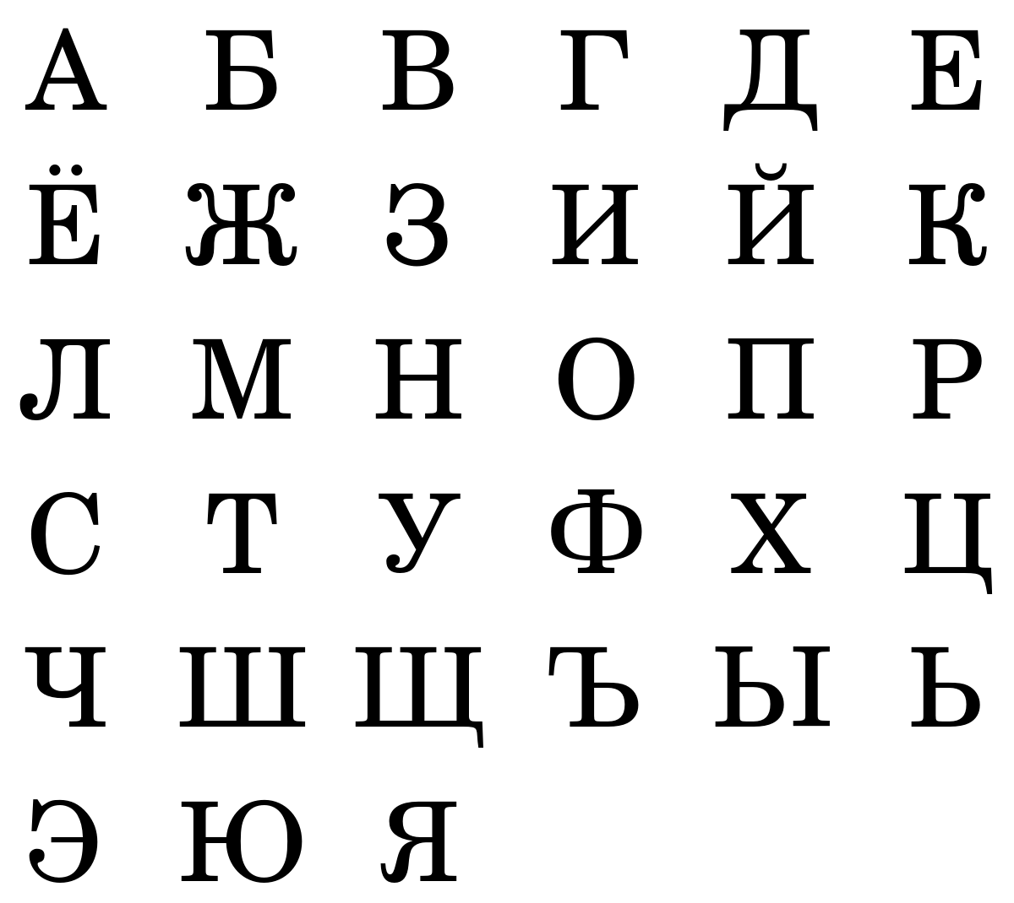
This Photo by Unknown Author is licensed under CC BY-SA
Notes:
Cynthia: For this slide we are just showing Cyrillic characters, which you are all likely familiar with to some extent, so you can clearly see differences from the Latin Script.

Slide 7
Connecting the two projects
OCLC supplied UCLA with OCNs for all the records for Russian language titles lacking Cyrillic with UCLA holdings set
Internally I realized that OCLC Research was undertaking a similar project for all of WorldCat.
Proposing that we work together
Shared ideas, strategies, and review of the project design
Notes:
Cynthia: In August/September 2019 we realized these 2 projects from UCLA and OCLC were both in the works and decided to join forces and work together. Peter Fletcher at UCLA became a major advisor for the OCLC work in terms of project design and review of test sets of records.

Slide 8
Wrinkles: Roman Numerals and English phrases
V. I. Lenin = В. И. Ленин
Slavi︠a︡nskie sʺezdy XIX-XX vv. / [redkollegii︠a︡ E.P. Aksenova, A.N. Gori︠a︡inov, M.I︠U︡. Dostalʹ (otv. redaktor)]. Славянские съезды XIX-XX вв. / [редколлегия Е.П. Аксенова, А.Н. Горяинов, М.Ю. Досталь (отв. редактор)].
Великая Победа, 1941-1945 гг. :юбилейный сборник статей / [авторы, В.И. Приписнов and others].
Notes:
Cynthia: While Jenny will cover the bulk of how the project was done, I’ll give you a foretaste of the type of problems encountered. One challenge was the use of Roman numerals in titles, often for numbered conferences and centuries, where the characters should be left alone during mapping to Cyrillic. We developed a fairly comprehensive stop-list of Roman Numerals, but “I” and “V” could not be included, and case sensitivity would not be helpful, since they can appear either way in a bibliographic record, especially since “I”s and “V”s appear very commonly as part of authors’ names (Example: V. I. Lenin = В. И. Ленин).
What enabled ultimate success with Roman Numerals, was help from David Bucknum from the Library of Congress. He was able to provide a configuration file that fixed the problem—it involved reordering the Roman Numerals so that they were handled in groups, based on letter combinations.
There are only 4000 possible Roman numbers and a limited number of characters that could usually come after them.
A string of 2 or more uppercase letters that could be Roman and the combination is a valid roman numeral – usually are roman – especially when they are surrounded by only whitespace or punctuation
A string of a single uppercase letter must not be followed by a period (likely an initial) and should be followed by something that means century, or the Russian version of ‘th’, ‘st’, etc.
Regarding the third example, the latest batch of 128k Russian records OCLC processed has 19k fields with ‘and others’ like the example above as well as 3400 instances of ‘et al’. There is a small list of English phrases/words that are part of the metadata not part of the actual title / bib data that Jenny knows to look for and leave alone.

Slide 9
How we did it
Notes:
Cynthia: And with that I’ll turn things over to my colleague Jenny to discuss the details of how the project was accomplished.

Slide 10
Overview of process
Select a set of records with high probability of good transliterated text
Review and correct until satisfied
Add Cyrillic data to OCLC Research copy of WorldCat records
Add enhanced records to production WorldCat
Notes:
Jenny: High probability means we are confident in the transliteration
Review cycles lasted about a month and consisted of a set of transliterated data sent to reviewers. Then the results were analyzed by Jenny, code changes made, data mining and questions back and forth to clarify as needed and then we would be ready for the next round of reviews.
This is a stretch assignment for both myself and the reviewers so we are working outside the usual project pathways inside OCLC – but we are working hand in hand with bib quality.

Slide 11
Selected Records
Language of cataloging is English
Single language present in the record (no parallel titles or translations)
Published in the native country
Skipped ContentDM records
Discovered some new criteria along the way
AACR2/RDA records only
Cognizant of reform dates
Notes:
Jenny:
English cataloging so we know the transliteration that was likely used
Try to avoid titles that are more likely to have bits in other languages – bi-lingual texts, translations, parallel titles
Works published in Russian but published in the US were deemed more likely to have non-Russian words in the title.
A lot of the contentDM records have Cyrillic in the 245 – instead of a linked 880 – so they threw things off.

Slide 12
To correct or ….
Starting with fixing errors in data
Lots of review time and lots of code trying to implement rules for specific words or word fragments
Less than half of corrected records end up being usable because errors rarely occur one at a time
Brittle solution because it relies on what we know today
If a pattern is wrong 80% of the time - trying to fix the 80% without breaking the 20% - arggh!
Notes:
Jenny: What is a pattern? 3 vowels in a row; adjective and adverb endings that have common misspellings – usually missing marks.

Slide 13
… not to correct
Slowly realized that corrections might be counter productive
Skip all records containing a questionable pattern – such as 3 vowels in a row with no marks
Errors rarely occur alone so better to notice the common errors
Yes: we avoid a few good records
But we save reviewer time and coder time
And we avoid doing bad things
And can always re-visit those records later

Slide 14
Technology Used
OCLC Research Hadoop Cluster
WorldCat Metadata API
Connexion client macros
Notes:
Jenny: Add Cyrillic to 128k Russian records in 62 seconds.
About 5 nights to add those records to production – use a single-threaded process overnight to avoid overloading the API.
My autho + metadata API cannot touch PCC records so those are handed to Robert Bremer to work his magic with a Connexion macro
Review cycle – write code, run data, send emails, gather results, make a to do list, repeat – last Russian load was 4 cycles at 4 days effort each (1 MH, 3 JT) so we corrected about 1000 records for each hour of our effort – pretty good win. MH estimates about 20-30/hr could be done manually so our efforts to review and code paid off at 33:1 ☺
16x8x30 = 3840 so as long as we do batches of greater than 4000 and in no more than 16 days of effort then it is a win.

Slide 15
Progress and next steps
Russian – 1.1M records
Ukrainian – 28k
Bulgarian – reviewing 25k
Future Cyrillic work: Serbian (35k), Belarusian (10k), Macedonian (12k), Uzbek (10k)
Notes:
Jenny: possibly other languages that have ‘Cyrillic’ in the 546
142K Ukrainian language records without Cyrillic in WorldCat
Categories eliminated (AACR1, pre-1933, illegal characters for Ukrainian, records with uncommon vowel patterns, etc.
29K were candidates
OCLC worked with Ukrainian catalogers at many libraries to review test samples
28,445 were updated over Labor Day weekend in early September 2020 with Cyrillic fields added
Manual follow-up is happening with the remaining candidates
Cynthia: Following the success of adding Cyrillic to Russian language titles published in Russia, OCLC decided to move forward with additional languages that use Cyrillic. Jenny Toves of OCLC Research again led this effort. Metadata Quality staff put her in touch with Cyrillic catalogers, and she took it from there. Librarians at many libraries helped with this, mainly 2 people from University of Toronto , but also folks from universities of Chicago, Harvard, Washington, Wisconsin and more.
The initial run was completed earlier this month, as you can see on the slide, with over 28K records for Ukrainian language materials updated with Cyrillic script.
Note that when we do these projects in WorldCat, we are only looking at records with English language of cataloging, since we cannot assume the same transliteration for other languages of cataloging. It would be nice to eventually explore the other languages of cataloging – if we can identify the transliteration scheme used then those are tractable as well.

Slide 16
Statistics for WorldCat
June 2019: 1,632,293 WorldCat Records had Cyrillic characters
November 2020: 3,085,920 WorldCat records had Cyrillic characters
89% increase over that time span, mainly due to this project
Notes:
Cynthia: Note the huge increase in statistics of records in WorldCat with Cyrillic over the year in which this project took place. Cyrillic is now in second place in WorldCat for non-Latin scripts behind CJK or Chinese/Japanese/Korean, which we must count as one statistic due to the way CJK scripts were initially implemented in WorldCat. Cyrillic is followed very closely by Hebrew and Arabic script records in terms of numbers with over 2.8 million records for each of those scripts.

Slide 17
Follow-up projects: UCLA - Armenian
43,000 Armenian titles.
Uniform title: Bible. Psalms. Armenian. 1913. Title: Girkʻ Saghmosatsʻ Dawtʻi. Գիրք Սաղմոսաց Դաւթի. Published/Distributed: Konstandnupolis : A.B.S., 1913 (Kostandnupolis : Tpagr. A.H. Pōyachean) Կոնստանդնուպոլիս : Ա.Բ.Ս., 1913 (Kostandnupolis : Tpagr. A.H. Pōyachean)
Notes:
Cynthia: In addition to the follow-up projects with other Cyrillic languages besides Russian that Jenny mentioned. UCLA decided to tackle another script altogether. Armenian is another language and script with a one-for-one character mapping.
UCLA obtained a set of record numbers for Armenian language titles in WorldCat and recently added script to 43,000 records.

Slide 18
Model for future projects
Any alphabetic script is a candidate for this
Assumption is that the Latin transliterated script in the record has been Romanized consistently
Where do we go next?
Notes:
Cynthia:
We definitely hope we can move on to attempt this enrichment of the discovery experience with other languages. Every language probably warrants an assessment of the unique wrinkles that might exist for that language, as well as a consultation of the relevant metadata community.
One of the highlights of this project is the cooperative work done with catalogers at UCLA and elsewhere in the Slavic cataloging community. That cooperation in managing and improving WorldCat is definitely something OCLC aspires to continue

Slide 19
References
Hanging Together Blog postings earlier this year
Cyrillicizing WorldCat Russian Records (https://hangingtogether.org/?p=7658 by Karen Smith-Yoshimura)
Кириллица в WorldCat (https://hangingtogether.org/?p=7868 by Jenny Toves, Mary Haessig, Bryan Baldus)
Notes:
Cynthia: If you wish to read a bit more about the Russian/Cyrillic project, here are 2 blog posts on the OCLC Research blog, Hanging Together. I believe you’ll have access to the slides after this presentation, so that you have the links.

Slide 20
Jenny Toves
tovesj@oclc.org
Cynthia Whitacre
whitacrc@oclc.org
Notes:
And, here is our contact information for any follow-up questions.

