Slide 1
19 November 2020
OCLC, Archives, the Research Library Partnership, and You!

Slide 2
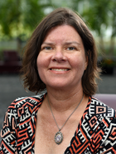
Merrilee Proffitt Senior Manager
Chela Scott Weber Senior Program Officer
Notes:
Merrilee https://www.oclc.org/research/people/proffitt-merrilee.html
Chela https://www.oclc.org/research/people/weber-chela-scott.html

Slide 3
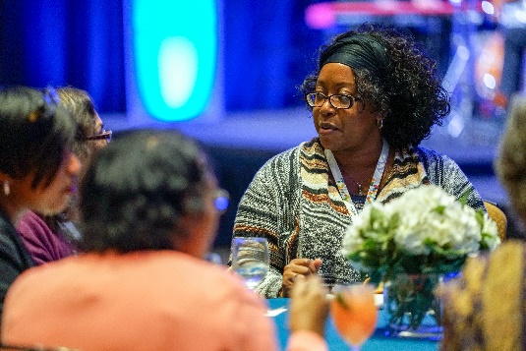
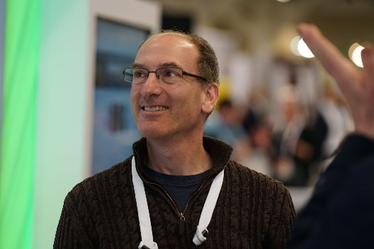
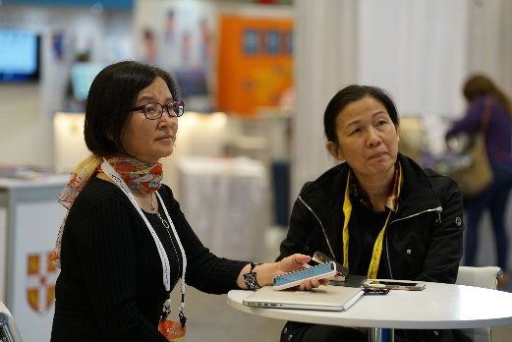
16,000
member libraries worldwide who elect
48
delegates to Global Council, who elect
6
members of the 15-member
OCLC Board of Trustees
Notes:
The founders of OCLC created the concept of a Global Council and made it part of the governance structure to ensure that they heard directly from the members and to have a way of considering new ideas, initiatives, and participation.
So, the OCLC cooperative is member-governed. Its 16,000 member libraries worldwide elect 48 member representatives – delegates – to OCLC's Global Council, who in turn elect six members of the 15-member OCLC Board of Trustees.
[Notes current as of 11/9/20]

Slide 4
WorldCat and archives
Over 498M records / 3B holdings
Archival records an important subset!
Over 5 million records: historical documents, personal papers, family histories, records.
Over 1,000 different institutions: archives, libraries, museums and historical societies.

Slide 5
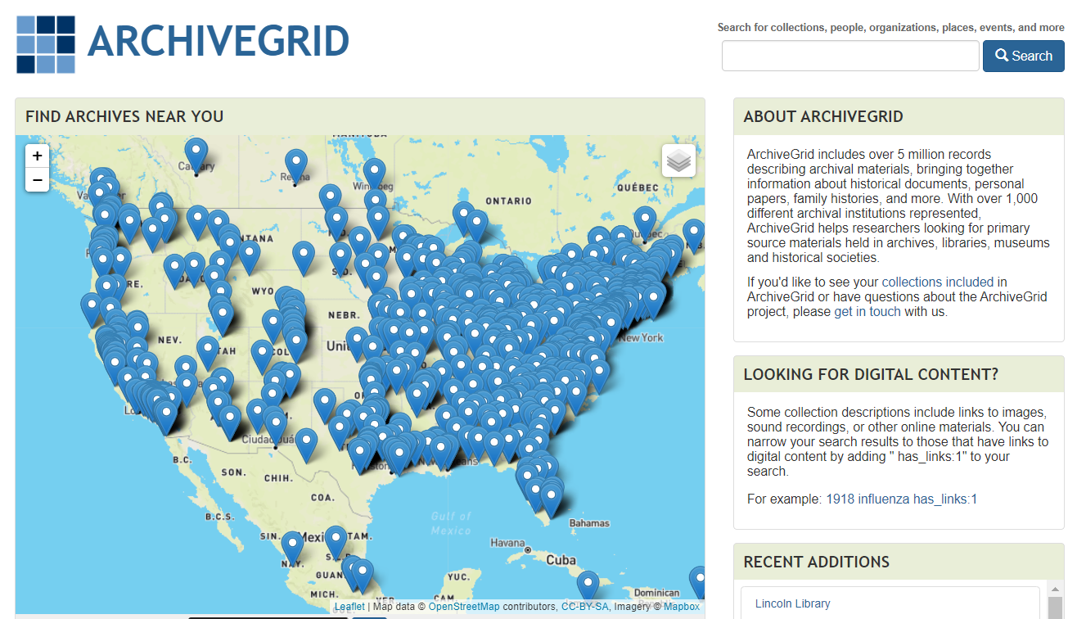
Notes:
Can be accessed at: https://researchworks.oclc.org/archivegrid/

Slide 6
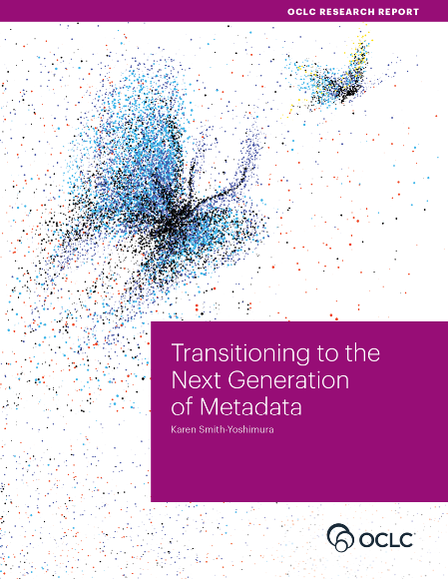
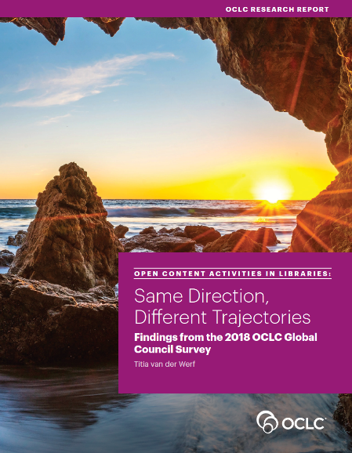
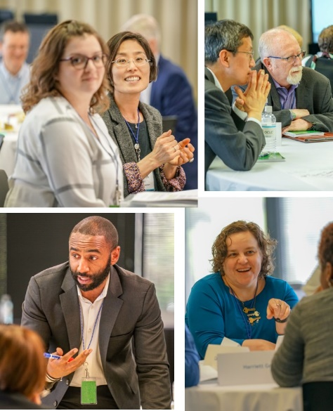
OCLC’s Membership and Research Division
Research devoted exclusively to the challenges facing libraries
Support for elected delegates to OCLC Regional and Global Council; a venue for local and regional views on the issues facing libraries today
The OCLC RLP is embedded in the Membership and Research Division, and helps you connect, contribute, and participate in discussions about challenges and solutions
Notes:
OCLC's Membership and Research Division serves the OCLC global network of 16,000+ member libraries and beyond in several key ways:
OCLC Research concentrates its efforts on research devoted exclusively to the challenges that libraries and archives face.
The OCLC Research Library Partnership includes some 130 research library partners who collaborate with other libraries and each other on research and related issues through working groups.
[Notes added 8/27/18]

Slide 7
OCLC Research Library Partnership
Transnational network of research libraries (130+)
Supported by partnership dues and co-investment from OCLC
The RLP supports organizations as they evolve to meet 21st century challenges, providing the connections, knowledge, and resources to plan with confidence in a complex, rapidly changing ecosystem
Notes:
https://www.oclc.org/research/partnership.html

Slide 8
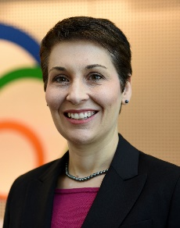
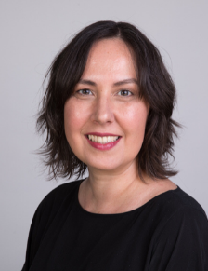
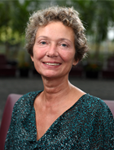
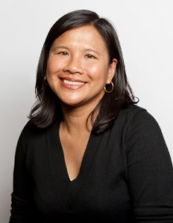
OCLC Research Library Partnership
Activities are led by an energetic team who work with member institutions to develop an array of programming for both senior library leaders and staff

Slide 9
OCLC RLP Activities
Learning Together
Research support
Unique and distinctive collections
Resource sharing / Collective collections
Next generation metadata
Notes:
https://www.oclc.org/research/partnership/work.html
Research support activities: Research Data Management and Research Information Management have emerged as areas of focus where RLP institutions can learn and evolve best practices with one another.
Unique and distinctive collection: Our Research and Learning Agenda outlines additional challenges for the profession. As an example of the new work we are leading, we have a new working group on Collection Building and Operational Impacts. Gearing up to perhaps redo the survey we did in the US / Canada, UK / Ireland
Resource sharing: SHARES, the resource sharing arm of the RLP, is a generous resource sharing program, which provides access to libraries’ strong, rich, diverse, and unique collections. SHARES also supports active collaboration to innovate and support best practices for resource sharing.
Making metadata work harder and smarter: OCLC and institutions in the RLP lead by developing innovative approaches to linked data and collaborating around other topics related to metadata management.
Nascent initiatives around Wikipedia and Wikidata, as well as investigations for priorities in “open” materials

Slide 10
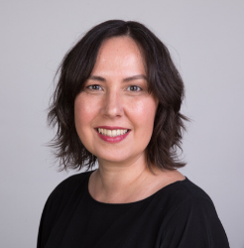
Unique and distinctive collections
“We work in special and distinctive collections because they are an important site of scholarly knowledge creation, made possible by libraries’ significant investment in the stewardship of these collections. The unique nature of material in special collections can make scaling a challenge, so we work to identify areas of common need and patterns of innovation to help libraries scale learning and expertise with these collections.”
Chela Scott Weber weberc@oclc.org

Slide 11
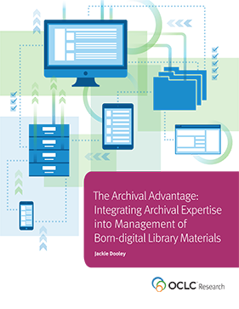
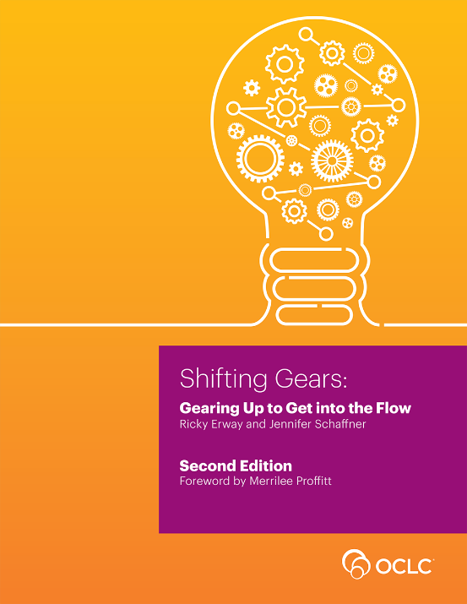
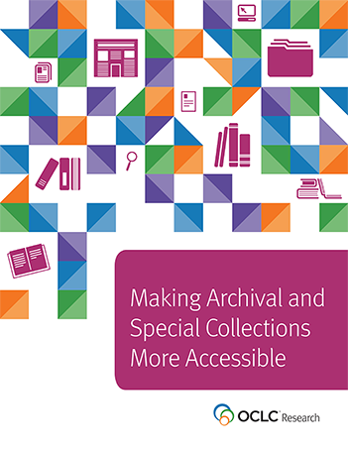
Archives, Special, and Distinctive Collections
Notes:
OCLC Research has a long history of work in the area of archives, special, and distinctive collections in research libraries. We work in special collections because they are an important sight of knowledge creation, made possible by library’s commitment to the stewardship of their distinctive collections. The unique nature of material in special collections can make scaling a challenge, and we work to identify areas of common need and patterns of innovation to help libraries scale learning and expertise with these collections.
Work in the past decade has focused on digitization, managing born-digital collections, and broadly making special collections more accessible.
Making Special Collections More Accessible https://www.oclc.org/research/publications/2015/oclcresearch-making-special-collections-accessible-2015.html
Recent https://hangingtogether.org/?p=7911 and past work on born-digital collections
More details on other work in special collections here https://www.oclc.org/research/areas/research-collections.html

Slide 12
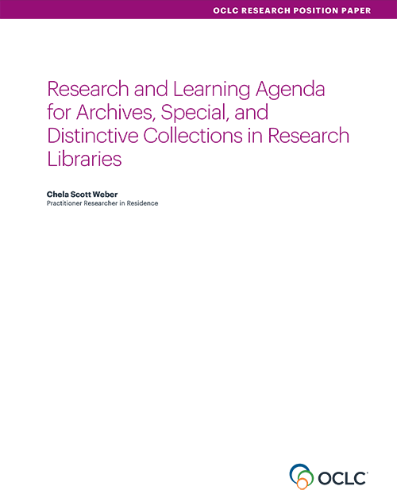
Created via a participatory, iterative process with the community
Articulates shared challenges and opportunities for research libraries
Suggests approaches for working on them together.
oc.lc/rlp-agenda
Notes:
In 2017, we put out the Research and Learning Agenda.
It was created via a participatory process – advisory board, interviews with practitioners, workshopped at RBMS and SAA, open comment period
Result is a document that really lays out key challenges and areas where we can work together, and suggests potential next steps
Guiding our work in this area over the past three years, and will continue to shape our priorities going forward, and we hope it will also serve to frame larger conversations and spur action across the field.
https://www.oclc.org/research/publications/2017/oclcresearch-research-and-learning-agenda.html

Slide 13
Areas of Investigation
Convergence of Special Collections and the Research Library
Advocating for Archives and Special Collections
Next Steps for Born Digital
Addressing Audiovisual Collections
Evolving Systems Environments
Stewardship Responsibility & Collection Management
Engaging the Challenge of Diversifying Collections
Notes:
The agenda called out seven major areas for investigation, and suggested potential actions to address issues in each area.
Today I’ll highlight a few of our major initiatives we’ve undertaken in response to the agenda, and talk a little bit about how they relate to these areas of investigation.
Convergence of Special Collections and the Research Library
Advocating for Archives and Special Collections
Next Steps for Born Digital
Addressing Audiovisual Collections
Evolving Systems Environments
Stewardship Responsibility and Collection Management
Engaging the Challenge of Diversifying Collections

Slide 14
Responding to the Agenda:
Addressing Audiovisual Collections
Identified as a key area in Research and Learning Agenda for Archives, Special, and Distinctive Collections
Concern echoed in one-on-one interviews with heads of special collections
Work throughout 2019-2020 to understand needs and support A/V work in the RLP
Notes:
A/V holdings continue to be a top concern in archival repositories, both because of evolving modes of scholarship in which these are increasingly valuable and sought-after sources, and because of preservation concern that many a/v formats are at or near end of life.
The volume of A/V holdings is staggering, and exceeds the ability to do preservation reformatting in many institutions. Additionally, legacy poor practice in collections management for these formats means that many a/v collections are not well enough managed or understood to make informed decisions about their care.

Slide 15
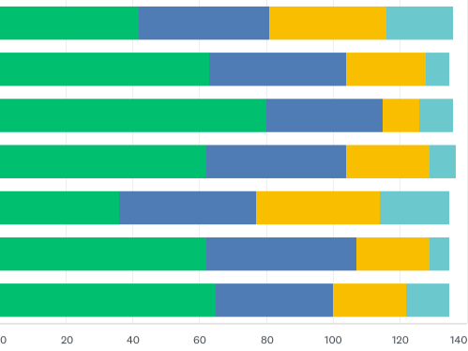
Action: Assessing A/V Needs in the RLP
What challenges related to managing A/V collections would you be interested in the RLP addressing?
Selection, Appraisal, Collection Development
Incorporating into Archival Workflows
Incorporating into Digital Collection Workflows
Digitization & Preservation Reformatting
Physical Collection Management
Digital Asset Management & Preservation
Resource Allocation, Assessment, & Prioritization
Notes:
In March 2019, we distributed a survey to RLP membership and got feedback from 137 different institutions.
https://hangingtogether.org/?p=7405
In May, we held a series of follow up conversations to further understand and prioritize needs in this area.
https://hangingtogether.org/?p=7479
Both of these emphasized to us that this is a multi-faceted concern, tightly tied to issues of collection stewardship, advocacy, born-digital, and evolving user needs and expectations for discovery and access, and our evolving systems environment.

Slide 16
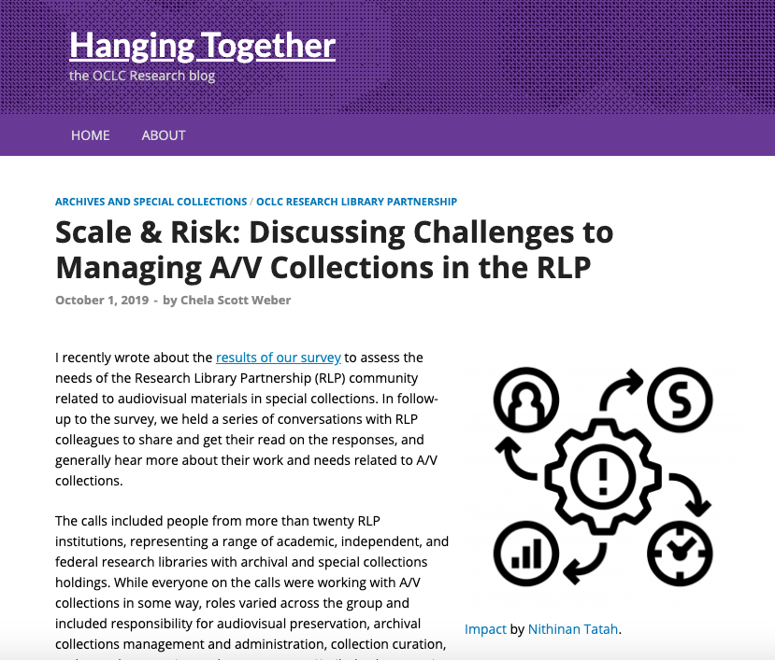
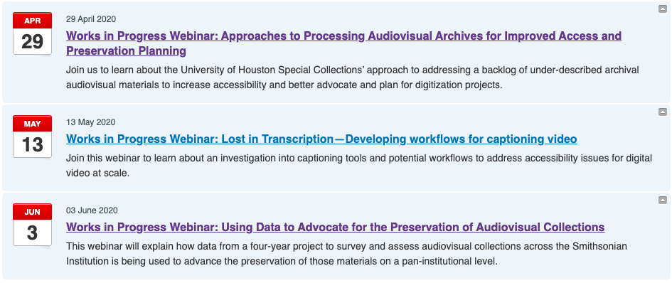
Notes:
We’ve responded with a body of research and programming designed to support work on the issues RLP members identified as most pressing:
Blog posts summarizing knowledge from the survey and conversations, in fall 2019
Series of webinars throughout this year addressing different aspects of work with AV, and sharing approaches to trying to scale up work with AV. Surveys, providing access, building capacity for transcription creation, and planning and prioritization.
I invite you to take a look at the page summarizing our work and linking out to further resources, which I’ll drop in chat
https://www.oclc.org/research/areas/research-collections/stewarding-audiovisual-materials.html

Slide 17
Responding to the Agenda: Appraisal, Advocacy, and Collection Management
“With an ever-expanding universe of information to steward and sizable existing backlogs, it is time to re-emphasize the importance of appraisal.”
…
“Our continued backlogs and resource challenges require a renewed energy be put toward appraisal and reappraisal as part of comprehensive strategies to fulfill our stewardship obligations.”
Notes:
Another key undertaking over the past two years responds to the
to multiple needs laid out in the agenda:
Appraisal – The agenda calls out appraisal as being a key skill and activity, and urges a renewed emphasis on and engagement with appraisal in our practice
Stewardship Responsibilities and Collection Management – It also calls attention to our continued struggle with backlogs and living up to our collection management responsibilities, and identifies appraisal as an important part of a comprehensive approach to dealing with these responsibilities.
Beyond appraisal, we think this work also addresses other issues raised in the agenda:
A desire for better tools and approaches to advocacy, a need to engage in data collection in support of reporting, assessment; and valuing the labor that goes into the responsible stewardship and care of collections.

Slide 18
Action: Collection Building & Operational Impacts Working Group
Acknowledges mismatch between desire to build distinctive collections and resources allocated to them
Deliverable: White paper on ethical imperatives around collection stewardship, as well as practical strategies for enacting responsible collecting
Deliverable: Toolkit to help institutions implement these strategies. Focus on communications and advocacy.
Notes:
To address needs articulated we assembled the Collection Building and Operational Impact working group. Great representation from across the RLP membership – representing different kinds of institutions and curatorial, tech services, and administrative roles.
The group has been focused on how special collections repositories can approach maintaining a balance between collection stewardship and collection building. We’ve working to develop a framework for thinking about the full range of resources necessary to responsibly acquire and steward archives, special, and rare book collections, and the impact that collection acquisitions have on operational capacities.
Our goals in this work have been to:
explore the intersections between current collecting and collection management practices
seek ways to better integrate collection management considerations and the collection development process
bring together colleagues across these important, interdependent functions
https://www.oclc.org/research/partnership/working-groups/collection-building-operational-impacts.html

Slide 19
Total cost of ownership stewardship
Notes:
We will be releasing the outputs from this group in February, so I’ll briefly share a bit about what those will look like.
The major deliverables will be a white paper that lays out the ethical imperatives around collection stewardship, as well as practical strategies for enacting responsible collecting and a toolkit to help institutions implement these strategies.
In the paper, we offer the concept of total cost of stewardship to consider the full and true resources required to bring in and responsibly care for a collection acquisition. This borrows from the idea of total cost of ownership, defined as the initial cost to purchase something, plus the costs of ongoing operation, and those of necessary upgrades and maintenance. It is a generally useful construct to help buyers and owners determine the direct and indirect costs of a product or system. However, its focus purely on ownership leaves out an important ethical dimension that is central to the values of the library and archives profession.
Total cost of stewardship adds an ethical layer to cost considerations, asking “what are the costs of performing the work that our professional values outline in relation to this acquisition?”
We offer a framework in the paper to consider the total cost of stewardship of a potential acquisition, alongside the potential types of value that a collection acquisition might bring

Slide 20
Tool Suite
Communication Tools
Resource Estimation Tools
Notes:
And in addition to the paper, we have created a suite of tools to support communication across all the people involved in collecting and caring for collections.
We have produced two kinds of tools:
Cost Estimation tools, to estimate the labor necessary to address collection needs, and determine operational impact of collections
Communication tools, to facilitate discussion of both tangible (labor, supply, and other costs) and intangible (research value, community and other relationships, etc) factors that are weighed in collection decisions, to facilitate better communication amongst peers across different functions, and support informed decision-making, as well as advocacy for the necessary resources for the ongoing stewardship of collections.
The group is at the tail end of its work now, and will be releasing these reports in February. So please keep an eye out for it!
https://www.oclc.org/research/partnership/working-groups/collection-building-operational-impacts.html

Slide 21
Next generation metadata
“A commitment to metadata is part of OCLC’s DNA. The OCLC RLP Metadata Managers Focus Group explores strategies on how metadata can work harder and smarter. Over the last year, the focus group held fourteen in-depth conversations on topics ranging from measuring the value of cataloging to creating metadata for equity, diversity, and inclusion, to serving needs of audio-visual collections.”
Karen Smith-Yoshimura smithyok@oclc.org
Notes:
A commitment to metadata is part of OCLC’s DNA. The OCLC RLP Metadata Managers Focus Group explores strategies on how metadata can work harder and smarter. Over the last year, the focus group held fourteen in-depth conversations on topics ranging from measuring the value of cataloging to creating metadata for equity, diversity, and inclusion, to serving needs of audio-visual collections.
“I get a chance to meet with others excited by metadata challenges and really dive deep into the issues that are at the forefront of our daily working lives.”
Stephen Hearn, Metadata Strategist, University of Minnesota [read more, Too much metadata?]
This group is a locus point that connects our community both to influence OCLC’s data research and to new pilot programs. Read more about this group's work

Slide 22
OCLC & Linked Data
Publish linked data - FAST, VIAF, WorldCat (2009 - )
EntityJS Research Project (2013)
Person Entity Lookup Pilot (2014)
CONTENTdm Metadata Refinery (2015-16)
Project Passage (2017-18)
CONTENTdm Linked Data Pilot (2019-20)
Entity Management Infrastructure (2020-21)
From research to production
Notes:
https://www.oclc.org/research/areas/data-science/linkeddata.html

Slide 23
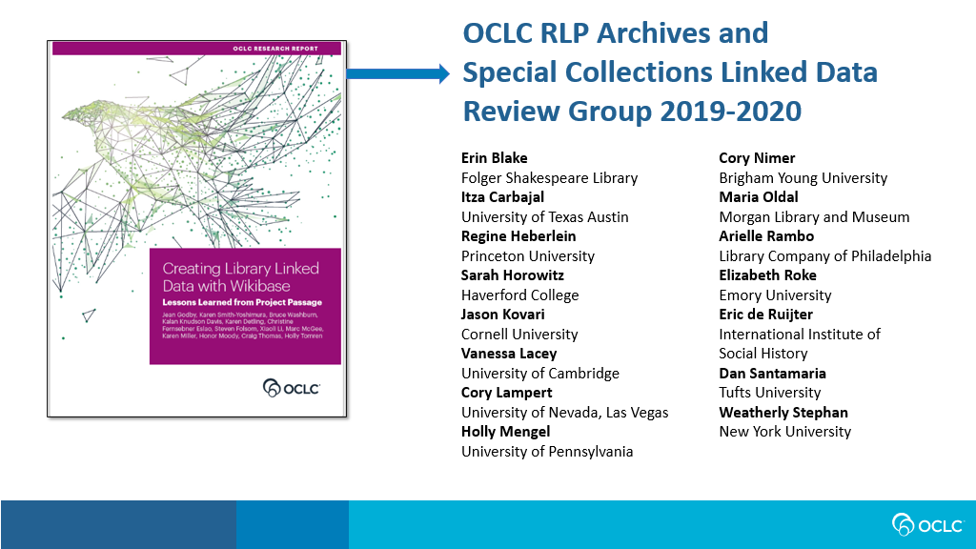
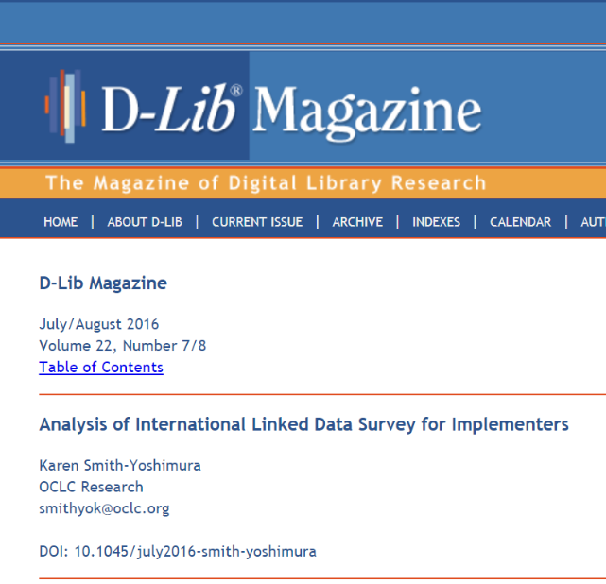
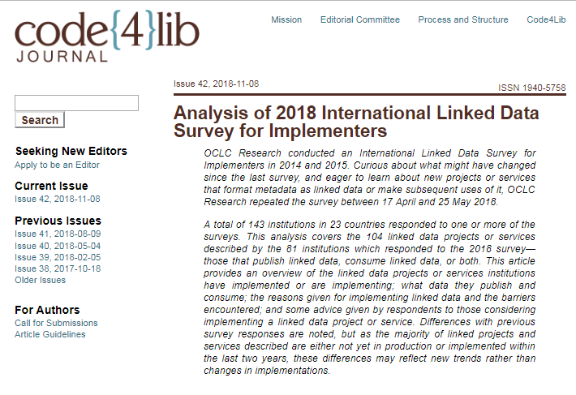
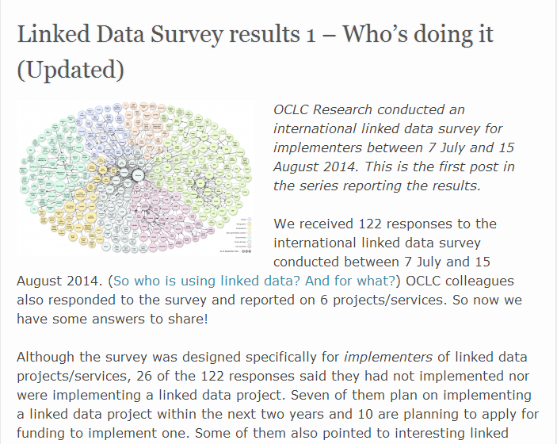
International Linked Data Surveys for Implementers
2014
2015
2018
Notes:
https://www.oclc.org/research/publications/2019/oclcresearch-creating-library-linked-data-with-wikibase-project-passage.html

Slide 24
Linked data for special collections and archives
Recognition of the promise and challenges of moving to a linked data environment
Explores opportunities and challenges for description and discovery
Focus on special collections and archives community

Slide 25
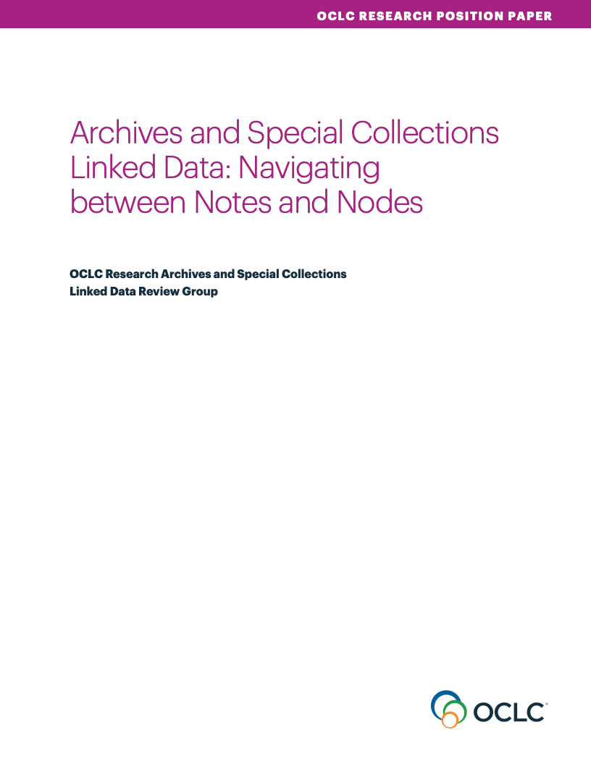
Descriptive data models for special collections in linked data environments
Challenges around multilinguality
Ethical issues, community engagement
Expressing relationships and change over time
The long tail of authorities and identifiers in special collections
Sustainability
Notes:
https://www.oclc.org/research/publications/2020/oclcresearch-archives-special-collections-linked-data.html

Slide 26
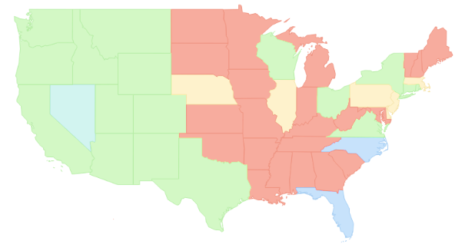
Building a National Archival Finding Aid Network (NAFAN)
▇ = Statewide/regional coverage
▇ = Partial coverage
▇ = Defunct aggregation
▇ = No coverage
*not to scale
Notes:
Now I’m going to share a little bit with you about a project which we are just getting off the ground, and which we are very excited to be a part of – the Building a National Archival Finding Aid Network project, led by the California Digital Library and supported by IMLS.
For a bit of background:
There are 15 extant aggregators in the US, which share very similar characteristics: within a given state or region, they are ingesting and providing persistent of hosting of finding aids -- primarily EAD, in but in a few cases, also in other formats such as MARC records and PDFs
In many cases, they are the primary, de facto finding aid interface for their contributors
There are 3 meta-aggregators, which we define as programs or organizations that harvest and index finding aid data --- or descriptions of archival context -- from aggregators and individual institutions.
Within the US, the primary meta-aggregators are ArchiveGrid, the History of Medicine Finding Aid Consortium, and the Social Networks and Archival Context program -- or "SNAC"
There is not comprehensive coverage for discovery of archival collections nationally

Slide 27
Building a National Archival Finding Aid Network (NAFAN)
▇ = Statewide/regional coverage
▇ = Partial coverage
▇ = Defunct aggregation
▇ = No coverage
*not to scale
Notes:
The CDL maintains the Online Archive of California -- or OAC -- which brings together finding aids across that state.
They have been reevaluating the scope and sustainability of the OAC, and believed it was a timely opportunity to convene a broader conversation with other aggregators to explore a more shared infrastructure and service model.
In late 2018, the California Digital Library received 1 year of LSTA funding from the California State Library to initially explore -- with other regional and statewide finding aid aggregators -- the idea of a national finding aid network
Findings from that grant indicated that this is an idea worth pursuing, which lead to the current phase of work.

Slide 28
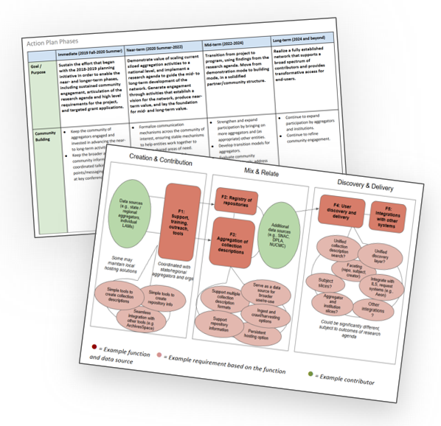
NAFAN: Goals and Objectives
Explore and create the blueprint for implementing a national finding aid network that is community-driven, -sustained, and -governed
Action plan (from 2018-19 planning phase): https://confluence.ucop.edu/display/NAFAN/
Narrative: https://bit.ly/nafan_2020-22_narrative
Schedule of completion: https://bit.ly/nafan_2020-22_timeline
Notes:
This is a 2-year R&D phase, from September 2020 through August 2022
Builds directly on 2018-19 LSTA planning phase -- which most of you collaborated with us on, culminating in an action plan that serves as the roadmap for this R&D phase
Over the next two years, we want to explore and create the blueprint for implementing a national finding aid network that is community-driven, -sustained, and -governed
The blueprint will embellish what we've spec'ed out from the 2018-19 planning initiative -- test, elaborate, and validate the functions [link to diagram]
Before the end of this project, we want to have a pretty clear idea of what the buildout would look like, for a post-2022 development phase

Slide 29
NAFAN: Activity Streams
Research
Technical assessment and prototyping
Sustainability and governance planning
Community engagement
Notes:
For this 2-year R&D project, we have 4 activity streams -- work will be happening in parallel across these areas:
Research: Initiate research to gain a current understanding of the needs of both researchers and cultural heritage institutions in regard to finding aid aggregation. Evaluate the quality of existing finding aid data at scale in order to scope the network's initial functionality to the specific existing characteristics of the data, and lay the groundwork for iterative data remediation and expanded network features in subsequent phases.
Technical assessment and prototyping: Conduct technical assessment of existing aggregation systems, develop prototypes to support research activities and demonstrate key network functions, and formulate specific system requirements for a minimum viable instantiation of the network (targeted for a post-2022 implementation phase). Key assessment dimensions will include: open source status and license; adaptability of the code base; size and engagement of the developer community; programming language adoption levels; and compliance with accessibility, standards and universal design principles.
Community engagement: Cultivate community engagement and broad participation by aggregators, individual cultural heritage institutions, and other stakeholders to support the development and implementation of the network.
Sustainability and governance: Engage in market research activities to identify viable sustainability and governance models for the network in subsequent phases.

Slide 30
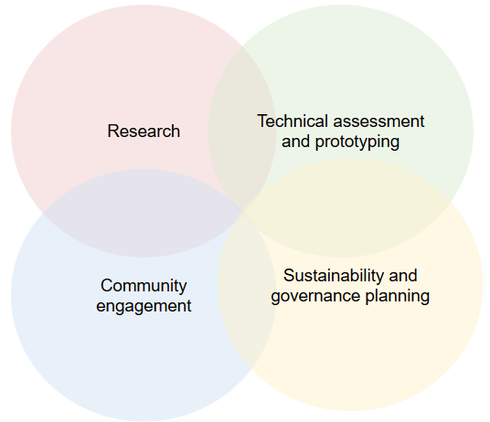
NAFAN: Project Team
CDL: Project coordination and administration
Chain Bridge Group: Business and market research, sustainability and governance model recommendations
OCLC: Research to gain a current understanding of researcher and contributor needs; assess finding aid data quality
Shift Collective: Project management support and community engagement activities
University of Virginia Library (UVA): technical assessment and prototyping; support development of specs/requirements for a minimum-viable instantiation of the system post-2022
Notes:
CDL has assembled a broad team to coordinate and lead the different activity streams:
CDL: leading the project, coordination and admin
Chain Bridge Group: sustainability and governance models
OCLC: end user and contributor research
Shift Collective: project management and community support
UVA: technical assessment and prototyping

Slide 31
NAFAN: OCLC Research Activities
End Users Needs
Cultural Heritage Institution Needs
Finding Aid Data Quality
Notes:
OCLC will be leading research to gain a current understanding of the needs of both researchers and cultural heritage institutions regarding finding aid aggregation.
End User Needs
Who are the current users of finding aid aggregations? Do they align with the persona types and needs identified in recent archival persona work?
What are the benefits and challenges users face when searching for descriptions of archival materials within finding aid aggregations?
Cultural Heritage Institution Needs
What are the enabling and constraining factors that influence whether and how institutions describe the archival collections in their care?
What are the enabling or constraining factors that influence whether institutions contribute to an aggregation?
What value does participation in an aggregation service bring to institutions?
Finding Aid Data Quality
What is the structure and extent of consistency across finding aid data in current aggregations?
Can that data support the needs to be identified in the user research phase of the study? If so, how? If not, what are the gaps?
An overview of our planned work is here https://hangingtogether.org/?p=8643

Slide 32
Professional development
Stay up to date
Engage around emerging issues
Learn alongside colleagues
Virtual engagement is affordable
Share your work!
“…being able to engage with colleagues at other universities from my desk has been an absolute lifeline for me. Thank you!”
Dr. Cathy Pink, Senior Data Librarian, University of Bath
Notes:
Organize viewing sessions to develop a learning cohort at your institution
Meet colleagues from around the globe

Slide 33
Upcoming webinars
24 November 2020 REALM project: Supporting the reopening of libraries, archives, and museums
Join this webinar to learn about the latest research from the REALM project and how to incorporate this information into local decision making.
12 January 2021 Works in Progress Webinar: What comes next? Grappling with data, reconsidering workflows, and expanding collaboration following a large-scale collection survey
Learn how assessment data can inform future collection development decisions, collection management activities, and preservation priorities.
16 March 2021 Works in Progress Webinar: Holistic approaches to born-digital appraisal and accessioning -- revising the UC Guidelines for Efficient Archival Processing
Viewers will learn about the revisions to the “Guidelines for Efficient Archival Processing in the University of California Libraries” and about new recommendations for accessioning and appraising born-digital materials.
Notes:
Upcoming and past webinars here:
https://www.oclc.org/research/events/works-in-progress-webinar-series.html

Slide 34
On demand webinars
Works in Progress Webinar: The nuts and bolts of conducting an efficient AV survey Demystification of the process of an AV assessment: how to get started, how to determine the essential elements, and how to retool midstream to fit your institution’s needs.
Works in Progress Webinar: This wasn’t for you yesterday, but it will be tomorrow—Digitization policy to counteract histories of exclusion An explorations of the intersection of digitization policy and anti-racist action, using LSU Libraries’ experience as a lens to explore the state of the field.
Works in Progress Webinar: Dynamics of change—continuing the conversation on library naming, finding, and relationship-building with Indigenous peoples
Participants will learn about how the University of Toronto Libraries is reckoning with both cultural change and the development of culturally appropriate metadata on a system-wide scale.
Works in Progress Webinar: Better design -- tools for creating user personas
Learn about tools, questions, and methodologies for building user personas–which can help you better understand user needs and behaviors to create better design.
Notes:
Upcoming and past webinars here:
https://www.oclc.org/research/events/works-in-progress-webinar-series.html

Slide 35
Engage with the OCLC RLP
Join our lists (especially OCLC RLP Announce) to learn about our work and new opportunities.
Read our group blog at HangingTogether.org
Attend webinars (over 25 last year)
Share your knowledge / expertise in a webinar
Call on us for informal consulting
Email your liaison, Chela Weber weberc@oclc.org or anyone on our team.

