Slide 1
Libraries Create Pathways to Civil Legal Justice
Brooke Doyle, WebJunction, Project Coordinator
November 10, 2020
Notes:
WJ has been partnering with LSC for more than a year on a national training initiative for PL to be better equipped to serve as access point for civil legal info.
I hope my talk with be informative and empowering. Lib are so well positioned to play a role in patrons accessing civil legal justice and I hope I can inspire some of that work.
Interactivity, Handout available

Slide 2
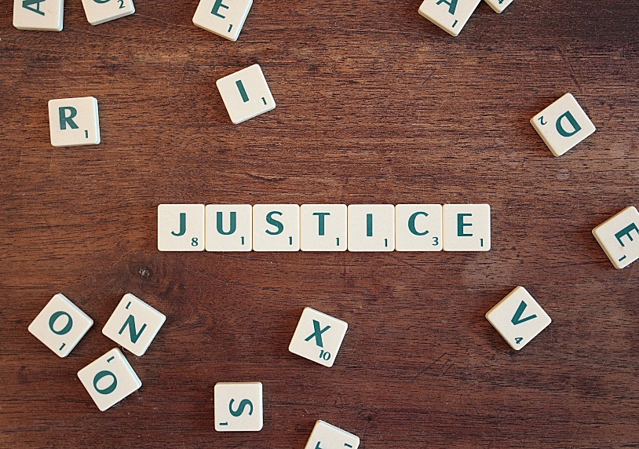
Topics for today
The civil legal justice gap and libraries
Civil legal issues on the rise
What libraries can do
  Finding local resources and referrals
  Connecting with partners
Understanding legal information vs legal advice
Build your skills
Image by CQF-avocat from Pixabay

Slide 3
The civil legal justice gap and libraries

Slide 4
Civil vs Criminal Law
CRIMINAL Law
the body of law that deals with crime and the legal punishment of criminal offenses
The Sixth Amendment guarantees the right to be defended by an attorney
CIVIL Law
deals with disputes between individuals, organizations, or between the two, in which compensation is awarded to the victim
There is NO guarantee of an attorney provided by the state
Notes:
What’s the difference between civil law and criminal law?
The key difference for our understanding the civil legal justice gap is the lack of a guaranteed attorney

Slide 5
The Justice Gap
86% of the civil legal problems
reported by low-income Americans
in the past year (2017) received inadequate or no legal help.
Data source: Legal Services Corporation, Justice Gap Report, June 2017
https://www.lsc.gov/media-center/publications/2017-justice-gap-report
Notes:
This lack of guaranteed representation in addition to other barriers to civil legal justice disproportionately affect low-income people in the U.S, creating the justice gap – the divide between the civil legal needs of low-income people and access to the resources to meet those needs.
The statistics are startling.
In 2017;
Almost 3/4 of low-income households experienced at least one civil legal problem
1 in 4 have experienced more than 6 civil legal problems in the last year
Percentages can be even higher for groups like seniors, veterans, people with disabilities
86% of the civil legal problems reported by low-income Americans received inadequate or no legal help.
The problem is both broad and deep
ALSO: Asset Limited, Income Constrained, Employed (ALICE) and justice gap
LSC report: Justice Gap Report: Measuring the Unmet Civil Legal Needs of Low-Income Americans, LSC, June 2017
LINK: https://www.lsc.gov/media-center/publications/2017-justice-gap-report

Slide 6
Why aren’t these needs being met?
There are not enough legal aid attorneys to help everyone
People may not realize they have a
legal issue and not be aware of available resources
Legal issues may be intensely personal and emotional
  It is estimated there is just 1 legal aid attorney for every 10,000 low income Americans
Notes:
Structural and emotional barriers
Legal issues can be about intensely personal and often traumatic life events
Many people experience fear and alienation when dealing with the legal system
Language barriers are common
Many people experience anxiety and fear with unfamiliar legal technology

Slide 7

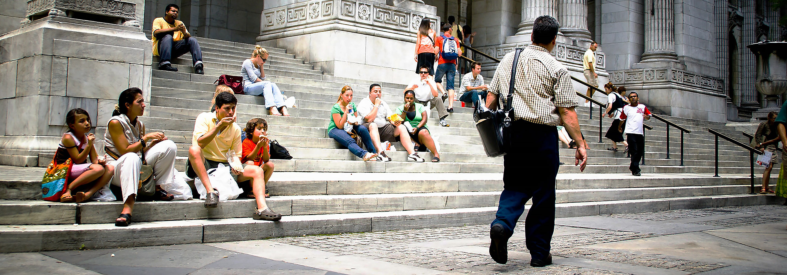
The role of libraries
People feel comfortable walking into a library
New York Public Library Steps by Zack Lee on Flickr CC BY-NC-ND 2.0
Notes:
Public libraries are well-positioned to help reduce the civil legal justice gap by increasing access to information and resources.
Why libraries?
Primary and trusted provider of free access to information and the Internet
Research, reference and organizational skillsets
Public service and community anchor role in connecting patrons to information and services.
understand the importance of neutrality required to provide legal information
Photo: NYPL Steps by Zack Lee https://www.flickr.com/photos/riacale/ on Flickr https://www.flickr.com/photos/riacale/1288680596/
CC BY-NC-ND 2.0 https://creativecommons.org/licenses/by-nc-nd/2.0/

Slide 8
Civil legal issues on the rise

Slide 9
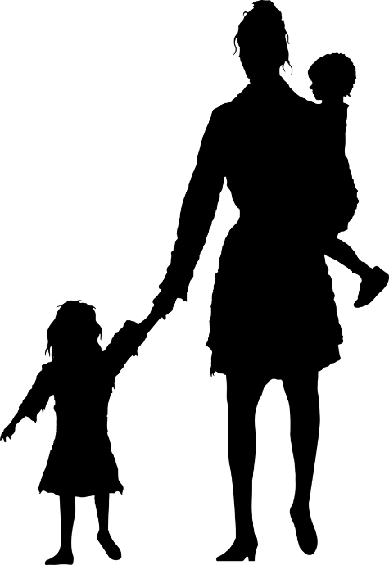





What are you hearing?
I’ve been locked out of my home
My medical bills are out of control
I was denied unemployment
I’m falling behind on paying my bills
My spouse is making me feel unsafe at home
I lost my health insurance when I lost my job
I can’t stand it – I need a divorce
All of these phrases indicate a possible civil legal issue
Notes:
The COVID-19 pandemic has created a surge in civil legal issues for many people with rising unemployment, housing insecurity, medical debt, concerns of safety and domestic violence, and more
When you hear these phrases, there is possibly a civil legal issue that the patron needs to resolve

Slide 10
Civil legal issues on the rise due to COVID
Family Issues
  Custody
  Visitation orders
  Divorce
Finances
  Unemployment
  Consumer debt
Health
  Medical debt
  Advanced directives, estate planning
Housing
  Evictions
  Illegal lock-outs
  Illegal utility shut-offs
Safety
  Domestic violence
Notes:
It is helpful to recognize the broad categories of civil legal issues that are on the rise because of the unique circumstances resulting from the COVID-19 pandemic. CHAT
Finances
Unemployment—In addition to the increased number of people filing unemployment claims, other issues can arise such as what steps to take if your unemployment claim has been denied or if health insurance coverage is lost due to unemployment.
Consumer debt issues can be compounded as unemployment rises and emergency household reserves are quickly depleted.
Housing—evictions and foreclosures
With rising unemployment and healthcare costs as a result of the pandemic, many people are experiencing housing insecurity. Some jurisdictions have issued a stay on evictions and/or foreclosures, but this may vary depending on your location. Some other potential issues to be aware of related to housing:
Illegal lockouts—This is when a landlord makes changes that prevent a tenant from entering their residence with no prior notice, including changing locks, security codes, access gates, and other similar measures.
Illegal utility shut-offs—Similar to lockouts, this occurs when someone cuts off essential services with no prior notice in an attempt force a tenant out, including water, electricity, gas, and possibly internet depending on the area.
Family issues
Custody—A parent could potentially struggle to pay child support due to unemployment or other financial barriers caused by the pandemic.
Visitation orders—A safety or health issue could interfere with visitation schedules during lockdowns. Or, what if one parent won’t comply with current visitation orders? Issues with finances, travel, health, and more could all be impacted by the pandemic that could interfere with pre-pandemic custody or visitation agreements.
Divorce—Court proceedings were put on hold during early lockdown periods creating significant caseload backlog and delays. Although some courts have tried virtual hearings, this requires a stable internet connection or significant data plan that many low-income people do not have access to.
Safety
Stay-at-home orders made living conditions much more dangerous for people experiencing domestic violence.
Emergency services are continuing regardless of stay-at-home orders, including emergency hearings in courts.
It can be valuable to have a list readily available of resources in your community to support people experiencing domestic violence, especially in the heightened situation created by the pandemic.
Health
Medical debt—Medical debt is often considered different from many other types of consumer debt as it is often resulting from sudden, unexpected injury or illness. With unemployment rising amid a global health crisis, civil legal issues involving medical debt are on the rise.
Advanced directives and estate planning—These are legal documents that spell out decisions about end-of-life care ahead of time

Slide 11
What libraries can do: prepare and partner

Slide 12
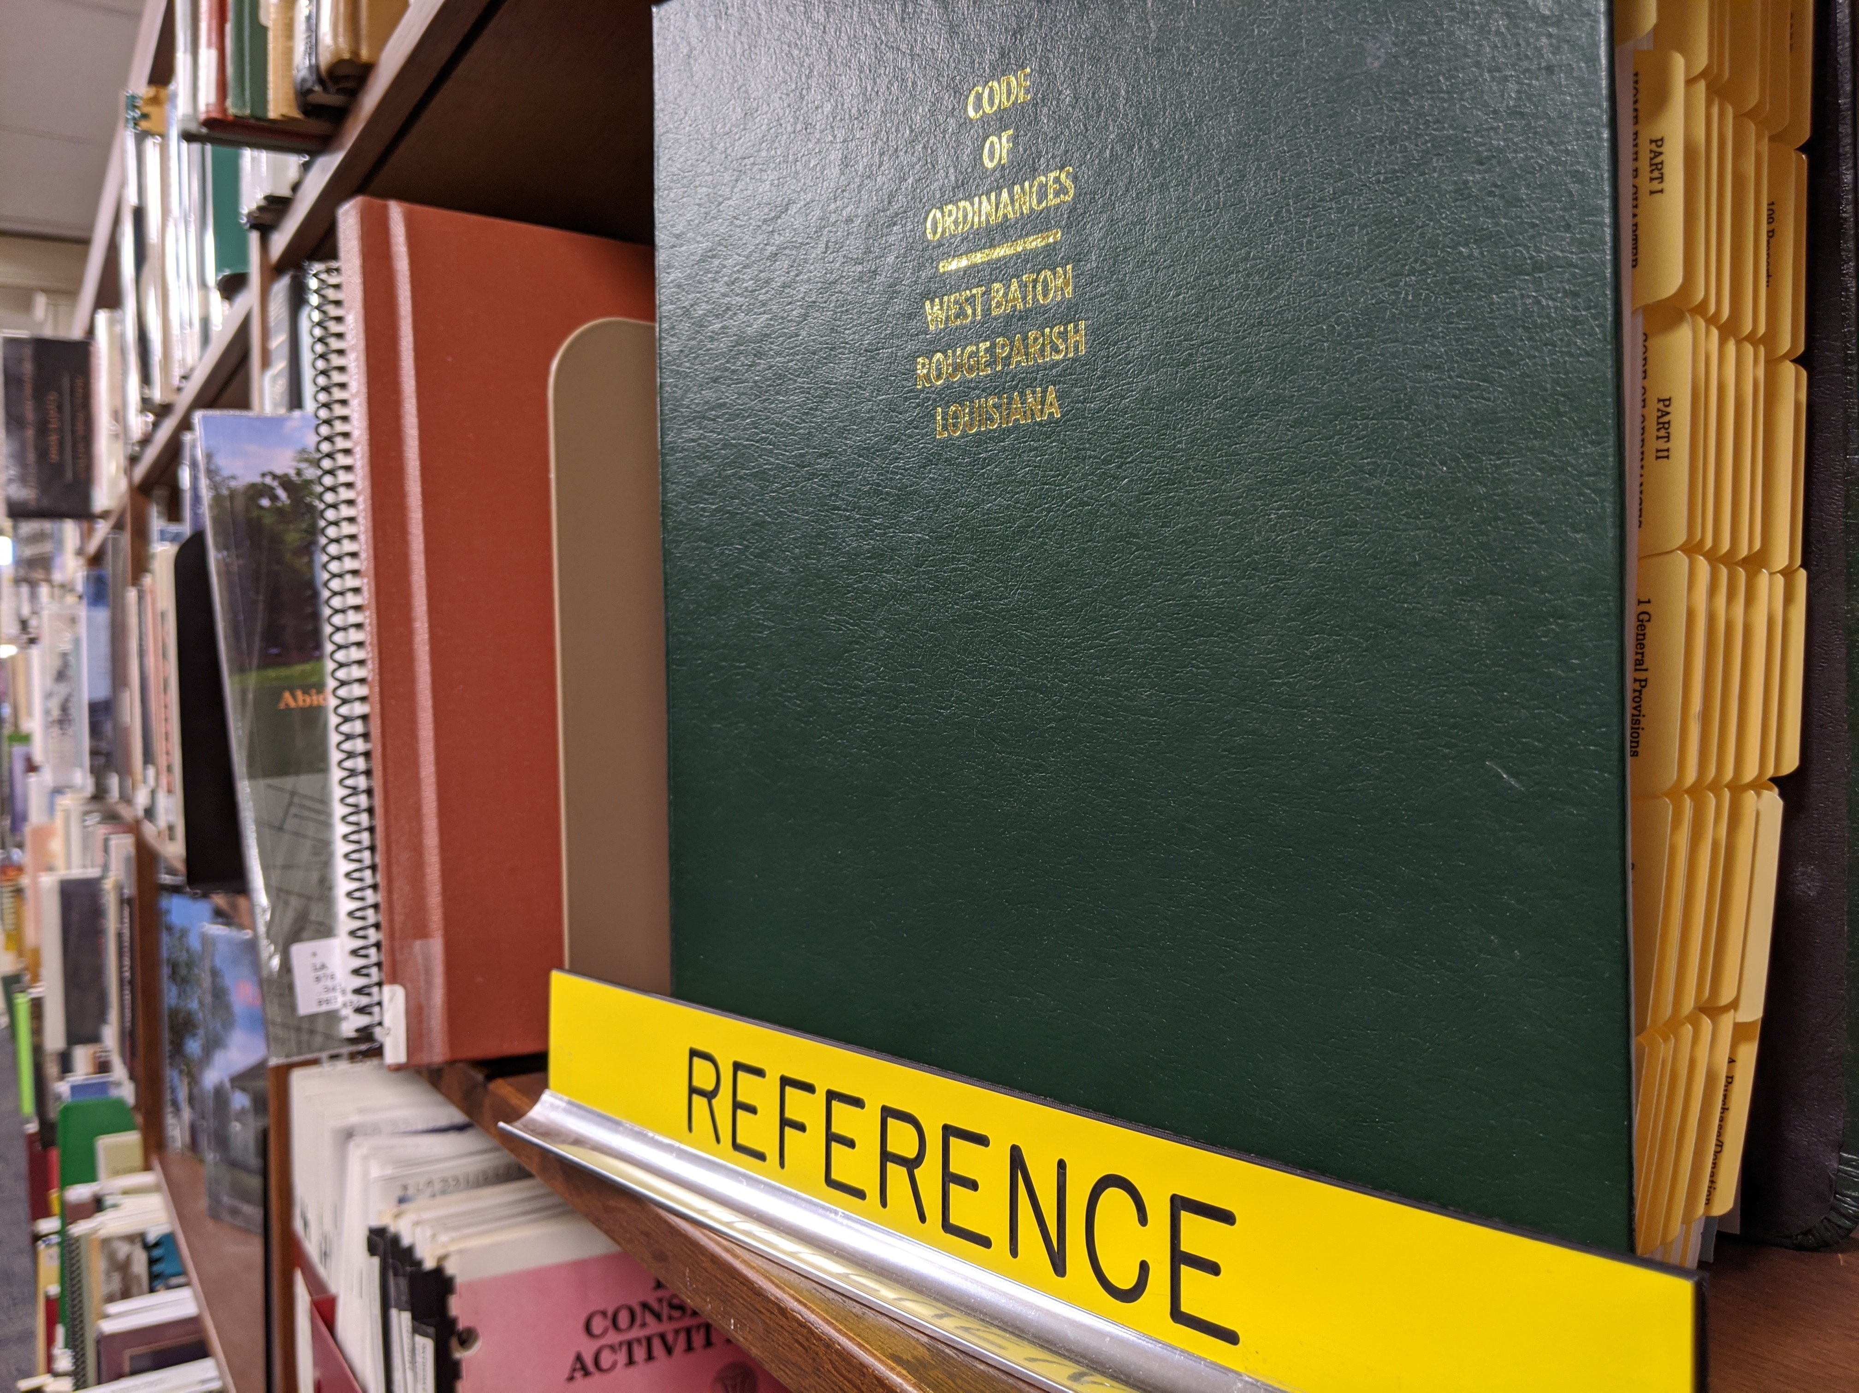
Prepare a legal reference collection
online
Find:
Fact sheets
State sites
Interactive forms
Legal aid directory
Resources in languages other than English
Photo: West Baton Rouge Library reference, courtesy of Luis Interiano
Notes:
You want authoritative, relevant, and current collection of resources.
Why focus on collecting online resources?
The law is constantly evolving so print references go out of date
Many states make their statutes and rules available online for free
With the combined considerations of currency, cost, and availability of resources written for the general public, it is the shared opinion of our advisors that most libraries are better advised to use primarily online resources with just a few possible exceptions. Most small public libraries are likely to be able to serve their communities well using only online legal resources.
Civil law is specific to each state and local jurisdiction. State specific is going to be better than general; looking at another state’s info not helpful – sometimes general will be helpful in background info. Secondary better than primary – start here and refine issue and it will guide you.
Fact sheets – cover the basics of the court system, working with a lawyer, getting an interpreter, etc.
Subject-specific resources available at the state sites

Slide 13
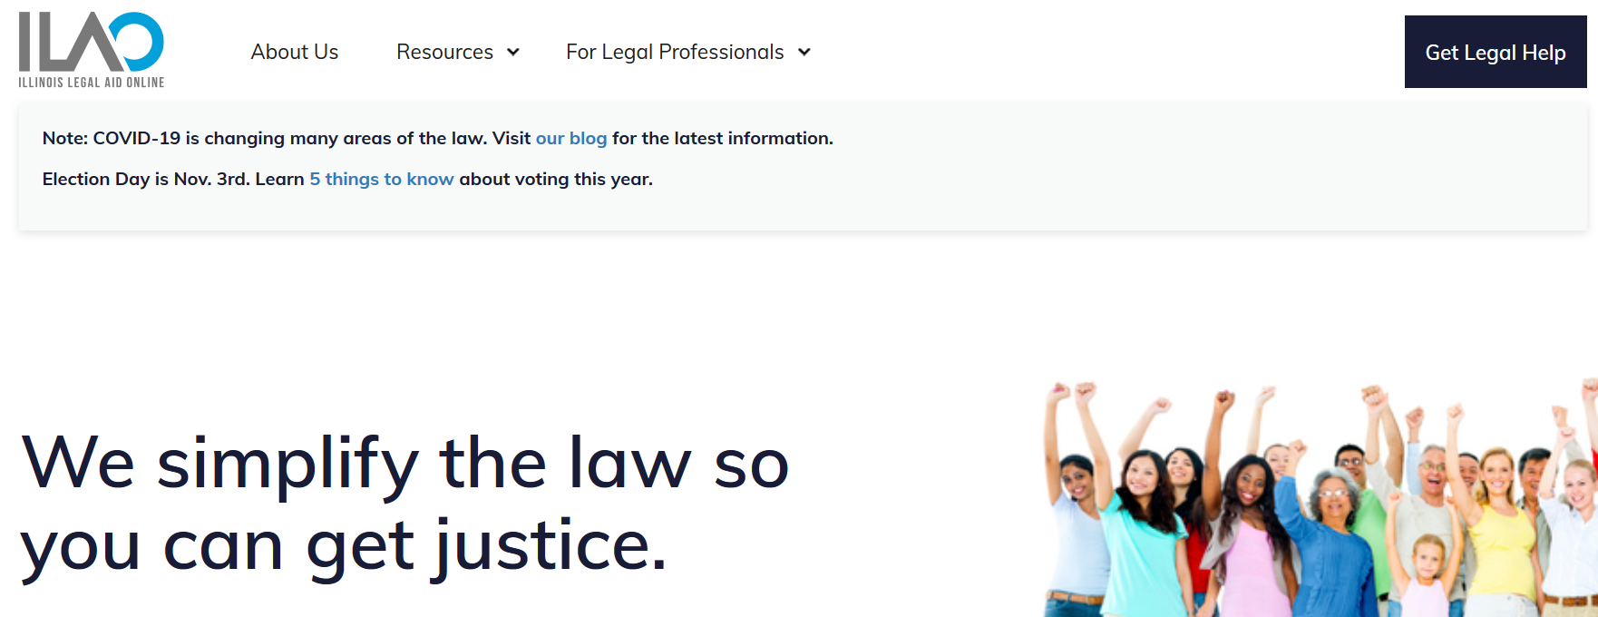
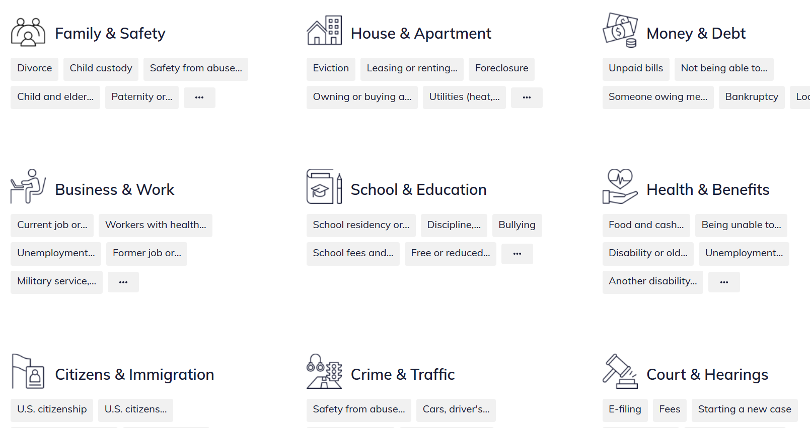
https://www.illinoislegalaid.org/
Notes:
Ilao is a fabulous resource – very comprehensive, very well organized.
Love the slogan – we simplify the law so you can get justice.
I have a screenshot here so you can see the many categories they have listed and then the subcategories.
So – they have done much of the work for you! Might tailor to a specific population or problem your population faces – make sure you’re well equipped for that. And you will want to become very familiar with their site, but again – so much legwork done for you!

Slide 14
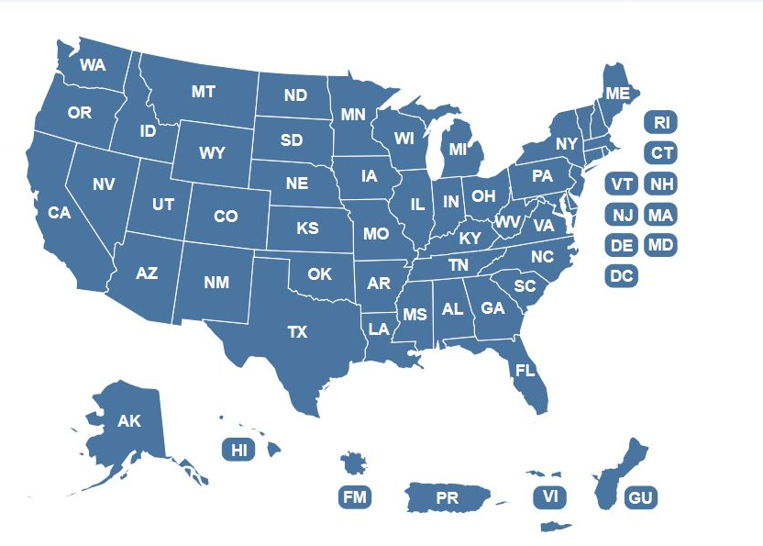
Other sources of local civil law
  Most civil legal issues are covered at the state or local level.
State Bar Associations
Local Legal Aid
State Court System
Law libraries – SIU Law Library
Notes:
I have prepared a handout with some good sites to start with in preparing your own online legal collection. Shout out to Teresa pennington from Paris PL
Law libraries are often great resources, but they vary significantly across the country. As I understand it here, almost every court house has a space they refer to as a law library but it may be a room with a computer, no staff; may even be locked.
I know a handful that do have staff – Madison co has law lib and self help center – good, helpful. Appt system. Multiple staff.
SIU Law Library open to public

Slide 15
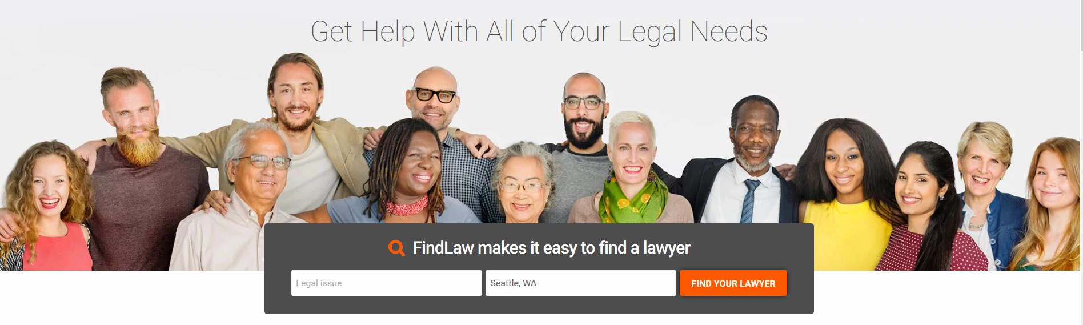
Online self-help resources: national/general
AALL Public Library Toolkits
Nolo publications
FindLaw
American Bar Association
Graphic: www.findlaw.com
Notes:
Other sources for national or general resources
Good for general overviews and definitions/terminology
Can help you know what to look for in order to find state-specific materials – terminology, general principles
Excellent for things like immigration, bankruptcy
AALL Public Library Toolkits: https://www.aallnet.org/lispsis/resources-publications/public-library-toolkit/
Nolo: http://www.nolo.com/
FindLaw: http://www.findlaw.com/
American Bar Association: https://www.americanbar.org/about_the_aba/aba_public_resources/

Slide 16

Identifying legal aid providers
Legal Services Corporation (LSC)
Statewide Legal Aid Organizations
Local or National Bar Associations
Law School Clinics
Land of Lincoln Legal Aid
https://lincolnlegal.org/
Image by geralt on Pixabay
Notes:
General legal aid providers will assist with pretty much any civil legal issue
Also likely to have specialized programs – for veterans, housing, family, immigration, etc. On the handout, I have listed many that serve specific populations.
Some legal aid may also offer a variety of levels of service – full representation, clinics, etc.
SIU clinics – Elderly, Juvenile, domestic violence, veterans
BUT: you should not guarantee that an organization will help someone – there is not enough capacity to serve everyone and even people meeting all eligibility requirements may be turned away
Land of Lincoln Legal Aid (southern half of the state, 4 offices) https://lincolnlegal.org/
Image: by geralt on Pixabay: https://pixabay.com/photos/books-man-person-businessman-3071110/

Slide 17

Identifying partners
Government agencies (local, state, federal)
Private law firms – pro bono hours
Image by fauxels on Pexels
Notes:
Local bar association – lawyer in library
Court navigator
Law libraries

Slide 18
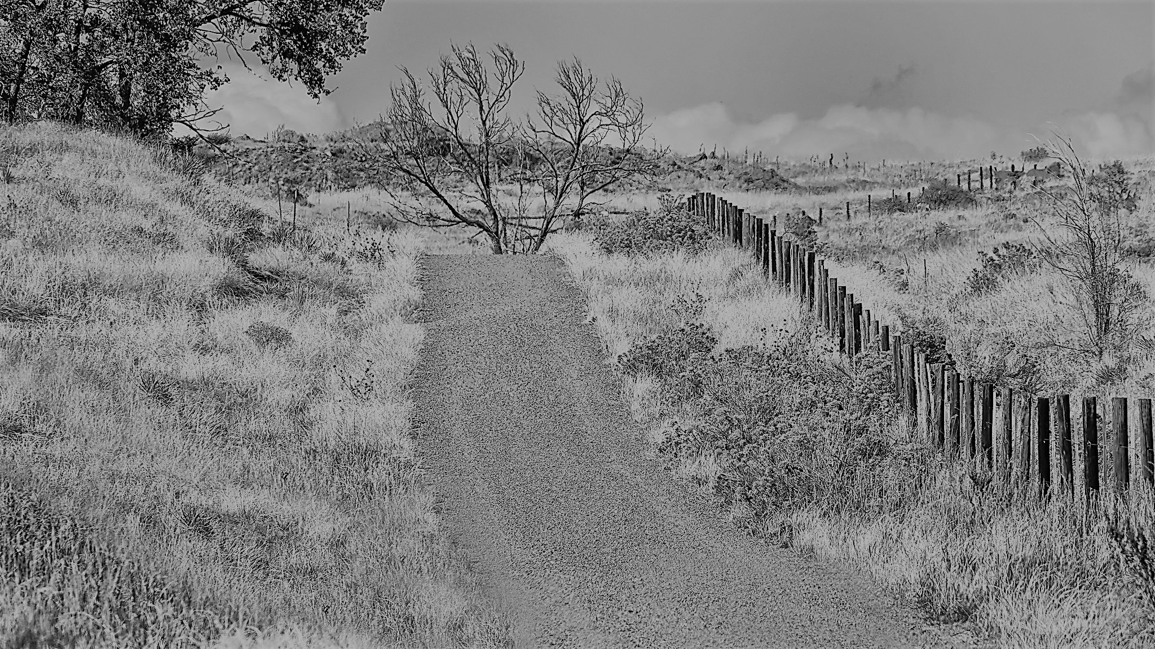

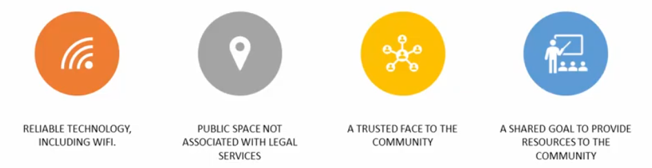
Partnering in the legal desert
High Desert Autumn by Barry Dale Gilfry on Flickr CC BY-SA 2.0
Notes:
We started out by defining the civil legal justice gap broadly. The gap is even more prevalent in rural areas referred to as “legal deserts” where there are no attorneys, regardless of cost.
Legal Aid offices
LSC has funded legal aid agencies in every state to achieve 100% coverage of the country
In remote areas, the agencies look for partners who can help them establish virtual services for clients in need
Public libraries are particularly good partners for legal aid clinics because they provide:
Reliable technology and internet connection
Public space that is familiar and is not associated with legal services
An established and trusted relationship with the community
A shared goal to provide resources to their community
Can use tech to connect remotely to legal aid attorneys in more urban areas. Lib can provide just the space or the space plus minimal assistance – zoom connection, printer.
Photo: High Desert Autumn by Barry Dale Gilfry on Flickr CC BY-SA 2.0
https://www.flickr.com/photos/websterwebfoot/
https://www.flickr.com/photos/websterwebfoot/48842487617/
https://creativecommons.org/licenses/by-sa/2.0/

Slide 19
Wicomico Library Legal Clinics
…the more we can do to remove those barriers, the better odds they have to stabilize their lives.
⎯ Susan Francis, Executive Director of MVLS
www.webjunction.org/news/webjunction/cyber-legal-clinics-create-access.html
Advocacy Clinic by GSK on Flickr CC BY-NC 2.0
Notes:
Another example of rural library partnership
At Wicomico Public Library in rural, low-income Maryland, library staff recognized a recurring issue in their Job Search Center with patrons who couldn’t land jobs due to their criminal records. This was the trigger to partner with the Maryland Volunteer Lawyer’s Service to offer cyber legal clinics, where volunteer lawyers provide remote help with the expungement process. Great example of partnership, use of tech, assessing community needs.
Read more of the story on WebJunction
https://www.webjunction.org/news/webjunction/cyber-legal-clinics-create-access.html
Photo: Advocacy Clinic by GSK https://www.flickr.com/photos/glaxosmithkline/ on Flickr https://www.flickr.com/photos/glaxosmithkline/49028229482/
CC BY-NC 2.0

Slide 20
Understanding legal information vs legal advice

Slide 21
Safe Harbor Policy
Supreme Court Policy offering guidance to certain people acting in a non-lawyer capacity around what may and may not be offered to court patrons
Protection against UPL – unauthorized practice of law
Section c – 9 things prohibited
Section d – 19 things permitted
https://courts.illinois.gov/SupremeCourt/Policies/Pdf/Safe_Harbor_Policy.pdf
Notes:
Prohibited examples:
Recommend whether a case should be brought to court or comment on the merits of a pending case;
Give an opinion about what will happen if a case is brought to court;
Refer a litigant to a specific lawyer or law firm for fee-based representation;
Permitted examples:
Provide information about electronic filing (e-filing) including, but not limited to…
Approved Forms (7)Assist court patrons in identifying approved forms and related instructions based on the court patron's description of what he or she wants to request from the court. When necessary, explain the nature of the information required to fill out the approved forms. When appropriate, share information about approved and translated forms and instructions. Where no approved form exists to accomplish the court patron's request, inform the litigant of that fact and direct him or her to other legal resources; (8)Record verbatim information provided by the self-represented litigant on approved forms if that person is unable to complete the forms due to disability or literacy barriers; (9)Review finished forms and documents to determine whether forms are complete, including checking for signature, notarization, correct county name and case number;
https://courts.illinois.gov/SupremeCourt/Policies/Pdf/Safe_Harbor_Policy.pdf

Slide 22
Is it information or is it advice?
Patron Mr. Jones says:
I stopped paying rent because my landlord hasn’t fixed any of the problems in my apartment. Now I’m being wrongfully evicted.
Library staff says:
I’m sorry to hear you’re being threatened with eviction! I’ll find the form you need.
Information
Advice
Notes:
In this scenario, is the library staff providing information or advice?
Enter in chat why you think it’s one or the other
In this scenario, the librarian crossed the line from information to advice by choosing
a course of action (“I’ll find the form”) without clarifying that is in fact what the patron wants to do. It’s important that we let the patron guide us to what they need – not decide for ourselves what actions they should take.
Could vs should: patrons may ask, “What should I do?” You can respond with info: I can’t tell you what to do but I can explain your options. There are 3 approved forms relating to what you are describing…
But you can give someone approved forms for the issue they are asking about if any exist.
2. The good part: the librarian expressed empathy for the patron’s situation without making any judgement on the wrong or right of the issue. CONSIDER MAKING REFERRALS TO ILLINOIS LEGAL AID ONLINE FOR MORE INFORMATION AND INFORMATION ABOUT LEGAL SERVICES.
Better answer would be to still express empathy. Explain court process for evictions; ask questions to understand situation more, explain some possible courses of action. Based on patron’s answer – you could guide to the appropriate form.

Slide 23
Is it information or is it advice?
Patron Jane Doe (visibly upset) says:
My abusive ex-husband is using dirty tricks to get custody of our two boys. What can I do to be sure the judge gives me sole custody?
Library staff says:
I can see that this is very distressing for you! Family law can be quite complex, so I suggest you seek legal advice for this.
Information
Advice
Notes:
In this scenario, is the library staff providing information or advice?
Enter in chat why you think it’s one or the other
In this scenario:
the library staff expressed appropriate empathy without expressing a judgment as to whether the situation is “right or wrong.”
It’s always allowable to connect a patron to an attorney, including as a first step. Going to court by yourself is difficult. If the patron can connect with an attorney, even just for a consultation, they are likely to be better off. This is where is helps for the library staff to be prepared with referrals to legal aid and local attorney options

Slide 24
Helpful “DO!” tips
Suggesting someone should seek legal advice is not giving legal advice
Promote open access to legal information,
including legal forms and instructions
Provide resources on court procedures, court rules, and other law
Direct patrons to legal treatises, legal dictionaries, or legal encyclopedias for explanations
Provide options, resources, and referrals
Refer to a specific pro bono lawyer or other free legal services

Slide 25
Helpful “DON’T!” tips
Don’t be invested in the case outcome
Don’t guess how a judge will rule
Don’t fill out legal forms or give advice on filling them out* (certain exceptions)
Don’t interpret or explain the law
Don’t identify a specific law for the patron’s problem
for them
Don’t advise a patron about a legal course of action
Don’t recommend a specific lawyer for fee-based representation
Notes:
According to D10, you could refer to a specific pro bono lawyer or other free legal services

Slide 26
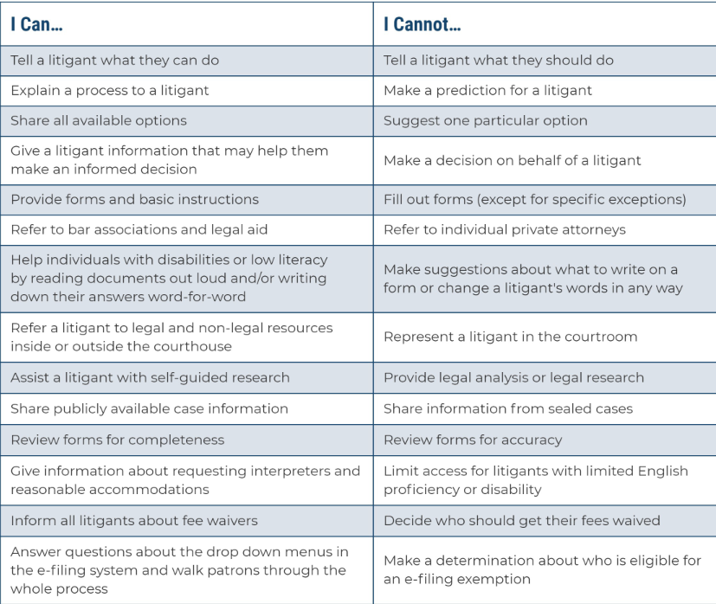
Reference Card
https://courts.illinois.gov/CivilJustice/Training_Education/Legal_Info_Reference_Card.pdf

Slide 27
Build your skills
Notes:
Every library staff who provides civil legal reference had to start at the beginning, including law librarians. Some law librarians were lawyers first but many started as librarians without legal expertise.

Slide 28

Reference and search skills
Play to your strengths
Reference and research
  Find the underlying issue
  Know your resources
Apply your search skills
  Term selection
  Google Advance search
  Use LawHelp.org
Search skills by geralt on Pixabay
Notes:
First recognize that you already have relevant skills
You have Research, reference and organizational skillsets
Apply your reference interview skills to listen with empathy and understand the real issues behind the patron’s questions
Apply all the search skills you’ve honed over the years to finding civil legal information
We get asked reference questions all the time about things we don’t know about – think of it the same way.
You may not have had any formal training in basic reference interview techniques. There are good courses online, such as the ABLE course series at learn. WebJunction; RUSA (Reference and User Services Association – part of ALA) regularly offers webinars and online instruction in reference strategies

Slide 29
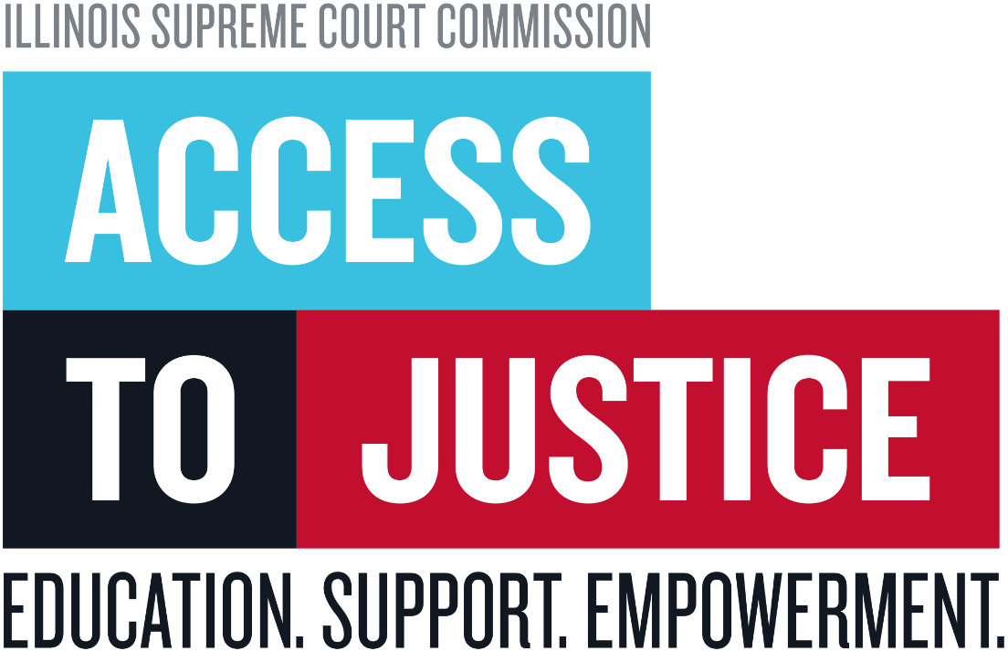
Free Training
Jill Roberts, Access to Justice Division, Administrative Office of the Illinois Courts
Free training:
jroberts@IllinoisCourts.gov
Notes:
**Jill Roberts at Illinois State Courts – director of the Court Navigator Network, a statewide program for court staff helping SRLs. She is offering free remote training and is encouraging you to email her to learn more. She can provide training on efiling and advice vs info for your staff, and can partner with Illinois Legal Aid Online for training on their new site, too. Contact her! Jill Roberts <jroberts@IllinoisCourts.gov>

Slide 30
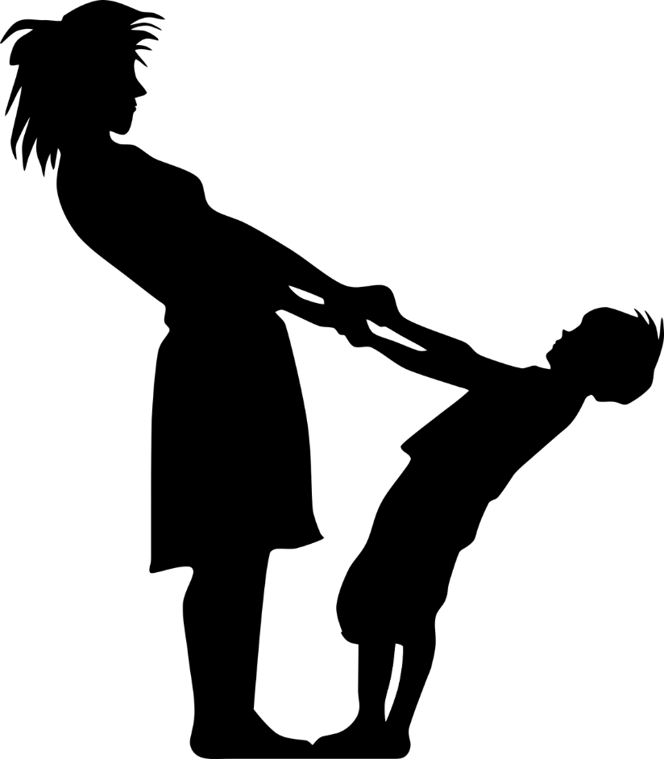
Applying basic reference skills
This experience confirmed for me the strong impact that everyday library service can have on individual lives and on the communities we serve.
⎯Luis Interiano, Reference Librarian,
West Baton Rouge Library
Full story at: https://www.webjunction.org/news/webjunction/legal-reference-at-the-library.html
Notes:
In his LIS program at Louisiana State University’s School of Library & Information Science, Luis completed two reference courses, which provided general preparation and only touched on general legal reference online. Over the past 10 years, learned on job. At first intimidating; challenging bc doesn’t get Qs that frequently, rusty. Most don’t return so never know your impact. This case stood out for him. A young patron asked for help forms for custody of her young child. I first searched the Gale US Legal Forms database and found 67 forms relating to child custody. As I expected, she asked me which one she should use. At this point, I gave her my standard disclaimer—I could not advise her on which one was correct for her case because then I would be practicing law without a license.
As I showed her examples on-screen, she offered some details of her case: she was not married to the father of the child, a two-year-old girl, but they had been living together for two years and had been engaged to be married. For various reasons, she broke the engagement and asked the father to move out. At first, visitations were amicable, but when she tried to create a set schedule for visitations rather than weekly discussions about custody, the father, who had some experience in the courtroom and had an attorney due to his prior legal problems, threatened to seek full custody of the child and have her raised at his parents’ home in another town. My patron was very afraid because she had no experience inside a courtroom. I felt pressure—not from the patron but from the importance of the situation—to try to find some information that might help her. Ask general questions so as not to pry.
The patron said she had no knowledge to use in choosing from among the 67 results, so I advised that she speak to an attorney about how to proceed. She said she had no funds for a lawyer, so I gave her two contacts that I have bookmarked bar and legal aid:
I printed three custody form packets for her and stressed that these were only examples that might be useful for her to familiarize herself with the information and format required by the courts, and that under no circumstances was I recommending that she use these forms. Only an attorney could advise her on that.
She had informed the father of the child that:
Her local library offers free and unlimited access to a database that shows all Louisiana legal forms with unlimited search and inexpensive printing
She had obtained three printed examples of child custody forms
She had obtained the contact information of two pro-bono organizations and had visited one to obtain more information on what her next steps should be
She was going to attend the monthly legal assistance informational program at her local library
After she had informed the father of the child of the actions she had taken, he became much more amicable about arranging visitations and ceased to threaten to get full custody of the child.

Slide 31
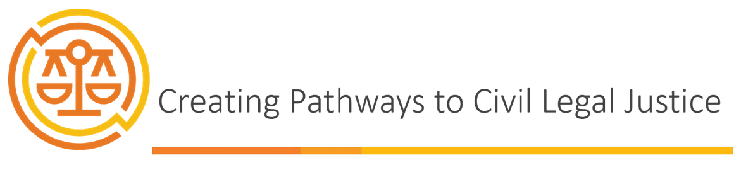
WebJunction’s self-paced courses
Training in four courses:
Course 1: The Justice Gap and the US Legal System
Course 2: Civil Legal Issues and Resources to Address Them
Course 3: Finding and Partnering with Legal Service Providers
Course 4: Conducting a Legal Reference Interview
https://oc.lc/civil-legal-course
https://oc.lc/civil-legal-course
Notes:
I have just skimmed the surface of the knowledge and skills involved in gaining comfort and confidence with civil legal reference
WebJunction is offering a 4-course series of self-paced training that will strengthen public library staff’s knowledge and ability to help identify when there is a civil legal issue at play and to direct library users to relevant, helpful information and services.
The courses:
Course 1: The Justice Gap and the US Legal System
Course 2: Civil Legal Issues and Resources to Address Them
Course 3: Finding and Partnering with Legal Service Providers
Course 4: Conducting a Legal Reference Interview
Facilitator training…

Slide 32





Thank you to our Funders and Partners!
Funders
Partners

Slide 33
Brooke Doyle, WebJunction
doyleb@oclc.org
Notes:
I hope it’s been informative and inspiring. I hope you will help strengthen library’s role in closing the justice gap.

