Slide 1
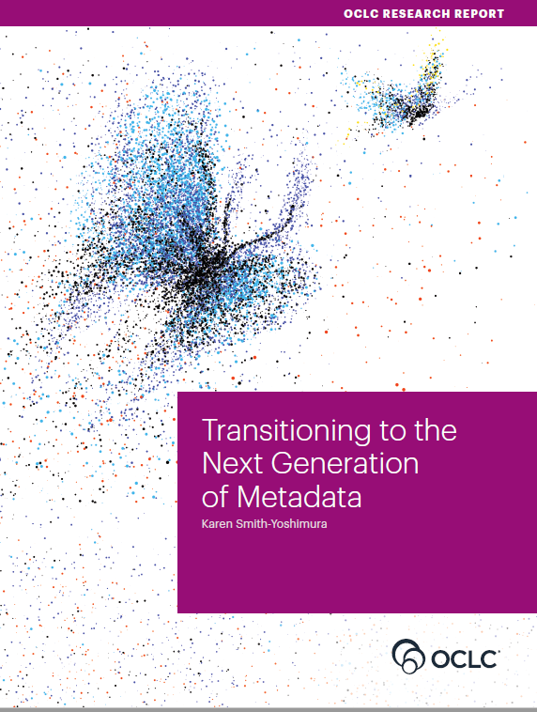
RLP Works in Progress Webinar • 5 November 2020​
Transitioning to the Next Generation of Metadata

Slide 2
Karen Smith-Yoshimura
OCLC Research Senior Program Officer
Introduction and overview

Slide 3
OCLC RLP Metadata Managers Focus Group – Report fodder
62
Partners in 11 countries
777
Pages of response compilations
93
Hours of discussion
Notes:
First, some background on the OCLC Research Library Partners Metadata Managers Focus Group. The discussions and responses to question sets over the last six years (2015 -2020) provided the fodder for the Transitioning to the Next Generation of Metadata report.

Slide 4
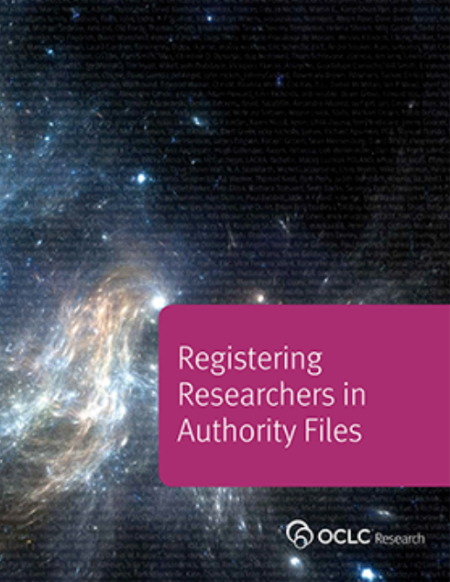
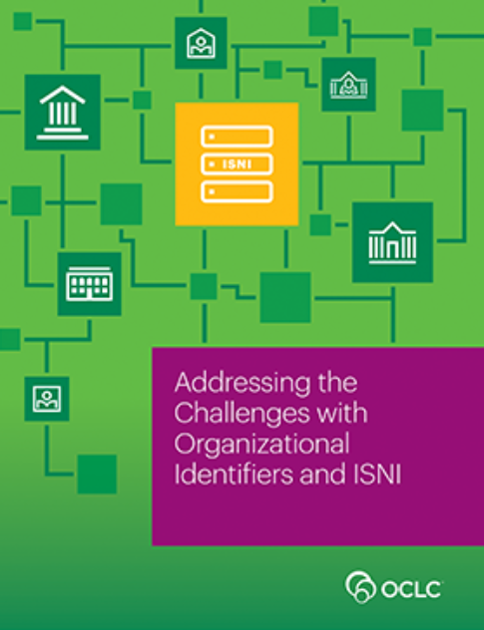
Spin-off working groups
(2014)
(2016 )
Notes:
These discussions also led to working groups who published the results of their investigations. These are two examples.

Slide 5
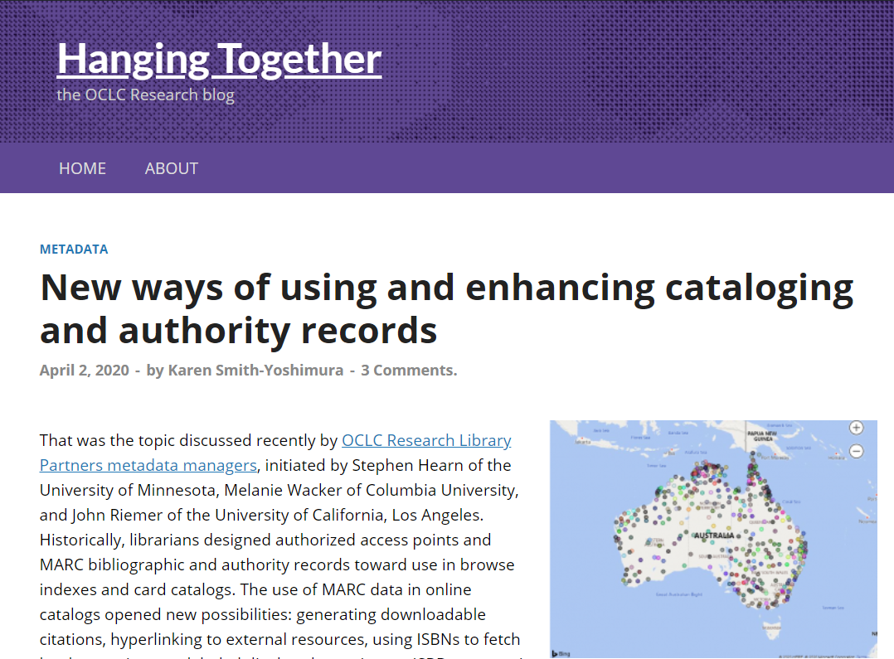
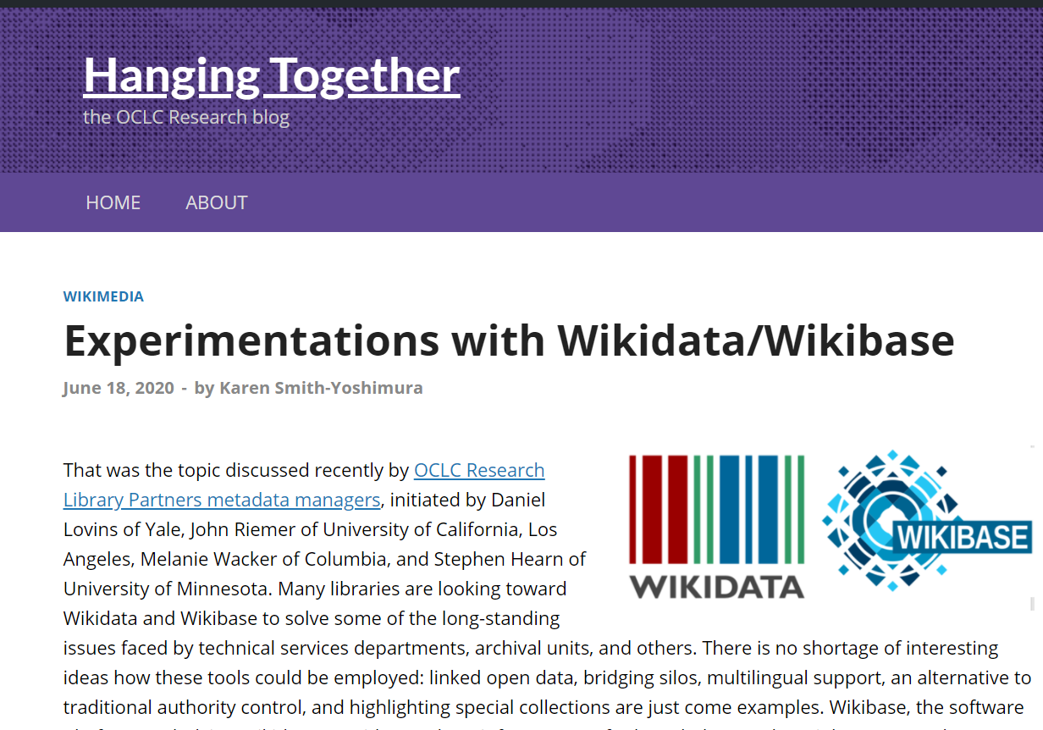
36 HangingTogether Blog Posts summarizing discussions
Notes:
All the discussions and Focus Group responses were summarized on our HangingTogether blog, 36 of them in this six-year period.

Slide 6
The Transition to Linked Data and Identifiers
Describing “Inside-Out” and “Facilitated” Collections
Evolution of “Metadata as a Service”
Preparing for Future Staffing Requirements
Impact
(48 pp, 148 citations)
Notes:
And I did a “meta-synthesis” of all of them and categorized them into these five sections in the report. The report includes 148 citations, not just to the HangingTogether blog posts, but to other OCLC Research reports and references the Focus Group members included in their responses to question sets. Our discussant panel today features three of the Focus Group members who served on the Planning Group and initiated some of the topics covered by the report.

Slide 7
Discussant panel
Stephen Hearn
Metadata Strategist, University of Minnesota
Suzanne Pilsk
Head, Metadata Department, Smithsonian Libraries
Roxanne Missingham
University Librarian, Australian National University

Slide 8
Transition to Linked Data & Identifiers
“Persistent identifiers were viewed as crucial to transitioning from current metadata to future applications.”
Notes:
Many Focus Group discussions focused on the changes taking place in the transition to linked data and identifiers.

Slide 9
“Identity management poses a change in focus…to describing entities …and the relationships among them.”
Notes:
One of the shifts underway is from authority control to identity management, and the value of “identifier hubs” such as Wikidata to aggregate identifiers pointing to the same entity and also offering labels in different languages and writing systems.

Slide 10
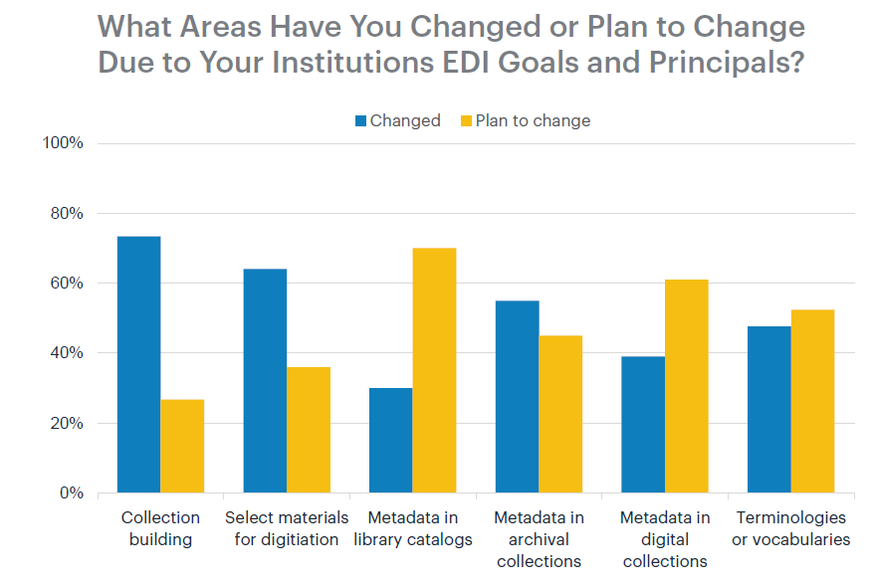
“Addressing language issues is important as libraries seek to develop relationships and build trust with marginalized communities.”
Notes:
When OCLC Research did a 2017 survey of the Research Library Partnership on Equity, Diversity, and Inclusion, metadata in library catalogs (third from left) lagged behind changes institutions had already changed in their workflows to comply with their EDI goals and principles. Ability to link to multiple vocabularies with different labels is a promising approach to address language issues.

Slide 11
The transition entails…
Expanding the use of persistent identifiers
Moving from “authority control” to “identity management”
Addressing the need for multiple vocabularies and equity, diversity, and inclusion
Addressing linked data challenges

Slide 12
Describing “Inside-Out” and “Facilitated” Collections
Archival collections
Archived websites
Audio and video collections
Image collections
Research data
“Metadata underlies all discovery regardless of format, now and in the future…”
Notes:
[Suzanne]: I want to share the part of the report that addresses the discussions around “Inside-Out” and “Facilitated” Collection
Over the years we have seen a clear addition to expectations of our metadata team members. Lorcan’s blog post labelled this shifting emphasis.
First lets acknowledge my defining our “traditional” work having been to describe the materials that we Brought (and bought) into our collections from outside sources – vendors and publishers, electronic resources and databases, etc. with the purpose of assisting our clientele in doing the work they do – teach, learn, and research.
But what “inside-out” refers to is the exposing of the outputs of our home institutions to be found and used – Pushing the scholarly outputs to the world.
This inside out necessitates the examination of the division of administrative responsibilities within library organizational structures and academic systems writ large.
This inside out has some uncomfortable tasks such as new looks at scholarly impact tracing, and on and on.
New services for libraries have been identified and some places have adopted them into the former traditional cataloging sections.
The shift of metadata services has been to support the creation, curation, and discoverability of institutional created resources. Over time these trends and experiments – which I truly believe continue to be learning opportunities – pointed to some major issues we all face such as data integrity and data synching, scalability, collection development, identifiers, linked data, open access - All the buzz words that are tied to true activities and challenges.

Slide 13
Notes:
Research data management. The OCLC RLP group has discussed - for quite some time - this growing need at our home institutions for librarian skillsets in advocating, leading or assisting in this growing area of responsibility. Our expertise in metadata standards, identifiers, linked data, data sharing systems as well as technical systems have proven to be invaluable to the research life cycle.
It has to be noted that the OCLC RLP group is A quite inclusive discussion group – the international make up in discussing research lifecycle management clearly highlighted national context. The differences in infrastructure, mandates, and funding requirements – incentives – can cause some jealousy in places where getting cooperation has been challenging.
This Inside-Out necessitates the collaboration with data producers and holders or owners of the materials, metadata specialists, and system developers - and, yes, each come from different perspectives. A challenge for sure. It is important to ensure that data creators feel their needs are met, THAT there is respect for the intention of the projects while also providing the access to a diverse audience that may have not been initially thought of during the creation of the data and metadata.
This exposing of information, this shift, has traditional library techservice librarians discussing more challenging areas and formats. Mentioned in the report were discussions on archival collections, archiving websites, audio and video collections, image collections, and, as previously mentioned, research data.
In our discussions, we shared our work with managing, creating and recreating metadata for resources in an extensive variety of systems—the library catalog, archive management, digital and preservation systems, the institutional repository, research management systems, discovery layers, etc.
The discussions of the group found ‘pain points’ in common.
We discovered what are colleagues were doing that our own institutions had yet to experience but the writing was on the wall.
Besides the newly created scholarly outputs of our Institutions, this concept of Inside-Out also covers what sometimes is referred to as “hidden” collections: Collections of materials that are unique to our home institutions. Exposing these collections – pushing our Inside Local collection to the Outside world beyond the previously known audience.

Slide 14
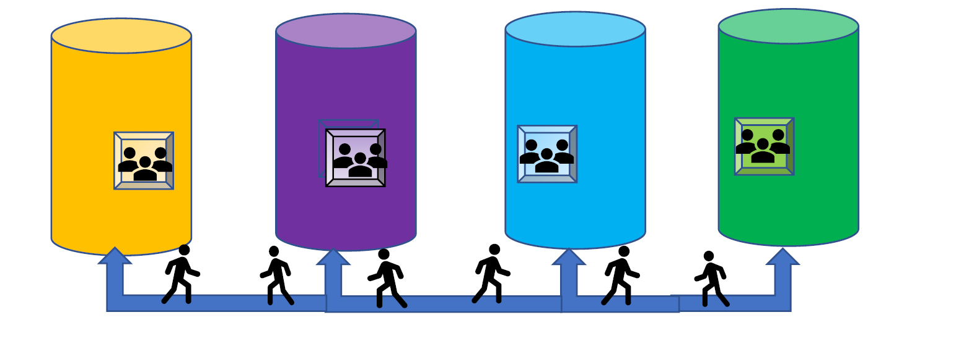
Challenge: Platforms & data owners
Research
Information
Library Catalog
Archives
Digital Collections
Notes:
One area discussed were our institutions’ unique archival holds. Archives have had more autonomy than libraries within institutions because they have unique collections - their own needs such as their own population of users, their own metadata standards, and their own systems. But the opportunity to do more Inside Out provides primary sources for new knowledge creation. Increasing the visibility for these collections reaps significant benefits for scholars previously unintentionally excluded and brings positive exposure to the home institutions.
The relatively recent SNAC project has brought many of these hidden, internal gems to be shared outside our institutional walls. Libraries can and do benefit from this exposed information. Like, the number of personal names in archival collections which can be so large, uncontrolled and without identifiers. However, the contextual information that archivists provide for persons and organization entities enrich the information provided in traditional authority files and vice versa of sharing / exposing library authority work to archival systems.

Slide 15
“Metadata underlies the ability to discover all resources in the inside-out and facilitated collections. Focus Group members anticipate more involvement with metadata creation beyond the traditional library catalog and new services that leverage both legacy and future metadata.”
Notes:
Metadata describing the same materials may differ across library, archival, and digital asset management systems.
Audio video collections and image collections have very unique issues including metadata granularity. Descriptions may, and often do, lack detail description, and administrative data required for storage, archiving, and viewing, etc. and there is the often lamented the unexpected duplication or redundancy and the inability to depict different items due to duplicate metadata. Depending on the nature of the collection and its users, questions arise concerning identification of works, depiction of entities, chronology, geography, provenance, genre, subjects – the “ofness” and the “about-ness”.
These inside collection also offer opportunities for crowdsourcing and interdisciplinary research.
Within our home institutions, these inside resources are stored on a vast array of systems and there are extreme challenges to getting access to these systems either to build a discovery layer or to produce internal federated search access. Recent discussion in the OCLC RLP group has brought up the need for the internal cross searching needs at our home academies to leverage our own internal expertise. Sharing amongst ourselves to improve our exposure to the Outside.
OCLC continues to work on ways to assist in the exposing and improving understanding of our hidden collections. Check out the work done on IIIF (interoperability image framework), linked data projects, wiki, and the research data investigations.
The increased reliance on electronic and digital resources during the COVID-19 pandemic will likely accelerate institutions digitizing their archival and distinctive collections that have been available only in physical form. The increasing pressure for openness in publishing and research data will expose the need for data integrity and compatibility leading to adoption of global unique identifiers across disciplines and formats. Libraries are finding that the skills they have are adaptable to the needs of these evolving responsibilities: expose those insides for outsiders to discover.

Slide 16
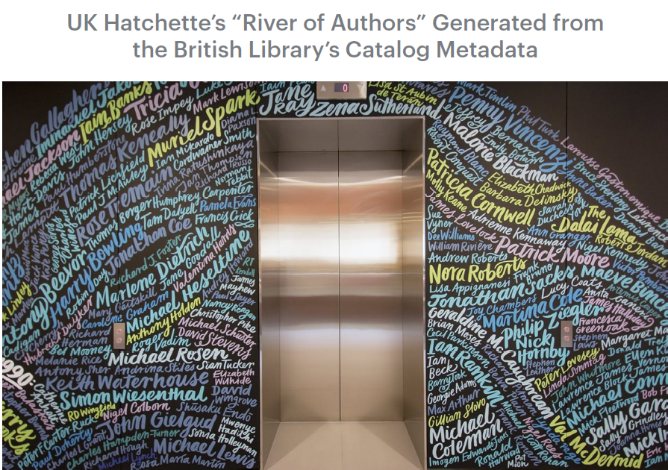
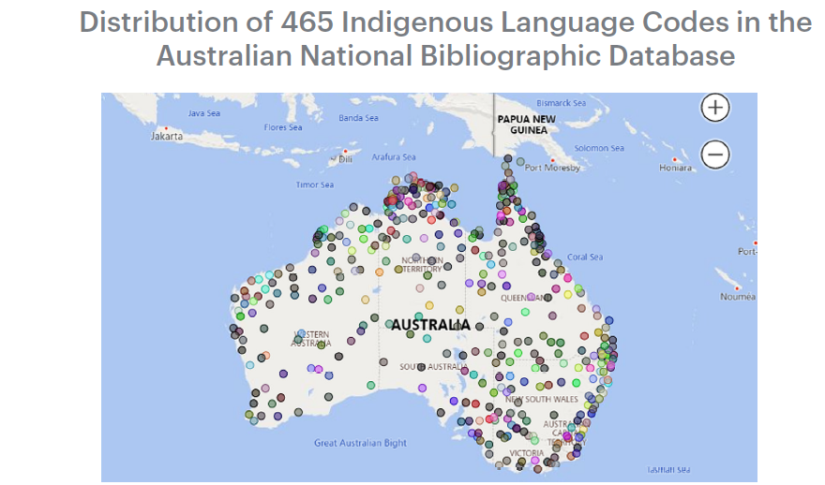
Evolution of “Metadata as a Service”
New applications
Bibliometrics
Plus:
Metrics
Consultancy
Semantic indexing
Notes:
We also covered uses of metadata beyond describing materials, “Metadata as a Service”. This included new applications, such as visualizing the distribution for different Australian aboriginal languages represented in the Australian National Bibliographic Database drawn from the language codes assigned (on the left) and bibliometrics supplied by the British Library to the UK Hatchette’s publisher group on their top authors represented in the BL’s catalog used to decorate their headquarters (on the right).

Slide 17
Preparing for Future Staffing Requirements
Notes:
The implications of the transition on staffing generated lots of discussion on the culture shift necessary, plus learning opportunities, the new tools and skills needed, self-education, and addressing staff turnover.

Slide 18
Impact
Notes:
The report concludes with the work underway at OCLC on the Shared Entity Management Infrastructure and the Focus Group’s expectation that it will address many of the challenges documented in the report around persistent identifiers, especially providing language-neutral links to trustworthy sources. A key take-away: Good linked data require good metadata!

Slide 19
Transitioning to the Next Generation of Metadata, RLP Works in Progress webinar * 5 November 2020​
Thank you!
Contacts: Karen Smith-Yoshimura
smithyok@oclc.org (until 30 November 2020)
Stephen Hearn: s-hear@umn.edu
Suzanne Pilsk: PilskS@si.edu
Roxanne Missingham: Roxanne.Missingham@anu.edu.au

