Slide 1
24 November 2020
REALM project
Supporting the reopening of archives, libraries, and museums
CERL Consortium of European Research Libraries
OCLC RLP Research Library Partnership

Slide 2
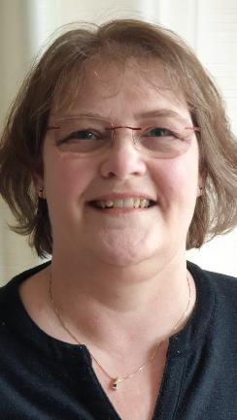
CERL
Consortium of European Research Libraries
Marian Lefferts, Executive Manager
2

Slide 3
CERL Services
Heritage of the Printed Book database 1997-
CERL Thesaurus 2000-
CERL Portal for Manuscripts and Early Printed Books 2005-2020
Can-you-help? database 2006-2016
Material Evidence in Incunabula (MEI) 2010-
Hosting 3rd party databases 2016-
CERL Provenance Digital Archive 2018-

Slide 4
CERL Network
HPB, CERL Thesaurus, Manuscripts and Incunabula Working Groups
Engagement and Promotion Working Group
Provenance Working Group
Digital Humanities Working Group
Book Binding Working Group
Security Network Working Group
About to be launched: Cultural Property Working Group

Slide 5
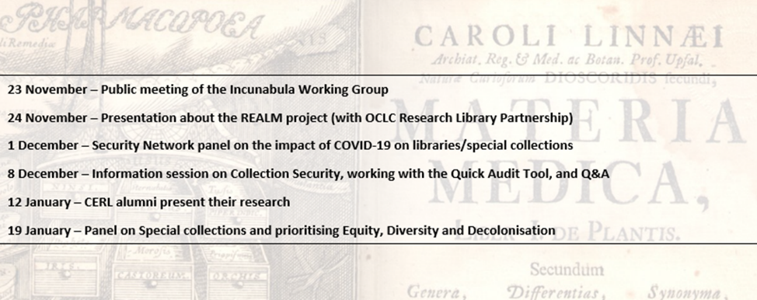
CERL (and members’) News
Website: www.cerl.org
Blog posts: cerlblog.wordpress.com
Mailing list: cerl_information@lists.gbv.de
Twitter: CERL_org

Slide 6
Thank you
marian.lefferts@cerl.org ( @MRL57)

Slide 7
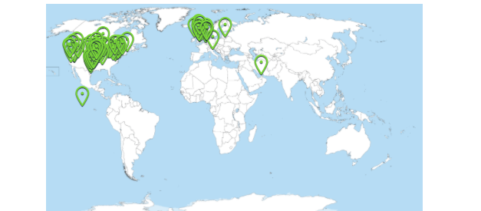
Poll #1 results: Where are you joining from today?

Slide 8

Chela Scott Weber
Sr. Program Officer,
OCLC Research Library Partnership

Slide 9
OCLC Research Library Partnership
Transnational network of research libraries (130+)
Supported by partnership dues and co-investment from OCLC
The RLP supports libraries as they evolve to meet 21st century challenges, providing the connections, knowledge, and resources to plan with confidence in a complex, rapidly changing ecosystem
Sharing Tacit Knowledge / Creating Common Practice

Slide 10
OCLC RLP Activities
Learning Together
Research support
Unique and distinctive collections
Resource sharing / Collective collections
Next generation metadata
Notes:
Research support activities: Research Data Management and Research Information Management have emerged as areas of focus where RLP institutions can learn and evolve best practices with one another.
Unique and distinctive collection: Our Research and Learning Agenda outlines additional challenges for the profession. As an example of the new work we are leading, we have a working group on Collection Building and Operational Impacts.
Resource sharing: SHARES, the resource sharing arm of the RLP, is a generous resource sharing program, which provides access to libraries’ strong, rich, diverse, and unique collections. SHARES also supports active collaboration to innovate and support best practices for resource sharing.
Making metadata work harder and smarter: OCLC and institutions in the RLP lead by developing innovative approaches to linked data and collaborating around other topics related to metadata management.

Slide 11
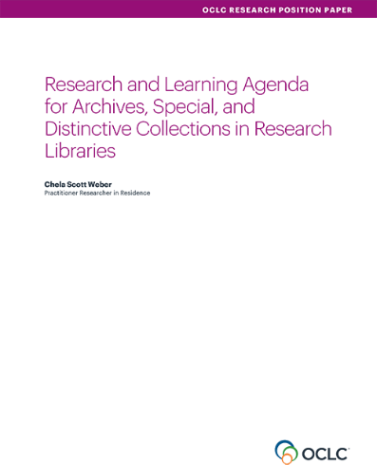
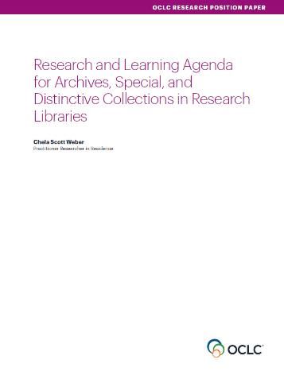
Our Work in Archives, Special, and
Distinctive Collections:
oc.lc/rlp-agenda
Notes:
OCLC Research has a long history of work in the area of archives, special, and distinctive collections in research libraries. We work in special collections because they are an important sight of knowledge creation, made possible by library’s commitment to the stewardship of their distinctive collections. The unique nature of material in special collections can make scaling a challenge, and we work to identify areas of common need and patterns of innovation to help libraries scale learning and expertise with these collections.
The Research & Learning Agenda for Archives, Special, and Distinctive Collections.
articulates the shared challenges and opportunities research libraries are facing in this sphere and suggests approaches for working on them together.
The agenda will guide OCLC Research work in this area in the future, and we hope it will also serve to frame larger conversations and spur action across the field

Slide 12
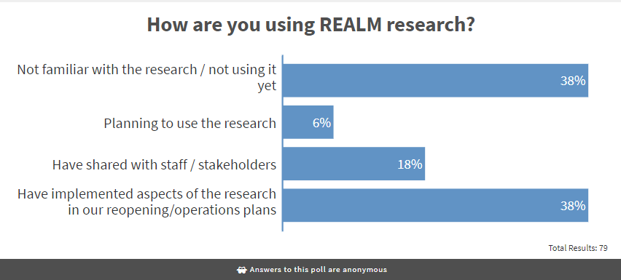
Poll #2 results

Slide 13
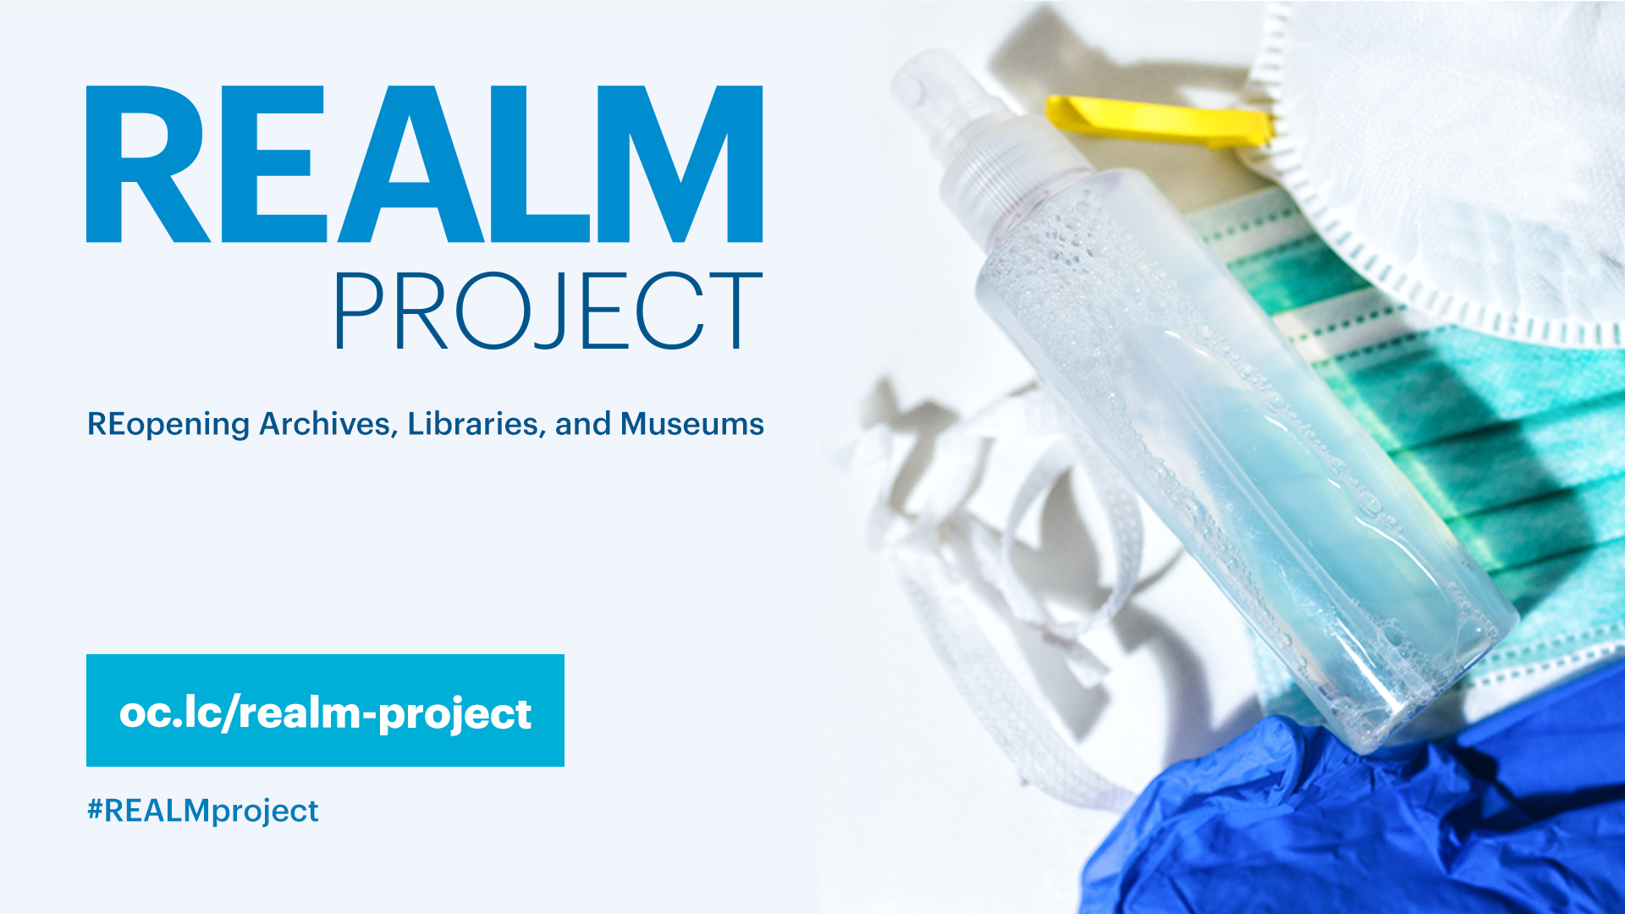
Notes:
REopening Archives, Libraries, and Museums (REALM) is a research partnership between OCLC, the Institute of Museum and Library Services, and Battelle. Its aim is to conduct research on how long the COVID-19 virus survives on materials that are prevalent in libraries and museums, and how materials can be handled to mitigate exposure to staff and visitors.
Visit this website for more information on the project including the research timeline. Project updates and resources will be added to this site as they become available.
https://oc.lc/realm-project

Slide 14
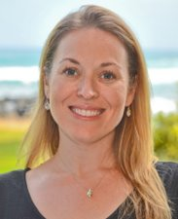
Kendra Morgan
Senior Program Manager ​
OCLC

Slide 15
IMLS
Battelle
OCLC
Project funder
Convenes steering committee and working groups
Conduct literature review
Conduct research on materials
Lead and manage execution of project deliverables
Publish and distribute research and information to the archives, libraries and museums communities
Consult on project goals and activities
Collect, synthesize stakeholder input to inform decisions
Notes:
This is a project that is a partnership of three organizations.
The Institute of Museum and Library Services is the primary source of federal support for US libraries and museums. Its mission is to advance, support, and empower America's museums, libraries, and related organizations through grantmaking, research, and policy development.
IMLS is the project funder and catalyzed this research partnership. Their ongoing role is to consult on project goals and activities. They also convene the steering committee and working groups that are advising the project.
The second organization is Battelle. It is a scientific research Institute that is headquartered in Columbus, Ohio. They have done extensive research in public health, consumer, industrial, and national security sectors. They have an extensive history doing research on emerging and infectious diseases.
OCLC was brought into the project to lead and manage the execution of the deliverables. So we are coordinating Battelle's scientific research; and we collect and synthesize the input from those two working groups, the steering committee, as well as other subject matter experts in the collective fields. We have established a cross sector communication network that has dozens of associations and organizations that support libraries, archives and museums that get information from the project and can pass it on to their constituents, and likewise bring information back to us. The final task is to distribute the research and information coming out of the project to a constituent communities.

Slide 16
Project activities
Review and summarize relevant authoritative research
Ongoing engagement with representatives and subject matter experts from archives, libraries, and museums
Laboratory testing of materials
Synthesize the above inputs into toolkit resources
Share project information and toolkit resources
Currently in Phase 3 – project began in May
Notes:
We have key activities for this project – and I’ll speak to each as we go through this session. One is to conduct literature reviews of published science to see what is emerging about COVID-19 that can be applicable to libraries, archives, and museums. We also continually engage with subject matter experts and representatives from the field. This informs the project planning processes and the laboratory testing of materials – which is really a key deliverable for this project, and one that was of high interest to the library, archives and museum communities here in the United States.
We are taking all of these inputs and synthesizing them into what we call toolkit resources. These are resources that apply the science to the real-world practices and operations of libraries and museums, and like the project research, these are published as they are available and we learn more about the needs of the project’s constituents.

Slide 17
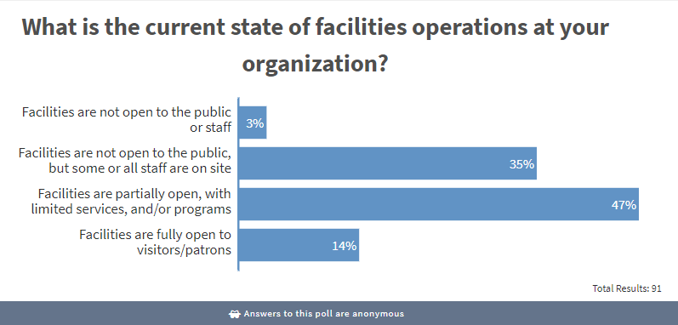
Poll #3 results

Slide 18
REALM project research
REALM data
Your institution
Local policies
... is providing data that helps us better understand the virus. You can use that data to inform your practices and policies.
The project is NOT making recommendations. Every institution is different and will need to develop policies that work for them and their community.
Notes:
The scope of the REALM project is to provide information to better understand the SARS-CoV-2 virus with the goal of informing local decision making in the development of operational practices and policies.
We understand the enormous strain that the staff of your organizations are under, and the REALM project is listening, learning, and adapting along the way. We recognize that it is a universal human trait to want to know what is best and how to mitigate the spread of COVID-19. And for many our institutions, this applies to how we work with staff, the public and our physical buildings and collections.
It’s important to note that REALM is not making recommendations. With significant variability among libraries and museums across the globe, each institution will need to develop policies that work along with their local, community needs.

Slide 19
STATUS of COVID-19 RESEARCH

Slide 20
Literature research questions
How might the virus spread through general operations?
How long does the virus survive on material surfaces through environmental attenuation? (Virus dying naturally, without intervention.)
How effective are various prevention and decontamination measures available in the near term? (Cleaning agents, PPE, shields, etc.)
?
?
?

Slide 21
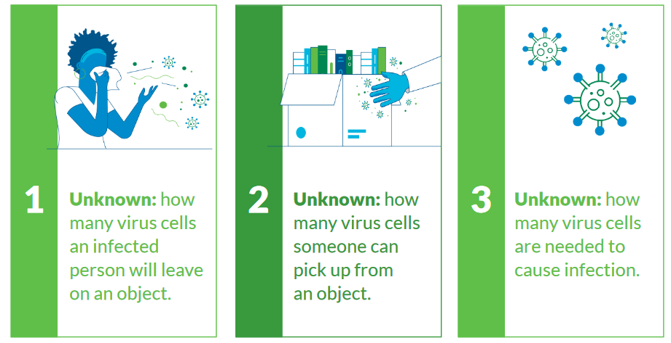
Known unknowns
Notes:
There are several things we still don’t know about SARS-CoV-2, and this is important to acknowledge when having this conversation.
The first is that we don't know how many virus cells an infected person leaves behind on an object, through sneezing, coughing. There has been lots of research, but there is no definitive answer. The next unknown is how many virus cells you can pick up from an object. So when you are touching something, what is likely to be transferred? And then finally, The human infectious dose for COVID-19 is still unknown. We don't know what it takes to get someone infected and to become sick. Studies of other viruses (e.g. SARS-CoV, MERS, influenza) have shown a wide range and scientists are continuing to explore this issue.
This is relatively new pandemic. It is going take a lot of time and effort in order to be able to answer these questions. But, sharing these unknowns with your stakeholders, including staff, can be helpful in understanding why policies and procedures may need to change. We are continuing to learn as a global community and will need to adapt as more information becomes available.

Slide 22
Key points in the findings
The human infectious dose is still unknown. Studies of other viruses (e.g. SARS-CoV, MERS, influenza) have shown a wide range.
Other areas that require more exploration are aerosol particle transmission and human matter (in solid and aerosol)
Environmental factors such as humidity, temperature, ventilation/air flow, and air conditioning may also affect the spread of SARS-CoV-2
Notes:
SARS-CoV-2 is generally understood to spread primarily through virus-containing water droplets expelled from infected persons (from sneezes, coughing, speaking, etc.).
Evidence has also suggested that other potential pathways for spreading the virus include
- breathing air that the virus is suspended in (i.e., after some sort of aerosolization event, such as a sneeze)
- touching surfaces of objects (sometimes called fomites) where the virus has been deposited (e.g., through exhaled virus-containing droplets).

Slide 23

How the virus spreads
Most likely
Direct contact between people
Droplets passed between people
Possibly
Aerosol particles
Contaminated objects (fomites)
Other body fluids, excretions
Photo by Blake Cheek on Unsplash
Notes:
SARS-CoV-2 is generally understood to spread primarily through virus-containing water droplets expelled from infected persons (from sneezes, coughing, speaking, etc.).
Evidence has also suggested that other potential pathways for spreading the virus include
- breathing air that the virus is suspended in (i.e., after some sort of aerosolization event, such as a sneeze)
- touching surfaces of objects (sometimes called fomites) where the virus has been deposited (e.g., through exhaled virus-containing droplets).

Slide 24
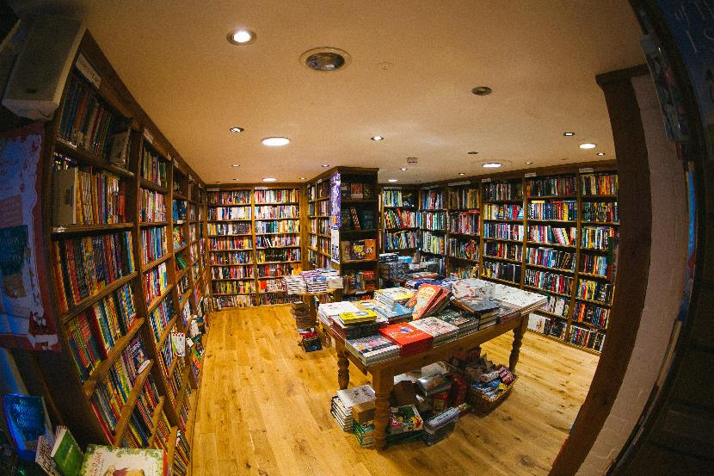
Environmental conditions are a factor
Temperature
Relative humidity
Air quality
Air flow
Photo by Phil Hearing on Unsplash
Notes:
Environmental factors such as humidity, temperature, and air quality have been identified as influential in the spread of the SARS-CoV-2, though additional research is needed to understand the complexities of these variables’ impact on people contracting the virus.
Some evidence has suggested that HVAC systems and other air circulation mechanisms can contribute to the spread of the virus through the air. However, until further research identifies the risk of people contracting COVID-19 through airborne virus, it is unclear what level of risk these systems contribute.

Slide 25
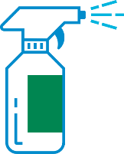
Prevention and decontamination tactics
Social distancing
Hand washing and toilet hygiene
Masks/PPE
Fresh air and open spaces
Surface cleaners and disinfectants*
UVA/UVC treatment*
NEDCC
Notes:
Tactics showing efficacy included handwashing/hand sanitizing, wearing personal protective equipment (PPE) including masks, air ventilation and open spaces, applications of ultraviolet (UV) light and/or increased heat, applying disinfectants to clean surfaces, and social distancing to prevent distribution of respiratory droplets from one person to another
There are important considerations about the type of agent and treatment, so as not to harm the materials and collections or the people using them. I recommend that you follow the NEDCC –Northeast Document Conservation Center -- for their excellent guidance on how to care for collection items so as not to damage the materials or the staff handling them.
If you’d like to learn more, WebJunction hosted a webinar last month that featured NEDCC director of book conservation, Bexx Caswell-Olson, discussing this. Links to the NEDCC resources and the webinar recording are included at the end of the presentation.
https://www.nedcc.org/free-resources/preservation-leaflets/3.-emergency-management/3.5-disinfecting-books
https://www.webjunction.org/events/webjunction/realm-collections-facilities.html

Slide 26
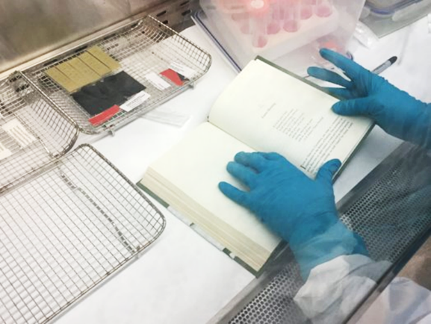
LAB TESTING
How long does the virus remain active on materials commonly found in libraries, archives, and museums?
Active…viable...infectious…“alive”
Notes:
Six tests have been conducted and their reports have been published, with the sixth released last week.
Those who have been following the project research may know that in very basic terms there are two types of tests: one is a test that detects presence of viral matter but does not distinguish between active and inactive particles. The other is focused on measuring infectious viral particles only. The Battelle research for the REALM project is using the latter method.
https://www.oclc.org/realm/research.html

Slide 27

Testing overview
Objectives
Determine the effect of ambient environmental conditions on the SARS-CoV-2 virus when applied to common materials found in libraries, archives, and museums
Provide data to consider for selecting potential quarantine durations before materials can return to public circulation
Experimental design
10 test rounds (6 completed), 5 material types per round
Droplets of live virus applied to material surface via ‘fake spit’
Materials stored in stacked or unstacked configurations
Measure quantity of viable virus at selected time points to capture the attenuation (drop) in total virus
Notes:
This research is iterative and cumulative, with findings from earlier tests informing successive testing. There continue to be refinements and shifts to our understanding over the course of the project.
Walk through of testing process
The lab cuts each material into rectangular coupons and applies drops of infectious virus with a known starting concentration of virus to the surface of the material via “fake spit”
The Battelle scientists put the test coupons, in stacked or unstacked configurations, into a chamber where the humidity and the temperature are constant.
At each preselected timepoint – of which there are four - they measure the quantity of viable virus on the coupons to document the attenuation (drop) in total virus.

Slide 28
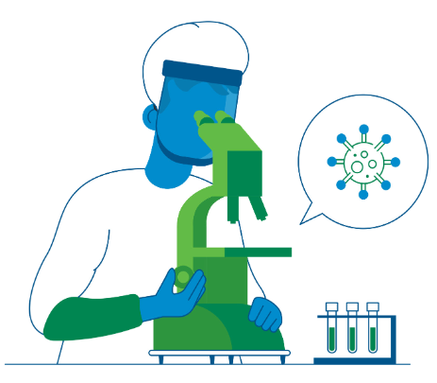
Testing: TCID50 cell-based assay
Starting virus amount
  Log scale (e.g., 5 Log = 100,000 virus particles)
Limit of quantitation (LOQ): Only presence/absence of virus per coupon
Limit of detection (LOD): Cannot find virus on any coupon
Notes:
https://www.webjunction.org/content/dam/WebJunction/Documents/webJunction/realm/test-plan.pdf
The experimental design includes 10 test rounds, 5 material types per round.
There are several key points that we look at. The first is the limit of quantitation. We start off with roughly 100,000 virus particles. So 100,000 pieces of virus are applied in each droplet that goes onto the materials. Once the virus count is below 26 (a drop from 100,000) it has dropped below what is called the limit of quantitation. Battelle cannot see anything using their testing system and they have to now look using a microscope. Below the limit of quantitation, the researchers do qualitative assessment, noting only the presence/absence of virus per coupon. When they look with their microscope, if they are not able to see any virus, then we have reached the limit of detection—when they cannot find virus on any of the coupons.

Slide 29
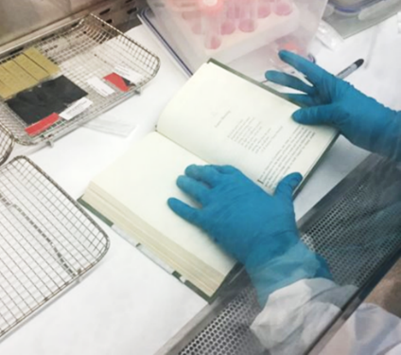
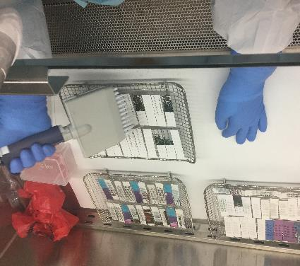
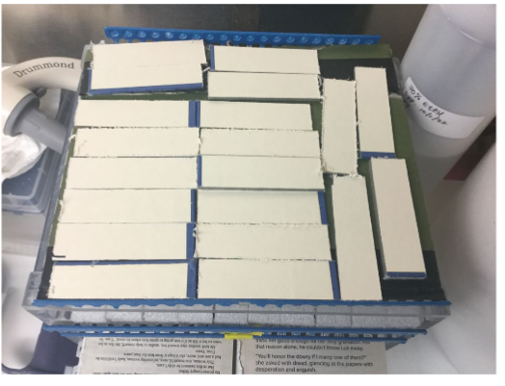
Photos courtesy of Battelle
Stacked books
Notes:
The plain paper coupons, after drying, were placed back into the book from which they were collected, and the entire book was placed into the environmentally controlled chamber for testing

Slide 30
Test 1 Unstacked library materials
LOQ
LOD

Slide 31
Test 4 Stacked library materials
Notes:
Samples from each item were inoculated, allowed to dry, and were then inverted and placed on top of a larger piece of the same material type (to create stacking effect).

Slide 32
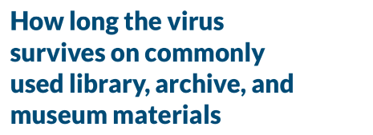
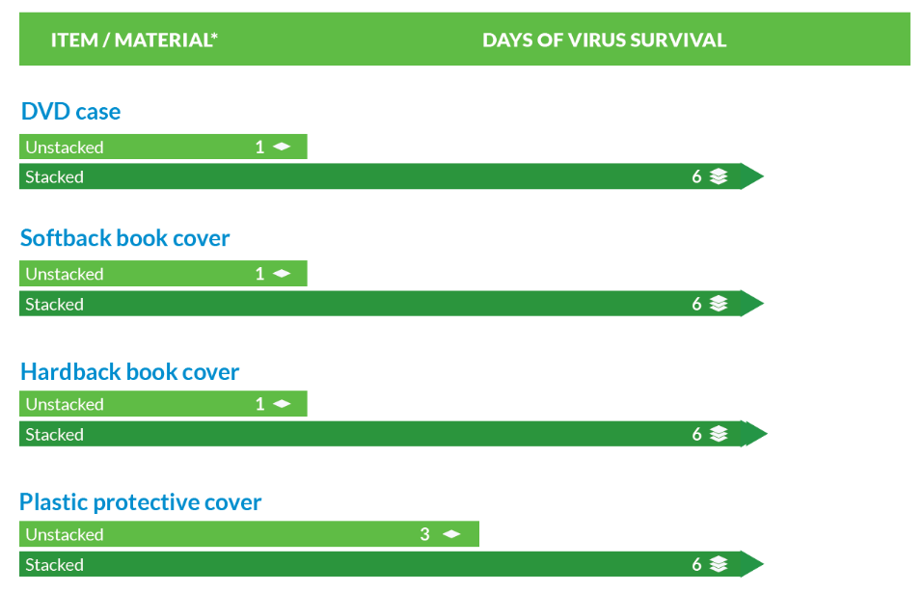
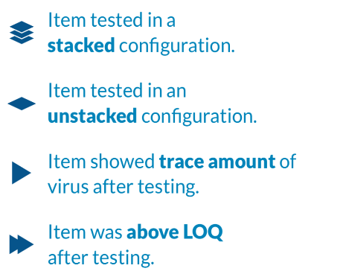

Slide 33
Test 5 test coupons

Slide 34
Test 5 materials
Notes:
Results show that after eight days of quarantine, SARS-CoV-2 virus was still detected on leather materials. For the leather book cover, the virus had dropped below the LOQ (1.42 log10, or 26.2 virus particles) by day 4, but the presence of virus was found on three of the five test coupons on day 8.

Slide 35
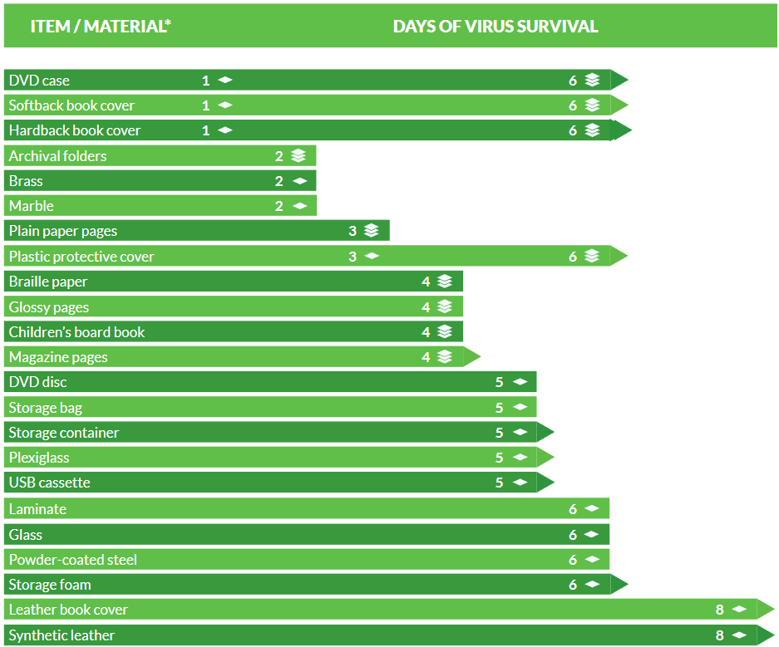
Notes:
This is a quick overview of items we have tested so far.
We have released the results of six tests. We are continuing to test items and plan future tests. But you can find information about all of these materials, including these charts, and the items that have been tested so far on the REALM website.

Slide 36
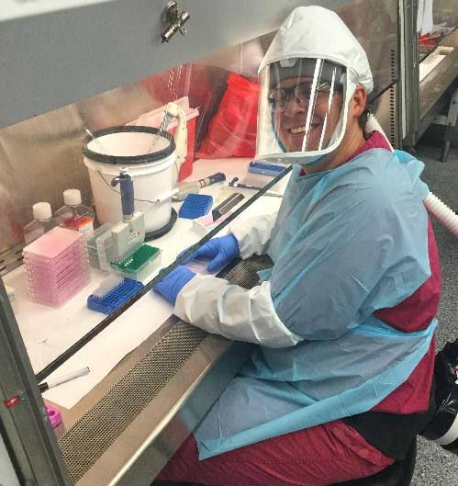
For more information
Visit project website oclc.org/realm:
Toolkit resources
Project research, test results
Frequently Asked Questions
Submit a question to the project team
Sign up for email updates

Slide 37
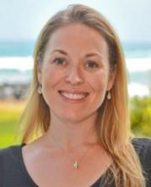
Kendra Morgan
Senior Program Manager ​
OCLC
Questions?

