Slide 1
Pandemic effects and collection reflections
Lorcan Dempsey
OCLC
@LorcanD
RLUK
Digital Shift Forum
28 October 2020

Slide 2
Divided into four parts
some
contrasts UK <> US
pandemic effects
collection directions accelerated
emerging collection imperatives

Slide 3
Similarities …. …. and differences
Stratification
Prestige, research funding
social equity?
specialization (e.g research support)
National context
Centralised (REF, Jisc, … )
Decentralised, consortia, …

Slide 4
Divided into four parts
contrasts UK <> US
pandemic effects
collection directions accelerated
emerging collection imperatives

Slide 5
Beyond the
current emergency
horizon ….

Slide 6
3 pandemic effects …
Online a holistic online library experience
On mission a sharp focus on alignment with evolving institutional priorities
Optimize an imperative to optimize against particular goals
Downward pressure on budget
Rolling strategy (see above)
Pluralization

Slide 7
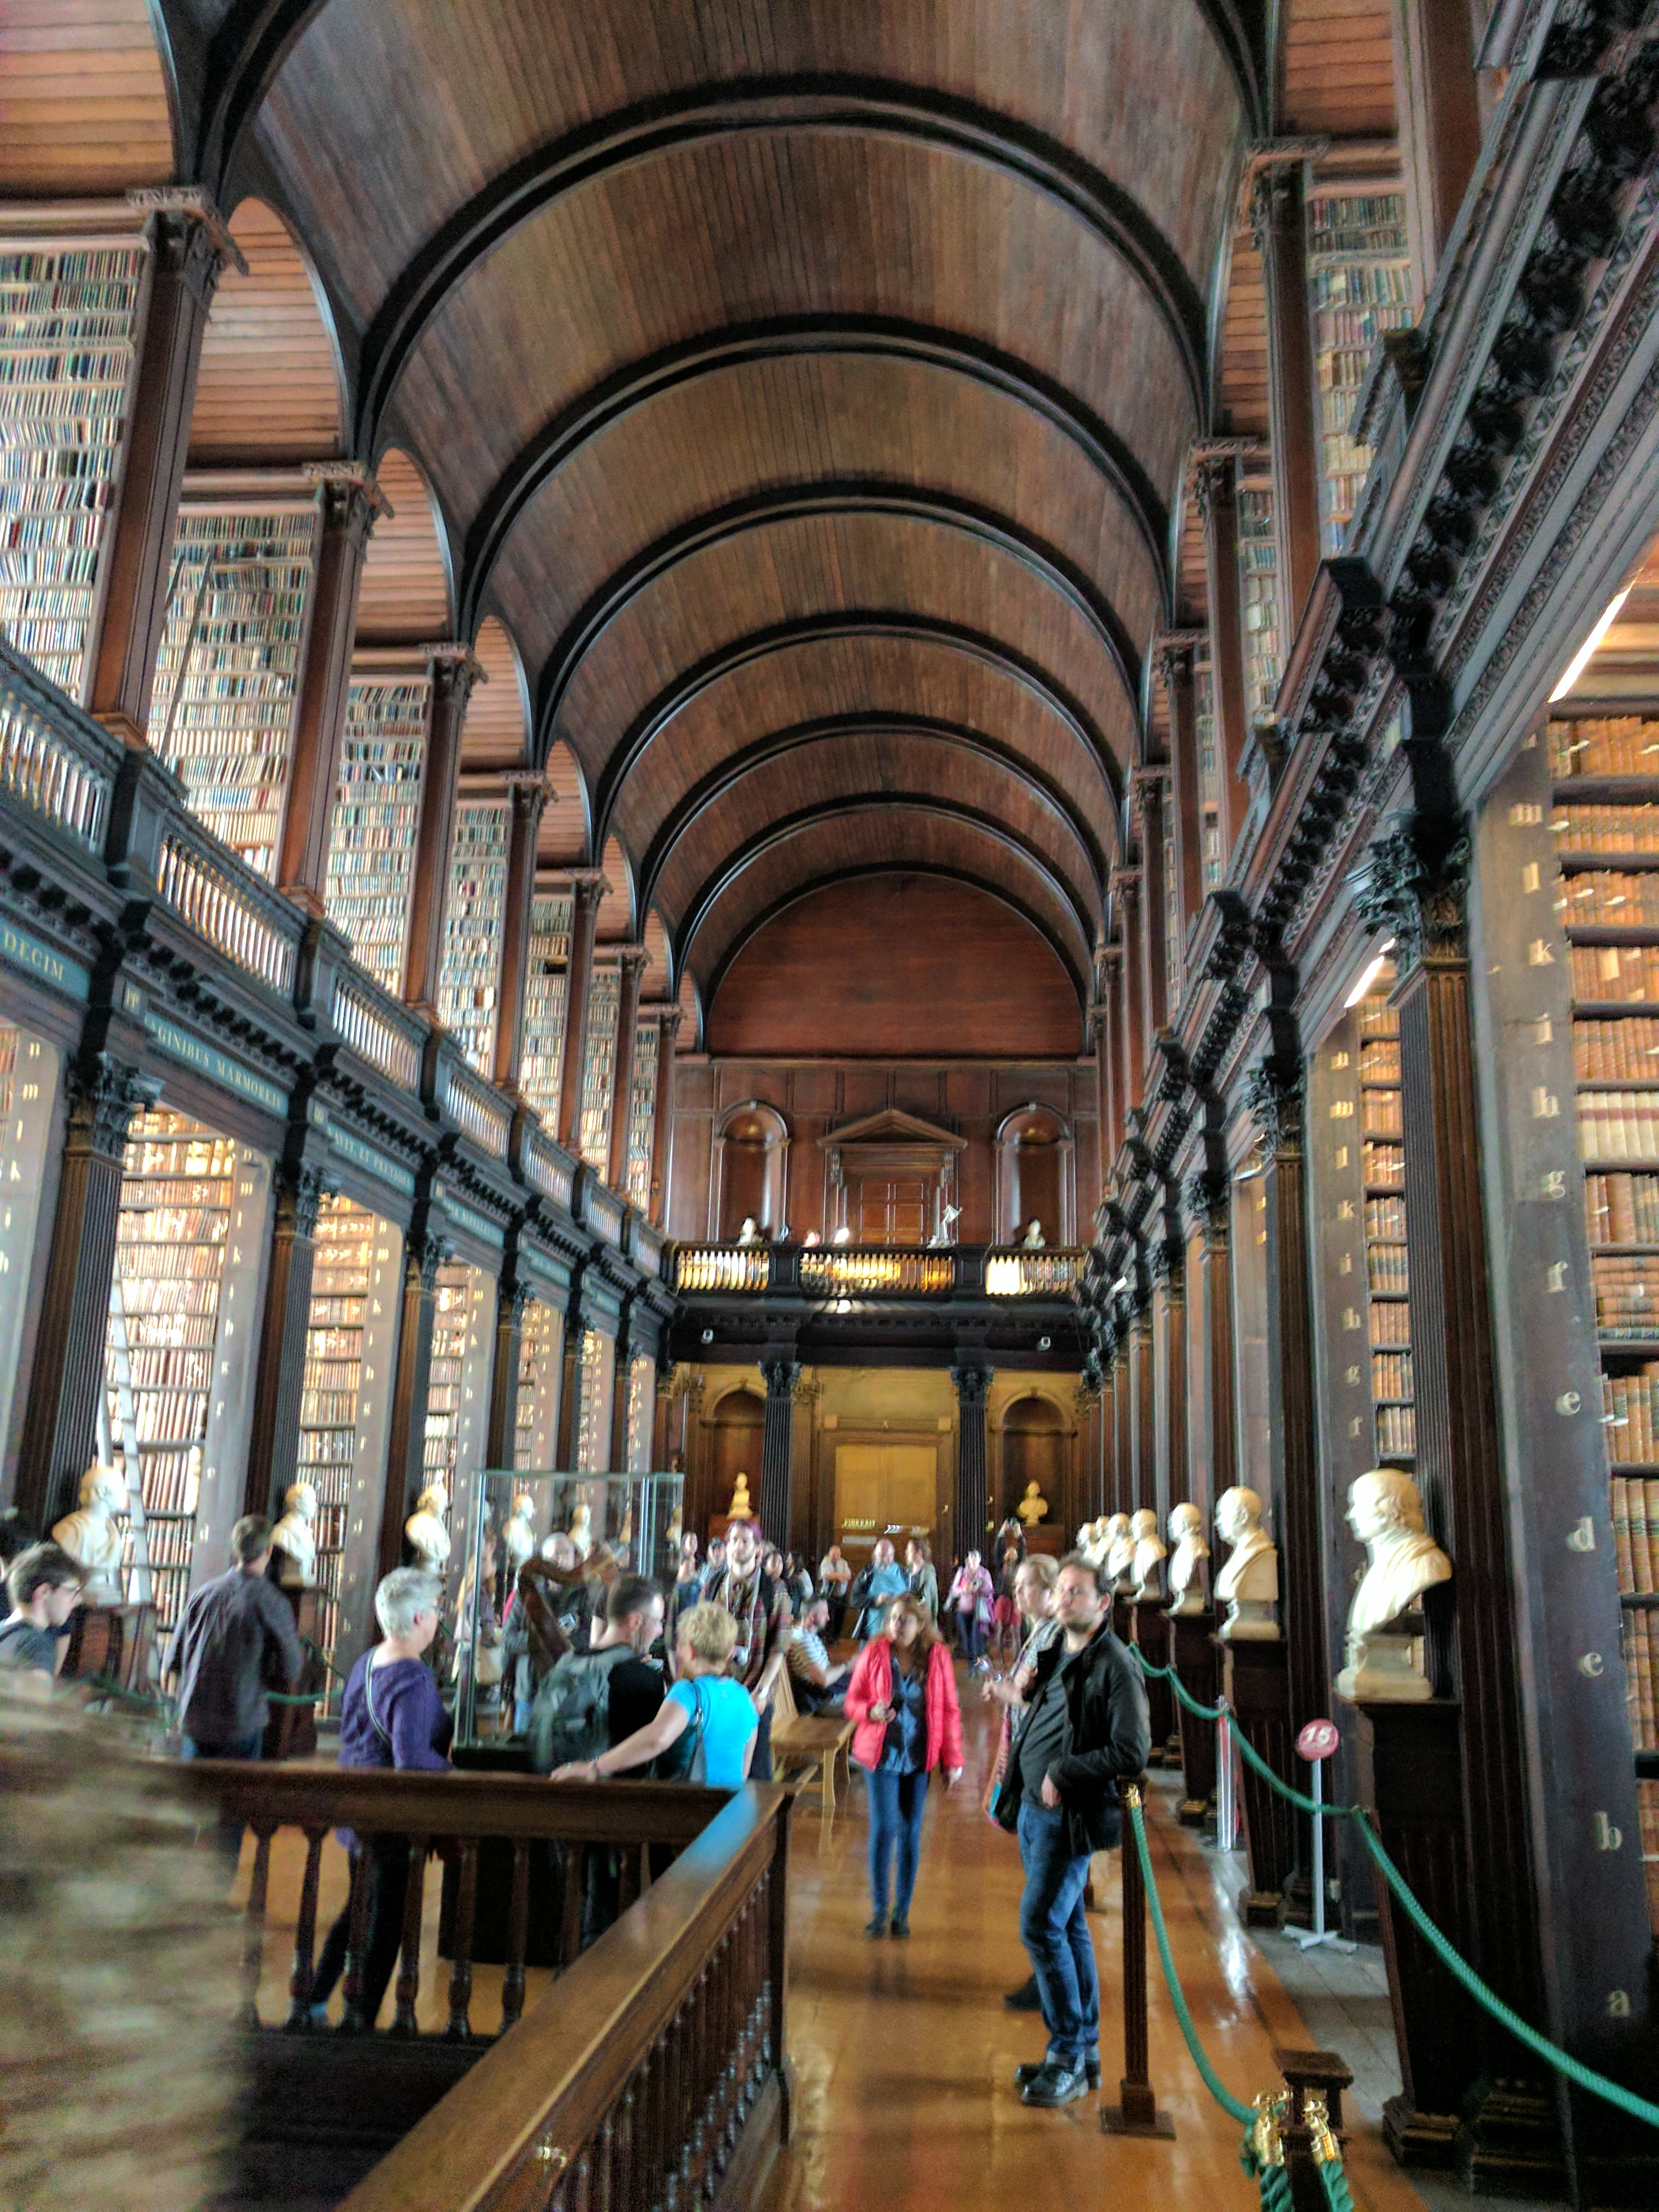
A holistic library experience? The new target?
Hybrid confusion:
Value, Identity, Workflow
Final recognition of library (as a service) separate from the library (as a building)?

Slide 8
Deliver full library experience online?
General
Academic
Public
Consultation and expertise?
Richer interaction and programming?
In the flow and social …
Deliver efficiently into the learning process (LMS/VLE)?
How to recreate the relational element - vital for developing good working relationships?
Integrate and present information services which go beyond the locally acquired collection (facilitated, collective)?
Personal connection (CRM, profile, …)?
Increased digital offering – ebooks, audio, streaming, learning, …

Slide 9
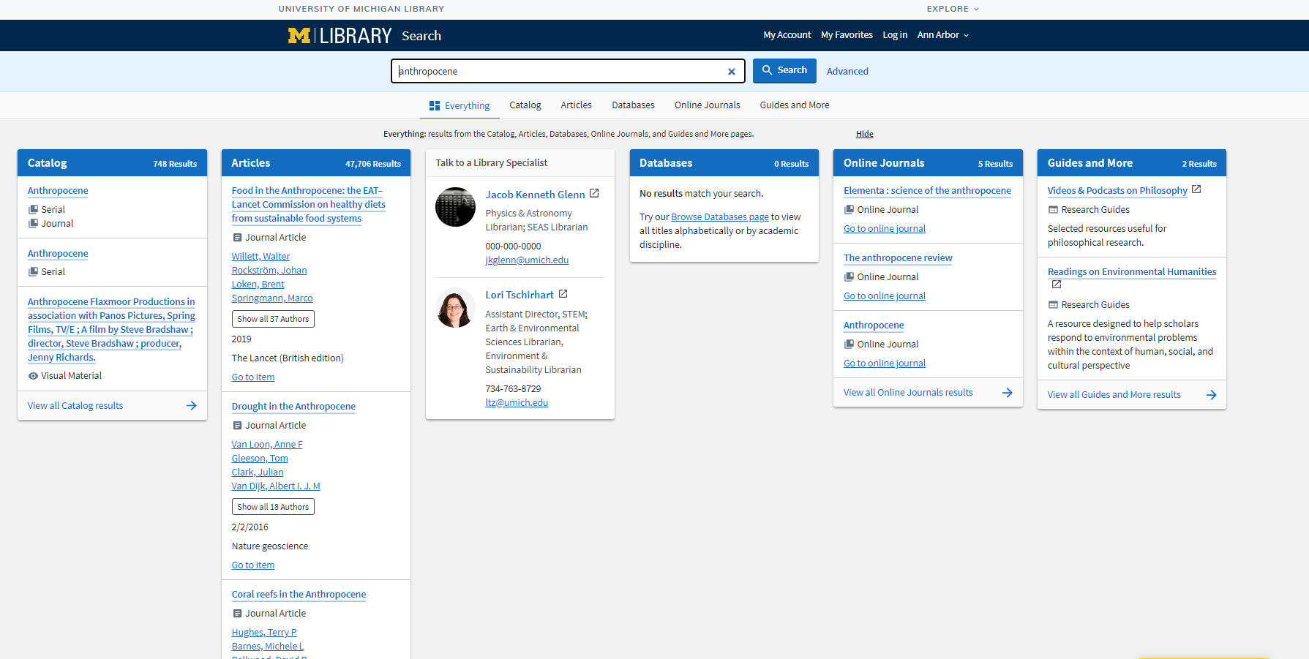
Full collection discovery >>>>> full library discovery

Slide 10
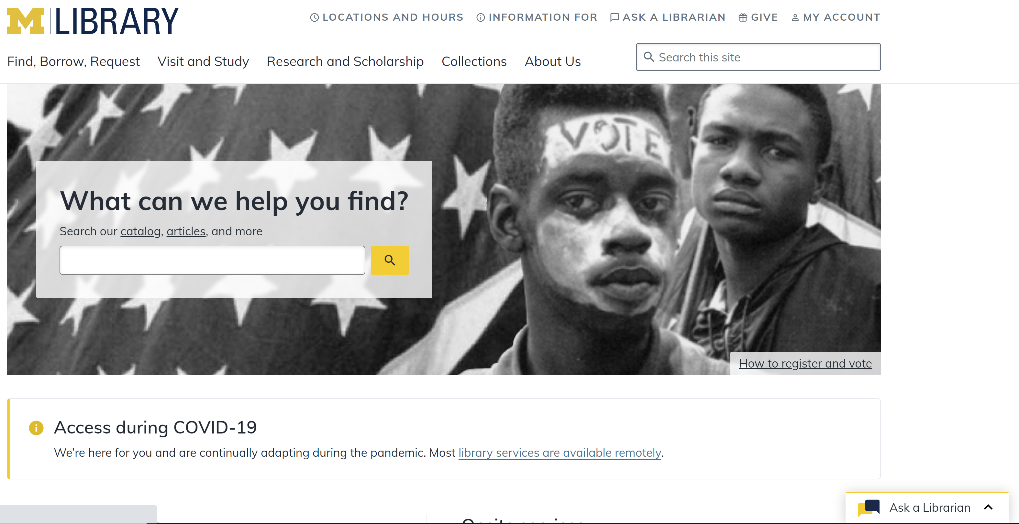
Hybrid library website >>>>> full library experience

Slide 11
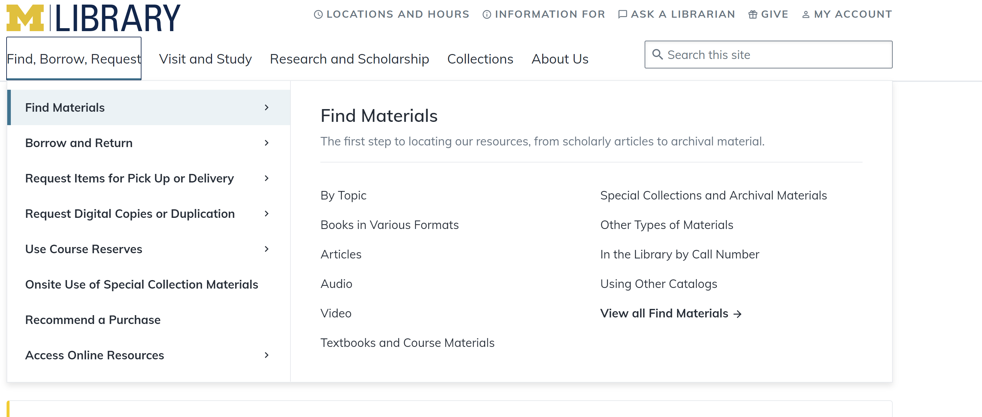
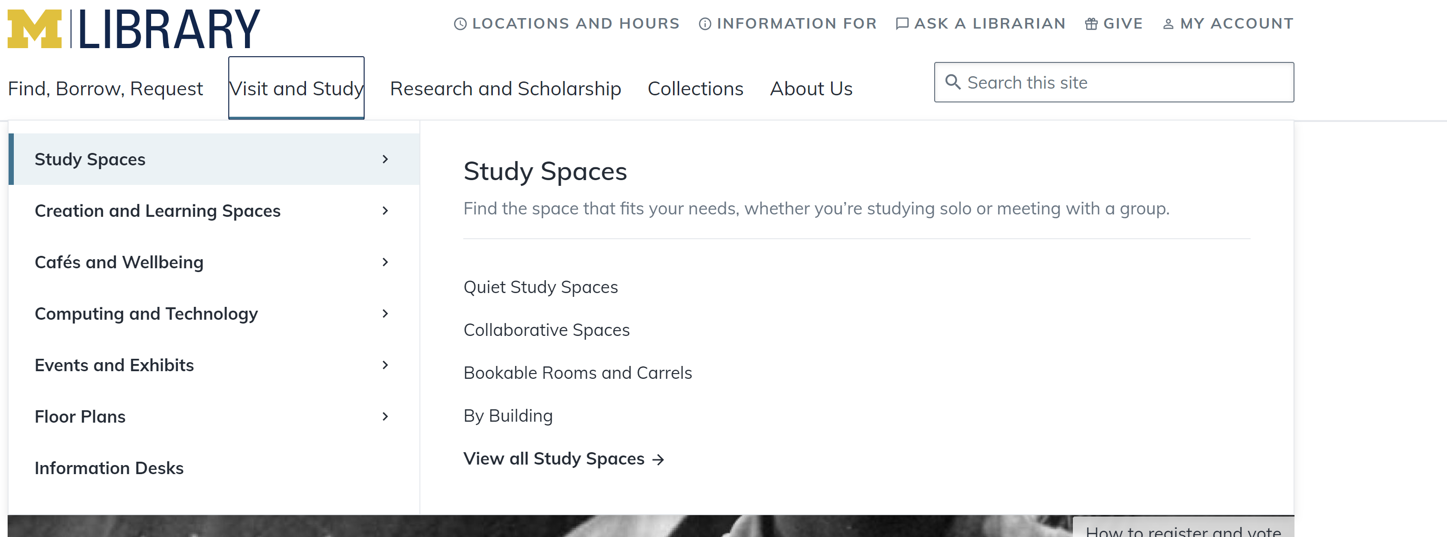

Slide 12
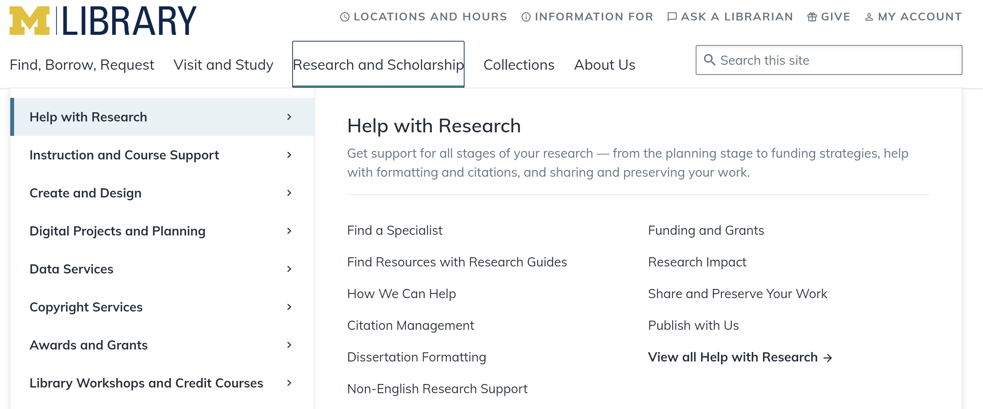
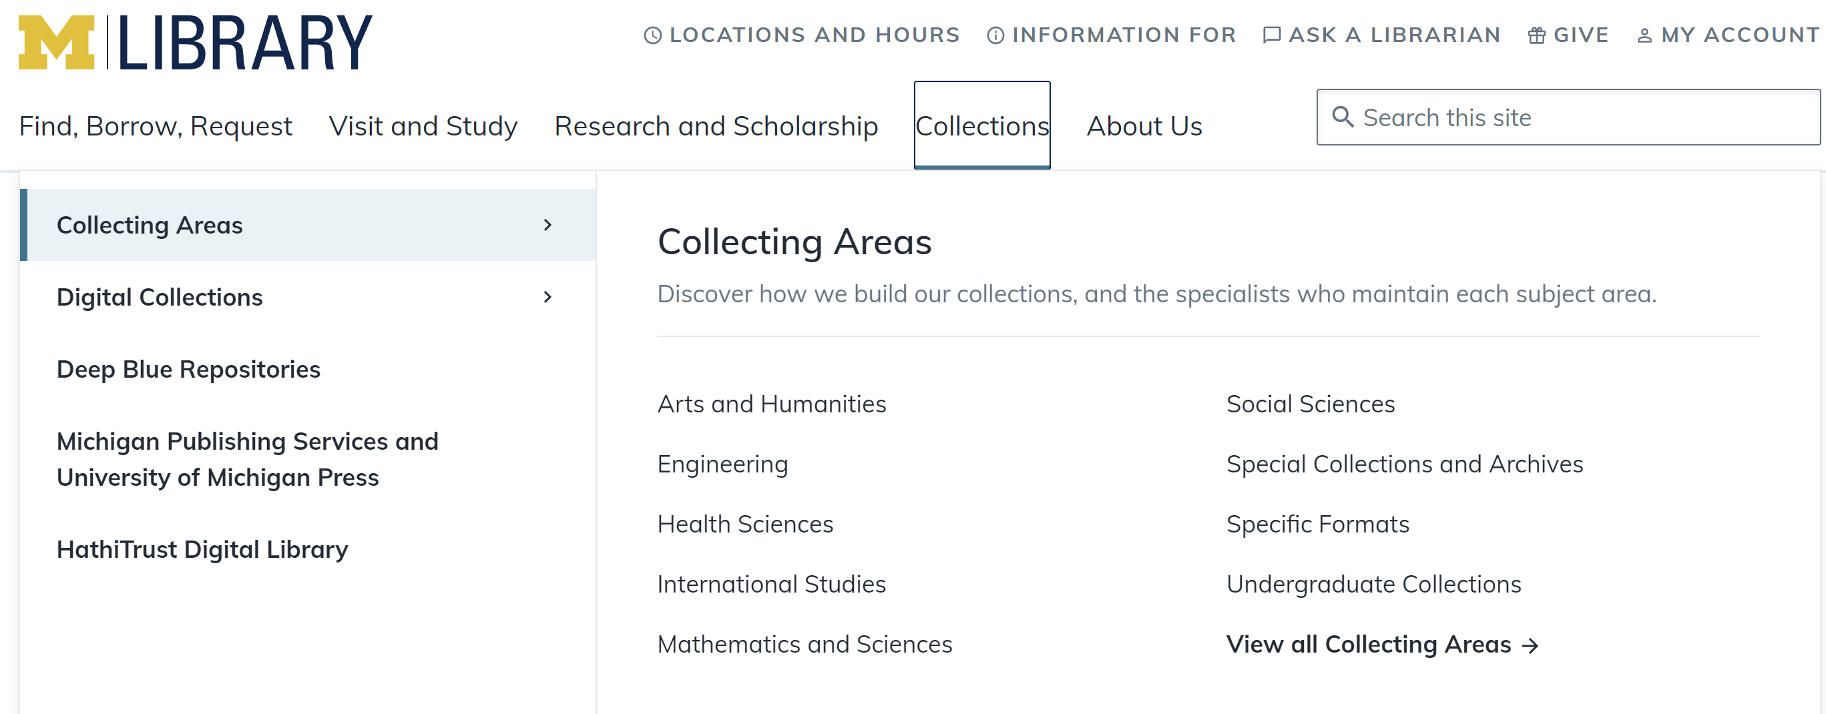

Slide 13
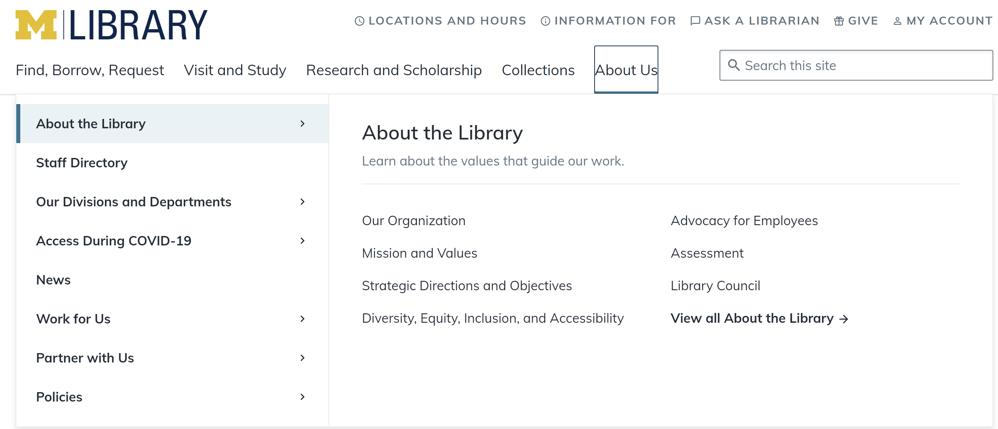

Slide 14
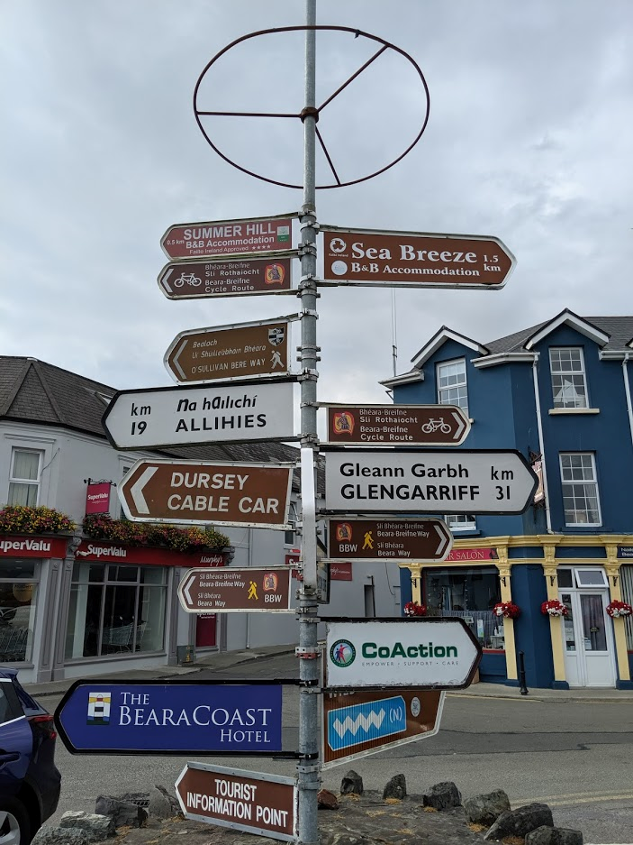
from hybrid …..
… to holistic
(Digital?)

Slide 15
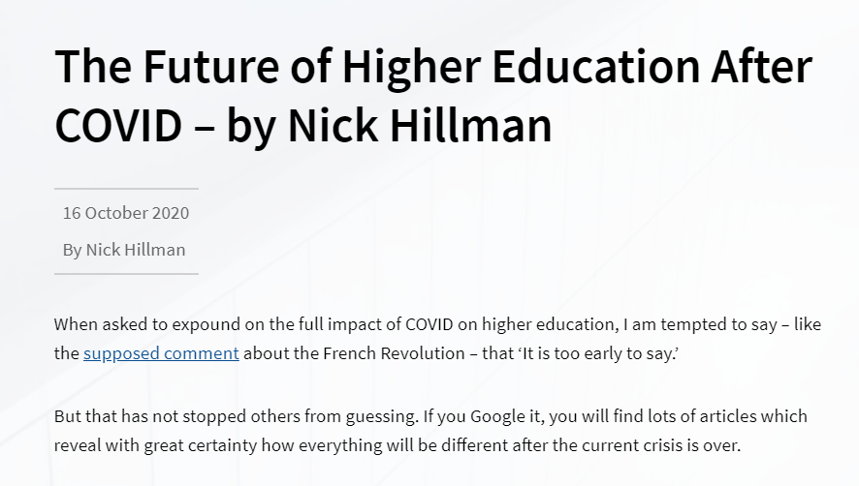
2. On mission

Slide 16
Engagement
Education
Supporting social and civic
engagement
Student success and retention
Presence in LMS
Critical research and media discrimination
Instructional design services
Collaboration spaces
Cultural services
Promotion of expertise and scholarship
Complete transition from the collection-based library.
Collections as service.
Supporting research, learning and engagement.
Research
Advancing research productivity
and dissemination
Research data management
Digital scholarship
Text and data analysis services
Reputation
Research infrastructure:
workflow is the new content.

Slide 17
3. Optimize … Strategic choices to meet particular goals
Example: Online learning
Increase visibility of library resources in LMS
Course reserves/reading lists
Resource guides
Interactive (LTI)
Embed library expertise in LMS
LibAnswers
Library instruction tailored to specific courses
Space as a service in LMS
Space – responsible management in pandemic
Calendar of events
The future of shared space?
Notes:
NB: because Mobius is a III-based consortium, they are not a market for Leganto
Screenshot sources:
https://libraryguides.missouri.edu/canvas/readinglist -- Mizzou has implemented EDS Curriculum Builder in Canvas
https://libguides.nwmissouri.edu/faculty/menu -- Northwest Missouri State has embedded library instruction modules within Canvas course pages
http://libcal.mst.edu/reserve/rooms -- although it doesn’t appear that Missouri Science & Technology University has integrated LibCal within their Canvas LMS, this integration is possible.

Slide 18
Strategic choices to meet particular goals
Example: Collections
Value (acquire what is needed, use what is acquired)
Open
Curricular support
Regional/local
Collaboration
Plural (respect/represent communities of interest)
Decision support
Tradeoffs

Slide 19
Divided into four parts
contrasts UK <> US
pandemic effects
collection directions accelerated
emerging collection imperatives

Slide 20
3 collection directions … accelerated
Collective collections
Facilitated
Inside out

Slide 21
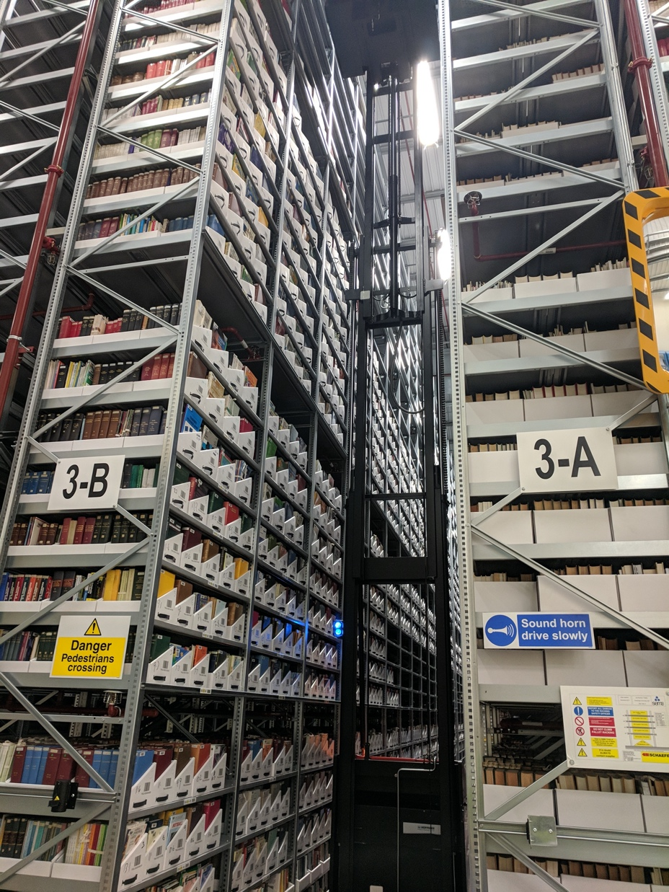
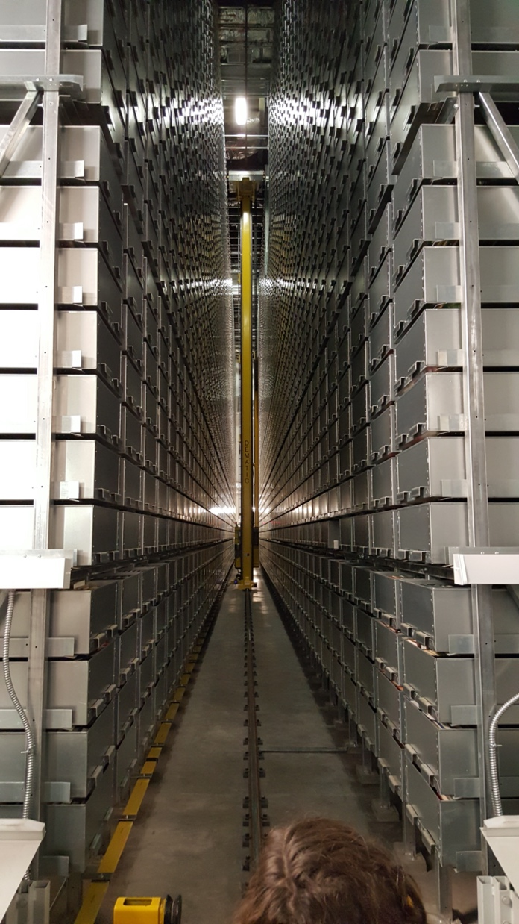
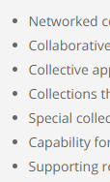
The rise of the collective collection
Increasingly organize collections at the network or systemwide level.

Slide 22
Consolidation
Degrees of coordination: tradeoff between autonomy and consolidation
Autonomy

Slide 23
Some collective collection questions
Pivotal moment in ScholCom .. licensing
Operationalize the monograph collective collection?
Some policy questions
Multiple paths to future
Academy outsourced reputation management to increasingly consolidated commercial pub. sector
Publishers diversifying – analytics/workflow.
Multiple competing viewpoints – e.g. rational top down design of system vs market forces
Institutional, national, international funding/policy agents at play
Pandemic push for open science
Shared print – optimal distribution?
Coordinate digitization plans?
Prospective collection coordination?
Group licenses to permit sharing of ebooks?
Stronger interest in EBA/DDA
Relationship between print stores, sharing, digitization, ebooks, acquisitions > decision support.
What responsibility do RLUK members collectively take for print scholarly record?
For the (published) digital scholarly record?
Reevaluating rights (controlled digital lending, course materials)
Scalar question – consolidation at what level (agency, budget, service, …)
Jisc and/or collective?

Slide 24
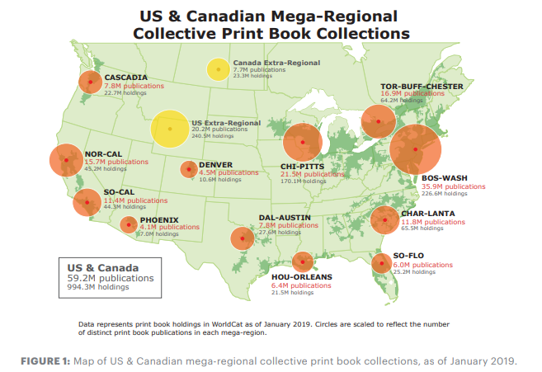
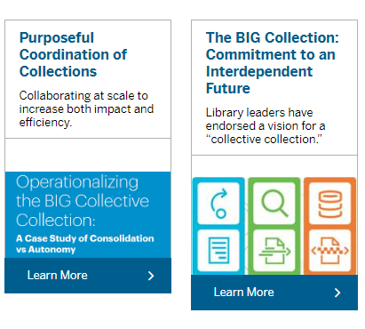

Slide 25
The facilitated
collection
Assemble a coordinated mix of local, external and collaborative services around user needs.
Move online accelerates need to provide targeted, relevant resources.

Slide 26
The ‘external’ collection:
Pointing researchers at Google Scholar;
Including freely available ebooks in the catalog;
Providing access to Open Access and Open Educational resources
Creating resource guides for web resources.
The ‘borrowed’ collection
The shared print collection
The shared digital collection
Shared scholarly outputs
Collective collections
A collections spectrum
The ‘owned’ collection
The ‘licensed’ collection
The ‘demand/data-driven’ collection
The ‘facilitated’ collection

Slide 27
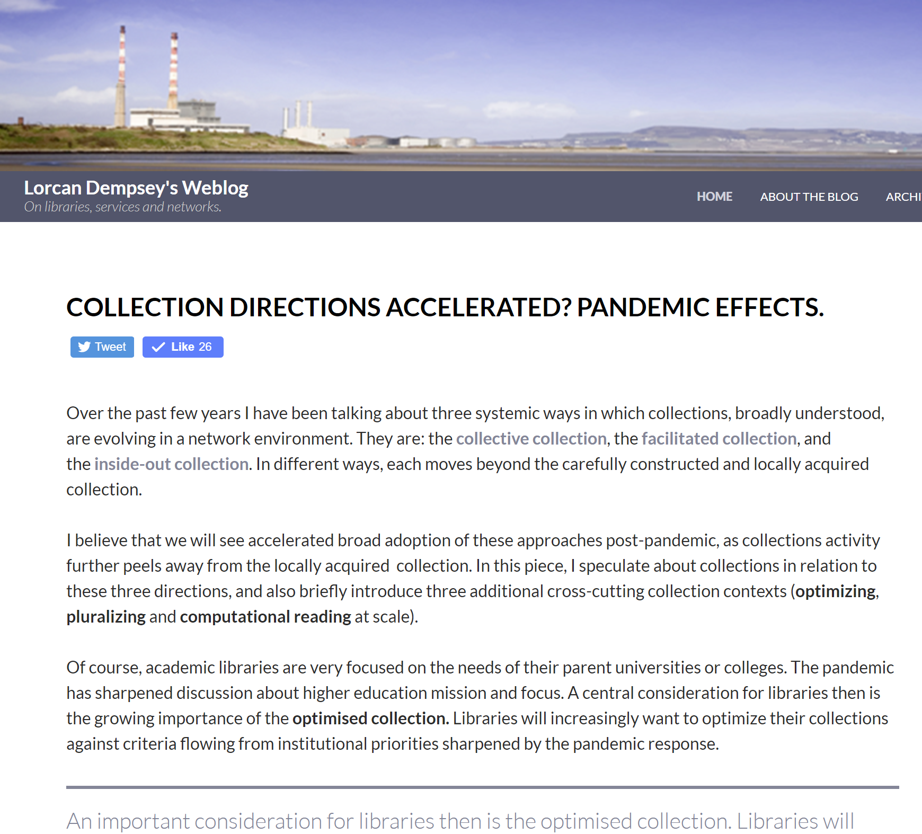
A new relationship to collections
Then: careful construction of a locally acquired collection.
Now: optimally satisfy research and learning needs from a facilitated network of resources (local, collaborative, open, commercial, etc.).
Open access, OER, …
Demand driven
Guided
Collaborative

Slide 28
The inside out collection
Create, manage and make discoverable evidence, community, memory..

Slide 29
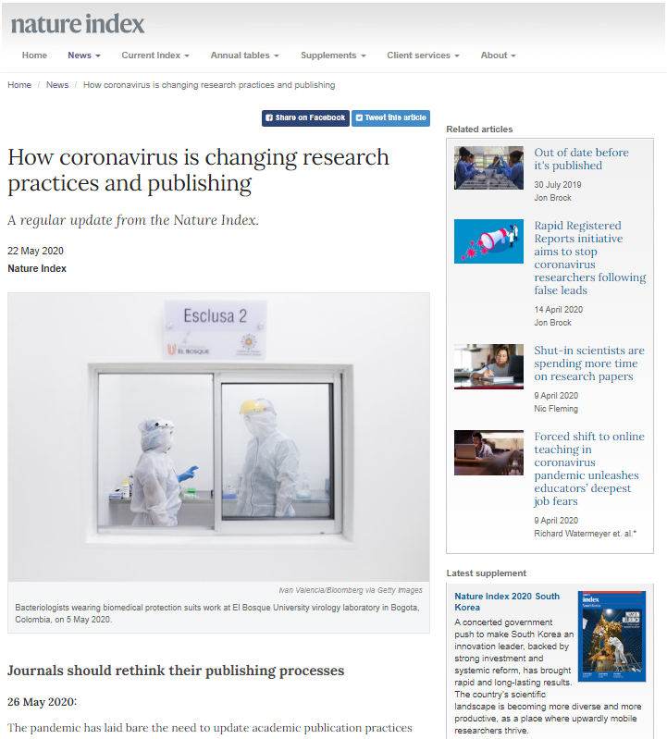
Research libraries will more purposefully partner to curate, manage and make more discoverable research outputs like preprints and research data.

Slide 30
Discoverability of university research outputs and expertise
Inside out library/collections

Slide 31
“Stakeholder interest in research support areas” by OCLC Research, from Social Interoperability in Research Support: Cross-campus Partnerships and the University Research Enterprise (https://doi.org/10.25333/wyrd-n586), CC BY 4.0

Slide 32
Divided into four parts
contrasts UK <> US
pandemic effects
collection directions accelerated
emerging collection imperatives

Slide 33
Optimizing
Libraries have focused on building, managing and sharing collections. Greater attention is now turning to optimizing collections, locally and across groups.

Slide 34
Optimize … strategic choices to meet particular goals
Decision support
Tradeoffs
Rush online <> open
Inside out <> acquired
….

Slide 35
“
What are Penn State University Libraries’ collection priorities for fiscal year 2020-21?
Budget administrators and subject-specialist and location-based selectors will prioritize the following considerations in collection development activities:
Resources essential for Penn State coursework and research;
Electronic resources for onsite and offsite access. Print resources will be ordered if no electronic option exists and once building access resumes;
Less duplication of titles across Penn State, applying a “One Penn State” shared collections approach;
Reviews of resources’ usage to guide purchasing and licensing decisions;
Diversity of collections;
More negotiation with vendors and publishers;
Consideration for collection space savings;
Collection fund consolidation to support interdisciplinary research; and
Open Access content promotion and exploration.
“

Slide 36
Data driven optimization …

Slide 37
Libraries are pluralizing their collections, services and perspectives – so that all the communities they serve recognize their own knowledges, experiences, voices and memories in library services.
They aim to decenter dominant perspectives and to help give a voice and name to all they serve.
Pluralizing

Slide 39
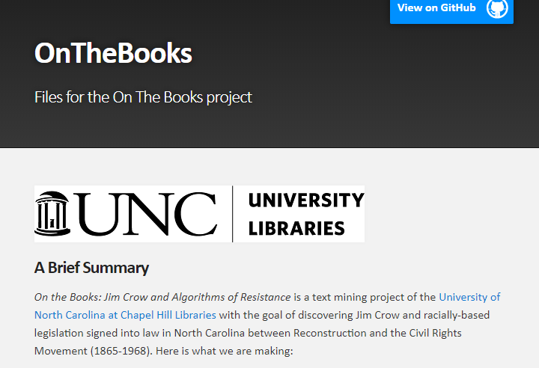
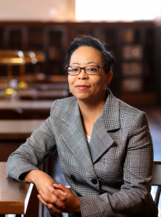
“reckoning”
The University Libraries’ Role in Reckoning with Systemic Racism and Oppression
https://library.unc.edu/2020/06/the-university-libraries-role-in-reckoning-with-systemic-racism-and-oppression/

Slide 41
Online
Collective
Facilitated
Inside out
On mission
Optimizing
Pluralizing
Optimized

Slide 42
Lorcan Dempsey
OCLC
@LorcanD
Thank
you
DempseyL@OCLC.org

