Slide 1
Scaling research support services through a graduate specialist program at Rutgers University
Dee Magnoni and Ryan Womack
Rutgers University
July 9, 2020

Slide 2
Outline
Background
Director’s Perspective
Startup
Expansion
Collaborations
Impact
Future Goals
Discussion

Slide 3
Background
Since 2010, Ryan has been involved with R instruction
A constant demand for more and more varied instruction, especially Python
Rutgers has also had an active Digital Humanities program
Francesca Giannetti, Digital Humanities Librarian, hired in 2014.
Work with Deborah Silver in Professional Master’s Program and Manish Parashar in RDI2 (Rutgers Discovery Informatics Institute) on grant proposals for “Data Science Learning Concierge”, seeding ideas for:
developing pathways to learning technology outside of coursework
hiring non-LIS graduate students for teaching and consulting
building out physical and virtual spaces
library as a neutral and friendly “third place”

Slide 4
Director’s Perspective
Rutgers | R1 research university, member of AAU and Big10
New Brunswick Libraries, Fall 2017 | Foundation of strong R, DH, and data management workshops
Need to expand advanced research services and partnerships
Approached late fall 2017 with a pilot proposal that would:
Address need for advanced research workshops and provide opportunities to PhD and advanced graduate students
Deliver augmented and new areas of expertise

Slide 5
Director's Perspective: Strategic Fit
Pilot in parallel with strategic planning data collection
Identified sandbox funding and drafted initial positons for Spring 2018 semester
COVID perspective: Pilots in the time of crisis

Slide 6
Poll Question
Currently, are pilots more challenging? Or are they in the opportunity zone?
What factors are driving opportunities?
This Photo by Unknown Author is licensed under CC BY-SA

Slide 7
Questions for the Director?
Please ask any questions relating to the Director’s perspective now.
This Photo by Unknown Author is licensed under CC BY

Slide 8
Defining the Program
Other data services such as NYU, Duke, Princeton have full time staff support
Initial name was Library Fellows, but “Graduate Specialist” was chosen to be more precise and not conflict with other position titles
Learning and skill-building opportunity for the specialists
Drawn from New Brunswick grad school population
Higher wage rate ($25 vs. $15) than the Libraries norm
Initial focus on quantitative data and digital humanities
Open to expansion beyond “data”
Combined teaching and consulting role

Slide 9
Pre-Spring 2018
Meeting with Libraries HR to clear the new positions and outline requirements
Developing position descriptions:
Data Services Graduate Specialist: Successful applicants will be highly motivated individuals with a strong interest in data analytics. Knowledge of statistics, data analysis, visualization, and relevant programming techniques is required. Intellectual curiosity and strong interpersonal and communication skills are required qualifications for this position.
Digital Humanities Graduate Specialist: Successful applicants will be highly motivated individuals with a strong interest in digital humanities work within an academic or GLAM (galleries, libraries, archives, and museums) setting. Knowledge of one or more digital humanities research methodologies is required. Intellectual curiosity and strong interpersonal and communication skills are important qualifications for this position.

Slide 10
Spring 2018
Posting, Interviewing, Onboarding
Marketing to Departments and Schools
Each Specialist has mentor/supervisor (Ryan and Francesca)
Curveball: family emergency
Getting used to spaces:
physical (DH lab and Library Classrooms)
virtual (creating LibGuides, Github repositories)
https://libguides.rutgers.edu/graduatespecialist
https://github.com/RUgraduatespecialist
.
This Photo by Unknown Author is licensed under CC BY-NC-ND

Slide 11
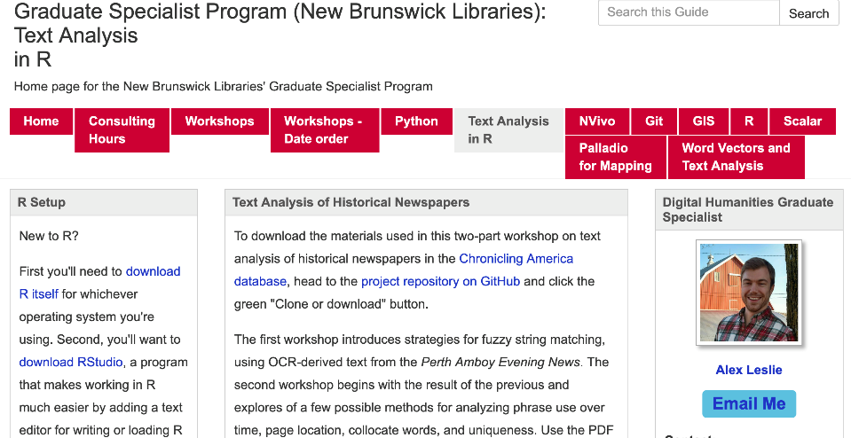
.

Slide 12
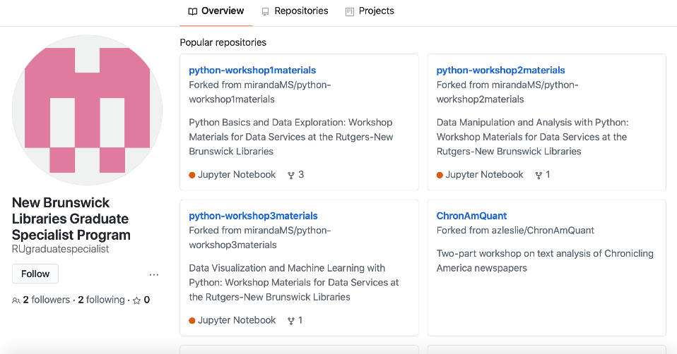
.

Slide 13
Spring 2018 - Results
Data workshops were developed on Python Basics and Data Exploration, Data Manipulation and Analysis with Python, and Data Visualization and Machine Learning with Python. Consulting on Python, Data Cleaning, and Data Analytics.
DH workshops created on Using Historical Newspapers in the Classroom, Chronicling America in R (2 part series), and Using Tropy to Organize Research Materials. Consulting on R for textual analysis, topic modeling, and geospatial analysis.
50 Python registrants, 29 DH registrants

Slide 14
Spring 2018 - Feedback
Candidate pool was good.
In spite of limited advertising, workshops had good attendance. The feedback was uniformly positive. For both instructors, almost all participants were "Extremely Satisfied"
"The instructor was super helpful and the material presented was easy to understand."
"I liked that the material is on github, and that the instructor provided us with practice examples and places to continue learning python."

Slide 15
Spring 2018 – Feedback, continued
The "consulting hours" on the other hand, were sparsely attended. The location of the DH Lab and lack of advertising/signage/marketing were a challenge.
Commenters asked for more workshops and a wider range of topics covered, rather than more hours for individual help. Since the workshops also produce reusable and accessible learning materials, this seemed to be the most beneficial area of focus.
Webinars – already in Spring 2018 these were being requested.
This Photo by Unknown Author is licensed under CC BY-NC-ND

Slide 16
AY 2019 - Expansion
Moved to 4 specialists (PhD students in English, Public Policy, Economics, and Masters in Data Science)
Added Qualitative Specialist and Open Science specialist with new library faculty mentors (Karen Hartman and Laura Palumbo)
Built on existing workshop content, plus new content on Nvivo, Github
Curveball: international student eligibility
Increasing registrations and attendance: 104 Python, 73 DH, 21 Nvivo in Spring 2019
We did not succeed in implementing webinars! Always seemed to run out of time.

Slide 17
AY 2020
Continuing demand for more Python led to reconfiguration:
Two Quantitative Data Specialists, DH, Qualitative, and new GIS Specialist
New topics: Scalar, Hugo, Cryptocurrency, Neural Networks, QGIS, Palladio, Tableau, and many more!
Spring 2020: 108 Python, 48 DH, 69 Nvivo, 18 GIS

Slide 18
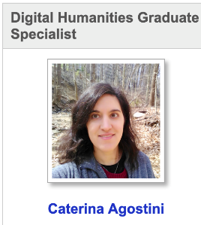
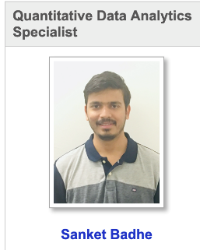
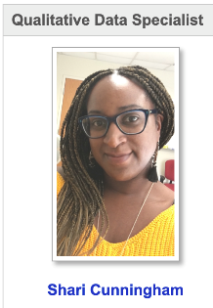
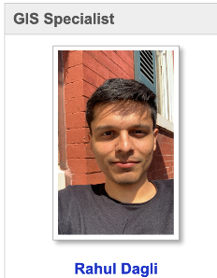
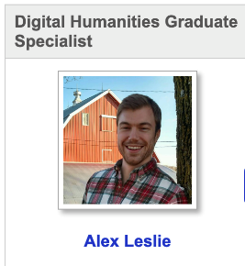
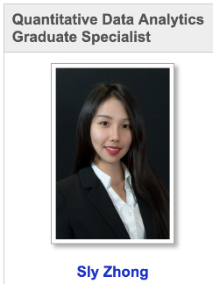

Slide 19
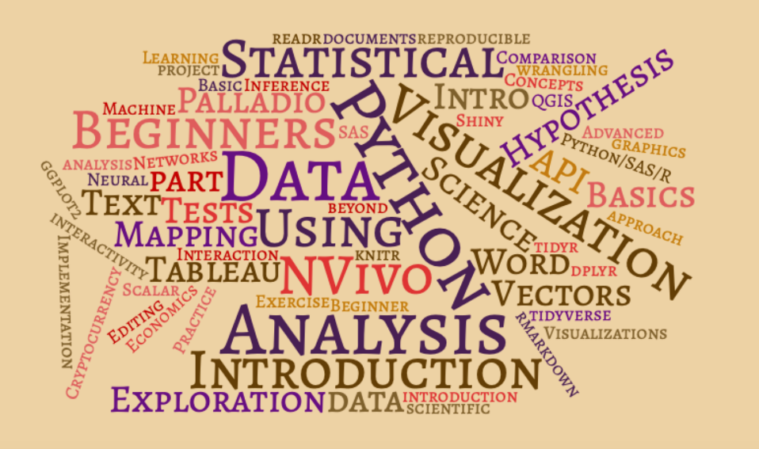
Spring 2020 Workshop Topics

Slide 20
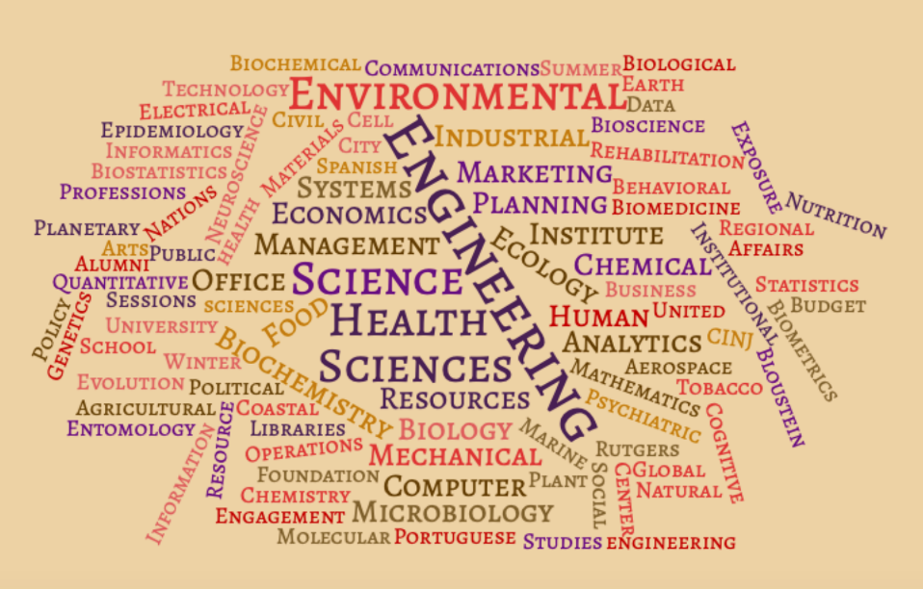
Departments attending Python Workshops AY20

Slide 21
Poll Question
What topics are you currently offering support for?
What topics would you most like to offer support for (but are not currently)?
This Photo by Unknown Author is licensed under CC BY-SA

Slide 22
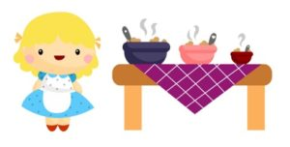
Feedback and Suggestions
Patient,detailed and clear instruction, approachability is valued
More topics: APIs, data wrangling, forecasting, statistical concepts, app development, video editing, software engineering, REDCap, MATLAB
General suggestions: Better advertising, materials in advance, snacks!
Pace and depth of content is a Goldilocks problem
This Photo by Unknown Author is licensed under CC BY-SA

Slide 23
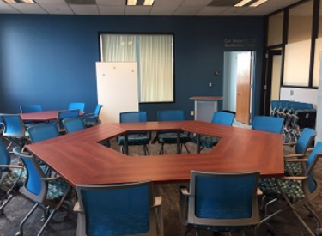
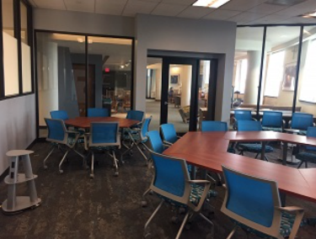
JetStream
One goal has been to provide a more welcoming, flexible, and modern space for interactive teaching. Insights from the hands-on workshops of the Graduate Specialists informed the design of the JetStream.
https://libguides.rutgers.edu/nbl_spaces/Jetstream
The ideal is to encourage collaborative, innovative learning
The funding model (free for events that meet the JetStream’s mission criteria) encourages this.
JetStream is also linked to other space initiatives (Hatchery - IDEA)

Slide 24
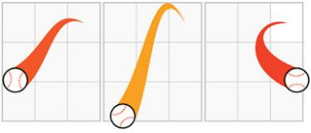
COVID-19
Within a couple of weeks (around Rutgers Spring Break), we rapidly moved from a warning situation to a complete closure of all library buildings [goodbye, JetStream!]
Because of our technologically expert cohort of specialists, and well-developed bank of online materials, all of our specialists were able to offer some of their workshops online.
In many cases, the series were offered in their entirety.
We finally succeeded with webinars!
We are well-prepared for primarily online contact in the Fall.

Slide 25
Collaborations
In AY 2019, we had several requests to repeat workshop content for specific audiences (departments or specific research methods classes), which we were able to accommodate. An indicator of the relevance of our content.
These continued in AY2020, and also two significant external collaborations developed, primarily due to interest in the Python and R content built up by our specialists.
After cross-posting workshops, the Office of Advanced Research Computing will be working with us in Summer 2020 to develop Python/R workshop that also introduces users to work on OARC’s HPC cluster, with big data examples.
Improved calendar tools via LibCal will enable us to cross-list and market workshops more effectively

Slide 26
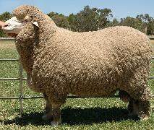
Poll Question
What units/groups on campus are you currently collaborating with?
Who would you like to collaborate with?
This Photo by Unknown Author is licensed under CC BY-SA

Slide 27
Colloborations - Erdos
The Erdos Institute (https://erdosinstitute.org) is an initiative to train PhD students in Data Science skills, begun at Ohio State, but expanding.
Rutgers-NB’s School of Arts and Sciences approached the Libraries to hold an Erdos Data Science Bootcamp at Rutgers, to be held in our JetStream room in May 2020.
Because of COVID, this went online and became a single nationwide joint event with participants from Ohio State, Rutgers, and other universities.
Our Quantitative Graduate Specialists (and Ryan) provided essential support as Teaching Assistants to the 129 students in this month-long intensive experience.
Rutgers students won the prize for best project!

Slide 29
Impact
Hundreds of students learned the use of advanced research tools
Graduate specialists (10 to date) given valuable teaching and instructional development experience
Archive of online material that can be used any time
Improved physical and virtual spaces for technology instruction
Seen as relevant by other units, building opportunities for collaboration
Transformative at a time when library budgets and staffing have otherwise stagnated

Slide 30
Other Considerations
Specialists need some time to get going. Rushed recruiting and workshop development at the start of Fall semester meant that Fall workshops did not reach full potential.
An increasing number of students have already focused on data science even from high school – so “Intro to …” may not be relevant for them. Finding the “sweet spot” of newish skills that are ready to see wider adoption.
A patchwork of tools across multiple platforms – Qualtrics, Google Forms, Microsoft Forms, Bit.ly, Rutgers link resolver, Github, Libguides, Google Colab
Staff resources often not easily accessible to students

Slide 31
Future Goals
Continue building virtual and (hopefully one day) physical community
Junior/Senior specialist model to provide mentoring within the cohort
Most relevant skills are a moving target
Consistent marketing, registration, feedback under one umbrella
Build further collaborations to more units on campus
This Photo by Unknown Author is licensed under CC BY-NC

Slide 32
Questions?
Let’s discuss anything on your mind now…
This Photo by Unknown Author is licensed under CC BY

Slide 33
Thank you!
Баярлалаа!
Thank you for your attention and thanks to OCLC for making this possible!
This Photo by Unknown Author is licensed under CC BY-SA-NC

