Slide 1
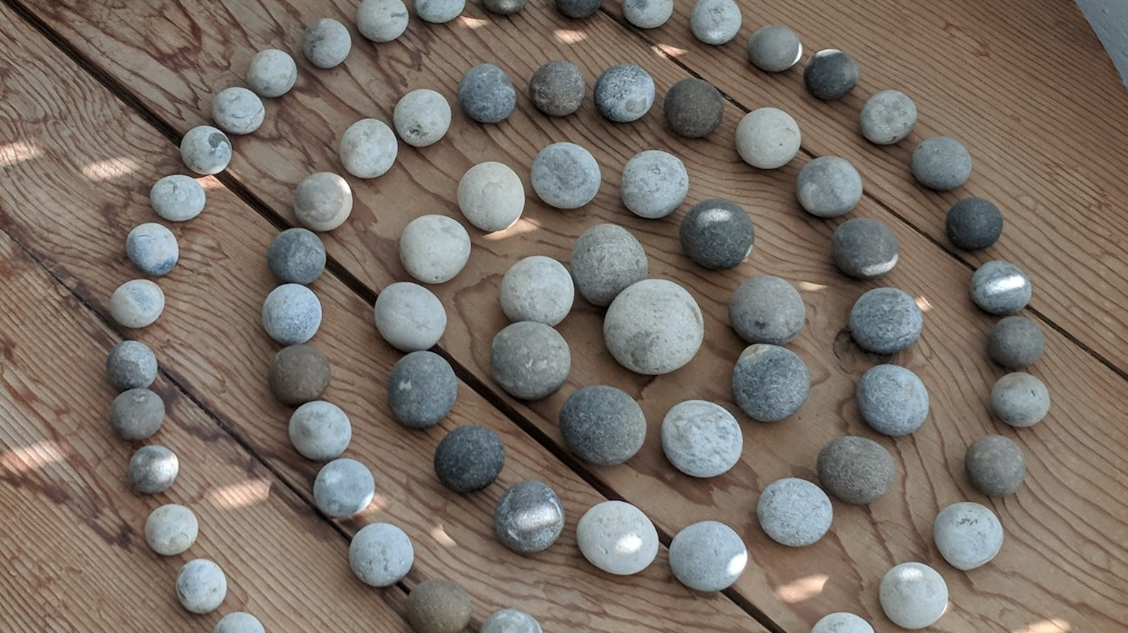
Lorcan Dempsey
OCLC
@LorcanD
Rediscovering
Discovery: three general examples
CNI Virtual Meeting
5/21/2020

Slide 2
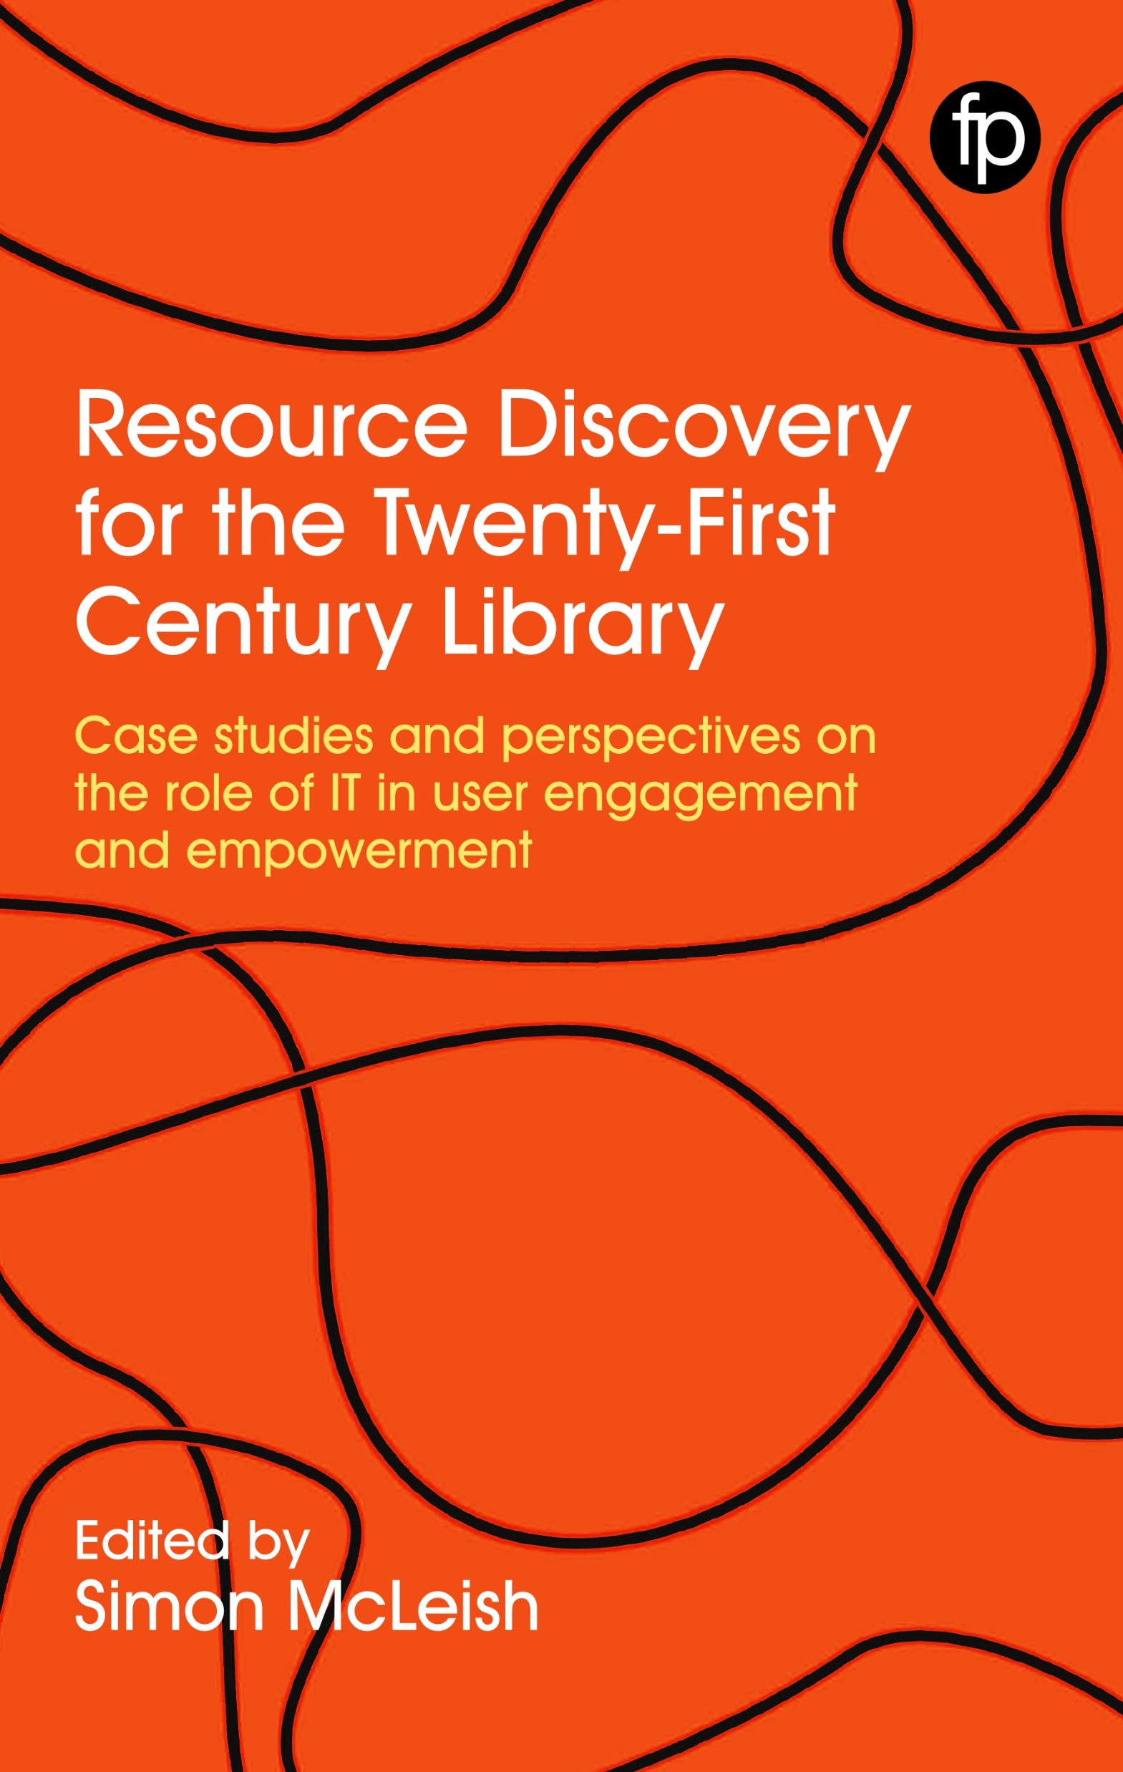
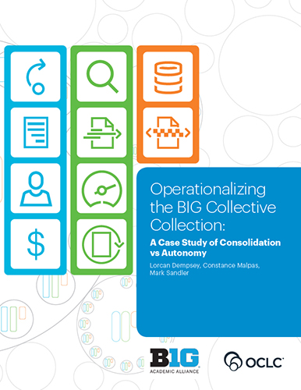
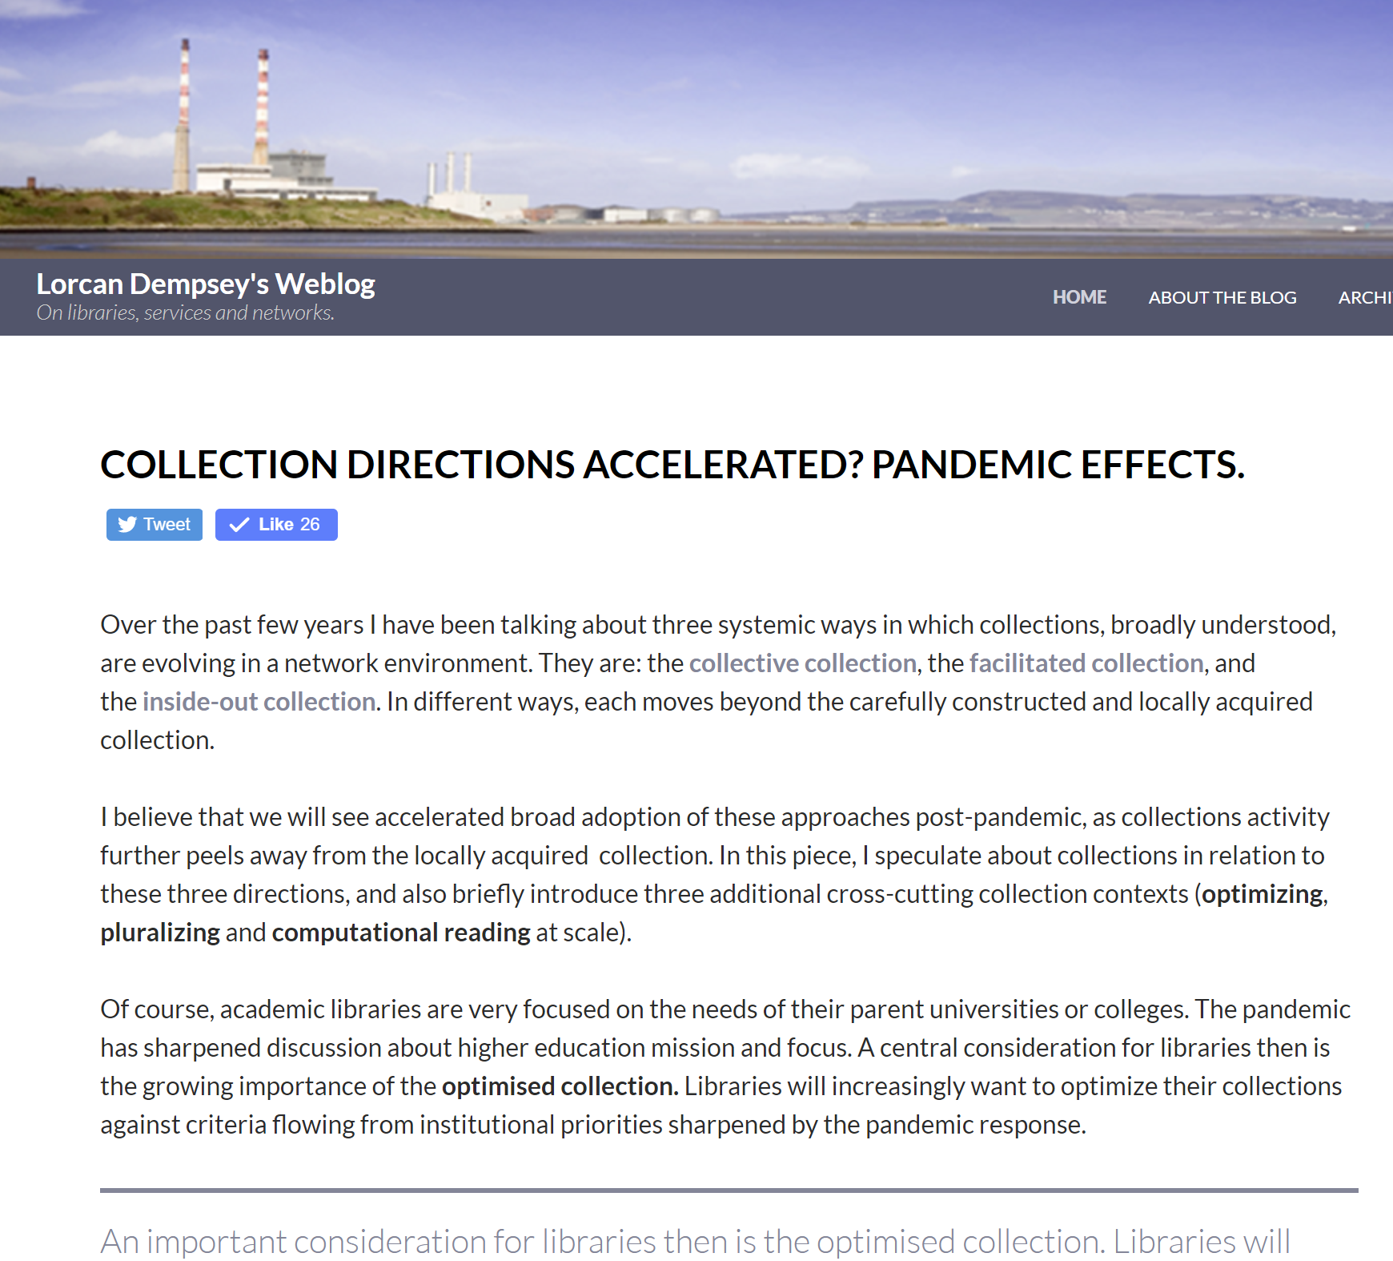

Slide 3
Three pandemic effects …
Online a holistic online experience
On mission sharp focus on alignment with evolving institutional priorities
Optimize optimizing services and collections against particular goals
Full library discovery
Discoverability of institutional
assets
D2D2D

Slide 4
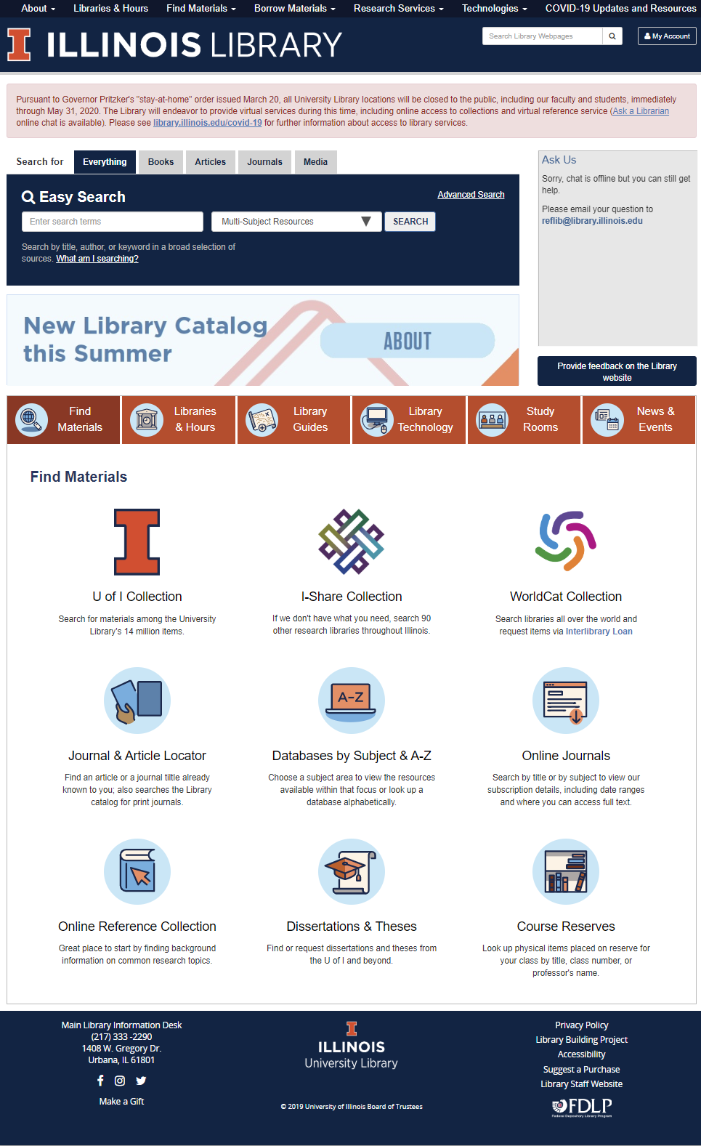
1. A holistic online experience? The new target.
Final recognition of library (as a service) separate from the library (as a building)?
Deliver full library experience online?
consultation and expertise?
Substitute for face to face interactions that now support good working relationships?
integrate and present information services which go beyond the locally acquired collection (facilitated, collective)?
deliver efficiently into the learning process (LMS)?
richer interaction and programming?
personal interactions (CRM, profile, …)?
in the flow and social …

Slide 5
A new relationship to collections: facilitated, collective, delivered ….
Literature search (some locally owned)
Resource guides
Open access, OER, …
Google Scholar, Meta, ….
Demand driven
Then: careful construction of a locally acquired collection.
Now: optimally satisfy research and learning needs from a facilitated network of resources (local, collaborative, open, commercial, etc.).
Spot acquisitions
Smart fulfilment

Slide 6
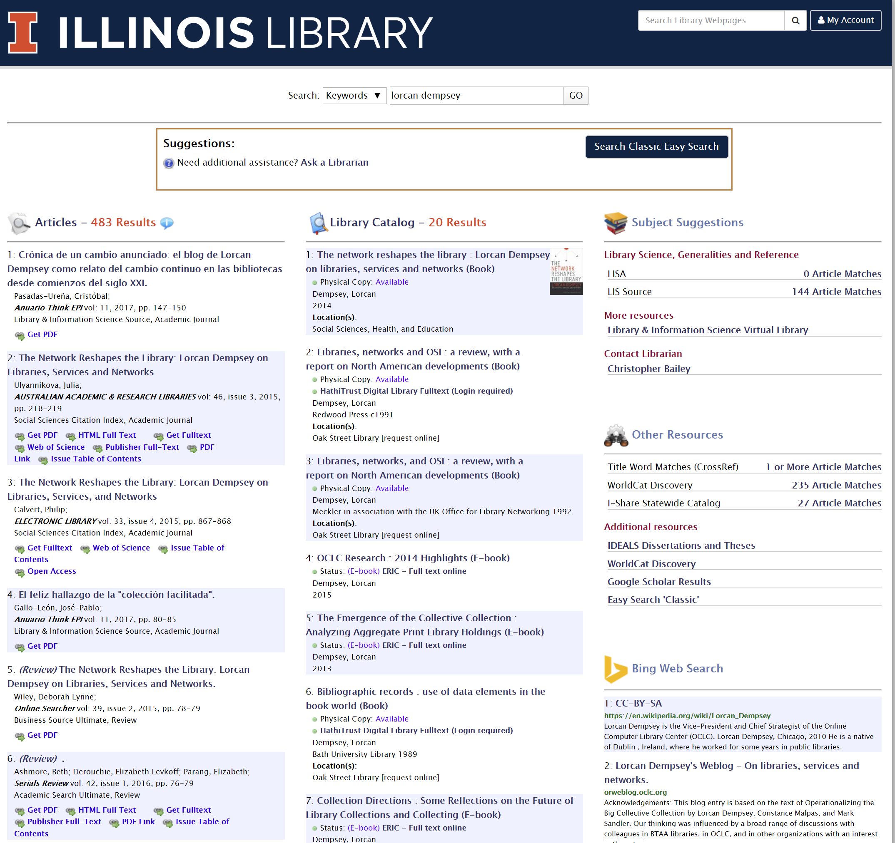
Full library discovery …
The library experience
Website (events, …)
Expertise
Facilitated collection
Acquired library collection

Slide 7
2. On mission

Slide 8
On mission: supporting research enterprise
Pandemic will have long lasting impact on research culture
Short circuiting processes and practices to respond urgently
Collaboration across disciplines, organizations, countries
Urgency around reporting results
Greater use of open channels
Concern about assessing validity and relevance
Stronger desire to showcase expertise and potential contributions – research profiles, etc.
Research libraries will more purposefully partner to curate, manage and make more discoverable research outputs like preprints and research data.

Slide 9
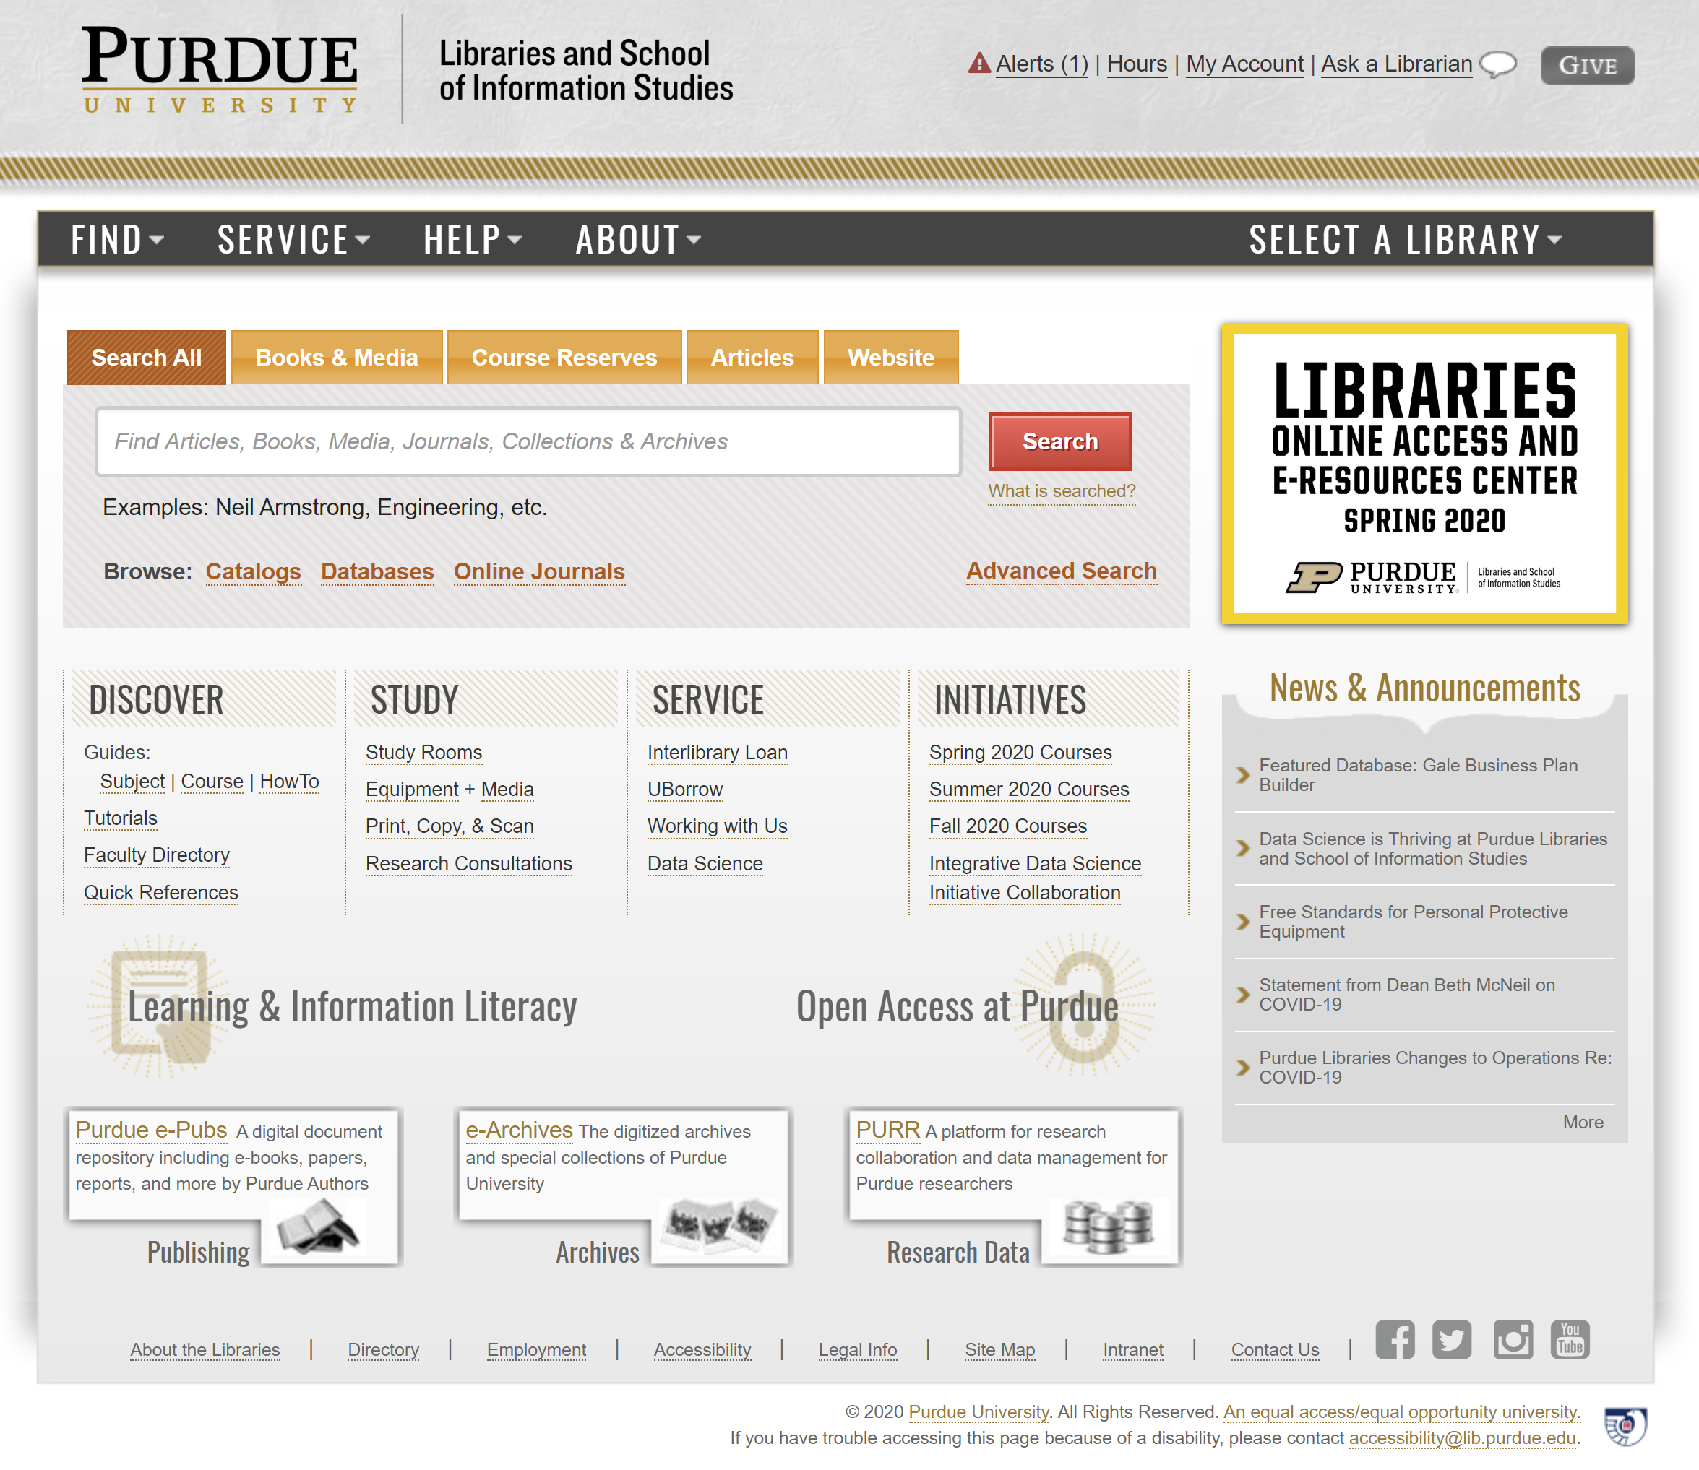
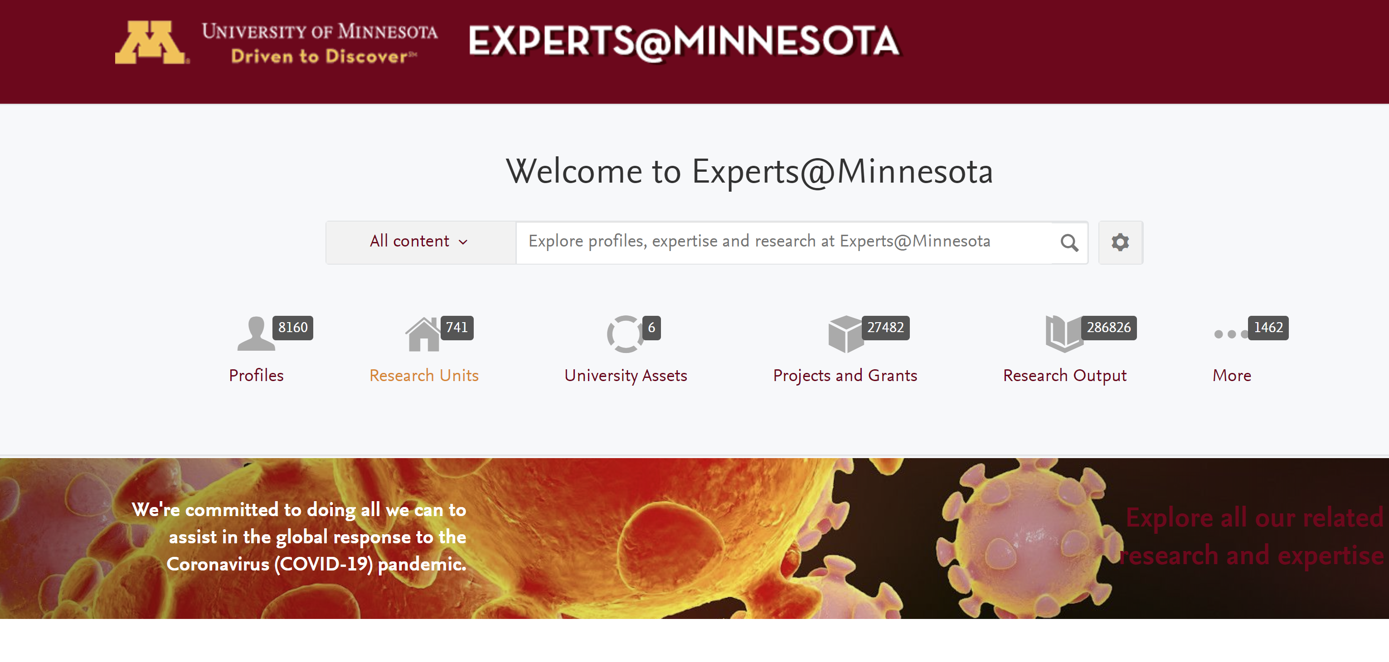
Discoverability of university research outputs and expertise
Inside out library/collections

Slide 10
3. Optimize … against particular goals
Collection examples
Value (acquire what is needed, use what is acquired)
Open
Curricular support
Regional/local
Collaboration
Plural (respect/represent communities of interest)
Increased focus on decision support (dashboard)

Slide 11
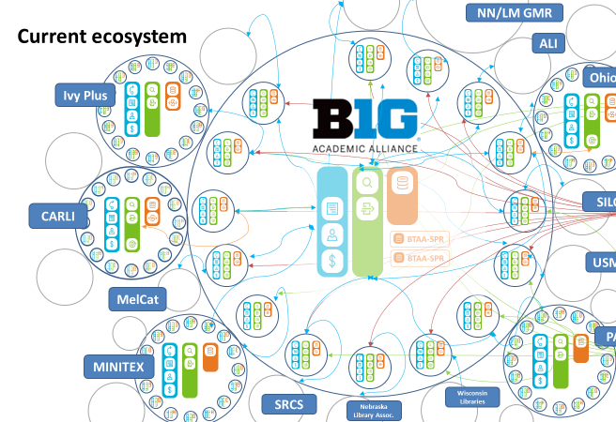
Optimize: discovery to delivery to dashboard: D2D2D
Operationalizing the Collective Collection - BTAA
Discovery is part of a complex ecosystem
Recommend (high level) ..
Optimal distribution of collections
Efficient network fulfilment
Systemwide awareness
Data driven ..
Discovery/ILL/acquisitions/ ….
Shared print, digitization, specialization
‘Dashboard’
Aggregation of data to drive decisions

Slide 12
Discovery choices will be made in data-driven environment that they help shape and are shaped by.
Collective, facilitated, fluid, …..

Slide 13
Rediscovering discovery: three examples
Full library discovery
Discoverability
D2D2D
Thank you, LorcanD, OCLC

