Slide 1
CNI | 13 May 2020
Total Cost of Stewardship:
Tools from the OCLC Research Collection Building & Operational Impacts Working Group
Chela Scott Weber
Sr. Program Officer
OCLC Research Library Partnership
Notes:
So, I’m Chela Scott Weber, and I’m a senior program officer with the OCLC Research Library Partnership, where I focus on work with archives, special, and distinctive collections.
I’m excited to be here today, talking about work we’ve been doing with colleagues across OCLC Research Library Partnership institutions in our Collection Building and Operational Impacts working group.
I’ll start by providing a little bit of background about how the group came to be and the issues we’re trying to address, and then share some details about the tools we’ve created.

Slide 2
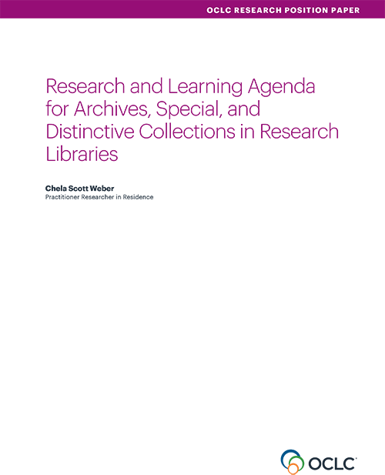
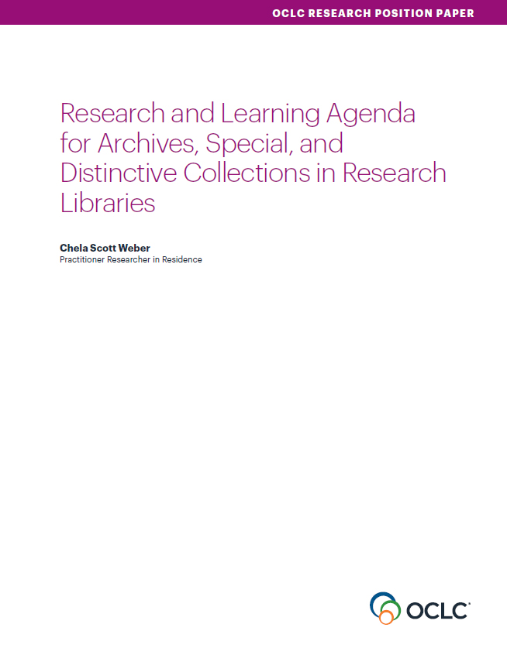
Our Work in Archives, Special, and
Distinctive Collections:
oc.lc/rlp-agenda
Notes:
So, for background –
OCLC Research has a long history of work in the area of archives, special, and distinctive collections in research libraries. We work in special collections because they are an important sight of knowledge creation, made possible by library’s commitment to the stewardship of their distinctive collections. The unique nature of material in special collections can make scaling a challenge, and we work to identify areas of common need and patterns of innovation to help libraries scale learning and expertise with these collections.
In October, we released the Research & Learning Agenda for Archives, Special, and Distinctive Collections.
articulates the shared challenges and opportunities research libraries are are facing in this sphere, and suggests approaches for working on them together.
The agenda is guiding OCLC Research work in this area, and the working group is a part of that

Slide 3
Responding to the Agenda
“With an ever-expanding universe of information to steward and sizable existing backlogs, it is time to re-emphasize the importance of appraisal.”
…
“Our continued backlogs and resource challenges require a renewed energy be put toward appraisal and reappraisal as part of comprehensive strategies to fulfill our stewardship obligations.”
Notes:
We see this working group as responding to multiple needs laid out in the agenda:
Appraisal – The agenda calls out appraisal as being a key skill and activity, and urges a renewed emphasis on and engagement with appraisal in our practice
Stewardship Responsibilities and Collection Management – It also calls attention to our continued struggle with backlogs and living up to our collection management responsibilities, and identifies appraisal as an important part of a comprehensive approach to dealing with these responsibilities.
Beyond appraisal, we think this work also addresses other issues raised in the agenda:
A desire for better tools and approaches to advocacy, a need to engage in data collection in support of reporting, assessment, and advocacy; and valuing the labor that goes into the responsible stewardship and care of collections.

Slide 4
“over 29,000 linear feet of manuscripts and archives in over 5,500 collections…Among the [institution’s] treasures are approximately 700 cuneiform tablets; 160 medieval and renaissance illuminated manuscripts…”
“over thirteen million manuscripts, 350,000 volumes and bound periodicals, 250,000 images, and thousands of hours of audio tape...”
“On average, the library adds between 10,000 and 15,000 books, 1,200 feet of archival material, and ore than 3,000 discrete manuscripts to its holdings each year.”
“over 33,000 books, 1600 archival collections, 1200 oral history interviews, 50,000 photographs, 8,000 artifacts, 300 paintings, and 2,000 maps …”
“over 350,000 volumes of books and other printed materials; more than 11,000 linear feet of archives, and over 100,000 individual and unique media elements”
Notes:
And this desire to think a bit differently about what we bring into our collections is happening against a backdrop of a shift of re-conceptualizing the value of archives and special collections in the research library.
I don’t need you to read every word on this slide – in fact, please don’t try! But it is illustrative of the way that we talk about our special collections, and the way we have traditionally used growth as a metric of value. These are the descriptions of collections at five different ARL libraries, and I promise you that I could have used any of a few dozen more that look very similar. – nearly all of us speak about our collections in this way, using size and growth as shorthand for value and prestige
Gordon is going to talk in a little bit about trying to create other metrics of value for special collections, but for now I’m going to keep talking about collection size.
The 2009 OCLC survey of special collections in research libraries indicated a 50% growth of special collections in ARL libraries between 1998-2009.
2015 survey by McCann and Priddle indicated that 81% of respondents ARL libraries are using offsite for special collections
That same 2009 OCLC report indicated that 50% of archival holdings, 68% of map, 75% of visual materials, and 15% of printed materials in our special collections did not have online catalog records. Certainly this has changed in the ensuing decade. We don’t have more current data, but I feel reasonably confident that many institutions may have better baseline control of their backlogs, but they still have backlogs of un- and under- described collections.
Even with significant growth in collections, we recognize that our collections are not at all diverse, equitable, or representative
And there is increasing interest in trying to remedy that, through approaches like post-custodial collecting, working with community archives, and creating oral history projects. All of which require sustained relationship building and trust, which of course requires considerable time and resources.
And so, to do the kind of collecting and relationship building we want to do, to live up to the expectations and promises we make to donors, and to make the rare and unique collections we hold in trust, we have to understand the resources available to not just collect, but to steward.

Slide 5


Notes:
But that the people tasked with making collection development decisions, and the people tasked with collection management responsibilities, are often not sharing information with each other at points in the process that would support this kind of shared, wholistic approach to collection building decision making
Wanted to bring together people across a range of responsibilities to think about how to address this issue.

Slide 6
Collection Building & Operational Impact
Working Group Members
Matthew Beacom
Yale University
Heather Briston
UCLA
Martha Conway
University of Michigan
Gordon Daines
Brigham Young University
Andra Darlington
Getty Research Institute
Audra Eagle Yun
University of California Irvine
Ed Galloway
University of Pittsburgh
Carrie Hintz
Emory University
Jasmine Jones
UCLA
Brigette Kamsler
George Washington University
Mary Kidd
New York Public Library
Sue Luftschein
University of Southern California
Nicholas Martin
New York University
Erik Moore
University of Minnesota
Susan Pyzynski
Harvard University
Andrea Riley
NARA
Gioia Stevens
New York University
Chela Scott Weber
OCLC
Notes:
We put out a call to the RLP and were fortunate that these folks responded.
It’s a great group, who hold a wide range of curatorial, collection management, and admin roles in both academic and independent research libraries
The work I’m sharing today is due to the efforts of everyone on this slide, and I’m grateful to everyone for the time and work they are putting in.

Slide 7
Working Group Goals
explore the intersections between current collecting and collection management practices
seek ways to better integrate collection management considerations and the collection development process
bring together colleagues across these important, interdependent functions
Notes:
Working Group Goals
explore the intersections between current collecting and collection management practices
seek ways to better integrate collection management considerations into the collection development process
bring together colleagues across these important, interdependent functions

Slide 8
To Help Us All
assess total cost of ownership of collections
determine operational impact of collections
facilitate better communication across our orgs
enable informed decision-making in collection building
advocate for the necessary resources to steward our collections.
Notes:
assess total cost of ownership of collections
determine operational impact of collections
facilitate better communication across our orgs
enable informed decision-making in collection building
advocate for the necessary resources to steward our collections.

Slide 9
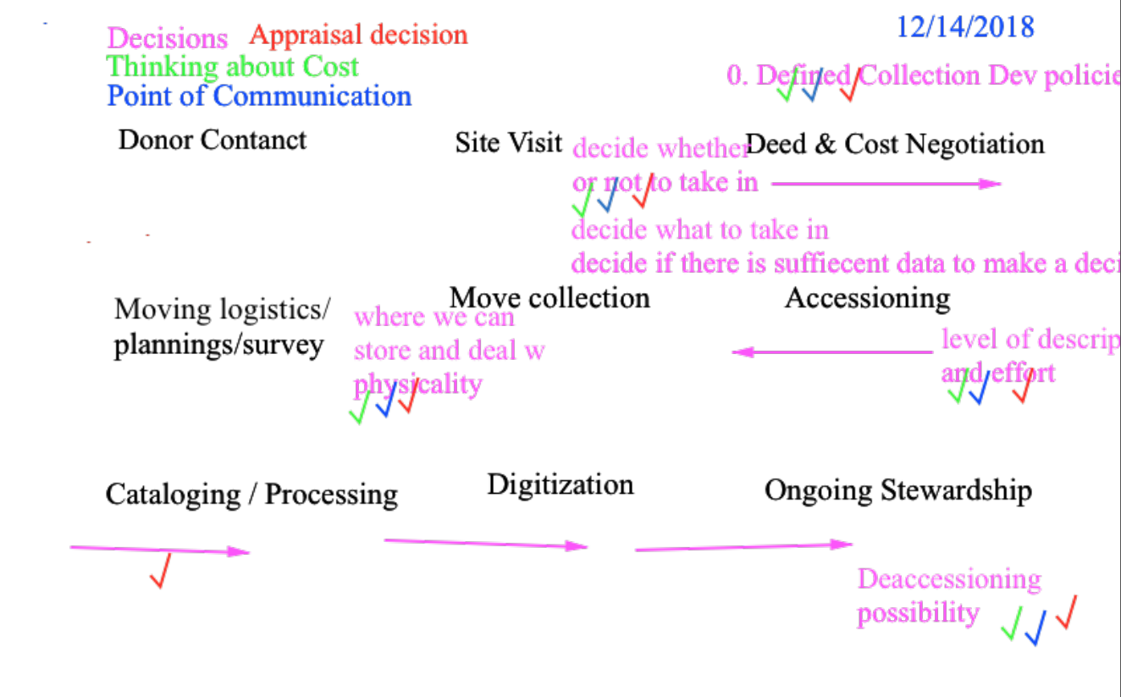
Notes:
One of the first things the group did together was a workflow analysis,
In it, we laid out the collection lifecycle – and identified points of decision making, communication, appraisal, and places where we think about labor and cost.
This work basically make us realize that these decision happen everywhere - all across the lifecycle of acquisition and stewardship, as work happens iteratively over time.
It also helped to bring into relief the many factors and people involved in these processes, as well as all the potential for communication breakdowns.

Slide 10
Total cost of ownership stewardship
Notes:
As we began to think about these issues and especially where they intersect, we started to see a need for a more wholistic approach to understanding the resources necessary for Cost of purchase plus the costs of living up to our responsibilities to donors, creators, and researchers
You have likely heard and perhaps used the term “total cost of ownership” – it’s used especially in talking about the true costs of open source software, but it a useful construct to help buyers and owners determine the direct and indirect costs of a product or system. Total cost of ownership is basically the initial cost to purchase something, plus the costs of ongoing operation, and those of necessary upgrades and maintenance. Though those costs might take specialized knowledge to estimate, it’s still a straightforward equation.
But things are a little less clear cut when thinking about acquiring archival and special collections. And we’d like to propose a total cost of stewardship approach – that takes into account the direct costs like purchase price, the ongoing operational costs of stewardship like cataloging, processing, and digitization, but also weighs the less tangible values like value to research, teaching, and knowledge creation, the value of community relationships or institutional prestige bringing in a collection can build.

Slide 11
Tool Suite
Communication Tools
Resource Estimation Tools
Notes:
And so when we talked about what we wanted to create, it was clear that we needed to produce not just a white paper or report as we often do, but also a suite of tools that would help to support communication across all those people and factoring in all those different points in the lifecycle where decisions, communication, and resource allocation are key.
We have produced two kinds of tools:
Cost Estimation tools, to facilitate estimation of the tangible costs of addressing collection needs
Communication tools, to facilitate discussion of both tangible (labor, supply, and other costs) and intangible (research value, community and other relationships, etc) factors that are weighed in collection decisions
Tools – are an expression and operationalization of this total cost of stewardship approach.

Slide 12

Resource Estimation Tools
  Interactive and Customizable
  Time Estimation Worksheets for cataloging and processing
  Operational Impact Estimator for estimating costs and capacity impact
Notes:
Interactive Cost Estimation – customizable to your context
Estimate your annual resources available for collection management activities, and assess a specific collection or potential acquisition in relationship to those resources, and be able to more clearly see its collection management needs and impacts.

Slide 13
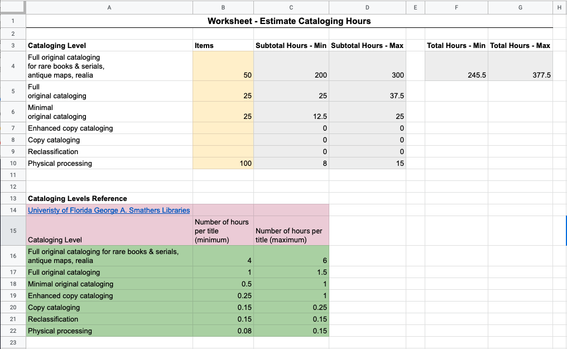
Collection Management Worksheets:
Time Estimation
Notes:
Take existing time estimation frameworks like University of Florida’s cataloging Levels Reference or UC Libraries Levels of Archival Processing and turn them into actionable spreadsheets. This gives the ability to get a quick sense of the work that might be necessary to process or catalog a collection, and what different levels of effort and detail might mean in terms of hours.
These are useful communication tools as well.
The general sense of time necessary that you get here can then be used in the other major Resource Estimation Tool we’ve built, something we’re calling the Operational Impact Estimator.

Slide 14
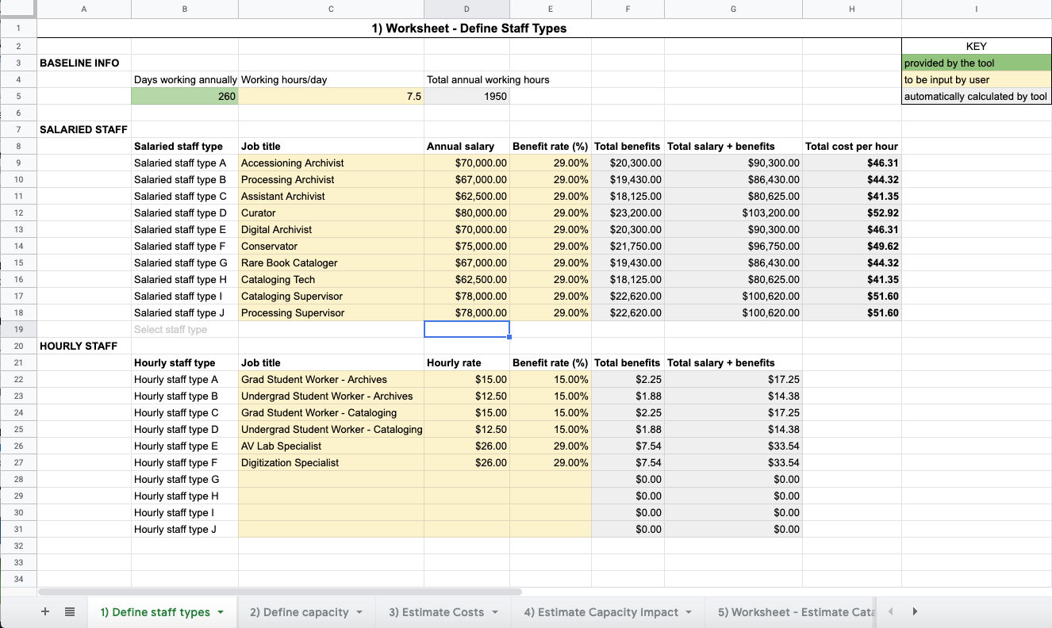
Operational Impact Estimator:
Define
Staffing
Notes:
Allows you to lay out the staff roles and associated salaries for everyone who works on collection management activities

Slide 15
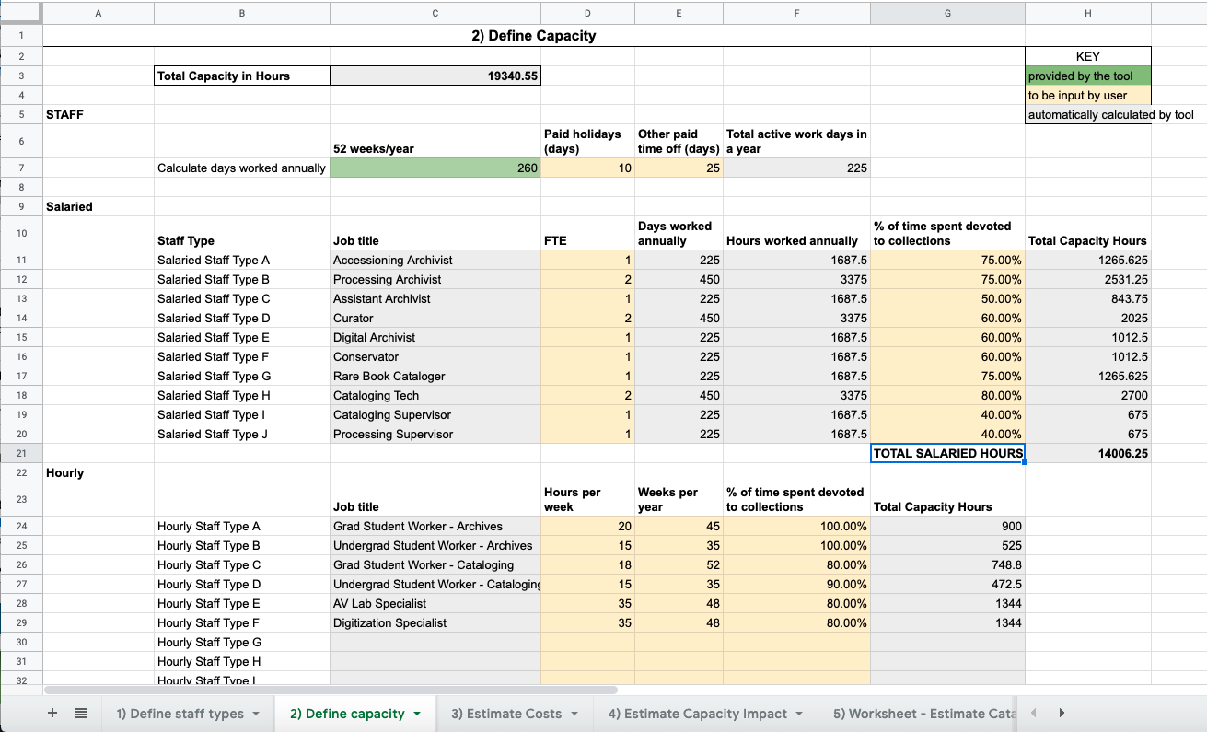
Operational Impact Estimator:
Define
Staff Capacity
Notes:
And then define the percentage of time those positions allocate to collection management activities

Slide 16
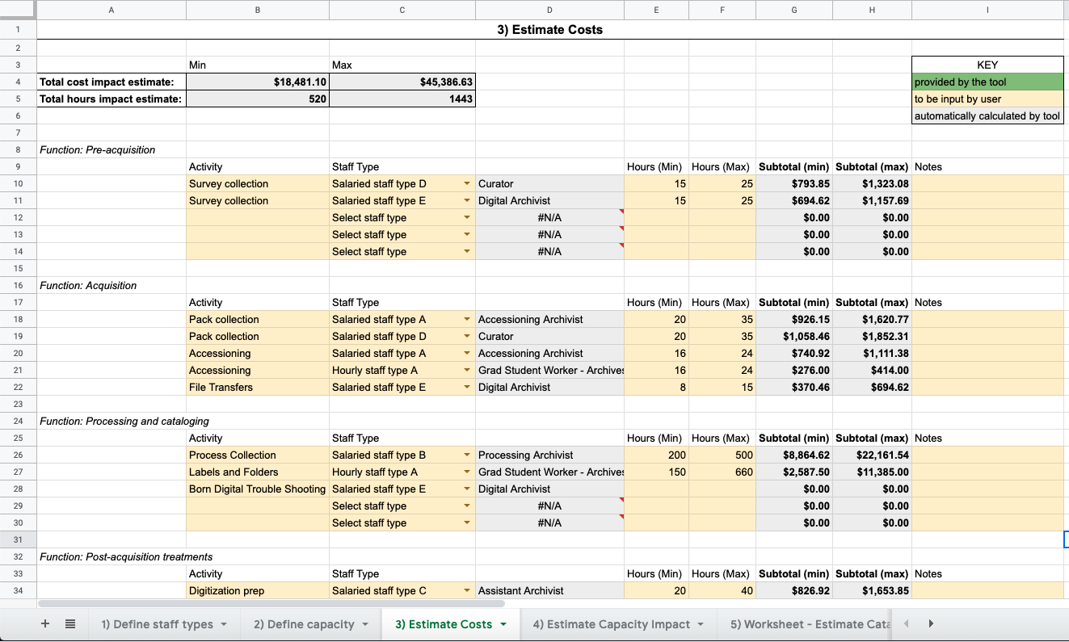
Operational Impact Estimator:
Estimate
Costs
Notes:
Then walk through the collection lifecycle from pre-acquisition through to ongoing stewardship, to estimate likely necessary activities and the time they will take

Slide 17
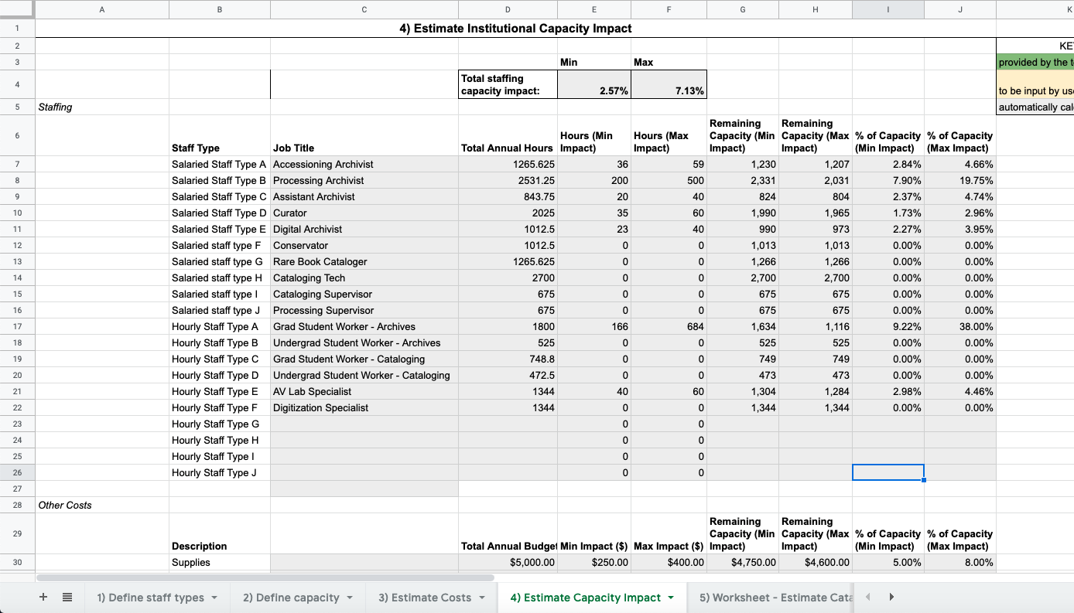
Operational Impact Estimator:
Estimate
Capacity
Impact
Notes:
And the tool then takes all of that data and shows you how that potential acquisition would impact your annual capacity to do this kind of work

Slide 18

Communication Tools
Record and Share Information About:
  Tangible Costs
  Hidden Costs
  Intangible Value
Notes:
Communication Tools – Factors
Tangible costs: purchase price, estimation of cataloging and processing resources, transportation, supplies
Hidden costs: try to identify factors that might cause extra work like the need for extensive FERPA, HIIPA, or legal review; condition issues that might impact conservation treatment needs; promises to donors that would be administratively difficult to operationalize; AV or born digital formats that would require specialized equipment the institution doesn’t have.
Intangible value: Alignment with collecting scope, institutional mission and goals; potentional research value of collection;

Slide 19
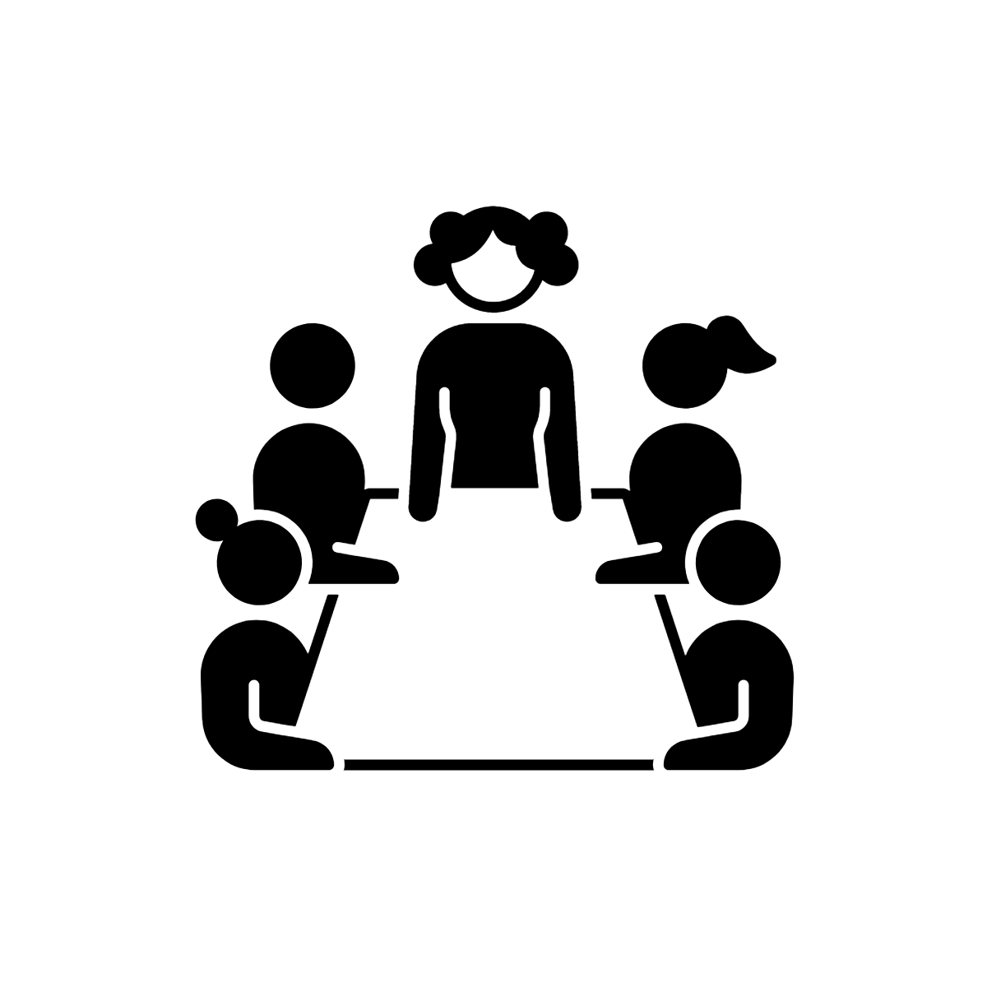
Communication Tools
To Communicate Potential Value
  Potential Acquisition Proposal
  Digitization Project Proposal
To Communicate Necessary Resources:
  Archival Processing Plan
  Operational Impact Report
Notes:
Communication Tools – outputs
We surveyed the landscape and ended up creating four templates to aid in bringing this kind of knowledge together and support shared, informed decision-making conversations.
To Communicate Potential Value
Potential Acquisition Proposal
Digitization Project Proposal
To Communicate Necessary Resources:
Archival Processing Plan
Operational Impact Report

Slide 20

What’s Next
Now:
  Working on revising the tool suite in response to community feedback
Fall 2020:
  Report and Tool Suite released
  Webinars and other communications
Notes:
So you may be wondering, how can I get my hands on these tools so my team will be high fiving each other for all their good, informed decision making?
Now: reviewing tester comments and revising the tool suite
Fall: release to the public tools, date is a little tentative given all the disruption from the pandemic, stay tuned.

Slide 21
Works Cited
Dooley, Jackie, and Katherine Luce. “Taking Our Pulse: The OCLC Research Survey of Special Collections and Archives.” Dublin, OH: OCLC Research, 2010. http://www.oclc.org/content/dam/research/publications/library/2010/2010-11.pdf.
Priddle, Charlotte, and Laura McCann. “Off-Site Storage and Special Collections: A Study in Use and Impact in ARL Libraries in the United States.” College & Research Libraries 76, no. 5 (2015): 652–70. https://doi.org/10.5860/crl.76.5.652.
Weber, Chela Scott. “Research and Learning Agenda for Archives, Special, and Distinctive Collections.” Dublin, OH: OCLC Research, 2017. https://doi.org/10.25333/C3C34F
Notes:
Here are my works cited, thanks so much, and we’ll answer questions at the end of all of the presentations.

