Slide 1
Virtual Symposium: Expertise Systems in Florida Universities * May 12, 2020
Research Information Management in the United States
Rebecca Bryant, PhD
Senior Program Officer, OCLC Research
bryantr@oclc.org @RebeccaBryant18
https://orcid.org/0000-0002-2753-3881

Slide 2
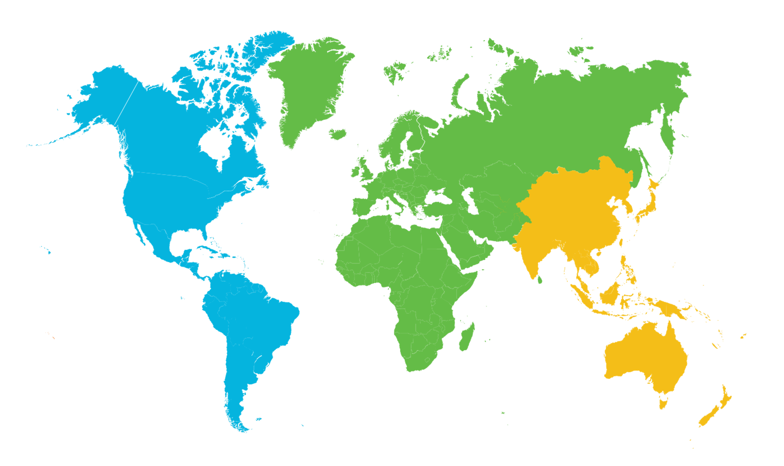
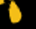
OCLC: A global network of libraries
EMEA
5,897 members in 75 countries
Americas
Asia Pacific
10,099 members in 25 countries
1,438 members in 21 countries
As of 30 June 2019
Notes:
OCLC libraries are part of an active and engaged global network of libraries with approximately 18,000 members across 121 countries.
Not-for-profit, cooperative structure
A global network provides unparalleled access to the world’s collected knowledge in ways that cannot be achieved independently
A global network provided the ability to address shared challenges at scale
Together, we connect people to the information they need to achieve their goals
[Notes current as of 3/26/20]

Slide 3

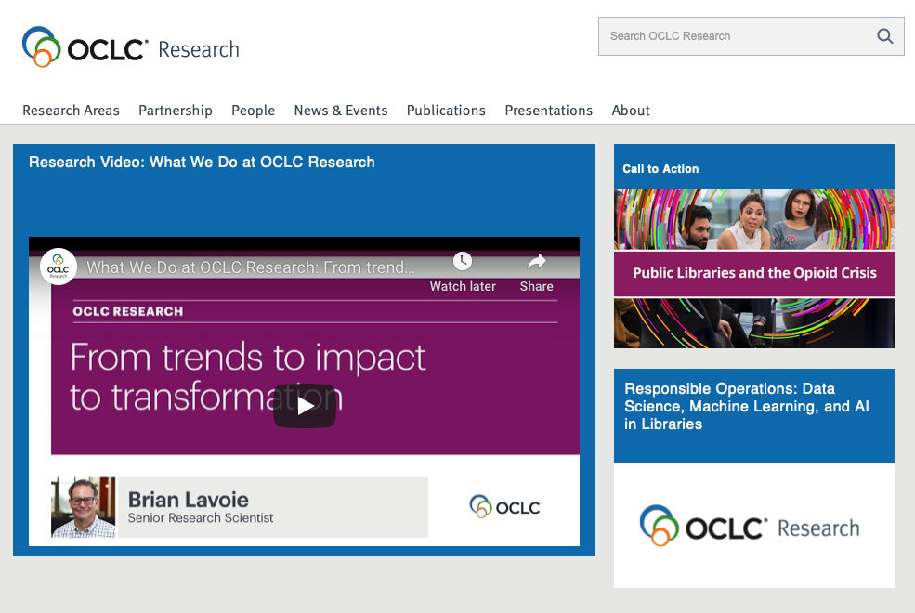
Devoted to challenges facing libraries and archives since 1978
Aims to scale and accelerate library learning, innovation, and collaboration
oc.lc/research
Notes:
OCLC Research recognizes that libraries are playing a larger role in Research Information Management, and we want to better understand these trends so we can share information with the library community to inform decision making.
OCLC Research concentrates its efforts on research devoted exclusively to the challenges that libraries, archives and museums face.
The OCLC Research Library Partnership includes some 130 research library partners who collaborate with other libraries and each other on research and related issues through working groups.
I joined OCLC Research nearly four years ago to develop a research agenda on this topic.

Slide 4

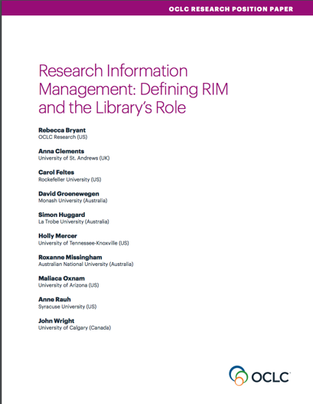
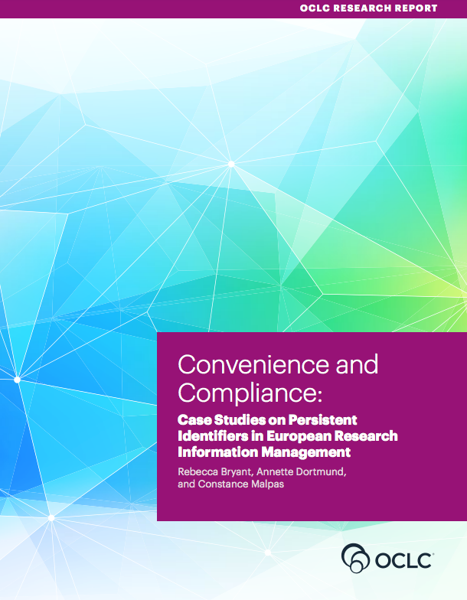
OCLC Research publications on Research Information Management
oc.lc/rim

Slide 5
Forthcoming publication on institutional stakeholders in research support
Examines the need for siloed campus units to work together to address institutional challenges & support enterprise-wide research support needs
Documents the operations, goals, and pain points of research university stakeholders based upon >20 interviews
Particularly in areas of:
  RIM
  Research Analytics
  Research Data Management (RDM)
  ORCID adoption
Expected later this summer, oc.lc/stakeholders

Slide 6
RIM =
The aggregation, curation, and utilization of (meta)data about research activities
Notes:
Definition developed in conjunction with a working group of RIM practioners from 4 countries.
The goal was to have a definition that included all of our practices, while still allowing us to focus on specific uses and practices that varied by region.
I also have (meta)data bracketed here because librarians will talk about publications and other research outputs as metadata, as separate from the full text output. But for most other folks on campus, you’re probably just calling this “data.” We’re talking about the same thing.

Slide 7
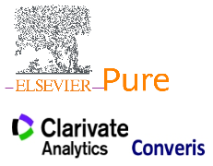

Overlapping terms:
  CRIS (Current Research Information System)
  RIMS (Research Information Management System)
  RIS (Research Information System)
  RNS (Research Networking System)
  RPS (Research Profiling System)
  EFS (Expert Finder System)
  FAR (Faculty Activity Reporting)
RIM =
The aggregation, curation, and utilization of (meta)data about research activities
Notes:
So we use the term Research Information Management to be inclusive of a number of terms and practices. And systems—I believe these practices include the services offered by products like Elements, Pure, VIVO, as well as newer offerings by Interfolio.
A clarification on what RIM is NOT:
It is not RDM, Research Data Management, which is the creation, management, curation, and sharing of the data produced by researchers in the course of scholarly or scientific study.
I also think of this separately from social media platforms like Research Gate, Google scholar, or Academia.edu. These systems DO aggregate a lot of the same content that a RIM system does, but ways that are not extractable or usable. These are largely separate from institutional practices, and that’s why I think it’s best to consider these as a separate product category.

Slide 8
RIM systems collect the scholarly output of an institution. . . and can be combined with other institutional data
“RIM Metadata” by OCLC Research, from Research Information Management: Defining RIM and the Library’s Role (doi.org/10.25333/C3NK88), CC BY 4.0
Notes:
Regardless of the use, we define RIM as the collection of metadata, which almost always includes publications, but increasingly includes research data sets, preprints, and other outputs.
At it’s most basic, it’s really just about research outputs, but we also see the aggregation with other content, such as teaching and service information.

Slide 9
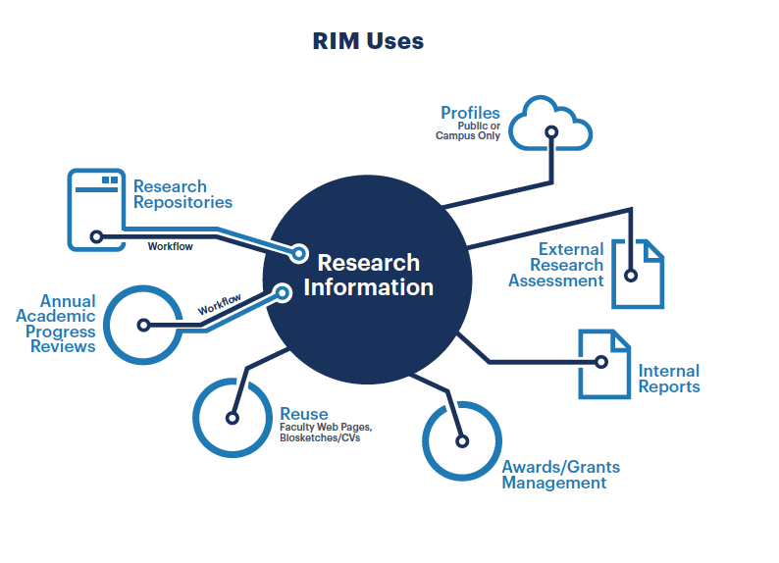
There are multiple RIM use cases, varying by institution and region
“RIM Uses” by OCLC Research, from Research Information Management: Defining RIM and the Library’s Role (doi.org/10.25333/C3NK88), CC BY 4.0
Notes:
We developed a second model that describes RIM uses. In general, if an institution is aggregating research metadata at least one of these uses, we would include it within our RIM model. In this way we unite CRIS type activities, so commonly seen in Europe, with other uses like supporting academic progress review workflows or displaying public profiles for institutional reputation management/public profiles, which are more prominent in the United States.
I expect this model to evolve over time, and it should work to represent new, extensible practices in research information management.

Slide 10
Most institutions have more than one use. . . and, in the US, more than one system

Slide 11
Why now? Because we can.
Advancing technologies, standards, and networked information
Publication metadata harvesting at scale
  Scopus
  Web of Science
  PubMed
Persistent Identifiers (PIDs)
  DOIs
  ORCIDs
  GRID/ROR identifiers for institutions
“Drivers of RIM Adoption” by OCLC Research, from Research Information Management: Defining RIM and the Library’s Role (doi.org/10.25333/C3NK88), CC BY 4.0
Notes:
This is a fairly new practice for us here in the US, although CRIS systems in Europe have been around since the late 1990s. Why are we seeing this growth now?
In our RIM position paper, we talked about key drivers. External mandates aren’t a major driver for us here—definitely not like we see in the UK or Australia. But we do see increasing competition in a global environment. But the main thing I want to emphasize here is that we now have a way to capture this information. Before the internet, before massive databases of published content, it wasn’t possible to capture this information at scale. But the scholarly communications community—publishers, libraries, indexers, standards organizations—have worked to build an infrastructure that supports these efforts.
We can now harvest metadata at scale
And the adoption of PIDs continues to improve the quality of that effort

Slide 12
Two primary uses cases driving practice in the US
(plus kind of a third)
“RIM Uses” by OCLC Research, from Research Information Management: Defining RIM and the Library’s Role (doi.org/10.25333/C3NK88), CC BY 4.0
Notes:
So for the rest of my talk, I want to focus on two primary use cases that we observe as most important in the US:
Public Profiles
Faculty Activity reporting (here called annual academic progress reviews)
I’ll also talk about a third category, internal reporting or “data analytics” that is also super important, and growing.

Slide 13
Use case #1: Public researcher profiles
Goals
Nomenclature
Support expertise discovery
Collaboration, particularly internal to campus
Catalyze business & university relationships
Institutional reputation management & enhance external funding dollars
RNS (Research Networking System)
RPS (Research Profiling System)
EFS (Expert Finder System)
Notes:
This is like Florida ExpertNet, at multi-institutional scale, but more often we see local implementations, as you are all well familiar with.

Slide 14

https://experts.umn.edu
Based on Elsevier Pure (since 2015)
Originally Elsevier SciVal Experts (2012-15 pilot)
Covers all five University of Minnesota campuses
  Faculty
  Researchers (including post docs)
  Graduate students who are employed in research-related positions
  Staff members who are likely to publish research (like librarians)
Notes:
Of course the Deans of the academic colleges weren’t thinking that deeply about bibliographic data in 2012 when they asked the Libraries to license and administer SciVal Experts. They wanted that product from Elsevier, and the Libraries were already working with Elsevier.
Experts@Minnesota is our implementation of Elsevier’s Pure. We currently have about 7,000 profiles include faculty, researchers, and a lot of staff members like me who publish research in our fields of expertise but are not strictly researchers.

Slide 15
Key institutional stakeholders
"I don't think that the campus [RIM system] would have been successful as a library-only initiative. . . . It's been absolutely critical that it was backed by the [office of research] because I think that's also helped keep it to be more of a campus-wide perspective.
VP Research & research development staff
  CTSA awards holders
Library
Campus IT
Campus communicators
Others:
  Academic affairs
  HR
  Graduate school
Research development has worked “hand in glove with the library” on the public profiles on our campus.
Notes:
The VP of research and research development professionals within the office of research are keen to connect researchers, develop strong interdisciplinary scientific research teams, and yield successful grant applications. Sponsored programs and medical center staff within the research enterprise may also use public profile systems to comply with US National Institutes of Health (NIH) Clinical and Translational Science Awards (CTSA) recommendations, which call for participating institutions to support collaboration among clinical and translational investigators through the provision of tools, training, and technology.
The library values these systems for registering the institutional record of the institution, a manifestation of the “inside out” library, and offers bibliographic expertise.
ITC professionals may be called upon to provide technical support as well as to support system to system interoperability. In one case, we found campus IT as the home for the institutional profile system.
Campus communicators value resources that can help support discovery of experts for press requests and public interest stories, values shared across silos—within academic affairs units as well as research units.
Other stakeholders—in academic affairs and other units in the office of research --are interested in how the aggregated content might inform institutional decision support.

Slide 16
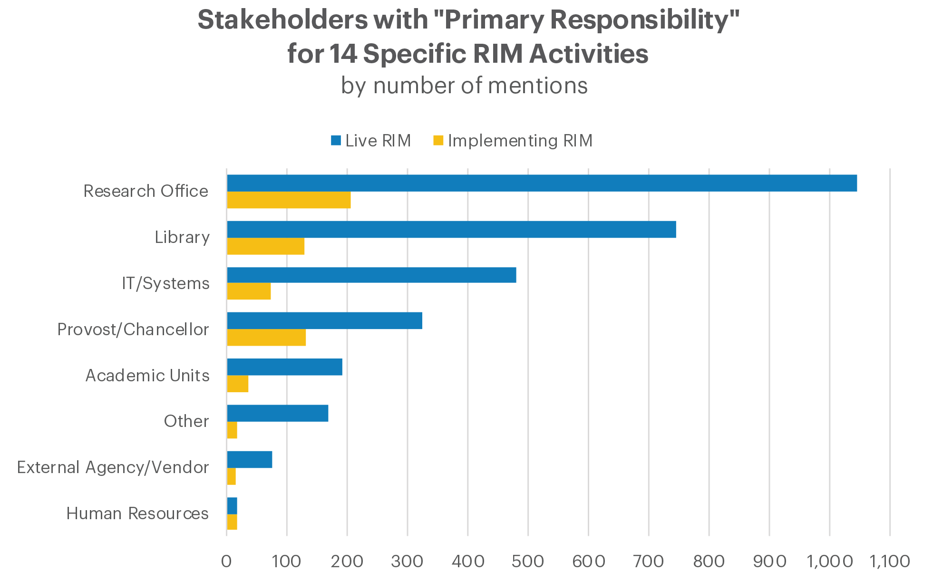

“Primary stakeholders based on total number of mentions across all responses for all areas of activity, in aggregate. Note that multiple primary stakeholders could be selected per area of activity” by OCLC and euroCRIS, Practices and Patterns in Research Information Management: Findings from a Global Survey (DOI:10.25333/BGFG-D241), CC BY 4.0
Notes:
These are GLOBAL figures
Libraries DO play an important role in RIM activities.
Libraries are the second most important player in this field, based on their primary responsibility for RIM activities. Only the Research Office has primary responsibility for more RIM activities.
Libraries were most likely to play a primary role in supporting
Open access, copyright, and deposit
Metadata validation workflows
Research data management activities
Metadata entry, and training and support
but less so project management or finances, which means that RIM activities are often supported but rarely led by libraries.

Slide 17
Stakeholders with Primary Responsibility for RIM Activities by Country
Based on # of Mentions (Decreasing Importance of Library)
Base: Institution with a Live RIM system
Practices and Patterns in Research Information Management: Findings from a Global Survey (DOI:10.25333/BGFG-D241), CC BY 4.0
Notes:
We also found regional differences in the role played by the library. The light blue box indicates when the library plays the greatest role in RIM responsibility. It’s greatest in the Netherlands where we’ve seen libraries increasingly assume responsibility that was previously held by the research office. We also see strong library engagement in the US. There’s less activity in other countries, and I’ll specifically call out Australia, where the research office maintains the RIM system and the libraries have primary responsibility for the publication and data repositories that increasingly need to intersect with the RIM systems.
But in many cases, we still see an important role for the library.

Slide 18
Libraries and RIM
“Libraries in Research Information Management” by OCLC Research, from Research Information Management: Defining RIM and the Library’s Role (doi.org/10.25333/C3NK88), CC BY 4.0

Slide 19
Use case #2: Faculty Activity Reporting (FAR)
Goals
Nomenclature
Support workflow for annually collecting research, teaching, and service activities
Aggregate information for reuse in decision support, academic review, accreditation, and even P&T
Faculty Activity Reporting (FAR)
Faculty Information System (FIS)
Annual academic progress reviews
Faculty Report of Professional Activities (FRPA)

Slide 20
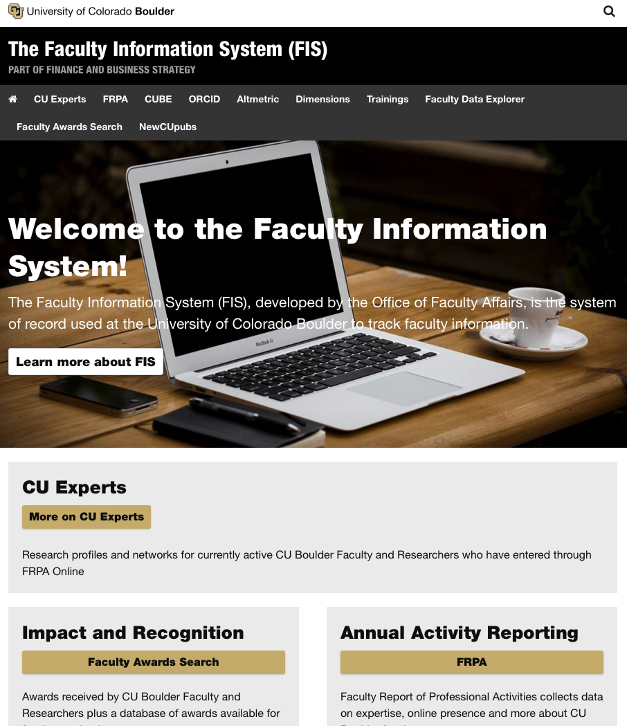
https://www.colorado.edu/fis/
FAR workflow uses Symplectic Elements
Also populates VIVO public profiles
    Data used to support
        Web pages
        Grant reporting
        Media requests

Slide 21
Key FAR stakeholders
Academic affairs units, including departments, colleges, and the provost’s office,
Faculty Affairs units
Campus IT
Library
Others:
  VP Research
  HR
  EDW
  Graduate school
  Registrar
Notes:
cademic affairs units, including departments, colleges, and the provost’s office, are interested in faculty activity reporting practices. Colleges and campus level units are particularly interested in not only improved workflows but also the improved aggregated data that can used to for decision support. However, there is often a great deal of unit autonomy, leading to heterogeneous practices and duplication of effort and systems. The data aggregated in FAR workflows can also be reused for academic program reviews and program accreditation. []
Faculty Affairs units at some institutions, usually housed in the Office of the Provost, may take a leading role in implementing and managing a single FAR system for the institution.
ITC professionals play a role in supporting FAR workflows—at all levels of operation, whether it’s at the departmental or institutional level. And they may also work to provide data from other campus systems to populate the system, such as HR appointment data.
The library is also a stakeholder, providing expertise related to publications metadata, metadata harvesting workflows, and research impact metrics. The library may also play a role in vendor negotiations.
There are other stakeholders whose roles are important because their unit or system provides data for the FAR system, such as human resources (for appointment information), the registrar and/or the data warehouse (for course information), and the graduate school (for doctoral mentoring and committee service).

Slide 22
Duplication
FAR, public profiles, and other workflows are still largely separate
Colleges, departments, institutes, still maintain their own processes
We have not yet achieved, “enter once, reuse often”
The data often can’t be aggregated for a consistent, enterprise-level view
“We have six or seven research profiling systems [on our campus]. That is duplication of service, for sure.”
Notes:
Because American higher education is decentralized and is characterized by a lot of local control, there’s duplication, as multiple units seek to address their local uses.

Slide 23
Use case #3 (sorta): Research analytics
Aggregation of content from internal & external sources
  More than the RIM system
  Data analysis & visualizations
  Competitive analysis, citation maps, altmetrics, co-authorship networks, and more
Increasing movement toward
  Centralized data analytics offices
  Campus data governance
  Data lakes
”Data. Data! I’d have data at my fingertips.”
The office of research wants “push button reporting” about grants, collaborators. . . .
Case study: Making Connections: Research Analytics at Virginia Tech. https://hangingtogether.org/?p=7854

Slide 24
We need improved interoperability
Technical
Social
Institutions struggle to aggregate content from various systems like HR, grants
Data not “fit for purpose”
We need broader PID adoption for disambiguation & data harvesting at scale
Individuals and units don’t know how their knowledge and data can work together
A new university president is “appalled” at the difficulty of understanding institutional research strengths in a data rich way.
“There just needs to be the human touch and coordination behind the scenes to make sure that all the units are working together in the way that they should, that all the efforts are strategically aligned.”

Slide 25

Some thoughts on the uniqueness of RIM practices in the United States
Photo by Morgan Lane on Unsplash
Notes:
To implement RIM practices in the US, we are often using systems developed in Europe like Pure (Denmark) and Symplectic Elements (UK), but these are developed in different environments, to fit different purposes. The products are evolving to better fit US needs, but I think it’s useful to take a look at some global data to better understand this landscape.

Slide 26
Practices and Patterns in Research Information Management: Findings from a Global Survey
Rebecca Bryant, PI, OCLC Research
Pablo de Castro, Strathclyde University and euroCRIS
Anna Clements, University of St. Andrews and euroCRIS
Annette Dortmund, OCLC EMEA
Jan Fransen, University of Minnesota, Twin Cities
Michele Mennielli, DuraSpace and euroCRIS
Plus a number of valuable collaborators at OCLC
oc.lc/rim
Notes:
We built upon that work in collaboration with the euroCRIS organization to develop the survey we are talking about today.
euroCRIS is an not for profit global association for research information experts, technology and best practice. Founded in 2002 – euroCRIS now has over 200 institutional and individual members in 45 countries – including Europe of course, but also North and South America, Australia / NZ, Middle East, China, Japan and India.
euroCRIS and OCLC entered into a strategic partnership in 2017. One of our goals is to conduct research together on research information management practices, including this survey on research information management practices. [which builds upon previous euroCRIS/EUNIS research].
Our main goal was to identify some global trends and to lay the foundation for future quantitative research in the field.

Slide 27
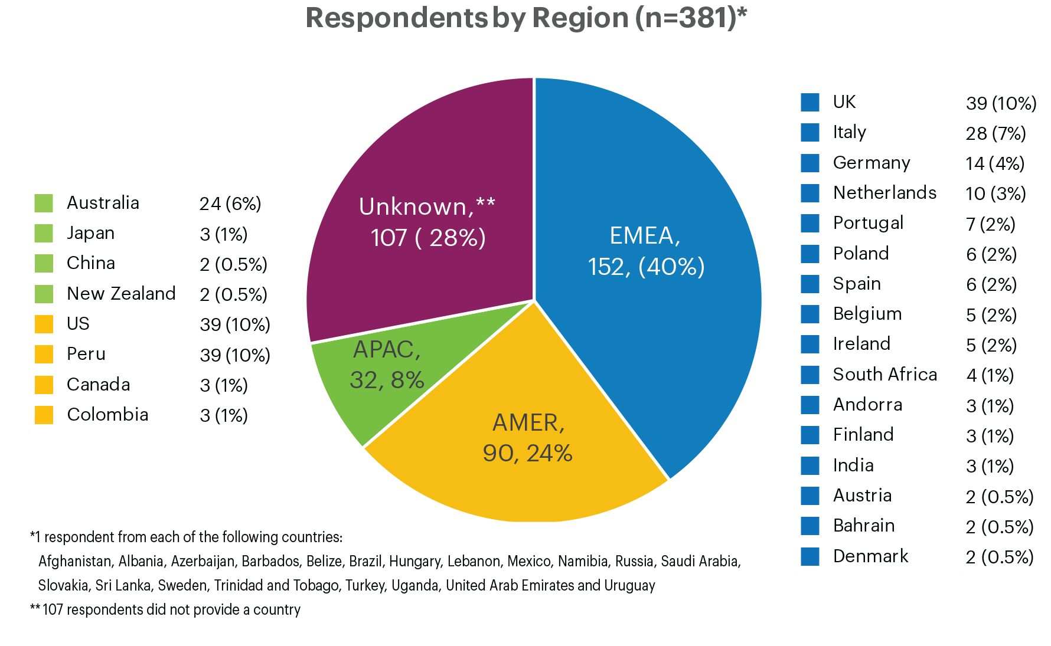
RIM Survey responses: geographic overview
381 survey respondents from 44 countries
Europe, Middle East, & Africa
Asia-Pacific
Americas
“Total number of survey respondents, by broad region” by OCLC and euroCRIS, Practices and Patterns in Research Information Management: Findings from a Global Survey (DOI:10.25333/BGFG-D241), CC BY 4.0

Slide 28
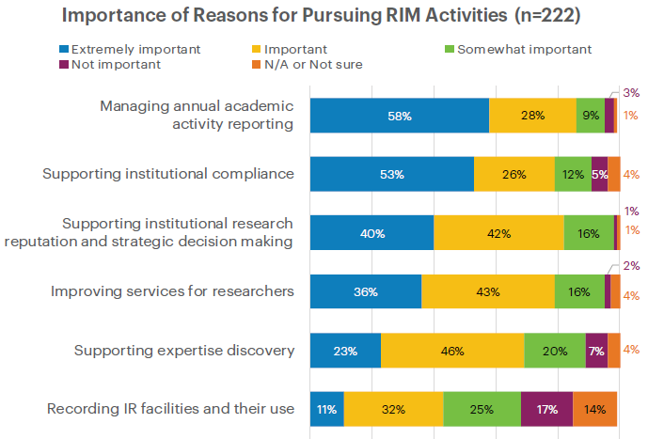
Reporting & compliance drive RIM adoption (globally)
Practices and Patterns in Research Information Management: Findings from a Global Survey (DOI:10.25333/BGFG-D241), CC BY 4.0

Slide 29
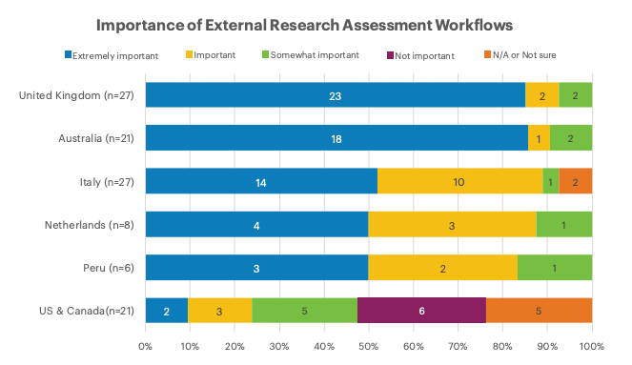
External research assessment is less important in the US
Practices and Patterns in Research Information Management: Findings from a Global Survey (DOI:10.25333/BGFG-D241), CC BY 4.0
Notes:
This is a response to a different question, but illustrates what we think is the reason for the importance of institutional compliance at so many institutions.
In addition to asking why institutions had pursued RIM, we also asked how they were using their current RIM system. One of the options was “Supporting external research assessment workflows,” and we saw some clear regional differences there. In the UK and Australia, countries with national research assessment exercises, this function was extremely important to nearly all respondents. And that use was at least important in most institutions in Italy, the Netherlands, and Peru. But it was far less important in the US and Canada, which don’t have standardized requirements for reporting research outcomes or national assessment exercises.
Figure 20. Importance of RIM function “External Research Assessment” by country.

Slide 30
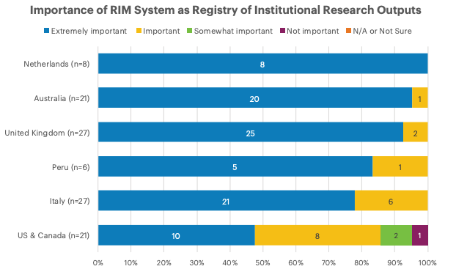
US institutions are also less concerned with maintaining a complete registry of all research outputs
Practices and Patterns in Research Information Management: Findings from a Global Survey (DOI:10.25333/BGFG-D241), CC BY 4.0
Notes:
Again, we were interested in regional differences. As with compliance with external mandates, most countries with enough respondents to look at separately considered the RIM an extremely important registry of institutional research outputs. The US and Canadian respondents, however, placed far less importance on this function.
Figure 24. Importance of RIM function “Registry of Institutional Research Outputs,” grouped by country.

Slide 31
While globally, supporting expertise discovery isn’t a primary use case
Notes:
Spoiler: For the University of Minnesota, supporting expertise discovery was our number one reason for pursuing RIM. If that’s the case at your institution too, these results might look surprising. Remember, the Blue side is extremely important.
And near the top you see supporting institutional compliance. If you’re asking “compliance with what?” you’re probably not alone.
The group designing the survey came from several different countries, though, so we suspected these bars would look different depending on your institution’s country. Let’s look first at expertise discovery.

Slide 32
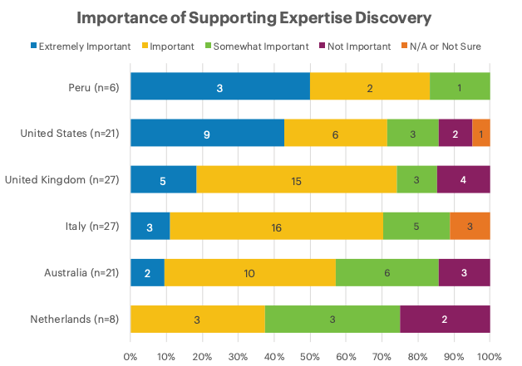
In the US, public profiles to support expertise discovery are quite important
Practices and Patterns in Research Information Management: Findings from a Global Survey (DOI:10.25333/BGFG-D241), CC BY 4.0
Notes:
These are the countries where we felt we had enough responses to draw some tentative conclusions from the results.
Expertise discovery wasn’t unimportant to many institutions overall, but if you’re not in Peru or the US or Canada it’s not likely to be a major driver.
By contrast, no institutions in the Netherlands considered Expertise Discovery “extremely important.” This is likely because the Dutch have a nationally aggregated portal, NARCIS, for discovery of expertise and research.

Slide 33
References
Bryant, Rebecca, Anna Clements, Carol Feltes, David Groenewegen, Simon Huggard, Holly Mercer, Roxanne Missingham, Maliaca Oxnam, Anne Rauh and John Wright. 2017. Research Information Management: Defining RIM and the Library’s Role. Dublin, OH: OCLC Research. doi:10.25333/C3NK88
Bryant, Rebecca, Annette Dortmund, and Constance Malpas. 2017.
Convenience and Compliance: Case Studies on Persistent Identifiers in European Research Information. Dublin, Ohio: OCLC Research. doi:10.25333/C32K7M
Bryant, Rebecca, Anna Clements, Pablo de Castro, Joanne Cantrell, Annette Dortmund, Jan Fransen, Peggy Gallagher, and Michele Mennielli. 2018. Practices and Patterns in Research Information Management: Findings from a Global Survey. Dublin, OH: OCLC Research. https://doi.org/10.25333/BGFG-D241

Slide 34
Virtual Symposium: Expertise Systems in Florida Universities * May 12, 2020
Research Information Management in the United States
Rebecca Bryant, PhD
Senior Program Officer, OCLC Research
bryantr@oclc.org @RebeccaBryant18
https://orcid.org/0000-0002-2753-3881

