Slide 1
SEADDA WG4 Exploratory Workshop • Virtual Meeting • 31 March – 2 April 2020
Archaeological data practices and the implications for successful data sharing and reuse
Ixchel M. Faniel, PhD
Senior Research Scientist
fanieli@oclc.org
@imfaniel

Slide 2
Data Reusability from the researcher’s perspective

Slide 3
Data Reuse for Research
“it’s around questions of society, economy, religion in the bronze and iron ages in the ancient Middle East…recently I’ve been mostly working with the museum collection…that was excavated in the 1920s and ’30s from one site.”
- Archaeologist 21
“We are analyzing…Phylogeographic information from more than 20 different species…in the light of the climatic data.”
- Zoologist 09
“I was interested in…how imprisonment rates co-occur with other larger social and economic processes, particularly the labor market.”
- Social Scientist 15

Slide 4
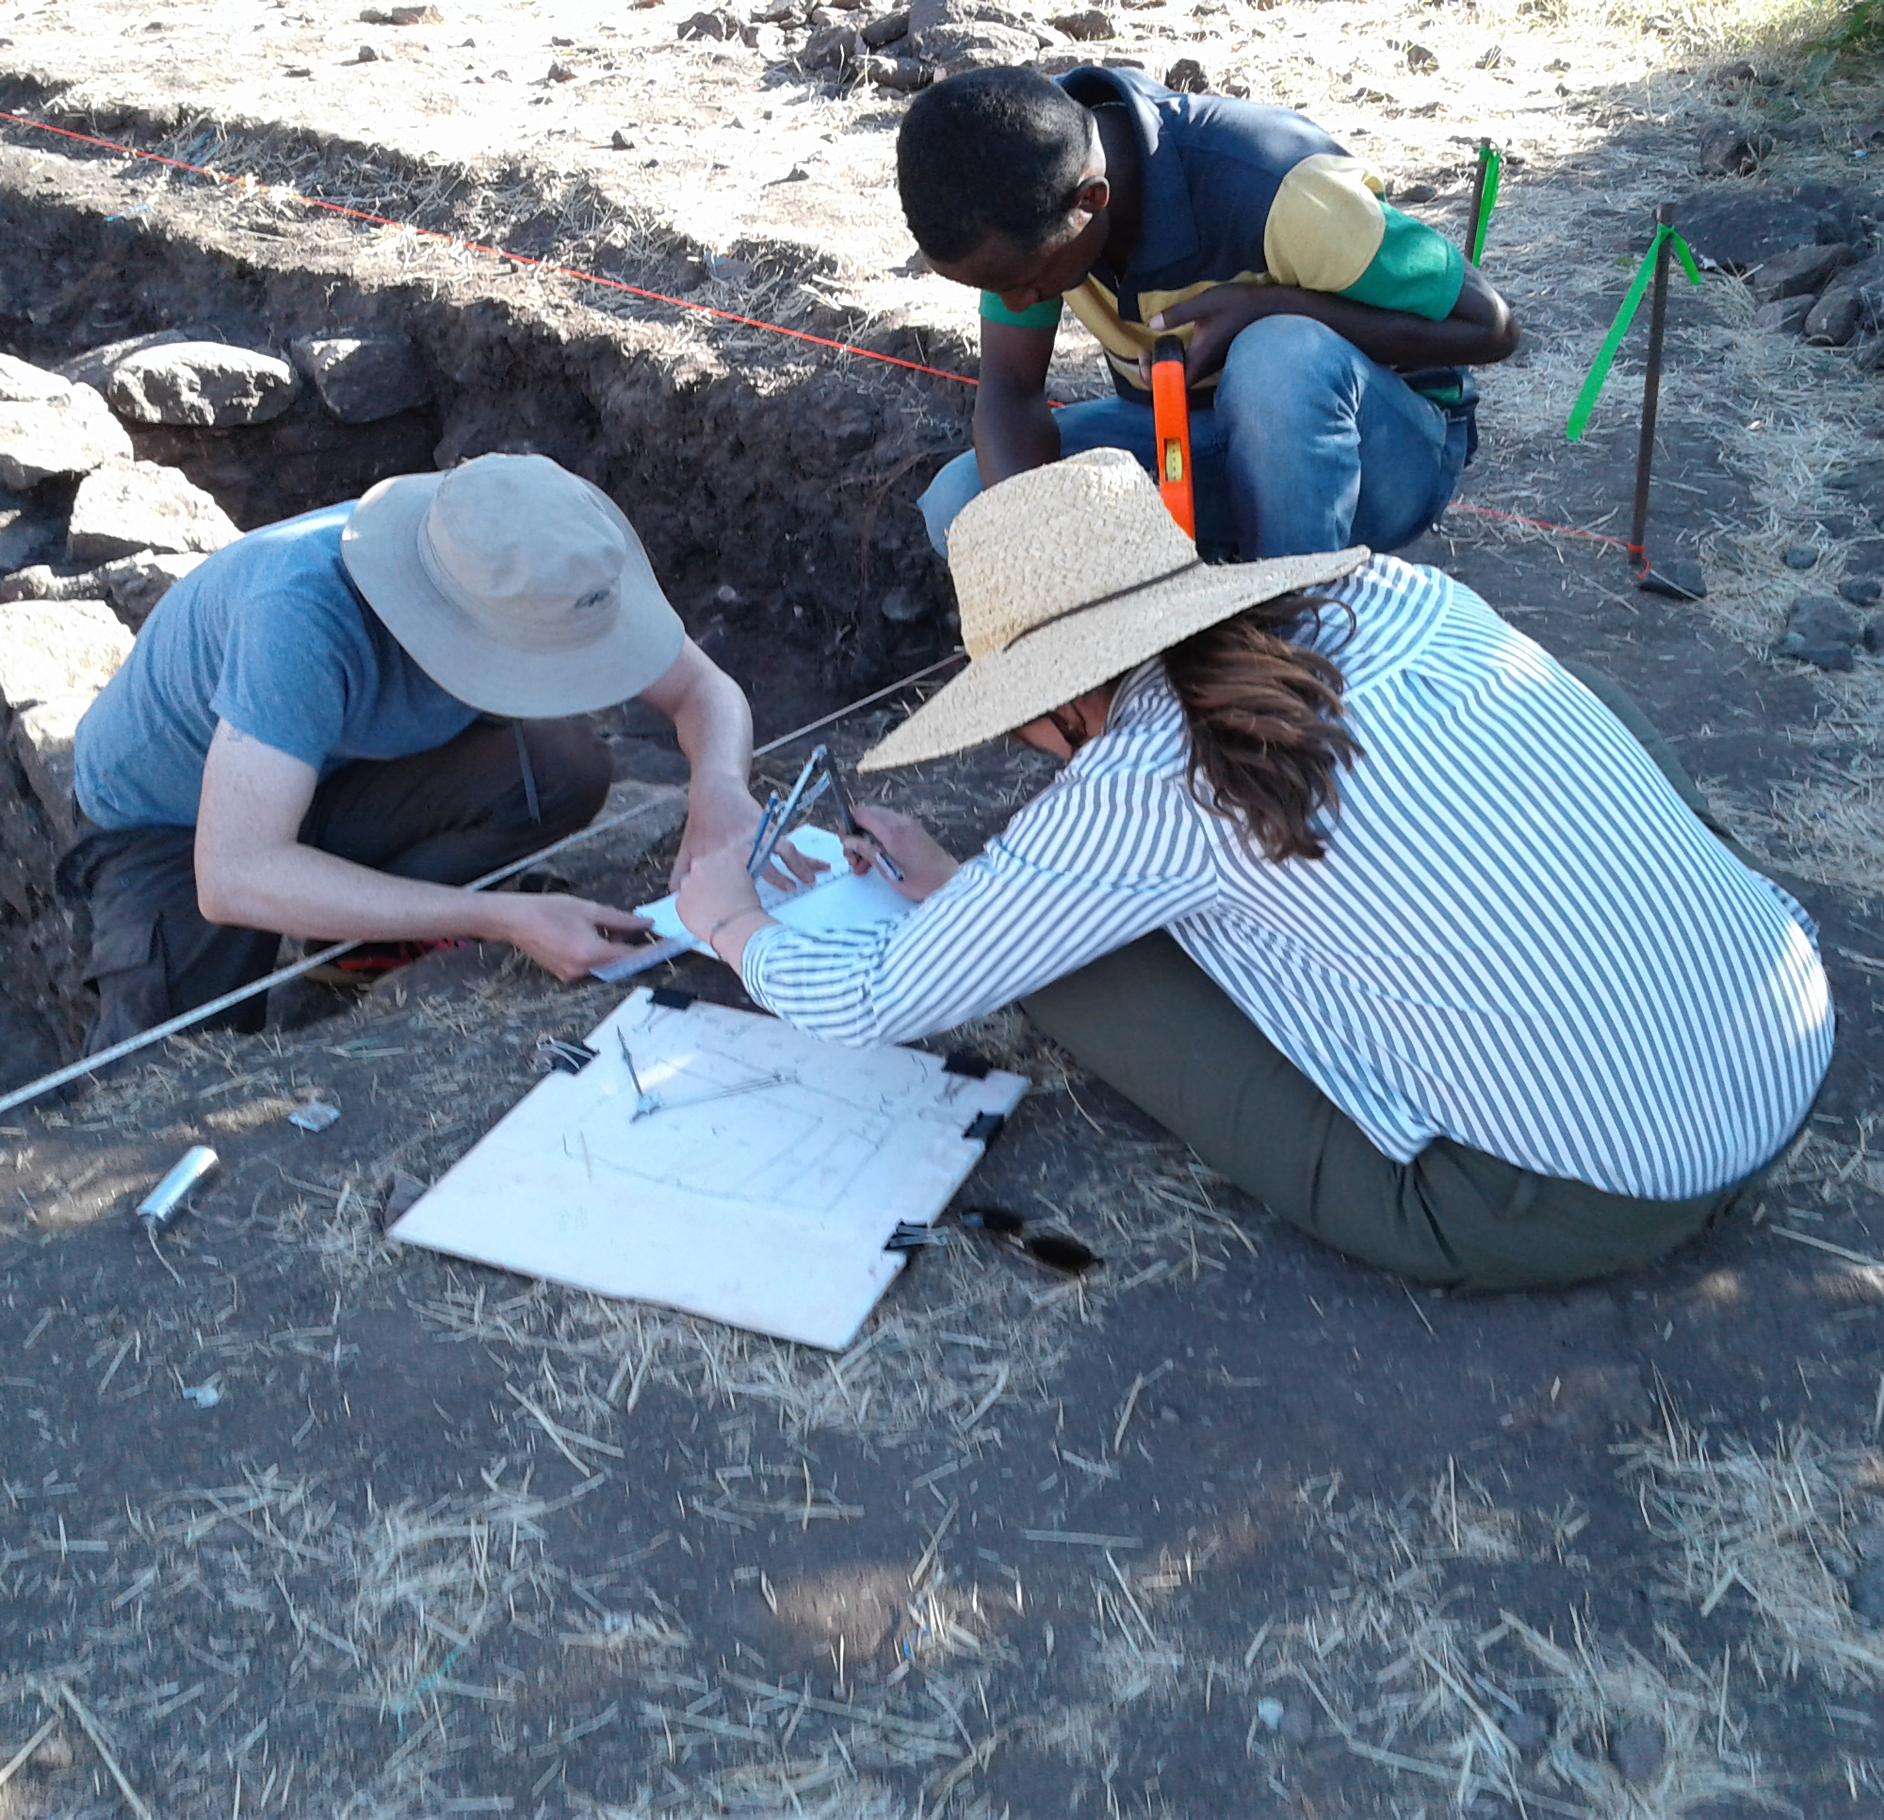
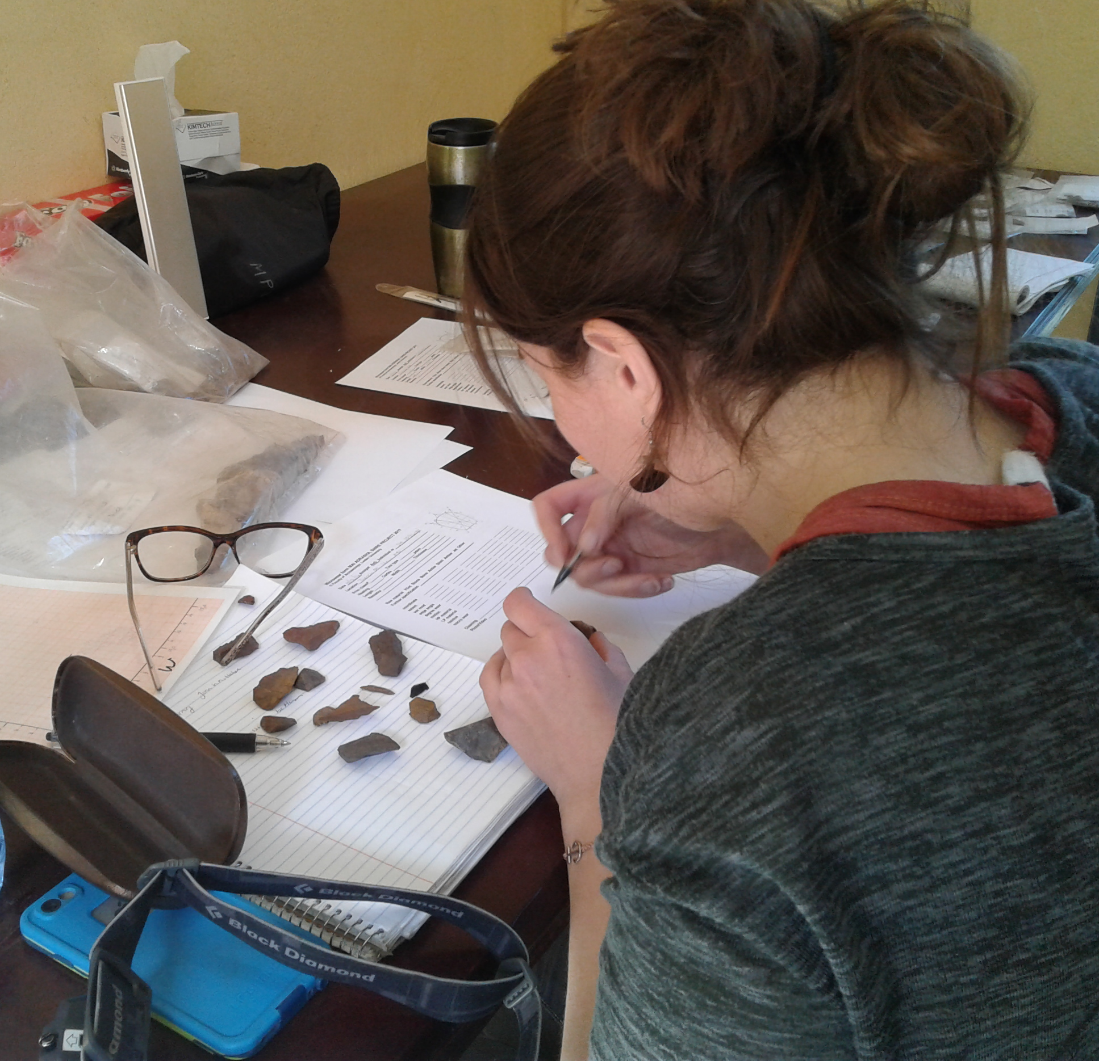
Successful data reuse from a researcher’s perspective requires information about the data, from a variety of sources, such that data’s quality can be evaluated.
(e.g., Faniel, Frank, & Yakel, 2019;
Faniel & Yakel, 2017;
Faniel, Kriesberg, & Yakel, 2016)

Slide 5
Types of Context Information
Repository Information
Provenance
Reputation and History
Curation and Digitization
Data Reuse Information
Prior reuse
Terms of Use
Advice on reuse
Data Production Information
Data Collection
Specimen and Artifact
Data Producer
Data Analysis
Missing Data
Research Objectives
(Faniel, Frank, & Yakel, 2019)

Slide 6
Role of Context Information
(Faniel, Frank, & Yakel, 2019)

Slide 7
Sources for Context Information
(Faniel & Yakel, 2017)

Slide 8
Reasons Reuser Needed Context
(Yakel, Faniel & Frank, unpublished mss.)

Slide 9
When we look at reusability from a researchers’ perspective, the ability of data repositories to provide reusable data is a direct result of what data producers are being asked to share during data deposit.

Slide 10
Virtuous and vicious circles in the data lifecycle

Slide 11
Virtuous and Vicious Circles in the Data Lifecycle
Production
Data Selection
Data Collection
Data Management
Data Consistency
File format
Reuse
Standards
Data Collection
Data Management
Increased sharing culture
Sharing
Selection
Ownership
Data Management
Decoding
Curation
Decoding
File format
Chronology
(Yakel, Faniel & Maiorana, 2019)

Slide 12
Key Findings
All stages influenced one another, except for curation, which only impacted reuse.
Sharing impacted curation the most, followed by reuse.
Production impacted the other stages most frequently and most impacts were negative.
Most curation impacts on reuse were positive.
Reuse impacted the other stages the least frequently, but all impacts were positive.
(Yakel, Faniel & Maiorana, 2019)

Slide 13
“Until this activity, most were unaware of the undue influence their idiosyncratic data documentation and management practices could have on themselves, data curators and reusers.”
(Yakel, Faniel, & Maiorana, 2019)

Slide 14
Aligning data production and sharing practices with curation and reuse needs

Slide 15
Archaeological Data Practices
Excavation Data
How are specialist data being integrated with excavation data during archaeological excavation projects?
What opportunities for collective curation might improve the integration of specialist data with excavation data?
Specialist Data
(Faniel et al., 2020)
Notes:
Image: Public domain (no attribution) via https://pixabay.com/vectors/computer-data-database-diagram-1294359/

Slide 16
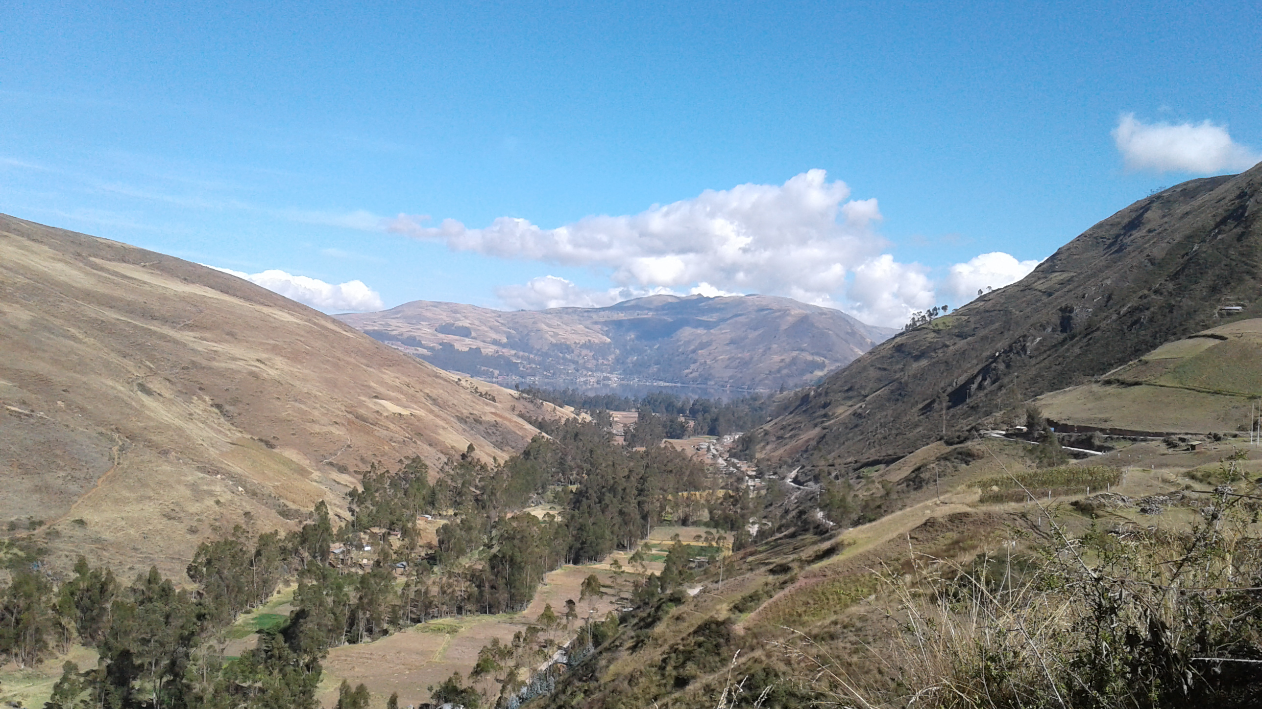
The Americas Project
Notes:
Image taken by project staff

Slide 17
Having specialist trench supervisors did not ease data integration.
“So whatever, you know, special data [one trench supervisor] may have people collecting for what she's sampling out or what [another trench supervisor] may be taking...I still have kind of the way we’ve been doing it so that the information that we're taking now can be comparable with at least other chunk of material that's been collected over the last 10 years.”
- Project director, Americas project
Collective curation must start at the point of data creation.
(Faniel et al., 2020)

Slide 18
Recommendations
Develop clearly written documentation guidelines for trench teams
Appoint bilingual supervisor to evaluate and supervise field work
Develop a written specialist agreement
ACCEPTED
AND
IMPLEMENTED
(Faniel et al., 2020)

Slide 19
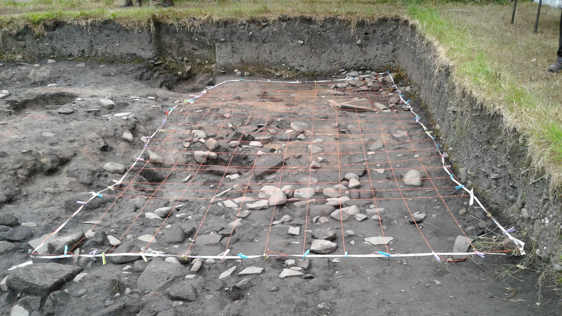
Europe Project 1
Notes:
Image taken by project staff

Slide 20
Limited project director-specialist communication about data exchange.
“But as far as I know, there is no convention set for…how reports are produced and what format they're produced in…Different specialists use so many different things.”
“So, it might just be that some of the specialist information doesn't get into the database, it just remains as a report that's there as part of the project [paper] archive.”
- Archaeobotanist,
Europe project 1
- Co-director,
Europe project 1
Collective curation requires negotiation of needs and expectations.
(Faniel et al., 2020)

Slide 21
Recommendations
Track progress of specialist analysis and incorporate into annual reporting
Develop a specialist agreement
Train specialists in database structure and determine how to best integrate their data
Train project director and data manager in options to integrate different data formats
ACCEPTED
BUT
POSTPONED
REJECTED
(Faniel et al., 2020)

Slide 22
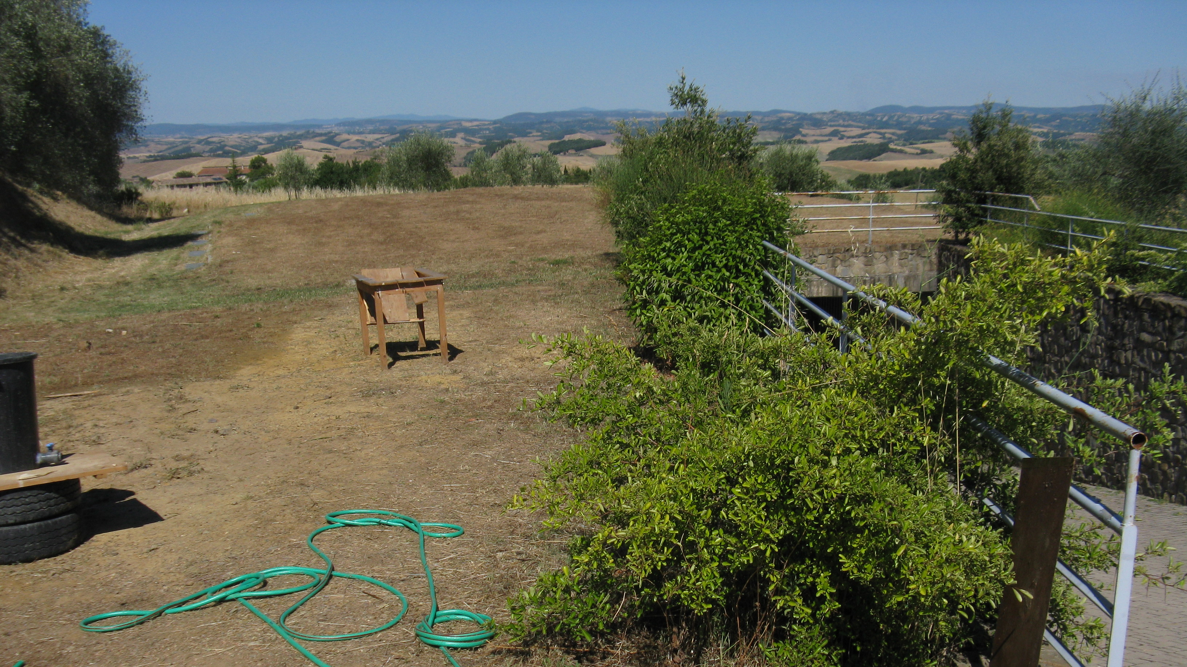
Europe Project 2
Notes:
Image taken by project staff

Slide 23
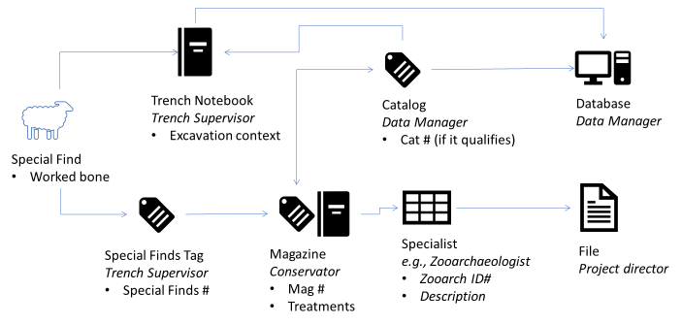
Specialists were not part of the project’s data workflow.
(Faniel et al., 2020)
Specialist data siloed
Collective curation requires redesigned workflows that eliminate silos.

Slide 24
Recommendations
Develop a written specialist agreement
Train project director and data manager in options for integrating different data formats
ACCEPTED
AND
IMPLEMENTED
(Faniel et al., 2020)

Slide 25
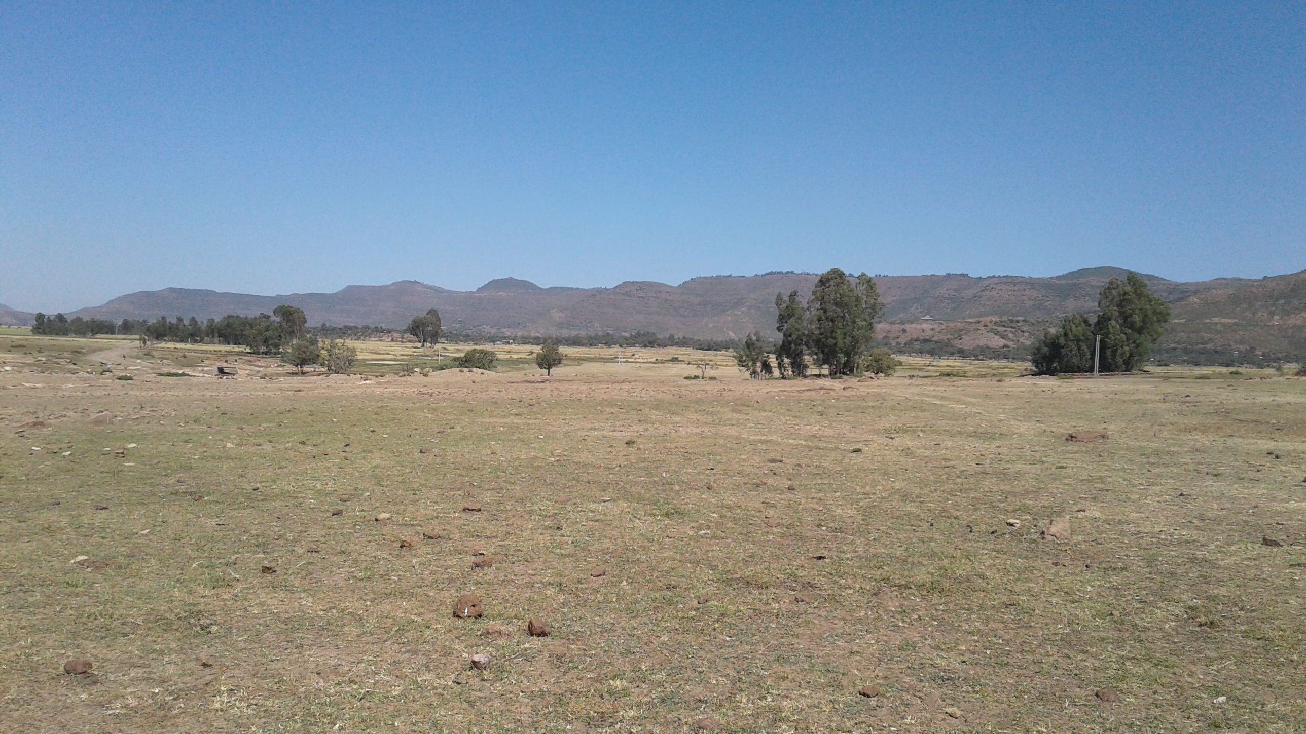
The Africa Project
Notes:
Image taken by project staff

Slide 26
Specialist-trench supervisor discussions fuel intellectual data integration.
“So there are a lot of these amorphous highs across the site...If one of the excavators was able to say, ‘Absolutely. I see that this amorphous whatever in my trench actually corresponds to this thermal feature or a concentration of metal,’…we could take that signature and look in areas that haven't been… excavated…So I had hoped for that, but it hasn't happened.”
- Geophysicist, Africa project
Collective curation needs intellectual as well as digital data integration.
(Faniel et al., 2020)

Slide 27
Recommendations
ACCEPTED
AND
IMPLEMENTED
Develop written specialist agreement
Restructure daily meetings to accommodate discussions about current field season’s excavations among trench supervisors and specialists
ACCEPTED
BUT
POSTPONED
(Faniel et al., 2020)

Slide 28
Implications

Slide 29
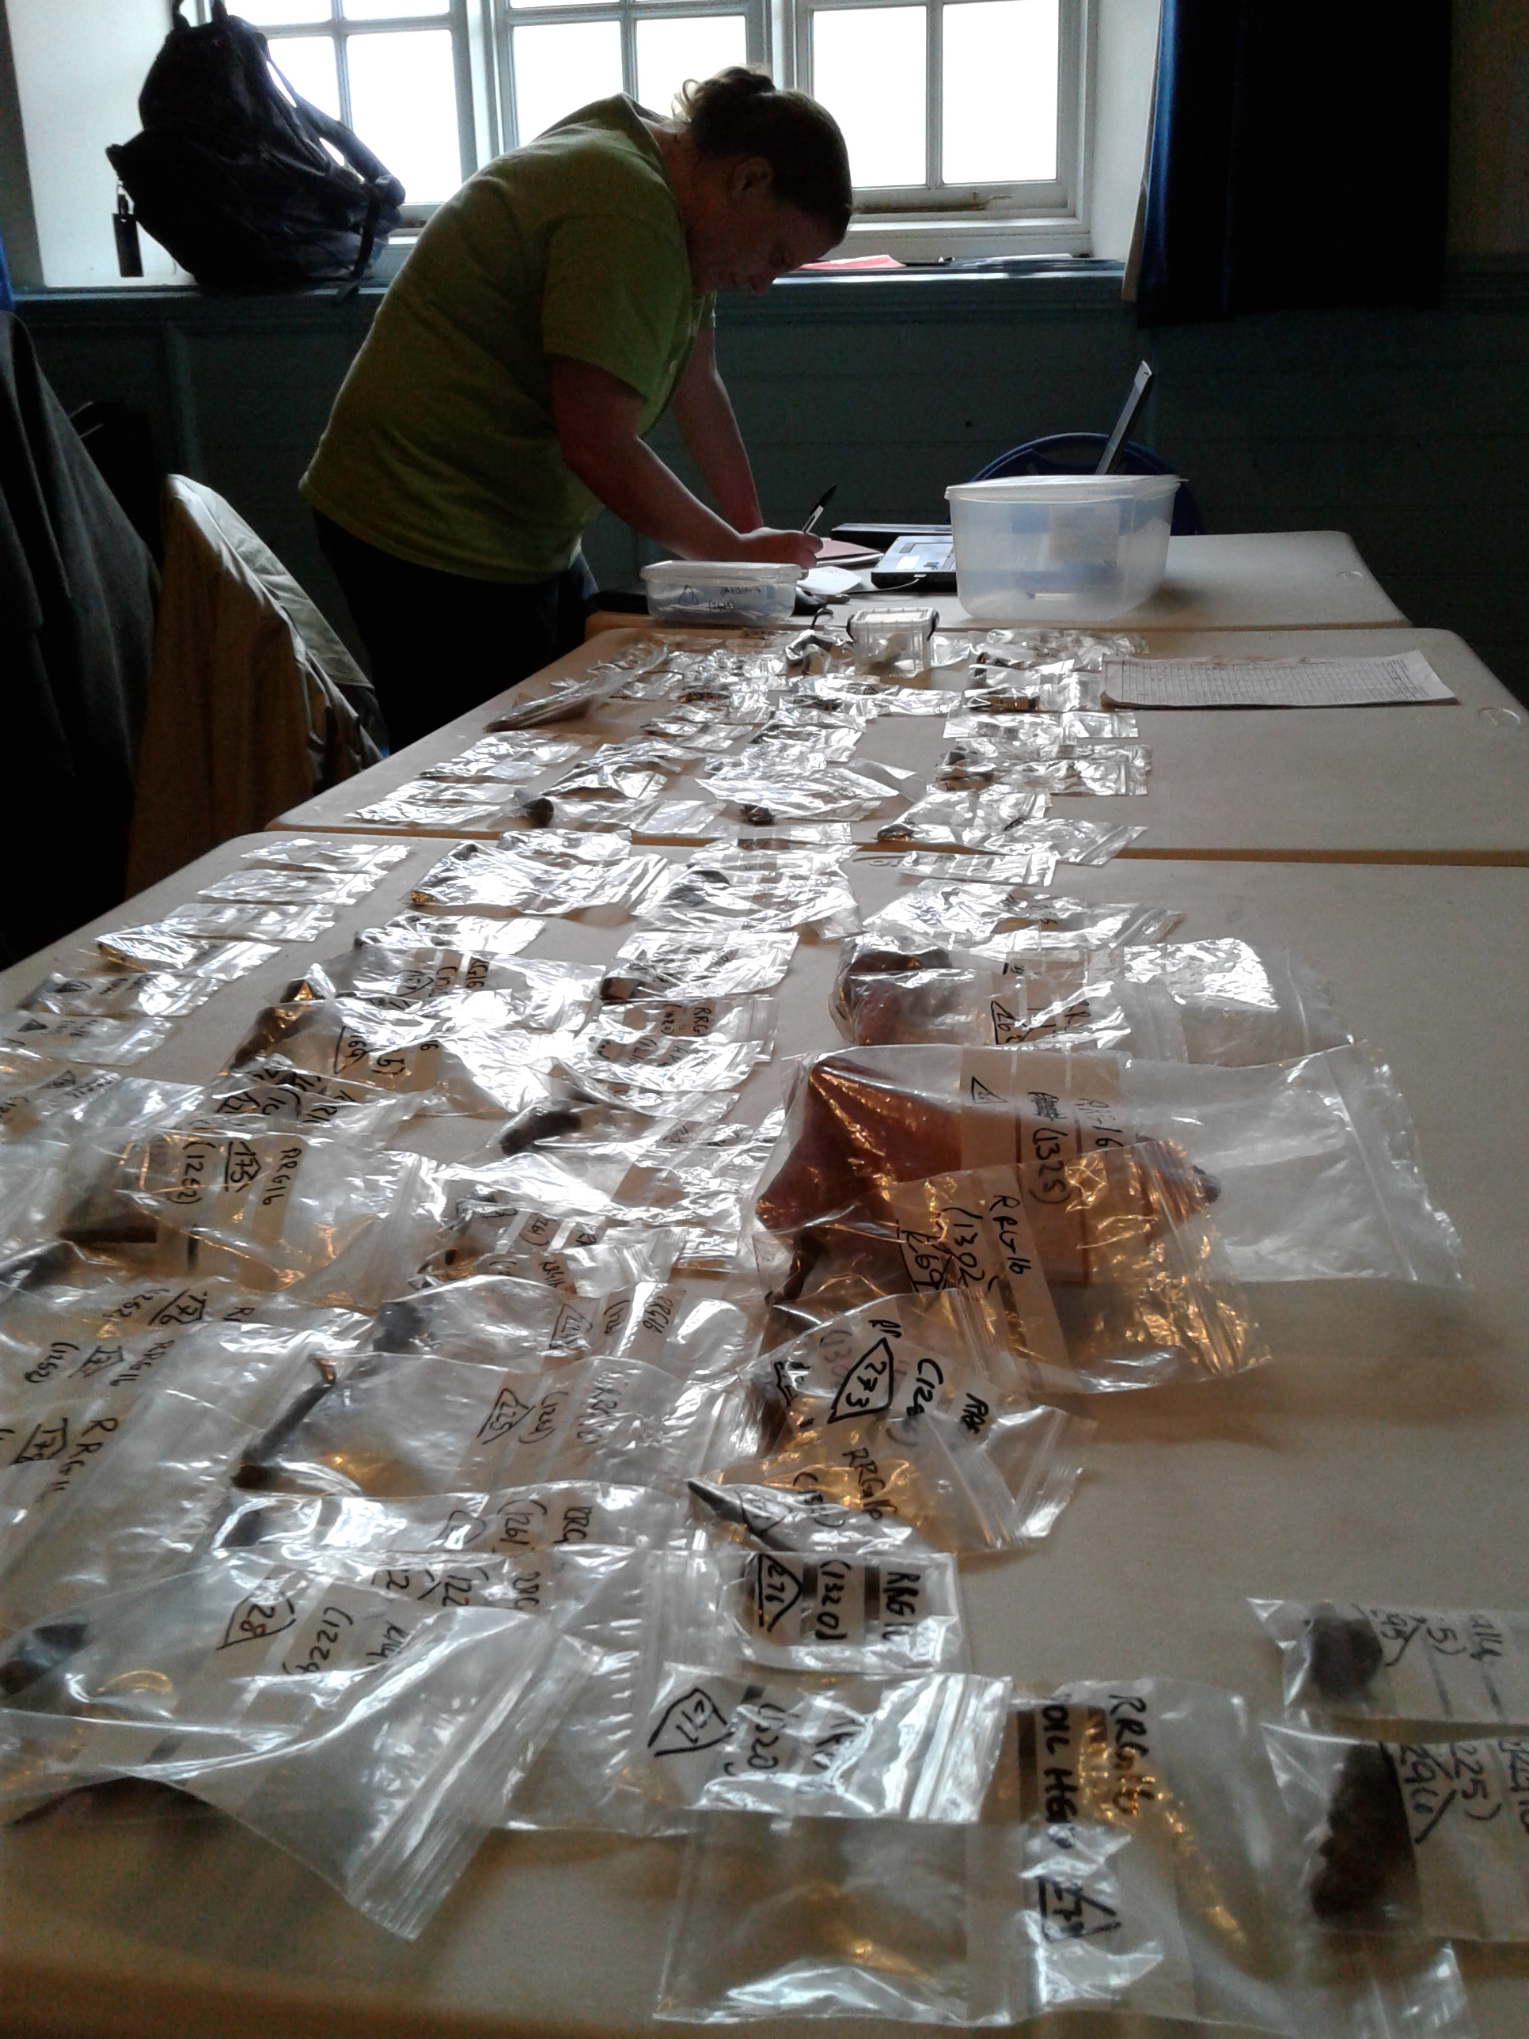
Implications
Begin curation at the point of data creation
Evolve data practices for smooth data flow throughout the lifecycle
Aligning data practices and needs through communication and coordination with multiple stakeholders
Notes:
Image taken by project staff

Slide 30
Projects
Dissemination Information Packages for Information Reuse (DIPIR)
https://www.oclc.org/research/themes/user-studies/dipir.html
Exploring Biogeography of Early Domestic Animals Using Linked Open Data
https://alexandriaarchive.org/linked-data/
The Secret Life of Data (SLO-data)
https://www.oclc.org/research/themes/research-collections/slo-data.html
The projects are listed here in the order in which the findings appear in this presentation.

Slide 31
Funding Acknowledgments
DIPIR
Institute of Museum and Library Services (LG-06-10-0140-10)
Exploring Biogeography of Early Domestic Animals Using Linked Open Data
Biogeography of Animal Domestication Using EOL, Encyclopedia of Life (http://eol.org/info/323) Computable Data Challenge 2012
Applying Linked Open Data: Refining a Model of Data Sharing as Publication, National Endowment for the Humanities (award #HK-50037-12)
Research Experience for Masters Students, Institute of Museum and Library Services (#RE-01-15-0086-15)
SLO-data
National Endowment for the Humanities (award #PR-234235-16)

Slide 32
Project Members
DIPIR
Ixchel Faniel, Elizabeth Yakel, Nancy McGovern, Eric Kansa, William Fink, Ji-Hyun Kim, Christopher Cyr, Julianna Barrera-Gomez, Rebecca Frank, Adam Kriesberg, Morgan Daniels, Ayoung Yoon, Anthea Josias, Alexa Hagen, Jessica Schaengold, Gavin Strassel, Michele DeLia, Kathleen Fear, Mallory Hood, Annelise Doll, Monique Lowe, Pearl Ko, Daniel Delmonaco, Molly Haig
Exploring Biogeography of Early Domestic Animals Using Linked Open Data
Sarah Whitcher Kansa, Eric Kansa, Benjamin Arbuckle, Elizabeth Yakel, Ixchel Faniel, Zachary Maiorana
SLO-data
Sarah Whitcher Kansa, Eric Kansa, Ixchel Faniel, Anne Austin, Jennifer Jacobs, Phoebe France, Brittany Brannon

Slide 33
References
Faniel, I. M., Austin, A., Kansa, S. W., Kansa, E., Jacobs, J., and France, P. (2020). Identifying opportunities for collective curation during archaeological excavations. International Digital Curation Conference, 17-20 February, Dublin, Ireland.
Faniel, I. M., Frank, R. D., & Yakel, E. (2019). Context from the data reuser’s point of view. Journal of Documentation. https://doi.org/10.1108/JD-08-2018-0133. Post-print at https://www.oclc.org/research/publications/2019/context-from-data-reuser-point-of-view.html.
Faniel, I. M., Kriesberg, A., & Yakel, E. (2016). Social scientists’ satisfaction with data reuse. Journal of the Association for Information Science and Technology, 67(6), 1404–1416. doi: 10.1002/asi.23480. Preprint at https://www.oclc.org/research/publications/2015/social-scientists-satisfaction-with-data-reuse.html.
Faniel, I.M., & Yakel, E. (2017). Practices do not make perfect: Disciplinary data sharing and reuse practices and their implications for repository data curation. In L.R. Johnston (Ed.), Curating research data volume 1: Practical strategies for your digital repository (pp. 103-125). Chicago: Association of College and Research Libraries Press. Retrieved from https://www.oclc.org/research/publications/2017/practices-do-not-make-perfect.html.
Yakel, E., Faniel, I. M., & Frank, R. D. (n.d.). Unpublished manuscript.
Yakel, E., Faniel, I.M. & Maiorana, Z.J. (2019). Virtuous and vicious circles in the data life-cycle. Information Research, 24(2), paper 821. Retrieved from http://InformationR.net/ir/24-2/paper821.html (Archived by WebCite® at http://www.webcitation.org/78mo44T8I)
All photographs taken by project team members

Slide 34
Thank you
Ixchel M. Faniel, PhD
Senior Research Scientist
fanieli@oclc.org
@imfaniel

