Slide 1
Melbourne • RMIT • 13 February 2020
Speaking on the Record:
Combining Interviews with Search Log Analysis in User Research
Lynn Silipigni Connaway, Ph.D.
Christopher Cyr, Ph.D.
Director of Library Trends and User Research, OCLC
Associate Research Scientist, OCLC
Brittany Brannon, MLIS, MA
Peggy Gallagher, MLS, MMC
Research Support Specialist, OCLC
Market Analysis Manager, OCLC

Slide 2
Research team
Lynn Silipigni Connaway
Director of Library Trends and User Research
connawal@oclc.org
@LynnConnaway
Christopher Cyr
Associate Research Scientist
Brittany Brannon
Research
Support Specialist
Peggy Gallagher
Market Analysis Manager
Erin Hood
Research Support Specialist

Slide 3
Theoretical Background
Log analysis to collect large amounts of unbiased user data
(Jansen 2006, Connaway and Radford 2017)
Logs used to study how people use online systems
Catalog Search failure rates
Behavior of digital library users
Use of e-journals
User experience with video and music streaming services
(Hunter 1991; Jamali, Nicholas, and Huntington 2005; Lamkhede and Das 2019; Nouvellet, et al. 2019)
Notes:
Jansen, Bernard J. 2006. “Search Log Analysis: What It Is, What’s Been Done, How to Do It.” Library and Information Science Research 28, no. 3: 407–432.
Connaway, Lynn Silipigni, and Marie L. Radford. 2017. Research Methods in Library and Information Science, 6th ed. Santa Barbara, CA: Libraries Unlimited.
Hunter, Rhonda N. 1991. “Successes and Failures of Patrons Searching the Online Catalog at a Large Academic Library: A Transaction Log Analysis.” RQ 30, no. 3: 395–402. https://www.jstor.org/stable/25828813.
Jamali, Hamid R., David Nicholas, and Paul Huntington. 2005. “The Use and Users of Scholarly E-Journals: A Review of Log Analysis Studies.” Aslib Proceedings 57, no. 5: 554–571. https://doi.org/10.1108/00012530510634271.
Lamkhede, Sudarshan, and Sudeep Das. 2019. “Challenges in Search on Streaming Services: Netflix Case Study.” In the Proceedings of SIGIR ’19, July 21–25, 2019, Paris, France. https://arxiv.org/pdf/1903.04638.pdf.
Nouvellet, Adrien, Florence D’Alché-Buc, Valérie Baudouin, Christophe Prieur, and François Roueff. 2019. “A Quantitative Analysis of Digital Library User Behaviour Based on Access Logs.” Qualitative and Quantitative Methods in Libraries 7, no. 1: 1–13.

Slide 4
Theoretical Background
Problems with log analysis
Ambiguity of log events
Actions not captured in logs
Combining log analysis with user interviews
Asked questions about search and analyzed transaction logs
(Connaway, Budd, and Kochtanek 1995)
No indication that combining search logs with individual interviews has been used since
Notes:
Connaway, Lynn Silipigni, John M. Budd, and Thomas R. Kochtanek. 1995. “An Investigation of the Use of an Online Catalog: User Characteristics and Transaction Log Analysis.” Library Resources and Technical Services 39, no. 2: 142–152.

Slide 5
Discovery and Access Project: How do academic library users navigate the path from discovery to access?
What do academic users do when searches don't result in fulfillment?
What differentiates searches that lead to access from searches that don’t?
What demographic characteristics influence the access of users?
How does access correlate with success?

Slide 6
Worldcat discovery
Search log analysis
“Log analysis is everything that a lab study is not.”
(Jansen 2017, 349)
Notes:
We started by analyzing the data that was already available to us—search logs from WorldCat Discovery.
Benefit: “One gets real behaviors from real users using real systems interacting with real information. Log analysis is everything that a lab study is not.” (Jansen 2017, 349)
Caveat: Log data is trace data, meaning it is a trace left behind of what a user did, and it must be interpreted.
Jansen, Bernard J. 2017. “Log Analysis.” In Research Methods for Library and Information Science, 6th ed., edited by Lynn Silipigni Connaway and Marie L. Radford, 348-349. Santa Barbara, CA: Libraries Unlimited.

Slide 7
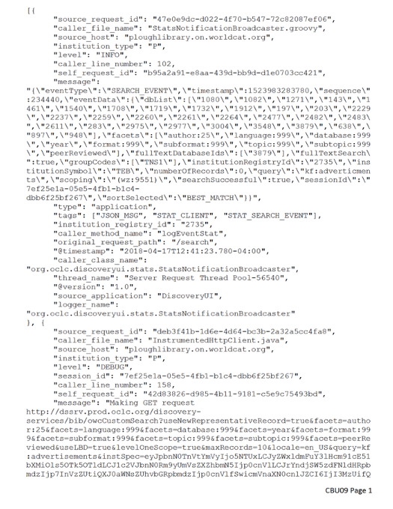
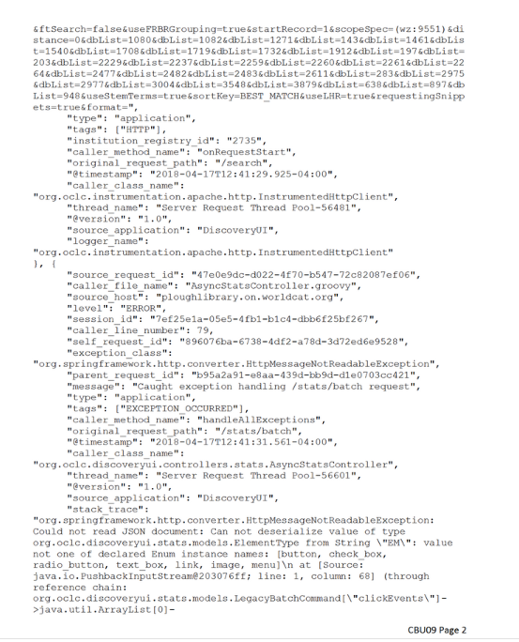
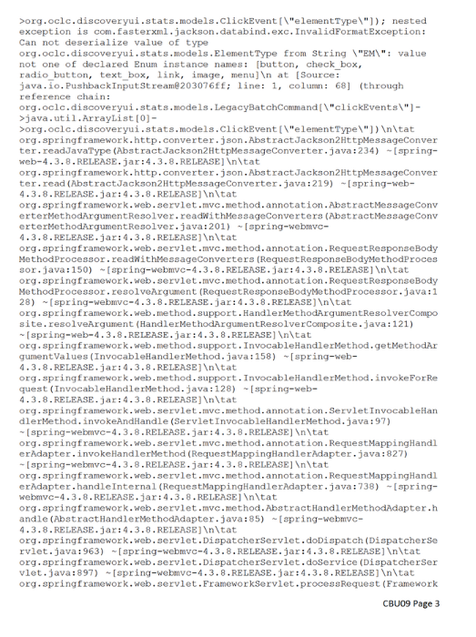
What do the raw logs tell us?
Did a keyword search but mistyped it
Had 0 results
Redid keyword search with correct spelling
Had 759,902 results
Began typing in additional keyword
Selected one of the autosuggested keyword phrases
Had 1,761 results
Notes:
One of the first things that we had to establish was what the search logs could tell us about user behavior. So we looked manually at some logs to determine what type of information we could glean. The logs could tell us:
Type of search (index)
Search terms/string
Elements of the system interacted with, in this case the autosuggest feature
Evolution of searches in a search session
Part of this process was working with libraries to recruit participants so we could connect logs with the users who created them. Logs in the system are anonymous—they can’t be tied to the user who generated them. The participants we recruited gave us the ID from their search, which we then used to pull all of the log events associated with that search.
On the left-hand side of this slide you can (maybe) see the search log for this participant, CBU09. What we found in interpreting the logs was that this participant started with a mistyped keyword search that returned 0 results. They corrected their spelling and returned over 700,000 results. They then began typing an additional word into their keyword search and selected one of the autosuggested keyword phrases, returning just under 2,000 results. Once we had interpreted the participant logs, we used that information to build an interview protocol. Peggy will talk about the interview process a little later.
CBU09 - Female, 19-25, undergraduate, humanities, Christian Brothers University

Slide 8
Ways of evolving a search
Corrected search
Shows greater than 90% similarity with the previous search string
Shows 80–90% similarity with the previous search string, with the first string contained in the second, or an index change
Refined search
New search
Shows less than 80% similarity with the previous search string
Notes:
One of the things that CBU09’s search session demonstrates are the different ways in which users can go about evolving a search during a single session. In order to perform bulk analysis of the search logs, which we wanted to do to be able to provide context for our interview data, we needed to be able to distinguish those different techniques quantitatively. Based on quantitative analysis that was manually reviewed, we established the three categories you see here. A corrected search was defined as being more than 90% similar to a previous search string. That primarily includes misspellings, as seen in step 2 of CBU09’s search. A refined search was defined at 80-90% similarity, but in manually reviewing, we also determined the need to include any instance in which the first search string was contained in the second search string or the search string remained the same, but the index was changed. You saw this in steps 3 and 4 of CBU09’s search. The final category we established was a new search, which showed less than 80% similarity with the previous search string. We want to emphasize that this does not necessarily mean that they began searching for a different topic or type of material (although it certainly could). Instead, it represents a search where they changed tactics and began searching using a new or meaningfully different search string.

Slide 9
Summary of results
Average of 5 minutes per session
Average of 2.2 searches per session
Average of 5.1 words per search
12% of sessions had search refinements
33% of sessions had multiple searches
n=282,307 sessions
Notes:
Once we had established those categories, we could begin looking at the overall patterns in our search logs. For the bulk log analysis, we looked at all of the logs in the Discovery system for April of 2018. We found that on average, a search session lasted 5 minutes and contained just over two searches, with an average of about 5 words per search. Twelve percent of sessions showed search refinements and 33% of sessions showed multiple searches.

Slide 10
Types of Requests
Search results
The user made a request for search results. This could include a new search, refinement of an existing search, or the addition of limiters.
Physical access options
Some users left the system after looking at holding, where they were able to identify the physical item call number and/or location. These users were categorized as having the option to physically access the item.
Online access attempt
The user clicked an item or made a request to digitally access the full text of the item.
Attempt to save
The user attempted to export or otherwise save the citation.
Physical access attempt
The user clicked an item or made a request to place a hold on a physical copy of the item.
Notes:
Log events for last requests and for the full sessions were categorized in the following way:
Online Access Attempt: The user clicked an item or made a request to digitally access the full text of the item.
Physical Access Attempt: The user clicked an item or made a request to place a hold on a physical copy of the item.
Physical Access Option: Some users left the system after looking at holdings. In these cases, users were in a place in the system where they were able to identify the physical item call number and/or location. The interviews revealed that at least some of the participants looked for the item on the library shelf at this point. Since logs cannot reveal what users did after leaving the system, these users were categorized as having the option to physically access the item.
Attempt to Save: The user made an attempt to export or otherwise save the citation.
Search Results: The user made a request for search results. This could include a new search, refinement of an existing search, or the addition of limiters.
Other: These requests and click events did not fit cleanly into any category, and there were no overarching themes to them.

Slide 11
Probability of Access
Notes:
55% left system with on of these access options:
Online Access
Physical Access
Save: ILL, reserve, exported citation, etc.
While 54% of the total click events were to generate search results, only 39% of users left on a search results page. More than 50% of users left the system with a request to access an item online, an attempt to access an item physically, or an option to find its physical location. This discrepancy between all request categories and last request categories suggests that users were more likely to leave the system on a successful note. However, it cannot be determined whether the access attempts were successful, so conclusions must be made cautiously.

Slide 12
Probability of fulfillment
Number of searches | 2
Number of search refinements | 0
Words per search | 2
Results per search | 1000
Keyword limiter (1 if yes, 0 if no) | 1
Author limiter (1 if yes, 0 if no) | 0
Title limiter (1 if yes, 0 if no) | 0
Chance of Fulfillment | 69.09%
Number of searches | 2
Number of search refinements | 0
Words per search | 7
Results per search | 1000
Keyword limiter (1 if yes, 0 if no) | 1
Author limiter (1 if yes, 0 if no) | 0
Title limiter (1 if yes, 0 if no) | 0
Chance of Fulfillment | 70.32%
Number of searches | 2
Number of search refinements | 0
Words per search | 2
Results per search | 1000
Keyword limiter (1 if yes, 0 if no) | 1
Author limiter (1 if yes, 0 if no) | 1
Title limiter (1 if yes, 0 if no) | 0
Chance of Fulfillment | 84.76%
Notes:
We were interested in seeing why some search sessions resulted in access of materials while others did not. To figure this out, we did some statistical modeling 189,000 search sessions from April of 2018.
We used logistic regression, which calculates the impact that different variables associated with the session had on the probability that user accessed materials during the session. We made a tool where you can play around with things like the number of searches in the session, the number of words per search, and the limiters that they used, and see how the probability changes as these values change.
At the top of this slide, there is a hypothetical search session where the user made two searches, with an average of two words per search, using only the keyword limiter, and got an average of 1000 results per search. That user had about a 69% chance of accessing materials during the session. Not terrible, but it could be better, so let’s see how making small changes to this session impacts this probability.
On the bottom left, we have almost the same search session, with one change. Instead of their searches averaging two words each, they averaged seven words each. We can see at the bottom that the chance that they accessed materials increases to a little more than 70%. A little better, but not a major improvement. On the bottom right, however, we see a much bigger improvement. This is almost the same as the top session, but they used the ”Author” limiter. Here, the probability of accessing materials increases to almost 85%, which is a major improvement.
This demonstrates, while both increasing the length of searches and using the author limiter both helped the users access materials, the author limiter helped substantially more. Encouraging users to use that limiter will have a bigger impact on user experience than encouraging users to make longer searches.

Slide 13
User interviews
“User interviews can help capture search and discovery behavior as the user understands it, rather than as a computer system understands it.”
(Connaway, Cyr, Brannon, Gallagher, and Hood 2019)
Notes:
Connaway, Lynn Silipigni, Chris Cyr, Brittany Brannon, Peggy Gallagher, and Erin Hood. 2019. “Speaking on the Record: Combining Interviews with Search Log Analysis in User Research.” ALISE/ProQuest Methodology Paper Competition Award Winner.
Go over methodology (semi-structured interviews with critical incident technique)
Connaway, Lynn Silipigni, and Marie L. Radford. 2018. Survey Research. Webinar presented by ASIS&T, January 23. https://www.slideshare.net/LynnConnaway/survey-research-methods-with-lynn-silipigni-connaway and https://www.youtube.com/watch?v=4dlpAT7MXh0 .

Slide 14
Example questions
“Please tell us what you were looking for and why you decided to do an online search.”
“Did the item you were searching for come up in your search results? In other words, did you find it?”
“I’d like to understand how you felt about your search experience overall. Would you say you were delighted with your search experience?”

Slide 15
What do the interviews tell us?
Just starting work on a paper on a broad topic; didn’t yet have a direction for the paper
Was overwhelmed with number of search results
Abandoned “library search” to do “Google searching” to better determine a direction for the paper
Later came back to the library search and found it useful
Also received help from student workers in the library
Felt “prepared” to use the library search due to 1st-year library instruction
What the logs told us:
Began keyword search but mistyped it
Had 0 results
Redid keyword search with correct spelling
Had 759,902 results
Began typing in additional keyword
Selected one of the autosuggested phrases
Had 1,761 results
Notes:
CBU09 - Female, 19-25, undergraduate, humanities, Christian Brothers University

Slide 16
Interview coding themes
Decision-making factors
Search strategies
Item formats
Evaluation of resources
Liked or
desired features
Feelings of frustration and delight
Influence of librarian

Slide 17
Decision-making factors
Convenience/ease of access is a major factor
Search strategies
Interviewees refine their searches in various ways:
Identifiers
Limiters
Different/additional search terms
Topic refinement

Slide 18
Methodology
Challenges and Benefits
“The methodology used for this study also could be extended beyond discovery systems. Other computerized activities that leave digital traces could be studied using interview protocols based on log analysis.”
(Connaway, Cyr, Brannon, Gallagher, and Hood 2019)
Notes:
Connaway, Lynn Silipigni, Chris Cyr, Brittany Brannon, Peggy Gallagher, and Erin Hood. 2019. “Speaking on the Record: Combining Interviews with Search Log Analysis in User Research.” ALISE/ProQuest Methodology Paper Competition Award Winner.

Slide 19
Challenges of methodology
(Tandem use of log data and user interviews)
Resource intensive
Time consuming
Multiple team members
Multiple IRBs
High level of expertise required

Slide 20
Benefits of methodology
(Tandem use of log data and user interviews)
Provide context for quantitative data
Clarify qualitative data
Most effective when digital traces are present
Inform development of literacy instruction

Slide 21
Impact of Study
Collaborate internally in new ways
Identify why and what users did during the search and when acquiring resources
Develop a new methodology for studying user behaviors
Influence product and system development
Notes:
It’s changing the way we think, the way we work together. Research goes beyond the academic… influencing product development
We earn the right to share our insights by listening.

Slide 22
Acknowledgements
We would like to thank the librarians and library users who participated in this research.
We also thank additional OCLC staff who assisted with the project: Jay Holloway and Ralph LeVan for assisting with data collection and analysis and Nick Spence for his assistance in preparing this presentation.

Slide 23
References
Connaway, Lynn Silipigni, John M. Budd, and Thomas R. Kochtanek. 1995. “An Investigation of the Use of an Online Catalog: User Characteristics and Transaction Log Analysis.” Library Resources and Technical Services 39, no. 2: 142–152.
Connaway, Lynn Silipigni, Chris Cyr, Brittany Brannon, Peggy Gallagher, and Erin Hood. 2019. “Speaking on the Record: Combining Interviews with Search Log Analysis in User Research.” ALISE/ProQuest Methodology Paper Competition Award Winner.
Connaway, Lynn Silipigni, and Marie L. Radford. 2017. Research Methods in Library and Information Science, 6th ed. Santa Barbara, CA: Libraries Unlimited.
Connaway, Lynn Silipigni, and Marie L. Radford. 2018. Survey Research. Webinar presented by ASIS&T, January 23. https://www.slideshare.net/LynnConnaway/survey-research-methods-with-lynn-silipigni-connaway and https://www.youtube.com/watch?v=4dlpAT7MXh0 .
Hunter, Rhonda N. 1991. “Successes and Failures of Patrons Searching the Online Catalog at a Large Academic Library: A Transaction Log Analysis.” RQ 30, no. 3: 395–402. https://www.jstor.org/stable/25828813.
Jamali, Hamid R., David Nicholas, and Paul Huntington. 2005. “The Use and Users of Scholarly E-Journals: A Review of Log Analysis Studies.” Aslib Proceedings 57, no. 5: 554–571. https://doi.org/10.1108/00012530510634271.
Jansen, Bernard J. 2006. “Search Log Analysis: What It Is, What’s Been Done, How to Do It.” Library and Information Science Research 28, no. 3: 407–432.
Jansen, Bernard J. 2017. “Log Analysis.” In Research Methods for Library and Information Science, 6th ed., edited by Lynn Silipigni Connaway and Marie L. Radford, 348-349. Santa Barbara, CA: Libraries Unlimited.
Lamkhede, Sudarshan, and Sudeep Das. 2019. “Challenges in Search on Streaming Services: Netflix Case Study.” In the Proceedings of SIGIR ’19, July 21–25, 2019, Paris, France. https://arxiv.org/pdf/1903.04638.pdf.
Nouvellet, Adrien, Florence D’Alché-Buc, Valérie Baudouin, Christophe Prieur, and François Roueff. 2019. “A Quantitative Analysis of Digital Library User Behaviour Based on Access Logs.” Qualitative and Quantitative Methods in Libraries 7, no. 1: 1–13.

Slide 24
Questions & Discussion
Lynn Silipigni Connaway, Ph.D.
connawal@oclc.org
@LynnConnaway

