Slide 1
Works In Progress Webinar:
Approaches to Preserving Private and Sensitive Data Managed by Digital Repositories
Hosted by OCLC Research, February 5, 2020
Courtney C. Mumma, Deputy Director, Texas Digital Library and Sibyl Schaefer, Digital Preservation Analyst / Chronopolis Program Manager, UC San Diego

Slide 2
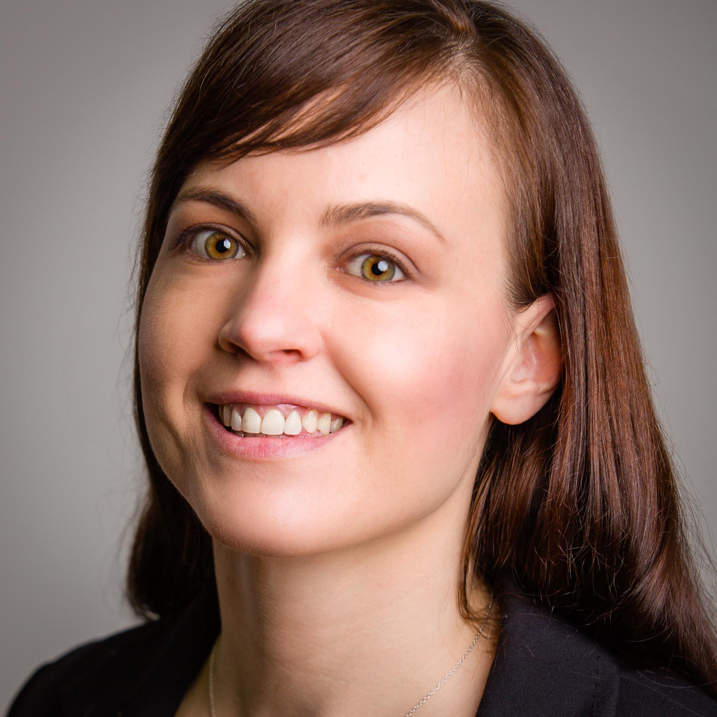
Speakers
Courtney Mumma Texas Digital Library
Sibyl Schaefer UC San Diego

Slide 3
Today’s session
Overview of the investigation to date
Grant problem, goal, methods, timeline
Use cases
Agreements necessary for DDP networks to function
Elements of a DDP network for Private and Sensitive Data
Technical
Governance
Identifying stakeholders
Cost modeling
How much will it cost to provide this service?
How much are depositors willing to pay?

Slide 4
Overview of the Investigation
Problem, Goal, Partners, Methods, Outcomes

Slide 5
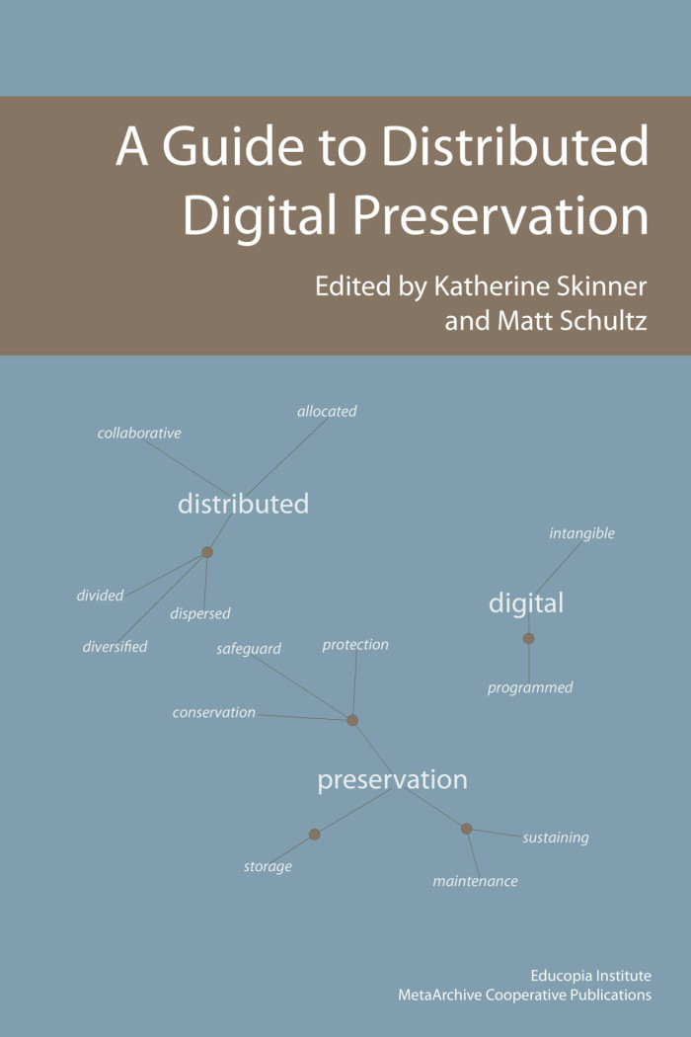
Distributed Digital Preservation (DDP)
Distributed digital preservation methodologies hold that any responsible preservation system must distribute copies of digital files to geographically dispersed locations. It also must preserve, not merely back-up, the files in these different locations.
MetaArchive Cooperative. A Guide to Distributed Digital Preservation, book, 2010; Atlanta, Georgia. (https://digital.library.unt.edu/ark:/67531/metadc12850/: accessed December 5, 2019).
Notes:
For those of you who are new to the term ‘Distributed Digital Preservation’, I’d like to take this opportunity define it since we’ll be referring to it throughout this presentation
In 2010, the MetaArchive Cooperative, home of one DDP network, published A Guide to Distributed Digital Preservation and offered this definition:
Distributed digital preservation methodologies hold that any responsible preservation system must distribute copies of digital files to geographically dispersed locations. It also must preserve, not merely back-up, the files in these different locations.
Sites preserving the same content should not be within a 75- 125-mile radius of one another.
Preservation sites should be distributed beyond the typical pathways of natural disasters, such as hurricanes, typhoons, and tornadoes.
Preservation sites should be distributed across different power grids.
Preservation sites should be under the control of different systems administrators. For security purposes, all preservation copies should not be accessible by any one person or team of people; instead, control and monitoring of each preservation site should ideally be handled locally by each site in order to ensure that the network’s contents are not subject to one point of human-based failure.
Content preserved in disparate sites should be on live media and should be checked on a regular basis for bit-rot and other issues.
Content should be replicated at least three times in accordance with the principles detailed above.
Regardless of what technical infrastructure a DDP network adopts, the network will perform three main tasks: content ingest/harvest, content monitoring, and content retrieval, and each of these tasks may vary radically across different technical infrastructures.

Slide 6
Problems
No Distributed Digital Preservation (DDP) service offering for sensitive data
Personally Identifiable Information (PII), Personal Health Information (PHI) and other sensitive data that has significant preservation value in libraries, archives, and academic health science centers is at risk
Notes:
The problem that we are trying to tackle with this grant is that although distributed digital preservation (DDP) services have been offered in the United States for well over a decade, there is no distributed service offering for sensitive data.
For this reason, we propose that Personally Identifiable Information (PII) or Personal Health Information (PHI), as well as other sensitive data in the custody of libraries, academic health science centers, and archives is at an escalated risk of loss. Academic health science libraries, especially, face a growing backlog of digital PHI governed by HIPAA. Additionally, university-held cultural heritage collections are likely to have materials governed by FERPA requirements as well as valuable cultural heritage materials that contain PII such as social security numbers and other data deemed sensitive or private based on local and jurisdictional policies.
The team assumes that the bar set by HIPAA and FERPA is sufficiently high to protect many other kinds of nonregulated sensitive data.

Slide 7
Goals
Determine the capacity and feasibility of a national DDP service offering for sensitive data
Identify the partnerships, agreements, models and processes needed to put existing technology, infrastructure and expertise together
Notes:
One of the goals of this grant is to investigate the capacity and feasibility of a nationwide model for a DDP service that would close this gap for sensitive data for various types of institutions.
The technology, infrastructure, and expertise needed to build a DDP service for sensitive data exist, but the connections, agreements and processes to put it all together to form a viable service are lacking. Since such an offering would be the first of its kind, it would be unwise to proceed to its creation before identifying what actually needs to be in place.
While building this service is outside the scope of this one year planning grant, the two lead institutions are interested in using the grant deliverables to assess their capacity to meet the outlined requirements and to initiate discussions with possible network partners.

Slide 8
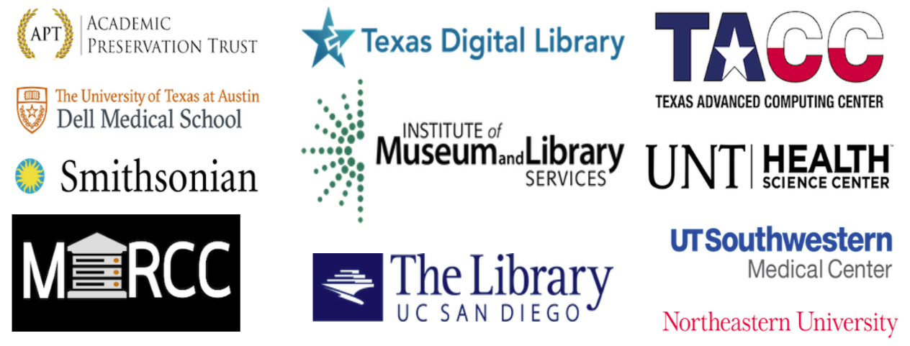
Partners
Notes:
Both lead grant partners have well-established business models and extensive experience in building and providing DDP services. The Texas Digital Library (TDL) is a consortium of Texas higher education institutions that builds capacity for preserving, managing, and providing access to unique digital collections of enduring value. Since 2015, TDL has also offered access to DDP storage systems. In 2017, TDL joined the Chronopolis DDP network headquartered at the University of California San Diego Library, providing access to Chronopolis services to its members (via TDL’s DuraCloud implementation) and serving as a replicating node for the network using storage at TACC.
The University of California, San Diego Library manages the internationally-recognized DDP service, Chronopolis. The Chronopolis network spans three sites across the United States and is one of the earliest established DDP services in the world, having been in operation for over 12 years. The UCSD Library partners with the University of Maryland Institute for Advanced Computing Studies (UMIACS), and the TDL to maintain geographically distinct nodes. Chronopolis offers preservation storage through the DuraCloud and Texas Digital Library services. It was certified as a Trusted Digital Repository by the Center for Research Libraries in 2012 and plans to undergo ISO 16363 certification.
Both project partners maintain close working relationships with organizations affiliated with their home institutions that could provide key resources for a DDP service for PII and PHI. The Texas Advanced Computing Center at UT Austin has partnered with TDL on several projects over the years and currently provides storage resources for the TDL’s Chronopolis node. TACC independently offers secure HIPAA/FERPA compliant storage to local partners. Similarly, the San Diego Super Computer (SDSC) provides HIPAA compliant storage to its faculty and researchers at UCSD. Both computing centers will share their expertise in providing sensitive data solutions, including service and cost modeling, with the project team.
Representatives from the Academic Preservation Trust (APTrust), the Smithsonian Institute, Northeastern University, the University of North Texas Health Sciences Center, the University of Texas Southwestern Medical Center, the Dell Medical School at the University of Texas at Austin, and the Maryland Advanced Research Computing Center (MARCC) at Johns Hopkins University Library have all expressed interest in this project as they also have a need to geographically distribute and preserve their sensitive data. The project team will contract with SecurityMetrics, experts in HIPAA compliance, to provide templates for policy creation and review various legal agreements and the final project deliverables.

Slide 9
Methodology
GRA conducts use case interviews, gathers agreements between parties in current DDP networks, creates technical network diagrams
Partner meeting discussions and information gathering
Determine gaps in current agreements and processes that must be addressed to satisfy requirements of private and sensitive data
Investigate service and cost models
Disseminate findings
Notes:
In summary, our GRA, Hesam Andalib, is conducting use case interviews, gathering agreements between parties in existing DDP networks and creating technical network diagrams.
We gathered more information in person from our discussions at the in person meeting in December 2019. The team is working to determine gaps in the current agreements and processes (both internal to DDP networks and any user barriers) that should be addressed to satisfy the requirements of private and sensitive data. We are also investigating service and cost models and then disseminate our findings at the end of the one year term.

Slide 10
Timeline
September, 2019 | Project start, hire GRA, begin data gathering
December, 2019 | In-person meeting of project participants
January, 2020 | Analyze data, draft final report
May, 2020 | Draft contract templates and service and cost models
June, 2020 | Disseminate drafts to project participants for feedback
August, 2020 | Virtual meeting of project participants
October, 2020 | Disseminate report and templates
Notes:
This is an overview of the methodology broken down by time. We started the grant in Sept of last year. One of the first steps we took was to hire Hesam Andalib. We started the data gathering at that point, researching the tasks I mentioned in the previous slide. We had a very successful in-person partner meeting in Austin in Dec. and we’re now outlining the draft final report and working with Security Metrics, the HIPAA compliance experts we’ve employed, to determine how our current slate of agreements and technical infrastructure would need to be changed in order to be compliant. Once we have solid drafts of the report and legal templates, we’ll disseminate those to our project participants and have a second meeting, this time virtually, to gather feedback. We’ll start to finalize the report based on that feedback and once final, publish the report and any agreement templates and cost modeling we’ve developed.

Slide 11
Potential Outcomes
A roadmap and recommendations for
A DDP solution for private and sensitive data
New technological and community partnerships
Further projects and/or grants
A conclusion that DDP for private and sensitive data is not feasible
Barriers could be anything including a lack of user readiness, cost, or technological complexity

Slide 12
Use Cases for Private and Sensitive Data Preservation
Use cases gathered so far:
https://texasdigitallibrary.atlassian.net/wiki/x/H4DjOw
UTSW Medical Center, UNT Health Science Center, UConn Library, Dell Medical School
In person meeting discussion about types of private and sensitive content that should be preserved in a distributed network and the perceived barriers to doing so.
Human rights records, first person accounts of trauma, commerce-related restrictions
In many cases, the assessment of sensitive content hasn’t been done and/or it isn’t being allowed into the custody of the library/archives (limited resources, whose authority? No place to keep it anyway, etc)
Notes:
So far, we have collected detailed information from UTSW Medical Center, UNT Health Science Center, UConn Library, and Dell Medical School. We also collected Not only that, but we need to know if institutions know they have sensitive data that justifies a high level of preservation. In some cases, we think that institutions suspect that there is private and sensitive data requiring a high level of preservation action, but hasn’t done the level of assessment or appraisal necessary to quantify the problem sufficiently.

Slide 13
Current state of agreements in DDP networks and private and sensitive data storage services
Notes:
We have also conducted a review of where and what kind of agreements are in place to enable the existing DDP networks with which the project partners engage (Chronopolis, TDL Digital Preservation Services, APTrust, DuraCloud). Such connections include agreements between infrastructure nodes as well as service contracts and agreements that enable DDP networks to function.
Additionally, we'll review the agreements, policies and procedures that allow TACC and SDSC to accept types of private and sensitive data.

Slide 14
Types of agreements
Legal Binds for Distributed Digital Preservation Services
https://texasdigitallibrary.atlassian.net/wiki/x/O4BOOw
Software licenses (ex. DuraCloud, Chronopolis, AWS)
Contracts, Service Level Agreements (SLAs) and/or Memoranda of Understanding (MOUs)
Service provider and storage node (TDL and TACC, Chronopolis and NCAR)
Service provider & depositor (UCSDL and UCSD community depositors, Lyrasis/DuraCloud and depositors)
Service provider & service provider (ex. Chronopolis and TDL, Lyrasis/DuraCloud and Chronopolis)
Requests and authorizations
Ex. TACC’s protected data service request form

Slide 15
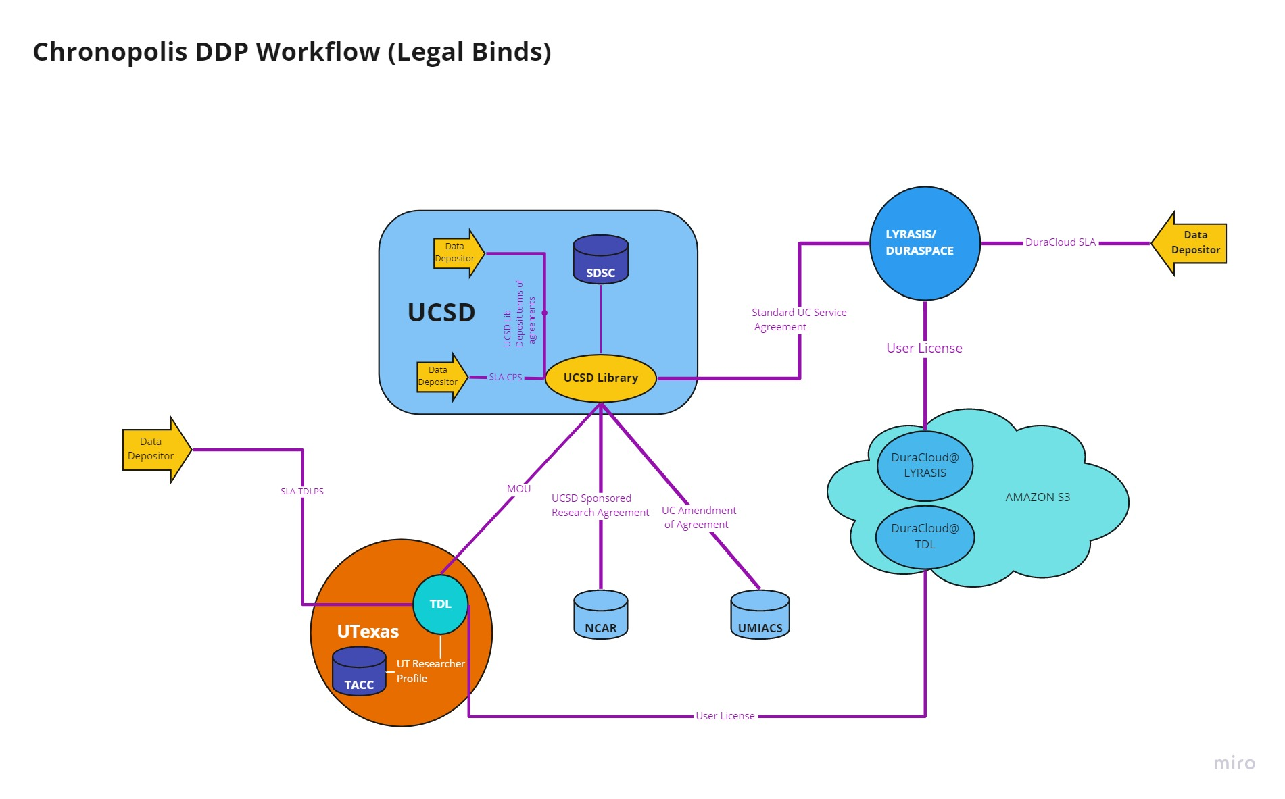
https://texasdigitallibrary.atlassian.net/wiki/x/O4BOOw

Slide 16
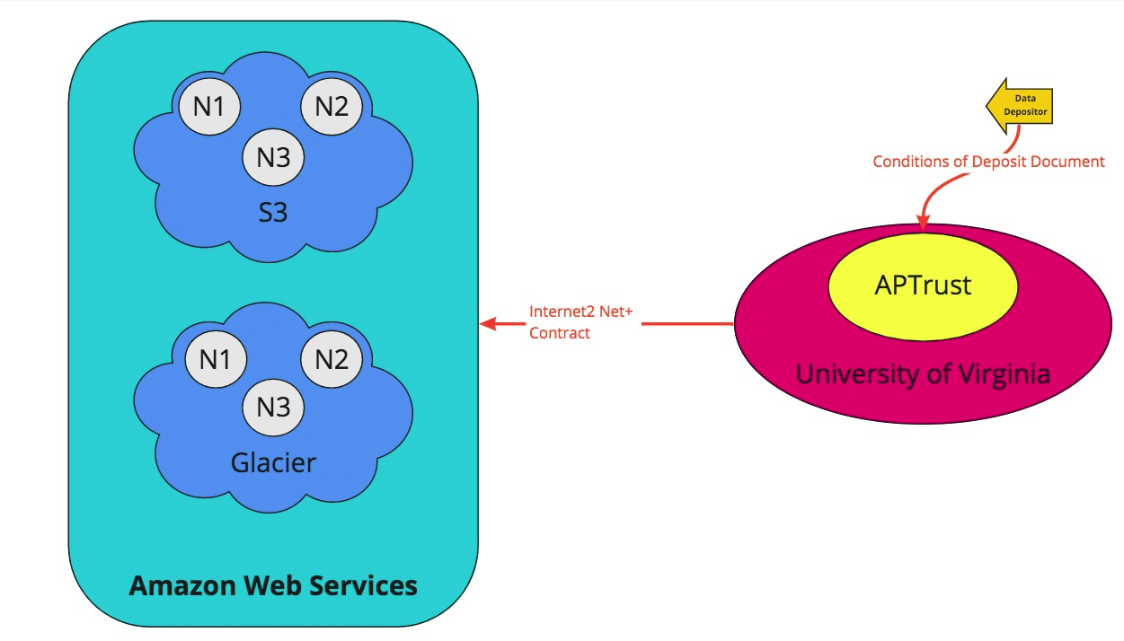
https://texasdigitallibrary.atlassian.net/wiki/spaces/DPS/pages/1008500755/APTrust

Slide 17
Challenges that have emerged
Alignment & enhancement of agreements.
According to HIPAA rules, Business Associate Agreements rather than more simple MOUs.
Liability.
Identify stakeholder(s) who will be likely to take on the liability requirements of this work.
Control.
Consider the technical/security controls for the liable body(ies).
Complexity of technical architecture.
The complexity of the current infrastructure for DDP services is prohibitive.
Readiness.
Many institutions are not at the assessment and custody stage that requires a DDP option.
Notes:
I’ll talk more about stakeholders in the next few slides.

Slide 18
Stakeholders and their roles
Depositors
Preservation staff::
Repository managers
Archives
Developers
Service providers
People in the data:
Person in a photograph or represented in the health record
Relative of person in the data (esp health)
Communities represented by data
Original creator of data (doctor, researcher)
Future users of the content
Administrators:
Academic Deans
EVPs for health system and research for clinical and research data
Presidents for overall support/approval
University CIO
University librarian
Data owner - complicated issue
See next slide
Who else??

Slide 19
Issue of Ownership
Who owns patient visit data? Doctor? Patient? Insurance?
new interest in old written records that are being digitized; patients seeking family history information vs persons who want to protect family history
Destruction of data is the ultimate ownership act of data - who is allowed to destroy?
In US, ownership of data is driven by commerce; in EU, it is driven by privacy.
California and NY are exceptions to US commerce driver
Capitalism is a significant impact on this project and on private and sensitive data in libraries
Archivists/librarians - data custodians who decide how and when the owner decisions are applied; classification and regulations apply
Notes:
Without knowing who owns the data, it can be hard to make good decisions about digital preservation. Data owners can make decisions unless the law indicates otherwise. In any use case, management decisions come down to data ownership - owner decides ultimately about destruction of data; decisions about use come down to ownership, too. Drives policies and management decisions.

Slide 20
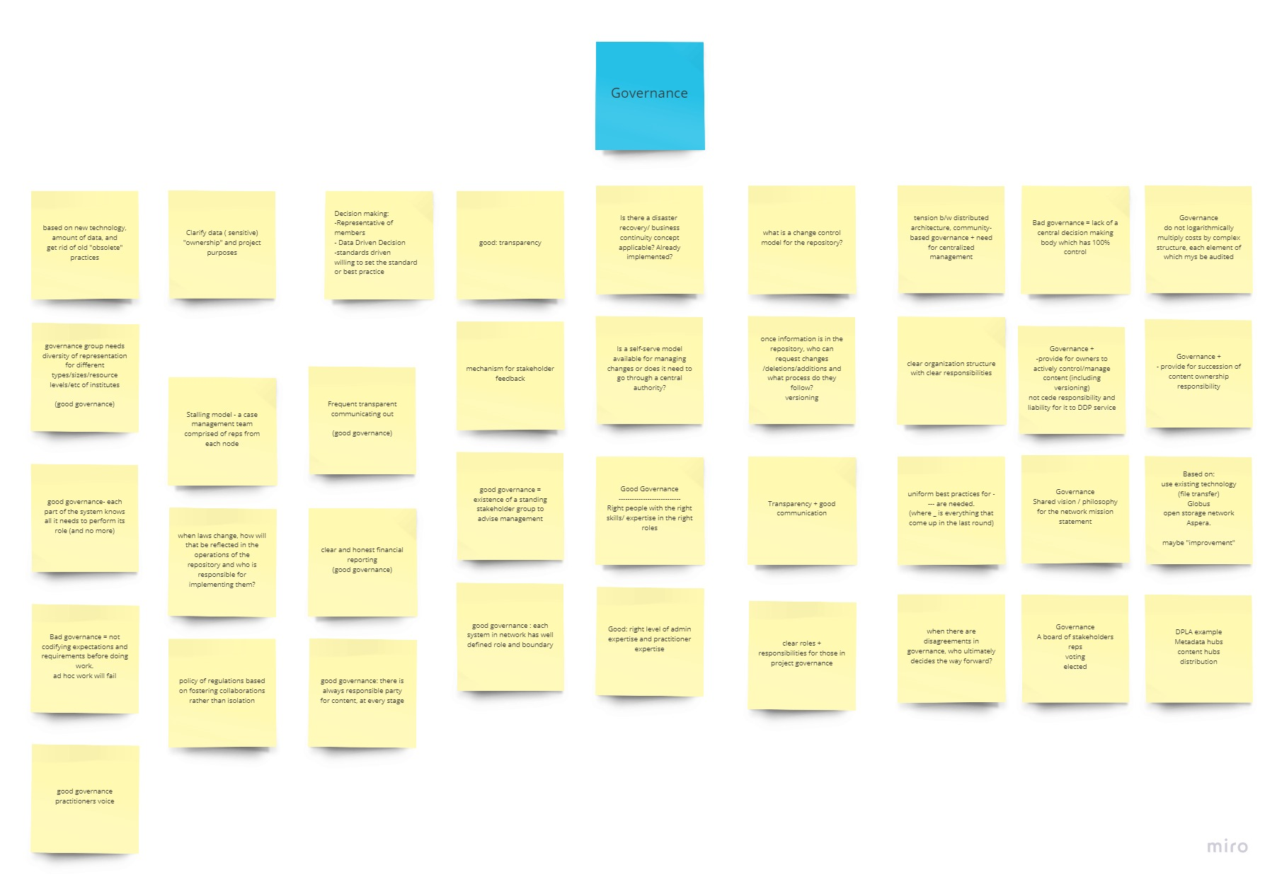
Governance for this type of service
Central decision-making after stakeholder consultation
Diverse representation of institution types and practitioners
Node representation
Data and standards driven
Clear vision, mission, roles and responsibilities
Foster collaboration
Responsive to legal fluctuation and jurisdictional differences
Transparent financial reporting
Succession plan
Open communication
Data owner stays in control of content

Slide 21
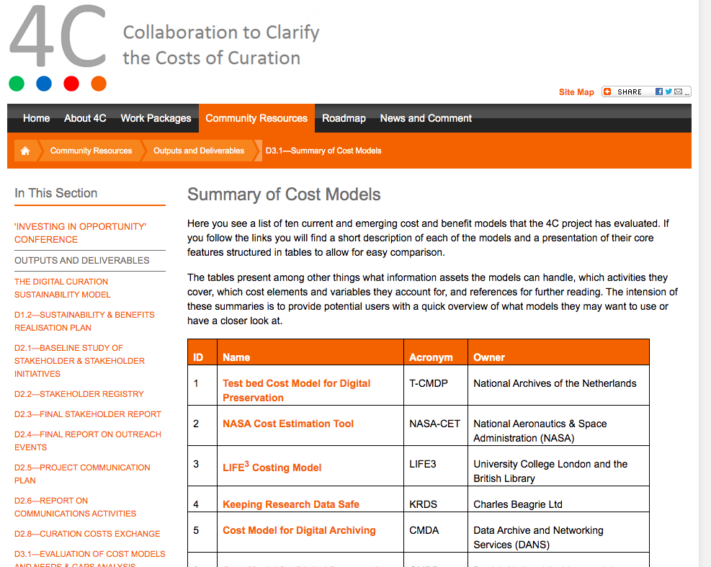
Costs & potential cost models
Significant seed funding towards HIPAA compliance
Project team leads have experience with DDP cost
4C Project as guidance, modeling based on services and activities

Slide 22
Continuing work
Still to do:
Continue collecting use cases for the distributed digital preservation of private and sensitive data (you can help!)
Review and identify gaps in agreements and in existing technological infrastructure
Recommend next steps including requirements for service and cost models based on feedback and investigation
Interested in partnering for the continuation of this work via another grant in the future? Contact us!

Slide 23
Contact us with questions and use cases:
c.mumma@austin.utexas.edu
sschaefer@ucsd.edu
Project documentation wiki
IMLS grant summary and full narrative

